Slide 1

Ethics and Analytics: What We Mean By Analytics
Stephen Downes
October 14, 2021

Slide 2
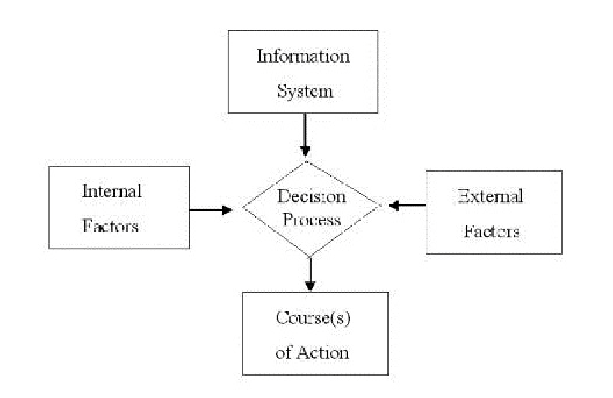
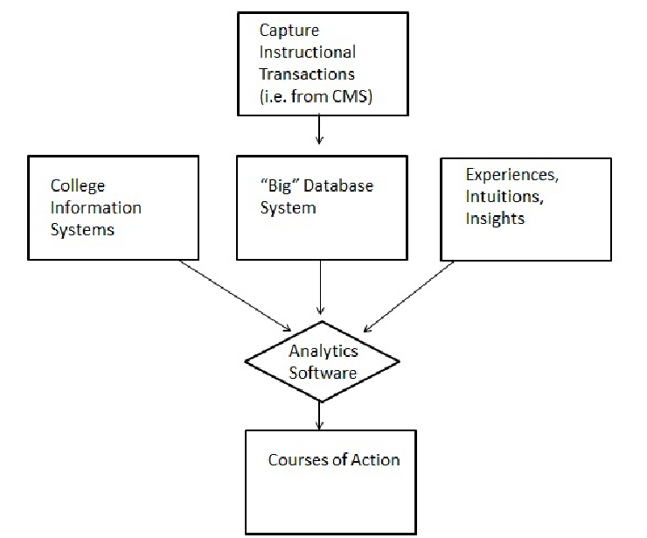
By ‘Analytics’ We Mean…
Analytics is thought of generally as “the science of examining data to draw conclusions and, when used in decision making, to present paths or courses of action.” (Picciano, 2012).
https://www.researchgate.net/publication/258206917_The_Evolution_of_Big_Data_and_Learning_Analytics_in_American_Higher_Education

Slide 3
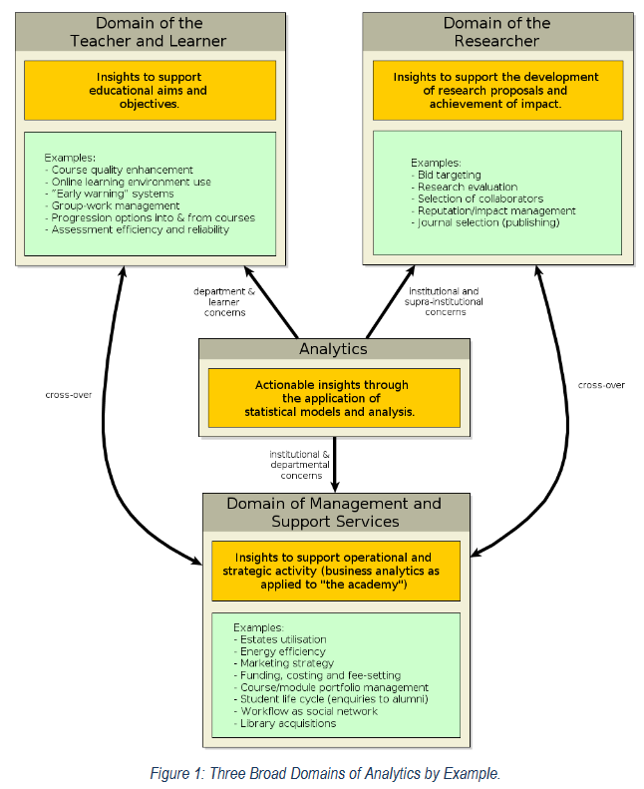
By ‘Analytics’ We Mean…
The overall process of “developing actionable insights through problem definition and the application of statistical models and analysis against existing and/or simulated future data.” (Cooper, 2012)
http://citeseerx.ist.psu.edu/viewdoc/download?doi=10.1.1.269.7294&rep=rep1&type=pdf

Slide 4
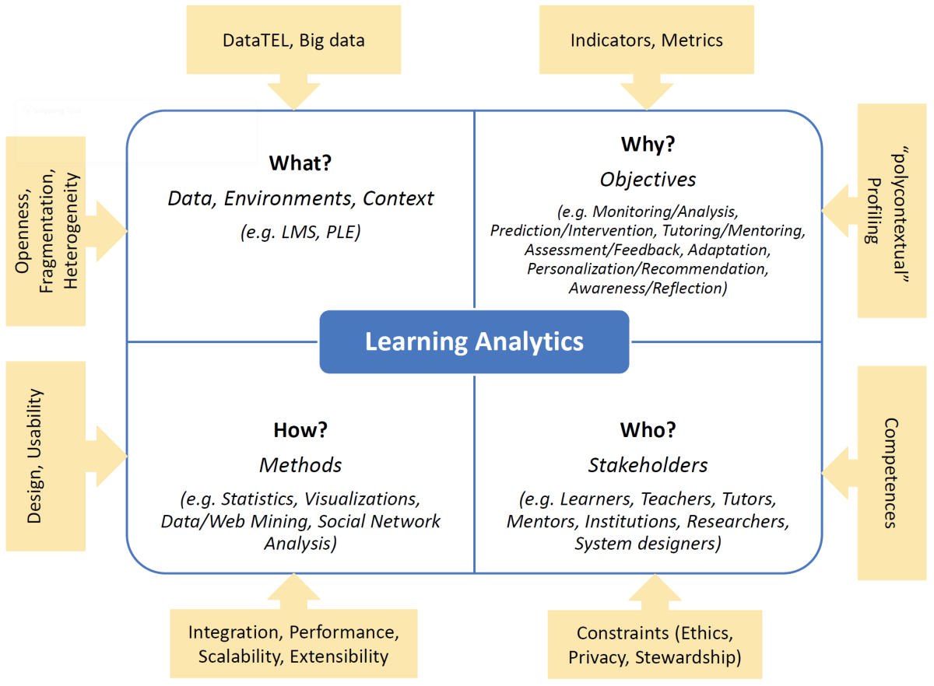
By ‘Analytics’ We Mean…
The focus of this course is the use of analytics as applied to learning and education (typically called ‘learning analytics’).
https://www.uni-due.de/soco/teaching/courses/lecture-la-ws19.php

Slide 5
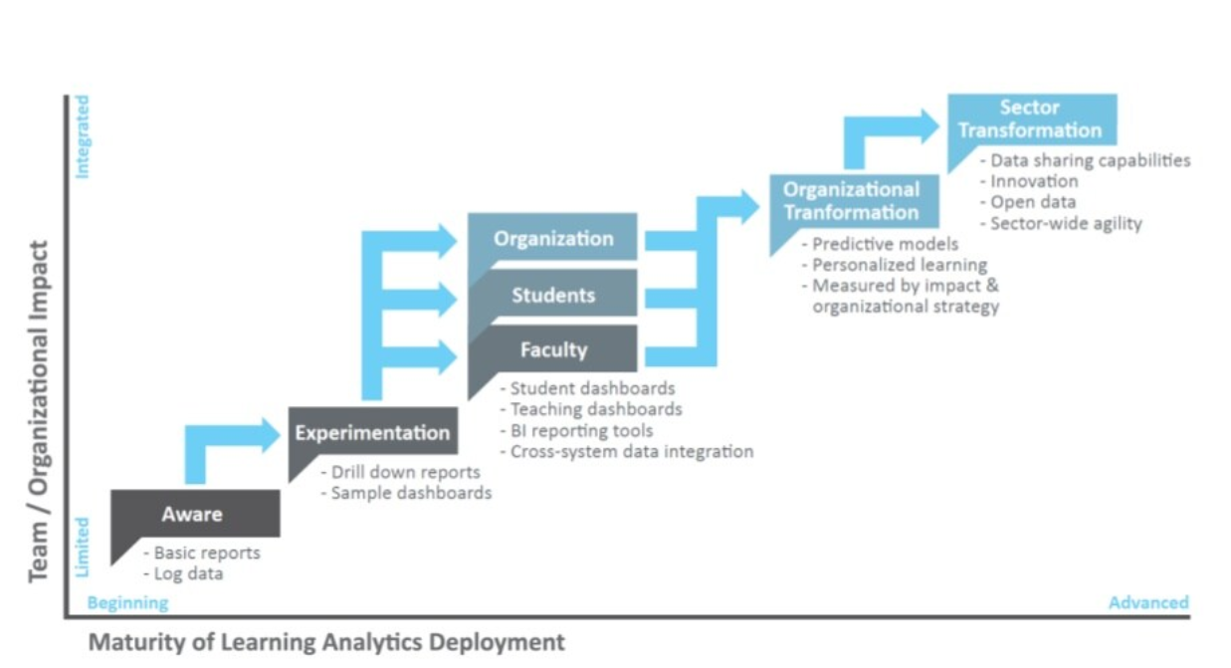
By ‘Analytics’ We Mean…
Learning analytics is typically defined in terms of its objective, which is to improve the chance of student success (Gasevic, Dawson & Siemens, 2015).
https://www.slideshare.net/EADTU/2015-d-gaevi-an-opportunity-for-higher-education

Slide 6
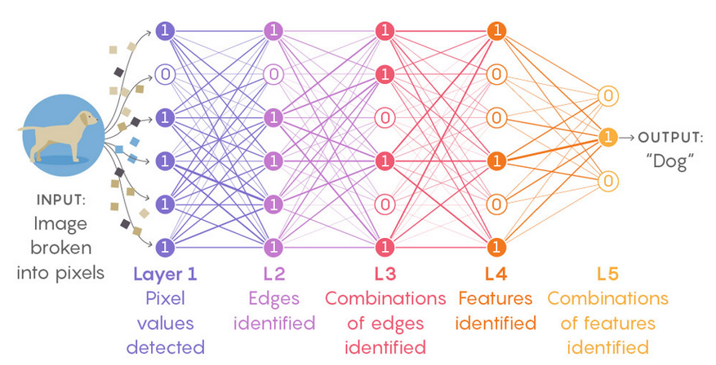
By Analytics We Mean…
There’s also a scientific goal, to “to open up what is sometimes called the ‘black box of learning’” (Self, 1999).
https://www.quantamagazine.org/new-theory-cracks-open-the-black-box-of-deep-learning-20170921/

Slide 7
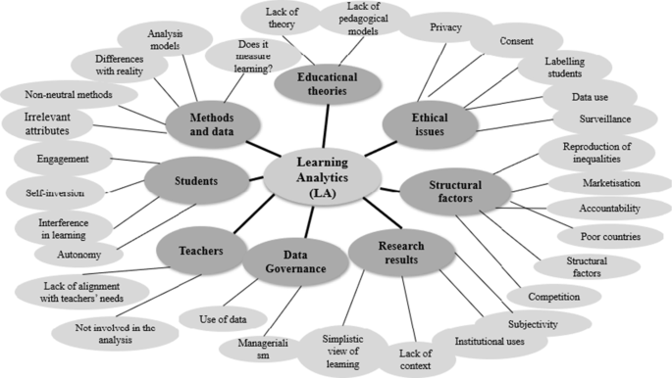
By ‘Analytics’ We Mean…
“The measurement, collection, analysis and reporting of data about learners and their contexts, for purposes of understanding and optimizing learning and the environments in which it occurs.” (Siemens, 2012)
https://educationaltechnologyjournal.springeropen.com/articles/10.1186/s41239-021-00258-x

Slide 8
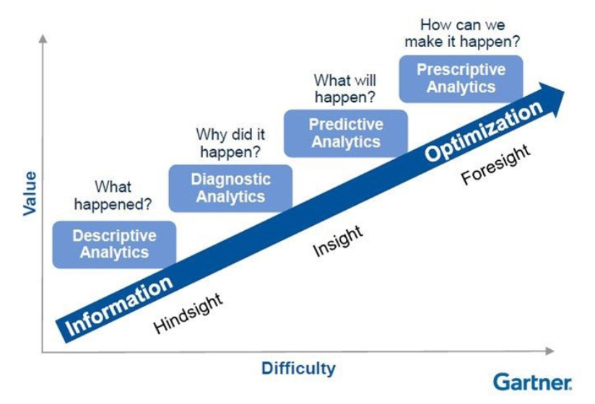
A Broad Scope
Analytics can be divided according to the type of question being answered.
https://de-model.blogspot.com/2021/03/gartner-analytics-maturity-model.html

Slide 9

A Broad Scope
The focus of learning analytics is often described from the institutional perspective.
For example, as Slade and Tait (2019) write, “The UK-based Higher Education Academy states that learning analytics offers the potential to provide educators with quantitative intelligence to make informed decisions about student learning… as well as to inform pedagogy, allocate resources and inform institutional strategy (Rienties, et.al. 2016).”
https://www.researchgate.net/publication/341425959_Global_guidelines_Ethics_in_Learning_Analytics/link/5ebf961392851c11a86c410b/download

Slide 10
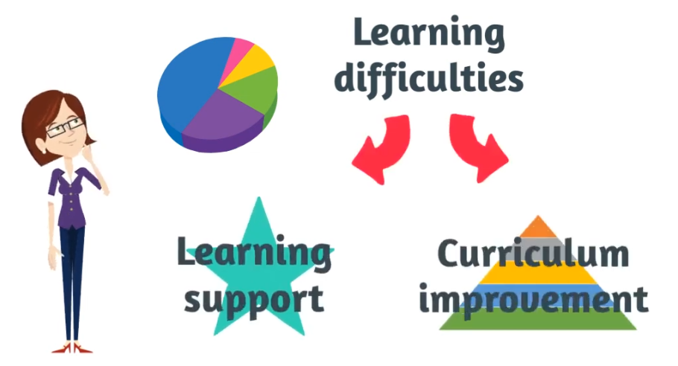
A Broad Scope
What we mean by ‘learning and education’ might be very different depending on who is being asked (Tsai, et.al., 2018).
https://www.solaresearch.org/2021/03/learning-analytics-3-challenges-and-opportunities/
Notes:
For example, in one study, “senior managers were most interested in using (learning analytics) to improve institutional performance, whereas teaching staff to reform curriculum and improve student support, and students to receive more personalised education tailored to meet their needs.” (Tsai, et.al., 2018)

Slide 11

A Broad Scope
“…it might be a case that we keep them, we retain them, but also, we’re able to provide them with better support.” – Institutional leader
“…you can reflect on what works, what doesn’t. What should I keep doing, what do I need to change?” – Teacher
“I’m always curious about which areas I’m struggling in and which areas I am doing better in.” – Student
https://www.solaresearch.org/2021/03/learning-analytics-3-challenges-and-opportunities/

Slide 12
A Broad Scope
The domain is often subdivided between institutional, student support and instructional applications (Zeide, 2019).
Institutional
aka ‘academic analytics’
to support operational and financial decision making
Teaching
pedagogy
learning design
curriculum
Learning
learning strategies
feedback
Notes:
The term ‘academic analytics’ (Goldstein, 2005; Campbell, et.al., 2007; Long & Siemens, 2011) has been used to distinguish between technologies used by higher education institutions “to support operational and financial decision making”, as opposed to ‘learning analytics’, defined as technologies “focused toward instruction, curriculum, and learning support with the objective of achieving specific learning goals.” (Van Barneveld, et al., 2012).
The “Jisc Code of Practice for Learning Analytics uses a wider definition of using data about students and their activities ‘to help institutions understand and improve educational processes, and provide better support to learners’ (Sclater 2014b).

Slide 13

A Broad Scope
Here we identify the different areas in which analytics is used.
The UC Berkeley Human Rights Center Research Team (2019) divides the domain into three categories: “AI tools fall into three categories: learner-facing, teacher-facing and system-facing.” However it quickly becomes apparent that the same tool will most probably have multiple faces
https://humanrights.berkeley.edu/about/about-us

Slide 14
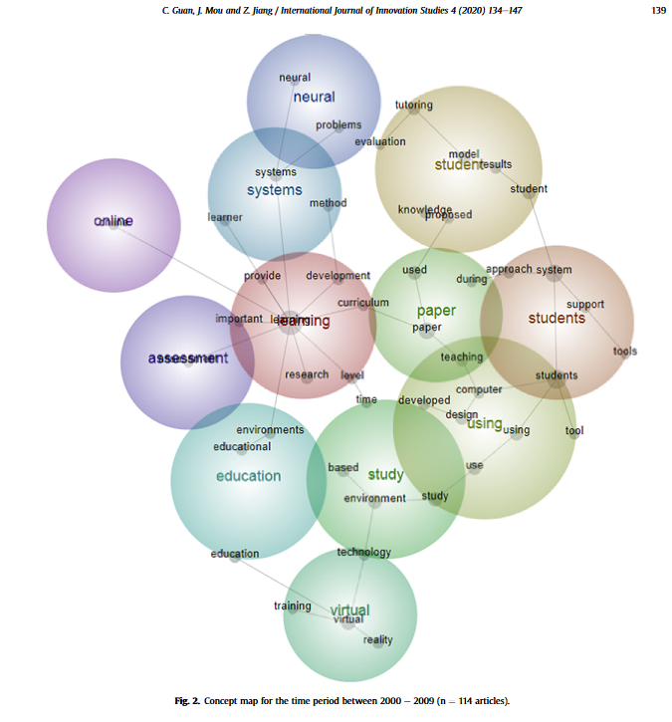
A Broad Scope
There are in fact numerous types, applications, and domains of analytics research in education (Guan, Mou & Jiang, A twenty-year data-driven historical analysis, 2020)
https://reader.elsevier.com/reader/sd/pii/S2096248720300369?token=9A29D3427A79DD70B346CAD57DEE3CFB1935B2E9D6B4CF2A28125A5AA95856954575CB41F018D7F414CFF2029BF77D9E&originRegion=us-east-1&originCreation=20211015143732

Slide 15
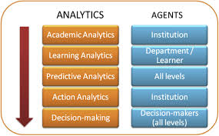
A Broad Scope
A wider definition not only avoids the difficulties of establishing a more narrow definition, but also ensures we do not disregard potential ethical implications simply because the practice is ‘outside the scope of learning analytics’.
For example: http://eprints.hud.ac.uk/id/eprint/16829/3/EllisBroadeningBJET_submission.pdf and https://www.researchgate.net/publication/314105426_Expanding_the_scope_of_learning_analytics_data_preliminary_findings_on_attention_and_self-regulation_using_wearable_technology
https://onlinelearningconsortium.org/wp-content/uploads/2016/02/1-s2.0-S074756321300188X-main.pdf

Slide 16
Analytics and AI
Terminologies and Concepts
Artificial Intelligence – “building machines and software that can mimic ‘intelligent’ behavior.”
Machine Learning – “focused on giving computer systems the ability to learn from data without being explicitly programmed.”
Deep Learning – “deep learning uses neural networks to “learn” a representation of a dataset”
https://www.unicef.org/innovation/media/10501/file/Memorandum%20on%20Artificial%20Intelligence%20and%20Child%20Rights.pdf

Slide 17
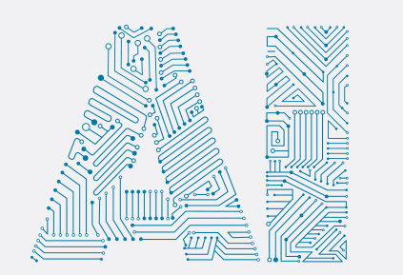
Analytics and AI
We take ‘analytics’ to include artificial intelligence (AI).
“Artificial intelligence (AI) systems are software (and possibly also hardware) systems designed by humans that, given a complex goal, act in the physical or digital dimension by perceiving their environment through data acquisition, interpreting the collected structured or unstructured data, reasoning on the knowledge, or processing the information, derived from this data and deciding the best action(s) to take to achieve the given goal.” (European Commission’s High-Level Expert Group on Artificial Intelligence, 2019: 36)

Slide 18
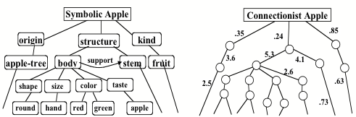
Analytics and AI
The AI and analytics under consideration in this paper are not based on symbolic rules, as the field has mostly turned away from such systems.
https://web.media.mit.edu/~minsky/papers/SymbolicVs.Connectionist.html

Slide 19
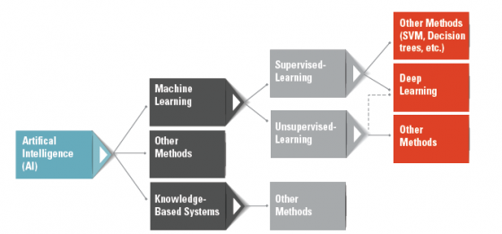
Analytics and AI
When we need to be precise we will be. But will generally use the global terms ‘AI’ and ‘Analytics’ interchangeably. “It is often difficult to clearly distinguish LA from AI in the field of education” Renz, et.al. (2020).
https://risnews.com/truth-about-ai-machine-learning-and-deep-learning-0

Slide 20
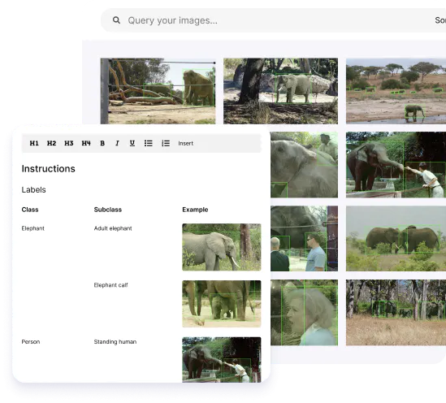
What Makes Digital Different?
Ware, et.al. (1973), for example, wrote that the dangers of digital technology stem from three effects (quoted):
Scale - Computerization enables an organization to enlarge its data-processing capacity substantially.
https://scale.com/

Slide 21
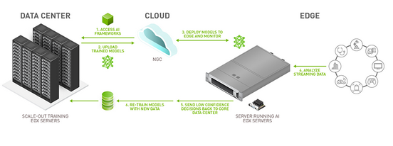
What Makes Digital Different?
Access - Computerization greatly facilitates access to personal data within a single organization, and across boundaries that separate organizational entities.
https://www.nvidia.com/en-us/deep-learning-ai/solutions/ai-at-the-edge/

Slide 22
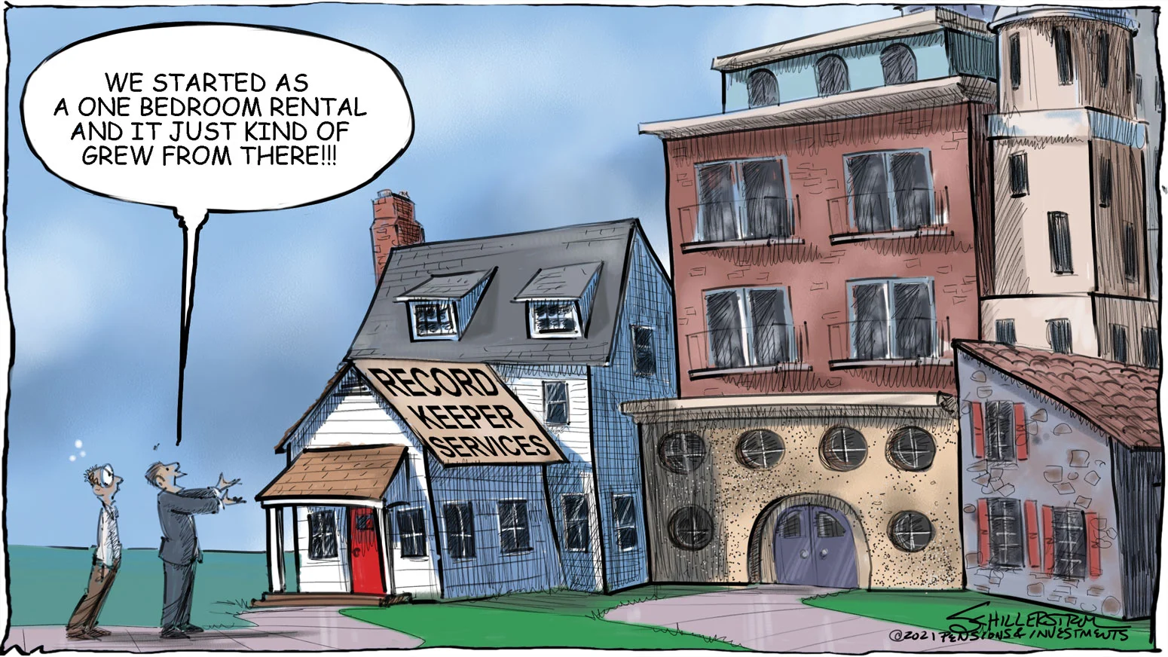
What Makes Digital Different?
Function - Computerization creates a new class of record keepers whose functions are technical and whose contact with original suppliers and ultimate users of personal data are often remote.
https://www.pionline.com/editorial/record-keepers-making-changes-long-haul

