Slide 1
Use of AI for eLearning in the Public Service
September 2021

Slide 2
Objective and deliverables
D1: Systematic review of the scope of AI for eLearning across governments around the world.
D2: Environmental scan and discussion paper on best practices of AI integration for learning and professional development in government workplaces.
D3: Proposal - A general plan for the adoption and leveraging of AI for training, learning on-the-job, and professional development within GoC.

Slide 3
General Findings
Governments throughout the world are increasingly experimenting and discussing AI to support their operations
Few examples of their use to support on-the-job learning, and the professional development of their workforce.
Limited use of AI in the public service (mostly through third party apps).
AI is researched and applied in higher education and leveraged by the private sector
Notes:
AI is researched and applied in highr education, and leveraged by the private sector (including in mobile apps).
Limited use of AI in the public service (mostly through third party apps).

Slide 4
Takeaways
AI will effectively support on-the-job learning
  if it reflects the context of work,
  If it aims for better performance and individualizes learning paths for career development.
Questions worth exploring further:
  How to curate specialized content for AI use.
  How support interoperability
  How to use AI to facilitate just-in-time learning for public servants.

Slide 5
Applying AI in Learning
Learning path recommendation
Content and learning resource selection and filtering
Audio transcription / Automated captioning
Language learning / writing aids / automated translation
Automated assessment and dashboards
Automated learning content creation and update
Intelligent assistants

Slide 6
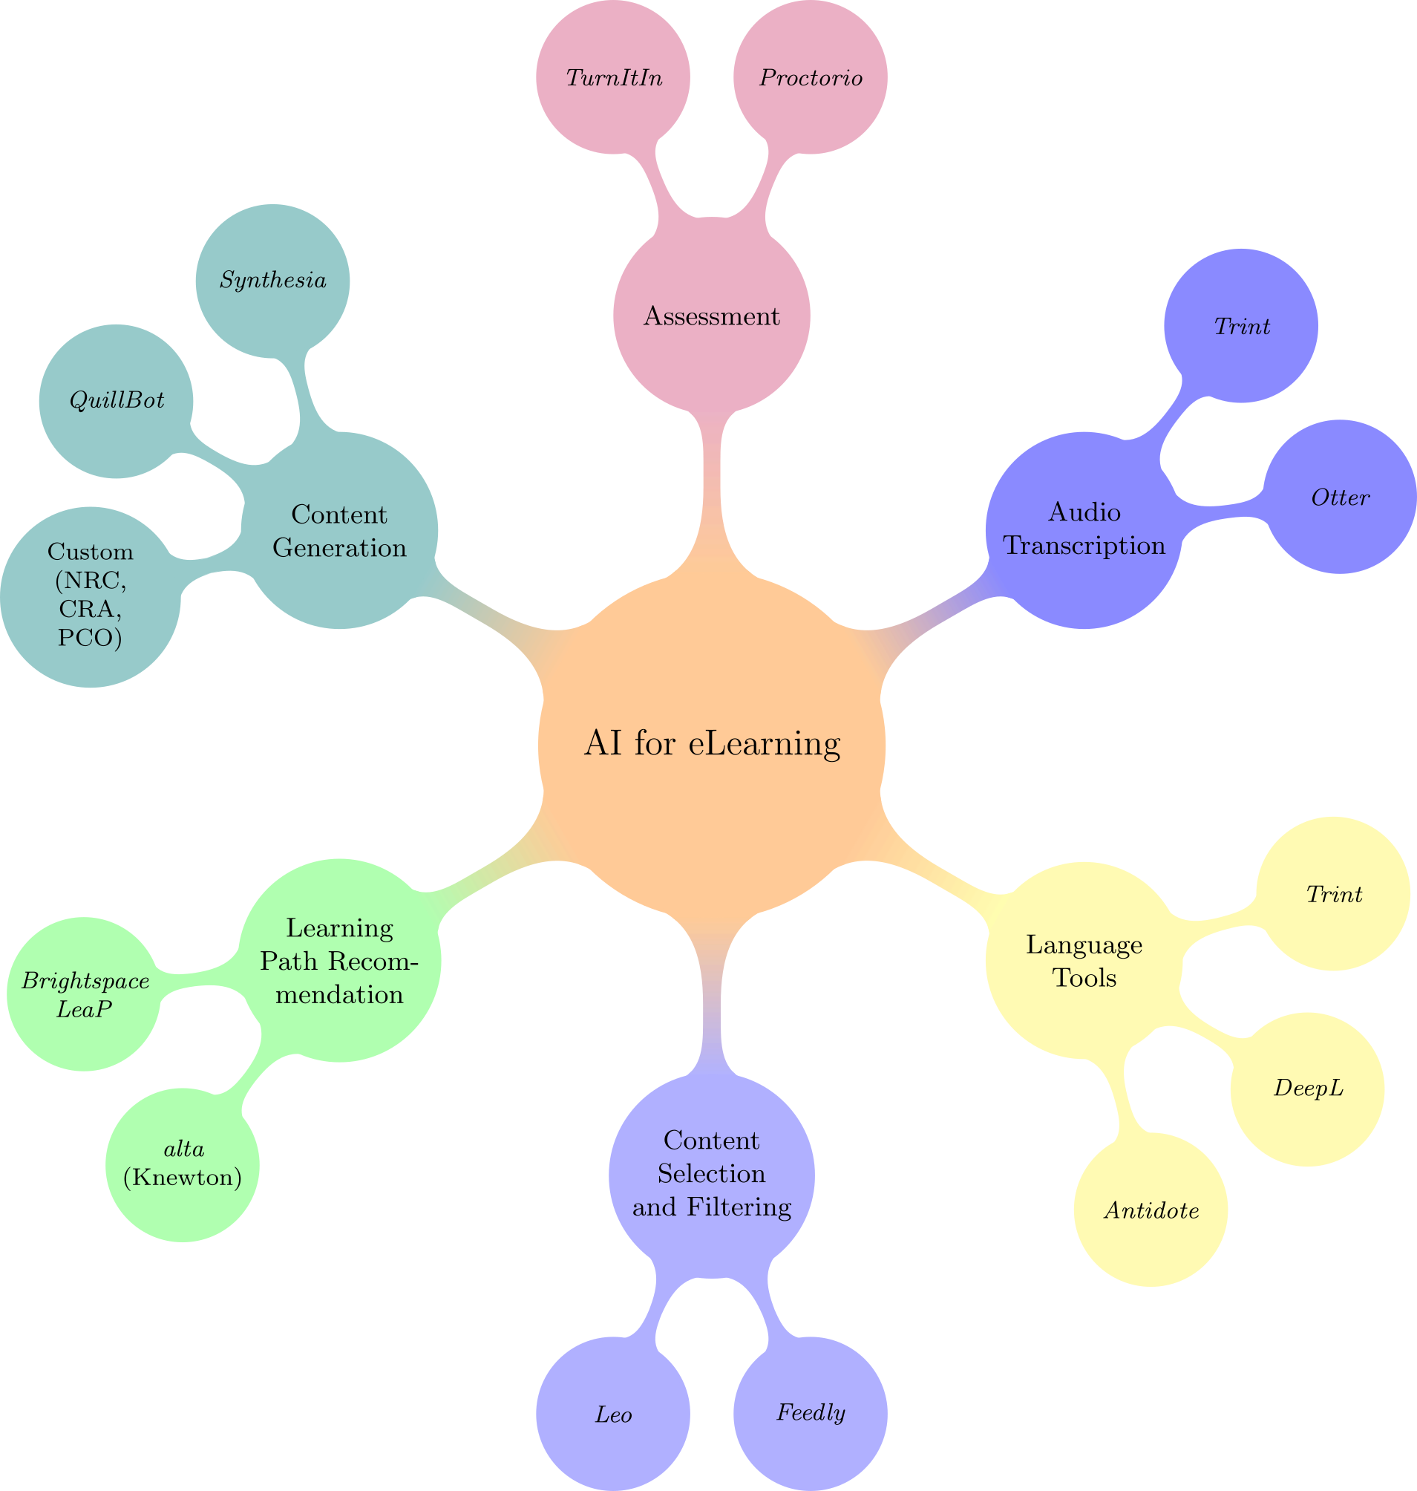
Tool map

Slide 7
Good Practices
Design for humans
Promote diversity, equity, inclusiveness
Understand AI
  Design for interpretation, explainability
Use AI appropriately
  Privacy, surveillance, security, accountability
Ensure social responsibility

Slide 8
Contributors
Contact: dodzi.amemado@cra-arc.gc.ca
Drafters:
Dodzi Amemado (working group lead)
Delphine Renié (deliverable 1 lead)
Stephen Downes (deliverable 2 lead)
Keating Reid
Colleen Durkee
Shirley Thai
Elaine Guimont
Consulted:
Matthew Smith, IDRC
ISED
Isa David, Mackenzie CSPS

