Slide 1

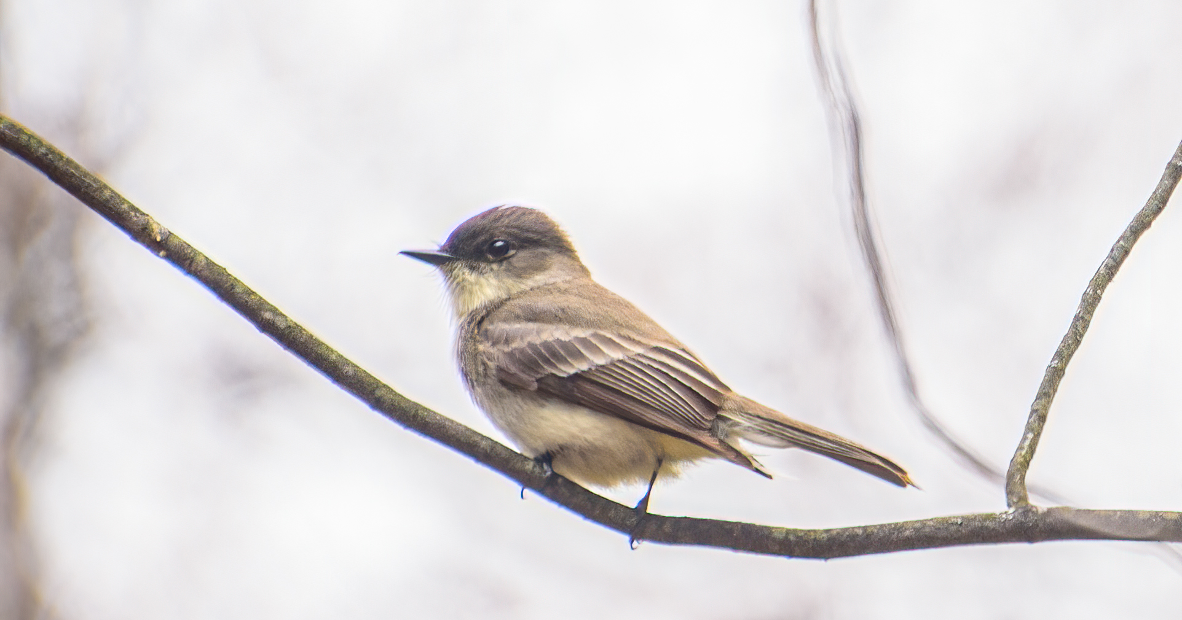
Supporting Everyday Learning
Stephen Downes, CNIE 2021, April 20, 2021 https://www.downes.ca/presentation/546

Slide 2
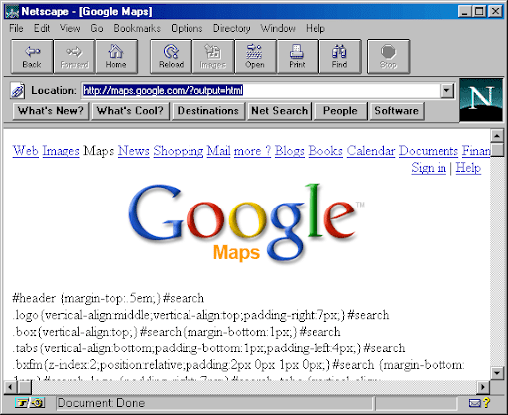
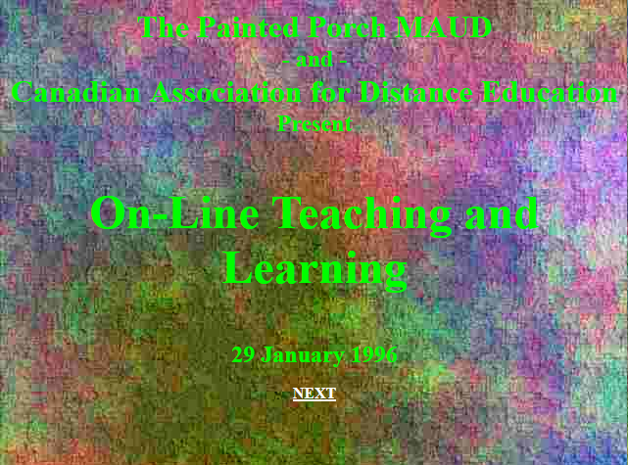
We’ve Been Here Before…
https://www.downes.ca/archive/1996/isiit/cade.htm

Slide 3

Ink-Stained Fingers
https://www.cbc.ca/news/canada/calgary/gauntlet-student-journalism-magazine-1.4069994

Slide 4

What is Everyday Learning?
“Learning does not take place only in the classroom. Children learn by observing animal friends in the backyard, discovering new ways to get moving, picking out shapes in a walk around the neighborhood or critiquing a famous piece of art. Learning occurs naturally, everyday!”
https://www.pbslearningmedia.org/collection/everyday-learning/

Slide 5
The Concept of ‘Everyday’
Not This:
This:
Course
…
Jan Feb
Course
Project
Vacation
Jan Feb
Work
Course
Hobby

Slide 6

What’s Your ‘Everyday?’

Slide 7
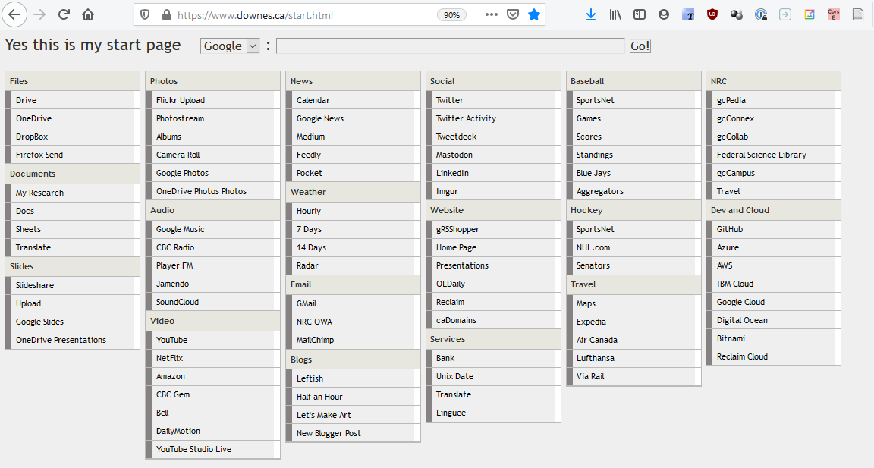
My ‘Everyday’

Slide 8
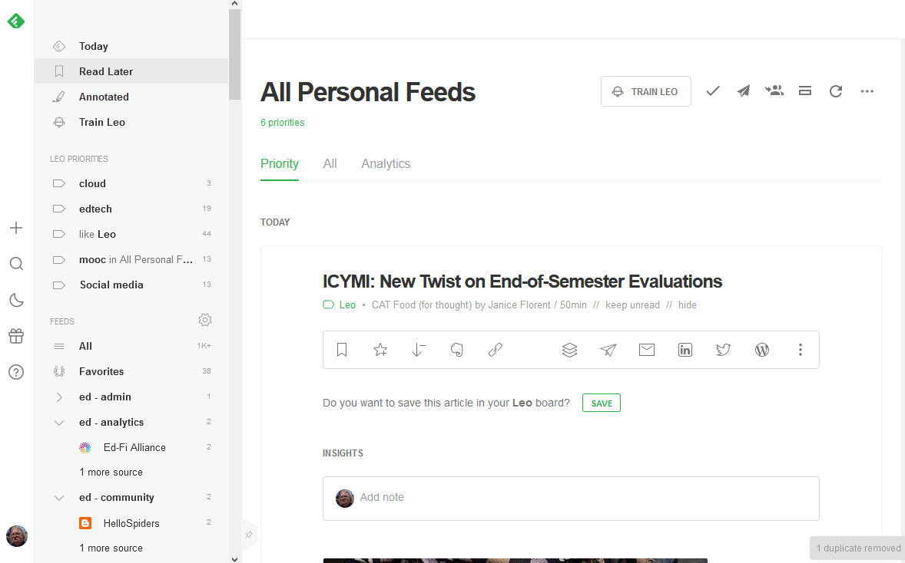
Feedly: An RSS Reader
https://feedly.com

Slide 9
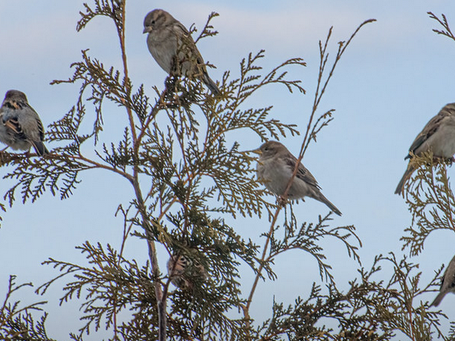
Examples

Slide 10



Magazines
Magazines offer a window to the public on current research and offer a frequent reminder of the institution’s value to the community.

Slide 11
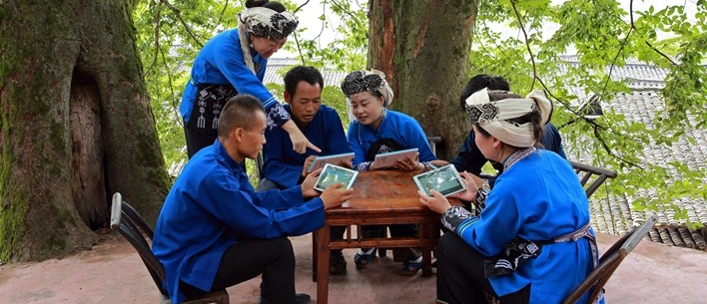
OUC for Rural learners
https://en.unesco.org/news/open-university-china-awarded-unesco-prize-its-use-ai-empower-rural-learners
“As local residents are mainly engaged in agriculture, forestry, animal husbandry and fishery, the University developed learning resources, which can be easily accessed via mobile applications from anywhere, including while working in the field or on the farm.”

Slide 12
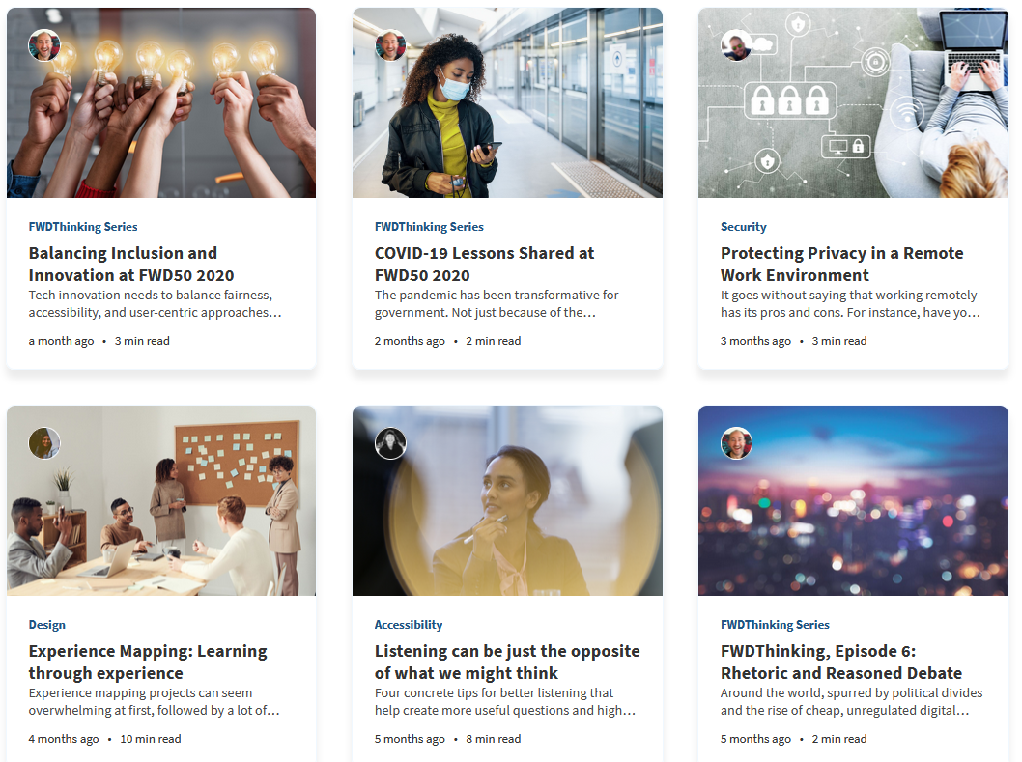
Busrides
“We want to give all public servants a basic and shared conceptualization of a Government of Canada ‘digital’ lens before they move on…”
https://www.busrides-trajetsenbus.ca/
https://www.busrides-trajetsenbus.ca/en/ep-13-en

Slide 13
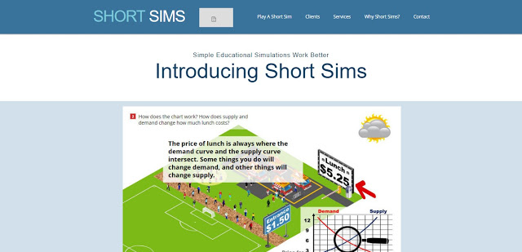
Short Sims
“Online scenarios where people learn by doing that are still cost- and time- effective to create and deploy… they map to how we learn in life. ”
https://www.shortsims.com/

Slide 14
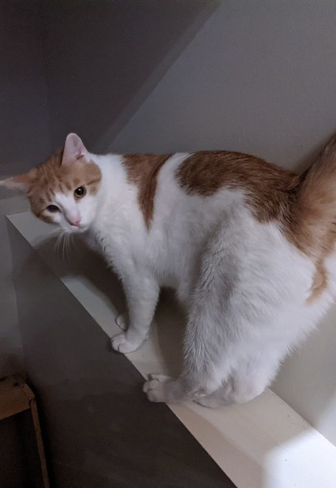
Daily Photo
“Welcome to the (woah) 14th year of this daily photo group. Besides sharing one photo per day, share some appreciation by commenting on other people's photos. For 2021... same group, same URL, no real rules.”
https://www.flickr.com/groups/366photos/

Slide 15
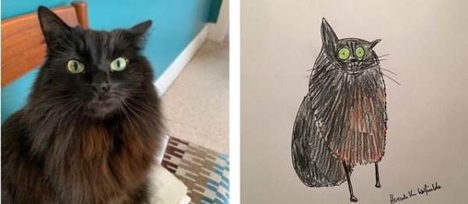

DS 106 Daily Create
“We encourage you to challenge yourself to create something new each day instead of using older photos or videos. But there are no enforced rules- if you re-use media, think how you can make it new by re-editing them. ”
https://daily.ds106.us/tdc3385/

Slide 16
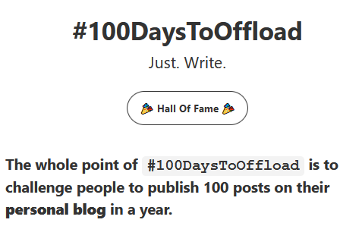
100 Days to Offload
“Posts don’t need to be long-form, deep, meaningful, or even that well written…. What’s important is that you’re writing about the things you want to write about.”
https://100daystooffload.com/

Slide 17
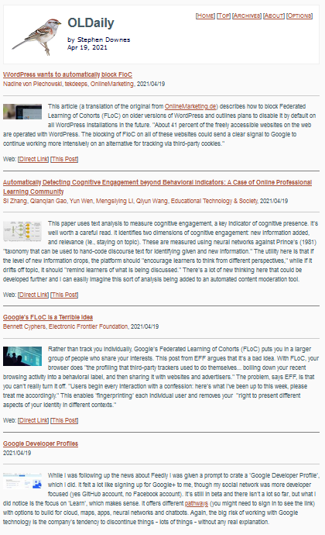
OLDaily
“Posts don’t need to be long-form, deep, meaningful, or even that well written…. What’s important is that you’re writing about the things you want to write about.”
https://www.downes.ca/news/OLDaily.htm

Slide 18
More Examples?

Slide 19
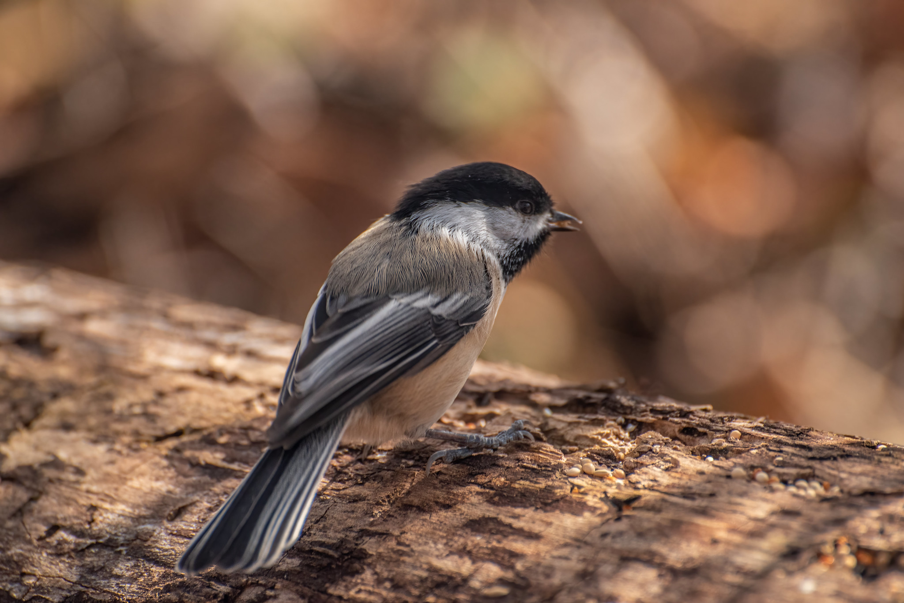
Types

Slide 20
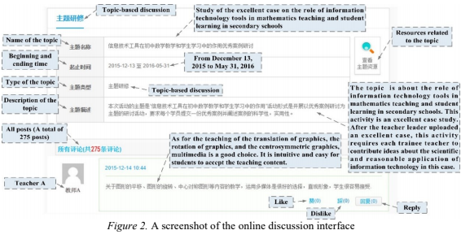
Conversations or Debates
“Effective discourse depends on negotiating existing information (given information) and constantly coming up with new information. ”
https://drive.google.com/file/d/1S2QgHnPRYkrmq4DcZYn3l-pBUYJsXPPi/view

Slide 21
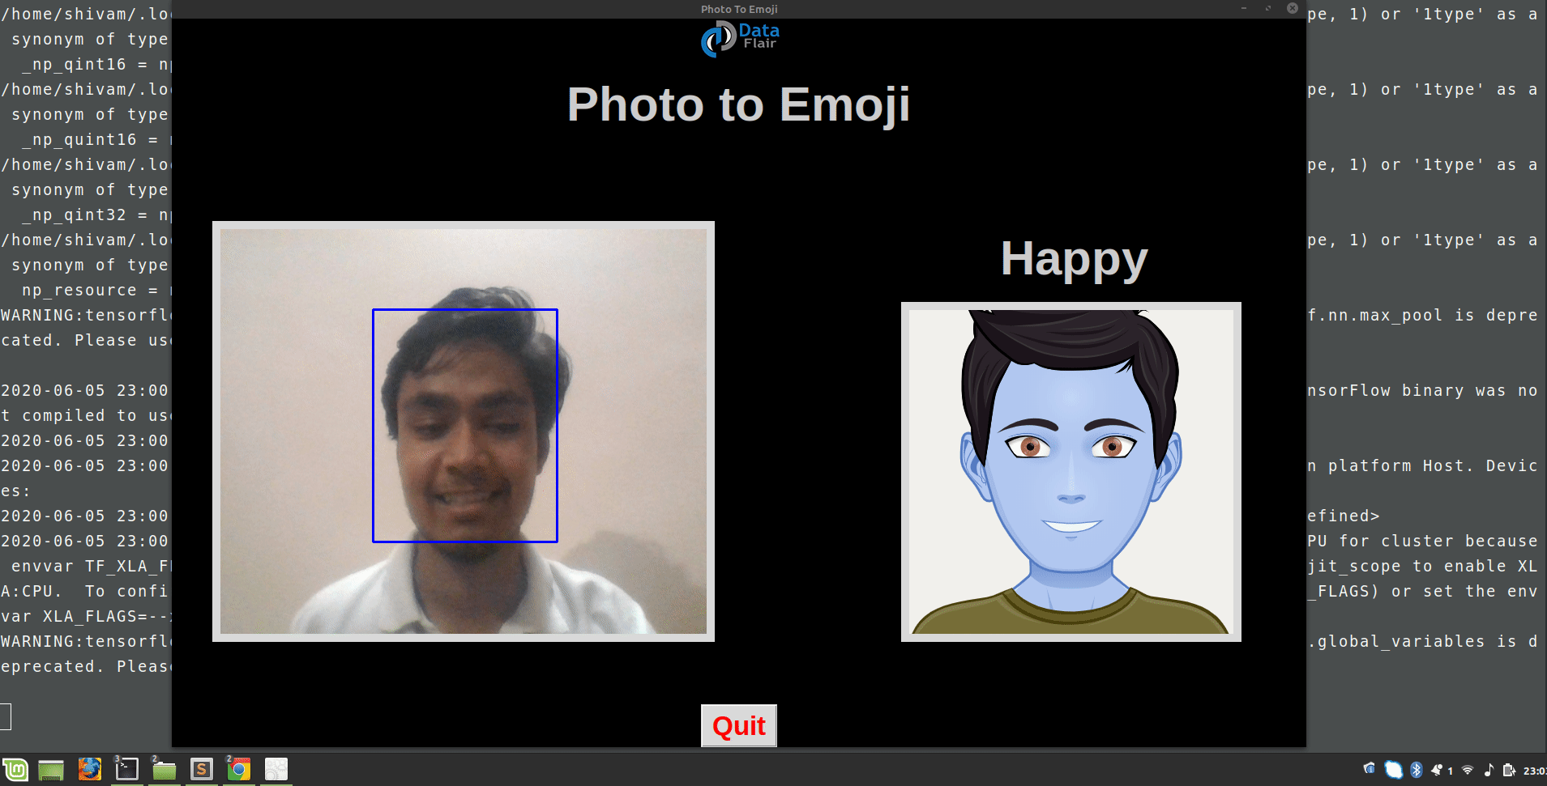
Projects and Activities
Machine Learning Projects for 2021
https://data-flair.training/blogs/machine-learning-project-ideas/

Slide 22

Link Sharing
It was one of the original activities on the web, but we’ve lost it in a sea of social media that does our link sharing for us (we just ‘like’ or ‘retweet’)
https://www.shortsims.com/
https://www.pinterest.ca/rootswingsk/distance-learning-ideas/

Slide 23

Resource Centres
“MediaSmarts is a Canadian not-for-profit charitable organization for digital and media literacy… the critical thinking skills to engage with media as active and informed digital citizens.”
https://mediasmarts.ca/

Slide 24
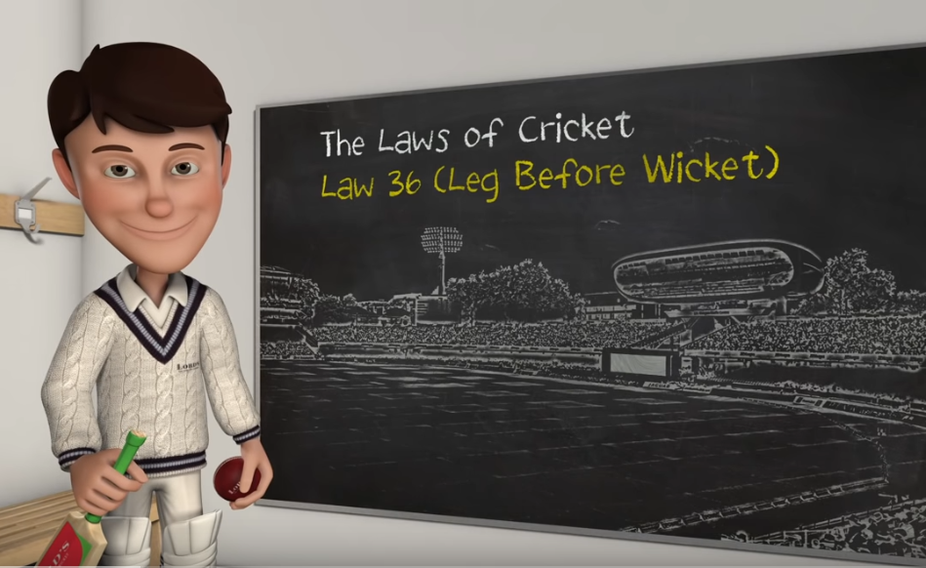
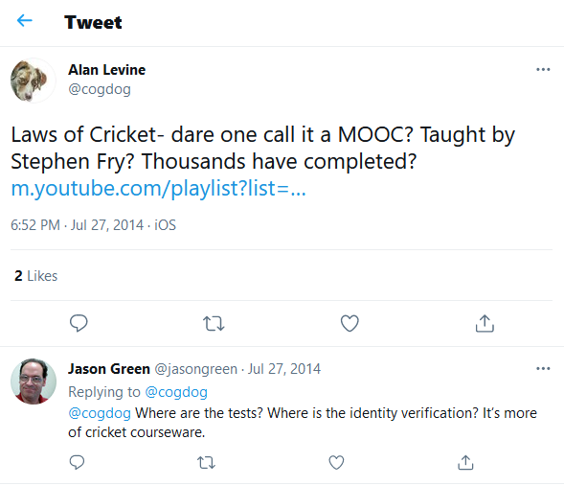
Video Series
What exactly is Leg Before Wicket? How do you bowl a No ball? Can a batsman force a Wide ball?
Stephen Fry narrates this animated series, which has been produced as a helpful guide to clarify the Laws of Cricket by MCC.
Laws of Cricket: https://www.youtube.com/playlist?app=desktop&list=PLMnF7vW2Mvk6nbkwzhytJlfSX6Qw1QeH6

Slide 25
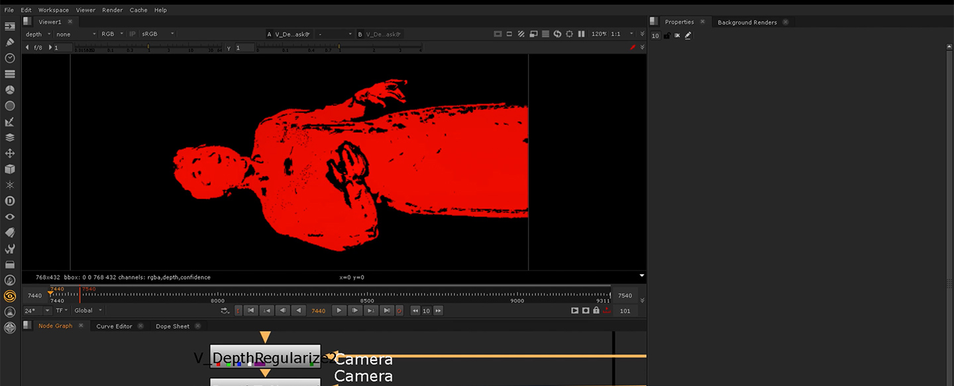
Volumetric video
Volumetric video is considered as the emerging technology for the 3D representation of real persons enabling truly immersive applications for Augmented and Virtual Reality.
https://www.foundry.com/insights/film-tv/volumetric-video-capture
https://sketchfab.com/3d-models/cat-flip-29308353e5aa49129393074cfa66ccbd

Slide 26
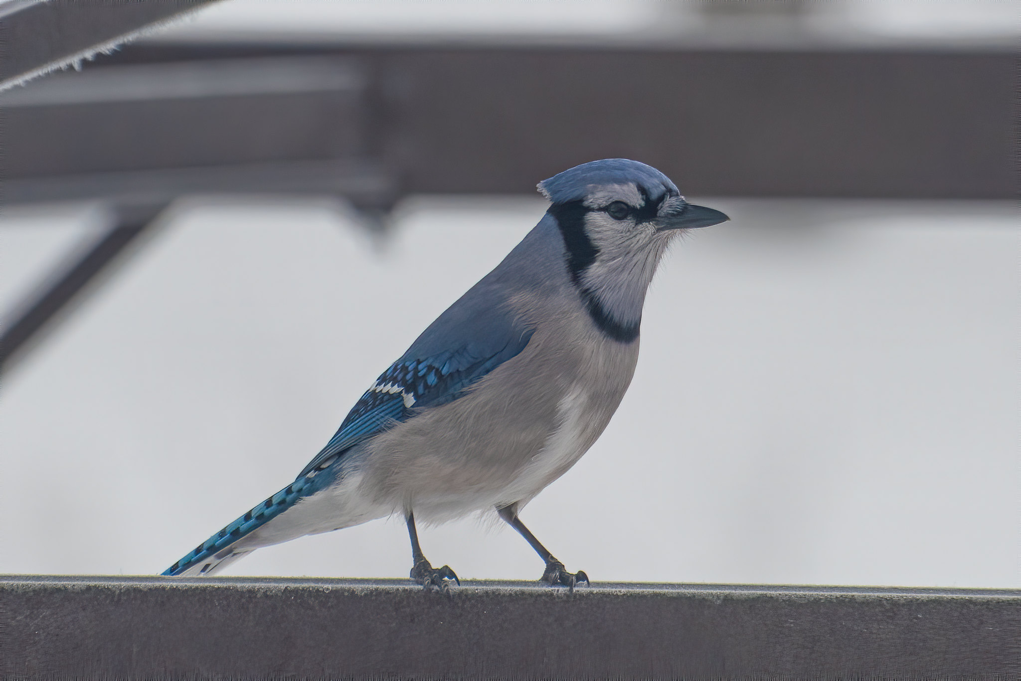
The Tech

Slide 27
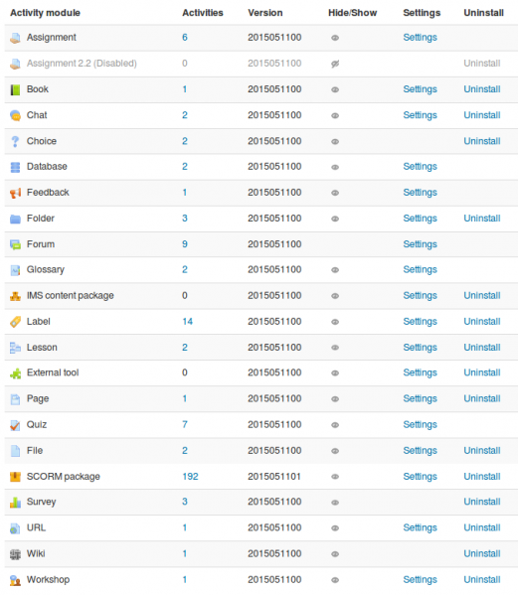
Moodle Activities
“A general name for a group of features in a Moodle course. Usually, an activity is something that a student will do that interacts with other students and or the teacher. ”
See Stefan Krueger – changing the name from ‘Database’ to ‘Peer Sharing’
How to make your Moodle course public without asking user to log in as a guest https://elearning.3rdwavemedia.com/blog/make-moodle-course-public-without-asking-user-log-guest/2022/
https://docs.moodle.org/310/en/Activities
Revamping Moodle Learning Experience to Support a Fully Online Masters Program, Stefan Krueger, KnowledgeOne, CNIE, 2021

Slide 28

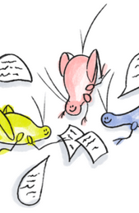
Cricket
“Designed to provide faculty, learning designers and others with a space to explore different approaches to student-focused instructional strategies for their courses, either in a campus setting or online.”
Based on SPLOTbox a WordPress Theme that “powers a site to allow collections of media content (termed ‘items’) where contributions can be made without requiring logins or providing personally identifying information.
https://cricket.trubox.ca/
https://splot.ca/
https://github.com/cogdog/splotbox

Slide 29

Podcasting
Anchor -- free service for recording, hosting, and distributing podcasts
Soundcloud -- record from desktop or mobile phone
Blubrry -- includes a WordPress site
Internet Archive -- upload audio to everyone for free
Zencastr - podcast recording
Educationalist, Hear Me Out https://educationalist.substack.com/p/hear-me-out

Slide 30
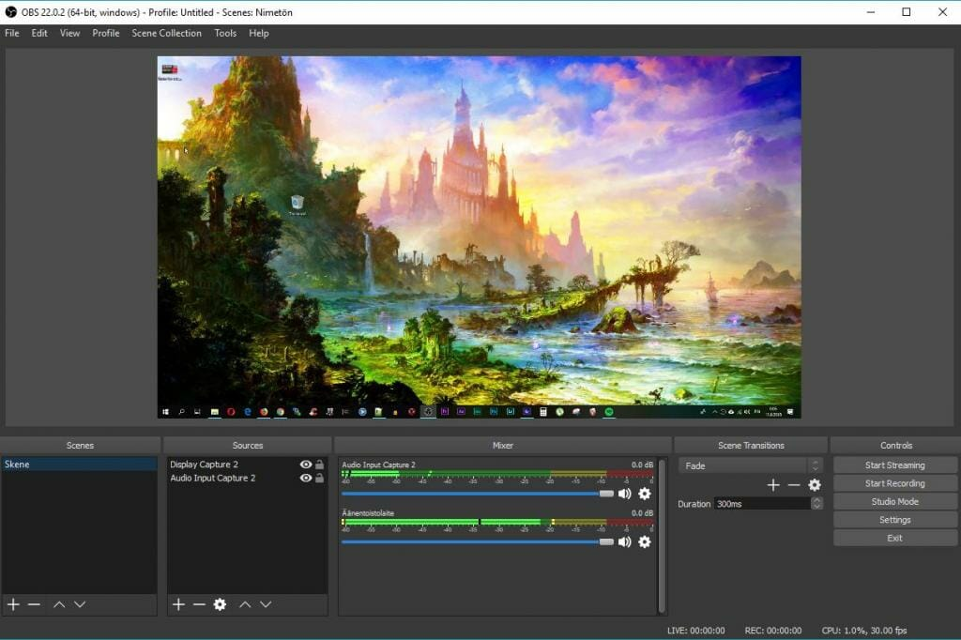
Webcasting
OBS: Open Broadcaster Software
A distribution platform, like YouTube Live
Loom -- Guides: Kathleen Morris,
Screencastify
Screencast-o-matic - Google extension
Zoom - record video conferences
Twitch - most often used to record games

Slide 31
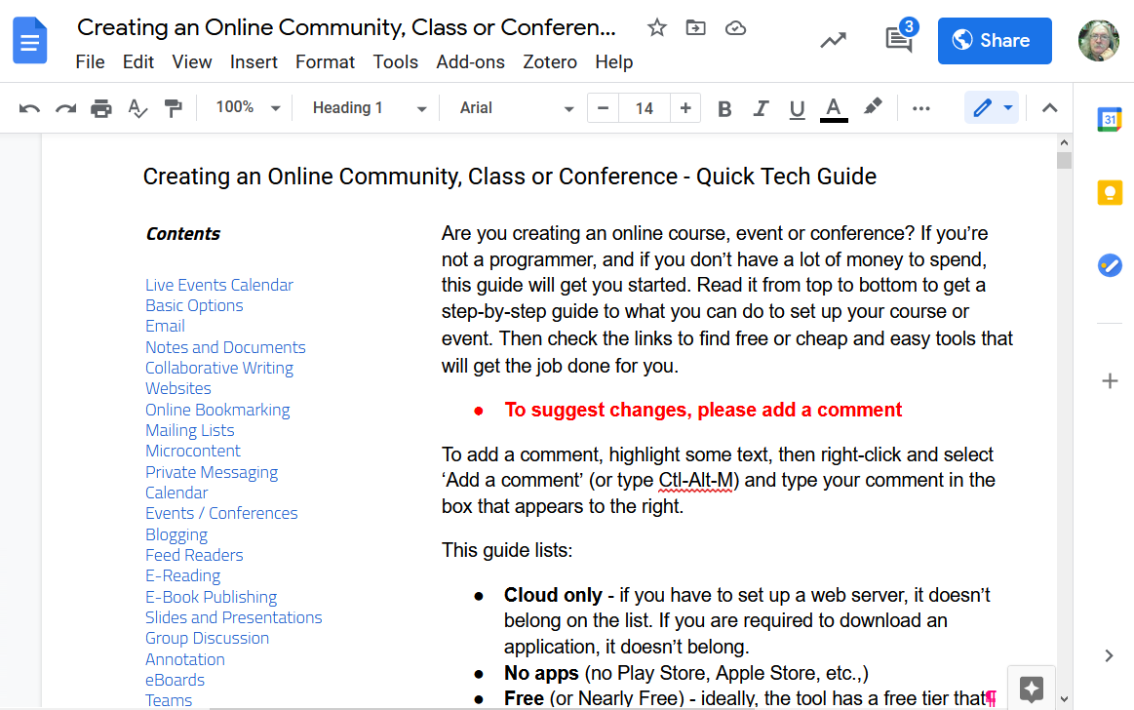
Collaborative Authoring
http://bit.ly/quicktechguide

Slide 32




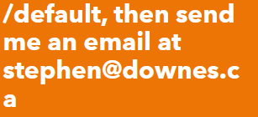


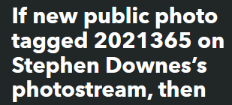










IFTTT
https://ifttt.com/

Slide 33
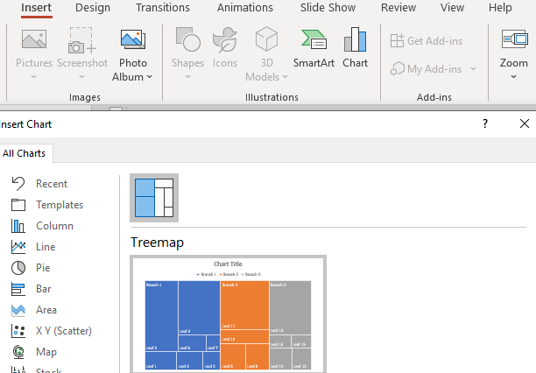
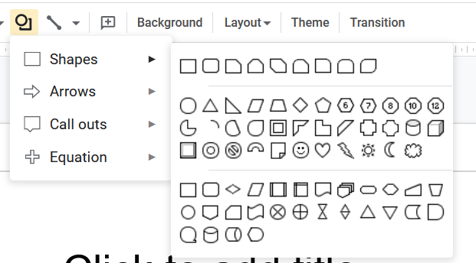
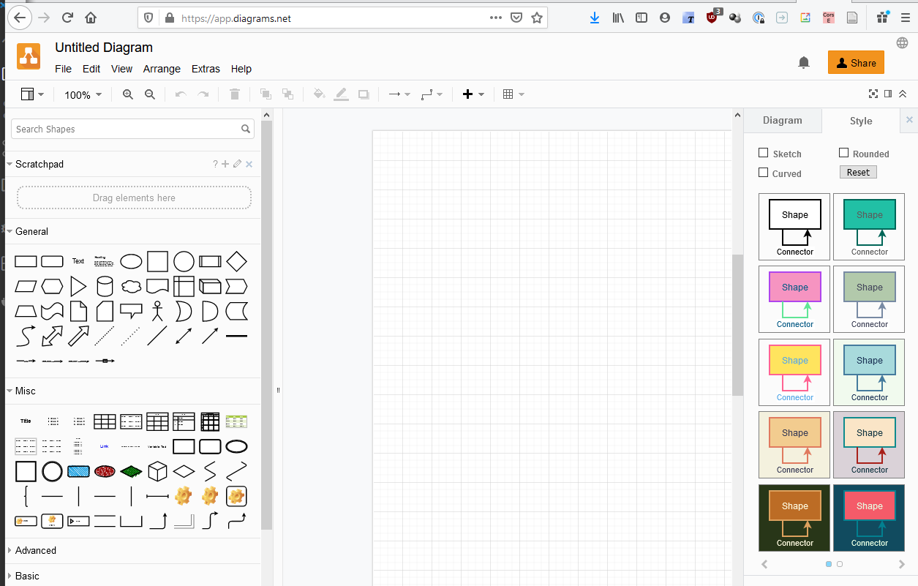
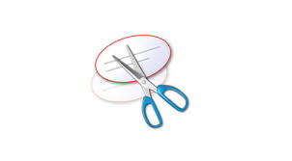
Pro Tip:
Use Design Tools to Make Images
app.diagrams.net
Canva -- makes flyers, posters, etc
  Guides: Edublogger,
Padlet -- makes boards, documents, and webpages
Piktochart -- presentations, posters, interactions (makes you do a survey when you start, just say “no thanks” to it)
Mindmeister -- concept mapping tool with group editing and conversations.
Miro -- for collaborative idea generation and visual feedback
Google Slides -- useful for simple diagrams (export to various formats)
Visme - create presentations, infographics, documents, videos, graphics
LucidChart -- collaborative whiteboard charts - free tier three charts only - [Guides]
Google Drawing -- useful for simple diagrams
Mural -- digital workspace for visual collaboration (like Miro)
Genial.ly -- Create presentations, infographics
app.diagrams.net - formerly draw.io
I create the diagram using the tool then copy it with a snipping tool

Slide 34

Good Practices

Slide 35
Good Practices?

Slide 36
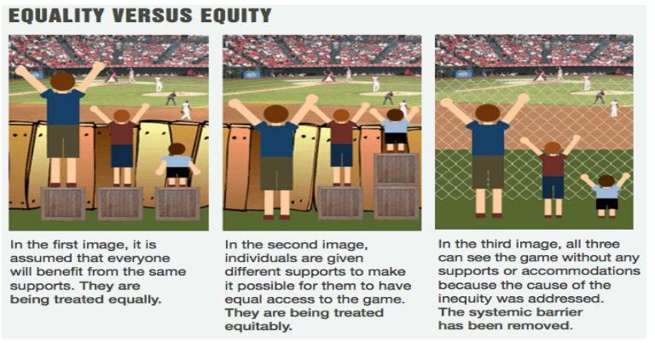
Eliminate Barriers to Access
Removing Barriers to Online Learning Through a Teaching and Learning Lens. Bccampus.
https://bccampus.ca/wp-content/uploads/2020/06/Report_Removing-Barriers-to-Online-Learning-Through-a-Teaching-and-Learning-Lens.pdf
Concepts of equality, equity ,and justice. Courtesy of Advancing Equity and Inclusion: A Guide for Municipalities by City for All Women Initiative (CAWI), Ottawa. https://www.cawi-ivtf.org/sites/default/files/publications/advancing-equity-inclusion-web_0.pdf

Slide 37
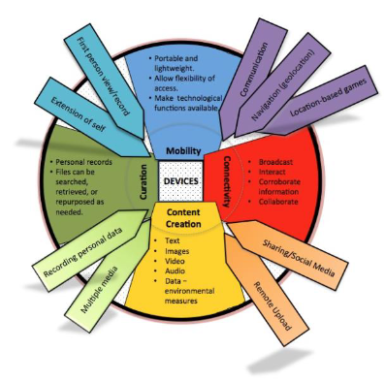
Don’t Assume Outcomes
Different people access learning resources for different reasons.
The outcome is “dependent on how the mechanism is ‘imagined’ and adopted in the given context, and how affordances are identified and exploited.” Margaret Lloyd, https://files.eric.ed.gov/fulltext/EJ1183002.pdf

Slide 38
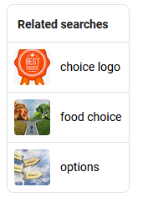
Various Things to Choose From
“Consider how a change to an activity could help your someone be more involved in the activity.”
https://ectacenter.org/~pdfs/decrp/PG_Env_EverydayLearningatHome_family_print_2017.pdf

Slide 39
Keep Things Clear
Use Clear and Precise Language.
Repeat Your Directions.
Explain the Purpose of the Task.
Make Sure Your Students Understand.
Use an Appropriate Tone.
Describe the Specifics.
Provide Examples.
Break Tasks into Manageable Chunks.
https://www.wgu.edu/heyteach/article/guide-giving-clear-instructions-students-that-they-will-actually-follow2001.html

Slide 40
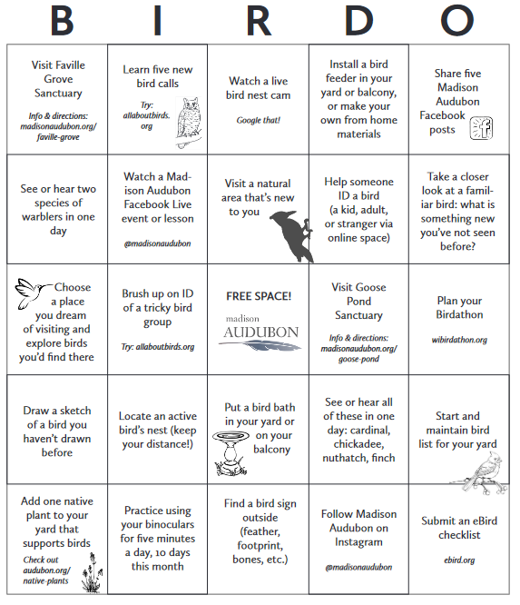
Stand-Alone Activities
While it’s tempting to build activities in a series, each depending on the next, people searching land in the middle of the series.
https://madisonaudubon.org/stand-alone-activities

Slide 41
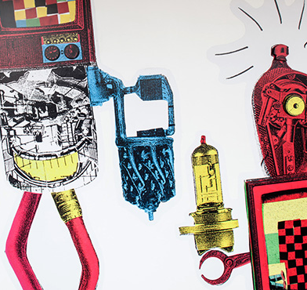
Stay on Topic
“In this tutorial on Docker, we will begin by installing Python and setting up Flask.”
https://bowarts.org/news/stay-on-topic-with-bow-arts

Slide 42
More Examples?

Slide 43
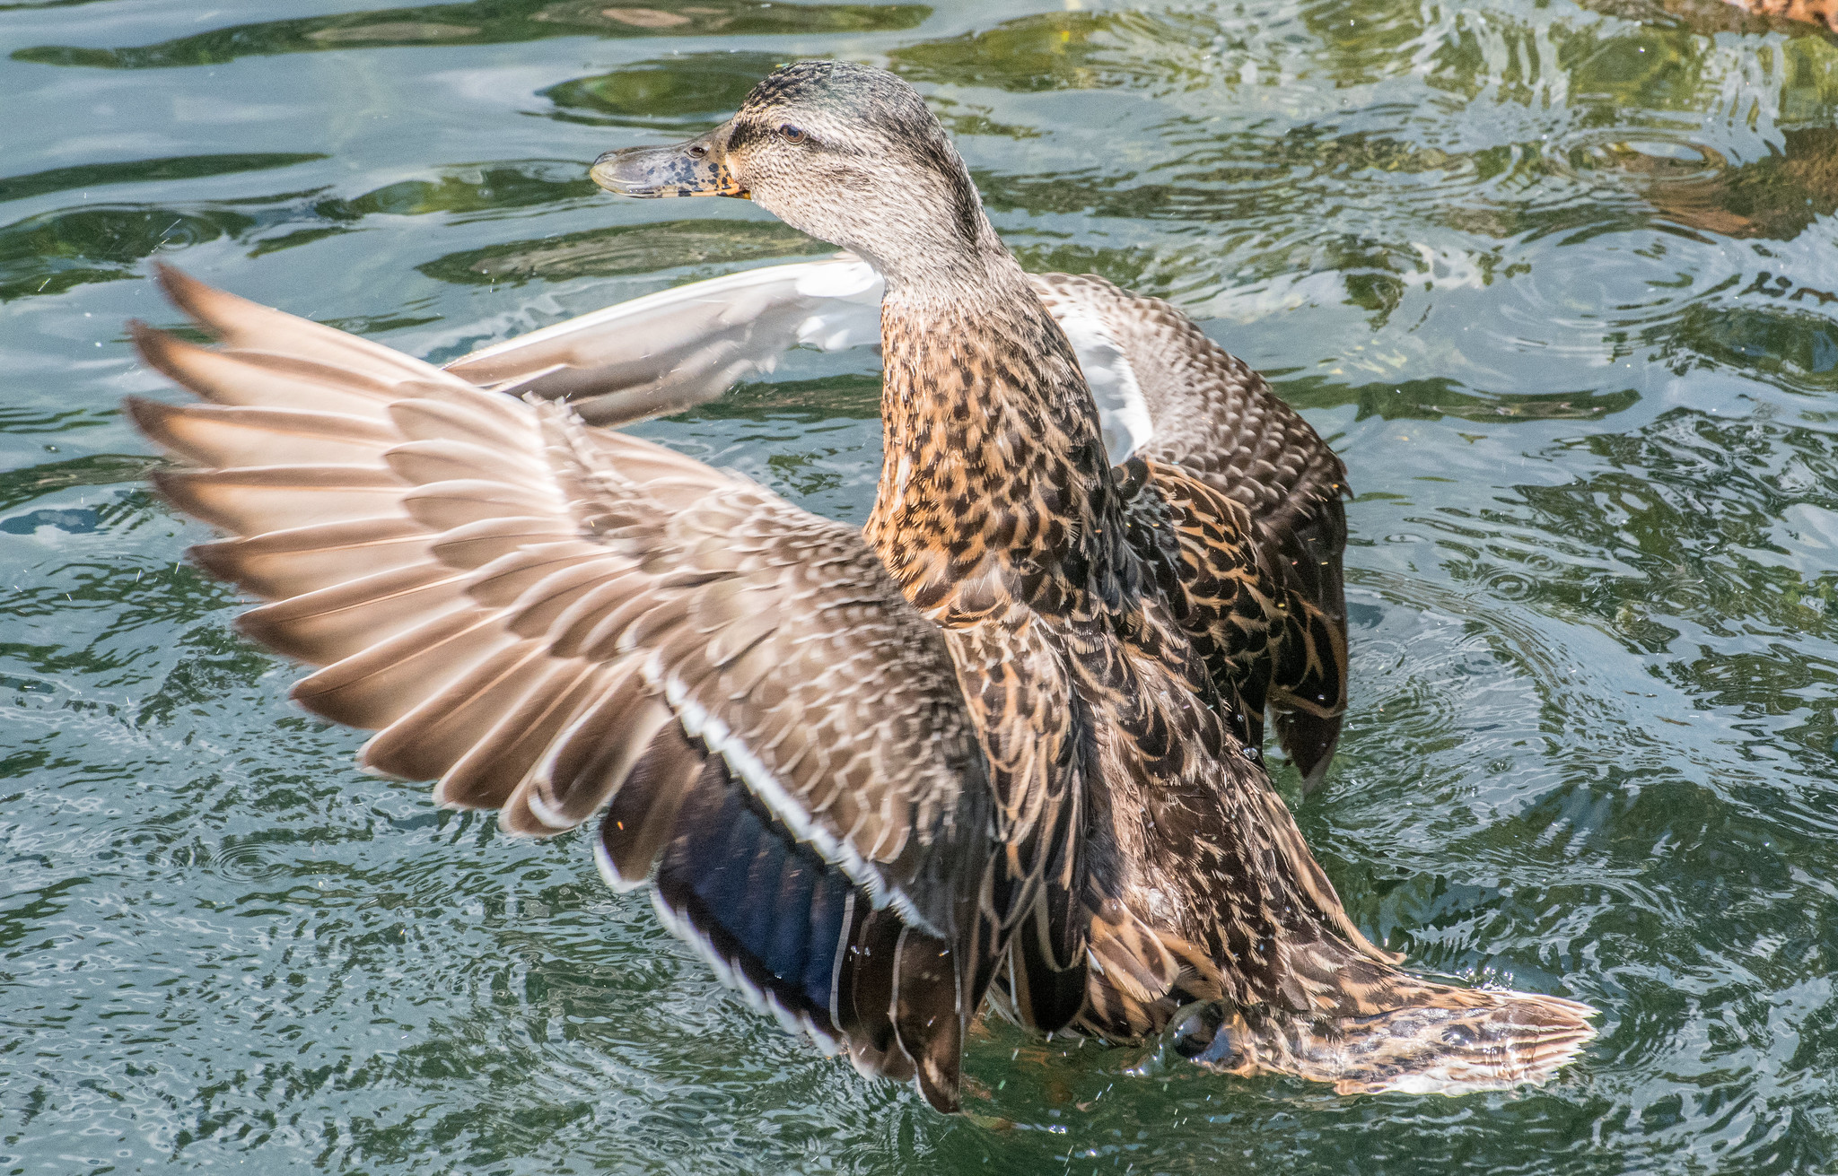
Benefits

Slide 44

Lifelong Learning
“Personal fulfillment and development refer to natural interests, curiosity, and motivations that lead us to learn new things. We learn for ourselves, not for someone else.”
https://www.valamis.com/hub/lifelong-learning

Slide 45

Equity and Inclusion
https://www2.deloitte.com/us/en/insights/topics/talent/six-signature-traits-of-inclusive-leadership.html

Slide 46
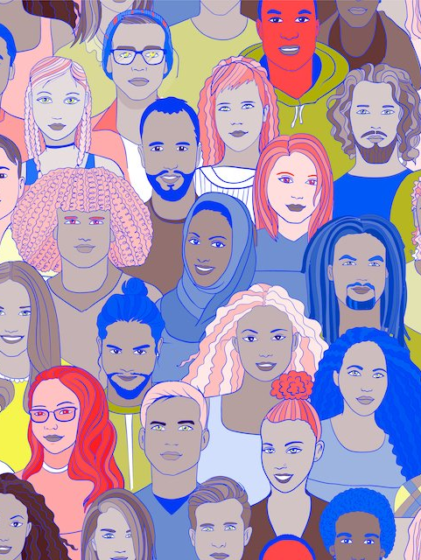
Diverse Markets
Different ways of reaching people discover different people to reach.
https://www.oecd.org/education/ceri/47229500.pdf
https://www.insidehighered.com/digital-learning/blogs/online-trending-now/changing-market-postsecondary-education
https://builtin.com/diversity-inclusion/diversity-in-the-workplace-statistics

Slide 47
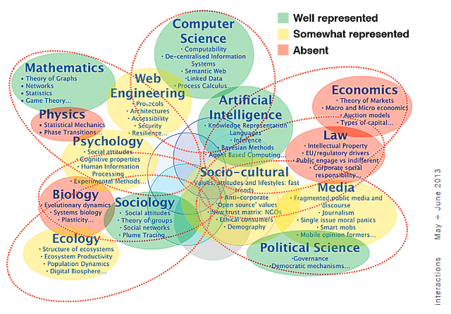
Collaborative Research
https://dl.acm.org/doi/abs/10.1145/2451856.2451868

Slide 48
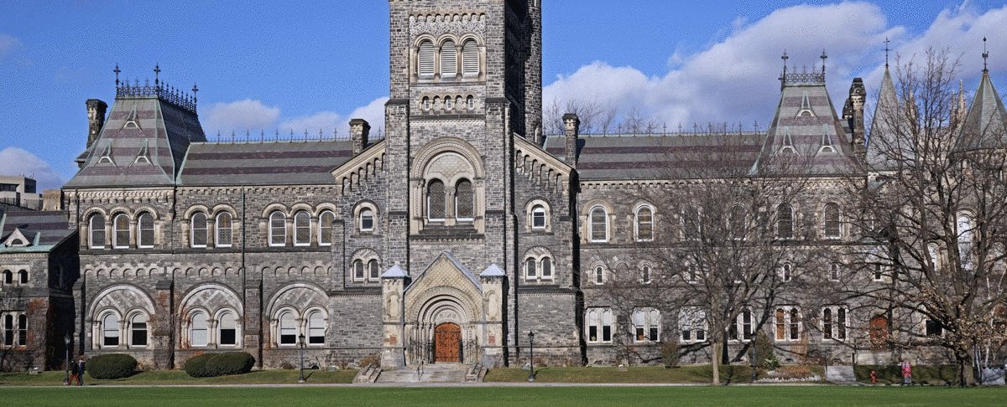
Greater Public Support
If universities were part of Canadians’ everyday lives, maybe Canadians would be more inclined to support them.
https://blogs.lse.ac.uk/politicsandpolicy/job-guarantees-education-reform/
https://www.theatlantic.com/magazine/archive/2020/12/school-wasnt-so-great-before-covid-either/616923/

Slide 49
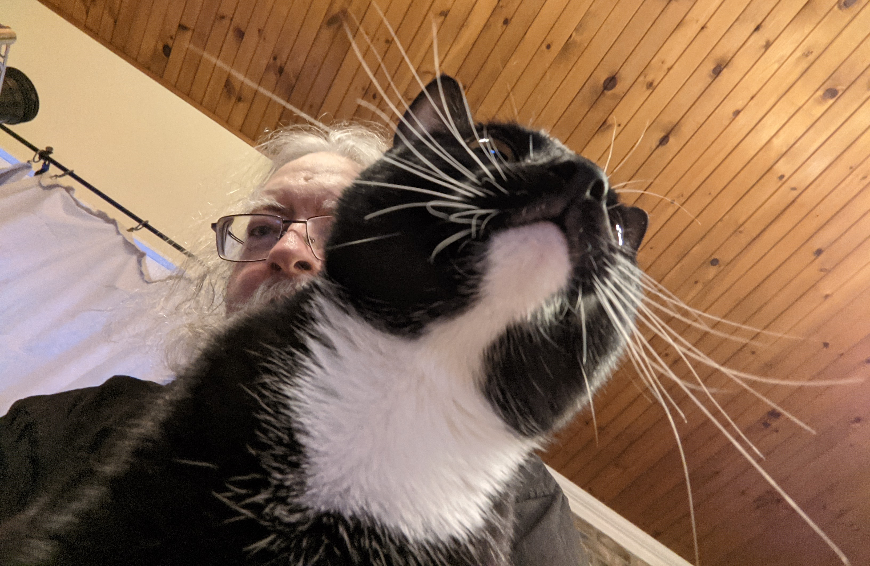
Stephen Downes https://www.downes.ca

Slide 50
Pre-Talk Checklist
Log into conference website
Open Powerpoint and start presentation in ‘individual view’
Start Firefox and remove all excess tabs
Start Alienware mobile connect
Turn on OBS and set up screens
Turn OBS virtual cam
Join Zoom meeting and test
Close email and other conferencing tools
If live streaming, set up YouTube stream
Start OBS recording, live streaming

