Slide 1
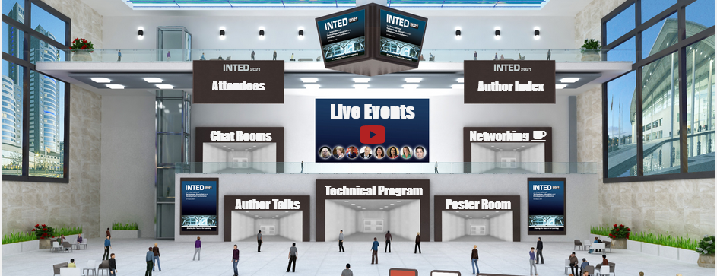
Your Instant Decentralized Learning Community
Stephen Downes
INTED2021
March 8, 2021

Slide 2
Why a Learning Community?
Can be added to a course, but isn’t a course
Can be created by any self-organizing cohort
Facilitates functions important to learning:
  Discussion
  Help and support
  Creativity and sharing
What is a Professional Learning Community? – Richard DuFour
Fully Online Learning Community (FOLC) Model - EILab
Learning Communities – video, University of Groningen
Professional learning networks for teachers – Research paper

Slide 3
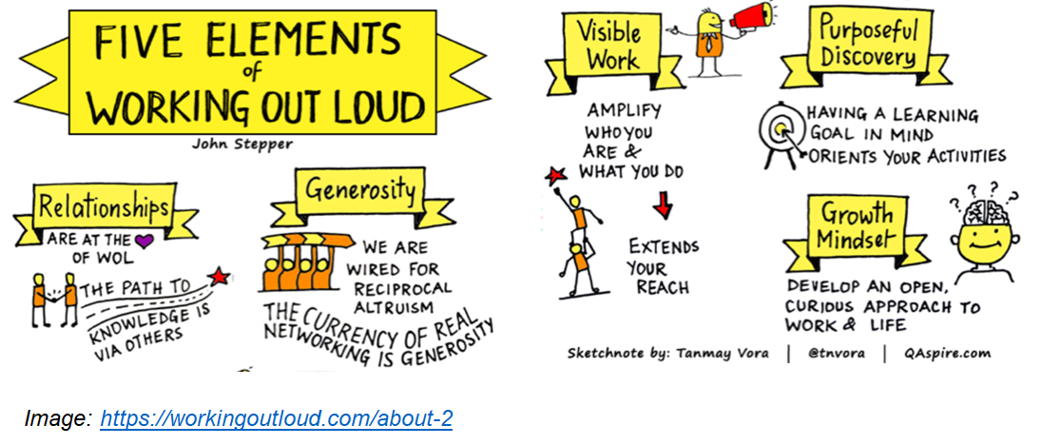
The Idea: Working Out Loud

Slide 4
Why Decentralized?
Continues to work even if parts break down
Eliminates bottlenecks and therefore high costs
Can work with any sized cohort
Decentralized Social Networks – Tulane
Social Networks Are the Next Big Decentralization Opportunity - CoinDesk
Future Learning in an Advanced Decentralized Learning Ecosystem – by me
Decentralized Modeling and Decentralized Thinking – Mitch Resnick

Slide 5
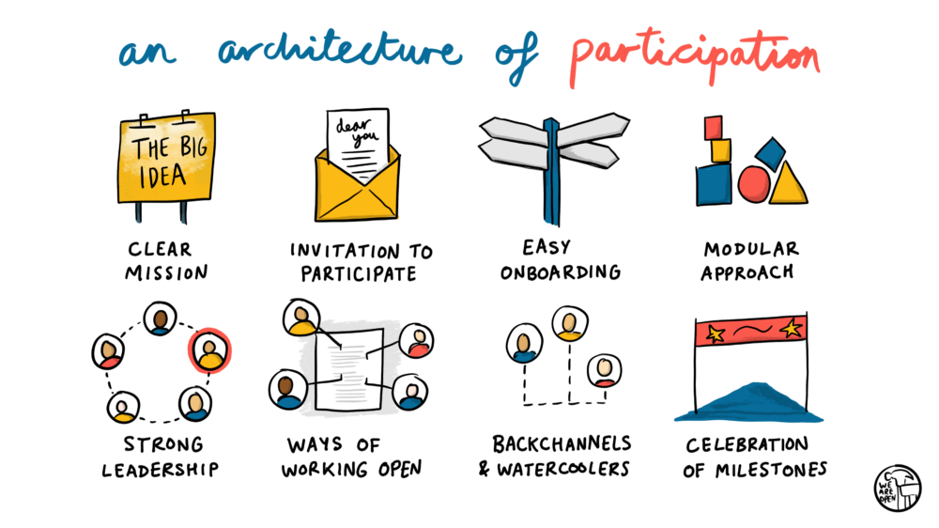
Cooperation, Not Consumption
Doug Belshaw - https://blog.weareopen.coop/howto-create-an-architecture-of-participation-for-your-open-source-project-a38386c69fa5

Slide 6
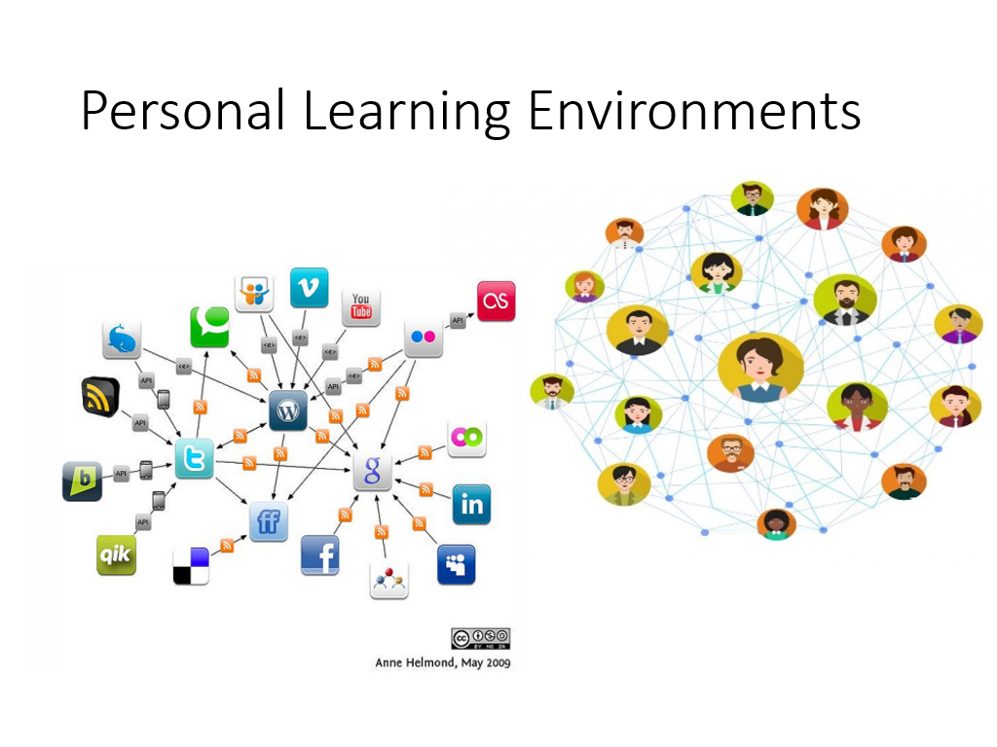

Slide 7
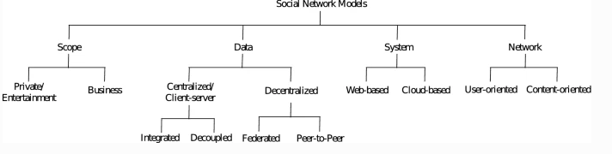
Why Instant?
Let’s see what we can do in this hour-and-a-half
Can we build a decentralized learning network around INTED2021?
What can we learn from that experience?
Praxis and the Indieweb – Daniel Goldsmith
Peer-to-Peer-Based Social Networks: A Comprehensive Survey - Masinde & Graffi

Slide 8
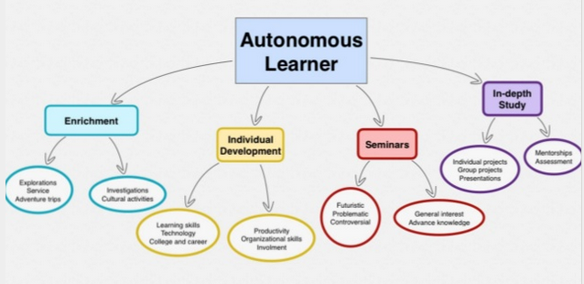
Every Step is Optional
A decentralized learning community is robust
People can choose their own learning technologies
This creates the greatest access and affordances
https://www.slideshare.net/Georgina23/autonomous-learner-38040255/2

Slide 9
Email
It’s a good starting point
Many (most?) people already have email
It’s useful for mailing lists and to register for services
Zoho Email - Free personal mail
GMail - Google mail service
Mail.com - free entry-level tier
Outlook - Microsoft’s rebranded Hotmail
Resource: Comparison of email providers - Wikipedia

Slide 10
Website
Home for your online community.
Provide essential information and a way for people to contact you
Link to other services (email lists, blogs, etc.).
Don’t expect people to visit your website regularly
Wix - free websites - [Instructions - video]
Google Sites -- Like the name says
Weebly - mostly for e-commerce, but other types of sites also work
Wordpress.com - can also be used to create pages and static sites
Resource: Free Web Hosting Sites - Wikipedia

Slide 11
Platform Choices…
Desktop applications (Windows, Apple, Linux)
Apps (iOS, Android)
Web applications (Google, Zoho, Microsoft)
Hosted internet (cPanel, Plesk, more) e.g. Reclaim, GoDaddy
Cloud hosted applications (using e.g. AWS, Azure, Google Cloud)
Considerations: cost, access, convenience

Slide 12
Bookmarking and Links
The entire web can be your library
Doesn’t require anyone to download and store resources
Might be too centralized
Also, links expire quickly
Wakelet - free, no need to be registered to view someone else’s collection, collaborative curation
Zotero web and desktop bibliography tool with shared groups and discussions.
Diigo - bookmarking too - [hints]
Pinboard - social bookmarking
Resource: Intro to Collaborative Bookmarking (video)

Slide 13
Hashtags
We can use commonly accepted words to collect resources of different types
They work better if we use the # symbol – hence, ‘hashtag’
Put the hashtag into the text to make it eacy to find
Our conference hashtag:
#INTED2021

Slide 14
Microcontent (aka Social Networking)
Short form messages, images, video sharing
Widely used and replaces email for many people
Often centralized and very public
Twitter - use a #hashtag for your community
  Try Tweetdeck to more easily follow topics and trends
Mastodon - decentralized microcontent - takes a bit of getting used to, but without Twitter’s chaos and issues (use masto.host to set up your own) -- [Instructions: video]
Backchannel Chat - class discussion tool
(Note: Facebook, Instagram, Snapchat, LinkedIn, and Reddit are additional options, but they’re really not appropriate for online courses and events).

Slide 15
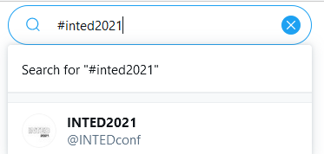
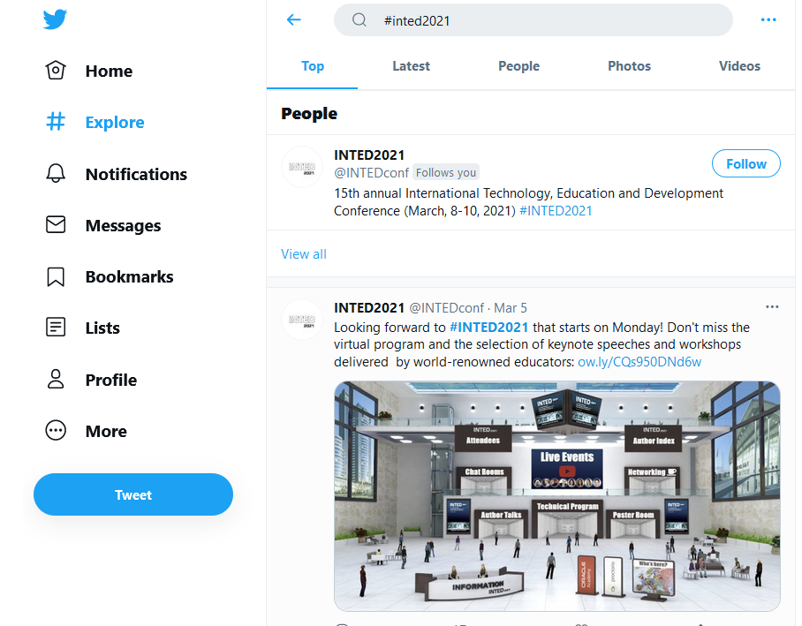
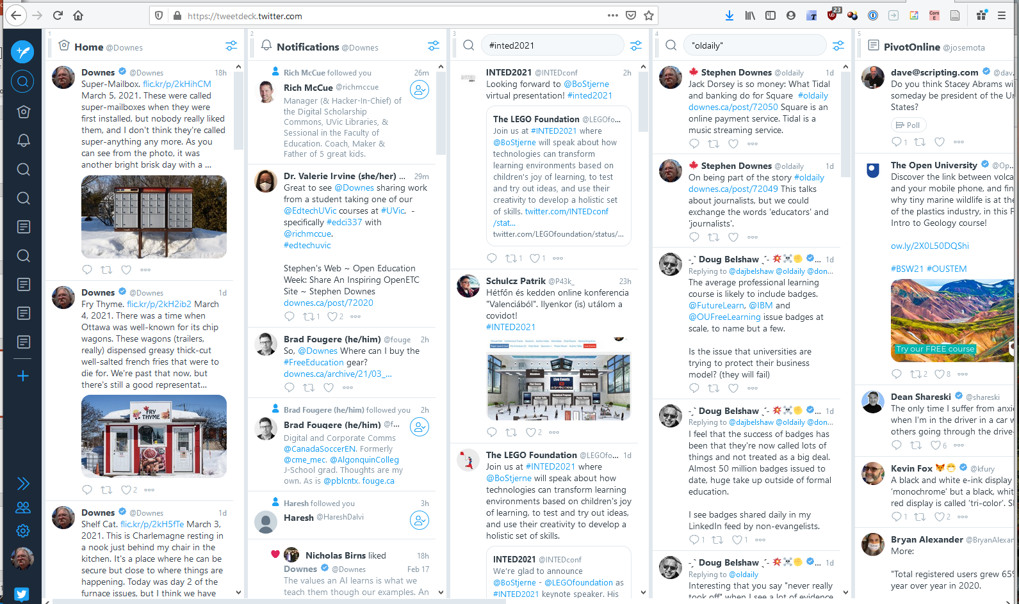
Let’s Get In Touch
https://twitter.com/search?q=%23inted2021
https://tweetdeck.twitter.com/

Slide 16
Creating Community vs Finding Community
Educators often want to set up their own (frequently private) learning community
This sometimes works but has its drawbacks:
  May suffer from small scale and few active users
  Takes people away from tools and places they’re already used to
  Creates silo effects rather than network effects
  Disappears when the course or conference is finished
The best tool is the one you’re using; the best community is the one you’re already in

Slide 17
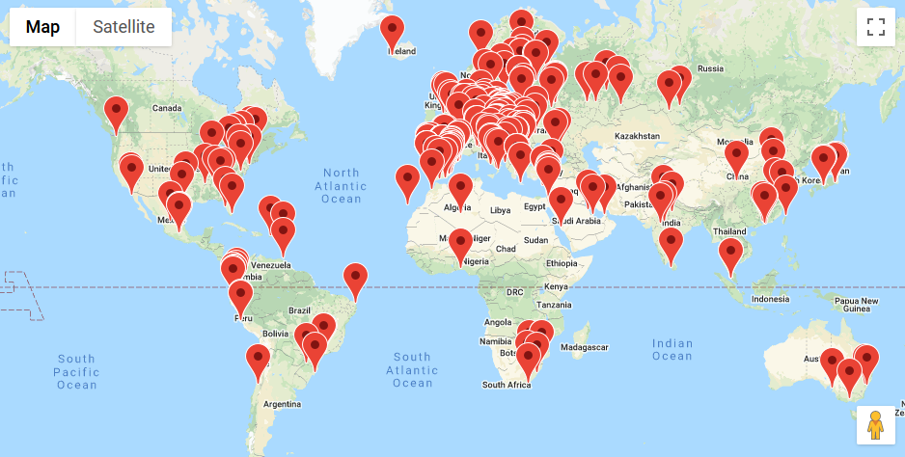
Our Community
https://iated.org/concrete3/map.php

Slide 18
Blogging
Online content sorted by date
Useful for regular columns or postings
Have an official blog (sometimes called a ‘mother blog’)
Also an excellent activity for community members
EduBlogs - WordPress based, free for education [Instructions: video]
Blogger - still free, still easy [instructions: video]
Medium - a lot of tech blogs use this
Tumblr - a lot of art blogs use this
WordPress - wordpress.com, other WordPress hosting sites

Slide 19
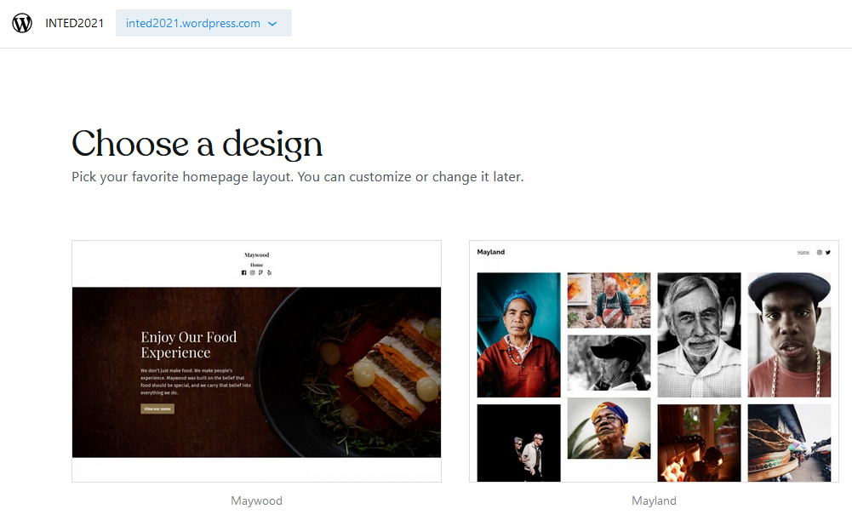
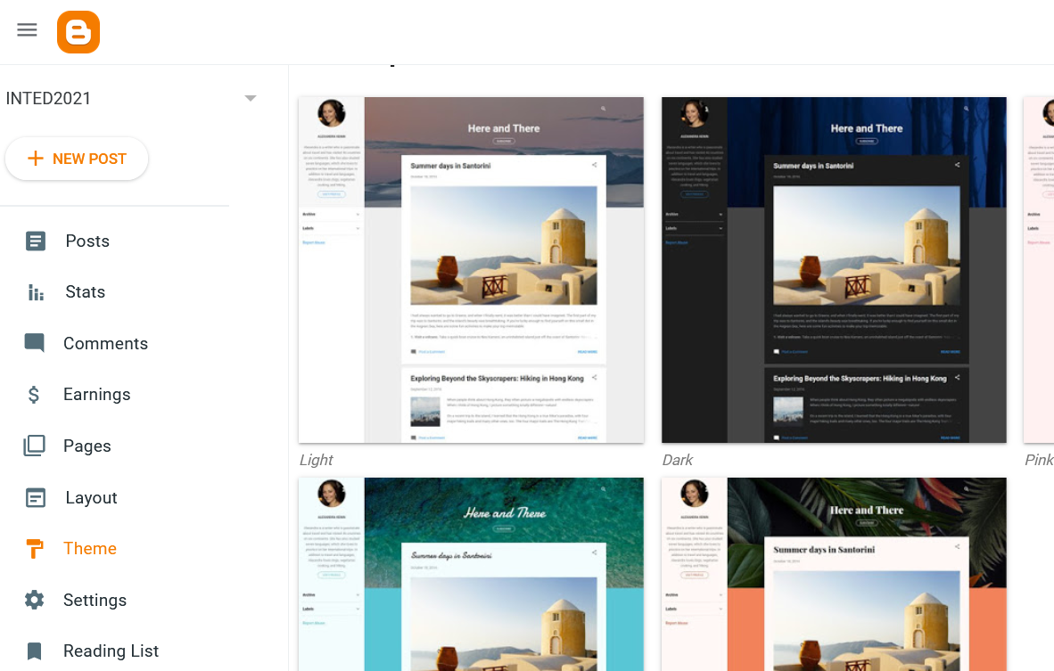
Let’s Make a Blog
https://www.blogger.com
https://wordpress.com

Slide 20
Lists
Keep track of email addresses, twitter handles, etc.
Right now, we want to keep a list of blogs
There are many complicated ways to do this
ListMoz - basic untitled lists each with their own URL
Yeah, that’s it – I only found one simple list service

Slide 21
Collaborative Writing
One document, many writers
Use it to work together and to collect information
Example: my technology guide - http://bit.ly/quicktechguide
Google Docs - ‘Share’ button to share – video instructions
Riseup Pad – Short-term collaborative documents
GitHub.com – code hosting, also hosts websites
MeetingWords -- texts must be edited in 7 days or are deleted
StackEdit, markdown editor
Resource: Comparison of wiki hosting services - Wikipedia

Slide 22
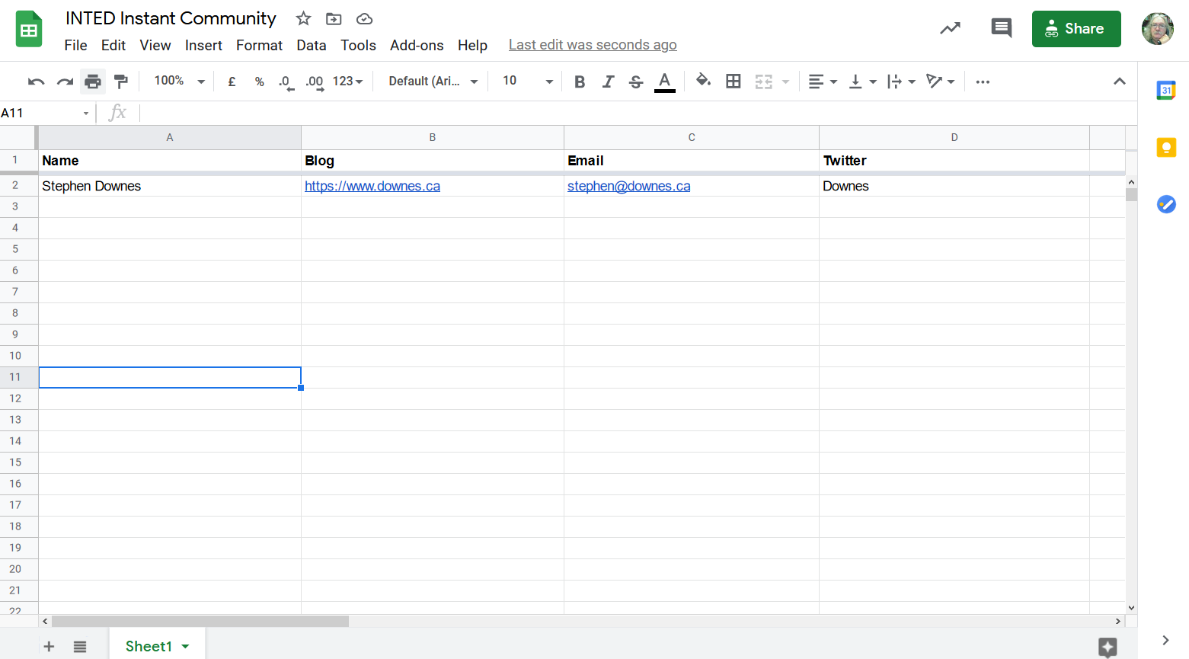
Let’s Make Some Lists…
https://www.downes.ca/post/72051/rd
Hey,
anybody can make a list

Slide 23
Feed Readers
Select blogs to read from the list of blogs
View them altogether in one place
Search by topic or hashtag
Feedly -- click on the + at the left to add new feeds
The Old Reader - free tier, 150 subscriptions
InoReader - free tier - [hints]
NewsBlur - free tier allows 64 subscriptions
Nextcloud - has a ‘News’ feed reader
Feed Informer - free, simple

Slide 24

Subscribing to Feeds
Normally you can just use the blog address
But some services need feed addresses
Look for the RSS icon, or use a feed-address service
Common Feed Conversions:
WordPress: <blog url>/feed
Blogger: <blog url>/feeds/posts/default
Find an RSS feed address for almost any site

Slide 25
Reading and Responding
Responding is the best way to create community
A decentralized community means using your own space
Everything connects by means of links
*
Link back to what they wrote
They write
You read
You write
* The W3C WebMention protocol is an attempt to automate this

Slide 26
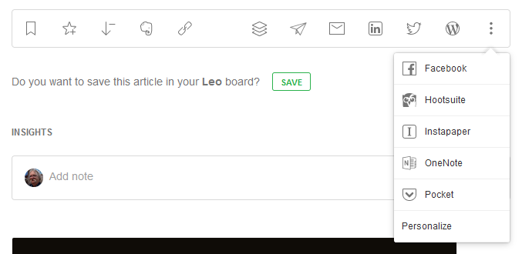
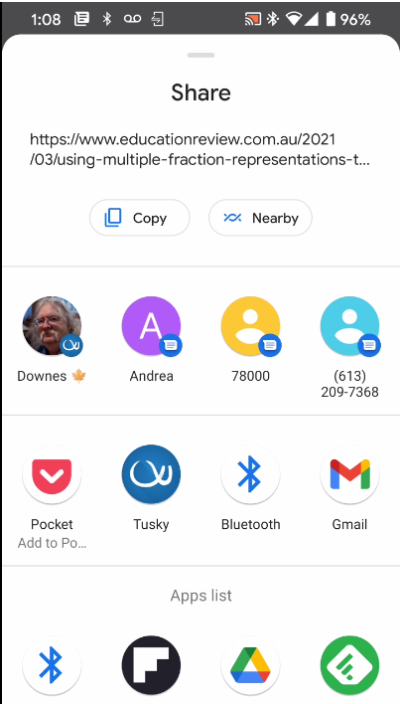
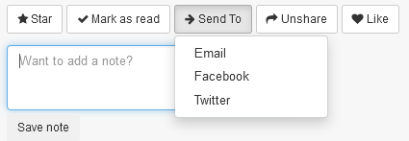
Ways to Respond - SharingOptions
Feedly
Feedly on my phone
The Old Reader

Slide 27
Conversions
Transform content from one platform to another
Some specialized, other generalized
Not always easy but very convenient
Sometimes called ‘workflow’ or ‘agent’ apps
IFTTT – numerous apps and services connected
Zapier – very limited free plan
dlvr.it – limited free plan
Automate.io – focused to business applications
There are also desktop applications, like Microsoft Flow, or Open Source software to run in the cloud, like Hugginn

Slide 28



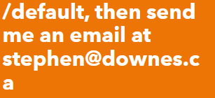
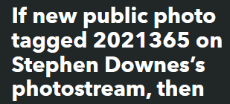
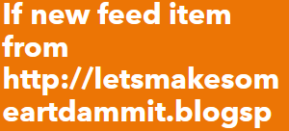






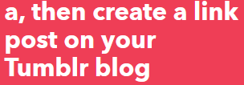



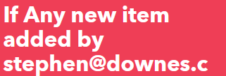
Some of My Recipes

Slide 29
How to Respond
Show that you understand what they’re saying
  Restate their argument or main point in your own words
  Offer an example or something from your own experience
Add something to what they’ve contributed
The process, in detail – from Hunter College
Traps to avoid – like spamming, rambling, nonsense
Eventually, you can add new things to the community by responding to things (news, events, commentary) outside your community

Slide 30
Types of Response
Add an example of what they’re saying
Offer an explanation for what they’re describing
Argue against something they’ve said
Compare what they’ve said with what someone else has said
How to Be Heard – by me
How to Write Articles and Essays Quickly and Expertly – also by me
It isn’t about getting page views or retweets of likes – it’s about whether you’ve said something worthwhile enough to continue the conversation (but also – it’s OK is no one responds)

Slide 31
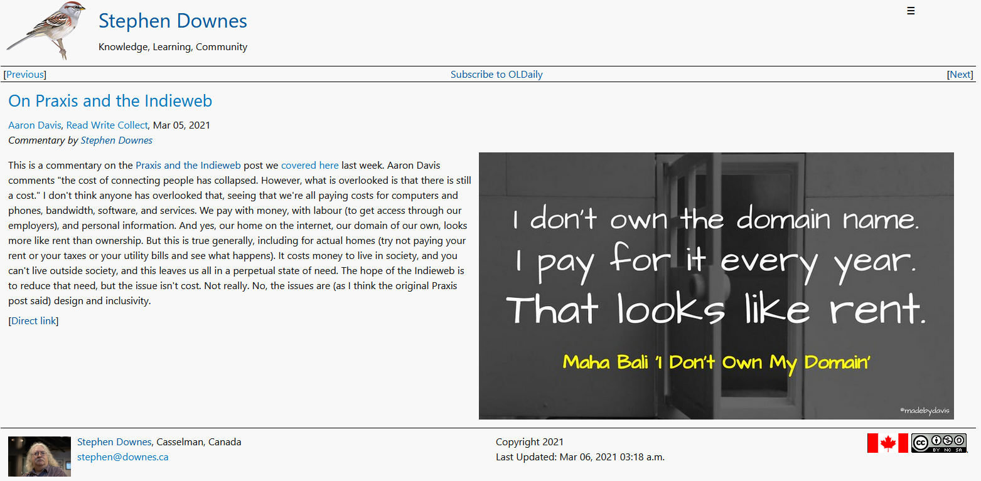
32,435 Examples
https://www.downes.ca/post/72044

Slide 32
Wait! Isn’t this 20-year Old Technology?
Well… yes it is
Most of the newer technology is centralized
And that’s a big problem:
  It’s really hard to share our sources and connections
  We’re all stuck using the same recommenders
  Companies are tracking us and selling data
  We are constantly fed advertisements and poromotions

Slide 33
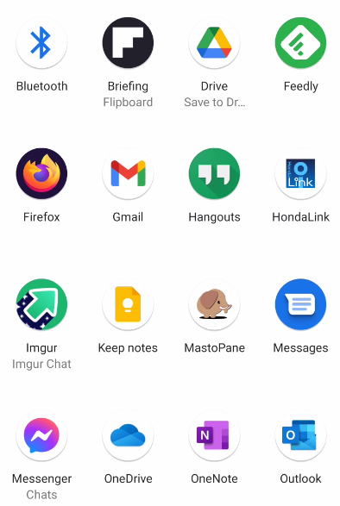
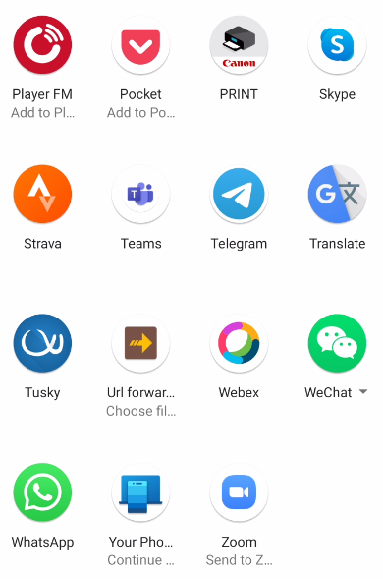
More Than Just Posts
Today we have a wide range of media we can create

Slide 34
Photos and Images
Can serve as a resource in their own right
Used to illustrate articles, blog posts, slide shows, etc.
Copyright applies, and use is limited to fair use or fair dealing.
Flickr - upload and share photos, create albums and collections, search by tag or license
Imgur - upload photos, community votes up or down
Deviant Art - Focuses on original art
Google Photos - share photos and folders, create link to share
(Note: Instagram is an additional option, but not appropriate for online courses and events).
Resource: Wikipedia list of photo sharing websites

Slide 35
Fair Use and Fair Dealing
Copyrighted content (i.e., not open content) can reused depending on:
  the purpose and character of your use – is it transformative? Is it educational, or commentary, or satire?
  the nature of the copyrighted work – the scope for sharing is more limited for works of fiction and unpublished work
  the amount and substantiality of the portion used, and
  the effect of the use upon the potential market.
Measuring Fair use – The Four Factors – Stanford
Fair Dealing and Other copyright exceptions – UK
European Copyright Directive – see esp. Section 24
Complying With Article 17 of the EU Copyright Directive

Slide 36
Slides and Presentations
  Most online conferencing systems have a mechanism to share slide presentations
  A good medium for live presentations
  Present visual content for people to read at their leisure.
Google Slides - part of Google Docs; cloud-based slide hosting
Slides.com - cloud editor plus slides hosting
Zoho Show - online slide editor, allows collaborative editing
Emaze - automated generation, visual effects
Prezi - dynamic/non-linear presentations, could customize templates (free or premium)
SlideShare.net – large body of shared slide presentations
Genial.ly -- interactive content platform - presentations, infographics, dossiers, video presentations, eposters, quizzes [About]

Slide 37
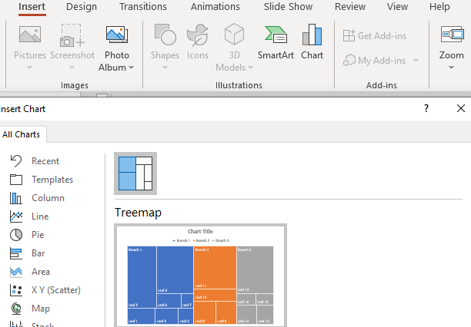
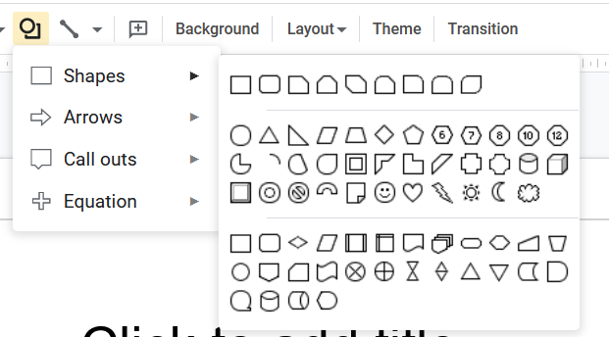
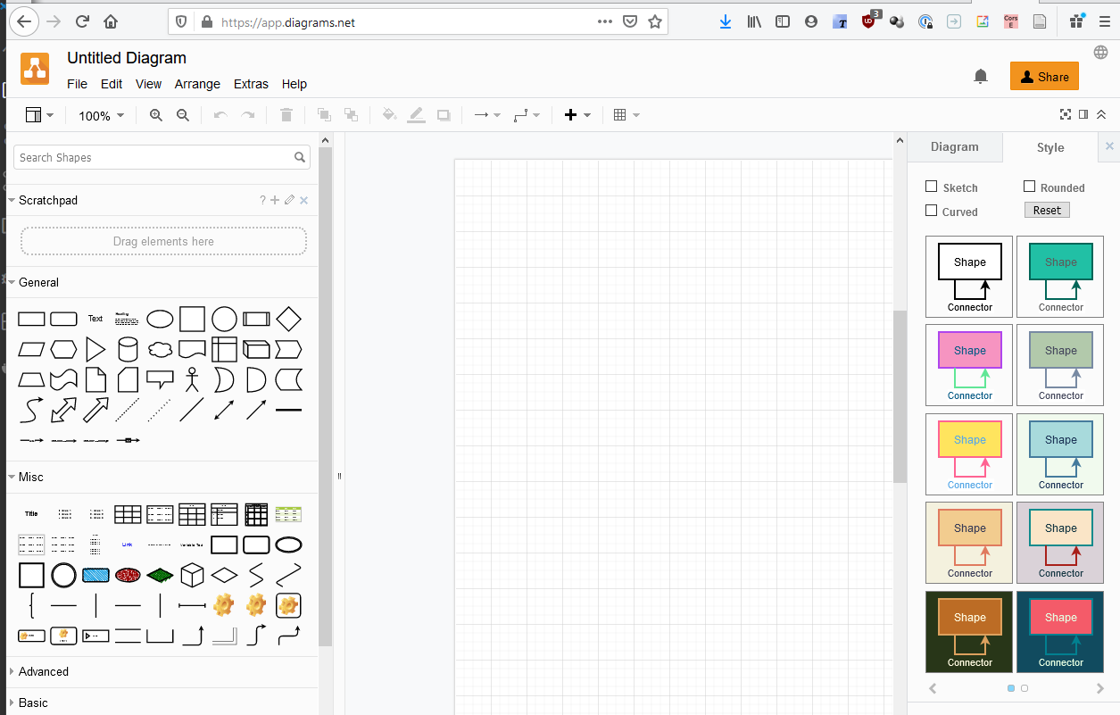
Pro Tip: Use Design Tools to Make Images
app.diagrams.net
Canva -- makes flyers, posters, etc
  Guides: Edublogger,
Padlet -- makes boards, documents, and webpages
Piktochart -- presentations, posters, interactions (makes you do a survey when you start, just say “no thanks” to it)
Mindmeister -- concept mapping tool with group editing and conversations.
Miro -- for collaborative idea generation and visual feedback (formerly RealTimeBoard)
Google Slides -- useful for simple diagrams (export to various formats)
Visme - create presentations, infographics, documents, videos, graphics
LucidChart -- collaborative whiteboard charts - free tier three charts only - [Guides]
Google Drawing -- useful for simple diagrams
Mural -- digital workspace for visual collaboration (like Miro)
Genial.ly -- Create presentations, infographics
app.diagrams.net - formerly draw.io
I create the diagram using the tool then copy it with a clipping tool

Slide 38
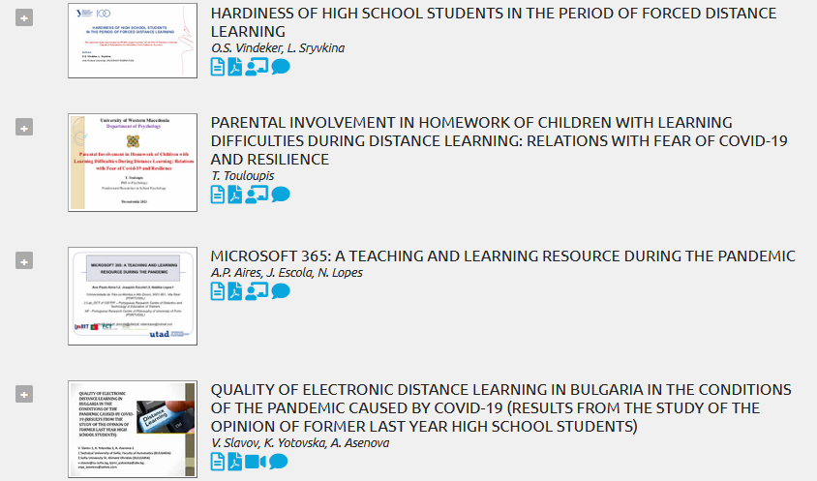
Slide Content in INTED2021
https://iated.org/concrete3/tracks_overview.php?event_id=39

Slide 39
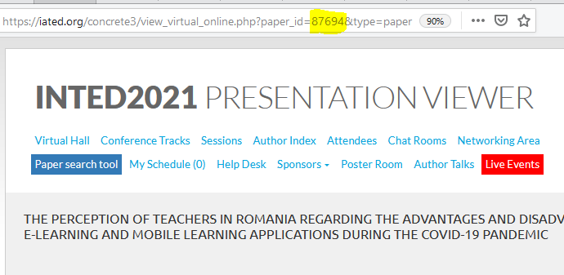
Create INTED2021 Session Hashtags
#INTED2021-87694
https://iated.org/concrete3/view_virtual_online.php?paper_id=87694&type=slides

Slide 40
Scheduling Community Events
  Shared calendars are helpful but not mandatory
  Create your own contents or use others’
Google Calendar - subscribe to different calendars; make your own -- [Instructions: video]
Outlook - Microsoft’s service also provides calendar functionality
Nextcloud - productivity suite featuring built-in calendar
Any.do - It's the easiest way to stay organized and get more done
Doodle - use a poll to set a meeting time

Slide 41
Hosting Community Events
  More than ever we have choices
  Don’t wait – just start hosting and joining
Zoom — software designed exclusively for video conferencing, with breakout rooms
Google Hangouts Meet— Part of G Suite - [Instructions: video] [TurboMeet - Chrome extension]
Microsoft Teams — communication and collaboration platform that’s part of Office 365
Big Blue Button -- open source conferencing tool [instructions]
Jitsi — free and open source video conferencing with built-in etherpad for collaboration
Whereby — WebRTC-based in-browser video conferencing for small groups
Skype - one-to-one and group video conferencing
Cisco Webex Personal Account (Covid outbreak special only)
Discord - free VoIP, text, and video chat, can be used in a browser [Description, Instructions,tips, Server List]
[Advice: basics of online meetings, virtual peer assists]

Slide 42
Recording Live Events
  Capture discussions, demonstrations, events
  Widely used today to broadcast (sometimes live) events, video games, meetings
OBS: Open Broadcaster Software
YouTube Live
Loom -- Guides: Kathleen Morris,
Screencastify
Screencast-o-matic - Google extension
Zoom - record video conferences
Twitch - most often used to record games, but is a general purpose tool
ShowMe - record whiteboard (on tablet) and large repository
Flipgrid: Recording and sharing short videos together.
Resource: Introduction to OBS, by me

Slide 43
All This Can Be Shared in RSS
In feed reader, submit YouTube channel address
In SlideShare, use the person’s individual page (RSS icon at bottom)
In general: if it does not provide easy content sharing, don’t use it
How to get an RSS Feed for a YouTube Channel – instructions
Get RSS From Twitter – Reddit thread (and lesson why not to depend on centralized services)
Four popular ways to use RSS – Zapier

Slide 44
What’s Next?
A lot of effort is being extended to build decentralized (learning) networks
They require active participation in order to succeed
Start today to begin thinking about tomorrow
Distributed Social Networks​
Opera Unite - http://mashable.com/2009/06/15/opera-unite/ ​
Mozilla OS - https://www.npmjs.com/package/fxos-web-server ​
Diaspora - https://www.joindiaspora.com/ ​
Solid - "social linked data“ - https://solid.mit.edu/ ​
Keybase - https://keybase.io/ ​
InterPlanetary File System (IPFS) - https://ipfs.io/ ​
Mastodon / Fediverse - https://mastodon.social/ ​

Slide 45
Personal Learning Environments
I have left out a lot in the interests of ‘instant’
Resource Repository Network (Aggregation) ​http://ec.europa.eu/ipg/standards/markup/web-content-syndication/index_en.htm ​
Personal Cloud – Dropbox, NextCloud, etc. ​https://nextcloud.com/ ​
Personal Learning Record – Learning Record Store (xAPI) ​https://www.adlnet.gov/tla/ ​
Personal Learning Assistant ​like Siri? Alexa?​
Distributed Intelligence – MLaaS​ https://www.slideshare.net/KarlSeiler/mlaas-machine-learning-as-a-service

Slide 46
Over to You…
I’ve given you a nudge, but…
Only the community can create the community
Are you willing to make the effort to see what more INTED can be?
What will you contribute to the community?
Can you take these experiences back home?

Slide 47
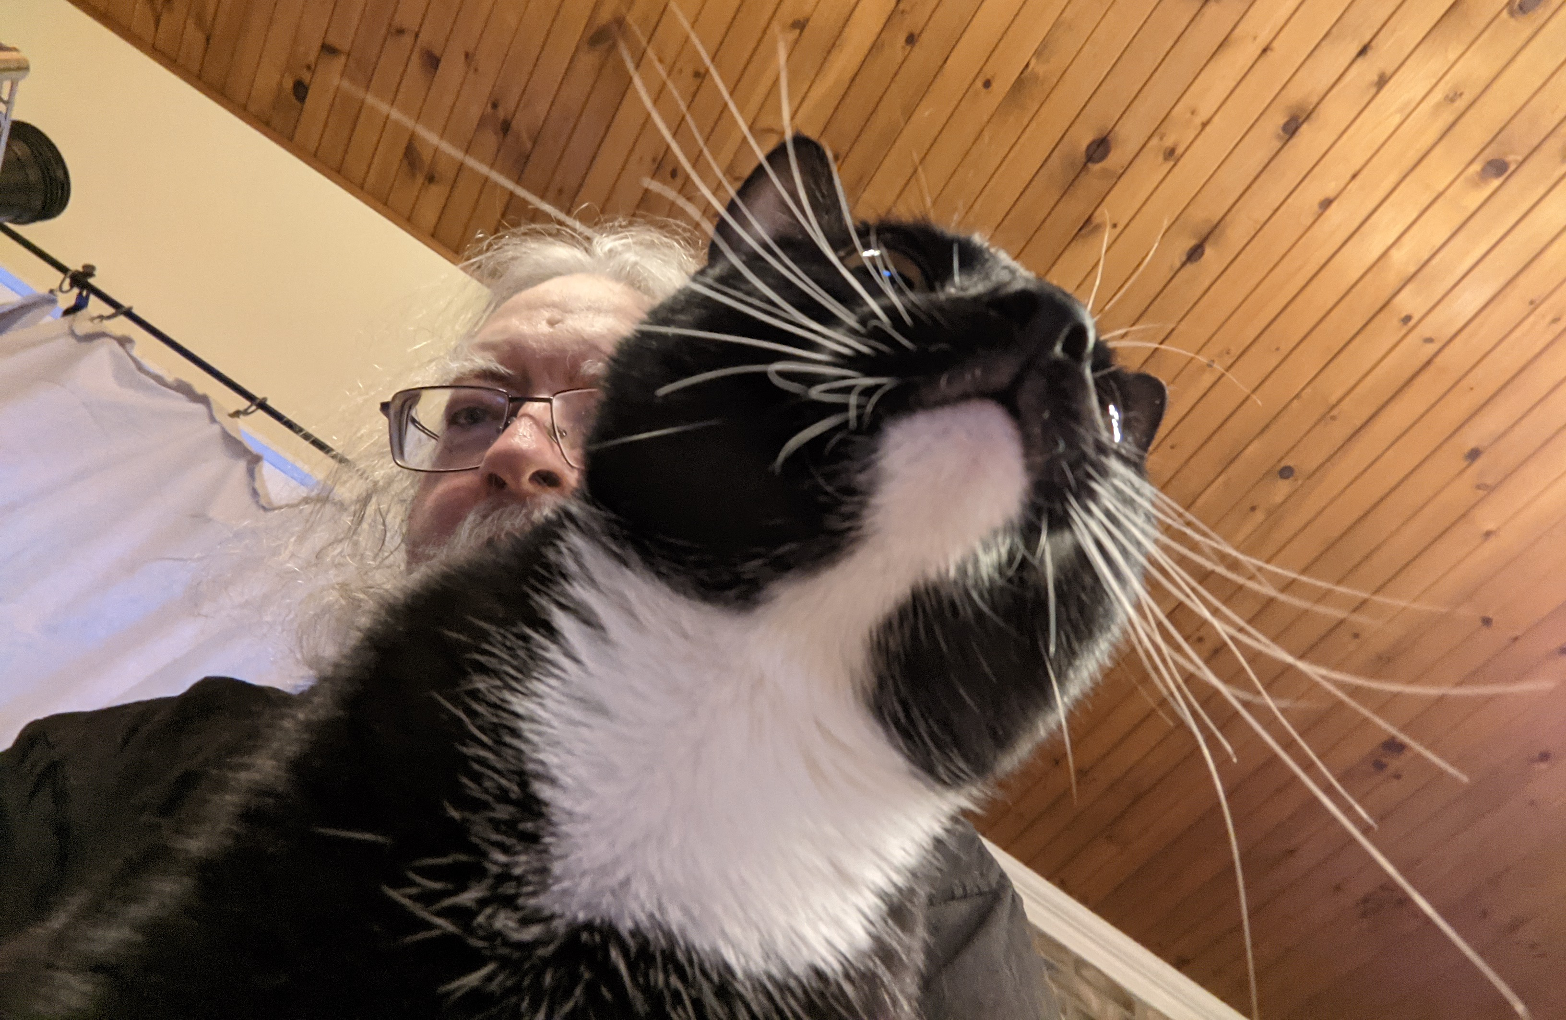
Stephen Downes https://www.downes.ca

Slide 48
Pre-Talk Checklist
Log into conference website
Open Powerpoint and start presentation in ‘individual view’
Start Firefox and remove all excess tabs
Start Alienware mobile connect
Turn on OBS and set up screens
Turn OBS virtual cam
Join Zoom meeting and test
Close email and other conferencing tools
If live streaming, set up YouTube stream
Start OBS recording, live streaming

