Slide 1

Lessons from the Covid-19 pandemic:
How to Improve How We Teach and learn Online
Stephen Downes
March 1, 2021

Slide 2
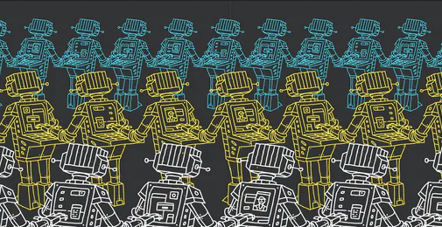
Notes:
Image: https://www.edsurge.com/news/2018-07-02-why-are-we-still-personalizing-learning-if-it-s-not-personal

Slide 3
As faculty and instructors…
What are we learning?
What can we build on?
What changes can we make?
Notes:
What are we learning from this experience about teaching and learning?
What can we build on as we get back to class in 2021?
What changes can we make to how we teach, assess and work with students to make learning more effective?

Slide 4
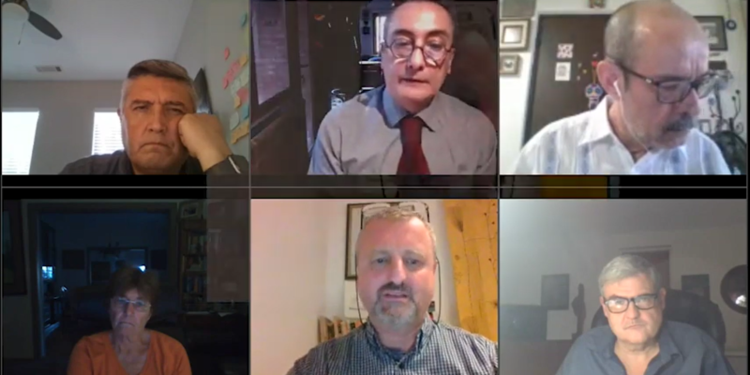
Notes:
Image: https://integratedcarefoundation.org/knowledge-tree/coronavirus-lessons-of-a-pandemic-webinar

Slide 5
In this interactive webinar…
10 lessons
Three challenges
Three improvements
Notes:
10 lessons from teaching and learning in a pandemic
Three challenges of leveraging these lessons for “what’s next” in online and blended learning
Three specific ways we can facilitate improvements in teaching and learning, based on these 10 lessons

Slide 6

Notes:
Image: https://lens.monash.edu/2018/08/14/1357398/the-nature-of-quality-in-teaching-and-learning

Slide 7
Key Takeaways
Nature of teaching and learning
Authentic assessment
Diverse needs of learners
Notes:
Understand the nature of teaching and learning in terms of both building a community of inquiry and enabling learners to flourish
Find out how authentic assessment and moving away from the mid-term and end-of-term exam can facilitate improvements in learning
Improve how we respond to the diverse needs of learners

Slide 8

Lessons

Slide 9

Notes:
Image: https://medium.com/mind-munchies/why-is-change-so-hard-807eae0b2dcb

Slide 10
Any change will be hard at first.
We can’t directly compare the new thing with the old thing.
Give ourselves some time
Notes:
It was hard to jump right into remote learning, and it was hard to jump back into the new classroom environment. So we can’t directly compare the new thing with the old thing. We have to give ourselves some time to get used to it and for people to get good at it.

Slide 11

Notes:
Image: https://www.td.org/insights/how-to-be-a-catalyst-for-social-learning

Slide 12
Learning is social.
We knew that already
Some outcomes are social
We learn as a community
We exchange ideas, conduct trade, and develop networks
Notes:
Of course, we knew that already,
but being apart underlined the idea that some of the important outcomes of learning are social.
We don’t just learn as individuals, we learn as a community, and
learning is about how we exchange ideas, conduct trade, and develop community networks with each other.

Slide 13
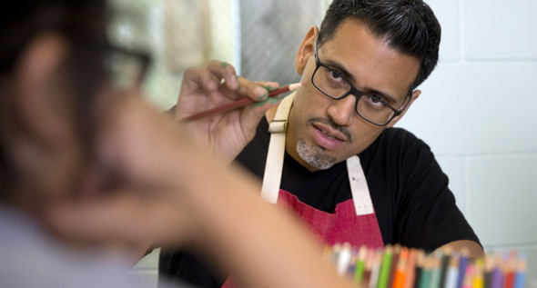
Notes:
Image: https://www.kqed.org/news/11040591/young-inmates-help-turn-solitary-confinement-cells-into-art-spaces

Slide 14
Teaching is not a solitary profession.
Teachers need buildings, etc.
Now they need a support team.
Like when we watch the news
Notes:
We already know teachers need buildings and facilities and support staff and computer networks and the rest.
But now that they are working with advanced technology in both digital and in-person environments, they need to be constantly developing their skills, and they need a team supporting them.
It’s like when we watch Newsfeed on CB-Stream: we may see only the presenters in our hololens, but we know there’s a team of people supporting them.

Slide 15
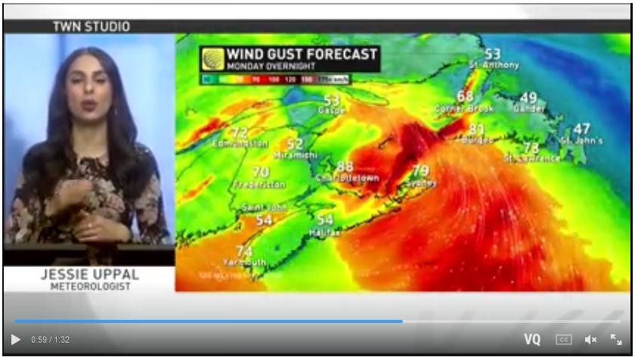
Notes:
Image: https://ca.news.yahoo.com/ge-2020-psp-prizes-character-not-just-academics-when-selecting-candidates-tan-cheng-bock-043855531.html

Slide 16

Notes:
Image: https://www.dacast.com/blog/virtual-events/

Slide 17
We need live events.
Not everything
But live events draw us in
Planning and anticipation
Interaction, presence
Notes:
Sure, not everything needs to be live – there’s a lot we can get from vids and sims and the rest.
But live events draw us in and challenge us. When we don’t know what’s going to happen, we are engaged in planning and anticipation. And live events have us interacting, even if indirectly with the people in the scene. It’s what we used to call ‘presence’, back in the day.

Slide 18
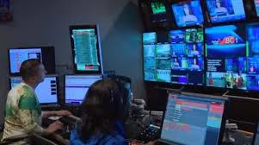

Slide 19
Open media plays a key role.
We can’t learn without it
We need an alphabet
We need words
We need data
Notes:
It’s not simply about saving money.
We can’t learn – we can’t even communicate – without open media.
We need an alphabet, we need words, we need data –
and these need to be available for any of us to use without worrying about who owns it or how much it costs.
We use open media to write the first draft of our experiences, the first draft of the lessons learned and the practices we should follow.
That’s why we needed Zoom, and that’s why open textbooks became so essential.

Slide 20
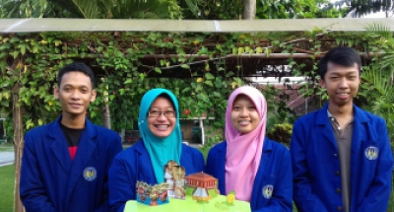
Notes:
Image: http://english.uny.ac.id/article/archipelago-pop-encyclopedia-learning-media

Slide 21
Quality matters,
It’s not guaranteed
We have to make our own judgements
We have to be critically-minded
Notes:
but is not guaranteed.
It doesn’t matter how much we paid, or where it came from.
We have to make our own judgements about quality, because of our different needs and circumstances.
There was a lot of misinformation in the 20s; some of it came from Russia, some of it came from advocacy groups, some of it was advertising, and some of it came from our own governments. The development of trust networks, zero-knowledge proofs and crypto-addressing helped a lot, but we still have to be critically-minded.
There was a lot of misinformation in the 20s; some of it came from Russia, some of it came from advocacy groups, some of it was advertising, and some of it came from our own governments.

Slide 22

Notes:
Image: https://thriveglobal.com/stories/8-ways-self-reflection-improves-your-life-and-helps-you-become-happier/

Slide 23
Teaching is more than broadcasting.
8-hour videos bad
Get us away from the keyboard
Still true when we return to the classroom
Notes:
Again, this is something we already knew, but had to learn again when we went online in the 20s.
We can still remember how bad those 8-hour days of video lectures were.
The best learning used the computer where needed, but then got us away from the keyboard and doing something practical.
And this was still true when we returned to the classroom. Suddenly we realized that we didn’t need to be stuck in a room in order to learn.

Slide 24

Notes:
Image: https://www.istockphoto.com/photos/broadcasting

Slide 25
Reading the room is harder.
We can scan a classroom
Online, it’s a lot more difficult
This needs to become a deliberate practice
Notes:
An experienced teacher can scan a classroom, observe how students are reacting, and change strategies on the fly to stimulate interest or attention.
Online, it’s a lot more difficult to gauge reactions.
So this needs to become a deliberate practice of asking directly for feedback and engaging in interactive exercises.
And it turns out that reading the room is not enough. We need to make understanding our learners a major part of what we do.
Comment about Tony Bates and Data

Slide 26

Notes:
https://www.constructionexec.com/assets/site_18/images/article/092320024449.jpg?width=1280

Slide 27
We need structure, order and routines.
A respite from uncertainty
Balance our work with our play, rest and self-care.
That’s what school often provides
Notes:
Here were not talking about military discipline, but rather, a respite from uncertainty and precarious circumstances.
When we were at home, we needed to learn how to balance our work with our play, rest and self-care.
We needed to know when we would eat, where we would sleep, and to be able to plan our days and our futures.
That’s what school often provides

Slide 28
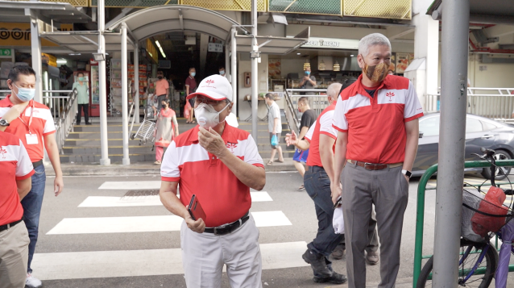
Notes:
Image: https://ca.news.yahoo.com/ge-2020-psp-prizes-character-not-just-academics-when-selecting-candidates-tan-cheng-bock-043855531.html

Slide 29
It’s not just school subjects
Not just schools and universities
Beyond traditional academics
Support in-home workers, self-employed, new careers
Notes:
. When we began looking at our learning needs on a society-wide basis, we realized that we couldn’t just focus on educational institutions like schools, colleges and universities.
We needed to think beyond traditional ‘academic’ subjects.
We needed to find ways to support in-home workers, people who were self-employed, and people trying to find a new career.

Slide 30
Challenges

Slide 31
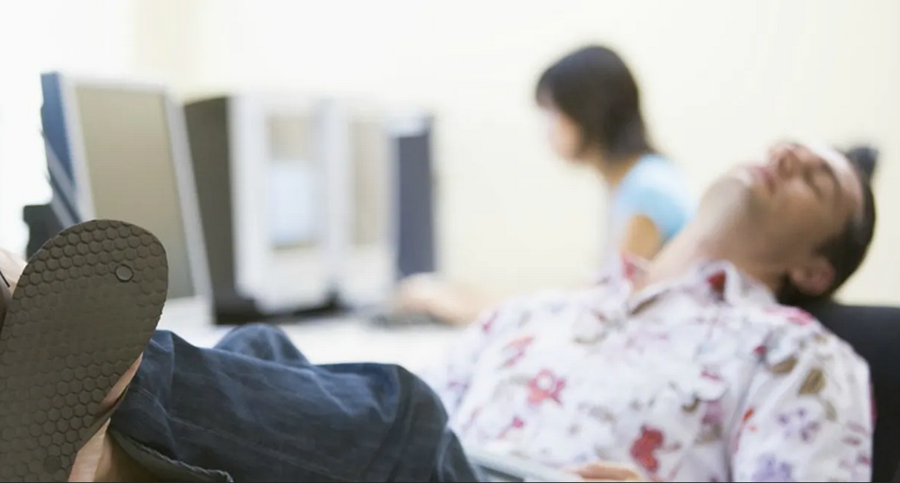
Notes:
Image: https://www.edsurge.com/news/2016-05-31-unpacking-the-problem-of-unmotivated-online-students

Slide 32
Motivation matters.
Educators have always known
Online we haven’t the same tools
  We can’t force them
Need people interested and engaged
Notes:
Educators have always known this, and have taken steps to keep students engaged in class.
But when people are out of school and learning online, we don’t have the same tools.
It’s harder to take attendance.
We can’t force them to stare at the computer screen.
People have to be interested and engaged in what they’re studying, which means they have to have a lot more say in what they’re doing and why it matters.

Slide 33
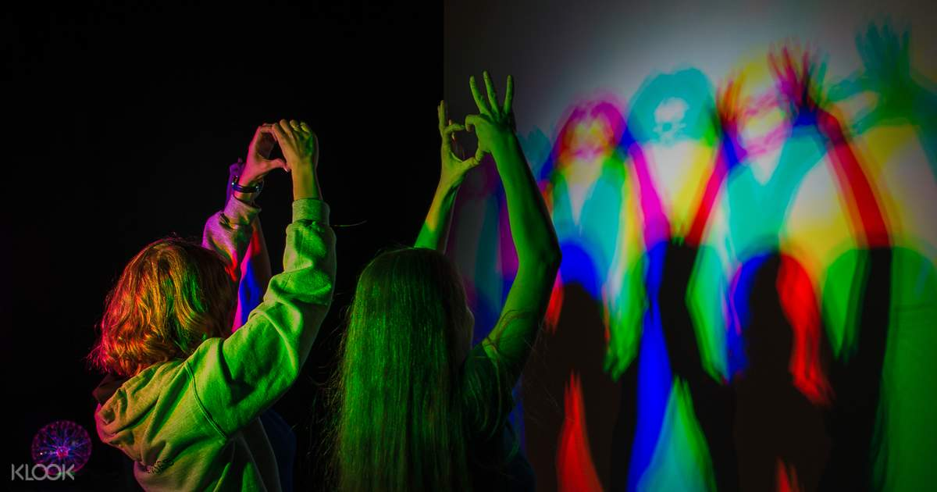
Notes:
Image: https://www.klook.com/en-IN/activity/24658-museum-senses-ticket-bucharest/

Slide 34
People have diverse needs.
Designed for the mainstream
Built-in, systemic discrimination
Everyone has special needs
Notes:
They come from different cultures, speak different languages, and have different abilities.
Before the 2020s we designed for the mainstream and hoped that the rest could adapt.
But a lot of difficult issues surfaced in those years, and we had to address built-in or systemic discrimination.
We had to get past the idea that some people are ‘special needs’ and to adopt the attitude that everyone has special needs.

Slide 35
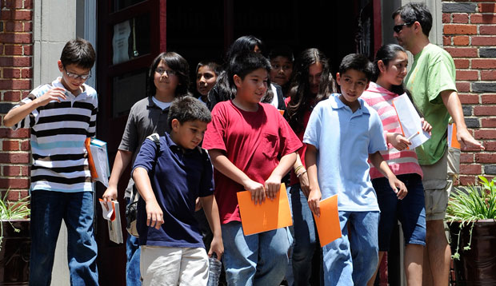
Notes:
Image: https://cdn.americanprogress.org/wp-content/uploads/2012/09/19031533/stealth_onpage1.jpg

Slide 36
Inequities harm learning.
School mitigated some of the worst inequities
This disappeared online
People in need just vanished.
We need the will to solve it
Notes:
In many ways, coming together to learn at school mitigated some of the worst impacts of poverty and disability
, because we could all access books, teachers and time to study at school. A lot of us depended on school for internet access and a good meal.
A lot of this support disappeared when we went online.
People in need just vanished.
We knew that this was a problem, but it took a long time to solve it.

Slide 37
Ways to Improve

Slide 38

Notes:
Image: https://www.nytimes.com/spotlight/learning-english-language-arts

Slide 39
We need to learn how to learn.
Can’t learn on their own.
If nobody there to teach them, they wouldn’t try to learn
Both teachers and students
Notes:
This applies to both teachers and students.
What we found was that many students who had been in school for ten years had no idea how to learn on their own.
They didn’t know where to start, they didn’t know how to structure their work, and often, they weren’t motivated to try.
If there was nobody there to teach them, then they simply wouldn’t try to learn.

Slide 40
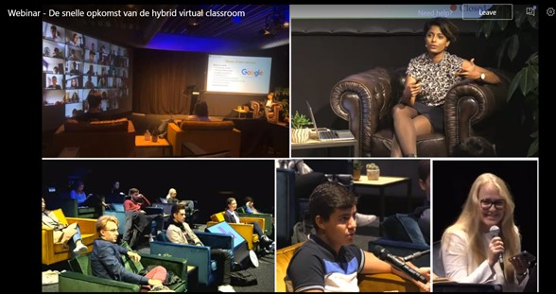
Notes:
Image: http://zacwoolfitt.blogspot.com/2020/11/the-rapid-rise-of-hybrid-virtual.html

Slide 41
Employ a range of strategies.
Develop ‘hybrid learning’
Not doing both at once
Meet the different needs of people at different times and in different ways
Notes:
We learned to develop ‘hybrid learning’, that is, learning that was at times based on digital tools and resources, and at other times interactive and in-person. We also learned not to have a teacher doing both of these at once, because the two methods are so different. But there was no need – by varying strategies, it’s possible to meet the different needs of people at different times and in different ways.

Slide 42

Notes:
Image: https://teachingblog.mcgill.ca/2019/10/08/flexible-assessment-one-instructors-implementation-in-a-large-class/

Slide 43
Assessment needs to be flexible.
Traditional testing has become dysfunctional
Depending on surveillance
Instead, show work directly to employers
Notes:
Moving online showed us just how dysfunctional traditional testing has become, and
we realized we were depending more and more on surveillance, when
we should have instead been offering counselling and feedback.
Once students were able to create portfolios and show their work directly to employers, the push for stringent testing eased.

Slide 44


Slide 45
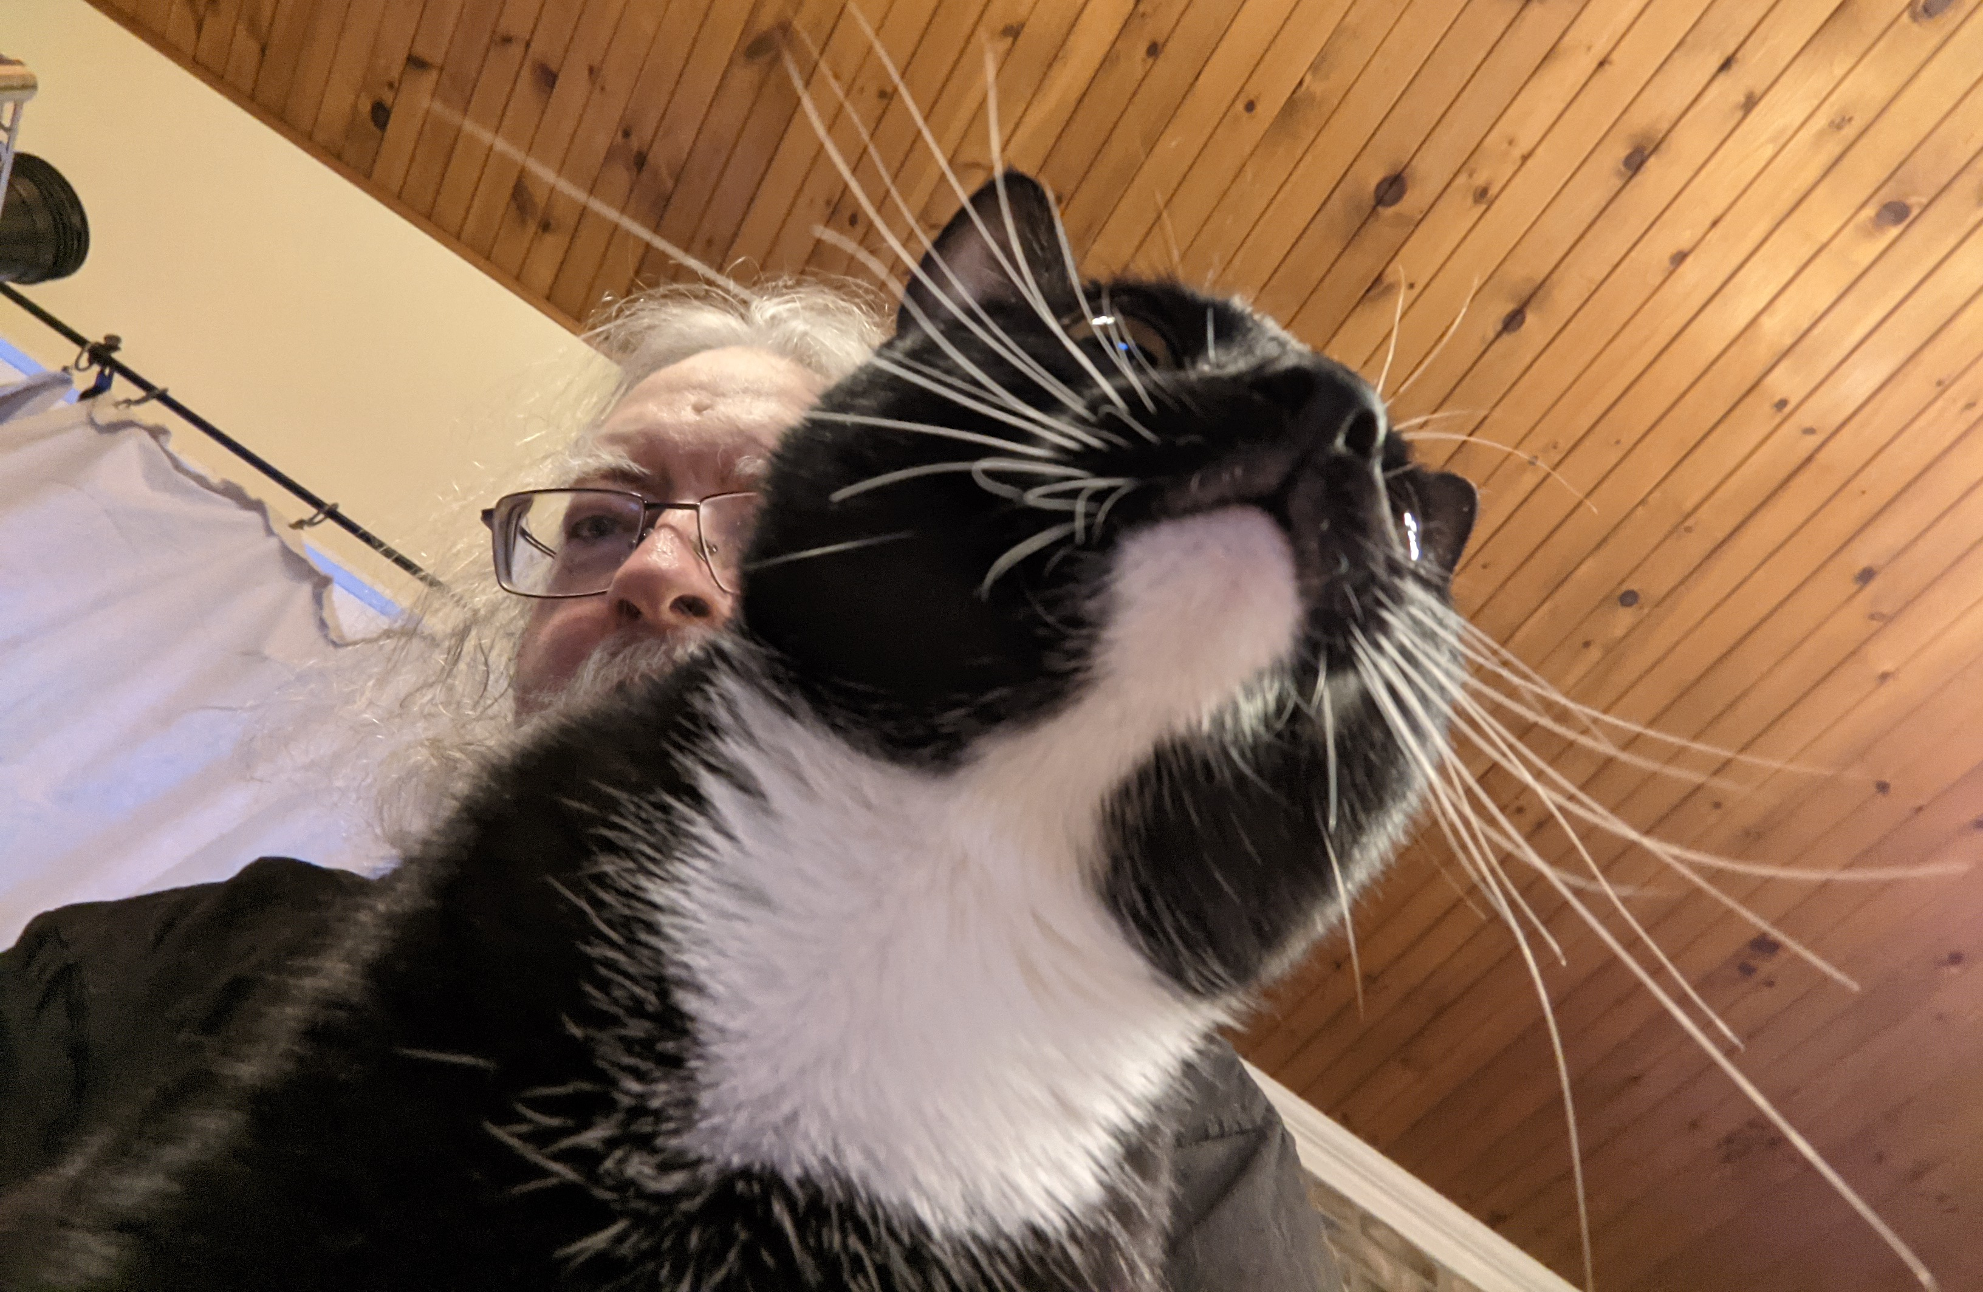
Stephen Downes https://www.downes.ca

