Slide 1

A Personal Learning Platform
Stephen Downes
CC Lightning Talks

Slide 2
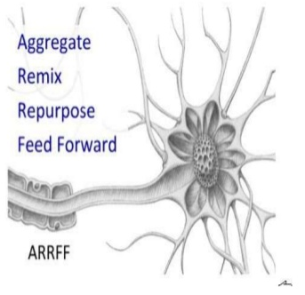

Slide 3
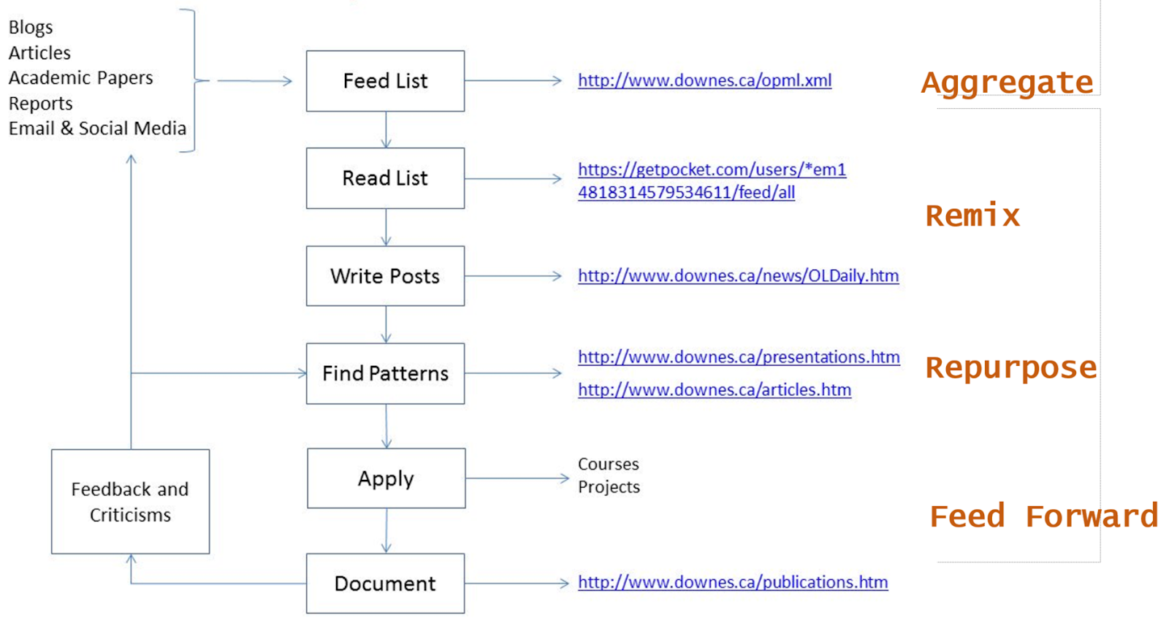

Slide 4
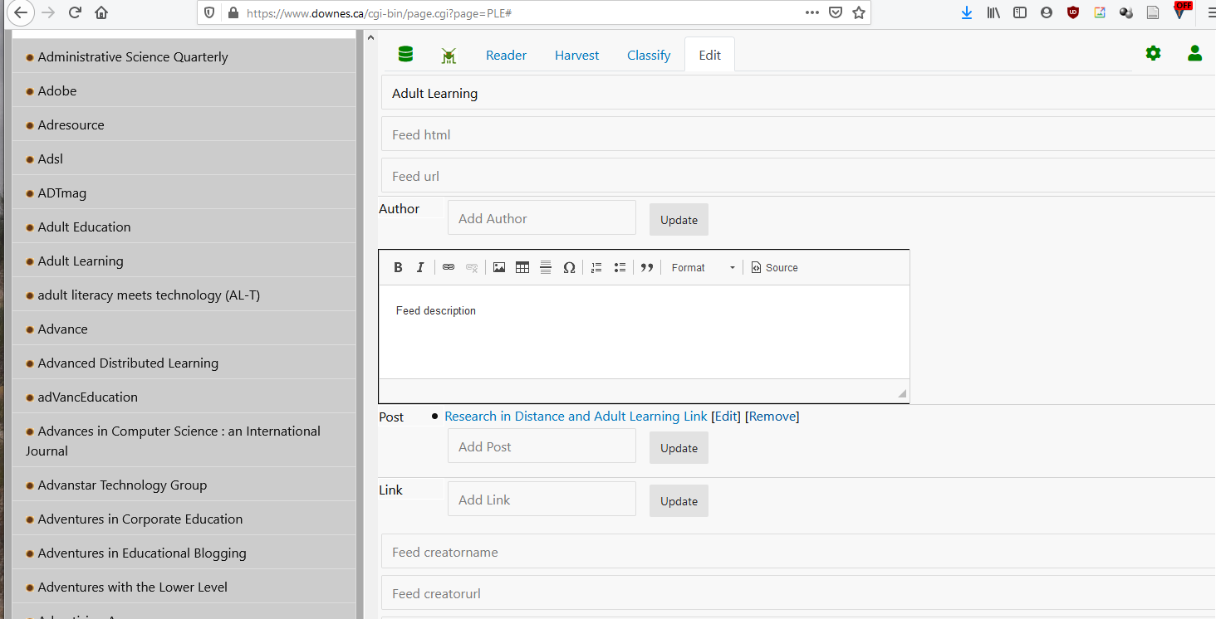
Aggregate
https://www.downes.ca/cgi-bin/page.cgi?page=PLE#

Slide 5
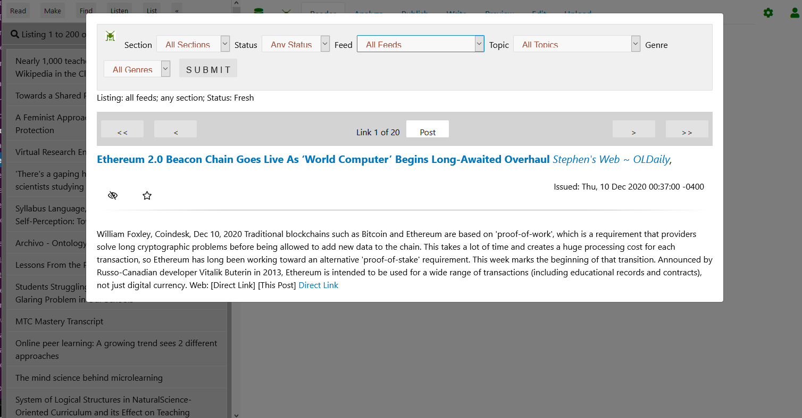
Aggregate
https://www.downes.ca/cgi-bin/page.cgi?page=PLE#

Slide 6
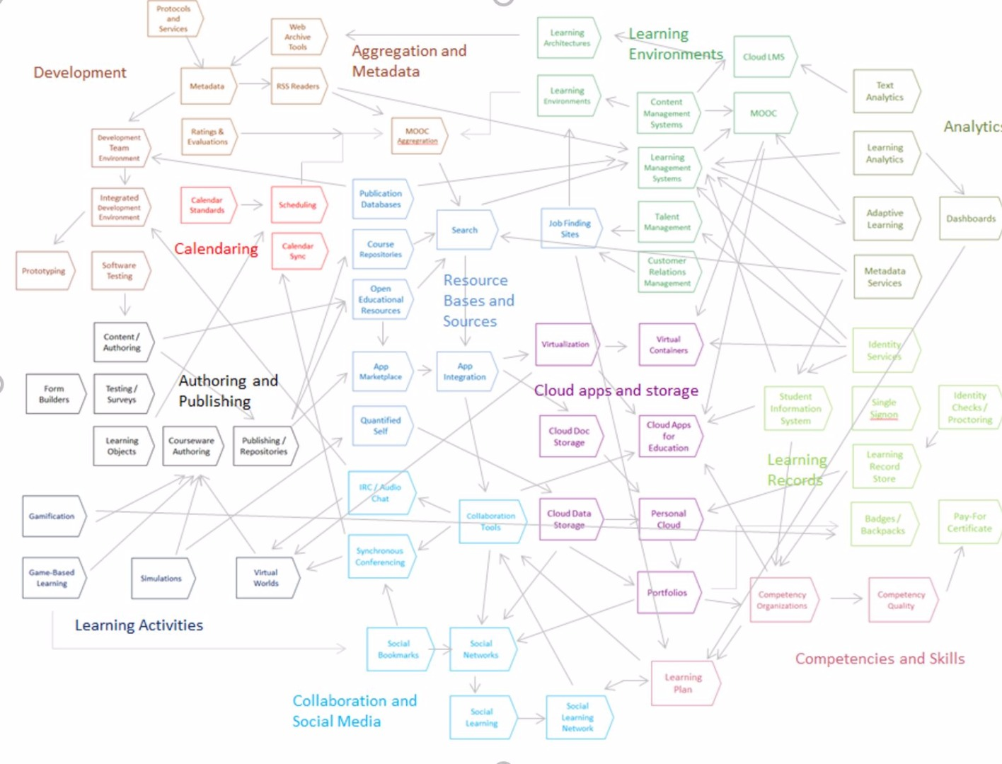
Remix
https://www.downes.ca/post/67078

Slide 7
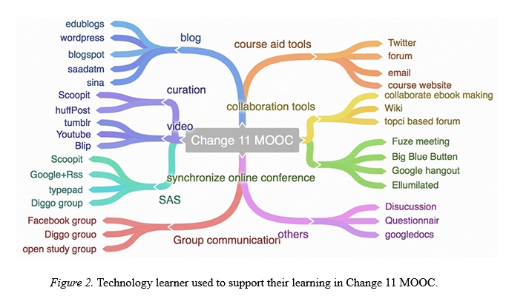
Remix
http://www.irrodl.org/index.php/irrodl/article/view/3269/4502

Slide 8
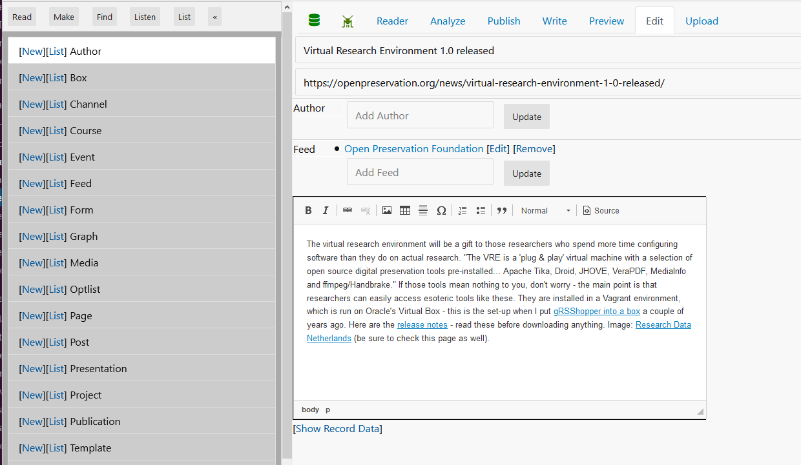
Repurpose
https://www.downes.ca/cgi-bin/page.cgi?page=PLE#

Slide 9
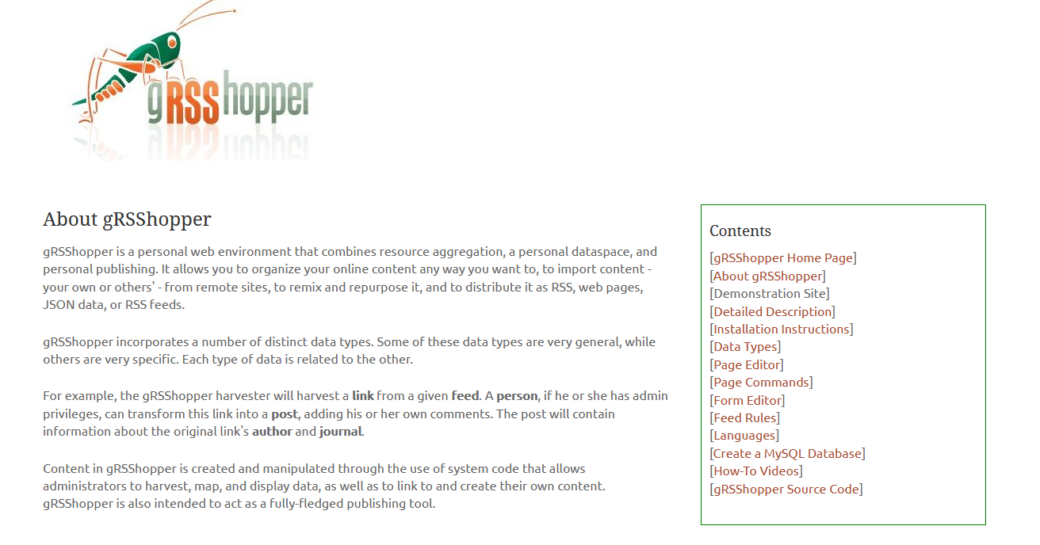
Repurpose
https://www.downes.ca/cgi-bin/page.cgi?page=PLE#

Slide 10
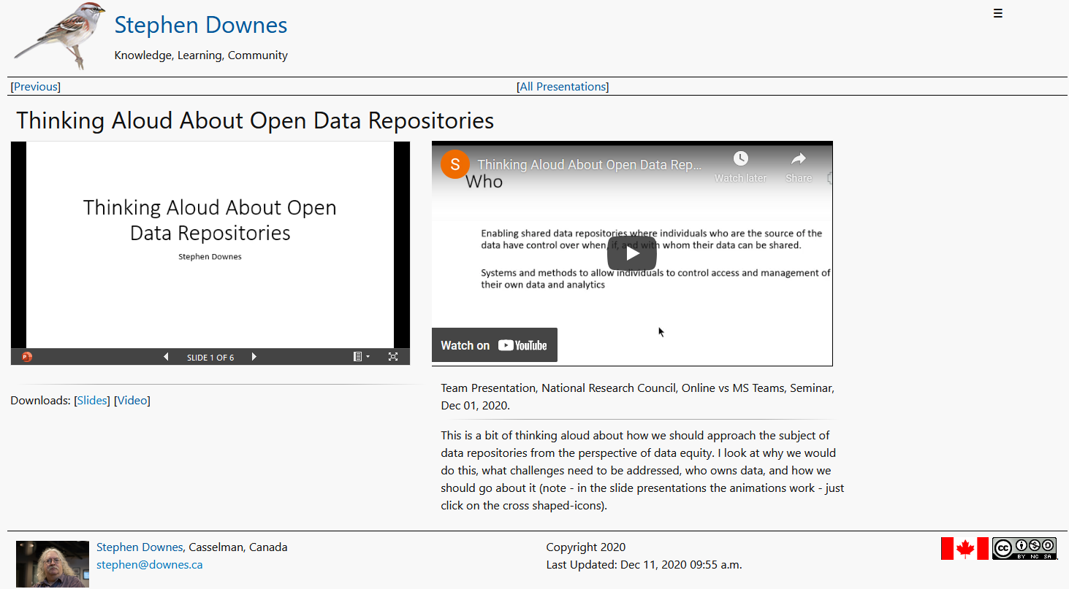
Feed Forward
https://www.downes.ca/presentation/537

Slide 11
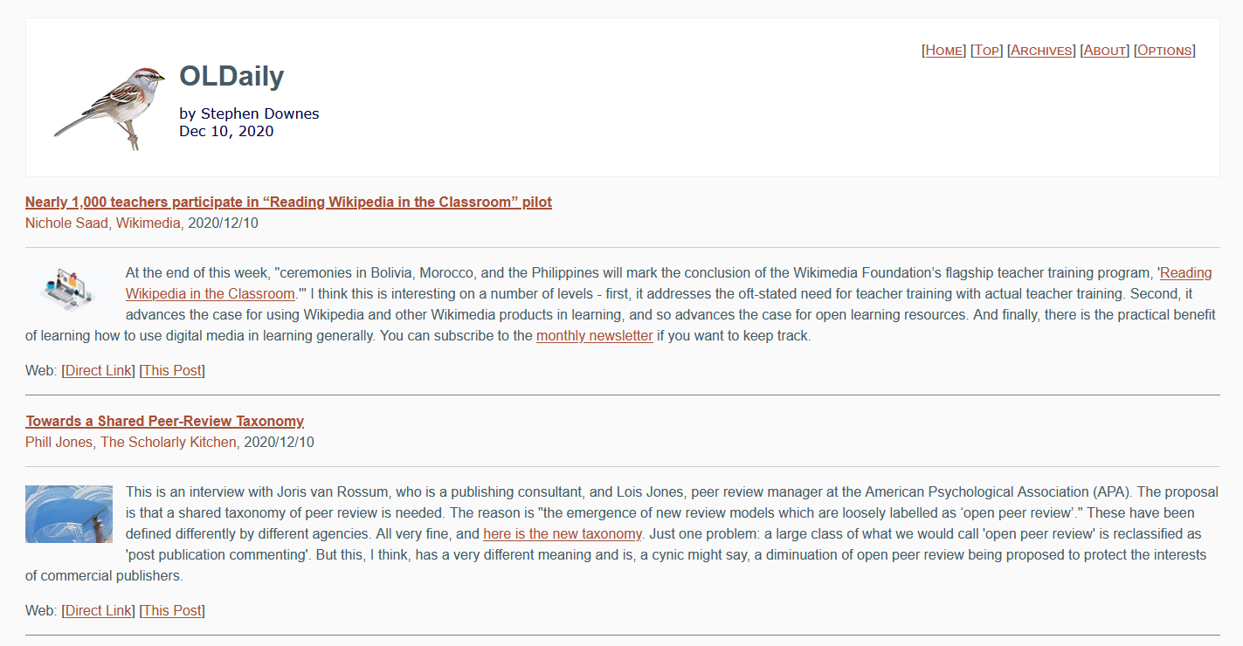
Feed Forward
https://www.downes.ca/news/OLDaily.htm

Slide 12
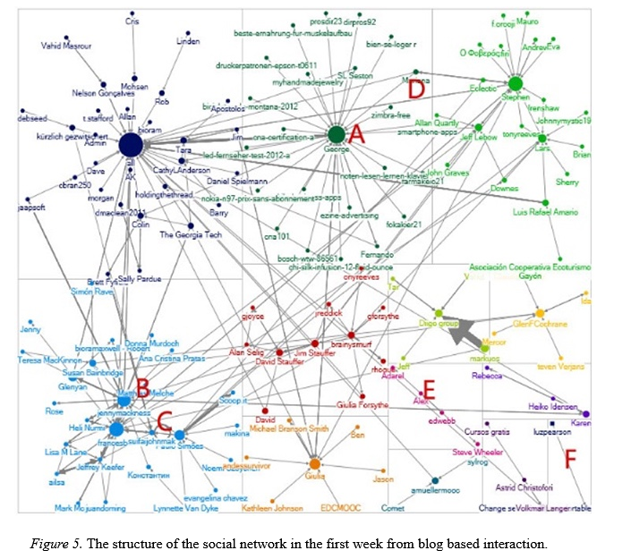
Feed Forward
http://www.irrodl.org/index.php/irrodl/article/view/3269/4502

Slide 13
Stephen Downes
https://www.downes.ca

