Slide 1

What’s Next for MOOCS?
Stephen Downes
December 8, 2020

Slide 2
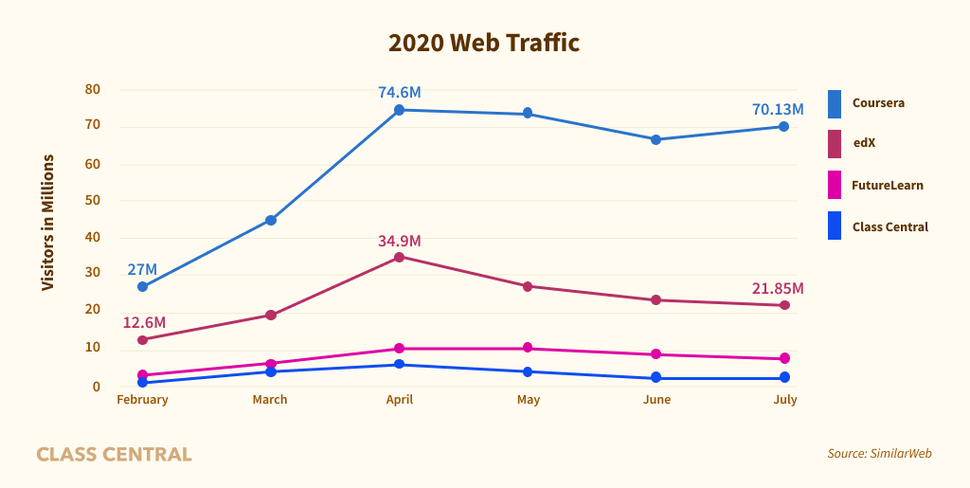
No they’re not dead yet!
https://www.classcentral.com/report/mooc-stats-pandemic/

Slide 3
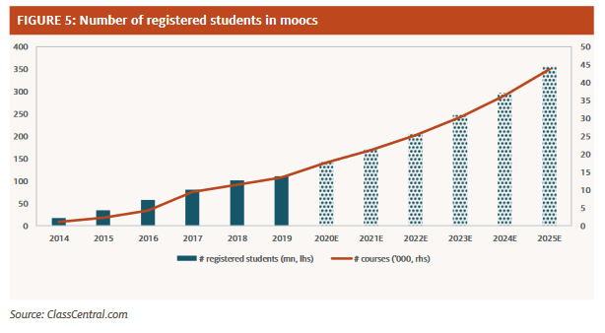
No they’re not dead yet!
http://www.eipny.com/wp-content/uploads/2020/08/The-Pandemic-Accelerant_FINAL.pdf

Slide 4
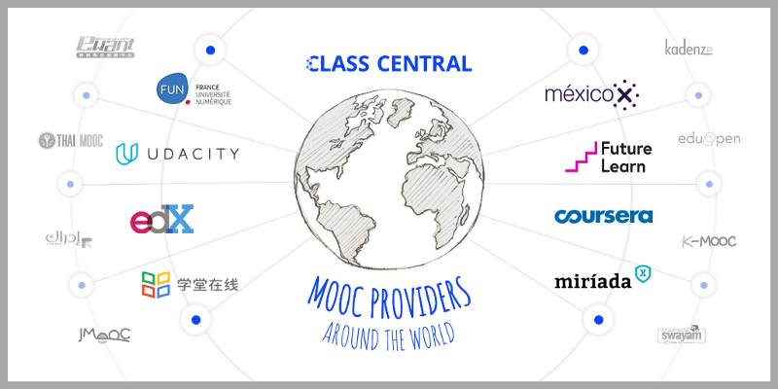
No they’re not dead yet!
https://www.freecodecamp.org/news/a-massive-list-of-free-online-course-providers-from-around-the-world-925766226f46/

Slide 5
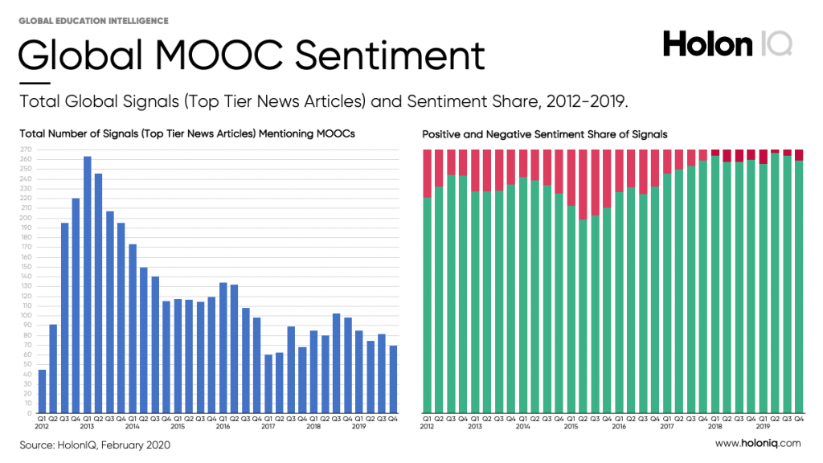
No they’re not dead yet!
MOOCs started the last decade as a proof of concept and finished with 380 million students taking over 30 thousand courses and 50 degrees from over 1000 Universities globally.
  https://www.holoniq.com/notes/the-mooc-decade.-380-million-students-later./

Slide 6
Contents
What’s Next for MOOCs?
  How MOOCs are exploding contrary to having been written off in 2018.
  How MOOCs can provide access to a global set of micro-credentials and skills-based learning, which employers want.
  How MOOCs are improving in terms of student engagement and completion?

Slide 7
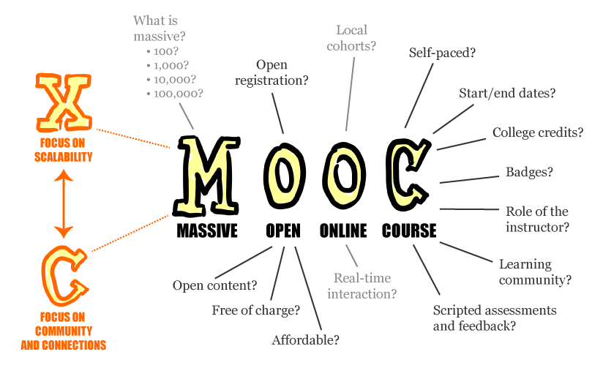
https://www.flickr.com/photos/mathplourde/8620174342/sizes/o/in/photostream/

Slide 8
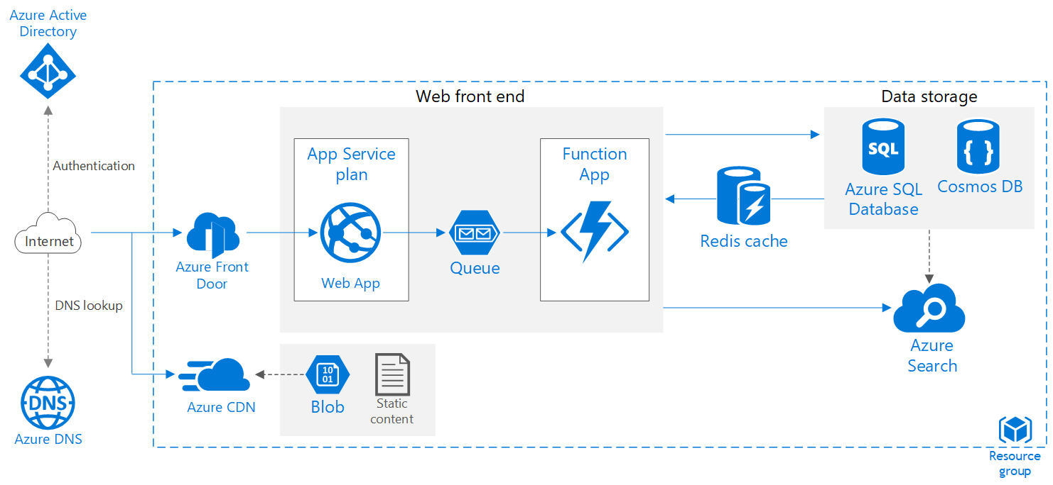

Scalable Web Application
https://docs.microsoft.com/en-us/azure/architecture/reference-architectures/app-service-web-app/scalable-web-app

Slide 9
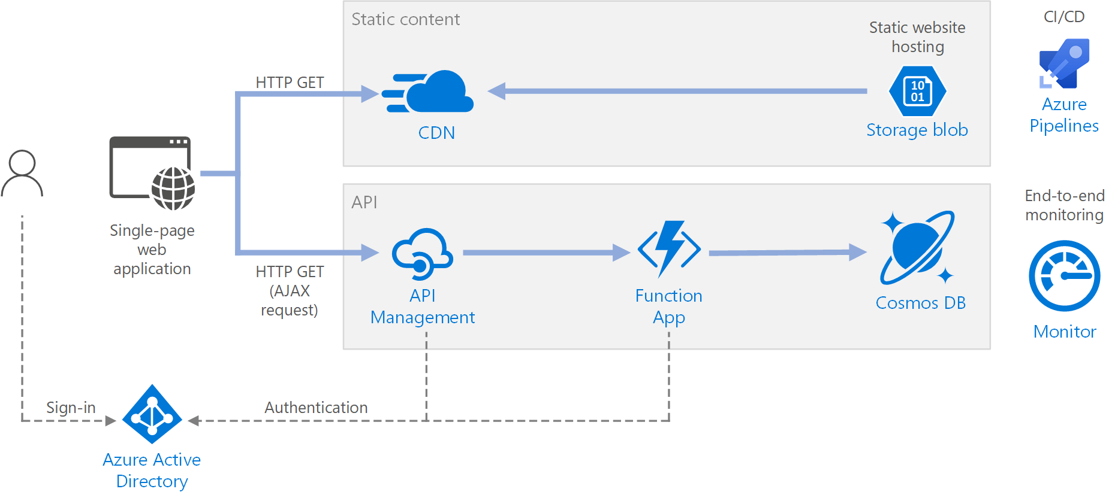
Serverless Web Application
https://docs.microsoft.com/en-us/azure/architecture/reference-architectures/serverless/web-app

Slide 10
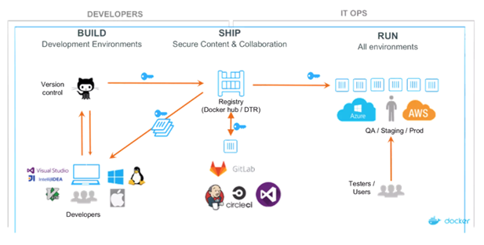
Continuous Integration & Delivery
https://www.mayfield.com/mayfield-cio-insights-mastering-the-multi-cloud/

Slide 11
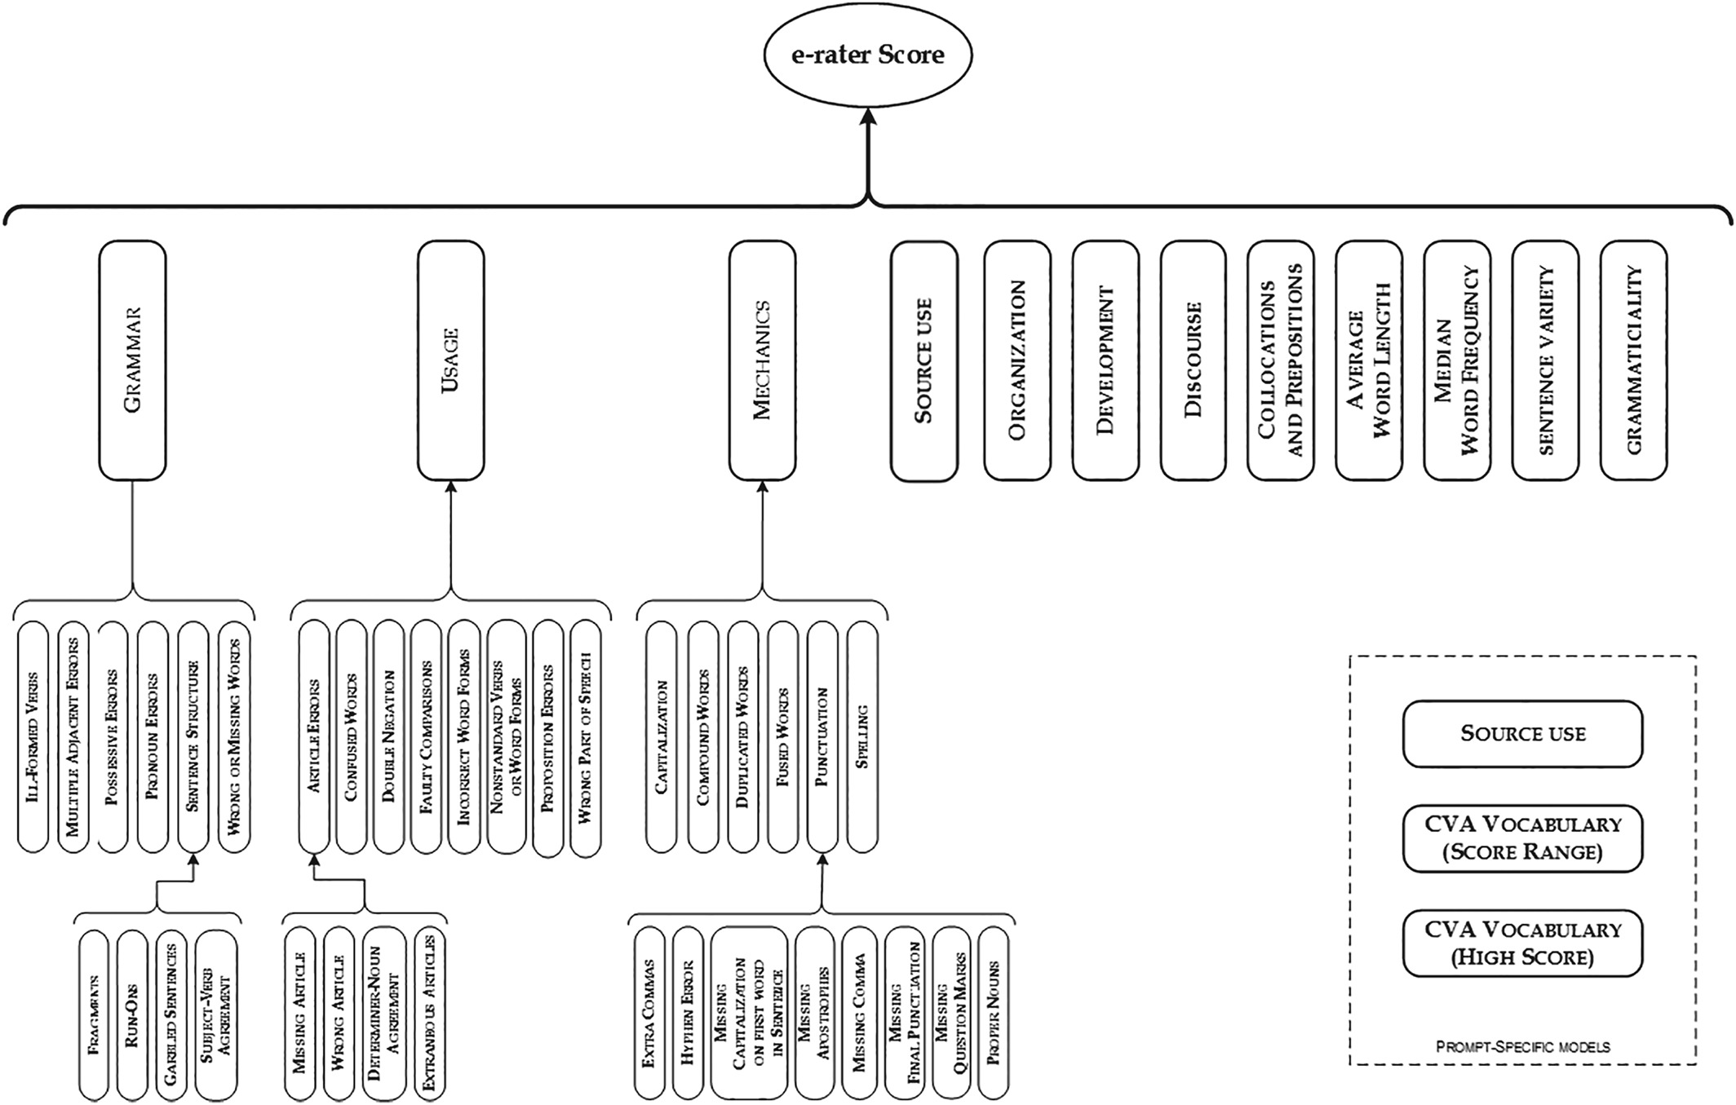
Automated Grading at Scale
https://onlinelibrary.wiley.com/doi/full/10.1002/ets2.12249
ETS Research Report Series, Volume: 2019, Issue: 1, Pages: 1-23, First published: 18 March 2019, DOI: (10.1002/ets2.12249)

Slide 12
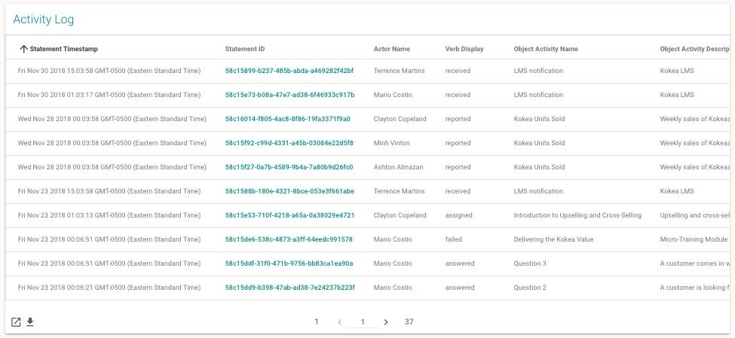
Activity Records
https://yet.zendesk.com/hc/en-us/articles/115001672832-Data-Card-Activity-Log

Slide 13
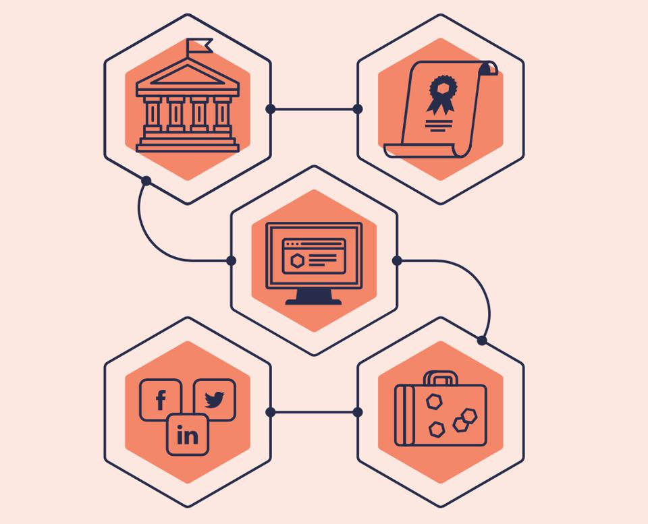
Microcredentials
The pandemic is accelerating this shift to verified credentials. Enrollment in short-term credential classes increased by 70% over last year while freshman college enrollment dropped by 16%.
https://www.wsj.com/articles/is-this-the-end-of-college-as-we-know-it-11605196909
https://www.forbes.com/sites/tomvanderark/2020/11/25/digital-credentials-a-better-way-capture-and-communicate-learning/?sh=4b7c8da62dd6
https://bloomboard.com/ https://www.glcredentials.com/
Notes:
Tom Vander Ark discusses projects like Bloomboard, which "powers the microcredentials that power the professional learning system at Harmony Public Schools - a great example of a well designed comprehensive talent development system." Another service, Greenlight Credentials, "helps north Texas high school scholars build and permission a digital profile to employers and postsecondary institutions."

Slide 14
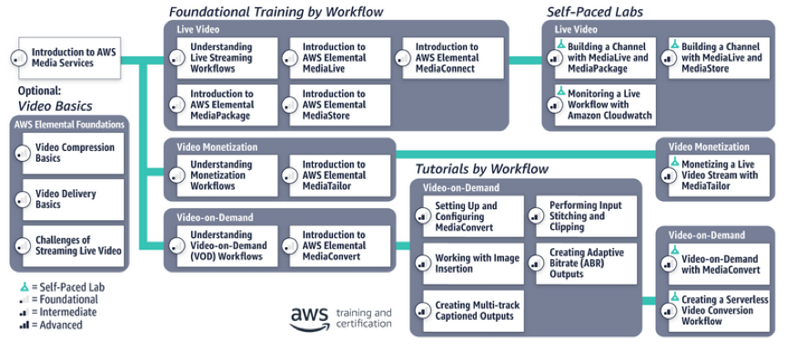
Recommendations and Learning Paths
https://aws.amazon.com/blogs/media/aws-media-services-learning-path/

Slide 15
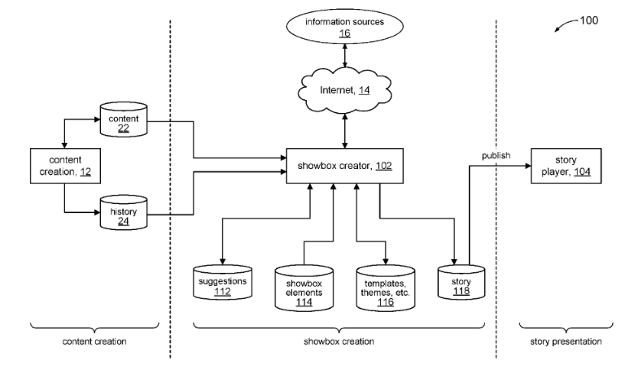
Automatically Generated Content
https://www.neowin.net/news/microsoft-patents-story-creation-system-with-auto-generated-content/
https://pdfaiw.uspto.gov/.aiw?PageNum=0&docid=20190243873
Notes:
How to Automatically Generate Content at Scale
https://www.marketingaiinstitute.com/blog/how-to-automatically-generate-content-at-scale

Slide 16
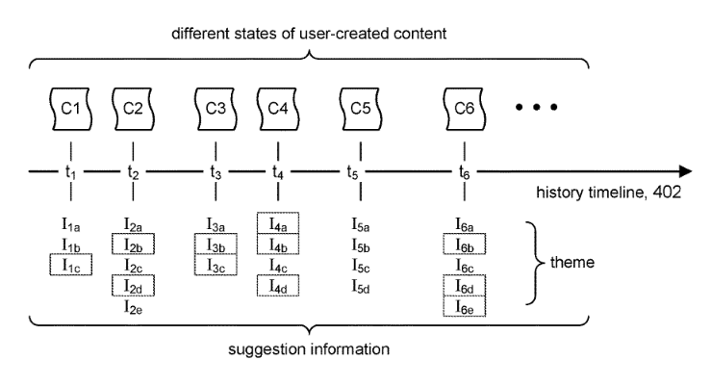
Automatically Generated Content
https://pdfaiw.uspto.gov/.aiw?PageNum=0&docid=20190243873
Notes:
Note how they use user-generated content as source material

Slide 17
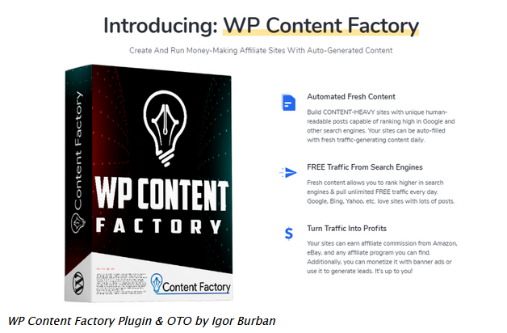
Automatically Generated Content
https://www.jvupsell.com/wp-content-factory-plugin-oto/
Notes:
Note how they use user-generated content as source material

Slide 18
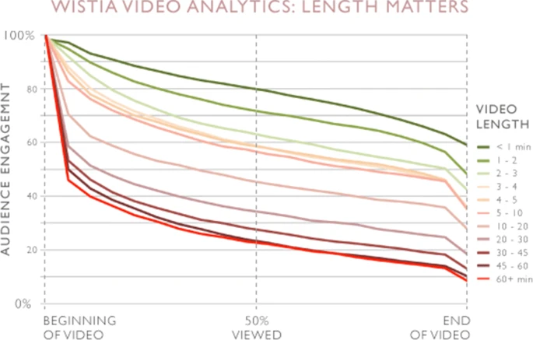
Addressing Completion: Time
Integrating micro-learning content in traditional e-learning platforms. Rebeca P. Díaz Redondo, Manuel Caeiro Rodríguez, Juan José López Escobar & Ana Fernández Vilas. Multimedia Tools and Applications (2020)
https://link.springer.com/article/10.1007/s11042-020-09523-z
Notes:
Note how they use user-generated content as source material

Slide 19
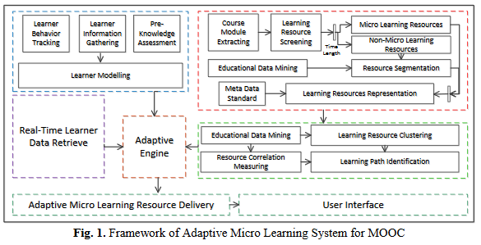
Addressing Completion: Micro-MOOCs
Micro Learning Adaptation in MOOC: A Software as a Service and a Personalized Learner Model
Geng Sun, T. Cui, et.al. Published in ICWL 2015
https://ro.uow.edu.au/cgi/viewcontent.cgi?article=6225&context=eispapers
Notes:
https://www.nature.com/articles/s41539-017-0016-3

Slide 20
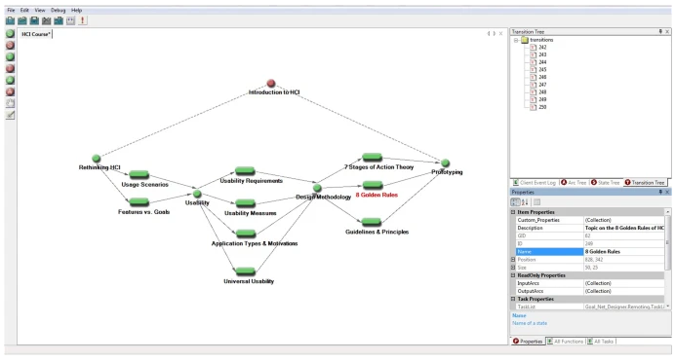
Addressing Completion: Micro-MOOCs
Towards AI-powered personalization in MOOC learning. Han Yu, Chunyan Miao, Cyril Leung & Timothy John White. npj Science of Learning volume 2, Article number: 15 (2017)
https://www.nature.com/articles/s41539-017-0016-3
Notes:
https://www.nature.com/articles/s41539-017-0016-3
Better to just dis-aggregate the MOOC and use microcredentials
People create their own learning path

Slide 21
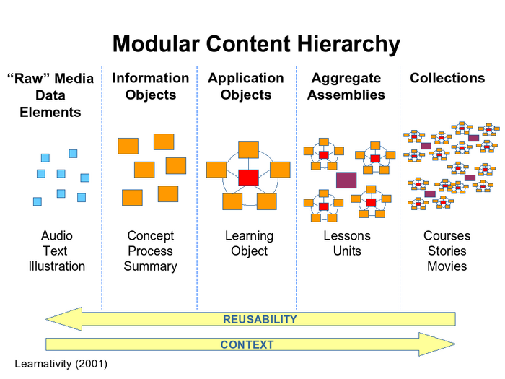
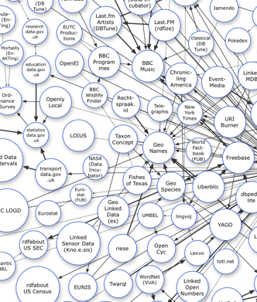
Micro-MOOCs vs Learning Objects, OERs
https://classroom-aid.com/2013/05/25/what-you-should-know-about-learning-object-part-ii/
https://circa.cs.ualberta.ca/index.php/CIRCA:Reference_links_to_Semantic_Web_Resources

Slide 22
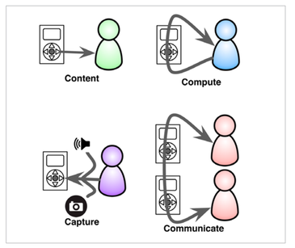

Micro-Learning Models
https://mobiletechnologyinlearning.weebly.com/creating-m-learning-lessons.html
https://theelearningcoach.com/elearning2-0/what-is-microlearning/
Notes:
Karl Kapp, Clark Quinn

Slide 23
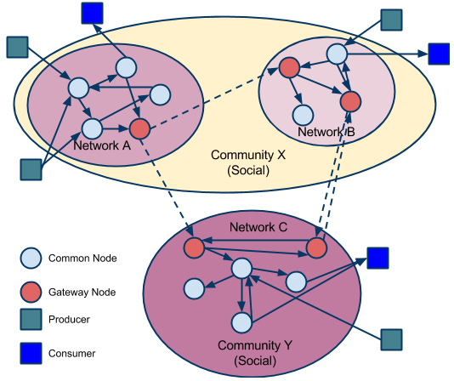
Community Resource Networks
https://classroom-aid.com/2014/06/08/social-network-of-learning-resources-learning-registry/
Notes:
Models of community – CoP, CoI

Slide 24
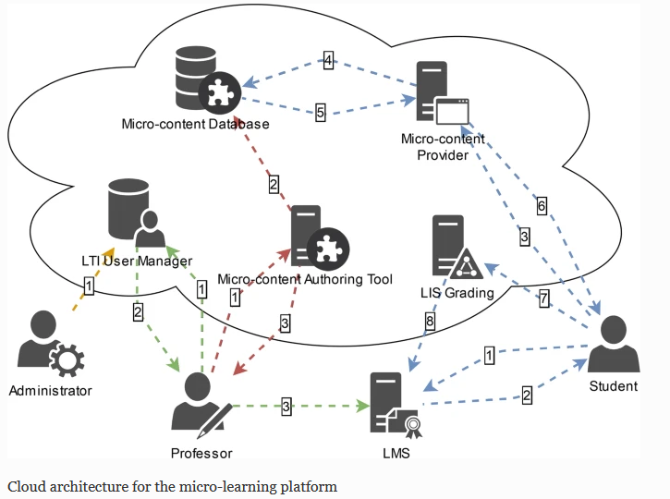
Micro-MOOC at Platform / In Platforms
Integrating micro-learning content in traditional e-learning platforms. Rebeca P. Díaz Redondo, Manuel Caeiro Rodríguez, Juan José López Escobar & Ana Fernández Vilas. Multimedia Tools and Applications (2020)
https://link.springer.com/article/10.1007/s11042-020-09523-z

Slide 25
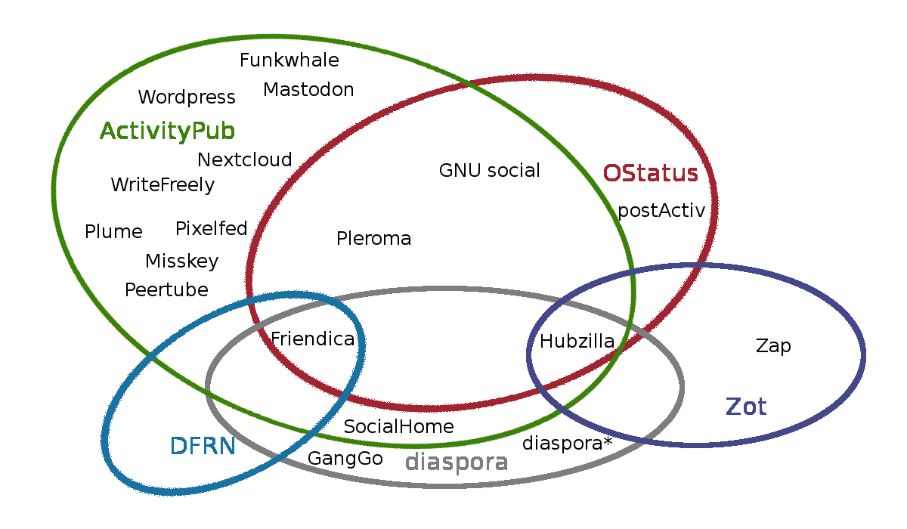
Decentralization - Fediverse
https://blogs.fsfe.org/tobiasd/2019/08/23/salonabend-im-schatzchen-vortrag-uber-das-fediverse/

Slide 26
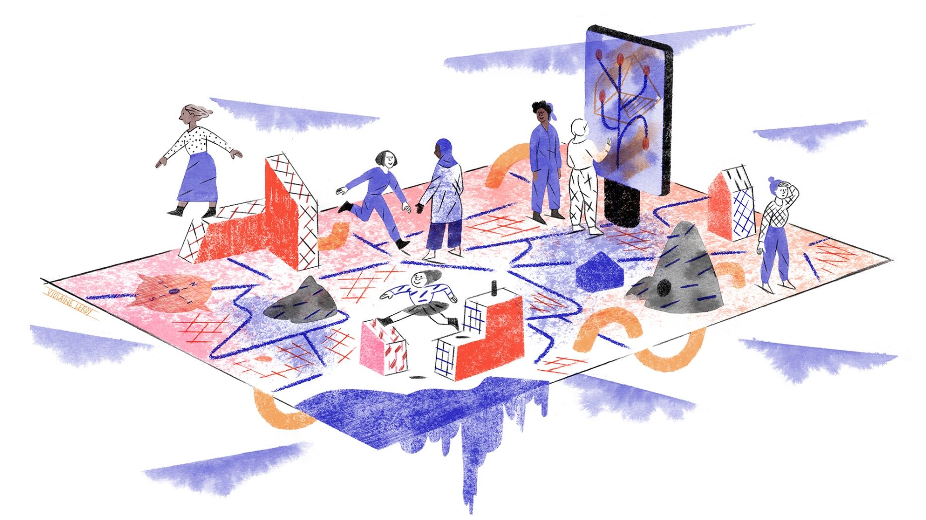
Violaine Leroy
“And what greater delight and wonder can there be than to leave the straight lines of personality and deviate into those footpaths that lead beneath brambles and thick tree trunks into the heart of the forest where live those wild beasts, our fellow men? That is true: to escape is the greatest of pleasures; street haunting in winter the greatest of adventures”. Virginia Woolf
http://in-situ.info/en/in-situ-narratives/en/acupuncture-2-hospitable-hostile-the-place-of-women-in-public-space-56

