Slide 1
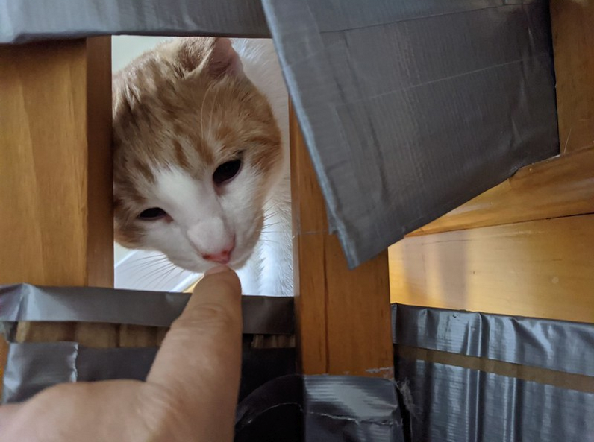
Being Online: Facing the Digital Future Together
Stephen Downes
November 28, 2020
Notes:
Being Online: Facing the Digital Future Together
Description:
Over the last few months, we have all become much more experienced with working and learning online. As we look to the future, we will no doubt carry on with a certain measure of digital teaching and collaboration. What will this new experience look like? Stephen Downes looks at our recent experiences using online learning and conferencing and paints a picture of what the longer-term future is likely to look like. He'll talk about what technologies worked, what didn't, and what we've learned about navigating the online environment.

Slide 2
Over the last few months, we have all become much more experienced with working and learning online. As we look to the future, we will no doubt carry on with a certain measure of digital teaching and collaboration. What will this new experience look like? Stephen Downes looks at our recent experiences using online learning and conferencing and paints a picture of what the longer-term future is likely to look like. He'll talk about what technologies worked, what didn't, and what we've learned about navigating the online environment.

Slide 3
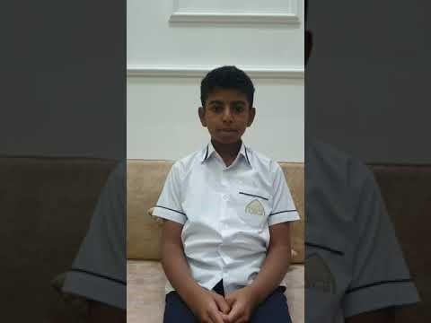

Slide 4
It’s Hard at First
“Student evaluations indicated that the course was considered adequate but less than ideal. Although grade performance in the course was similar overall to that in previous years, it is important to note that student perception of learning in this course was that it was significantly more difficult…” https://journals.physiology.org/doi/full/10.1152/advan.00140.2020
It feels like everything takes longer online
It gets easier

Slide 5

It’s Hard at First
“You cannot just replicate what you do IRL. I knew this, intellectually. But, I didn’t really know this until term started.” https://medium.com/damian-radcliffe/lessons-learned-9-takeaways-from-teaching-online-during-covid-19-8400cc3b36b0
https://royalsociety.org/blog/2020/09/teaching-during-lockdown/
Why is the student using a pencil and paper?

Slide 6
It’s Not All Business
Traditional learning environments include a lot of socialization and off-topic chit chat – online learning tends to skip that step and get straight into the work
It shouldn’t
“Despite staying in touch with my colleagues via online platforms I have missed the one-to-one interaction of ‘chats in the corridor’ and ‘popping into classrooms’.” https://royalsociety.org/blog/2020/09/teaching-during-lockdown/
“Teaching remotely provided a new opportunity to focus on how to carve out time for social and emotional activities with each class in the absence of face-to-face connections.” https://www.edutopia.org/article/reflections-and-lessons-learned-remote-learning

Slide 7
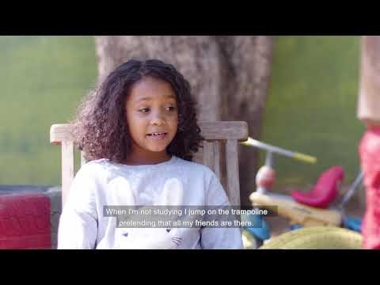

Slide 8
Support Online Learning Staff
Traditional support: eg., training in online course design, approaches to teaching use of key tools (eg. https://www.tonybates.ca/2020/11/05/post-pandemic-lesson-2-support-for-instructors-is-essential-for-quality-online-learning/ )
But online learning staff are going to eventually have to learn to learn these on their own

Slide 9
Support Online Learning Staff
Recommended practice is to have a tech or support person working alongside an instructional person
“Different faculty or support staff members had a variety of roles including facilitating the event, running the PowerPoint presentation, creating polls, handling student technical problems, and monitoring the meeting chat.” https://journals.physiology.org/doi/full/10.1152/advan.00140.2020

Slide 10
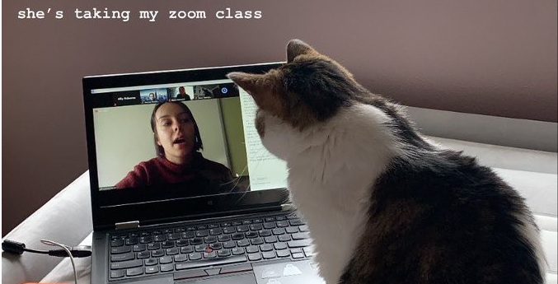
The Value of Live
“There is a value to hosting live classes… At a time when all the days feel the same, many students also tell me how valuable this is. For some, it is the only fixed point in their weekly calendar. Especially for students living alone, it not only helps to create some routine, but also a sense of community.” https://medium.com/damian-radcliffe/lessons-learned-9-takeaways-from-teaching-online-during-covid-19-8400cc3b36b0

Slide 11
Using Open Media
Using streaming video for lectures – so people can watch them or review them after the fact
“Record your Zoom classes, so if a student cannot join you, they can catch-up later. Be sure to record + share, the audio, as well as video, version of the class. The audio version consumes much less bandwidth.” https://medium.com/damian-radcliffe/lessons-learned-9-takeaways-from-teaching-online-during-covid-19-8400cc3b36b0

Slide 12
Using Open Media
Open Educational Resources – widely available, can be added to a course without adding to production costs
“This is something that we will be continuing to use in the near future as a school. I'm proud that we have created over 45Gb of remote learning resources, with over 170,000 resource views.” https://royalsociety.org/blog/2020/09/teaching-during-lockdown/

Slide 13

Using Open Media
Example: Caribbean Examinations Council (CXC) Learning Hub … a space for learners, educators, parents and employers to access multiple high-quality resources supporting teaching, learning and assessment. https://learninghub.cxc.org/

Slide 14
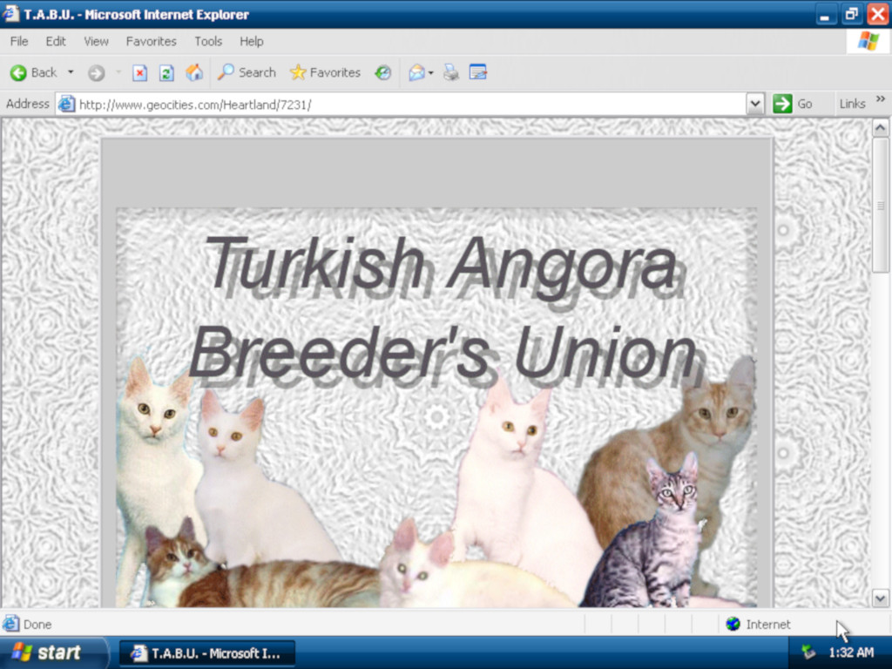
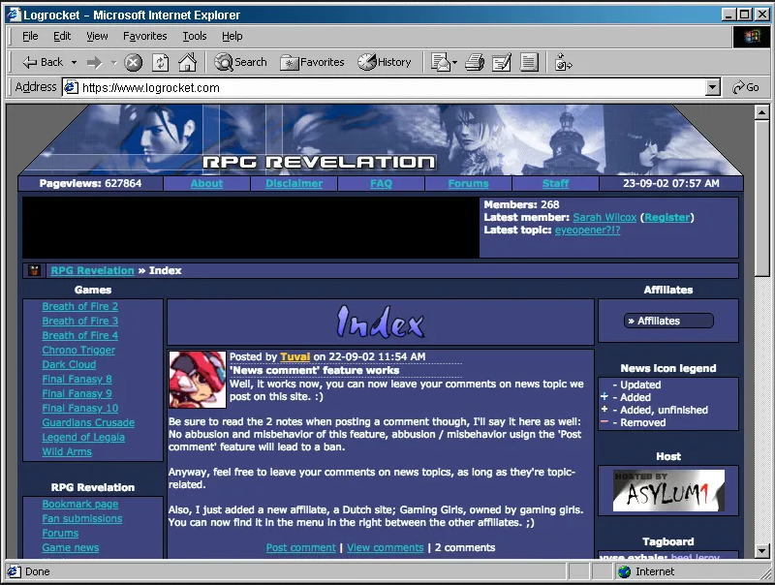
Using Open Media
However as some point out, “a lot of open educational resources lack high-level media production values.” https://www.tonybates.ca/2020/11/05/post-pandemic-lesson-6-we-are-beginning-to-see-the-advantages-of-media-and-open-educational-resources-for-teaching-and-learning/

Slide 15


Slide 16
Beyond the Broadcast
Horror stories of 8 hours watching lectures on Zoom?
“Real and meaningful learning occurs in the classroom only when curriculum goes beyond rote memorization and lecture-based instruction.” The same applies even more so in online and distance learning. https://www.brookings.edu/blog/education-plus-development/2020/08/07/taking-distance-learning-offline-lessons-learned-from-navigating-the-digital-divide-during-covid-19/

Slide 17
Create Routines
Working and learning at home requires that you set routines for yourself.
Set loose schedules to provide predictability, prioritization of tasks, division of time/balance
Share them with stakeholders (e.g., children, educators, therapists)
Include wake/bedtime, exercise, school, chores, and free time https://www.pattan.net/assets/PaTTAN/c4/c452a4c0-3e0d-45ad-aa7b-43f07d301139.pdf

Slide 18
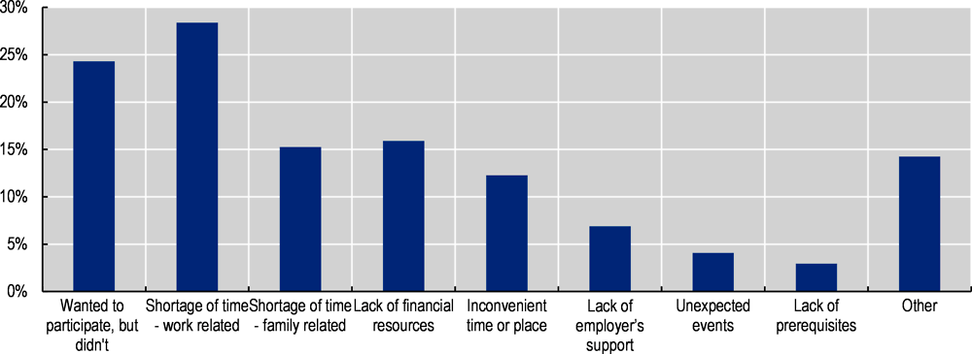
Access and Equity
Online Learning can increase access, especially for adult learning or remedial learning
  https://www.oecd.org/coronavirus/policy-responses/the-potential-of-online-learning-for-adults-early-lessons-from-the-covid-19-crisis-ee040002/#figure-d1e206

Slide 19
Access and Equity
When we moved to online or remote learning, we learned right away that a significant number of people didn’t have adequate internet access (what’s the appropriate bandwidth? 10 mbps?)
OECD: “Unequal access to the Internet risks exacerbating existing inequalities in education and training.” https://www.oecd.org/coronavirus/policy-responses/the-potential-of-online-learning-for-adults-early-lessons-from-the-covid-19-crisis-ee040002/

Slide 20
Access and Equity
There’s also accessibility in the sense of ensuring people with disabilities have alternatives to audio, text and video
Also: “We have had limited success with engaging our pupils who have mental health issues.” – “we have found that Teams has been very helpful with allowing catch ups with mental health professionals.” https://royalsociety.org/blog/2020/09/teaching-during-lockdown/
As well, 2020 highlighted a range of other equity issues related to race, culture, language and gender

Slide 21
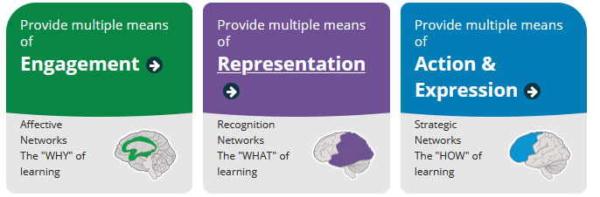
Access and Equity
Can we address access and equity through learning design? Bastes suggests UDDL http://www.cast.org/impact/universal-design-for-learning-udl

Slide 22
Broaden the Reach
Broaden the range of online courses to include more blue-collar occupations
Establish quality assurance mechanisms for online learning to ensure that online courses provide value for money/time to participants
Develop effective testing methods and certificates to ensure that online learning is valued in the labour market;
https://www.oecd.org/coronavirus/policy-responses/the-potential-of-online-learning-for-adults-early-lessons-from-the-covid-19-crisis-ee040002/#section-d1e708

Slide 23
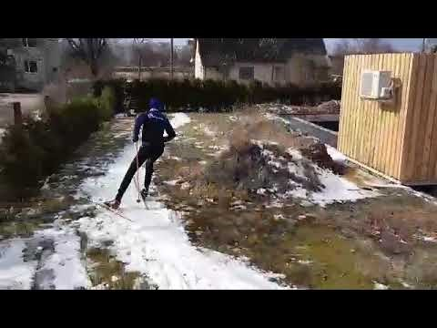

Slide 24

Motivation Matters
Motivation matters much more online
OECD: “In addition to basic digital skills, online learning requires autonomy and self-motivation.” https://www.oecd.org/coronavirus/policy-responses/the-potential-of-online-learning-for-adults-early-lessons-from-the-covid-19-crisis-ee040002/

Slide 25
Reading the Room
“In the classroom, many educators can ‘read the room’ and tell when things are going well and when they are not. Using a video chat platform left many instructors struggling to use this skill.” https://journals.physiology.org/doi/full/10.1152/advan.00140.2020
It’s important to do this deliberately:
  “ask students for questions more frequently, with significant pauses (at least 10 s) to provide time for students to turn on their microphones and actually ask their questions.”
  “build assessment into synchronous events that allow the instructor to ensure that core concepts are clearly understood before moving on.”
  Asking for volunteers = awkward. “Replacing those check-in style questions with polling using platforms such as Polly, TurningPoint, or Poll Everywhere allows for greater class participation.”

Slide 26
Recognizing Learner Realities
Brookings: “A key barrier we discovered through student surveys is that many youth have taken on new home responsibilities, cutting into time for their studies.” https://www.brookings.edu/blog/education-plus-development/2020/08/07/taking-distance-learning-offline-lessons-learned-from-navigating-the-digital-divide-during-covid-19/
This reflects a need to collect data from individual learners (or at least, to somehow allow those realities to be recognized)
Online means additional realities, like time zones. https://journals.physiology.org/doi/full/10.1152/advan.00140.2020

Slide 27

It Takes a Village
A number of studies show that when communities and parents are engaged in students’ learning, academic achievement increases. https://eric.ed.gov/?id=ED474521
Brookings: “After targeting outreach to families, we saw a 29 percent increase in participation in our remote programming” https://www.brookings.edu/blog/education-plus-development/2020/08/07/taking-distance-learning-offline-lessons-learned-from-navigating-the-digital-divide-during-covid-19/

Slide 28


Slide 29
Flexible Assessment
2020 saw a great increase in online proctoring tools such as Proctorio (eg See https://www.insidehighered.com/news/2020/05/11/online-proctoring-surging-during-covid-19)
Students hated them.
This practice is not recommended. “online proctoring systems, such as ProctorU or Proctorio, replicate a practice that isn’t effective in-person. Exams are only good for a few things: managing faculty workload and assessing low level skill and content knowledge.” https://www.edsurge.com/news/2017-04-19-online-courses-shouldn-t-use-remote-proctoring-tools-here-s-why
Alternatives: watching for indicators of progress (eg. In discussion forums) and tracking traces (projects they do, things they say) https://www.tonybates.ca/2020/11/05/post-pandemic-lesson-4-covid-19-showed-the-need-for-more-flexible-assessment-methods/

Slide 30
Flexible Assessment
OECD: “There is a risk that the proliferation of certificates and credentials from online learning may dilute its value in the labour market and in granting access to further training. Some regulation and standardisation are needed to guarantee that skills learnt online are recognised and valued by companies and education institutions.” https://www.oecd.org/coronavirus/policy-responses/the-potential-of-online-learning-for-adults-early-lessons-from-the-covid-19-crisis-ee040002/

Slide 31
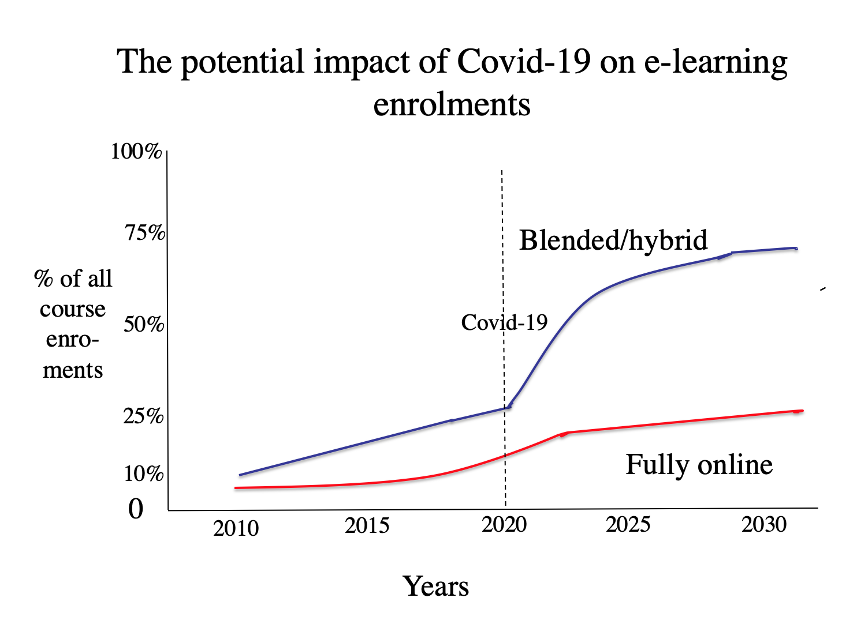
Hybrid Learning on the Increase
Image: https://www.tonybates.ca/2020/11/05/post-pandemic-lesson-1-online-and-blended-learning-will-increase-substantially-post-covid-19/

Slide 32
Hybrid Learning: Issues
Some sources say hybrid learning is “where some students attend class in-person, while others join the class virtually from home.” Eg. https://www.owllabs.com/blog/hybrid-learning
This practice is not recommended
Better: “Hybrid learning is a way of combining traditional classroom experiences, experiential learning objectives, and digital course delivery that emphasizes using the best option for each learning objective.” Eg. https://ethinkeducation.com/blog/what-is-hybrid-learning-how-to-implement-a-hybrid-learning-strategy/
But ensure students have the resources for effective online, offline experiences

Slide 33

Digital Learning in the Classroom
Bates https://www.tonybates.ca/2020/11/05/post-pandemic-lesson-8-we-need-more-flexible-learning-spaces/ :
  Many institutions have a central learning commons, often linked to the library, but students also need many smaller, local learning spaces
  More space and fewer students per room is not only healthier, but also allows for better learning.

Slide 34
Some Resources
Tony Bates - 10 Lessons for a Post-Pandemic World from Covid-19 for Canadian universities and colleges - https://www.tonybates.ca/2020/11/05/10-lessons-for-a-post-pandemic-world-from-covid-19-for-canadian-universities-and-colleges/
OECD Policy Responses to Coronavirus (COVID-19) - Early lessons from the COVID-19 crisis - https://www.oecd.org/coronavirus/policy-responses/the-potential-of-online-learning-for-adults-early-lessons-from-the-covid-19-crisis-ee040002/
World Bank - How countries are using edtech (including online learning, radio, television, texting) to support access to remote learning during the COVID-19 pandemic https://www.worldbank.org/en/topic/edutech/brief/how-countries-are-using-edtech-to-support-remote-learning-during-the-covid-19-pandemic

Slide 35
Some Resources
Brookings: Taking distance learning ‘offline’: Lessons learned from navigating the digital divide during COVID-19 https://www.brookings.edu/blog/education-plus-development/2020/08/07/taking-distance-learning-offline-lessons-learned-from-navigating-the-digital-divide-during-covid-19/
Royal Society - Lessons learnt during COVID-19 lockdown - https://royalsociety.org/blog/2020/09/teaching-during-lockdown/
UNESCO - How are you learning during the COVID-19 pandemic? https://en.unesco.org/covid19/educationresponse/learningneverstops
Damian Radcliffe. Lessons learned: 9 takeaways from teaching online during COVID-19: Tips for remote instruction developed in the past 10 weeks https://medium.com/damian-radcliffe/lessons-learned-9-takeaways-from-teaching-online-during-covid-19-8400cc3b36b0

