Slide 1
Personal Learning:
Taking Ownership of
Learning Online – Part 6
Stephen Downes
November 16, 2020
https://www.downes.ca/presentation/531

Slide 2
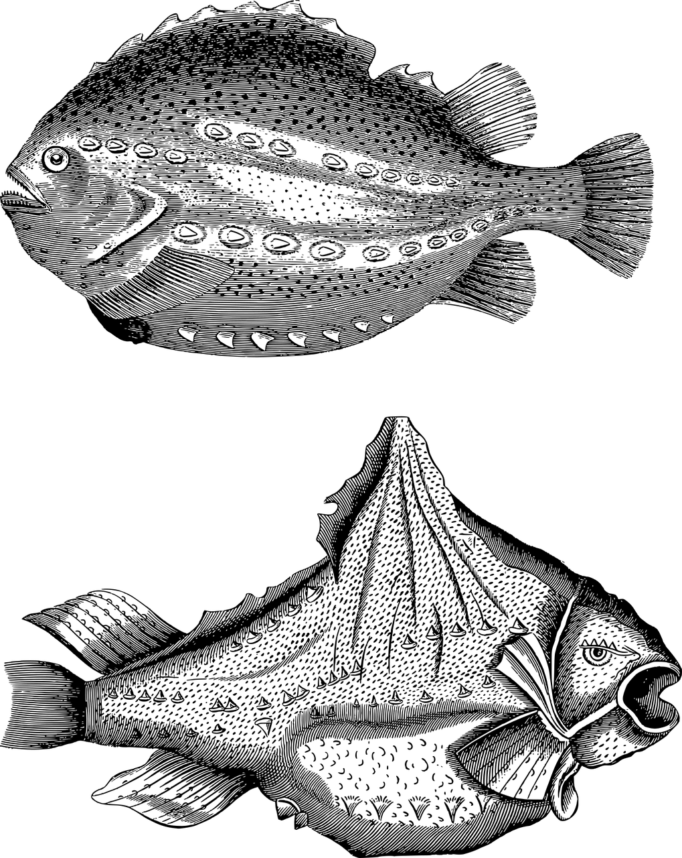
Topics for Discussion - Practical
Part One: Relevance and Usability y
Starting points y
Supporting them when they’re not supported y
https://www.downes.ca/presentation/525
Part Two: Interactivity y
Starting points y
Supporting them when they’re not supported y
https://www.downes.ca/presentation/528

Slide 3
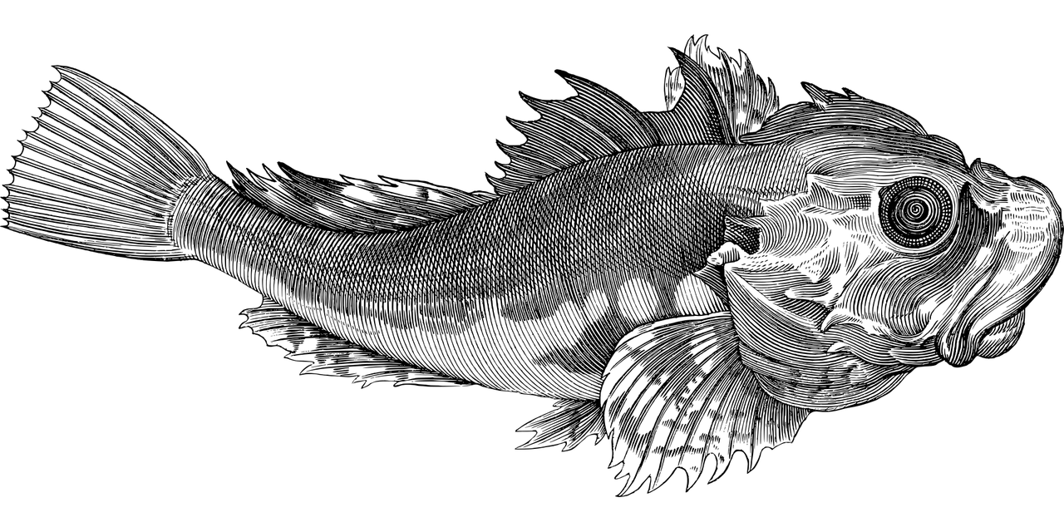


Topics for Discussion - Theory
Part Three: Personal Learning y
What is personal learning? y
Elements of personal learning y
https://www.downes.ca/presentation/530
Part Four: Supporting Personal Learning
Personal learning starting points - 1
https://www.downes.ca/presentation/531
Part Five: Supporting Personal Learning
Personal learning starting points - 2
Supporting personal learning online:
        - Learning objectives
https://www.downes.ca/presentation/532

Slide 4
Topics for Discussion - Theory
Part Six: Supporting Personal Learning
- Forming Networks
https://www.downes.ca/presentation/535

Slide 5
Personal Learning Starting Points

Slide 6
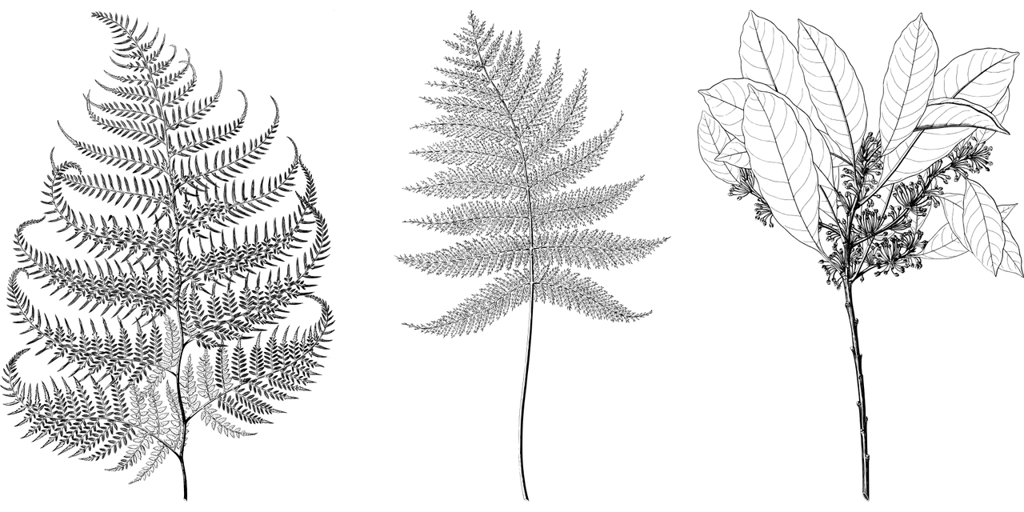
Items to Consider
Learning objectives y
Learning processes
Forms of evaluation that best suit personal learning
Image by Gordon Johnson

Slide 7
Networks in Learning
The major value proposition offered by top tier universities isn't knowledge. This is available anywhere.
Nor is it even top-flight professors. Great teachers and researchers can be found in institutions large and small around the world.
No, the value proposition is access to the network of contacts, influencers, and collaborators. Access to networks matters, and it's this gap that isn't addressed in education reform programs ignore, to the detriment of participants.

Slide 8
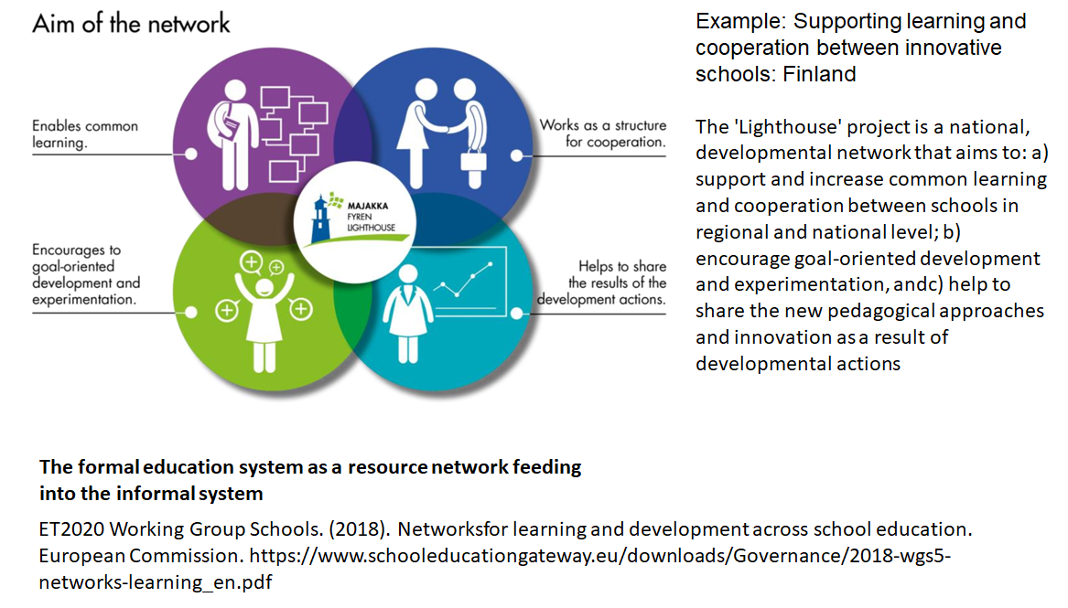
Networks in Learning

Slide 9
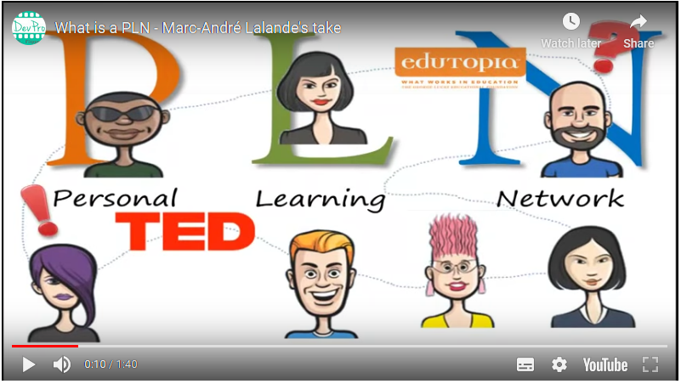
Personal Learning Network
https://extend.ecampusontario.ca/collaborator-engage-personal-learning-networks/

Slide 10
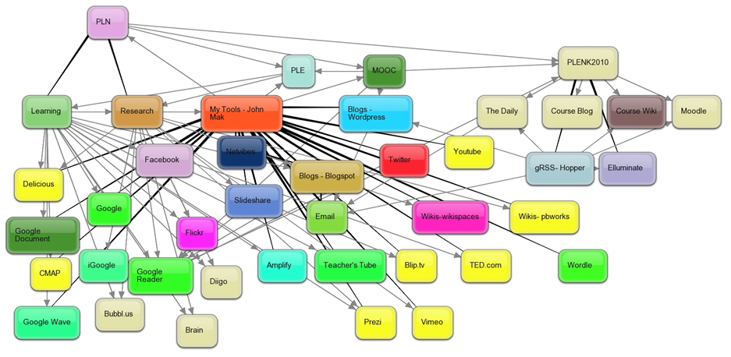
Personal Learning Environments
Martin Weller: "Open universities across the world have been operating large scale, open, equitable learning for decades." My response. I write, "the cost of educational labour is what makes it so expensive... (but) The connectivist approach is to do whatever can be done to help students perform this labour themselves." https://www.downes.ca/post/69410

Slide 11

Stephen Downes
https://www.downes.ca

