Slide 1

Reimagining Open Educational Resources
Stephen Downes
National Research Council Canada
Open Education Conference
November 10, 2020
https://www.downes.ca/534
Notes:
This session introduces and demonstrates content-addressable resources for education, a set of tools and processes for the creation and storage of learning resources in a distributed peer-to-peer network.
Closed and commercial models of education are often based on the argument that open learning is not sustainable, and thus, must be supported by means of professional content creators and some mechanism for subscription fees or other revenue-based models. This presentation argues that there are community-based models supporting open educational resources and learning technology that offer a response to this argument.
Specifically, the presentation will describe the use of hash algorithms to create a unique address for every resource, describe mechanisms for resource revisions, combining aggregations of resources, and identifying the provenance of resources. Participants will see for themselves how such a system works through a demonstration of open source tools.
The authors recently developed and used these resources in a MOOC, which will be shared. Participants can see how content-addressable resources could be used in combination with other graph-based technologies to create such features as learner-generated content, activity records, and digital badges. Because these records are stored and linked as one-way encrypted data, they are private and secure. Participants can determine for themselves whether any course-related activity is shared to a wider audience.
The presentation will then describe the application of these mechanisms to support a global distributed network of open educational resources as an alternative to centralized resource repositories. It will suggest how educators can access, reuse, and contribute to the global network.
The presentation will argue that content-addressable resources offer an alternative to license-based resources by offering new community-based models of sustainability as well as being able to guarantee provenance and authenticity.
An important aspect of these resources is that they can be developed or modified by anyone. This supports not only content revision but also a common mechanism for community-based meta-tagging or content reviews and to, optionally, provide data on context and use. Thus participants will be able to appreciate how content-addressable resources can inhabit a rich ecosystem that provides an open alternative to published-based and controlled repositories.
Learning Outcomes:
Participants will learn about content addressing for open educational resources as an alternative to URL and domain-based addressing. They will be able to:
- describe how content addressing works-
- describe the use of content addressing to enable a secure and distributed resource network
- create and add their own open educational resources to the network
- access and reuse resources from the network
- appreciate how content addressing provides an alternative to license-based OER

Slide 2

This session introduces and demonstrates content-addressable resources for education, a set of tools and processes for the creation and storage of learning resources in a distributed peer-to-peer network.

Slide 3
Learning Outcomes
You will be able to:
describe how content addressing works
describe the use of content addressing to enable a secure and distributed resource network
create and add their own open educational resources to the network
access and reuse resources from the network
appreciate how content addressing provides an alternative to license-based OER

Slide 4
Issues for Open Educational Resources
Licensing alone is not enough
  “CC licenses and tools are proving indispensable in certain domains, most notably in the education and research sectors. However, they do not entirely address mainstream content sharing on the internet today. Indeed, most sharing occurs on proprietary platforms designed to keep users within their own systems.”
Resources are no longer community-based
  “Our existing licenses and tools do not fully address the collateral damage caused by exploitative, decontextualized, unethical, and antisocial reuse of shared content. We cannot turn a blind eye.”
Creative Commons Strategy 2020 - Second Draft, November 2, 2020
https://docs.google.com/document/d/1oRDt7Lk0tp571xygWyDsS7rRvKWiK1BFPuiDm9jbF-c/edit?usp=sharing

Slide 5
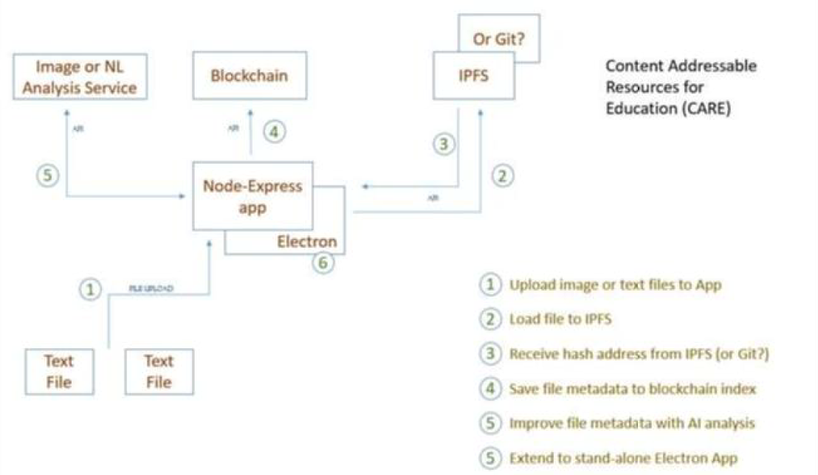
Content Addressable Resources for Education
CARE are content-addressable, they are stored and access in the web as a whole
CARE are also associated with each other in an Open Resource Graph (ORG)
CARE can be cloned and edited by any user
https://github.com/Downes/CARE-project

Slide 6
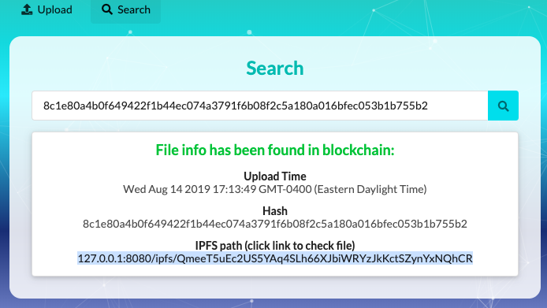
Content Addressable Resources for Education
CARE are content-addressable, they are stored and access in the web as a whole
CARE are also associated with each other in an Open Resource Graph (ORG)
CARE can be cloned and edited by any user
https://github.com/Downes/CARE-project

Slide 7
Encryption Algorithms
These are open source!
Algorithms
Algorithm and variant |  | Output size (bits) | Internal state size (bits) | Block size (bits) | Rounds | Operations
MD5 (as reference) |  | 128 | 128 (4 × 32) | 512 | 64 | And, Xor, Rot, Add (mod 2³²), Or
SHA-0 |  | 160 | 160 (5 × 32) | 512 | 80 | And, Xor, Rot, Add (mod 2³²), Or
SHA-1
SHA-2 | SHA-224 SHA-256 | 224 256 | 256 (8 × 32) | 512 | 64 | And, Xor, Rot, Add (mod 2³²), Or, Shr
 | SHA-384 SHA-512 | 384 512 | 512 (8 × 64) | 1024 | 80 | And, Xor, Rot, Add (mod 2⁶⁴), Or, Shr
 | SHA-512/224 SHA-512/256 | 224 256
SHA-3 | SHA3-224 SHA3-256 SHA3-384 SHA3-512 | 224 256 384 512 | 1600 (5 × 5 × 64) | 1152 1088 832 576 | 24^{[5]} | And, Xor, Rot, Not
 | SHAKE128 SHAKE256 | d (arbitrary) d (arbitrary) |  | 1344 1088
https://en.wikipedia.org/wiki/Secure_Hash_Algorithms

Slide 8
One-way Encryption
Algorithms
2-way - Code
“Come on over!”
“Come on over!”
wUwDPglyJu9LOnkBAf4v
1-way - Hash
“Come on over!”
wUwDPglyJu9LOnkBAf4v
wUwDPglyJu9LOnkBAf4v

Slide 9
Uniqueness
Algorithms
1-way - Hash
“Come on over now!”
SpQgQZltcz7LWwEquhd
SpQgQZltcz7LWwEquhd
1-way - Hash
“Come on over!”
wUwDPglyJu9LOnkBAf4v
wUwDPglyJu9LOnkBAf4v

Slide 10
Content-based Address
Algorithms
1-way - Hash
“Come on over now!”
SpQgQZltcz7LWwEquhd
dat://001245SpQgQZltcz7LWwEquhd

Slide 11
Revisions
wUwDPglyJu9LOnkBAf4v
SpQgQZltcz7LWwEquhd
2FdgvdIC7sDv7G1Z7pCNz
“Come on over!”
“Come on over now!”
wUwDPglyJu9LOnkBAf4v
SpQgQZltcz7LWwEquhd

Slide 12
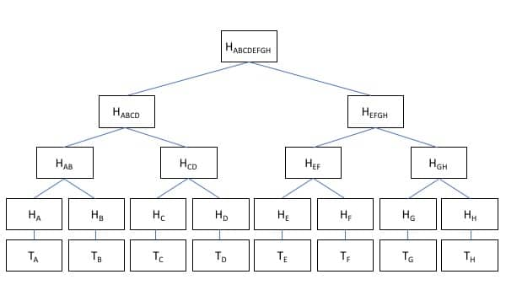
Merkle Chain
https://btc-investor.net/merkle-tree-hashing-blockchain/

Slide 13
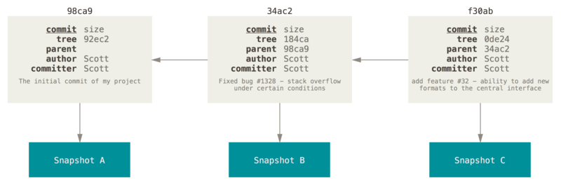
How Git Uses Merkle Chains
https://git-scm.com/book/en/v2/Git-Branching-Branches-in-a-Nutshell
Hash trees are also used in the IPFS, Btrfs and ZFS file systems; Dat protocol; Apache Wave protocol; Git and Mercurial distributed revision control systems; the Tahoe-LAFS backup system; Zeronet; the Bitcoin and Ethereum peer-to-peer networks; the Certificate Transparency framework; and a number of NoSQL systems such as Apache Cassandra, Riak, and Dynamo. https://en.wikipedia.org/wiki/Merkle_tree

Slide 14
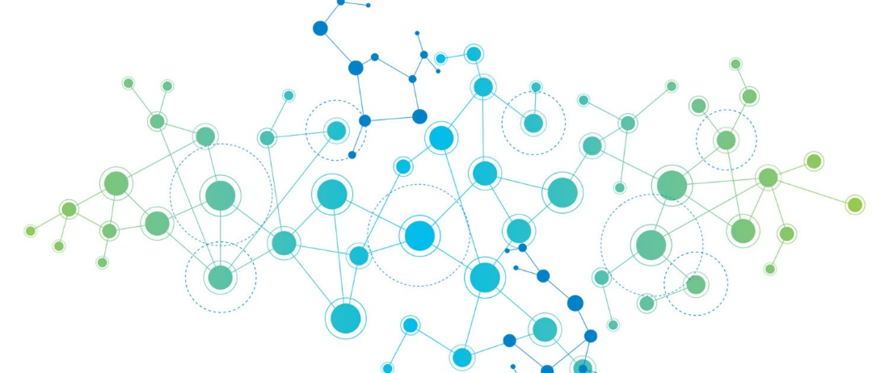
Peer-to-Peer Networks
Each node is a server. Some are big, some are small. They each connect to some, but not all, of the other servers, so nobody is overloaded.
https://www.kindpng.com/imgv/iTJwhxT_connection-png-page-network-effect-transparent-png/

Slide 15
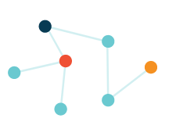
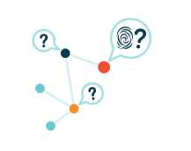
Peer-to-Peer Networks
Each network node stores only content it is interested in, plus some indexing information that helps figure out which node is storing what.
When you look up a file to view or download, you're asking the network to find the nodes that are storing the content behind that file's hash.
https://ipfs.io/#how

Slide 16
Secure Access
Request
dat://001245SpQgQZltcz7LWwEquhd
“Come on over!”
Verify
Retrieve
Algoirithm: 001245
“Come on over!”
SpQgQZltcz7LWwEquhd

Slide 17
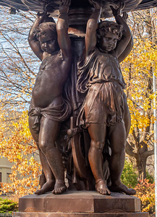
A Range of Applications
Content-addressable resources could be used in combination with other graph-based technologies to create such features as:
  learner-generated content
  activity records, and
  digital badges
Because these records are stored and linked as one-way encrypted data, they are private and secure.
Participants can determine for themselves whether any course-related activity is shared to a wider audience.

Slide 18
The authors recently developed and used these resources in a MOOC, which will be shared. Participants can see how content-addressable resources could be used in combination with other graph-based technologies to create such features as learner-generated content, activity records, and digital badges. Because these records are stored and linked as one-way encrypted data, they are private and secure. Participants can determine for themselves whether any course-related activity is shared to a wider audience.

Slide 19
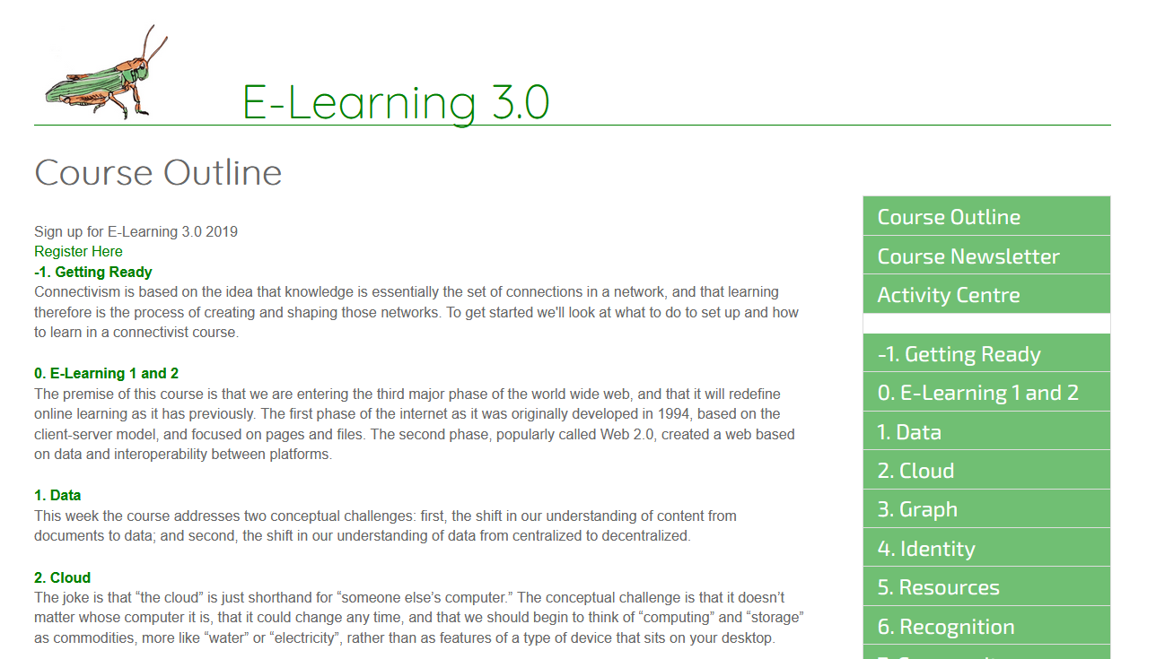
E-Learning 3.0 Course
https://el30.mooc.ca/course_outline.htm

Slide 20
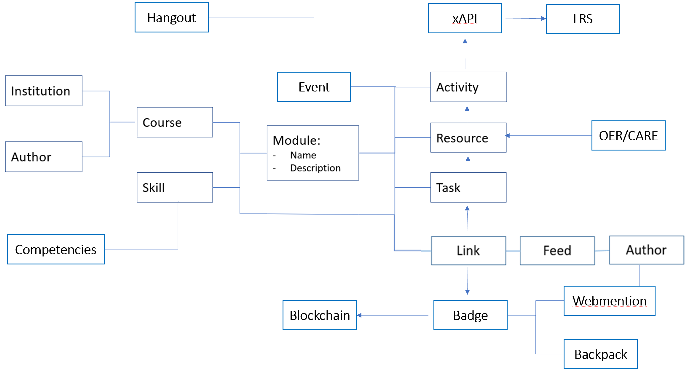
EL30 - A Course as Linked Open Data
https://www.downes.ca/presentation/515

Slide 21
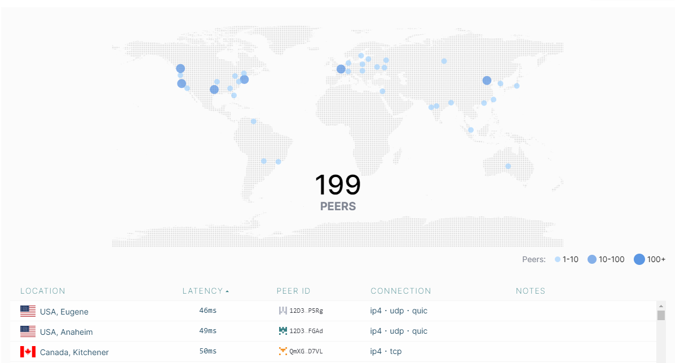
IPFS Desktop
https://ipfs.io/#install

Slide 22
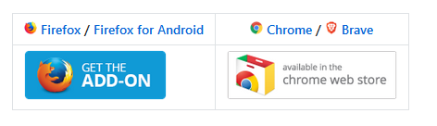
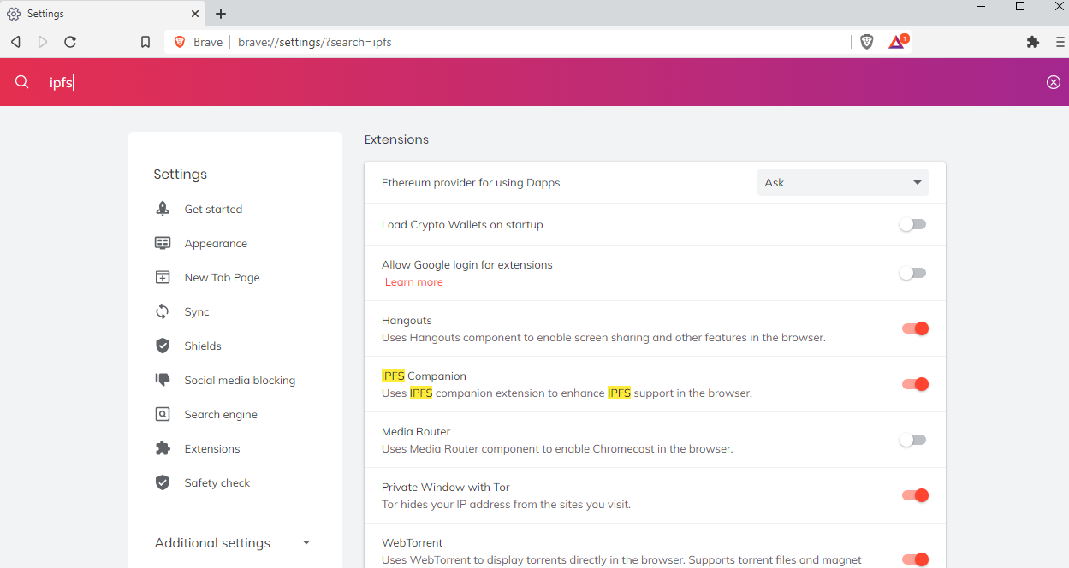
Browsing the IPFS Network
https://github.com/ipfs/in-web-browsers
IPFS Web Hub
https://ipfs.io/ipfs/QmdmQXB2mzChmMeKY47C43LxUdg1NDJ5MWcKMKxDu7RgQm
https://brave.com/

Slide 23
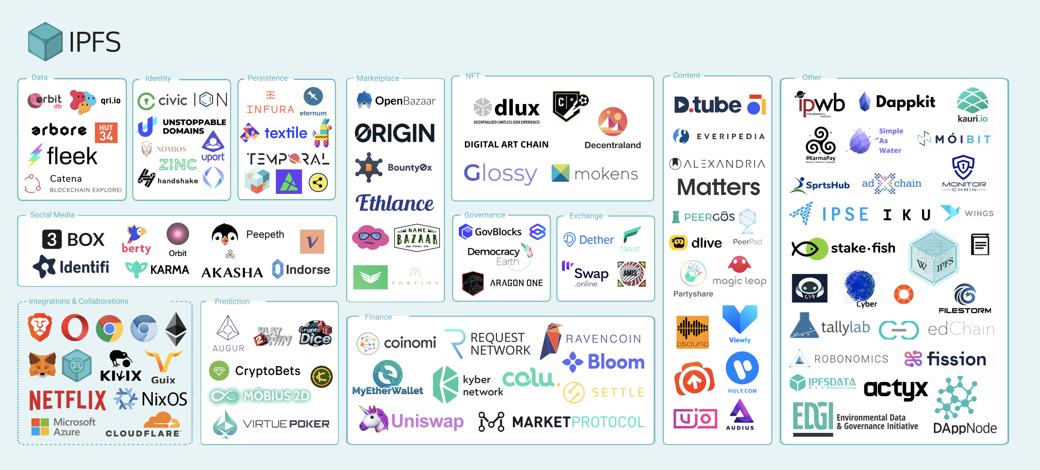
Interplanetary File System (IPFS)
https://ipfs.io/images/ipfs-applications-diagram.png

Slide 24
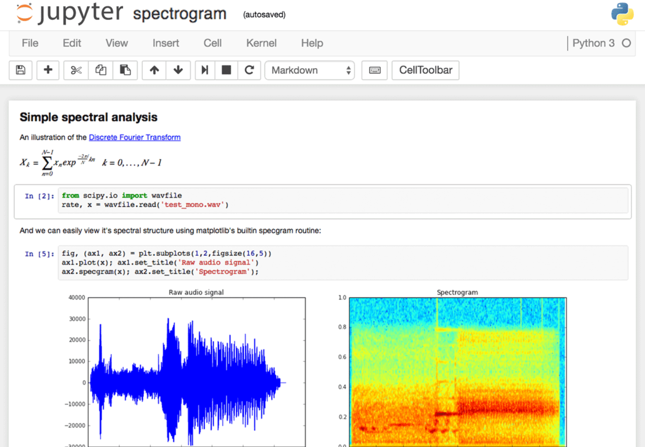
Example: Notebooks
https://github.com/jupyter/jupyter/wiki/A-gallery-of-interesting-Jupyter-Notebooks#machine-learning-statistics-and-probability
OpenLearn Jupyter Books Remix, TM351 Notebooks in VM and Electron.
https://www.dataquest.io/blog/jupyter-notebook-tips-tricks-shortcuts/

Slide 25
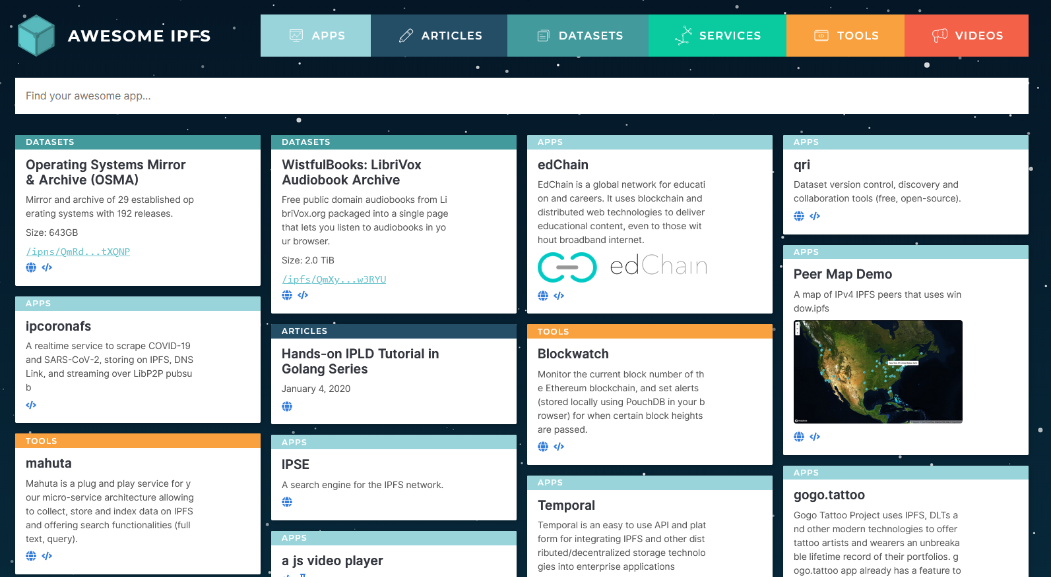
Applications
https://awesome.ipfs.io/

Slide 26
Dweb
One significant current project implementing such a protocol is called Dweb (for ‘distributed web’ or ‘decentralized web’). (Ayala, 2018)
Based on the dat protocol, a mechanism for finding and distributing content
    dat://502bdf152d00a35f9785f78d107b9037b5eca9354bcf593e7b4995f9be97a614/
This address is in fact the dat:// address for the first Content Addressable Resource for Education (CARE)
https://hacks.mozilla.org/2018/07/introducing-the-d-web/
https://www.datprotocol.com/

Slide 27
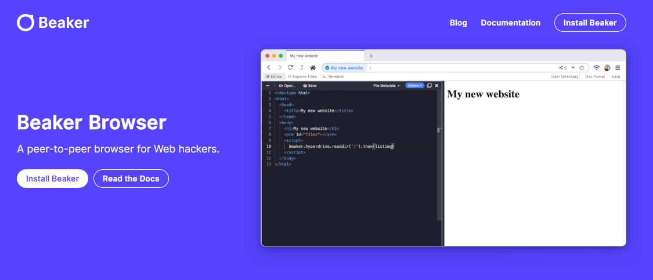
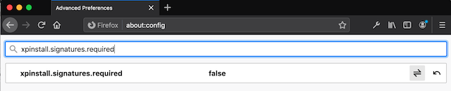
Browsing the Dweb Network
https://beakerbrowser.com/
https://sammacbeth.eu/blog/2020/05/08/install-dat-for-firefox.html

Slide 28
An important aspect of these resources is that they can be developed or modified by anyone. This supports not only content revision but also a common mechanism for community-based meta-tagging or content reviews and to, optionally, provide data on context and use. Thus participants will be able to appreciate how content-addressable resources can inhabit a rich ecosystem that provides an open alternative to published-based and controlled repositories.

