Slide 1
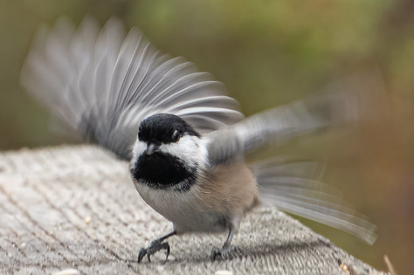
Open Learning, Open Networks
Online Learning in 2020
Stephen Downes
Numérique2020
November 3, 2020
https://www.downes.ca/presentation/533

Slide 2

Share and Edit Links
https://bit.ly/34R0OQn
Presentation Page
http://www.downes.ca/presentation/533
Join the Chat - #numerique2020

Slide 3
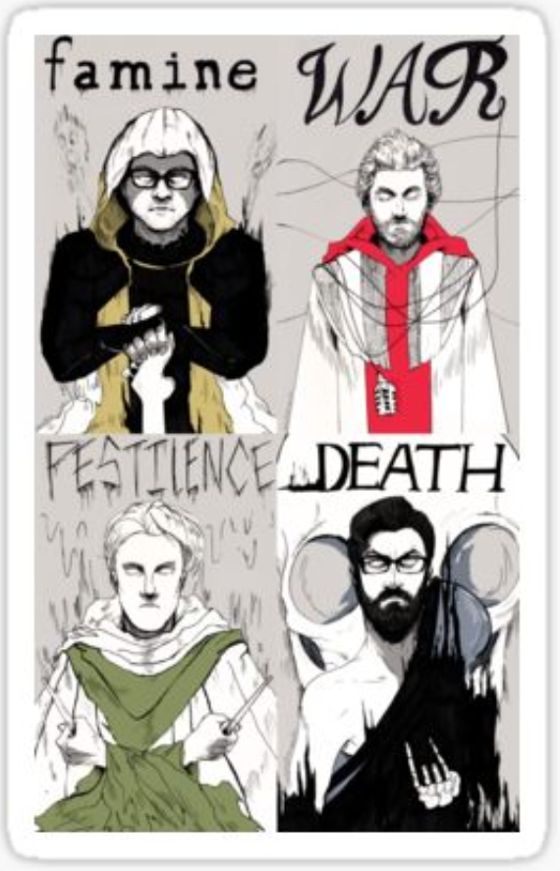
A Time of Challenges
The usual: famine, war, etc., plus:
  Climate Change https://climate.nasa.gov/ https://www.fire.ca.gov/incidents/
  Democracy in crisis https://www.cnn.com/2020/10/02/world/freedom-house-covid-democracy-intl-hnk/index.html
  Poverty & Inequality http://www.oecd.org/social/inequality-and-poverty.htm
  Social Media http://www.npr.org/2016/11/08/500686320/did-social-media-ruin-election-2016 https://shatteredmirror.ca/
  Pandemic https://www.who.int/emergencies/diseases/novel-coronavirus-2019
  Economic Crisis https://en.wikipedia.org/wiki/COVID-19_recession
Redbubble - https://www.redbubble.com/shop/four+horsemen+stickers

Slide 4
Current Work
https://www.downes.ca/now
Covid Response
eXtended Reality Training for Transportation Emergency And Management)
Data Literacy
Ethics, Analytics and the Duty of Care
Personal Learning Environments

Slide 5
Covid Response
Inside NRC:
  Expanded VPN
  Adopted Zoom Meetings
  Set Up Slack for Quick Messaging
  Longer Term: MS Teams
  Issues to consider:
    Cloud services
    Security
    Processes (eg., onboarding)
    Long-term Impact

Slide 6
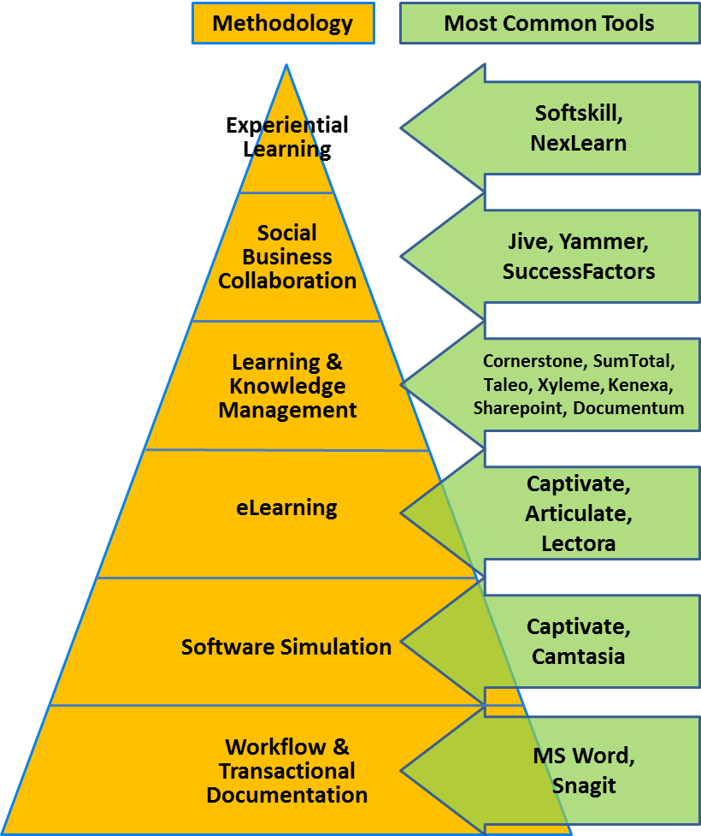
Covid Response
http://epiloguesystems.com/about/

Slide 7
Covid Response
Quick Tech Guide:
  http://bit.ly/quicktechguide
  Constraints:
    Needed to be web-based
    Needed to be free/open access
    Up Slack for Quick Messaging
  Set up as Google Doc / Open editing
    Also set up calendar service, which failed
  Issues to consider:
    Long-term Impact
    Expansion to include pedagogy, subject-specific resources

Slide 8
Covid Response
MOOCs
  True History of the MOOC
    https://sites.google.com/site/themoocguide/home
  cMOOC and xMOOC
    http://www.tonybates.ca/2014/10/13/comparing-xmoocs-and-cmoocs-philosophy-and-practice/
  Personal Learning
    http://www.downes.ca/presentation/380

Slide 9
Covid Response
CovidEA:
  International Science Council expert panel
  https://www.foggs.org/covidea/
  Constraints:
    High-level discussion for policy-makers
    Addresses what we need to learn, pedagogy, technology

Slide 10
Moving Forward
Moving Forward
  Competencies? Vs. Capabilities http://www.downes.ca/post/64879
  Badges? Vs. Evidence https://openbadges.org/
  Classes Vs. Performance Support http://www.nrc-cnrc.gc.ca/eng/solutions/collaborative/lpss.html
  Microlearning? Vs. Spaced Learning - https://www.td.org/Publications/Blogs/Science-of-Learning-Blog/2015/01/Spaced-Learning-an-Approach-to-Minimize-the-Forgetting-Curve
  Course Libraries? Vs. Subscription-based Learning - http://www.downes.ca/news/OLDaily.htm

Slide 11
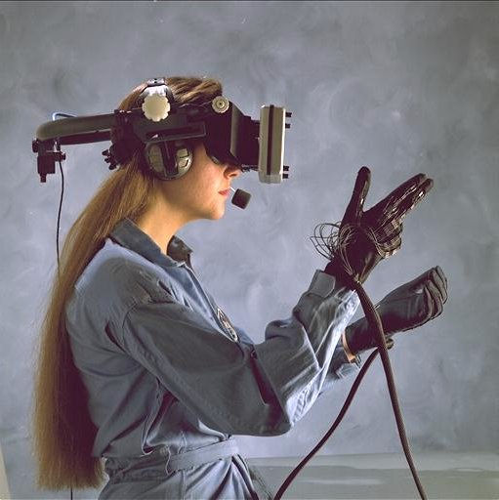
Immersive Reality
What is ‘Immersive’ – a VR helmet?
Key element of immersion: belief
  (authentic) applications that matter
  social presence (cognitive presence, teaching presence) - https://www.mnsu.edu/its/academic/isalt_social_presence_theory.pdf
  multi-modality – cognitive + kinesthetic, etc. - https://www.slideshare.net/jtholden/the-learning-styles-revelation-research-from-cognitive-science
Games and Gamification?

Slide 12
eXtended Reality Training
XR – eXtended Reality (or Augmented Reality)
  Eg. HUD, QR codes
VR – Virtual Reality
  Platforms:
    Unity - https://unity.com/ - initially released for Mac OS X
    Unreal - https://www.unrealengine.com/en-US/ (Epic Games)
  Headsets:
    HTC Vive - https://www.vive.com/ca/ ($1.3K)
    Hololens - https://www.microsoft.com/en-us/hololens ($4.7K)
    Oculus - https://www.oculus.com/ ($0.6K + Facebook account)

Slide 13
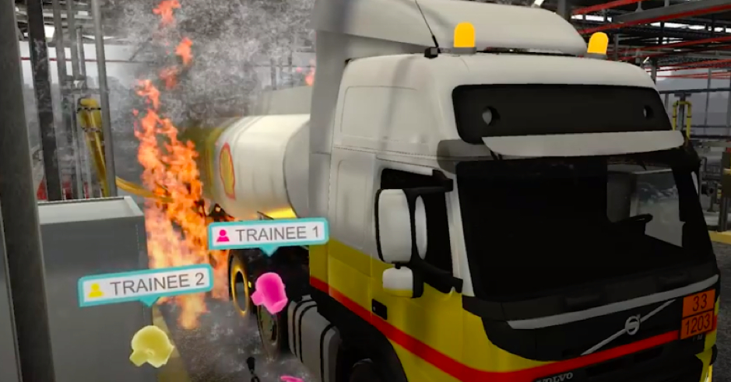
eXtended Reality Training
for Transportation Emergency And Management
  Image: https://hackernoon.com/vr-is-changing-the-energy-sector-here-is-how-ei1a325u
  https://www.gti.energy/training-events/emergency-response-virtual-reality-vr-training-module/

Slide 14
eXtended Reality Training
Being There: What Presence Means in a Digital World
  https://www.downes.ca/presentation/526
  Community of Inquiry (CoI)
  Other types of presence (interface, learning, autonomy, agency, affective, competitive, immanent)
  Creating presence
  Presence and AI
  The feeling of presence (what changes in the digital world are not the modalities of presence but how they’re produced)

Slide 15
Data Literacy
http://bit.ly/downes-data-literacy
  Data Literacy Models:
    Data stewardship
    Science and research
    Information literacy
    Analytics and decision-making
  Measurement Frameworks
    Self-assessment vs objective assessment
    Individual vs collective data literacy
    Mapping literacy to values and benefits
  Studies:
    https://dalspace.library.dal.ca/handle/10222/64578
    https://www150.statcan.gc.ca/n1/pub/11-633-x/11-633-x2019003-eng.htm

Slide 16
Data Literacy
http://bit.ly/downes-data-literacy
  Data Literacy Models:
    Data stewardship
    Science and research
    Information literacy
    Analytics and decision-making
  Measurement Frameworks
    Self-assessment vs objective assessment
    Individual vs collective data literacy
    Mapping literacy to values and benefits
  Studies:
    https://dalspace.library.dal.ca/handle/10222/64578
    https://www150.statcan.gc.ca/n1/pub/11-633-x/11-633-x2019003-eng.htm

Slide 17
Data Literacy
Challenges to Learning Providers
  Content Knowledge Vs. Literacies
    Not just reading and writing…
    http://www.downes.ca/presentation/369
  Employment skills Vs. Education
  Courses Vs. Performance Support
  Authority Vs. the Wisdom of Crowds
    Autonomy, Diversity, Openness, Interactivity
    Social Proof? https://en.wikipedia.org/wiki/Social_proof
  Credentials Vs. Learning Vs. Connections - http://er.educause.edu/articles/2015/3/credentialing-in-higher-education-current-challenges-and-innovative-trends

Slide 18
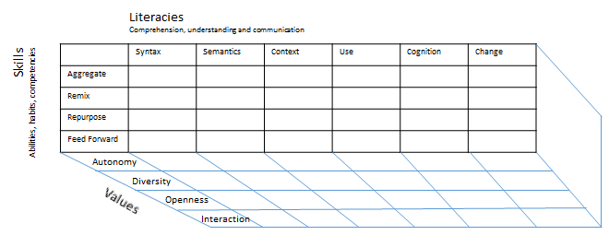
Data Literacy

Slide 19
Ethics, Analytics and the Duty of Care
Open Recognition Networks
  https://www.downes.ca/presentation/532
  Competencies and stackable credentials
  Badges and blockchain
  A proliferation of certificates
  How do we evaluate credentials
  Forms of recognition
  Peer recognition
  Knowing as recognition
  Recognition networks
  Challenges in human activity recognition

Slide 20
Ethics, Analytics and the Duty of Care
Committees and Councils
  AIPCoP - eLearning and AI Working Group
    GoC working group
    https://gccollab.ca/discussion/owner/84765
  Data Equity Working Group
    Digital Technologies internal working group

Slide 21
Ethics, Analytics and the Duty of Care
http://bit.ly/downes-ethics-analytics
  Applications of AI & Analytics
  Ethical Issues and Controversies
  Ethical Codes and Review Boards
  The Duty of Care
  The Decisions We Make in Analytics
  Ethical Practices and Harmony

Slide 22
Personal Learning Environments
E-Learning 3.0
  https://el30.mooc.ca
  Data – Graph – Cloud
  Identity – Resources – Recognition
  Experience – Community – Agency

Slide 23
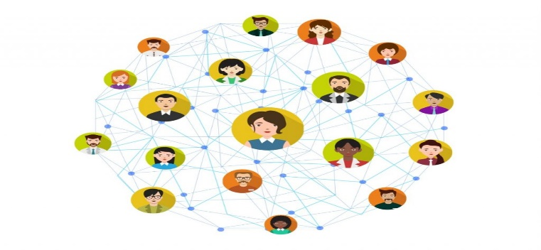
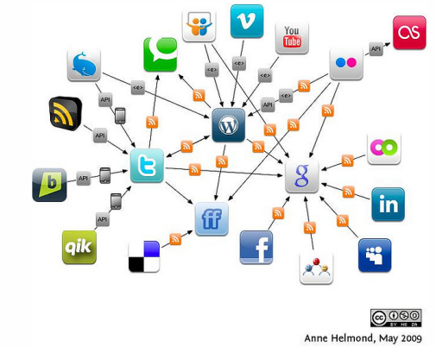
Personal Learning Environments

Slide 24
Personal Learning Environments
Distributed Social Networks
  Opera Unite - http://mashable.com/2009/06/15/opera-unite/
  Mozilla OS - https://www.npmjs.com/package/fxos-web-server
  Diaspora - https://www.joindiaspora.com/
  Solid - "social linked data“ - https://solid.mit.edu/
  Keybase - https://keybase.io/
  InterPlanetary File System (IPFS) - https://ipfs.io/
  Mastodon / Fediverse - https://mastodon.social/

Slide 25
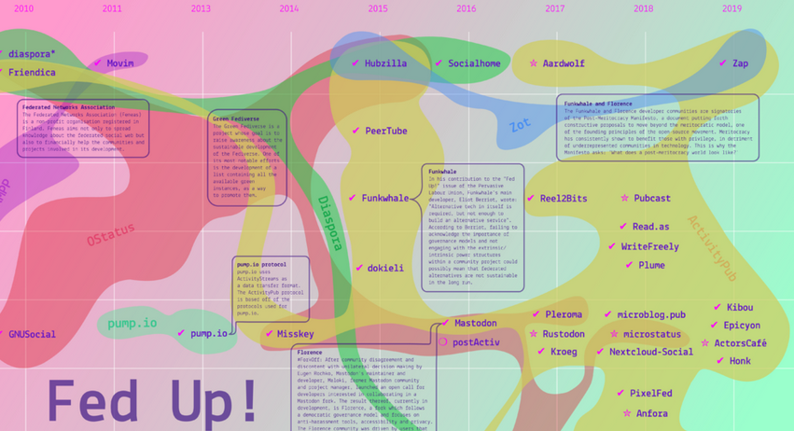
Personal Learning Environments
https://monoskop.org/Federated_networks

Slide 26
Personal Learning Environments
gRSShopper in a Box
  https://grasshopper.downes.ca

Slide 27
Personal Learning Environments
Cloud Infrastructures
  Environments: VMWare Fusion, VirtualBox
  Provisioners: Docker, Vagrant
  Configuration: Chef, Puppet
  Providers: AWS, MS Server
  Services: MS Cognitive, Wolfram Alpha, Segment
  Serverless CMS - http://www.downes.ca/post/66459

Slide 28
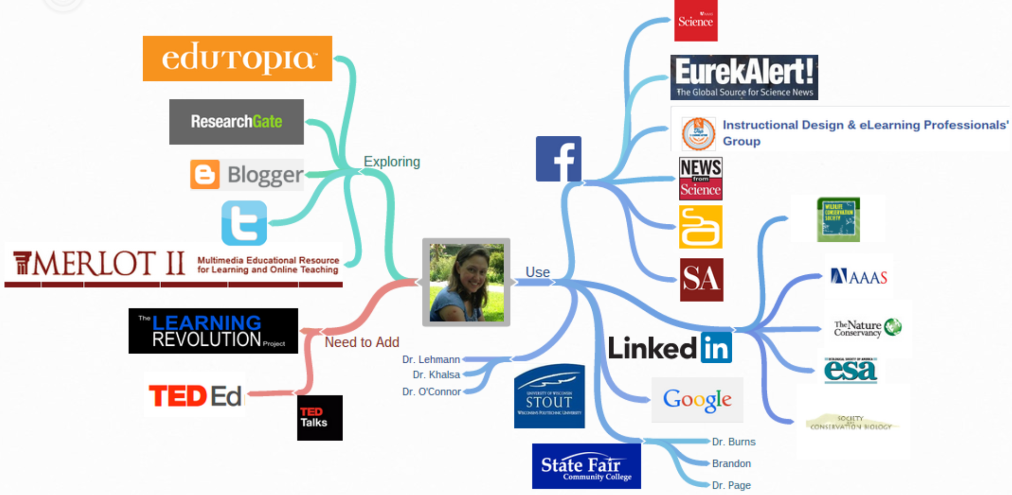
Personal Learning Environments
Heather Taft http://taftportfolio.blogspot.com/p/personal-learning-environment-ple.html

Slide 29
Personal Learning Environments
Resource Repository Network (Aggregation)
  http://ec.europa.eu/ipg/standards/markup/web-content-syndication/index_en.htm
Personal Cloud – Dropbox, NextCloud, etc.
  https://nextcloud.com/
Personal Learning Record – Learning Record Store (xAPI)
  https://www.adlnet.gov/tla/
Personal Learning Assistant
  like Siri? Alexa?
Distributed Intelligence – MLaaS
  https://www.slideshare.net/KarlSeiler/mlaas-machine-learning-as-a-service

Slide 30
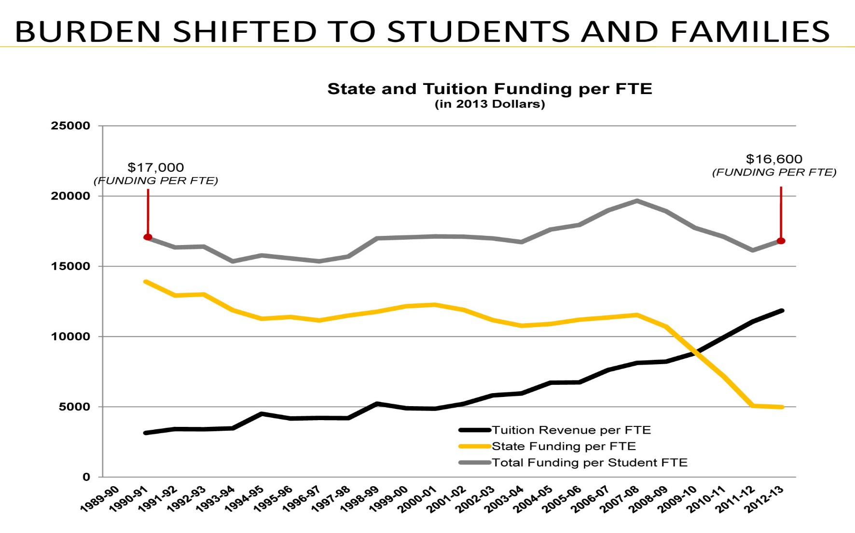
Challenges to Educational Institutions
http://old.seattletimes.com/html/opinion/2018504888_guest25blakecole.html

Slide 31
Challenges to Educational Institutions
Public Education Vs. Private Sector
Funding: Tuition, Grants, Reseach….?
Enterprise Vs. Distributed?
Federated Vs. Open? (Social signon Vs. Single Signon Vs. ??)
Transcripts Vs. Blockchain Vs. ??
  http://blockgeeks.com/guides/what-is-blockchain-technology/

Slide 32
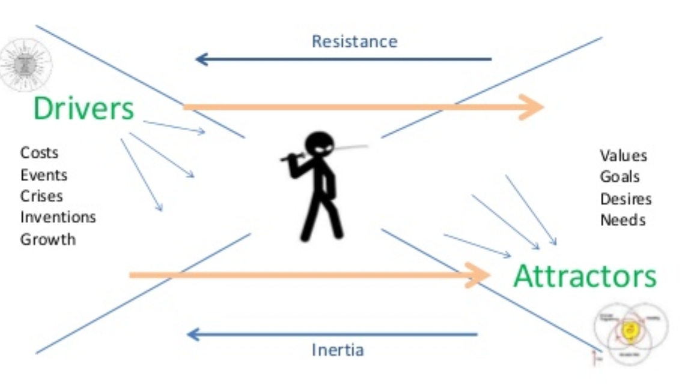
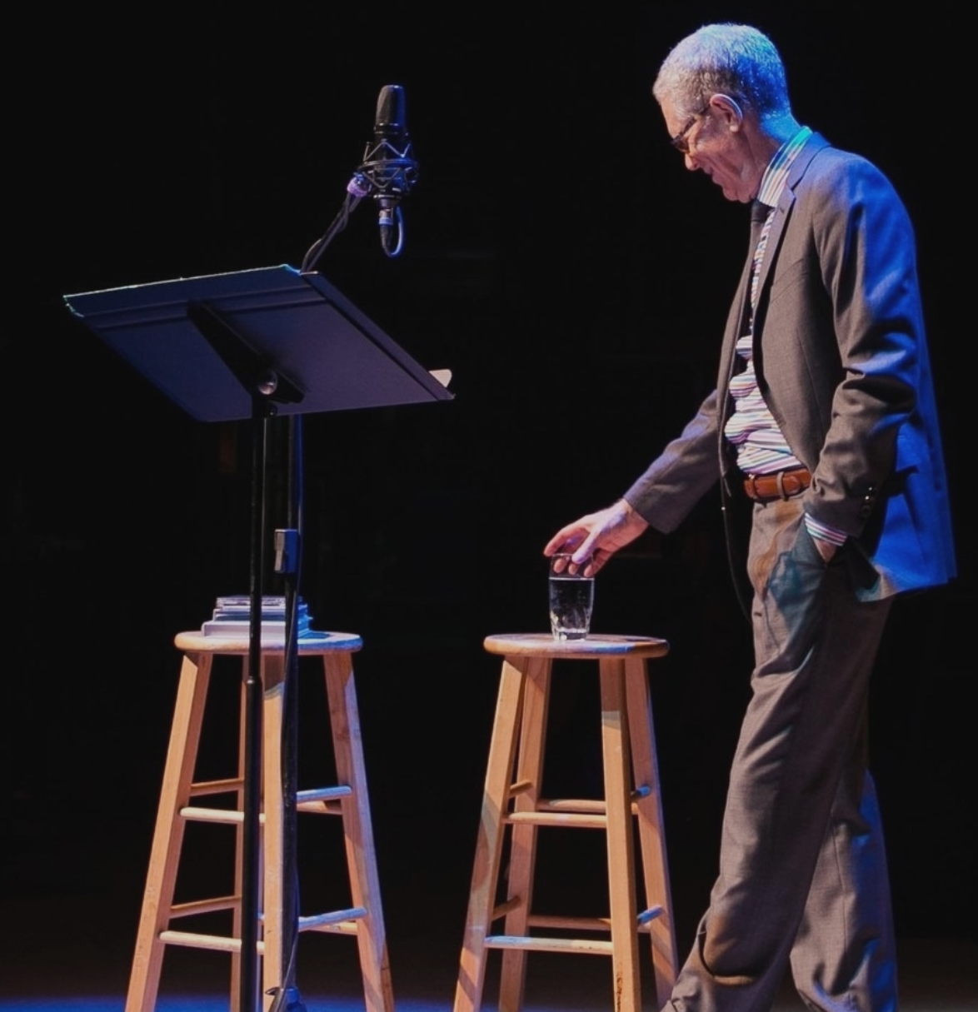
Doing the Right Thing
Who are your clients?
  The state? The governor?
  Technology companies?
  Your department? Your institution?
https://www.slideshare.net/Downes/disruptive-innovations-in-learning
What are you Building?
  Drivers Vs. Attractors
  Empowerment Vs. Dependence?
How does the story end?
https://www.vinylcafe.com/

