Slide 1

Being There
What Presence Means in a Digital World
Stephen Downes
CIET: EnPED 2020
August 28, 2020

Slide 2



There…
Person
Woman
Man
Camera
TV

Slide 3
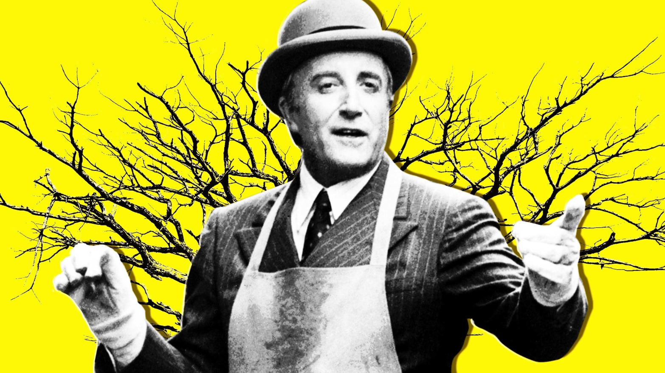
There…
Chance
There is no there there in Being There
https://www.thedailybeast.com/being-there-is-the-trump-eras-bible
What’s inside?

Slide 4
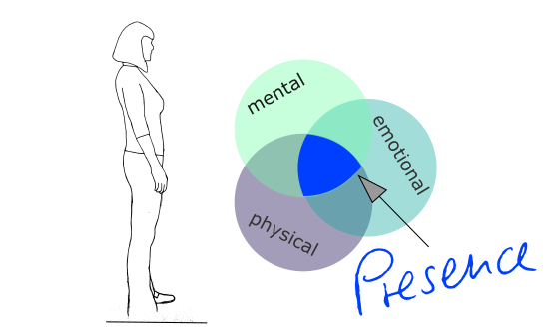
Presence…
1 : the fact or condition of being present (see present entry 3)
2 a : the part of space within one's immediate vicinity
b : the neighborhood of one of superior especially royal rank
3 archaic : company sense 2a
4 : one that is present: such as
a : the actual person or thing that is present
b : something present of a visible or concrete nature
5 a : the bearing, carriage, or air of a person especially
: stately or distinguished bearing
b : a noteworthy quality of poise and effectiveness
: the actor's commanding presence
6 : something (such as a spirit) felt or believed to be present
https://www.merriam-webster.com/dictionary/presence
Defined?
https://bodies-at-work.com/en/defining-presence/

Slide 5
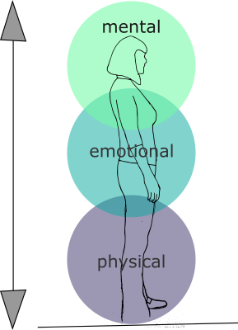
Presence…
Defined?
Presence is a state where I have my abilities and skills available in the moment so I can respond to life in an adequate way. I am present when my thinking, my emotional state and my physical being are aligned and when my perception of what’s going on inside my body and what’s going on around me are coherent.
https://bodies-at-work.com/en/defining-presence/

Slide 6
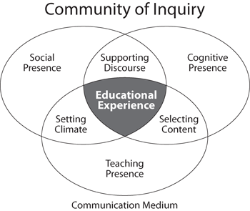
Presence…
The Community of Inquiry has emerged as the most widely referenced (the seminal 1999 article approaches 3,000 citations) and arguably the most widely used model for constructivist based e-learning design and research.
https://virtualcanuck.ca/2016/01/04/a-fourth-presence-for-the-community-of-inquiry-model/

Slide 7
Presence…
Community of Inquiry
Social presence is “the ability of participants to identify with the community (e.g., course of study), communicate purposefully in a trusting environment, and develop inter-personal relationships by way of projecting their individual personalities.” (Garrison, 2009)
Teaching Presence is the design, facilitation, and direction of cognitive and social processes for the purpose of realizing personally meaningful and educationally worthwhile learning outcomes (Anderson, Rourke, Garrison, & Archer, 2001).
Cognitive Presence is the extent to which learners are able to construct and confirm meaning through sustained reflection and discourse (Garrison, Anderson, & Archer, 2001).
Garrison, D. R., Anderson, T., & Archer, W. (2000).
Critical inquiry in a text-based environment: Computer conferencing in higher educationmodel. The Internet and Higher Education, 2(2-3), 87-105.

Slide 8
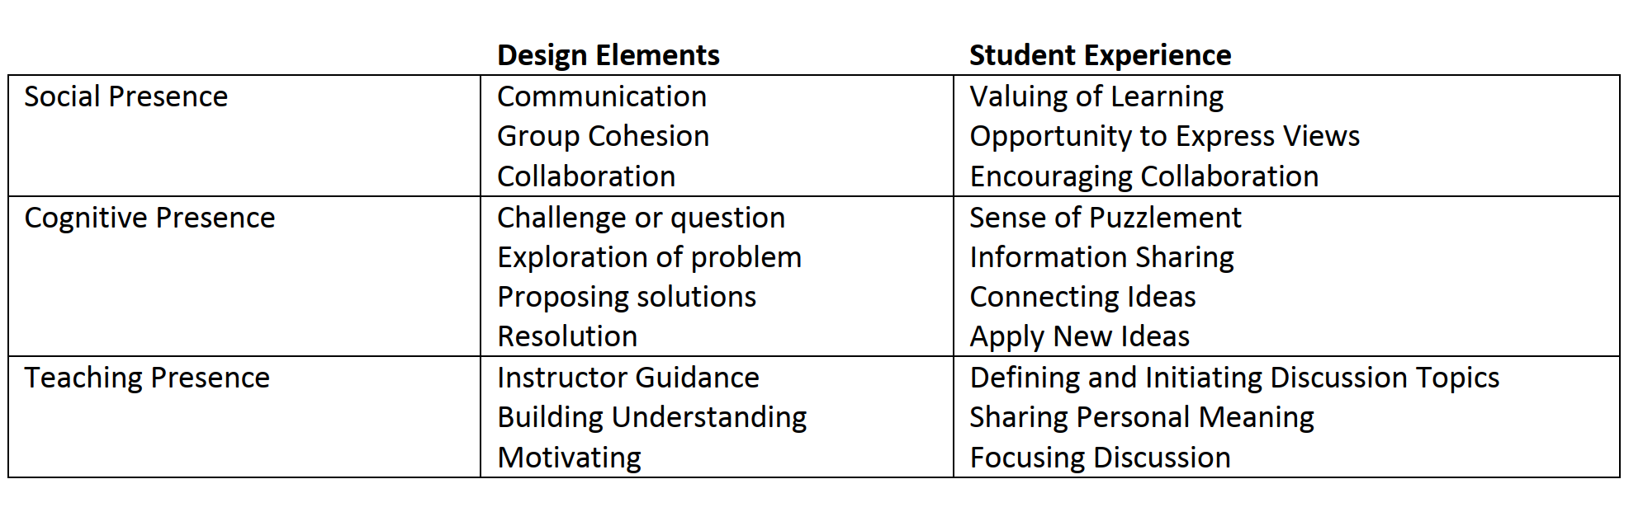
Presence…
Community of Inquiry
Critical inquiry in a text-based environment: Computer conferencing in higher educationmodel. The Internet and Higher Education, 2(2-3), 87-105.

Slide 9

Presence…
What is presence, then? The thing that makes you feel something
Creating presence acknowledges that there is a person at the other end of the line…
  A thinking person
  A feeling person
  A guiding person

Slide 10
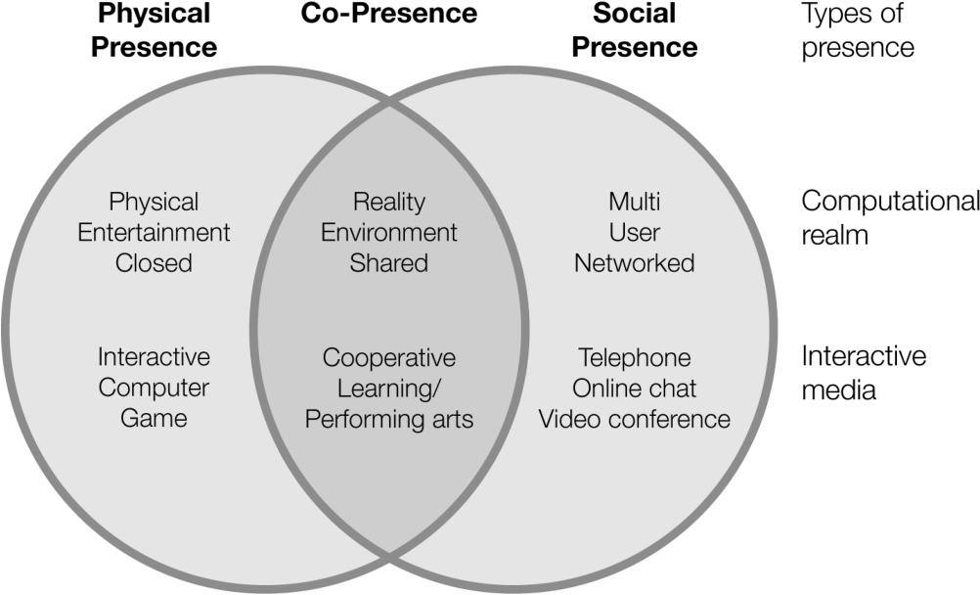
Other Types of Presence…
Contextual / Interface
“A number of researchers picked up on the need for the contextual or interface “presence” and in the case of distance education for the participants to master the mediating technology.”
https://virtualcanuck.ca/2016/01/04/a-fourth-presence-for-the-community-of-inquiry-model/
https://www.semanticscholar.org/paper/Chapter-5-.-Bridging-Contextual-Gaps-with-Blended/ddb707157b57dd6cc9b599851564fd2073f3ff89

Slide 11
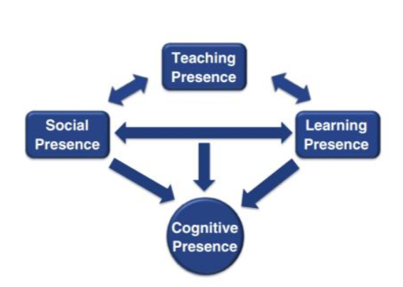
Other Types of Presence…
Learning / Autonomy
“Lam (2015) who validated the existence of the original three presences, and then coined a new term for the type of learner agency that resonates with Shea’s ‘learning presence.’”
“The word is used largely in the context of independence and freedom to make one’s own decisions. In educational context, this “autonomy” is valued to some degree, but as all students know, is severely curtailed by the edicts and wishes of the teacher.”
“We suggest that learning presence represents elements such as self efficacy as well as other cognitive, behavioral, and motivational constructs supportive of online learner self-regulation.” (Shea)
https://virtualcanuck.ca/2016/01/04/a-fourth-presence-for-the-community-of-inquiry-model/
https://psycnet.apa.org/record/2010-17226-001 (Shea)

Slide 12
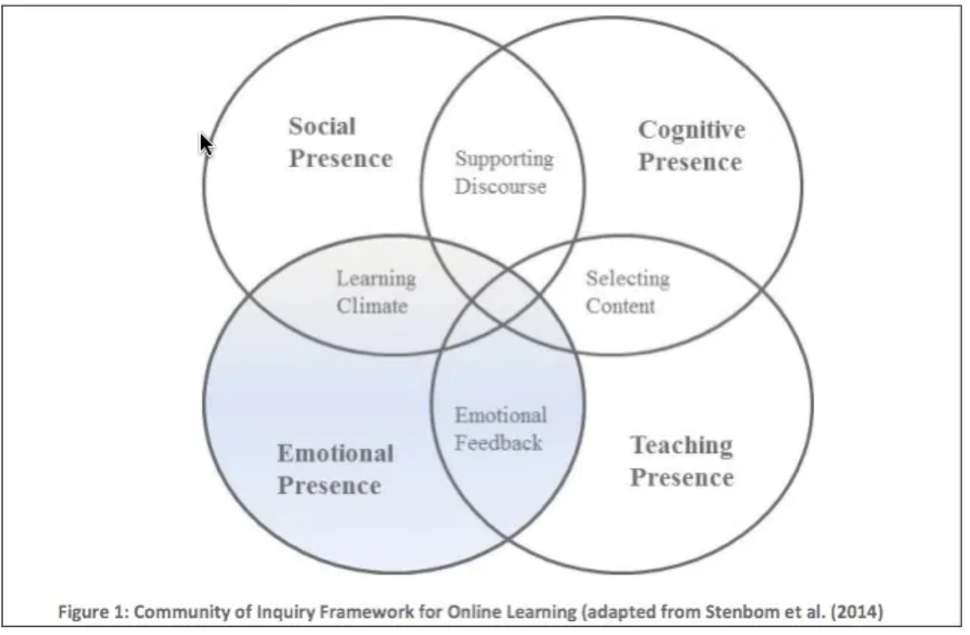
Other Types of Presence…
Emotional
“Marti Cleveland-Innes, Prisca Campbell (2012) and other of Marti’s colleagues next argued that “emotional presence” was notably absent from the original COI model.”
Emotional presence is the outward expression of emotion, affect, and feeling by individuals and among individuals in a community of inquiry, as they relate to and interact with the learning technology, course content, students, and the instructor.
https://virtualcanuck.ca/2016/01/04/a-fourth-presence-for-the-community-of-inquiry-model/
http://www.irrodl.org/index.php/irrodl/article/view/1234

Slide 13
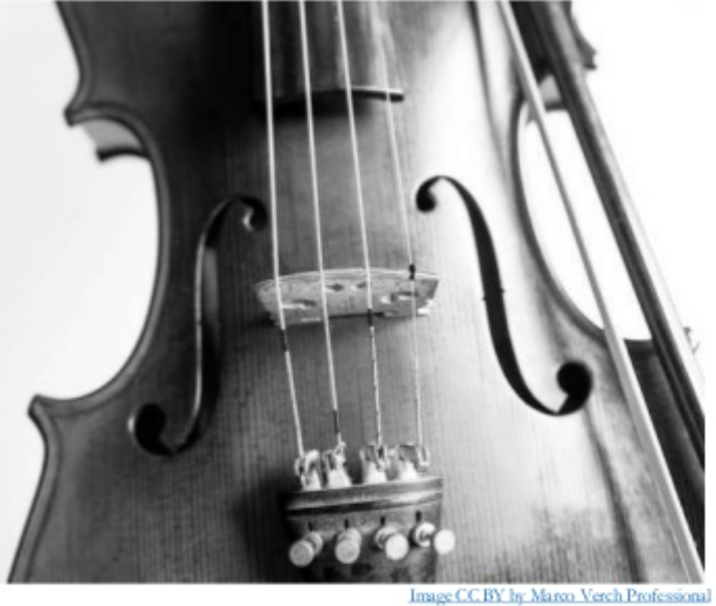
Other Types of Presence…
Agency
“Agency presence in line with both Bandura’s autonomous interaction – the capacity to recognize and use the power, insights and liability of emotional responses and his emergent agency in which emotions can be used to reach insights not accessible to those denying their existence or unable to deal with them effectively.”
“Perceived self-efficacy helps to account for such diverse phenomena as changes in coping behavior produced by different modes of influence, level of physiological stress reactions, self-regulation of refractory behavior, resignation and despondency to failure experiences, self-debilitating effects of proxy control and illusory inefficaciousness…”
https://virtualcanuck.ca/2016/01/04/a-fourth-presence-for-the-community-of-inquiry-model/
Bandura: https://content.apa.org/record/1982-25814-001
https://www.slideshare.net/LauraRitchie3/laura-ritchie-keynote-august-2019-brazil

Slide 14

Other Types of Presence…
Affective
How you make others feel.
“Affective Presence refers to the consistent and stable feelings that an individual tends to leave in their interaction partners.”
First described nearly 10 years ago in a study by Noah Eisenkraft and Hillary Anger Elfenbein.
“It's not very easy to detect, because you don't actually get to see what the world is like when you are not around.”
https://www.frontiersin.org/articles/10.3389/fpsyg.2020.00705/full
https://www.theatlantic.com/family/archive/2019/01/affective-presence-how-you-make-other-people-feel/579643/
https://www.scientificamerican.com/article/the-me-effect/

Slide 15
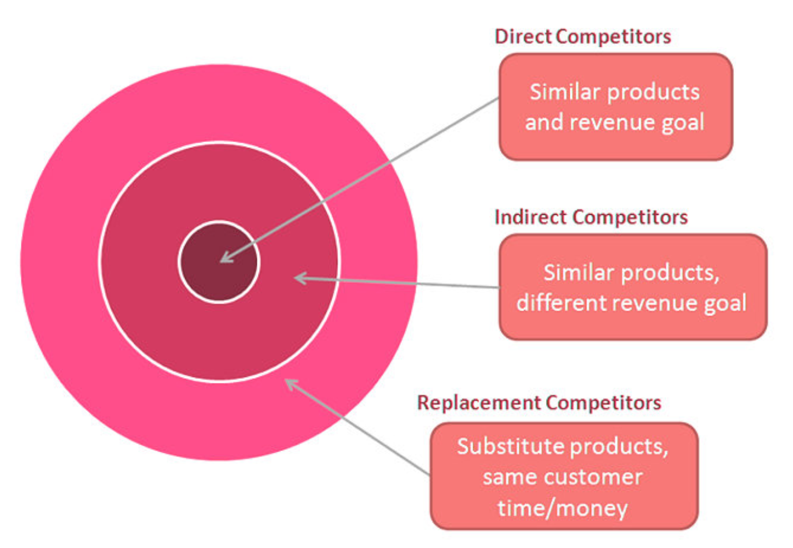

Other Types of Presence…
Competitive
For example: “the need to have curricula guidelines for teaching, molding and training students to become progressive, competitive, productive, cross-cultural and cross-functional members of a global workforce incorporated into the mainstream of the educational process.” https://www.tandfonline.com/doi/abs/10.1080/19186444.2012.11658348
https://devrix.com/tutorial/perform-competitive-analysis-establish-presence/

Slide 16

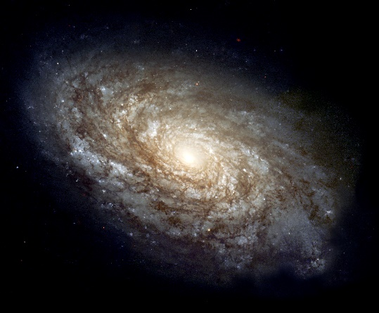
Other Types of Presence…
Holy / Immanence
Rudolf Otto – The Idea of the Holy
“mysterium, tremendum & fascinans”
https://streetartnews.net/2013/11/faith47-mysterium-tremendum-et.html

Slide 17
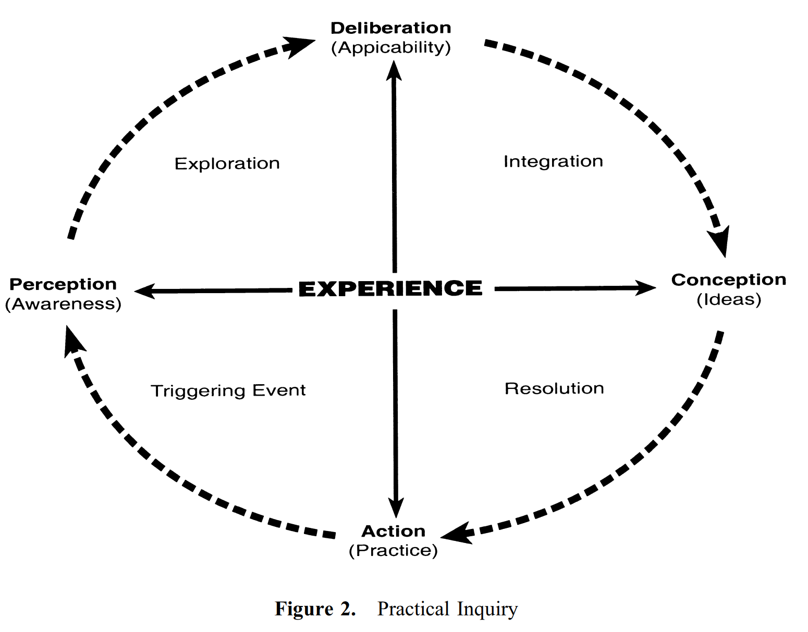
Creating Presence…
Interaction
http://cde.athabascau.ca/coi_site/documents/Garrison_Anderson_Archer_Critical_Inquiry_model.pdf

Slide 18
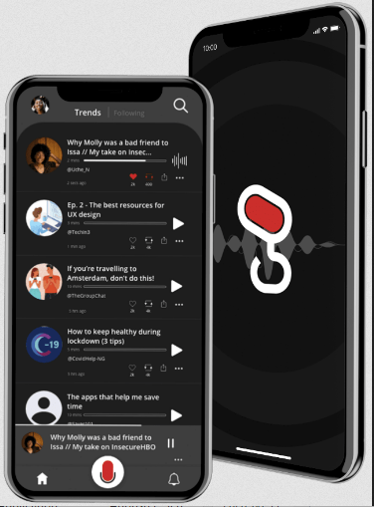
Creating Presence…
Interaction
“I promoted in my Interaction Equivalency Theory. I proposed there that given high levels of one of the three levels of interaction, the other two could be reduced without loss of academic achievement.”
https://virtualcanuck.ca/2016/03/03/the-enigma-of-interaction/
Gist https://gist.digital/

Slide 19
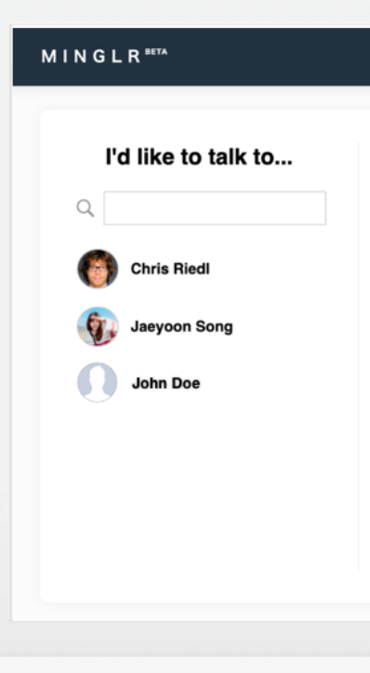
Creating Presence…
Interaction
Minglr is "an experimental software system developed to explore ways of supporting ad hoc, private videoconferences." The authors "We expect it to be useful for virtual conferences and many other kinds of online events, both business and social." The idea is that people log in during a conference, see a list of people who want to talk, or add themselves to the list. They can also select someone from the list and request a talk, and if accepted, they're placed in a private room. It's open source (MIT license) and available on GitHub. It's built on top of Jitsi (an open source video-conferencing environment) and written in Javascript. "We see potential uses in virtual classes, parties, and other kinds of social engagements."

Slide 20
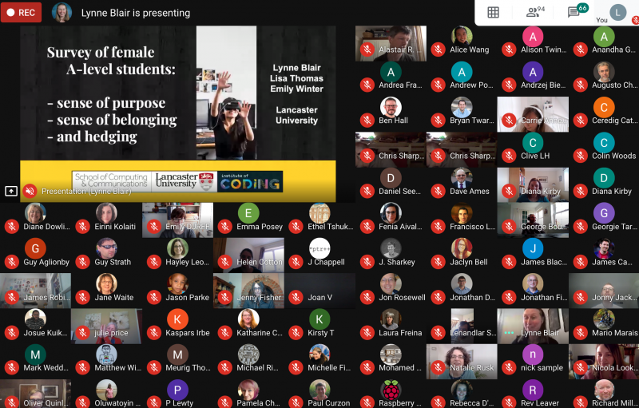
Creating Presence…
Conferencing
There are tips in this post that you've probably seen before, but I'm including it here for one piece of advice that is new: "Run a staffed green room for presenters – it worked so well getting everyone prepared and ready to transition smoothly between presentations."
http://www.oliverquinlan.com/blog/2020/08/07/taking-conferences-online-during-the-pandemic/

Slide 21
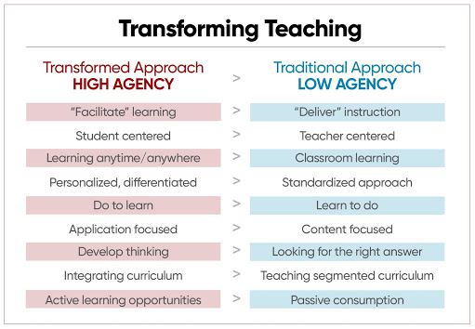
Creating Presence…
Agency
http://esheninger.blogspot.com/2020/08/keeping-kids-engaged-in-remote-learning.html

Slide 22
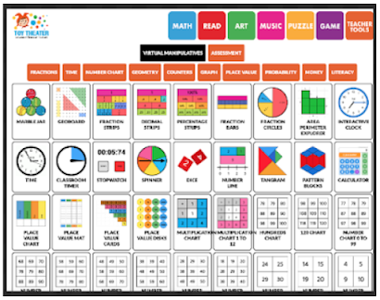
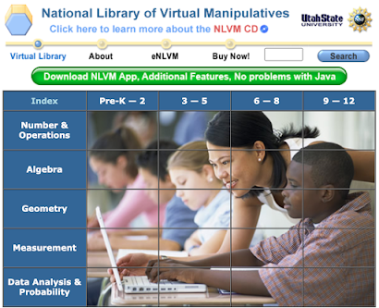
Creating Presence…
Manipulatives
https://www.educatorstechnology.com/2020/08/two-good-websites-that-offer-virtual.html

Slide 23
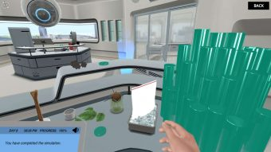
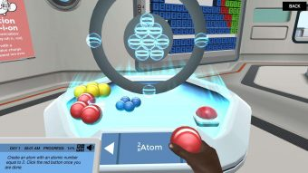
Creating Presence…
Virtual Labs
“The Virtual Lab is an online simulation of a chemistry lab. It is designed to help students link chemical computations with authentic laboratory chemistry. The lab allows students to select from hundreds of standard reagents (aqueous) and manipulate them in a manner resembling a real lab.”
https://www.labster.com/
http://chemcollective.org/vlabs

Slide 24
Creating Presence…
Learning Experience Platform
A lot of my early thinking about online learning was based on my experience with online role-playing games (RPG) such as MUDs - Multi-User Dungeons - which were open-ended online multi-user gaming environment. They contrasted well with the linear content-heavy media of email list servers and Usenet discussion boards.
"LXPs with its philosophy, its use of data science, its personalization, with it being social in nature, providing for continuous learning needs and updating personal skill sets is as close to an RPG and a new way in which we learn in our modern world."
https://www.upsidelearning.com/blog/2020/08/13/lxps-are-possibly-the-dungeons-dragons-of-the-learning-world/

Slide 25
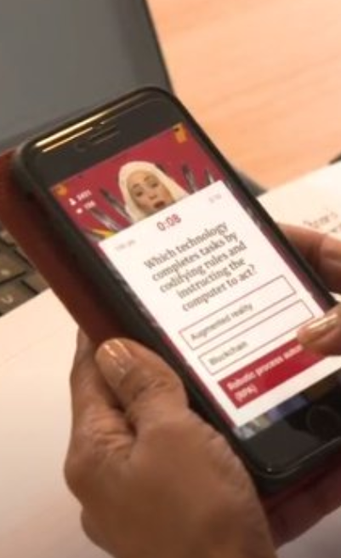
Creating Presence…
Gamification
No matter what the educational outcome, the use of gamification fosters better feelings about working there. "83% of those who received gamified training felt motivated. However, 61% of those who received non-gamified training said they felt bored and unproductive." It's worth highlighting the most significant element of this story: the use of chat with gamification. "PwC's Take Flight game juxtaposed the intimacy of a classic board game with people sitting around a table."
https://www.hrdive.com/news/how-pwc-uses-gamification-to-support-learning-engagement/582440/

Slide 26
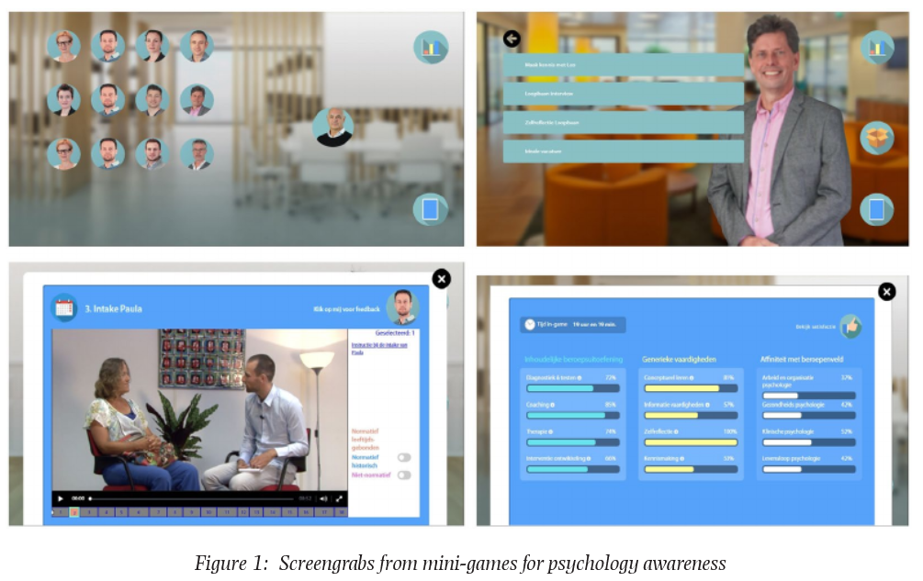
Creating Presence…
Gamification
One of the reasons games support learning, according to this article, is that they support learner autonomy. "A way to provide students with motivational learning experiences is to offer them ill-defined, authentic tasks from realistic problem contexts, and give them autonomy in finding solutions through meaningful gameplay... Research highlights the importance of personalising learning experiences in order to keep learners motivated and in their ‘flow channel’." See also the full article (17 page PDF) on which this short summary is based.
https://www.bera.ac.uk/blog/the-thin-line-between-gaming-and-learning

Slide 27
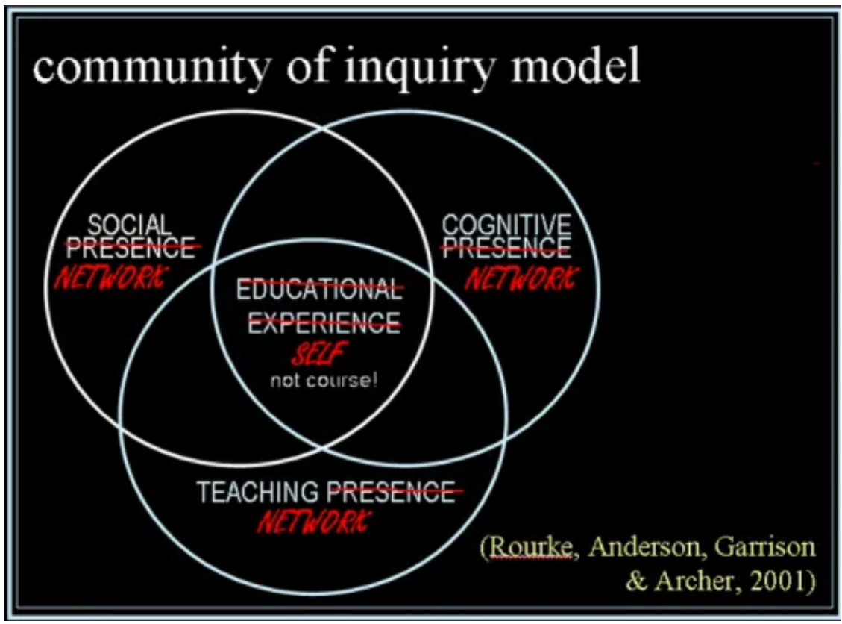
Network…
Presence as Network
When we look through the internet, we are creating networks… perception - as an extension of ourselves... McLuhan - our networks are extensions of ourselves - facets of our identity… when we look at the computer we see ourselves through our contacts, our liaisons, our interactions…
https://www.downes.ca/presentation/68
Stephen provides the first major edits to the model in 5 years
https://virtualcanuck.ca/2006/06/16/ples-getting-fleshed-out-conceptually-and-coi-model/

Slide 28
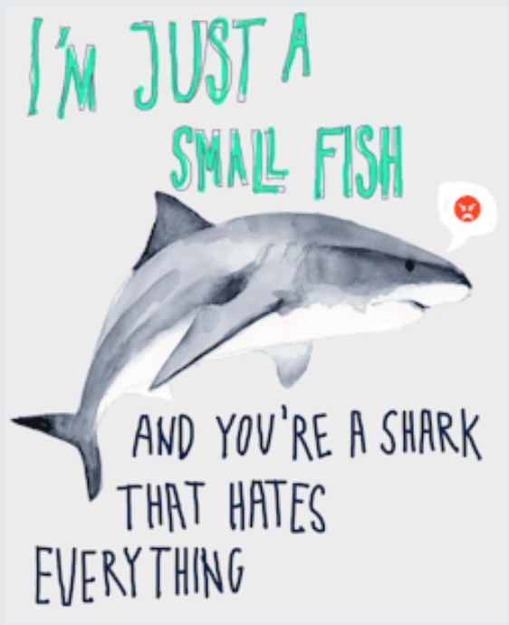
Network…
Understanding presence as a network effect leads to some very practical ways to understand it… for example:
"How should our education policy progress if it turns out that (as we suspect) the history environmental conditions are inseparable from individual development. Poverty, austerity, unemployment, stress, etc will all contribute to developmental problems - an uneven playing field which serves nobody well."
https://birteluehmann.tumblr.com/
autopoesis
http://dailyimprovisation.blogspot.com/2020/08/luhmann-and-biology.html

Slide 29
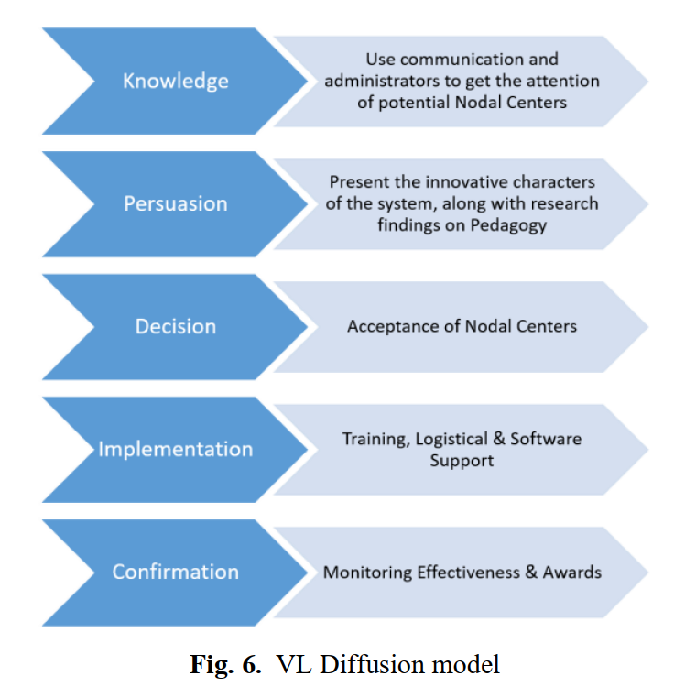
Promoting Presence…
Roger’s Innovation Diffusion Theory
“In our categorization, with faster rate of diffusion, the adopters may show 1) having advantage relative to other innovations 2) compatibility with existing practices and values 3) not being very complex 4) tried on a limited basis before adoption, and 5) offered tangible results.”
Virtual Labs in India
https://en.wikipedia.org/wiki/Diffusion_of_innovations
https://online-journals.org/index.php/i-joe/article/view/11685

Slide 30
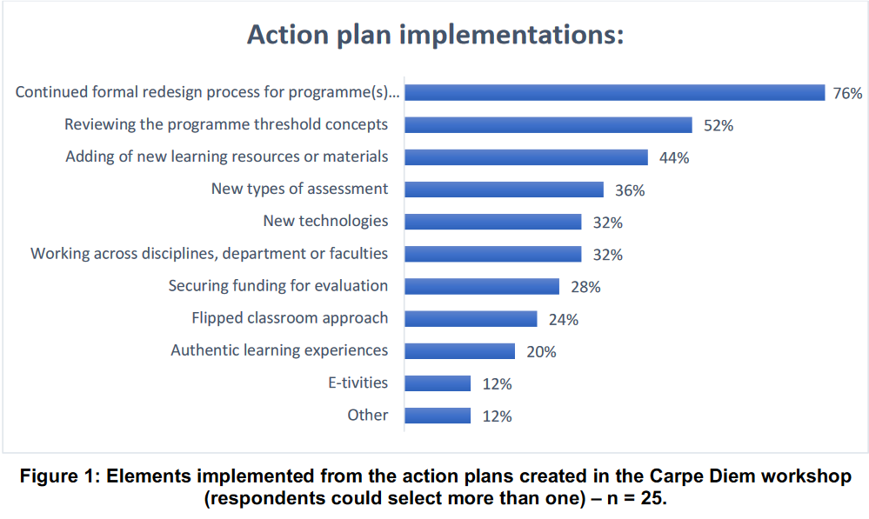
Promoting Presence…
Carpe Diem
This article (15 page PDF) describes the Carpe Diem design methodology and recounts its application at a South African university. The "process draws on agile collaborative project development, creative and visual techniques" such that "every moment during the workshop is spent on designing something that can be put into immediate use with learners."
https://jl4d.org/index.php/ejl4d/article/view/392/473

Slide 31
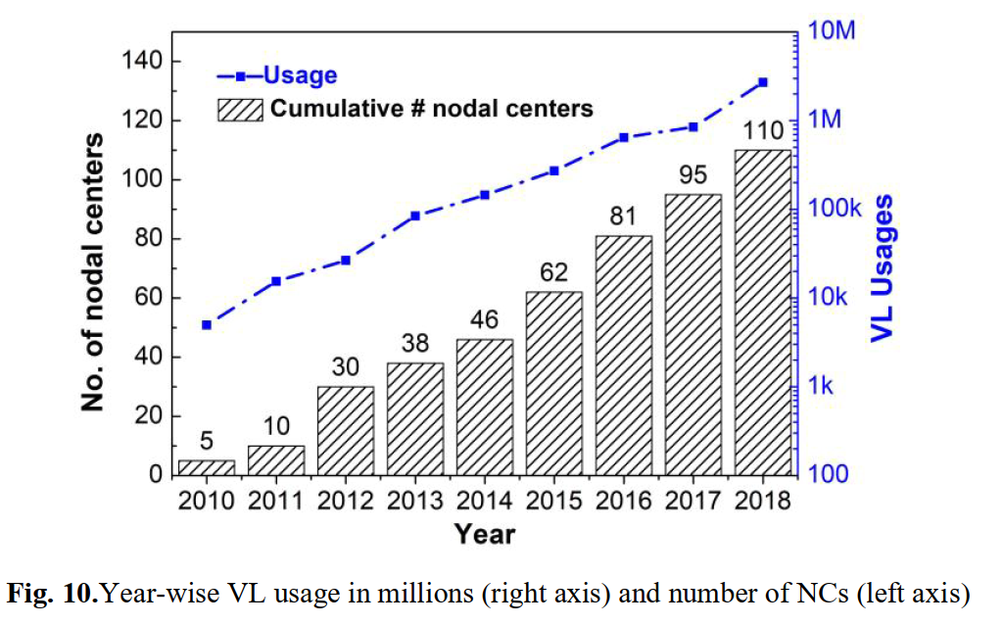
Promoting Presence…
Critical Mass
“Critical Mass of Adoption can be defined as a stage wherein at a given point, enough adopters have “adopted innovation such that the innovations further rate of adoption becomes self-sustaining” [7]. Until the critical ‘mass’ was achieved the rate of VL adoption remained slow [62], however adoption accelerated after the critical mass was achieved. .”
https://online-journals.org/index.php/i-joe/article/view/11685

Slide 32
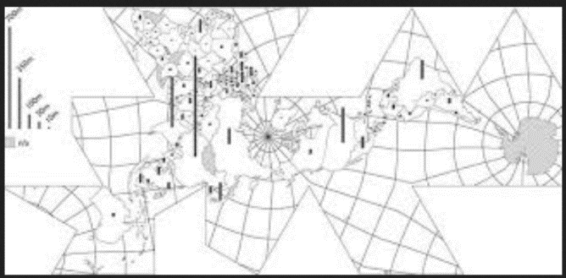
Promoting Presence…
Quiet Acts of Education
Forms of activism that focus on quiet acts of caring rather than amplification of a message or platform. Rianka Singh takes as a starting point the work of Saidiya Hartman, who describes a movement "driven not by uplift or the struggle for recognition or citizenship, but by the vision of a world that would guarantee to every human being free access to earth and full enjoyment of the necessities of life, according to individual desires, tastes, and inclinations.
https://firstmonday.org/ojs/index.php/fm/article/view/10631/9418

Slide 33

Promoting Presence…
While writing that "hierarchical organizations cause employees, including depression, anxiety and heart attacks, as well as being subjected to the inequality of privilege and income disparity" Nancy Dixon notes that these maladies inflict organizations as a whole, leading to what she depicts as a set of responsibilities for people trying to improve that organization. The responsibilities are such things as "function as a co-participant in the creation, maintenance, and transformation of organizational realities" and "willingly share what each knows with colleagues and create forums and systems by which that can be accomplished." In my first draft I wrote 'society' instead of 'organization', and while it's not what Dixon meant, these rules seem to be good starting points to define social responsibility. Image: Jason Westland.
Responsibilities of Members of Society

Slide 34
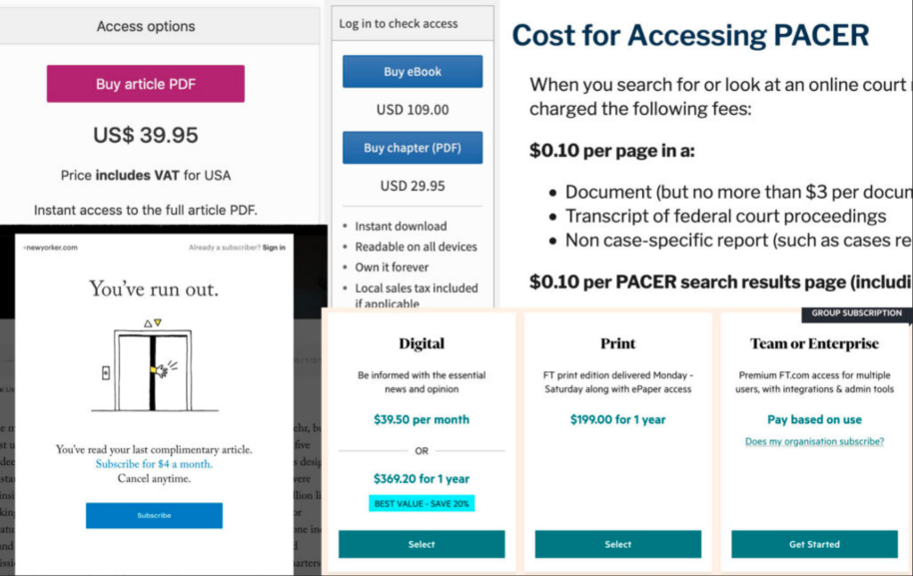
Promoting Presence…
Responsibilities of Members of Society
Trevor Noah, Born a Crime
"crime succeeds because crime does the one thing the government doesn’t do: crime cares. Crime is grassroots. Crime looks for the young kids who need support and a lifting hand."
It's the same with fake news and propaganda. And I have to wonder, if as a society we really wanted children to learn and be educated and know the truth, why do we make it so difficult and costly to obtain? As I've said numerous times: "Democracy dies behind a paywall.“
The Truth Is Paywalled But The Lies Are Free
https://www.currentaffairs.org/2020/08/the-truth-is-paywalled-but-the-lies-are-free/

Slide 35
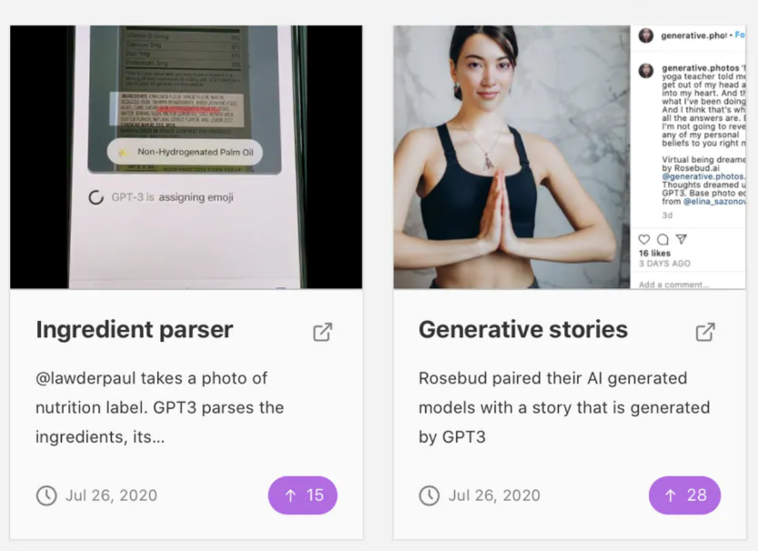
Presence and AI…
What they can do (or perform)
the highlights of the article are the responses from GPT-3 itself. "As I read the paper," it says, "a strange feeling came over me. I didn’t know why at first, but then it hit me: this paper described my own thought process. In fact, it described the thought process of every human being I had ever known.“ http://dailynous.com/2020/07/30/philosophers-gpt-3/
GPT Crush https://www.producthunt.com/posts/gpt3-crush

Slide 36
Presence and AI…
what they can detect (or intuit)
Testing: "more importantly, a spring of protest reminded us to consider college-entrance requirements in their essential context: structural inequality.... If an admissions policy disproportionately harms low-income and underrepresented minority students, is it right, in this broken world, to cling to that policy?" https://www.chronicle.com/article/crisis-is-changing-the-debate-over-standardized-exams-but-our-relationship-with-them-is-as-conflicted-as-ever
An AI hiring firm says it can predict job hopping based on your interviews https://www.technologyreview.com/2020/07/24/1005602/ai-hiring-promises-bias-free-job-hopping-prediction/
Machines can spot mental health issues—if you hand over your personal data
https://www.technologyreview.com/2020/08/13/1006573/digital-psychiatry-phenotyping-schizophrenia-bipolar-privacy/

Slide 37
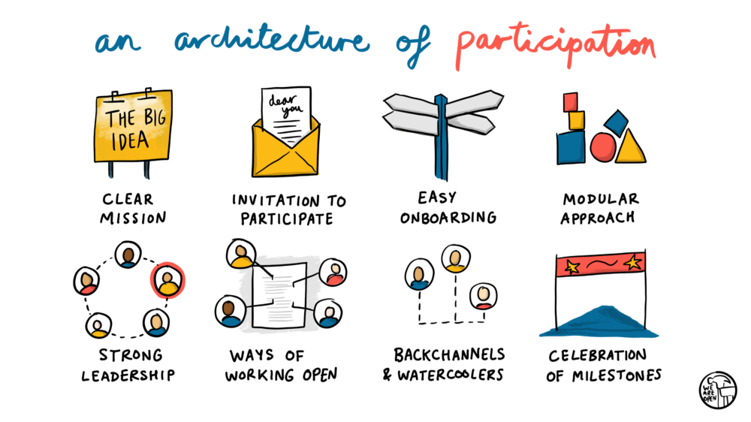
Being There…
An Architecture of Participation
Doug Belshaw may be limiting his discussion to open source projects, but I see this as a blueprint for how to create learning environments that maximize learner autonomy and engagement. The architecture he describes has eight components, but what brings them together (in my mind) is that each represents an element of an open-ended negotiation between the participants. The rest of this post details some of the practical aspects of cooperative organization - knowing who is participating, clearly identifying a project home, pathways to participation, signposting and orientation, recognition, and more.
https://blog.weareopen.coop/howto-create-an-architecture-of-participation-for-your-open-source-project-a38386c69fa5

Slide 38
Being There…
What changes in the digital environment is not the modalities of feeling, but rather, how they’re produced
  Some argument that different media produce different feelings
Unlike earlier communications theorists (Daft
& Lengel, 1986; Short, Williams, & Christie, 1976; Sproull & Kiesler, 1986), we do not
believe that the effect of media per se is the most salient factor in determining the degree of
social presence that participants develop and share through the mediated discourse. Rather, the communication context created through familiarity, skills, motivation, organizational
commitment, activities, and length of time in using the media directly influence the social
presence that develops. (Anderson, Archer, Garrison, op.cit.)

Slide 39
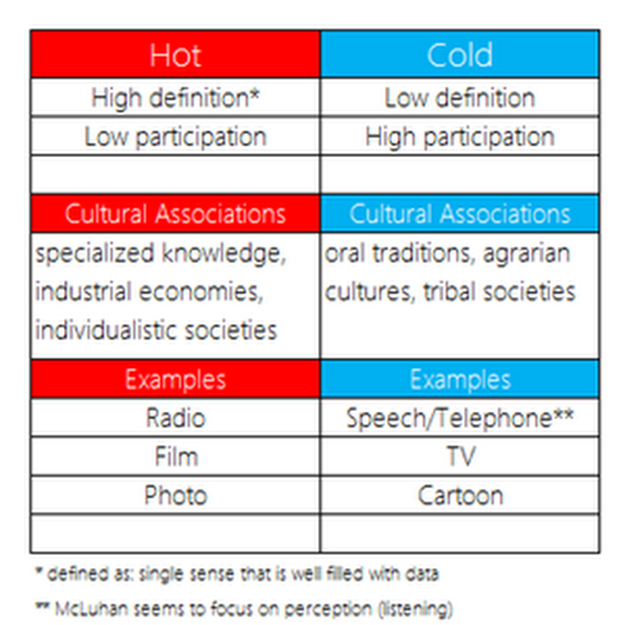
Being There…
McLuhan – hot media, cool media
https://medium.com/mediascene/hot-and-cool-in-the-mediascene-a-mcluhan-style-art-and-theory-project-658ce02a6af8

Slide 40
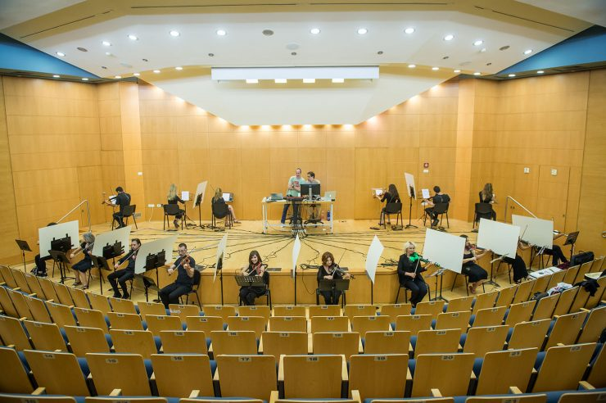
Being There…
Networking is Feeling
There’s no network without presence
https://www.futurity.org/violin-synchronization-human-networks-2422592-2

Slide 41
Stephen Downes
https://www.downes.ca

