Slide 1
Personal Learning:
Taking Ownership of
Learning Online
Stephen Downes
August 27, 2020
https://www.downes.ca/presentation/525

Slide 2
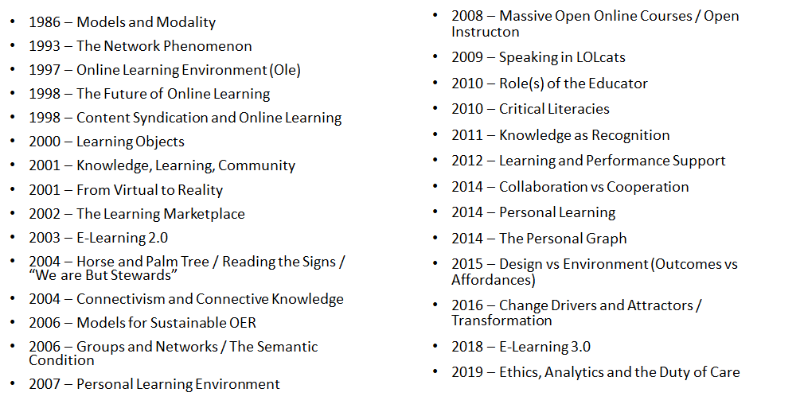
Three Decades of Enquiry

Slide 3
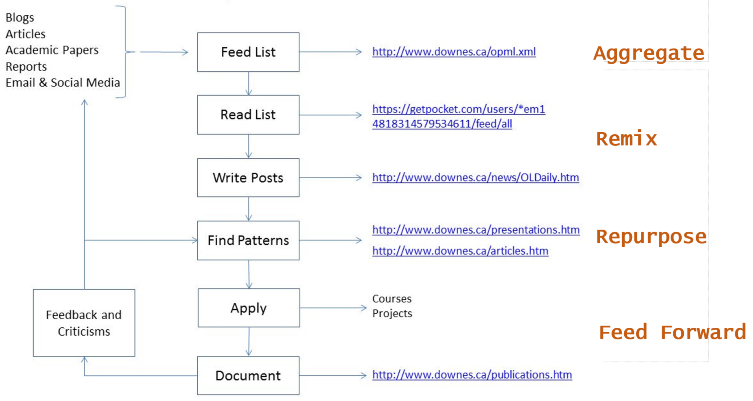
My Research Workflow

Slide 4
Takeaways for this Webinar
In this webinar, you learn:
The difference between ‘personalized learning’ and ‘personal learning’.
Why personal learning is the preferred concept for student success.
Key starting points for personal learning, objectives, learning processes and forms of evaluation that best suit personal learning.
Strategies to implement personal learning in the form of support for remote teaching, online learning, and lifelong learning.

Slide 5
Topics for Discussion - Practical
What are relevance, usability, interactivity?
Starting points
Supporting them when they’re not supported (a.k.a. Geurilla Tactics)
These slides will be available at: https://www.downes.ca/presentation/525
Silhouette Images via Gordon Johnson https://pixabay.com/users/gdj-1086657/

Slide 6
Topics for Discussion - Theory
What is personal learning?
Personal learning starting points
Supporting personal learning online
These slides will be available at: https://www.downes.ca/presentation/5245
Silhouette Images via Gordon Johnson https://pixabay.com/users/gdj-1086657/

Slide 7
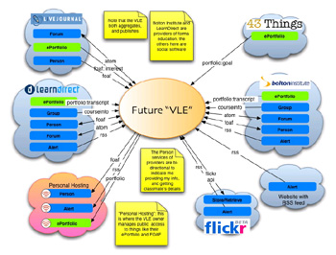
Three Principles:
Interaction – participation in a learning community (or a community of practice)

Slide 8
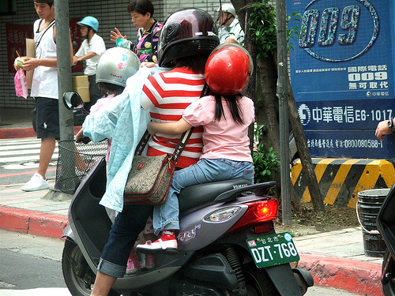
Three Principles:
Usability – simplicity and consistency

Slide 9

Three Principles:
Relevance – or salience, that is, learning that is relevant to you, now

Slide 10
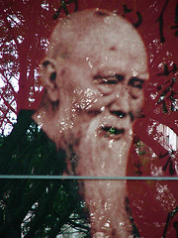
Interaction:
Why do we want it?
  Human contact … talk to me…
  Human content … teach me…
“… the capacity to communicate with other people interested in the same topic or using the same online resource.”

Slide 11

Interaction: How to Get It
You cannot depend on traditional learning for interactivity…
  Most learning based on the broadcast model
  Most interactivity separated from learning

Slide 12
Interaction: How to Get It
Built your own interaction network
  Place yourself, not the content, at the centre
YOU

Slide 13
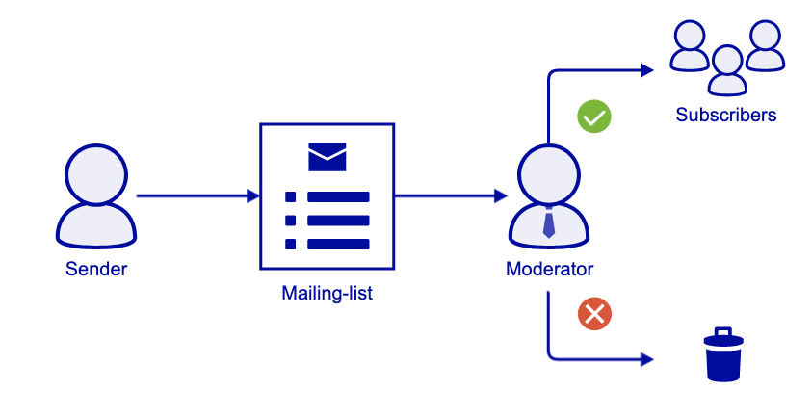
Interaction: Your Personal Network
Email and mailing lists
  Google Groups
  Institutional Lists
https://it.ubc.ca/services/email-voice-internet/mailing-lists

Slide 14
Interaction: Your Personal Network
Blogging – reading your subscriptions, leaving comments, longer responses in your own blog
  Wordpress
  Edublogs
  Blogger

Slide 15
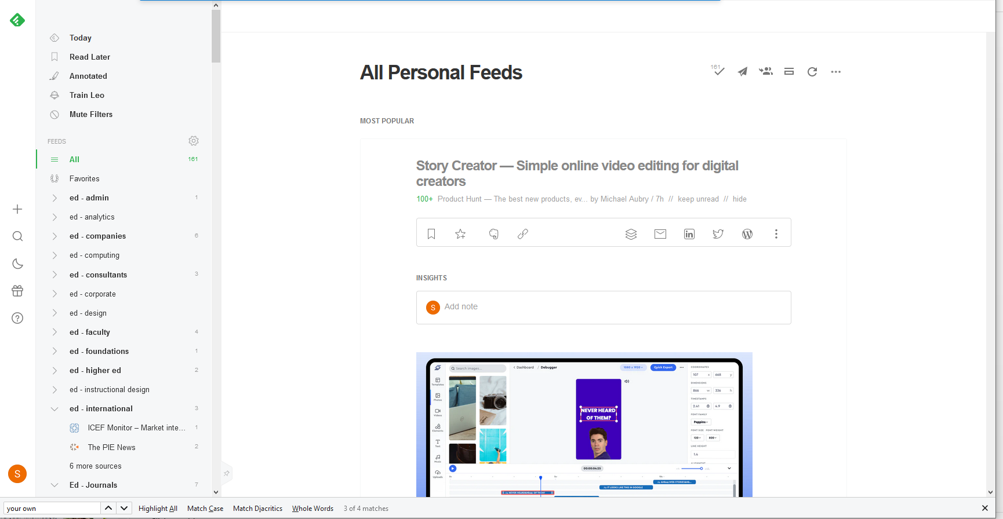
Interaction: Your Personal Network
Personal communication – instant messaging, Skype
Social Networks – Twitter, Mastodon
RSS – Feedly
https://feedly.com

Slide 16

Interaction: Principles
Pull is better than push…
Speak in your own (genuine) voice (and listen for authenticity)
Share your knowledge, your experiences, your opinions
Make it a habit and a priority

Slide 17

Interaction: Guerilla Tactics
If interaction isn’t provided, create it…
  Eg., if you are at a lecture like this, blog it

Slide 18

Interaction: Guerilla Tactics
If your software doesn’t support interaction, add it
  Eg., embed Javascript comment, RSS in LMS pages

Slide 19

Interaction: Guerilla Tactics
Use back-channels
  Private lists, Gmail accounts,
  Flickr, IM, more…

Slide 20
Usability:
Elements of Usability
  Consistency … I know what to expect…
  Simplicity … I can understand how it works…
“… probably the greatest usability experts are found in the design labs of Google and Yahoo!”

Slide 21
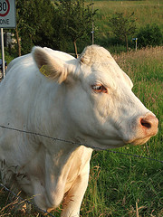
Consistency? As a Learner?
Yes! Take charge of your learning…

Slide 22

Consistency? As a Learner?
Clarify first principles…
  for example, how do you understand learning theory? Eg. Five Instructional Design Principles Worth Revisiting

Slide 23
Consistency? As a Learner?
Organize your knowledge
  For example, build your own CMS (using, say, Drupal)

Slide 24
Simplify the Message
Summarize, summarize, summarize
  (and then put it into your own knowledge base)

Slide 25
Simplify the Message
Use your own vocabulary, examples
  You own your language – don’t let academics and (especially) vendors tell you what jargon to use

Slide 26

Simplify the Message
Don’t compartmentalize (needlessly)

Slide 27
Usability: Principles
Usability is Social:
  Can you search your own learning?
  Do you represent similar things in similar ways?
Usability is Personal:
  Listen to yourself
  Be reflective – eg., is your desktop working for you?

Slide 28
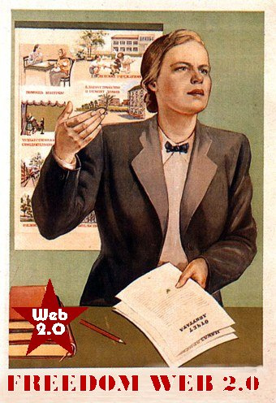
Usability: Guerilla Tactics
Important: your institutional CMS is almost certainly dysfunctional – create your own distributed knowledge management system…

Slide 29

Usability: Guerilla Tactics
  Create a blog on Blogger, just to take notes

Slide 30

Usability: Guerilla Tactics
  Store photos on Flickr

Slide 31

Usability: Guerilla Tactics
  Create a GMail account and forward important emails to yourself (and take advantage of Google’s search)

Slide 32
Usability: Guerilla Tactics
  (Maybe) use Google desktop search

Slide 33
Relevance:
Generating Relevance
  Content … getting what you want
  Location, location, location…
“… learners should get what they want, when they want it, and where they want it “

Slide 34
Getting What You Want
Step One: maximize your sources – today’s best bet is RSS – go to www.google.com/reader, set up an account, and search for topics of interest

Slide 35
Getting What You Want
Step Two: filter ruthlessly – if you don’t need it now, delete it (it will be online somewhere should you need it later)

Slide 36

Getting What You Want
Important: Don’t let someone else dictate your information priorities – only you know what speaks to you

Slide 37

Getting It Where (and When) You Want
Shun formal classes and sessions in favour of informal activities

Slide 38
Getting It Where (and When) You Want
Do connect to your work at home (and even on vacation) – but – feel free to sleep at the office
  Most work environments are dysfunctional
  Your best time might not be 9 to 5 …
  Ideas (and learning) happen when they happen

Slide 39
Principles of Relevance
Information is a flow, not a collection of objects
  Don’t worry about remembering, worry about repeated exposure to good information
Relevance is defined by function, not topic or category
Information is relevant only if it is available where it is needed

Slide 40

Relevance: Guerilla Tactics
Develop unofficial channels of information (and disregard most of the official ones)

Slide 41
Relevance: Guerilla Tactics
  For example, I scan, then delete, almost all institutional emails (and everything from the director)

Slide 42

Relevance: Guerilla Tactics
Create ‘project pages’ on your wiki (you have a wiki, right?) with links to templates, forms, etc.

Slide 43

Relevance: Guerilla Tactics
Demand access

Slide 44

What I’m Really Saying Here…
You are at the centre of your own personal learning network

Slide 45

What I’m Really Saying Here…
To gain from self-directed learning you must be self-directed

Slide 46

What I’m Really Saying Here…
These principles should guide how we teach as well as how we learn

Slide 47

What Is Personal Learning?

Slide 48
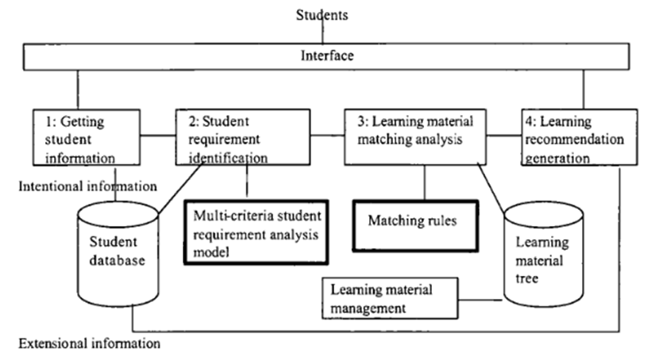
Personalized Learning
Image: Jie Lu, 2004. Framework for personalized learning recommender system. P. 376

Slide 49
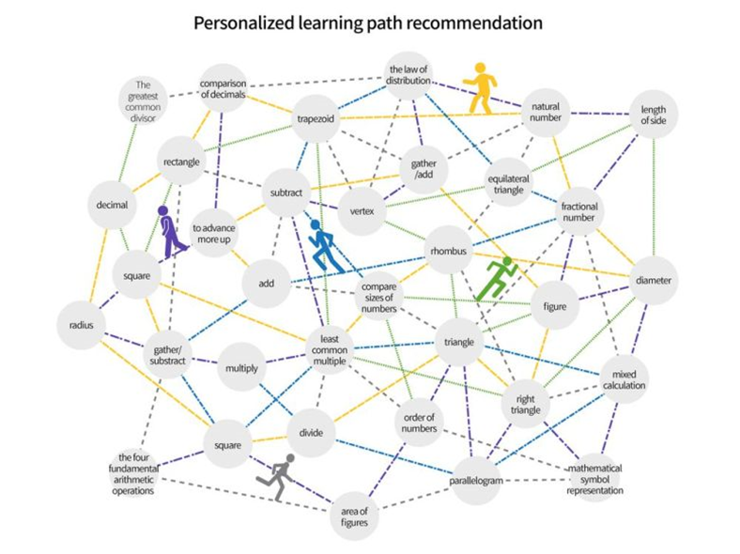
Learning Path Recommendation
Image: Bitnine Global, Inc. (2019). Personalized learning path recommendation.

Slide 50
Criticisms of Personalized Learning
Personalized learning is ineffective
Recommendations just aren’t very good
It’s isolating and depersonalizing
Personalized learning systems depend on surveillance and violates personal privacy

Slide 51
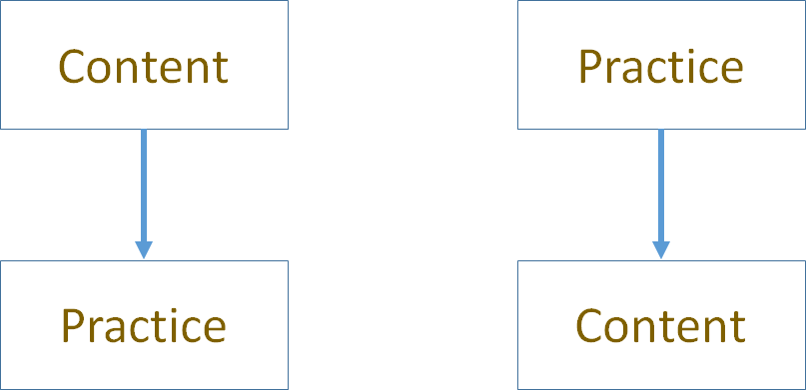
Two Approaches

Slide 52
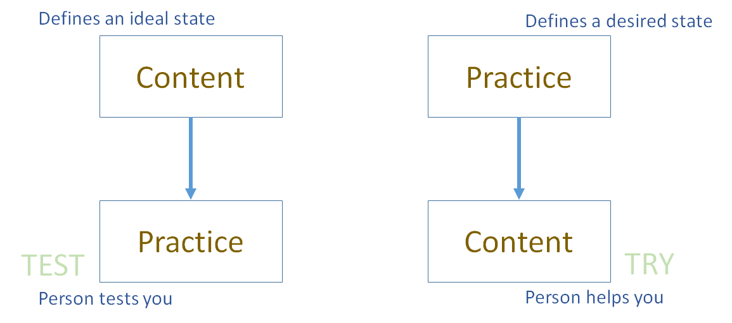
Two Approaches

Slide 53
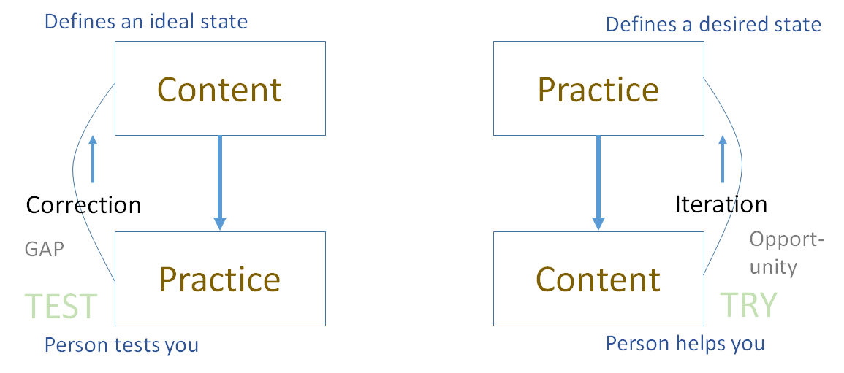
Two Approaches

Slide 54
Library Environment

Slide 55
Personalized Personal
We do for you (you consume) You do for yourself (we help)

Slide 56
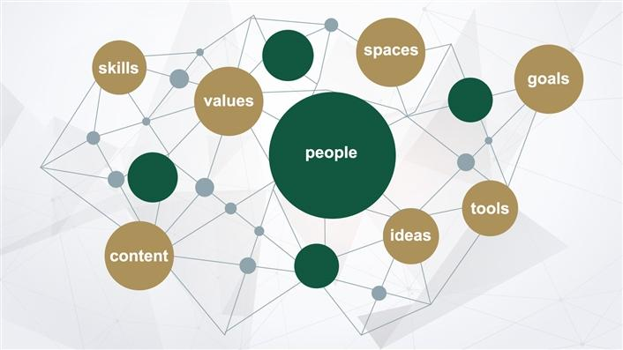
Self-Directed Learning
Students "will need to be self-directed in their learning. This includes making sound judgements about how much they know compared to how much they need to know, how they are progressing towards completing quality work and whether or not they need to shift strategies."
Digital learning environments, the science of learning and the relationship between the teacher and the learner. Jason M Lodge, Gregor Kennedy, L. Lockyer. https://www.downes.ca/files/TandS_Relationship_SoL_Preprint.pdf

Slide 57

Personal Learning Starting Points

Slide 58
Items to Consider
Learning objectives
Learning processes
Forms of evaluation that best suit personal learning

Slide 59

Learning Objectives
"The oft-repeated assumption that children would have to face an uncertain job market and a fast-changing world a few years from now is already amidst us," write the authors. "Today we are rightly being forced to prioritize well-being over economic growth, for ourselves and the planet."
What if Kindness Is the New Normal? A Call to Re-Imagine the Purpose of Education in the Post-COVID World. Vishal Talreja, Sucheta Bhat, Qatar Foundation. https://www.wise-qatar.org/what-if-kindness-is-the-new-normal-a-call-to-re-imagine-the-purpose-of-education-in-the-post-covid-world/

Slide 60
Objectives for Learners
How to BUILD AWARENESS (e.g. of contexts and environments, cultures, needs, change, circumstance)
How to BUILD KNOWLEDGE (e.g. of sciences and technologies, formalization, models, algorithms, etc)
How to BUILD CHARACTER (e.g. purpose and value, ethics and emotional intelligence)
How to BUILD JUDGMENT (e.g. recognizing and countering deception, inference and explanation)
How to BUILD RESILIENCE (e.g. global challenges and their impacts, sustainable development, stewardship)
How to BUILD SOCIETY (e.g. develop consensus, collaborate and cooperate, responsible citizenship)
Notes:
International Science Council - https://council.science/call-for-nominations-covidea/

Slide 61
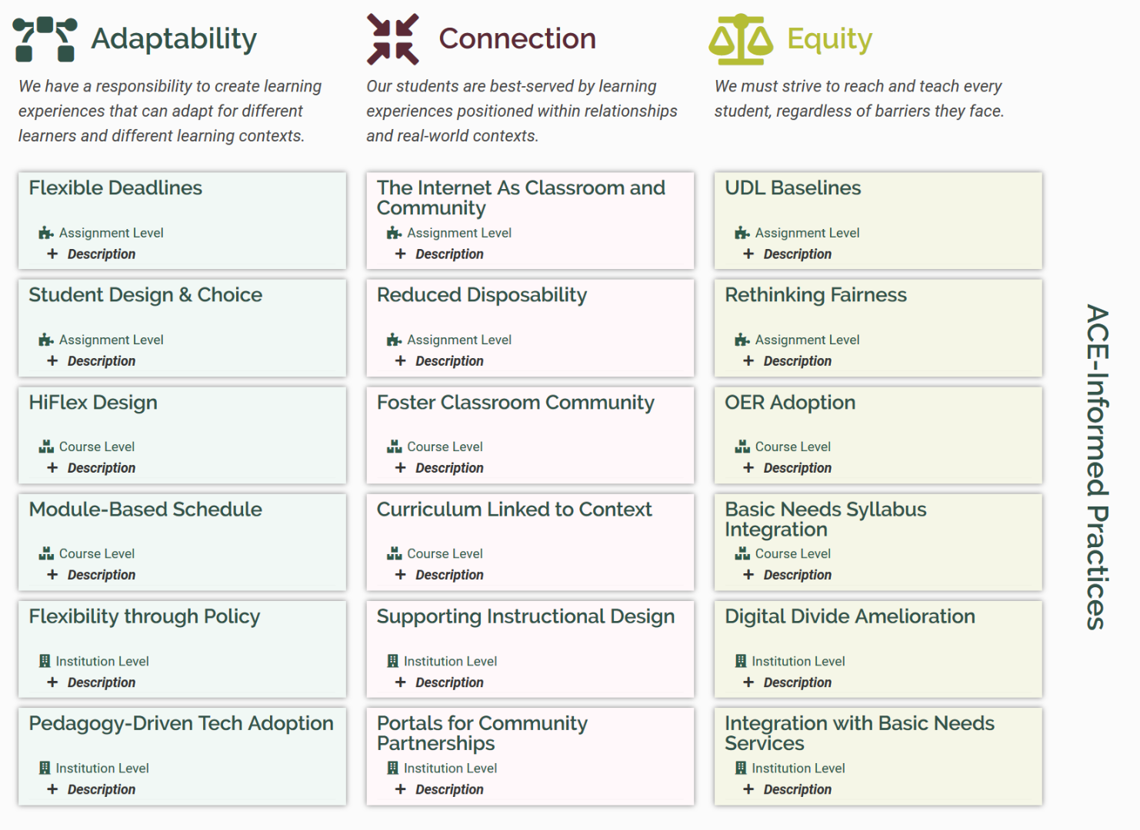
Objectives for Institutions
ACE
ACE Framework. Robin DeRosa, Plymouth State University. https://colab.plymouthcreate.net/ace/

Slide 62
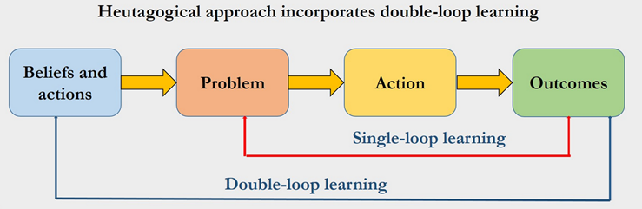
Learning Processes
Learning when the learner is ready
Requires the learner to move beyond knowledge and
Learner does not depend solely on the teacher
Learning is focused on the student not on a syllabus
The principles of heutagogy as outlined in Hase and Kenyon (2013)
Image: Eachempati , et.al. Heutagogy through Facebook for the Millennial learners
https://www.mededpublish.org/manuscripts/1268

Slide 63
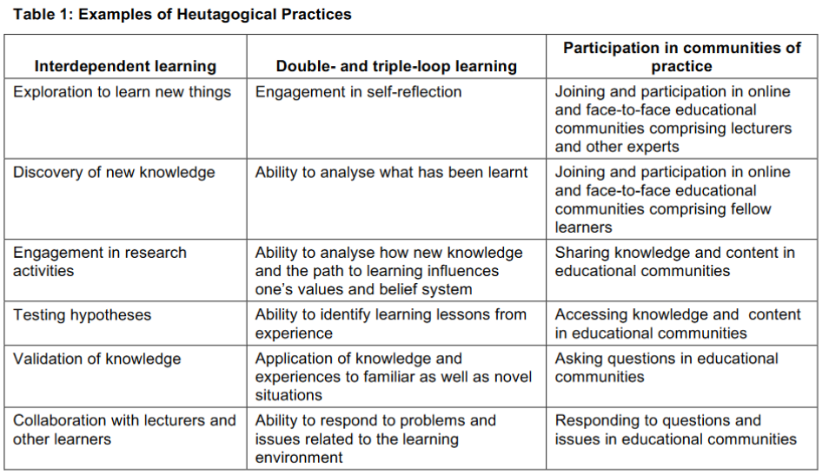
Learning Processes
Of these, only the third is employed to any significant degree. Andrew Chimpololo concludes, "training institutions need to create a conducive environment where learners are provided the freedom to define their own learning paths and determine individual learning styles."
An Analysis of Heutagogical Practices through Mobile Device Usage in a Teacher Training Programme in Malawi
Andrew Chimpololo, Journal of Learning for Development, https://jl4d.org/index.php/ejl4d/article/view/391/485

Slide 64
Learning in Context
Active learning
Problem-based learning
Case studies
Work-integrated learning
Design and creation
Learning Supports
Coaching and encouragement
Methods, tools and models
Access to learning resources
Connection to community
The effect of authentic project‐based learning on attitudes and career aspirations in STEM. Margaret E. Beier, et.al. https://doi.org/10.1002/tea.21465

Slide 65

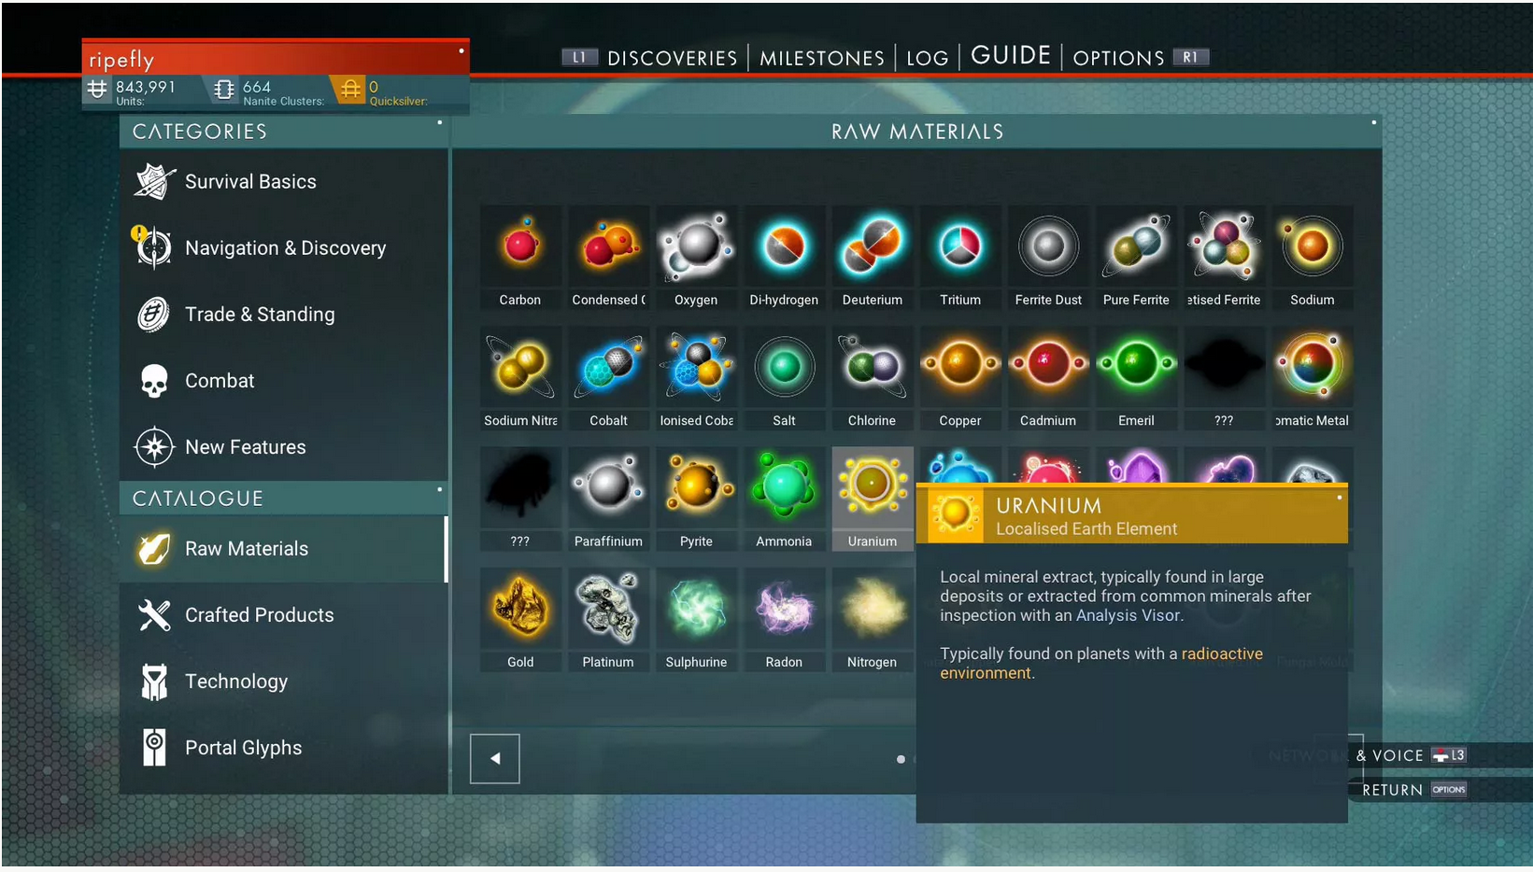
Learning in Context
https://www.nomanssky.com/

Slide 66
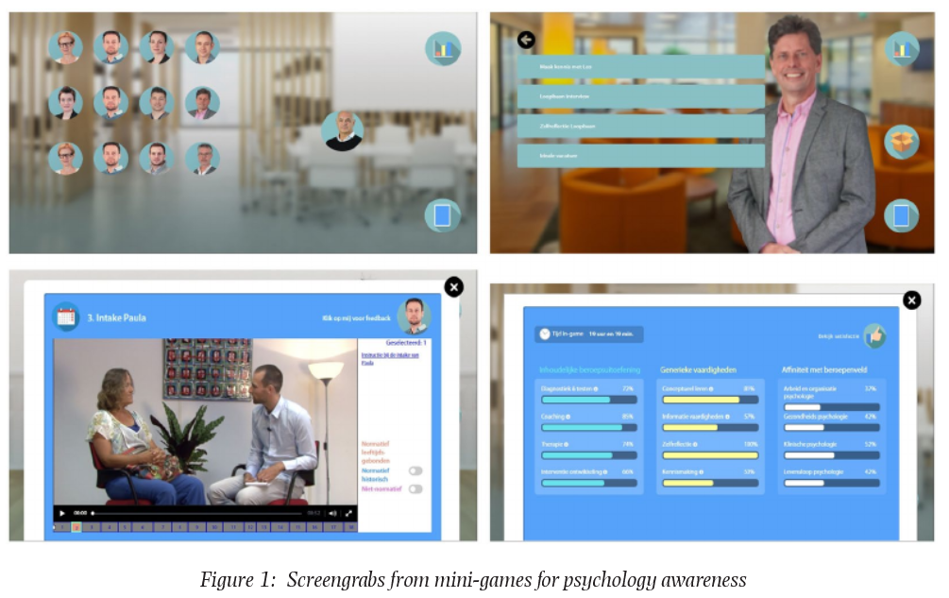
Gaming and Simulations
Serious game in introductory psychology for professional awareness: Optimal learner control and authenticity. Hans Hummel, BERA Blog. https://www.bera.ac.uk/blog/the-thin-line-between-gaming-and-learning

Slide 67

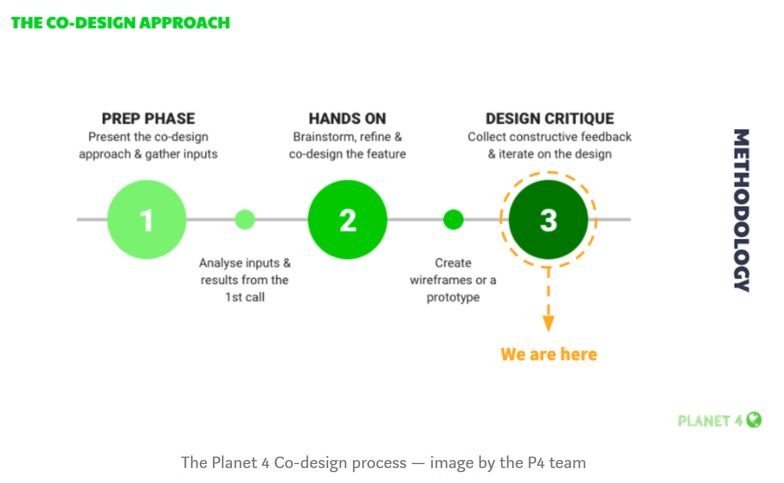
Supporting Agency
CMSI executive director, Caty Borum Chattoo joins host Rev. Lennox Yearwood Jr., President & Founder of Hip Hop Caucus,. https://mailchi.mp/american/july-2020?e=6eb0d07479
Co-design of the “Challenges”: the design critique. Magali Fatome. https://medium.com/planet4/co-design-of-the-challenges-the-design-critique-a096b46b3e13

Slide 68
Networks in Learning
The major value proposition offered by top tier universities isn't knowledge. This is available anywhere.
Nor is it even top-flight professors. Great teachers and researchers can be found in institutions large and small around the world.
No, the value proposition is access to the network of contacts, influencers, and collaborators. Access to networks matters, and it's this gap that isn't addressed in education reform programs ignore, to the detriment of participants.

Slide 69
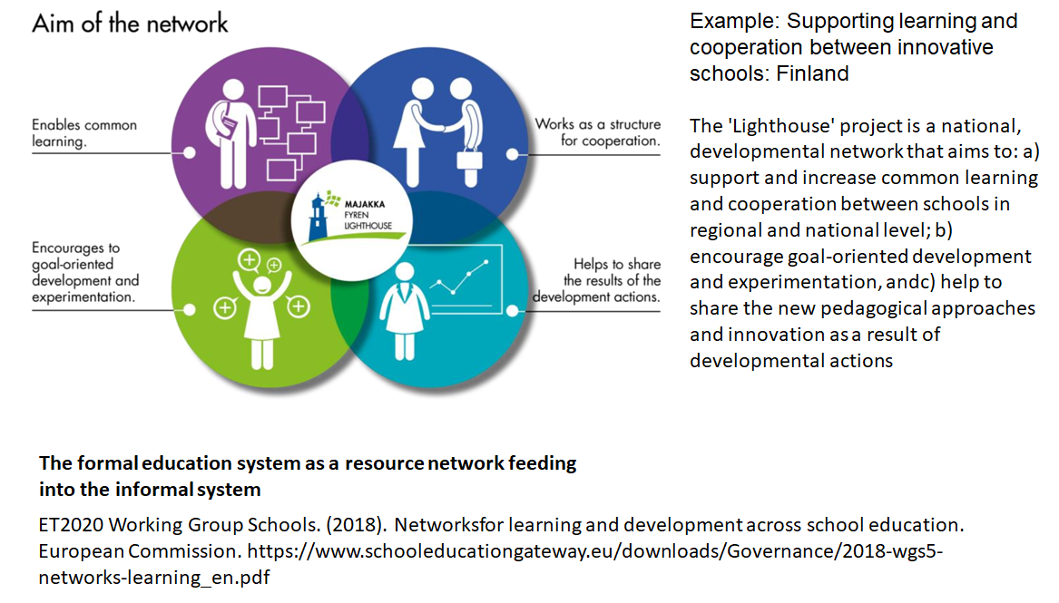
Networks in Learning

Slide 70
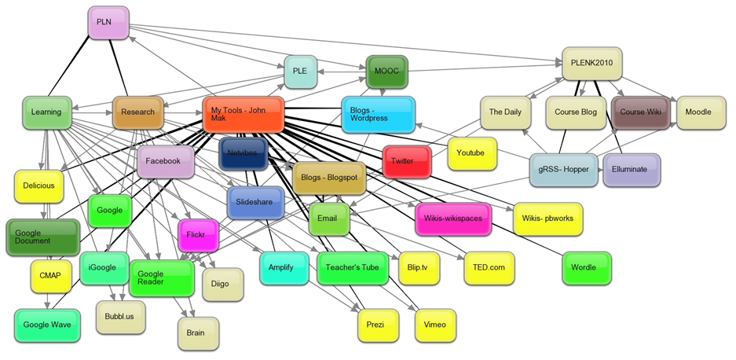
Personal Learning Environments
Martin Weller: "Open universities across the world have been operating large scale, open, equitable learning for decades." My response. I write, "the cost of educational labour is what makes it so expensive... (but) The connectivist approach is to do whatever can be done to help students perform this labour themselves." https://www.downes.ca/post/69410

Slide 71
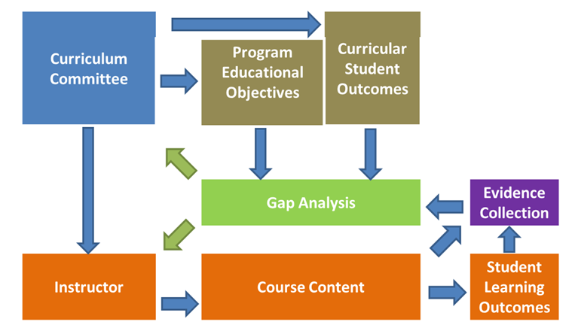
Evaluation and Assessment
Gap-Based Assessment - What You Know
Curtis, et.al. (2012). Development of evidence management and gap analysis tools for continuous improvement of engineering programs . American Society for Engineering Education. https://images.app.goo.gl/3XXtbRZ8KPxSHuRD8

Slide 72
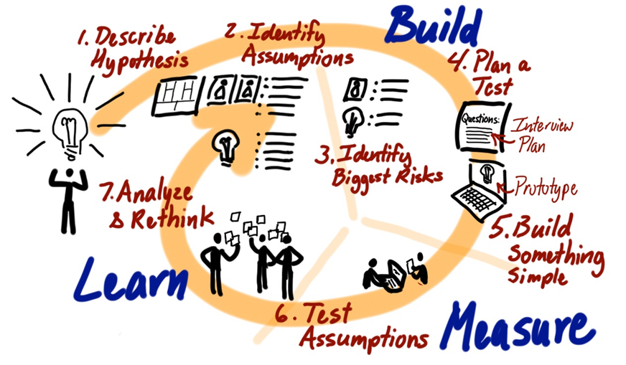
Evaluation and Assessment
Iterative Assessment - What You Can Do
Image: Jeff Patton. (2015). Common Agile Practice Isn’t for Startups. https://www.jpattonassociates.com/common-agile-isnt-for-startups/

Slide 73
Evaluation and Assessment
Assessing a physicist:
Do they know a certain body of information
vs
Do they see the world the way a physicists does?
Do they ask the same sorts of questions? Use words the same way?
Do they accept the same sort of evidence to change their beliefs?
Can they do thing physicists can do?
Have they actually done physics and shared the results?
Would other physicists recognize them as a physicist?

Slide 74
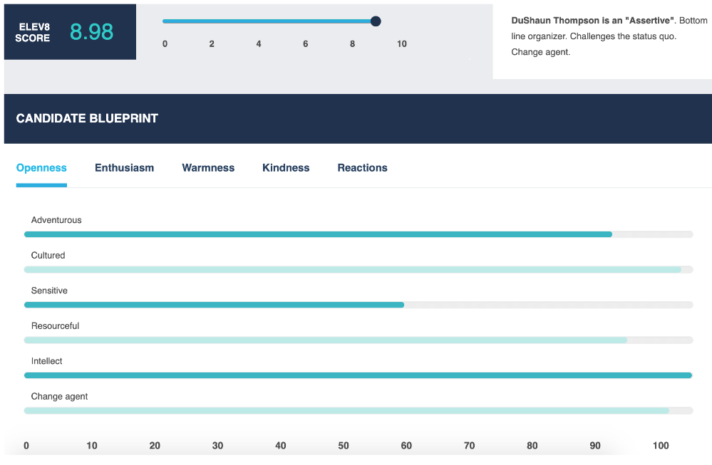
Algorithmic Assessment
Mitigating Bias in Algorithmic Hiring: Evaluating Claims and Practices
Manish Raghavan, Solon Barocas, Jon Kleinberg, Karen Levy, arXiv, Nov 23, 2019 https://arxiv.org/pdf/1906.09208.pdf

Slide 75

Supporting Personal Learning Online

Slide 76
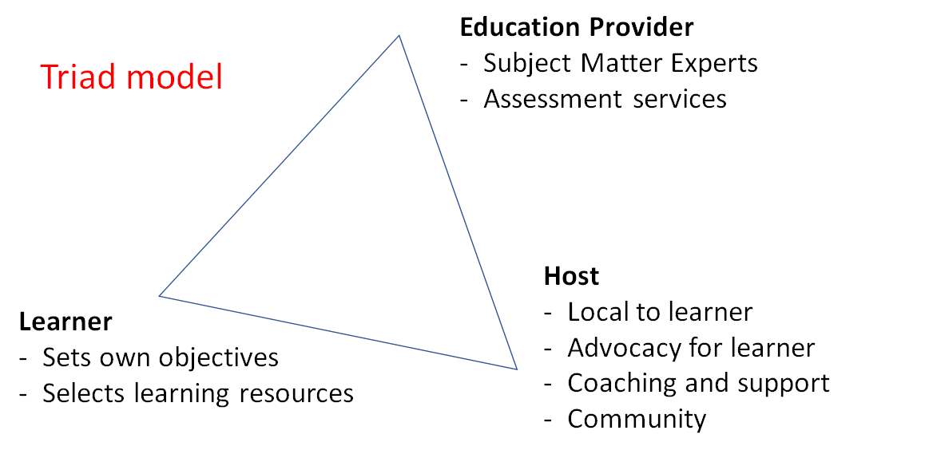
Online Host-Provider Framework

Slide 77
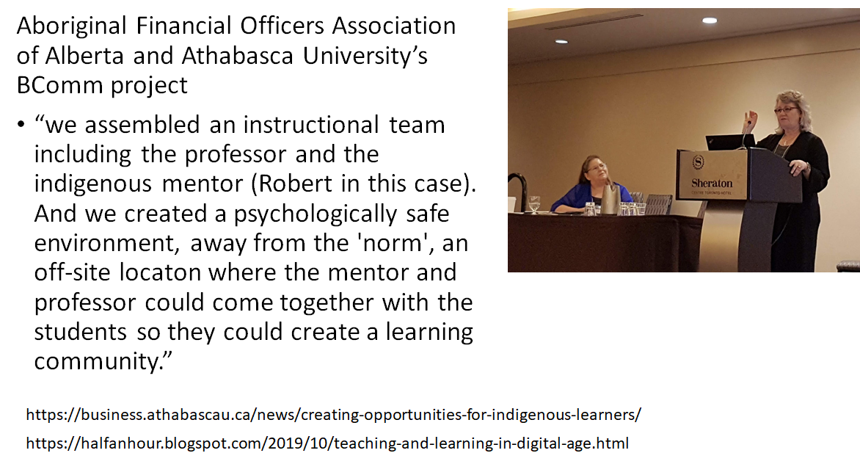
Online Host-Provider Framework

Slide 78
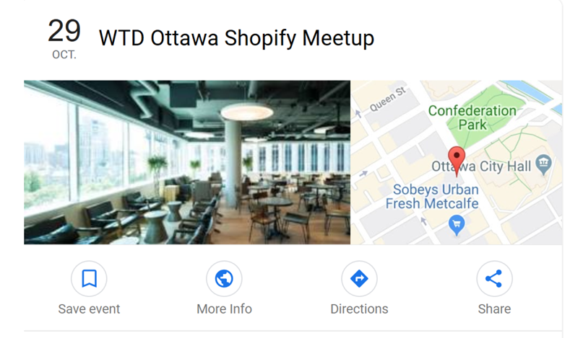
Online Host-Provider Framework
Community Learning Centres
Image: Google Events
https://www.google.com/search?client=firefox-b-d&q=shopify+ottawa+meetups&ibp=htl;events

Slide 79
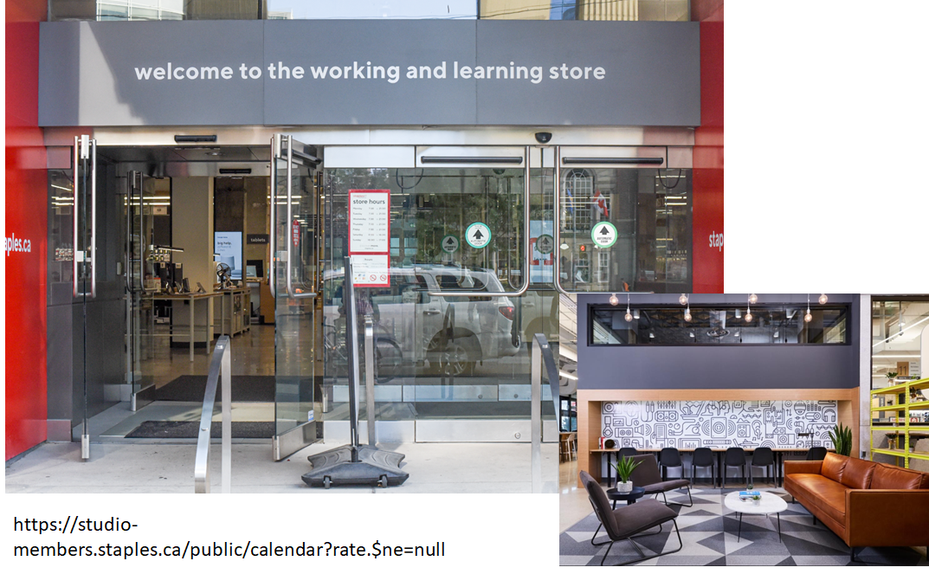
Online Host-Provider Framework

Slide 80
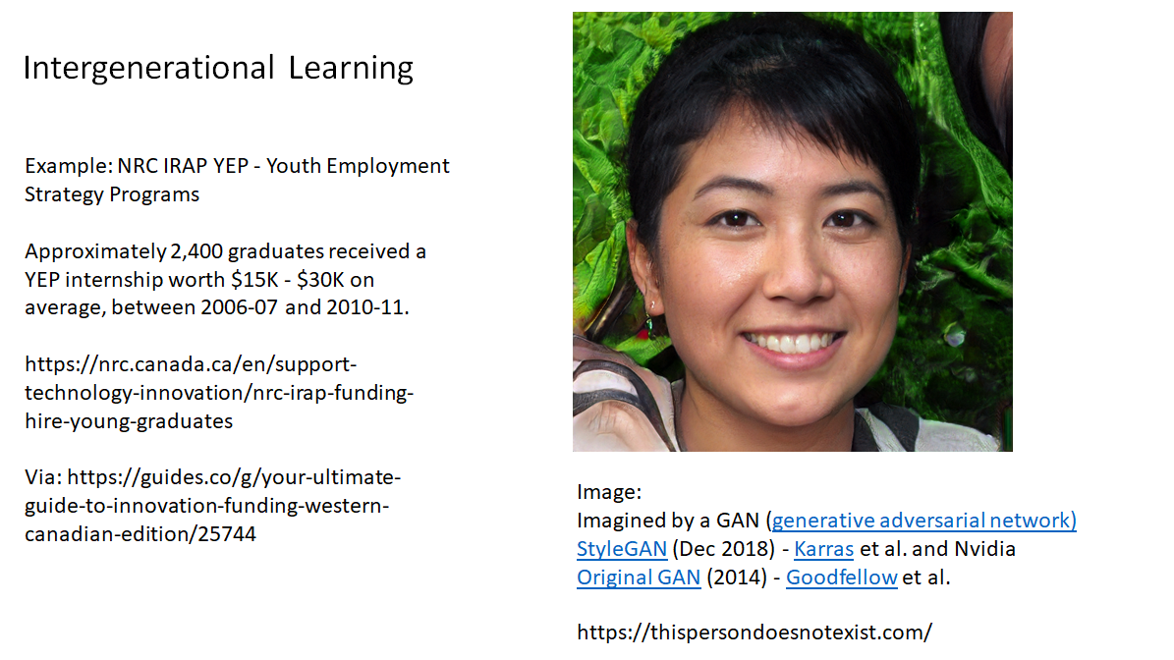
Education Providers...

Slide 81
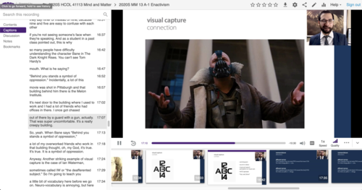
Education Providers...
Teaching from Home
Creating an Online Community, Class or Conference - Quick Tech Guide - http://bit.ly/quicktechguide

Slide 82
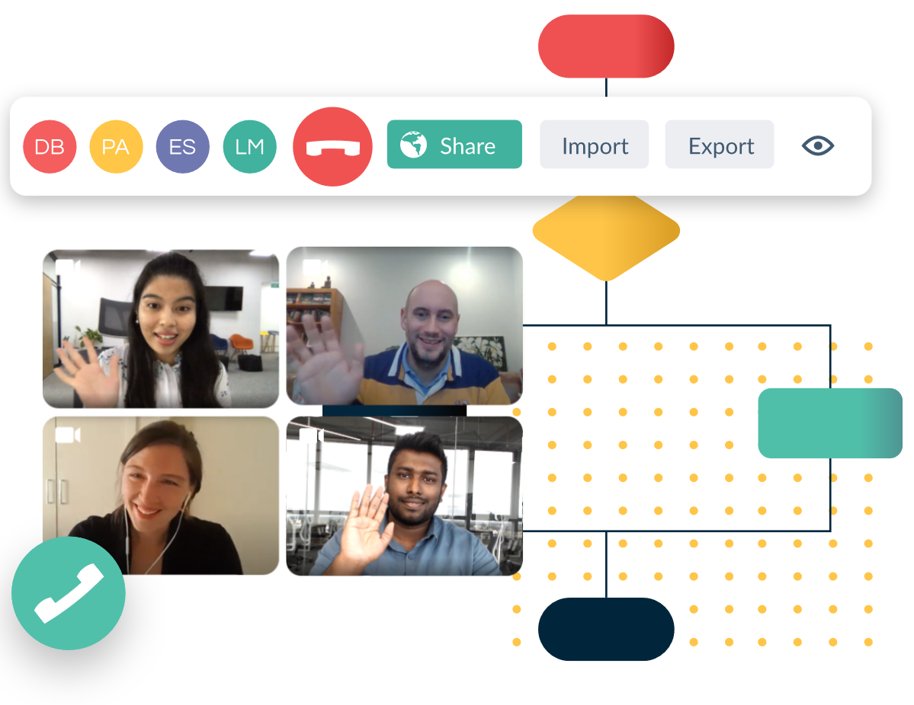
Education Providers...
Collaborative Tools
For example, Creately, a web-based tool that allows users to collaboratively create designs using a common interface.
https://creately.com/

Slide 83
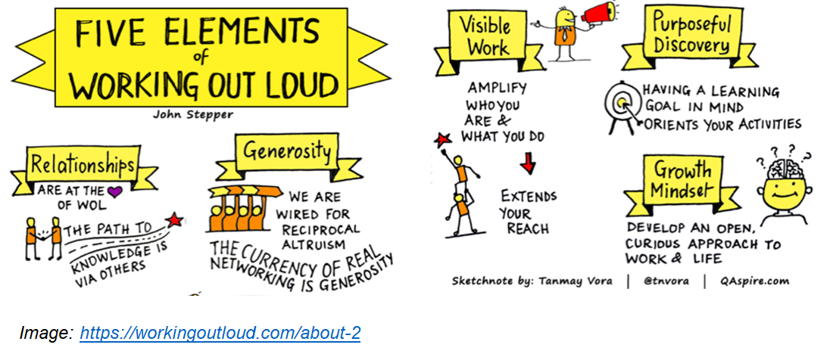
Education Providers...

Slide 84
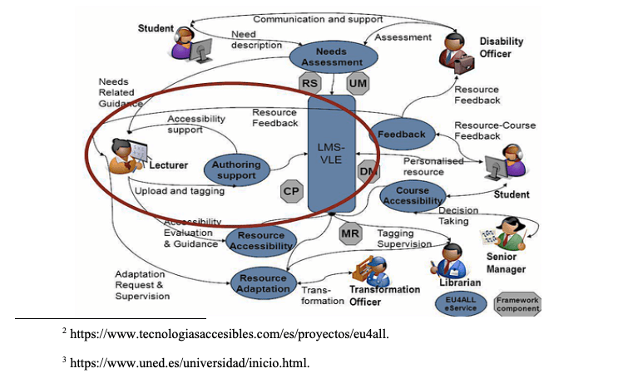
Education Providers...
OERs
Support for community in the development, discovery, use and sharing of open educational resources
Accessible Open Educational Resources and Librarian Involvement
Silvana Temesio, International Journal of Open Educational Resources. https://www.ijoer.org/accessible-open-educational-resources-and-librarian-involvement/

Slide 85
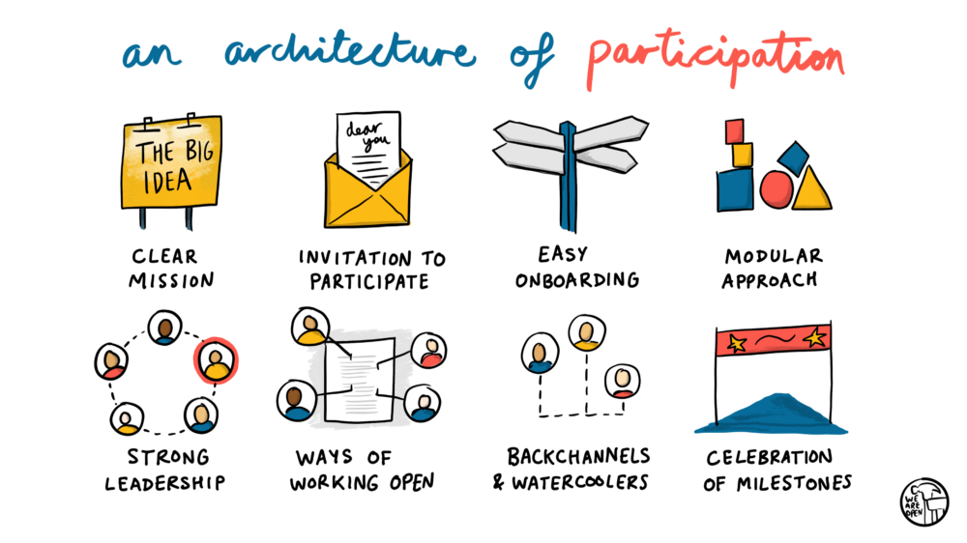
Education Providers...
Doug Belshaw - https://blog.weareopen.coop/howto-create-an-architecture-of-participation-for-your-open-source-project-a38386c69fa5

Slide 86

Stephen Downes
https://www.downes.ca

