Slide 1
Personal Learning:
Taking Ownership of
Learning Online – Part 2
Stephen Downes
September 10, 2020
Previously: https://www.downes.ca/presentation/525
This one: https://www.downes.ca/presentation/528

Slide 2
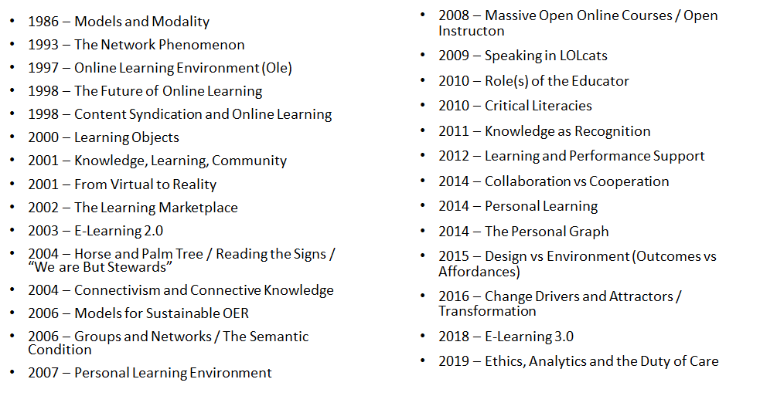
Three Decades of Enquiry

Slide 3
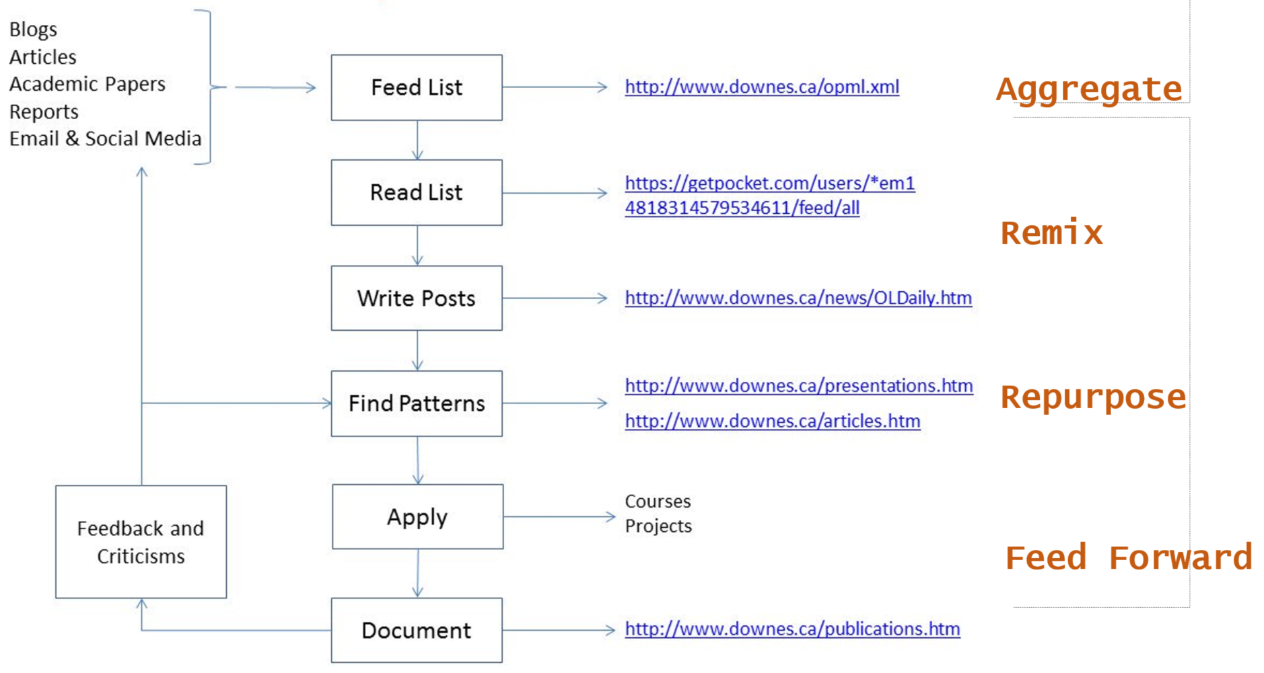
My Research Workflow

Slide 4
Takeaways for this Webinar
In this webinar, you learn:
The difference between ‘personalized learning’ and ‘personal learning’.
Why personal learning is the preferred concept for student success.
Key starting points for personal learning, objectives, learning processes and forms of evaluation that best suit personal learning.
Strategies to implement personal learning in the form of support for remote teaching, online learning, and lifelong learning.

Slide 5
Topics for Discussion - Practical
What are relevance, usability, interactivity?
Starting points
Supporting them when they’re not supported (a.k.a. Geurilla Tactics)
These slides will be available at: https://www.downes.ca/presentation/525
Silhouette Images via Gordon Johnson https://pixabay.com/users/gdj-1086657/

Slide 6
Topics for Discussion - Theory
What is personal learning?
Personal learning starting points
Supporting personal learning online
These slides will be available at: https://www.downes.ca/presentation/5245
Silhouette Images via Gordon Johnson https://pixabay.com/users/gdj-1086657/

Slide 7
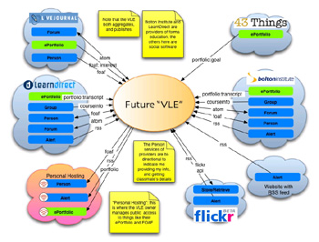
Three Principles:
Interaction – participation in a learning community (or a community of practice)

Slide 8
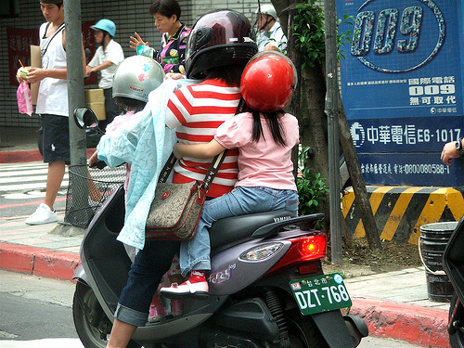
Three Principles:
Usability – simplicity and consistency

Slide 9
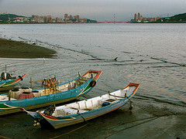
Three Principles:
Relevance – or salience, that is, learning that is relevant to you, now

Slide 10
Relevance:
Generating Relevance
  Content … getting what you want
  Location, location, location…
“… learners should get what they want, when they want it, and where they want it “

Slide 11
Getting What You Want
Step One: maximize your sources – today’s best bet is RSS – go http://www.feedly.com , set up an account, and search for topics of interest

Slide 12
Getting What You Want
Step Two: filter ruthlessly – if you don’t need it now, delete it (it will be online somewhere should you need it later)

Slide 13

Getting What You Want
Important: Don’t let someone else dictate your information priorities – only you know what speaks to you

Slide 14
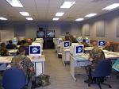
Getting It Where (and When) You Want
Shun formal classes and sessions in favour of informal activities

Slide 15
Getting It Where (and When) You Want
Do connect to your work at home (and even on vacation) – but – feel free to sleep at the office
  Most work environments are dysfunctional
  Your best time might not be 9 to 5 …
  Ideas (and learning) happen when they happen

Slide 16
Principles of Relevance
Information is a flow, not a collection of objects
  Don’t worry about remembering, worry about repeated exposure to good information
Relevance is defined by function, not topic or category
Information is relevant only if it is available where it is needed

Slide 17
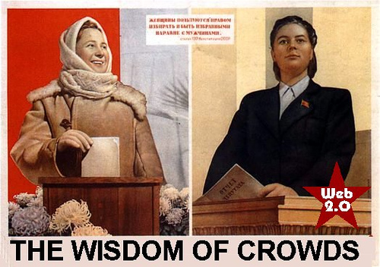
Relevance: Guerilla Tactics
Develop unofficial channels of information (and disregard most of the official ones)

Slide 18
Relevance: Guerilla Tactics
  For example, I scan, then delete, almost all institutional emails (and everything from the director)

Slide 19

Relevance: Guerilla Tactics
Create ‘project pages’ on your wiki (you have a wiki, right?) with links to templates, forms, etc.

Slide 20
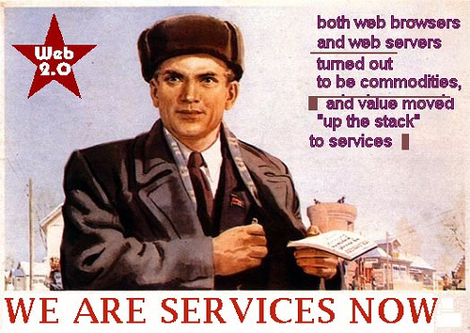
Relevance: Guerilla Tactics
Demand access

Slide 21

Stephen Downes
https://www.downes.ca

