Slide 1

The Future of Online Learning 2020
Stephen Downes
April 27, 2020

Slide 2
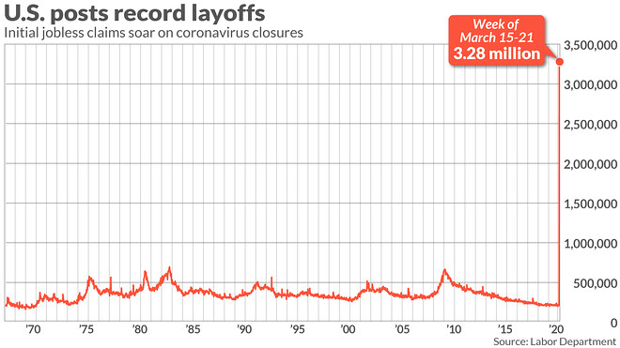
Change is cyclical, but not all change is cyclical, and one day every cycle stops.

Slide 3
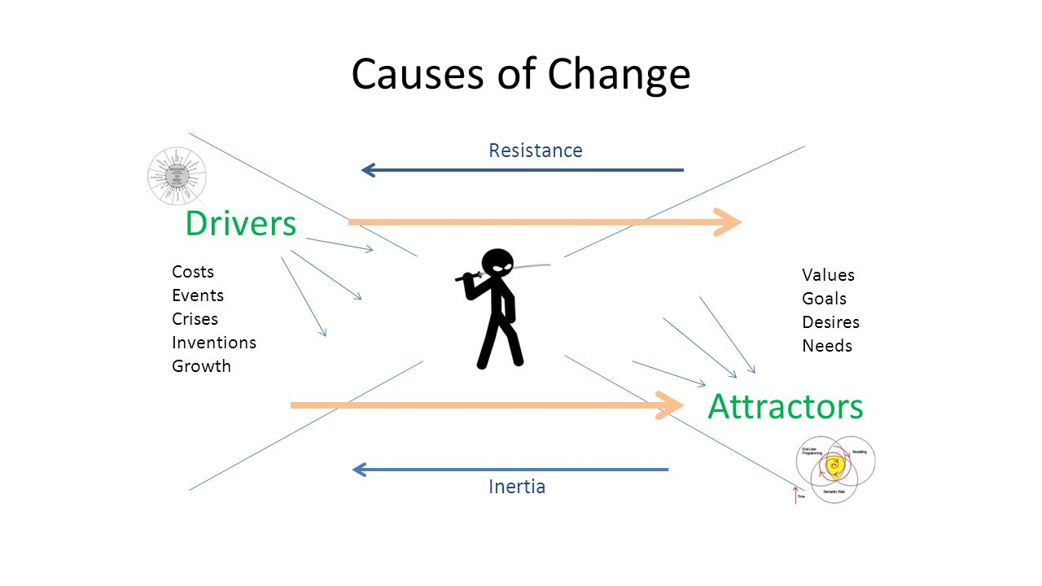

Slide 4

What is the Value Proposition?
“The proposition is an easy-to-understand reason why a customer should buy a product or service from that particular business. A value proposition should clearly explain how a product fills a need, communicate the specifics of its added benefit, and state the reason why it's better than similar products on the market.” https://www.investopedia.com/terms/v/valueproposition.asp
Notes:
What is the value proposition of a school, of a teacher, of a university, of online learning?
babysitting?
socialization?
Preparing for work?
Creating a social network?
The Elite “College Experience” is Not Compatible with Covid-19, Steven D. Krause, 2020/04/27
http://stevendkrause.com/2020/04/27/the-elite-college-experience-is-not-compatible-with-covid-19/
Steve Krause hits the nail on the head with this one. Several nails. In elite education, he argues, "taking classes is just not what it’s all about... it’s also a whole lifestyle of dorms or near campus apartments, sporting events, frats and sororities and clubs, parties, beautiful buildings and campuses, etc." Also, "elite universities don’t like online classes because they are not the college experience (see above) and they still believe online classes are for poor people." And that creates a challenge. Because, yes, higher education institutions will need government support, and government support isn't going to include funding for sporting events, frats and sororities and clubs, parties, beautiful buildings and campuses. At a certain point, people are going to realize that the problems of equity exist not so much in online learning as they do in the higher education system in general.
School-system priorities in the age of coronavirus, Jake Bryant, Li-Kai Chen, Emma Dorn, Stephen Hall, McKinsey, 2020/04/23
https://www.mckinsey.com/industries/public-sector/our-insights/school-system-priorities-in-the-age-of-coronavirus
This isn't a bad report, and it has some good examples, but more detail about how to do all this would have been helpful. Also, it would have been more useful had it arrived two months ago. The authors argue, "There are four priorities for school systems: maintaining health and safety of students, staff, and the community; maximizing student learning and thriving; supporting teachers and staff; and establishing a sound operational and financial foundation. In each case, we believe that issues regarding equity—that is, ensuring that the needs of the most vulnerable are met—should be front and center, both during the closure and after students return to school." Probably the most useful bit is its account of the role of the school as a social support agency in many communities, up to and including feeding children who might not otherwise get enough.

Slide 5
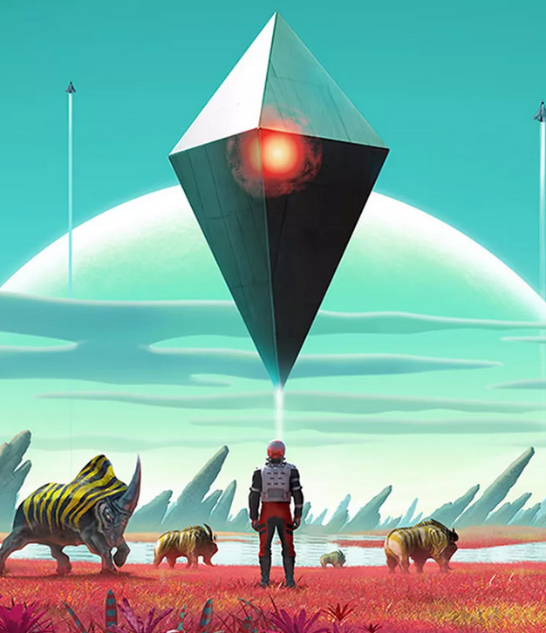
Technology as Environment
Environment as Technology
While the capacity to provide cheap and high quality Internet to everyone in the world exists, the will to provide it does not.
We will need to negotiate a social contract between ourselves and our devices. The coming debate in the next decade will centre around the values and principles we want to based these on.
Notes:
Technology is just another word for environment
Face-to-face is for special occasions - 2020 edition, Clive Shepherd, Clive on Learning, 2020/04/22
http://www.cliveonlearning.com/2020/04/face-to-face-is-for-special-occasions.html
Pundits are predicting the future of online learning in 2020 and beyond. Clive Shepherd invites us to think about how we watch music, drama or sport - if you wanted to do it all live face-to-face, "unless you're rich and with considerable discretionary time, it would be completely impractical." And the same too with learning, in the future. Others, meanwhile, disagree. Fordham's Robert Pondiscio argues "Kids will go back to brick-and-mortar schools... the act of sending our kids every morning to a place called a school is a cultural habit formed over many generations." Not to mention the fact that, in many home, both parents have to go to work just to makes ends meet.
Similarly, Alex Usher says predictions that all learning will go online are nonsense. "Education is social," he argues, and online learning isn't set up for that. Well, first, yes it is set up for that, but more importantly, second, as I've argued numerous times in the past, voters at some point will tire of paying for social clubs for rich people while doing nothing for people who can't afford it. Bryan Alexander, meanwhile, covers his bases and predicts three different outcomes.
But it doesn't matter. I think any genuine futurist in the field of online learning could and should have seen this coming. As I've repeated through the years, "educational providers will one day face an overnight crisis that was 20 years in the making." Now it's here.

Slide 6
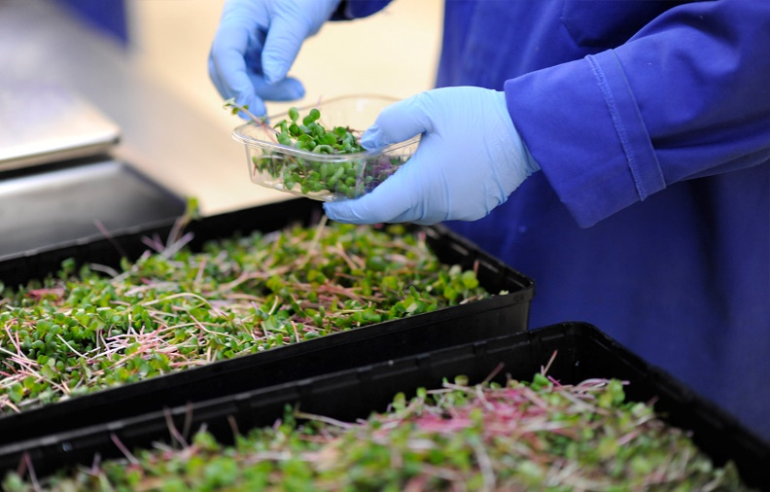


Affordances
Change is really about what we can do that we couldn’t do before, and sometimes what we can’t do that we used to be able to do.
We want students to see beyond what is possible in today’s world, with today’s technology, and acquire the ability to learn skills, conceptualize and design in future environments that do not exist today.
Notes:
The technologies that will be important in the future will be those that help us create new things, in new ways.

Slide 7
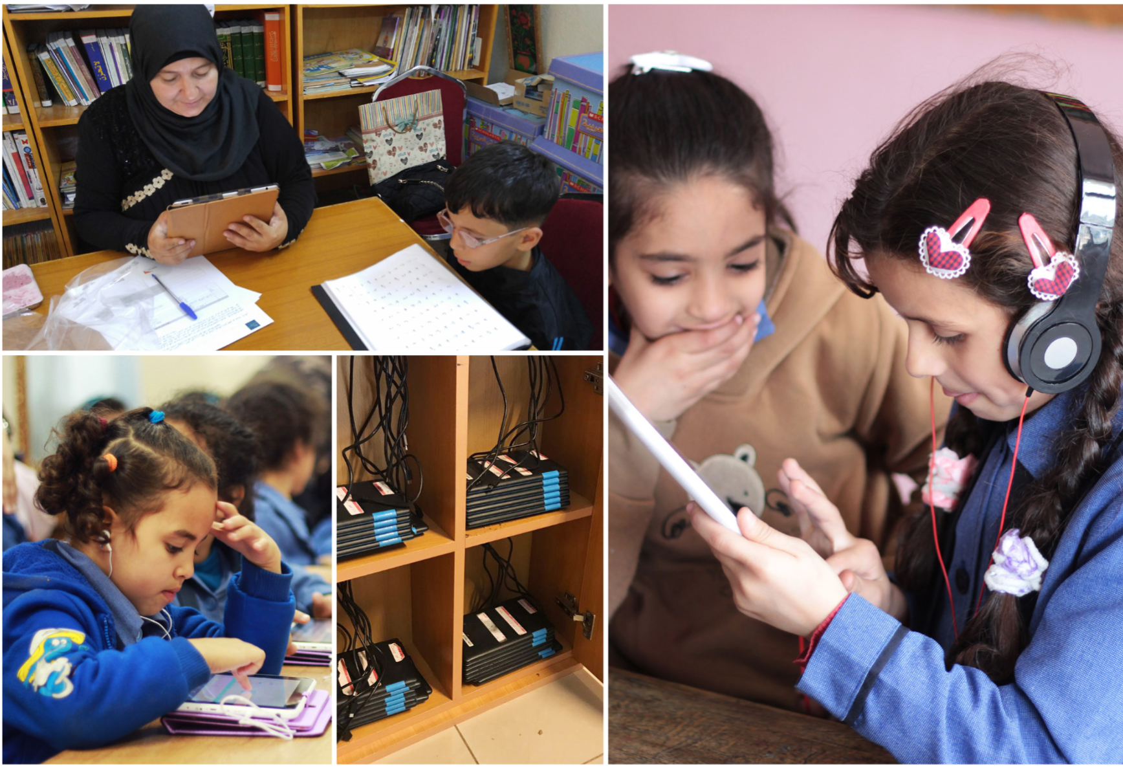
Normal Education
When we look at the core elements of ‘normal’ education - classrooms, cohorts, textbooks, and assessment - we see the beginnings of change pushing us gradually to that point where ‘normal education’ is no longer viable.
Notes:
The saddest part of ‘make America great again’ is that it is fundamentally a look backward
Marshall McLuhan famously wrote of the tetrad of media effects: when contemplating a new or emergent medium, we should ask, what does the new medium enhance, what does it make obsolete, what does it retrieve, what does it become when pushed to its limit?
Why are we doing it this way? Why are we offering online courses in virtual classrooms to cohorts?
The static structures that used to define education have shifted; we are in an era of changing boundaries between formal, non-formal, informal and post-formal education.
Cohorts
The reason a person wants to study at MIT or Yale or Oxford is
Sweeping changes being planned to replace traditional cohorts - and, indeed, traditional education, with a model (defined here) of competency-based education (CBE).not only the quality of the instructor or the facilities, it is the quality of the person next to them in class.
texts are also challenged by the idea of open educational resources (OER).
Pedagogy
What did it matter what a teacher did? What were the outcomes we hoped for? How does our current understand of instructional design meet those, or fall short? What can we develop in the future to address these issues?
Credentials
Academic engagements will be short-term, focused, increasingly online, and more and more frequently offered by private companies offering validation in the form of portfolios, work experience (think internships) and industry-specific certificates.

Slide 8
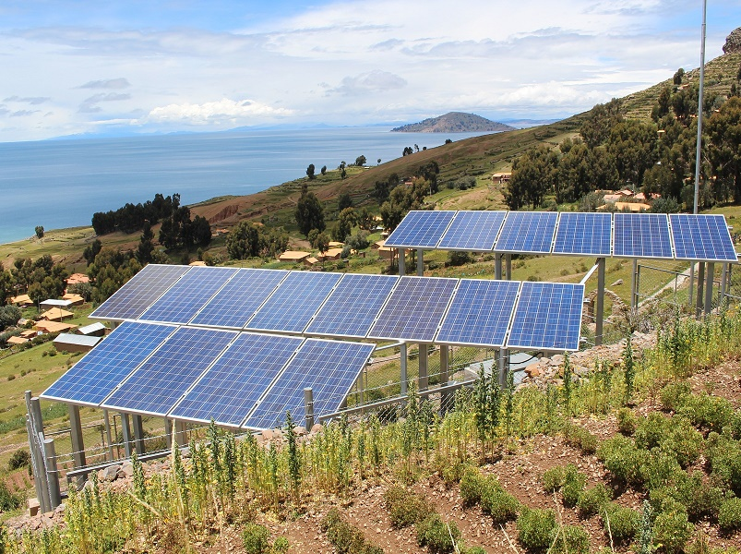
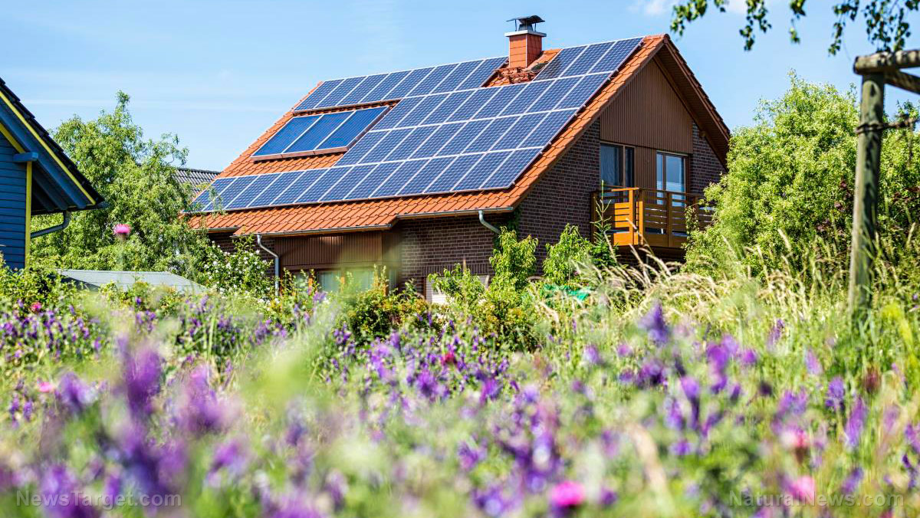
Toward Decentralization
On the one hand, it makes sense to migrate from an app-based model to a cloud-based model as soon as possible.
On the other hand, centralized resources and services will begin to disaggregate gradually from cloud provider to department or board to institution to individual.
Notes:
Expect the centralized systems to collapse in on themselves at some point. Not just the massive data centres, but also the huge companies that operate them, and the enormous economies that sustain them. It takes a perfect storm, but perfect storms happen.
Eventually, the wheel stops turning. Eventually, one alternative or the other becomes unsustainable. We reach what is eventually a singularity, where all options collapse into a single point, a single decision. Left or right. Forward or backward. “The die,” as Caesar famously said, “is cast.” The Rubicon has been crossed and cannot be uncrossed.
What is the educational technology equivalent of the solar cell? This is probably the core question facing people making long-range predictions about educational technology. At some point, we will each have our own personal learning assistant, probably. But the route from here to there is far from clear.

Slide 9
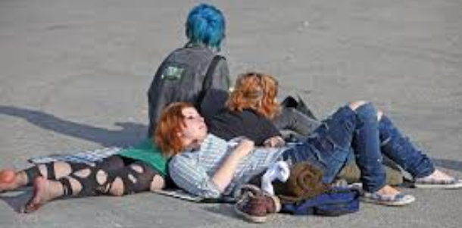
Conferencing and Communication
Teachers need to talk about the online world as a place where we converse and collaborate, not as some other sort of news media or textbook publisher.
The locus of external control is no longer based on authority figures. It is increasingly driven by the student’s self-perception, identity formation, and understanding of his or her place in society.
Notes:
A decentralized systems is 100% about Conferencing and Communication. The teacher must change roles to one who acts as an advocate and support person when they face tests imposed on them by the wider community.
The early framework
Granularity – network messages are either ‘one-to-one’ or ‘one-to-many’.
Synchronicity – the interaction can be happening in real time, or not
Privacy – the message is (in theory) confidential to its participants
Media – the earliest Internet messages were text messages, but other media quickly followed.
New dimensions
Context – this is the time, place and situation in which collaboration and communication occur.
Characters –NPCs and bots se become more sophisticated – and they will – they will become more useful and more accepted as well.
Platform – each generational change in platform creates a new layer in the network, which in turn sees collaboration and communications media spread anew.
Function – this is the least defined dimension and therefore the one with the most potential for innovation. We have seen collaboration and communications tools used for everything from business management to software development to criminal syndicates to modern warfare. The software is now used to provide automated counselling and support, student advice, medical information, and travel advice.
Interactivity and Presence
Structure shifts from linear to multidimensional. Interaction, if you will, becomes less like ‘telling a story’ and more like ‘painting a picture.
Dialogue shifts from text-based to multi-media. We gradually transform from communicating in words to communicating using a rich toolset
Autonomy shifts from demand-driven to needs-driven.

Slide 10
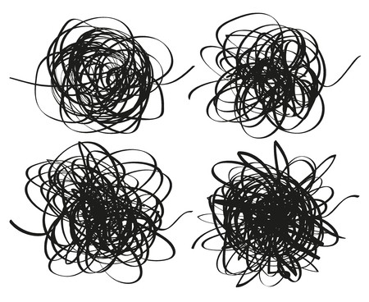
Patterns and Recognition
a.k.a. What Learning Really Is
From the substrate, the patterns emerge out of more basic media, and from above, something needs to recognize the patterns as this or that – an archer, a bear or a fluffy bunny.
Learning resources aren’t the patterns. They’re the stars.
...a massive and complex ecosystem of people, devices, websites, resources, contents and services.
Notes:
There are two parts to this: first, the theory of knowledge as recognition, and second, the theory of learning resources as substrate, out of which patterns emerge.
Stare into chaos long enough and you begin to see things. Stare into static, or into clouds, or into the night sky filled with stars, and patterns begin to emerge. The patterns form and reform as the chaos folds and unfold. Nobody would say that Orion is really there, drawing his bow in the heavens. No great bear really circumnavigates the pole each year. But we see them clearly, and the stars, clouds and static are as real as you and I.
What we are talking about here is the idea that patterns arise out of complex phenomena. It’s a two-way street: from the substrate, the patterns emerge out of more basic media, and from above, something needs to recognize the patterns as this or that – an archer, a bear or a fluffy bunny. As the substrate moves, so does the pattern. When we see a storm front, we are recognizing a pattern in a complex mass of air and mist. As it approaches, it is not a thing that is approaching (though it really seems that way) but rather nothing more than a change in the underlying conditions.
The picture that should emerge from this short description is a galaxy of resources, a massive and complex ecosystem of people, devices, websites, resources, contents and services. The changes that emerge from this ecosystem are massive system-wide changes and can only be recognized when viewed at some distance from the source.

Slide 11

Who Speaks for Us?
How does a master plumber solve a problem, as compared to a novice? Experts don’t just have more knowledge, they see things differently. How will this inform how we analyze and inform student learning? We don’t know yet, nor will we know in five years, but the research is already underway.
Ethics, Analytics and the Duty of Care
https://docs.google.com/document/d/1I-9SUZbSTfZbOuYeGm5JIMV3ilw8vPIT1l67jteiF8w/edit?usp=sharing

Slide 12

Stephen Downes
https://www.downes.ca

