Slide 1
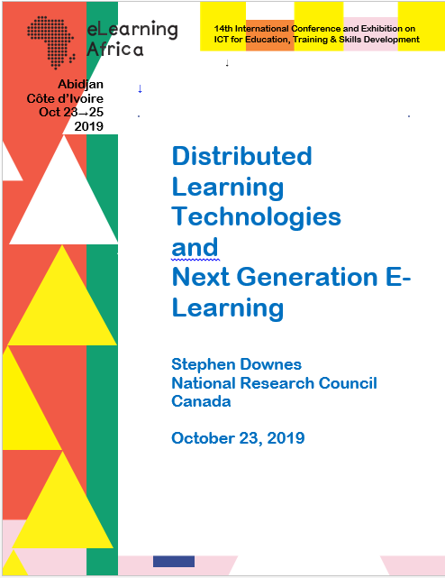
Distributed Learning Technologies and Next Generation E-Learning
Stephen Downes
National Research Council Canada
October 23, 2019

Slide 2
Description
This workshop will give participants a map of the next-generation learning technology landscape.
how the major developments in new technologies relate to each other a
how they will change the learning landscape
presentation of the concept of ‘web3’ as it has emerged from the decentralized digital currently community
trace the relation between new and unfamiliar concepts such as hash-graphs, consensus, cloud architecture and machine
explore several new technologies piloted over the last year, including blockchain-based badges, identity graphs, and new types of open educational resources.

Slide 3
Agenda
09:00 – 10:30 Data and Cloud
10:30 – 11:00 Tea/Coffee Break
11:00 – 13:00 Graph and Resources
13:00 – 14:00 Lunch
14:00 – 15:30 Identity and Recognition
15:30 – 16:00 Tea/Coffee Break
16:00 – 17:30 Experience, Community and Agency

Slide 4
The Learning Context
These are my perspectives. They represent the areas of expertise I have developed over the years. As I study new pedagogies and technologies, I ask questions from the following points of view:
ψ
Philosophy
My degrees are in philosophy and I specialized in philosophies of mind, science, knowledge and logic. I ask questions about the bases for arguments and claims, look for presumptions about meaning and value, and consider ways of sensing, comprehending and knowing.
%
Education
I am interested in the processes of learning, inference and discovery on a practical level. I ask what it is to learn – why and how people learn - and what are the conditions for best learning outcomes. I am focused on learning experience and personal agency.

Slide 5
The Learning Context (2)
:
Computing
I took a few courses but have mostly taught myself computer programming over the years, learning a number of languages, and building websites, content management systems, and learning technology. I think of programming as a means of expression.
Ξ
Media
Since my days as a newspaper carrier to my involvement in student journalism to my work today in online media I have worked on new and better means of conveying information, illustration and photography, community-building and interactivity.

Slide 6
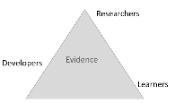
Designing Learning Experiences
1. Learning from Experts 2. Learning with Others 3. Learning through Making 4. Learning through Exploring 5. Learning through Inquiry 6. Learning through Practising 7. Learning from Assessment
8. Learning in and across Settings
http://discovery.ucl.ac.uk/1475754/4/Luckin_SoTL_Luckin_Final.pdf
From a connectivist perspective, knowledge is the organization of connections between a set of entities, where the result of that organization is the capacity to ​recognize​ objects or states of affairs in the world. For all practical purposes, we can recognize anything: friends, pets, past events, future events, types, consequences, whatever. Moreover, there are different ways of recognizing: we can have a memory, imagine an object, exercise a certain skill, have some emotion or another.

Slide 7
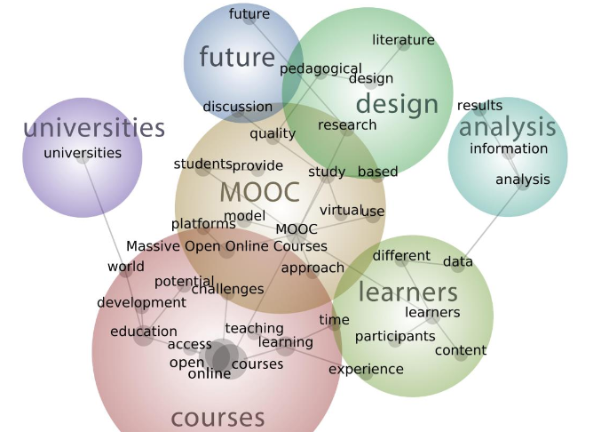
Open Online Learning
The course creates an open and distributed learning environment.
Not to pass on a certain body of content
The ​experience​ of participating in this network leads to individual learning
Each person defines success in their own way.

Slide 8
Open Pedagogy
Participatory | Interacting via social networks and mobile apps
People and trust | Develop trust, confidence and openness
Innovation & creativity | Encourage spontaneous innovation and creativity
Sharing ideas and resources | Share freely to disseminate ideas and thoughts
Connected community | Participate in a community of practice
Learner-generated | Facilitate learner contributions to OER
Reflective practice | Create opportunities for dialogue and reflection
Peer review | Contribute to an open critique of scholarship
Gráinne Conole. 2015. MOOCs as disruptive technologies: strategies for enhancing the learner experience and quality of MOOCs. Revista de Educación a Distancia. Número 39.
http://www.um.es/ead/red/39
Bronwyn Hegarty. 2015. Attributes of Open Pedagogy: A Model for Using Open Educational Resources. Educational Technology, July/August, 2015. https://upload.wikimedia.org/wikipedia/commons/c/ca/Ed_Tech_Hegarty_2015_article_attributes_of_open _pedagogy.pdf

Slide 9
Data
This part of the workshop addresses two conceptual challenges: first, the shift in our understanding of content from documents to data; and second, the shift in our understanding of data from centralized to decentralized.

Slide 10
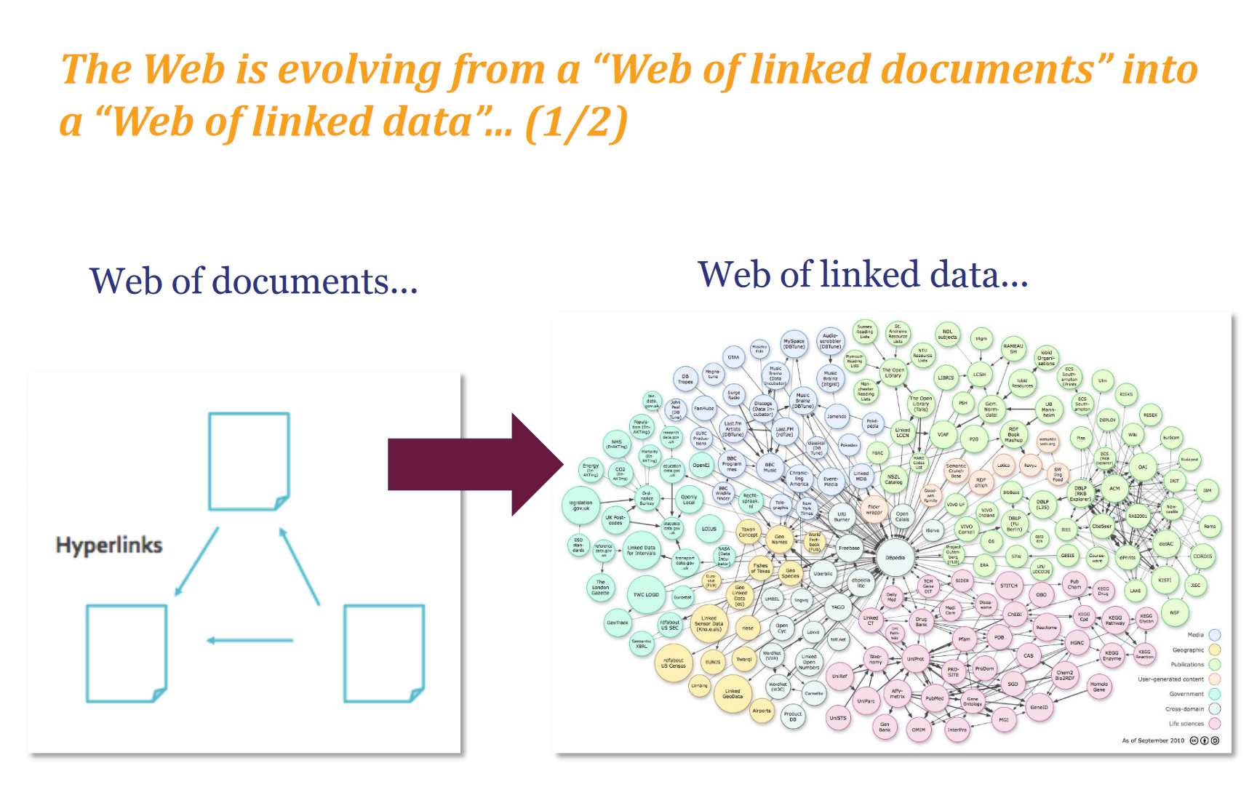
Introduction to Linked Data. This slide show introduces linked data principles. https://www.europeandataportal.eu/sites/default/files/d2.1.2_training_module_1.2_introduction_to_linked_data_en_edp.pdf

Slide 11
ψ
From Document to Data
Storing our content as data makes it more flexible and more useful. One piece of data could be inserted into another piece of data, such as a template. Our perspective shifts from a linear organization to something more complex.

Slide 12
:
Application Interfaces
The central role played by platforms is diminished in favour of direct interactions between peers, that is, a distributed web, which communicate with each other by means of application programming interfaces (API).

Slide 13
%
Learning with Data
Learning with data isn’t the same as learning with books. It’s interactive, immersive and engaging, a process of learning how to perceive and comprehend rather than to decode and store.

Slide 14
Ξ
Linked Data
Today we are seeing a trend toward decentralized linked data. This is the idea that each person can manage his or her own data, storing it wherever they want, and using it whenever they like.
Feature Article: Data. https://el30.mooc.ca/post/68416
Featured Video: Conversation with Shelly Blake-Plock https://el30.mooc.ca/event/80

Slide 15
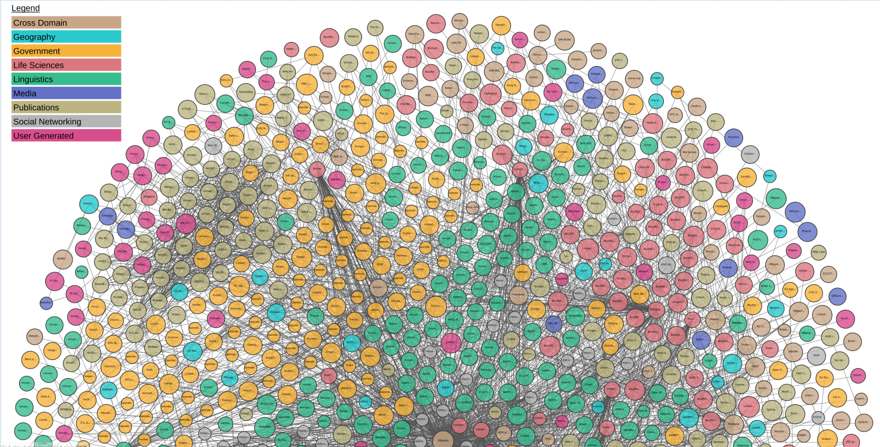
The Linked Open Data Cloud. John P. McCrae. This web page is the home of the LOD cloud diagram. https://lod-cloud.net/

Slide 16
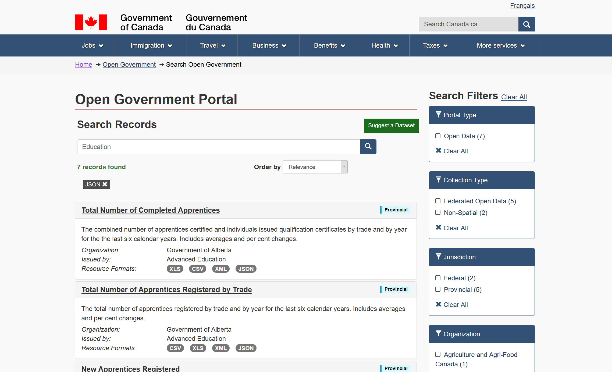
Open Government Portal: Enables access to open data on the government of Canada website. https://open.canada.ca/data/en/dataset?res_format=JSON

Slide 17
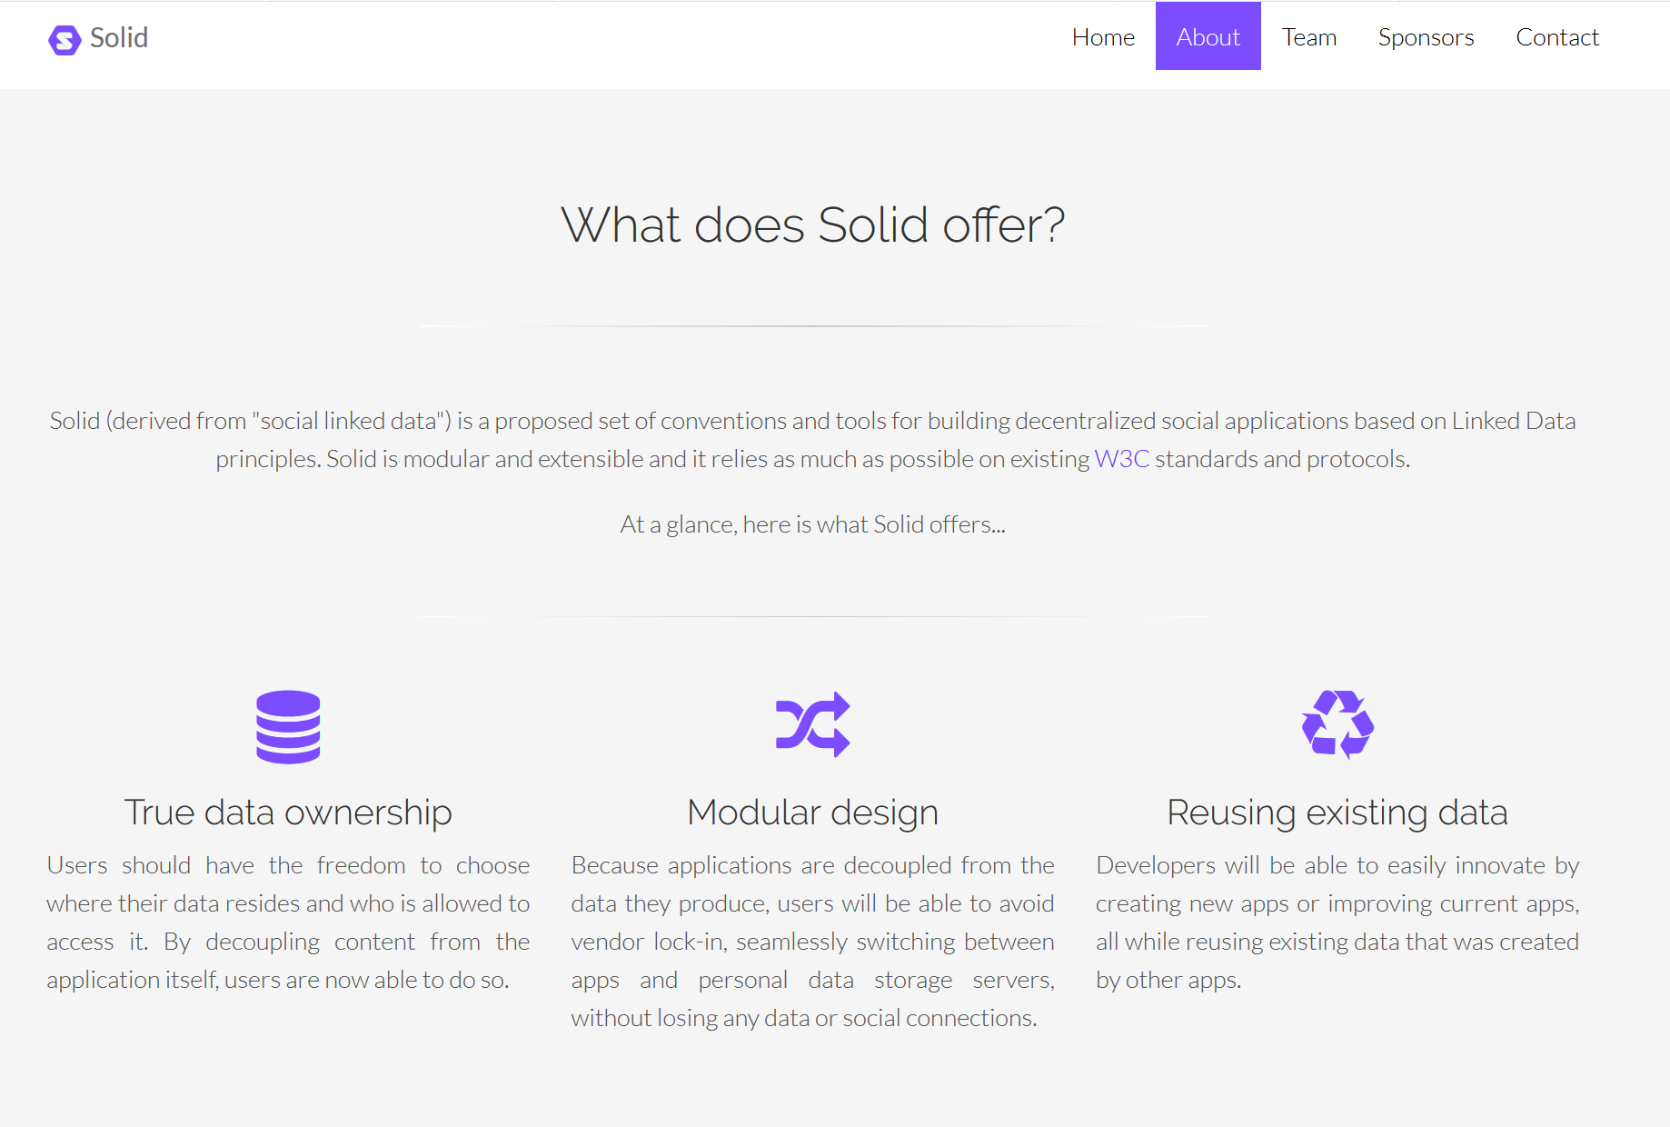
Solid. Tim Berners-Lee. Solid (derived from "social linked data") is a proposed set of conventions and tools for building decentralized social applications. https://solid.mit.edu/
Inrupt. New start-up developing Solid. https://www.inrupt.com/

Slide 18
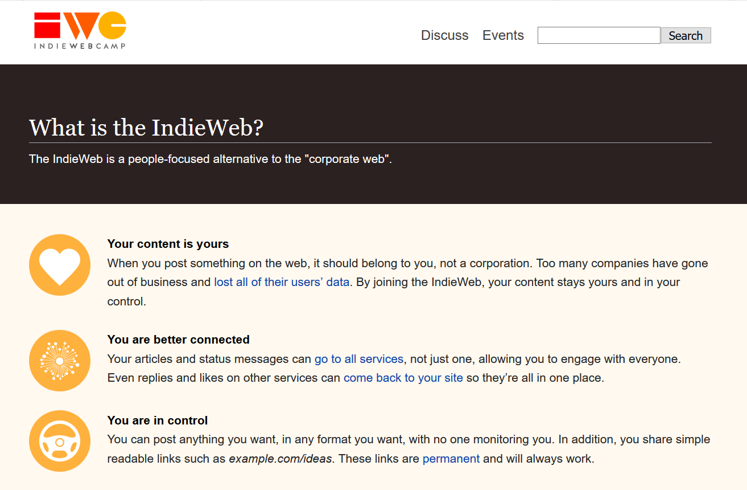
IndieWeb. The IndieWeb is a people-focused alternative to the "corporate web". https://indieweb.org/

Slide 19
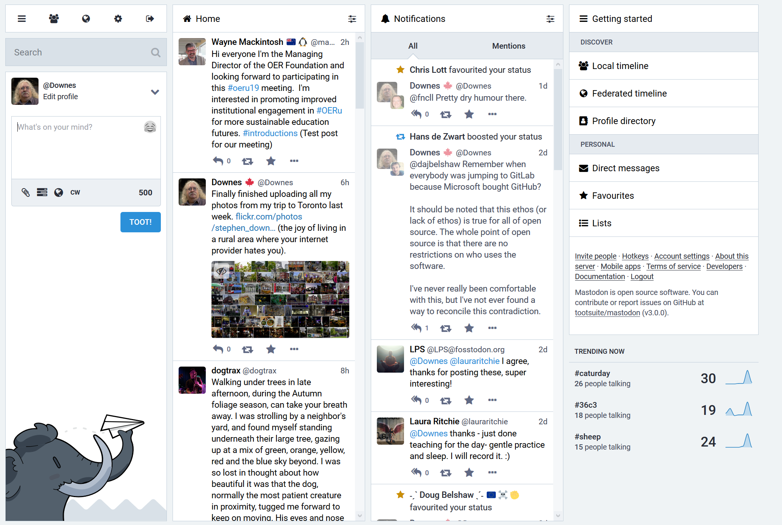
An Increasingly Less-Brief Guide to Mastodon. Noëlle Anthony. GitHub. https://github.com/joyeusenoelle/GuideToMastodon/
Mastodon: https://mastodon.social

Slide 20
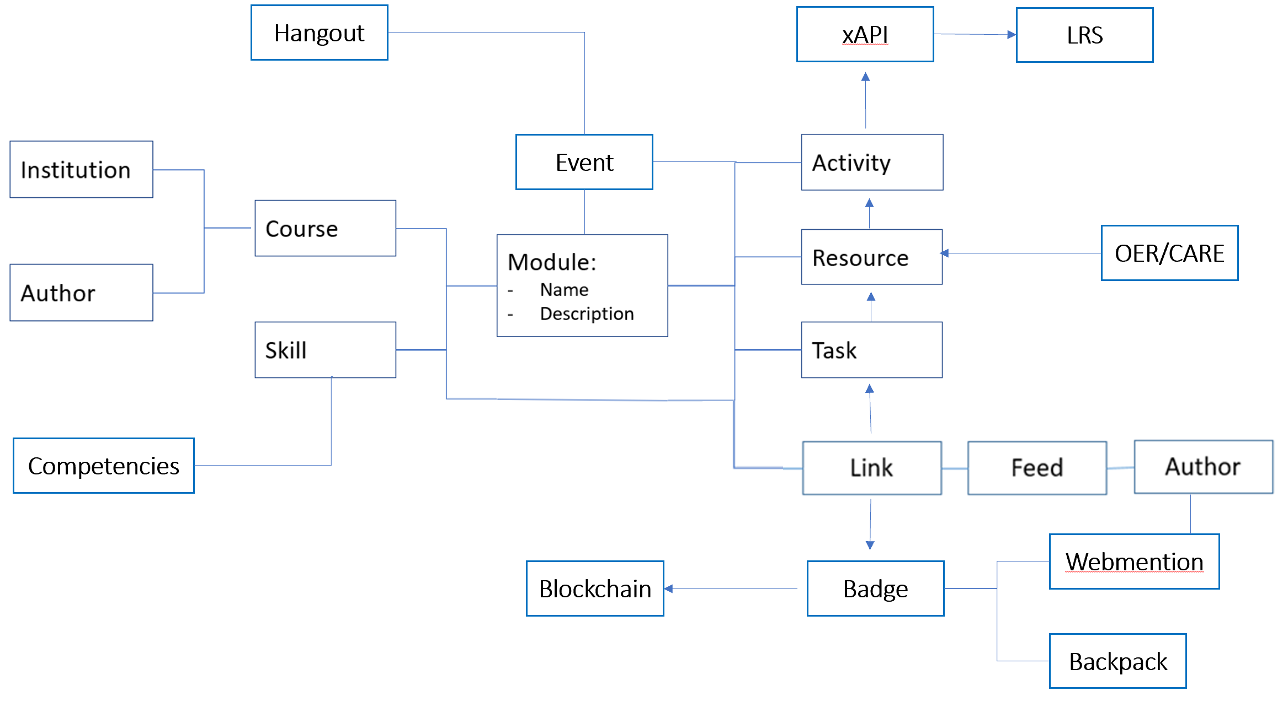
The BIG Idea - Course(?) as Open Data
Decentralized, Distributed, Open
“Open Data is the idea that some data should be publicly available and usable
The course as decentralised: "Decentralized means that there is no single point where the decision is made. “
The course as distributed: There is no one place where the course is.

Slide 21
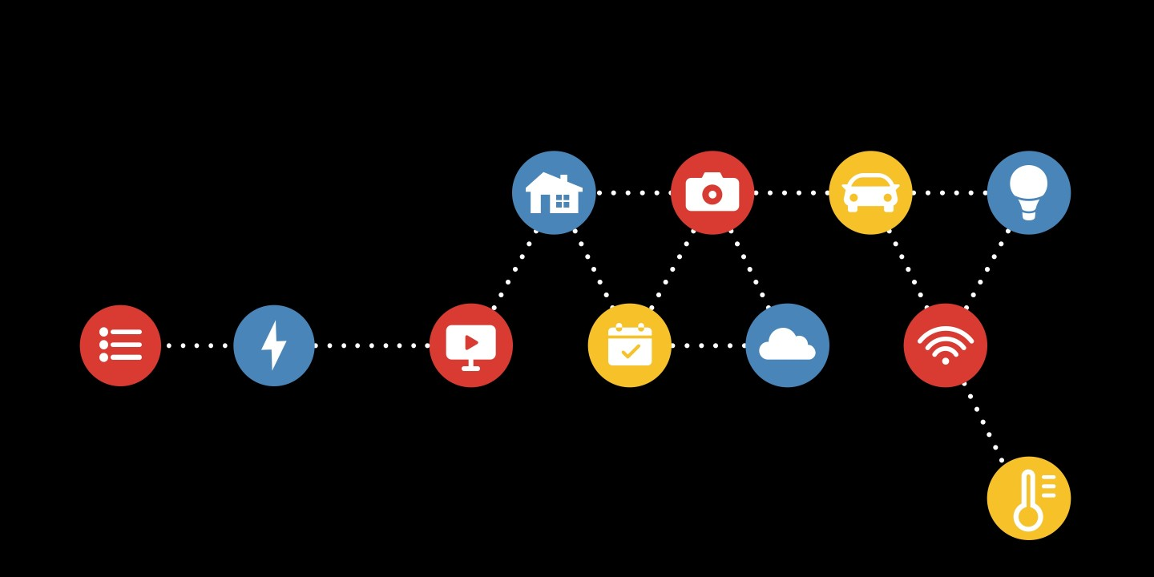
Activity - My Open Data Feed
Use this space to design a data flow for your course, thinking of different sources of data and how they might be applied.
Working With Open Data: IFFFT
‘If This Then That (IFTTT) is a service that allows you to link data from different information sources. Thus, for example, you could have IFTTT send you an email each time the fridge is opened. Or compile a spreadsheet of all your Twitter posts.
http://www.ifttt.com
It is helpful to have a focus, e.g. ‘Space’ or ‘Health professionals’

Slide 22

Cloud
Cloud computing involves using servers and infrastructure hosted by internet-based providers. You can then access these from any computer, and also link them together for advanced applications.
Feature Article: Cloud: https://el30.mooc.ca/post/68440
Featured Video: Conversation with Tony Hirst https://el30.mooc.ca/event/81

Slide 23
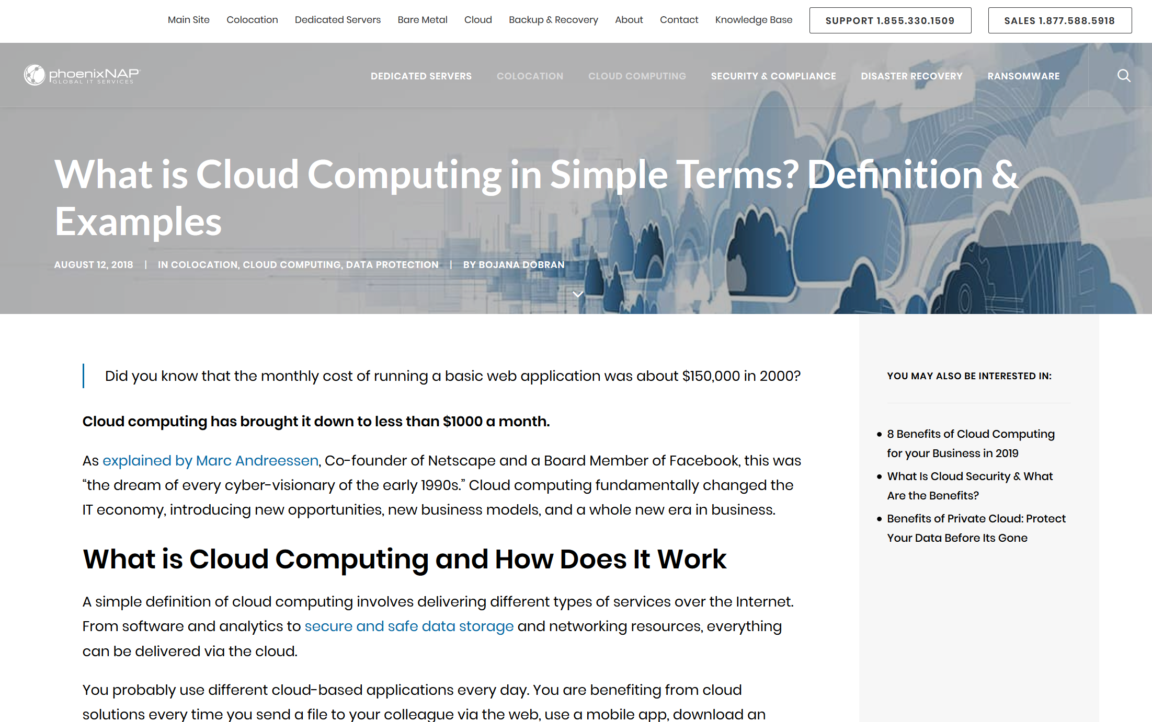
What is Cloud Computing in Simple Terms? Definition & Examples. Bojana Dobran. https://phoenixnap.com/blog/what-is-cloud-computing

Slide 24
ψ
Computing as Commodity
The conceptual challenge is that it doesn’t matter whose computer it is, that it could change any time, and that we should begin to think of “computing” and “storage” as commodities, more like “water” or “electricity”.

Slide 25
:
Virtualization
Server virtualization begins with applications such as VMWare or Parallels, and progresses through a range of increasingly sophisticated computing containers created using programs like Docker and run using services like Amazon Web Services.

Slide 26
%
Direct Experience
Students are now able to edit and create new tools to create text, music and art. They will be able to directly experience the relation between algorithm and outcome, or between mathematics and music, as the case may be.

Slide 27
Ξ
New Possibilities
These new resources allow us to redefine what we mean by ‘textbooks’ and even ‘learning objects’. By putting powerful applications into the hands of students we create new possibilities for manipulation, visualization and creativity.
Feature Article: Data. https://el30.mooc.ca/post/68416
Featured Video: Conversation with Shelly Blake-Plock https://el30.mooc.ca/event/80

Slide 28
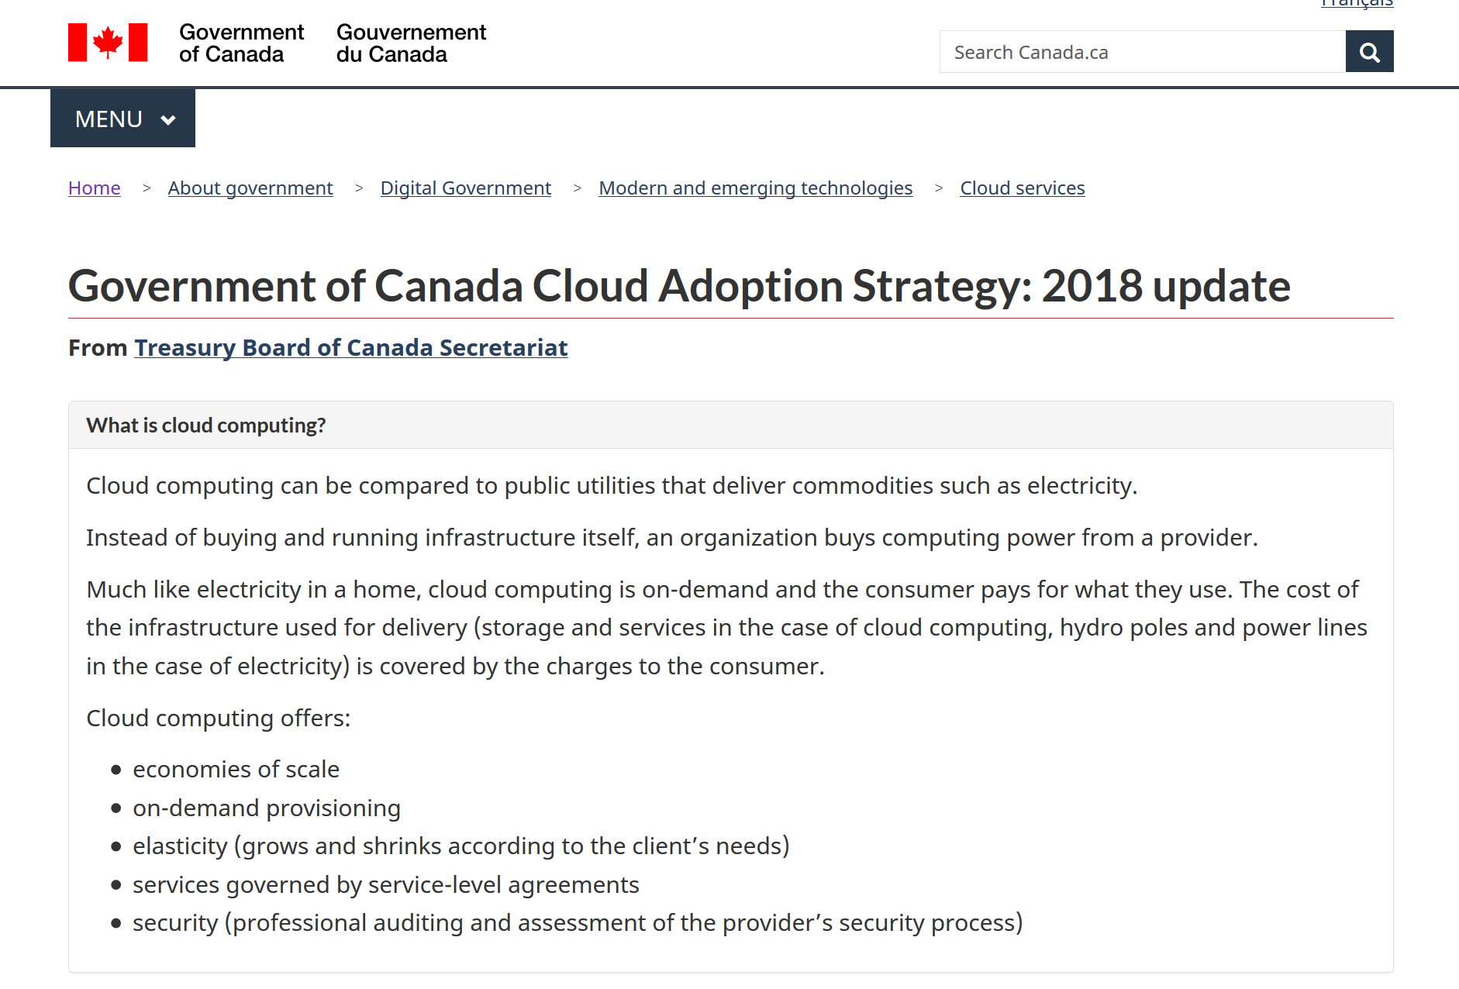
Cloud Adoption Strategy: 2018 update. Government of Canada. https://www.canada.ca/en/government/system/digital-government/modern-emerging-technologies/cloud-services/government-canada-cloud-adoption-strategy.html

Slide 29
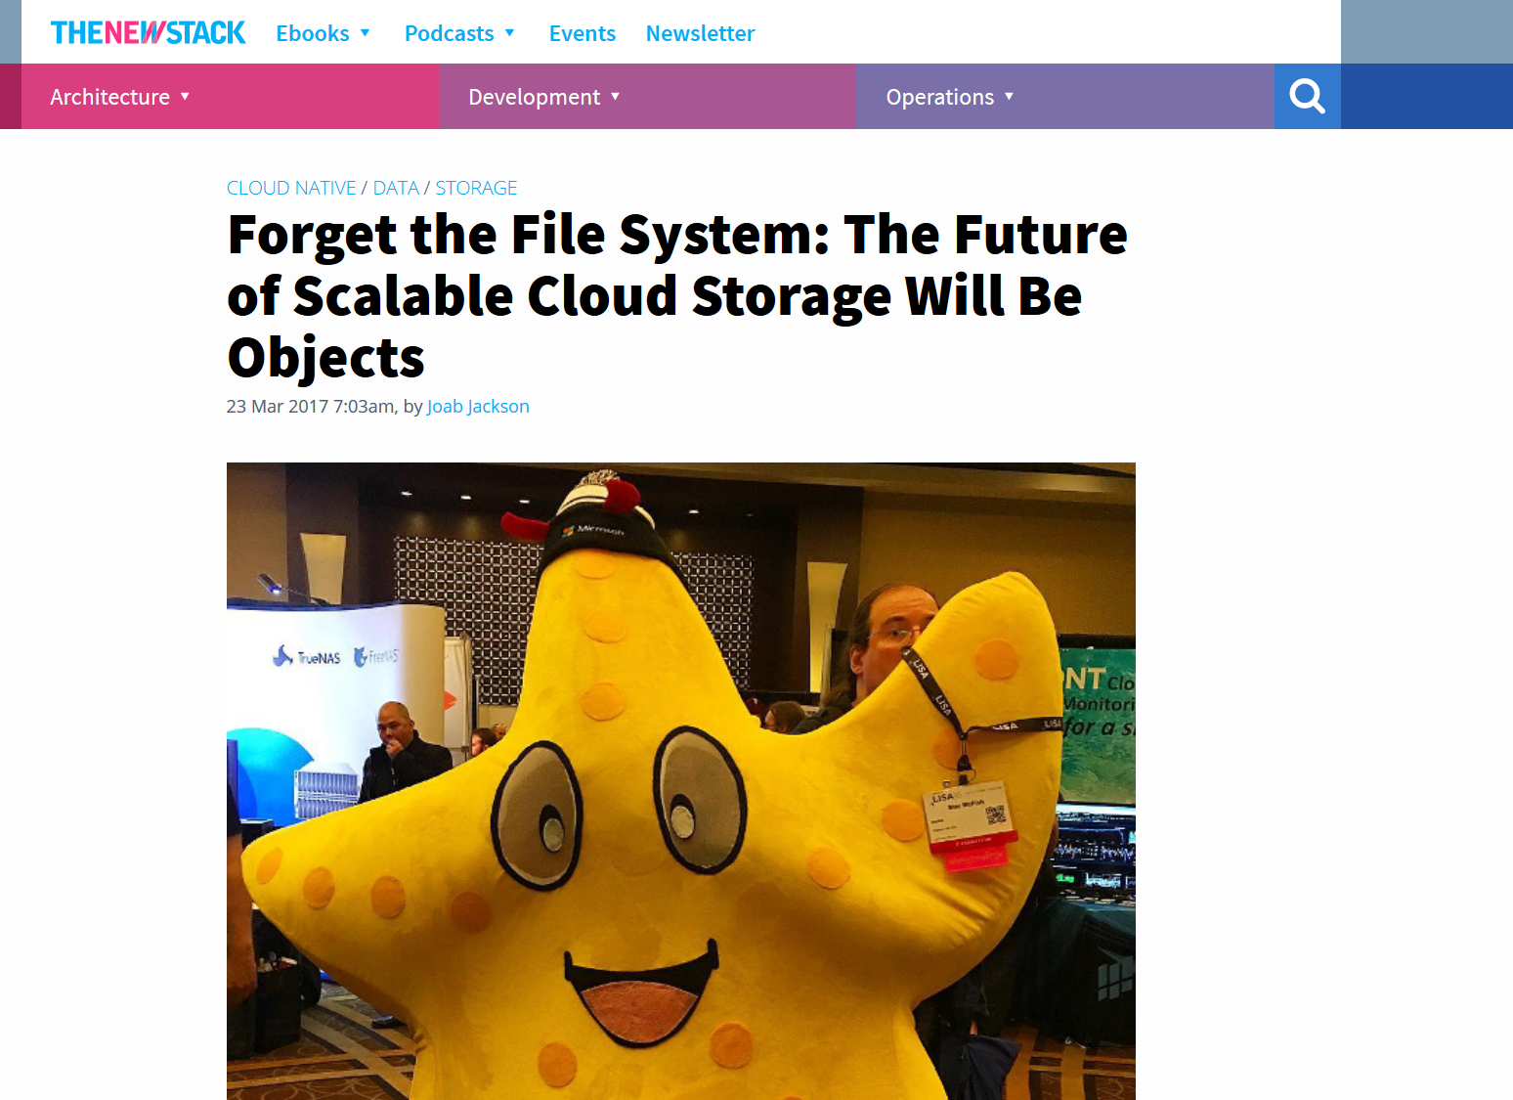
Forget the File System: The Future of Scalable Cloud Storage Will Be Objects. Joab Jackson. https://thenewstack.io/forget-file-system-future-scalable-cloud-storage-will-objects/

Slide 30
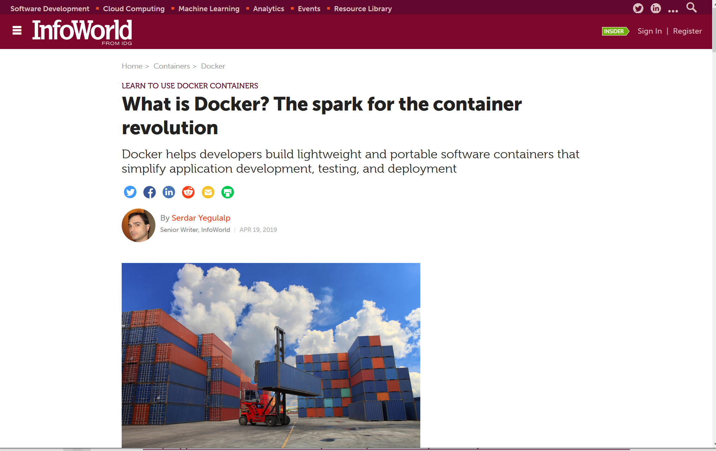
What is Docker? Docker containers explained. Serdar Yegulalp, InfoWorld. https://www.infoworld.com/article/3204171/docker/what-is-docker-docker-containers-explained.html

Slide 31
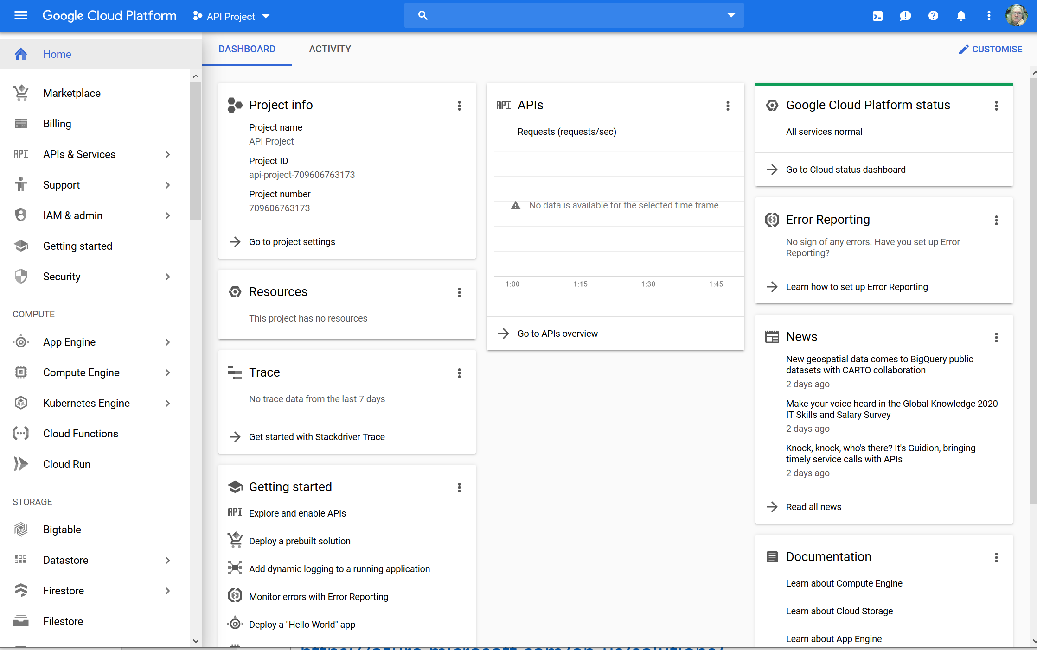
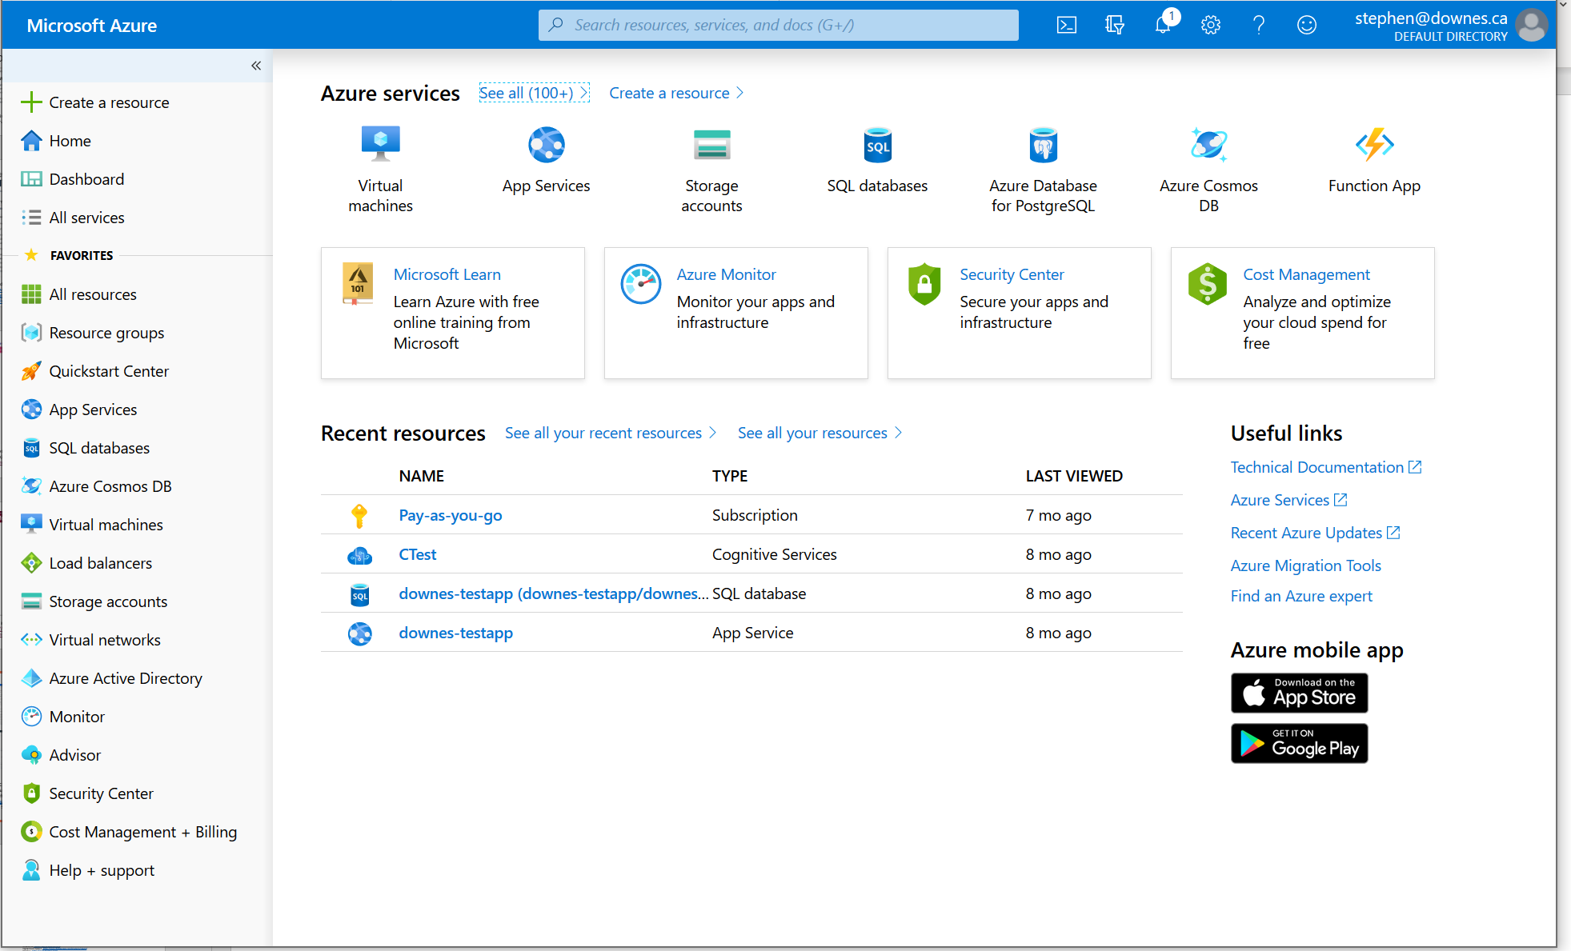
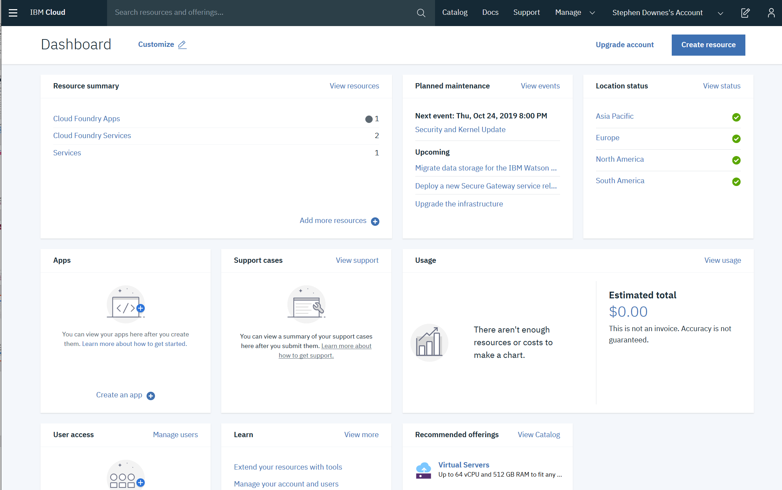
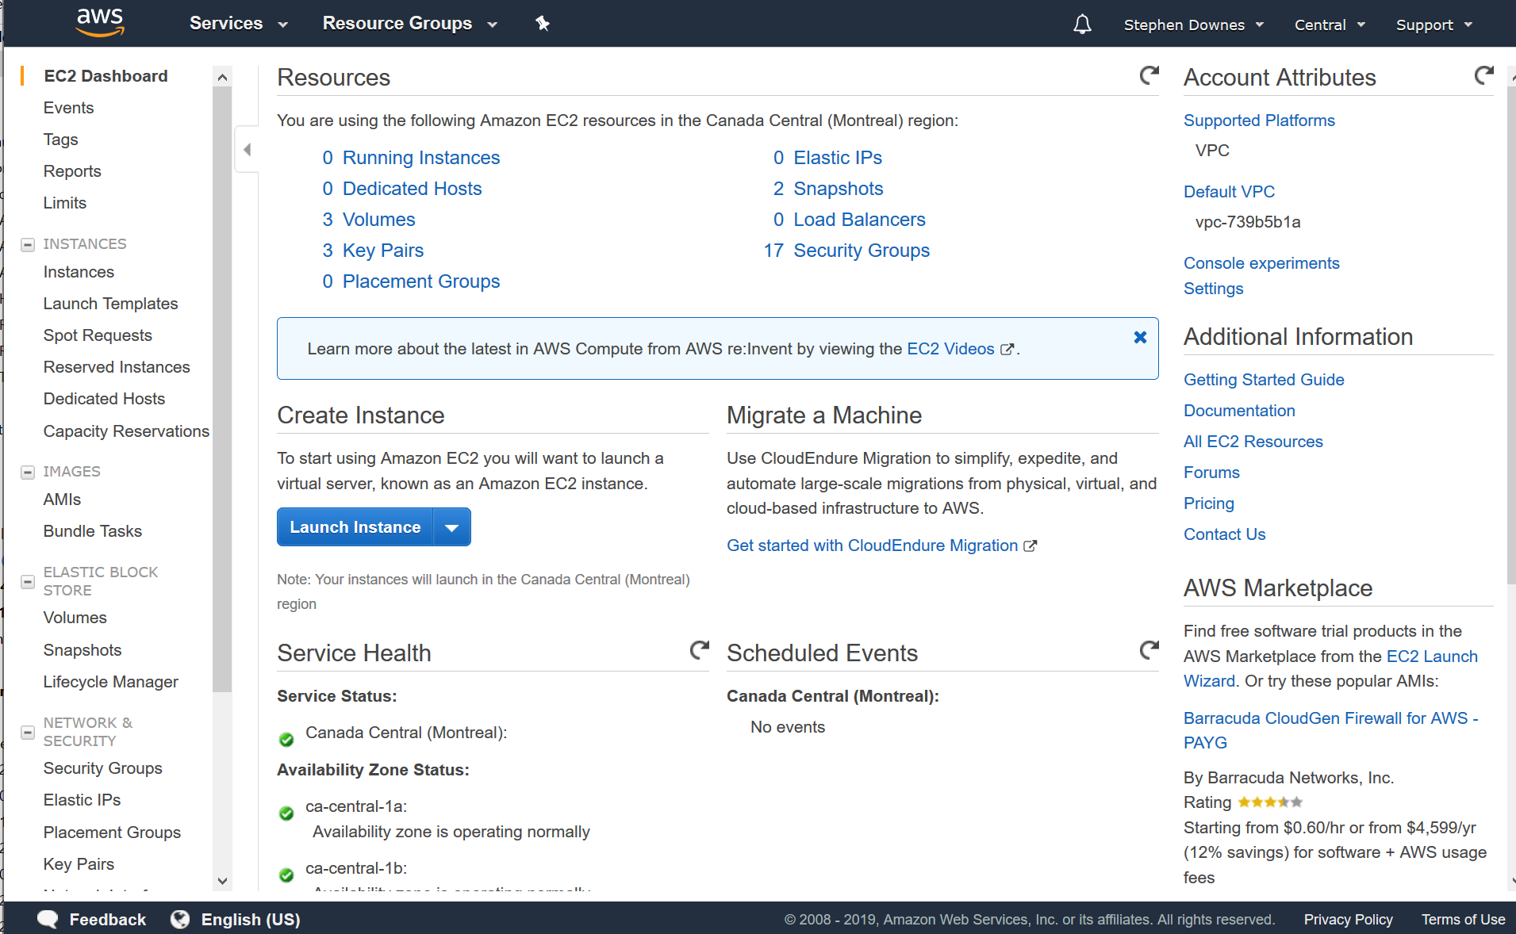
Google Cloud - https://cloud.google.com/
Microsoft Azure - https://azure.microsoft.com/en-us/solutions/
Amazon S3 - https://aws.amazon.com/s3/
IBM Cloud https://cloud.ibm.com

Slide 32
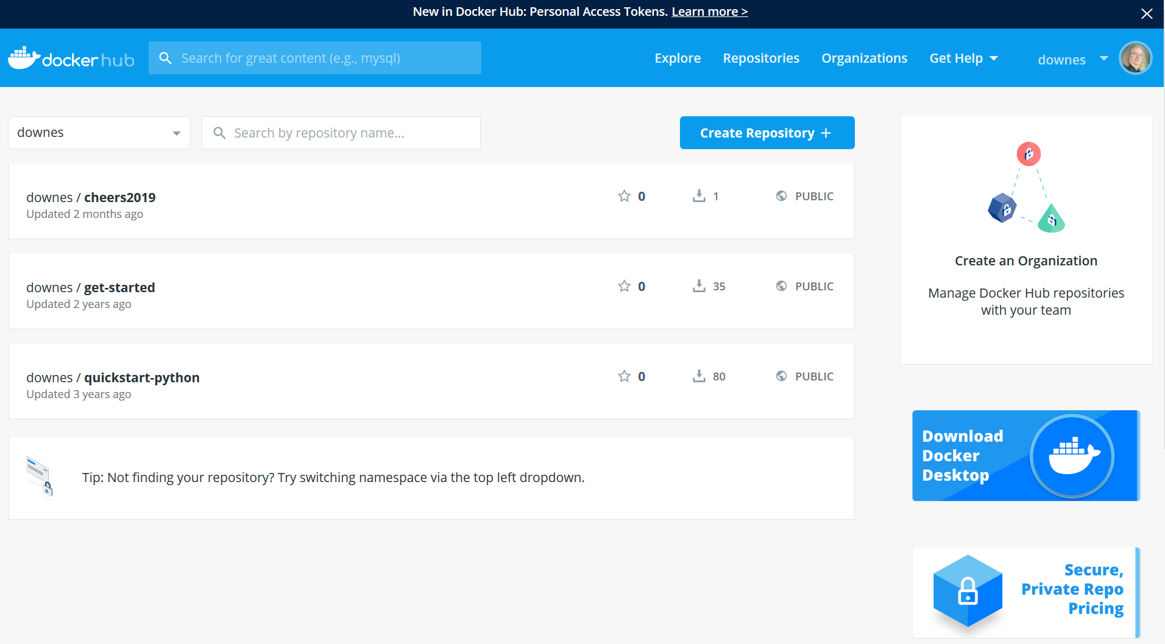
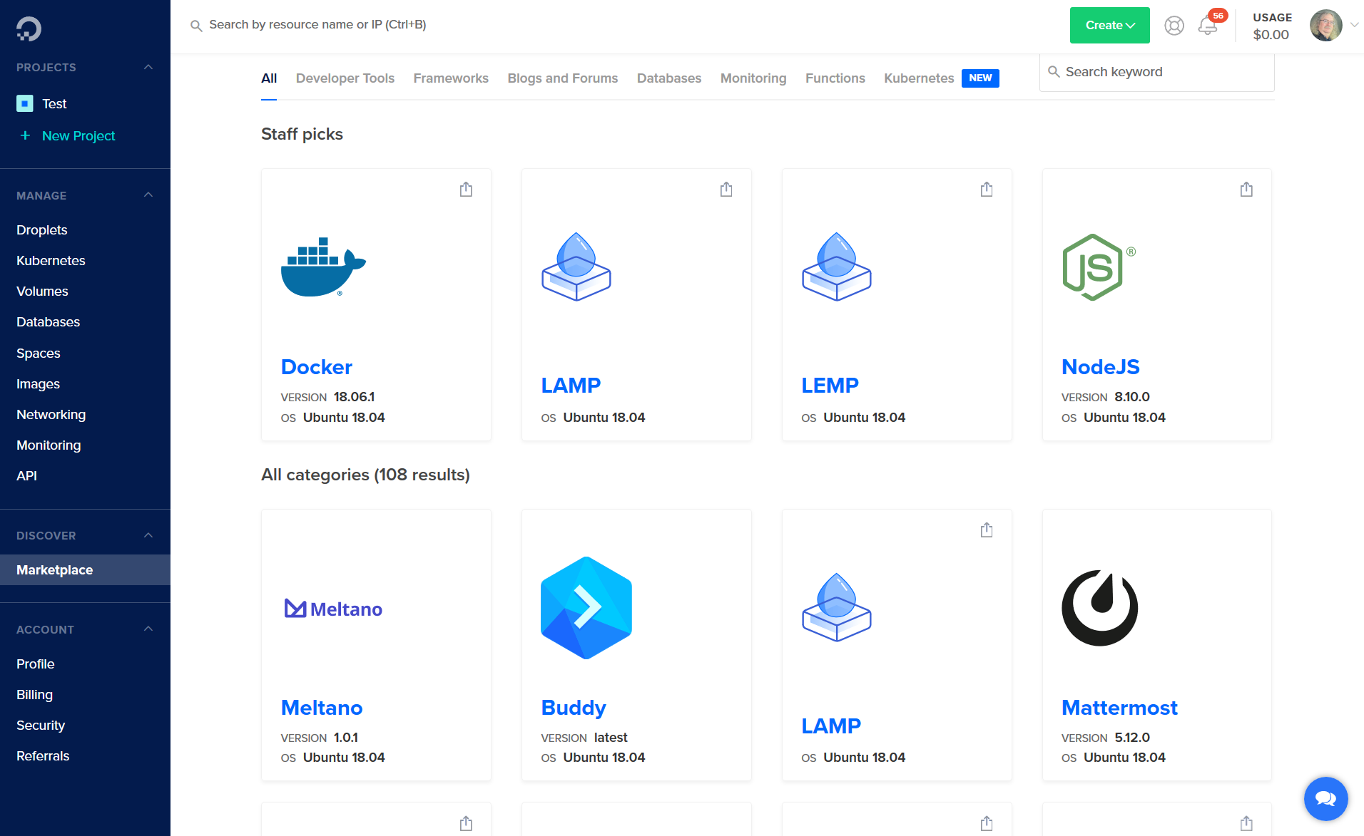
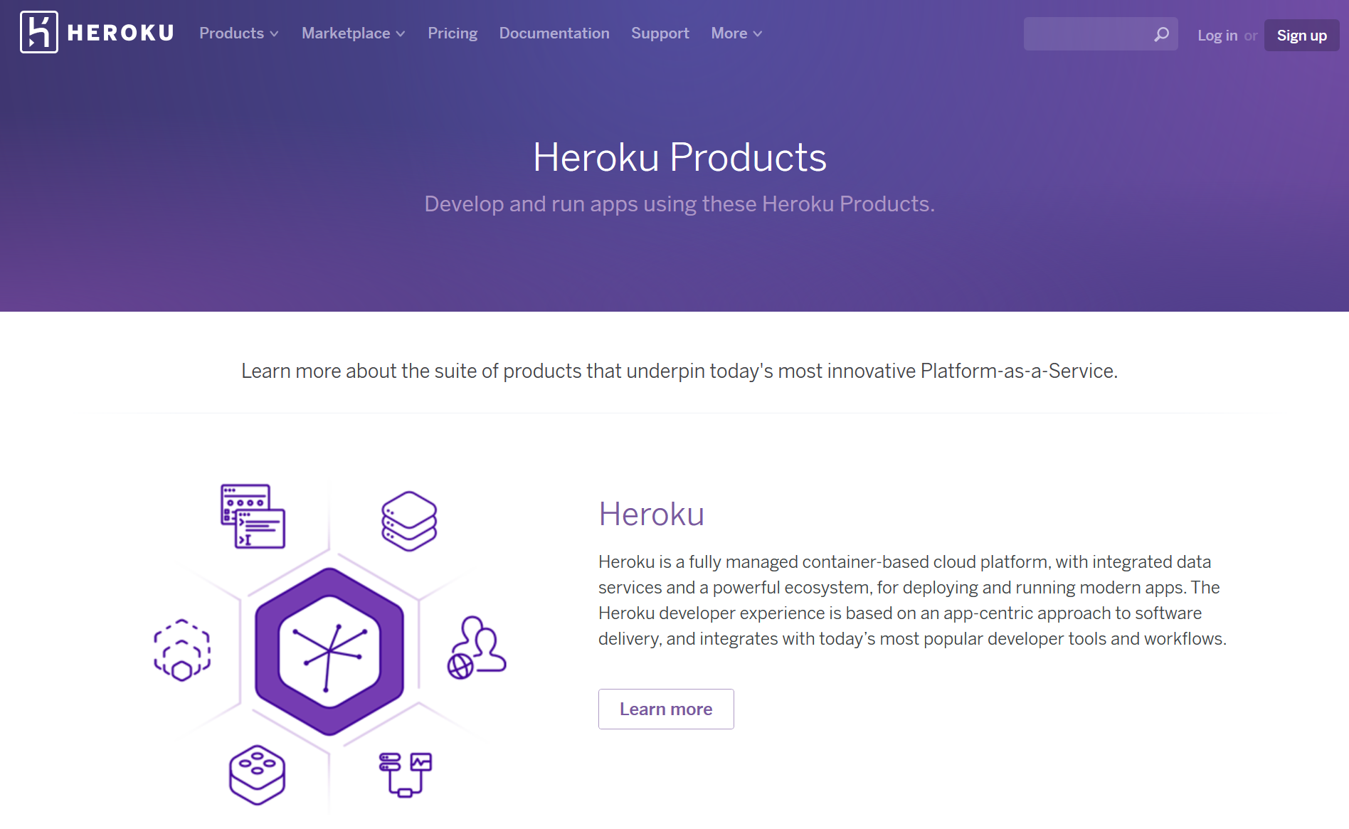
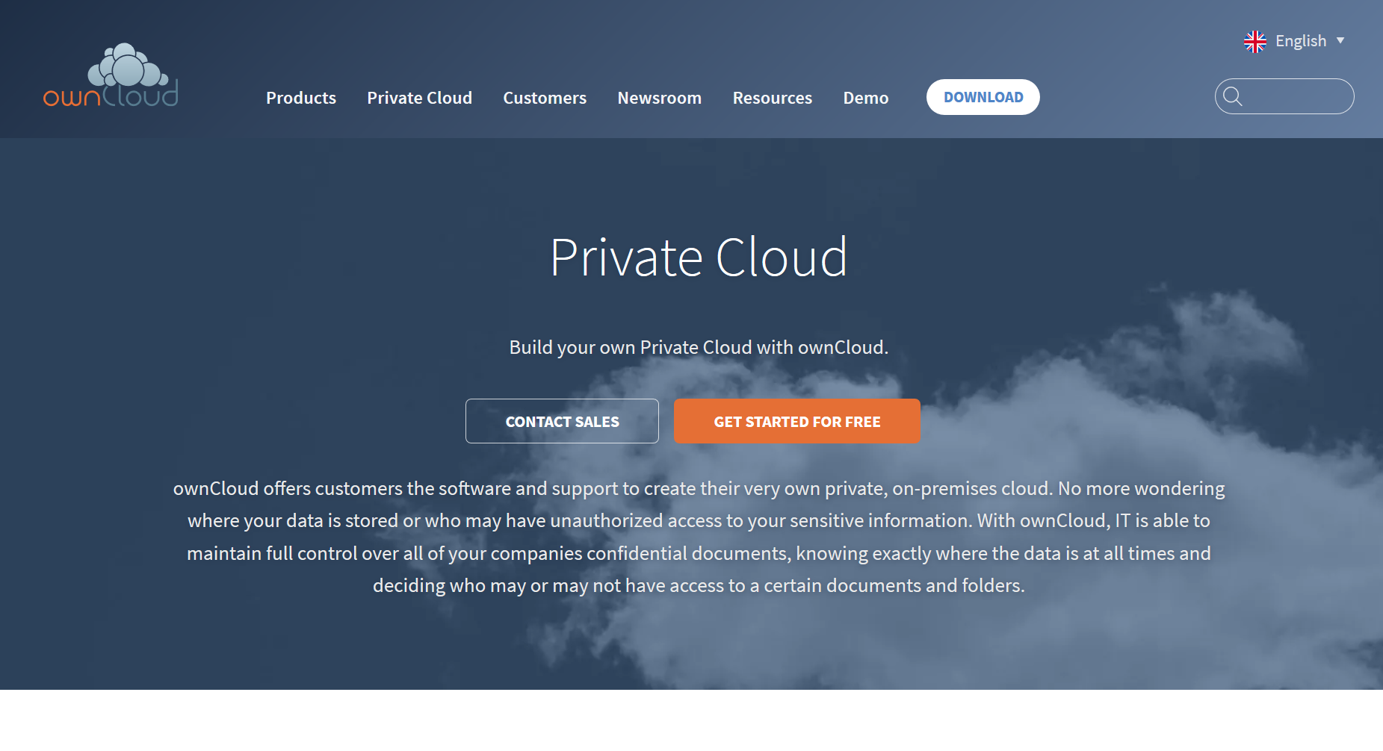
https://www.docker.com/
https://www.digitalocean.com/
https://owncloud.com/overview/
https://www.heroku.com/

Slide 33
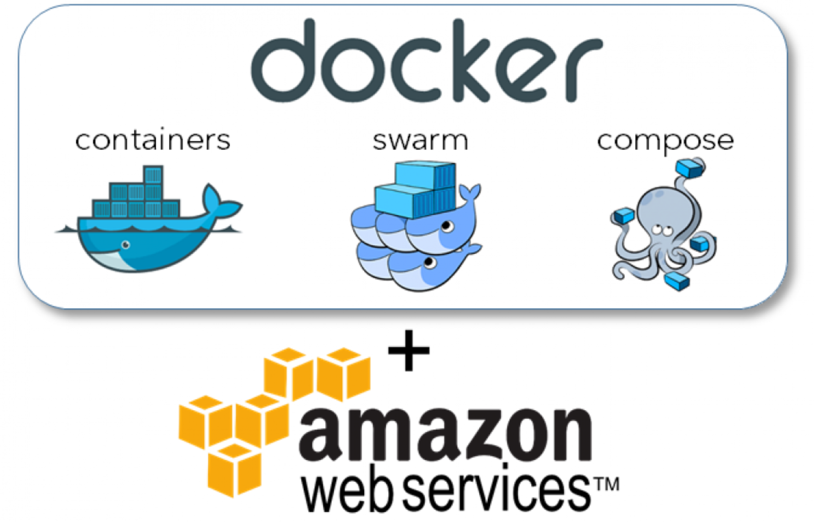
The BIG Idea - ​Courses in Containers
Today, we can automate the creation and deployment of cloud containers. This means that a course can be created ‘in a box’ and then deployed when and were needed.
What is Docker? Docker containers explained. Serdar Yegulalp, InfoWorld. https://www.infoworld.com/article/3204171/docker/what-is-docker-docker-containers-explained.html

Slide 34
Activity - Create a Cloud-Based Service
Use this space to design the architecture of a cloud-based online course. What services would you need? How would you provide them?
It might be a good idea to focus on a particular application, e.g. space, health care.
Eg. MS Azure service

Slide 35
Graph
When we connect things together we have created a graph. A graph has two types of component: the entities being connected (sometimes called nodes), and the connections between those entities (sometimes called edges).
Feature Article: Graph. https://el30.mooc.ca/post/68472
Featured Video: Conversation with Ben Werdmuller https://el30.mooc.ca/event/82

Slide 36
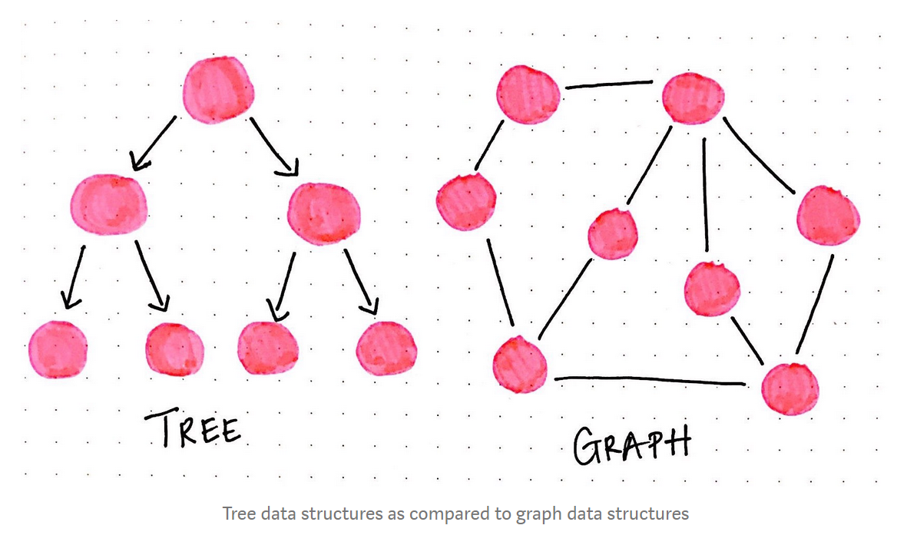
A Gentle Introduction To Graph Theory. Vaidehi Joshi. https://medium.com/basecs/a-gentle-introduction-to-graph-theory-77969829ead8

Slide 37
ψ
Knowledge as a Graph
In connectivism we explored the idea of thinking of knowledge as a graph. Yet, what makes it knowledge? In the Semantic Web, we are faced with a similar question. What is the ‘source of truth’ of a distributed representation?

Slide 38
:
New Types of Inference
As repositories of knowledge, graphs enable the same data to be viewed from a variety of perspectives. Manipulations of and inferences from these data structures allow us to draw conclusions and make new connections – drawing associations between similar entities, for example.

Slide 39
%
Learning as Growth
It helps to understand that each idea connects to another, and it’s not the individual idea that’s important, but rather how the graph grows and develops. It protects us from category erors and helps prevent things like confirmation bias.

Slide 40
Ξ
New Types of Content
The data structures we can build using these technologies have created a new type of content. One example is BitCoin, based on the recording of transactions in a blockchain, which is essentially a hash graph.
Feature Article: Data. https://el30.mooc.ca/post/68416
Featured Video: Conversation with Shelly Blake-Plock https://el30.mooc.ca/event/80

Slide 41
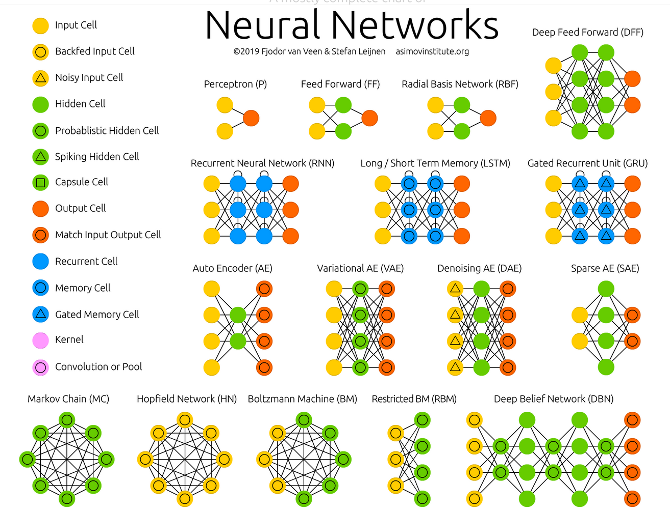
The Neural Network Zoo. Fjodor van Veen. Neural Networks are types of graphs. http://www.asimovinstitute.org/neural-network-zoo/

Slide 42
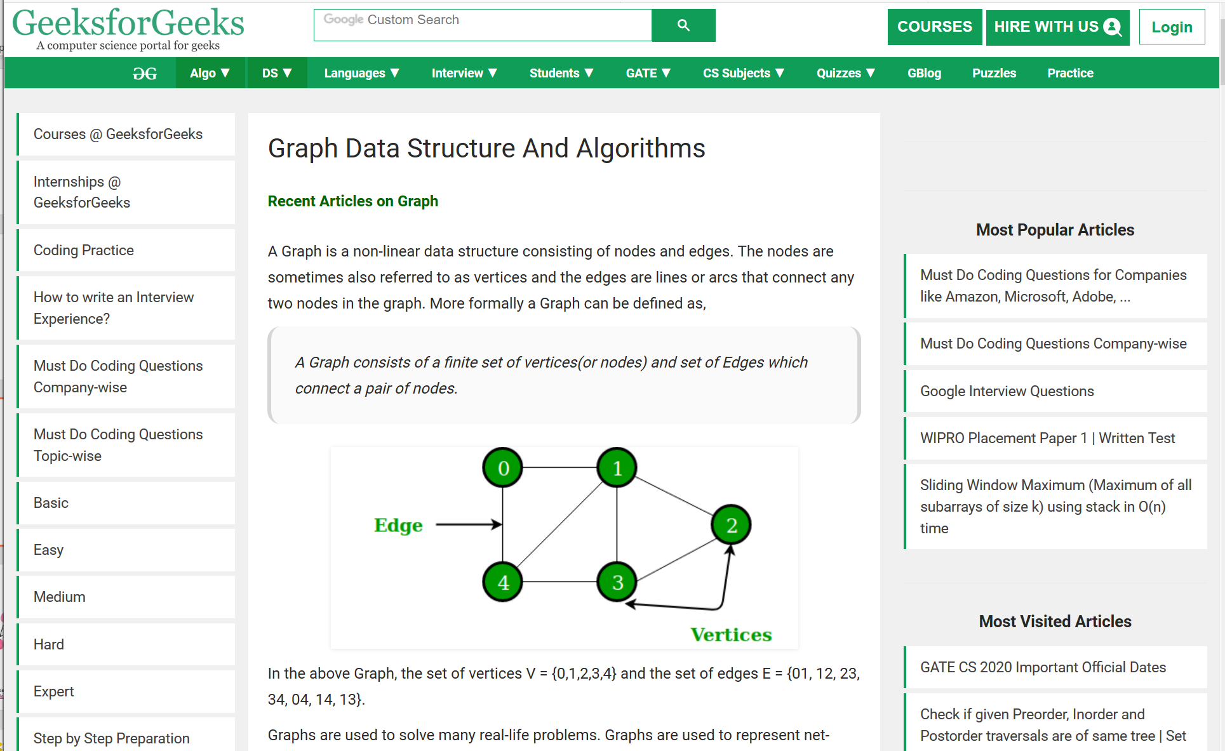
Graph Data Structure And Algorithms. This page has a very brief description of a graph data structure and then a long list of things that can be done with graphs - cycling, sorting, spanning, searching. https://www.geeksforgeeks.org/graph-data-structure-and-algorithms/

Slide 43
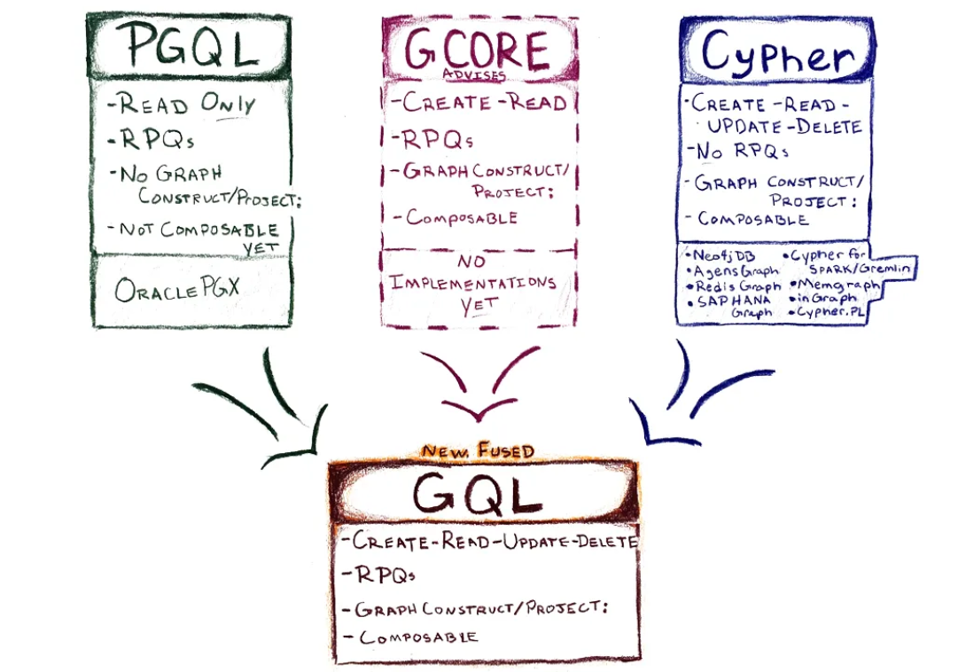
GQL Is Now a Global Standards Project alongside SQL. https://gql.today/
Neo4J – What is a Graph Database? - https://neo4j.com/developer/graph-database/

Slide 44
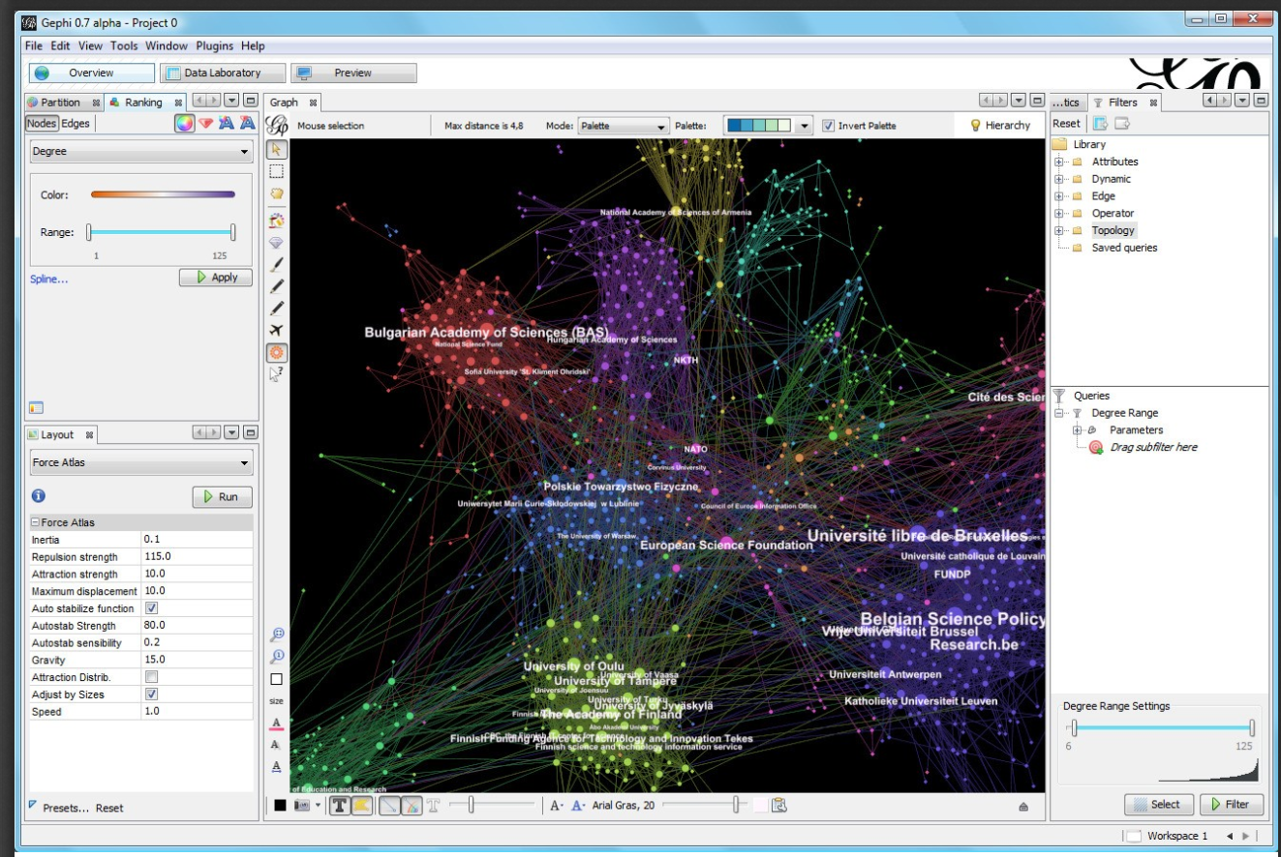
Social Network Analysis. Philip Leifeld. http://www.bearnetwork.ca/wp-content/uploads/2018/10/slides-leifeld-bear.pdf
Gephi – free and open source visualization and exploration software for all kinds of graphs and networks. https://gephi.org/

Slide 45
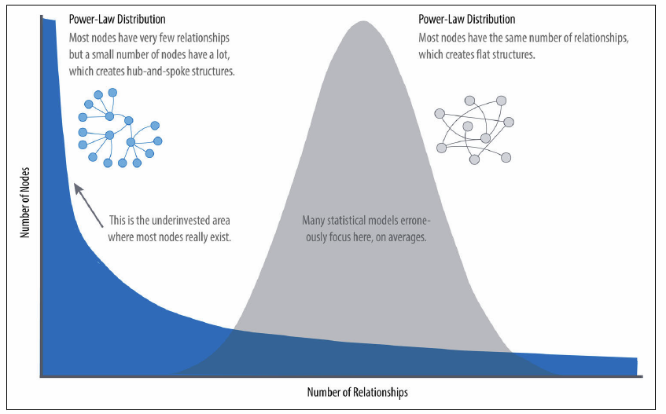
The BIG Idea - Graph, Not Story
All events are complex events and all disciplines are complex disciplines. Yet we have the urge to represent events and disciplines from the perspective of a narrative
We are seeing the flaws of the narrative approach in contemporary journalism - a power-law understanding of the world, with a focus on a small and narrow set of interests and priorities.
https://www.vanityfair.com/news/2019/01/how-the-media-can-prevent-2020-from-becoming-2016

Slide 46
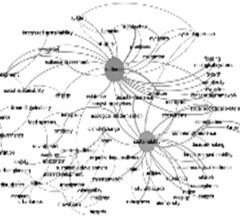
Urban Resilience Discourse Analysis
By mapping the graph of topics discussed by authors in a set of journal articles researchers can obtain a ‘map’ of the field, helping them instantly perceive trends and relations of ideas. This gives students multiple entry points into the study.

Slide 47
Activity - My Model Graph
Instructions
Create a model graph of some aspect of this workshop (it doesn't have to be an actual graph, only a representation of what an actual graph might look like. We've already seen, eg., graphs on the relations between people in the workshop. Could there be other types of graphs?
In your model, consider how the states of the entities in that graph might vary. Consider not only how nodes might vary (eg., a person might have a different height over time) but also how the edges might vary (eg., a person might have a different strength of relation (calculated how?) with another person over time).
In your model, consider how knowledge about the changes in states in the graph might be used.
Optional: Create your graph using an online service like https://www.draw.io/

Slide 48
Resources
Learning resources have traditionally been things like textbooks and media, but now learning resources can be anything from video to virtual reality to application. How we describe these, and access them, is changing.
Feature Article: Resources. https://el30.mooc.ca/post/68554
Featured Video: Conversation with Sukaina Walji and Cheryl Hodgkinson-Williams https://el30.mooc.ca/event/84

Slide 49
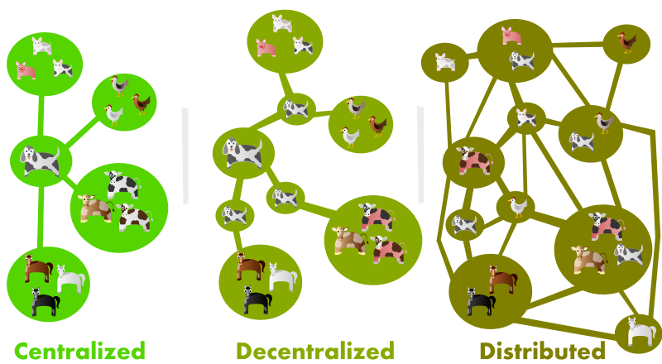
Introducing the Dweb. Dietrich Ayala. The “d” in “dweb” usually stands for either decentralized or distributed. https://hacks.mozilla.org/2018/07/introducing-the-d-web/

Slide 50
ψ
Closing of the Web
Since the early days the web has been increasingly locked down, and the once seamless interaction between people and data has been put behind paywalls and content silos. Web3 is to a large degree a reaction against this.

Slide 51
:
Content Addressing
Content addressable resources for education create mechanisms for the creation of resource graphs linking data, media, software and people, redefining our idea of an open course and open pedagogy.

Slide 52
%
New Forms of Open
The concept of Content Addressable Resources for Education addresses thequestion of the sustainability of open educational resources. These resources will be packaged across a content-addressable network, whereupon they become permanently open.

Slide 53
Ξ
New Types of Content
We have already seen more traitional contents, such as books, media and music being distributed through IPFS. Similar technologies support more complex content, for example, distributed applications (dApps), subscriptions and lists, contract networks, and even distributed organizations.

Slide 54
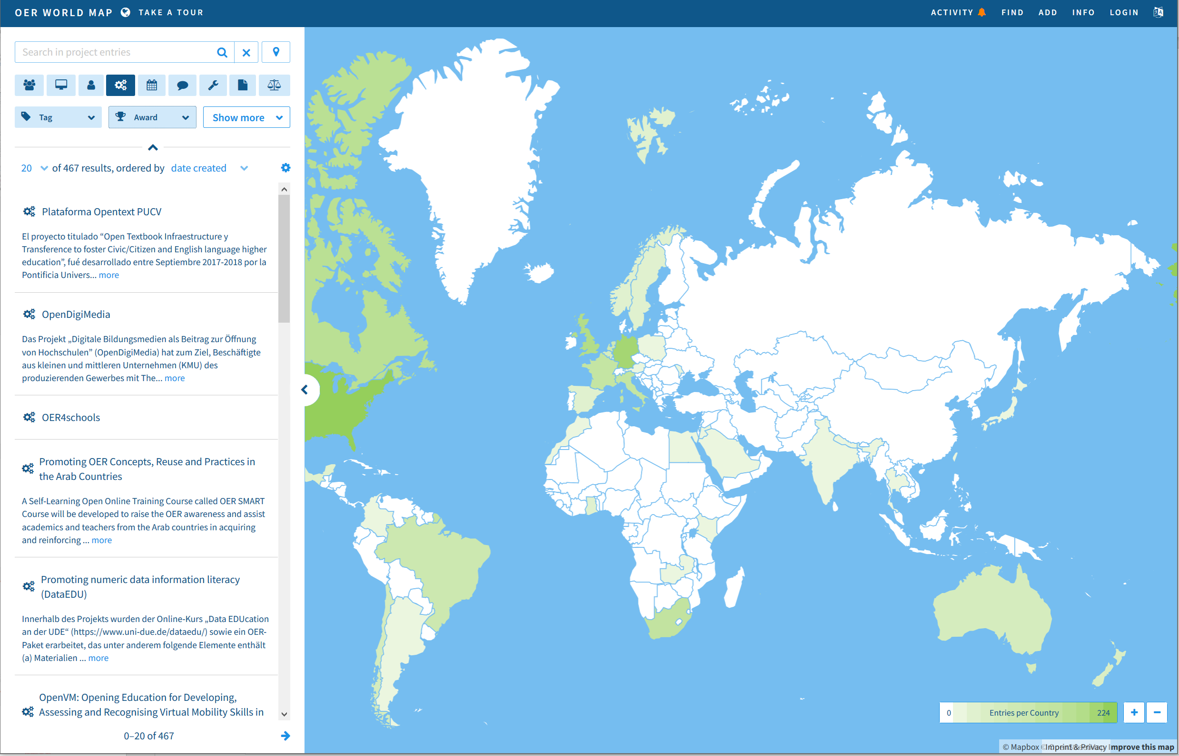
OER World Map. A couple years or so ago UNESCO launched an OER mapping project. https://oerworldmap.org/

Slide 55
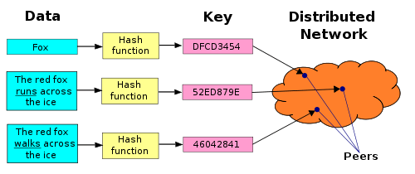
Distributed Hash Table. Type of decentralized distributed system. https://ipfs.io/ipfs/QmXoypizjW3WknFiJnKLwHCnL72vedxjQkDDP1mXWo6uco/wiki/Distributed_hash_table.html
Interplanetary File System (IPFS) - A peer-to-peer hypermedia protocol designed to make the web faster, safer, and more open. https://ipfs.io/

Slide 56
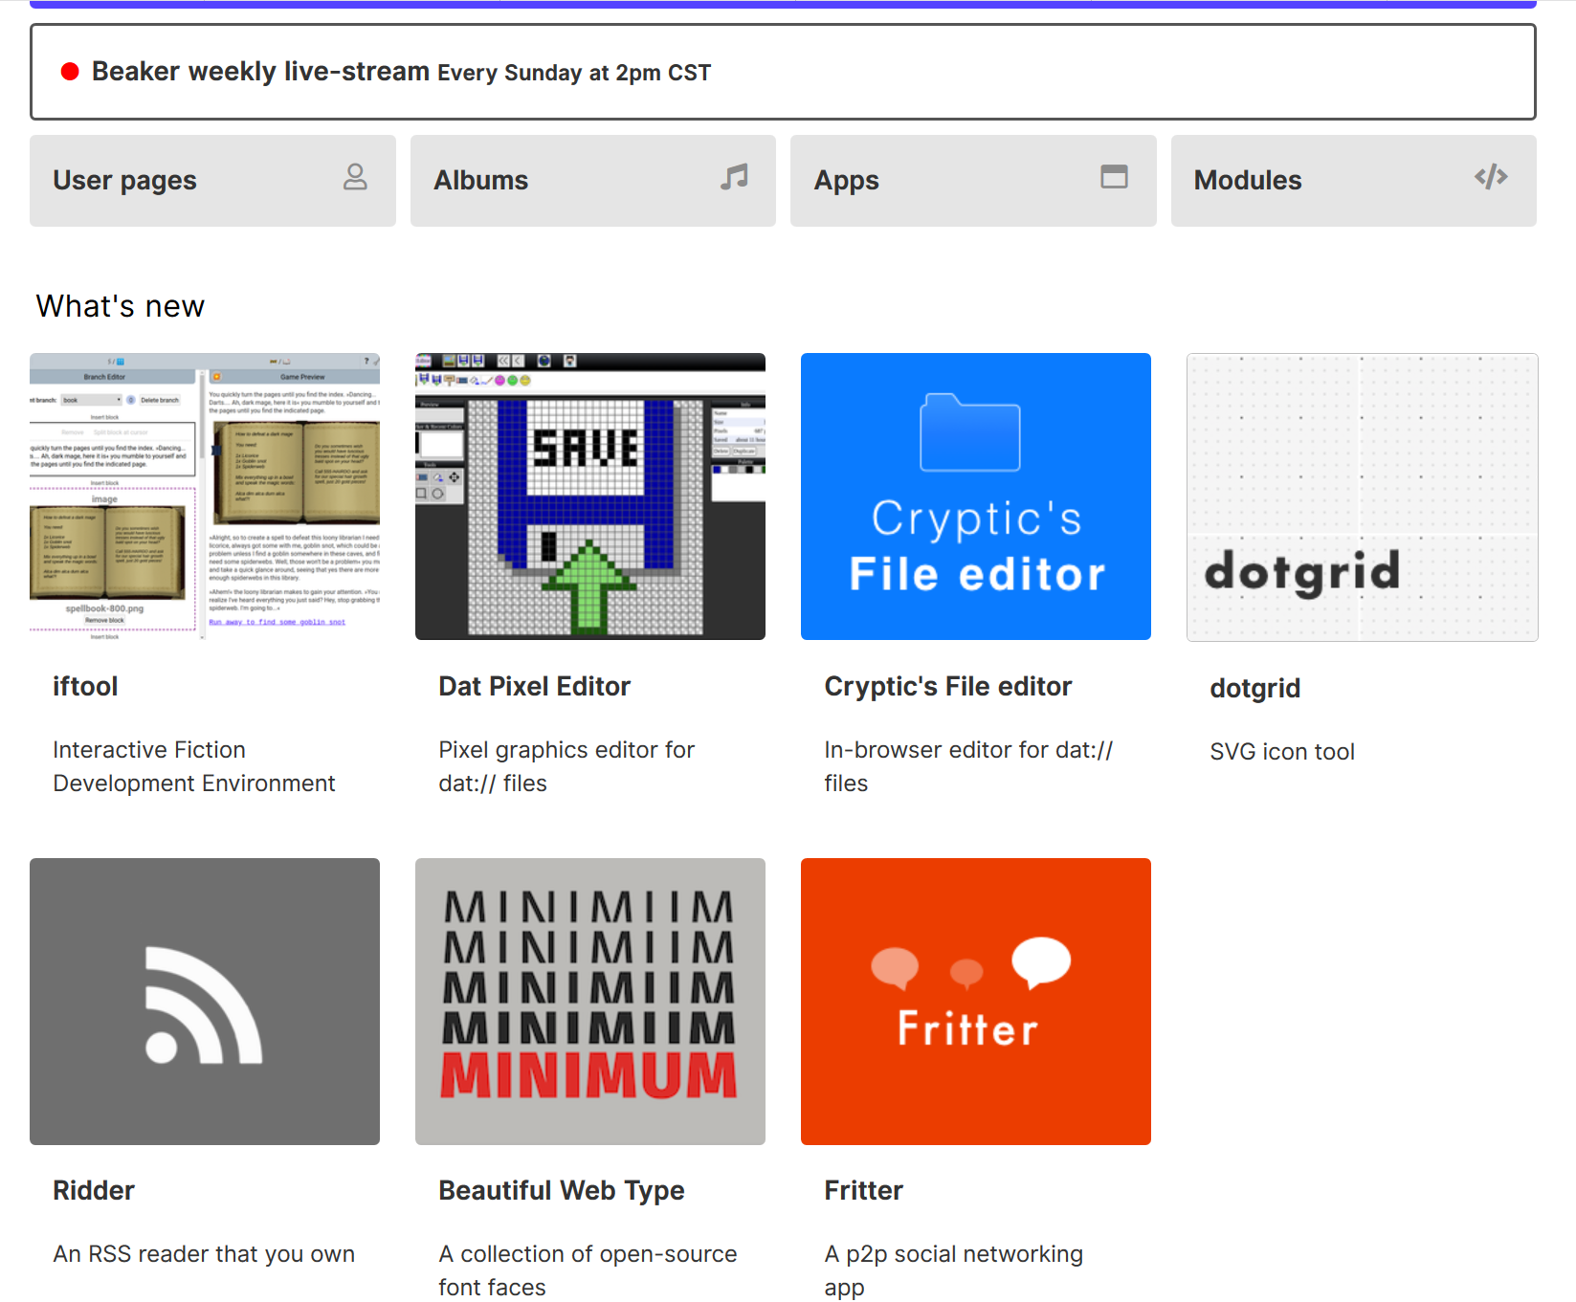
Beaker. Beaker is an experimental browser for exploring and building the peer-to-peer Web. https://beakerbrowser.com/

Slide 57
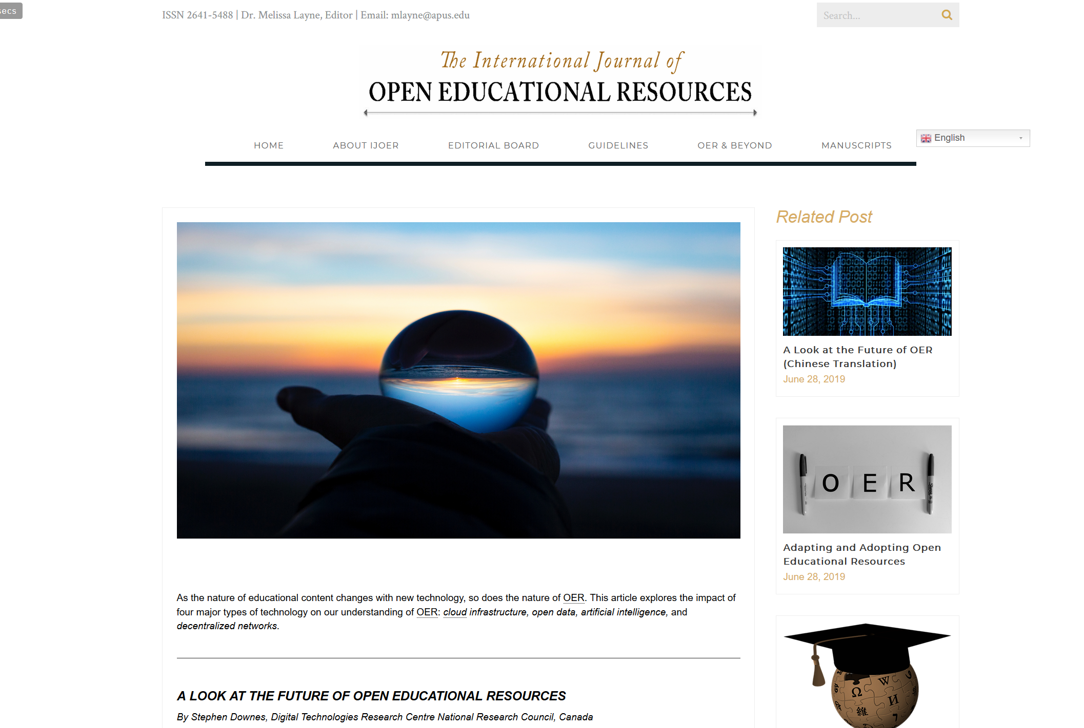
A Look at the Future of Open Educational Resources. https://www.ijoer.org/a-look-at-the-future-of-open-educational-resources/

Slide 58
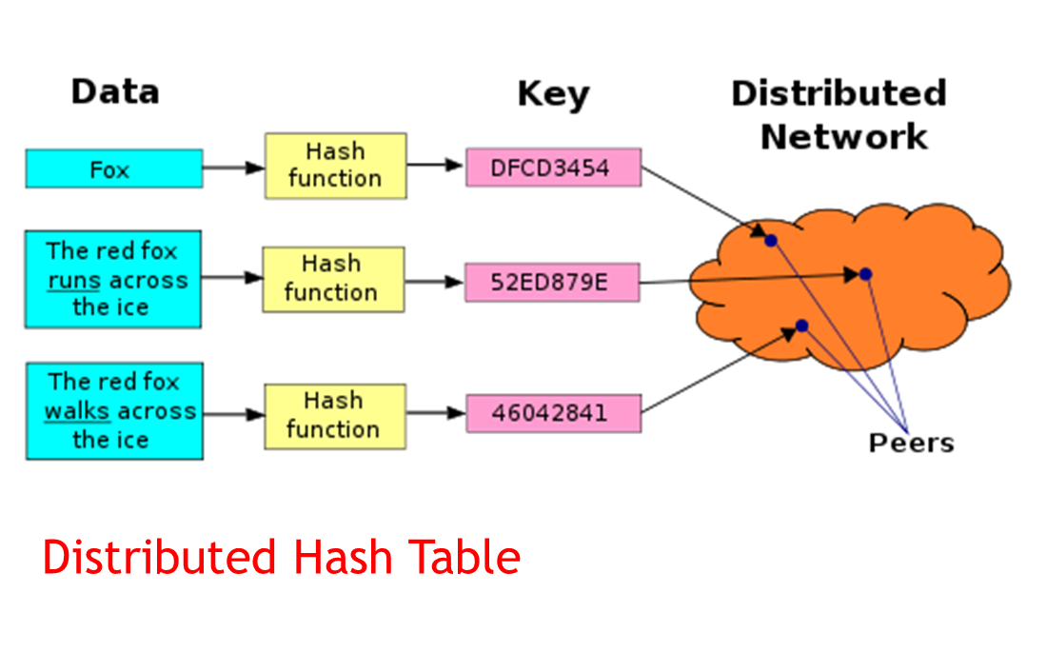
The BIG Idea - ​Content Addressable Resources for Education
Each piece of content has a unique address, which is a hash of its content

Slide 59
Open educational resources in the future:
OER will be more like tools that students use in order to create their own learning content, which they will then consume or use for some other purpose.
The learning happens through the use of the content.
Licensing fades to the background is that most resources are created and used only once.
Technologies such as encryption, hashing and blockchain create a record of ownership and provenance of any resource.

Slide 60
Activity - My OER
Instructions:
Design a scenario where students could obtain content or data, revise or remix that content or data, and create a new learning resource for their own use.
Bonus: try downloading and using the Beaker browser

Slide 61
Identity
In this workshop we look at identity relatively narrowly, asking how we know who someone is, how we project ourselves on the internet, and how we can be safe and secure.
Feature Article: Identity. https://el30.mooc.ca/post/68516
Featured Video: Conversation with Maha Bali https://el30.mooc.ca/event/83

Slide 62
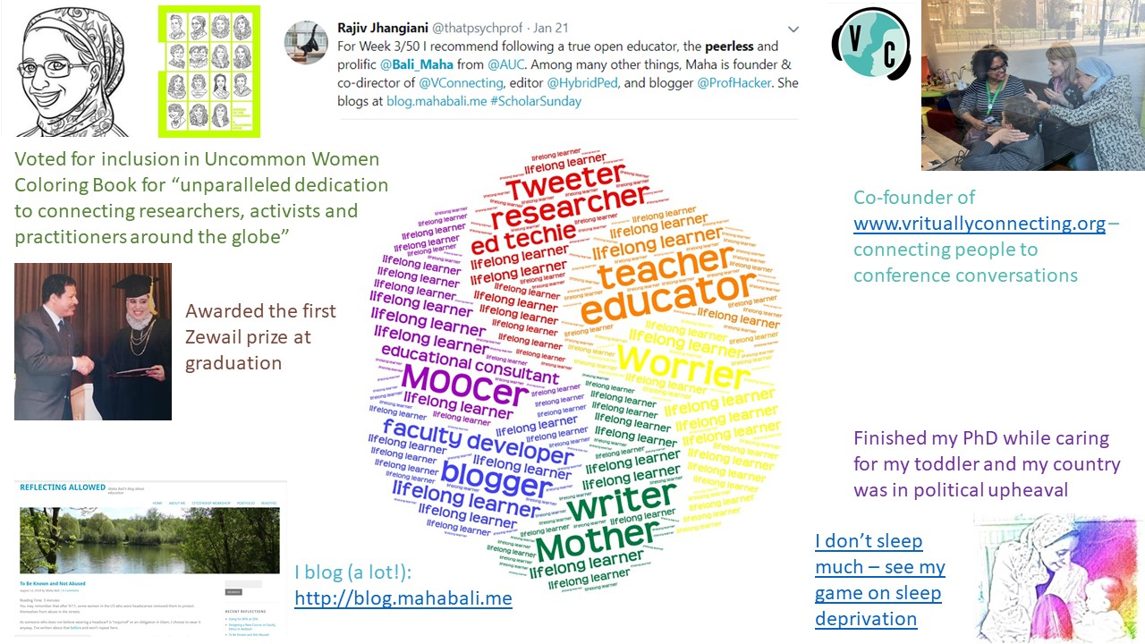
Identity as Evolving, Dynamic, Contextual. Maha Bali. https://blog.mahabali.me/writing/identity-as-evolving-dynamic-contextual-el30/

Slide 63
ψ
The Qualified Self
Instead of demographics being about quantity we will now have access to a rich tapestry of data and relations. The quantified self will give way to the qualified self.

Slide 64
:
Digital Identity
We look t identity narrowly, asking how we know who someone is, how we project purselves onto the internet (and into society), and how we can be safe and secure. In a wider sense, however, we are developing a mechanism for the creation of a digital identity.

Slide 65
%
Teaching Identity
Should we think of identity from the outside in or the inside out? Can we teach identity? Is identity something that can be done to us or for us? Or is it inherent in our nature, something we bring to education as course participants, something that informs how we see and how we learn?

Slide 66
Ξ
We are the Content
We were the client, we were the product, are we at last the content? We are the thread that runs through an otherwise disconnected set of data. Knowledge about ourselves will create an underlying fabric against which the value and relevance of everything else will be measured.

Slide 67
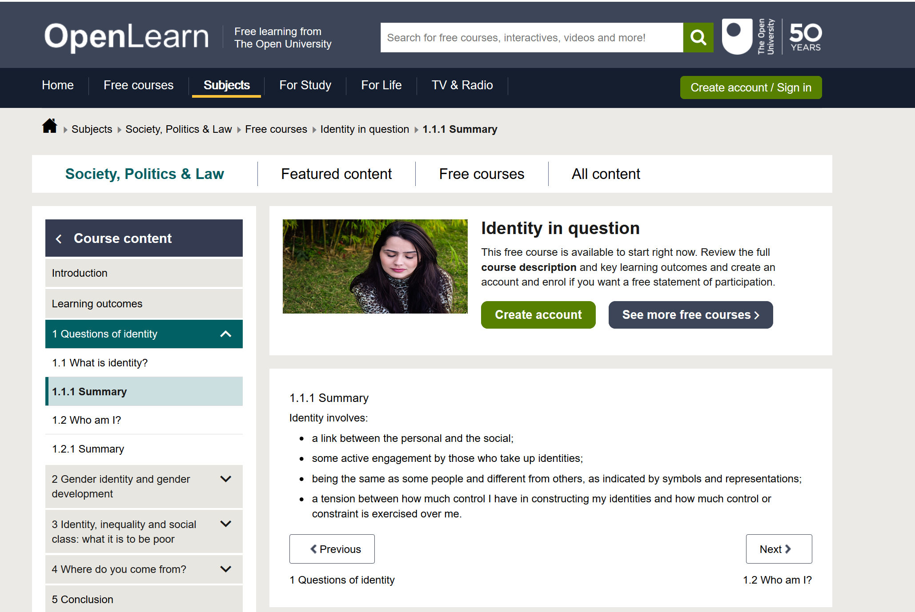
What Is Identity? OpenLearn. Read through the first part of this short course. https://www.open.edu/openlearn/people-politics-law/politics-policy-people/sociology/identity-question/content-section-1.1

Slide 68
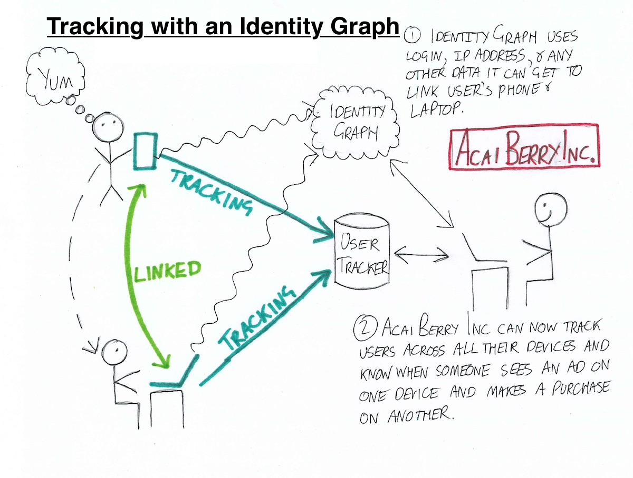
Identity Graphs: how online trackers follow you across devices. Robert Heaton. https://robertheaton.com/2017/11/24/identity-graphs-how-online-trackers-follow-you-across-devices/

Slide 69
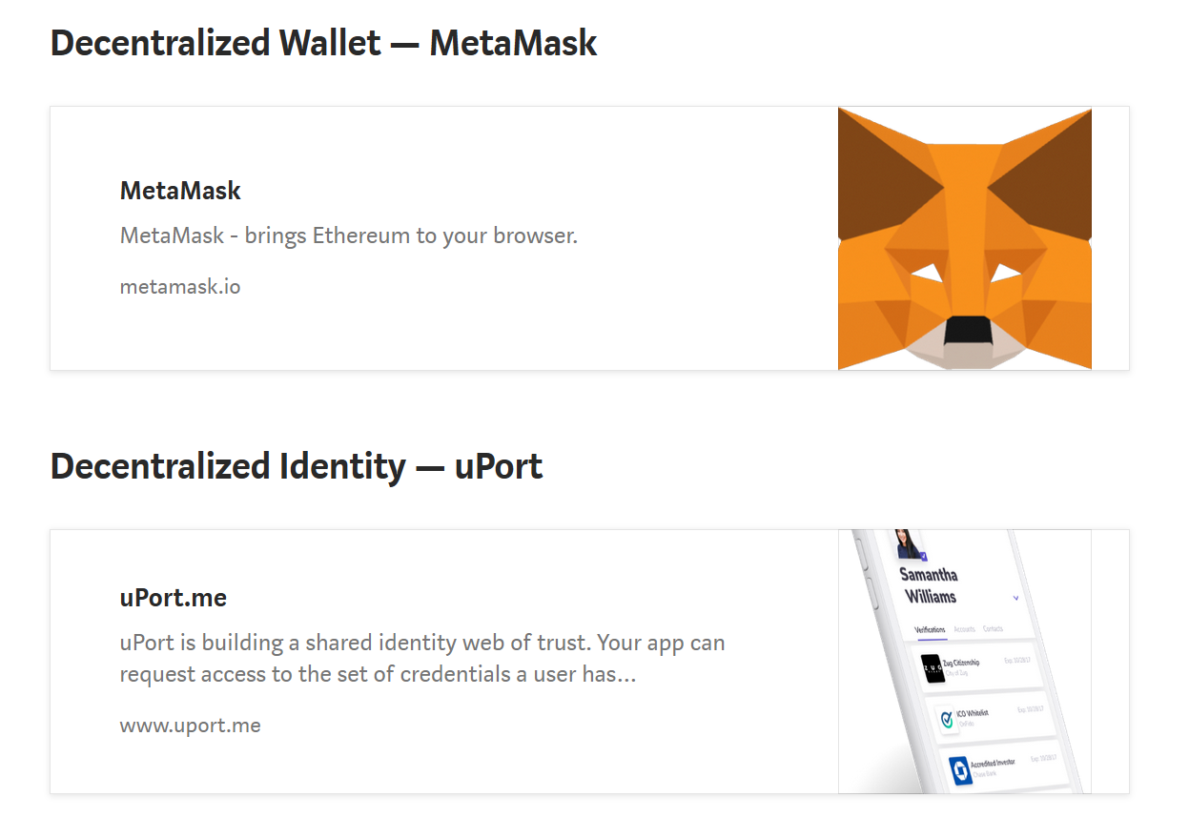
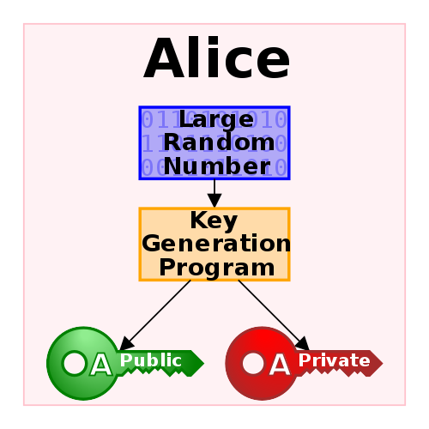
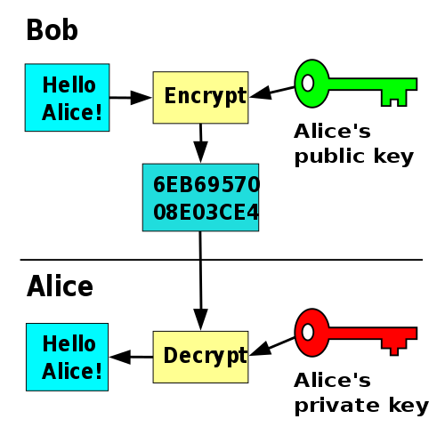
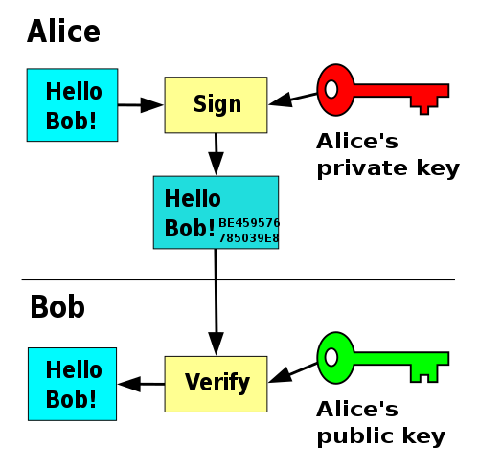
The Basics of Decentralized Identity. Kames. https://medium.com/uport/the-basics-of-decentralized-identity-d1ff01f15df1
Public-key cryptography. Wikipedia. https://en.wikipedia.org/wiki/Public-key_cryptography

Slide 70
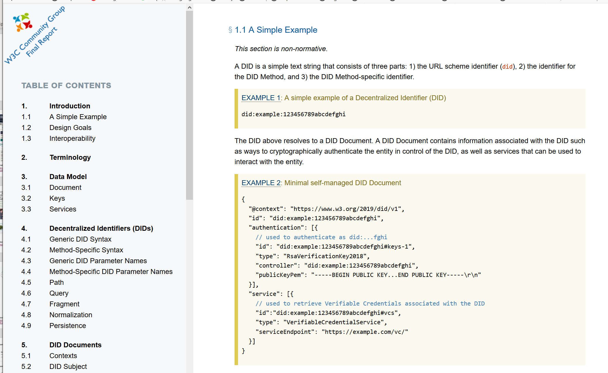
Decentralized Identifiers. A new World Wide Web Confortium (W3C) specification. https://w3c-ccg.github.io/did-spec/

Slide 71
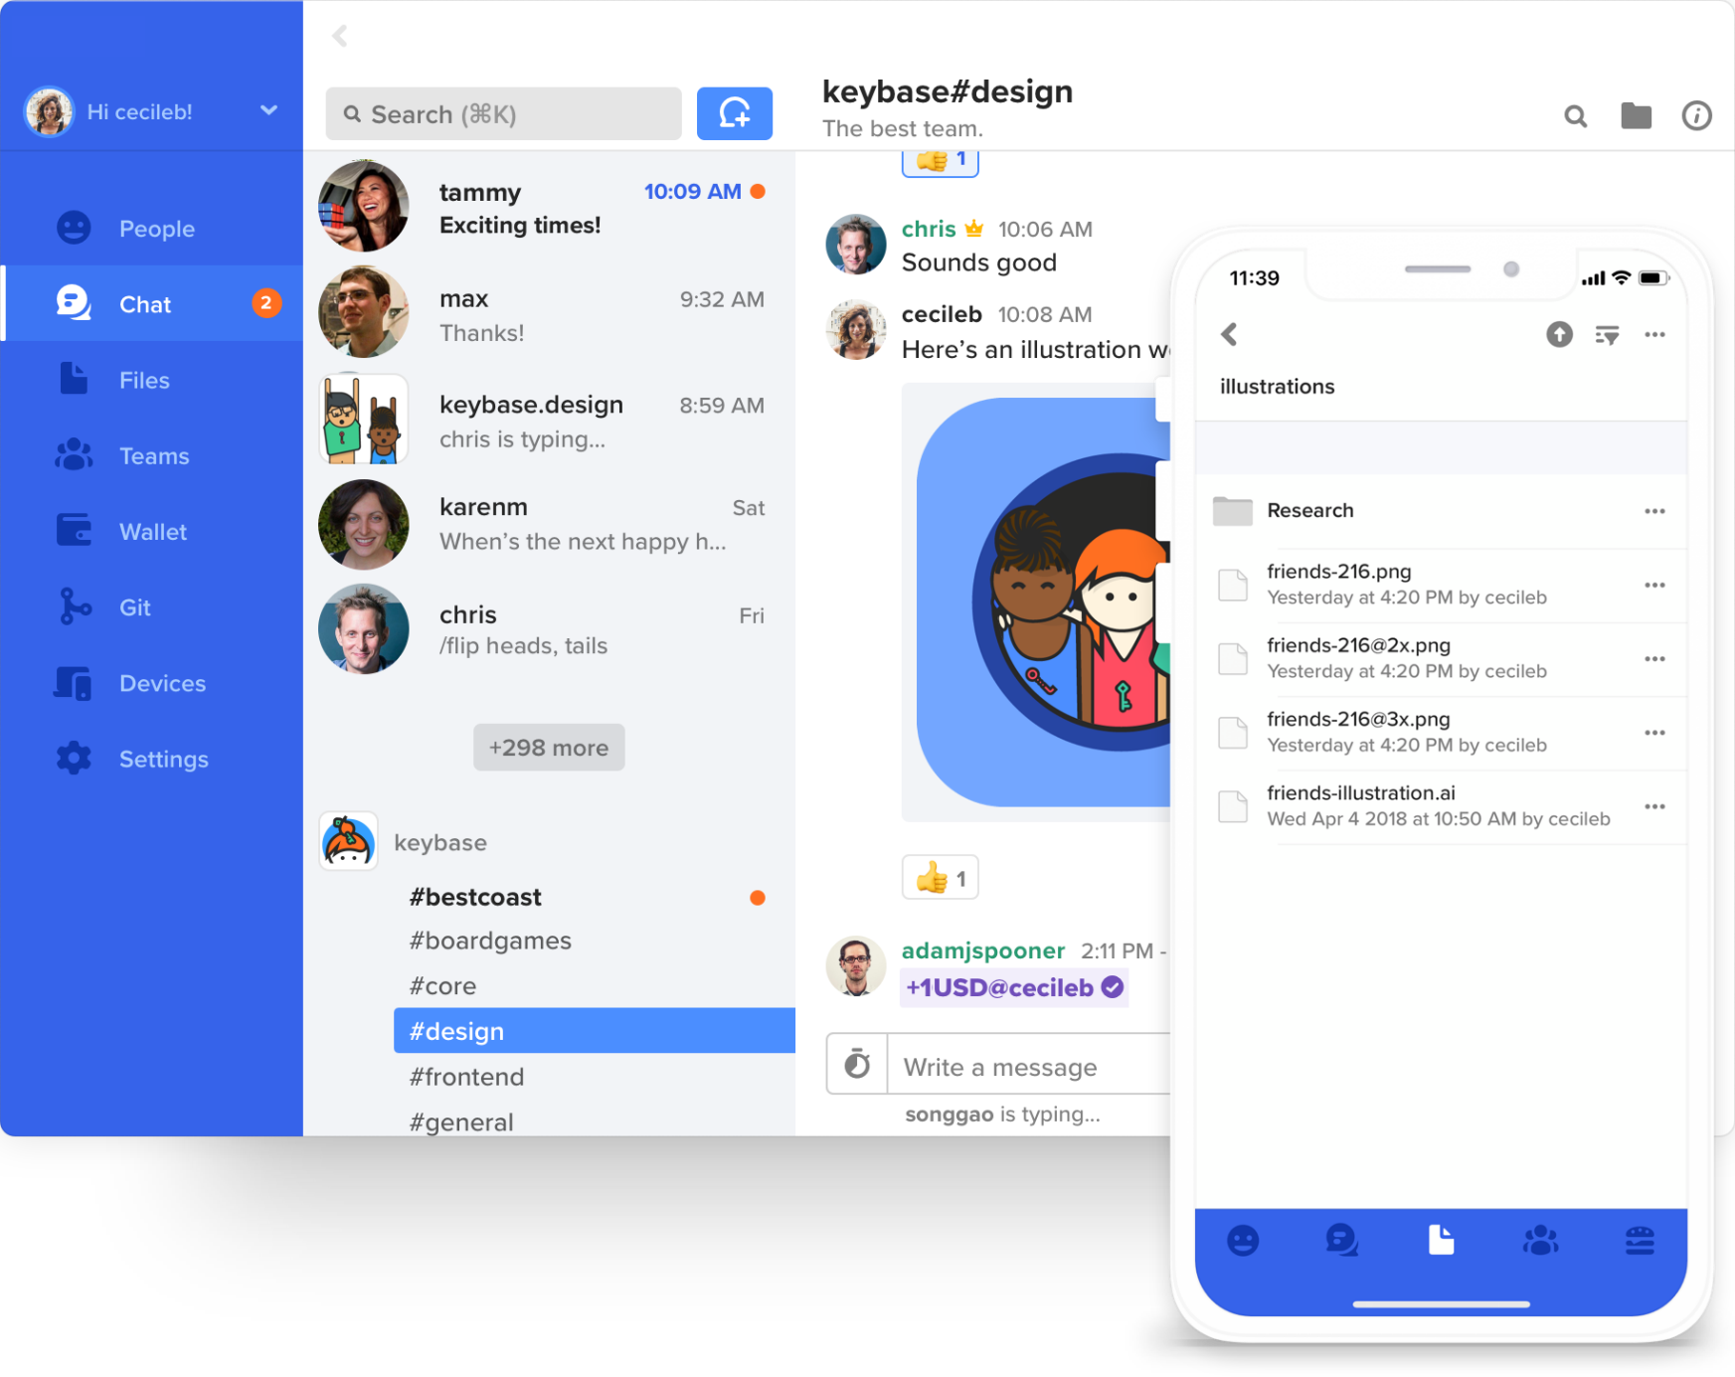
Keybase.io - Downes. This is my Keybase page. https://keybase.io/downes

Slide 72
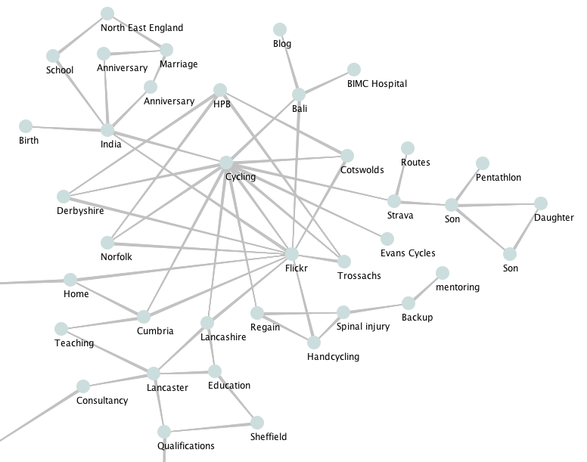
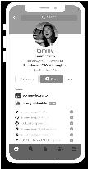
The BIG Idea - We Are the Content
Will the ‘connected self’ be more reflective? Will ‘the connective self’ more honestly reflect our hopes, aspirations and dreams?
https://www.youtube.com/watch?v=QNKpK_InQHQ
https://jennymackness.wordpress.com/tag/digital-identity/
https://mitpress.mit.edu/books/qualified-self
https://markcarrigan.net/2014/07/23/qualitative-self-tracking-and-the-qualified-self/
Cryptographic keys - either digital or physical - will become the norm, but this gives us a permanent identity that not only secures our data, it is our data.
Our new identities have the potential to be an enormous source of strength or a debilitating weakness. Will we be lost in the sea of possibilities, unable to navigate through the complexities of defining for ourselves who we are, or will we be able to forge new connections, creating a community of interwoven communities online and in our homes?

Slide 73
Activity - My Identity Graph
Instructions
Create an Identity Graph: We are expanding on the marketing definition of an identity graph. It can be anything you like, but with one stipulation: your graph should not contain a self-referential node titled ‘me’ or ‘self’ or anything similar
Think of this graph as you defining your identity, not what some advertiser, recruiter or other third party might want you to define.
Don't worry about creating the whole identity graph - focusing on a single facet will be sufficient. And don't post anything you're not comfortable with sharing. It doesn't have to be a real identity graph, just an identity graph, however you conceive it.
Optional: consider some of these questions about your identity graph:
What is the basis for the links in your graph: are they conceptual, physical, causal, historical, aspirational?
Is your graph unique to you? What would make it unique? What would guarantee uniqueness?
How (if at all) could your graph be physically instantiated? Is there a way for you to share your graph? To link and/or intermingle your graph with other graphs?
What’s the ‘source of truth’ for your graph?

Slide 74
Recognition
How do we know a course has been successful? How do we know what someone has learned? How can we know whether to trust in the education of our mechanics, doctors, engineers and pilots.
Feature Article: Recognition. https://el30.mooc.ca/post/68595
Featured Video: Conversation with Viplav Baxi https://el30.mooc.ca/event/85

Slide 75
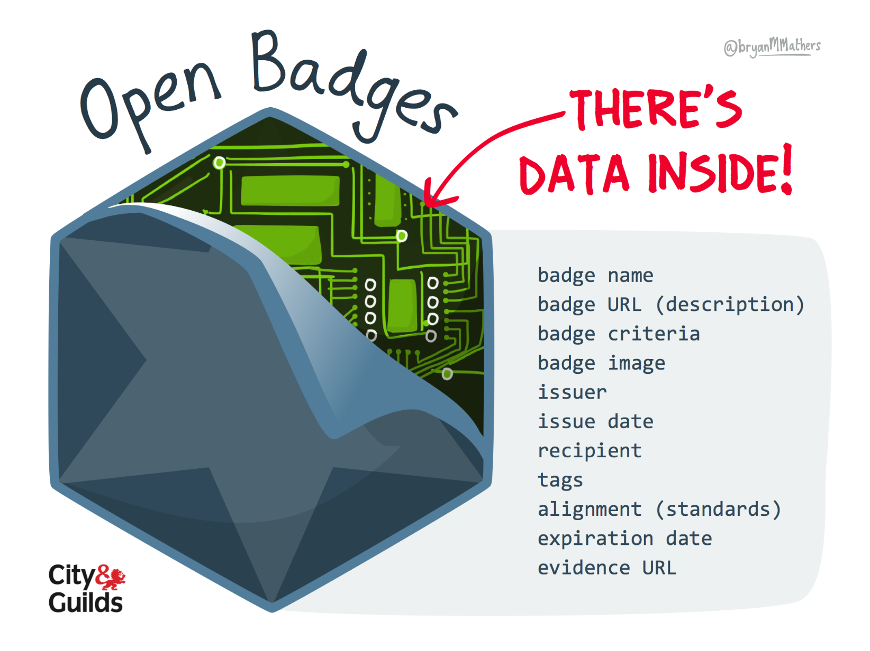
Open Badges. General information page about badges. https://openbadges.org/ Open Badges Peeled by Bryan Mathers

Slide 76
ψ
What Counts as Success?
There is not clear agreement on what counts as success. Different outcomes from learning events can be tracked and measured in any number of ways. And there is the danger of bad actors – of those who cheat on tests, fake certificates, or misrepresent their qualifications.

Slide 77
:
AI-based Competency Models
Actual AI-based assessment of competent performance will be used to create competency models that can inform AI-based speech-raters, competency systems, and professional evaluation. Actual authentic tasks designed or contributed by humans may be needed to balance the possibility of biased algorithms.

Slide 78
%
Competencies and Activities
There are numerous competency standards, everything from Australia’s National Competency Standards to NIH’s Nursing Competency Standard. Activity tracking has been formalized by xAPI and records are stored in Learning Record Stores (LRS)

Slide 79
Ξ
Certificate of the Future
The certificate of the future will be a job offer. Software is being developed to map directly from a person’s online profile to jobs and work. These today are unreliable and superficial, but with trustworthy data from distributed networks we will be able to accurately determine the skills and potential of every individual.

Slide 80
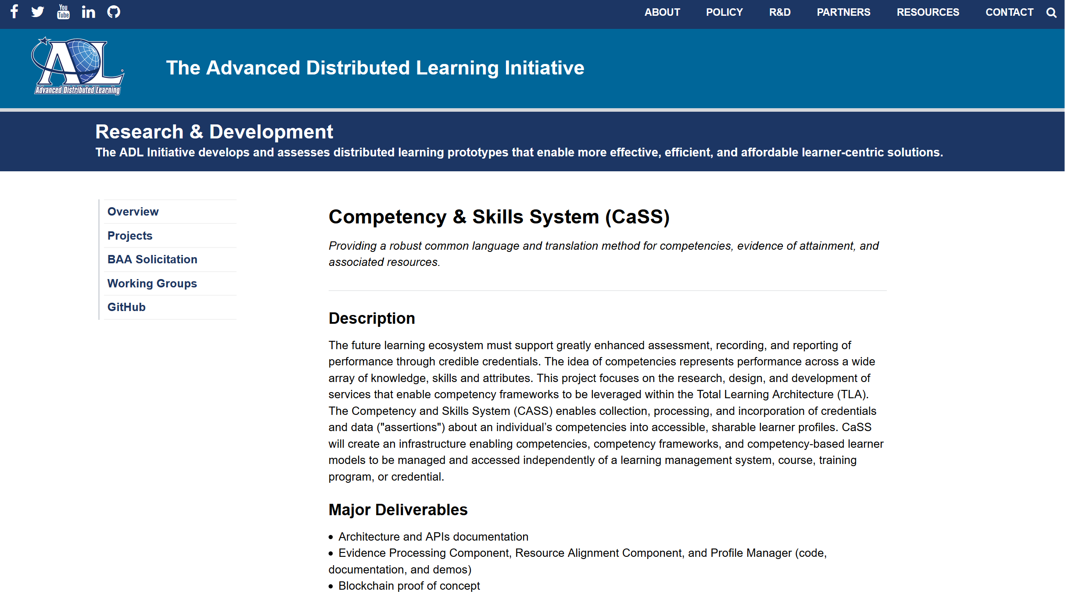
Competency & Skills System (CaSS). Advanced Distributed Learning. https://adlnet.gov/projects/cass

Slide 81

An Experience API for learning everywhere (also in virtual worlds). Roland Legrand. https://www.mixedrealities.com/2018/10/25/an-experience-api-for-learning-everywhere-also-in-virtual-worlds/
The Experience API. https://xapi.com/overview/

Slide 82

The xAPI is composed of four separate, yet interdependent API Resources:
Statement: Records of specific interactions and outputs of an actor (often learner) during an experience.
State: Data relating to the state of a learning activity.
Agent Profile: Data relating to a human actor or a system.
Activity Profile: Data related to a learning activity.
2018 Technical Report on xAPI. IEEE LTSC TAGxAPI. https://www.tagxapi.org/ieee-technical-report/

Slide 83

China’s Social Credit System: A Mark of Progress or a Threat to Privacy? https://piie.com/publications/policy-briefs/chinas-social-credit-system-mark-progress-or-threat-privacy

Slide 84

The BIG Idea - AI-Based Learning Recognition
xAPI lets you capture (big) data on human performance, along with associated instructional content or performance context information…
We can also gather data outside the school or program, looking at actual results and feedback from the workplace.

Slide 85
Activity – My Badge
Instructions
Use this space to design your badge, clearly identifying different data elements:
create a badge and give it a name, criteria, design
award it to yourself or describe how it would be awarded.
use a blog post on your blog as the 'evidence' for awarding yourself the badge
place the badge on the blog post.
Optional
Define how your digital badge connect to or ties in to your identity graph
If you have internet access, create a free account on a Badge service (https://badgr.com/ , https://www.openbadges.me/ , https://openbadgefactory.com/ ).

Slide 86
Community
The fundamental challenge to community is to make decisions on matters affecting everybody while leaving to individuals, companies and institutions those matters not effectively managed by consensus.
Feature Article: Community. https://el30.mooc.ca/post/68638
Featured Video: Conversation with Pete Forsyth https://www.youtube.com/watch?v=1Urc4EW9hiE

Slide 87

The Byzantine Generals Problem - https://lamport.azurewebsites.net/pubs/byz.pdf

Slide 88
ψ
The Concept of Community
The traditional concept of community was built on sameness, on collections of people from the same family, speaking the same language, living in the same place, believing the same things. This has been challenged by social and political reforms through the last few centuries. ons.

Slide 89
:
How to we Create Consensus?
Digital currencies such as Bitcoin and Ethereum use ‘proof of work’. Other tyes of content create other types of consensus: ‘proof of stake’ relies on guarantees of resources or assets; ‘proof of authority’ depends on certification or validation.

Slide 90
%
Learning by Agreement
What is required for learning to work is not merely control, but agreement on the part of members of the community. Underlying this is a respect for law, institutions and processes, and when these break

Slide 91
Ξ
Critical Literacies
The critical literacies include not just being able to communicate with each other, but to be able to build and create. Consensus, ultimately, is a question of stigmergy, and we will look not only how it s created but also how it is undermined (think ‘dark patterns’).

Slide 92

Trust, Truth, Consensus and Community on the distributed web - Jenny Mackness https://jennymackness.wordpress.com/2018/12/09/trust-truth-consensus-and-community-on-the-distributed-web/

Slide 93

How Does Distributed Consensus Work? Preethi Kasireddy. Distributed systems and consensus. https://medium.com/s/story/lets-take-a-crack-at-understanding-distributed-consensus-dad23d0dc95

Slide 94

ConsensusPedia: An Encyclopedia of 29 Consensus Algorithms. Consensus algorithms are the basis of all the blockchains/DAGs. https://hackernoon.com/consensuspedia-an-encyclopedia-of-29-consensus-algorithms-e9c4b4b7d08f

Slide 95

What is Blockchain? Lucas Mostazo, YouTube. Blockchain explained in plain English. https://www.youtube.com/watch?v=3xGLc-zz9cA
Image: https://www.mckinsey.com/business-functions/operations/our-insights/blockchain-technology-for-supply-chainsa-must-or-a-maybe

Slide 96

Education Blockchain Market Map. HolonIQ. https://www.holoniq.com/news/education-blockchain-50-fuzzy-front-end/

Slide 97

The BIG Idea – Community as Consensus
The mechanisms we use to interact and reach consensus are what define us as a community… but what are the conditions for consensus?

Slide 98
Activity - My Community
Instructions
As a community, create an assignment the completion of which denotes being a member of the community. For the purposes of this task, there can only be one community for the entire workshop.
Use the space above to contain your contribution to the community.
For each participant, your being a member of the community completes the task.
Note: in the workshop, you may be presented with the ‘Byzantine Generals Problem’ and left to consider how you, as a community of communities, might solve it.

Slide 99
Experience
It is a truism that we learn from experience, and yet creating a role for experience in learning has been one of the most difficult problems in education. And so much of education continues to rely on indirect methods depending on knowledge transfer - reading, lectures, videos - rather than hands-on practice and knowledge creation.
Feature Article: Experience. https://el30.mooc.ca/post/68683
Featured Video: Conversation with Amy Burvall https://el30.mooc.ca/event/87

Slide 100

How to Be an Artist. Jerry Saltz. Good advice that could be applied not only to art but to anything. https://www.vulture.com/2018/11/jerry-saltz-how-to-be-an-artist.html
Notes:
Art Is Not About Understanding. Or Mastery.
It is about doing and experience.
Learn how to think like an artist

Slide 101
ψ
Experience and Meaning
No experience is inherently meaningful. What a new experience means depends on previous experience. And experience is active. “Observation alone is not enough. We have to understand the significant of what we see, hear and touch. This is determined by us, as recognition.

Slide 102
:
Reflective Practice
New technology is beginning to combine the ability of teachers and role models to model and demonstrate successful practice, and the ability of learners to practice and reflect on their learning in that environment. Live streaming events are transforming real-world events into hands-on learning experiences.

Slide 103
%
Learning Together
Just as multiple authors can edit Wikipedia articles or work on code in GitHub, participatory learning media enables learners to interact creatively without management or direction. The outcome is a consensus determined not by voting but by participation.

Slide 104
Ξ
Working Openly
The creation of the content becomes a part of the content itself. We see this with the recent self-shredding art by Banksy or the inside look at how the single-scene time-lapse sequence was filmed. Some artists have made working openly a part of the act – Deadmau5, for example, showing how electronic music is produced.

Slide 105


Openness to Experience and Creative Achievement. Scott Barry Kaufman, Scientific American. https://blogs.scientificamerican.com/beautiful-minds/openness-to-experience-and-creative-achievement/

Slide 106

Twitch. A global community of millions who come together each day to create their own entertainment. https://www.twitch.tv/

Slide 107

CodePen. Interactive live generation of web pages and scripts. This example at https://codepen.io/meowwwls/pen/qBBWYJJ

Slide 108

Jupyter Notebooks. https://jupyter.org/
Binder. https://mybinder.org/

Slide 109

Jupyter Notebook combines data and code in a document. In the JupyterLab Environment - work with code, data, and the Jupyter notebook format.
A Gallery of interesting Jupyter Notebooks: https://github.com/jupyter/jupyter/wiki/A-gallery-of-interesting-Jupyter-Notebooks
Binder - https://mybinder.org - runs Jupyter Notebooks in a web browser, eg. Jupyter for kids - https://mybinder.org/v2/gh/mikkokotila/jupyter4kids/master

Slide 110

The BIG Idea - Content and Creation Combined
A good example of this is the live-streaming platform Twitch and especially games like Fortnite, in which players become spectators, and back again, ver and over.
Using applications like xSplit or Open Broadcaster Software individuals can make their experiences part of the learning experience shared by others.

Slide 111
Tools for Creating
➢Twitch https://www.twitch.tv/ live-streaming site for game playing, game-watching, and chat
➢Filmora and Filmore Go https://filmora.wondershare.com video creation, editing, upload
➢Tiktok http://www.tiktok.com social video meme and sharing
➢Turtle http://turtle.audio/ make music - see also
https://www.youtube.com/watch?v=lg_LKkMx2FE
➢Glitch https://glitch.com/ make apps, remix others
➢Livecaster https://intrsection.com/2017/04/8396/ make webcasts
➢Open Broadcaster https://obsproject.com/ stream desktop
➢Workbench https://www.dataquest.io/blog/jupyter-notebook-tips-tricks-shortcuts/ free and open source data journalism

Slide 112
Activity - My Community
Instructions
Be creative! Using the medium of your choice, create a representation of your experience of this workshop. Optional: post your creation (or post a link to your creation) on your blog.
Here's a good example of the sort of thing you could create, by Kevin Hodgeson: http://dogtrax.edublogs.org/2018/12/12/el30-a-visual-sense-of-community-connected/
If you need inspiration, visit the DS106 Assignment Bank and select one of the assignments, and then interpret it in the light this workshop. http://assignments.ds106.us/

Slide 113
Agency
What we learn depends on why we learn, and the idea of agency is to enable this to be shaped by the learner. Learning technology and pedagogy needs to support and reflect this, ensuring that the learner has the capacity to express and preserve their interests and their identity. So we close our enquiry with a consideration of issues related to power and control, to peace and prosperity, to hopes and dreams.
Featured Video: Conversation with Silvia Baldiris and Jutta Treviranus https://el30.mooc.ca/event/88

Slide 114

The three dimensions of the framework are:
Recognize, respect, and design for human uniqueness and variability.
Use inclusive, open & transparent processes, and co-design with people who have a diversity of perspectives, including people that can’t use or have difficulty using the current designs.
Realize that you are designing in a complex adaptive system.
The Three Dimensions of Inclusive Design. Jutta Treviranus. GitHub. https://handbook.floeproject.org/TheThreeDimensionsPartOne.html

Slide 115
ψ
A Projection of Ourselves
McLuhan said that technology is a projection of ourselves into the world. Our senses are amplified by virtual and augmented reality, our cognitive capacities are extended by machine vision and AI, and our economic and social agency is represented by our bots and agents.

Slide 116
:
What Technology Supports
What we learn, and what makes learning successful, depends on why we learn. Four key elements of the new technological framework: security, identity, voice, opportunity. These elements are in turn what consensus-based decentralized communities are designed to augment.

Slide 117
%
More than Just Knowledge
Learning therefore demands more thn just the transmission or creation of knowledge. Our leaning will need to emphasize and promote individual agency as much as it needs to develop the tools and capacities needed to support social, political and economic development.

Slide 118
Ξ
What we Want to Project
How do we ensure that what we project in the world is what we want to project, both as teachers and learners? As content and media become sophisticated and more athonomous, how do we bind these to our cultural and ethical frameworks.

Slide 119

APA Good Practices Guide - http://dailynous.com/2019/09/19/apa-publishes-good-practices-guide/

Slide 120

Social Justice Repair Kit. Inclusive Design Research Centre. https://sojustrepairit.org/
Wikipedia offline – Kiwix - https://www.kiwix.org/en/

Slide 121

Self-efficacy beliefs of medical students: a critical review - Klassen & Klassen - https://link.springer.com/article/10.1007/s40037-018-0411-3

Slide 122

Agency and responsibility in adolescent students: A challenge for the societies of tomorrow - https://onlinelibrary.wiley.com/doi/full/10.1111/bjep.12215

Slide 123

Digital Wellbeing, BBC - https://www.bbc.co.uk/rd/projects/digital-wellbeing

Slide 124

The BIG Idea - Redefining Success
Each of the major developments in the internet - from the client-server model to platform-based interoperability to web3-based consensus networks - has been accompanied by a shift in agency. The relative standing of the individual with respect to community, institutions, and governments was shifted, for better or worse.

Slide 125
Each stage in technological development is inspired by social, political and economic aspirations, and understanding the next generation of learning and technology requires understanding the forces that shaped them.
‘Success’ in the future will not be defined by employment opportunities, by competencies, by skills and expertise, but by agency - can the learner learn, think and do for themselves in a rapidly changing and complex environment?

Slide 126
Activity - My Definition of Success
Instructions
Using the space below or one of the many online tools at your disposal, consider what success - in this workshop, in your career, in life - looks like to you.

