Slide 1

Personal Learning Versus Personalized Learning - Making Lifelong Learning Happen
Stephen Downes
Online Learning 2019
October 10, 2019, Toronto, Canada

Slide 2
Abstract
This presentation draws a contrast between the concept of ‘personalized learning’, as exemplified in new learning technologies such as adaptive learning, and the concept of ‘personal learning’, which draws from a tradition of adult learning theory and heutagogy. Contrasting starting points, objectives, learning processes and forms of evaluation are identified. The article then considers strategies to implement personal learning in the form of support for lifelong learning, and contrasts this approach with the prevalent model governing educational institutions, and casts it as a means to address ongoing issues of access and sustainability.
Notes:
Presentation Format: Special Briefing
Description
Get a Special Briefing from Stephen Downes on:
• The difference between Personalized Learning and Personal Learning.
• Why personal learning is of growing importance, the tools which enable personal learning and the significant potential of personal learning as a key to lifelong learning and the skills agenda.
Takeaways
An understanding of:
1. The distinctions between personalized and personal learning and their implications for a college, university or training organization, including an examination of specific cases of effective personal learning and share some of the challenges of encouraging and enabling effective personal learning.
2. The range of tools available to enable personal learning.
3. The challenge of designing and delivering personal learning “systems” within an organization.

Slide 3
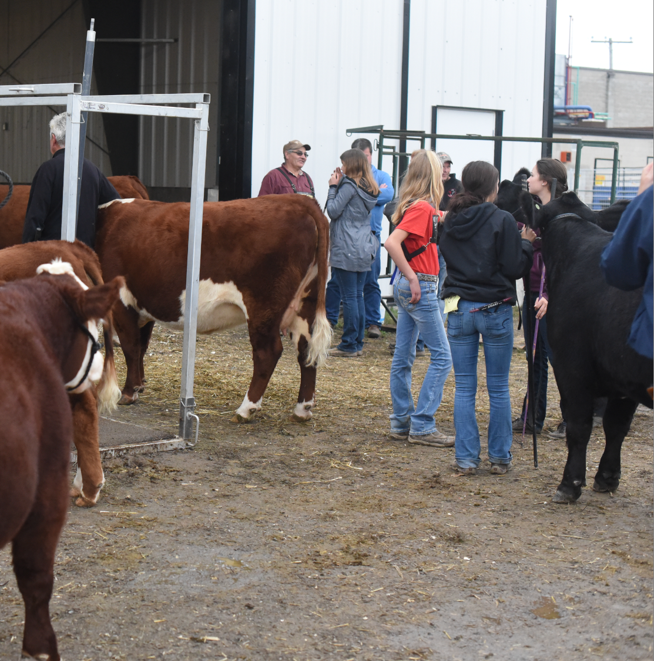
Background
How do I learn?
What is my evidence?
Who am I talking to?
What counts as success?
Notes:
What is Personalized Learning

Slide 4
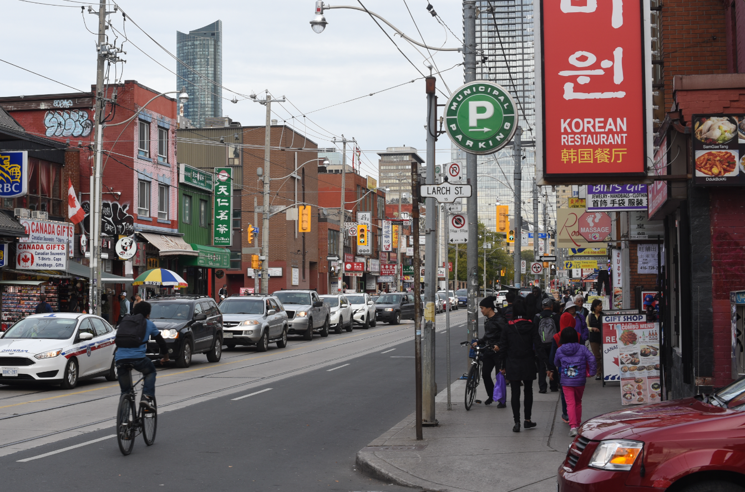
The concept of personalized learning
1
Notes:
The term ‘personalized learning’ has taken on many meanings in the literature and popular press. It is used as often as a marketing term as it is a description of technology or pedagogy. (Kerr, 2017)
Evaluating personalization, Philip Kerr, Adaptive Learning in ELT, Jul 20, 2017
This post looks at "the constellation of meanings that are associated with the term ('personalization'), suggest a way of evaluating just how ‘personalized’ an instructional method might be, and look at recent research into ‘personalized learning’." It follows a previous post illustrating how the term has been rendered meaningless by marketers. Unfortunately, writes the author, "but perhaps not surprisingly, none of the elements that we associate ... [Direct Link]

Slide 5
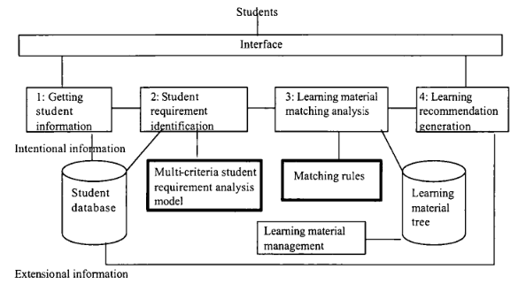
Recommender Systems
Image: Jie Lu, 2004. Framework for personalized learning recommender system. P. 376
Notes:
Some of the earliest descriptions of ‘personalized learning’ are with reference to recommender systems. Such systems may propose learning materials directly, or suggest learning paths. For example, Jie Lu (2004) describes “a computational analysis model for identifying the student's learning requirement and then use matching rules to generate a recommendation of learning materials (or activity).” And for example, Hwang et.al. (2010) describe a ‘heuristic algorithm’ that “models the objectives and criteria for determining personalized context-aware ubiquitous learning paths” for individual students learning about, say, butterflies.
Image: Jie Lu, 2004. Framework for personalized learning recommender system. P. 376
Image: Bitnine Global, Inc. (2019). Personalized learning path recommendation.
(Links)
Jie Lu. 2004. A Personalized e-Learning Material Recommender System. Proceedings of the 2nd International Conference on Information Technology for Application (ICITA2004) Pp. 374-379. https://opus.lib.uts.edu.au/bitstream/10453/3057/1/2004001806.pdf
Gwo-Jen Hwang; Fan-Ray Kuo; Peng-Yeng Yin; Kuo-Hsien Chuang. (2010), A Heuristic Algorithm for planning personalized learning paths for context-aware ubiquitous learning. Computers & Education, Vol: 54, Issue: 2, Page: 404-415. https://plu.mx/plum/a/?doi=10.1016/j.compedu.2009.08.024&theme=plum-sciencedirect-theme&hideUsage=true

Slide 6
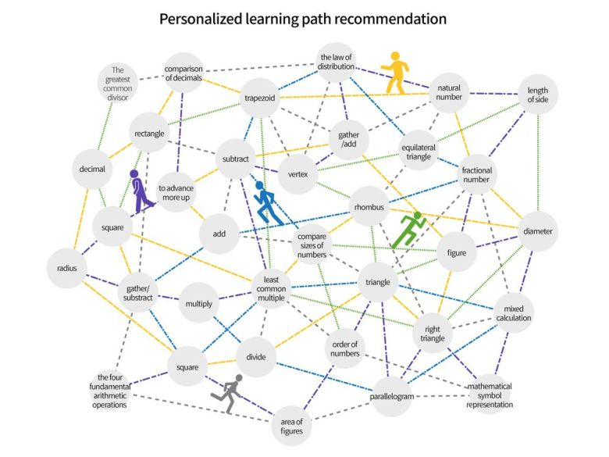
Learning Path Recommendation
Image: Bitnine Global, Inc. (2019). Personalized learning path recommendation.

Slide 7
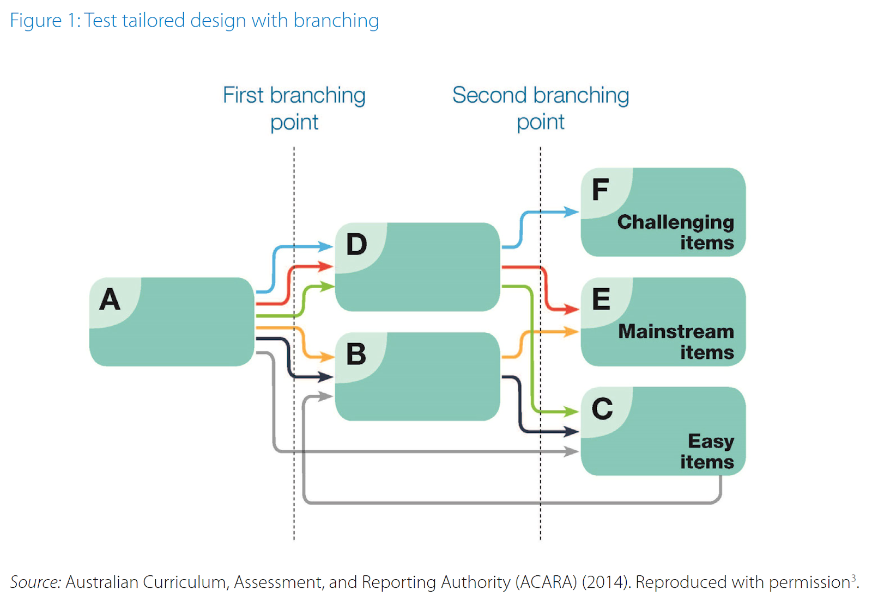
Adaptive learning
Image: via Wyatt-Smith, et.al., 2019.
Notes:
The term ‘personalized learning’ is also often associated with adaptive learning. This in turn is the use of rule-based or machine learning technology to analyze a learner’s performance and then to ‘adapt’ the presentation of learning materials in a course or learning program.
Image: via Wyatt-Smith, et.al., 2019.
Claire Wyatt-Smith, Bob Lingard, Elizabeth Heck. (2019).
Digital learning assessments and big data: implications for teacher professionalism UNESCO. https://unesdoc.unesco.org/ark:/48223/pf0000370940
(Links)
Short eLiterate Course on Analytics and Adaptive Learning, Mar 18, 2018
This is a nice collection of six videos on the topic. Topics covered include continuous formative assessment, memory decay, and adaptive learning. None of the videos is very long and you can complete the 'course' in half an hour easily. They're intended to introduce teachers to personalized learning. [Direct Link]
Opening the Black Box of Adaptivity, Dale Johnson, EDUCAUSE Review, Jun 28, 2017
This article identifies "four techniques which have been used by vendors to decide which lesson sequence and content selection is most effective. Algorithm (analytics) – recommendations Assessment – rapid remediation Association – decision tree Agency – student chooses." It's a good effort at opening the 'black box' of adaptive courseware. But is the core problem of learning technology really "lesson sequence and ... [Direct Link]
Analysis — What If We Personalized Education Funding? How Routing Dollars to Students Instead of Schools Could Fund a More Nimble System, Travis Pillow, Paul Hill, The 74, Feb 27, 2019
The idea touted in the title is being floated by a publication created to support the charter school movement. It would also be supported by proponents of a voucher movement. I don't agree with it, but think it's important to look at the argument. As I read it, I consider the provision of other services - health care, say? From where I sit, it makes the most sense simply to fund the services directly and ensure that people can access them as needed, so we don't have the overhead ... [Direct Link]
Personalized precision education and intimate data analytics, Code Acts in Education, Ben Williamson, Apr 16, 2018
So now we have 'precision education' as described on the Blog on Learning and Development: "Scientists who investigate the genetic, brain-based, psychological, or environmental components of learning … aim to find out as much as possible about learning, in order to accommodate successful learning tailored to an individual’s needs." Ben Williamson notes, "the task of precision education requires the generation of ‘intimate’ data from individuals, ... [Direct Link]
Design of a Personalized Massive Open Online Course Platform, Junfu Xi, Yehua Chen, Gang Wang, International Journal of Emerging Technologies in Learning, Apr 09, 2018
You might think (as I did) that this has to do with personalized access to MOOCs, but the article is in fact about building an analytics engine into a MOOC platform. It's still an interesting article. "Through the analysis of learning behaviours on the MOOC platform, the model digs deep into the pattern of learning behaviours, and lays the basis for personalized intervention in the learning process." [Direct Link]
Adaptive Learning: The Premise, Promise, and Pitfalls, Petr Johanes, Larry Lagerstrom, American Society for Engineering Education, Jan 18, 2018
This is a review paper intended to "explain what adaptive systems are and what kinds of data they require,... to categorize the main use cases and possibilities of adaptive systems [and] to outline the current limitations and concerns surrounding adaptive systems." In two paragraphs it deftly summarizes the landscape, listing new companies (Acrobatiq, Knewton, CogBooks, Cerego, Realizeit, LoudCloud, Smart Sparrow) as well as the work of publishers, LMS companies and ... [Direct Link]

Slide 8
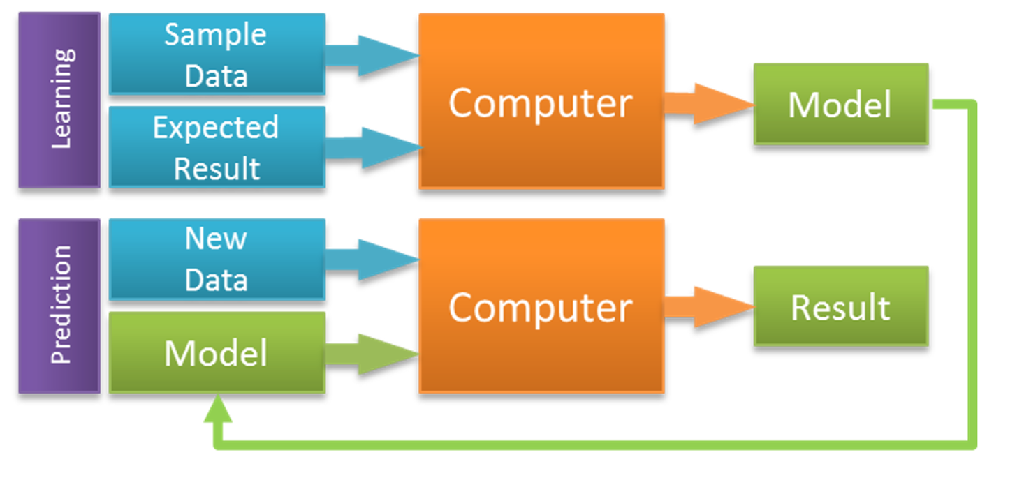
Empirical Bases
Image: Simon Kassel . Predicting Building Code Compliance with Machine Learning Models. https://www.azavea.com/blog/2017/09/21/building-inspection-prediction/
Notes:
Personalized learning depends on evidence to make recommendations or adapt learning, and different systems use different types of evidence.
The most direct evidence is a measurement of student learning using a test or activity. For example, we read that “the ‘AI Teacher’ of REDPEN AI Math analyzes the learning data of the members taking a mathematics course online to recommend a set of customized questions in real time and then identifies the cause(s) of any incorrect answers in each phase.”
In the absence of direct evidence (for example, at the start of a learning programme) personalized learning systems may rely on characteristics of the learner. Here it is common for developers to measure individual ‘learning styles’ and then tailor the learning experience accordingly.
In general, the empirical basis for personalized learning is provided by what is now generally called ‘learning analytics’. For example, Chatti & Muslim (2019) describe “the Personalization and Learning Analytics (PERLA) framework which represents the convergence of personalization and learning analytics and provides a theoretical foundation for effective analytics-enhanced personalized learning.”
Hwang, GJ., Sung, HY., Hung, CM. et al. (2012). Development of a personalized educational computer game based on students’ learning styles. Education Tech Research Dev 60: 623. https://doi.org/10.1007/s11423-012-9241-x https://link.springer.com/article/10.1007/s11423-012-9241-x
Bitnine Global, Inc. (2019). Bitnine: The Newly Revealed 'AI Teacher' Powered by Graph Database Delivers Hyper-Personalized Learning Experience. Financial Post. March 25, 2019. https://business.financialpost.com/pmn/press-releases-pmn/business-wire-news-releases-pmn/bitnine-the-newly-revealed-ai-teacher-powered-by-graph-database-delivers-hyper-personalized-learning-experience
Mohamed Amine Chatti & Arham Muslim. (2019). The PERLA Framework: Blending Personalization and Learning Analytics,, International Review of Research in Open and Distributed Learning, Feb 28, 2019.
From the abstract: "This paper discusses the Personalization and Learning Analytics (PERLA) framework which represents the convergence of personalization and learning analytics and provides a theoretical foundation for effective analytics-enhanced personalized learning." It's important to not that the authors distinguish personalization from adaptation (or adaptive learning systems). "Personalization is learner-driven; the system only helps learners decide what to do next.&... [Direct Link]

Slide 9
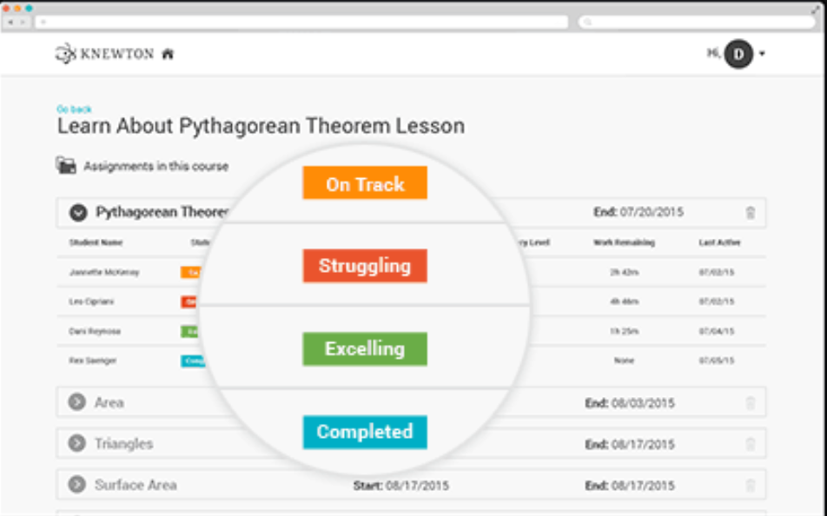
Implementation in Technology and Learning Systems
Knewton
Alt School
InBloom ASU
Image: Getting Smart.
https://www.gettingsmart.com/2015/09/knewton-brings-adaptive-and-personalized-learning-to-the-masses/
Notes:
Machine Learning in Corporate E-learning - Applications and Trends , Stella Lee, SlideShare, Sept 11, 2018
This 30 page slide presentation is a pretty quick read, but provides a high level overview of how machine learning is being applied to e-learning (and specifically, to chatbots, recommenders, performance indicators, and adaptive assessment). I think this shows both the potential but also the limitations of machine learning in e-learning. Via e-learning, conocimiento en red. Now just testing: test [Direct Link]
IMS Compliant Ontological Learner Model for Adaptive E-Learning Environments, Othmane Zine, Aziz Derouich, Abdennebi Talbi, International Journal of Emerging Technologies in Learning, Aug 29, 2019
The first sentence of this paper (23 page PDF) makes me want to reframe the learning styles debate. Here's the sentence: "It has been proven that adopting the 'one size fits one' approach has better learning outcomes than the 'one size fits all' one." The paper cites several references to say "an accurate definition the learner’s characteristics influences and increases considerably the capability and efficiency of learning activities." Well, this ... [Direct Link]
Learner Model's Utilization in the e-Learning Environments, Vija Vigale, Laila Niedrite, University of Latvia, Oct 28, 2018
This is quite a good paper describing the need for, creation of, and use of a learner model in support of adaptive learning. In current systems, the learner model is at the core of such systems. In conjunction with a domain mode, which maps the learning required in a field, the adaptive system employs an adaptive model to generate the activity, resource or intervention required. Learner data can be static or dynamic, includes personal data, pedagogic, preference, system experience, cognitive, ... [Direct Link]
Arizona State Working with Community Colleges in Interactive OER Pilot, Dian Schaffhauser, Campus Technology, Apr 04, 2019
The initial concept is laudable. "What Anbar has in mind is something he calls "active OER." That's taking the standard digital textbook and expanding it with the addition of digital resources, including simulations that are both interactive and adaptive." So is the committment of $25 million to the project. But why then would it be narrowed down to one commercial provider? "That's where Smart Sparrow comes in: The company produces aero, a learning platform ... [Direct Link]
The Next Frontier of Adaptive Learning, Dian Schaffhauser, Campus Technology, Dec 06, 2018
This article describes Arizona State University's plans to personalize by "developing a complete adaptive undergraduate program dubbed the 'Adaptive Chassis.'" What is Aaptive Chassis? "In our traditional model, each course was its own island — even to the point where each section of each course may have been its own island.... We're aligning all of the learning objectives in those courses, then we're integrating all of the instructional resources, and,... [Direct Link]
(Links)
xAPI: A Guide for Technical Implementers, Shelly Blake-Plock, IEEE LTSC TAG xAPI, Aug 05, 2018
This is a comprehensive guide (41 page PDF) describing the history, content and application of the Experience API (xAPI) specification. "xAPI is an application programming interface which allows software applications to exchange data regarding human activity. Designed for the domain of learning, xAPI enables the capture of data about human performance and its context." The document is authored by many of the people responsible for developing and implementing the specification and ... [Direct Link]
The Theranos Story and Education Technology, John Warner, Inside Higher Ed, May 30, 2018
John Warner compares the promises made by AI and personalized learning vendors with tne owner of the blood testing 'vaporware' product Theranos. "Through a combination of secrecy, lies, flattery, and intimidation, she maintained a fiction about having developed a truly revolutionary piece of technology." There was no requirement that the product actually work; her customers were venture capitalists, who only need to be sold on the idea. Theranos was revealed only after the ... [Direct Link]
Personalized Learning Meets AI With Watson Classroom, Erin Gohl, Getting Smart, Feb 22, 2018
"Generally speaking," says Erin Gohl, in personalized learning, "reducing people to a set of numbers overlooks so many factors that are integral to understanding a student, but explainable only as narrative comments." Rather, you need something that can brige the gap between words and numbers, for example, IBM Watson. Watson classroom is being positioned as an assistant, not a replacement, for teachers. " Watson Classroom is not a teacher nor does it replace the ... [Direct Link]
With New Personalized-Learning Software, AltSchool Moves Into Public Schools, Benjamin Herold, Education Week, Jan 26, 2018
More on AltSchool's pivot from running schools to selling personalized learning software as reported in December (more), including numerous criticisms of the company. AltSchool also reports that it has discontinued surveillance technologies that "included fisheye ceiling cameras and constantly running audio recorders to harvest massive volumes of data on its students." Not because they were wrong, of course, but because "the team has recognized that the utilities of some of ... [Direct Link]
Why I Left Silicon Valley, EdTech, and “Personalized” Learning, Paul Emerich, Inspired, Jan 18, 2018
This is a post describing a teacher's experiences "opening a brand new micro-school and to work on technology tools that were intended to personalize my students’ learning." It was AltSchool, the Silicon Valley startup where Emerich worked for three years, leaving last June. The company changed course last year from running schools to selling software. Emerich suggests a possible reason for the change in course: "It was isolating with every child working on ... [Direct Link]
Hitting Reset, Knewton Tries New Strategy: Competing With Textbook Publishers, Jeffrey R. Young, EdSurge, Dec 08, 2017
Remember Knewton? Pundits loved it. It positioned itself as "the world’s leading adaptive learning technology provider with the mission of bringing personalized education to the world" and drew some $157 million in funding. Now they're executing a pivot "along with mounting criticism that its founding CEO, Jose Ferreira, overhyped its technology." Now the company is trying to compete with publishers. "The secret to its swift entry into publishing was OER (... [Direct Link]
Hitting Reset, Knewton Tries New Strategy: Competing With Textbook Publishers, Jeffrey R. Young, EdSurge, Dec 08, 2017
Remember Knewton? Pundits loved it. It positioned itself as "the world’s leading adaptive learning technology provider with the mission of bringing personalized education to the world" and drew some $157 million in funding. Now they're executing a pivot "along with mounting criticism that its founding CEO, Jose Ferreira, overhyped its technology." Now the company is trying to compete with publishers. "The secret to its swift entry into publishing was OER (... [Direct Link]
Knewton Releases $44 Adaptive Digital Textbooks, Dian Schaffhauser, Campus Technology, Jan 25, 2018
OK, there's some merit to the idea of selling software-enhanced textbooks directly to students. But I am sceptical as to whether these represent an advanced on the 'programmed texts' of the 1970s. Additionally, the $44 covers only a two year license, rendering them useless for future reference. [Direct Link]
Wiley to Acquire Knewton Assets, Rhea Kelly, Campus Technology, May 07, 2019
Remember Knewton? For a while it was touted as the model for learning analytics and adaptive learning for the future. Then it became, well, obscure. And today we read that Wiley "today announced it will purchase the assets of adaptive learning company Knewton." Assets. As in, what's left after a company fails. Read the history of Knewton as seen through the pages of OLDaily. [Direct Link]

Slide 10
Criticisms of Personalized Learning
Personalized learning is ineffective
Personalized learning depersonalizes learning
Personalized learning systems depend on surveillance and violates personal privacy
Notes:
Despite its widespread popularity (indeed, ubiquity) the concept of personalized learning has attracted numerous criticisms in recent years. Among them:
Personalized learning is ineffective. For example, “(T)he basic formula of both traditional and computerized instruction has been ‘I, we, you,’ where the teacher (or computer) tells the student something, followed by a worked-out example gone over together, and ending with independent student practice. Everything we know about teaching and learning tells us that this formula is flawed and not working.”
Personalized learning depersonalizes learning. “For Lauren Peronace, the transition meant an hour of ‘personalized learning time’ each week in math class, where they worked through ‘playlists,’ watching videos and reading lessons, and then taking assessments whenever they felt ready. ‘Basically we would do the math work we would be doing with a teacher any other year — alone,’ she recalled.” (Tabor, 2018)
Personalized learning systems depend on surveillance and violate personal privacy. For example, “In 2014, inBloom, a nonprofit that offered to warehouse and manage student data for public school districts, announced that it would shut down, after parents objected to 400 categories of information, including children’s reasons for absences and sensitive family relationships, being included in its database.” (Ghosh & Steyer, 2018)
(Links)
Dipayan Ghosh & Jim Steyer. (2018). Kids Shouldn’t Have to Sacrifice Privacy for Education , Dipayan Ghosh, Jim Steyer, New York Times, Dec 17, 2018
Enyedy, N. (2014). Personalized Instruction: New Interest, Old Rhetoric, Limited Results, and the Need for a New Direction for Computer-Mediated Learning.National Education
Policy Center. http://nepc.colorado.edu/publication/personalized-instruction
Nick Tabor. (2018). Mark Zuckerberg Is Trying to Transform Education. This Town Fought Back. The Intelligencer. October 11, 2018. http://nymag.com/intelligencer/2018/10/the-connecticut-resistance-to-zucks-summit-learning-program.html
The Backlash Against Personalized Learning, National Education Policy Center, Dec 11, 2018
This is an archive copy of the NEPC newsletter summarizing recent negative reactions against personalized learning. There are several concerns: software glitches, concerns about data privacy, and lessons that are easy to game and trick. The bulk of the newsletter refers to a policy brief written in 2014 by Noel Enyedy which argues that personalized learning simply transfers the flaws of traditional learning to the individual level. [Direct Link]
Scientists Seek Genetic Data to Personalize Education, Ben Williamson, DML Central, Jun 21, 2018
This strikes me as a really bad idea, but I present it here so readers can judge for themselves. That said, as the article notes, "It raises significant concerns about biological discrimination and rekindles long debates about eugenics and the genetic inheritance of intelligence." The idea is that "educational genomics seeks to unpack the genetic factors involved in individual differences in learning ability, behavior, motivation, and achievement." The problem, as I see it, ... [Direct Link]
An Alternative to the Engineering Model of Personalized Learning, e-Literate, online learning, Feb 14, 2018
Larry Berger "is exactly right that there is a fundamental problem with the assumptions behind what he calls the engineering model of personalized learning," writes Phil Hill. Berger argues that he "spent a decade believing in this model—the map, the measure, and the library, all powered by big data algorithms" but that ""the map doesn't exist, the measurement is impossible, and we have, collectively, built only 5% of the library." Hill reiterates ... [Direct Link]
Personalized Learning Is a Problem of Privilege, Paul France, EdSurge, Feb 06, 2018
Yes it's another rant against personalization but there are also some interesting things in this article. First is this: "We often conflate individualization with personalization." According to Paul France, 'individualization' means " to have the assistance of a complex technological algorithm to assign activities to children," which he says is " impersonal and dehumanizing" and " focuses on consumption of educational material instead of ... [Direct Link]
Friends don’t let friends use Facebook, Doug Belshaw, Open Educational Thinkering, Jun 02, 2017
According to Doub Belshaw (assisted with quotes from others), "Personalised advertising isn’t useful. It’s invasive, and it’s used to build a profile to manipulate you and your ‘friends’." If we say this about personalized advertising, what do we say about personalized content? If personalized content, working exactly as intended on Facebook, is so harmful, what are we to say about personalized learning? There's a big gaping question here that people are not answering. [Direct Link]
The Propaganda behind Personalised Learning, Benjamin Doxtdator, A Long View on Education, Dec 22, 2017
This is a more recent article from Benjamin Doxtdator on personalized learning (the previous one cited was from July). "Chomsky and Herman describe how five filters – media ownership, revenue through advertising, reliance on official sources, flak, and anticommunist ideology – shape not only the opinions expressed in the media, but the selection of what is newsworthy in the first place," he writes. "Here, I slightly modify their filters to examine how the ... [Direct Link]
E-learning: Why employees expect a Netflix experience, Steve Wainwright, Personnel Today, May 16, 2018
I can see why this will resonate with readers, and certainly we want something much better than pre-arranged courses and expensive fees. And if learning and watching videos were the same then the Netflix analogy would work. But learning - especially informal learning - isn't about selecting something to view from a recommender. It's about solving problems, getting help, working together, and reflecting on experiences and lessons learned. It's as much about creation as consumption. ... [Direct Link]
Learning lessons from data controversies, Ben Williamson, Code Acts in Education, Dec 18, 2018
This is the transcript of a talk devoted to showing how people have lost faith in the idea that data will solve the problems of 21st century education and technology. "We’re now learning some hard lessons from the rapid expansion of data analytics, algorithms, and AI across society," writes Ben Williamson. "For many educators and students alike, education is more than the numbers in an adaptive, personalized learning platform, and includes non-quantifiable relationships, ... [Direct Link] [Edit]
Against the 3A’s of EdTech: AI, Analytics, and Adaptive Technologies in Education, Maha Bali, Chronicle of Higher Education, Dec 06, 2017
"I agree with all of Audrey Watters‘, Chris Gilliard’s, Autumm Caines’ and Benjamin Doxtdator’s critiques on these topics (also: it’s scary how my Google docs app immediately recommended their websites when I started inserting the links here)," writes Maha Bali. She adds, "there tends to be a reduction of what a teacher’s role is." Teaching "is about helping learners express themselves clearly and ... [Direct Link]
Adaptive Learners, Not Adaptive Learning, George Siemens, elearnspace, Jul 21, 2016
George Siemens gets this right. "This is where adaptive learning fails today: the future of work is about process attributes whereas the focus of adaptive learning is on product skills and low-level memorizable knowledge. I’ll take it a step further: today’s adaptive software robs learners of the development of the key attributes needed for continual learning – metacognitive, goal setting, and self-regulation – because it makes those decisions on behalf of the learner." ... [Direct Link]

Slide 11
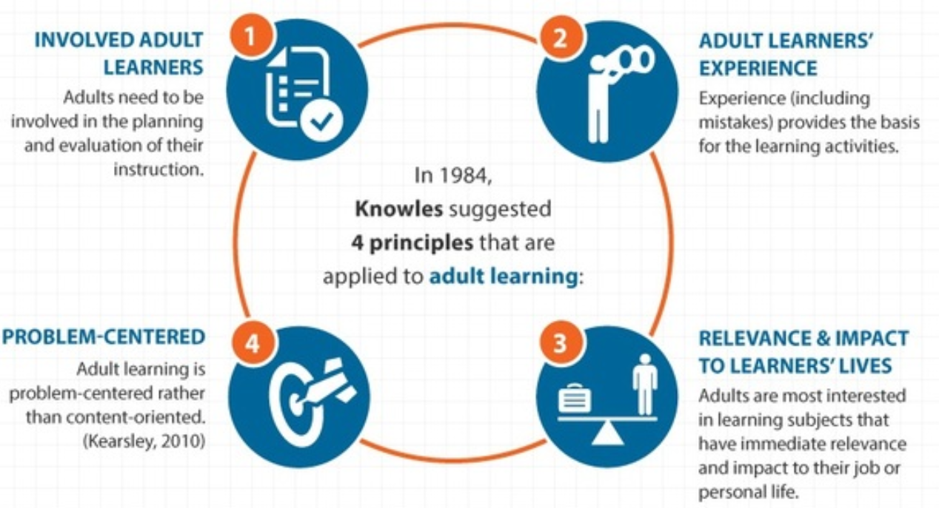
Andragogy
Four principles of andragogy, Knowles 1984 https://knowlestheories.weebly.com/principles-of-andragogy.html
Notes:
Four principles of andragogy, as laid out by Knowles in 1984
Adults need to be involved in the planning and evaluation of their instruction.
Experience (including mistakes) provides the basis for the learning activities.
Adults are most interested in learning subjects that have immediate relevance and impact to their job or personal life.
Adult learning is process-centered rather than content-oriented.
Theories for Learning with Emerging Technologies, Terry Anderson, Emergence, Innovation in Digital Learning: Foundations, Jun 06, 2016
In an accessible paper that is a breeze to read, Terry Anderson illustrates "how learning and learning designs that use emerging technologies can be enhanced via the lens of theory." He presents several taxonomies of theory to illustrate his point, for example: the presentational view, the epistemic engagement view, and the view from complexity theory. He alsop discusses 'net-aware' theories of learning, including heutagogy, connectivism, and groups vs networks (to which, following ... [Direct Link]
A review of the research literature on adult learning and employability, Tove Midtsundstad, European Journal of Education, Feb 06, 2019
Based on this survey, we don't really have the data "to conclude that adult learning (formal or informal) has a causal effect on older workers’ employability." This is partially a problem with the number of the studies, partially a problem with methodology, and partially a proiblem with the mixed results produced by the existing studies. We see this especially in cases where adult

Slide 12
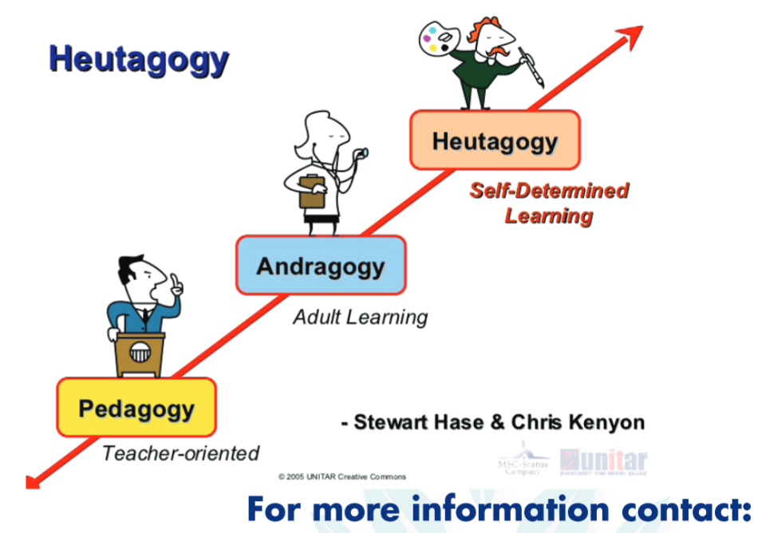
Heutagogy
Image: Stuart Hase. http://australasianleadership.com/wp-content/uploads/2016/01/HEUTAGOGY-WORKSHOP_July-2017.pdf
Notes:
“Self-determined learning focuses on the learner as the primary driver of the learning process and experience.” (Blaschke, Kenyon & Hase, 2014, p. 10)
http://mportfolios.blogspot.com/2019/10/heutagogy-workshop-with-dr-steward-hase.html
https://johndabell.com/2019/02/05/what-is-heutagogy/
Dr. Steward Hase, one of the theorist behind the concept of heutagogy.
What Is Heutagogy?
John Dabell writes: “Heutagogy is clearly not for everyone and certainly not ‘glam teachers’. It’s more of a punk way of learning (see Coles, 2014) and as Eberle and Childress (2006) note, teachers need to be courageous because heutagogy isn’t for the faint hearted.”
Stewart Hase. Self-determined Learning (heutagogy): Where Have We Come Since 2000? https://www.sit.ac.nz/Portals/0/upload/documents/sitjar/Heutagogy%20-%20One.pdf
Lisa Blaschke, Chris Kenyon& Stewart Hase (Eds.) (2014). Experiences in Self-determinded Learning https://uol.de/fileadmin/user_upload/coer/Experiences-in-self-determined-learning.pdf
A call for promoting ownership, equity, and agency in faculty development via connected learning, Maha Bali, Autumn Caines, International Journal of Educational Technology in Higher Education, Dec 20, 2018
"In this article we advocate for and give examples of educational development opportunities for educators that encourage heutagogy with outcomes that focus on ownership and agency which can potentially lead to transformative learning," write the authors. What follows is an extended tour through philosophies such as transformative learning, heutagogy, connectivism and connected learning, and models such as #DigPINS, MOOCs, untethered faculty development, and many more. Image: Getting ... [Direct Link]
Maker Education: Pedagogy, Andragogy, Heutagogy, Jackie Gerstein, User Generated Education, Jun 27, 2016
To be clear, the term 'Andragogy' does not mean (as suggested in this article) "self-directed learning". The term refers specifically to adult learning - "andr (meaning ‘man’) could be contrasted with pedagogy (paid- meaning ‘child’ and agogos (meaning ‘leading’)". And educators do love their levels and series of progressions, hence the movement in this article from pedagogy to andragogy to heutagogy (from 'heut', meaning 'self). ... [Direct Link]
ECTEL2015 Mon a.m. (1): Lisa Marie Blaschke Keynote , Doug Clow, New Technolopgy in Higher Education, Sept 19, 2015
I talk a lot about personal learning (and have for a very long time). But I have to be clear that there is also a tradition in self-determined learning, under the name of heutagogy, which has been around since the early 2000s. Here's Lisa Marie Blaschke: "The heutagogical approach can be viewed as a progression from pedagogy to andragogy to heutagogy, with learners likewise progressing in maturity and autonomy. More mature learners require less instructor control and course structure and ... [Direct Link]
Heutagogy and Lifelong Learning: A Review of Heutagogical Practice and Self-Determined Learning, Lisa Marie Blaschke, International Review of Research in Open, Distance Learning, Feb 01, 2012
One thing I've learned over the years in education and social science generally: for anything you can think of, someone has created a 'theory' of that thing. Thus we have heutagogy, which is "a form of self-determined learning with practices and principles rooted in andragogy." A key concept in heutagogy is 'double-loop learning' "In double-loop learning, learners consider the problem and the resulting action and outcomes, in addition to reflecting upon the problem-solving ... [Direct Link]
From Andragogy to Heutagogy, Stewart Hase, Chris Kenyon, ultiBASE, Feb 18, 2009
This is a very nice paper, cited by Barbara Dieu on the WikiEducator mailing list, describing the evolution of 'heutagogy' - self-directed learning - through developments in philosophy and educational theory. I like not only the overview of the principles of heutagogy but the way the discussion of power and democracy in learning comes to have wider social implications. Citing John Ralston Saul (whose work has informed my own thinking as well) the authors note, "there is an almost ... [Direct Link]

Slide 13
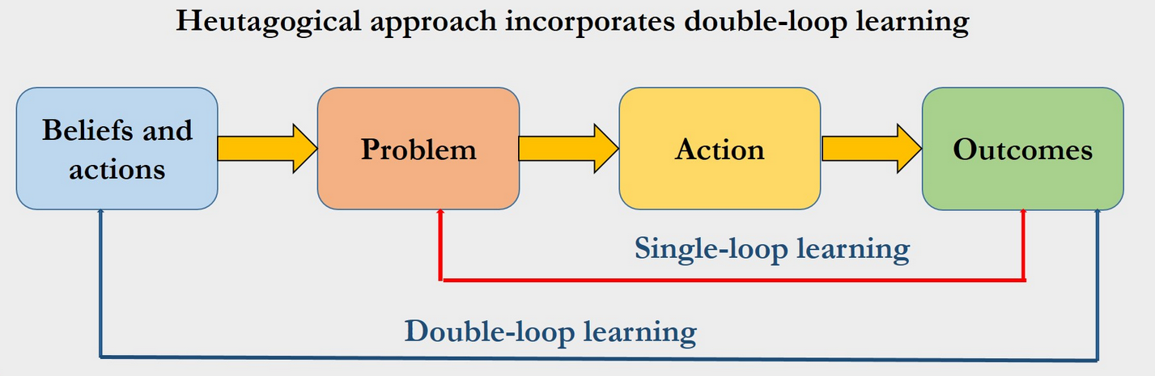
Learning when the learner is ready
Requires the learner to move beyond knowledge and
Learner does not depend solely on the teacher
Learning is focused on the student not on a syllabus
The principles of heutagogy as outlined in Hase and Kenyon (2013)
Image: Eachempati , et.al. Heutagogy through Facebook for the Millennial learners
https://www.mededpublish.org/manuscripts/1268
Notes:
The principles of heutagogy are outlined in Hase and Kenyon (2013):
QUOTE
There are four key principles:
Learning when the learner is ready: the learner has a role in controlling the process of learning, making their own decisions about pace according to need and interest
Learning is seen as a complex process requiring the learner to move beyond knowledge and skills – it is not regurgitation, copying, modelling; it requires new connections and more inventive insights to be made
Learner does not depend solely on the teacher and can be triggered by an experience beyond the control of the teacher
Learning is focused on the student not on a syllabus: it is about what the pupil needs to know and chooses to explore to advance their learning
END QUOTE

Slide 14
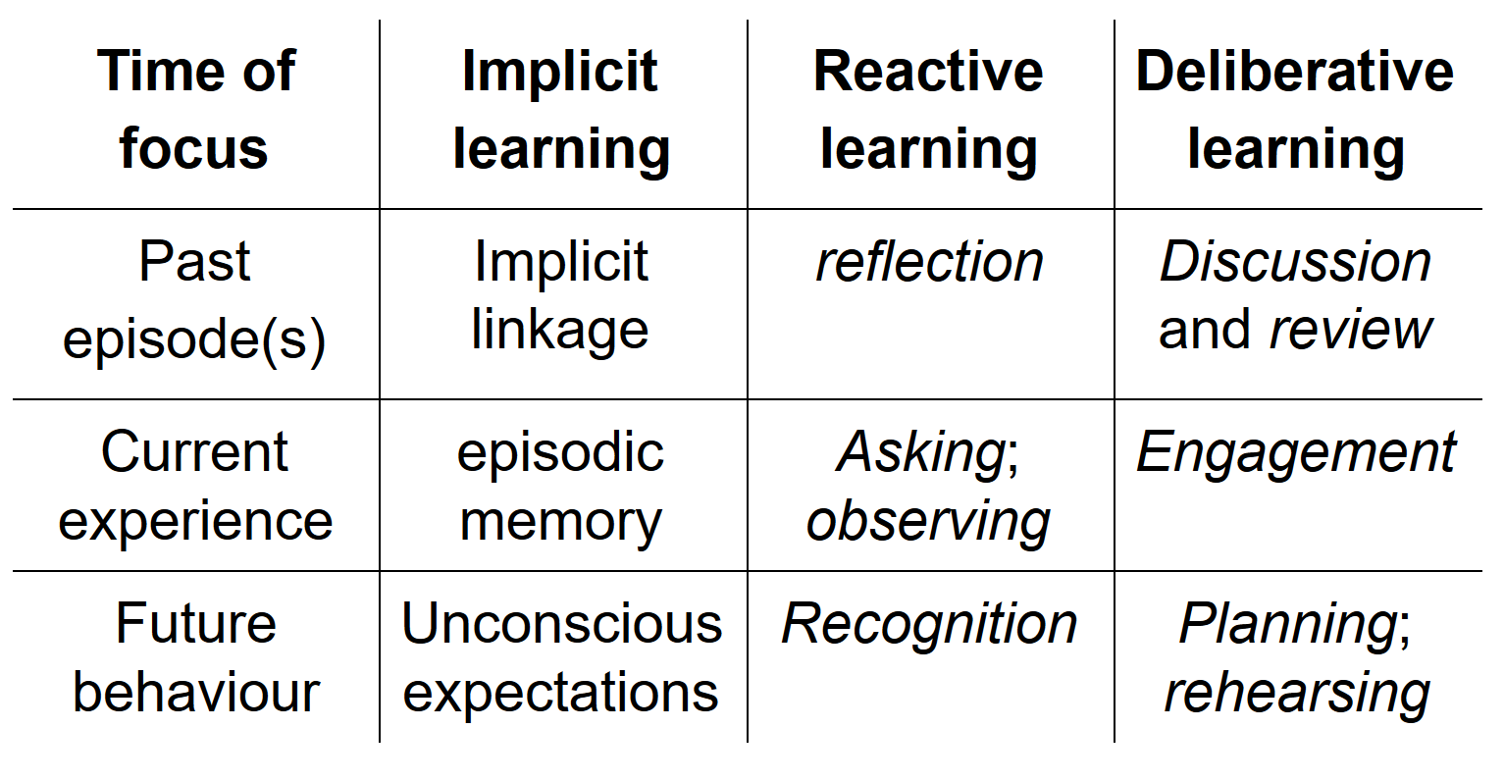
Informal Learning
(Eraut, 2004, p. 250)
Notes:
“The term ‘informal learning’ has been used increasingly in adult education for several reasons. It provides a simple contrast to formal learning or training that suggests greater flexibility or freedom for learners. It recognizes the social significance of learning from other people, but implies greater scope for individual agency than socialization. It draws attention to the learning that takes place in the spaces surrounding activities and events with a more overt formal purpose, and takes place in a much wider variety of settings than formal education or training. It can also be considered as a complementary partner to learning from experience, which is usually construed more in terms of personal than interpersonal learning.” (Eraut, 2004)
A typology of informal learning
Time of focus
Implicit learning
Reactive learning
Deliberative learning
Past episode(s)
Implicit linkage of past memories with current experience
Brief near‐spontaneous reflection on past episodes, events, incidents, experiences
Discussion and review of past actions, communications, events, experiences
Current experience
A selection from experience enters episodic memory
Noting facts, ideas, opinions, impressions; asking questions; observing effects of actions
Engagement in decision making, problem solving, planned informal learning
Future behaviour
Unconscious expectations
Recognition of possible future learning opportunities
Planning learning opportunities; rehearsing for future events
CSV
(Eraut, 2004, p. 250)
What is being learned? (Quoted)
Codified knowledge that is not academic can be found in nearly all workplaces, including those of educational organizations, in the form of textual material containing organization‐specific information, records, correspondence, manuals, plans, etc.
Cultural knowledge that has not been codified plays a key role in most work‐based practices and activities.
personal knowledge as what individuals bring to situations that enables them to think, interact and perform. … not only personalized versions of public codified knowledge but also everyday knowledge of people and situations, know‐how in the form of skills and practices, memories of episodes and events, self‐knowledge, attitudes and emotions.
(Eraut, 2004, pp. 263-264)
QUOTED
four main types of work activity that regularly gave rise to learning:
1. Participation in group activities included teamworking towards a common outcome, and groups set up for a special purpose such as audit, development or review of policy and/or practice, and responding to external changes.
2. Working alongside others allows people to observe and listen to others at work and to participate in activities, and hence to learn some new practices and new perspectives, to become aware of different kinds of knowledge and expertise, and to gain some sense of other people's tacit knowledge.
3. Tackling challenging tasks requires on‐the‐job learning and, if well‐supported and successful, leads to increased motivation and confidence.
4. Working with clients also entails learning (1) about the client, (2) from any novel aspects of each client's problem or request and, (3) from any new ideas that arose from their joint consultation.
(Eraut, 2004, pp. 266-267)
Michael Eraut. (2004). Informal learning in the workplace, Studies in Continuing Education, 26:2, 247-273, DOI: 10.1080/158037042000225245 https://www.tandfonline.com/doi/full/10.1080/158037042000225245
Ectel2019 keynote Geoff Stead , Inge deWaard, Ignatia Webs, Sept 23, 2019
This is a detailed summary of a talk by Geoff Stead, chief product person of the Babbel language corporation, talking about informal learning at scale. "Digital learning is not content distribution," says Stead. "We are only a small slice of our learner's day, we never really know what is going on." See also: Rose Luckin's Golden Triangle. [Direct Link]
Knowledge Management and Reuse in Virtual Learning Communities, Houda Sekkal, Naila Amrous, Samir Bennani, International Journal of Emerging Technologies in Learning, Aug 29, 2019
The idea of capturing knowledge from informal communication has been around for decades - see for example this proposal from 2003 called Semex - but there are different ways to capture this knowledge and different kinds of knowledge are captured. This is a relatively short paper (17 page PDF) that looks at those options. It's based on an analysis of several knowledge-capture papers using something called the 'Markus Knowledge Reuse Process', which is in reality a simple four-... [Direct Link]
Formal and Informal Learning: What’s the Difference?, Emma O'Neill, LearnUpon, Jul 30, 2019
This article misses the point in a way that's illustrative. It defines formal learning as "planned and guided by an instructor" and informal learning as "unstructured, often unintended, and it occurs outside of a conventional learning setting." But Emma O'Neill adds, it "has no real objectives, rather it just happens naturally." Not exactly. If you just think of learning as the acquisition of content, then sure, informal learning has "no real ... [Direct Link]
Digital Media’s Alteration Mechanism for Informal Learning, Otto Petrovic, Proceedings of the 10th International Conference on Computer Supported Education, Jun 20, 2019
What's interesting about this paper (10 page PDF) is that it covers familiar ground from a quite distinct perspective. The result is that the terminology and approach is different - for example, we have "collaborativism" instead of "connectivism", and we read of "alteration mechanisms" where "Learning can be defined as acquiring new or modify existing knowledge, skills, competencies, and perceptions which lead to alterations in thinking, feeling, and ... [Direct Link]
Revisiting 70:20:10, Clark Quinn, Learnlets, Nov 14, 2017
I think that Twitter is a terrible place to hold a conversation, but if you can get past how annoying these tweets would be to a non-participant you get what is actually a pretty good stream of comments in Will Thalheimer's debunk session. What are my takeways from it? Well, first of all, the numbers don't matter - what the phrase expressdes is the idea that there is a split between formal, social and espetiental forms of learning (except the numbers do matter; if it'... [Direct Link]

Slide 16

Personal vs Personalized Learning
2

Slide 17
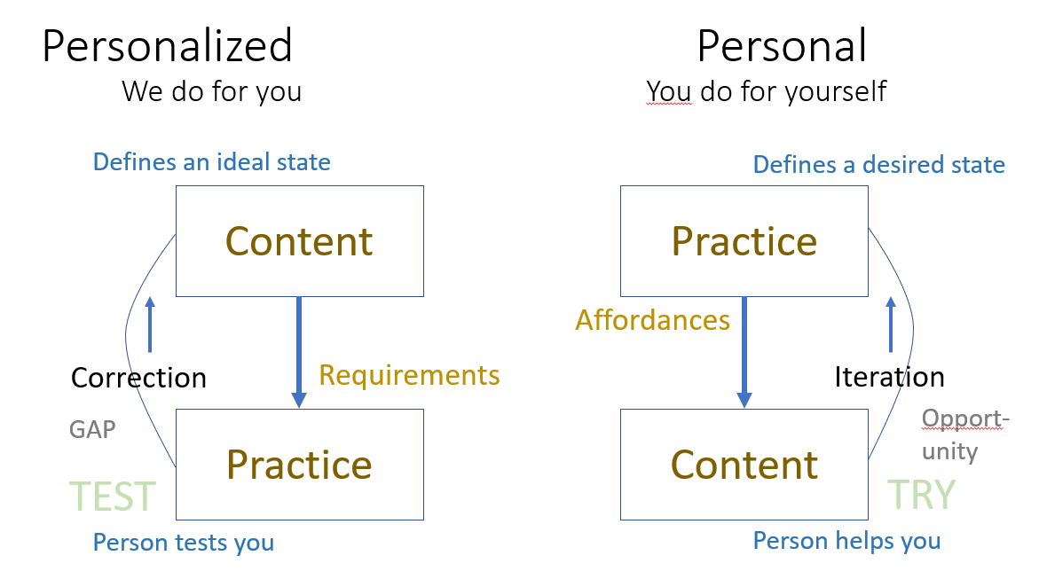
The distinction
Notes:
The Future Of Learning? Well, It's Personal, Anya Kamenetz, NPR, Nov 16, 2018
This NPR article on personal and personalized learning (cast here as two types of personalized learning) has a hard focus on U.S. schools sector issues and voices, which is unfortunate. It also lacks some historical depth, and as a result doesn't explore the application and development of personalized learning and competency-based learning in the military (think: Advanced Distributed Learning) and corporate sectors. And for 'evidence' we get Sal Khan's opinions. "We'... [Direct Link]
Second Draft: A Continuum of Personalized Learning, Larry Cuban, Larry Cuban on School Reform and Classroom Practice, Sept 27, 2018
This is one of those articles where a diagram would have helped a lot. Well, mostly because it would have shown how the idea of a 'continuum' here is incoherent. But still. Here's Larry Cuban's description of the continuum: "At one end of the continuum are teacher-centered lessons within the traditional age-graded school.... At the other end of the continuum are student-centered classrooms, programs, and schools." OK, so what's in between? Cuban clusters ... [Direct Link]
Personalized Learning Vs Personalization of Learning, George Couros, The Principal of Change, Feb 10, 2018
This is, I think, another effort to grapple with the distinction between 'personalized learning' and what I have been calling 'personal learning' and is called 'personalization of learning' in this article. The difference is that it is focused on an in-class perspective: the idea of “personalization of learning” is about "how does the teacher understand the student, build on their interests, and create learning opportunities for the student." I ... [Direct Link]

Slide 18
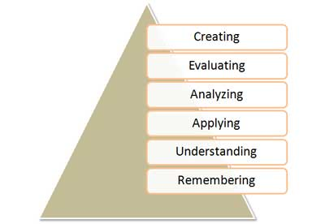
Starting Points and Goals
Image: Via Donald Clark: http://www.nwlink.com/~donclark/hrd/bloom.html
Notes:
QUOTED from Clark
Bloom's Taxonomy was created in 1956 under the leadership of educational psychologist Dr Benjamin Bloom in order to promote higher forms of thinking in education, such as analyzing and evaluating concepts, processes, procedures, and principles, rather than just remembering facts (rote learning). It is most often used when designing educational, training, and learning processes.
The Three Domains of Learning
The committee identified three domains of educational activities or learning (Bloom, et al. 1956):
Cognitive: mental skills (knowledge)
Affective: growth in feelings or emotional areas (attitude or self)
Psychomotor: manual or physical skills (skills)
Since the work was produced by higher education, the words tend to be a little bigger than we normally use. Domains may be thought of as categories. Instructional designers, trainers, and educators often refer to these three categories as KSA (Knowledge [cognitive], Skills [psychomotor], and Attitudes [affective]). This taxonomy of learning behaviors may be thought of as “the goals of the learning process.” That is, after a learning episode, the learner should have acquired a new skill, knowledge, and/or attitude.

Slide 19
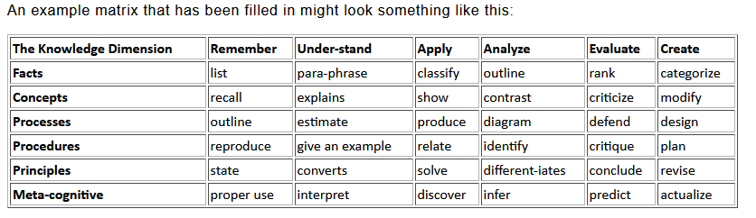
Image: Via Donald Clark: http://www.nwlink.com/~donclark/hrd/bloom.html

Slide 20
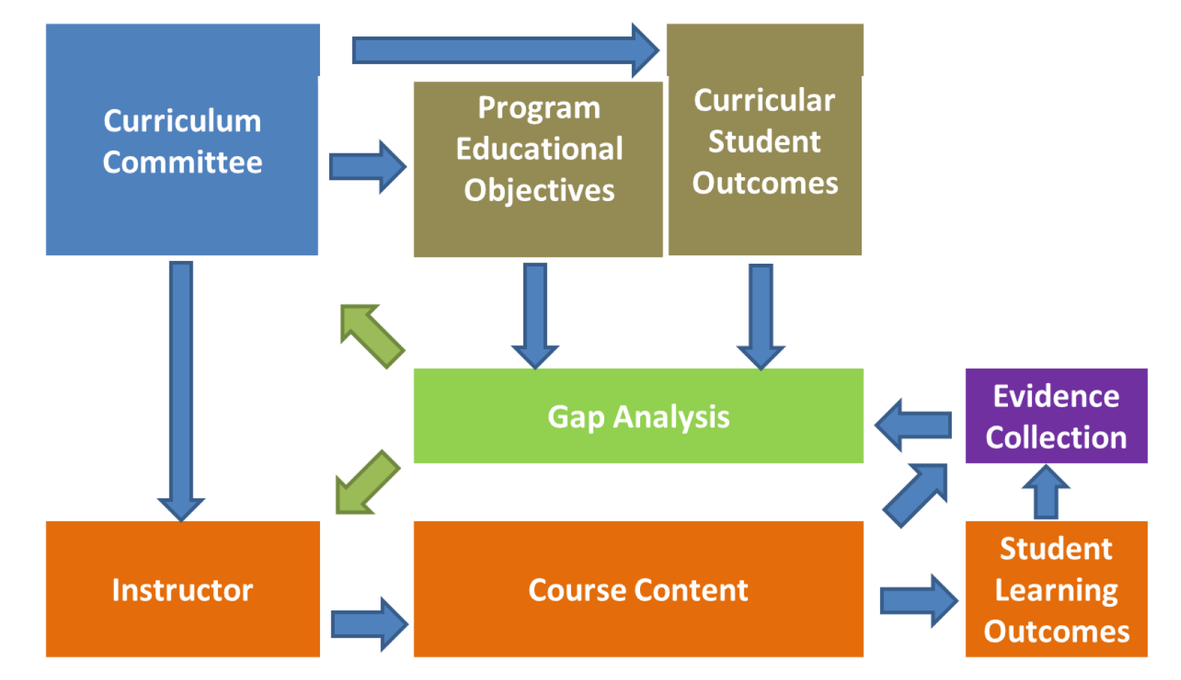
Assessment: Gap vs Iteration
Curtis, et.al. (2012). Development of evidence management and gap analysis tools for
continuous improvement of engineering programs . American Society for Engineering Education. https://images.app.goo.gl/3XXtbRZ8KPxSHuRD8
Notes:
In the case of personalized learning, assessment consists of a performance by the student of an action that satisfies one of the conditions defined by the learning objective or competency definition. Except in the case of of a perfect performance, the assessment identifies a ‘learning gap’ that identifies the difference between the idealized performance and the learner’s actual performance.
Note - the need for experts, alternatives?
Opportunity vs gap
Correction vs feedback
Using Semantic Technologies for Formative Assessment and Scoring in Large Courses and MOOCs, Miguel Santamaría Lancho, Mauro Hernández, Ángeles Sánchez-Elvira Paniagua, José María Luzón Encabo, Guillermo de Jorge-Botana, Journal of Interactive Media in Education Latest Articles, Aug 15, 2018
This paper shows "to what extent assessment software such as G-Rubric is mature enough to be used with students." G-Rubric is a tool to automatically evaluate student's open-ended answers in a MOOC - see the website (in Spanish). According to the authors, "It offers them enriched and personalised feedback that proved entirely satisfactory." Moreover, "Comparing tutors’ marks with G-Rubric grades, a remarkable correlation and no significant differences ... [Direct Link]
Badges Need Rigor! (Or do they really?)
David Leaser, IBM Training and Skills Blog, 2019/10/04
According to David Leaser, "the value of Open Badges may be lost if we prescribe a fixed set of expectations and present assumptions to constrain their enormous potential." How so? A lot of people ask about rigor, he writes, but they are confusing open badges with certifications or skills. But open badges should register passions or interests, not just formal qualifications. "By creating 'playlists' that incorporate passions like music and fashion with soft skills and business focused education, LRNG connects a person's passions with a pathway to a great life."
Web: [Direct Link]
Access, Openness and Elitism
The Harvard Ruling Misses the Point
Richard Ford, Boston Review, 2019/10/02
As much as I am loathe to delve into U.S. education politics, I think it's important to highlight the nugget of wisdom in this post. While people tend to think of higher education as a 'social leveler' - "anyone, we are told, can ascend an ever-steepening social and economic hierarchy". But, "of course, it isn’t. The result is that class stratification, cutthroat capitalist competition, and racial resentment collide in university admissions." And this continues to exist even if you open up admissions to the lower classes. "The children of the elite must always predominate if the school is to remain elite. A truly elite school admits the most talented student body it can while still ensuring that most of the student body is drawn from the upper class."
Web: [Direct Link]
Iterations, agile methodology

Slide 21
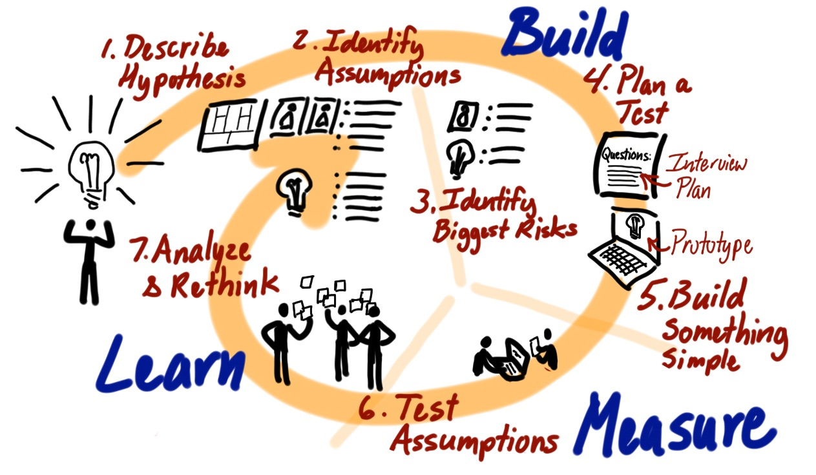
Image: Jeff Patton. (2015). Common Agile Practice Isn’t for Startups. https://www.jpattonassociates.com/common-agile-isnt-for-startups/

Slide 22
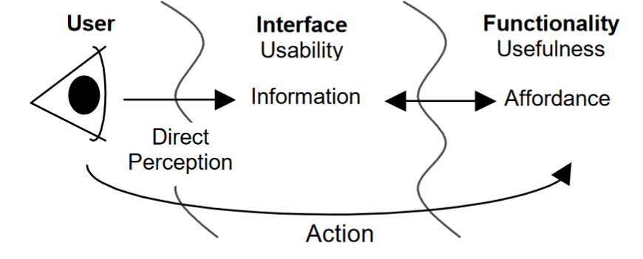
Requirements vs Affordances
Affordance as action possibility
Image: McGrenere & Ho. (2000). Affordances: Clarifying and Evolving a Concept. http://graphicsinterface.org/wp-content/uploads/gi2000-24.pdf

Slide 23
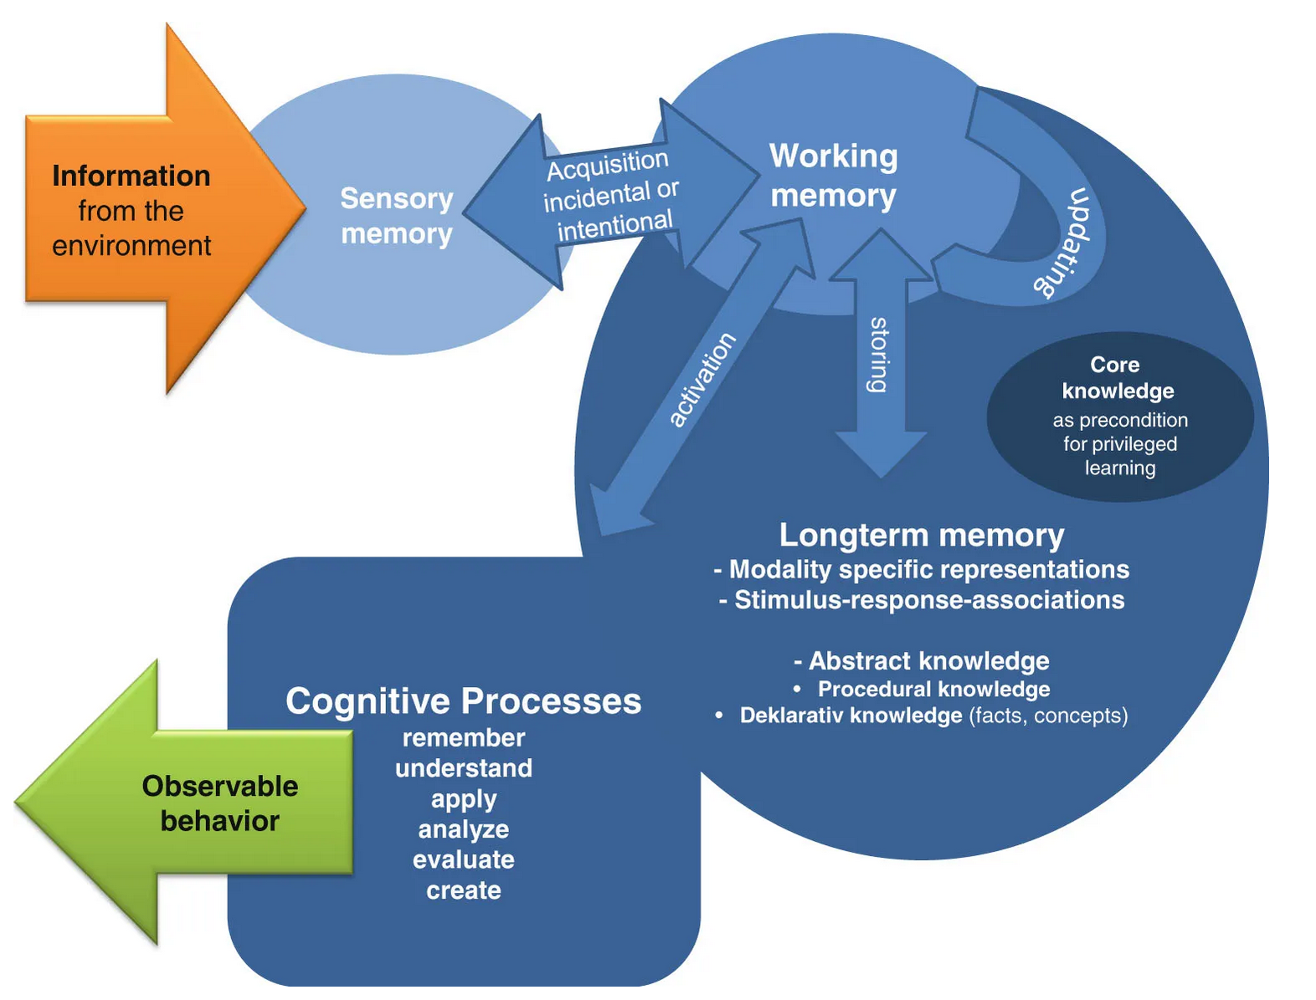
Assessments
Learning as a cognitive phenomenon
Image: Elsbeth Stern. (2017). Individual differences in the learning potential of human beings. npj Science of Learning volume 2, Article number: 2. https://www.nature.com/articles/s41539-016-0003-0
Notes:
What is the evidence for all this? How do we know it would work?
The question is: what does success (for you) look like? And measure for that.

Slide 24
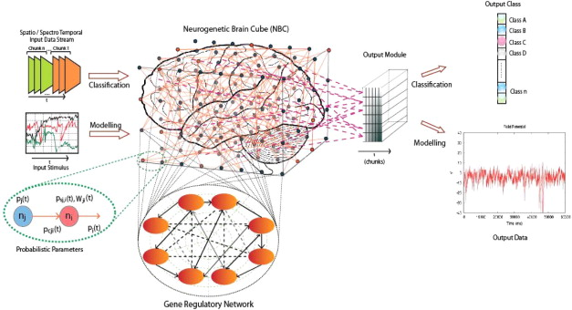
Nikola K.Kasabov. (2014). Evolving connectionist systems for adaptive learning and knowledge discovery: Trends and directions. Knowledge-Based Systems Volume 80, May 2015, Pages 24-33 https://doi.org/10.1016/j.knosys.2014.12.032
assessment as remembering vs capability

Slide 25
Assessing a physicist:
Do they know a certain body of information
vs
Do they see the world the way a physicists does?
Do they ask the same sorts of questions? Use words the same way?
Do they accept the same sort of evidence to change their beliefs?
Can they do thing physicists can do?
Have they actually done physics and shared the results?
Would other physicists recognize them as a physicist?

Slide 27
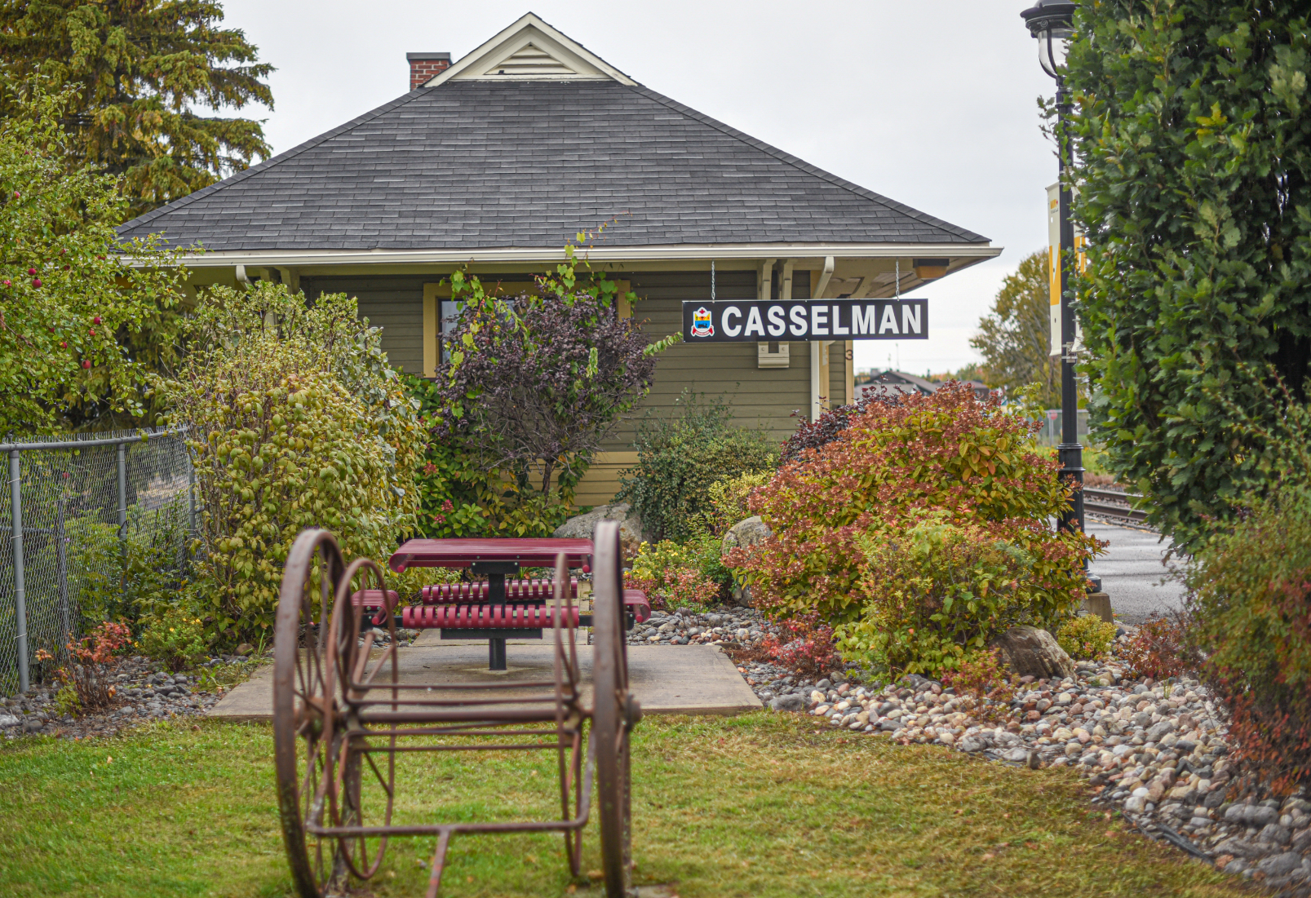
Making Lifelong Learning Happen
3
Notes:
The Fourth Industrial Revolution is here, and it is changing everything, Colleges and Institutes Canada, Desire2Learn, Nov 09, 2018
Desire2Learn has updated and published a Canadian edition of its report on the future of learning (28 page PDF) (and you don't even have to give them information to read it; well done D2L). The premise is that the nature of work is changing and that therefore "societies must embrace new or hybrid learning models to allow individuals and economies to thrive going forward." A challenge is coming from automation and AI, "putting cognitive jobs at risk." There's also ... [Direct Link]
https://teachonline.ca/sites/default/files/tools-trends/downloads/ontario_needs_to_tackle_five_major_social_and_pedagogical_challenges_in_online_learning.pdf

Slide 28
Triad model
Education Provider
Subject Matter Experts
Assessment services
The online host-provider framework
Host
Local to learner
Advocacy for learner
Coaching and subbort
Community
Learner
Sets own objectives
Selects learning resources
Notes:
Downes - https://www.downes.ca/future/triad.htm
Host-Provider Framework
“The Host Provider framework was developed by the Oregon Community College Distance Learning Association (OCCDLA) as a means of providing more course options to community college students throughout the state. “The program began in the fall of 1997. As an online teacher at Chemeketa, this program is very likely to affect you.
The Provider-Many colleges have opened space within their distance education classes for students from other community college districts. These colleges are referred to as "provider colleges" because they provide classes that might otherwise be unavailable to these students.The instructors for the courses are located at the provider colleges.
The Host-The colleges that wish to "host" such classes advertise the "provider" course(s) as if it were their own course/s. Registration and student services are provided by the local or host college. The only difference is the instructor is located at the provider campus and typically the student has to login to the provider college‟s learning management system (eLearn) to access course materials.
Host Students–Are those registered through another community college, but taking your online class provided by Chemeketa.”
Chemeketa Community College. (2010). Chemeketa Online Faculty Guide, 2010-2011 Edition.
http://techhub.chemeketa.edu/wp-content/uploads/manuals/FacultyGuide_2010-11.pdf
P. 8

Slide 29
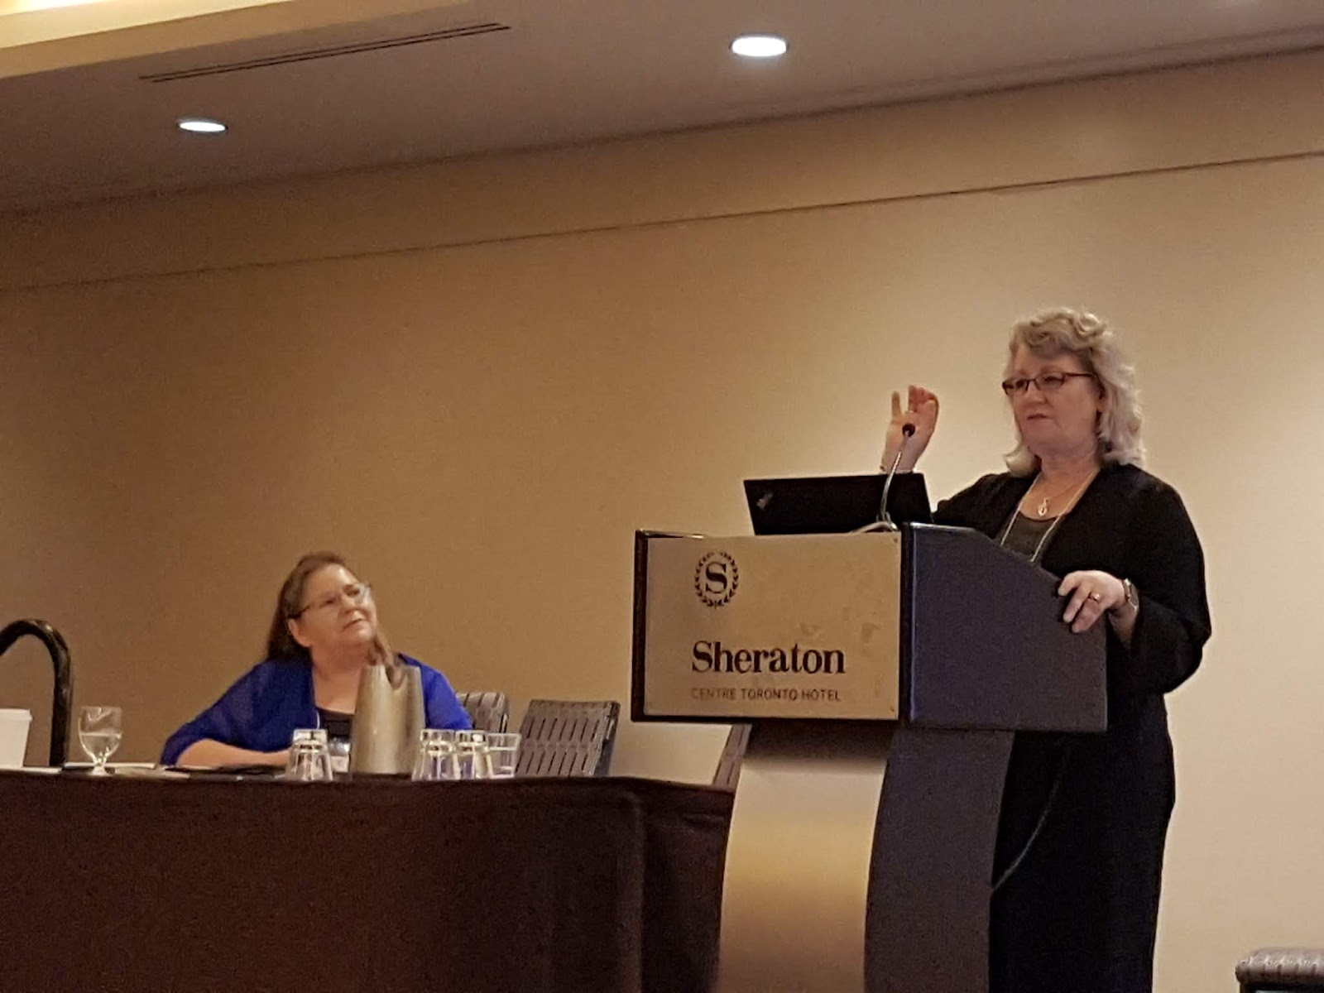
Aboriginal Financial Officers Association of Alberta and Athabasca University’s BComm project
“we assembled an instructional team including the professor and the indigenous mentor (Robert in this case). And we created a psychologically safe environment, away from the 'norm', an off-site locaton where the mentor and professor could come together with the students so they could create a learning community.”
https://business.athabascau.ca/news/creating-opportunities-for-indigenous-learners/
https://halfanhour.blogspot.com/2019/10/teaching-and-learning-in-digital-age.html

Slide 30
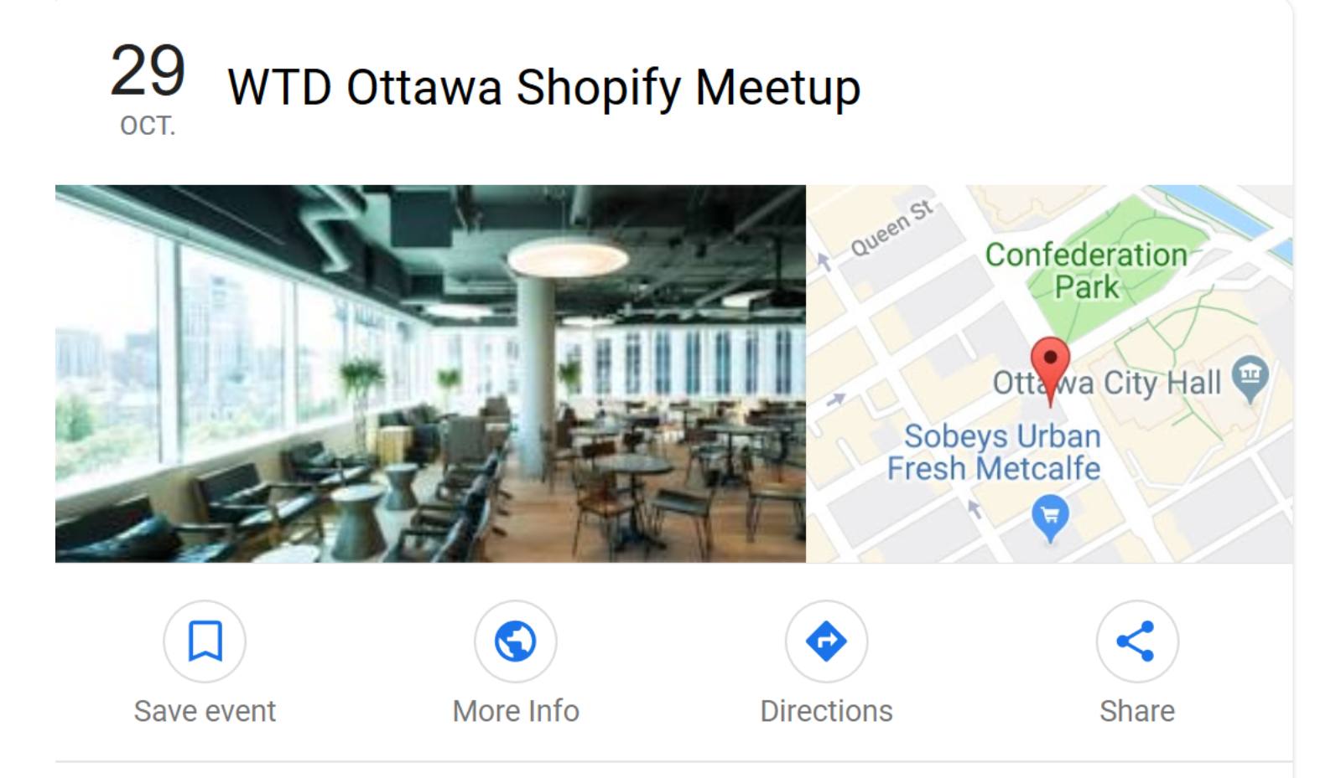
Community Learning Centres
Image: Google Events
https://www.google.com/search?client=firefox-b-d&q=shopify+ottawa+meetups&ibp=htl;events
Notes:
Shopify, for example, offers open Meet-Ups on current topics in its fifth-floor coffee room and lounge in central Ottawa. - Meetups - etc. Here’s an example of one of those - on web documentation - being advertised via Google Events:
Image: https://www.google.com/search?client=firefox-b-d&q=shopify+ottawa+meetups&ibp=htl;events&rciv=evn&sa=X&ved=2ahUKEwic0tOOy4_lAhVhg-AKHc-BAAUQ5bwDMAF6BAgKEAE#fpstate=tldetail&htidocid=MKaeaAhu3Y4oOibnJpA8-A%3D%3D&htivrt=events&sxsrf=ACYBGNRyGWuGq0AiXbWKCHAybU5218tCnA:1570638163936
Cedefop paper
https://www.cedefop.europa.eu/files/2226_en.pdf
“Discussing the potential of a community-based one-stop-shop also requires reflection on its impact on all aspects of European education systems. Psifidou (2017) acknowledges from Cedefop’s research on early leaving from VET (2016) that…
An active outreach approach is needed to reach early leavers from education and training;
Multidisciplinary teams have been key to address potential early leavers with complex multifaceted kinds of needs;
Intergenerational learning is an untapped human capital;
Complementarity between formal and non-formal education systems allows for a holistic approach of personal development.
Potentially, the added value of the one-shop-stop includes (Psifidou 2017):
Stopping the fragmentation of services;
Preventing individuals “falling through the net”;
Helping individuals in need to build up trust;
Strengthening families and communities’ role and contribution to education;
Ensuring accessibility (e.g. for minority groups);
Providing flexibility (to select support services needed);
Placing ECEC, compulsory education, and VET within a lifelong learning framework to support the development of soft skills;
Combining informal, non-formal and formal education including VET;
Making use of shared public infrastructures to their best potential
Online Course on Community Learning Centres and Lifelong Learning in Asia and the Pacific
https://bangkok.unesco.org/content/online-course-community-learning-centres-and-lifelong-learning-asia-and-pacific
Also: https://bangkok.unesco.org/content/launch-online-course-community-learning-centres-and-lifelong-learning-asia-and-pacific
Staples Canada recently opened what it calls the Working and Learning Store "Start-ups, small businesses and students can access the innovative and collaborative workspace, featuring beautiful lounge spaces, community kitchens, private and shared offices, and meeting rooms fully equipped with modern office furniture and state-of-the-art technology to meet the needs of the ever-growing start-up community."
Staples Canada ULC. (2019) Staples Canada opens the Working and Learning Store concept in Oakville. Press Release, published on Cision, August 12, 2019. https://www.newswire.ca/news-releases/staples-canada-opens-the-working-and-learning-store-concept-in-oakville-featuring-a-new-coworking-space-thousands-of-new-products-and-elxr-juice-lab-896221005.html

Slide 31
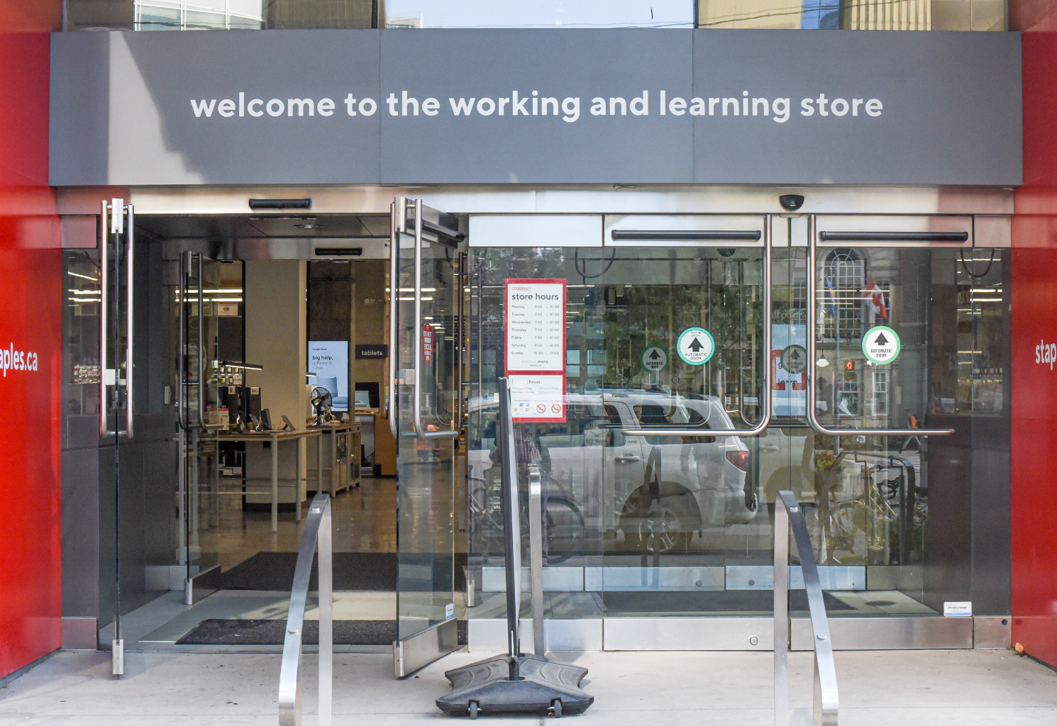
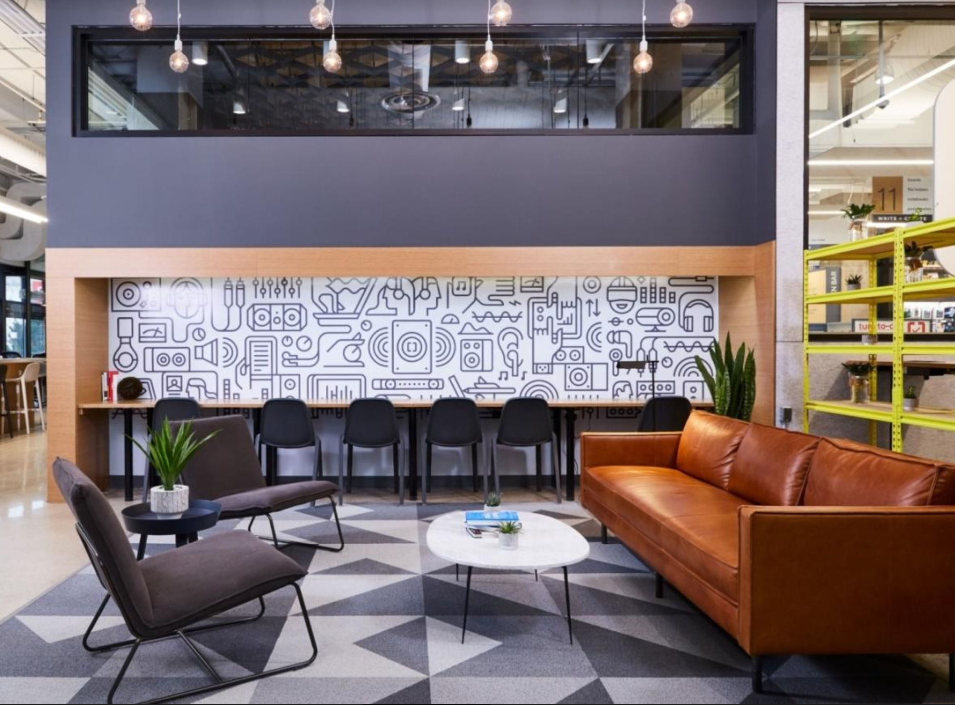
https://studio-members.staples.ca/public/calendar?rate.$ne=null

Slide 32
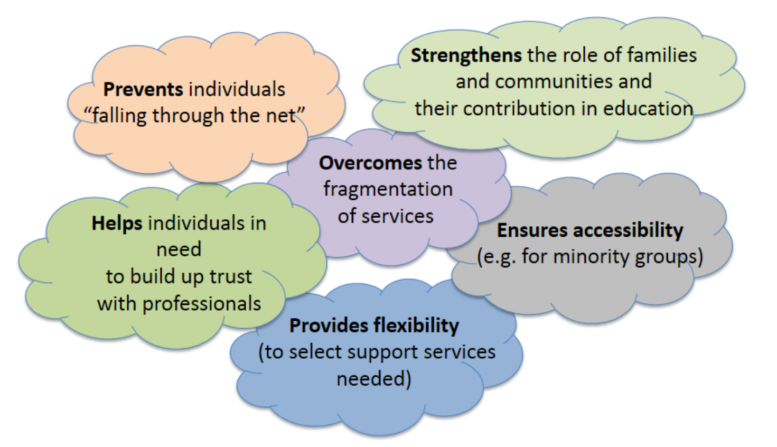
Image: P. Downes, 2019
Notes:
Cedefop: “Multidisciplinary teams have been key to address potential early leavers with complex multifaceted kinds of needs;”
Found a lot of cases here from medical education - eg. https://www.researchgate.net/publication/11857303_Interdisciplinary_Health_Professional_Education_A_Historical_Review (Lavin, et.al., 2001)
Also Engineering (eg. CDIO seminar: Towards agile, interdisciplinary and individualised engineering education http://cdio.org/meetings-events/cdio-seminar-towards-agile-interdisciplinary-and-individualised-engineering )
“We are proposing a gateway principle for these one-stop shops where the community outreach lifelong learning centres engage with a wide range of young people and adults in areas of high socio-economic exclusion; and within this group, those with more complex needs requiring multidisciplinary team services can gain further supports.” (P. Downes, 2019)
Also:
“As part of a community outreach approach, these centres are in accessible locations in the local community. These locations are accessible both in terms of physical proximity and in terms of being a place where learners feel they belong. This is especially important for learners from marginalised and minority groups.
“Community lifelong learning centres act as gateways to support services from different disciplines which are located together as holistic teams in the same place (co-location). This approach means people attending lifelong learning sessions may receive additional support if needed, such as emotional counselling, family support, etc.” (P. Downes, 2019)
Also from P. Downes
leaflets, websites, posters and other forms of information will not suffice to engage ‘hard-to-reach’ groups.
• Need to question the communicative approach itself, rather than blame the individuals who do not become enchanted by such ‘information’.
https://www.cedefop.europa.eu/files/cedefop_pf_cllc_downes_29.5.2019.pdf
Image: P. Downes, 2019
Repko (2009) asserts that interdisciplinary instruction fosters advances in cognitive ability and other educational researchers (Kavaloski 1979, Newell 1990, Field et al. 1994, Vess 2009) have identified a number of distinct educational benefits of interdisciplinary learning including gains in the ability to:
Recognize bias
Think critically
Tolerate ambiguity
Acknowledge and appreciate ethical concerns
(From https://serc.carleton.edu/econ/interdisciplinary/why.html )
But also diversity, representation
Diversity - inclusion - https://www.linkedin.com/pulse/why-higher-education-must-more-inclusive-dr-patrick-blessinger/?trackingId=mwSOIm3rvzEf3wLcMKVoBA%3D%3D
Image: via Furick, et.al., 2010.
Paul Downes. (2019). Turning community lifelong learning centres into one-stop shops with the help of multidisciplinary teams. Electronic Platform for Adult Learning in Europe (EPALE) (Weblog). European Commission. https://epale.ec.europa.eu/en/blog/turning-community-lifelong-learning-centres-one-stop-shops-help-multidisciplinary-teams
Furick, Michael and Stearns, Jennie, "Strategies for Success in Interdisciplinary Team Teaching" (2010). SoTL Commons Conference. 8.
https://digitalcommons.georgiasouthern.edu/sotlcommons/SoTL/2010/8
Giselle Kovary. (2019). The Gen Z Learning Journey From Higher Education To The Workplace. Online Learning 2019, October 9, 2019. Summary: https://halfanhour.blogspot.com/2019/10/the-gen-z-learning-journey-from-higher.html
Lavin, Mary & Ruebling, Irma & Banks, Roxanne & Block, L & Counte, Mike & Furman, Gail & Miller, P & Reese, C & Viehmann, V & Holt, J. (2001). Interdisciplinary Health Professional Education: A Historical Review. Advances in health sciences education : theory and practice. 6. 25-47. 10.1023/A:1009875017951.
https://www.researchgate.net/publication/11857303_Interdisciplinary_Health_Professional_Education_A_Historical_Review

Slide 33
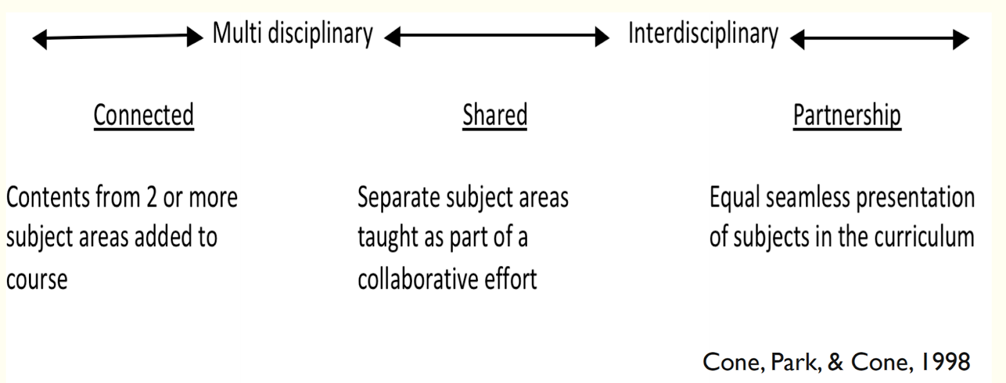
Multidisciplinary Teams
Image: via Furick, et.al., 2010.

Slide 34

Found a lot of cases here from medical education - eg. https://www.researchgate.net/publication/11857303_Interdisciplinary_Health_Professional_Education_A_Historical_Review (Lavin, et.al., 2001)
Also Engineering (eg. CDIO seminar: Towards agile, interdisciplinary and individualised engineering education http://cdio.org/meetings-events/cdio-seminar-towards-agile-interdisciplinary-and-individualised-engineering )

Slide 35
Outreach and Advocacy
Eg. Paul Hunter, IMD App -
knowledge nudge - where you receive fresh and relevant learning nuggets
empathy nudge - we reach proactively to people anticipating their pain points implementing changes back at work
reminder nudge - highlighting deadlines and commitment points
network nudge - staying in touch with the network in the course
Paul Hunter. (2019). Digital Learning 4.0: How to Guarantee Measurable Learner Impact Where Others Have Failed. Summary: https://halfanhour.blogspot.com/2019/10/digital-learning-40-how-to-guarantee.html
Notes:
There is an ongoing need from all parts of the educational system for outreach and advocacy. These are slightly different functions: one is to provide learner with notifications, resources and services they may need, and the other acts as an agent for the learner, offering support and guidance while working to advance the lerner’s interests, as opposed to those of the learning institution.
In my own work I experienced this role first-ha;ld
My own experience with Sunrise project, Assiniboine
Not just contect, need for support, representation
We see the need for the role of the advocate in programs like Athabasca University’s BComm program being offered in collaboration with the Aboriginal Financial Officers Association of Alberta. This program layers in-person community support over more traditional self-paced BComm courses. Along with the instructor there is a student mentor who can intervene on behalf of students, step them through the work involved in navigating the University’s online offering and services, and help provide culturally-specific advice and support. (Andrews, Hurst & Lightning, 2019).
At traditional universities, most advocacy is conducted by the Students’ Association. For example, the Continuing Education Students’ Association of Ryerson “can assist with grade appeals or standing, charges of academic misconduct or other issues in the University (and) can guide you through the university’s policies to protect your student rights.”
Eg. Paul Hunter, IMD App -
We also use 'nudges'. There are four types of nudge:
knowledge nudge - where you receive fresh and relevant learning nuggets
empathy nudge - we reach proactively to people anticipating their pain points implementing changes back at work
reminder nudge - highlighting deadlines and commitment points
network nudge - staying in touch with the network in the course
Robert Andrews, Deborah Hurst & DeAnne Lightning. (2019). Teaching and Learning in the Digital Age for Indigenous Learners. Summary: https://halfanhour.blogspot.com/2019/10/teaching-and-learning-in-digital-age.html
Continuing Education Students’ Association of Ryerson. (2019). Advocacy. Web page. https://mycesar.ca/studentrights/
Paul Hunter. (2019). Digital Learning 4.0: How to Guarantee Measurable Learner Impact Where Others Have Failed.

Slide 36
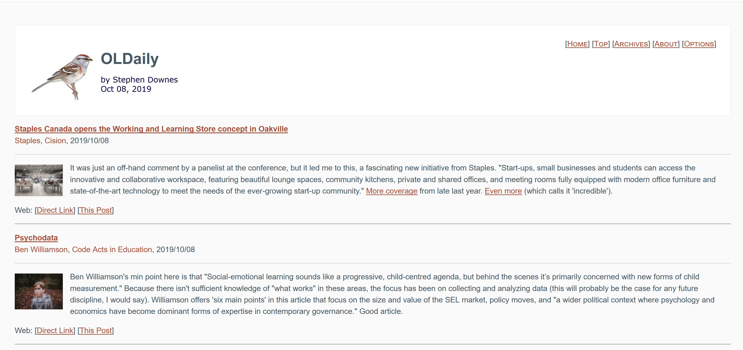
https://www.downes.ca/news/OLDaily.htm
A company the size of NRC should have a daily newspaper

Slide 37
Advocacy
The role of the advocate in programs like Athabasca University’s BComm program being offered in collaboration with the Aboriginal Financial Officers Association of Alberta.
This program layers in-person community support over more traditional self-paced BComm courses.
Along with the instructor there is a student mentor who can intervene on behalf of students, step them through the work involved in navigating the University’s online offering and services, and help provide culturally-specific advice and support.
(Andrews, Hurst & Lightning, 2019).

Slide 38

Intergenerational Learning
Example: NRC IRAP YEP - Youth Employment Strategy Programs
Approximately 2,400 graduates received a YEP internship worth $15K - $30K on average, between 2006-07 and 2010-11.
https://nrc.canada.ca/en/support-technology-innovation/nrc-irap-funding-hire-young-graduates
Via: https://guides.co/g/your-ultimate-guide-to-innovation-funding-western-canadian-edition/25744
Image:
Imagined by a GAN (generative adversarial network)
StyleGAN (Dec 2018) - Karras et al. and Nvidia
Original GAN (2014) - Goodfellow et al.
https://thispersondoesnotexist.com/
Notes:
Mentoring, yes, but….
= learning out loud, working out loud
https://workingoutloud.com/
Image: https://workingoutloud.com/about-2
Image: Ragnar Heil https://techcommunity.microsoft.com/t5/Yammer-Blog/Build-a-cross-company-Working-out-Loud-Community-to-change-the/ba-p/353755
NRC IRAP YEP - Youth Employment Strategy Programs

Slide 39
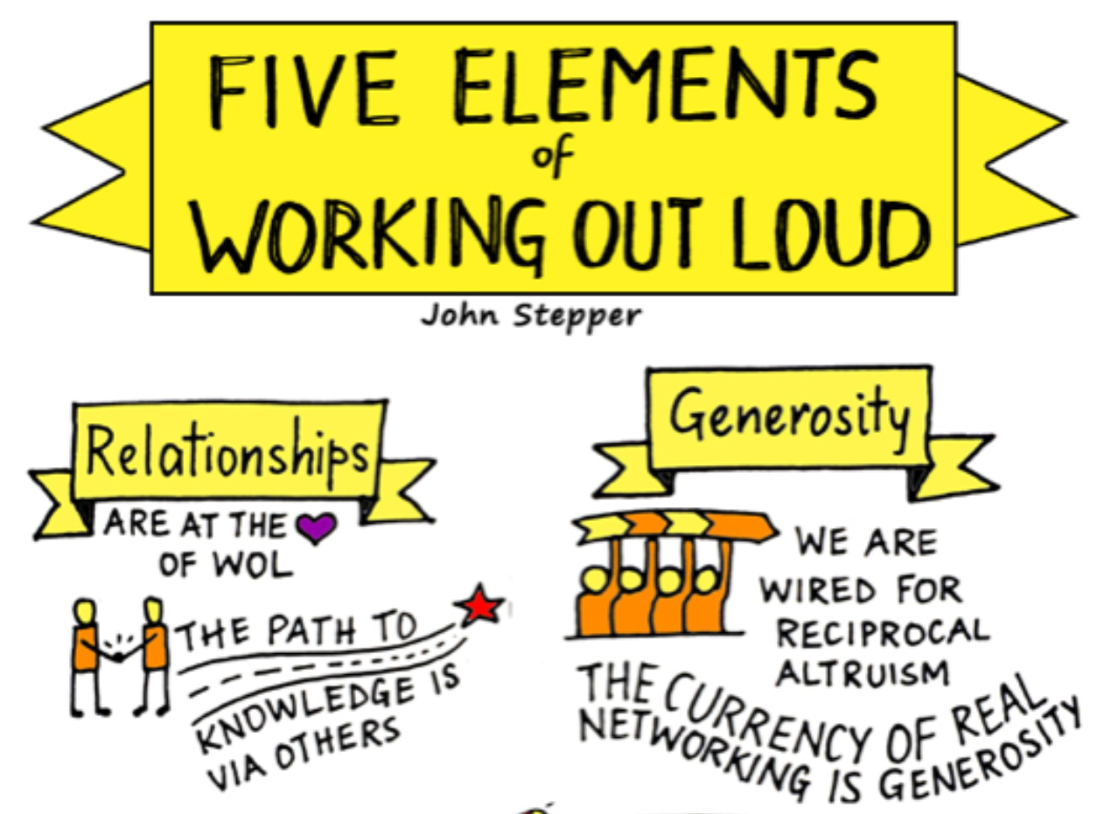
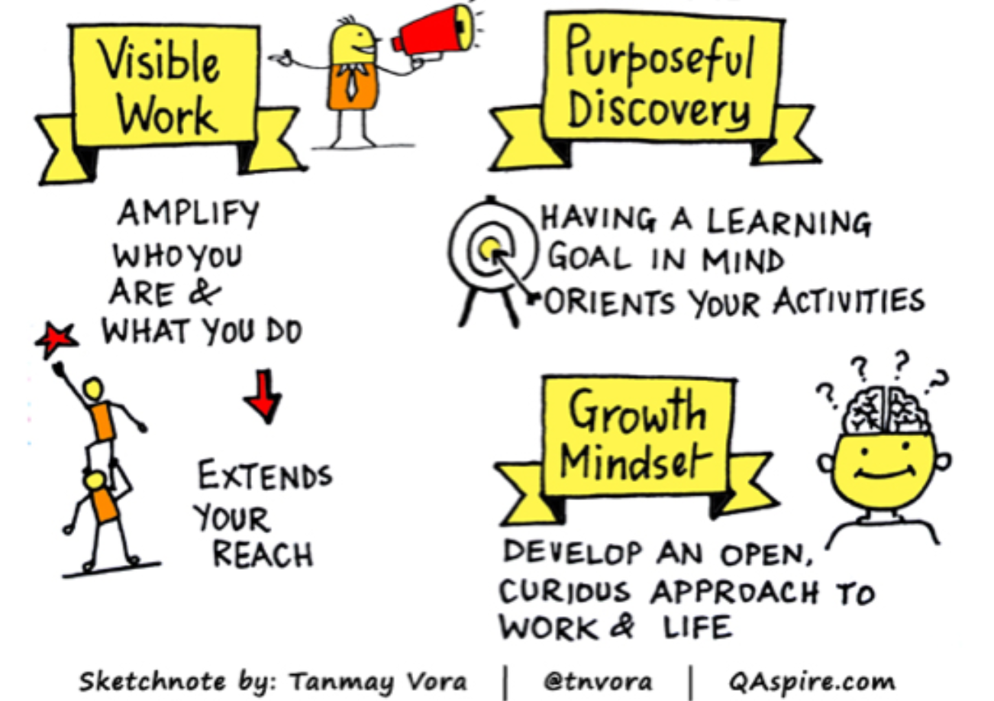
Working Out Loud
Image: https://workingoutloud.com/about-2

Slide 40
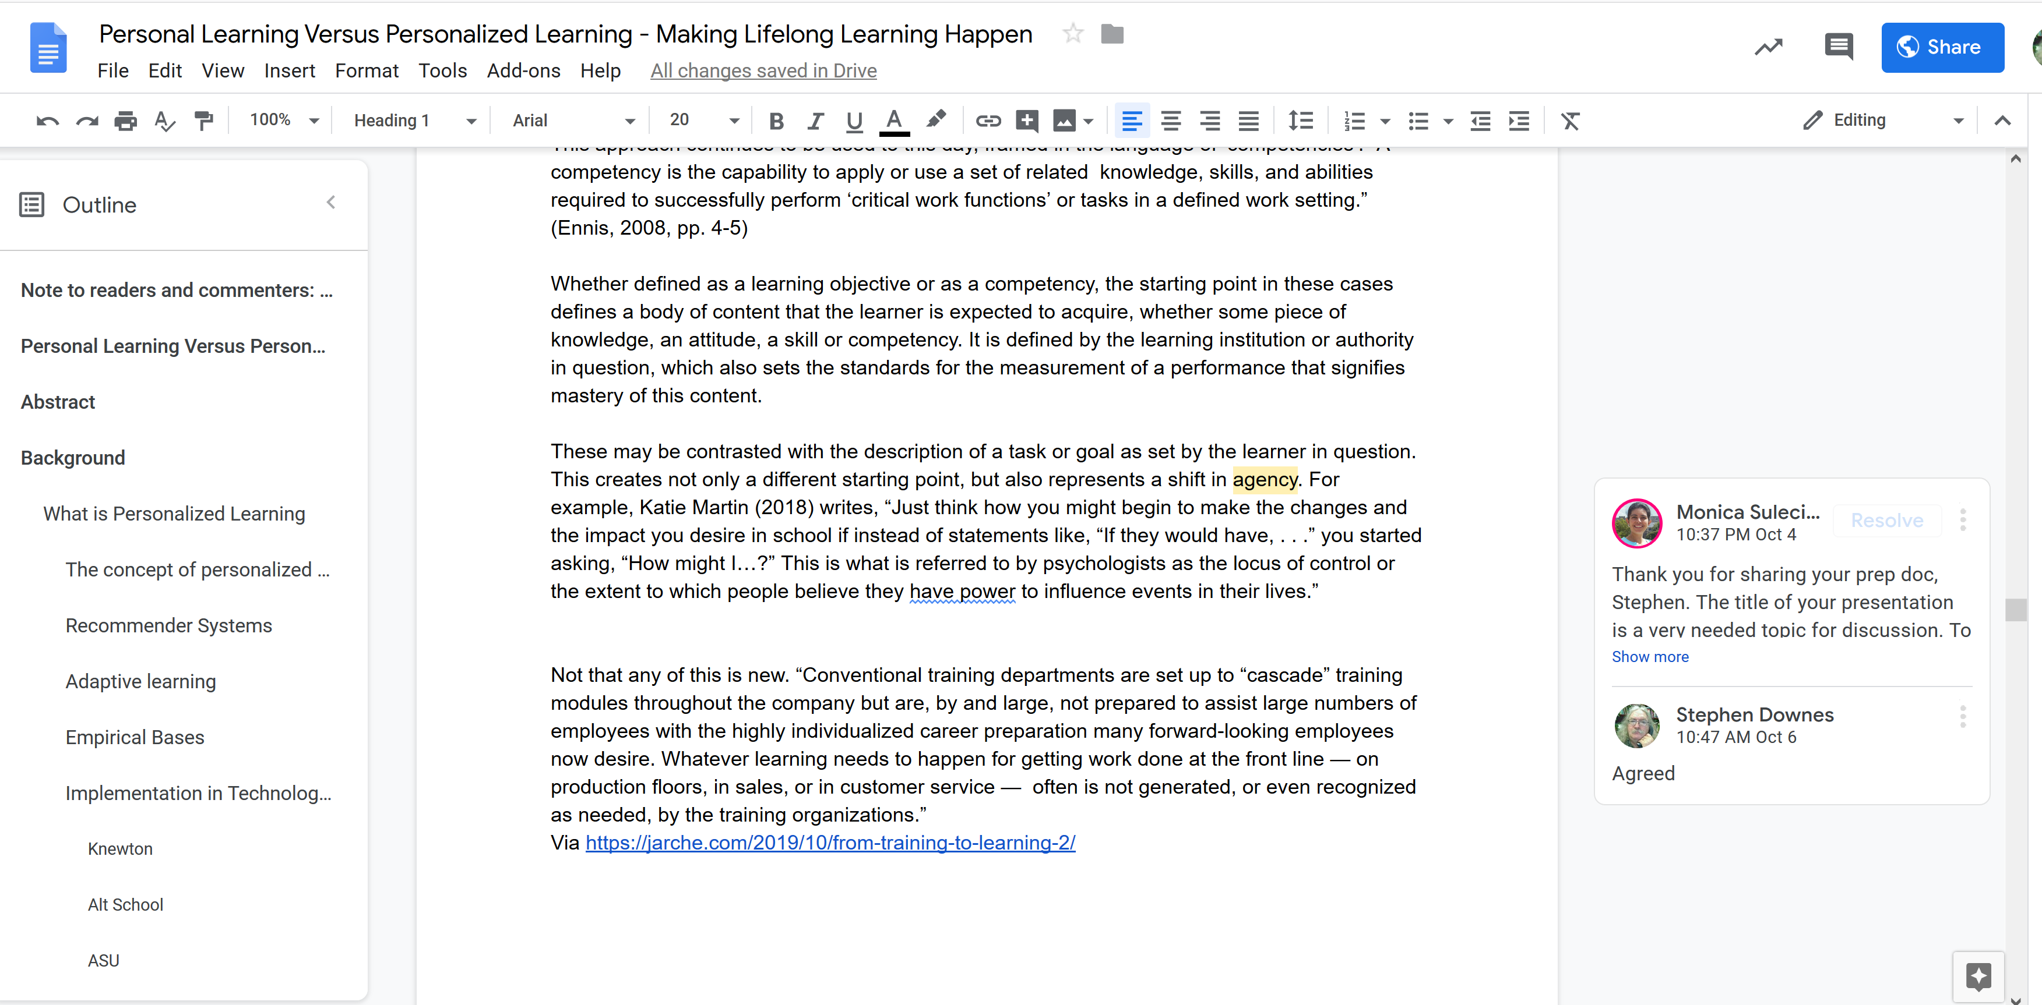

Slide 41
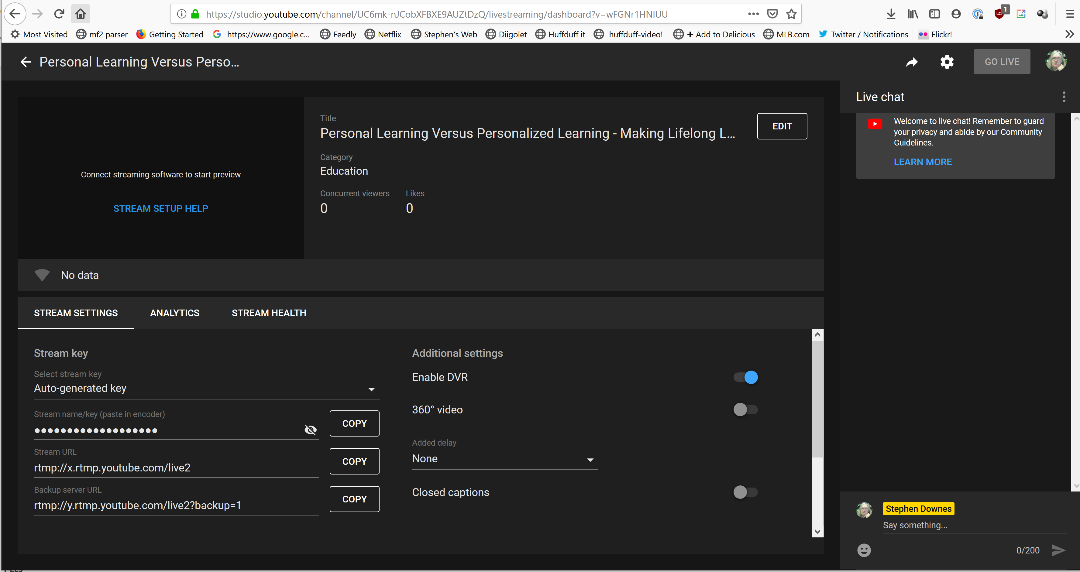

https://obsproject.com/welcome
https://studio.youtube.com/

Slide 42
Networks in learning (vs the elite institute)
The major value proposition offered by top tier universities isn't knowledge. This is available anywhere.
Nor is it even top-flight professors. Great teachers and researchers can be found in institutions large and small around the world.
No, the value proposition is access to the network of contacts, influencers, and collaborators. Access to networks matters, and it's this gap that isn't addressed in education reform programs ignore, to the detriment of participants.
Notes:
Networks in learning (vs the elite institute)
Not Just What But Who You Know Matters, Julia Freeland Fisher, Education Next, Aug 29, 2018
The major value proposition offered by top tier universities isn't knowledge. This is available anywhere. Nor is it even top-flight professors. Great teachers and researchers can be found in institutions large and small around the world. No, the value proposition is access to the network of contacts, influencers, and collaborators. Access to networks matters, and it's this gap that isn't addressed in education reform programs ignore, to the detriment of participants. As this story ... [Direct Link]
Building badge value with Endorsement, Don Presant, Open Badge Factory, Sept 03, 2018
This item introduces two major concepts to the badge ecosystem. The first is the idea of 'endorsement', which "promises to resolve recurring questions about the “credibility of badges” by providing third party validation that can be formal (like accreditation) or informal (“fits our purpose”). Endorsement can also strengthen collaboration, increase portability and encourage the development of meaningful badge ecosystems." The second is the idea of a &#... [Direct Link]
Apostolos K. ("AK") (2019). Formal education and social capital. Multilitteratus Incognitus
(weblog). September 24, 2019. http://idstuff.blogspot.com/2019/09/formal-education-and-social-capital.html
“So where does learning about social and cultural capital come from in the higher education environment? Extracurricular activities!”

Slide 43
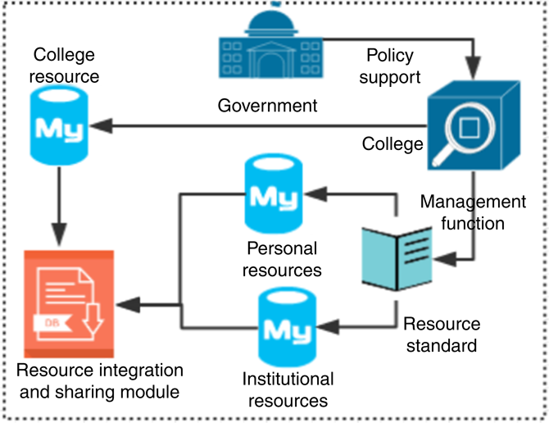
Complementarity between formal and non-formal education systems
Yongrong Xin, Xiuping Zuo, Qingping Huang. (2018). Research on the construction of seamless learning platform based on open education. Asian Association of Open Universities Journal. https://www.emerald.com/insight/content/doi/10.1108/AAOUJ-01-2018-0005/full/html

Slide 44
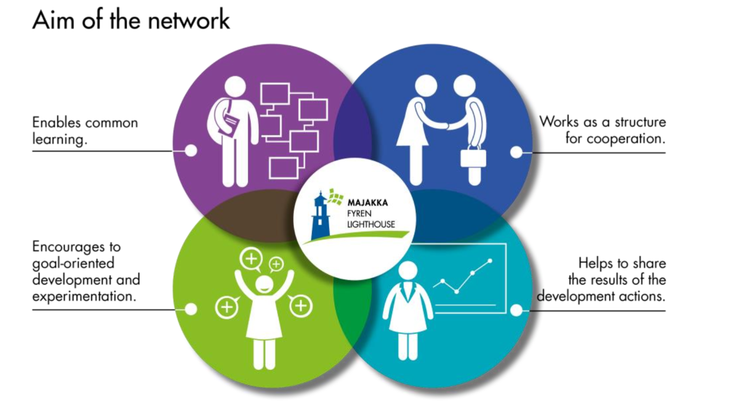
Example: Supporting learning and cooperation between innovative schools: Finland
The 'Lighthouse' project is a national, developmental network that aims to: a) support and increase common learning and cooperation between schools in regional and national level; b) encourage goal-oriented development and experimentation, andc) help to share the new pedagogical approaches and innovation as a result of developmental actions
The formal education system as a resource network feeding into the informal system
ET2020 Working Group Schools. (2018). Networksfor learning and development across school education. European Commission. https://www.schooleducationgateway.eu/downloads/Governance/2018-wgs5-networks-learning_en.pdf

Slide 45
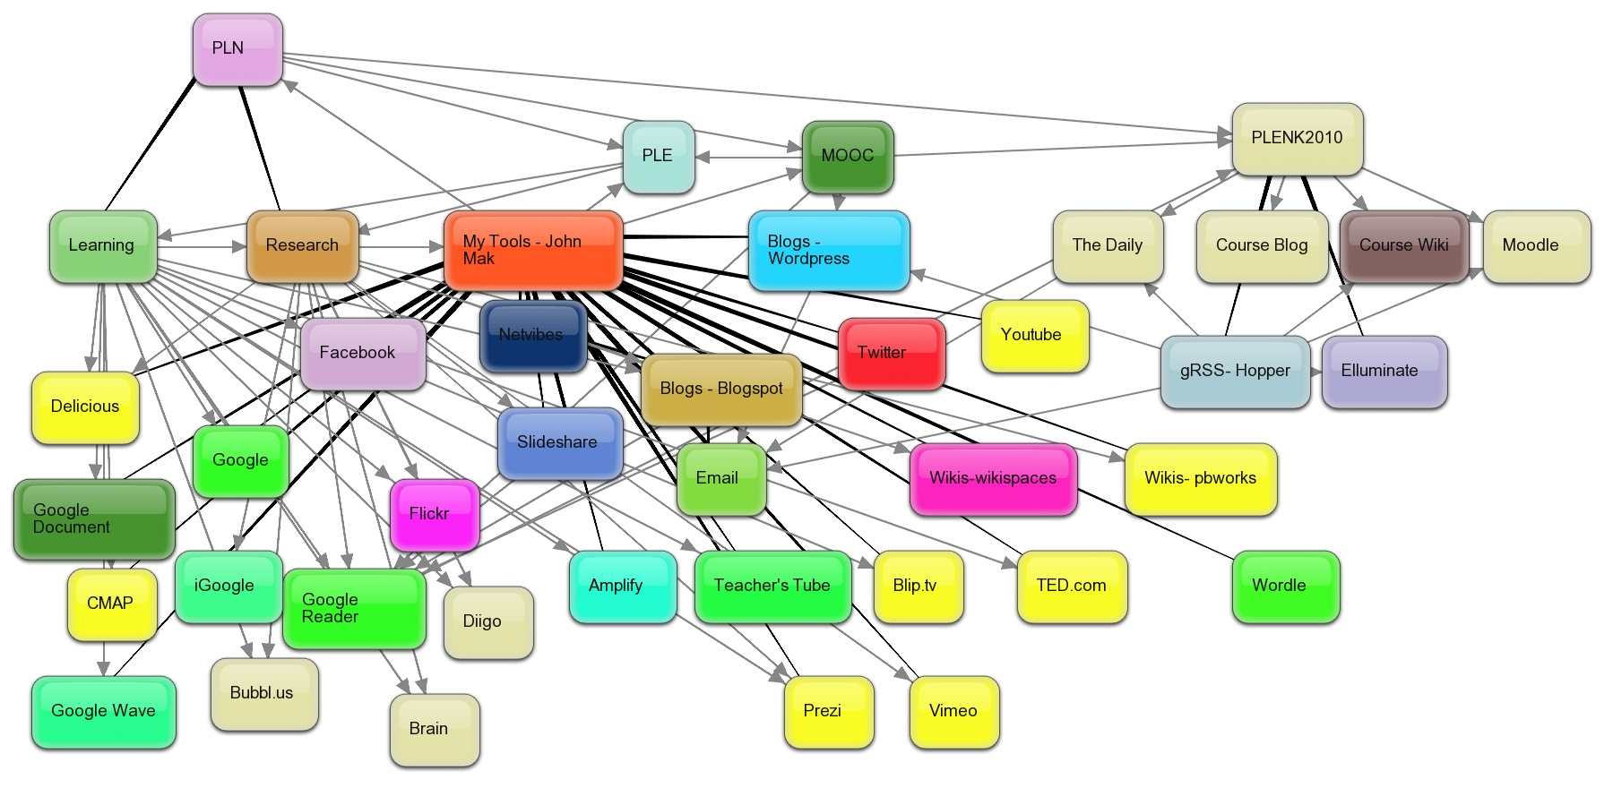
PLEs
Martin Weller: "Open universities across the world have been operating large scale, open, equitable learning for decades."
My response. I write, "the cost of educational labour is what makes it so expensive... (but) The connectivist approach is to do whatever can be done to help students perform this labour themselves."
https://www.downes.ca/cgi-bin/page.cgi?post=69410
Notes:
Personal Learning Environments: An Interview with EdMedia Keynote Speaker Linda Castaneda, Allie Alayan, AACE Review, Jun 24, 2019
There isn't a lot to this interview of Linda Castaneda, who teaches at Universidad de Murcia in Spain. There's some cookie-cutter intoductory information about PLEs, and then this: "A vision of PLEs as a posthumanistic proposal: a techno-social reality that embodies the socio-material entanglement with which people learn; and at the same time, an image of PLEs as a practical techno-pedagogical approach that enacts contemporary ideas about how people learn and how the learning ... [Direct Link]
Learning Technology Research Project Report, Tim Buff, Agylia, May 31, 2017
There are no real surprises in this report (despite what this summary says) but it offers a useful refocus on learner needs and preferences in mobile learning (27 page PDF). "Personalised content selections that reduce the mass of available information to the items most useful to the individual learner, are increasingly important... The timeliness and accuracy of content is still vital. However, the form that the content takes, the ease of use and the ability to find the short, sharp piece of ... [Direct Link]
A Conceptual Framework for Task and Tool Personalisation in IS Education, Philipp Melzer, Mareike Schoop, International Conference on Information Systems, Dec 23, 2015
Useful exploration of personal learning with the objective of creating a personalised learning framework (PLF). "The main advantage of the personalised learning framework is that it enables the learners themselves to personalise their learning experience in a self-regulated way." It deploys a number of common learning theories (constructivism, cognitive fit, Bloom's taxonomy, and adheres to "the narrow definition of PLEs adhering to a learning institution to “enable self-direction, ... [Direct Link]
Weaving quicksilver: ‘We-searching’ for a pedagogy of small, Tanya Dorey, Small Stories, Dec 12, 2017
I've been on Mastodon for just over a year; my first post was last December 3. Since then I've written small stories, discussed theory, documented 1500 km of bike rides, and engaged in general banter. What I like about it is that it is a small and informal community I can share with. Some people call it a pedagogy of small. Others call it a pedagogy of slow. If it's a pedagogy at all, it's a pedagogy of harmony (which really, at long last, may be my answer to Friere). Tanya ... [Dect Link]

Slide 46
Agency
Notes:
https://longviewoneducation.org/making-room-for-asset-pedagogies/
Benjamin Doxtdator. (2019). Making Room for Asset Pedagogies. Long View on Education (Weblog). Sep 8, 2019.
Federico R. Waitoller and Kathleen A. King Thorius extend recent discussions on culturally sustaining pedagogy (CSP) in order to explicitly account for student dis/ability.
https://www.hepg.org/her-home/issues/harvard-educational-review-volume-86-number-3/herarticle/cross-pollinating-culturally-sustaining-pedagogy-a

Slide 47
Cases
Notes:
Offline networked learning
Gráinne Conole, e4innovation, 2019/10/02
Gráinne Conole previews her contribution to the Open University's 2019 Innovating Pedagogy report looking at networked learning beyond the internet. This feels like a return to open learning of the 1970s, but even today, "there are many places where Internet access is unavailable and phone networks are limited or too expensive to use." But technology can still play a role, for example, there's "the MAZI project developed a web-based set of tools running on a Raspberry Pi computer" that has been used in rural Zambia and also in Guyana. Or there's the case of the Personal Inquiry Project where " enabled school students to walk together in groups across a town, gathering data about urban pollution and loading into a netbook running a webserver based on an inquiry learning framework."
Web: [Direct Link]
A living systems perspective encompasses humans within all elements of their environments
The unique potential of each individual can be nurtured, within a specific community context
Generative diversity - within and across the communities that compose a society -- encourages richly plural perspectives and multiple expressions
Emphasis on relationships and processes, as well as on outcomes, stimulates engagement and negotiation
The engaged participation of everyone concerned involves people in decisions
Nested systems recognized as influencing one another will provide opportunities for different sectors and disciplines to work together
Feedback and self-organization will ensure measuring what matters for the well-being and sustainability of people, communities and societies
(LLLP, 2019)
“We report an observational case study of how an English-speaking scientist (ecologist) engaged in team-teaching with a language instructor, his long-term collaborator, in an English for Research Publication Purposes (ERPP) course for research students in agronomy at a Chinese university on a teaching visit.”
“The data analysis revealed three key dimensions of the scientist's instruction: putting “a scientific spin” on the lecture, advising the novices to do what a scientist does, and illuminating the identity of a scientist.”
(Li, et.al., 2019)
FamiliBase
“Working with the local community underpinned by community development principles and equality of outcome philosophy
• Deliver services/programmes ‘with the young people’ not ‘to the young people’. They are the experts in their lives!
• Needs-led programme development—based on the young people’s feedback the programme may need to be changed!!!”
(O’Reilly, 2019)
Lifelong Learning Platform. (2019). LLLP Briefing Paper: Implementing a holistic approach to lifelong learning: Community Lifelong Learning Centres as a gateway to multidisciplinary support teams. Lifelong Learning Platform, European Civil Society for Education. http://lllplatform.eu/lll/wp-content/uploads/2019/02/BriefingPaper_CLLC.pdf
Yongyan Li, Margaret Cargill, Xin Gao, Xiaoqing Wang, Patrick O'Connor. (2019). A scientist in interdisciplinary team-teaching in an English for Research Publication Purposes classroom: Beyond a “cameo role”. Journal of English for Academic Purposes. Volume 40, July 2019, Pages 129-140.
Siobhán O'Reilly. (2019). FamiliBase, Dublin, Ireland. Cedefop Policy Forum, May 2019 What role for Community Lifelong Learning Centres? https://www.cedefop.europa.eu/files/cedefop_pf_cllc_oreilly_29.5.2019.pdf
Adaptive Leadership For The New #MedEd: The One Hour Read, Royal College of Physicians and Surgeons of Canada, Mar 01, 2019
This booklet (41 page PDF) is a well-informed and forward-looking survey of new appproaches to medical education. Each of its ten sections contains a challenge, short outline of the concept, and a practical example in the form of a case. Topics covered include co-creation, trust networks, personal learning networks, and co-leadership models. As the authors write, "Medical education is shifting its focus from knowledge as the product of learning to realworld competence as its desired ... [Direct Link]
Open Education in Chile: small steps in an adverse context, Werner Westermann, Carlos Ruz, Open Education Working Group, Feb 04, 2019
Several things are happening at once in this article as the new Open University of Recoleta is at once embarking on an institutional policy based on Open Educational Resources, and at the same time, as an "informal institution", pioneering the concept of the “Pluriversity”, which they say "is similar to the concept of Volkshochschule in Germany, where the idea of popular universities is widely adopted and well regarded." The bulk of the article highlights ... [Direct Link]
From CEDEFOP Report: “A number of examples of multidisciplinary, community-based family support centres is available in European contexts.” https://www.cedefop.europa.eu/files/2226_en.pdf
An example is the SPIL centre in Eindhoven. The municipality of Eindhoven has chosen a family support policy based on multifunctional services directly linked to primary schools in these SPIL Centres. This choice had been made based on the principle of the early detection of children at risk as early as possible and as close to the family as possible. The main reason for this approach is that schools, daycare centres and kindergartens are best-placed to ‘find’ children at risk and their parents (Eurochild 2011, p.21)
Another example is the General Learning Centres (Általános Művelődési Központ, ÁMK) in Hungary. They existed from the 1960’s until 2010. A place where usually the local cultural centre, library, sports centre and very often the kindergarten and primary school existed under one roof and under one leader, they were typical in smaller settlements and strong communities in big cities like living areas of a large factory. They offered services for adults - courses, hobby clubs - often in cooperation with the main employer of the area.
The LQN project (LebensQualität durch Nähe-Quality of life through proximity) presented at the LLLP Working Group on Wider Benefits of Learning, was carried out by five adult education institutions in Austria, Germany and Italy and the European Association for the Education of Adults. The project addresses the needs of municipalities to empower citizens and improve their involvement in participatory projects for civic and social challenges.
Latvia has another interesting example on ways to transforming schools into Multifunctional Community Learning Centres (Aija Tuna 2014). The goal of this initiative is to prevent threatening social disintegration by supporting revival and development of (small) schools and multifunctional community centres in economically and socially depressed areas.
In Sweden, European Social Funds have been used with similar objectives to develop multi-skilled teams who support youth with complex needs. UngKOMP was co-financed by the European Social Fund (ESF) and the Swedish Public Employment Service (PES) to reduce and prevent long-term unemployment of young people.
Creating learning experiences, and spaces, for future students, Lawrie Phipps, JISC, Apr 26, 2017
It could be that I was working on personal learning environments a decade too early. Take this as a description of the next generation learning environment, for example: "The business school’s intention is to create an online space that is less like a content repository and that becomes a dynamic, adaptive space where students take control of their own learning." Or from the OU: "It won’t look like anything. Instead, it’ll be a series of spaces and application programming ... [Direct Link]
Working Out Loud Community
https://workingoutloud.com/en/home/

Slide 48
Concluding Remarks
Notes:
Survival of the institution
Roads

