Slide 2
Test
  Test
  Test

Slide 3
Agenda
The Learning Context
  Beginning to a.m. break - "wider trends in pedagogy and curriculum, including new critical literacies" - this will situate them firmly in a learning context, and also allow me to introduce a 'critical literacies' tool they can use for reflection through the day
Data and Cloud
  Content: developing an understanding of dynamic and fluid data networks, how to access open data, and how to work with data in cloud-based resources.
  Hands-on activities: access to and use of open data; exploration of a cloud environment.
Graph and Resources
  Content: new types of graph-based resources, including distributed knowledge networks.
  Hands-on activities: experience developing graphs, use of distributed resources such as Jupyter Notebooks.
Identity and Recognition
  Content: how we know who someone is, how we project ourselves on the internet, and how we can be safe and secure; how we know what someone has learned.
  Hands-on activities: creation of &#39;identity graphs&#39;, creation of public and private keys, and creation of digital credentials
Experience, Community and Agency
  Content: how to enable learning experiences based on hands-on practice and knowledge creation sufficient to support a rapidly evolving sense of community based on information exchange and consensus.
Actionable Practices
  Community network development and management, and
  Personal learning management and support

Slide 5
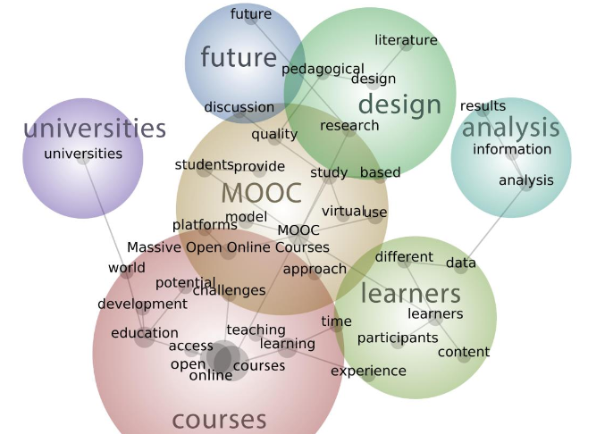
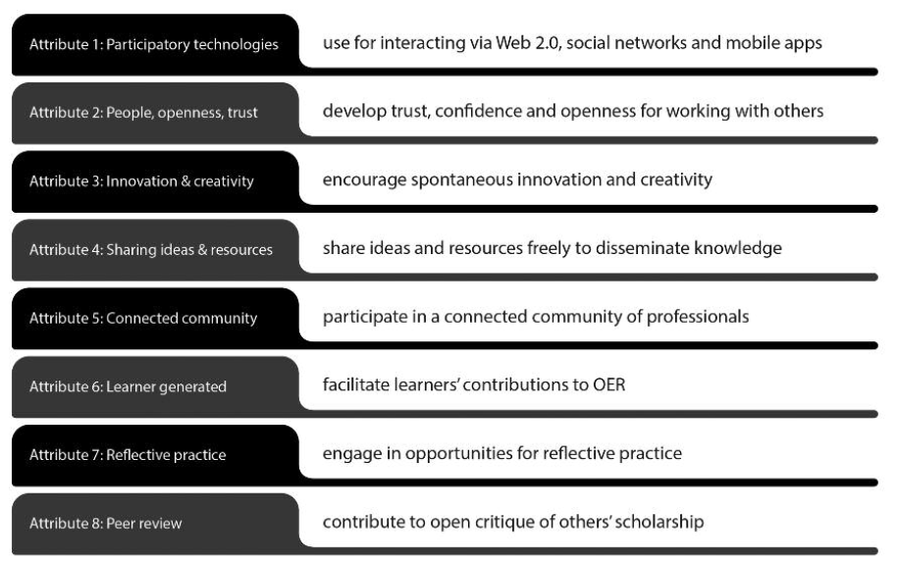
The Learning Context
Open Online Learning
Open Pedagogy
Zawacki-Richter, Bozkurt, Alturki,and Aldraiweesh. 2018. What Research Says About MOOCs –An Explorative Content Analysis. InternationalReview of Research in Open andDistributed LearningVolume 19, Number 1. https://files.eric.ed.gov/fulltext/EJ1174059.pdf
Gráinne Conole. 2015. MOOCs as disruptive technologies: strategies for enhancing the learner experience and quality of MOOCs. Revista de Educación a Distancia. Número 39. http://www.um.es/ead/red/39
Bronwyn Hegarty. 2015. Attributes of Open Pedagogy: A Model for Using Open Educational Resources. Educational Technology, July/August, 2015. https://upload.wikimedia.org/wikipedia/commons/c/ca/Ed_Tech_Hegarty_2015_article_attributes_of_open_pedagogy.pdf

Slide 6
Perspectives
These are my perspectives. They represent the areas of expertise I have developed over the years. As I study new pedagogies and technologies, I ask questions from the following points of view:
ψ
 | Philosophy My degrees are in philosophy and I specialized in philosophies of mind, science, knowledge and logic. I ask questions about the bases for arguments and claims, look for presumptions about meaning and value, and consider ways of sensing, comprehending and knowing. |  | Education I am interested in the processes of learning, inference and discovery on a practical level. I ask what it is to learn – why and how people learn - and what are the conditions for best learning outcomes. I am focused on learning experience and personal agency.
 | Computing I took a few courses but have mostly taught myself computer programming over the years, learning a number of languages, and building websites, content management systems, and learning technology. I think of programming as a means of expression. |  | Media Since my days as a newspaper carrier to my involvement in student journalism to my work today in online media I have worked on new and better means of conveying information, illustration and photography, community-building and interactivity.
%
:
Ξ
What are your perspectives? Be sure to give each perspective an icon!

Slide 7
The Critical Literacies
Open Pedagogy
Syntax | Cognition
Semantics | Context
Pragmatics | Change
v
z
c
x
I
h
The Critical Literacies are best thought of as ways of seeing the world. They are the way we make sense of whatever is in front of us.
Gráinne Conole. 2015. MOOCs as disruptive technologies: strategies for enhancing the learner experience and quality of MOOCs. Revista de Educación a Distancia. Número 39. http://www.um.es/ead/red/39
Bronwyn Hegarty. 2015. Attributes of Open Pedagogy: A Model for Using Open Educational Resources. Educational Technology, July/August, 2015. https://upload.wikimedia.org/wikipedia/commons/c/ca/Ed_Tech_Hegarty_2015_article_attributes_of_open_pedagogy.pdf

Slide 8
Syntax
Semantics
Pragmatics
The Critical Literacies are best thought of as ways of seeing the world. They are the way we make sense of whatever is in front of us.
Gráinne Conole. 2015. MOOCs as disruptive technologies: strategies for enhancing the learner experience and quality of MOOCs. Revista de Educación a Distancia. Número 39. http://www.um.es/ead/red/39
Bronwyn Hegarty. 2015. Attributes of Open Pedagogy: A Model for Using Open Educational Resources. Educational Technology, July/August, 2015. https://upload.wikimedia.org/wikipedia/commons/c/ca/Ed_Tech_Hegarty_2015_article_attributes_of_open_pedagogy.pdf

Slide 9
Cognition
Context
Change
The Critical Literacies are best thought of as ways of seeing the world. They are the way we make sense of whatever is in front of us.
Gráinne Conole. 2015. MOOCs as disruptive technologies: strategies for enhancing the learner experience and quality of MOOCs. Revista de Educación a Distancia. Número 39. http://www.um.es/ead/red/39
Bronwyn Hegarty. 2015. Attributes of Open Pedagogy: A Model for Using Open Educational Resources. Educational Technology, July/August, 2015. https://upload.wikimedia.org/wikipedia/commons/c/ca/Ed_Tech_Hegarty_2015_article_attributes_of_open_pedagogy.pdf

Slide 10
Data
This part of the workshop addresses two conceptual challenges: first, the shift in our understanding of content from documents to data; and second, the shift in our understanding of data from centralized to decentralized.
ψ
 | From Document to Data Storing our content as data makes it more flexible and more useful. One piece of data could be inserted into another piece of data, such as a template. Our perspective shifts from a linear organization to something more complex. |  | Learning with Data Learning with data isn’t the same as learning with books. It’s interactive, immersive and engaging, a process of learning how to perceive and comprehend rather than to decode and store.
 | Application Interfaces The central role played by platforms is diminished in favour of direct interactions between peers, that is, a distributed web, which communicate with each other by means of application programming interfaces (API). |  | Linked Data Today we are seeing a trend toward decentralized linked data. This is the idea that each person can manage his or her own data, storing it wherever they want, and using it whenever they like.
%
:
Ξ
What are your perspectives?

Slide 11
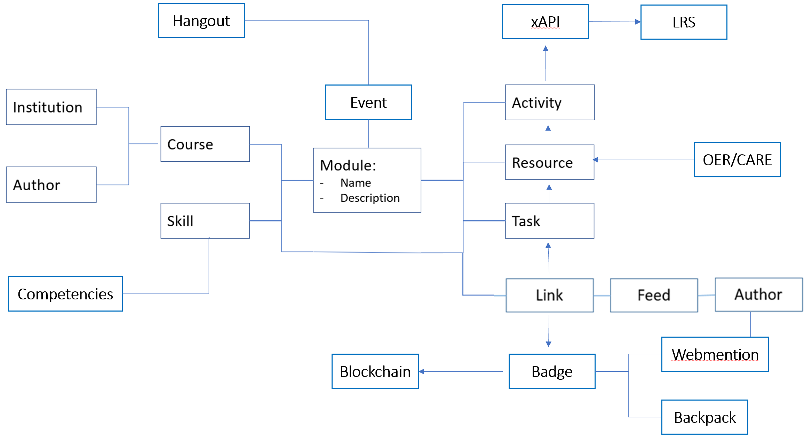
The BIG Idea
Course as Open Data

Slide 12
Activities // Resources // The BIG Idea??
Subscribe to RSS Feeds
Access Open Data
Create an Open Data Feed
Gráinne Conole. 2015. MOOCs as disruptive technologies: strategies for enhancing the learner experience and quality of MOOCs. Revista de Educación a Distancia. Número 39. http://www.um.es/ead/red/39
Bronwyn Hegarty. 2015. Attributes of Open Pedagogy: A Model for Using Open Educational Resources. Educational Technology, July/August, 2015. https://upload.wikimedia.org/wikipedia/commons/c/ca/Ed_Tech_Hegarty_2015_article_attributes_of_open_pedagogy.pdf

Slide 13
My Open Data Feed
Gráinne Conole. 2015. MOOCs as disruptive technologies: strategies for enhancing the learner experience and quality of MOOCs. Revista de Educación a Distancia. Número 39. http://www.um.es/ead/red/39
Bronwyn Hegarty. 2015. Attributes of Open Pedagogy: A Model for Using Open Educational Resources. Educational Technology, July/August, 2015. https://upload.wikimedia.org/wikipedia/commons/c/ca/Ed_Tech_Hegarty_2015_article_attributes_of_open_pedagogy.pdf

Slide 14
Data: Worksheet
Data from your perspectives
Critical reflections
v
c
I
z
x
h

Slide 15
Cloud
These are my perspectives. They represent the areas of expertise I have developed over the years. As I study new pedagogies and technologies, I ask questions from the following points of view:
ψ
 | Computing as Commodity The conceptual challenge is that it doesn’t matter whose computer it is, that it could change any time, and that we should begin to think of “computing” and “storage” as commodities, more like “water” or “electricity”. |  | Direct Experience Students are now able to edit and create new tools to create text, music and art. They will be able to directly experience the relation between algorithm and outcome, or between mathematics and music, as the case may be.
 | Virtualization Server virtualization begins with applications such as VMWare or Parallels, and progresses through a range of increasingly sophisticated computing containers created using programs like Docker and run using services like Amazon Web Services. |  | New Possibilities These new resources allow us to redefine what we mean by ‘textbooks’ and even ‘learning objects’. By putting powerful applications into the hands of students we create new possibilities for manipulation, visualization and creativity.
%
:
Ξ
What are your perspectives?

Slide 16
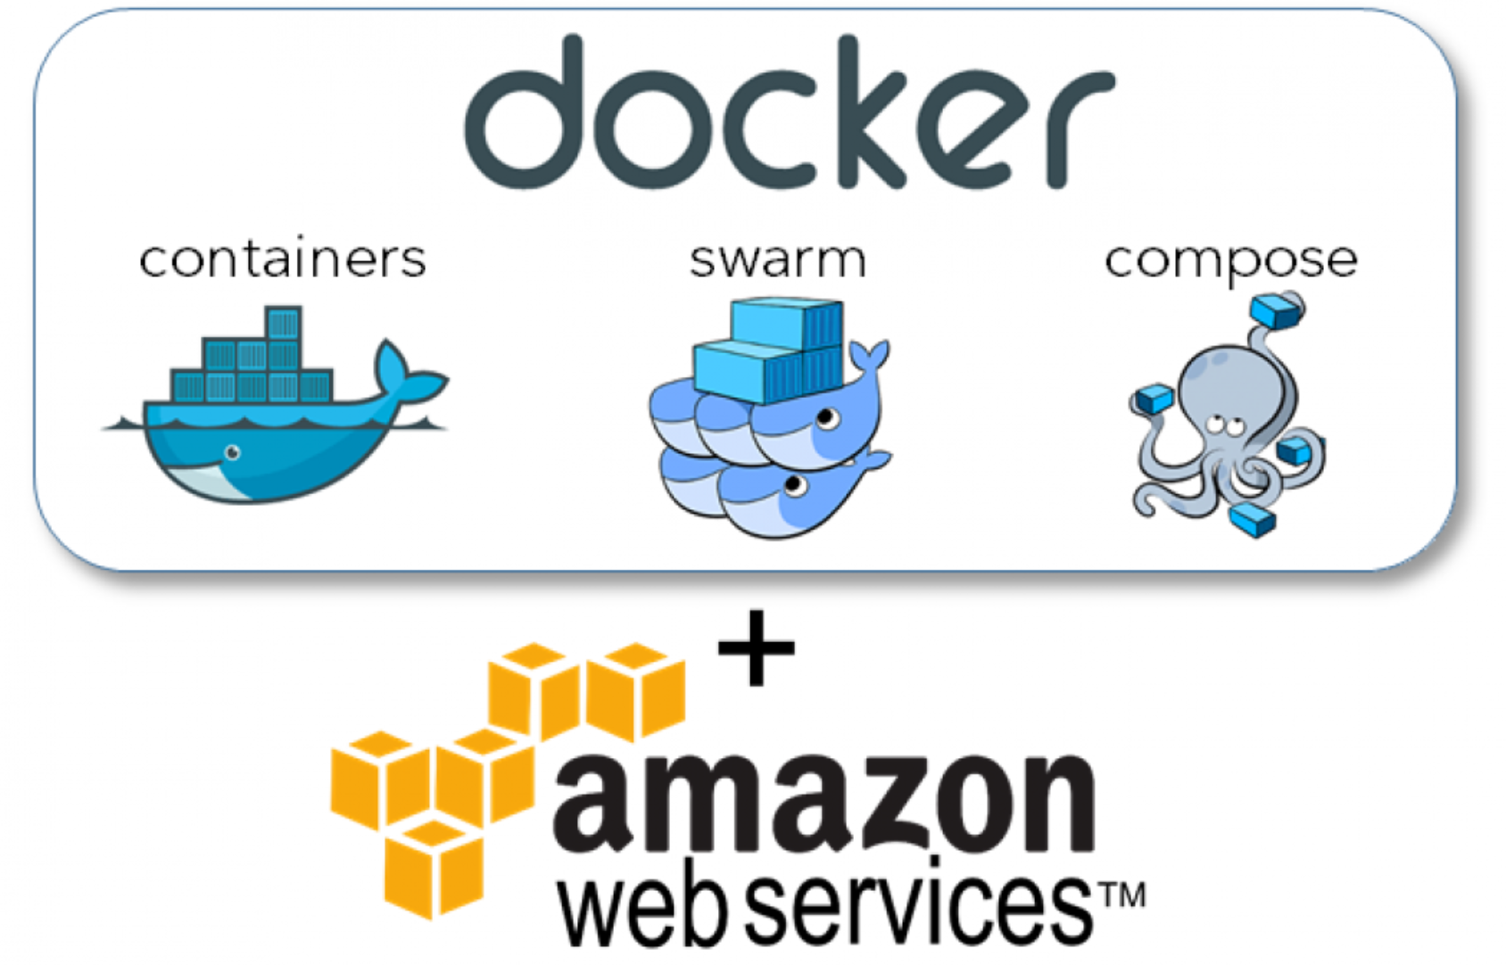
The BIG Idea
Courses in Containers

Slide 17
Cloud: Worksheet
Data from your perspectives
Critical reflections
v
c
I
z
x
h

Slide 18
Graph
These are my perspectives. They represent the areas of expertise I have developed over the years. As I study new pedagogies and technologies, I ask questions from the following points of view:
ψ
 | Philosophy My degrees are in philosophy and I specialized in philosophies of mind, science, knowledge and logic. I ask questions about the bases for arguments and claims, look for presumptions about meaning and value, and consider ways of sensing, comprehending and knowing. |  | Education I am interested in the processes of learning, inference and discovery on a practical level. I ask what it is to learn – why and how people learn - and what are the conditions for best learning outcomes. I am focused on learning experience and personal agency.
 | Computing I took a few courses but have mostly taught myself computer programming over the years, learning a number of languages, and building websites, content management systems, and learning technology. I think of programming as a means of expression. |  | Media Since my days as a newspaper carrier to my involvement in student journalism to my work today in online media I have worked on new and better means of conveying information, illustration and photography, community-building and interactivity.
%
:
Ξ
What are your perspectives? Be sure to give each perspective an icon!

Slide 19
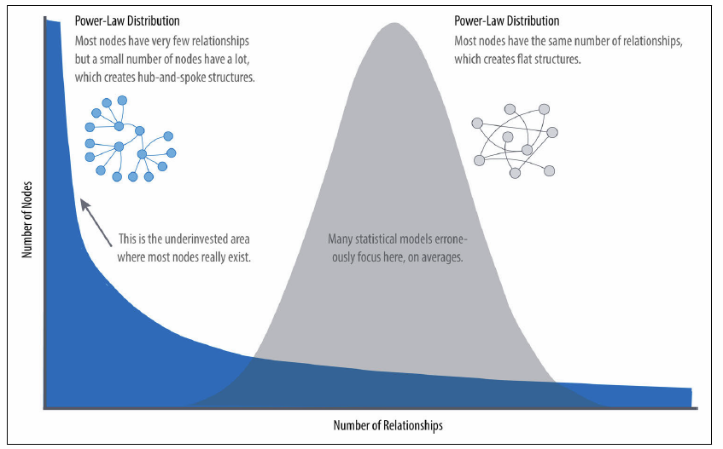
The BIG Idea
Graph, Not Story
Narrations and models focus on common or ‘best’ practices
Graphs capture patterns, outliers, and the unexpected.
Knowledge is recognition, not remembering
https://ontotext.com/linked-open-data-cultural-heritage/
https://www.w3.org/wiki/LinkedData
https://www.w3.org/wiki/SweoIG/TaskForces/CommunityProjects/LinkingOpenData
https://communitywiki.org/wiki/MachineCodeBlocks (Lion Kimbro, 2005ish)

Slide 20
Graph: Worksheet
Data from your perspectives
Critical reflections
v
c
I
z
x
h

Slide 21
My Model Graph
Instructions
Create a model graph of some aspect of this workshop (it doesn't have to be an actual graph, only a representation of what an actual graph might look like. We've already seen, eg., graphs on the relations between people in the workshop. Could there be other types of graphs?
In your model, consider how the states of the entities in that graph might vary. Consider not only how nodes might vary (eg., a person might have a different height over time) but also how the edges might vary (eg., a person might have a different strength of relation (calculated how?) with another person over time).
In your model, consider how knowledge about the changes in states in the graph might be used.

Slide 22
Resources
These are my perspectives. They represent the areas of expertise I have developed over the years. As I study new pedagogies and technologies, I ask questions from the following points of view:
ψ
 | Philosophy My degrees are in philosophy and I specialized in philosophies of mind, science, knowledge and logic. I ask questions about the bases for arguments and claims, look for presumptions about meaning and value, and consider ways of sensing, comprehending and knowing. |  | Education I am interested in the processes of learning, inference and discovery on a practical level. I ask what it is to learn – why and how people learn - and what are the conditions for best learning outcomes. I am focused on learning experience and personal agency.
 | Computing I took a few courses but have mostly taught myself computer programming over the years, learning a number of languages, and building websites, content management systems, and learning technology. I think of programming as a means of expression. |  | Media Since my days as a newspaper carrier to my involvement in student journalism to my work today in online media I have worked on new and better means of conveying information, illustration and photography, community-building and interactivity.
%
:
Ξ
What are your perspectives?

Slide 23
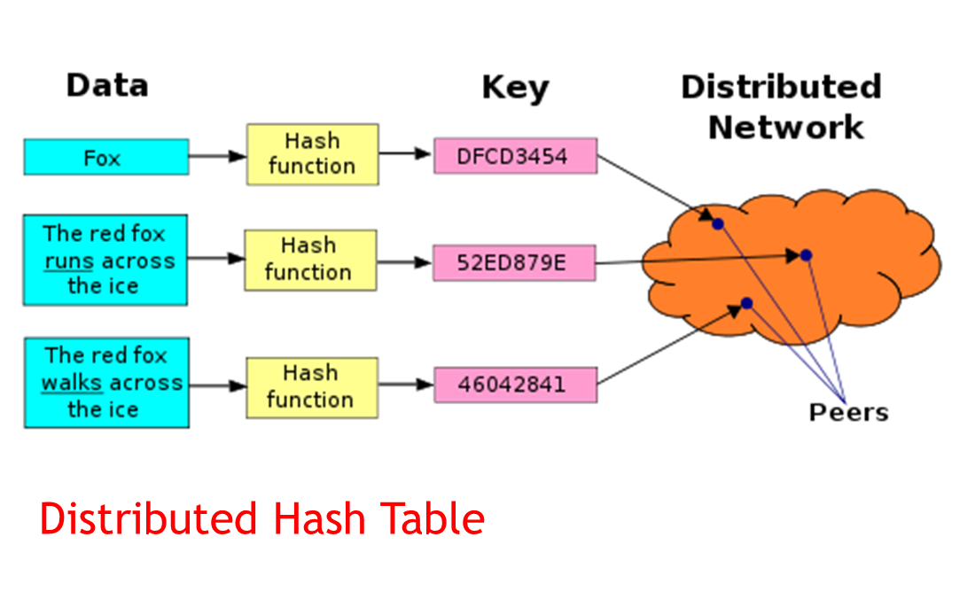
The BIG Idea
Content Addressable Resources for Education (CARE)
Each piece of content has a unique address, which is a hash of its content
https://ipfs.io/ipfs/QmXoypizjW3WknFiJnKLwHCnL72vedxjQkDDP1mXWo6uco/wiki/Distributed_hash_table.html

Slide 24
Resources: Worksheet
Data from your perspectives
Critical reflections
v
c
I
z
x
h

Slide 25
My Notebook
Instructions
Open a link and visit a Jupyter Notebook
Consider what sort of notebook you would find useful as a teaching or learning resource
Create an outline of the Notebook in the space above.

Slide 26
Identity
These are my perspectives. They represent the areas of expertise I have developed over the years. As I study new pedagogies and technologies, I ask questions from the following points of view:
ψ
 | Philosophy My degrees are in philosophy and I specialized in philosophies of mind, science, knowledge and logic. I ask questions about the bases for arguments and claims, look for presumptions about meaning and value, and consider ways of sensing, comprehending and knowing. |  | Education I am interested in the processes of learning, inference and discovery on a practical level. I ask what it is to learn – why and how people learn - and what are the conditions for best learning outcomes. I am focused on learning experience and personal agency.
 | Computing I took a few courses but have mostly taught myself computer programming over the years, learning a number of languages, and building websites, content management systems, and learning technology. I think of programming as a means of expression. |  | Media Since my days as a newspaper carrier to my involvement in student journalism to my work today in online media I have worked on new and better means of conveying information, illustration and photography, community-building and interactivity.
%
:
Ξ
What are your perspectives?

Slide 27
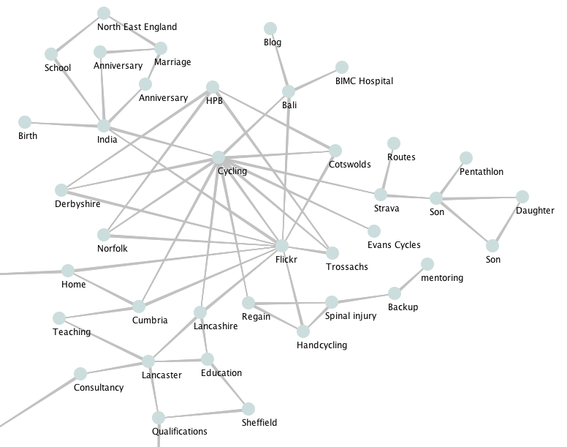
The BIG Idea
We Are the Content
Will the ‘connected self’ be more reflective? Will ‘the connective self’ more honestly reflect our hopes, aspirations and dreams?
https://www.youtube.com/watch?v=QNKpK_InQHQ
https://jennymackness.wordpress.com/tag/digital-identity/
https://mitpress.mit.edu/books/qualified-self
https://markcarrigan.net/2014/07/23/qualitative-self-tracking-and-the-qualified-self/

Slide 28
Identity: Worksheet
Data from your perspectives
Critical reflections
v
c
I
z
x
h

Slide 29
My Identity Graph
Instructions
Create an Identity Graph
We are expanding on the marketing definition of an identity graph. It can be anything you like, but with one stipulation: your graph should not contain a self-referential node titled ‘me’ or ‘self’ or anything similar
Think of this graph as you defining your identity, not what some advertiser, recruiter or other third party might want you to define.
Don't worry about creating the whole identity graph - focusing on a single facet will be sufficient. And don't post anything you're not comfortable with sharing. It doesn't have to be a real identity graph, just an identity graph, however you conceive it.
Optional: consider some of these questions about your identity graph:
What is the basis for the links in your graph: are they conceptual, physical, causal, historical, aspirational?
Is your graph unique to you? What would make it unique? What would guarantee uniqueness?
How (if at all) could your graph be physically instantiated? Is there a way for you to share your graph? To link and/or intermingle your graph with other graphs?
What’s the ‘source of truth’ for your graph?

Slide 30
Recognition
These are my perspectives. They represent the areas of expertise I have developed over the years. As I study new pedagogies and technologies, I ask questions from the following points of view:
ψ
 | Philosophy My degrees are in philosophy and I specialized in philosophies of mind, science, knowledge and logic. I ask questions about the bases for arguments and claims, look for presumptions about meaning and value, and consider ways of sensing, comprehending and knowing. |  | Education I am interested in the processes of learning, inference and discovery on a practical level. I ask what it is to learn – why and how people learn - and what are the conditions for best learning outcomes. I am focused on learning experience and personal agency.
 | Computing I took a few courses but have mostly taught myself computer programming over the years, learning a number of languages, and building websites, content management systems, and learning technology. I think of programming as a means of expression. |  | Media Since my days as a newspaper carrier to my involvement in student journalism to my work today in online media I have worked on new and better means of conveying information, illustration and photography, community-building and interactivity.
%
:
Ξ
What are your perspectives?

Slide 31
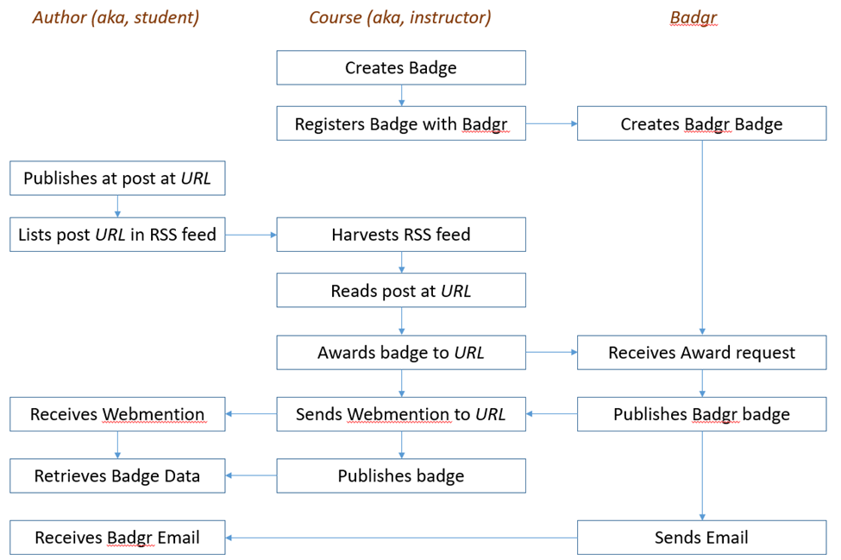
The BIG Idea
AI-Based Learning Recognition
xAPI lets you capture (big) data on human performance, along with associated instructional content or performance context information…
We can also gather data outside the school or program, looking at actual results and feedback from the workplace.

Slide 32
My Digital Badge
Instructions
If you have internet access, create a free account on a Badge service (several are listed in the resources for this module). Otherwise, use this space to design your badge, clearly identifying different data elements:
create a badge and give it a name, criteria, design
award it to yourself or describe how it would be awarded.
use a blog post on your blog as the 'evidence' for awarding yourself the badge
place the badge on the blog post.
Optional
Define how your digital badge connect to or ties in to your identity graph

Slide 33
Recognition: Worksheet
Data from your perspectives
Critical reflections
v
c
I
z
x
h

Slide 34
Community
These are my perspectives. They represent the areas of expertise I have developed over the years. As I study new pedagogies and technologies, I ask questions from the following points of view:
ψ
 | Philosophy My degrees are in philosophy and I specialized in philosophies of mind, science, knowledge and logic. I ask questions about the bases for arguments and claims, look for presumptions about meaning and value, and consider ways of sensing, comprehending and knowing. |  | Education I am interested in the processes of learning, inference and discovery on a practical level. I ask what it is to learn – why and how people learn - and what are the conditions for best learning outcomes. I am focused on learning experience and personal agency.
 | Computing I took a few courses but have mostly taught myself computer programming over the years, learning a number of languages, and building websites, content management systems, and learning technology. I think of programming as a means of expression. |  | Media Since my days as a newspaper carrier to my involvement in student journalism to my work today in online media I have worked on new and better means of conveying information, illustration and photography, community-building and interactivity.
%
:
Ξ
What are your perspectives?

Slide 35
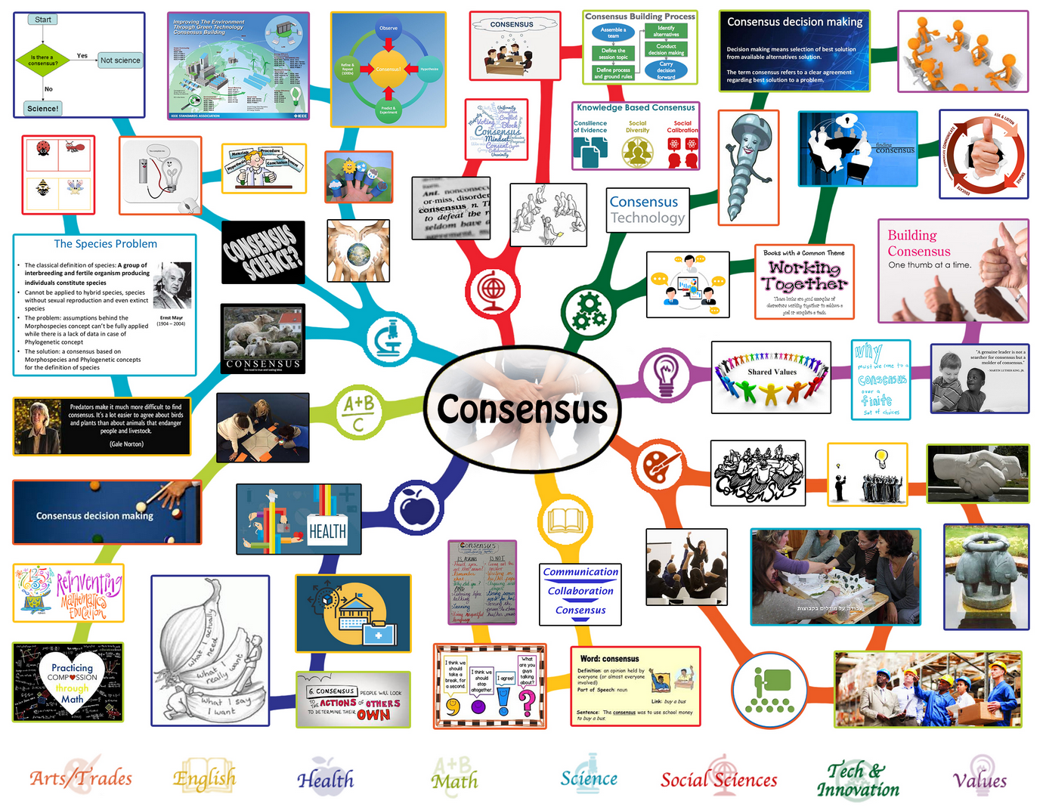
The BIG Idea
Community As Consensus
The mechanisms we use to interact and reach consensus are what define us as a community…
Is consensus based in work, stake, importance, authority…? What are the conditions for consensus?

Slide 36
Community: Worksheet
Community from your perspectives
Critical reflections
v
c
I
z
x
h

Slide 37
My Community
Instructions
As a community, create an assignment the completion of which denotes being a member of the community. For the purposes of this task, there can only be one community for the entire workshop.
Use the space above to contain your contribution to the community.
For each participant, your being a member of the community completes the task.

Slide 38
Experience
These are my perspectives. They represent the areas of expertise I have developed over the years. As I study new pedagogies and technologies, I ask questions from the following points of view:
ψ
 | Philosophy My degrees are in philosophy and I specialized in philosophies of mind, science, knowledge and logic. I ask questions about the bases for arguments and claims, look for presumptions about meaning and value, and consider ways of sensing, comprehending and knowing. |  | Education I am interested in the processes of learning, inference and discovery on a practical level. I ask what it is to learn – why and how people learn - and what are the conditions for best learning outcomes. I am focused on learning experience and personal agency.
 | Computing I took a few courses but have mostly taught myself computer programming over the years, learning a number of languages, and building websites, content management systems, and learning technology. I think of programming as a means of expression. |  | Media Since my days as a newspaper carrier to my involvement in student journalism to my work today in online media I have worked on new and better means of conveying information, illustration and photography, community-building and interactivity.
%
:
Ξ
What are your perspectives?

Slide 39
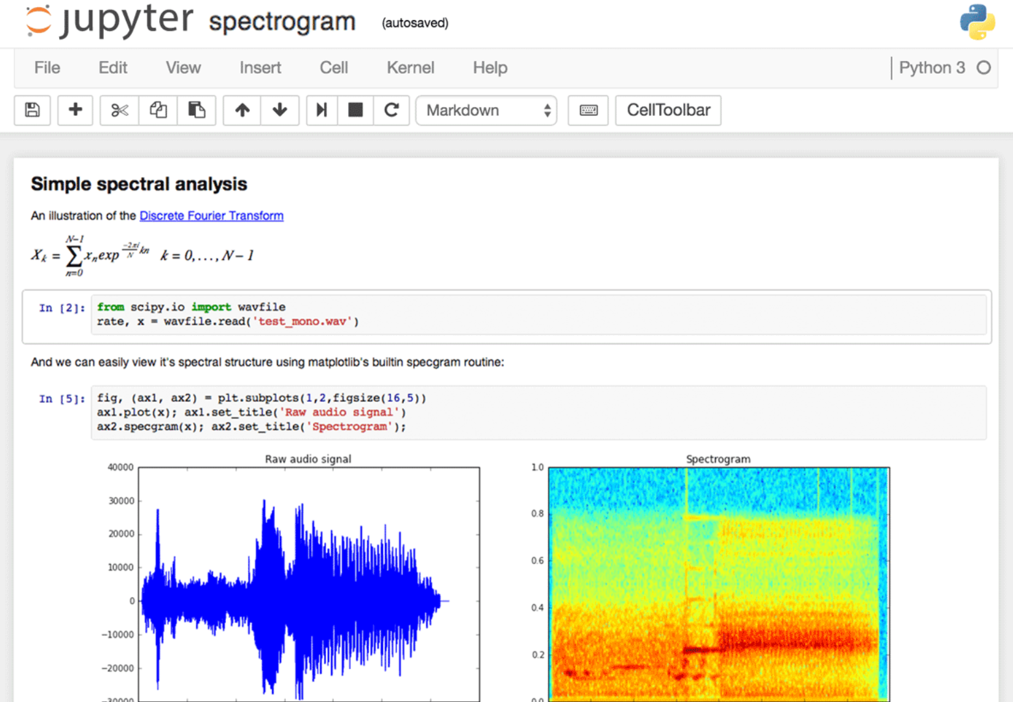
The BIG Idea
Content and Creation Combined
Jupyter Notebook combines data and code in a document
JupyterLab Environment - work with code, data, and the Jupyter notebook format.

Slide 40
Experience: Worksheet
Data from your perspectives
Critical reflections
v
c
I
z
x
h

Slide 41
My Workshop Experience
https://www.iskysoft.com/video-editing/youtube-merge-videos.html
Instructions
Be creative! Using the medium of your choice, create a representation of your experience of E-Learning 3.0. Then post your creation (or post a link to your creation) on your blog.
Here's a good example of the sort of thing you could create, by Kevin Hodgeson: http://dogtrax.edublogs.org/2018/12/12/el30-a-visual-sense-of-community-connected/
If you need inspiration, visit the DS106 Assignment Bank and select one of the assignments, and then interpret it in the light this workshop. http://assignments.ds106.us/

Slide 42
Agency
These are my perspectives. They represent the areas of expertise I have developed over the years. As I study new pedagogies and technologies, I ask questions from the following points of view:
ψ
 | Philosophy My degrees are in philosophy and I specialized in philosophies of mind, science, knowledge and logic. I ask questions about the bases for arguments and claims, look for presumptions about meaning and value, and consider ways of sensing, comprehending and knowing. |  | Education I am interested in the processes of learning, inference and discovery on a practical level. I ask what it is to learn – why and how people learn - and what are the conditions for best learning outcomes. I am focused on learning experience and personal agency.
 | Computing I took a few courses but have mostly taught myself computer programming over the years, learning a number of languages, and building websites, content management systems, and learning technology. I think of programming as a means of expression. |  | Media Since my days as a newspaper carrier to my involvement in student journalism to my work today in online media I have worked on new and better means of conveying information, illustration and photography, community-building and interactivity.
%
:
Ξ
What are your perspectives?

Slide 43
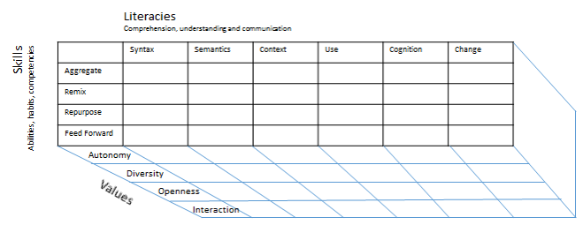
The BIG Idea
Redefining Success
Four key outcomes for a modern distributed learning environment: security, identity, voice and opportunity.

Slide 44
Agency: Worksheet
Data from your perspectives
Critical reflections
v
c
I
z
x
h

Slide 45
Actionable Practices

Slide 46
1234567890−= !≅#∃%⊥&∗()_+ θωερτψυιοπ[]∴ ΘΩΕΡΤΨΥΙΟΠ{}| ασδφγηϕκλ;’ ΑΣΔΦΓΗϑΚΛ:” ζξχϖβνμ,./ ΖΞΧςΒΝΜ<>?

