Slide 1
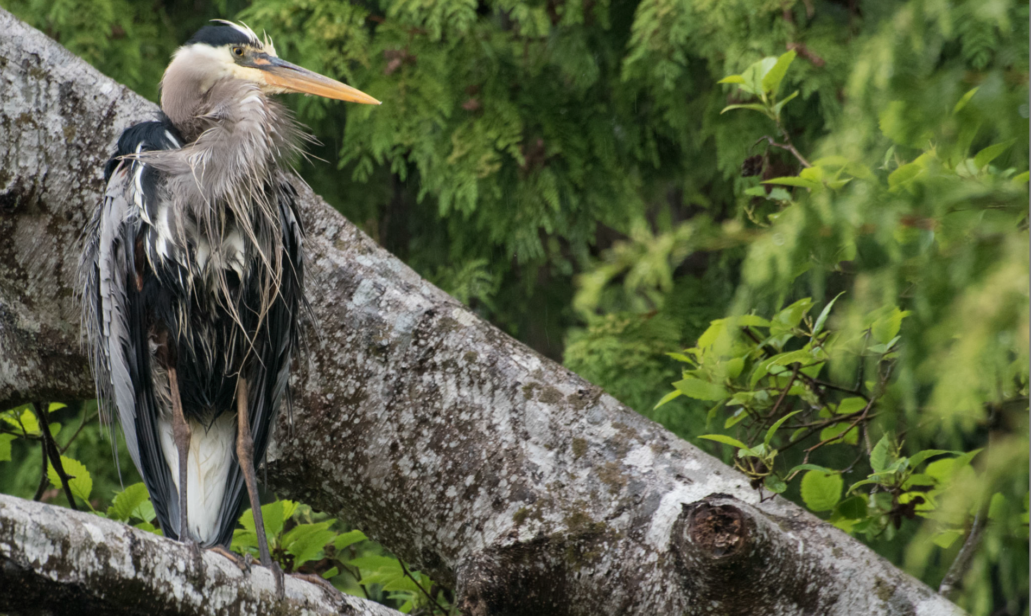
The Third Wave: the Next Generation of Distributed Learning Technology
Stephen Downes
CNIE, Vancover, B.C.
May 22, 2019

Slide 2
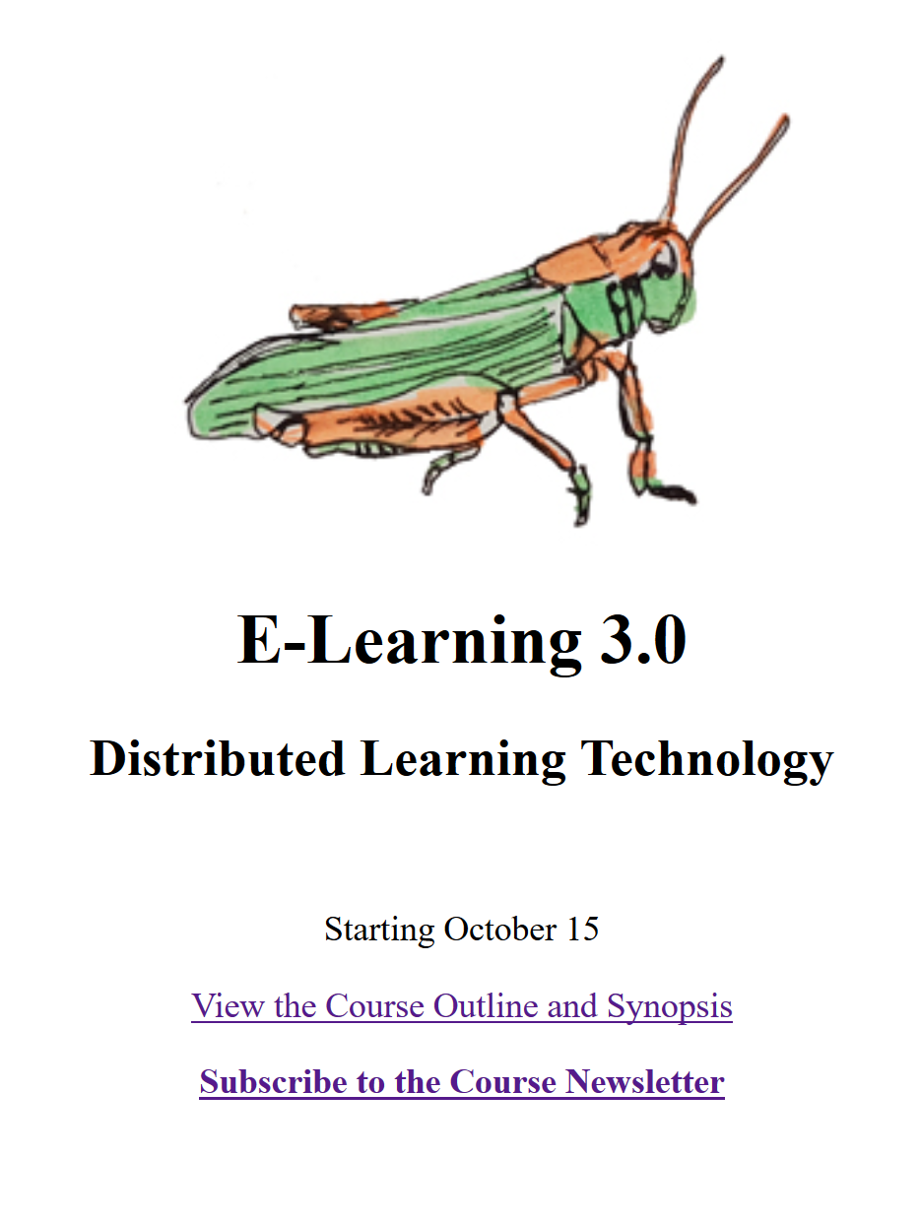
https://el30.mooc.ca

Slide 3
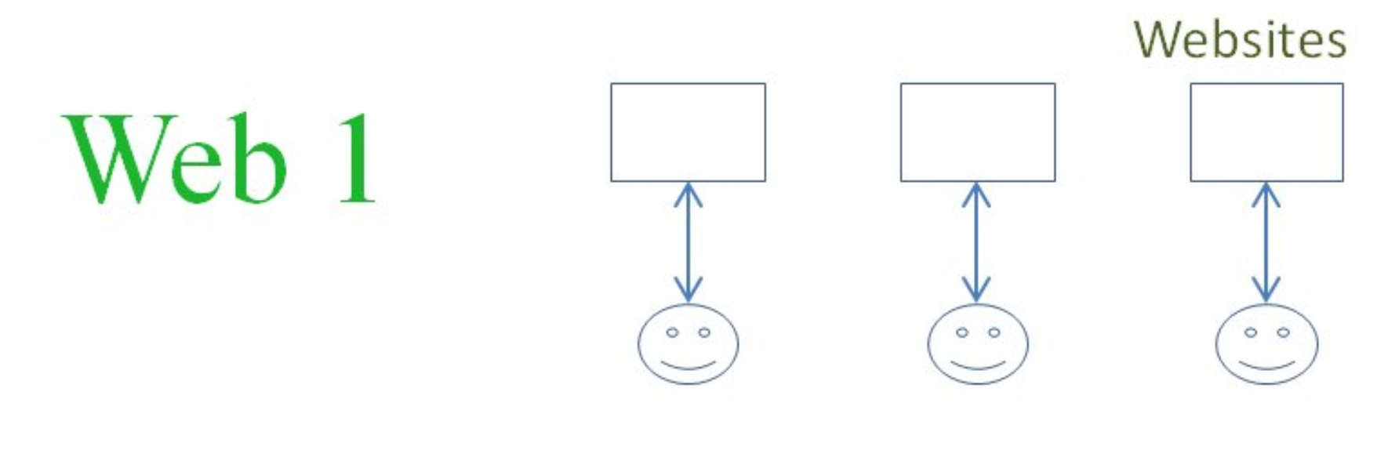
Websites
CMS / LMS
Learning Objects
Client-Server
Content Delivery
Sequencing
Learning Design
SCORM
Repositories
E-learning
The First Wave
The Client-Server Model

Slide 4
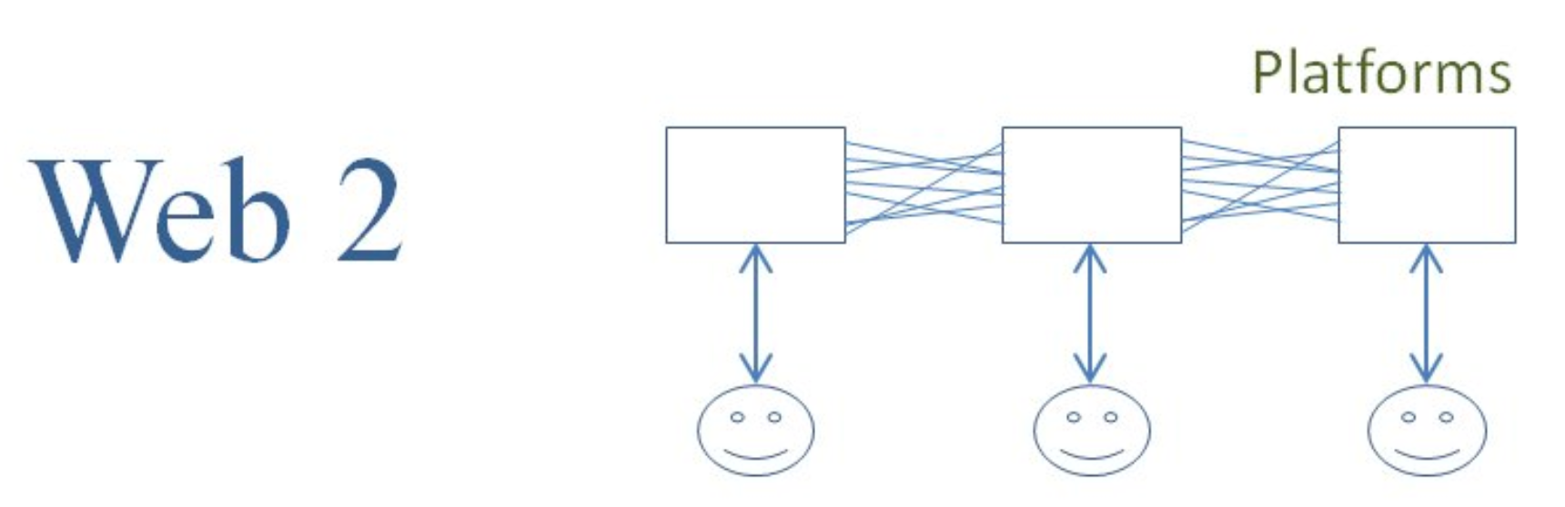
Web Services
Learning Platform
API / REST
Server-Server
Social Networks
IMS-LTI
Learning Design
Recognition Net
Curation
E-learning 2.0
The Second Wave
The Platform Model

Slide 5
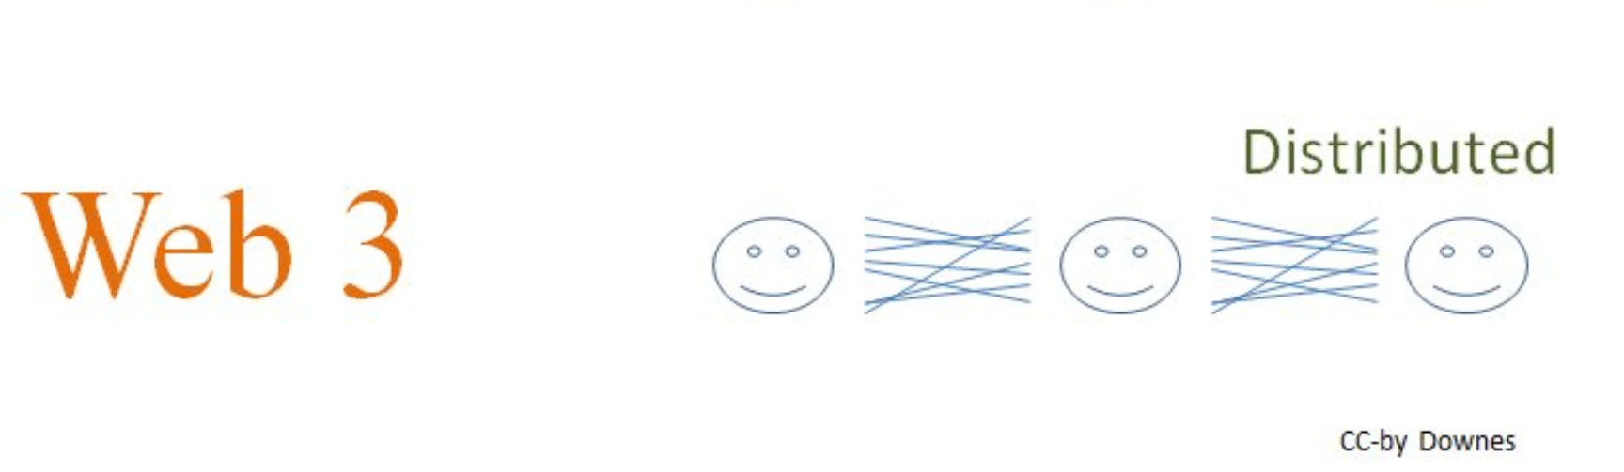
Open Data
Cloud Services
Graph Tech
Sovereign Identity
Sharing Network
Recognition
Consensus
Experience
Agency
E-learning 3.0
The Third Wave
The Distributed Model

Slide 6

Part One: Technology

Slide 7
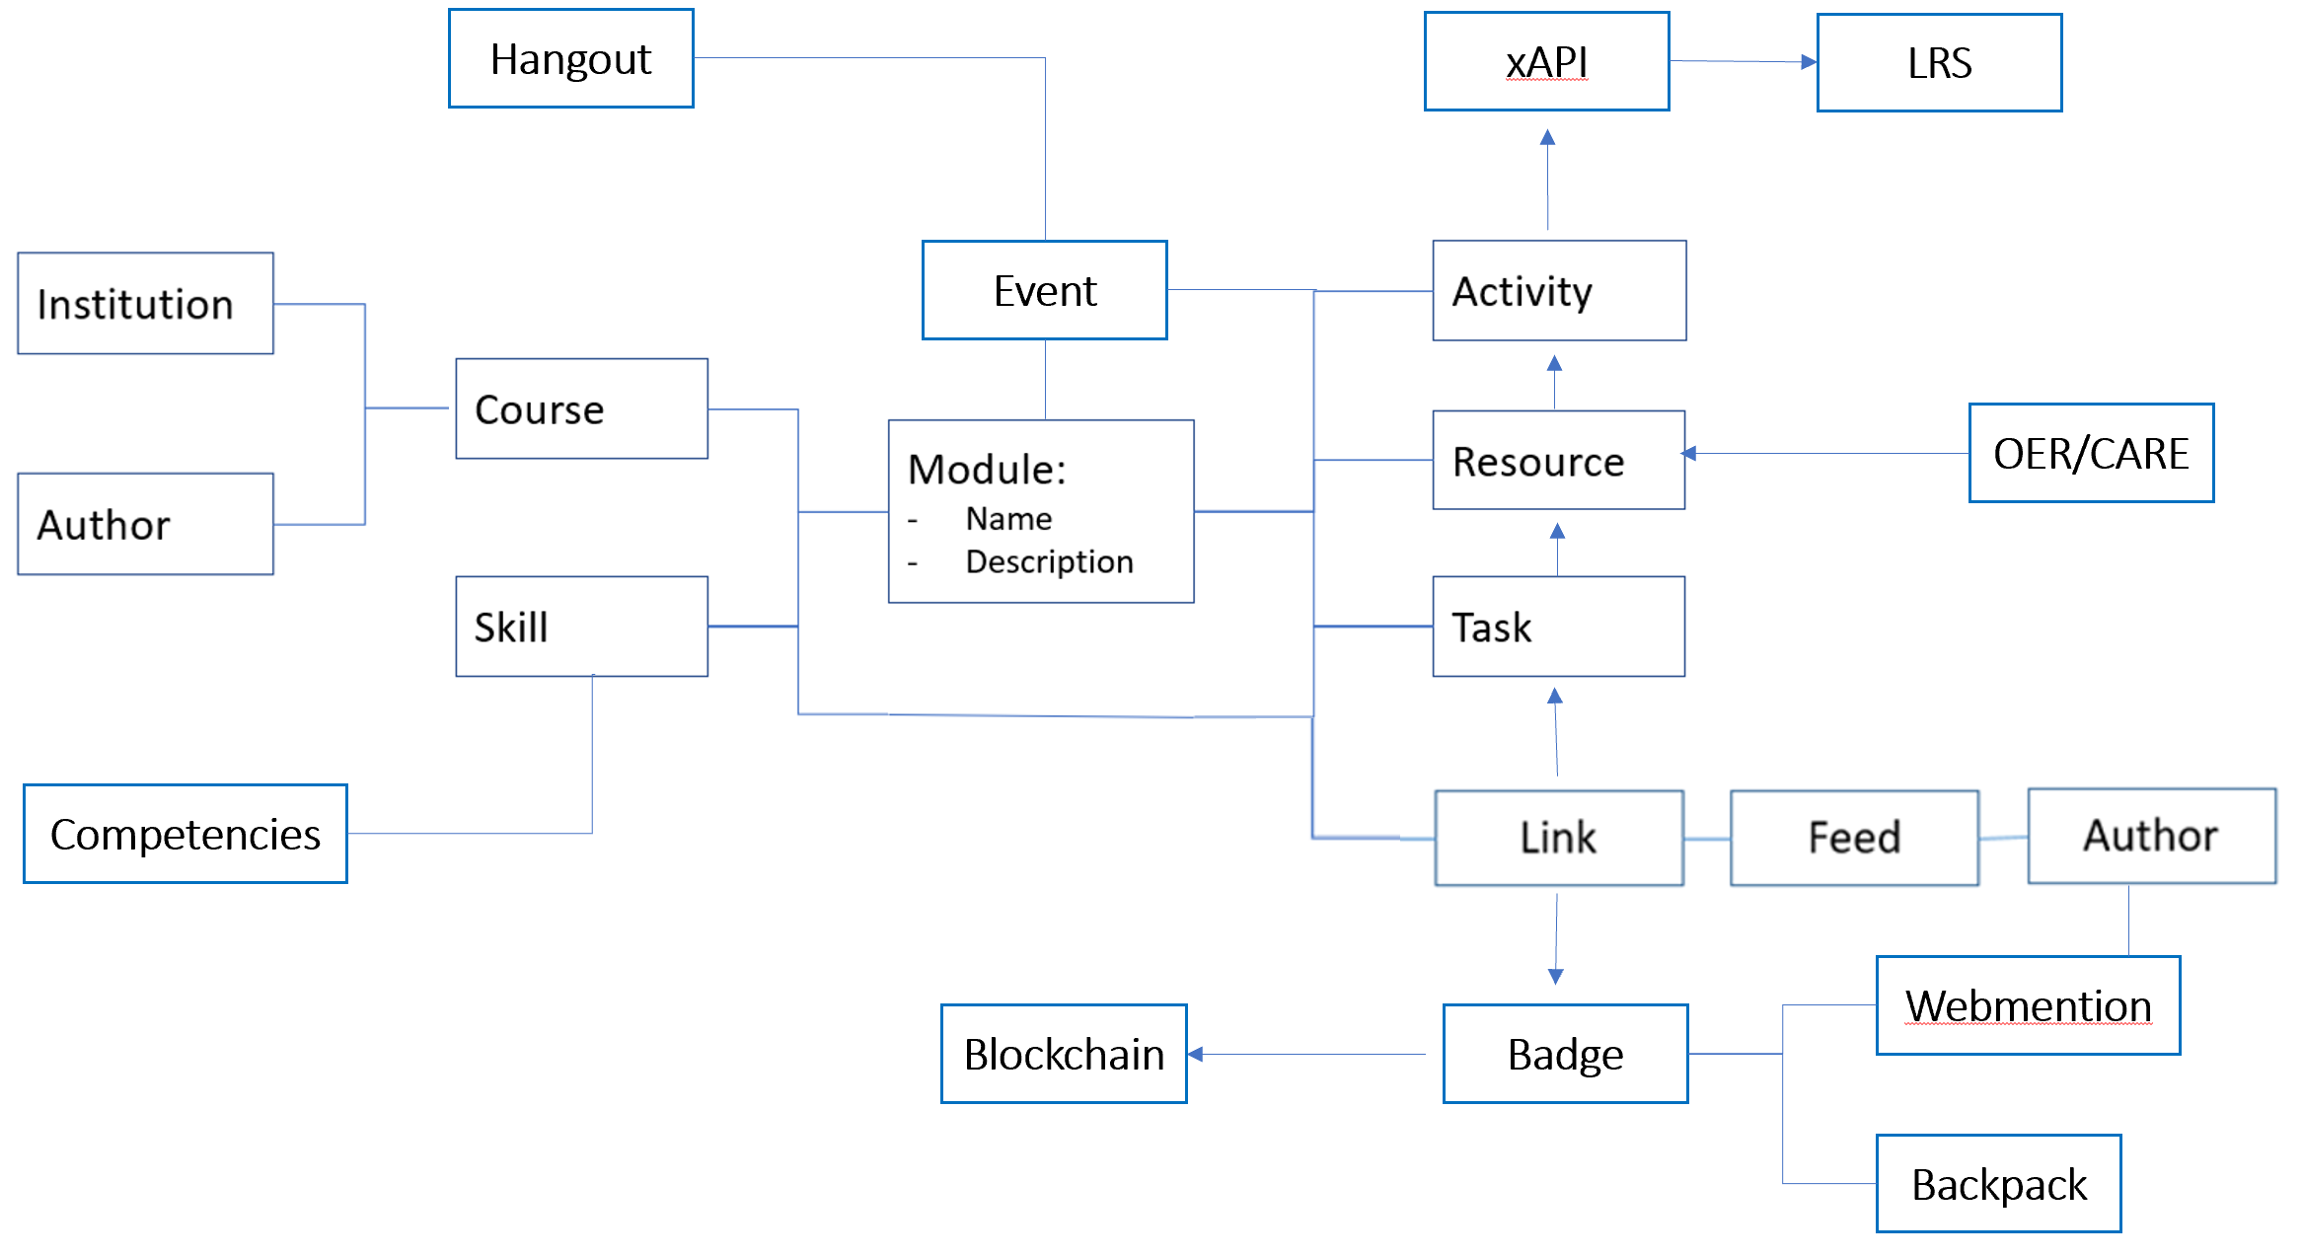
Big Idea 1: Course(?) as Open Data

Slide 8
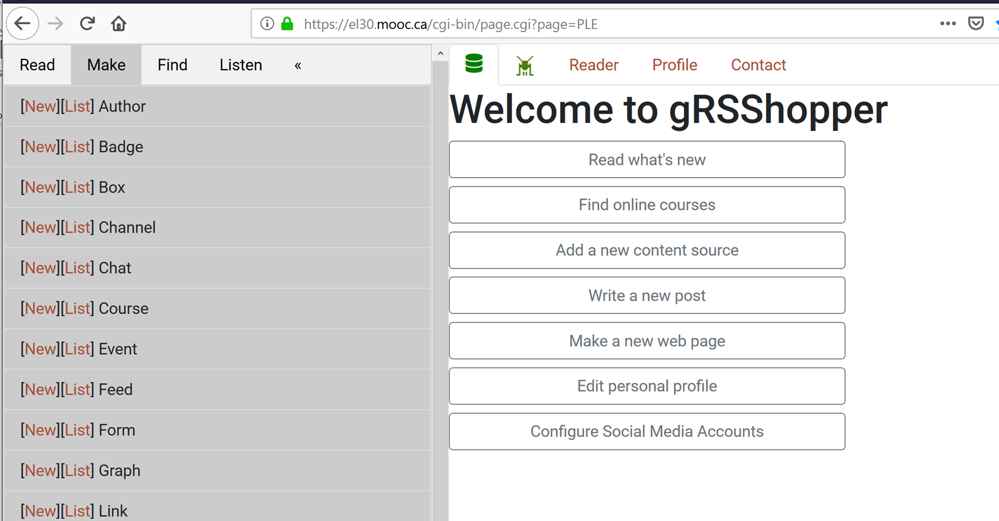
Course as Open Data in gRSShopper
https://el30.mooc.ca/cgi-bin/page.cgi?page=PLE (requires admin login)

Slide 9
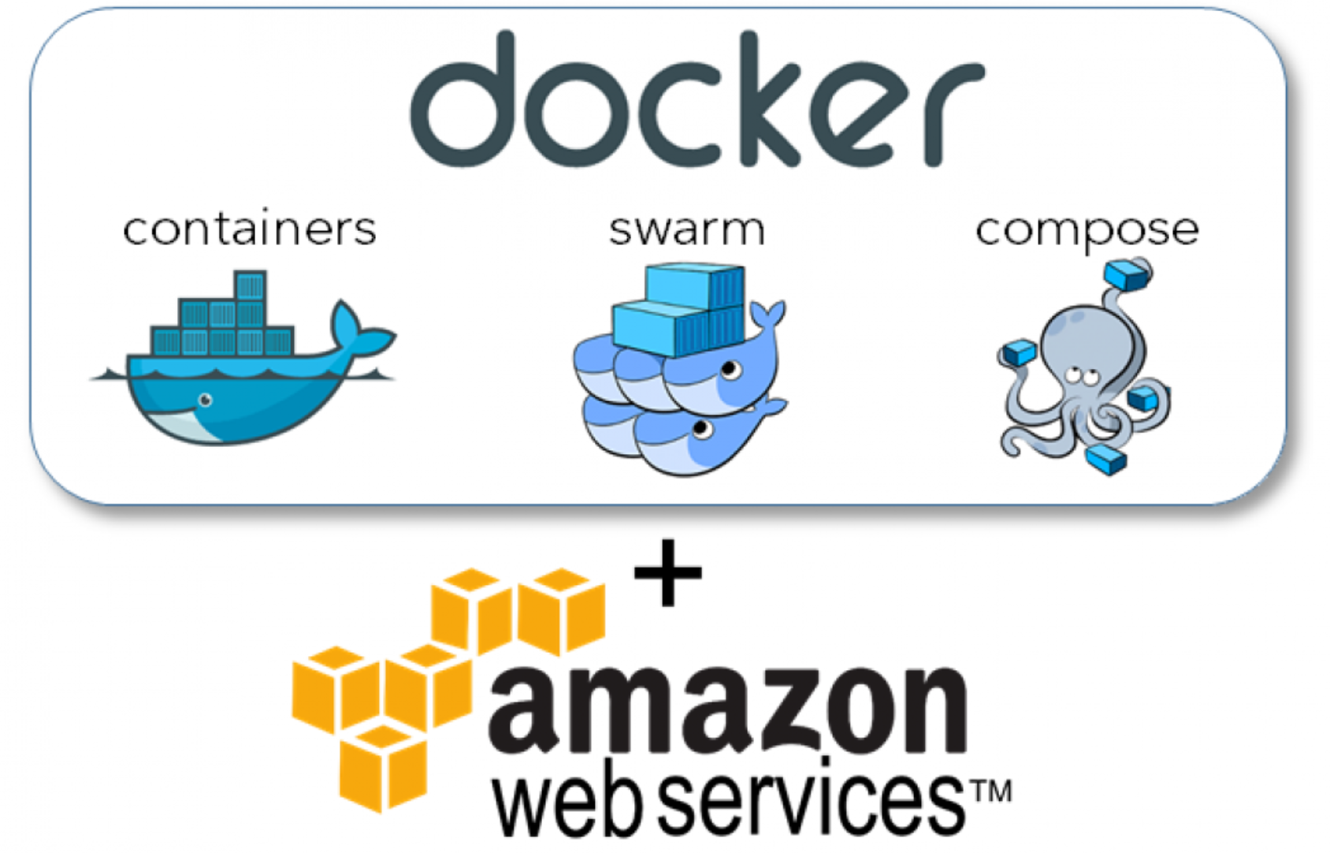
Big Idea 2: Course(?) in Containers
Tools that enable cloud-on-demand applications and services
https://www.techradar.com/news/what-is-container-technology
gRSShopper in a Box
https://www.downes.ca/presentation/482

Slide 10
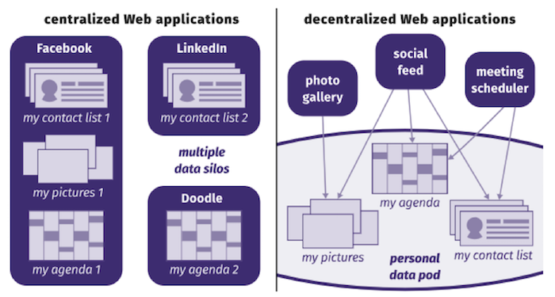
Re-Decentralizing the Web
Containers
Notes:
Re-decentralizing the Web, for good this time
Ruben Verborgh, Ghent University – imec – IDLab
11 January 2019
https://ruben.verborgh.org/articles/redecentralizing-the-web/
Challenges and Opportunities for use of Social Media in Higher Education
Terry Anderson, Journal of Learning for Development, 2019/04/23
https://jl4d.org/index.php/ejl4d/article/view/327/361

Slide 11
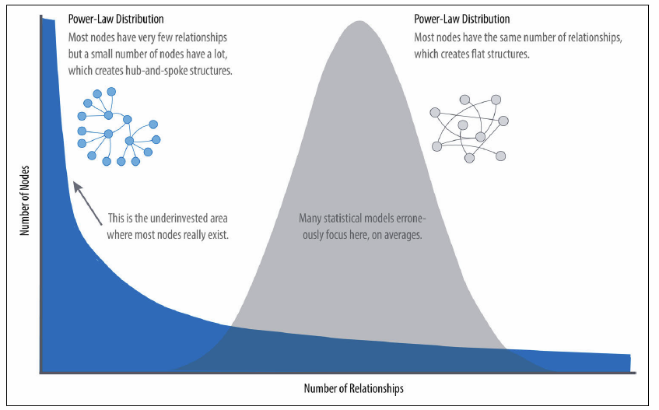
Big Idea 3: Graph, Not Story
Narrations and models focus on common or ‘best’ practices
Graphs capture patterns, outliers, and the unexpected.
Knowledge is recognition, not remembering
Notes:
https://ontotext.com/linked-open-data-cultural-heritage/
https://www.w3.org/wiki/LinkedData
https://www.w3.org/wiki/SweoIG/TaskForces/CommunityProjects/LinkingOpenData
https://communitywiki.org/wiki/MachineCodeBlocks (Lion Kimbro, 2005ish)

Slide 12
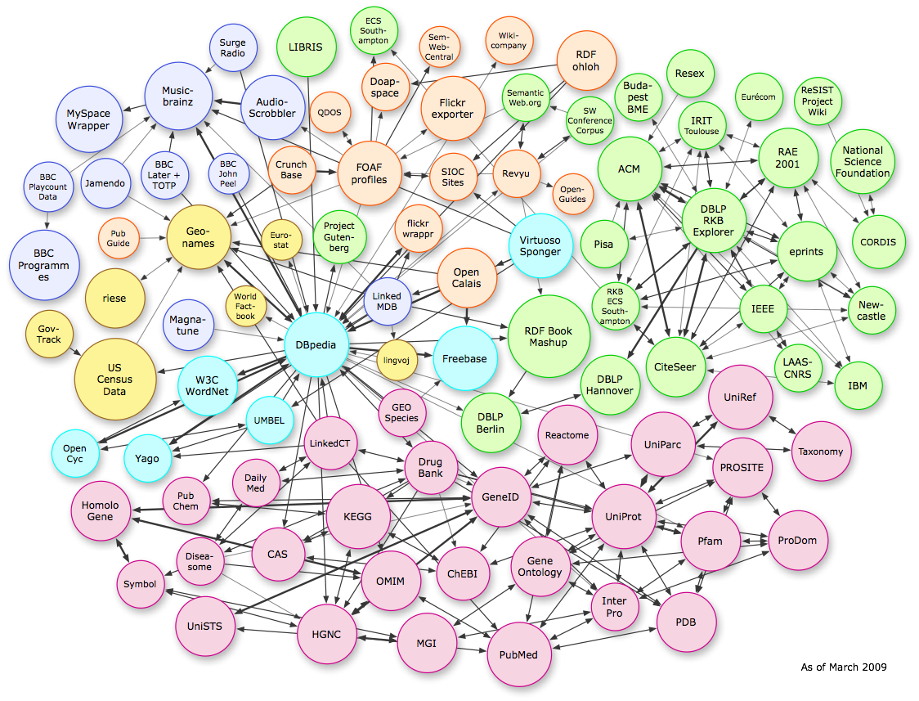
Linked Open Data
https://lod-cloud.net/
Notes:
SOLID – Tim Berners Lee

Slide 13
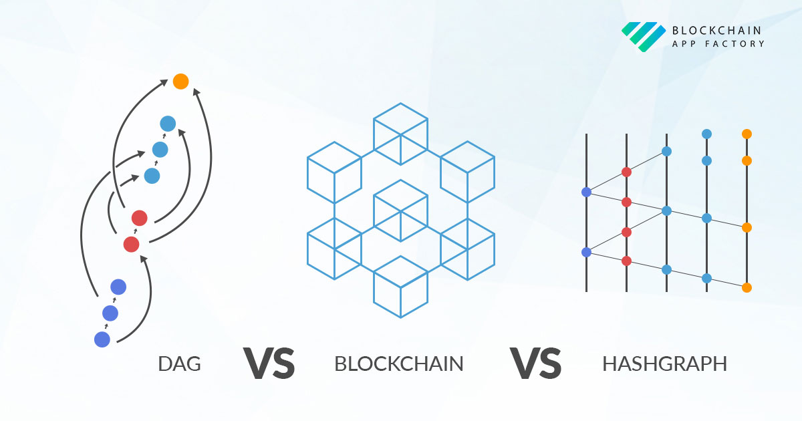
Hashgraphs and Merkle Chains
https://www.blockchainappfactory.com/blog/dag-vs-blockchain-vs-hashgraph/

Slide 14
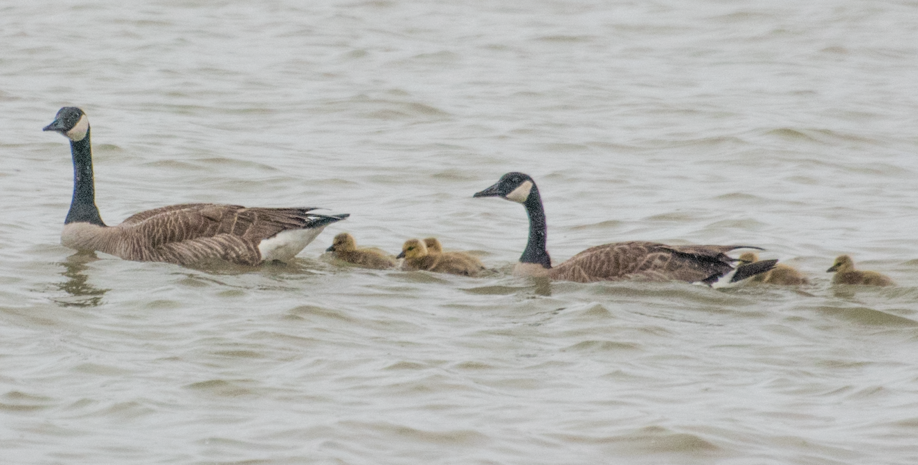
Part Two: Pedagogy

Slide 15
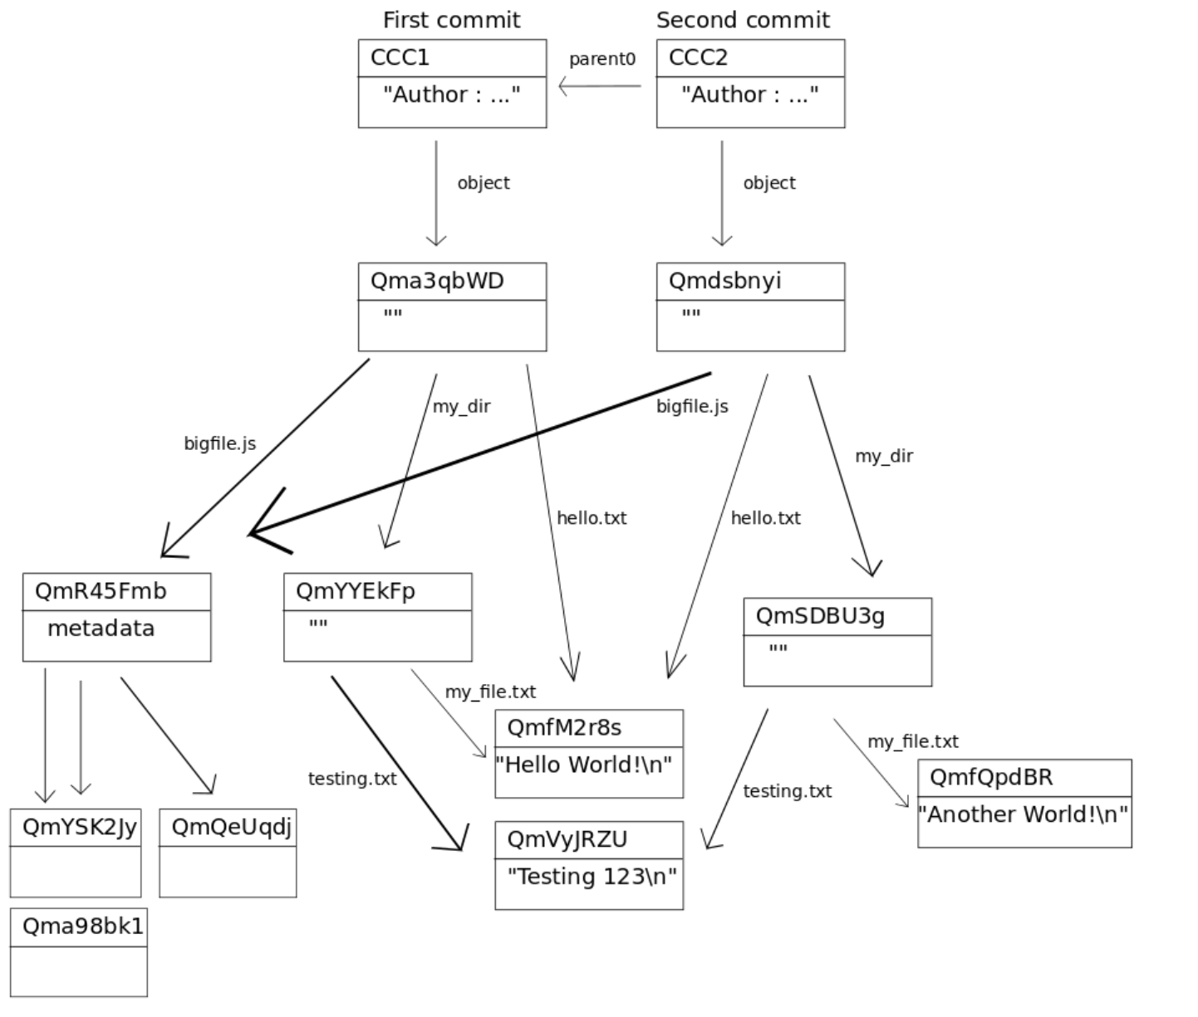
Big Idea 4: CARE
CARE is based on the idea of distributed hashgraph networks
A lot like Git http://www.gthub.com
https://www.youtube.com/watch?v=QNKpK_InQHQ

Slide 16
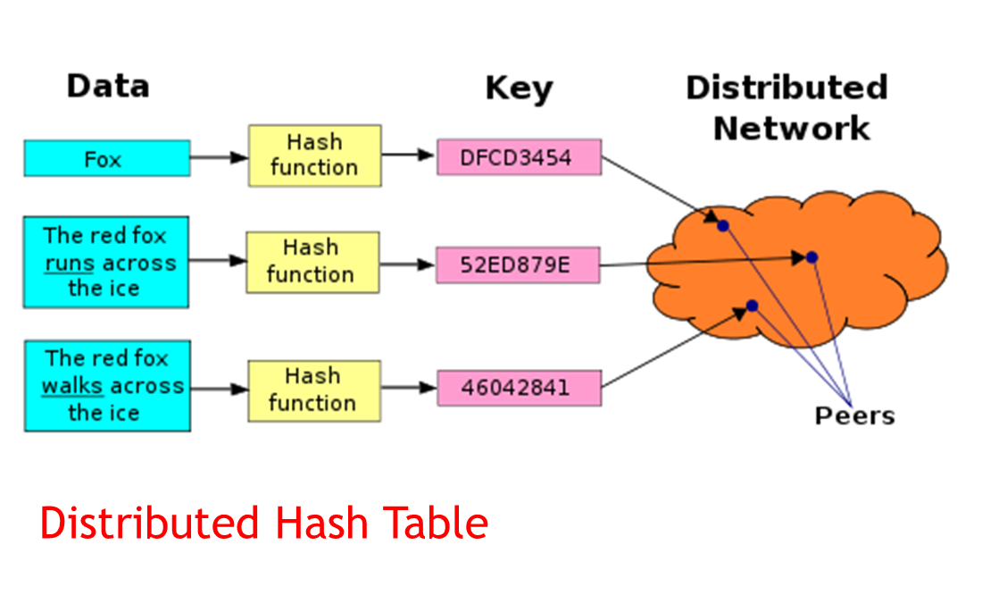
Hash Addresses
Each piece of content has a unique address, which is a hash of its content
https://ipfs.io/ipfs/QmXoypizjW3WknFiJnKLwHCnL72vedxjQkDDP1mXWo6uco/wiki/Distributed_hash_table.html

Slide 17
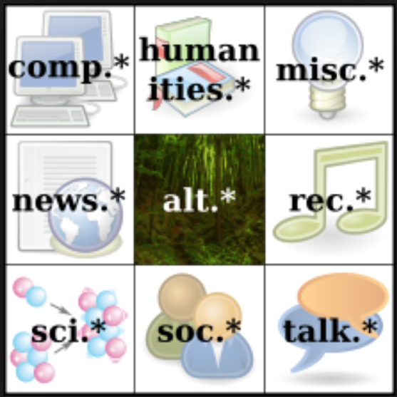
CARE
Content Addressable Resources for
Education
The new OER
https://ipfs.io/

Slide 18
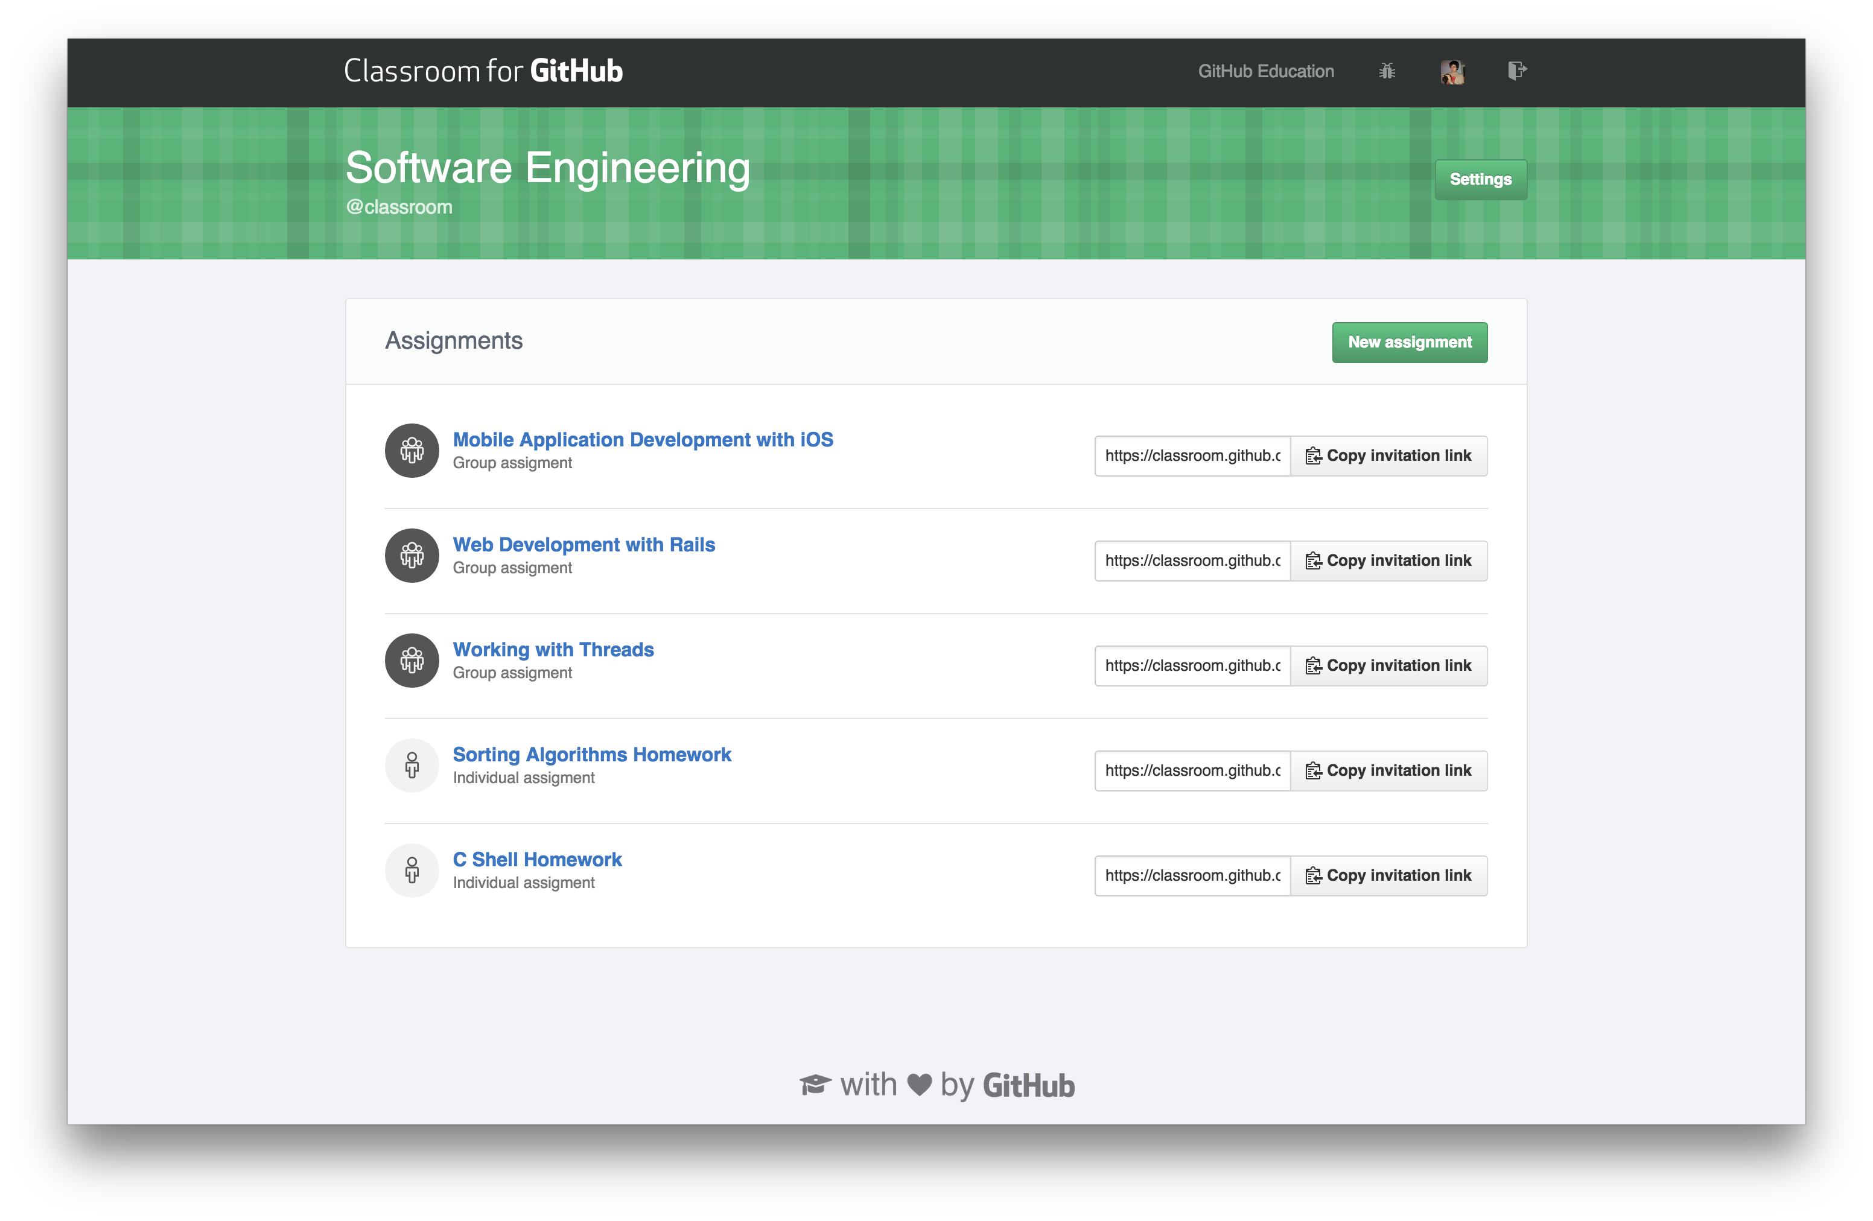
A Distributed GitHub for Learning Resources
Creativity happens in a context, in a community, where building on each other’s work and sharing is the norm
https://github.com/topics/educational-materials
https://github.blog/2015-09-22-teachers-manage-your-courses-with-classroom-for-github/

Slide 19
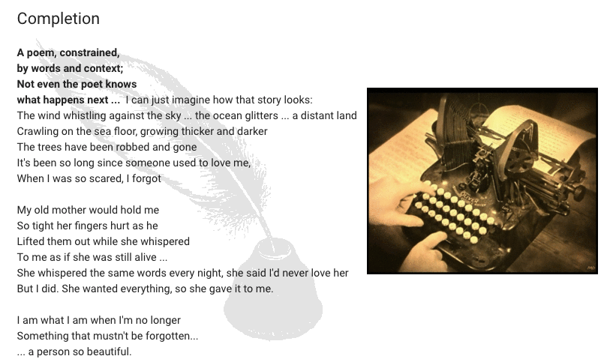
Creating With OpenAI
http://dogtrax.edublogs.org/2019/05/18/writing-collaboration-with-openai-context-and-constraints/
Notes:
Ultimately, our learning resource will be created as needed by artificial intelligence – as learners we will work with AI to create these resources and share them on CAENet for future use by other AIs
AI generated patent claims - https://aipatent.wordpress.com/
AI in application development - https://venturebeat.com/2019/05/20/microsoft-wants-to-apply-ai-to-the-entire-application-developer-lifecycle/

Slide 20

Big Idea 5: Content and Creation Combined
https://www.mediavillage.com/article/how-banksys-disruptive-approach-informs-the-best-creative-campaigns/

Slide 21
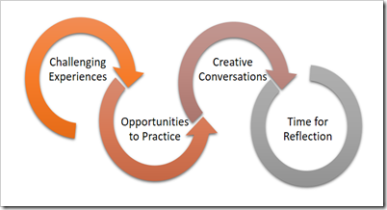

Practice and Reflection
We learn from experience…
And reflecting on experience. We are beginning to combine the experience and reflection
https://charles-jennings.blogspot.com/2016/07/the-power-of-reflection-in-ever.html
https://www.epicgames.com/fortnite/en-US/home

Slide 22

Content and Creation
Creation of the content is becoming a part of the content itself.
Livecaster
Twitch
Open Broadcaster
https://intrsection.com/2017/04/8396/
https://www.twitch.tv/
https://obsproject.com/

Slide 23
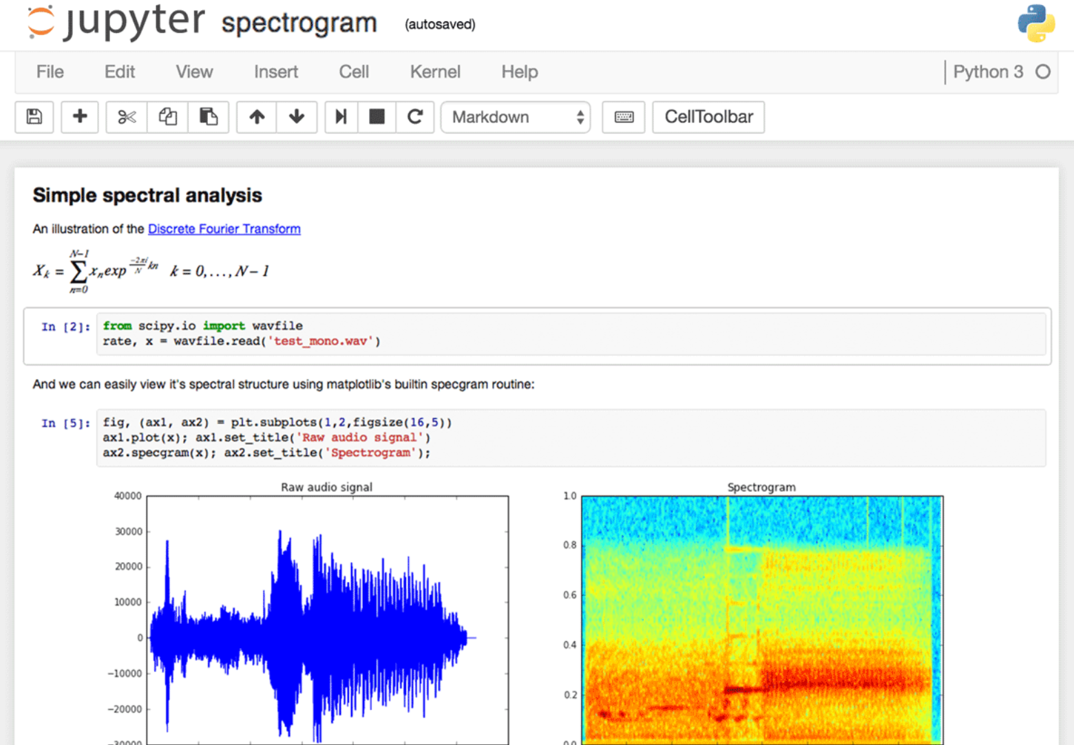
Notebooks
Jupyter Notebook combines data and code in a document
JupyterLab Environment - work with code, data, and the Jupyter notebook format.
https://www.dataquest.io/blog/jupyter-notebook-tips-tricks-shortcuts/
Notes:
See also: OpenLearn Jupyter Books Remix, TM351 Notebooks in VM and Electron.

Slide 24
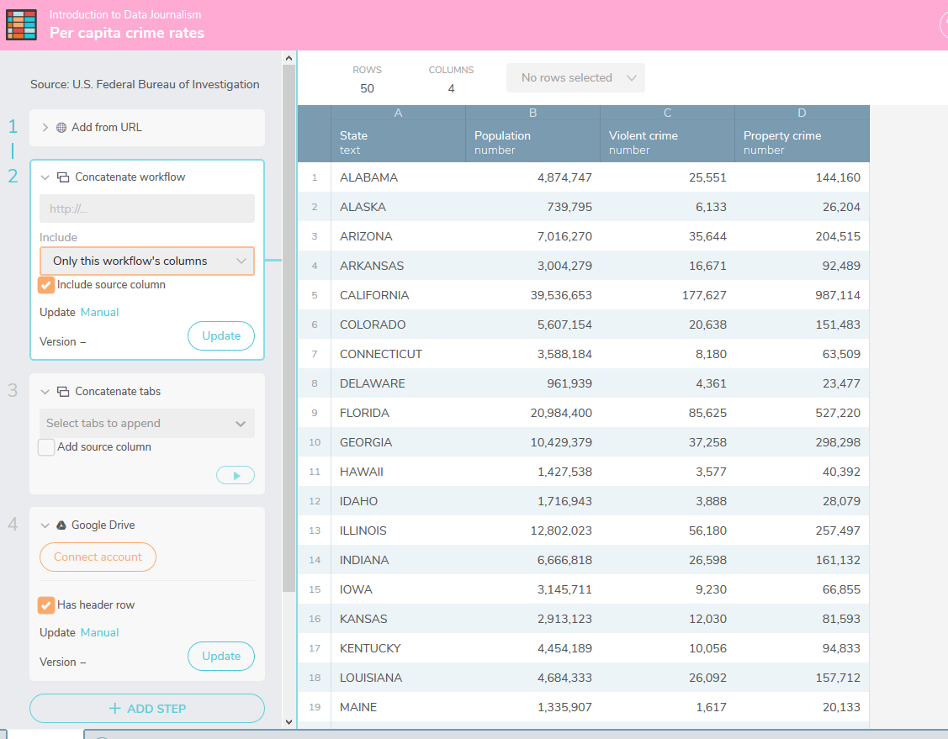
Workbench
Workbench is a free and open source data journalism platform "that enables all stages of data journalism: getting data (including scraping), then cleaning, analyzing, visualizing, and sharing it.
https://www.dataquest.io/blog/jupyter-notebook-tips-tricks-shortcuts/

Slide 25
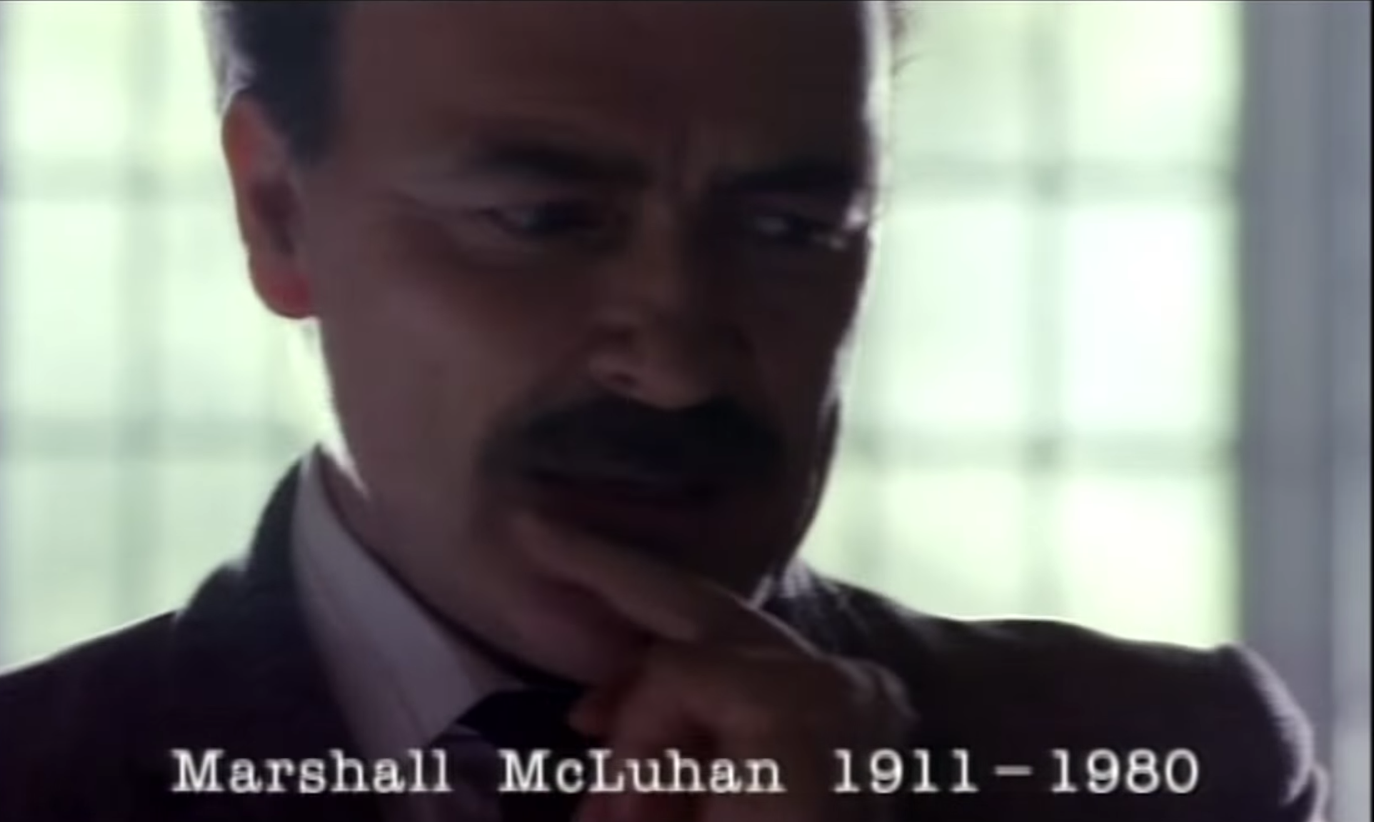
Big Idea 6: We are the Content
McLuhan: The Content is the Audience
https://www.youtube.com/watch?v=QNKpK_InQHQ

Slide 26
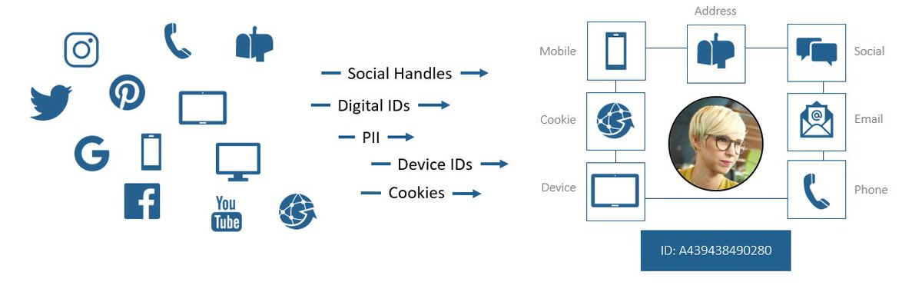
Identity Graph
https://twitter.com/merkle/status/938123229335613440
Notes:
Instead of demographics being about quantity (sales charts, votes in elections and polls, membership in community) we will now have access to a rich tapestry of data and relations. Instead of grades or scores (or hit counts, or followers) our self-assessments will be based on the quality of the experience, the depth of the insight, or the richness of the interaction. The “quantified self” will give way to the “qualified self” (here, and here)

Slide 27
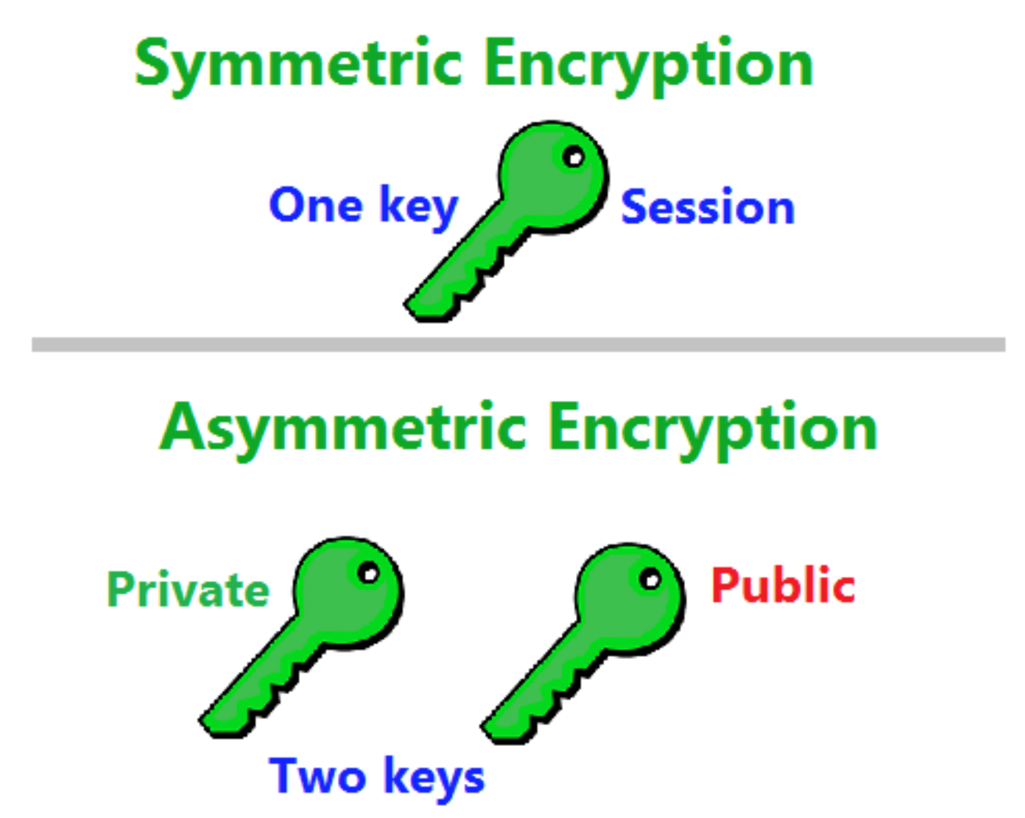
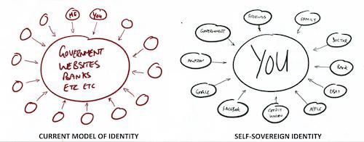
Self-Sovereign Identity
https://medium.com/@carrascosa.cobos/will-europe-aim-for-digital-identity-796afa3ce6cd

Slide 28
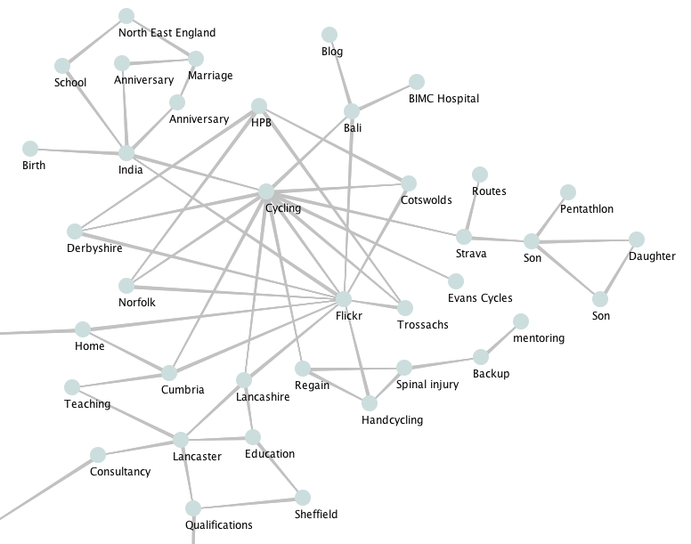
The Qualified Self
Will the ‘connected self’ be more reflective? Will ‘the connective self’ more honestly reflect our hopes, aspirations and dreams?
https://jennymackness.wordpress.com/tag/digital-identity/
https://mitpress.mit.edu/books/qualified-self
https://markcarrigan.net/2014/07/23/qualitative-self-tracking-and-the-qualified-self/
Notes:
Jwnny Mackness: The connected self will be more about our relations and interactions. Will this lead to a more ethical Web? Will digital identity as a ‘connected self make the ‘source of truth’ of these identities more visible? Will the ‘connected self’ be more reflective? Will ‘the connective self’ more honestly reflect our hopes, aspirations and dreams?

Slide 29
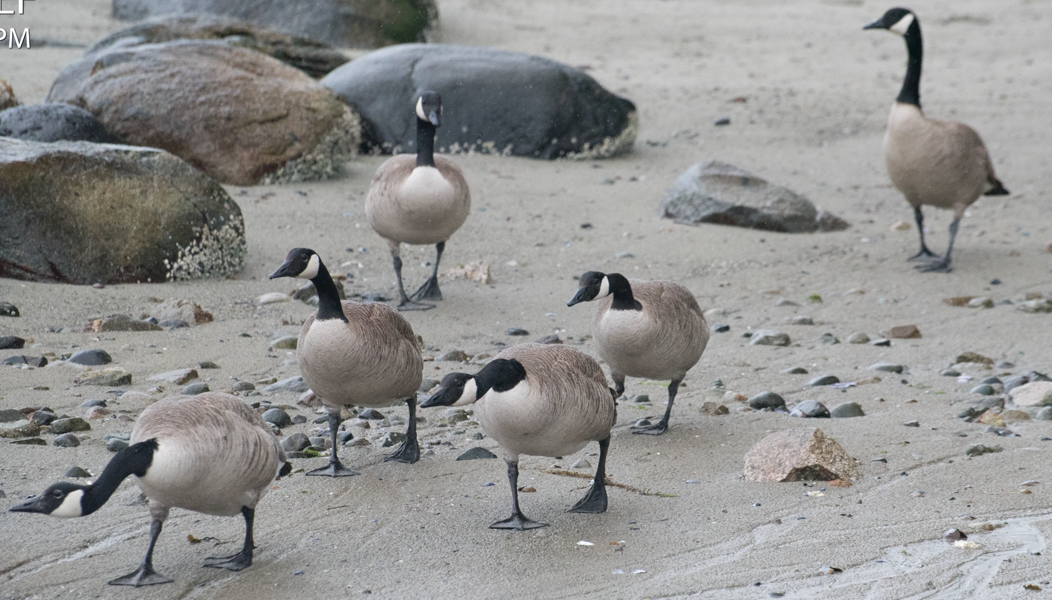
Part Three: Outcomes

Slide 30
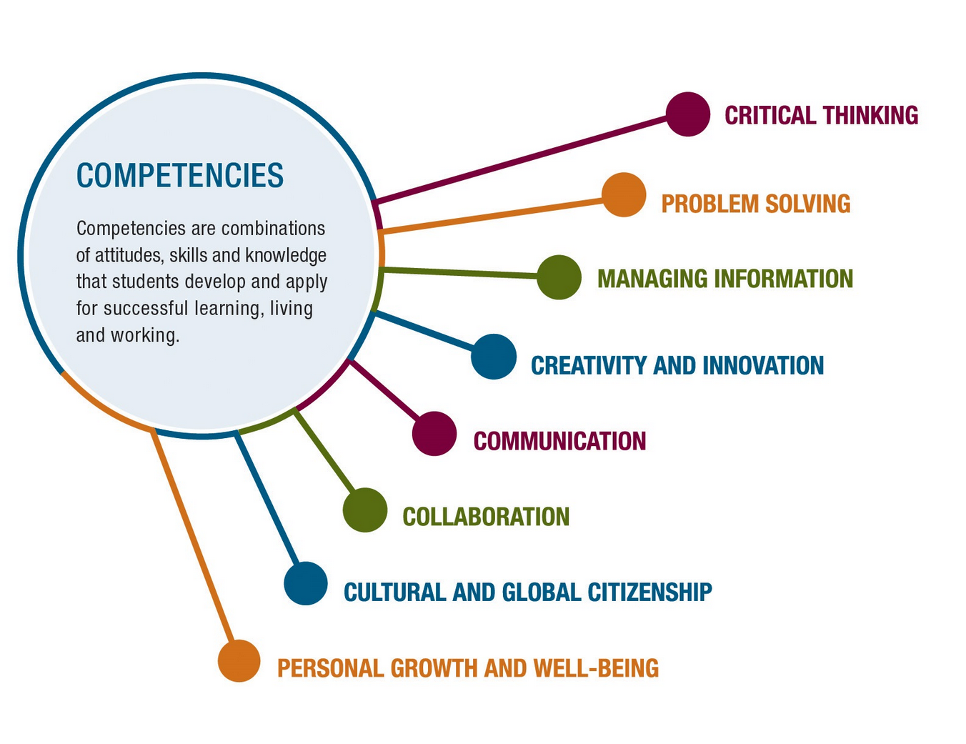
Big Idea 7: AI-Based Learning Recognition
What happens when we recognize skills and competencies rather than content knowledge?
We no longer need to depend on tests and exams and can instead rely on a body of work.
Notes:
https://www.pearson.com/us/higher-education/products-services-institutions/career-success-program.html

Slide 31
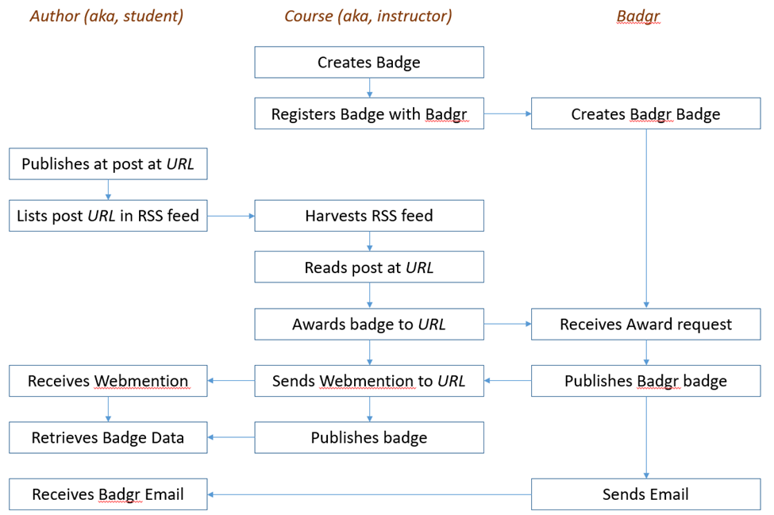
Badges, Microcredentials…
Open Badges are the global standard for verifiable digital credentials.
https://openbadges.org/ https://openbadgefactory.com/
https://www.openbadges.me/ https://badgr.com/

Slide 32
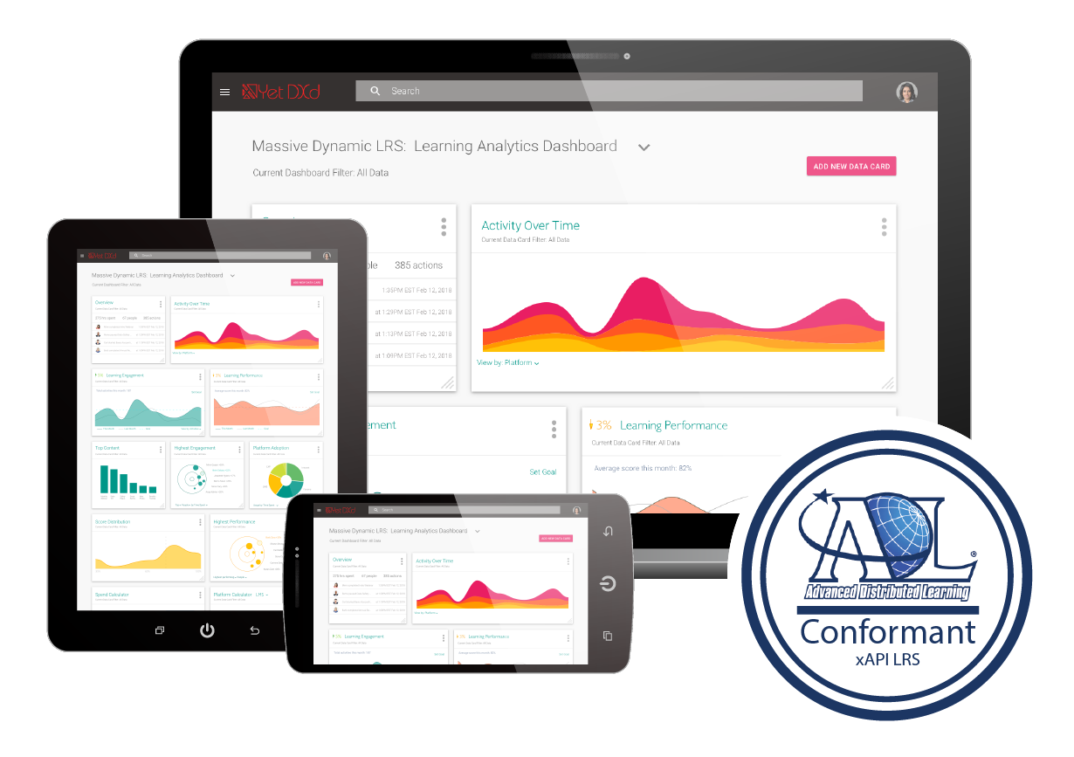
Activity Records, xAPI…
xAPI lets you capture (big) data on human performance, along with associated instructional content or performance context information…
https://adlnet.gov/research/performance-tracking-analysis/experience-api/
https://www.yetanalytics.com/xapi-lrs

Slide 33

Recognizing Learning as a Totality of Achievement
We can also gather data outside the school or program, looking at actual results and feedback from the workplace.
https://www.cdc.gov/chronicdisease/resources/publications/aag/workplace-health.htm

Slide 34
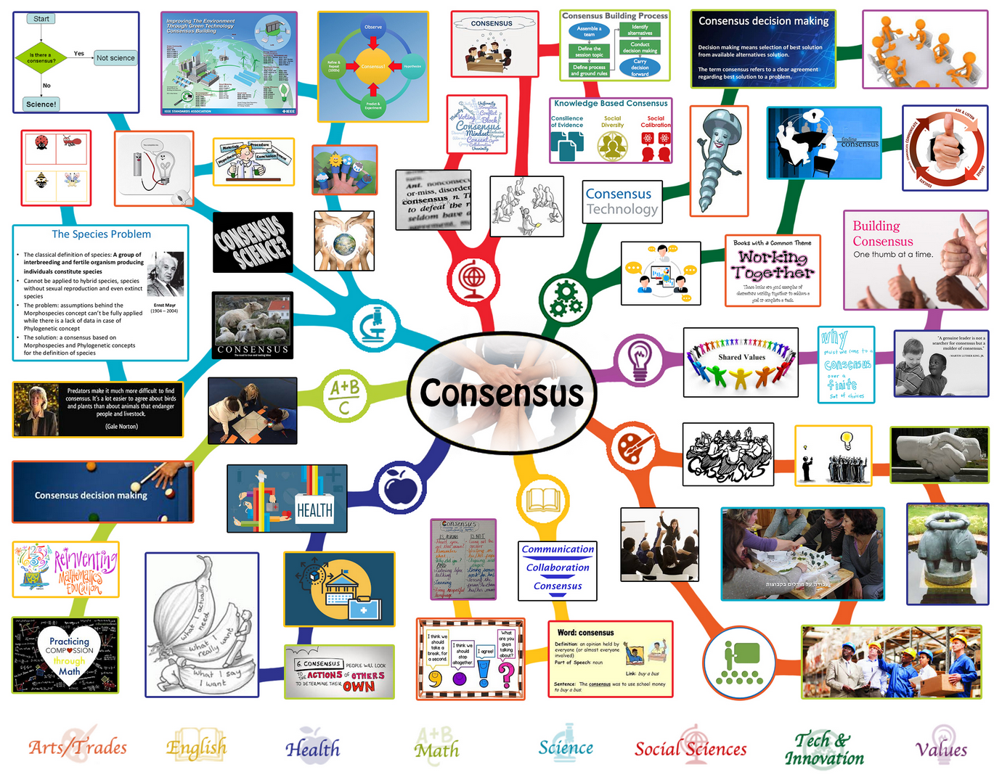
Big Idea 8: Community as Consensus
Notes:
No longer based on sameness…
Now based on making decisions together…
On consensus
https://www.onecommunityglobal.org/consensus-and-decision-making-lesson-plan/

Slide 35
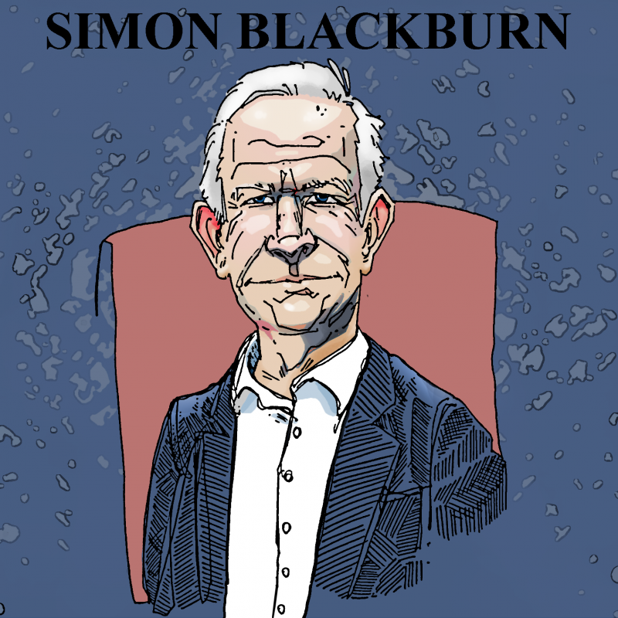
A Basis in Personal Experience
Truth begins with personal knowledge…
We can describe how it works in a specific domain
https://partiallyexaminedlife.com/2018/08/06/ep196-1-simon-blackburn/
https://halfanhour.blogspot.com/2016/12/detecting-fake-news.html

Slide 36
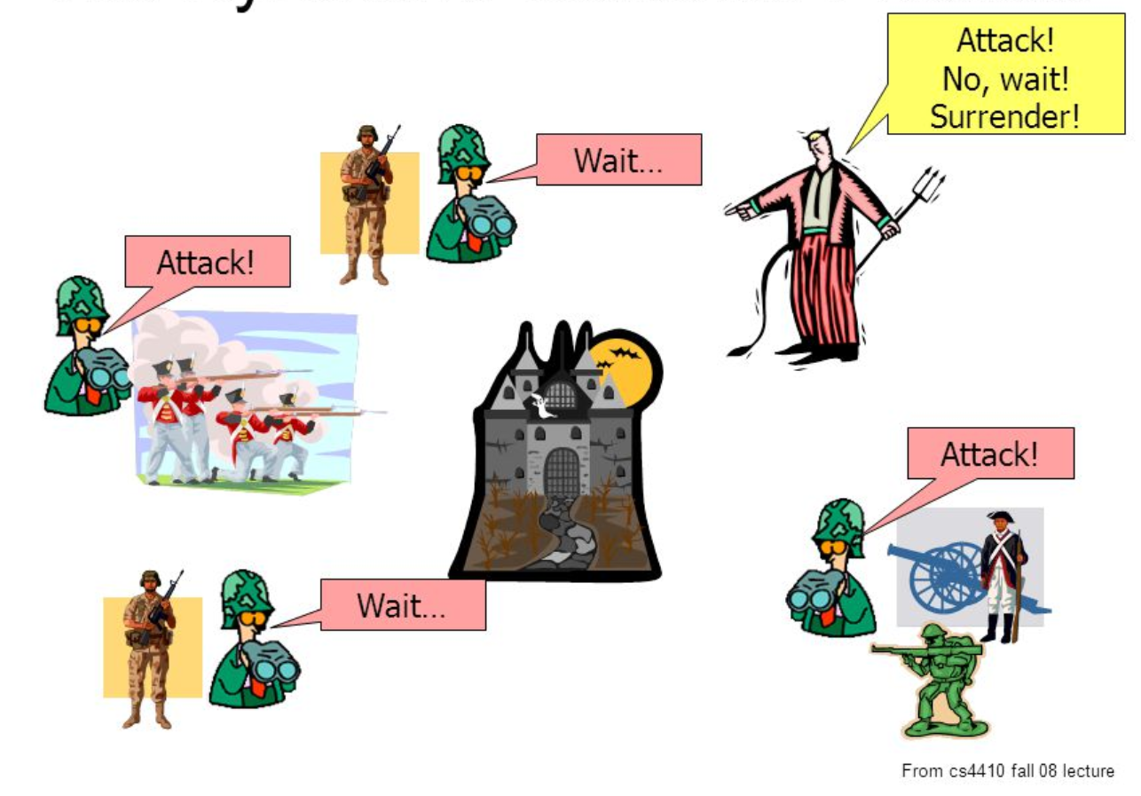
The Byzantine Generals Problem
Trust no one…
https://slideplayer.com/slide/5163640/

Slide 37
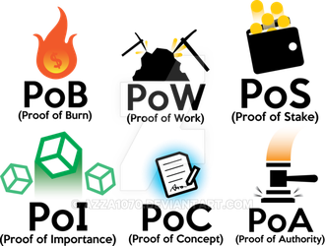
Distributed Consensus
The mechanisms we use to interact and reach consensus are what define us as a community…
Is consensus based in work, stake, importance, authority…? What are the conditions for consensus?
https://www.deviantart.com/azza1070/art/Blockchain-Protocols-PoB-PoW-PoS-PoI-PoC-PoA-734159319
Paxos https://en.wikipedia.org/wiki/Paxos_(computer_science)

Slide 38
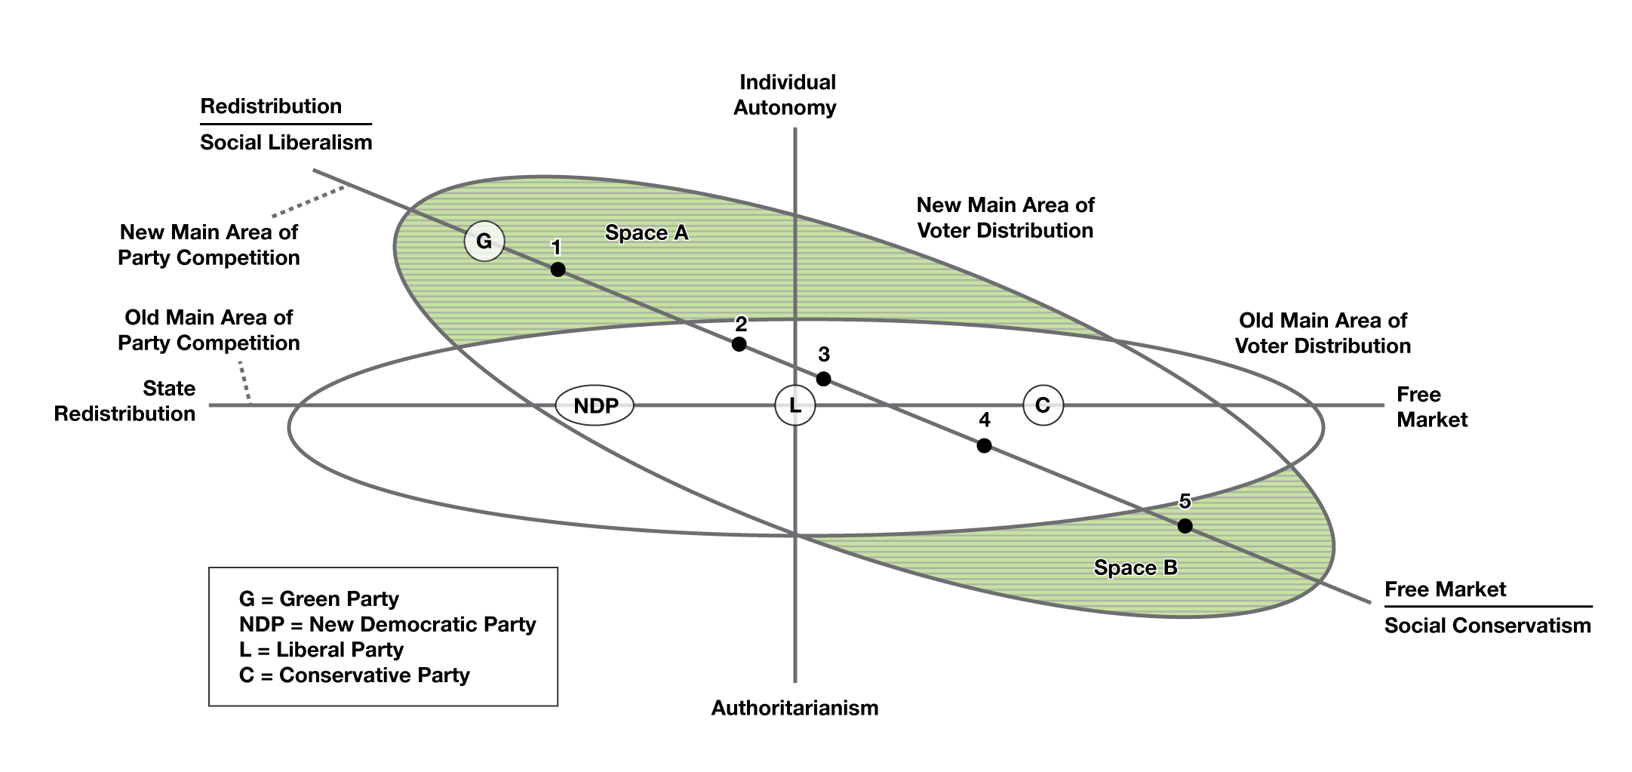
Big Idea 9: Redefining Success
Agency: The relative standing of the individual with respect to community, institutions, and governments
https://opentextbc.ca/introductiontosociology/chapter/chapter17-government-and-politics/

Slide 39
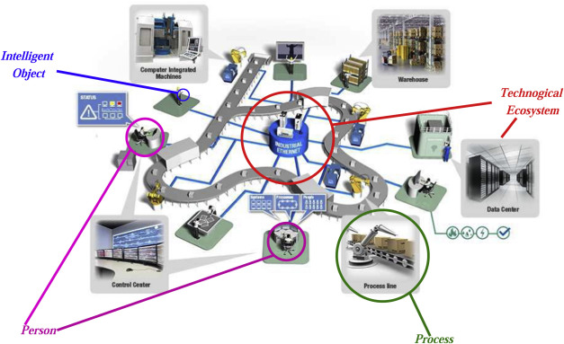
Agency
Four key outcomes for a modern distributed learning environment: security, identity, voice and opportunity.
https://www.downes.ca/post/68088

Slide 40

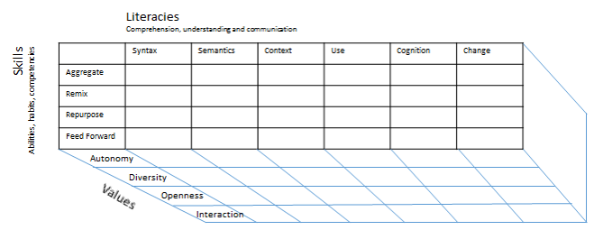
Agency
Education must focus on the tools and capacities for agency
https://www.globalpartnership.org/blog/building-peace-through-education
https://science.sciencemag.org/content/364/6441/702
Notes:
The hidden curriculum
The point of instruction-based learning is to learn how to be instructed
etc

Slide 41

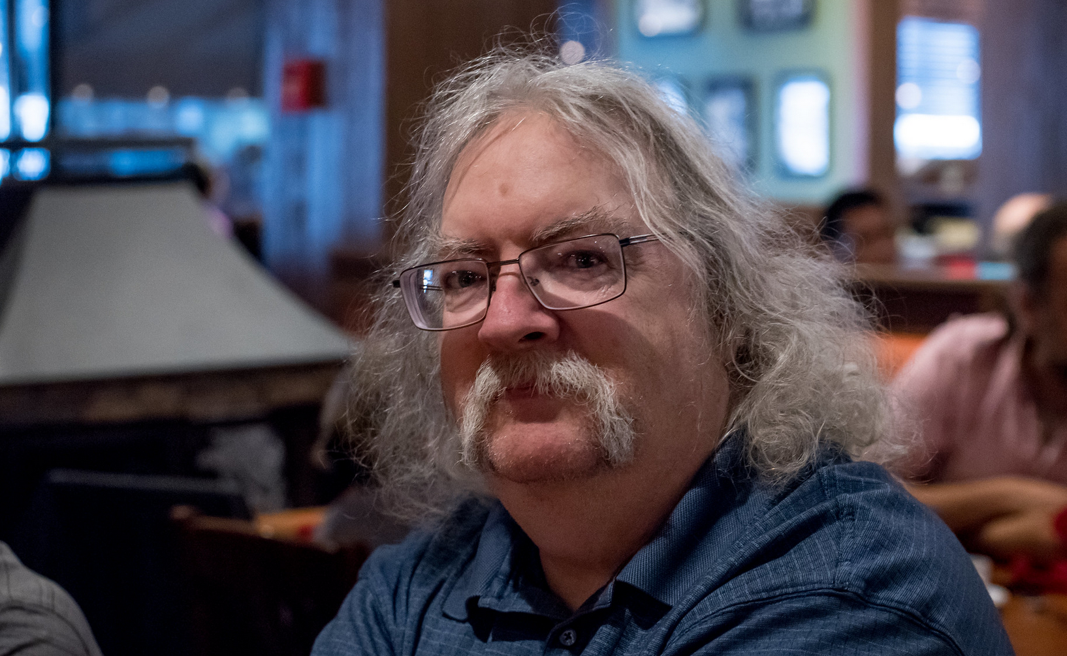
http://www.downes.ca

