Slide 1
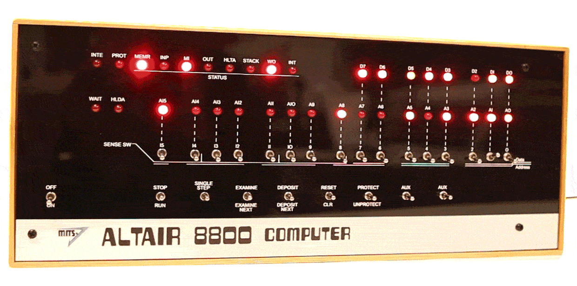
Future Learning in an Advanced Decentralized Learning Ecosystem
Stephen Downes
May 1, 2019
Notes:
https://spectrum.ieee.org/geek-life/hands-on/build-your-own-altair-8800-personal-computer
Gif: Randi Klett

Slide 2

INTRO: PERSONAL LEARNING
https://giphy.com/gifs/cat-kitty-pet-TA6Fq1irTioFO

Slide 3
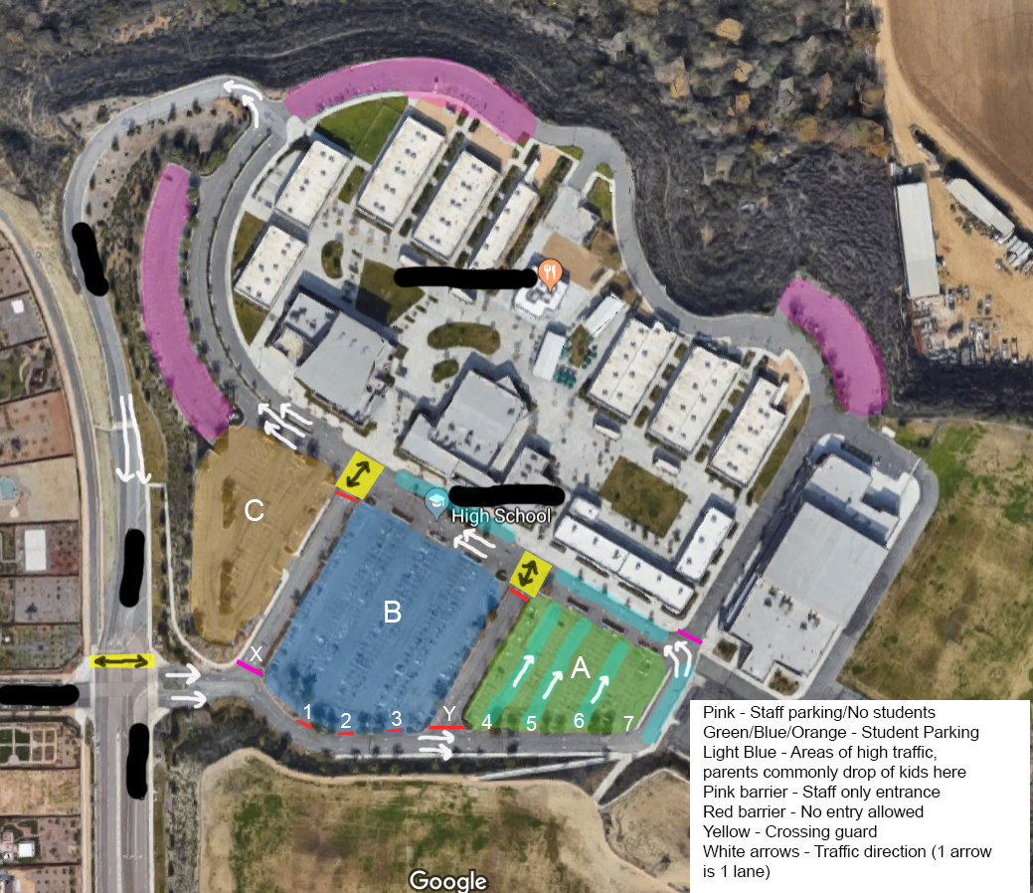
High School Math ML Problem
Here we have a case where a high school student has been given the problem of optimizing traffic flow in his school parking lot.
When they’re in trafic, it’s not about what you want to teach them, it’s about what they need to know; it’s not about what you can do for them, it’s about what they can do for themselves
https://www.reddit.com/r/MachineLearning/comments/bhp6bw/p_can_you_solve_this_high_school_ml_problem/
Notes:
Can you solve this High School ML problem?
LittleLouis, Reddit, Apr 27, 2019
https://www.reddit.com/r/MachineLearning/comments/bhp6bw/p_can_you_solve_this_high_school_ml_problem/

Slide 4
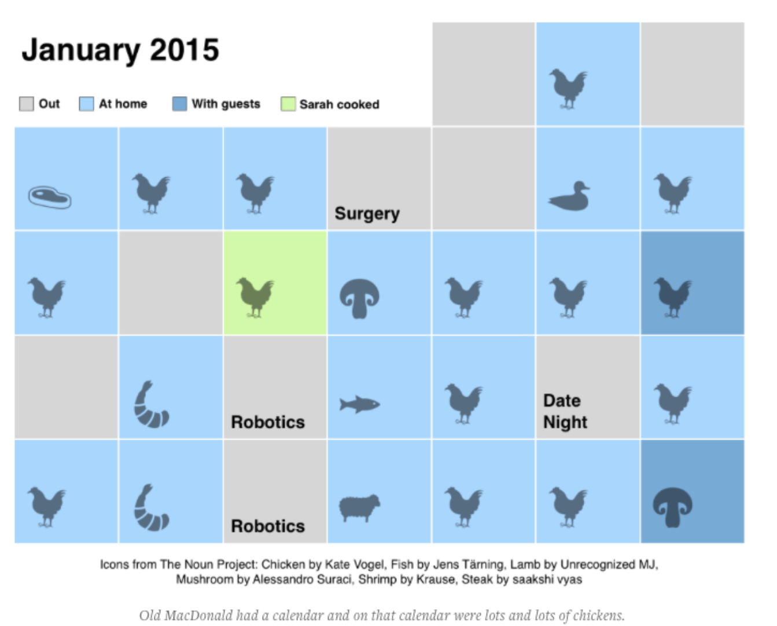
Identity and Recognition
The quantified self will give way to the qualified self
http://quantifiedself.com/reporter-app/

Slide 5
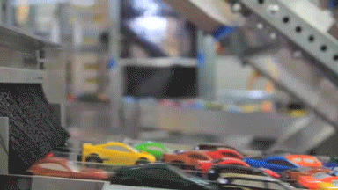
You’re Not Stuck In Traffic, You Are Traffic
“a new generation of designers has emerged, concerned with designing strategies to subvert this “natural default-setting” in which each person understands themselves at the center of the world.”
https://jods.mitpress.mit.edu/pub/design-as-participation
Notes:
Design as Participation
Kevin Slavin, Journal of Design and Science, 2019/04/29
https://jods.mitpress.mit.edu/pub/design-as-participation

Slide 6
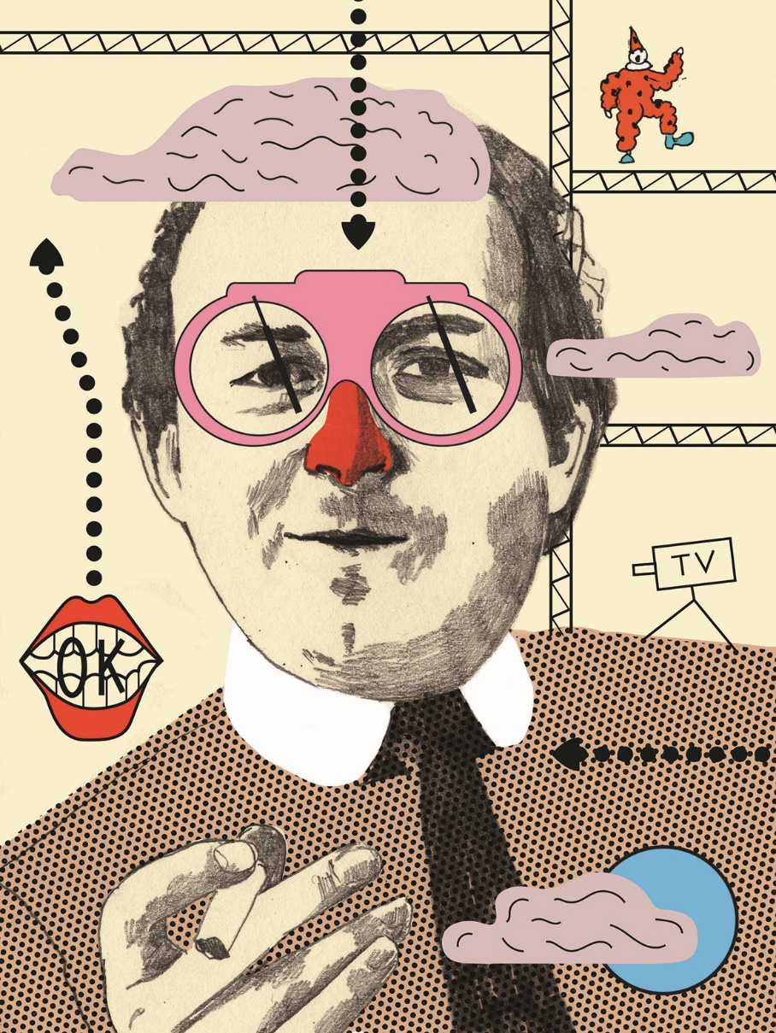
Cedric Price
Cedric Price: "Price was designing not for the uses he wished to see, but for all the uses he couldn’t imagine.... As opposed to the 'user' of a building who is interacting with a smart thermostat, the participants in a building are engaged with one another."
Or as I like to say, we built a trillion-dollar communication system, and people use it to send cat pictures, and that's the beauty of it.
https://www.architectural-review.com/essays/reputations-pen-portraits-/cedric-price-1934-2003/10026650.article
Notes:
https://www.architectural-review.com/essays/reputations-pen-portraits-/cedric-price-1934-2003/10026650.article

Slide 7

RESOURCES – EXPERIENCE - AGENCY
https://giphy.com/gifs/cat-lazy-sleepy-papAALBn286ty

Slide 8

Experience
We are beginning to combine experience and reflection
https://www.epicgames.com/fortnite/en-US/home

Slide 9

Content and Creation
Creation of the content is becoming a part of the content itself.
Livecaster
Twitch
Open Broadcaster
https://intrsection.com/2017/04/8396/
https://www.twitch.tv/
https://obsproject.com/

Slide 10

Connect LMS via LTI WordPress Plugin
Workbench is a free and open source data journalism platform "that enables all stages of data journalism: getting data (including scraping), then cleaning, analyzing, visualizing, and sharing it.
Notes:
https://blog.ouseful.info/2019/04/24/creating-team-and-individual-wordpress-blogs-from-your-vle-via-an-lti-wordpress-plugin/

Slide 11
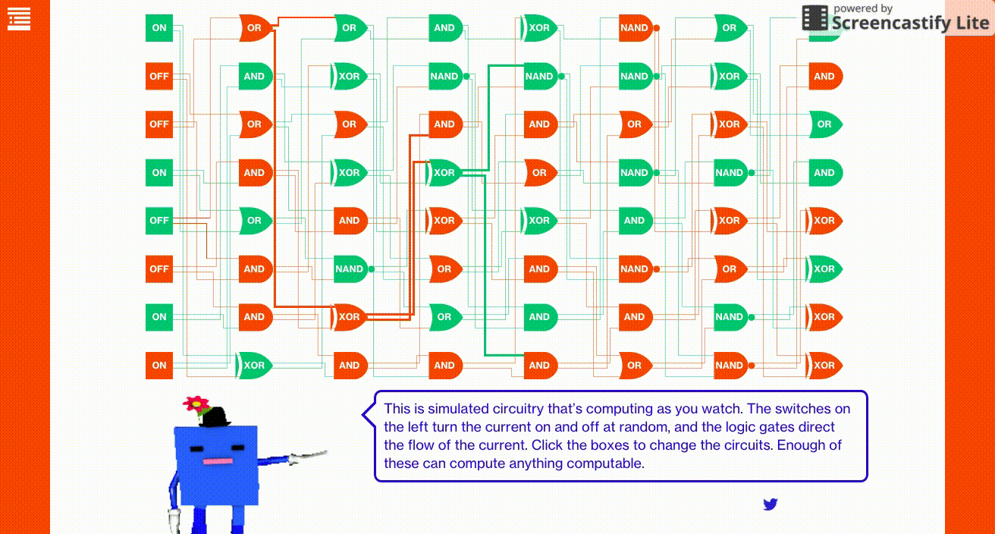
Creating and learning – code and outcome - combine in a single environment​
This is simulated circuitry that can compute as you watch. The switches on the left turn the current on and off at random, and the logic gates direct the flow of the current.
https://www.bloomberg.com/graphics/2015-paul-ford-what-is-code/

Slide 12
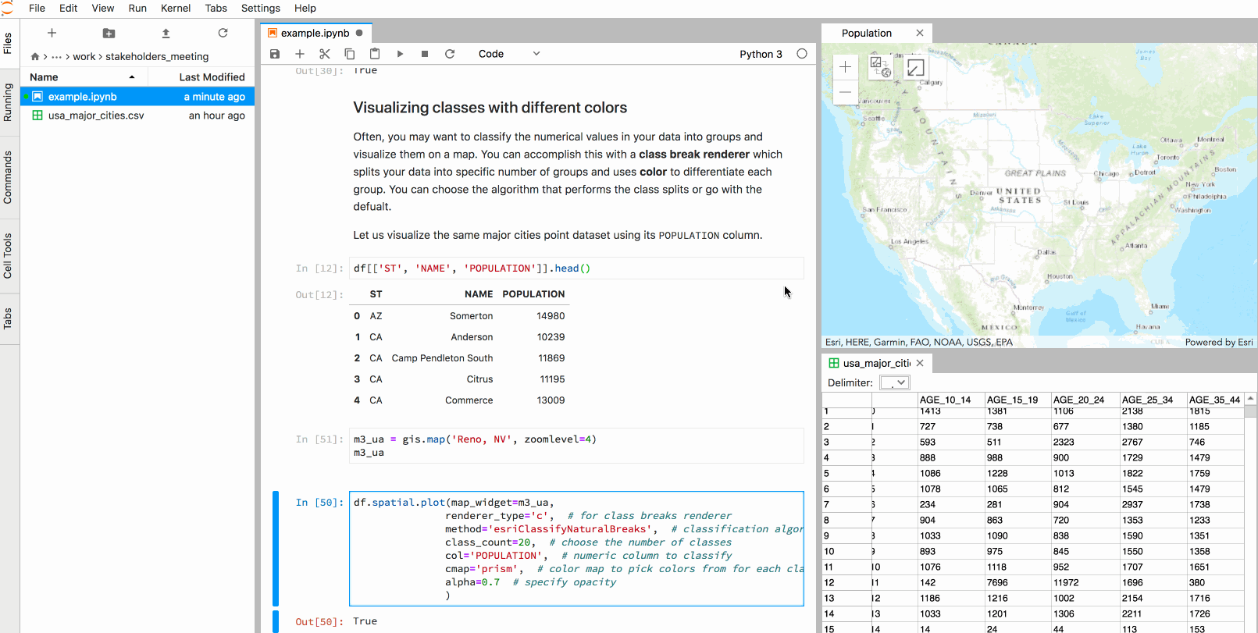
New types of learning resources​
Jupyter Notebook combines data and code in a document
JupyterLab Environment - work with code, data, and the Jupyter notebook format.
https://jupyter.org/try (Binder demo)
https://www.dataquest.io/blog/jupyter-notebook-tips-tricks-shortcuts/
Notes:
https://developers.arcgis.com/python/guide/using-the-jupyter-lab-environment/
https://noteable.edina.ac.uk/ - Computational notebooks allow you to create and share live code, equations, visualisations and explanatory text. Noteable is a bespoke cloud-based application that lets students and lecturers run Jupyter notebooks online.

Slide 13
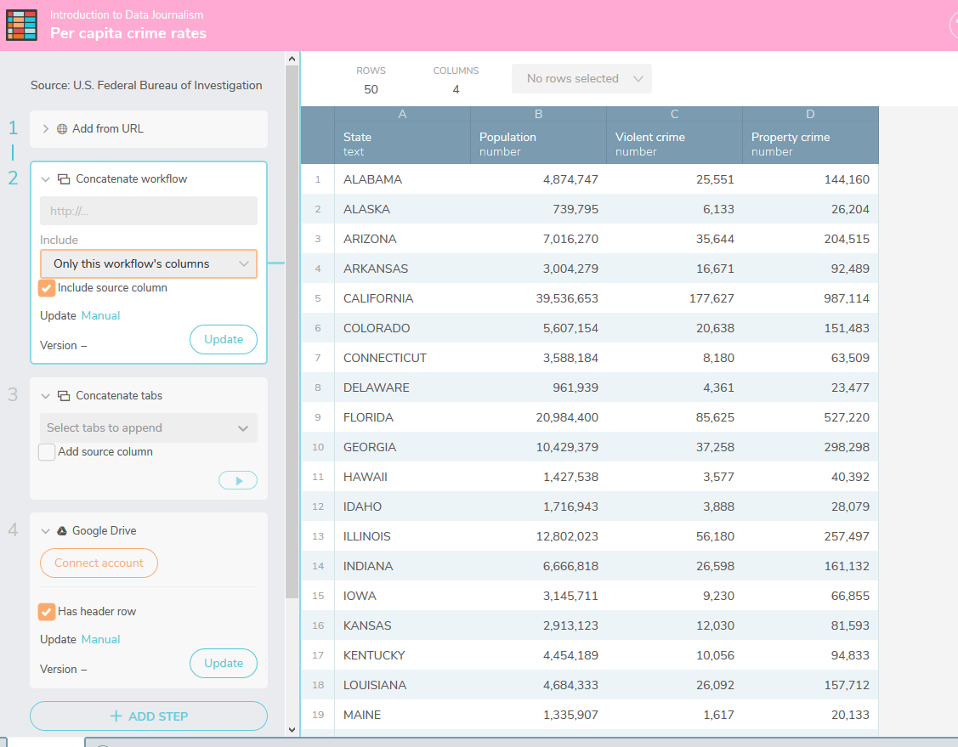
Workbench
Workbench is a free and open source data journalism platform "that enables all stages of data journalism: getting data (including scraping), then cleaning, analyzing, visualizing, and sharing it.
https://github.com/CJWorkbench
https://app.workbenchdata.com/courses/intro-to-data-journalism
Notes:
Introducing Workbench, an Open Source Platform
Pierre Conti, Adam Hooper, Jonathan Stray
https://source.opennews.org/articles/workbench-data-journalism-open-source-platform/
Course - https://app.workbenchdata.com/courses/intro-to-data-journalism, Source, 2019/04/25

Slide 14
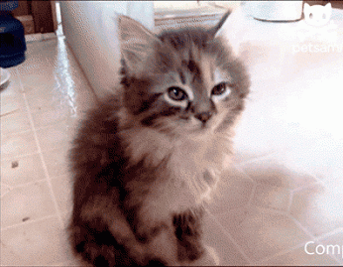
DATA - CLOUD - AI
https://giphy.com/gifs/cat-just-sleepy-DAmosupuFkPjG

Slide 15
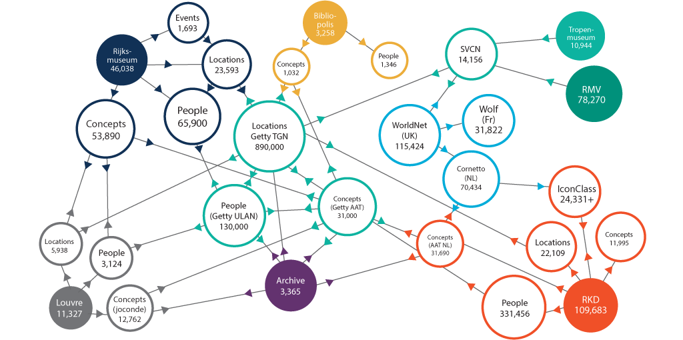
The Linked Open Data Cloud
LinkedData is to spreadsheets and databases what the Web of hypertext documents is to word processor files.
https://lod-cloud.net/
https://ontotext.com/linked-open-data-cultural-heritage/
Notes:
https://ontotext.com/linked-open-data-cultural-heritage/
https://www.w3.org/wiki/LinkedData
https://www.w3.org/wiki/SweoIG/TaskForces/CommunityProjects/LinkingOpenData
https://communitywiki.org/wiki/MachineCodeBlocks (Lion Kimbro, 2005ish)

Slide 16
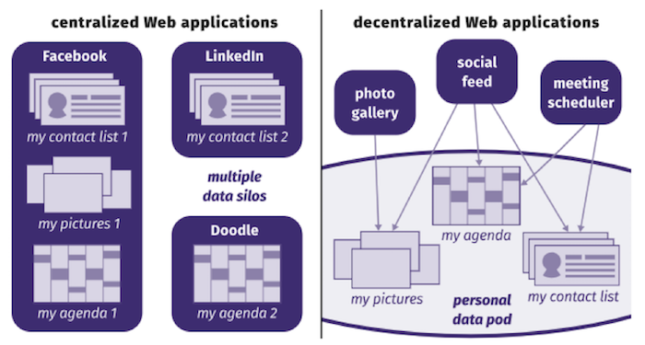
Re-Decentralize the Web
current Web apps combine data and service. Because of this coupling, our LinkedIn contacts cannot comment on our Facebook pictures, and an RSVP on a Facebook event will not be reflected in our Doodle calendar’s availability. Decentralized applications, on the other hand, act as views on top of our data pod and those of others.
https://ruben.verborgh.org/articles/redecentralizing-the-web/
Notes:
Re-decentralizing the Web, for good this time
Ruben Verborgh, Ghent University – imec – IDLab
11 January 2019
https://ruben.verborgh.org/articles/redecentralizing-the-web/
Challenges and Opportunities for use of Social Media in Higher Education
Terry Anderson, Journal of Learning for Development, 2019/04/23
https://jl4d.org/index.php/ejl4d/article/view/327/361

Slide 17
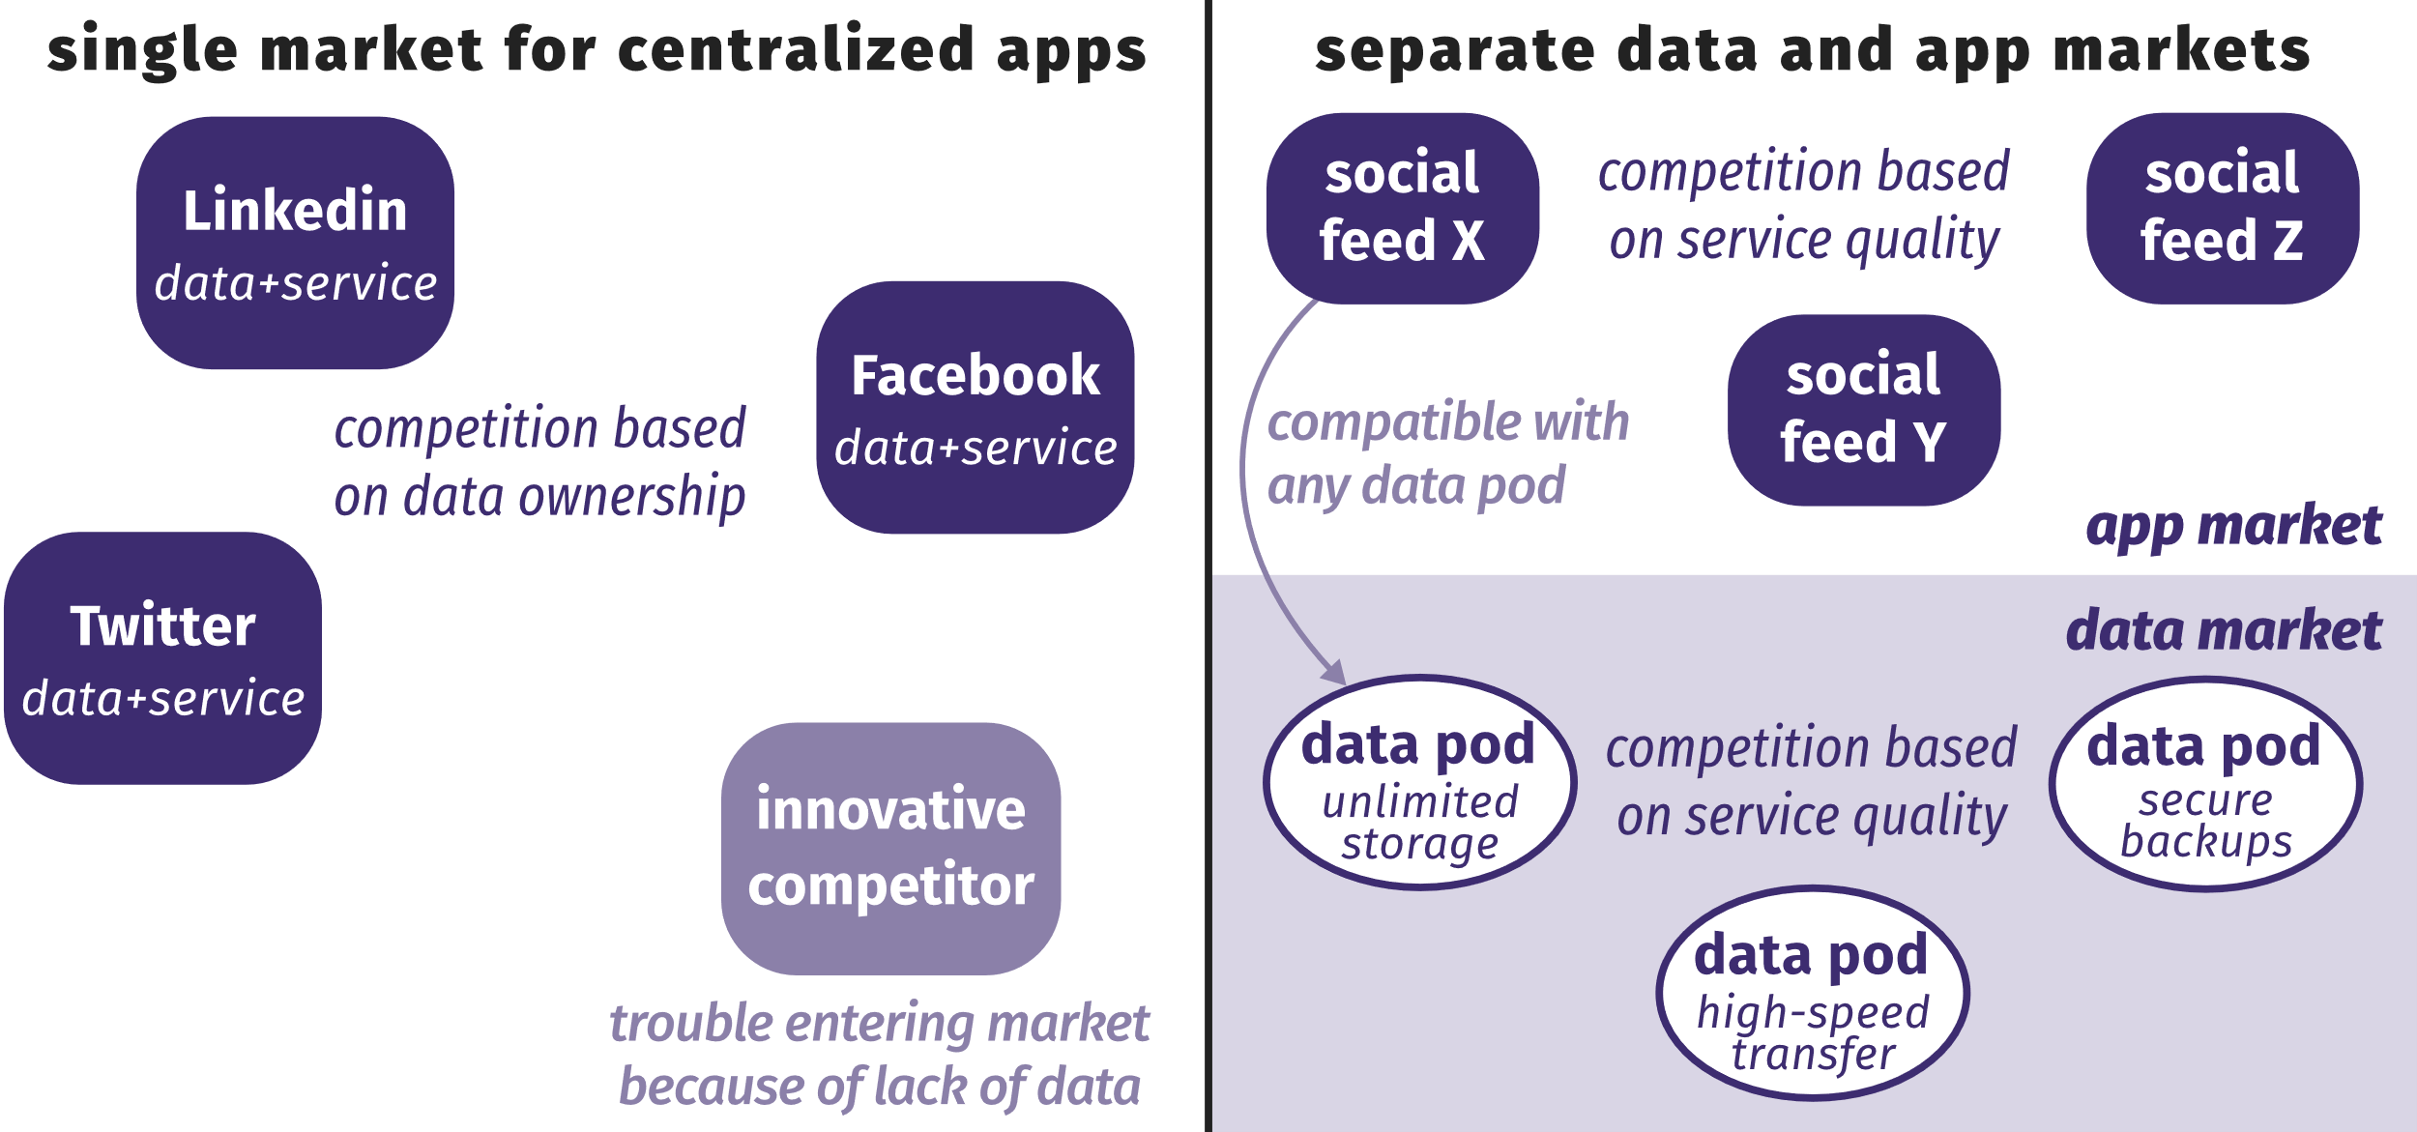
Decentralized Data and Service Providers
Centralized applications compete in a single market, based on data ownership. On a decentralized Web, data and service providers compete in different markets.
Notes:
Re-decentralizing the Web, for good this time
Ruben Verborgh, Ghent University – imec – IDLab
11 January 2019
https://ruben.verborgh.org/articles/redecentralizing-the-web/

Slide 18
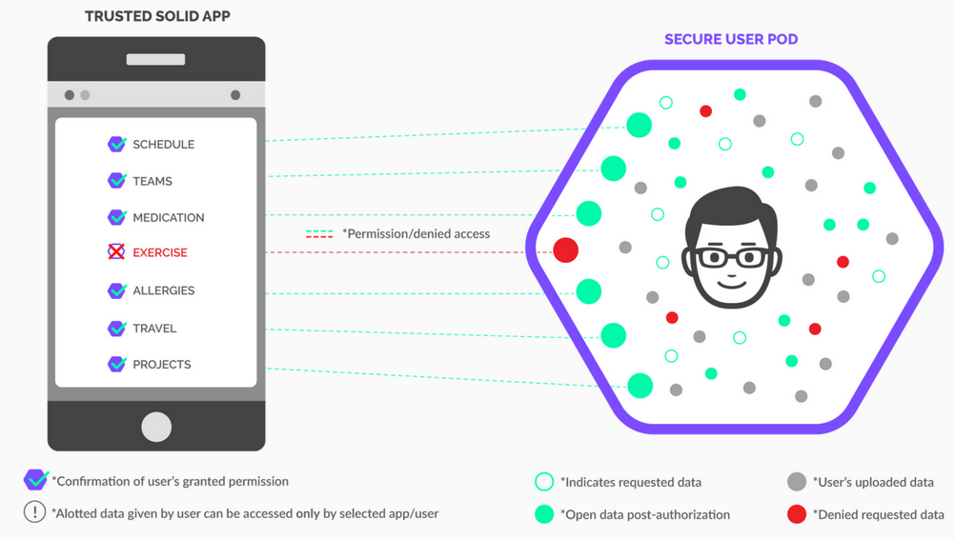
Decentralized Social Networks
Solid
IndieWeb
Mastodon
MeFi
ActivityPub
https://www.w3.org/TR/activitypub/
https://solid.mit.edu/
Notes:
“Solid”. (n.d.). , available at: https://solid.mit.edu/.
Berners-Lee, T. (2006), “Linked Data”, 27 July, available at: https://www.w3.org/DesignIssues/LinkedData.html.
Berners-Lee, T. and O’Hara, K. (2013), “The read–write Linked Data Web”, Philosophical Transactions of the Royal Society A, Vol. 371 No. 1987.
Image: http://blog.economie-numerique.net/2018/11/08/solid-le-projet-ambitieux-de-tim-berners-lee-linventeur-dinternet/

Slide 19
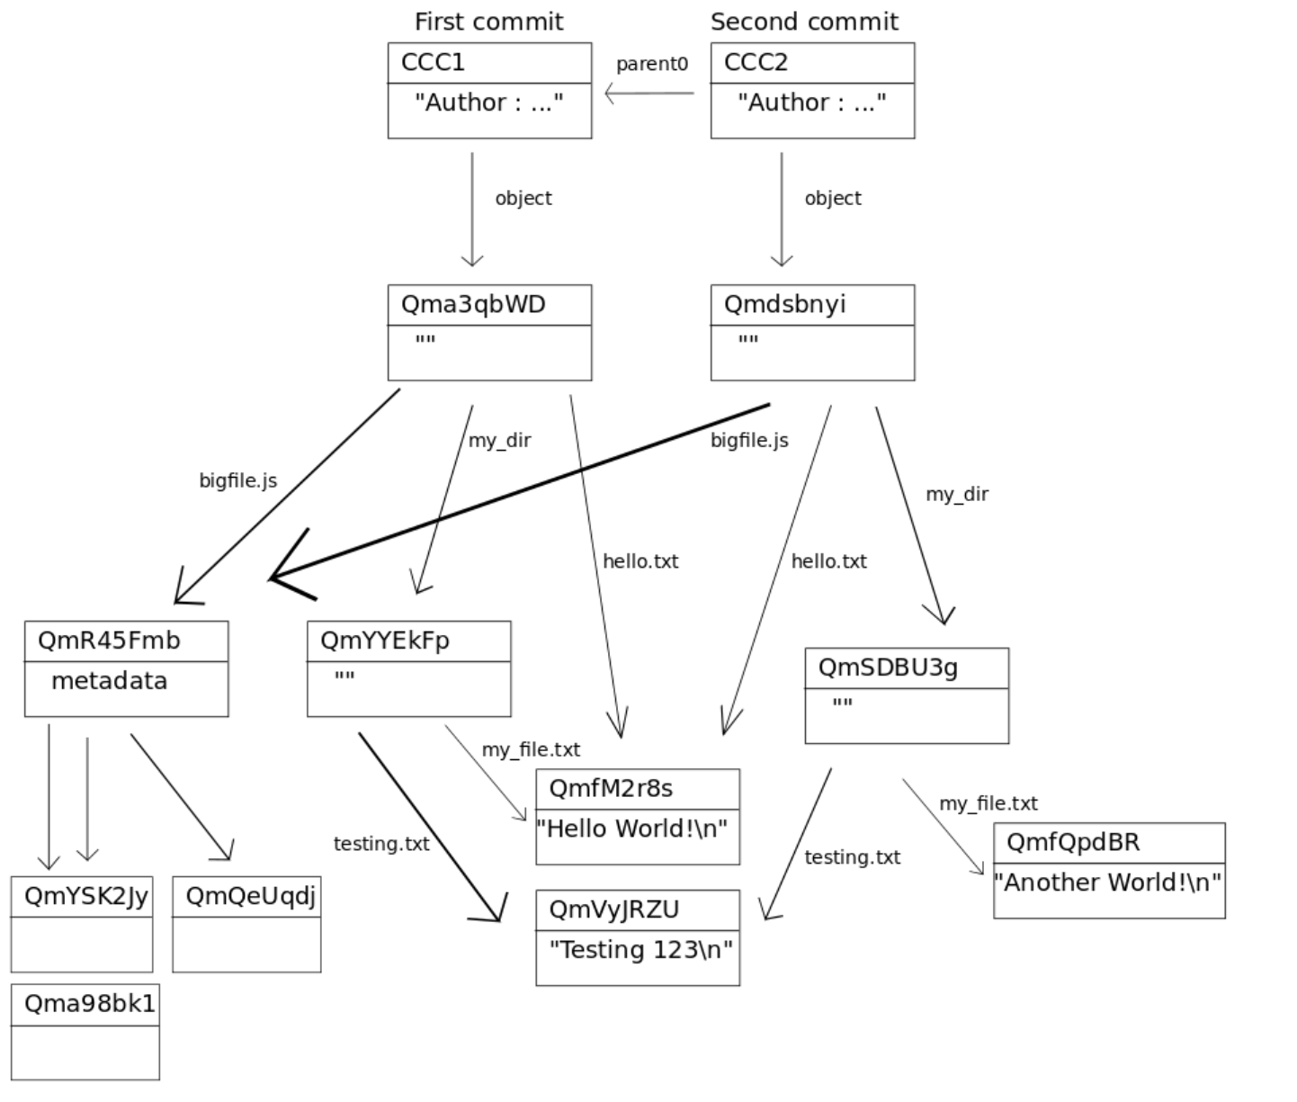
Web3
Web3 is to a large degree a reaction against centralization
Eg. IPFS, IPLD, dat://
http://whatdoesthequantsay.com/2015/09/13/ipfs-introduction-by-example

Slide 20
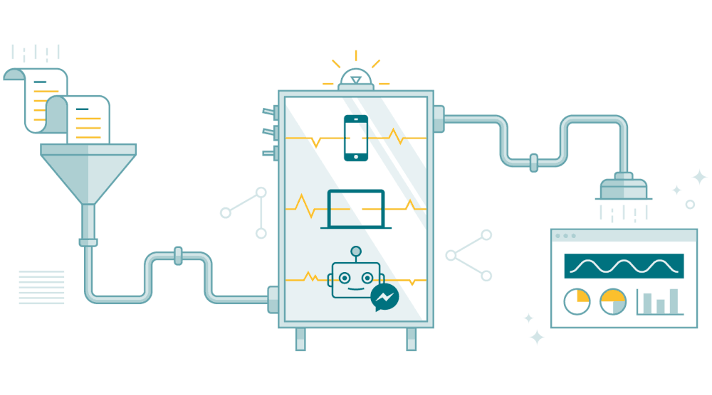
Linked AI Services
AI will be useful for creating resources, and will be accessible as a service we plug into
https://hackernoon.com/understanding-artificial-intelligence-as-a-service-aiaas-780f2e3f663c

Slide 21

AI-Generated Music
MuseNet, " a deep neural network that can generate 4-minute musical compositions with 10 different instruments, and can combine styles from country to Mozart to the Beatles.“
Relentless Doppelganger, the Bot Prownies, who produce an almost-acceptable brand of punk. If you prefer guitar metal, Coditany of Timeness might be more to your taste. Not quite as successful is Evolution 22 by Deep the Beatles. For something a little softer (and quite good) try On the Edge, by AIVA. AIVA also does a nice classical tune or movie score. Need royalty-free music for your videos? Try JukeDeck (a little too house for my tastes). Taryn Southern, meanwhile, uses an AI to compose the music, then adds her own lyrics and vocals - her song Break Free is quite nice.
Notes:
MuseNet
Christine Payne, OpenAI, 2019/04/26
Icon
https://openai.com/blog/musenet/

Slide 22
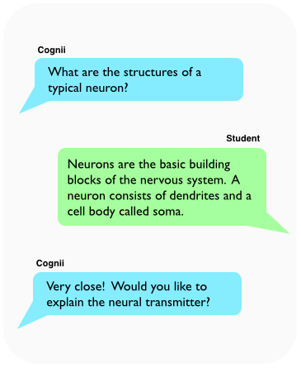
Cognii – SquirrelAI – Magpie – X5GON
Cognii Virtual Learning Assistant engages a student in a chatbot-style learning conversation by prompting them to construct an answer, giving them instant formative assessment - http://cognii.com/
Squirrel AI - pure-play AI-powered adaptive education provider in China… provides personalized and high-quality K-12 after-school tutoring - http://squirrelai.com/
magpie recommends high-quality content and integrates with your learning systems - starts with a configurable chatbot conversation - prioritises most relevant content for each user. https://learn.filtered.com/magpie
X5GON.org – fully automated creation of OER courses - https://www.x5gon.org/follow/oer/

Slide 23
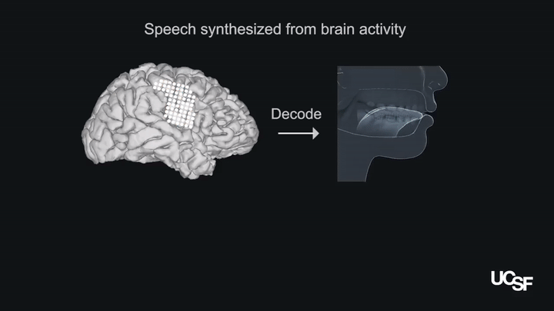
Brain Implant Can Say What You’re Thinking
"it translates brain signals into movements of the vocal tract, including the jaw, larynx, lips, and tongue." These movements are then translated into speech.
https://spectrum.ieee.org/the-human-os/biomedical/devices/implant-translates-brain-activity-into-spoken-sentences
Notes:
Published: 24 April 2019
Speech synthesis from neural decoding of spoken sentences
Gopala K. Anumanchipalli,
Josh Chartier &
Edward F. Chang
Naturevolume 568, pages493–498 (2019)
https://www.nature.com/articles/s41586-019-1119-1
24 Apr 2019 | 17:45 GMT
Brain Implant Can Say What You’re Thinking
A brain-computer interface that records signals in the motor cortex can synthesize speech from activity in a user’s brain
By Megan Scudellari
IEEE Spectrum
https://spectrum.ieee.org/the-human-os/biomedical/devices/implant-translates-brain-activity-into-spoken-sentences

Slide 24

GRAPH – COMMUNITY – AGENCY
https://giphy.com/gifs/weekend-days-129NVCr1UfsGTS

Slide 25
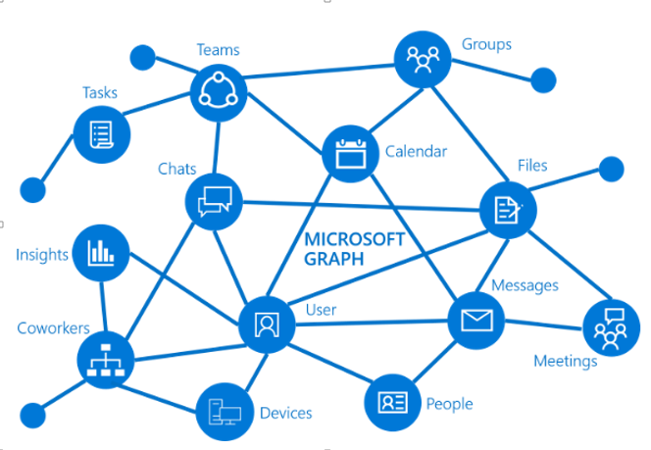
Graph as the conceptual basis for web3 networks
Graph connects all the resources across these services using relationships.
Graph Data Connect provides a way to interact with the data that's available through the Graph APIs.
https://docs.microsoft.com/en-us/graph/overview
Notes:
https://developer.microsoft.com/en-us/graph/docs/concepts/overview

Slide 26
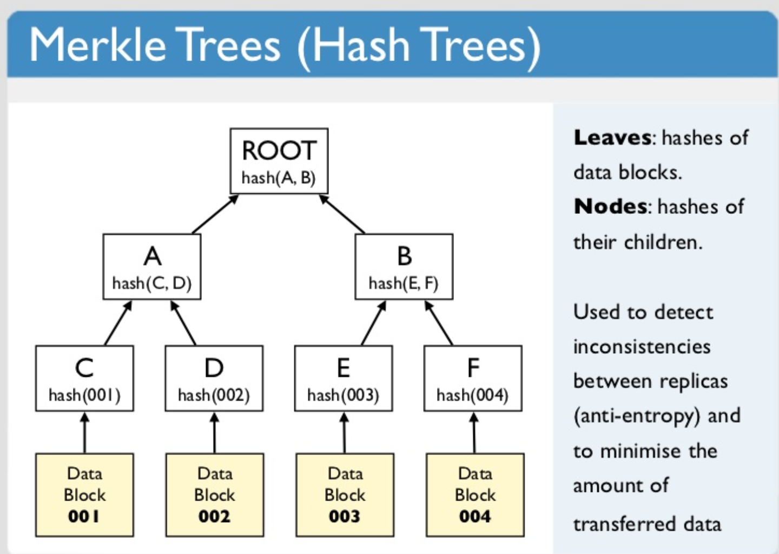
From semantics to cryptography
The transition: the Merkle graph
https://www.slideshare.net/quipo/nosql-databases-why-what-and-when/91-Merkle_Trees_Hash_Trees_Leaves

Slide 27
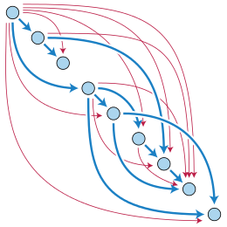
Directed Acyclic Graph (DAG)
Used to create collections of related data elements
https://en.wikipedia.org/wiki/Directed_acyclic_graph

Slide 28
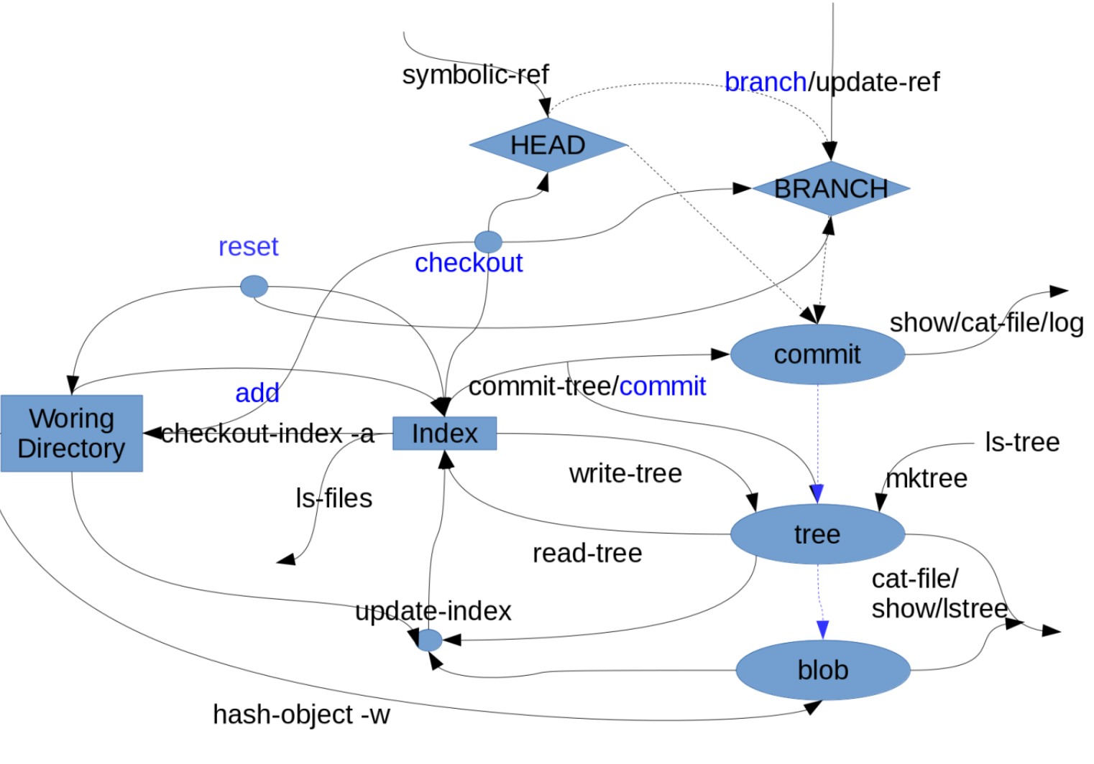
GitHub
Version control in a DAG
https://lukeluo.blogspot.com/2014/06/git-as-i-understand-4-working.html

Slide 29
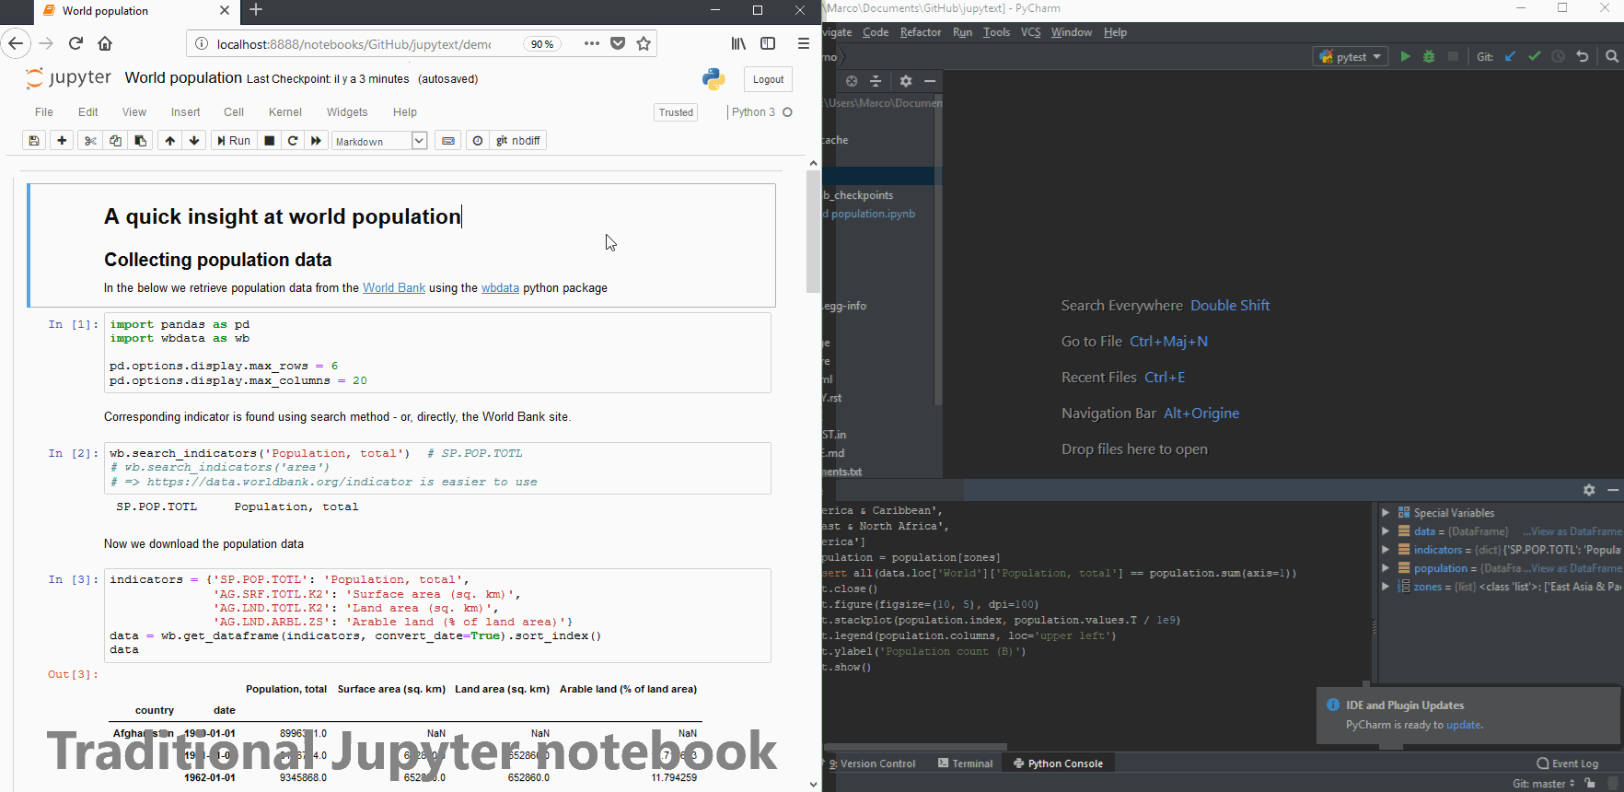
Jupytext – Notebook plus version control
Jupytext saves two (synced) versions of your notebook. A .ipynb file and a .py file. (Other formats are possible as well.) Y
https://github.com/mwouts/jupytext

Slide 30
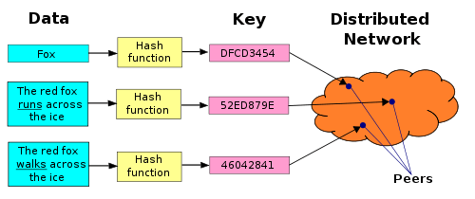
Content Addressable Networking
Locating data and resources by content has rather than location
https://ipfs.io/ipfs/QmXoypizjW3WknFiJnKLwHCnL72vedxjQkDDP1mXWo6uco/wiki/Distributed_hash_table.html
Distributed Hash Table

Slide 31
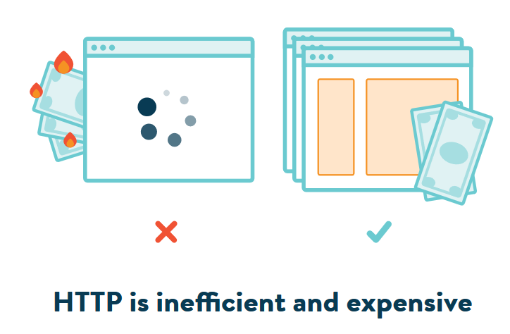
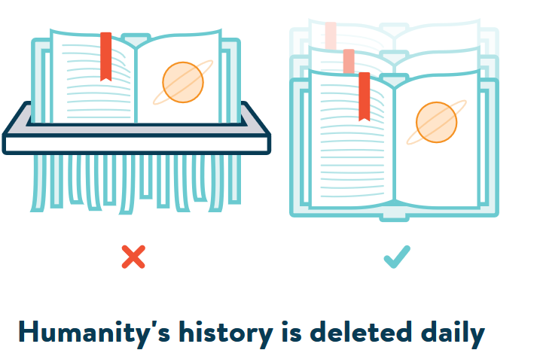
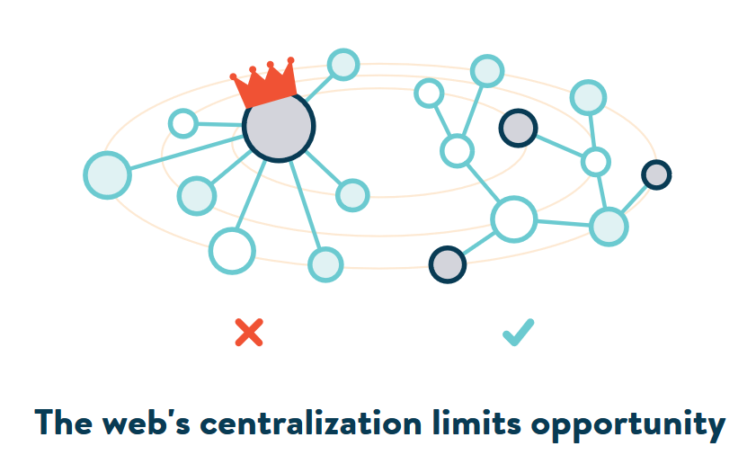
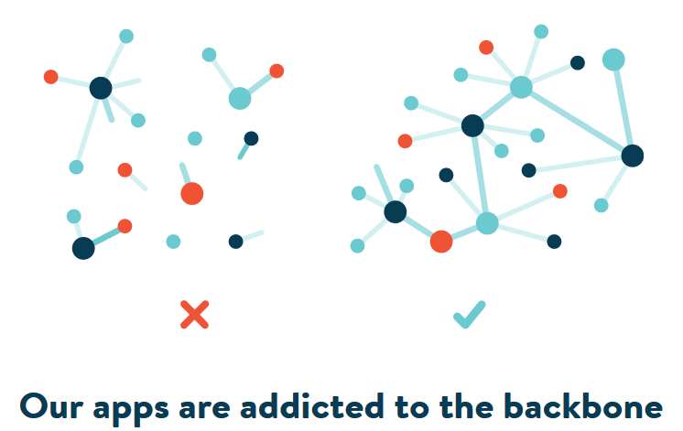
Resources
Content Addressable Resources for
Education
The new OER
https://ipfs.io/

Slide 32
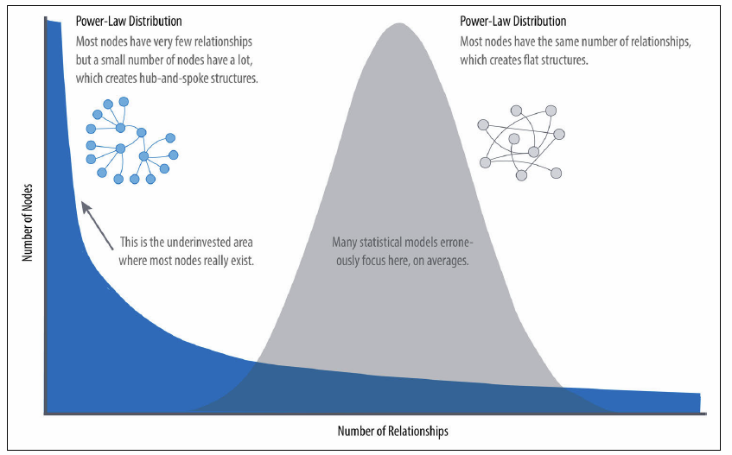
Graph Algorithms
Real-world networks have uneven distributions of nodes and relationships represented in the extreme by a power-law distribution. An average distribution assumes most nodes have the same number of relationships and results in a random network.
Notes:
Graph Algorithms: Practical Examples in Apache Spark and Neo4j
Mark Needham, Amy E. Hodler, O'Reilly, 2019/04/23
https://neo4j.com/graph-algorithms-book/

Slide 33
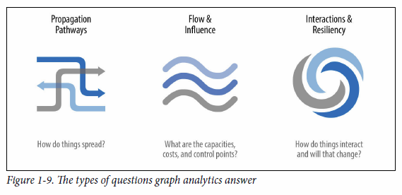
The types of questions graph analytics answer
Investigate the route of a disease or a cascading transport failure.
Uncover the most vulnerable, or damaging, components in a network attack.
Identify the least costly or fastest way to route information or resources.
https://neo4j.com/graph-algorithms-book/
Notes:
Graph Algorithms: Practical Examples in Apache Spark and Neo4j
Mark Needham, Amy E. Hodler, O'Reilly, 2019/04/23
https://neo4j.com/graph-algorithms-book/
• Investigate the route of a disease or a cascading transport failure.
• Uncover the most vulnerable, or damaging, components in a network attack.
• Identify the least costly or fastest way to route information or resources.
• Predict missing links in your data.
• Locate direct and indirect influence in a complex system.
• Discover unseen hierarchies and dependencies.
• Forecast whether groups will merge or break apart.
• Find bottlenecks or who has the power to deny/provide more resources.
• Reveal communities based on behavior for personalized recommendations.
• Reduce false positives in fraud and anomaly detection.
• Extract more predictive features for machine learning.

Slide 34
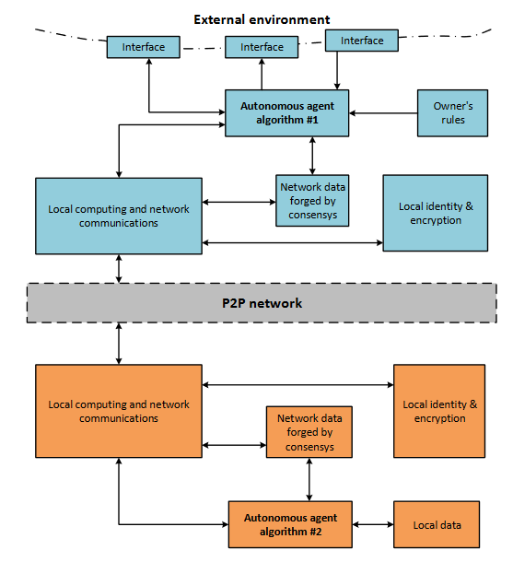
Autonomous Agents Communication Scheme
autonomous agents communication scheme. The arrows indicate transfer of any data. The dashed line shows the P2P network between agents.
The dotted line shows external environment of the agent.
(2) (PDF) Blockchain-based protocol of autonomous business activity for multi-agent systems consisting of UAVs. Available from: https://www.researchgate.net/publication/325451400_Blockchain-based_protocol_of_autonomous_business_activity_for_multi-agent_systems_consisting_of_UAVs [accessed Apr 28 2019].
Notes:
(PDF) Blockchain-based protocol of autonomous business activity for multi-agent systems consisting of UAVs. Available from: https://www.researchgate.net/publication/325451400_Blockchain-based_protocol_of_autonomous_business_activity_for_multi-agent_systems_consisting_of_UAVs [accessed Apr 28 2019].

Slide 35
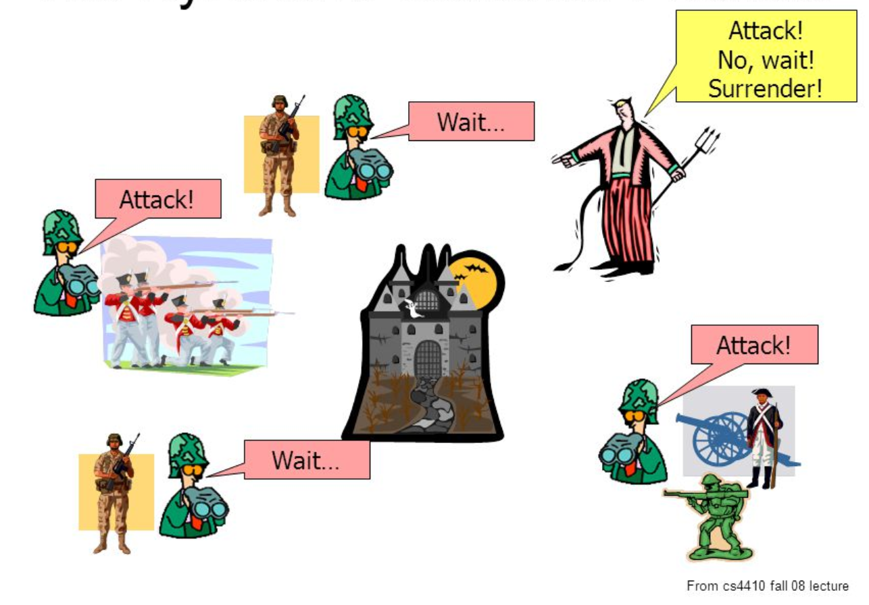
Community
The Byzantine Generals Problem
How to find the ‘source of truth’ in a world filled with bad actors and unknown quantities
https://slideplayer.com/slide/5163640/

Slide 36
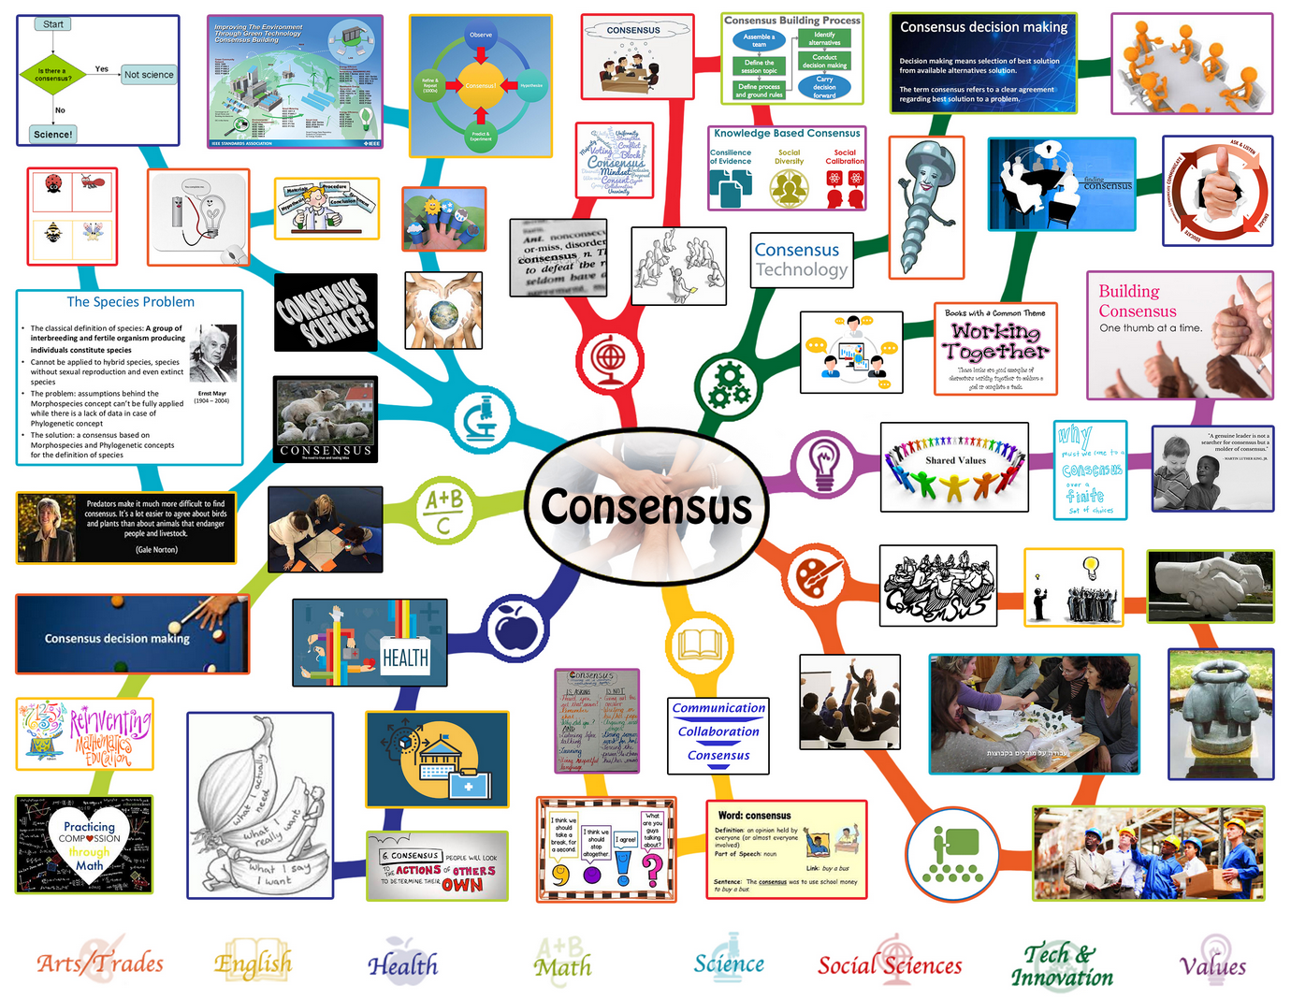
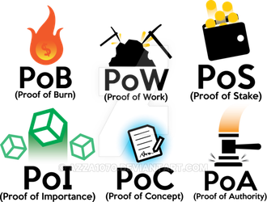
Consensus
https://www.deviantart.com/azza1070/art/Blockchain-Protocols-PoB-PoW-PoS-PoI-PoC-PoA-734159319
Notes:
https://www.onecommunityglobal.org/consensus-and-decision-making-lesson-plan/

Slide 37
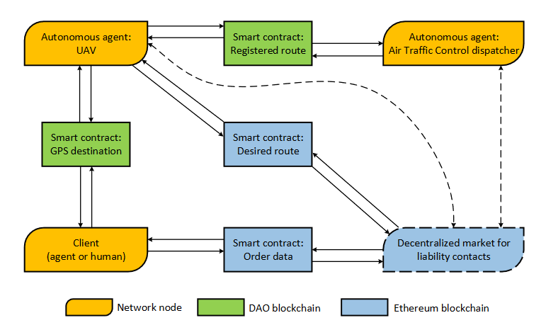
Blockchain-based protocol for autonomous business activity
Typical work scenario of Drone Employee. Dashed arrows indicate waiting of contract appearance. A set of all contracts in the network are integrated into decentralized market block.
(2) (PDF) Blockchain-based protocol of autonomous business activity for multi-agent systems consisting of UAVs. Available from: https://www.researchgate.net/publication/325451400_Blockchain-based_protocol_of_autonomous_business_activity_for_multi-agent_systems_consisting_of_UAVs [accessed Apr 28 2019].
Forget about artificial intelligence, extended intelligence is the future…
Instead of thinking about machine intelligence in terms of humans vs machines, we should consider the system that integrates humans and machines – not artificial intelligence but extended intelligence.
Notes:
(PDF) Blockchain-based protocol of autonomous business activity for multi-agent systems consisting of UAVs. Available from: https://www.researchgate.net/publication/325451400_Blockchain-based_protocol_of_autonomous_business_activity_for_multi-agent_systems_consisting_of_UAVs [accessed Apr 28 2019].

Slide 38

PERSONAL LEARNING: REPRISE
https://giphy.com/gifs/cat-kitty-meow-UZz8BikCqfYzK

Slide 39
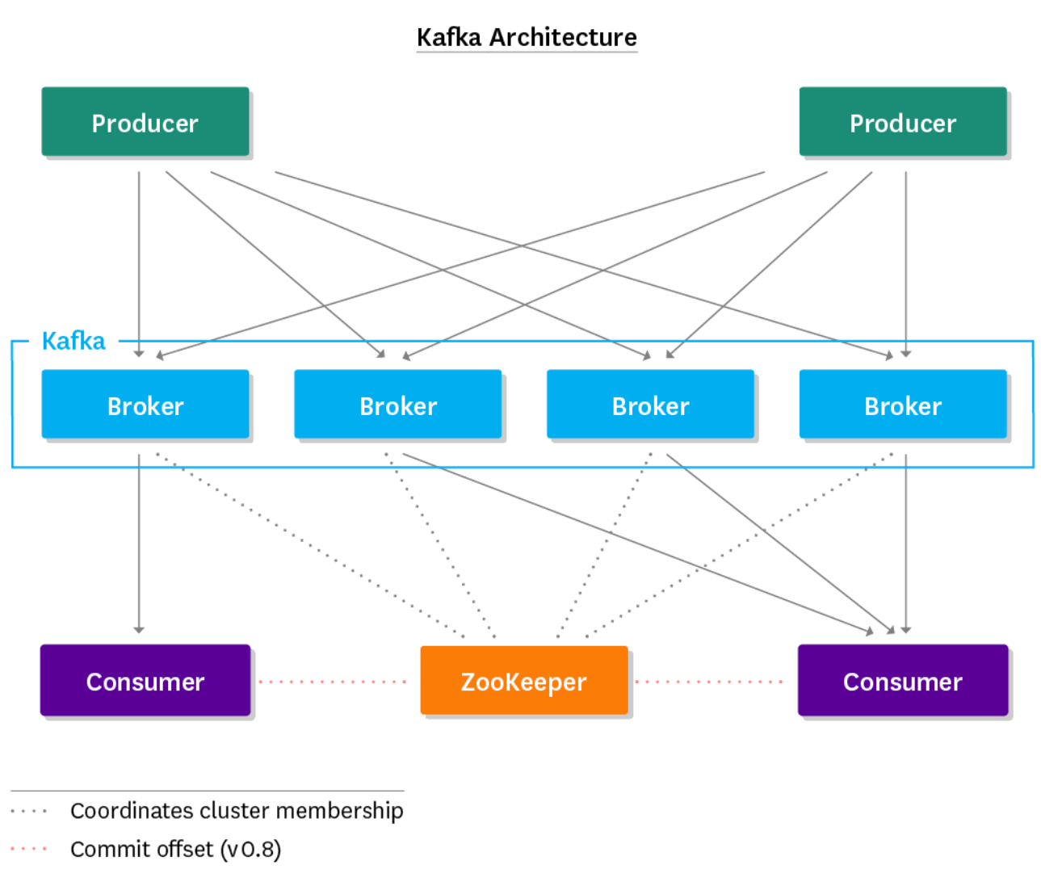
Identity
We are the thread that runs through an otherwise disconnected set of data
https://www.datadoghq.com/blog/monitoring-kafka-performance-metrics/

Slide 40

Extended intelligence is the future
Joi Ito: design of systems as and by participants – that is more akin to the increase of a flourishing function, where flourishing is a measure of vigour and health rather than scale, money or power.
Notes:
Forget about artificial intelligence, extended intelligence is the future
Joi Ito, Wired, 2019/04/29
https://www.wired.co.uk/article/artificial-intelligence-extended-intelligence?utm_source=pocket&utm_medium=email&utm_campaign=pockethits

Slide 41

Rememeber…
Remember….
It’s all just cat pictures
https://giphy.com/gifs/air-zzz-biscuits-9ociuoxbsNeE0

