Slide 1
Trends in e-Learning and Virtual Education
By Stephen Downes
National Research Council Canada
for the
7 Internacional e-Learning Seminar
January 28, 2019

Slide 2

AI in Education
Assisted intelligence – improves manual tasks, requires constant human intervention – eg. Auto-grading
Augmented intelligence – helps people perform tasks faster and better through access to services and resources – eg. Natural language processing, image recognition
Autonomous intelligence – establishes machines that perform in the place of humans – eg. Auto-tutor
Marek Hyla - Ai in Learning Thought Paper - https://www.slideshare.net/MarekHyla/ai-in-learning-thought-paper
https://www.downes.ca/search/%20ai%20

Slide 3
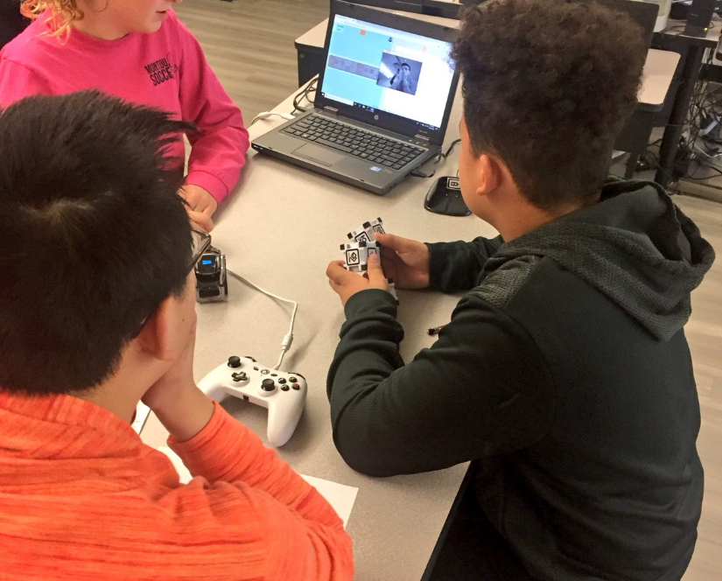
AI in Education – Montour School District
AI Ethics course ... The three-day course is a required for all 5th through 8th graders students through Media Arts.
Bill Black… teaching a six-week AI Autonomous Robotics to 7th and 8th-grade students
7th and 8th-grade students are creating their own music through Montour’s AI ten-day music program in collaboration with Amper Music
Carnegie Learning - Montour School District: An Artificial Intelligence Program in Action - https://www.carnegielearning.com/blog/montour-school-district-ai-program/
Justin Aglio - An Inside Look – America’s First Public School AI Program - https://www.gettingsmart.com/2019/01/an-inside-look-americas-first-public-school-ai-program/
Amper Music - https://www.ampermusic.com/

Slide 4
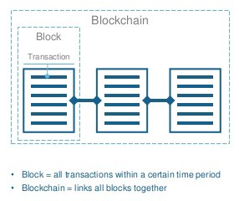
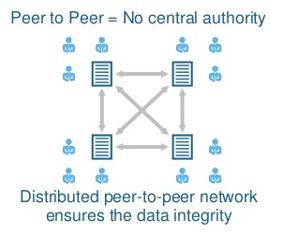
Blockchain
Linked data through hash technology
Distributed database through linked nodes
Consensus through:
Proof of work
Proof of authority
Proof of stake
Nolan Bauerle - What is Blockchain Technology? https://www.coindesk.com/information/what-is-blockchain-technology
Tech Geek - What is Blockchain. Guide for Beginners - https://medium.com/@techgeek628/what-is-blockchain-guide-for-beginners-ed093fdbb8c5

Slide 5

Blockchain in Education
Verify credentials, skills and experience
Payment and education financing
IP and knowledge
Peer-to-Peer Ecosystems
Education resource marketplace
David McArthur - Education Blockchain Market Map - Will Blockchains Revolutionize Education? https://er.educause.edu/articles/2018/5/will-blockchains-revolutionize-education
Rachael Hartley - What is the role of blockchain in education?– https://edtechnology.co.uk/Blog/what-is-the-role-of-blockchain-in-education/ https://www.downes.ca/search/blockchain

Slide 6
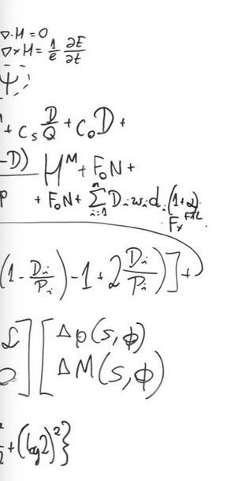
Spitball, Rocketshoes, Learning Machine
Spitball… “students learn and earn while helping each other.”
Rocketshoes… “allow students to produce and keep track of their learning materials, such as assignments, notes and digital assets
Learning Machine… “provides a complete system to issue official records using a blockchain format”
Spitball - https://www.spitball.co/
Rocketshoes - https://rocketshoes.io/
Learning Machine - https://www.learningmachine.com/

Slide 7
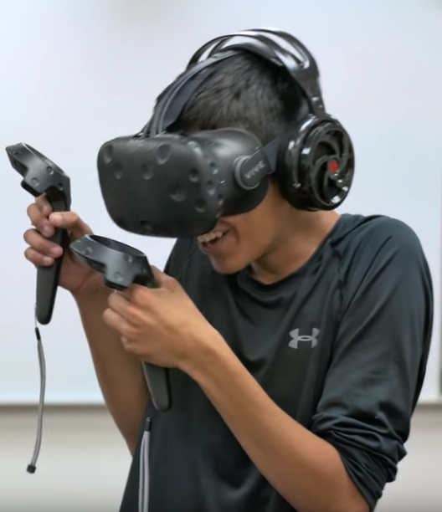
Virtual and Augmented Reality
Immersive storytelling and journalism
Immersive simulations
VR, AR being merged with AI to create open-ended experiences
Emory Craig and Maya Georgieva - VR and AR: The Art of Immersive Storytelling and Journalism - https://er.educause.edu/blogs/2018/2/vr-and-ar-the-art-of-immersive-storytelling-and-journalism
OISE - Virtual Reality in the Classroom - https://guides.library.utoronto.ca/c.php?g=607624&p=4494048
Rob Marvin - How Unity Is Building its Future on AR, VR, and AI - https://www.pcmag.com/feature/362057/how-unity-is-building-its-future-on-ar-vr-and-ai/1

Slide 8

Brandon’s WW1 internment camp
“Players’ choices will affect their experiences in the camp and give them a chance to interact with a variety of people involved with or interned in the facility.”
Brandon University - Grant will help faculty and students develop interactive virtual reality look at Brandon’s WW1 internment camp - https://www.brandonu.ca/news/2018/08/21/grant-will-help-faculty-and-students-develop-interactive-virtual-reality-look-at-brandons-ww1-internment-camp/
Internment Canada - https://www.internmentcanada.ca/

Slide 9
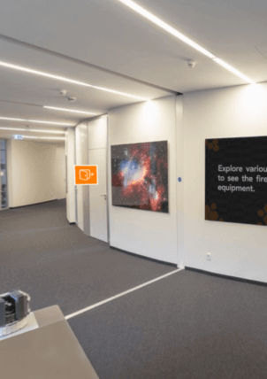
VR in eLearning: A Case Study On Safety Training
“Would give the employees a realistic feel for the situation such as a fire emergency. ”
“Employees can decide to fight the fire, but they must first find the fire extinguishers, water sprinklers, and fire alarms in their workplace…”
Tesseract Learning - Virtual Reality In eLearning: A Case Study On Safety Training - https://tesseractlearning.com/blog/a-case-study-on-gamification-in-corporate-elearning.html

Slide 10
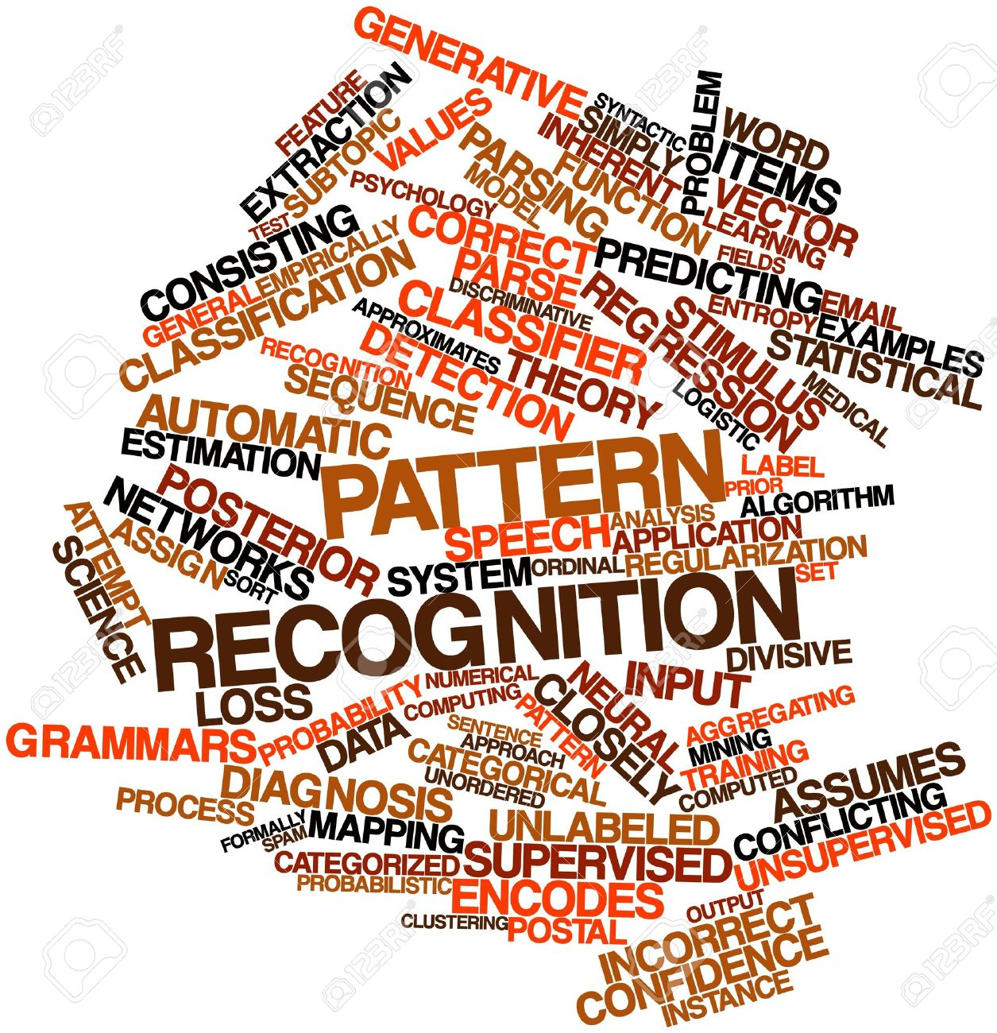
New Critical Literacies
Working with Data
Mastering cloud technologies
Network competencies
Micro – as a node
Macro – pattern recognition
E-Learning 3.0 - https://el30.mooc.ca/course_outline.htm

Slide 11
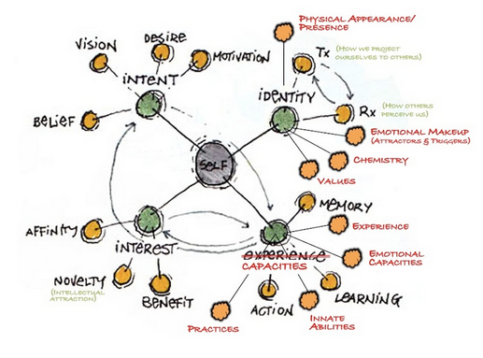
Community Network Development
Identity management
Rich data-informed learning resources
Consensus-building and community formation
Dave Pollard - A Model of Identity and Community - https://www.resilience.org/stories/2013-08-21/a-model-of-identity-and-community/
https://el30.mooc.ca/course_outline.htm

Slide 12

Growth and Development
Recognition – identifying, expanding and marketing one’s skills and competencies
Experience – active engagement, interacting with the world and others
Agency – initiative, motivation, self-management
Dave Pollard - A Model of Identity and Community - https://www.resilience.org/stories/2013-08-21/a-model-of-identity-and-community/
https://el30.mooc.ca/course_outline.htm

