Slide 1

Distributed Ledger Technologies like Blockchain…looking under the hood
Stephen Downes
Digital Technologies Research Centre
November 23, 2018

Slide 2

Why Blockchain?
Immutability and Finality
Equity?
Trust
Consensus
Provenance
Distributed Ledger Technologies like Blockchain… Looking Under the Hood

Slide 3

1. Core Concepts
Distributed Ledger Technologies like Blockchain… Looking Under the Hood

Slide 4
1.1 Assets, Ledgers
Ledger contents include:
  Transactions: P gives x to Q
  States: P has n instances of x
  Conditions:
    Contract: if <transaction> then <transaction>
    Inferences: if <state> then <state>
Distributed Ledger Technologies like Blockchain… Looking Under the Hood

Slide 5
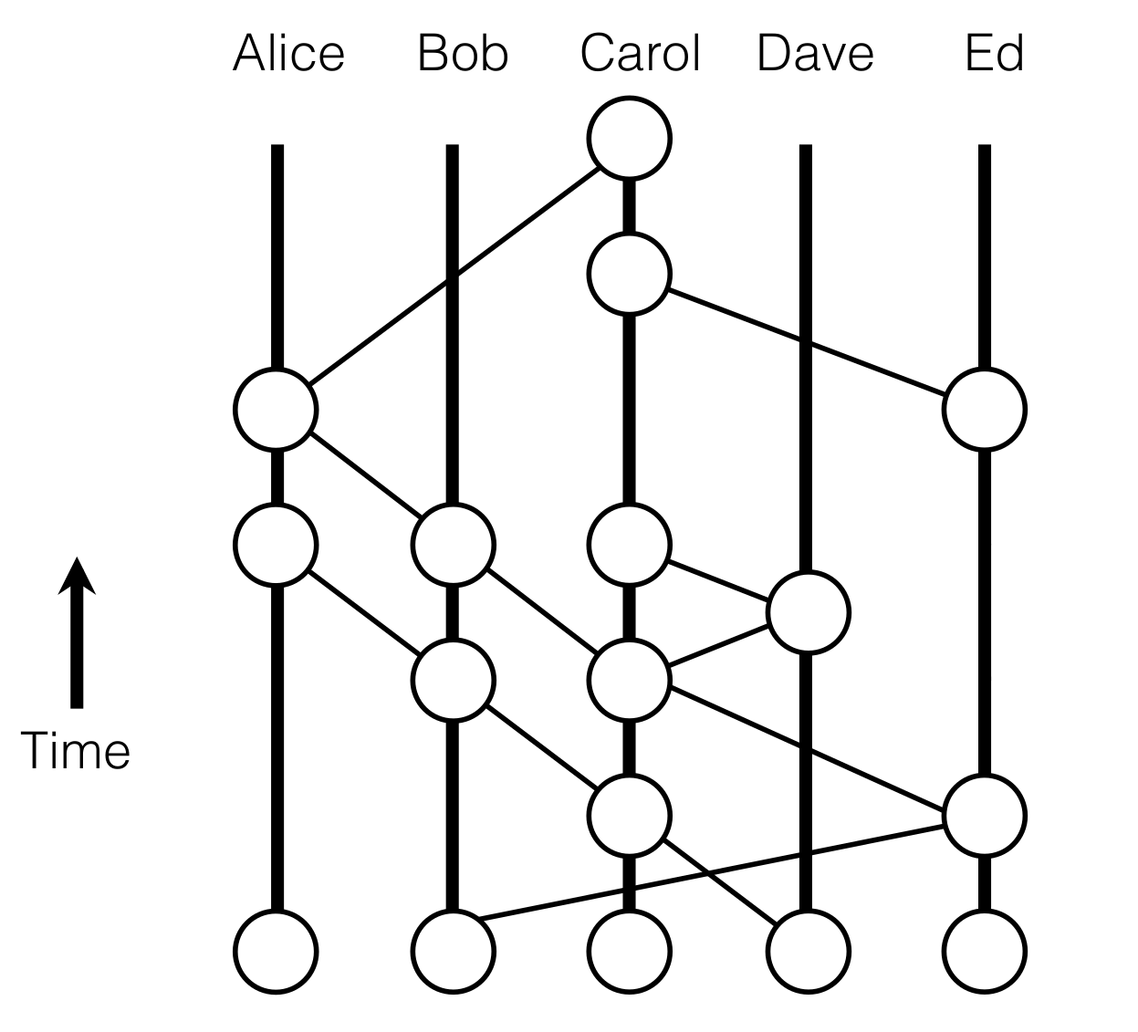
1.2 Distributed Ledgers
“A distributed ledger technology (DLT) is a system where we share information and we don’t trust each other individually, but we trust the group as a whole. DLTs allow us to come up with a consensus on the order of transactions and timestamps.”
https://hackernoon.com/an-overview-of-hashgraph-b0900a1fd7bf
Distributed Ledger Technologies like Blockchain… Looking Under the Hood

Slide 6
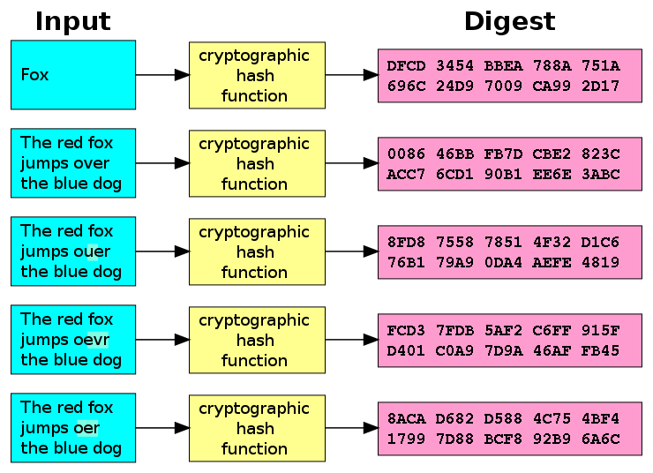
1.3 Cryptographic Hash Functions
“a mathematical algorithm that maps data of arbitrary size to a bit string of a fixed size (a hash) and is designed to be a one-way function..”
- Algorithms:
  MD5, SHA1 (unsuitable)
  SHA2 (SHA-256 and SHA-512)
  SHA3, BLAKE2
- Signatures
https://en.wikipedia.org/wiki/Cryptographic_hash_function
Distributed Ledger Technologies like Blockchain… Looking Under the Hood

Slide 7
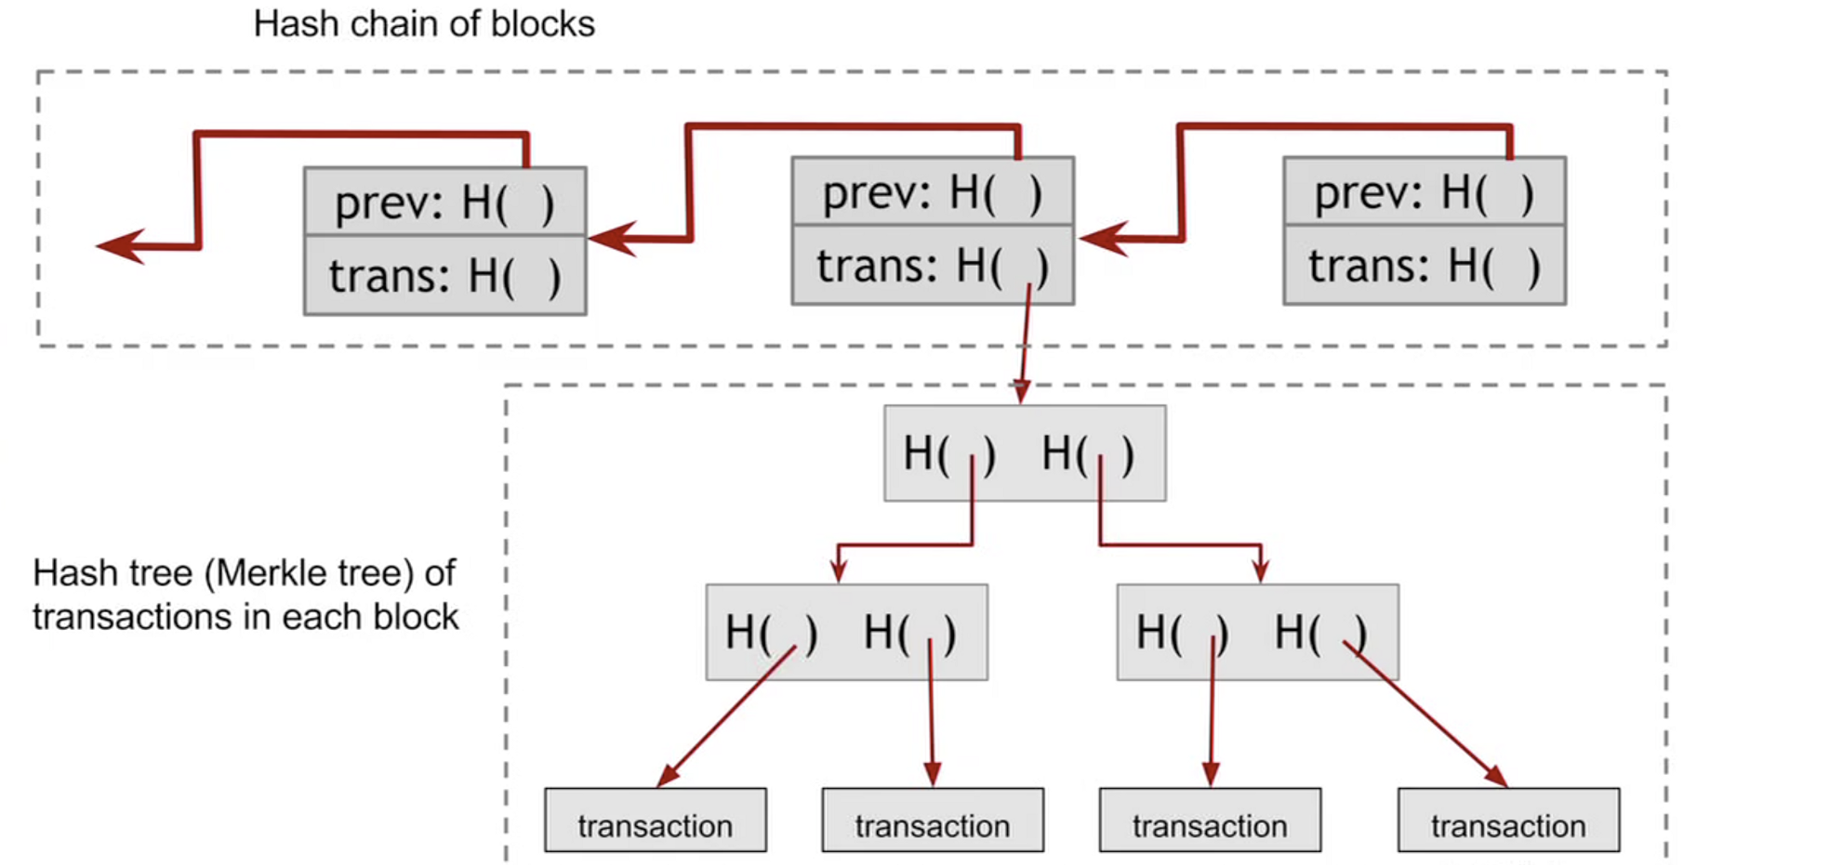
1.4 Construction of a Blockchain
https://hackernoon.com/how-does-blockchain-technology-work-ceeeee47eaba
Distributed Ledger Technologies like Blockchain… Looking Under the Hood

Slide 8
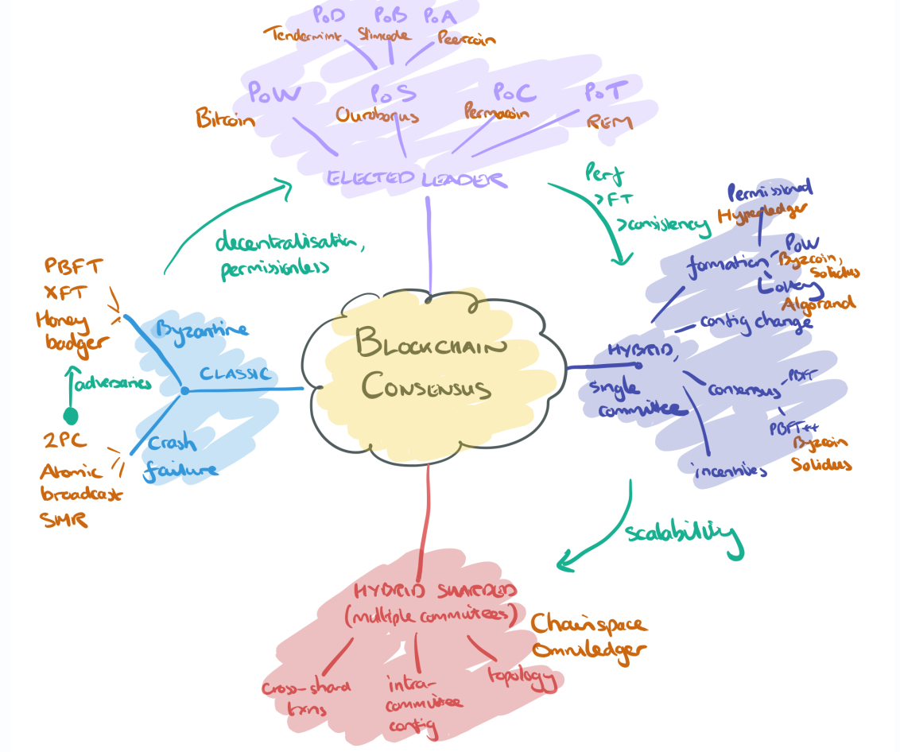
1.5 Consensus
“The best known and most widely deployed mechanism is of course proof-of-work (aka. Nakamoto consensus). Forks can occur, and are resolved by PoW consensus, which amounts to picking the chain with the most accumulated work.”
https://blog.acolyer.org/2018/02/12/sok-consensus-in-the-age-of-blockchains/
Distributed Ledger Technologies like Blockchain… Looking Under the Hood

Slide 9
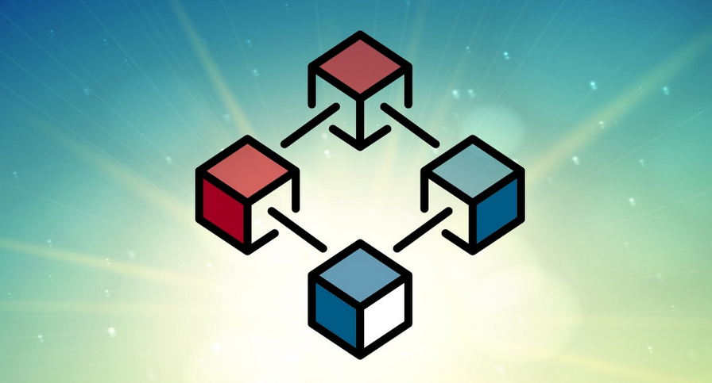
2. Examples of
Applications
Distributed Ledger Technologies like Blockchain… Looking Under the Hood

Slide 10

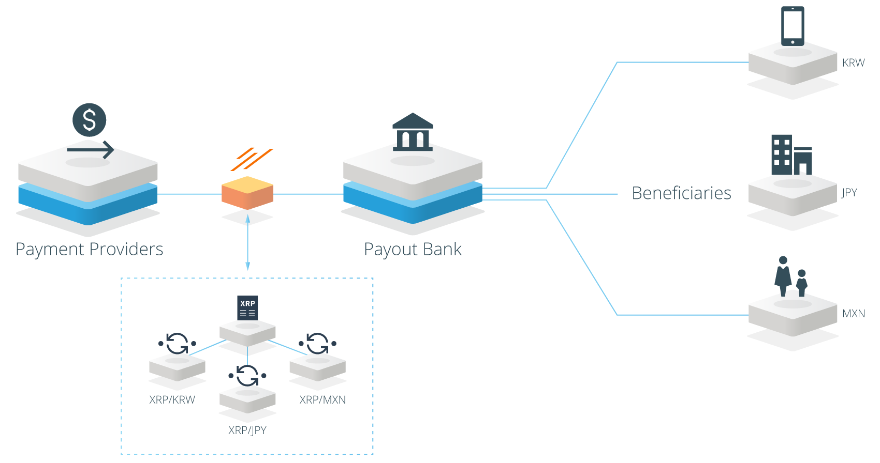
2.1 Currency and Financial
Payments
  Square - https://www.coindesk.com/square-gets-a-bitlicense-new-york-crypto/
Gift Cards
  eGifter, Gyft - https://www.gyft.com/bitcoin/ , https://www.egifter.com/
Financial services
  Banks - https://www.ethnews.com/gmo-internet-group-creates-a-bank
  Hedge Funds - https://www.bitwiseinvestments.com/fund
  Bonds and Liquidity - https://ripple.com/solutions/source-liquidity/
  Crowdfunding - https://www.idgconnect.com/blog-abstract/30700/blockchain-africa
Distributed Ledger Technologies like Blockchain… Looking Under the Hood

Slide 11
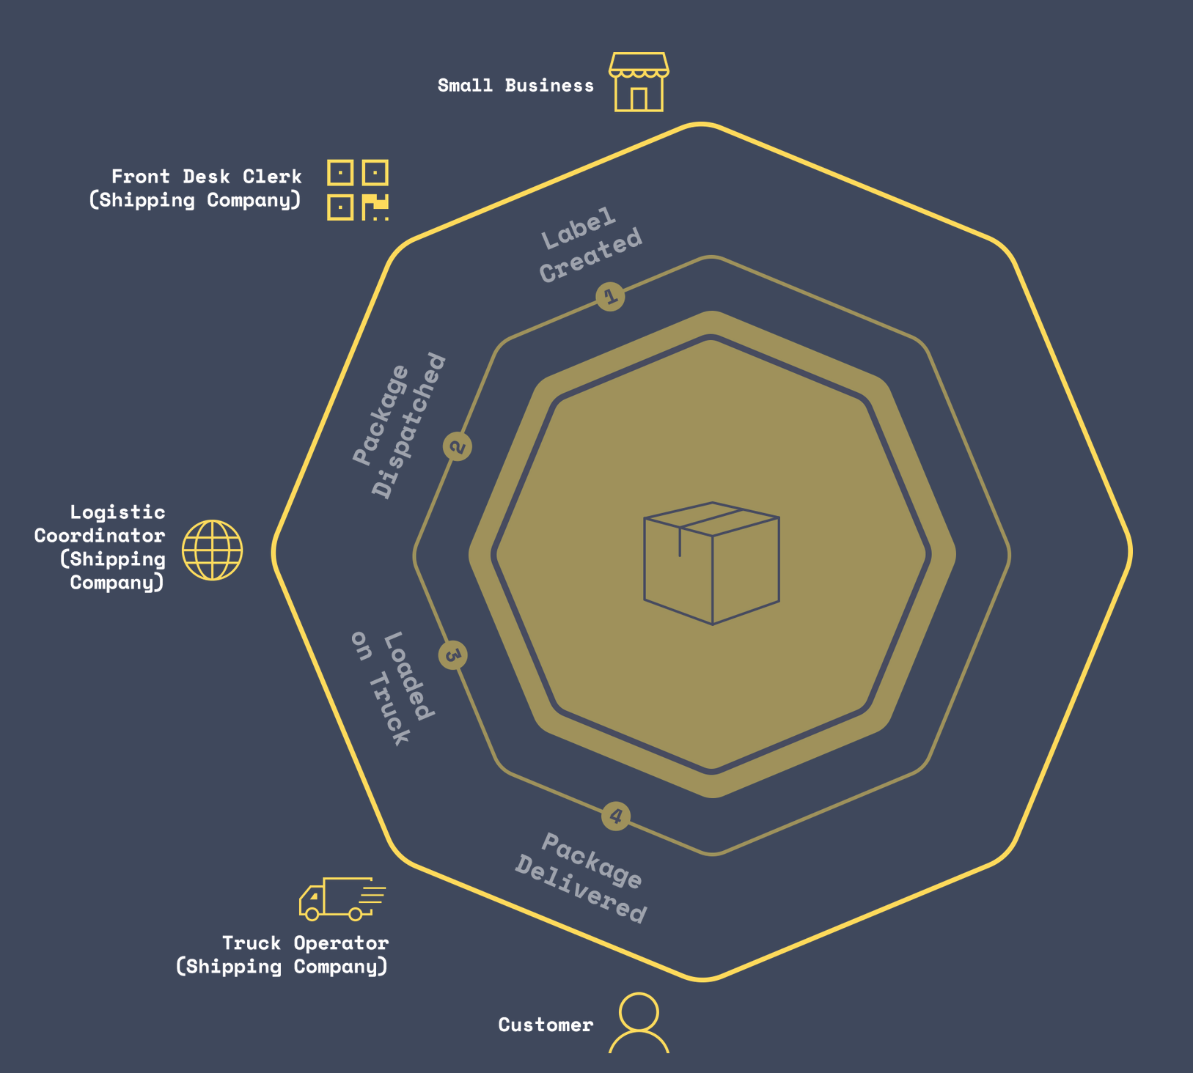
2.2 Business, Audit, Compliance
Law and contracts - https://agreements.network/
Markets - https://techcrunch.com/2017/04/11/bext360-is-using-robots-and-the-blockchain-to-pay-coffee-farmers-fairly/
Asset Management - https://www.coindesk.com/td-bank-considers-public-blockchain-for-asset-tracking/
Supply Chain - https://peerledger.com/mimosi/ gives companies a trusted, immutable record of all track-and-trace transactions across supply chains, https://viant.io/ Supply chain mgmt. built on Ethereum
Shipping - 94 organizations have joined blockchain trade platform https://www.reuters.com/article/us-shipping-blockchain-maersk-ibm/maersk-ibm-say-94-organizations-have-joined-blockchain-trade-platform-idUSKBN1KU1LM
https://viant.io/
Distributed Ledger Technologies like Blockchain… Looking Under the Hood

Slide 12
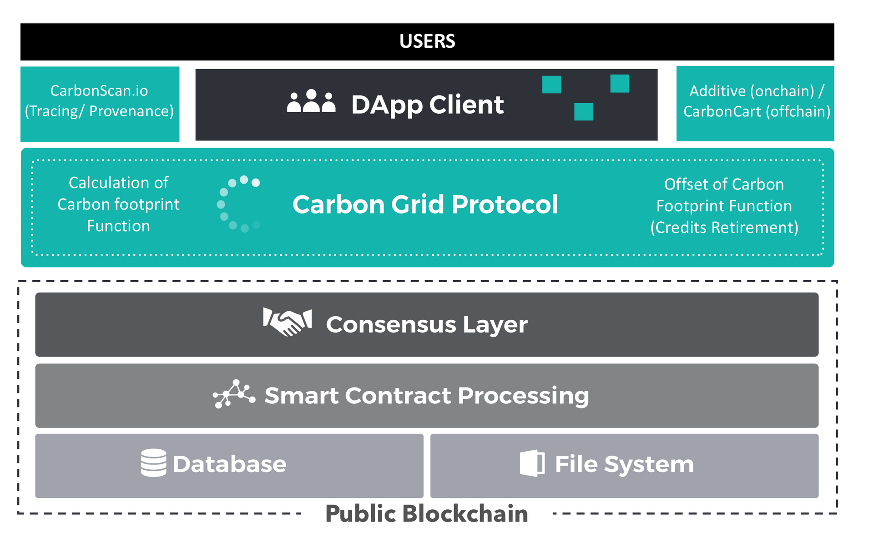
2.3 Resources and Industry
Agriculture - https://www.cio.com.au/article/644491/cba-helps-ship-17-tonnes-almonds-blockchain/
Forestry - blockchain to track the planting of trees worldwide and create rewards for planting trees - https://medium.com/@afhenderson/blockchain-for-social-good-4e6d0d4468d3
Mining - https://techcrunch.com/2018/04/26/ibm-introduces-trustchain-a-blockchain-to-verify-the-jewelry-supply-chain/
Energy – PowerLedger - https://www.powerledger.io/
https://carbongrid.io/
Distributed Ledger Technologies like Blockchain… Looking Under the Hood

Slide 13
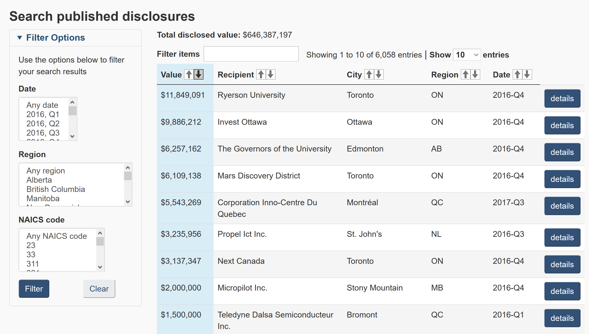
2.4 Government, Education, Health
Currency - https://www.technologyreview.com/s/608910/governments-are-testing-their-own-cryptocurrencies/
Registries - https://cointelegraph.com/news/netherlands-land-registry-to-test-blockchain-solution-for-real-estate
Shipping - Denmark will be “the first country in the world [to] use blockchain technology to register ships in the Danish ship registers.” - https://cointelegraph.com/news/denmark-joins-eu-blockchain-partnership-plans-to-implement-tech-in-shipping
Data – NRC-IRAP Blockchain Prototype - https://nrc-cnrc.explorecatena.com/en/
Medical Records - https://cointelegraph.com/news/alibaba-founded-insurtech-firm-promotes-blockchain-use-in-healthcare-industry
https://nrc-cnrc.explorecatena.com/en/
Distributed Ledger Technologies like Blockchain… Looking Under the Hood

Slide 14
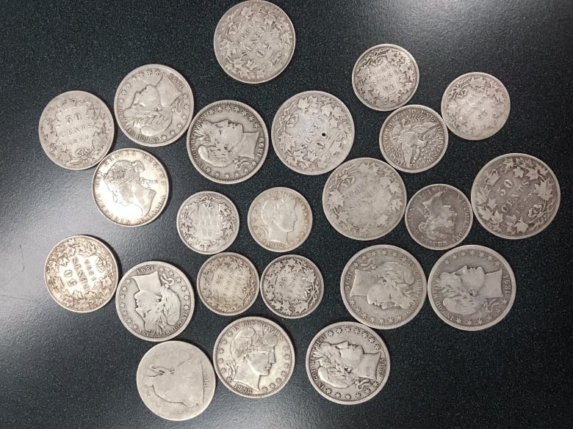
3. Coins
Distributed Ledger Technologies like Blockchain… Looking Under the Hood

Slide 15

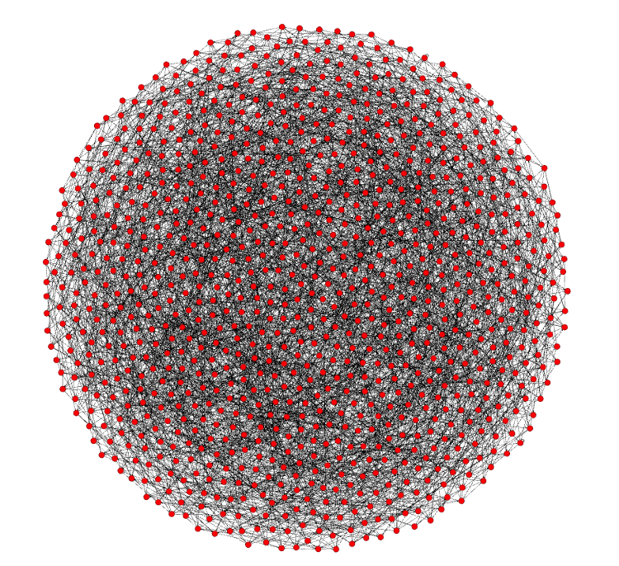
3.1 Bitcoin
Bitcoin: A Peer-to-Peer Electronic Cash System white paper by Satoshi Nakamoto - https://bitcoin.org/bitcoin.pdf
Currently 115,000 nodes
Each node connects to 8 other nodes
Bitcoin’s “state” is represented by its global collection of Unspent Transaction Outputs (UTXOs).
Lightning - https://lightning.network/
The Lightning Network is a "second layer" payment protocol that operates on top of a blockchain (most commonly Bitcoin) - https://en.wikipedia.org/wiki/Lightning_Network
Distributed Ledger Technologies like Blockchain… Looking Under the Hood

Slide 16
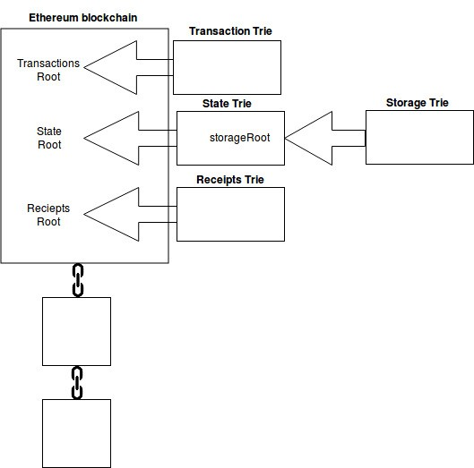
3.2 Ethereum (and dApps)
“Bitcoin is the Digital Gold but Ethereum is the Silicon” https://medium.com/@Michael_Spencer/bitcoins-glory-days-over-the-future-of-blockchain-5fe303f18537
Founder: Vitalik Buterin - https://github.com/ethereum/wiki/wiki/White-Paper
Solidity - “Solidity is a contract-oriented programming language for writing smart contracts.[1] It is used for implementing smart contracts[2] on various blockchain platforms.” https://en.wikipedia.org/wiki/Solidity
Decentralized Applications (dApps) - consist of everything ranging from prediction markets to gaming, and will continue to grow stronger as the network is improved upon. 1573 today (June 4, 2018) https://www.stateofthedapps.com/
Distributed Ledger Technologies like Blockchain… Looking Under the Hood

Slide 17
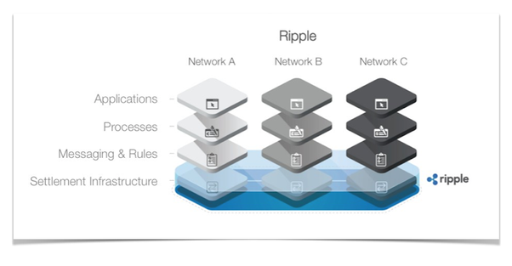
3.3 Ripple and Stellar
Ripple has a network of banks around the world on its platform. International payments can be processed by participating banks within three to five seconds, rather than two to five days, it says. https://www.therecord.com/news-story/8653190-uw-gets-research-funding-for-deep-dive-into-blockchain-technology/
it will replace SWIFT as a global provider of secure financial messaging services http://www.europarl.europa.eu/cmsdata/149900/CASE_FINAL%20publication.pdf
An upcoming product (xRapid) will use XRP as a way to ‘source liquidity’
Interledger is the protocol that sits under RippleNet.
It is being developed as a potential web standard under the the W3C - https://w3c.github.io/webpayments/proposals/interledger/
Stellar
Decentralized Ripple, collaboration with IBM
Distributed Ledger Technologies like Blockchain… Looking Under the Hood

Slide 18
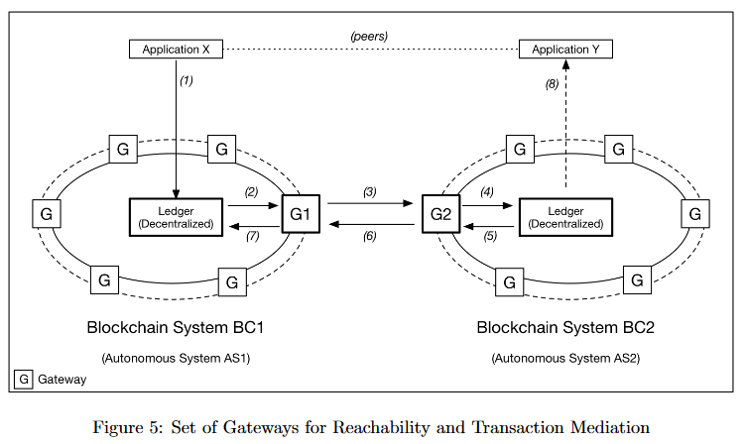
3.4 Wallets, Exchanges, Networks
Exchanges
  Centralized – Coinbase https://blog.coinbase.com/ , Binance - https://www.binance.com/
  Decentralized – Altcoin - https://altcoin.io/ , IDEX - https://idex.market/eth/aura
Networks
  Towards a Design Philosophy for Interoperable Blockchain Systems, Thomas Hardjono, Alexander Lipton, Alex Pentland https://arxiv.org/abs/1805.05934
Wallets
  “What you’re actually keeping in your wallet is the private key that is used to access (spend/transfer) your coins.”
https://cryptocurrencyhub.io/i-bought-my-first-bitcoin-now-what-fdf7dc9ad150
Distributed Ledger Technologies like Blockchain… Looking Under the Hood

Slide 19

4. Platforms and Services
Distributed Ledger Technologies like Blockchain… Looking Under the Hood

Slide 20
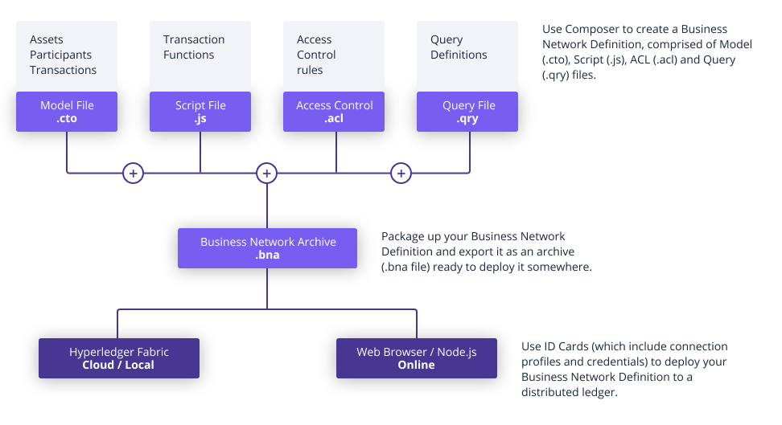
4.1 Hyperledger Fabric
Private business networks, IBM Bluemix hosting, or Docker containers
Emphasizes open governance, open standards & open source
Business Network Definitions
  a set of model files
  a set of JavaScript files
  an Access Control file
https://www.hyperledger.org/projects/fabric
Distributed Ledger Technologies like Blockchain… Looking Under the Hood

Slide 21
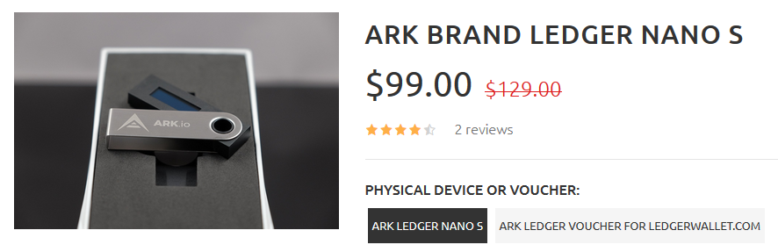
4.2 Ark
ARK is a secure platform designed for mass adoption and will deliver the services that consumers want and developers need.” https://ark.io/ - explorer: https://explorer.ark.io/
Ark! The wordpress of crypto! https://decentralize.today/some-great-projects-are-out-there-they-just-dont-talk-about-them-21d677e29ecf
ARK Desktop Wallet supports the Ledger Nano S secure hardware wallet.
Distributed Ledger Technologies like Blockchain… Looking Under the Hood

Slide 22
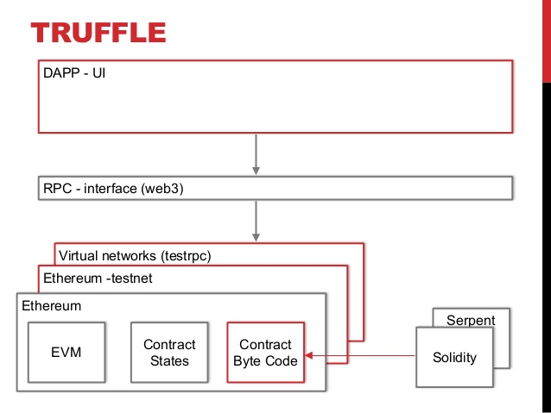
4.3 Truffle (NRC Example)
a development framework for Ethereum - http://truffleframework.com/
  Truffle takes care of managing your contract artifacts so you don't have to.
  Ganache - https://truffleframework.com/ganache - one-click blockchain
  Drizzle- A collection of front-end libraries that make writing dapp user interfaces easier and more predictable.
https://www.slideshare.net/MartinKppelmann/build-dapps-13-dev-tools
Distributed Ledger Technologies like Blockchain… Looking Under the Hood

Slide 23
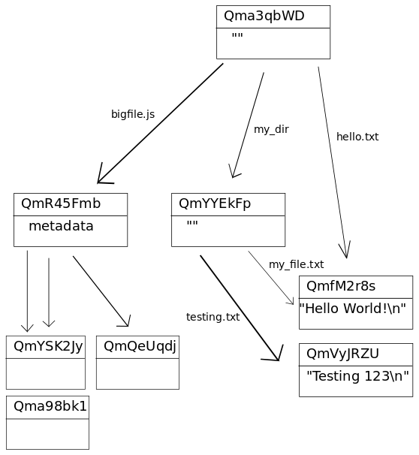
4.4 IPFS / IPLD
IPFS white paper: IPFS - Content Addressed, Versioned, P2P File System (DRAFT 3).
IPFS consists of a network of peer-to-peer nodes (aka computers that talk to each other directly)
These nodes can store content (any type of file)
Content is represented by a hash and is immutable (if the content changes, so does the hash) - In the case of IPFS, the key of the distributed hash table is a hash over the content.
IPLD - Inter Planetary Linked Data
IPLD website - https://ipld.io/
the IPLD specs and the IPLD implementations.
Hosting a website on IPFS - https://ipfs.io/ipfs/QmdPtC3T7Kcu9iJg6hYzLBWR5XCDcYMY7HV685E3kH3EcS/2015/09/15/hosting-a-website-on-ipfs/
https://whatdoesthequantsay.com/2015/09/13/ipfs-introduction-by-example
Distributed Ledger Technologies like Blockchain… Looking Under the Hood

Slide 24

5. Some Issues
Distributed Ledger Technologies like Blockchain… Looking Under the Hood

Slide 25

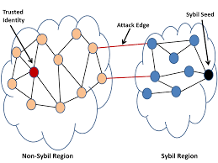
5.1 Conceptual Issues
Locus of Value - Fat Protocols vs Fat Dapps vs Fat Wallets
  https://medium.com/lightspeed-venture-partners/fat-protocols-vs-fat-dapps-vs-fat-wallets-4d33ead29130
Economic Incentives and the Nothing at Stake Problem
  https://medium.com/loom-network/understanding-blockchain-fundamentals-part-2-proof-of-work-proof-of-stake-b6ae907c7edb
Immutability (and GDPR)
https://pdfs.semanticscholar.org/30e4/1ec151d1499b580155be4dee168530d80145.pdf
Distributed Ledger Technologies like Blockchain… Looking Under the Hood

Slide 26
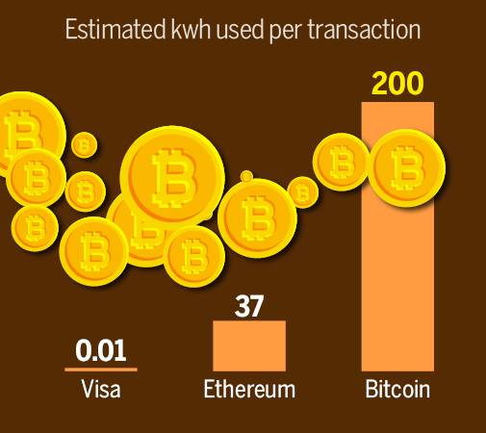
5.2 Cost and Energy Consumption
Software reliability
Energy Consumption
  Bitcoin uses an amount of energy that could power over 6,000,000 homes.
  It currently consumes the equivalent of 10% of Canada's total energy consumption.
  1 BC transaction costs more than 100,000 Visa transactions.
Scaling - Bitcoin 7 tx/s, Ethereum 50 tx/s Visa’s 24,000 tx/s. https://medium.com/thunderofficial/2018-blockchain-scaling-all-else-7937b660c08
Distributed Ledger Technologies like Blockchain… Looking Under the Hood
https://www.businesstoday.in/top-story/bitcoins-now-an-energy-guzzler/story/266310.html

Slide 27
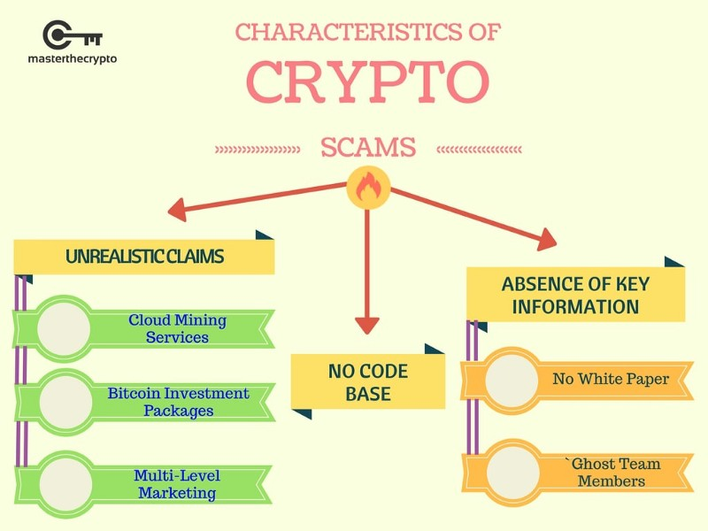
5.3 Social and Ethical Issues
Token distribution and inequality
Regulation and taxation
  https://medium.com/forbes/tax-trouble-for-certain-bitcoin-traders-41414e4d47a8
Market failures, libertarian culture
Scams and fraud
  Fake ICOs
  Market manipulation
  Ponzi schemes
Cybersecurity
https://medium.com/@bdaqio/top-10-stay-away-ico-directions-in-2018-117973fe8a66
Distributed Ledger Technologies like Blockchain… Looking Under the Hood

