Slide 1
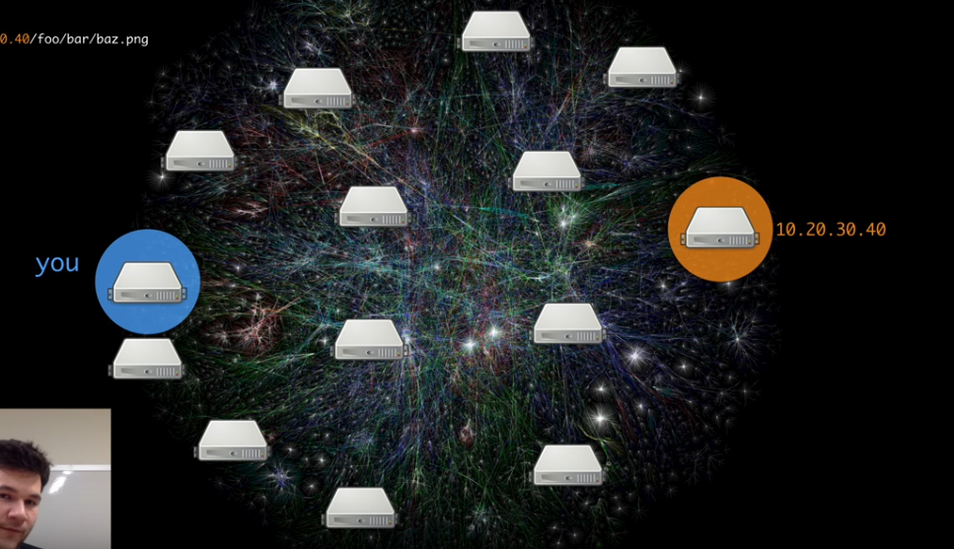
From Repository to the Distributed Web
Image Source: https://www.youtube.com/watch?v=skMTdSEaCtA
Stephen Downes
November 20, 2018
E-Learning 3.0

Slide 2
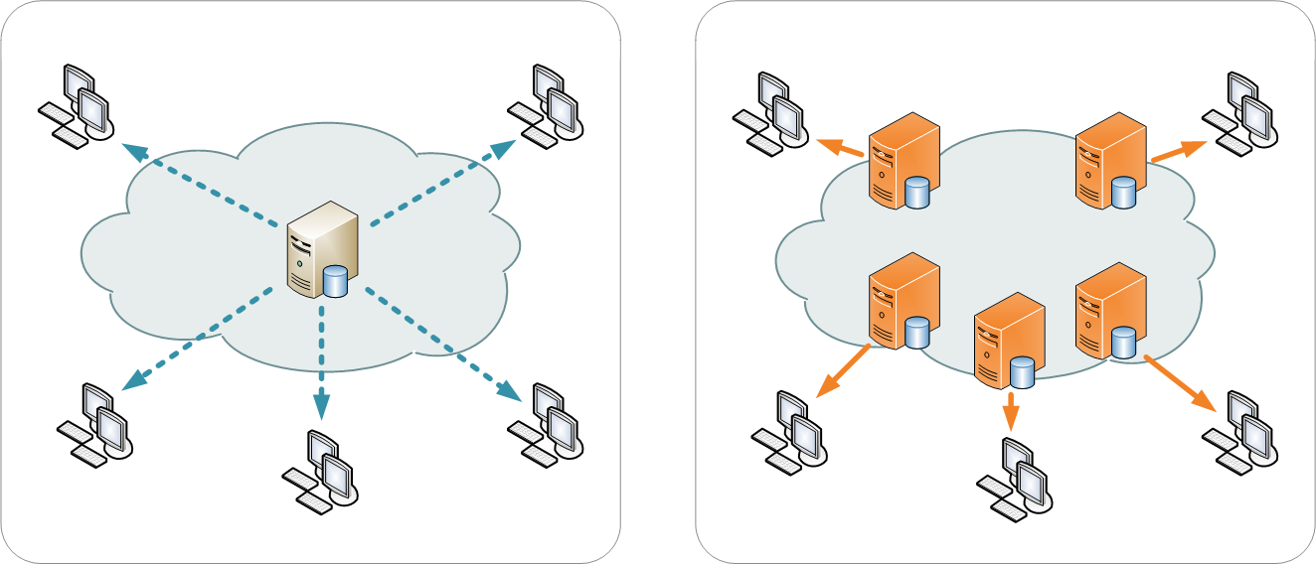
Content Delivery Network (CDN) https://en.wikipedia.org/wiki/Content_delivery_network
https://www.youtube.com/watch?v=Bqs_LzBjQyk
A content delivery network or content distribution network (CDN) is a geographically distributed network of proxy servers and their data centers. The goal is to distribute service spatially relative to end-users to provide high availability and high performance.

Slide 3
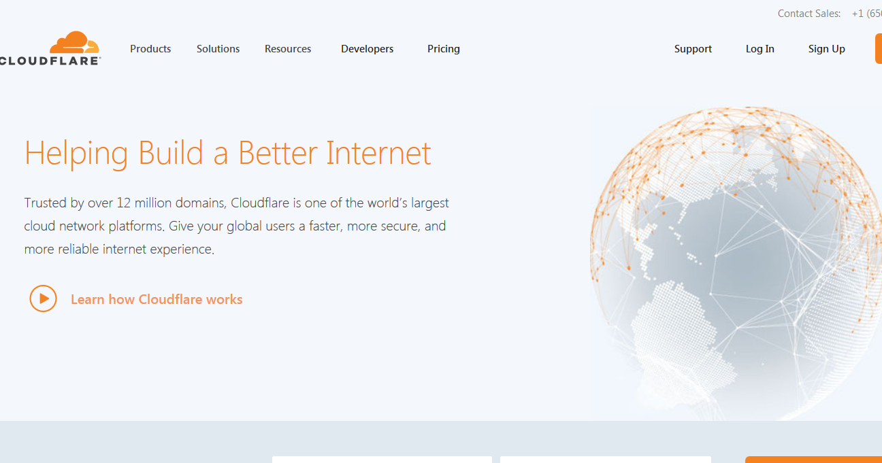
Cloudflare https://www.cloudflare.com/
https://www.youtube.com/watch?v=Bqs_LzBjQyk
“Caching content on Cloudflare's network reduces the number of requests to an origin by serving static content from a Cloudflare data center, lowering bandwidth consumption from the origin.”

Slide 4
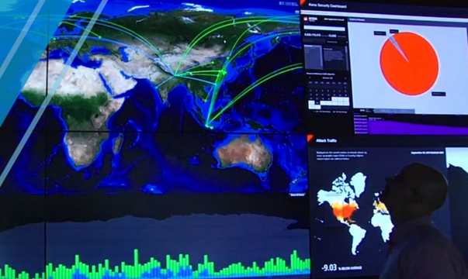
Akamai https://www.akamai.com/us/en/cdn/
https://www.youtube.com/watch?v=Bqs_LzBjQyk
“Content Delivery Networks, also known as CDNs, carry nearly half of the world’s Internet traffic. They are ubiquitous by their presence and mitigate the challenges of delivering content over the Internet.”

Slide 5
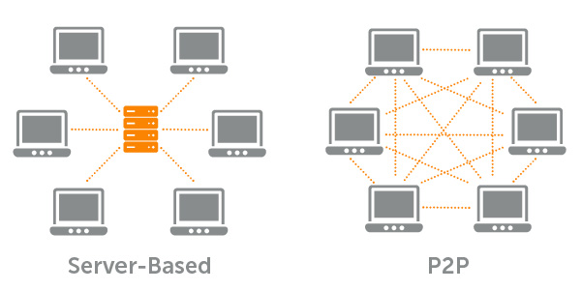
Peer-to-Peer CDNs https://en.wikipedia.org/wiki/Peer-to-peer
Image: https://www.wowza.com/blog/six-benefits-of-p2p-unicast-streaming
https://www.youtube.com/watch?v=Bqs_LzBjQyk
“Peers make a portion of their resources, such as processing power, disk storage or network bandwidth, directly available to other network participants, without the need for central coordination by servers or stable hosts. Peers are both suppliers and consumers of resources”

Slide 6
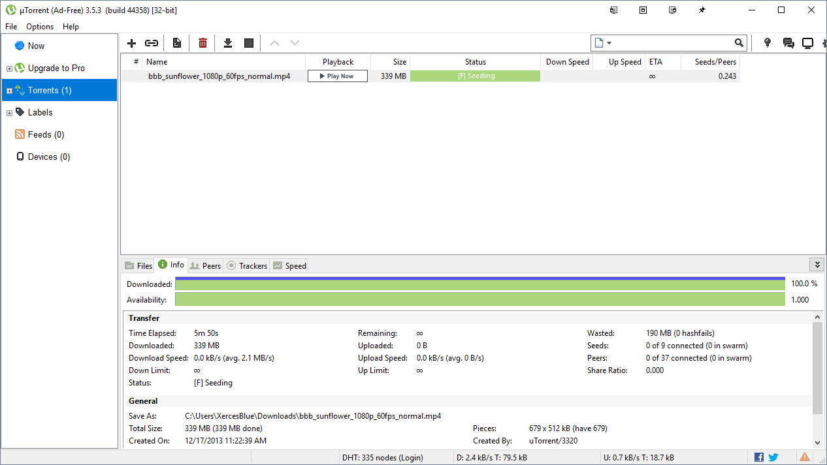
BitTorrent / uTorrent https://lifehacker.com/285489/a-beginners-guide-to-bittorrent
https://www.youtube.com/watch?v=Bqs_LzBjQyk
“Peers make a portion of their resources, such as processing power, disk storage or network bandwidth, directly available to other network participants, without the need for central coordination by servers or stable hosts. Peers are both suppliers and consumers of resources” Eg. https://www.utorrent.com

Slide 7
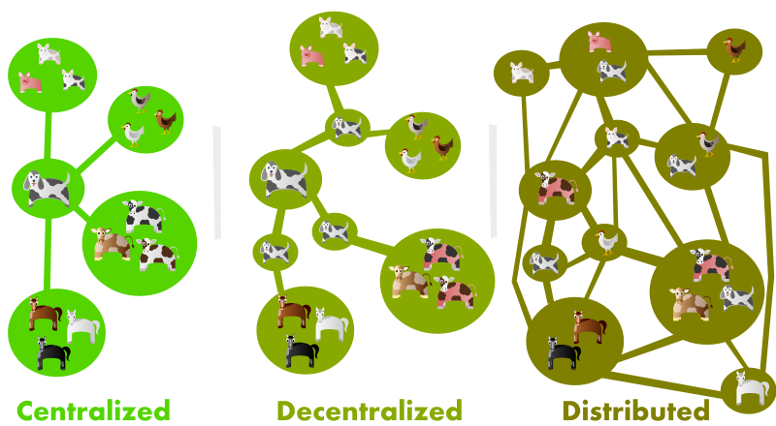
Dweb Project https://hacks.mozilla.org/2018/07/introducing-the-d-web/
https://www.youtube.com/watch?v=Bqs_LzBjQyk
A few examples of decentralized or distributed projects that became household names are Napster, BitTorrent and Bitcoin. Some of these new dweb projects are decentralizing identity and social networking… and others are distributed application protocols or platforms

Slide 8
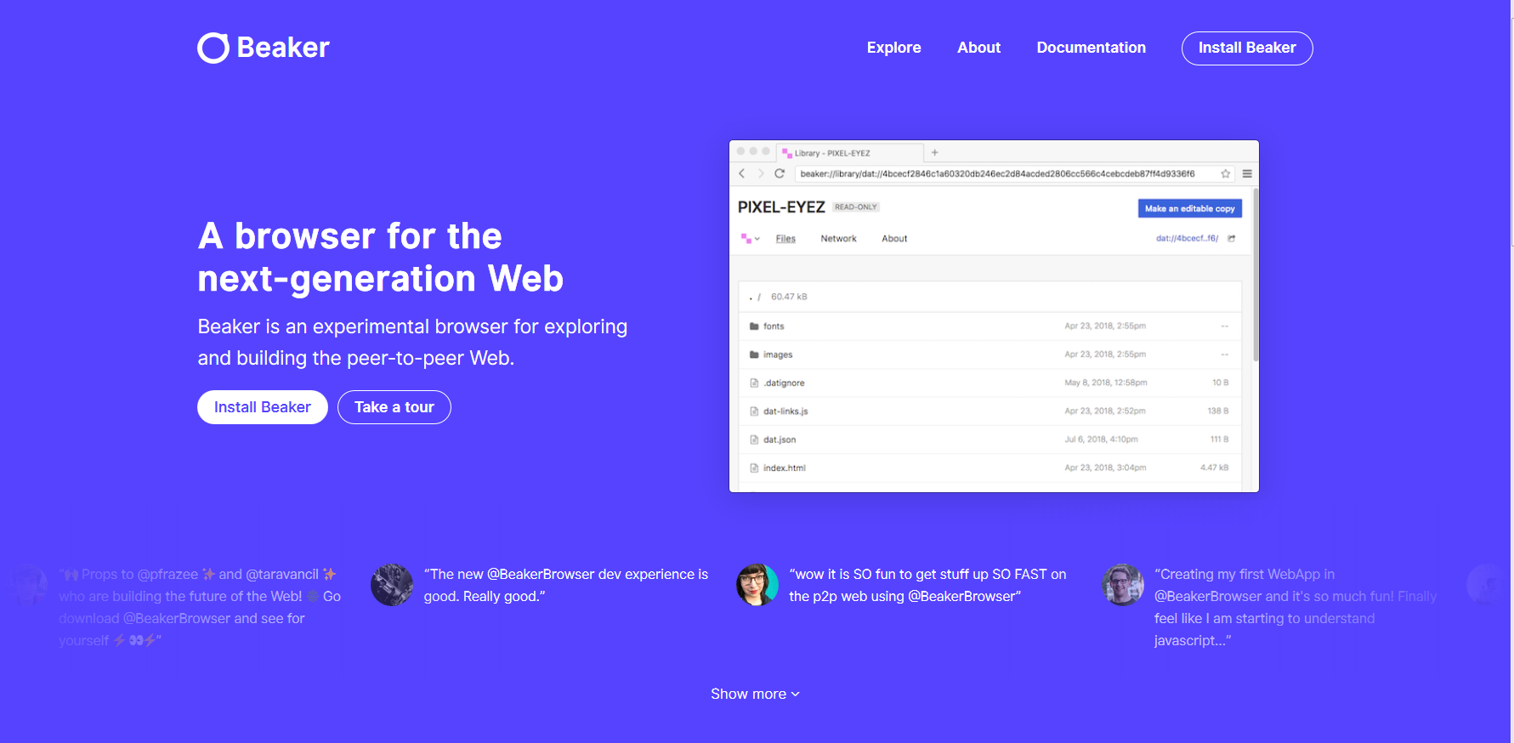
Beaker Browser https://beakerbrowser.com/
https://www.youtube.com/watch?v=Bqs_LzBjQyk
A browser for the next-generation web, Beaker is an experimental browser for exploring and building the peer-to-peer Web.

Slide 9
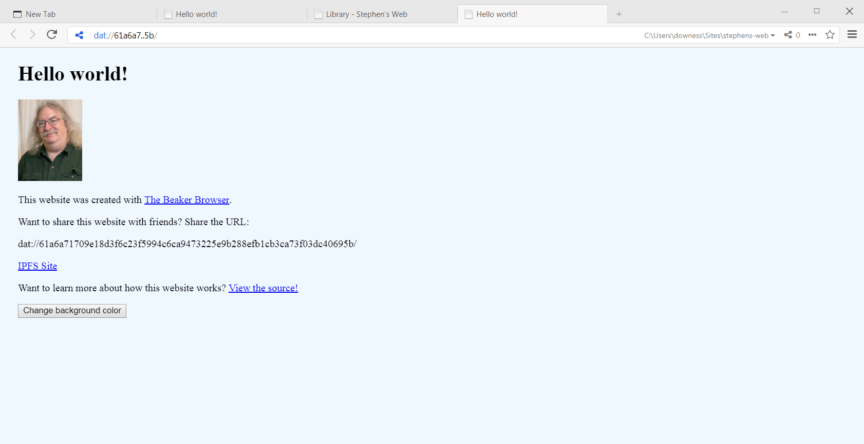
Beaker Browser https://beakerbrowser.com/
https://www.youtube.com/watch?v=Bqs_LzBjQyk
A browser for the next-generation web, Beaker is an experimental browser for exploring and building the peer-to-peer Web.
- View a page: dat://61a6a71709e18d3f6c23f5994c6ca9473225e9b288efb1cb3ca73f03dc40695b/

Slide 10
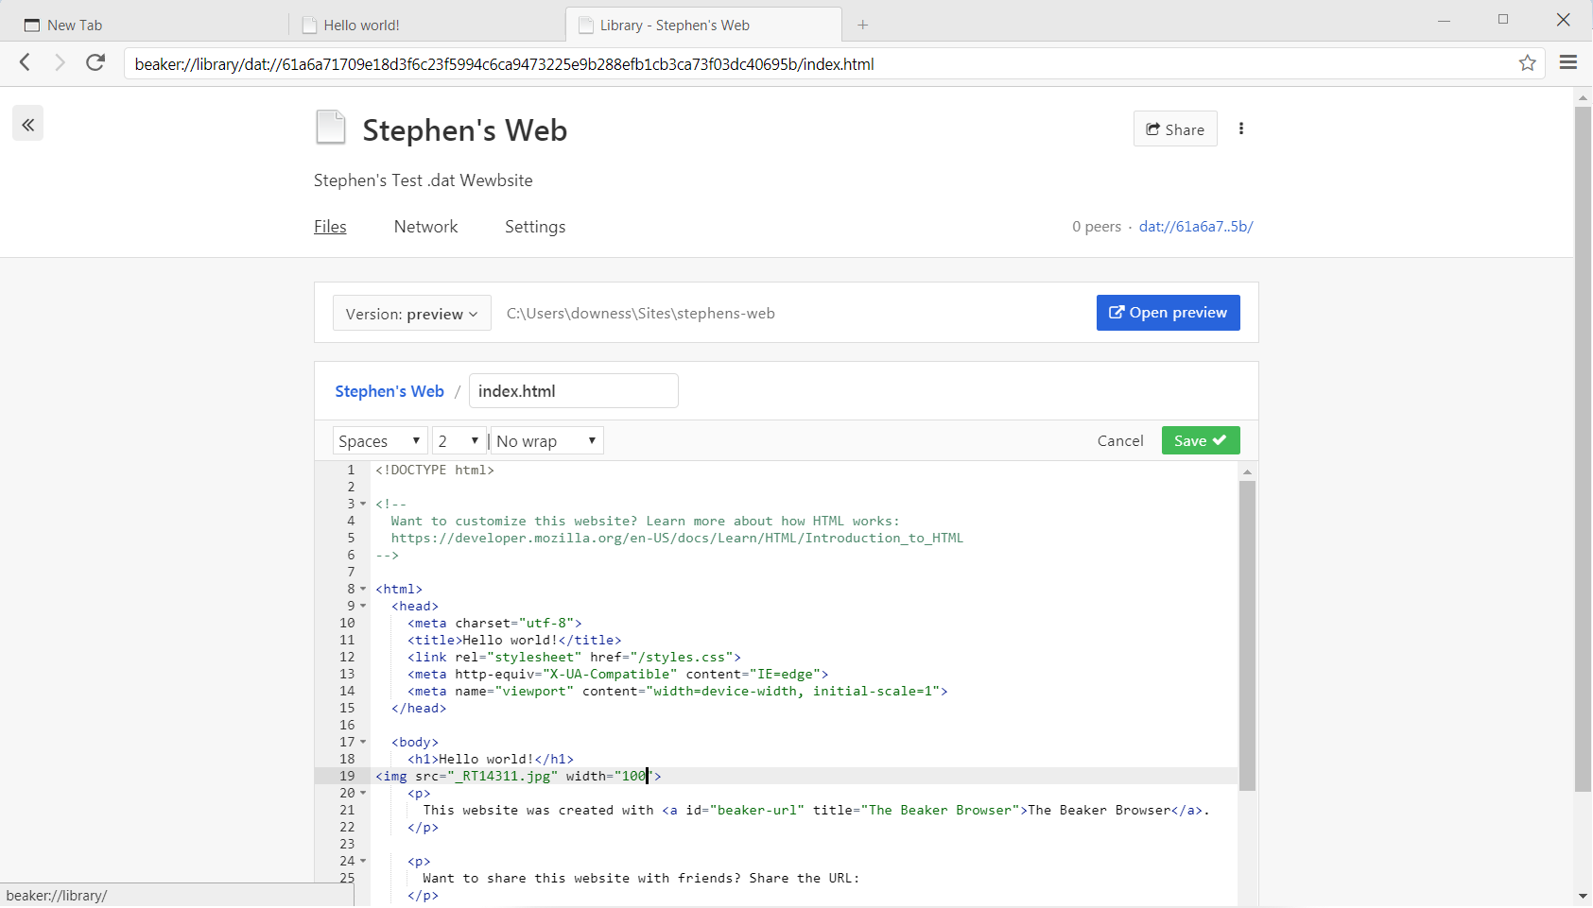
Beaker Browser https://beakerbrowser.com/
https://www.youtube.com/watch?v=Bqs_LzBjQyk
A browser for the next-generation web, Beaker is an experimental browser for exploring and building the peer-to-peer Web.
- Editing page

Slide 11
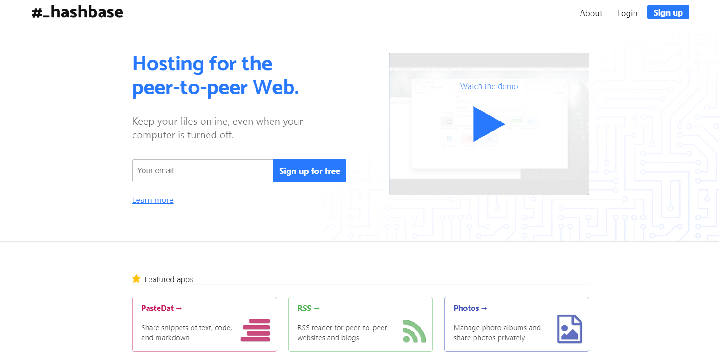
Hashbase https://hashbase.io/
https://www.youtube.com/watch?v=Bqs_LzBjQyk
Publishing with Dat means that peers will contribute bandwidth, but only if they're online and sharing your files. If nobody's hosting your files, then they won't be accessible. That's where Hashbase comes in. We act as a "super peer" that makes sure your content is always available.

Slide 12
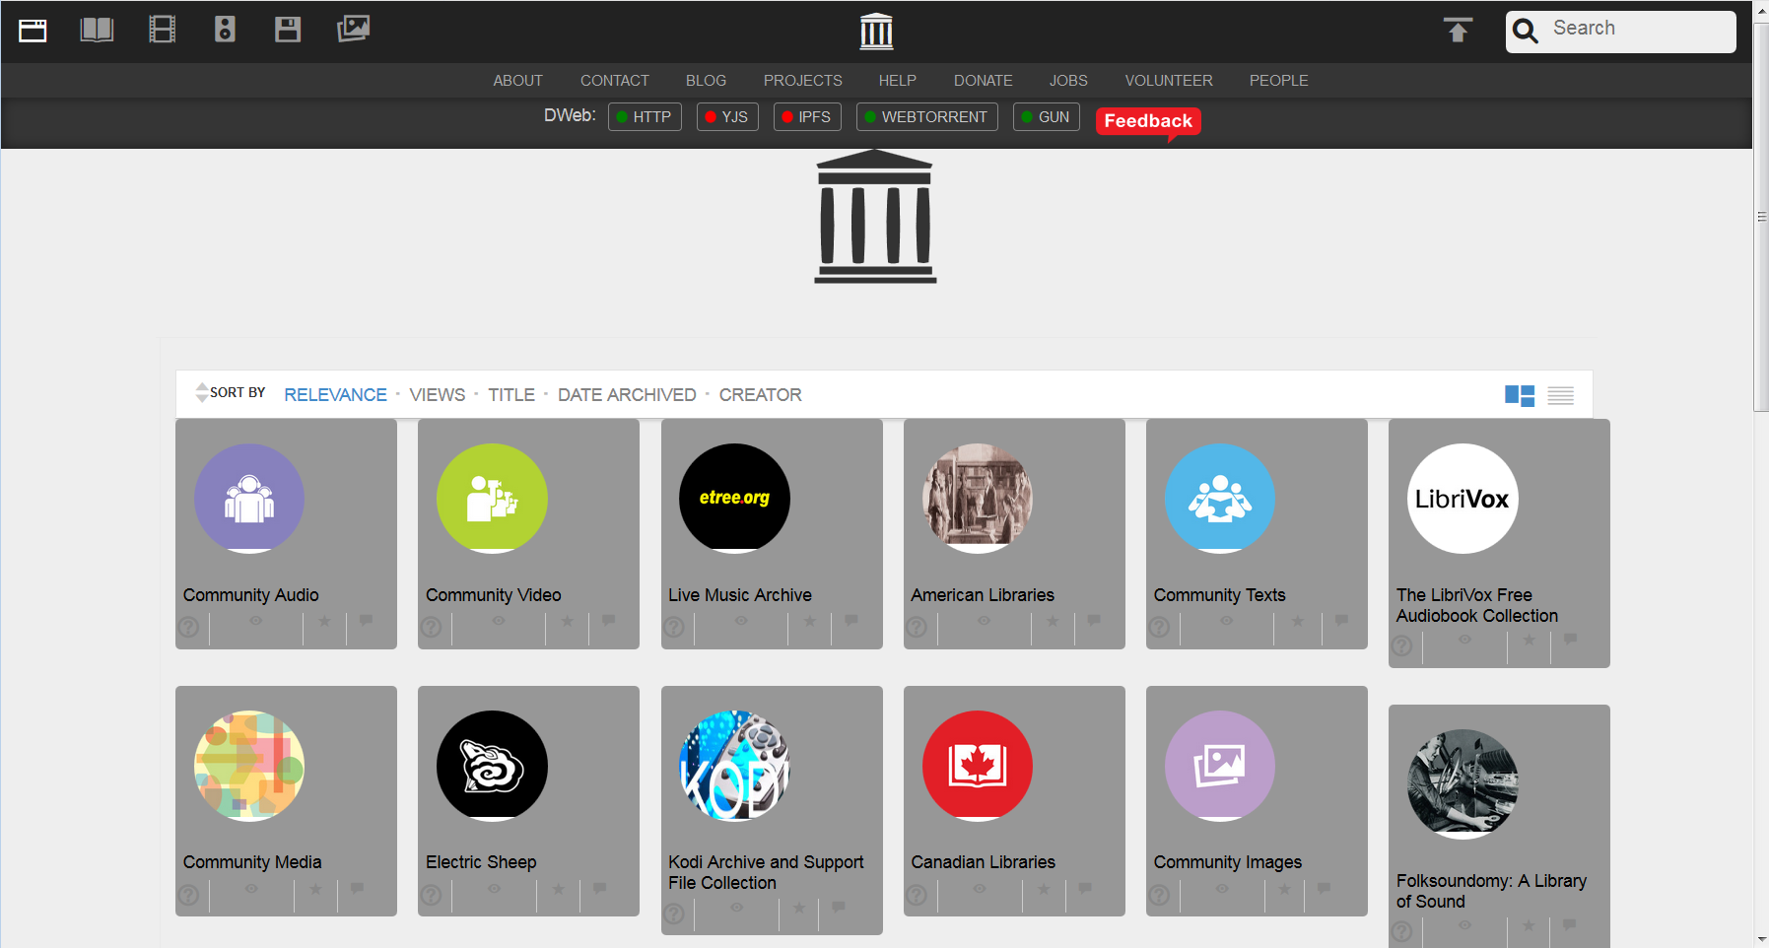
Dweb version of Internet Archive https://dweb.me/arc/archive.org/details?
https://www.youtube.com/watch?v=Bqs_LzBjQyk
“Archive.org is testing a decentralized version, or DWeb version, of their web site that allows their content to be delivered over peer-to-peer connections with different hosts sharing portions of or the same content.” https://www.bleepingcomputer.com/news/technology/archiveorg-has-created-a-decentralized-or-dweb-version-of-their-site/

Slide 13
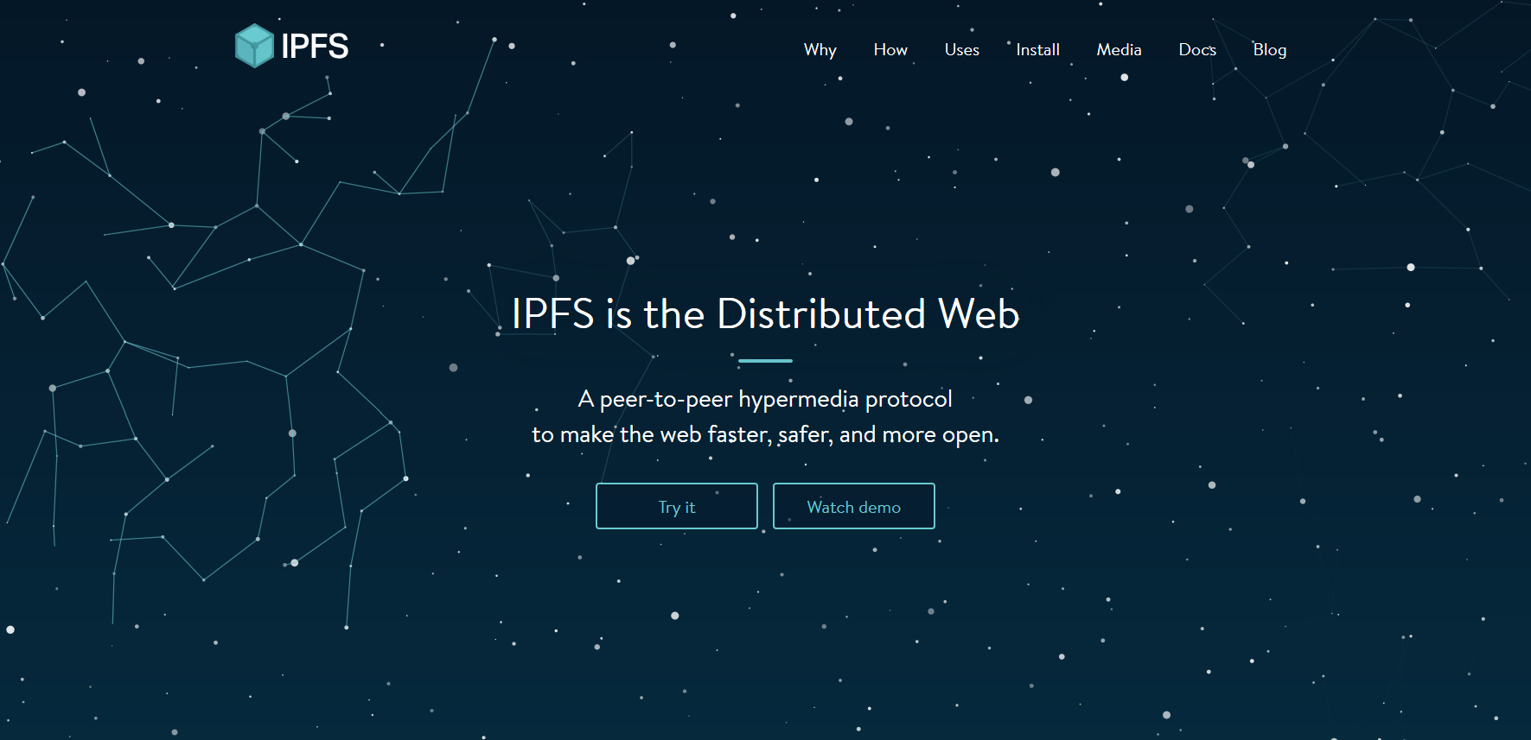
Inter Planetary File System (IPFS) https://ipfs.io/
https://www.youtube.com/watch?v=Bqs_LzBjQyk
Each file and all of the blocks within it are given a unique fingerprint called a cryptographic hash. When looking up files, you're asking the network to find nodes storing the content behind a unique hash.

Slide 14
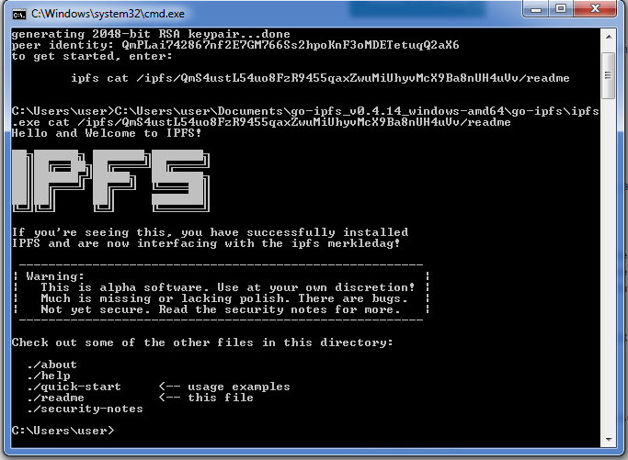
Installing IPFS https://blockchainmind.com/installation-procedure-of-ipfs-on-windows-platform/
https://www.youtube.com/watch?v=Bqs_LzBjQyk
IPFS is an application that runs on your computer. Installing it involves creating a ‘node’ on the IPFS network, identified by a public key, and running an IPFS daemon, which will share your files (and other people’s files) with the IPFS network. Cf https://www.youtube.com/watch?v=4O053XvP3fs

Slide 15
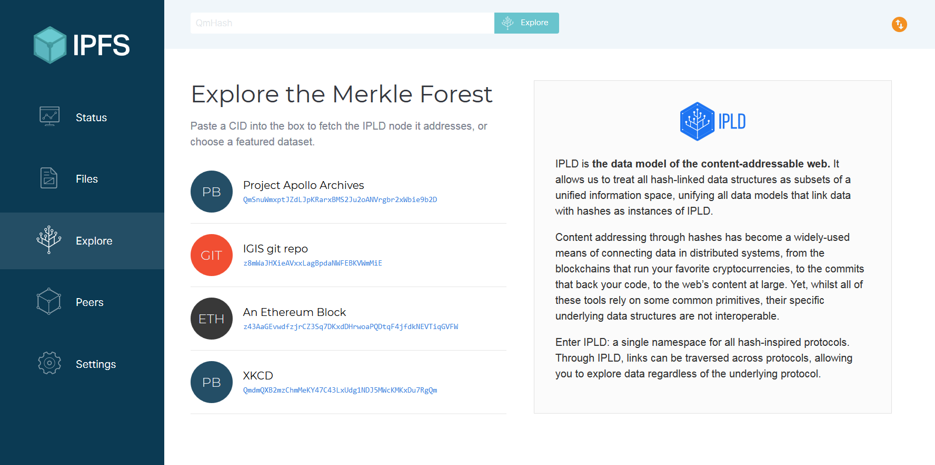
IPFS Companion https://github.com/ipfs-shipyard/ipfs-companion
https://www.youtube.com/watch?v=Bqs_LzBjQyk
“This add-on enables everyone to access IPFS resources the way they were meant: from locally running IPFS node” Firefox: https://addons.mozilla.org/en-US/firefox/addon/ipfs-companion/ Chrome: https://chrome.google.com/webstore/detail/ipfs-companion/nibjojkomfdiaoajekhjakgkdhaomnch?hl=en

Slide 16
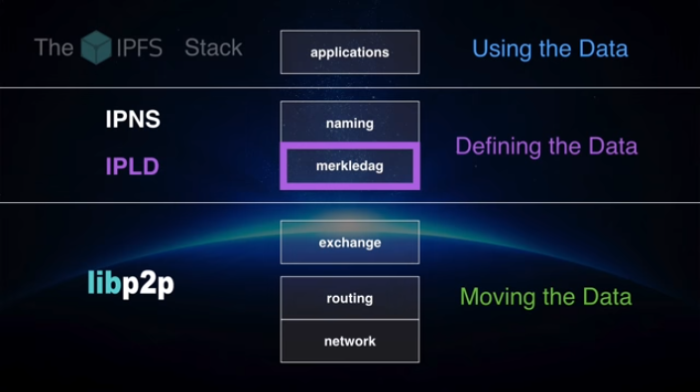
Inter-Planetary Linked Data (IPLD) https://ipld.io/
https://www.youtube.com/watch?v=Bqs_LzBjQyk
IPLD is the data model of the content-addressable web. It allows us to treat all hash-linked data structures as subsets of a unified information space, unifying all data models that link data with hashes as instances of IPLD.

Slide 17
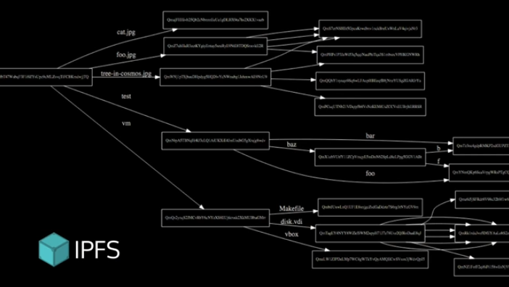
Inter-Planetary Linked Data (IPLD) https://ipld.io/
https://www.youtube.com/watch?v=Bqs_LzBjQyk
IPLD is the data model of the content-addressable web. It allows us to treat all hash-linked data structures as subsets of a unified information space, unifying all data models that link data with hashes as instances of IPLD.

Slide 18
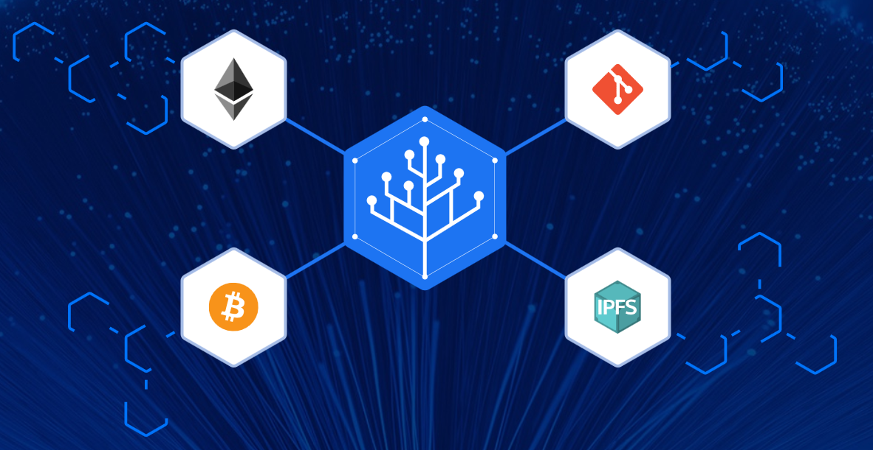
Inter-Planetary Linked Data (IPLD) https://ipld.io/
https://www.youtube.com/watch?v=Bqs_LzBjQyk
IPLD is the data model of the content-addressable web. It allows us to treat all hash-linked data structures as subsets of a unified information space, unifying all data models that link data with hashes as instances of IPLD.

Slide 19
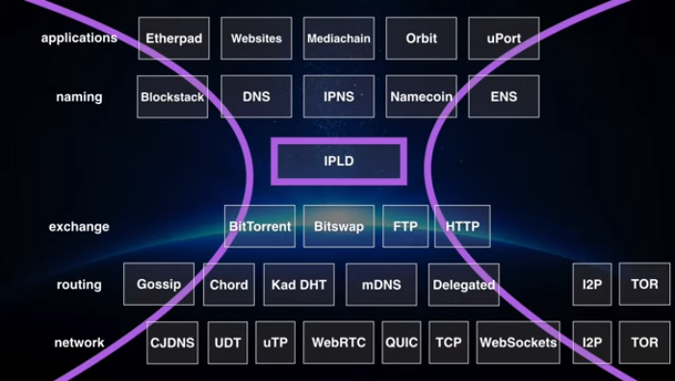
Inter-Planetary Linked Data (IPLD) https://ipld.io/
https://www.youtube.com/watch?v=Bqs_LzBjQyk
IPLD is the data model of the content-addressable web. It allows us to treat all hash-linked data structures as subsets of a unified information space, unifying all data models that link data with hashes as instances of IPLD.

Slide 20
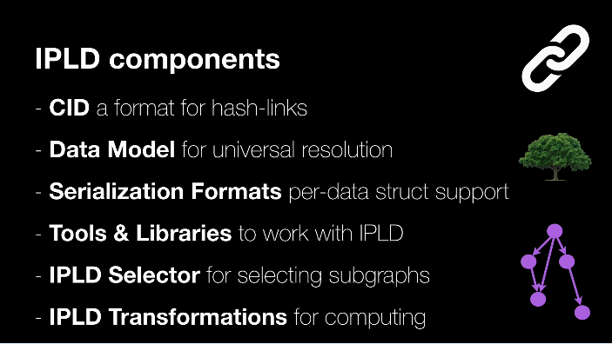
Inter-Planetary Linked Data (IPLD) https://ipld.io/
https://www.youtube.com/watch?v=Bqs_LzBjQyk
IPLD is the data model of the content-addressable web. It allows us to treat all hash-linked data structures as subsets of a unified information space, unifying all data models that link data with hashes as instances of IPLD.

Slide 21
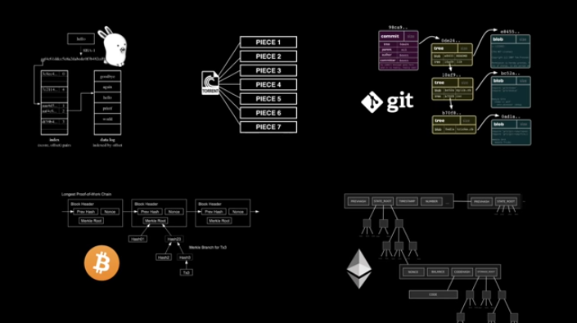
Distributed, Authenticated, Hash-Linked Data Structures
https://www.youtube.com/watch?v=Bqs_LzBjQyk
These are all Merkle Trees (clockwise from top left) Plan 9 from Bell Labs, BitTorrent, Git, Ethereum, BitCoin

Slide 22
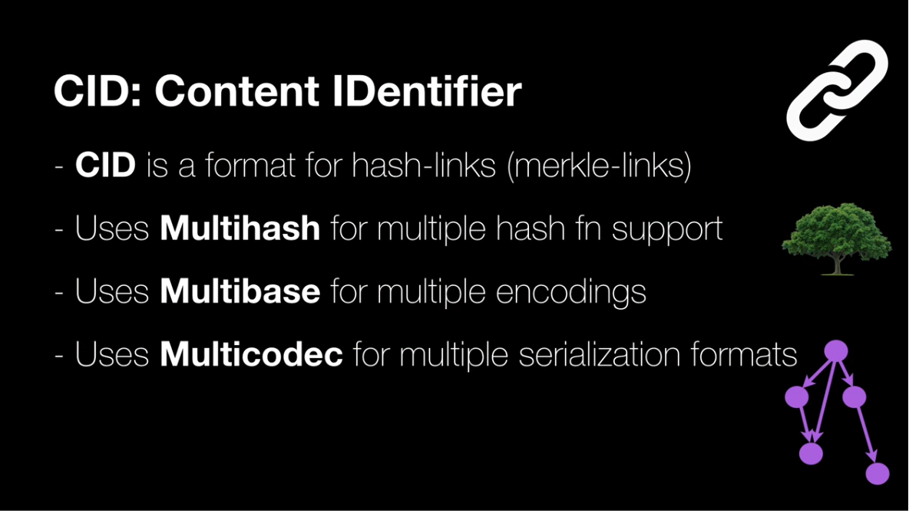
Content Identifier https://docs.ipfs.io/guides/concepts/cid/
https://www.youtube.com/watch?v=Bqs_LzBjQyk
A content identifier, or CID, is a label used to point to material in IPFS. It doesn’t indicate where the content is stored, but it forms a kind of address based on the content itself.

Slide 23
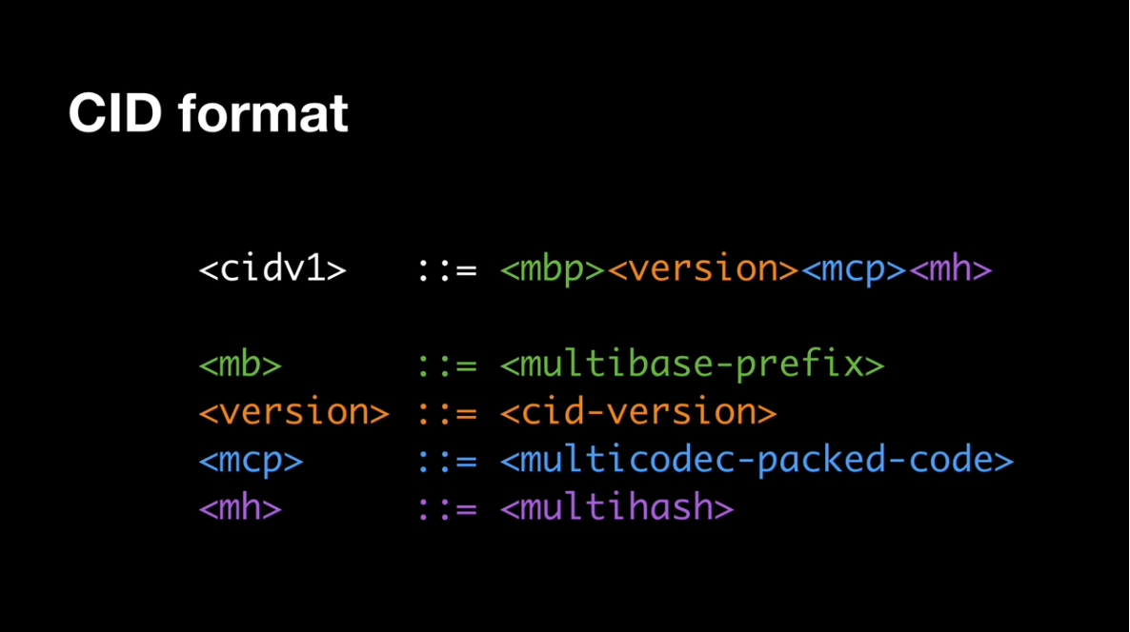
Content Identifier https://docs.ipfs.io/guides/concepts/cid/
https://www.youtube.com/watch?v=Bqs_LzBjQyk
A content identifier, or CID, is a label used to point to material in IPFS. It doesn’t indicate where the content is stored, but it forms a kind of address based on the content itself.

Slide 24
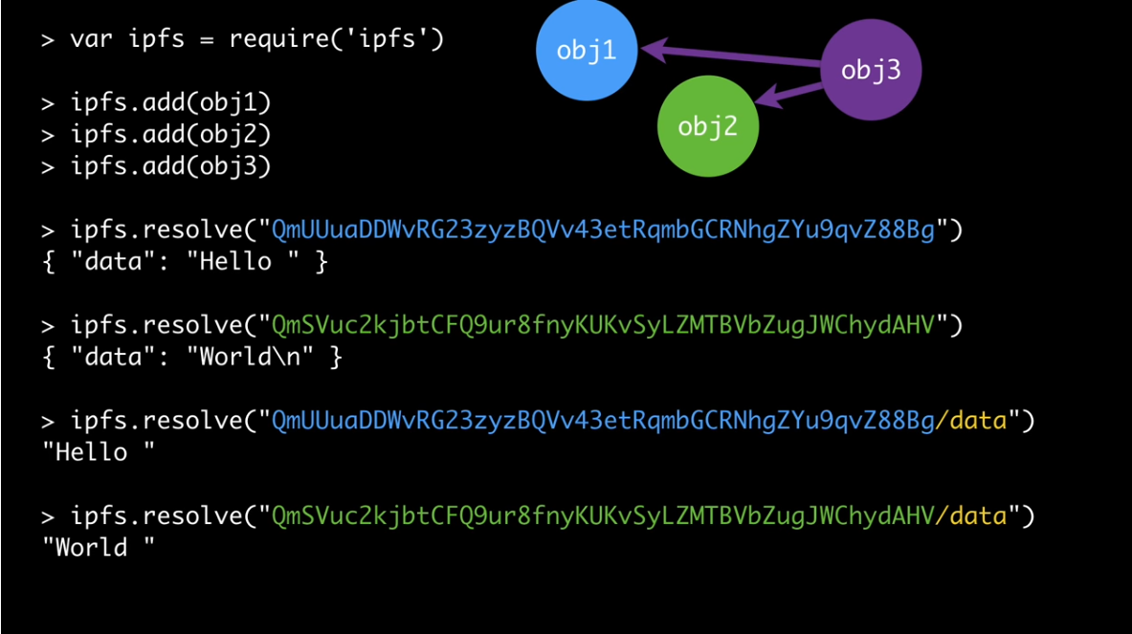
Content Identifier https://docs.ipfs.io/guides/concepts/cid/
https://www.youtube.com/watch?v=Bqs_LzBjQyk
A content identifier, or CID, is a label used to point to material in IPFS. It doesn’t indicate where the content is stored, but it forms a kind of address based on the content itself.

