Slide 1

Vision 2030: Redesigning Education for the Future
Stephen Downes, National Research Council Canada
presenting to
The 3rd Asbar World Forum 2018 (AWF)
Riyadh, Saudi Arabia

Slide 2

A New Challenge
“With the automation of many of the functions employees currently perform, the emphasis will switch from answering simple queries to dealing with more complex problems that will require higher level of analysis, access to experts and greater autonomy.”

Slide 3
Part One.
What Does Learning Become?
Relevant
Engaging
Personal

Slide 4
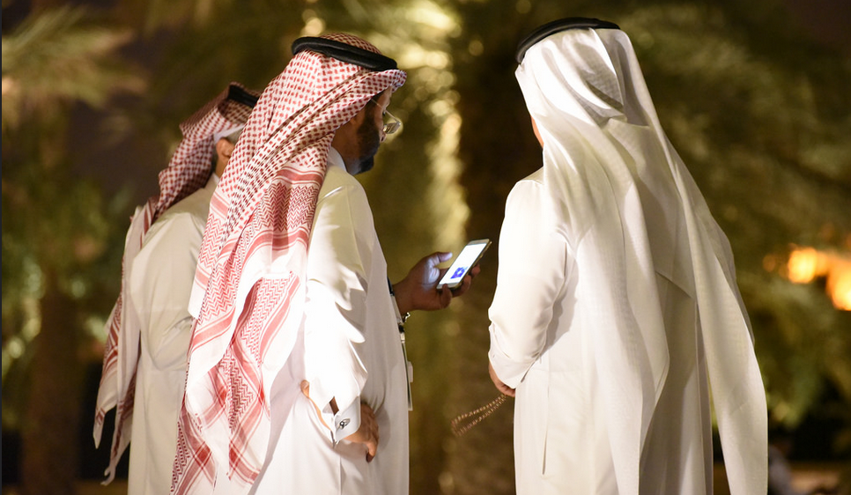
Relevant

Slide 5

Relevant
Any time / Any place
Ubiquitous
Context-Aware
Problem-Focused

Slide 6

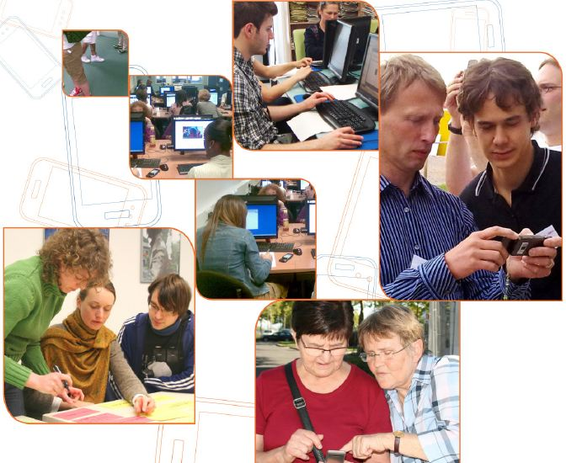
Case
Mobile Learning, Mobile Support
Access - learning as you go, with different devices
Device – smartphone only? Or tablets and laptops?
Location - learners can learn outside their office
Design - content specifically designed for mobile

Slide 7
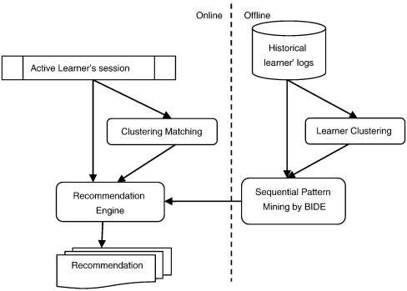
Case
Content Recommendations
Resource Recommendation
Collaborative filtering
Human cognitive modeling
Content analysis
Self-assessment
Sensor & data analysis

Slide 8

Engaging

Slide 9

Engaging
Engaging = Immersive + Wanted
We have to want to be there
And we have to believe that we’re there

Slide 10
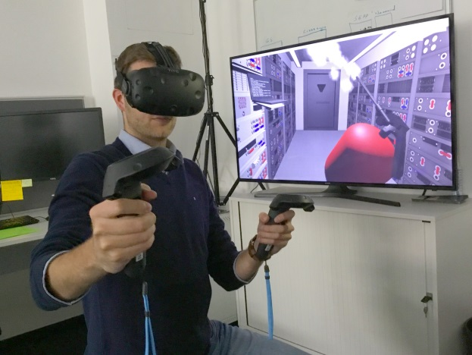
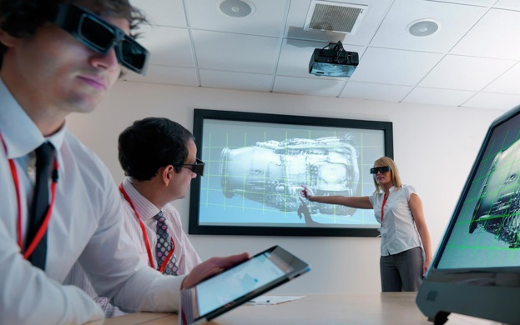
Engaging
Immersive
Slack, Airtable, Trello: what makes them good? Presence
Social presence
Cognitive presence
Teaching presence
(Anderson, Archer, Garrison)
https://pt.slideshare.net/AnantCorp/team-collaboration-slack-airtable-trello-what-makes-them-good-76384318

Slide 11
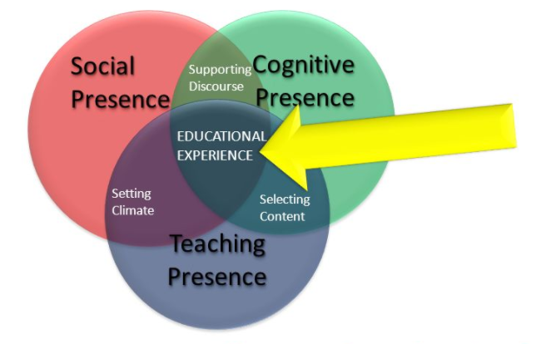
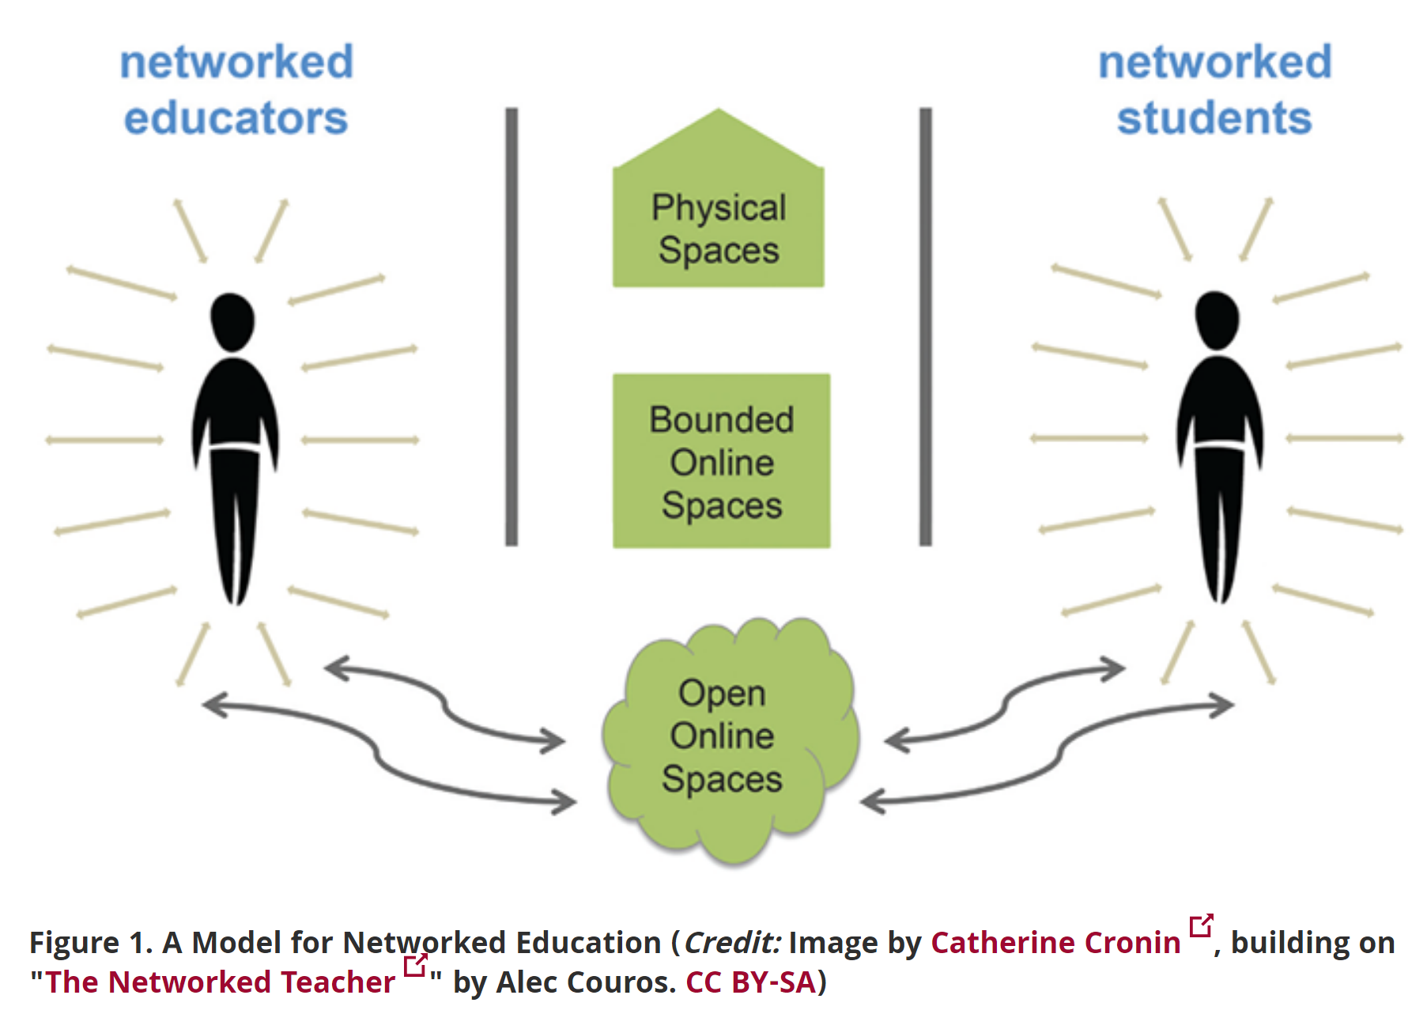
Engaging
Presence
Presence is the idea that there is a person at the other end of the interaction… the presence of that person makes us believe, makes it matter

Slide 12
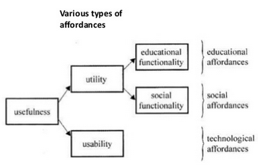
Engaging
Affordances
What does wanted make you think of…?
personal, spontaneous, opportunistic
informal, pervasive, situated
private, context-aware
bite-sized, and portable
Jari Laru - https://www.slideshare.net/larux/affordances-short-introductionlarulet2011

Slide 13
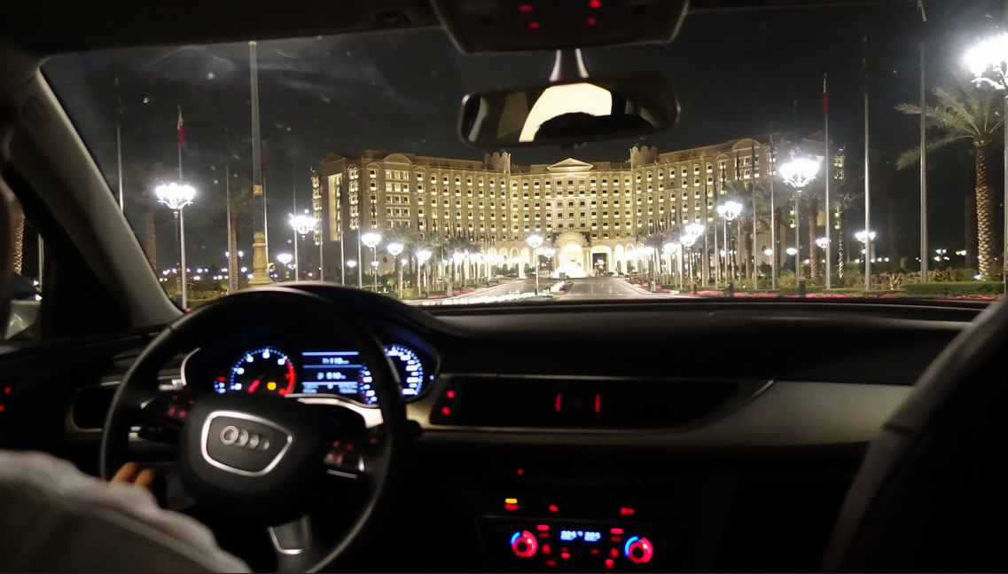
Personal

Slide 14

Personal
Competencies
Support
Iteration
Opportunity

Slide 15
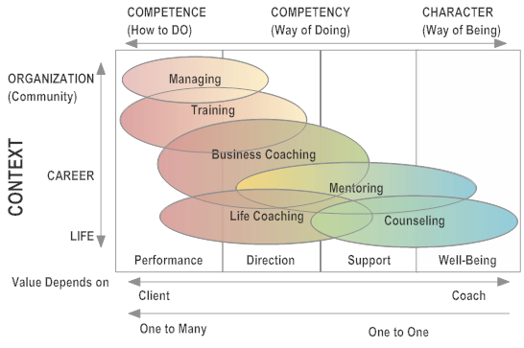
Personal
Competencies
http://leadershipadvantedge.com/

Slide 16
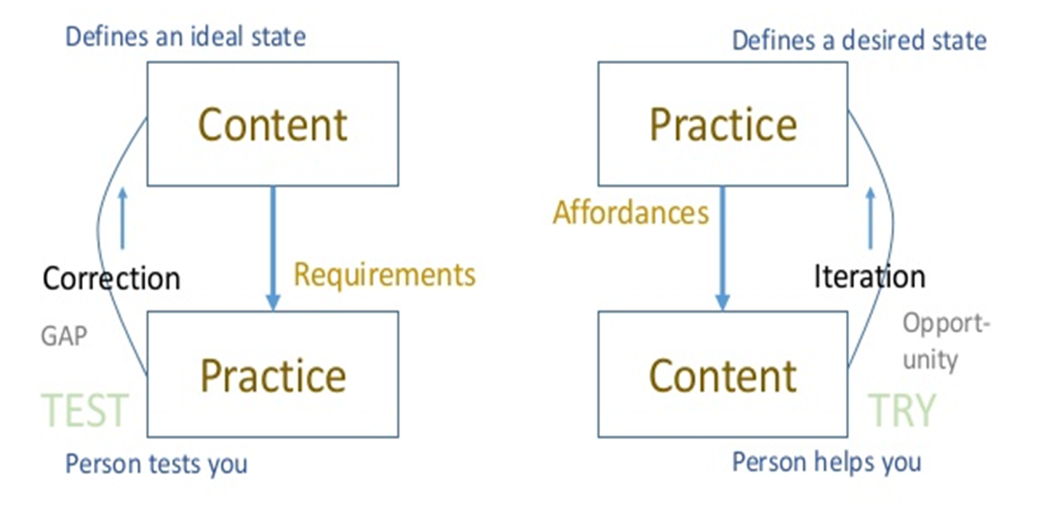
Personal
Support and Iteration

Slide 17
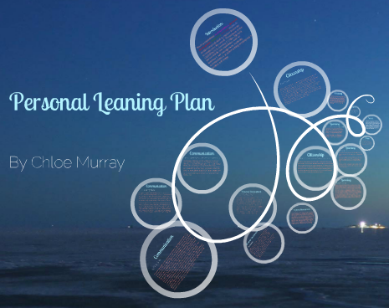
Case
Personal Learning Plan
Illuminate Education - data-based learning path
FilterED Global Filter - specializes in rapid personal path creation
MiCLUES - personal learning paths through museums and exhibits
ItsLearning - learning platform
Apereo OpenSSP - success plan
Chloe Murray - https://prezi.com/9i69gkg75eqc/copy-of-chloe

Slide 18
Personal
Practice vs Presentation
Don’t tell me, show me:
- “show me how to think strategically“
- “show me how to reframe an issue”
- “show me how to deal with the ambiguity of the world right now”
Steve Lowenthal - https://elearningindustry.com/bridging-the-learning-and-doing-gap-3-best-practices

Slide 19
Part Two.
How Do We provide That?
Learning Resources
Environments
Assessment

Slide 20

Learning Resources

Slide 21

Learning Resources
Open Educational Resources
Open Data and Data Books
Personalized Learning Practices
Performance Support

Slide 22




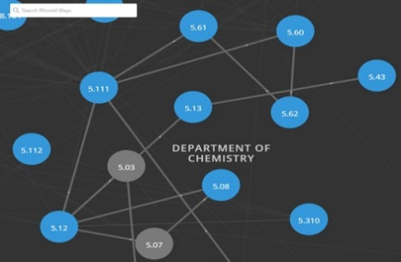

Learning Resources
Open Educational Resources
https://www.oercommons.org/
https://openstax.org/
https://ocw.mit.edu/

Slide 23
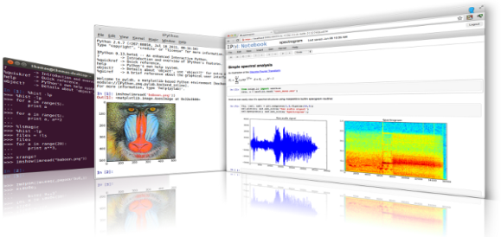

Learning Resources
Open Data and Data Books
iPython is an interactive programming shell for the Python programming language https://ipython.org/
The Jupyter Notebook is an open-source web application that allows you to create and share documents that contain live code… http://jupyter.org/

Slide 24
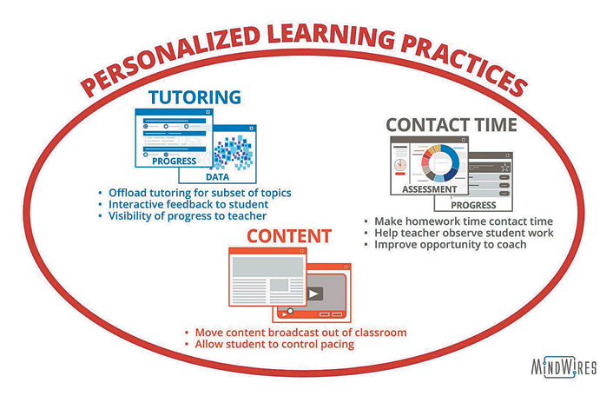
Learning Resources
Personalized Learning Practices
Moving content broadcast out of the classroom
Turn class time into contact time
Providing tutoring
“…a delicate balance between student autonomy and instructor-led direction and scaffolding…”
Feldstein & Hill (2016)

Slide 25
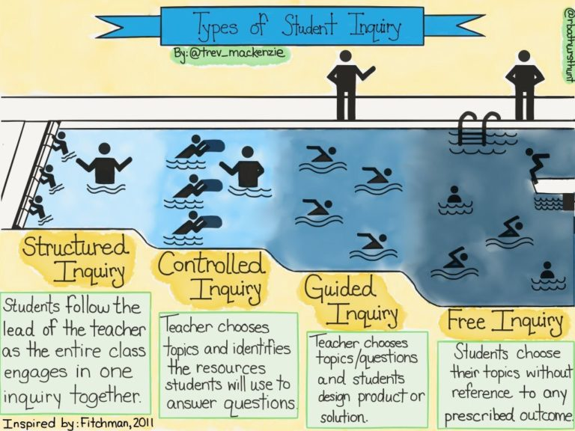
Case
Types of Student Inquiry
A range of approaches (after Dana Fichtman, Thomas & Boynton, 2011, Inquiry: a districtwide approach to staff and student learning) http://sk.sagepub.com/books/inquiry

Slide 26
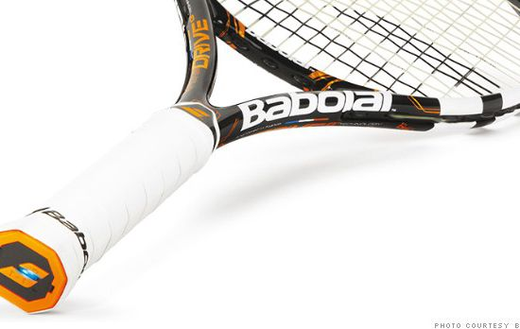
Learning Resources
Performance Support
http://fortune.com/2014/05/27/a-tennis-racquet-that-isnt-just-strung-but-wired/

Slide 27
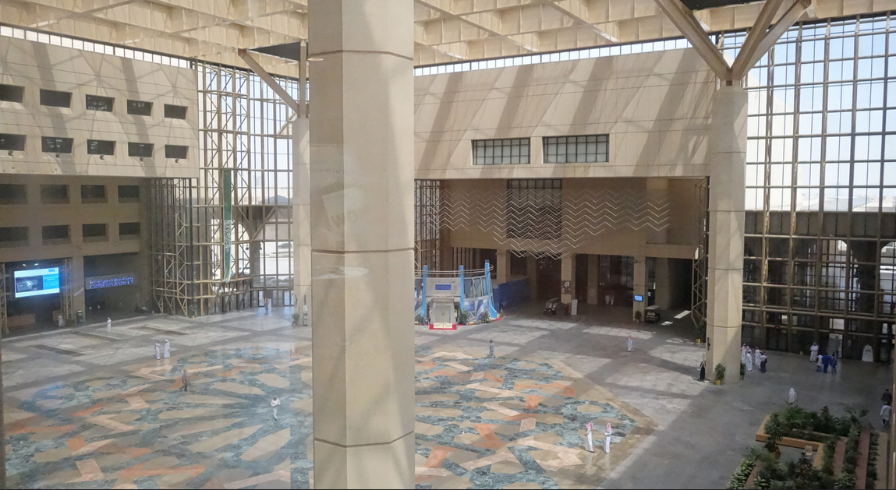
Environments

Slide 28

Environments
Learning platforms
Internet of Things
Social Learning
LTI, API and JSON
Cloud Apps and Storage

Slide 29
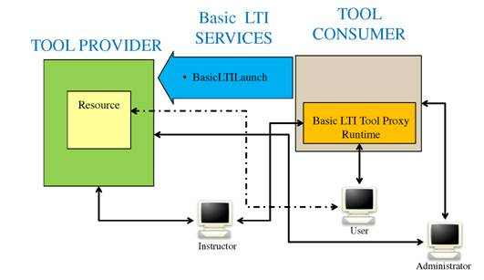
Environments
Learning Platforms
LTI Producer – provides features
LTI Consumer – connects to features
https://www.imsglobal.org/specs/ltiv1p0/implementation-guide

Slide 30
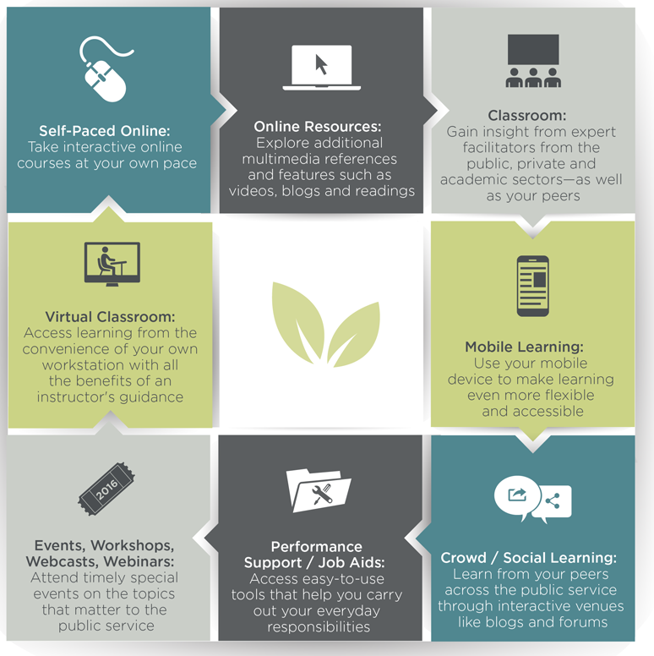
Case
Learning Platforms
Saba learning management system (LMS)
Drupal 7 content management system (CMS)
Moodle LMS
Kaltura OVP
CSPS service bus
CSPS GCCampus

Slide 31
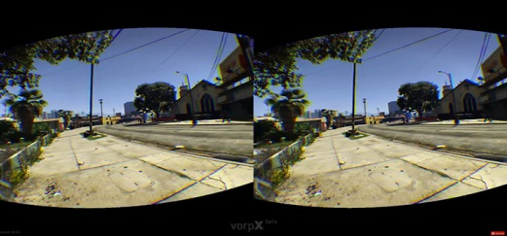
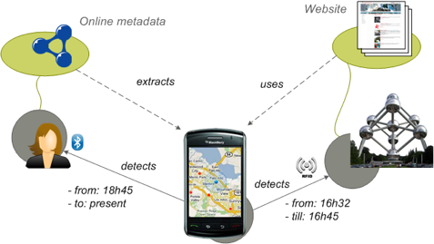
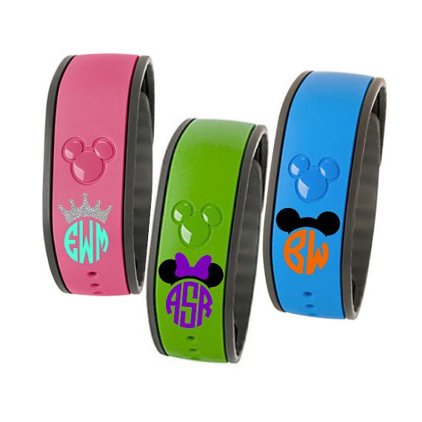
Environments
Internet of Things
https://www.pcgamesn.com/grand-theft-auto-v/the-best-grand-theft-auto-v-mods
WISE Research Group, 2012 - https://wise.vub.ac.be/project/context-aware-mobile-application-development
MagicBand. It’s a bracelet Disney hands out (story on Gizmodo)

Slide 32
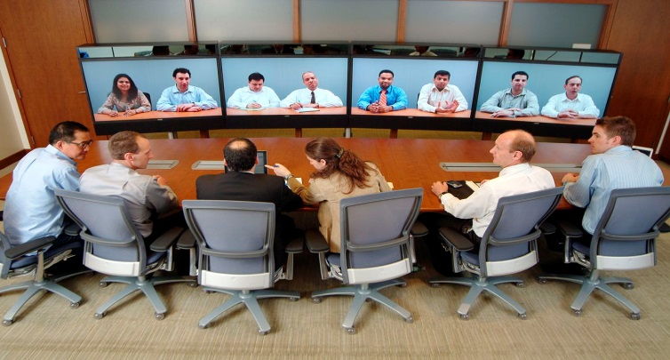
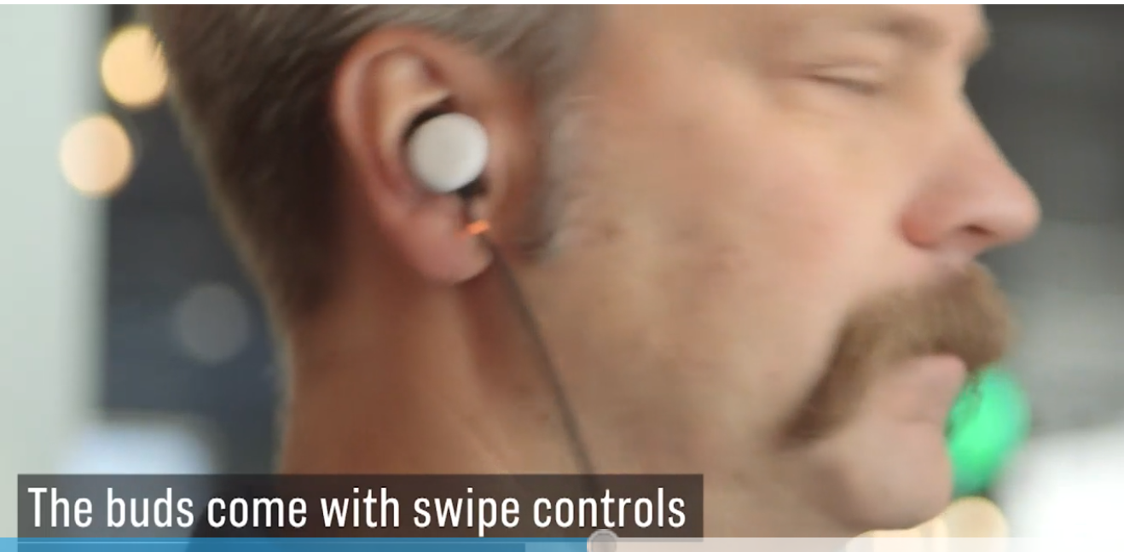
Environments
Social Learning
Based on interaction from difference perspectives
Ranges from collaborative to cooperative to competitive learning
Open networks, open standards
https://www.cnbc.com/2017/10/04/google-translation-earbuds-google-pixel-buds-launched.html

Slide 33
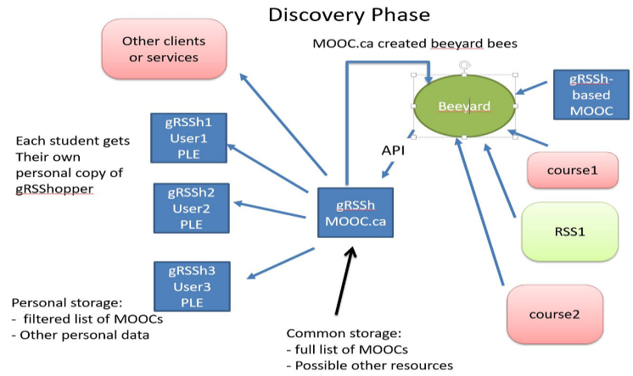
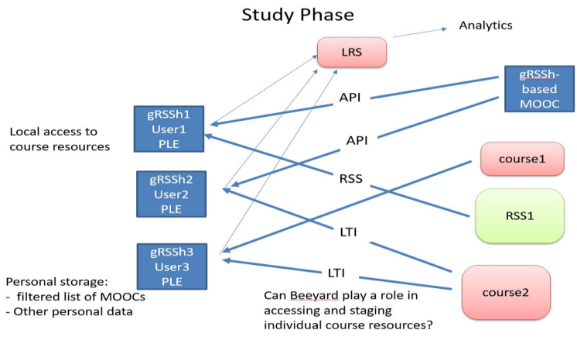
Environments
LTI / API / JSON
Learning Tools Interoperability
Application Programming Interface
JavaScript Object Notation and Linked Data

Slide 34

Case
Resource Integration
Linkage - to other systems
Single signon - to all services
Common Services – Listed among other services
Extending the bus – data and user information exchange
Learning Tools Interoperability
Full enterprise integration
Canada School of Public Service

Slide 35
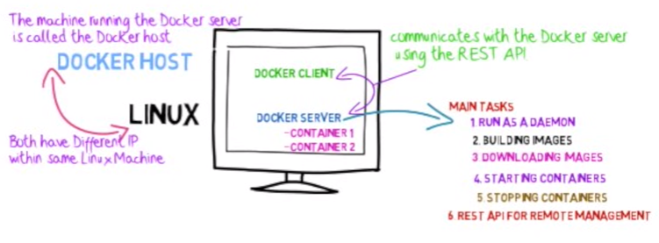
Environments
Cloud Applications and Storage
Universities are now deploying using Docker Containers managed by Kubernetes on AWS or Digital Ocean

Slide 36

Assessment

Slide 37

Assessment
Competencies and Skills
Learning records
Quantified Self / Dashboards
Feed Forward

Slide 38
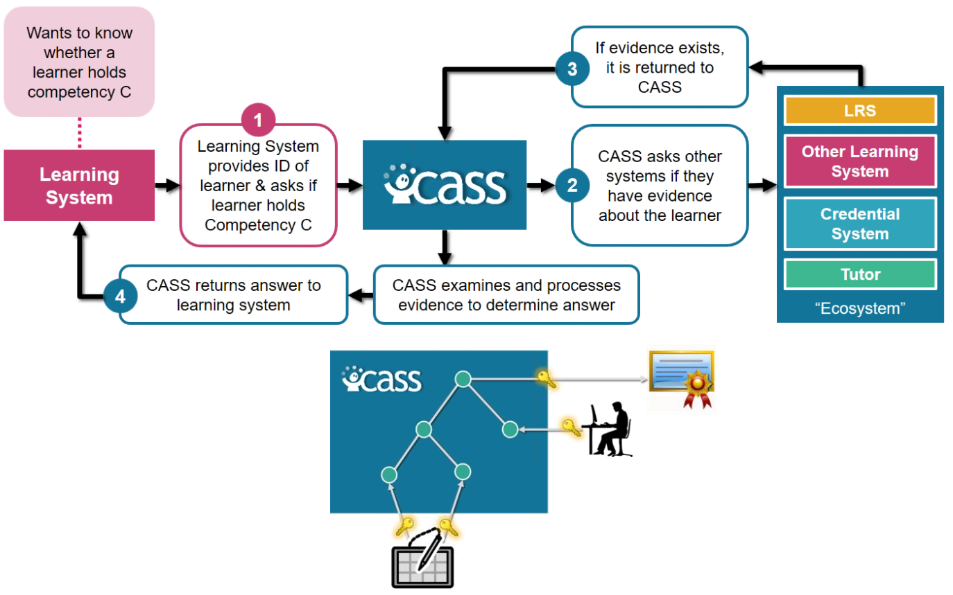
Assessment
Competencies and Skills
Learning Plan
Automated Assessment
http://pagecentertraining.psu.edu/public-relations-ethics/core-ethical-principles/lesson-2-sample-title/the-pillars-of-public-relations-ethics/

Slide 39
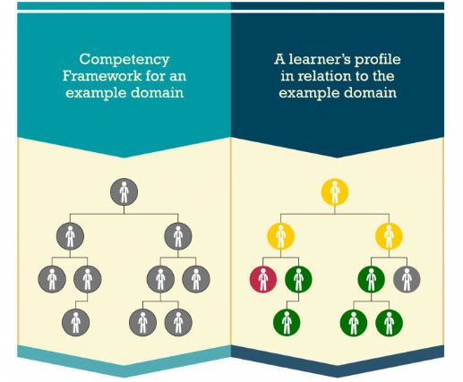
Case
Competencies and Skills System (CASS)
Workforce Planning
Recruiting and Onboarding
Performance and Goal Management
Learning Management
Career and Succession Planning
Compensation Management
Advanced Distributed Learning (ADL)
https://www.adlnet.gov/introducing-the-next-big-thing-cass/

Slide 40
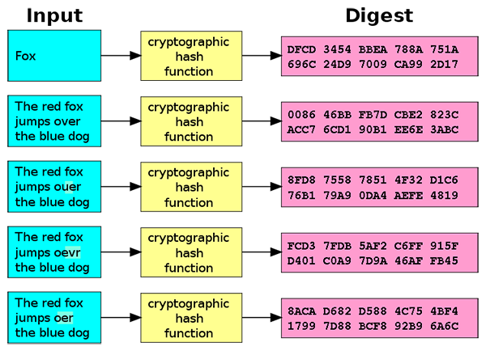
Assessment
Learning Records
Doug Belshaw: "If we used the blockchain for Open Badges," he writes, "then we could prove beyond reasonable doubt that the person receiving badge Y is the same person who created evidence X.
http://dmlcentral.net/blog/doug-belshaw/peering-deep-future-educational-credentialing
http://www.downes.ca/search/blockchain

Slide 41
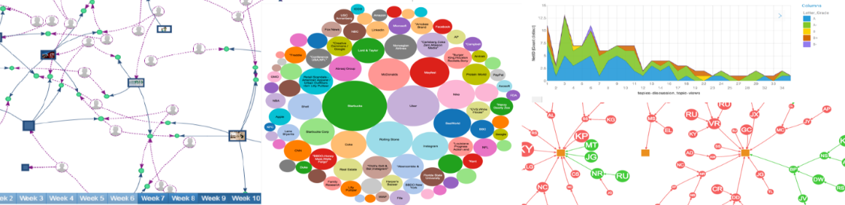
Assessment
Quantified Self
Siemens and Long https://er.educause.edu/articles/2011/9/penetrating-the-fog-analytics-in-learning-and-education

Slide 42
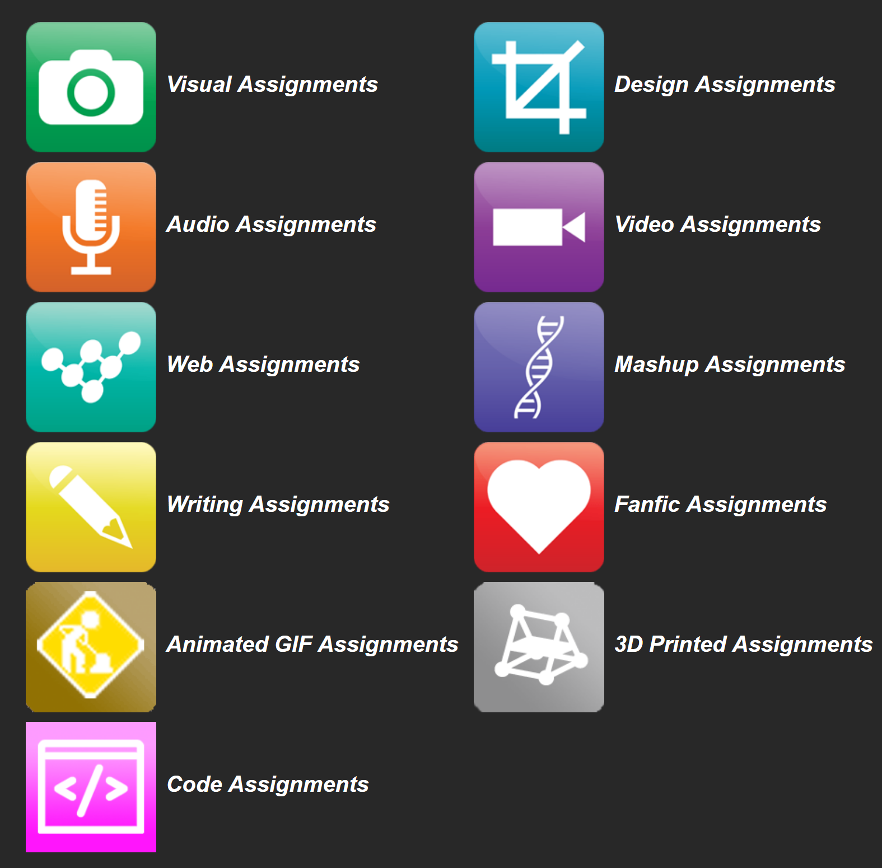
Assessment
Feed Forward and Share
OERs are now widely available through subject-specific libraries with provisions forauthoring as well
Course commentary
User-generated content
External content
Content curation
Collaborative learning
DS106 assignment bank http://assignments.ds106.us/

Slide 43
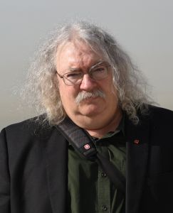
http://www.downes.ca

