Slide 1

Continuing Professional Development:
Looking at Old Problems in New Ways
Stephen Downes
10th National CPD Accreditation Conference
Mississauga, Ontario
October 2, 2018

Slide 2
Preliminaries: The Backchannel
www.downes.ca/chat channel 10NAC
or use hashtag #10NAC in Twitter or Mastodon
Your comments will be displayed in the order received and shown for 10 seconds each (you can view the archive on the website)

Slide 3
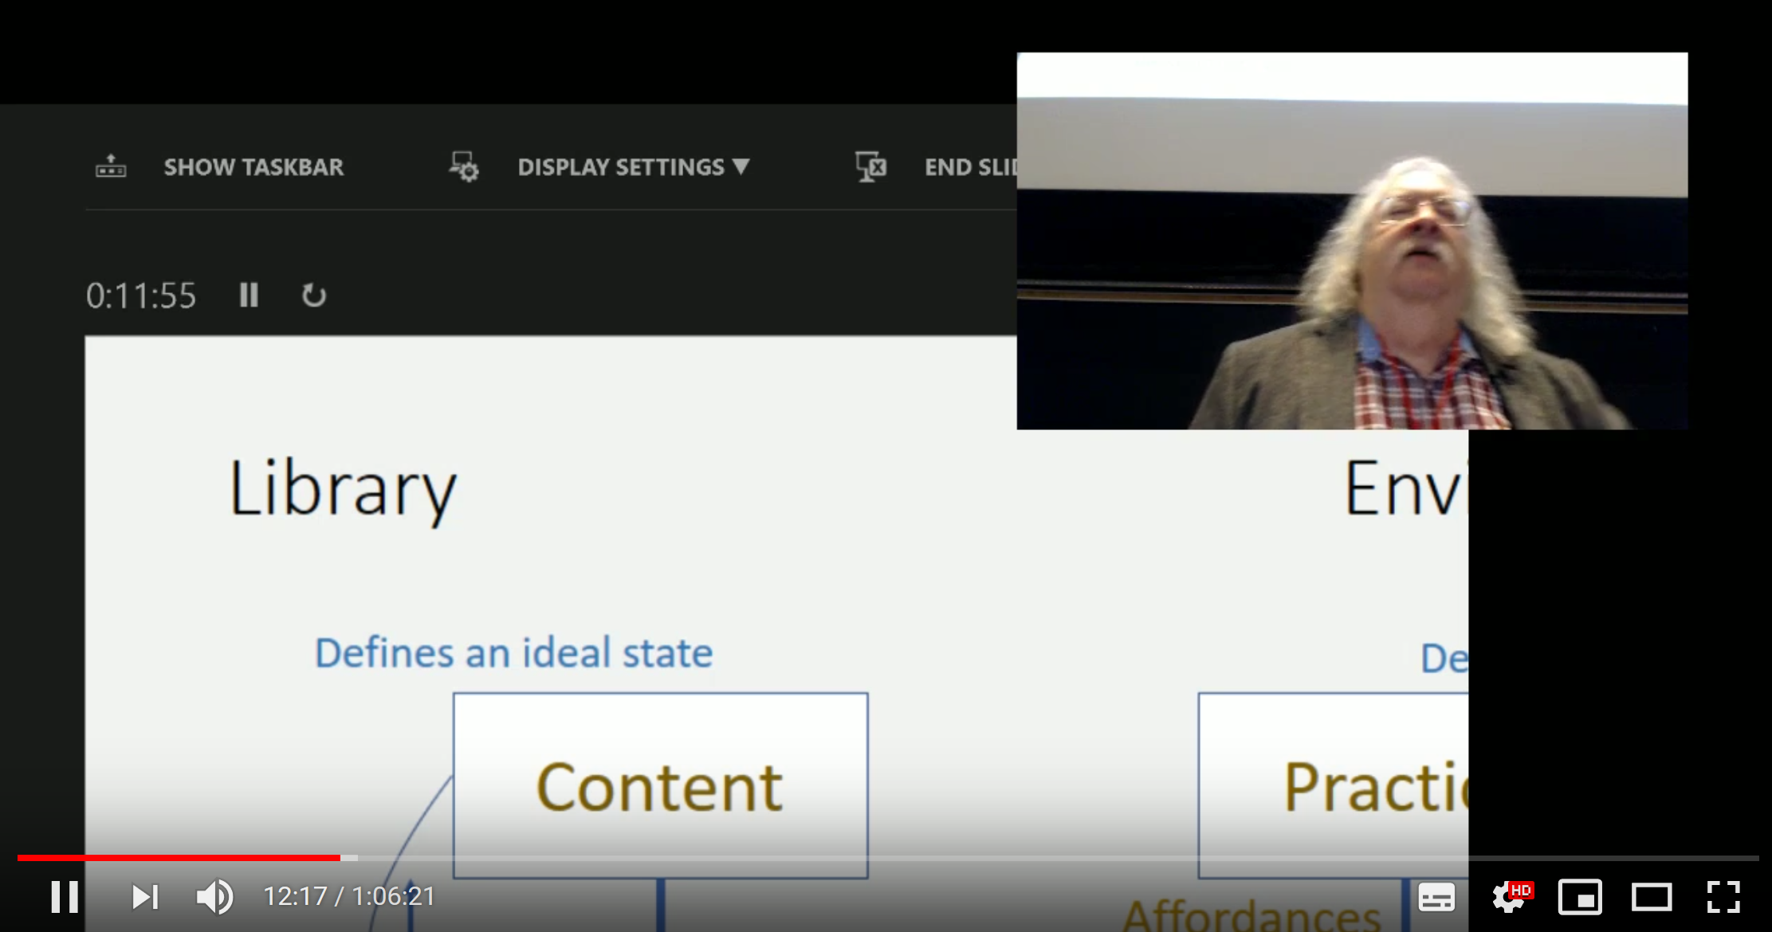
Preliminaries: The Webcast
This talk is being webcast on YouTube Live
https://www.youtube.com/watch?v=JMqi7rsnWxg
YouTube channel (for other videos): https://www.youtube.com/user/StephenDownes

Slide 4
Preliminaries: The Backchannel
Faculty: Stephen Downes
Relationships with commercial interests
None
Where I get Money
I work for the National Research Council of Canada
Some external consulting for agencies and NGOs
Donations on my website - www.downes.ca/donate.htm
Expenses for talks - www.downes.ca/presentations.htm

Slide 5
Preliminaries: Objectives
Assess learning technologies from the perspective of affordances
Describe core elements of a personal learning environment
Identify emerging trends in continuing professional development

Slide 6
Preliminaries: Contents
Affordances
Personal Learning
Old Problems
Evidence

Slide 7
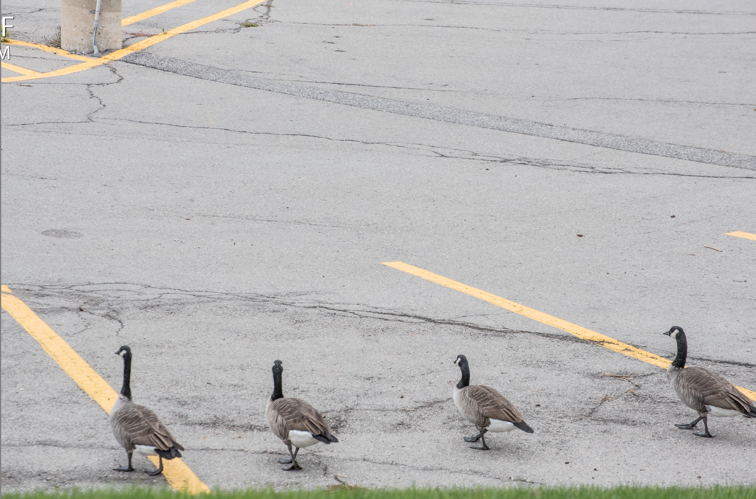
1. Affordances

Slide 8
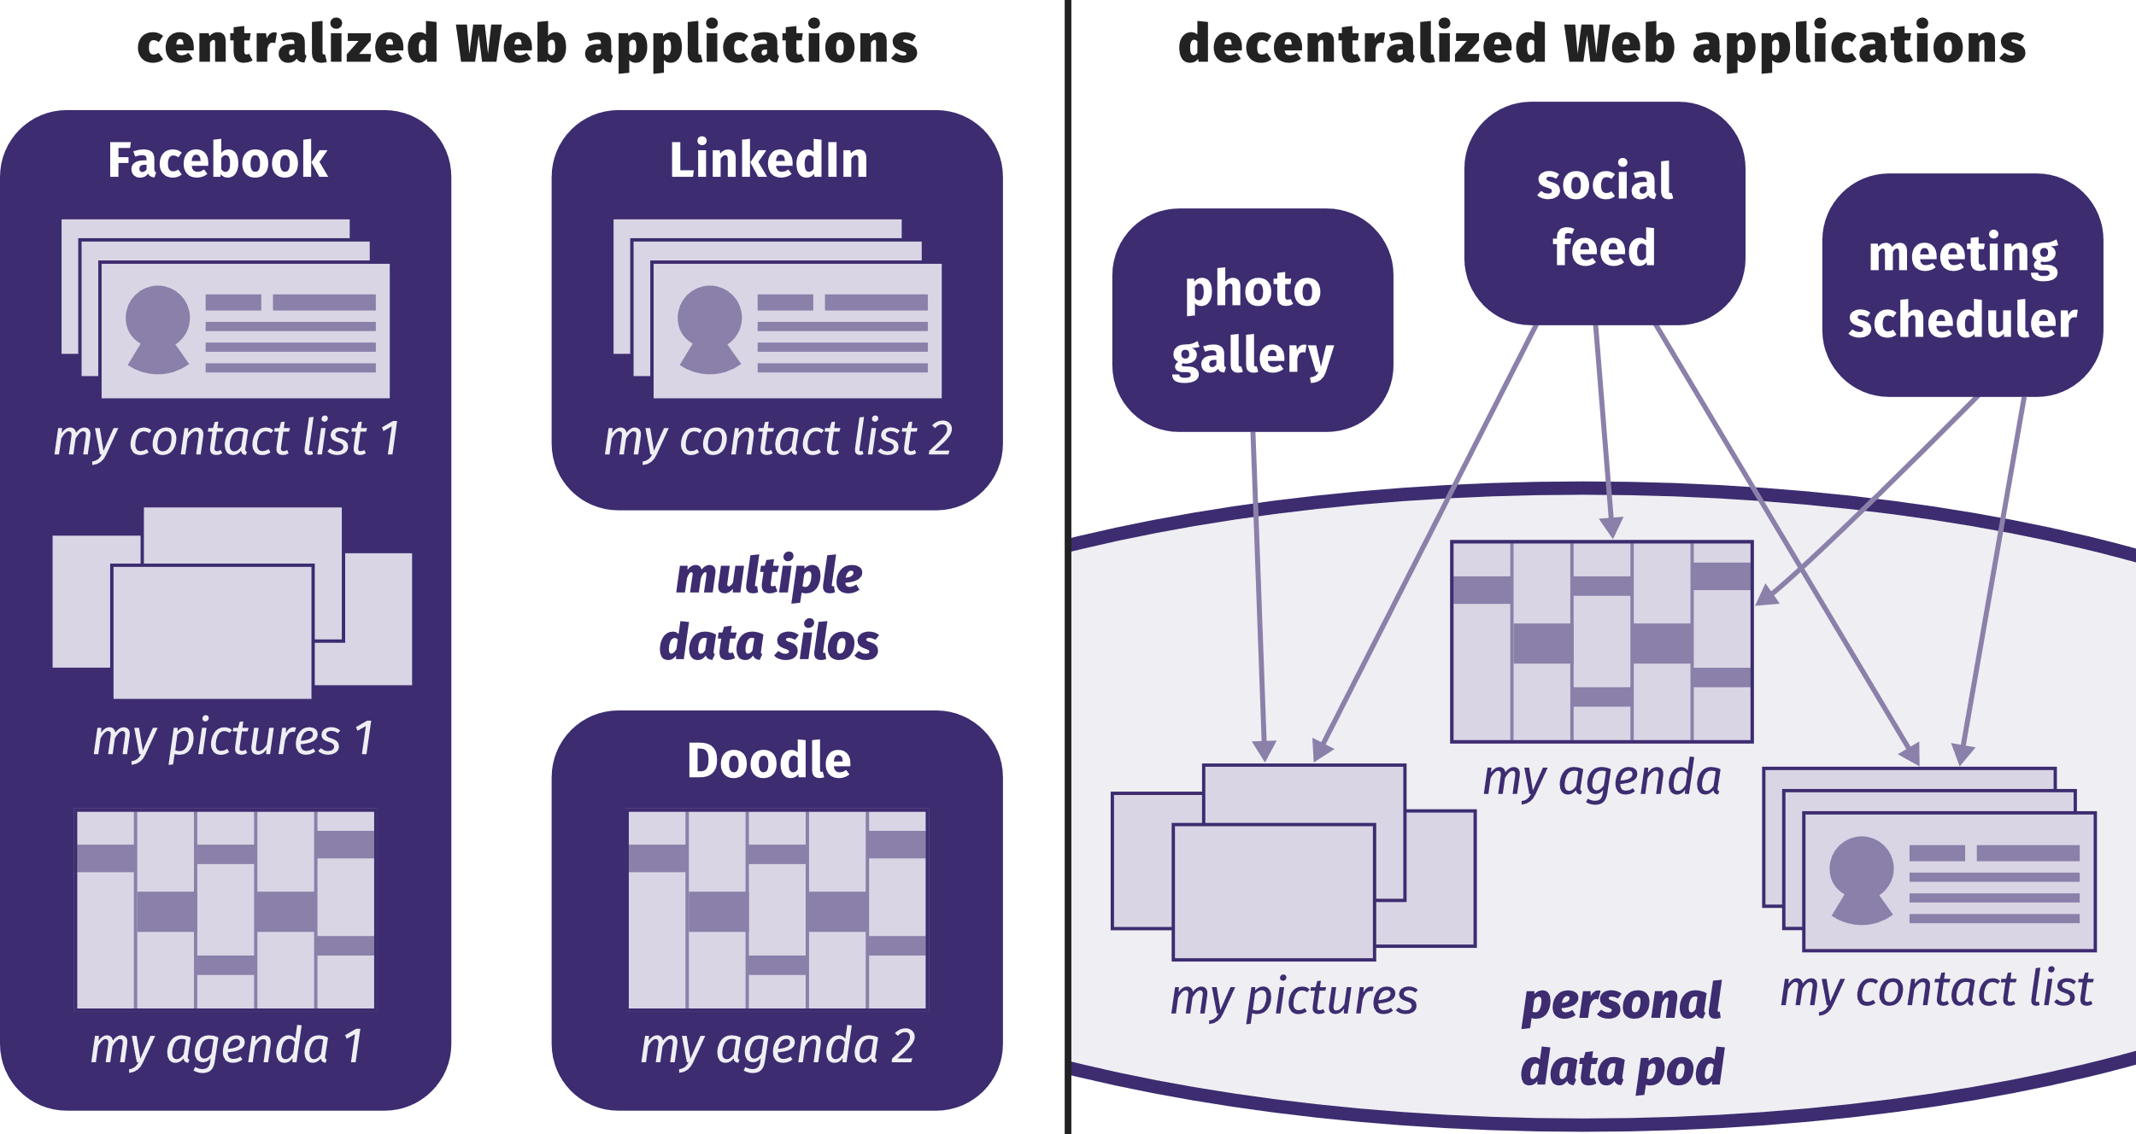
Solid / Inrupt
On Saturday Tim Berners-Lee announced he was launching a startup to develop and distribute his SoLiD application (which stands for Social Linked Data)
https://ruben.verborgh.org/blog/2017/12/20/paradigm-shifts-for-the-decentralized-web/
https://www.downes.ca/post/68660

Slide 9

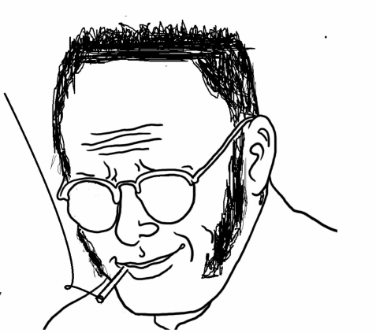
The State The Individual

Slide 10
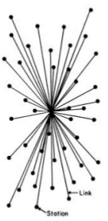

The State The Individual

Slide 11
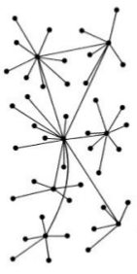
The State The Individual

Slide 12
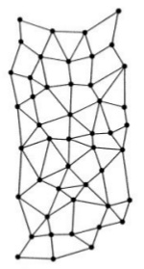
The State The Network The Individual

Slide 13
Groups Networks

Slide 14



Groups Networks
SAMENESS
AFFINITY
Collectives
Communities
ONE WAY
MANY WAYS

Slide 15
Groups Networks
SAMENESS
AFFINITY
Collectives
Communities
ONE WAY
MANY WAYS
Metallic - Elemental
Organic - Biological
UNITY | DIVERSITY
COORDINATION | AUTONOMY
CLOSED | OPENNESS
DISTRIBUTIVE | INTERACTIVE
VISION
STATEMENT
SOMETIMES EVEN PURITY
MELTING POT
MIXTURES
SALAD BOWL

Slide 16
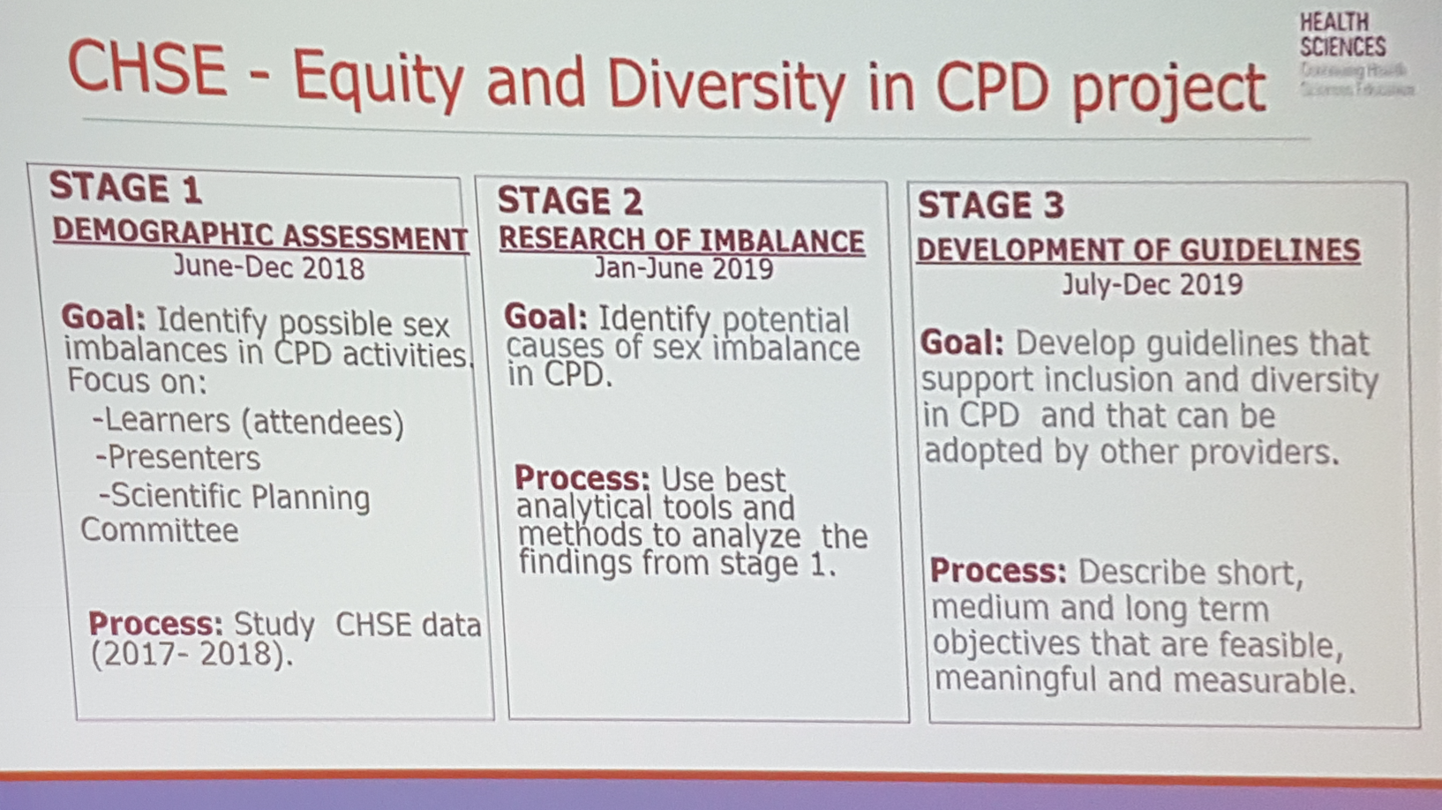
Metallic - Elemental
Organic - Biological
UNITY | DIVERSITY
COORDINATION | AUTONOMY
CLOSED | OPENNESS
DISTRIBUTIVE | INTERACTIVE
VISION
STATEMENT
SOMETIMES EVEN PURITY
MELTING POT
MIXTURES
SALAD BOWL
McMaster Health Sciences

Slide 17
Groups Networks
SAMENESS
AFFINITY
Collectives
Communities
ONE WAY
MANY WAYS
Metallic - Elemental
Organic - Biological
UNITY | DIVERSITY
COORDINATION | AUTONOMY
CLOSED | OPENNESS
DISTRIBUTIVE | INTERACTIVE
VISION
STATEMENT
SOMETIMES EVEN PURITY
MELTING POT
MIXTURES
SALAD BOWL
LEADERS! COLLABORATION
GROUP VALUE
(= LEADER VALUE)
COOPERATION
EXCHANGE
MUTUAL VA:UE

Slide 18
Groups Networks
SAMENESS
AFFINITY
Collectives
Communities
ONE WAY
MANY WAYS
Metallic - Elemental
Organic - Biological
UNITY | DIVERSITY
COORDINATION | AUTONOMY
CLOSED | OPENNESS
DISTRIBUTIVE | INTERACTIVE
VISION
STATEMENT
SOMETIMES EVEN PURITY
MELTING POT
MIXTURES
SALAD BOWL
LEADERS! COLLABORATION
GROUP VALUE
(= LEADER VALUE)
COOPERATION
EXCHANGE
MUTUAL VA:UE
LOCK-IN
MEMBERSHIP / IN CAMERA
STANDARDS - JARGON
WALLS
CONNECTION
PERSPECTIVE / CONTEXT
BRIDGES

Slide 19
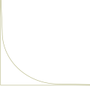
Groups Networks
SAMENESS
AFFINITY
Collectives
Communities
ONE WAY
MANY WAYS
Metallic - Elemental
Organic - Biological
UNITY | DIVERSITY
COORDINATION | AUTONOMY
CLOSED | OPENNESS
DISTRIBUTIVE | INTERACTIVITY
VISION
STATEMENT
SOMETIMES EVEN PURITY
MELTING POT
MIXTURES
SALAD BOWL
LEADERS! COLLABORATION
GROUP VALUE
(= LEADER VALUE)
COOPERATION
EXCHANGE
MUTUAL VA:UE
LOCK-IN
MEMBERSHIP / IN CAMERA
STANDARDS - JARGON
WALLS
CONNECTION
PERSPECTIVE / CONTEXT
BRIDGES
AKA
TRICKLE DOWN
BROADCAST
STARS AND GURUS
CENTRALIZED
POWER – POWER LAWS
CONVERSATION
DISTRIBUTED
DEMOCRACY (OR POST-DEMOCRACY)
KNOWLEDGE
EMERGES
RICH
KNOWLEDGE,
LIKE MONEY,
FLOWS FROM AUTHORITY
POOR

Slide 20


Groups Networks
SAMENESS
AFFINITY
Collectives
Communities
ONE WAY
MANY WAYS
Metallic - Elemental
Organic - Biological
UNITY | DIVERSITY
COORDINATION | AUTONOMY
CLOSED | OPENNESS
DISTRIBUTIVE | INTERACTIVITY
VISION
STATEMENT
SOMETIMES EVEN PURITY
MELTING POT
MIXTURES
SALAD BOWL
LEADERS! COLLABORATION
GROUP VALUE
(= LEADER VALUE)
COOPERATION
EXCHANGE
MUTUAL VA:UE
LOCK-IN
MEMBERSHIP / IN CAMERA
STANDARDS - JARGON
WALLS
CONNECTION
PERSPECTIVE / CONTEXT
BRIDGES
AKA
TRICKLE DOWN
BROADCAST
STARS AND GURUS
CENTRALIZED
POWER – POWER LAWS
CONVERSATION
DISTRIBUTED
DEMOCRACY (OR POST-DEMOCRACY)
KNOWLEDGE
EMERGES
RICH
KNOWLEDGE,
LIKE MONEY,
FLOWS FROM AUTHORITY
POOR

Slide 21
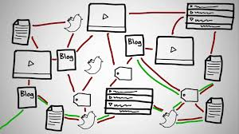
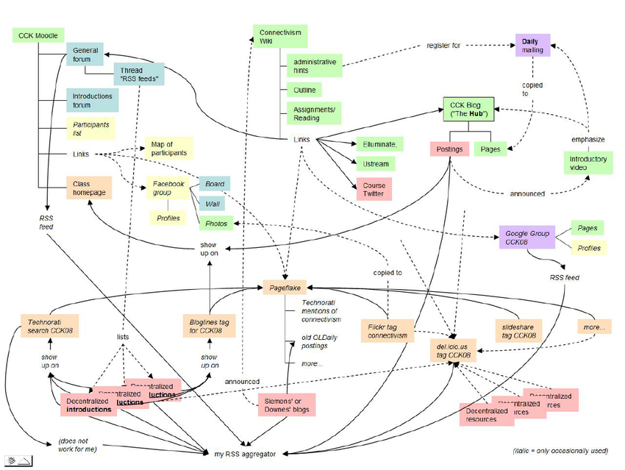
The MOOC: Course as Network

Slide 22
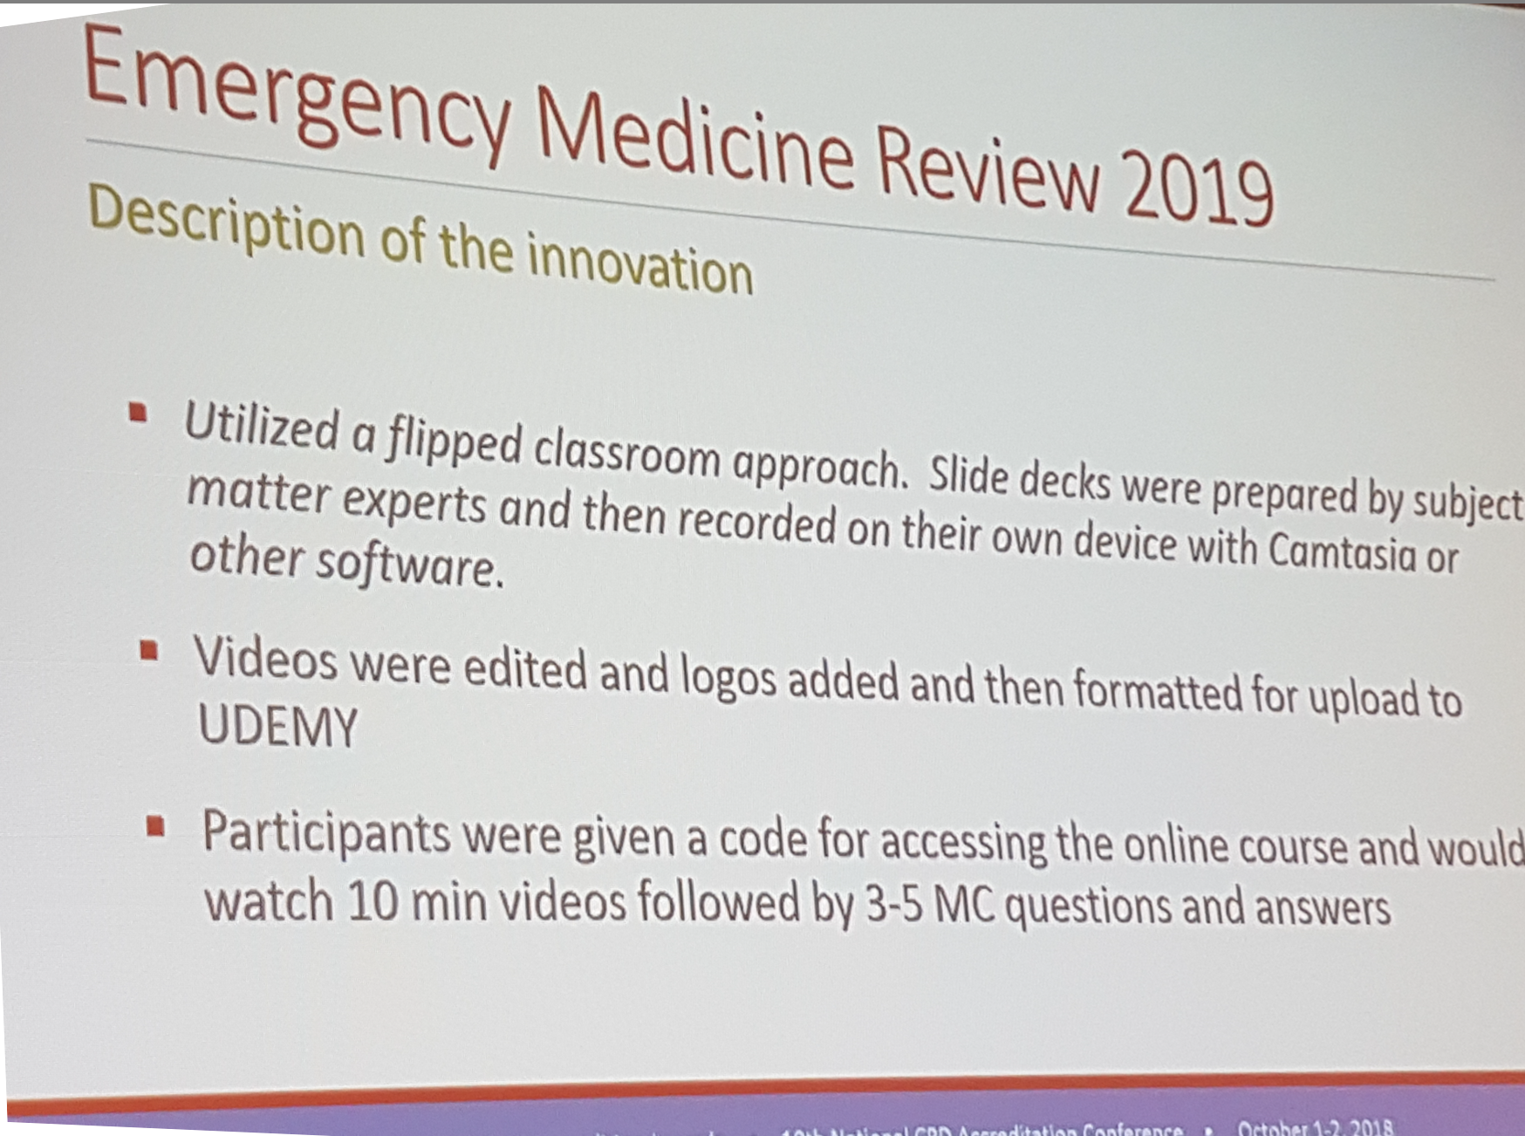

The MOOC: Course as Course?
A contrast between two approaches…
Mark Mensour
CAEP

Slide 23
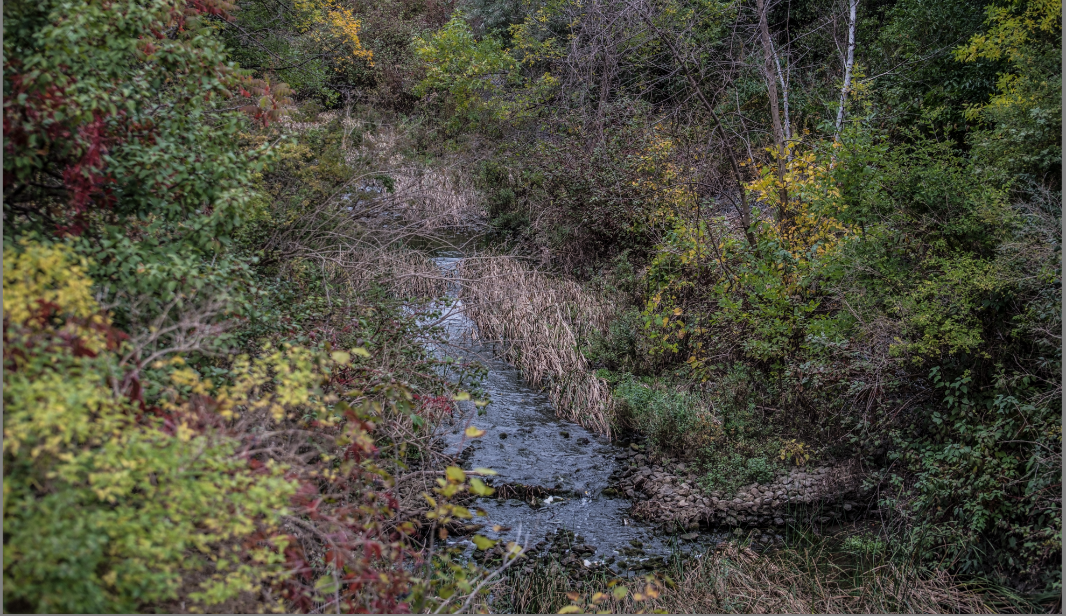
2. Personal Learning

Slide 24
Two Approaches…
Content
Practice
Practice
Content

Slide 25
Two Approaches…
Defines an ideal state
Defines a desired state
Content
Practice
Practice
Content
TEST
TRY
Person tests you
Person helps you

Slide 26
Two Approaches…
Defines an ideal state
Defines a desired state
Content
Practice
Correction
Iteration
GAP
Practice
Content
Opport-unity
TEST
TRY
Person tests you
Person helps you

Slide 27
Library Environment
Defines an ideal state
Defines a desired state
Content
Practice
Affordances
Correction
Requirements
Iteration
GAP
Content
Opport-unity
Practice
TEST
TRY
Person tests you
Person helps you

Slide 28
Personalized Personal
We do for you You do for yourself
Defines an ideal state
Defines a desired state
Content
Practice
Affordances
Correction
Requirements
Iteration
GAP
Practice
Content
Opport-unity
TEST
TRY
Person tests you
Person helps you

Slide 29
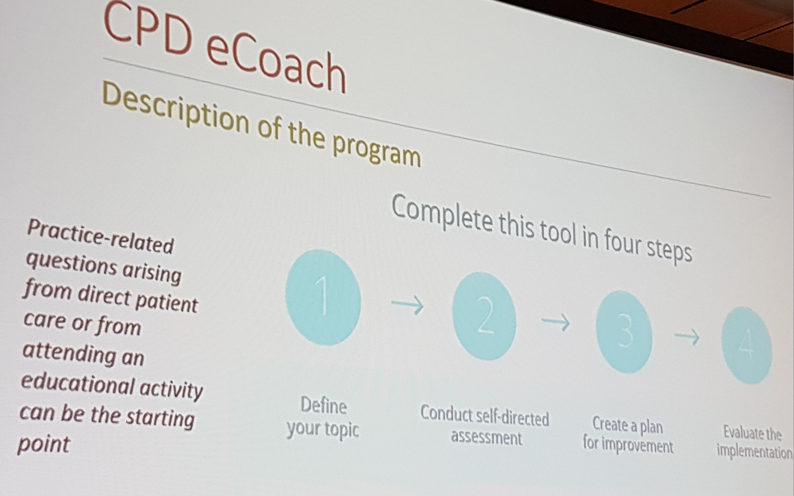
Self-Designed, Self-Directed
Bob Blumen
UBC CPD

Slide 30
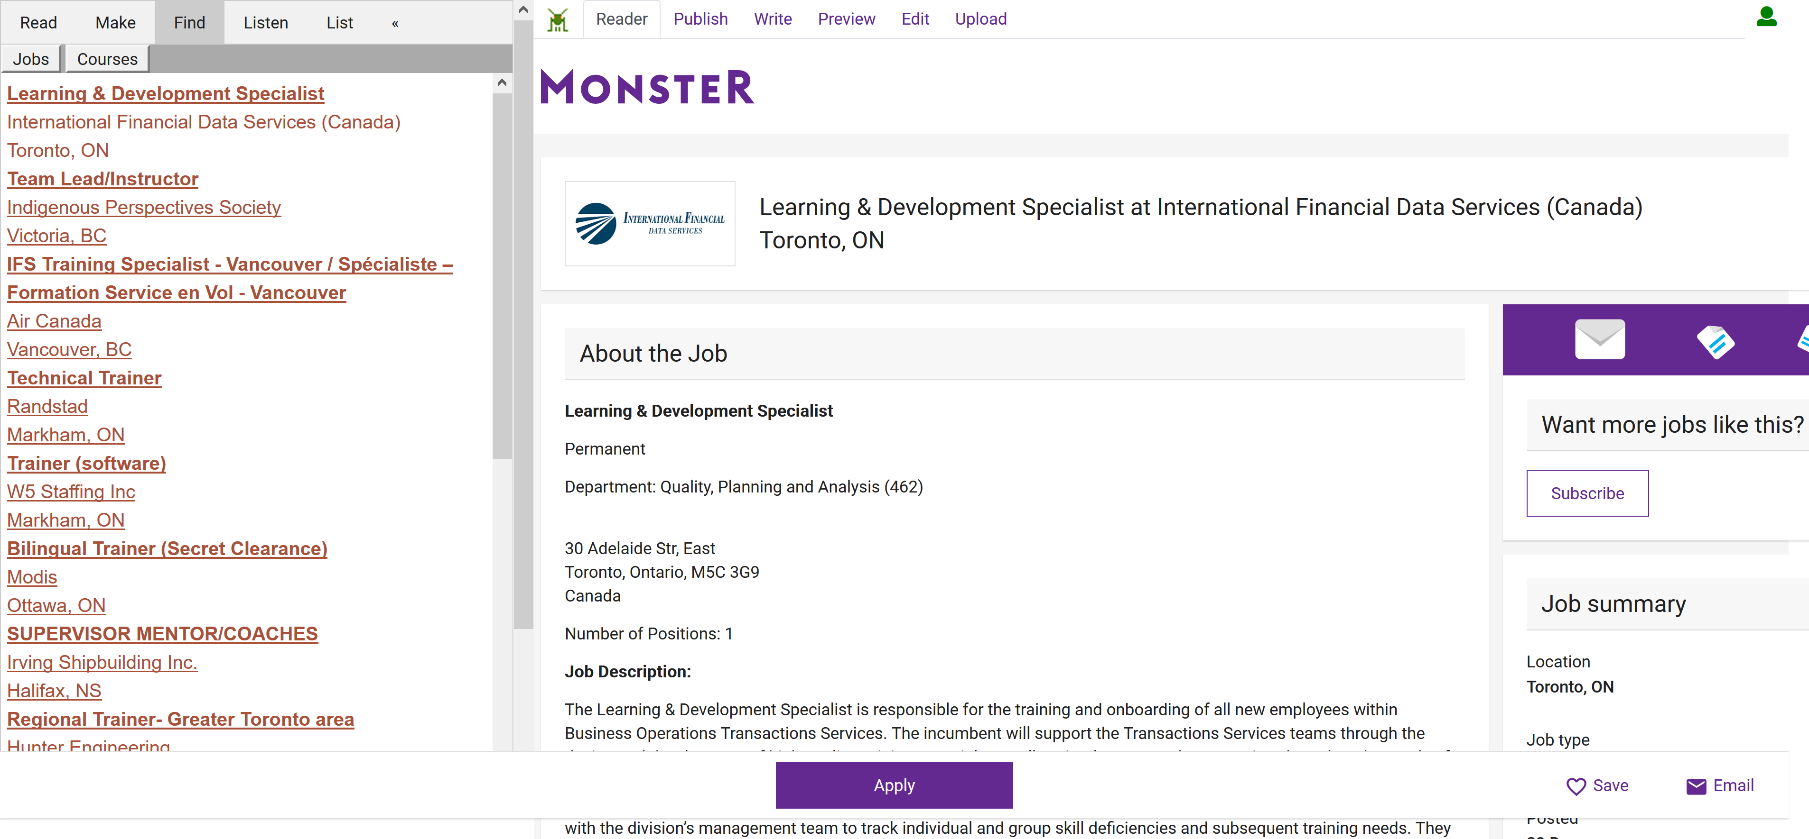
Look for a job, contract, project…

Slide 31
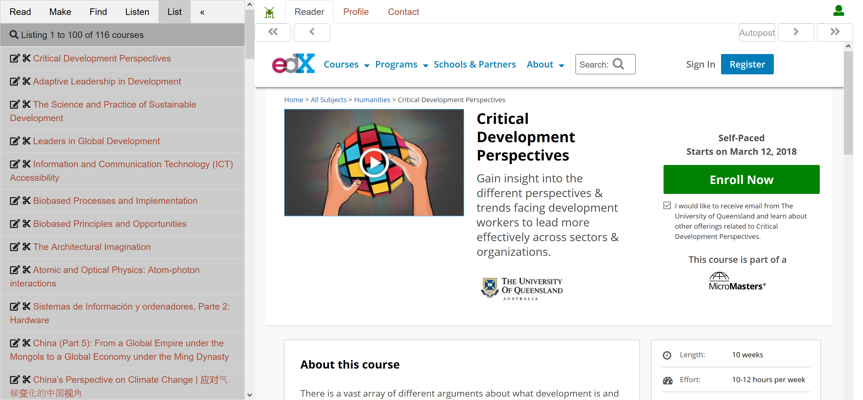
Register for the course

Slide 32
Personal Learning Workflow
Personal
Context
Article
Photograph
Video
Person
Author
Publisher
Organization
Job Opportunity
Competency
Cetrificate
Event
Location / Place
Time / Date
Email
RSS
OAI
Sharepoint
Facebook
Twitter
Monster
Government
Repositories
Desire2Learn
Coursera
EdX
etc
Parsing
Scraping
Analytics
etc
Storage
RELATIONS

Slide 33
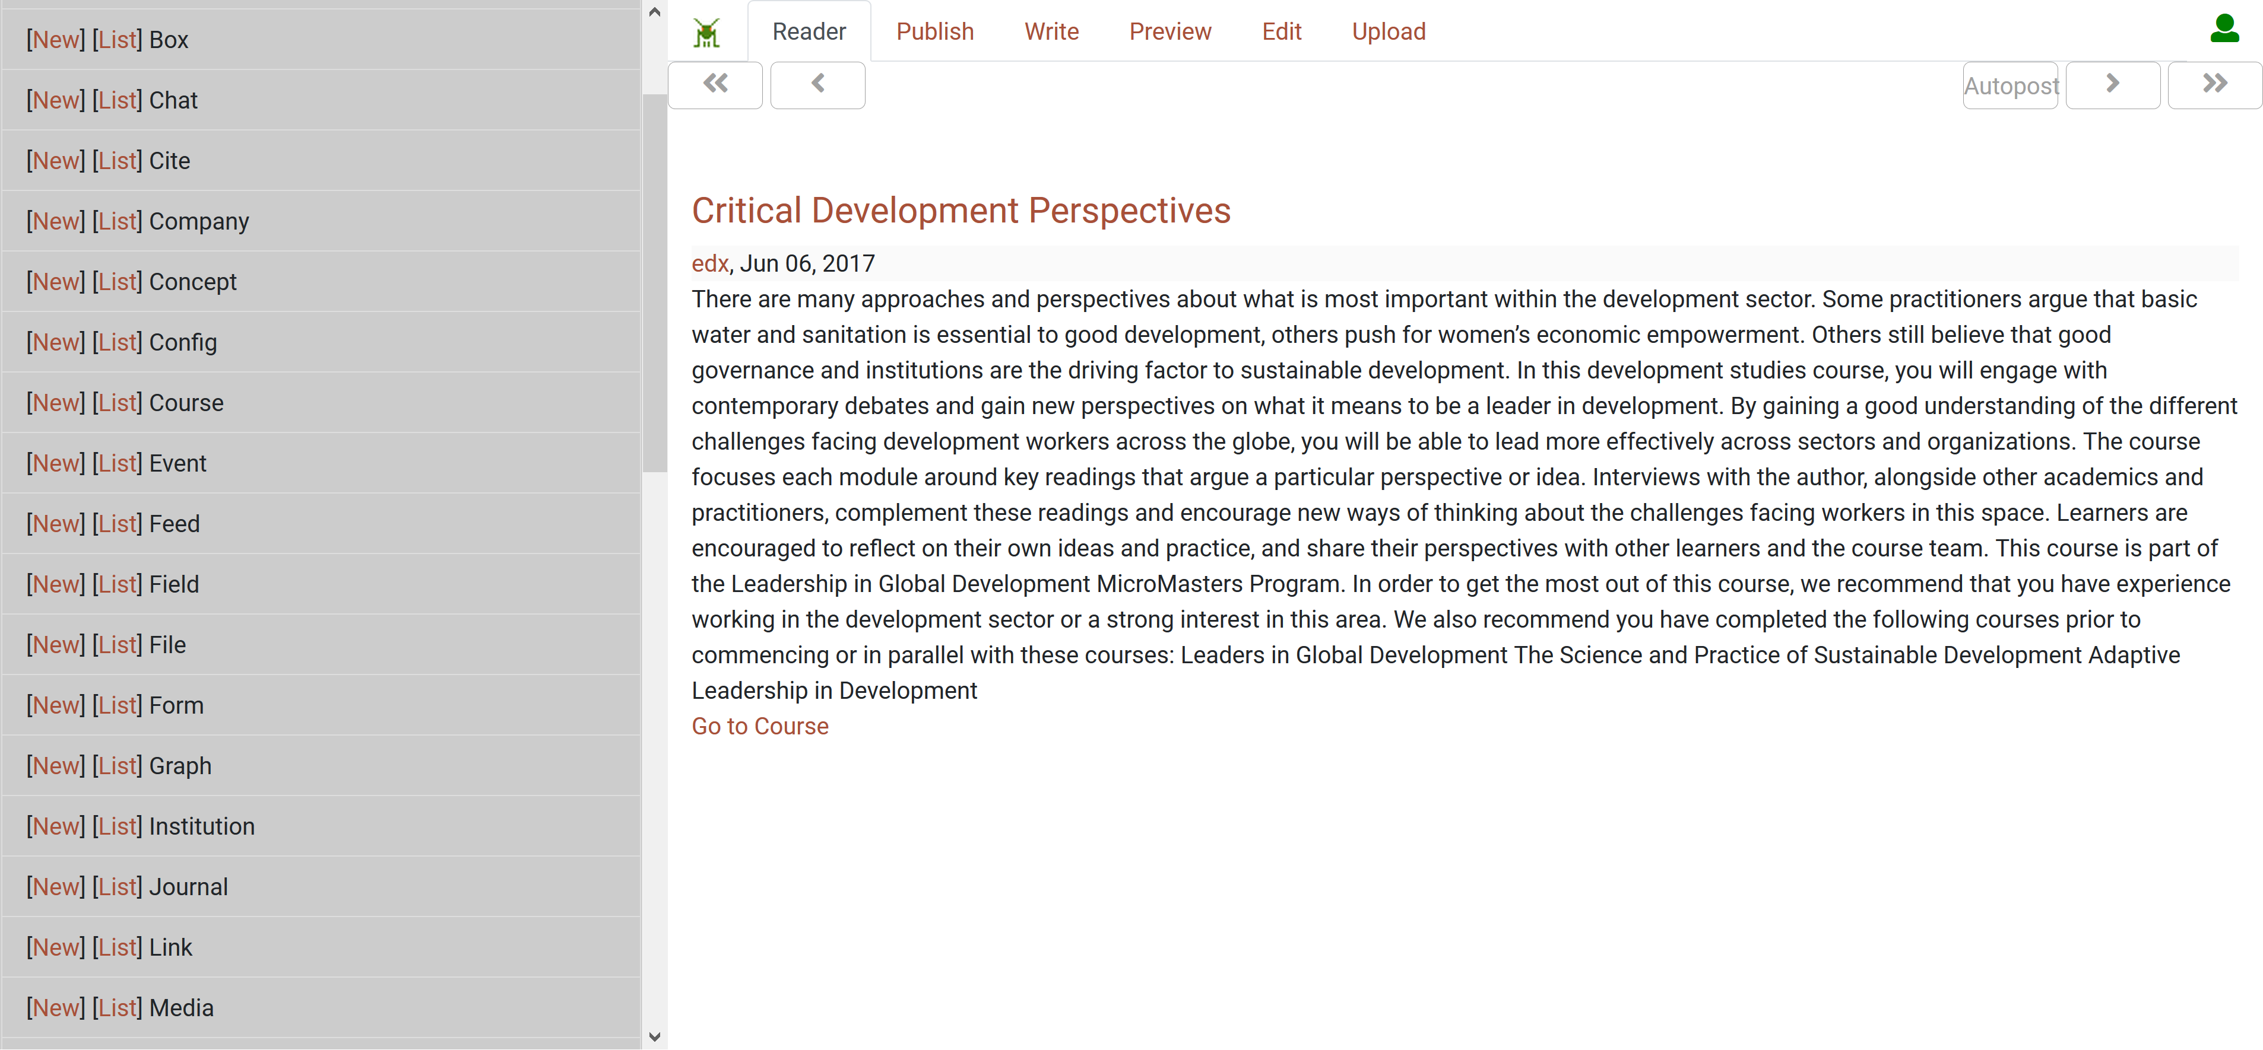
Work with various data types

Slide 34
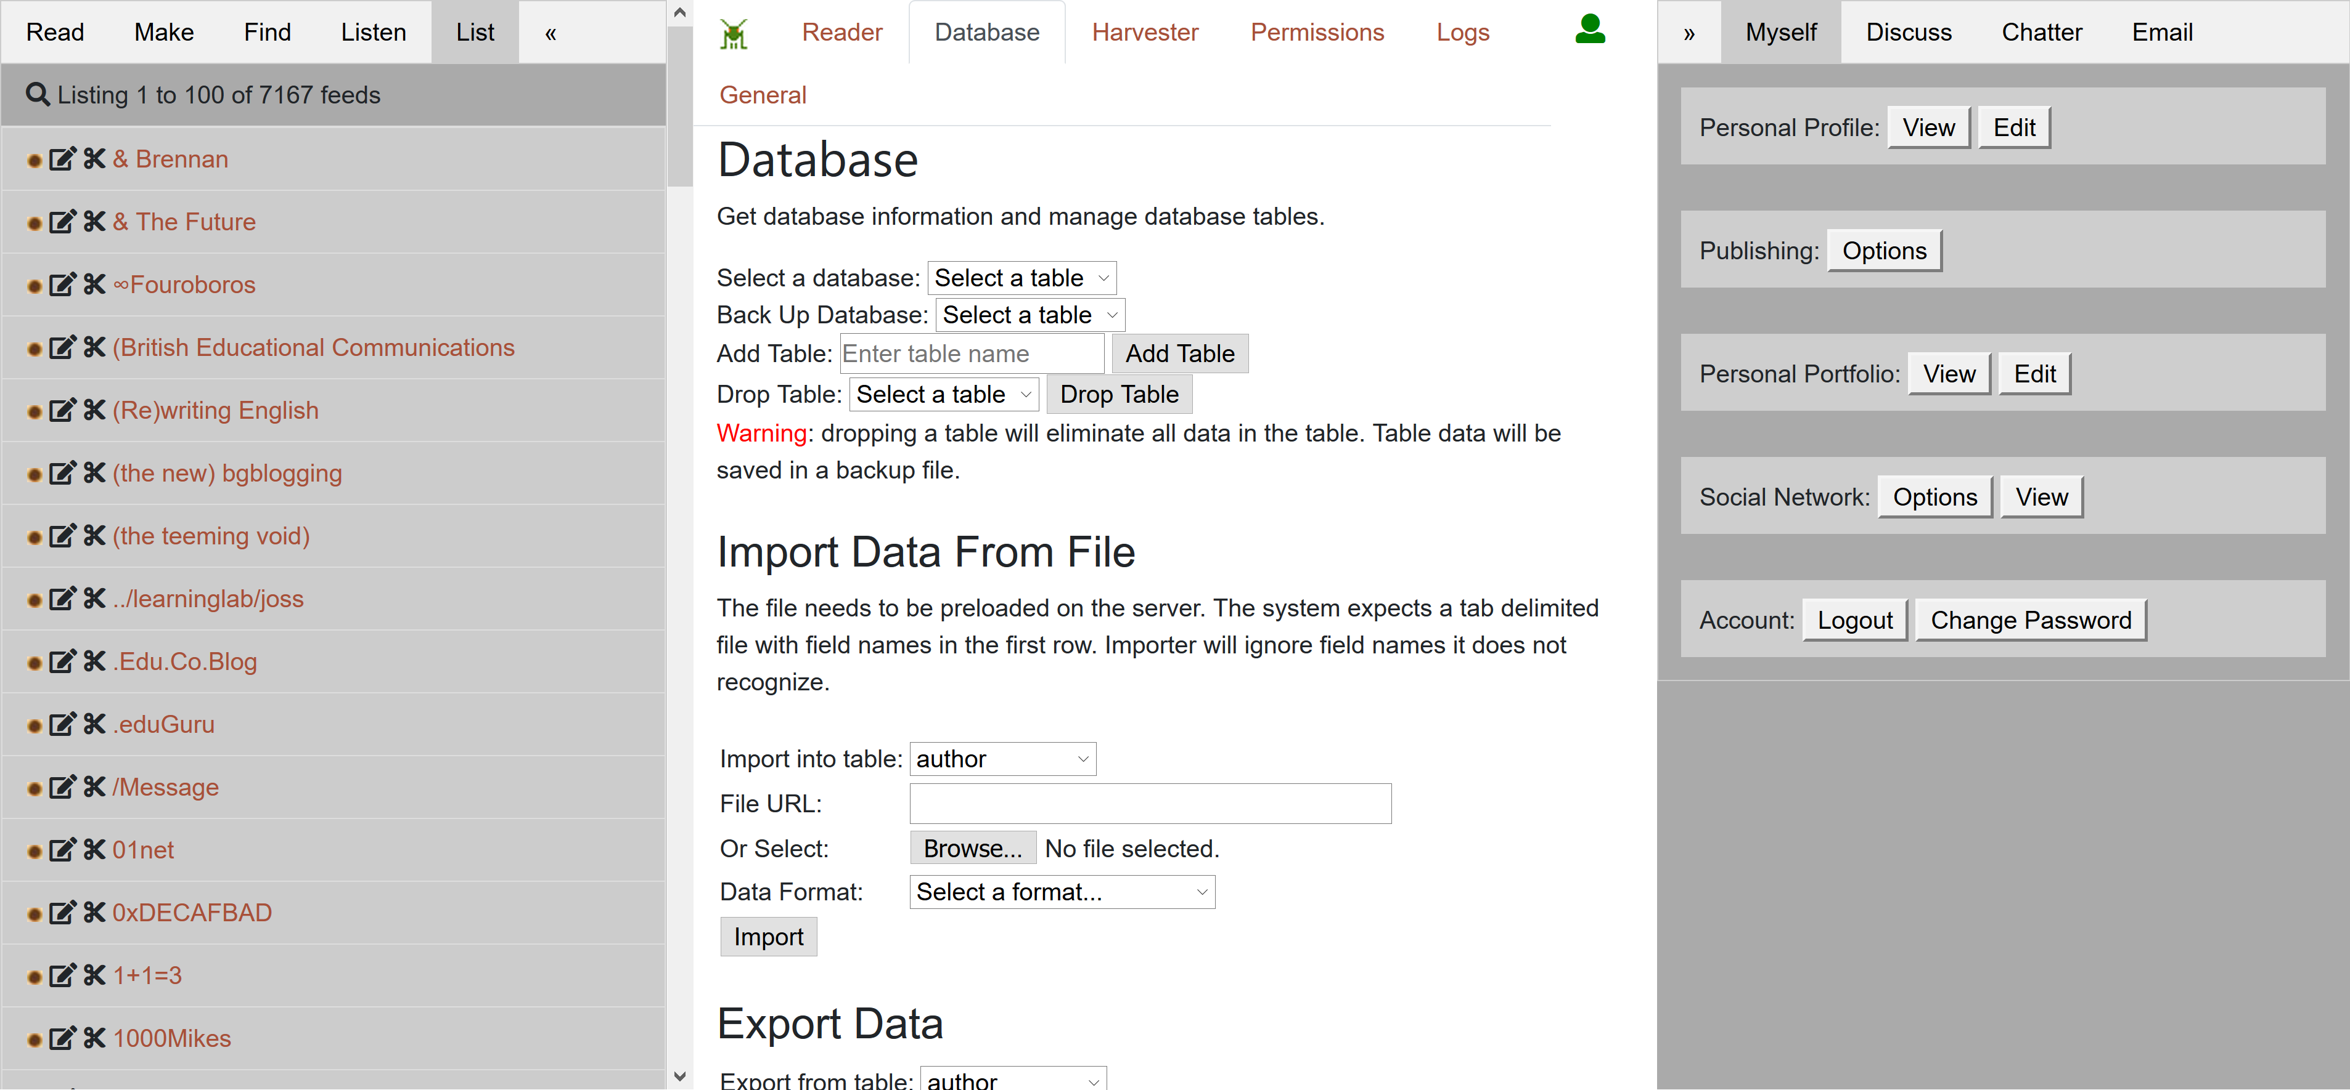
Creating my personal learning record

Slide 35
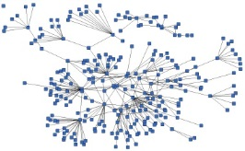
Creating my Personal Learning Record
Stuff Goes Out
Stuff Comes In
Learning Activities
I read and watch stuff
I play with toys
I make stuff
Things, Properties, Relations
Things I did
Stuff I make
Big stuff goes here
Me
Questions
Personal Library
Pictures
Books
Movies
Answers
Learning Analytics Services

Slide 36
Creating my Personal Learning Record
This is a new type of data – it’s called the personal graph.
Each person has their own private personal graph.
The PLR contains all a person’s learning records, including:
certificates, badges and credentials
activity records, test results, scores
Assignments, papers, drawings, things they create
Me

Slide 37

3. Old Problems

Slide 38
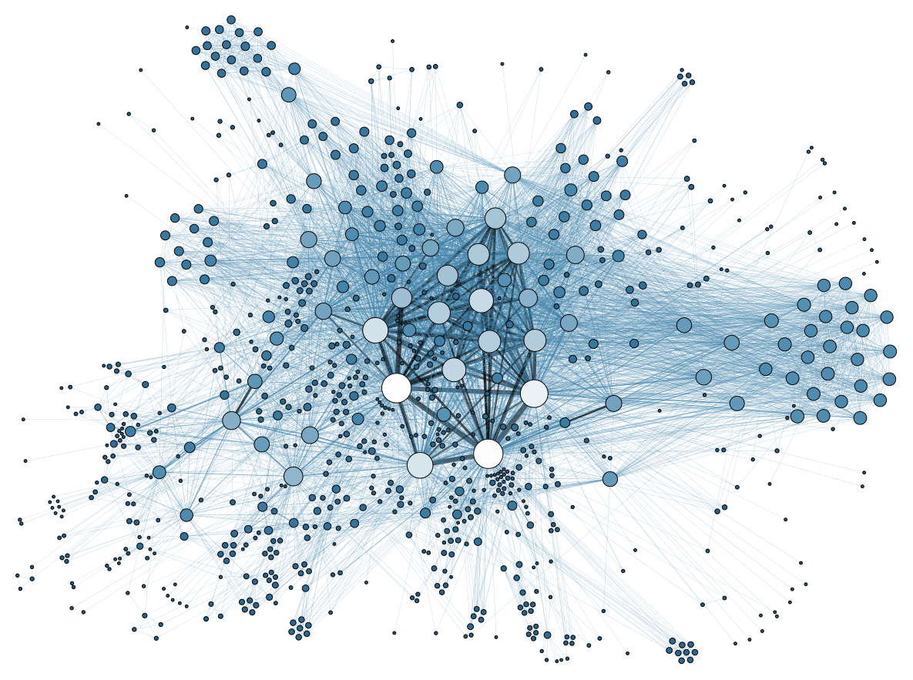
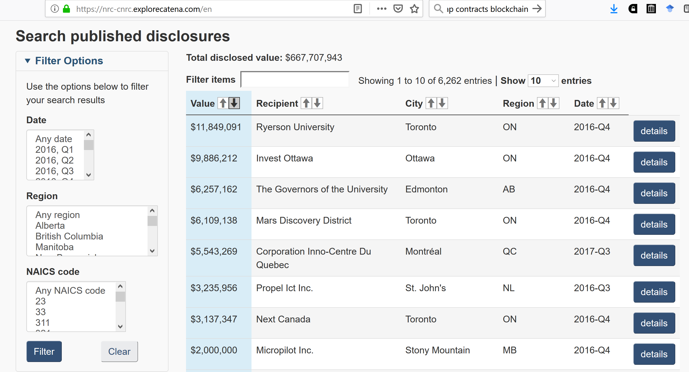
Managing Conflicts of Interest
https://nrc-cnrc.explorecatena.com/en

Slide 39

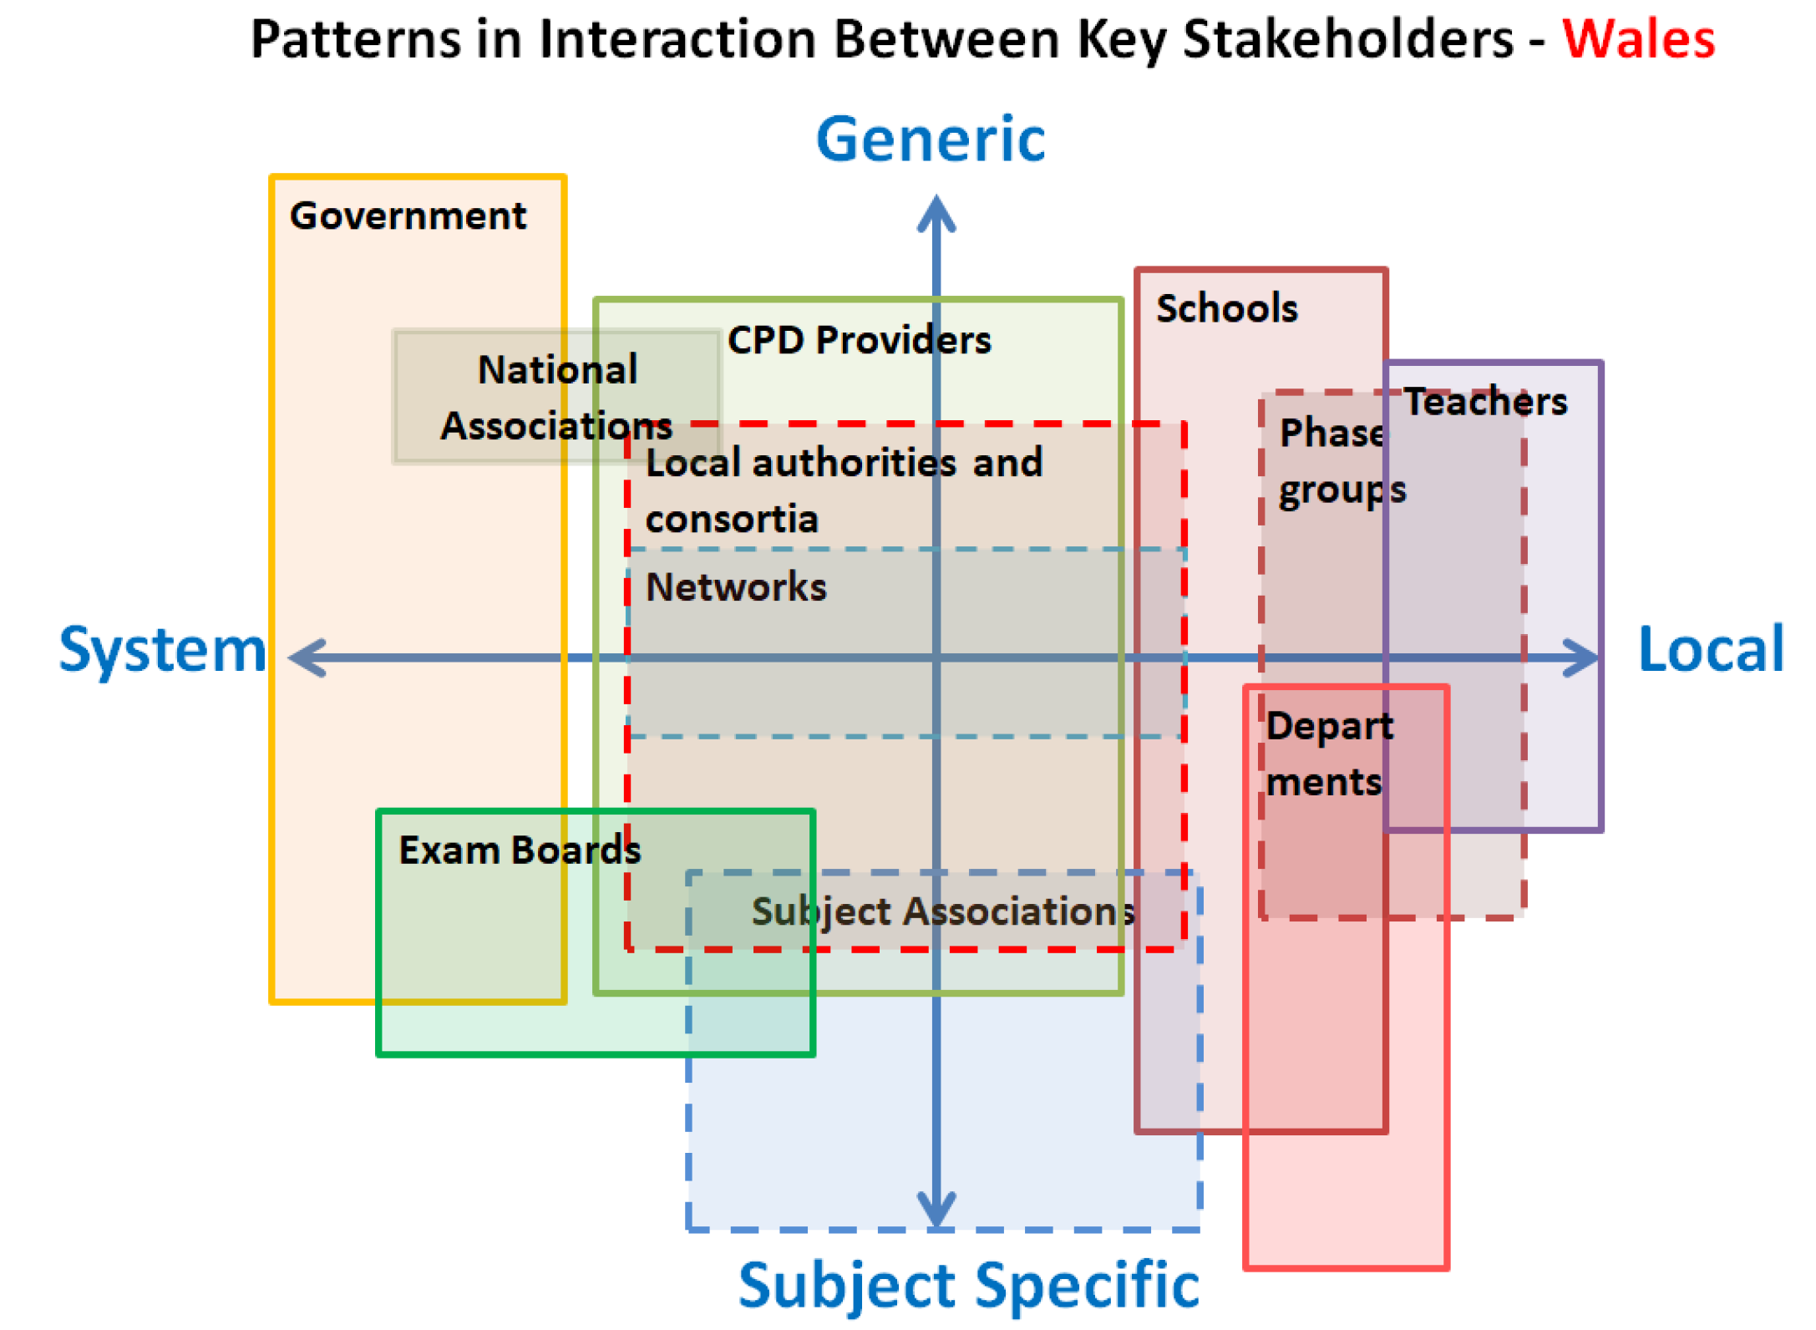
Funding of CPD
https://ispe.org/ispeak/communities-of-practice-whats-that
https://wellcome.ac.uk/sites/default/files/developing-great-subject-teaching.pdf

Slide 40
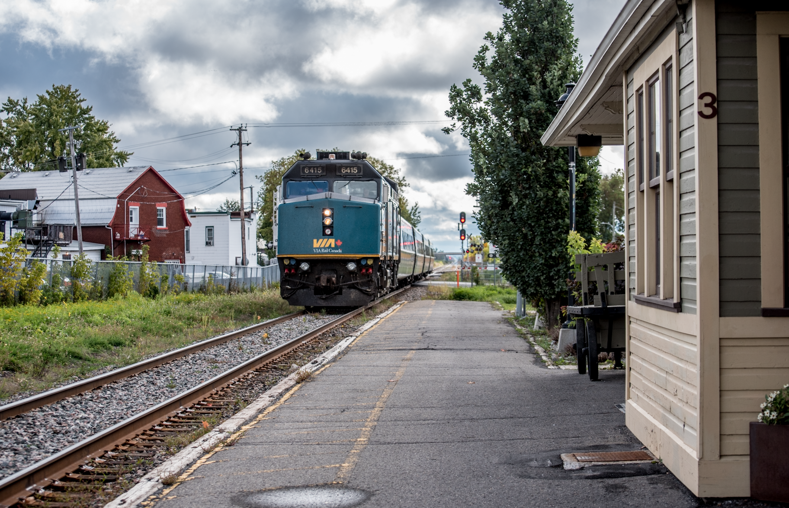
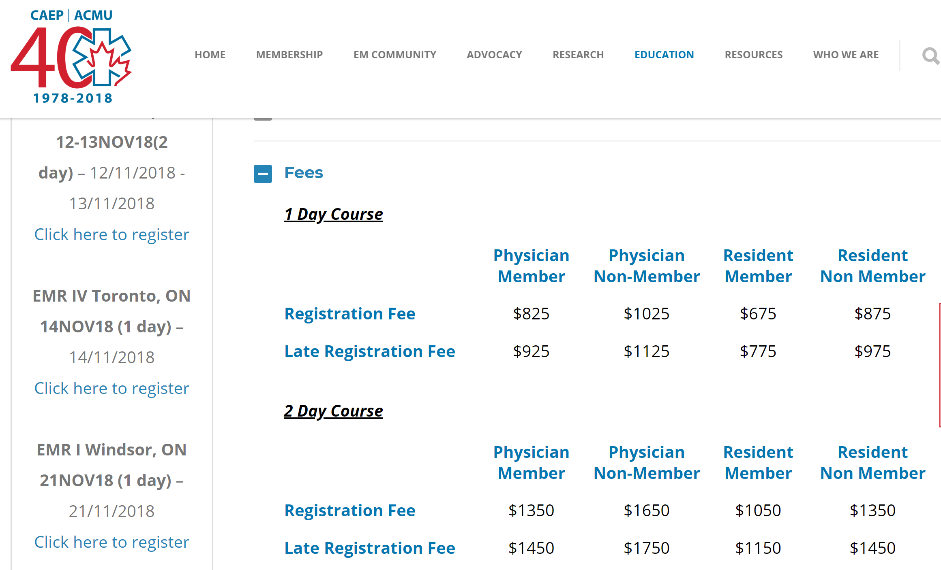
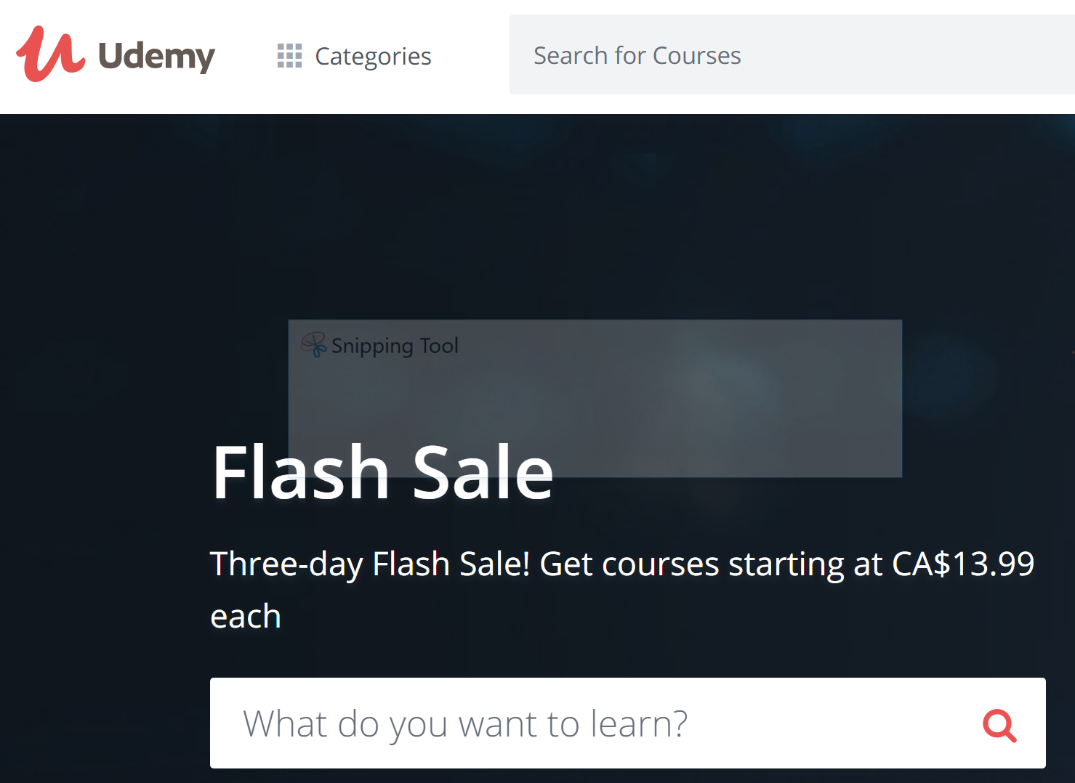
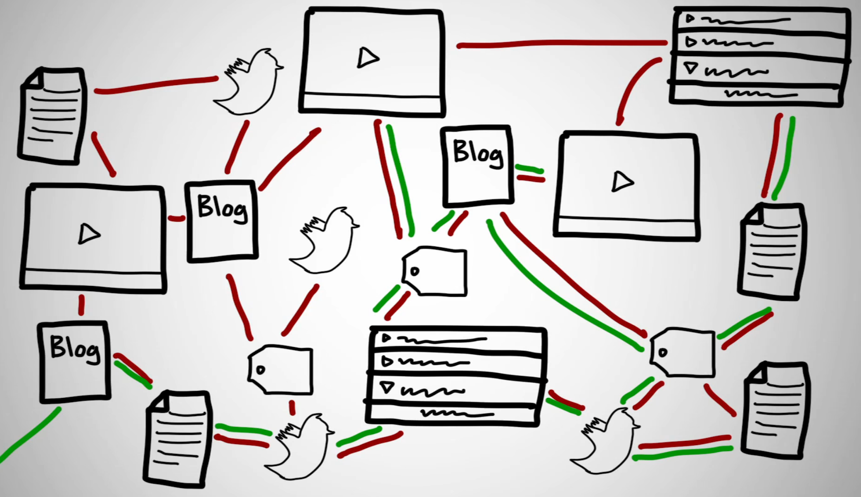
Access to CPD

Slide 41
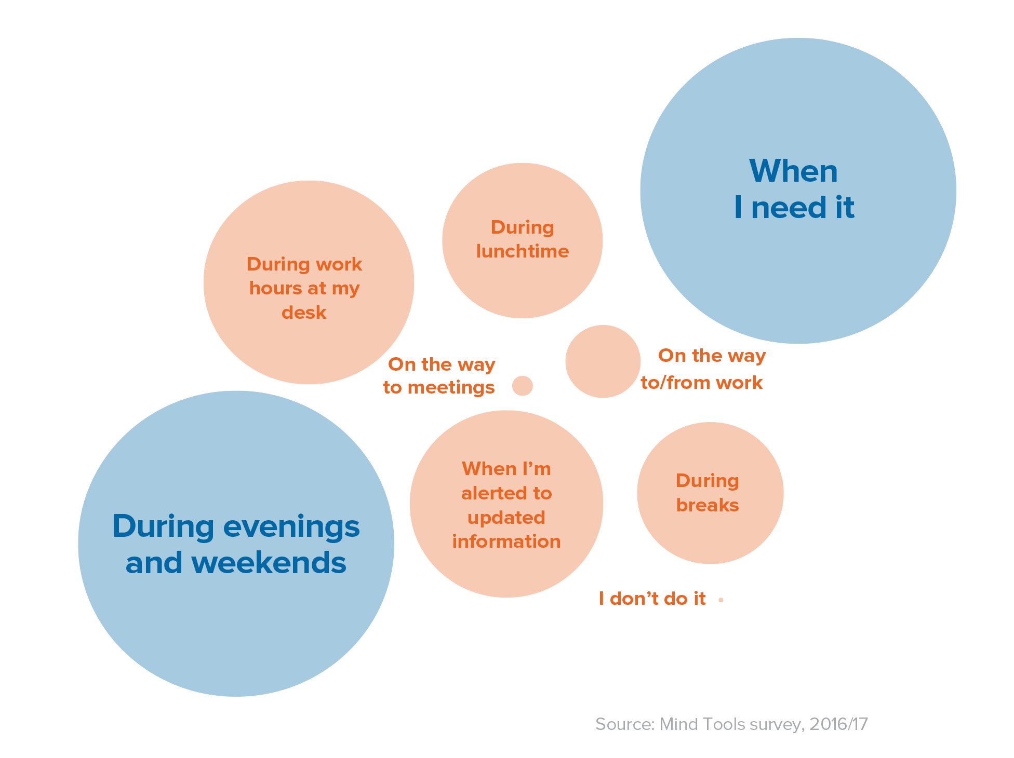
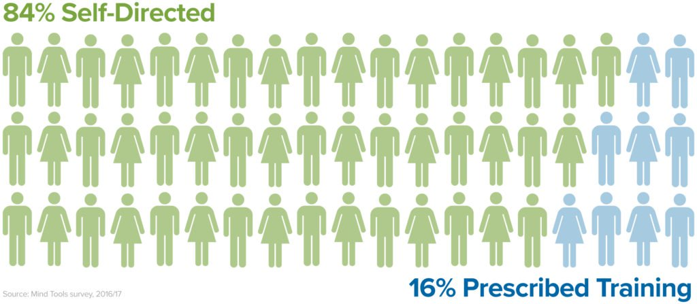
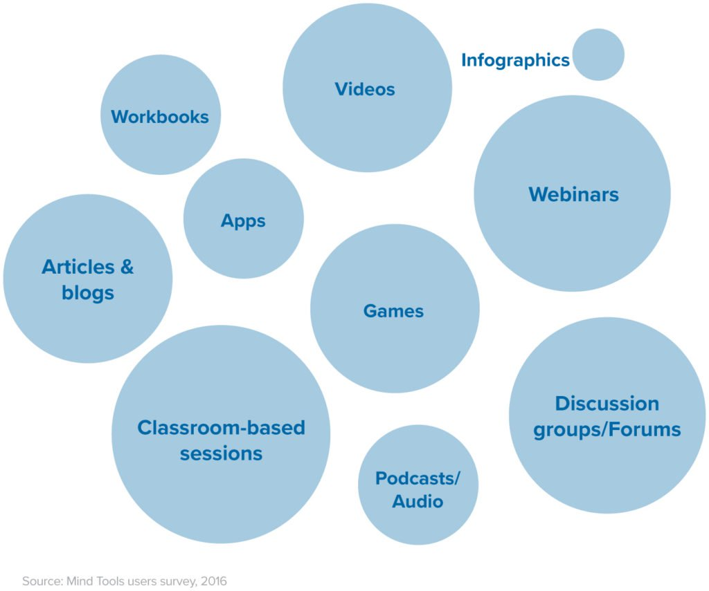
Identifying Learner Needs
https://www.mindtools.com/blog/corporate/consumer-learner-expectations/
The Delphi Process?

Slide 42
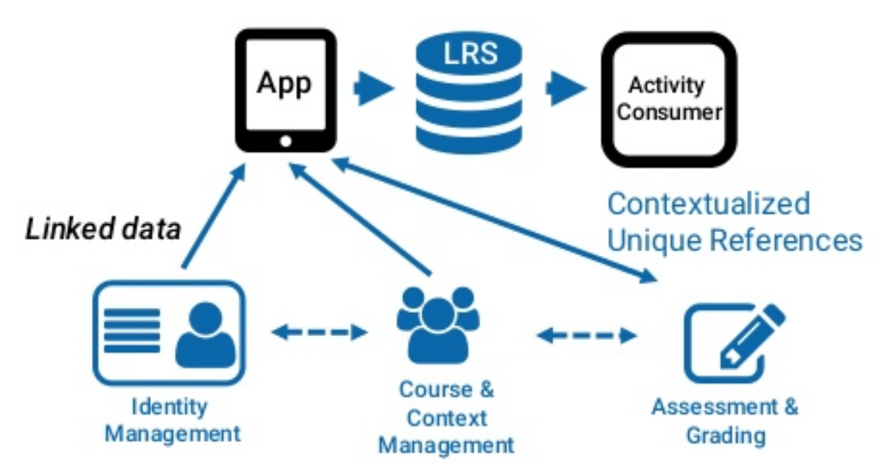
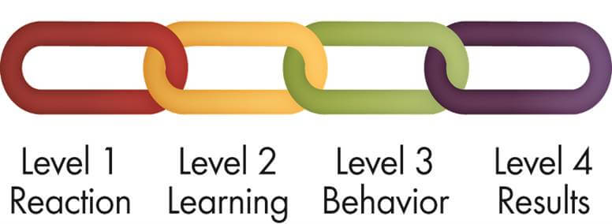
Measuring Outcomes
xAPI
https://www.slideshare.net/phish108/bridging-xapi-into-higher-education-learning-analytics-ownership-and-privacy
https://www.kirkpatrickpartners.com/Our-Philosophy/The-Kirkpatrick-Model

Slide 43
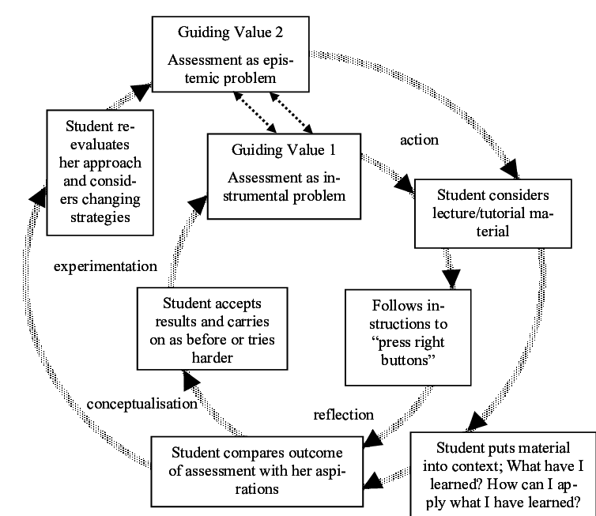
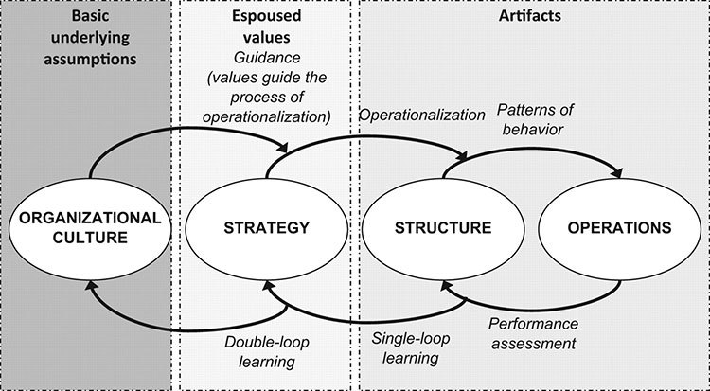
Improving patient outcomes
Double Loop
https://shiftworkplace.com/trying-teach-something-link-organizational-learning-polar-bears/
https://www.researchgate.net/figure/Assessment-as-double-loop-learning_fig1_252709657

Slide 44
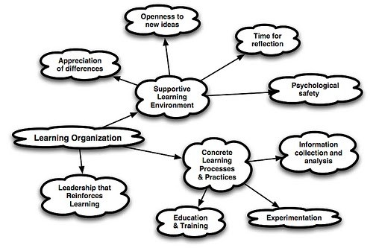
Resiliency
https://shiftworkplace.com/trying-teach-something-link-organizational-learning-polar-bears/

Slide 45

4. A Few Words on Evidence

Slide 46
Is Learning Like Medicine?
Is online learning an “intervention”
Should we think of teaching as “treatment”
Is psychology the same as physiology?
Is there an educational Hippocratic Oath?

Slide 47
Evidence
What counts as “success” in learning?
What would count as evidence for that?
Remembering something…
vs. Being able to do something
vs. Doing the right thing
vs. Knowing why it’s right
vs. Being able to determine what’s right

Slide 48
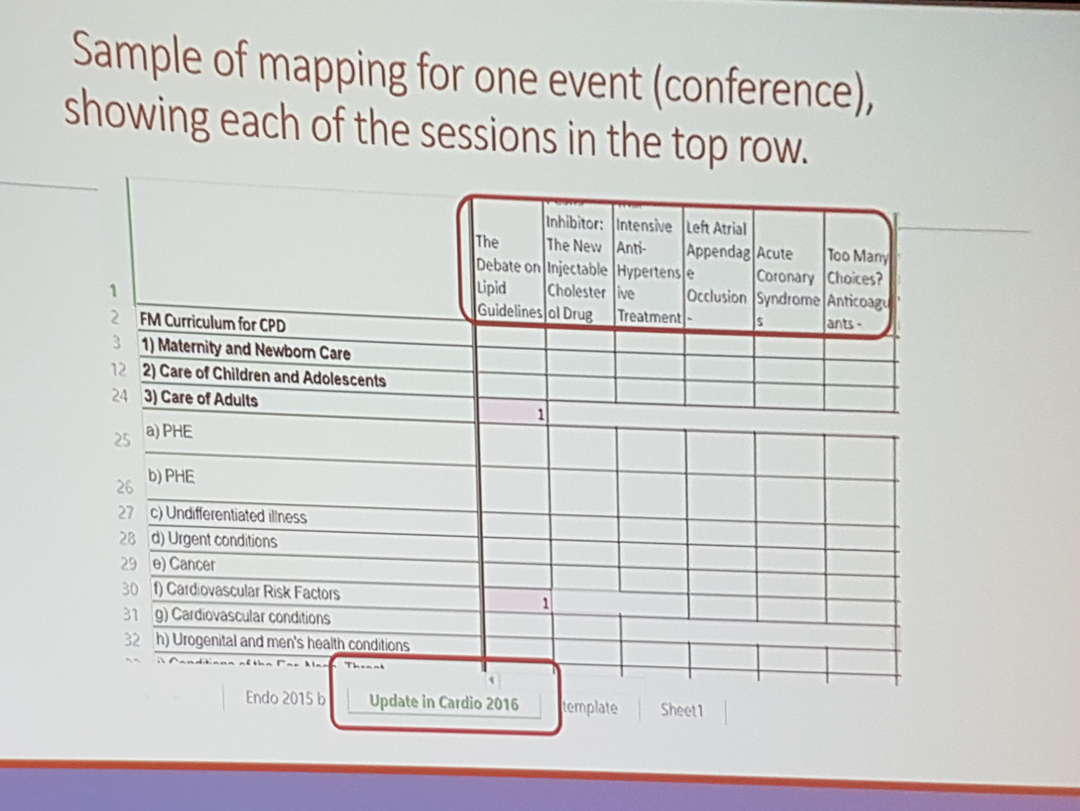
Competencies?
Is an assessment of performance the same as an assessment of the competencies making up that task?
Objective
Resource
Assessment
Performance
Benefit
Competency?

Slide 49
Bias
Do we bring the same biases to learning that other people bring to (say) medical research?
Consider the issues raised by Michael Allen yesterday Michael Allen

Slide 50
Looking Deeper
OLDaily Newsletter – 30,000 posts over 17 years
http://www.downes.ca/news/OLDaily.htm
E-Learning 3.0 Course starting shortly
http://el30.mooc.ca

Slide 51
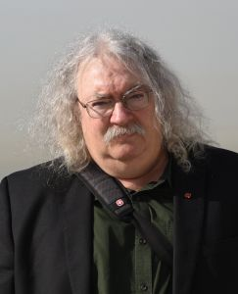
https://www.downes.ca

