Slide 1

Topics in Distributed Ledger Technology
Stephen Downes
August 30, 2018

Slide 2

1. Core Concepts

Slide 3
1.1 Assets, ledgers
Ledger contents include:
  Transactions: P gives x to Q)
  States: P has n instances of x)
  Conditions:
    Contract: if <transaction> then <transaction>
    Inferences: if <state> then <state>

Slide 4
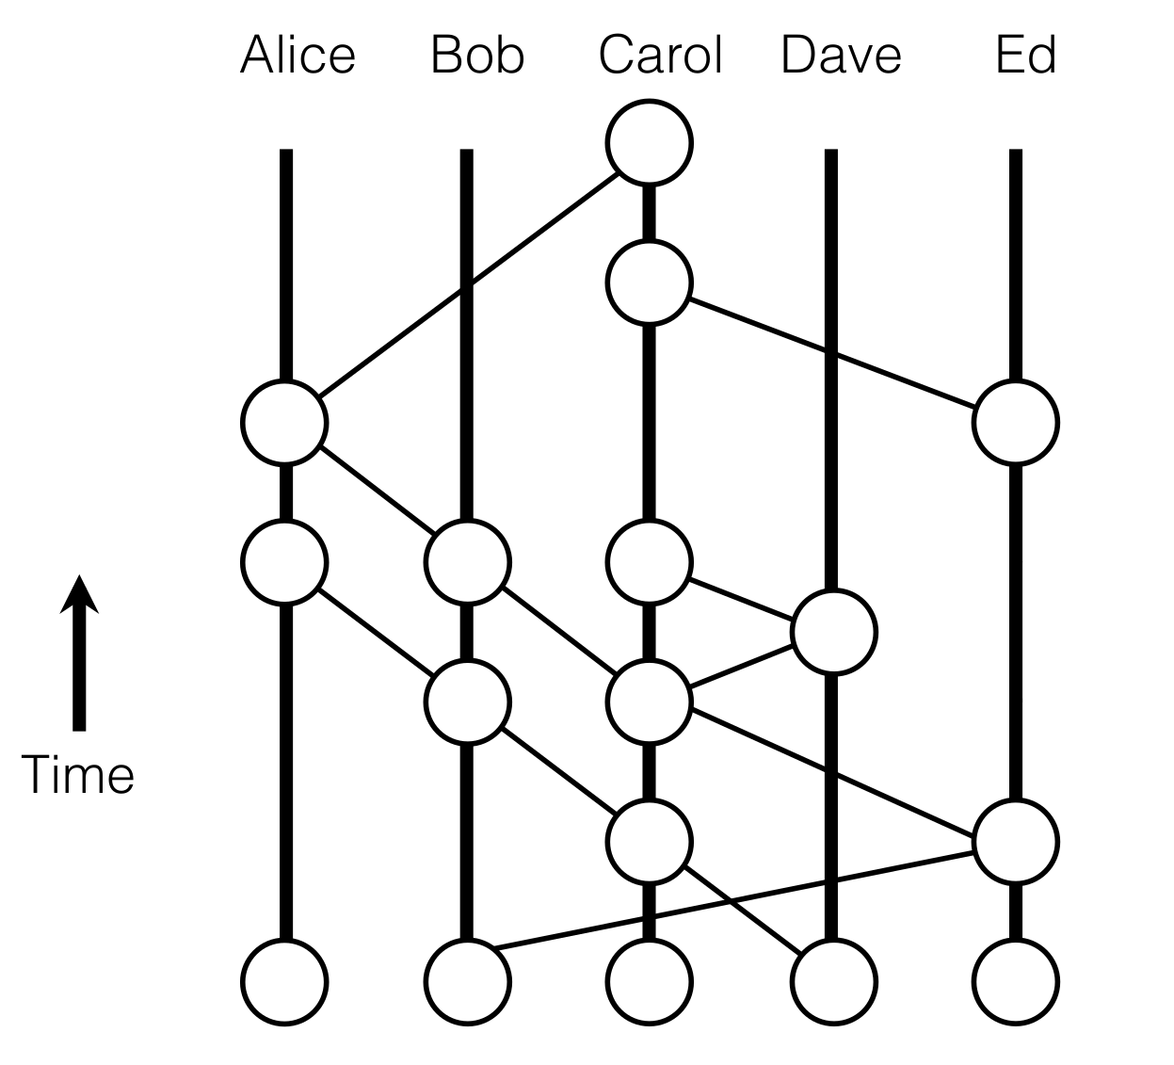
1.2 Distributed ledgers
“A distributed ledger technology (DLT) is a system where we share information and we don’t trust each other individually, but we trust the group as a whole. DLTs allow us to come up with a consensus on the order of transactions and timestamps.”
https://hackernoon.com/an-overview-of-hashgraph-b0900a1fd7bf

Slide 5
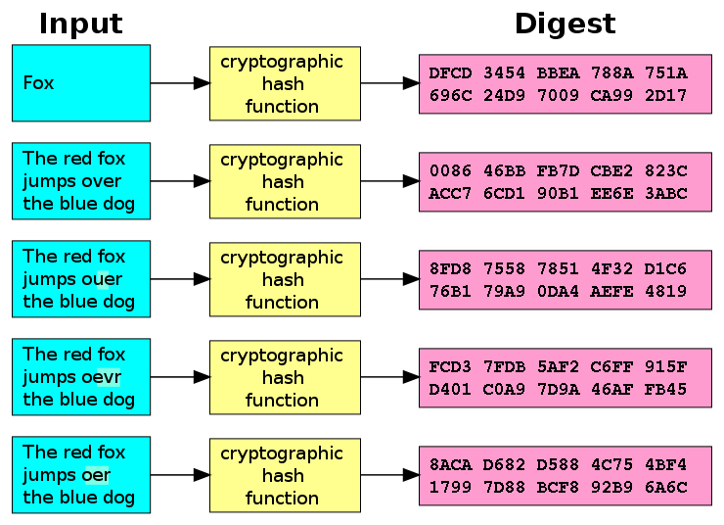
1.3 Cryptographic hash functions
“a mathematical algorithm that maps data of arbitrary size to a bit string of a fixed size (a hash) and is designed to be a one-way function..”
- Algorithms:
  MD5, SHA1 (unsuitable)
  SHA2 (SHA-256 and SHA-512)
  SHA3, BLAKE2
- Signatures
https://en.wikipedia.org/wiki/Cryptographic_hash_function

Slide 6
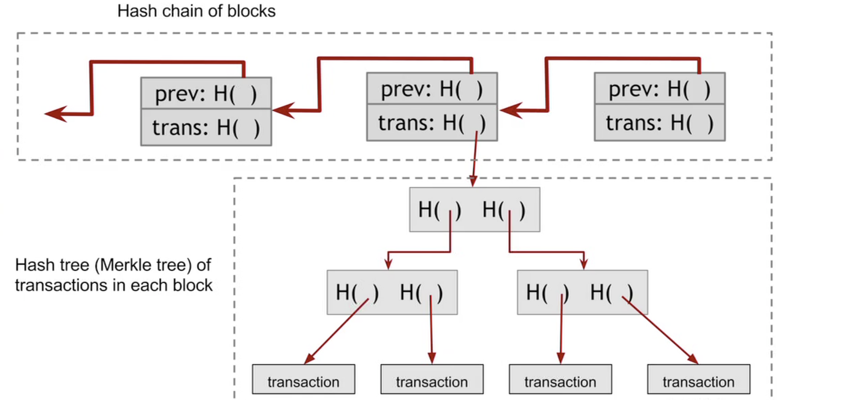
14 Construction of a blockchain
https://hackernoon.com/how-does-blockchain-technology-work-ceeeee47eaba

Slide 7
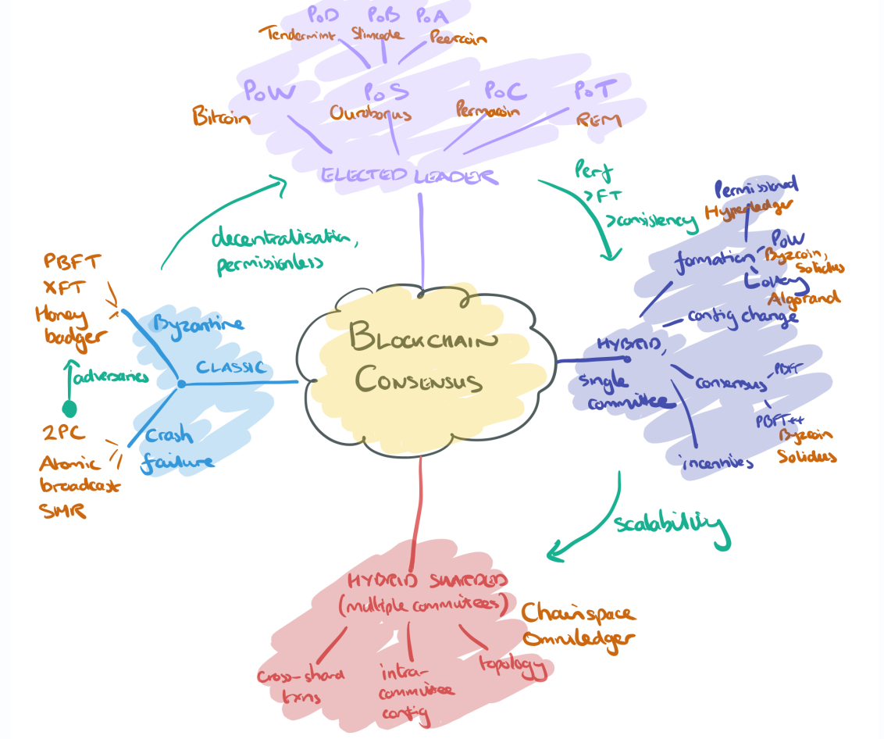
1.5 Consensus – an intro, proof of work, alternatives
“The best known and most widely deployed mechanism is of course proof-of-work (aka. Nakamoto consensus). Forks can occur, and are resolved by PoW consensus, which amounts to picking the chain with the most accumulated work.”
https://blog.acolyer.org/2018/02/12/sok-consensus-in-the-age-of-blockchains/

Slide 8
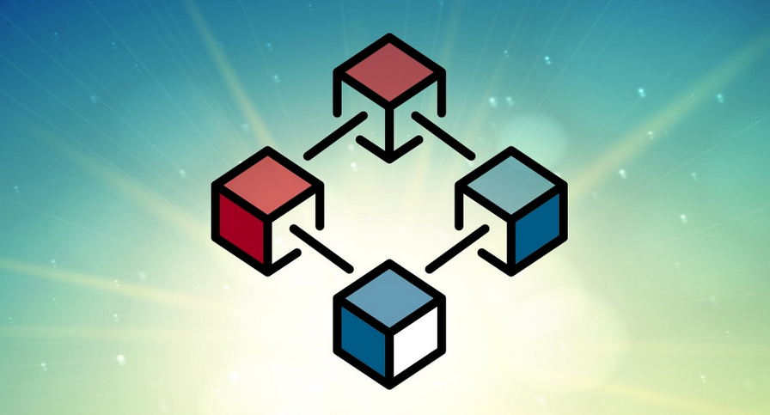
2. Examples of Applications

Slide 9
2.1 Benefits of Blockchain
Trust
Consensus
Provenance
Immutability and Finality
Equity?

Slide 10
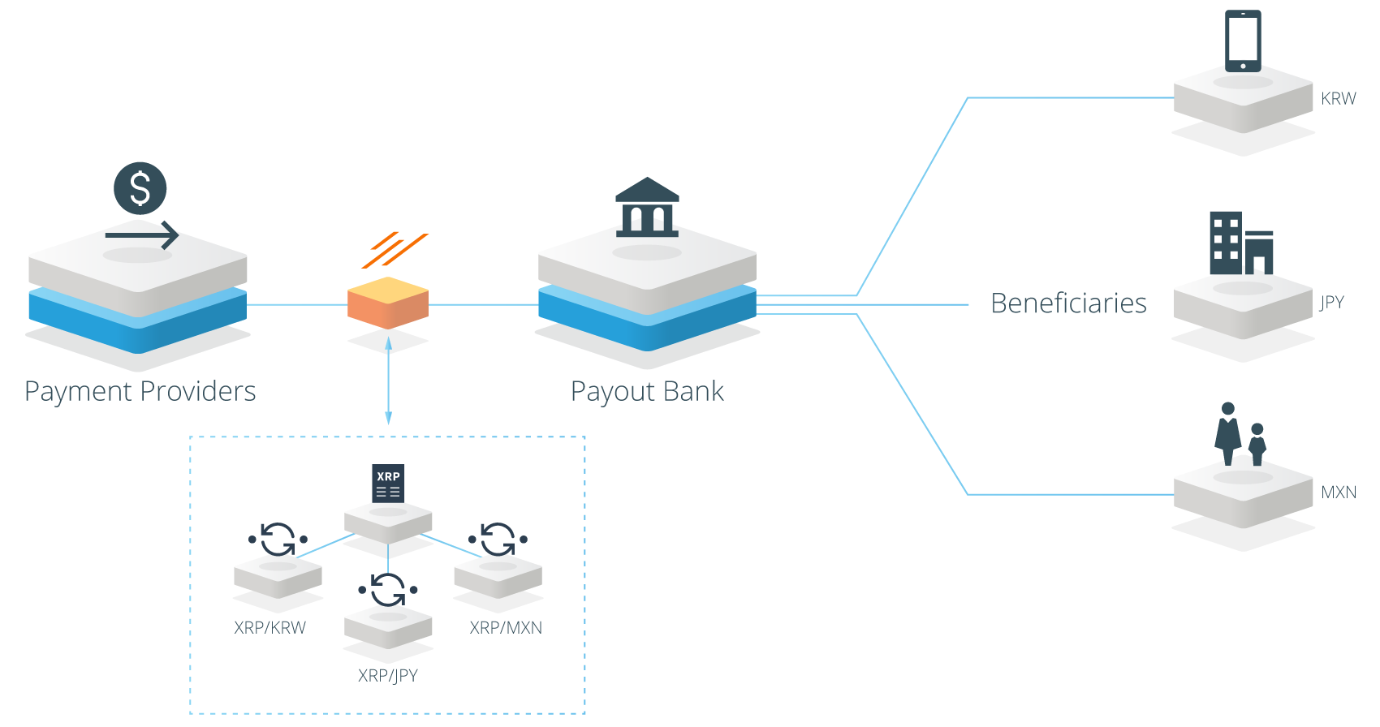
2.1 Currency and Financial
Payments
  Square - https://www.coindesk.com/square-gets-a-bitlicense-new-york-crypto/
Gift Cards
  eGifter, Gyft - https://www.gyft.com/bitcoin/ , https://www.egifter.com/
Financial services
  Banks - https://www.ethnews.com/gmo-internet-group-creates-a-bank
  Hedge Funds - https://www.bitwiseinvestments.com/fund
  Bonds and Liquidity - https://ripple.com/solutions/source-liquidity/
  Crowdfunding - https://www.idgconnect.com/blog-abstract/30700/blockchain-africa

Slide 11
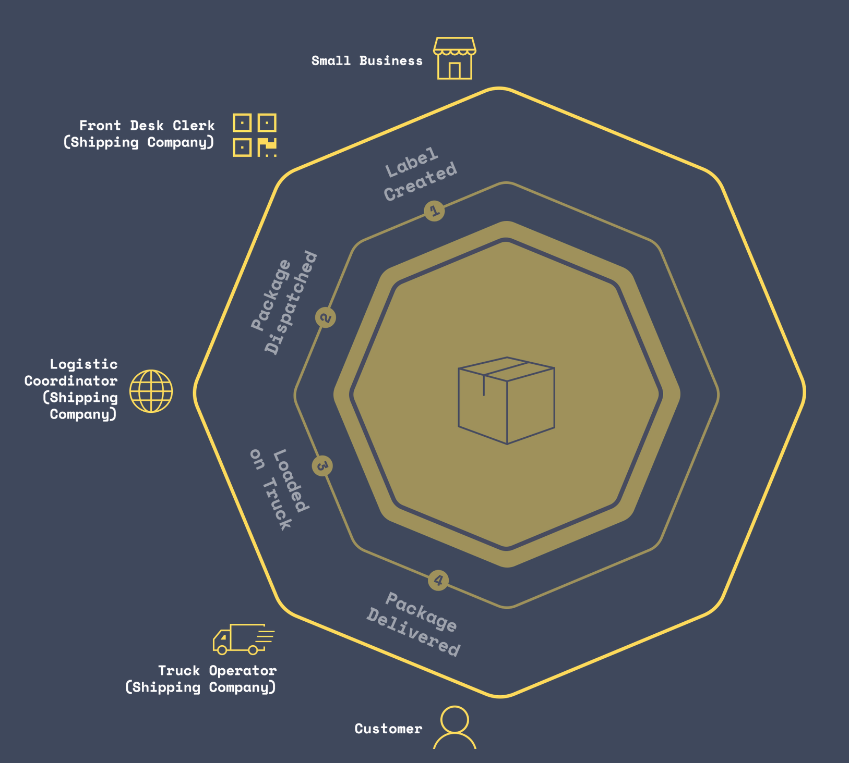
2.2 Business networking, audit, compliance
Law and contracts - https://agreements.network/
Markets - https://techcrunch.com/2017/04/11/bext360-is-using-robots-and-the-blockchain-to-pay-coffee-farmers-fairly/
Asset Management - https://www.coindesk.com/td-bank-considers-public-blockchain-for-asset-tracking/
Supply Chain - https://peerledger.com/mimosi/ gives companies a trusted, immutable record of all track-and-trace transactions across supply chains, https://viant.io/ Supply chain mgmt. built on Ethereum
Shipping - 94 organizations have joined blockchain trade platform https://www.reuters.com/article/us-shipping-blockchain-maersk-ibm/maersk-ibm-say-94-organizations-have-joined-blockchain-trade-platform-idUSKBN1KU1LM
https://viant.io/

Slide 12
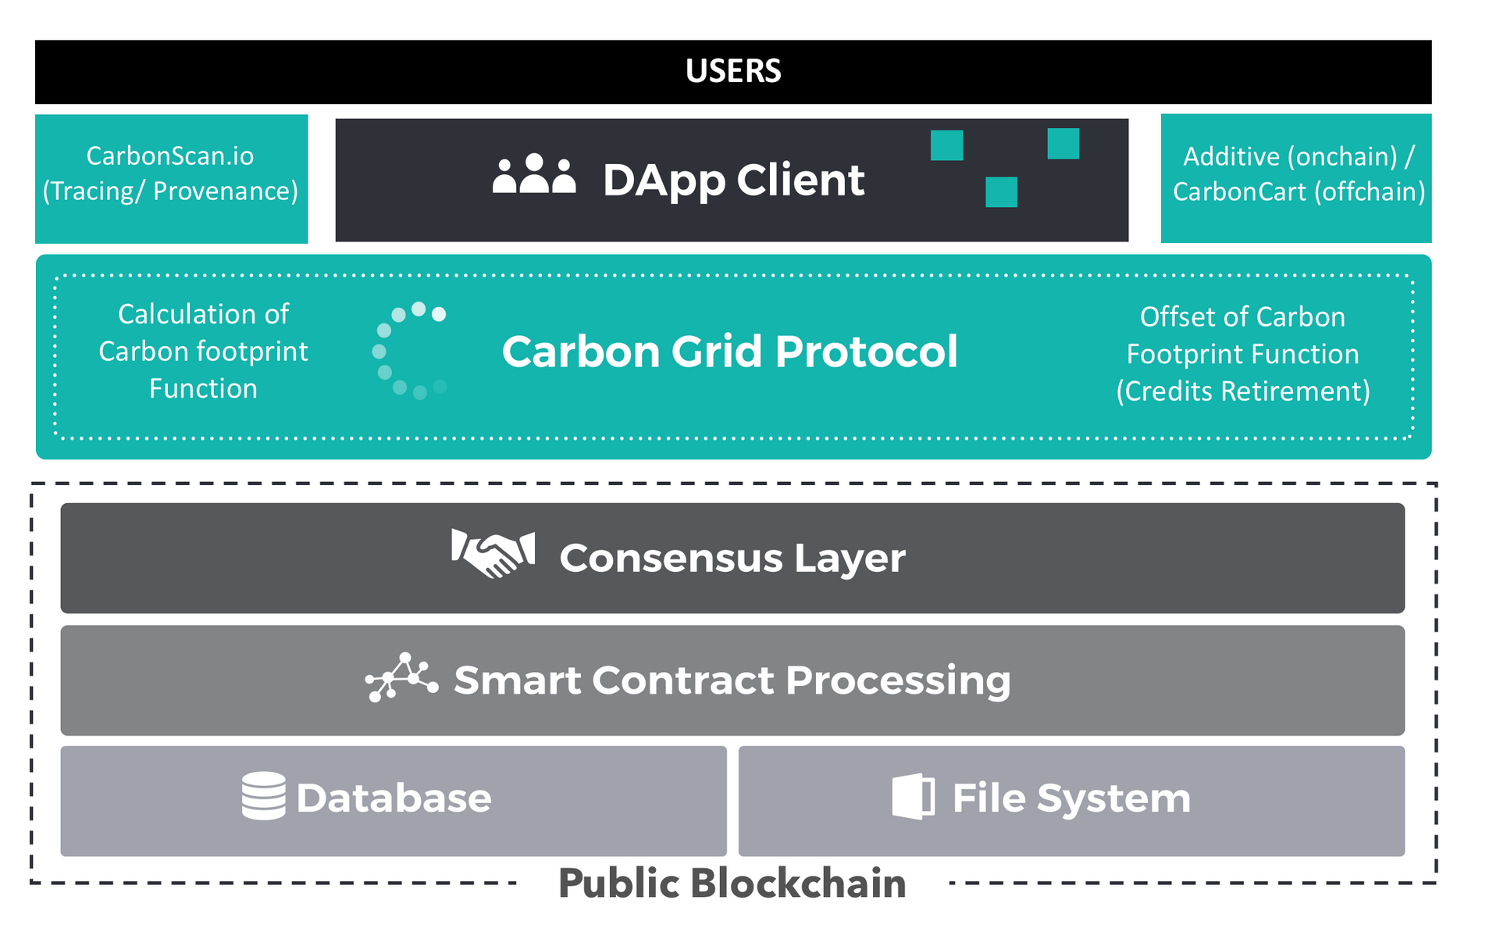
2.3 Resources and industry
Agriculture - https://www.cio.com.au/article/644491/cba-helps-ship-17-tonnes-almonds-blockchain/
Forestry - blockchain to track the planting of trees worldwide and create rewards for planting trees - https://medium.com/@afhenderson/blockchain-for-social-good-4e6d0d4468d3
Mining - https://techcrunch.com/2018/04/26/ibm-introduces-trustchain-a-blockchain-to-verify-the-jewelry-supply-chain/
Energy – PowerLedger - https://www.powerledger.io/
https://carbongrid.io/

Slide 13
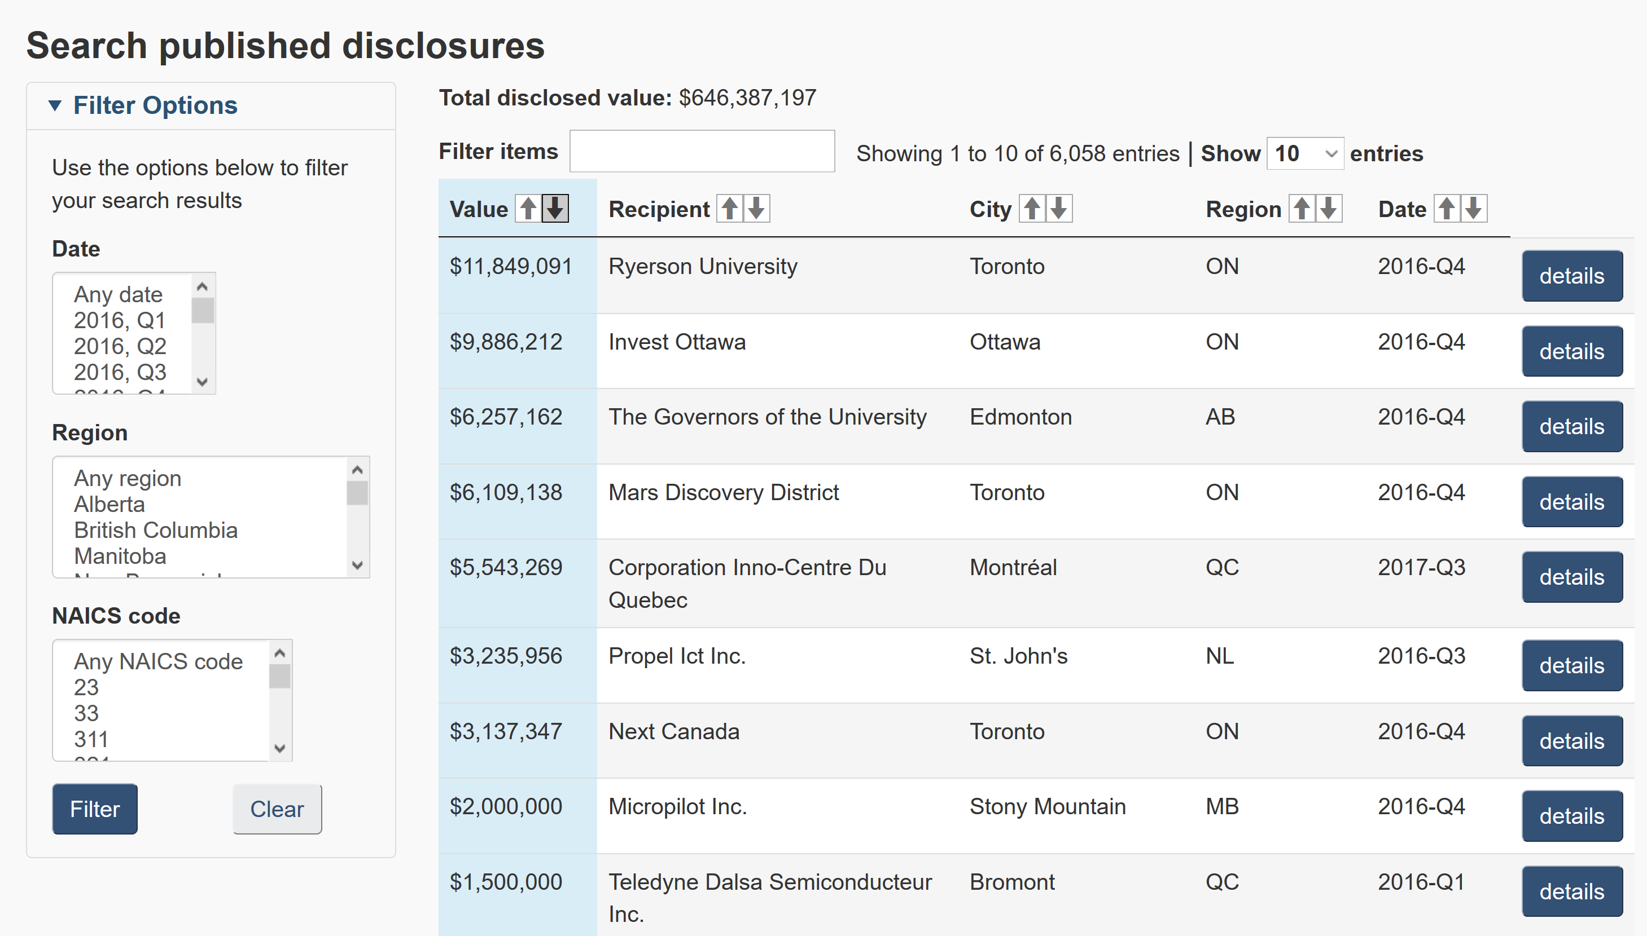
2.4 Government, education and health
Currency - https://www.technologyreview.com/s/608910/governments-are-testing-their-own-cryptocurrencies/
Registries - https://cointelegraph.com/news/netherlands-land-registry-to-test-blockchain-solution-for-real-estate
Shipping - Denmark will be “the first country in the world [to] use blockchain technology to register ships in the Danish ship registers.” - https://cointelegraph.com/news/denmark-joins-eu-blockchain-partnership-plans-to-implement-tech-in-shipping
Data – NRC-IRAP Blockchain Prototype - https://nrc-cnrc.explorecatena.com/en/
Medical Records - https://cointelegraph.com/news/alibaba-founded-insurtech-firm-promotes-blockchain-use-in-healthcare-industry
https://nrc-cnrc.explorecatena.com/en/

Slide 14

3. Coins

Slide 15
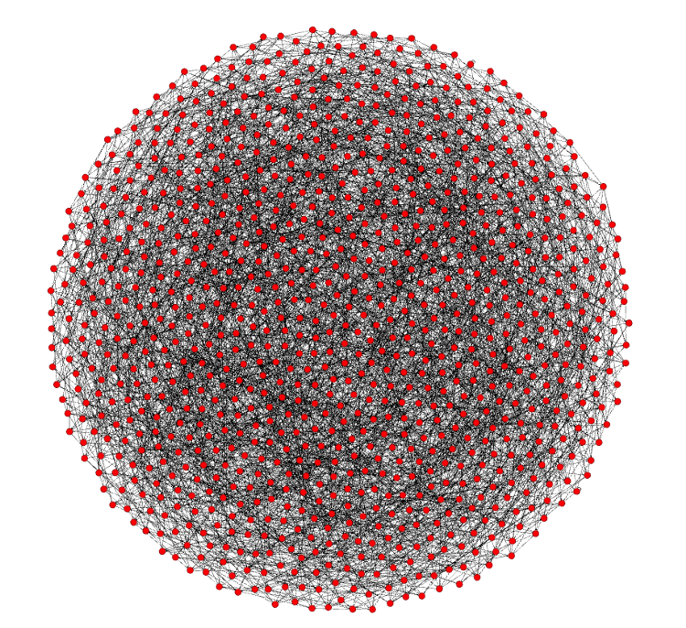
3.1 Bitcoin
Bitcoin: A Peer-to-Peer Electronic Cash System white paper by Satoshi Nakamoto - https://bitcoin.org/bitcoin.pdf
Currently 115,000 nodes
Each node connects to 8 other nodes
Bitcoin’s “state” is represented by its global collection of Unspent Transaction Outputs (UTXOs).
Lightning - https://lightning.network/
The Lightning Network is a "second layer" payment protocol that operates on top of a blockchain (most commonly Bitcoin) - https://en.wikipedia.org/wiki/Lightning_Network

Slide 16
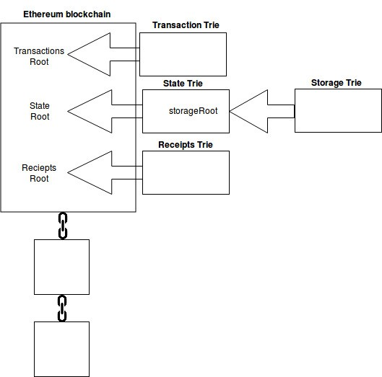
3.2 Ethereum (and dApps)
“Bitcoin is the Digital Gold but Ethereum is the Silicon” https://medium.com/@Michael_Spencer/bitcoins-glory-days-over-the-future-of-blockchain-5fe303f18537
Founder: Vitalik Buterin - https://github.com/ethereum/wiki/wiki/White-Paper
Solidity - “Solidity is a contract-oriented programming language for writing smart contracts.[1] It is used for implementing smart contracts[2] on various blockchain platforms.” https://en.wikipedia.org/wiki/Solidity
Decentralized Applications (dApps) - consist of everything ranging from prediction markets to gaming, and will continue to grow stronger as the network is improved upon. 1573 today (June 4, 2018) https://www.stateofthedapps.com/

Slide 17
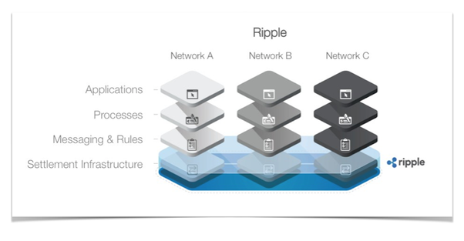
3.3 Ripple and Stellar
Ripple has a network of banks around the world on its platform. International payments can be processed by participating banks within three to five seconds, rather than two to five days, it says. https://www.therecord.com/news-story/8653190-uw-gets-research-funding-for-deep-dive-into-blockchain-technology/
it will replace SWIFT as a global provider of secure financial messaging services http://www.europarl.europa.eu/cmsdata/149900/CASE_FINAL%20publication.pdf
An upcoming product (xRapid) will use XRP as a way to ‘source liquidity’
Interledger is the protocol that sits under RippleNet.
It is being developed as a potential web standard under the the W3C - https://w3c.github.io/webpayments/proposals/interledger/
Stellar
Decentralized Ripple, collaboration with IBM

Slide 18
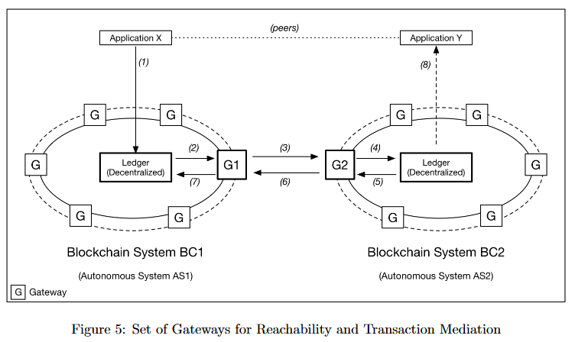
3.4 Wallets, exchanges and networks
Exchanges
  Centralized – Coinbase https://blog.coinbase.com/ , Binance - https://www.binance.com/
  Decentralized – Altcoin - https://altcoin.io/ , IDEX - https://idex.market/eth/aura
Networks
  Towards a Design Philosophy for Interoperable Blockchain Systems, Thomas Hardjono, Alexander Lipton, Alex Pentland https://arxiv.org/abs/1805.05934
Wallets

Slide 19

4. Platforms and Services

Slide 20
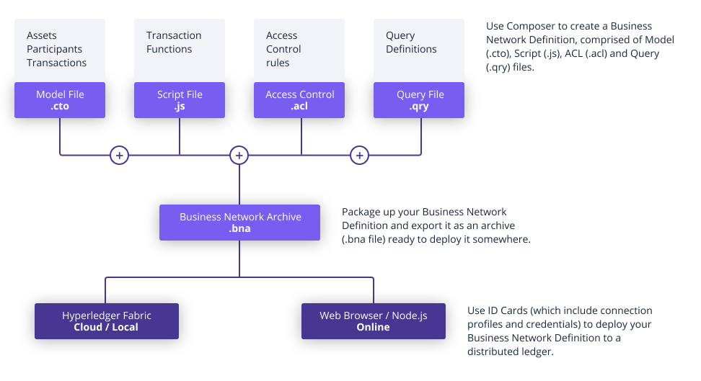
4.1 Hyperledger Fabric
Private business networks, IBM Bluemix hosting, or Docker containers
Emphasizes open governance, open standards & open source
Private business networks, IBM Bluemix hosting, or Docker containers
Emphasizes open governance, open standards & open source
Business Network Definitions
  a set of model files
  a set of JavaScript files
  an Access Control file
https://www.hyperledger.org/projects/fabric

Slide 21
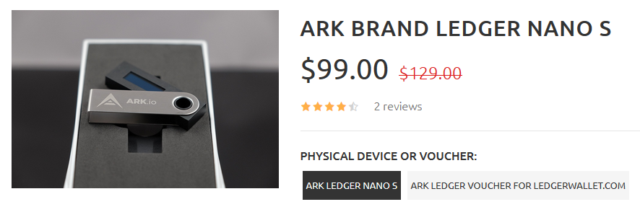
4.2 Ark
ARK is a secure platform designed for mass adoption and will deliver the services that consumers want and developers need.” https://ark.io/ - explorer: https://explorer.ark.io/
Ark! The wordpress of crypto! https://decentralize.today/some-great-projects-are-out-there-they-just-dont-talk-about-them-21d677e29ecf
ARK Desktop Wallet supports the Ledger Nano S secure hardware wallet.

Slide 22
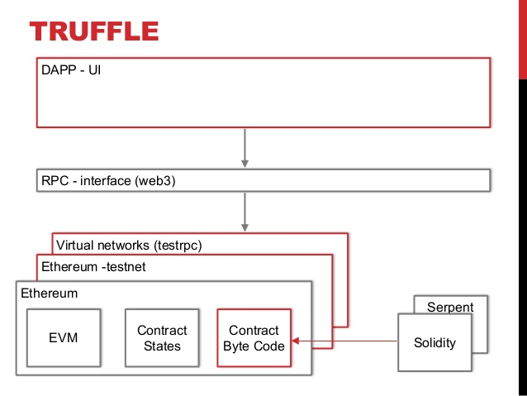
4.3 Truffle (NRC example)
a development framework for Ethereum - http://truffleframework.com/
  Truffle takes care of managing your contract artifacts so you don't have to.
  Ganache - https://truffleframework.com/ganache - one-click blockchain
  Drizzle- A collection of front-end libraries that make writing dapp user interfaces easier and more predictable.
https://www.slideshare.net/MartinKppelmann/build-dapps-13-dev-tools

Slide 23
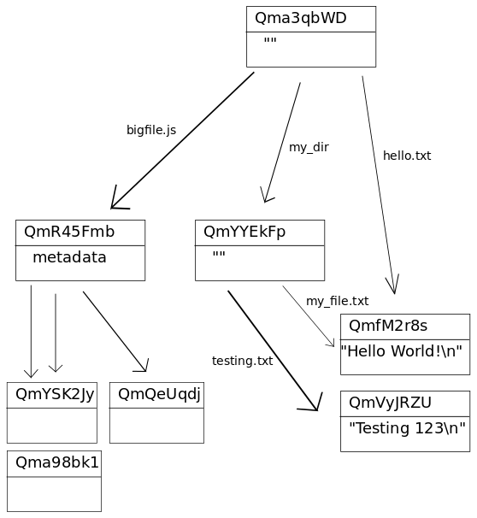
4.4 IPFS - IPLD
IPFS white paper: IPFS - Content Addressed, Versioned, P2P File System (DRAFT 3).
PFS consists of a network of peer-to-peer nodes (aka computers that talk to each other directly)
These nodes can store content (any type of file)
Content is represented by a hash and is immutable (if the content changes, so does the hash) - In the case of IPFS, the key of the distributed hash table is a hash over the content.
IPLD - Inter Planetary Linked Data
IPLD website (Inter Planetary Linked Data) - https://ipld.io/
the IPLD specs and the IPLD implementations.
Hosting a website on IPFS - https://ipfs.io/ipfs/QmdPtC3T7Kcu9iJg6hYzLBWR5XCDcYMY7HV685E3kH3EcS/2015/09/15/hosting-a-website-on-ipfs/
https://whatdoesthequantsay.com/2015/09/13/ipfs-introduction-by-example

Slide 24

5. Some Issues

Slide 25
5.1 Conceptual issues

Slide 26
5.2 Cost and energy consumption

Slide 27
5.3 Social and ethical issues

