Slide 1
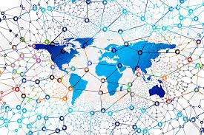
Blockchain in the Life Sciences
Stephen Downes
National Research Council Canada
May 30, 2018

Slide 2
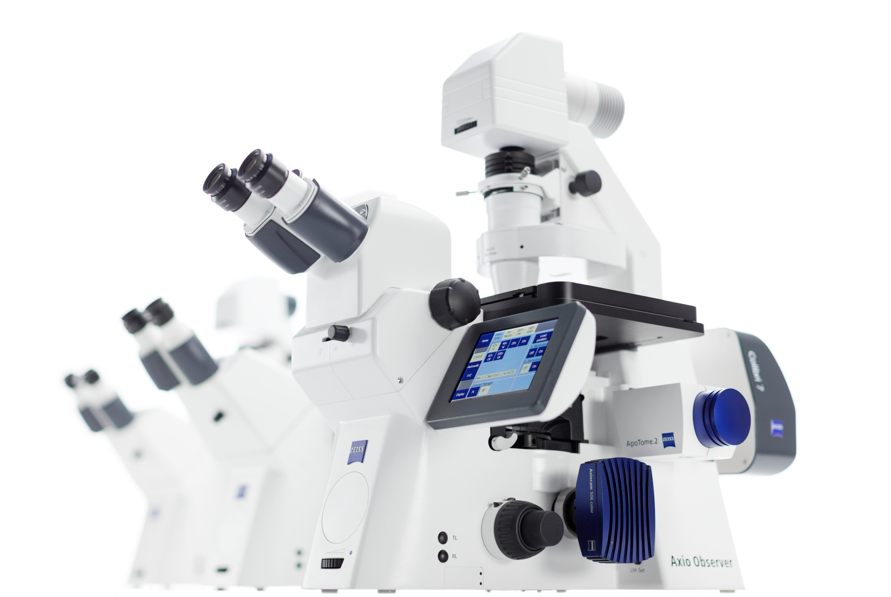
Areas of Application
Electronic Health Record
Medical Inventory
Certification and Compliance
Medical Research Data

Slide 3
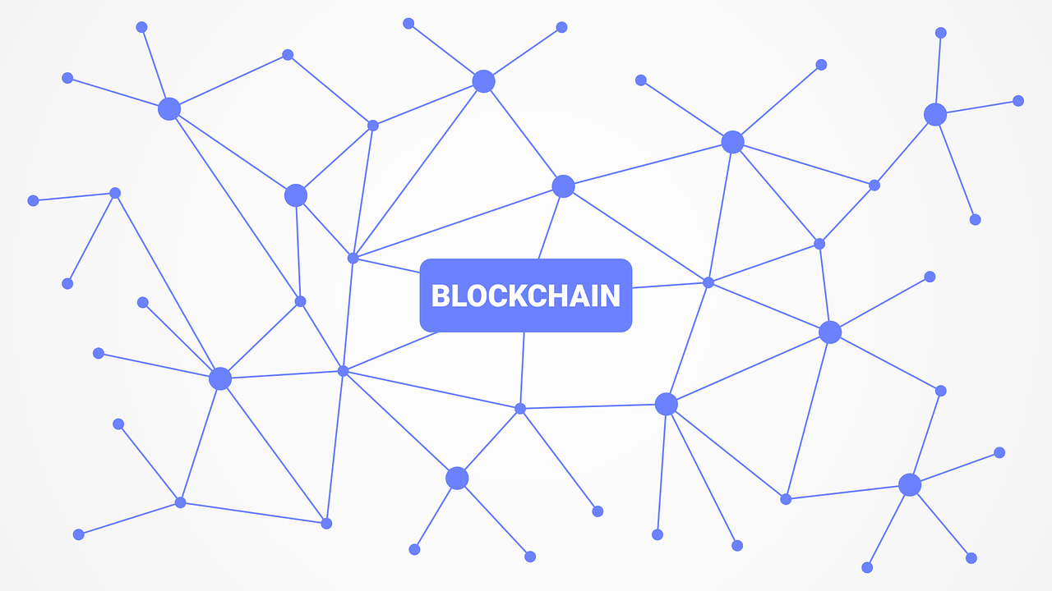
What is Blockchain?
‘A permanent distributed consensus-based ledger’

Slide 4
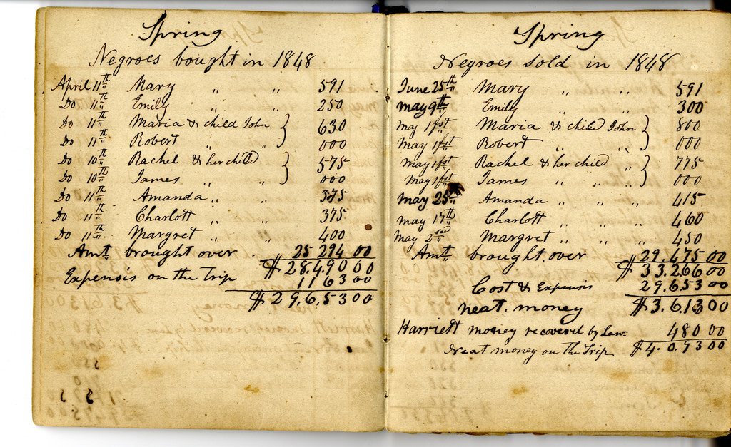
Ledger
Transactions (a=b)
Contracts (if c then (a=b) )
Activities (a did b)

Slide 5
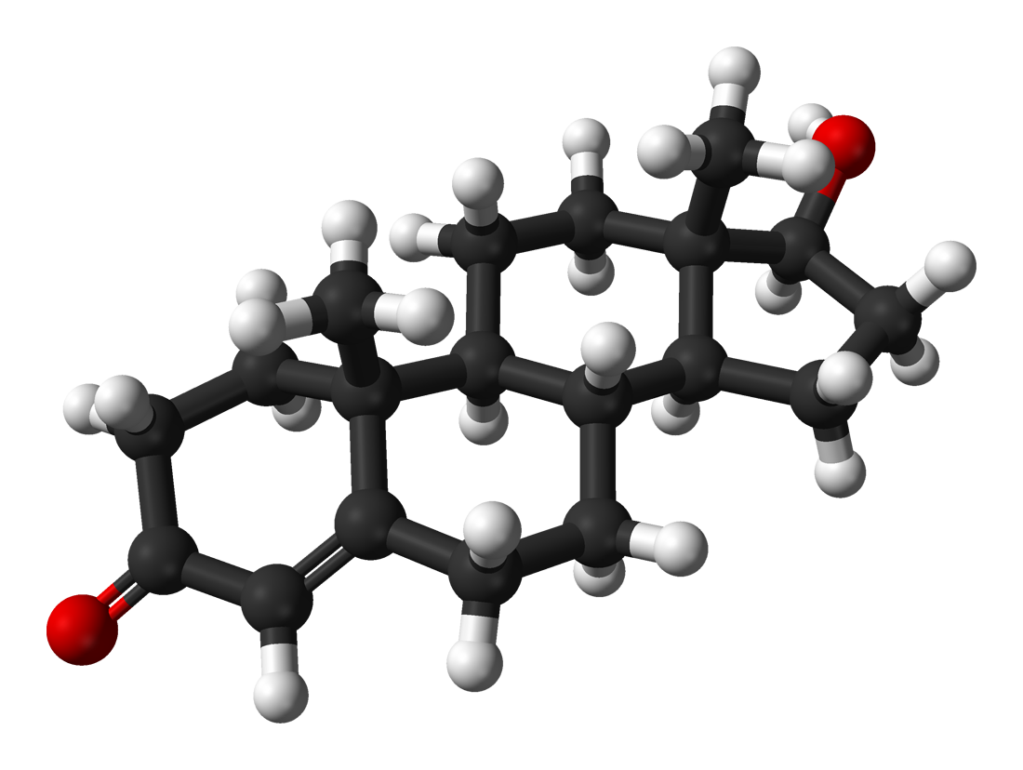
Consensus
Methods of agreements –
  proof of work,
  proof of stake,
  authorization

Slide 6
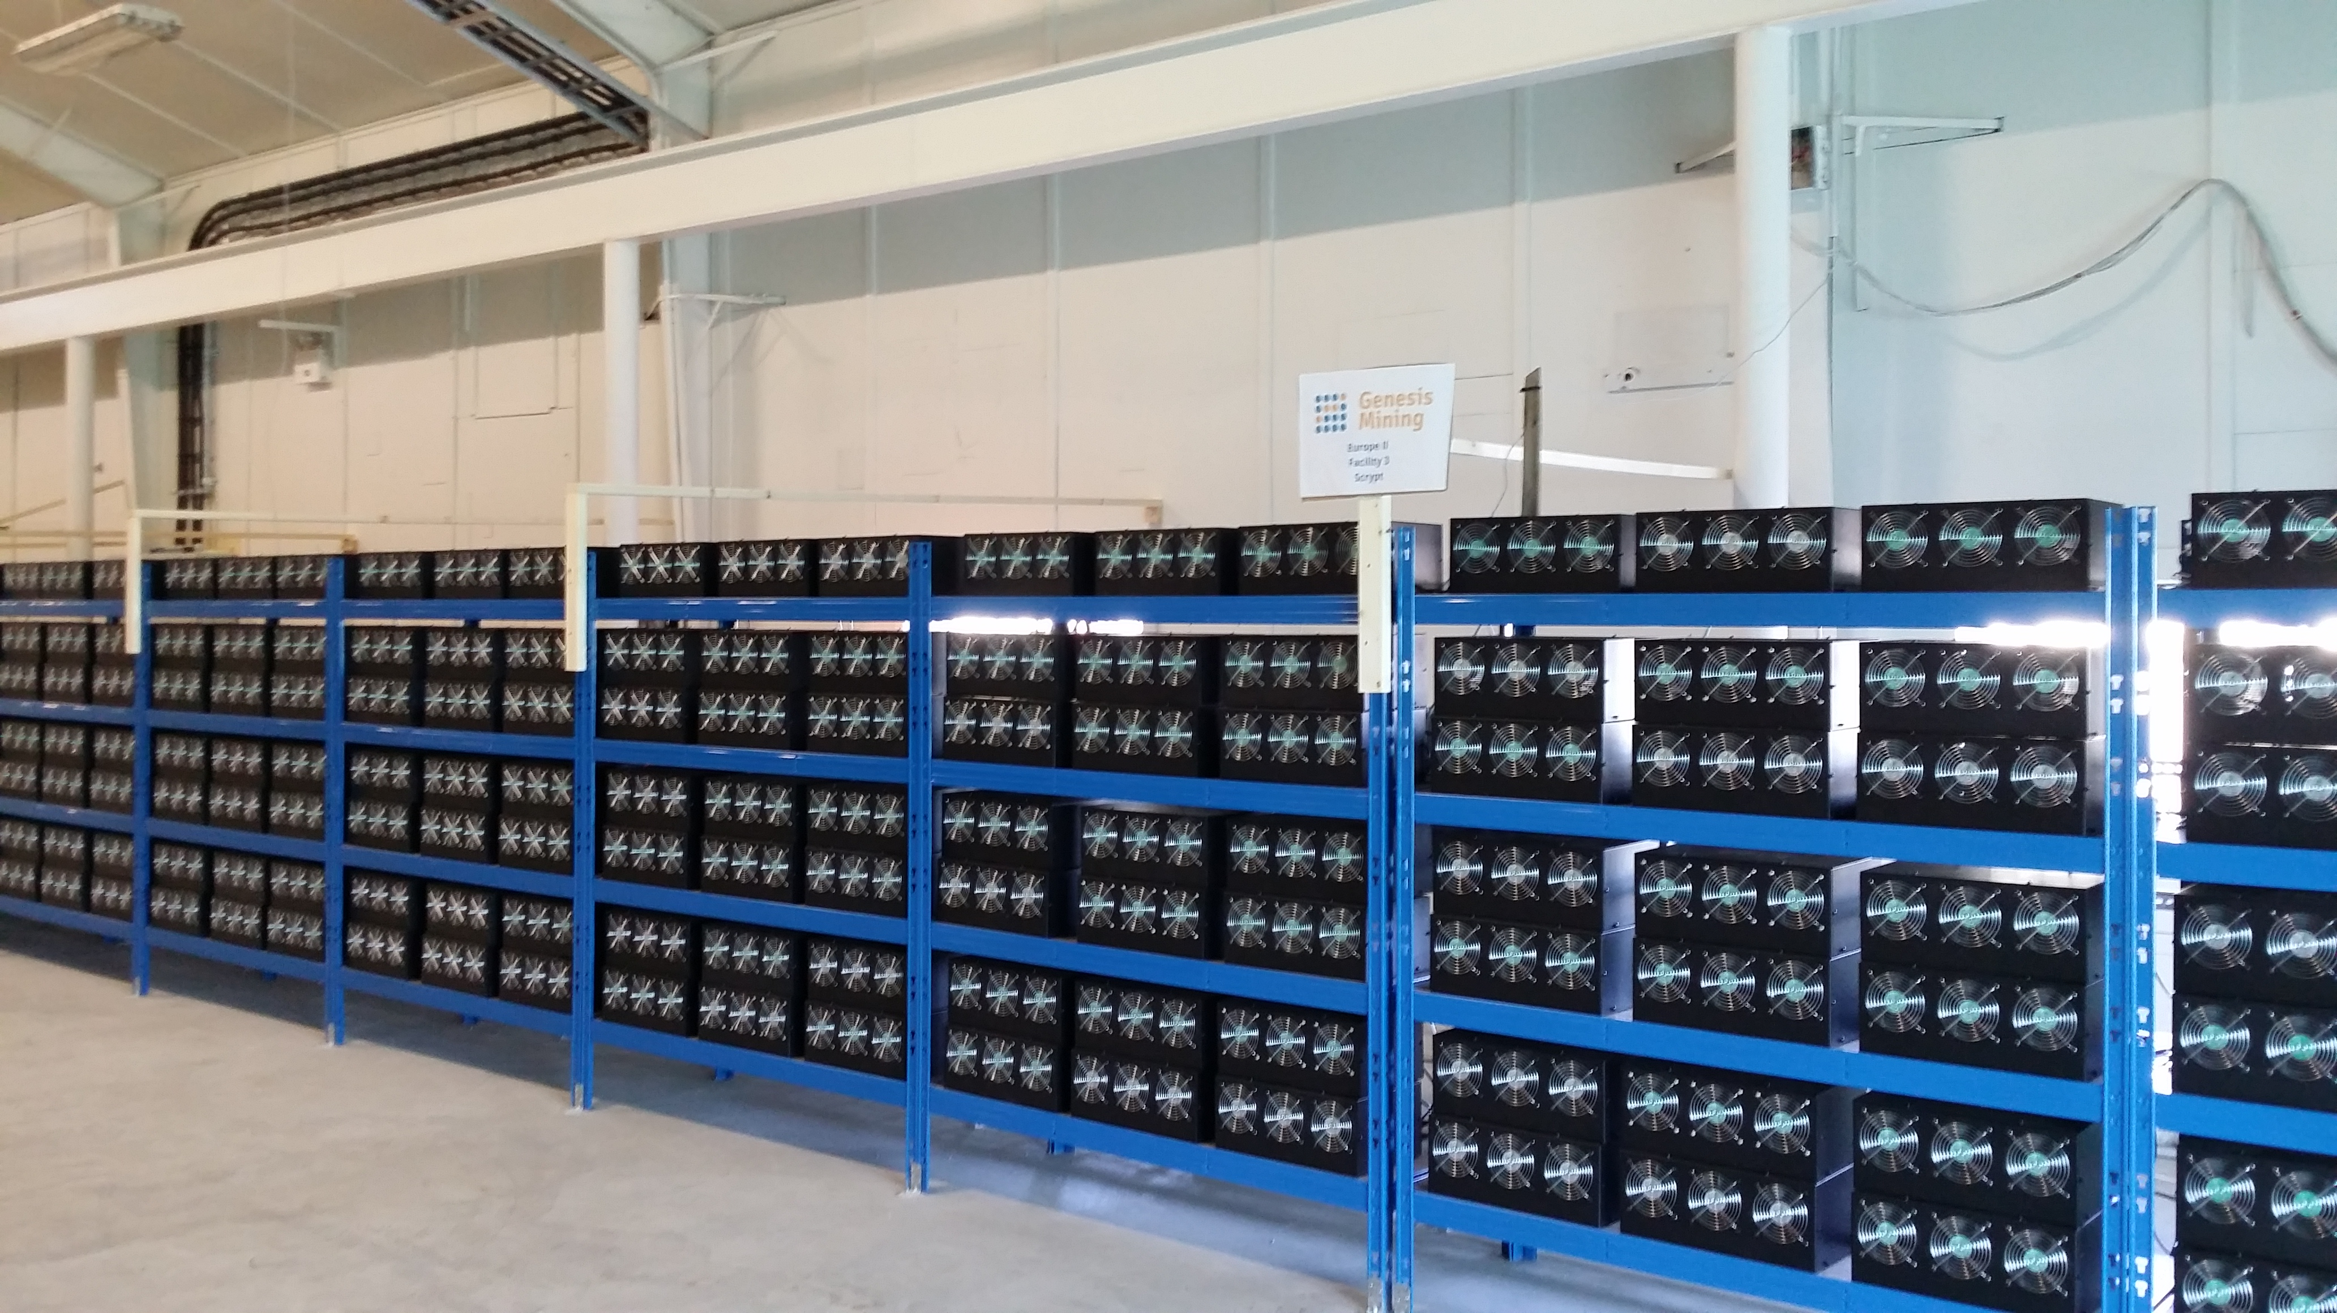
Distributed
One ledger with many owners vs:
  One big ledger owned by someone
  Many individual & separate ledgers

Slide 7
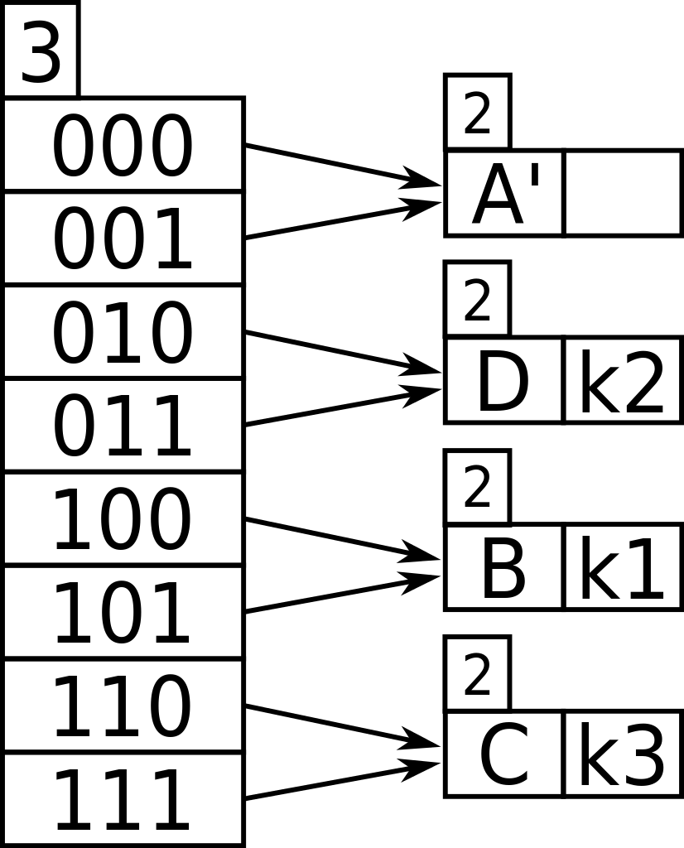
Permanent
Write-only, verification ensured by hashing

Slide 8
Public vs Private Blockchains
Public
  For example: Bitcoin
  Transactions are viewable by anyone
  Participant identity is more difficult to control
Private
  For example: Hyperledger Fabric
  Network members are known but transactions are secret
Permissioned
  anyone to join the permissioned network after verification of identity
  allocation of select and designated permissions to perform only certain activities on the network.

Slide 9
Requirements for Life Sciences Blockchains
Identity / Authentication – know who is contributing, track information to source
Permission-based – not just anyone contributes, different participants have different rights
Consensus – based on authorization, not proof of work
Privacy – records are encrypted, cannot be accessed without authorization and key

Slide 10
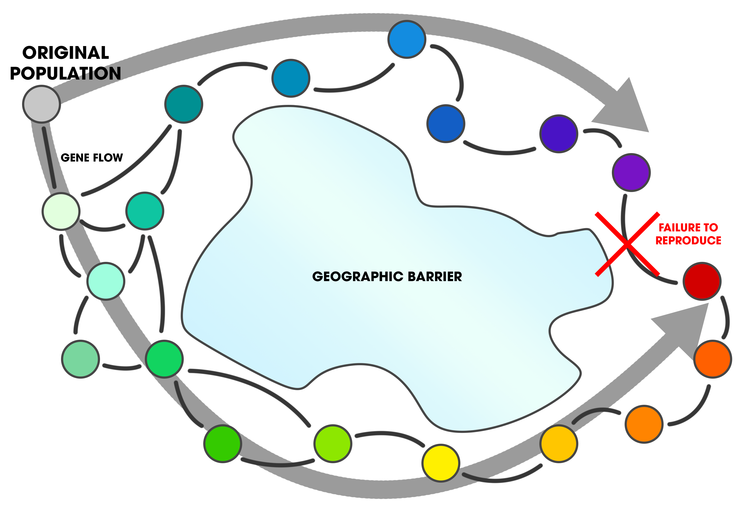
Issues
Data-entry overhead
Betamax vs VHS
Digital overhead – processing and data requirements
Privacy and security

Slide 11
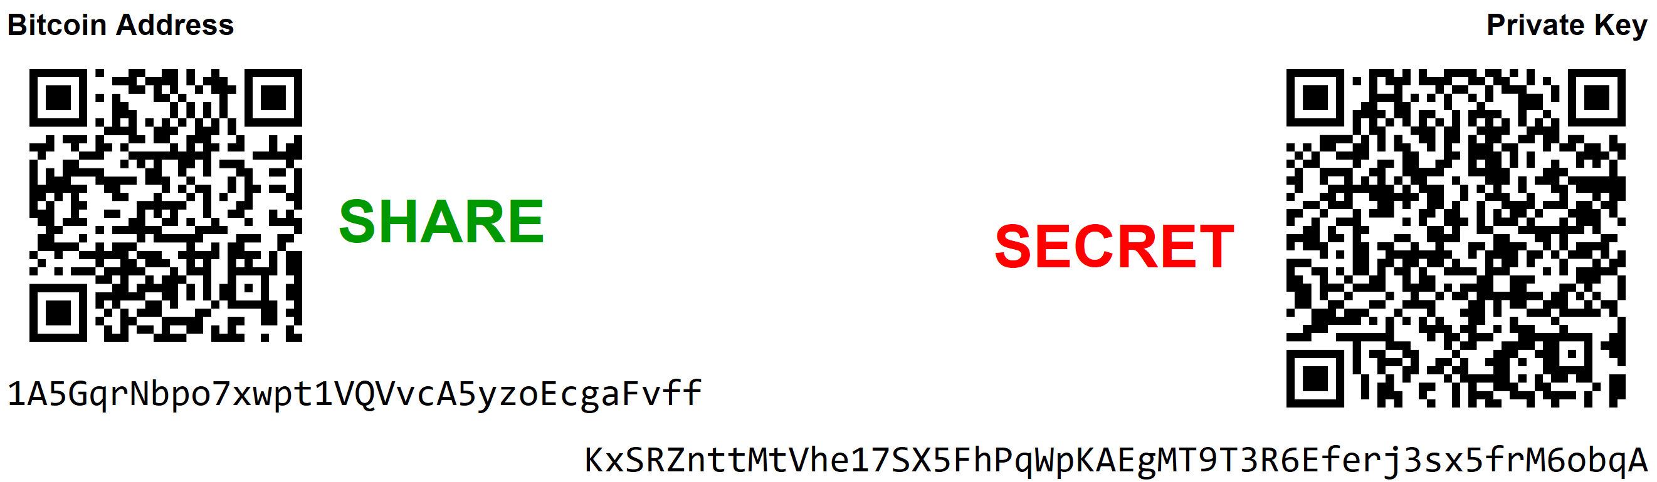
The Future
Public encrypted write-only records are mainstream
We will all have digital signatures / keys
Automation of data entry / internet of things
Multiple interconnected blockchains / interoperability
https://commons.wikimedia.org/wiki/File:A_paper_printable_Bitcoin_wallet_consisting_of_one_bitcoin_address_for_receiving_and_the_corresponding_private_key_for_spending.png

Slide 12

Stephen Downes
National Research Council Canada http://www.downes.ca

