Slide 1
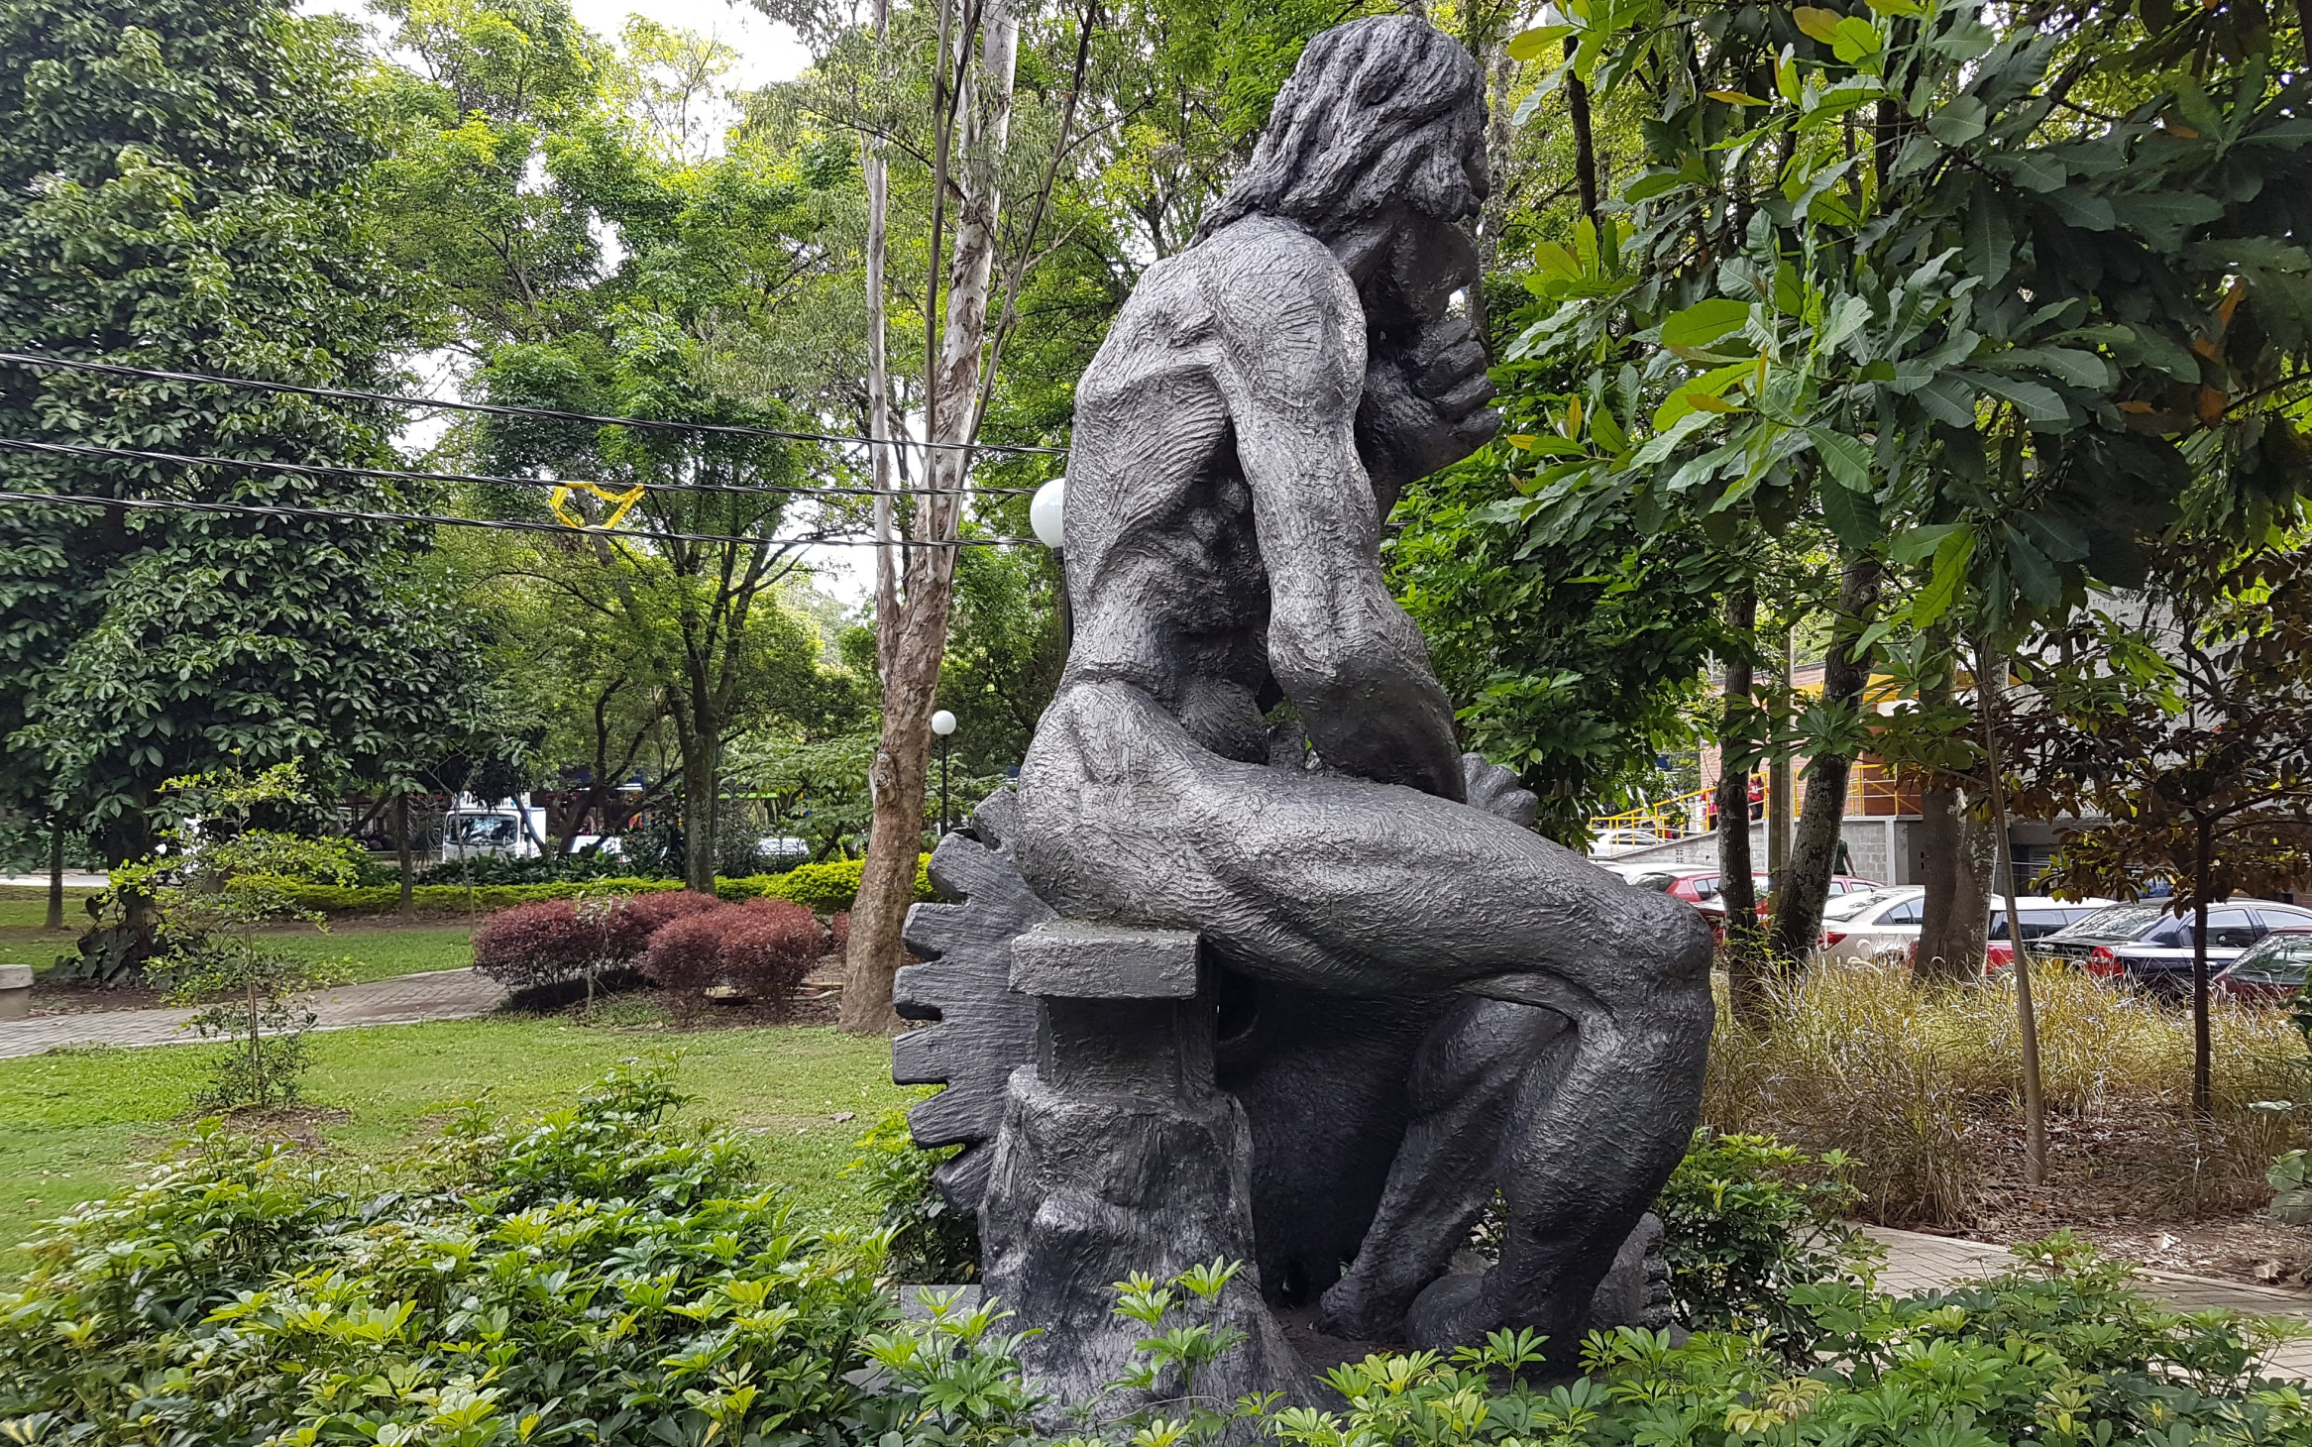
What is Open Education?
Stephen Downes, Medellin, Colombia, April 26, 2018

Slide 2

Open education is a philosophy about the way people should produce, share, and build on knowledge. Proponents of open education believe everyone in the world should have access to high-quality educational experiences and resources, and they work to eliminate barriers to this goal.
https://opensource.com/resources/what-open-education

Slide 3

What are OERs?
“OERs range from textbooks to curricula, syllabi, lecture notes, assignments, tests, projects, audio, video and animation.”
http://www.unesco.org/new/en/communication-and-information/access-to-knowledge/open-educational-resources/what-are-open-educational-resources-oers/

Slide 4
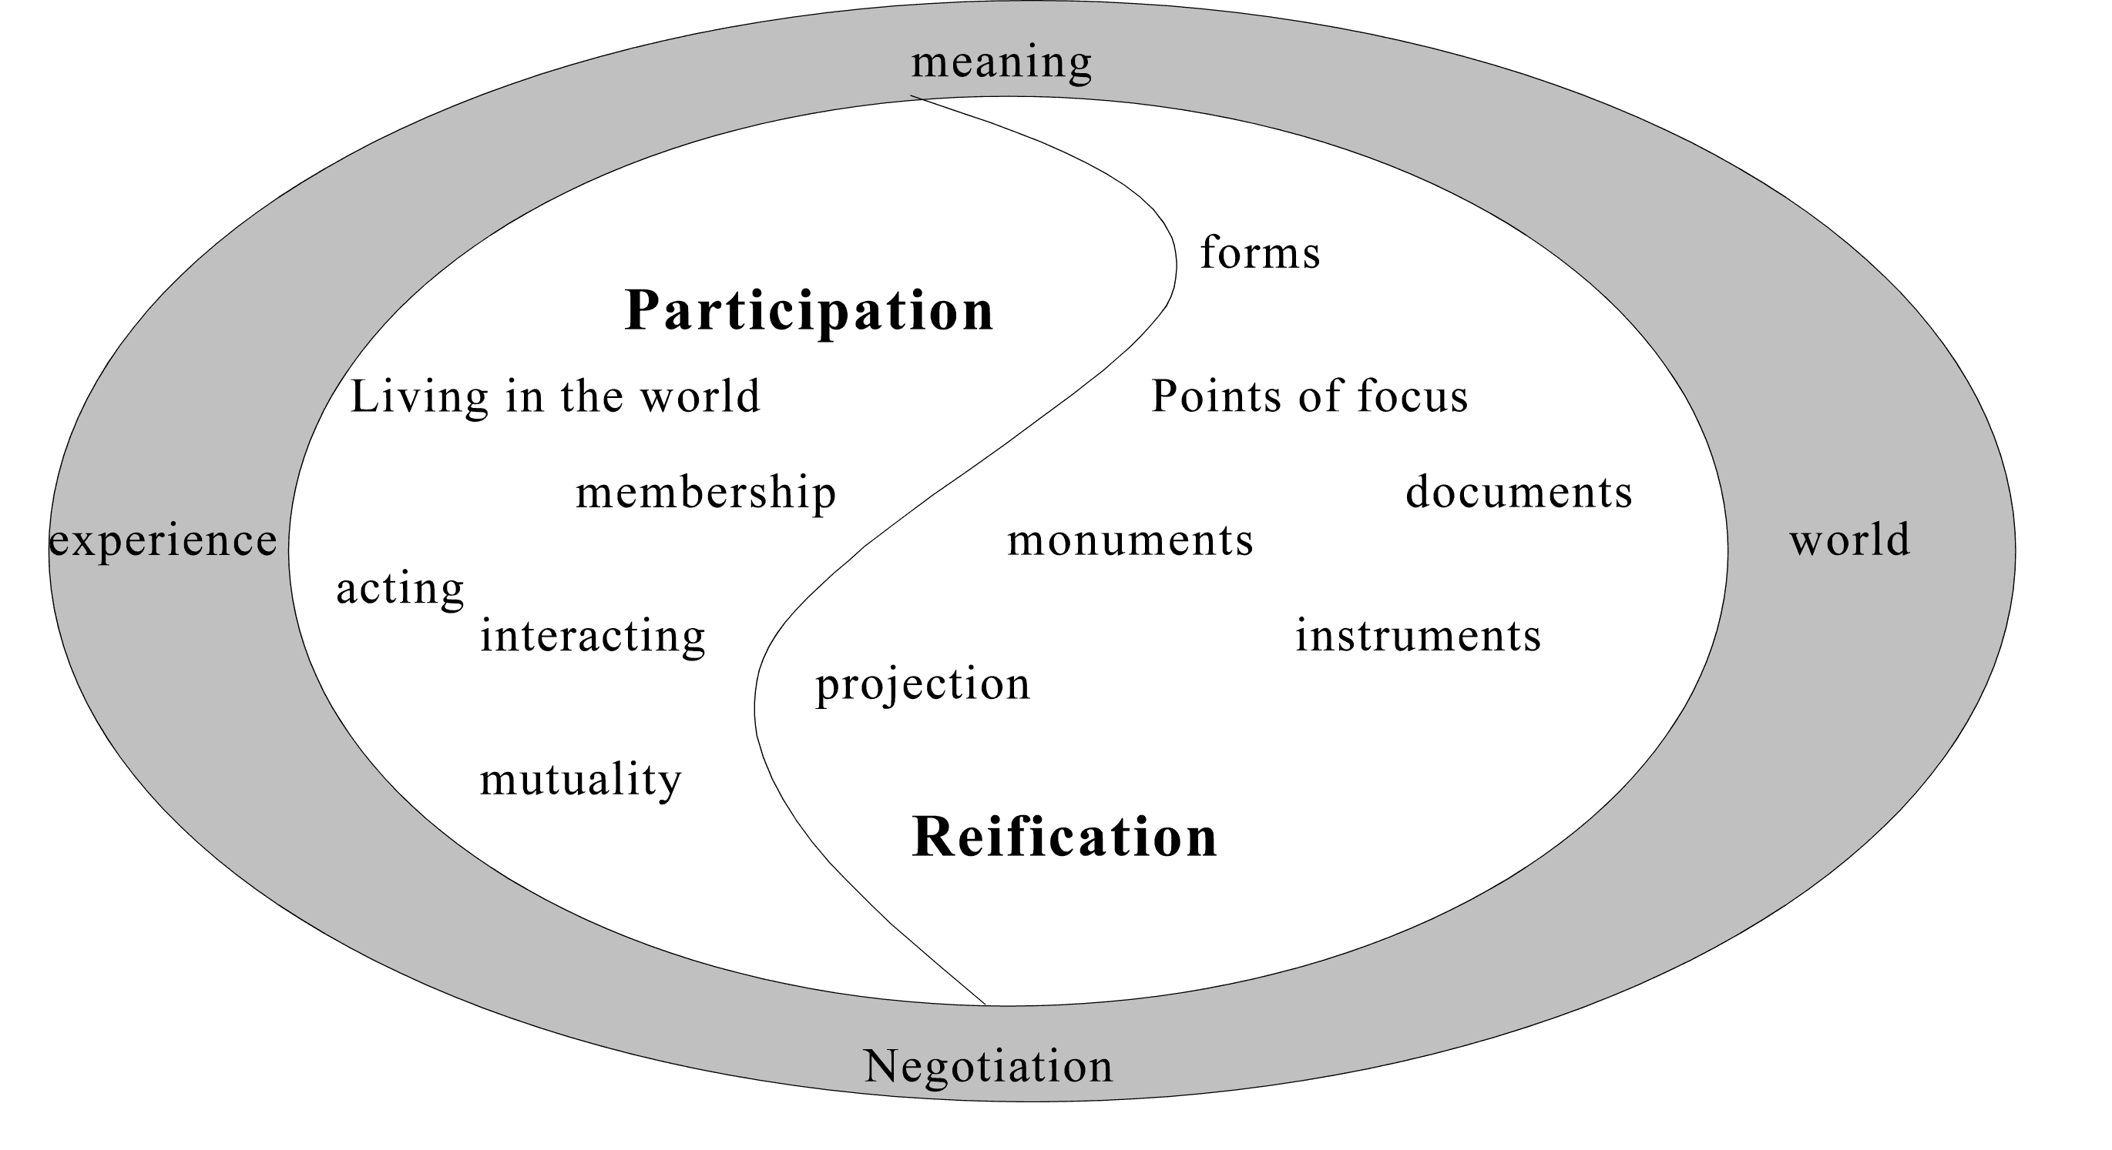
Knowledge is reified by, and is the product of, not only an individual, but of the wider community.
http://www.informationr.net/ir/8-1/paper142.html

Slide 5
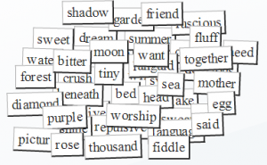
Think of OERs as words in a conversation

Slide 6

It forces us to think about how they can be used.
http://oerworkshop.pbworks.com/w/page/33932297/OER%20Workshop

Slide 7
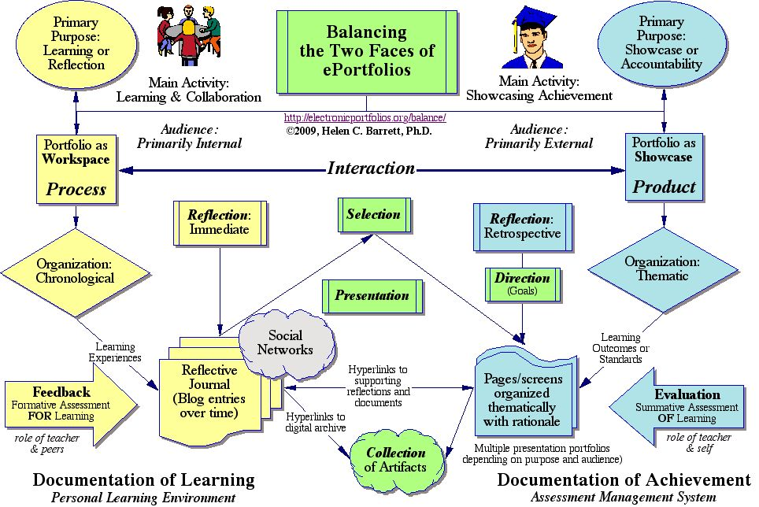
Consider how words are used in education.
http://electronicportfolios.org/balance/index.html

Slide 8
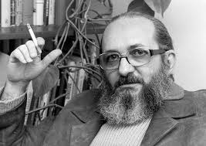
Understanding Knowledge
http://www2.webster.edu/~corbetre/philosophy/education/freire/freire-2.html

Slide 9
We are constrained in so many ways
Limited to objectives and educational purpose
The words have to contain educational content
They must perform (say) one of Gagne’s tasks
That pedagogy is limited to one of knowledge transfer
Students are rendered essentially mute
http://citt.ufl.edu/tools/gagnes-9-events-of-instruction/

Slide 10

Knowing a Pile of Facts?
Image: http://www.rightattitudes.com/

Slide 11
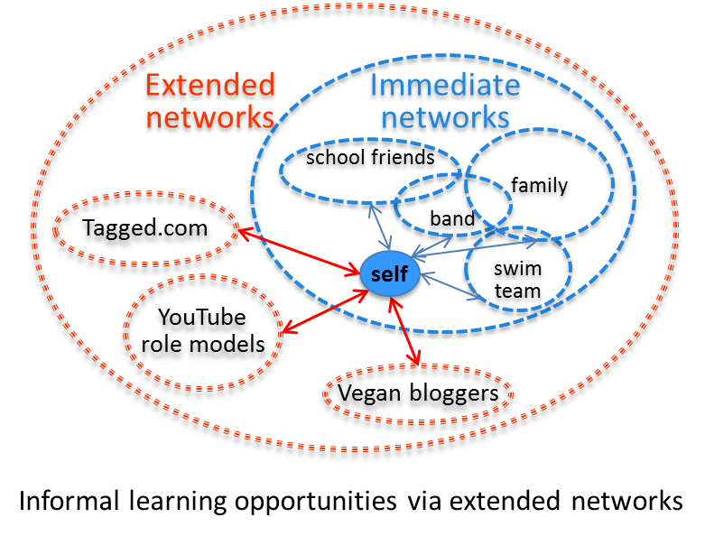
Learning in Context
Task-Focused
Network-based

Slide 12
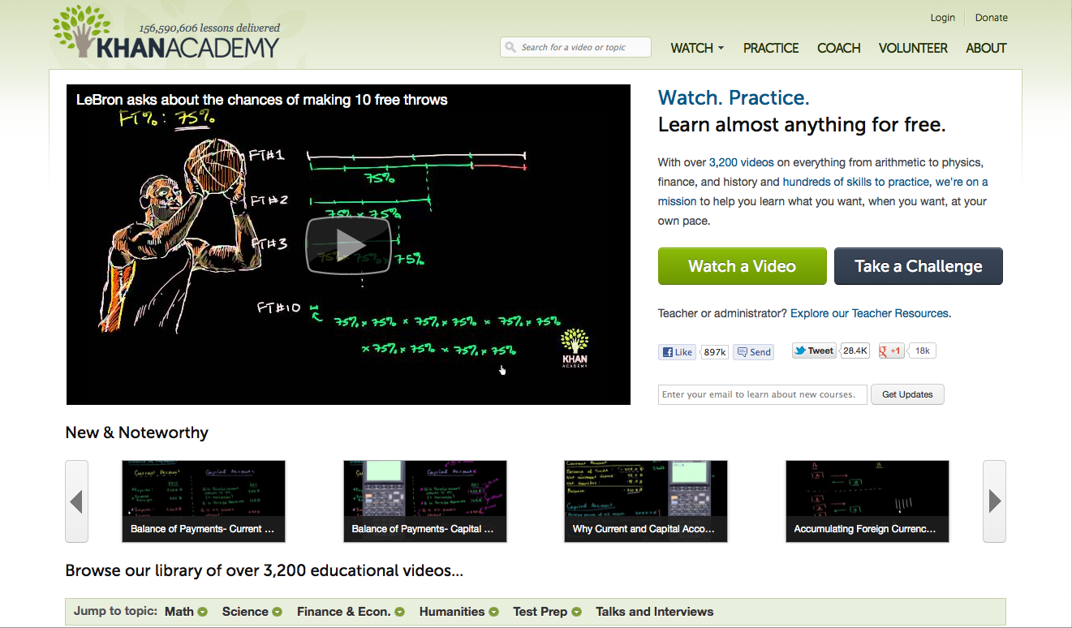
How OERs (Really) Begin
http://www.khanacademy.org/

Slide 13
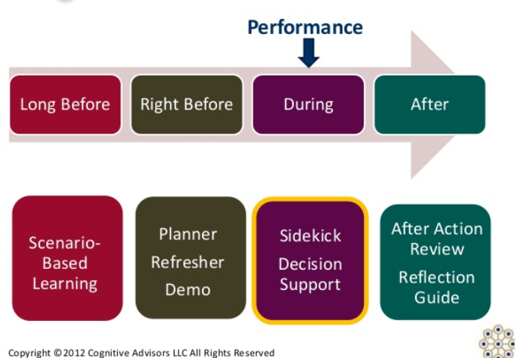
Performance Support
http://www.cognitiveadvisors.com/resources/mobile-performance-support-design-principles

Slide 14
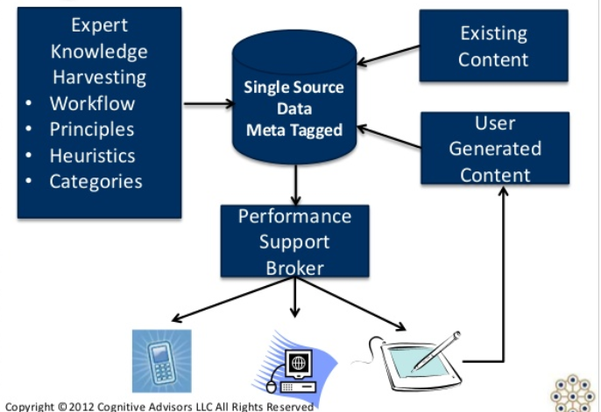
User-Generated OERs

Slide 15

Working Out Loud
http://johnstepper.com/2014/01/04/the-5-elements-of-working-out-loud/

Slide 16





Informal OER Ecosystem

Slide 17
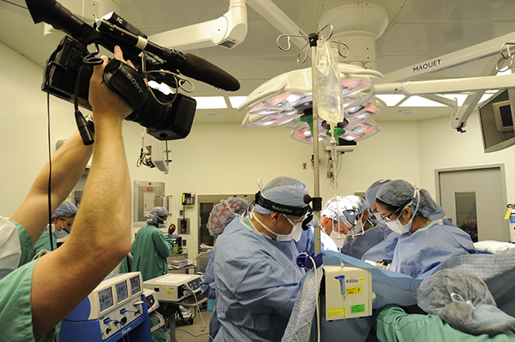
Creating Live OERs

Slide 18
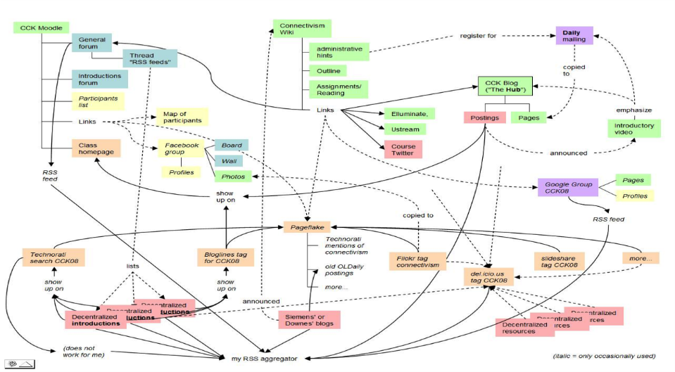
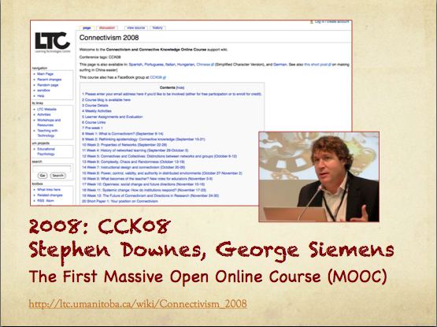
MOOC – CCK08
https://sites.google.com/site/themoocguide/3-cck08---the-distributed-course

Slide 19
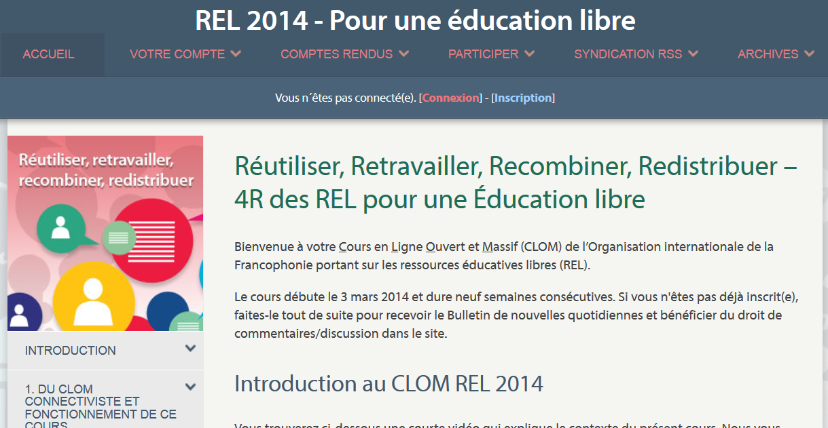
OIF – MOOC-REL
http://rel2014.mooc.ca/

Slide 20
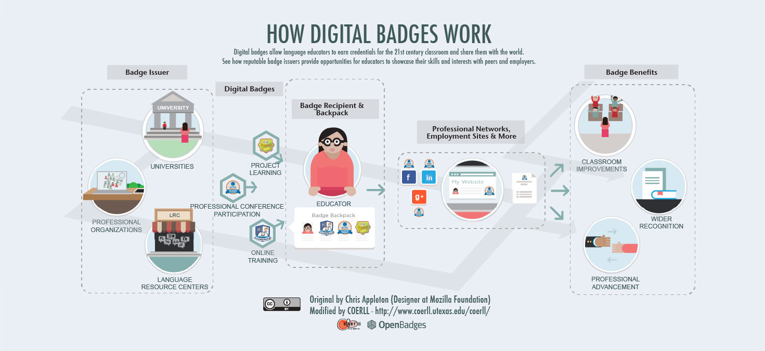
PCO Badges for Learning
http://www.downes.ca/post/63738

Slide 21
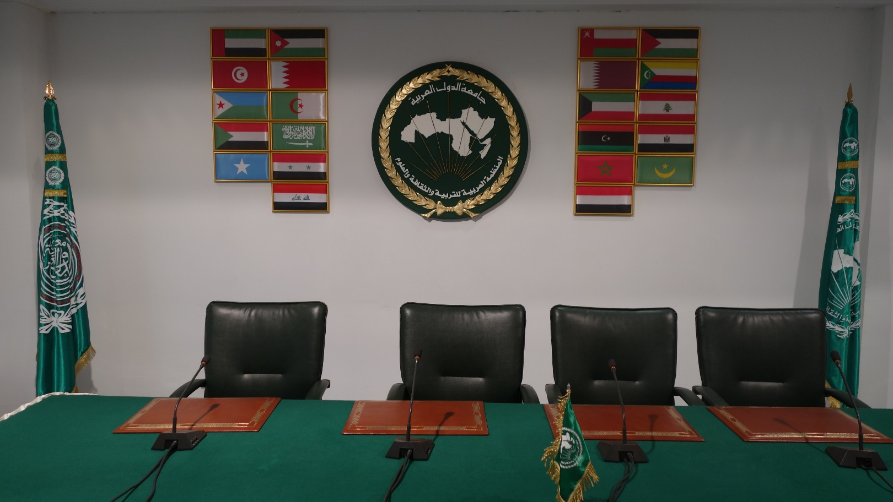
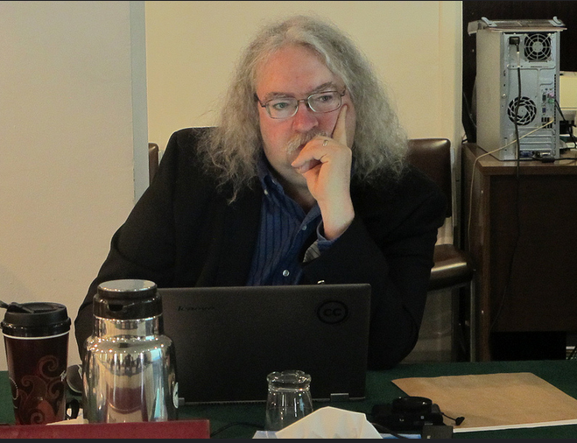
ALECSO – Capacity Building
http://www.downes.ca/presentation/337

Slide 22
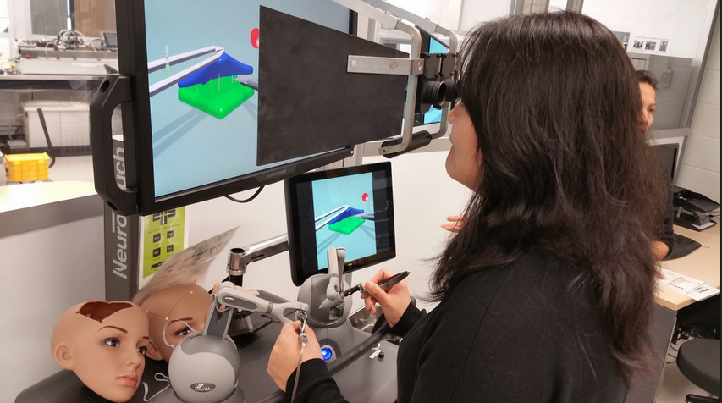
Med Sims
https://www.flickr.com/photos/stephen_downes/15710336207/
http://www.nrc-cnrc.gc.ca/eng/rd/medical/

Slide 23
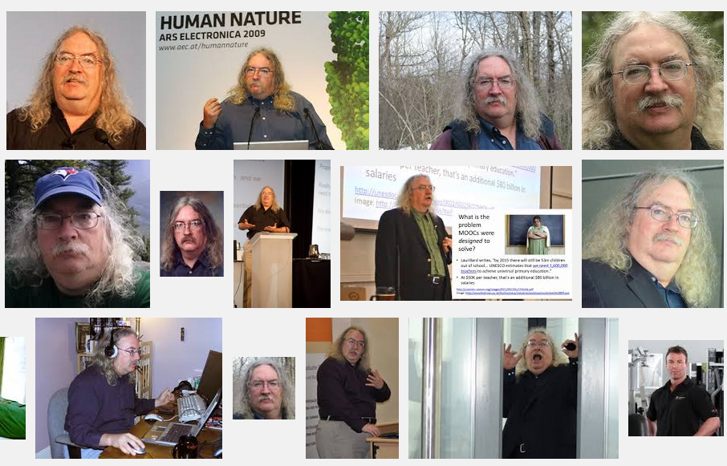
Stephen Downes
http://www.downes.ca

