Slide 1
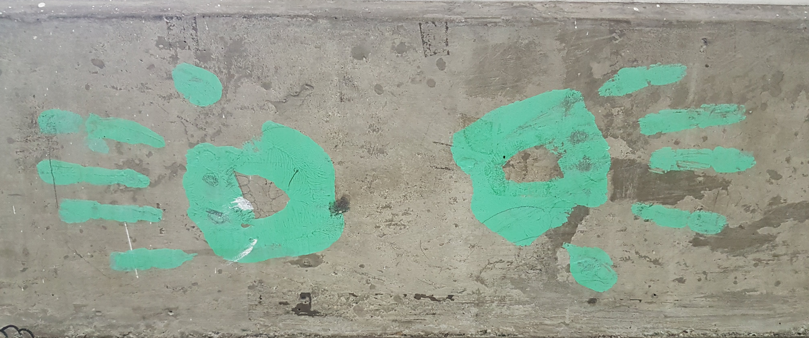
How Open Education Can Change the World
Stephen Downes, Medellin, Colombia, April 26, 2018

Slide 2

Open education is a philosophy about the way people should produce, share, and build on knowledge. Proponents of open education believe everyone in the world should have access to high-quality educational experiences and resources, and they work to eliminate barriers to this goal.
https://opensource.com/resources/what-open-education

Slide 3

What are OERs?
“OERs range from textbooks to curricula, syllabi, lecture notes, assignments, tests, projects, audio, video and animation.”
http://www.unesco.org/new/en/communication-and-information/access-to-knowledge/open-educational-resources/what-are-open-educational-resources-oers/

Slide 4
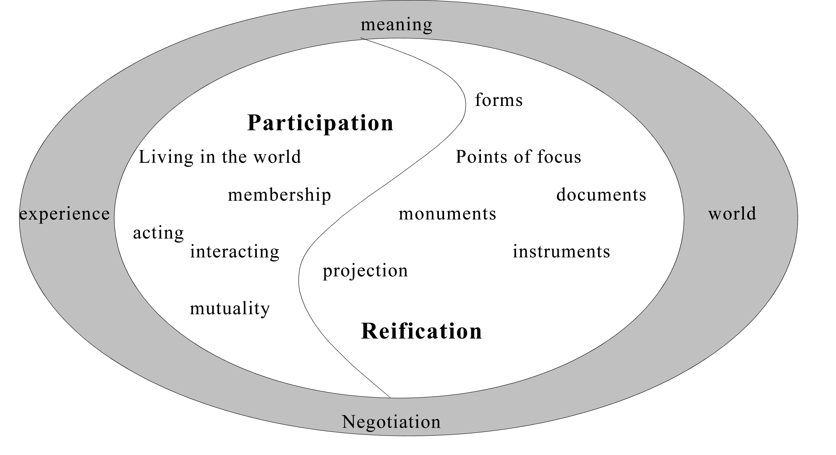
Knowledge is reified by, and is the product of, not only an individual, but of the wider community.
http://www.informationr.net/ir/8-1/paper142.html

Slide 5
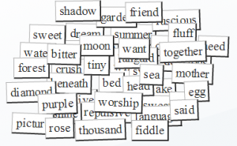
Think of OERs as words in a conversation

Slide 6
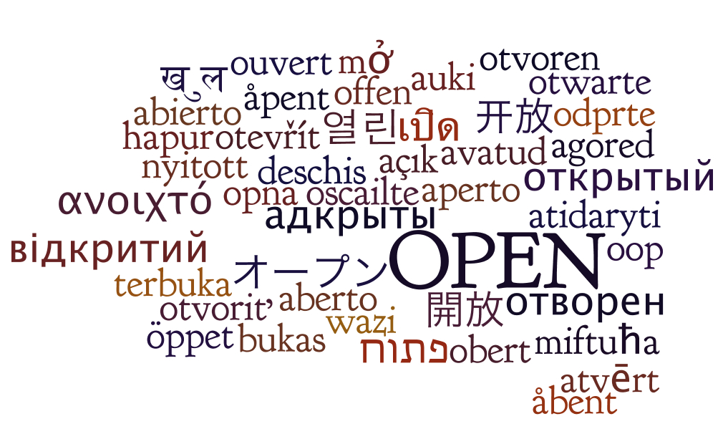
It forces us to think about how they can be used.
http://oerworkshop.pbworks.com/w/page/33932297/OER%20Workshop

Slide 7
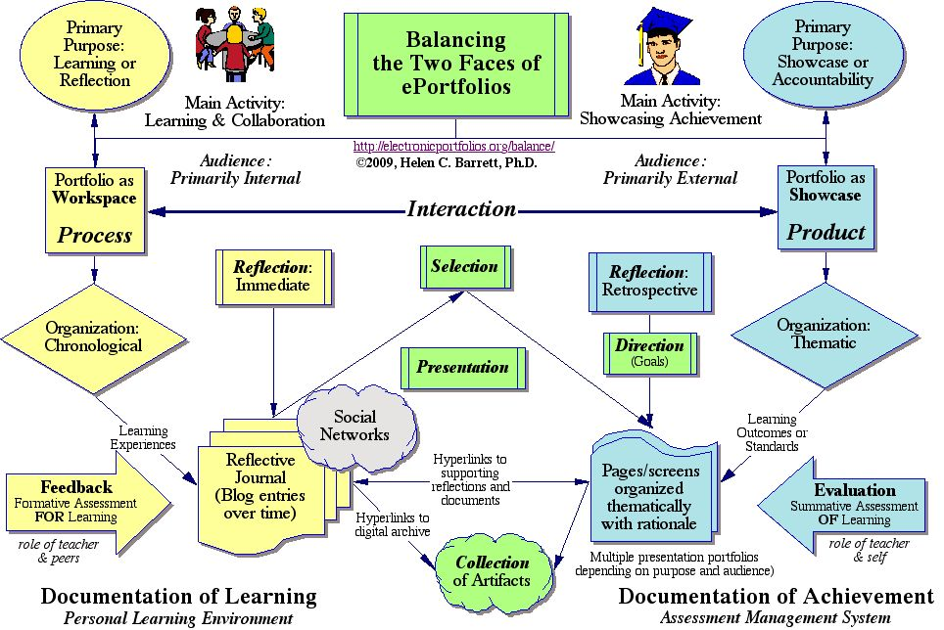
Consider how words are used in education.
http://electronicportfolios.org/balance/index.html

Slide 8

1. The Promise of Technology

Slide 9
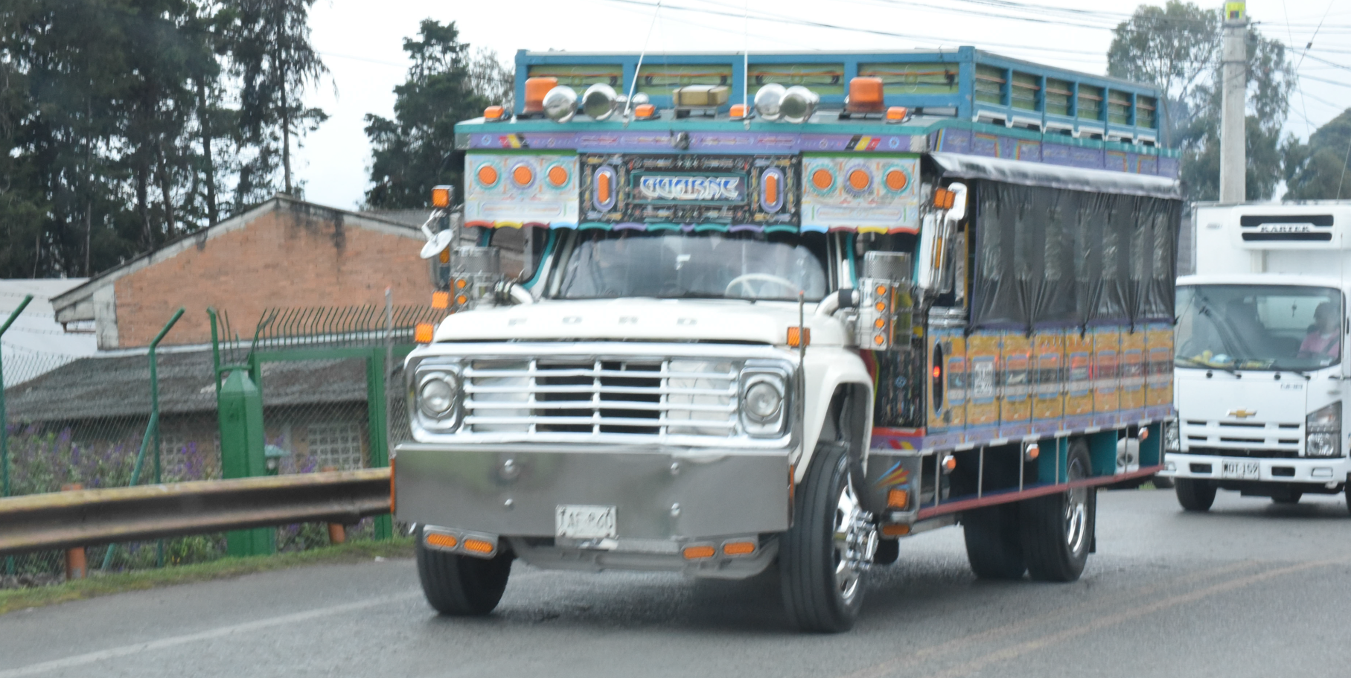
Every citizen in their heart of hearts seeks a peaceful transformation of society towards a future that ensures inclusive economic and social development.
- Veronica Hope Hailey
http://www.bath.ac.uk/management/news_events/news/2017/23-10-jose-restrepo-explains-how-he-is-spreading-peace-in-colombia.html

Slide 10
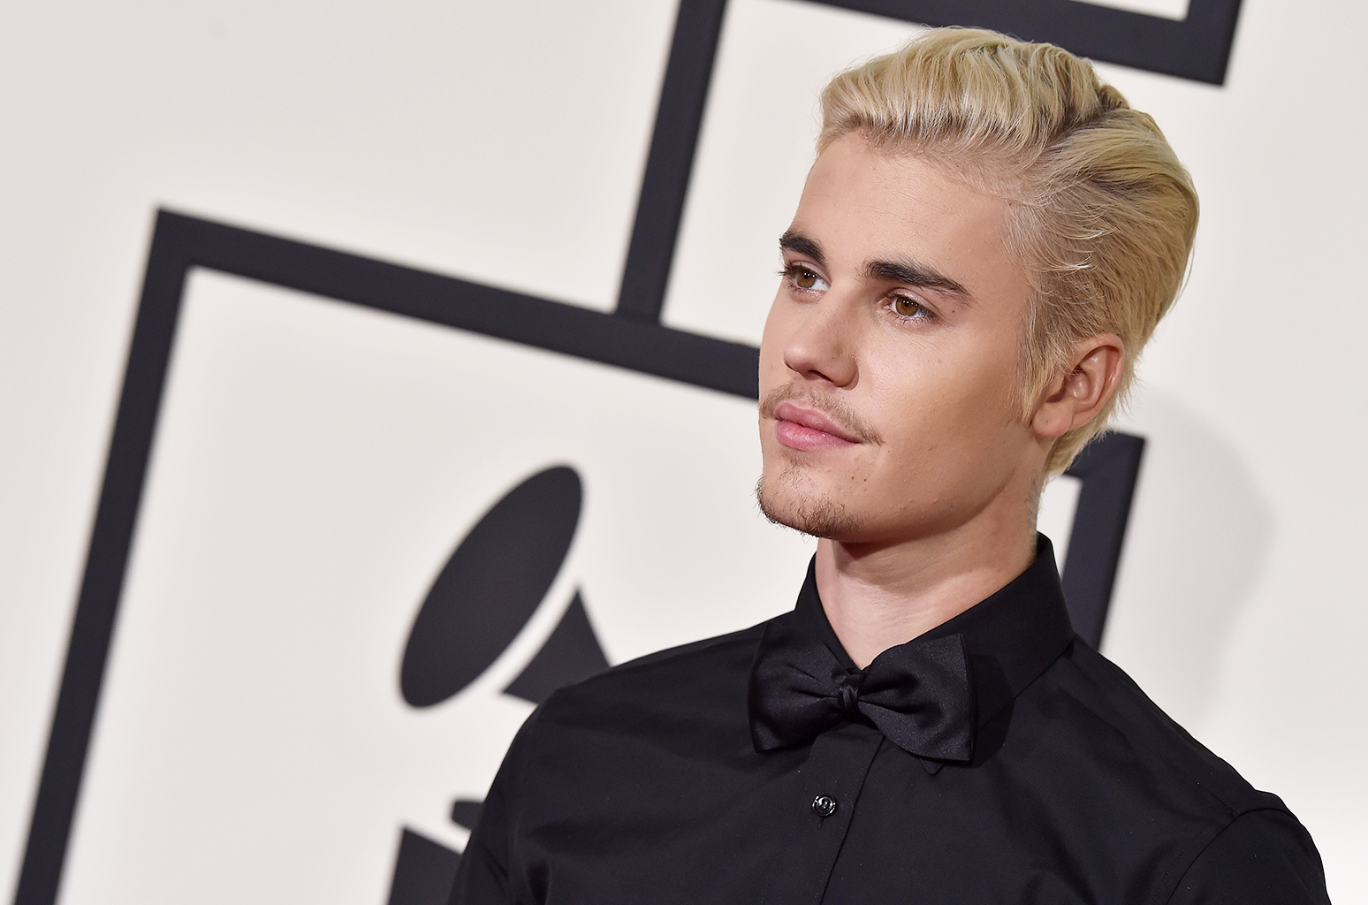
Digital technology has not only disrupted industry, it has changed the way change is made. There is a common thread that unites Justin Bieber, the Arab Spring, and the Oculus Rift.

Slide 11
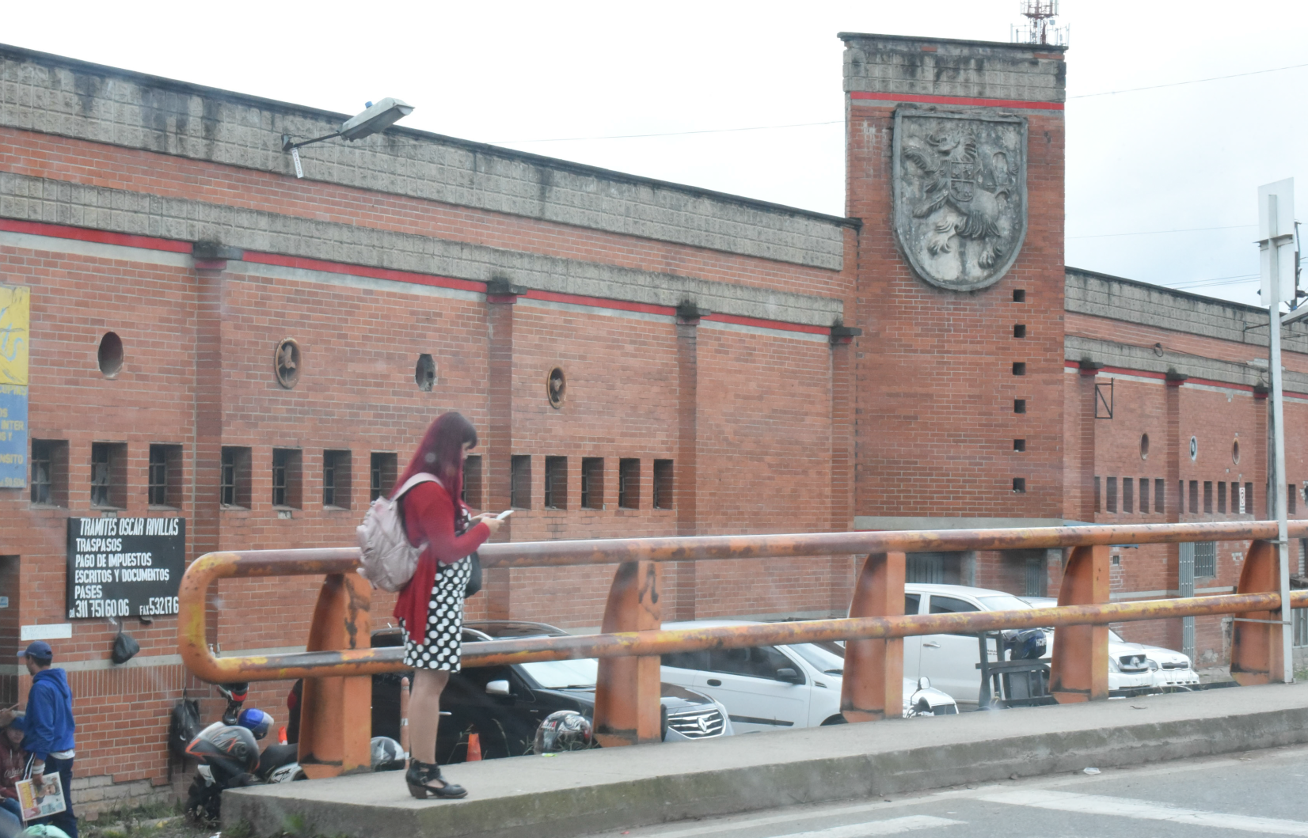
Almost five billion people today use mobile phones, and many more have access if they want it or need it. But almost equally significant is the world wide access to millions of videos and other resources on sites like YouTube and Facebook.

Slide 12
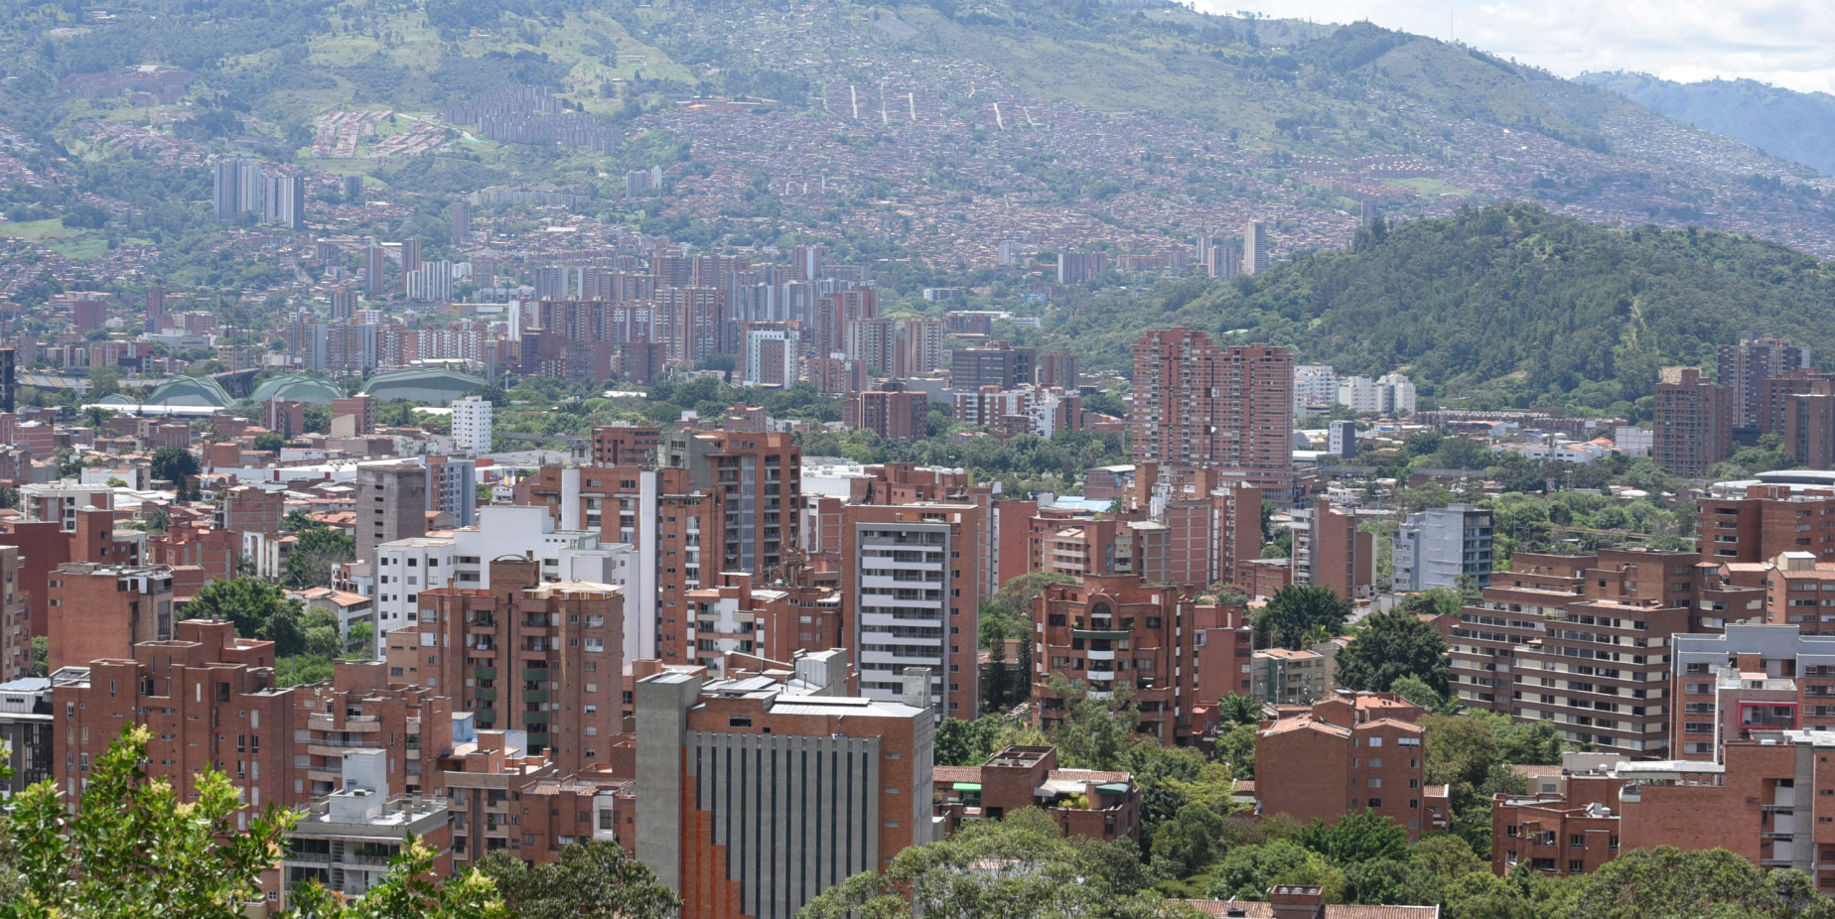
Digital technology has transformed society, created entire industries, informed minds young and old, and given each of us an opportunity to connect with others in our communities or across oceans.

Slide 13
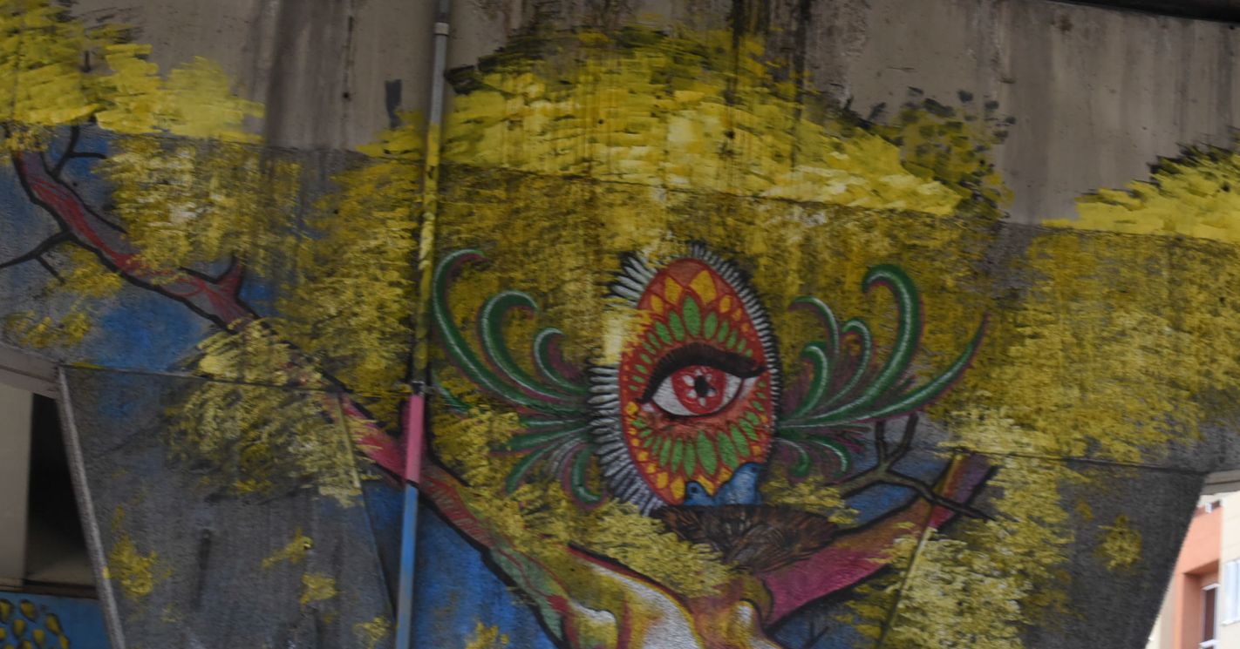
Belief in one’s own capacity. “The skill of self-advocacy is crucial for everyone, but especially for young people confronted by steep challenges.” – Beth Hawkins

Slide 14

2. The Rise of Open Education

Slide 15
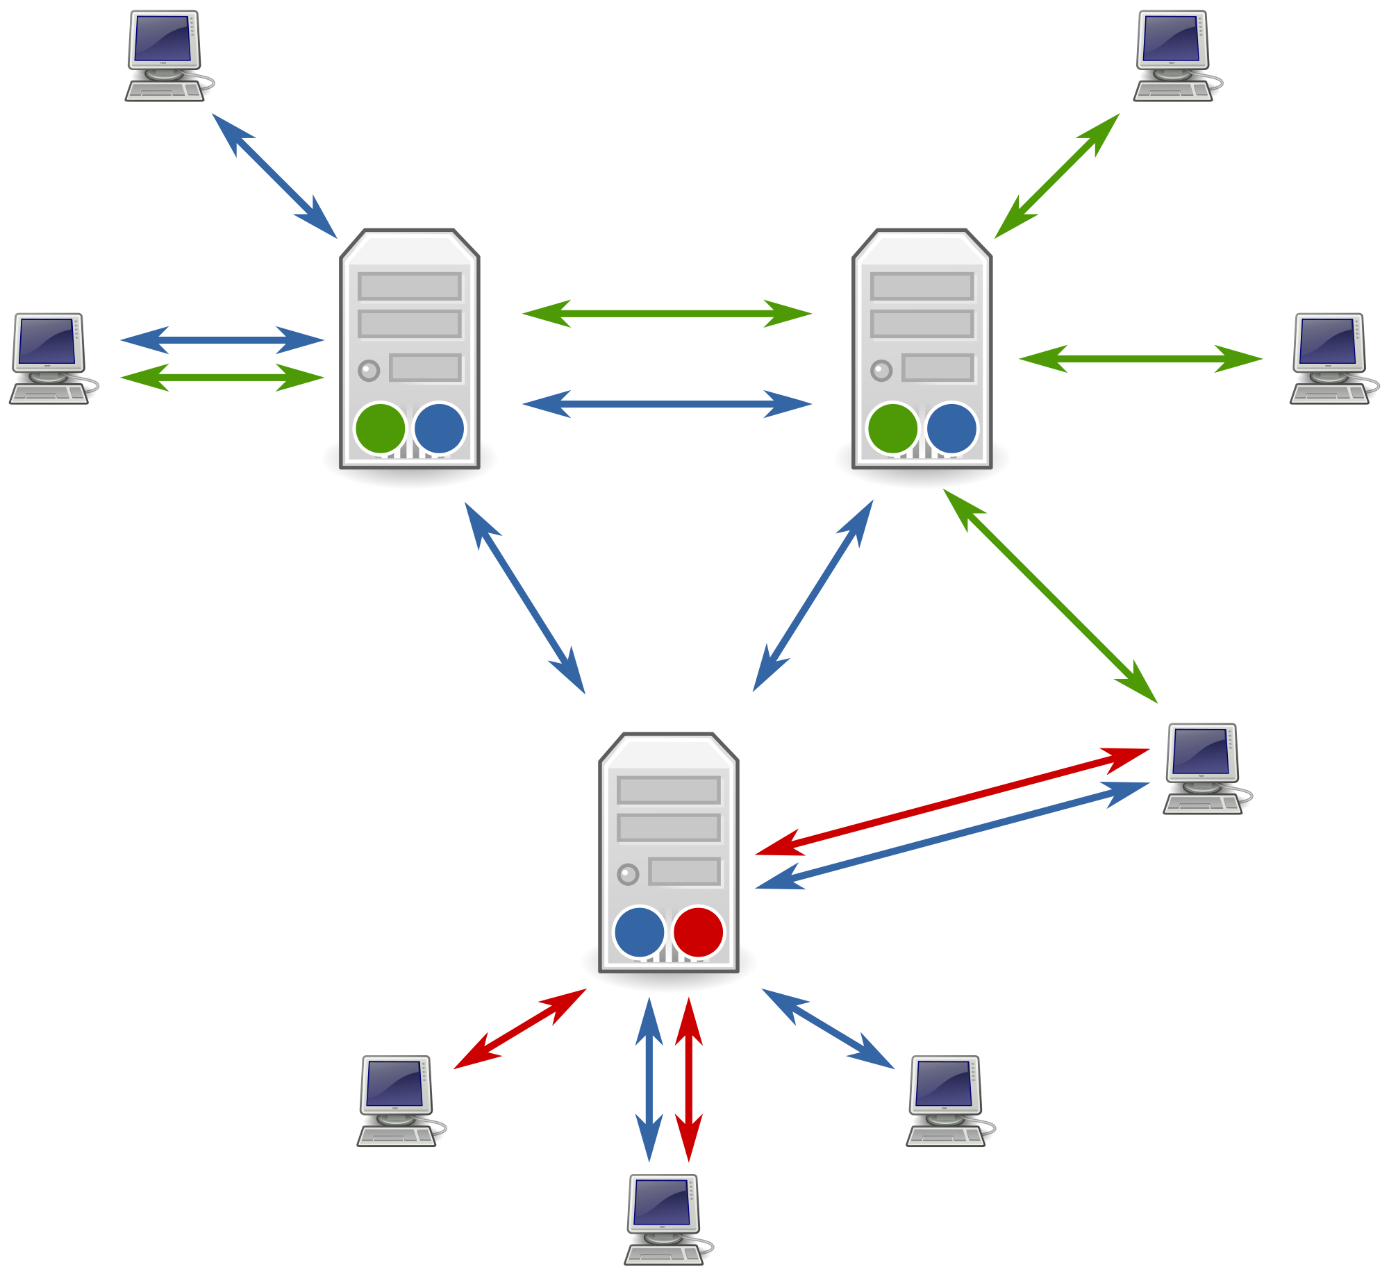
It began as email lists and Usenet groups. It grew through blogs and personal websites, from sites as humble as my own to those as sprawling in their ambition as Wikipedia. And it thrived in the age of social networks, online classrooms, and massive open online courses.

Slide 16
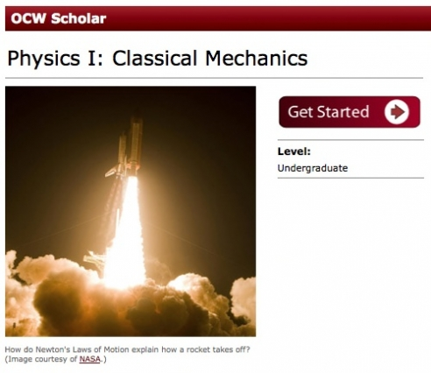
“About 40 to 45 per cent of visitors to OCW are students at other universities who are looking for material to complement their course. Nearly as many are what MIT terms "self-learners" - people, usually working professionals, who are not enrolled in any formal education programme.” - Rebecca Attwood
https://www.timeshighereducation.com/cn/features/get-it-out-in-the-open/408300.article?sectioncode=26&storycode=408300&c=2

Slide 17
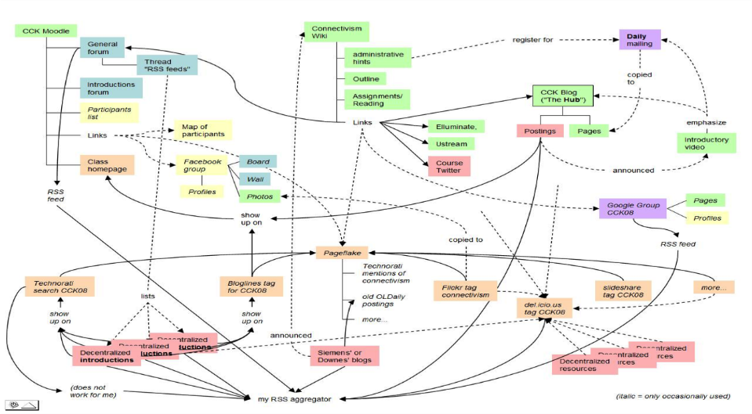
Today a significant percentage of open education is offered in the form of the Massive Open Online Course (MOOC). A MOOC is more than just the online course materials - the idea is that the actual teaching of the course also takes place online.

Slide 18
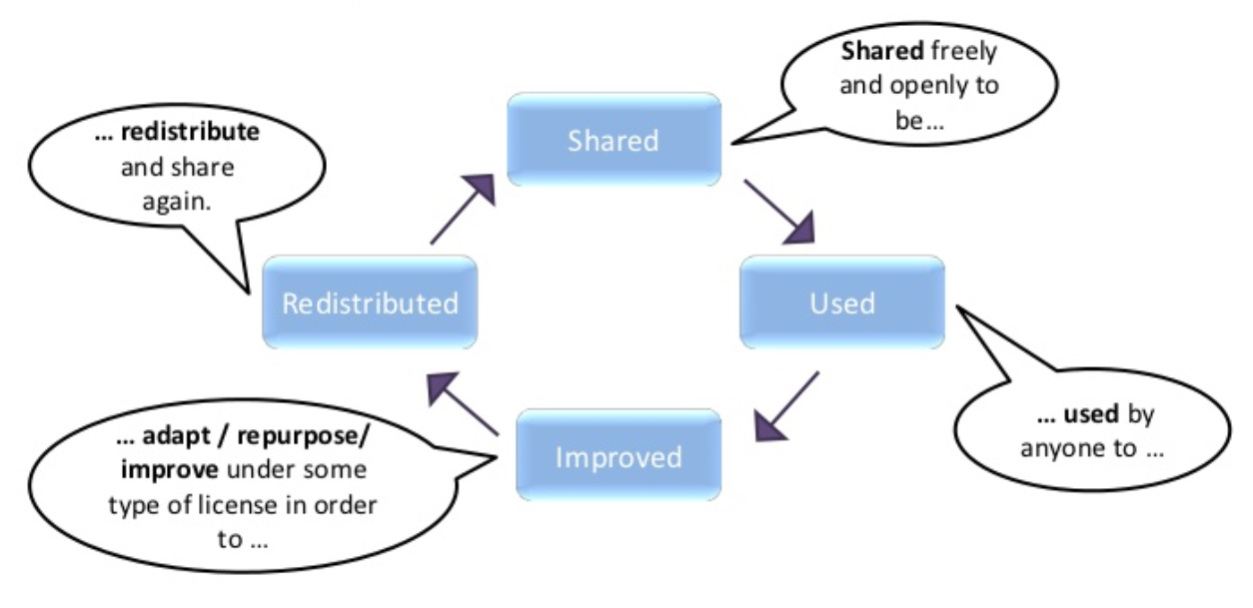
What does it mean to be open? “Open education is a philosophy about the way people should produce, share, and build on knowledge. Proponents of open education believe everyone in the world should have access to high-quality educational experiences.”
https://openedreader.org/

Slide 19
World-class universities should be tasked with a shared responsibility for building capacity in higher education systems as a whole. Scarce national resources be focused on creating world-class systems rather than world-class universities. - Rajani Naidoo
http://www.universityworldnews.com/article.php?story=20180417162622337

Slide 20

3. Meeting the Challenges

Slide 21

“The most typical course registrant is a male with a bachelor’s degree who is 26 or older.” But while this is true, the same data from the first year of EdX shows 9,148 people from Colombia completing the course and obtaining a certificate, which is a significant outcome even if the percentages are small. - Andrew Ho, et.al.

Slide 22
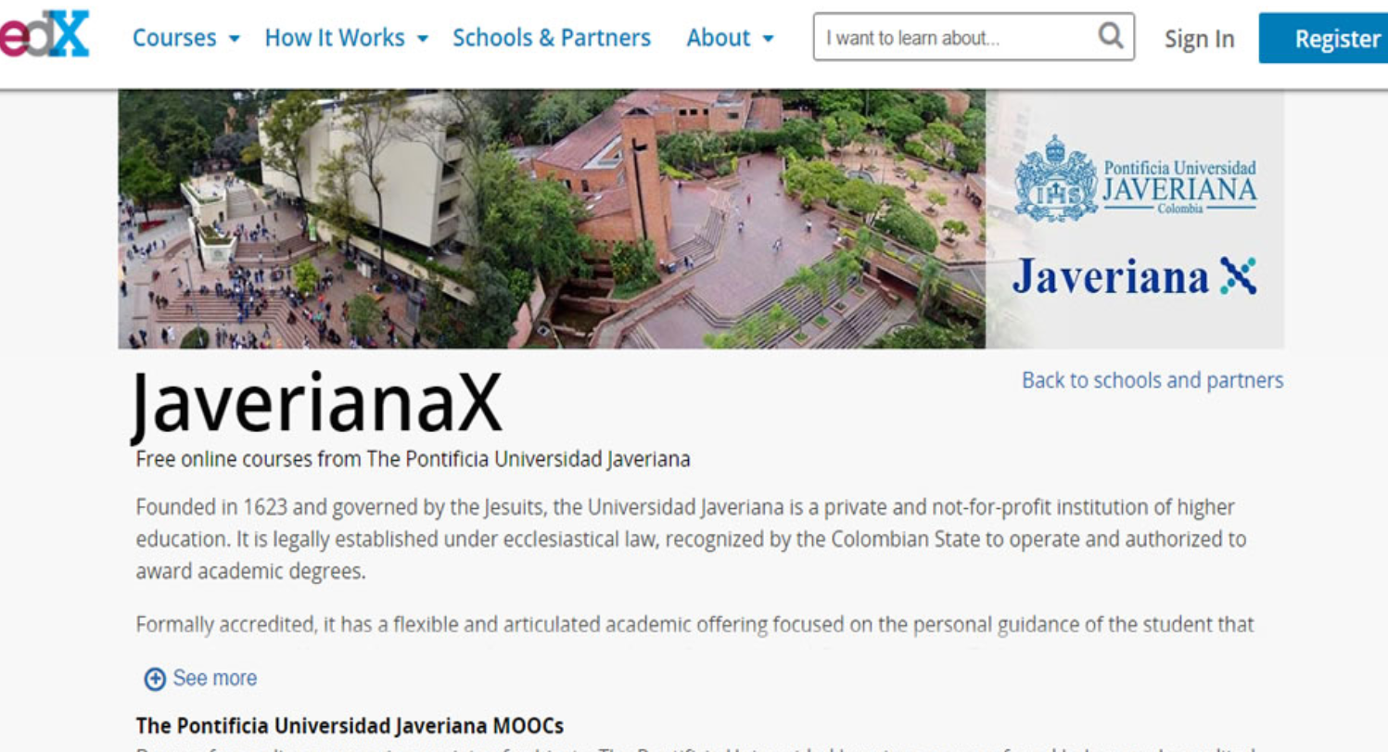
MOOCs and other forms of open online learning are emerging from around the world. In Colombia, for example, MOOCs have been produced by the University of Los Andes, Javeriana and Pereira.

Slide 23
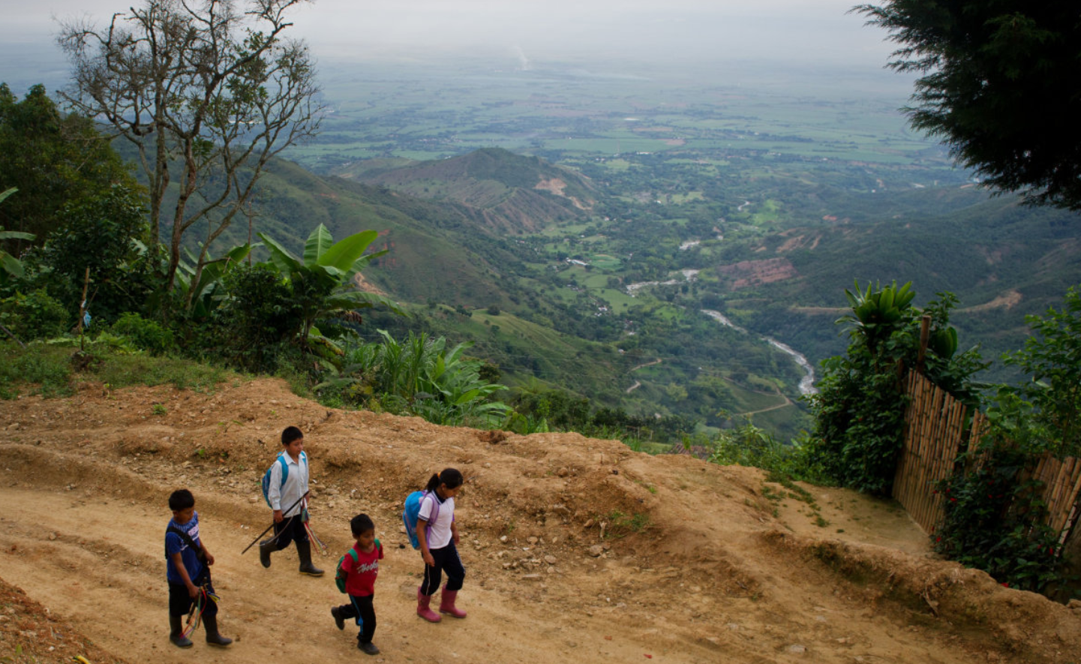
https://www.usnews.com/dims4/USNEWS/a82e3ab/2147483647/crop/4050x2700%2B0%2B0/resize/1200x1200%3E/quality/85/?url=http%3A%2F%2Fmedia.beam.usnews.com%2F8d%2F8a%2F1440b33d4b57a3850a6542b033a7%2F60531bc.BeatenPath_49_Columbia.jpg
In a study of MOOC users from Colombia, the Philippines and South Africa, “less than half of the MOOC users surveyed had completed higher education… a quarter of MOOC users reported high school as their highest level of education finished.
http://tascha.uw.edu/wp-content/uploads/2016/04/Press-release_final-research-report.pdf

Slide 24
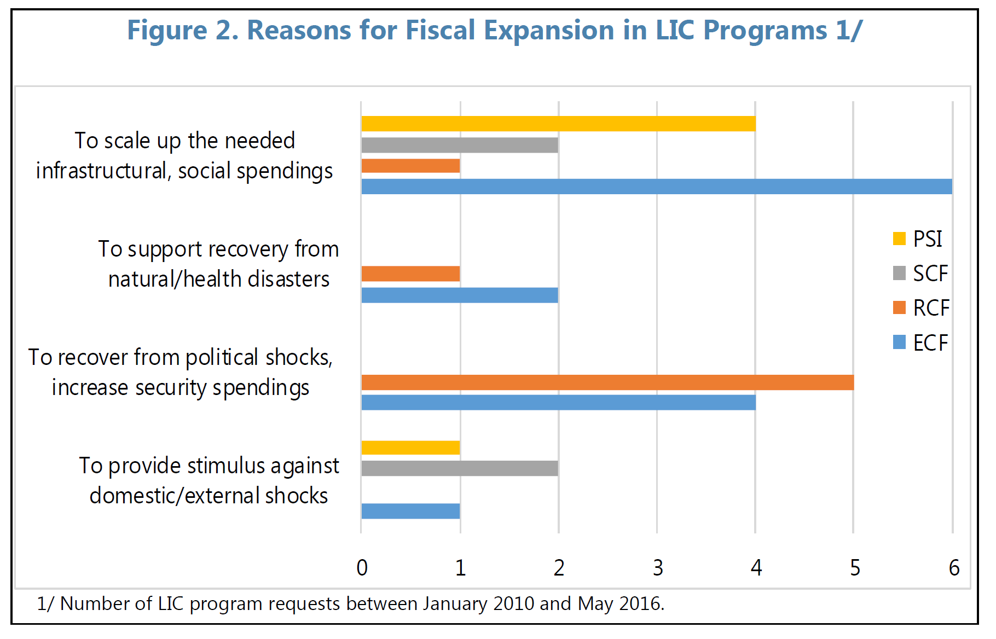
“The success of low-income country programs increasingly depends on two key factors—(i) minimum levels of government spending on health, education, and social safety nets; and (ii) specific reform measures to protect vulnerable groups.” - IMF. 2017
http://www.imf.org/en/Publications/Policy-Papers/Issues/2017/06/01/pp042117social-safeguards-and-program-design-in-prgt-and-psi

Slide 25
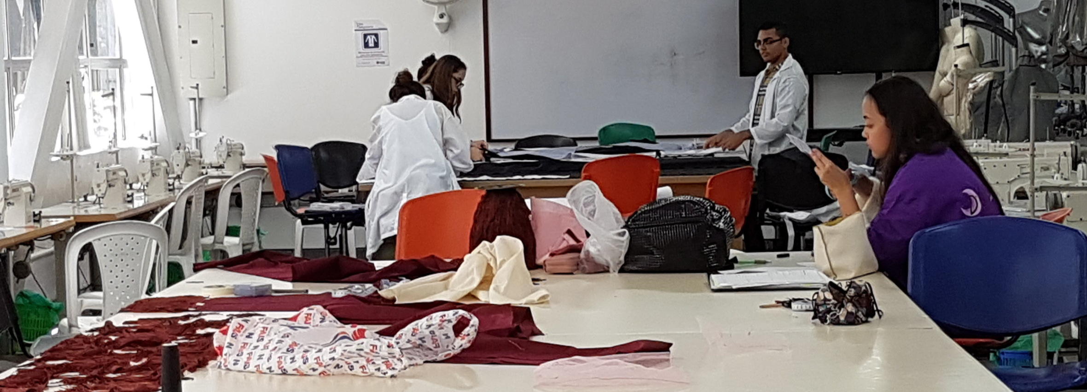
Think of open education as more than just courses. Think of it as sharing practices, tools, videos, and experiences and stories. Think of it as more than employment and economy, but also the skills and attitudes fundamental to learning and growing together as a society.

Slide 26
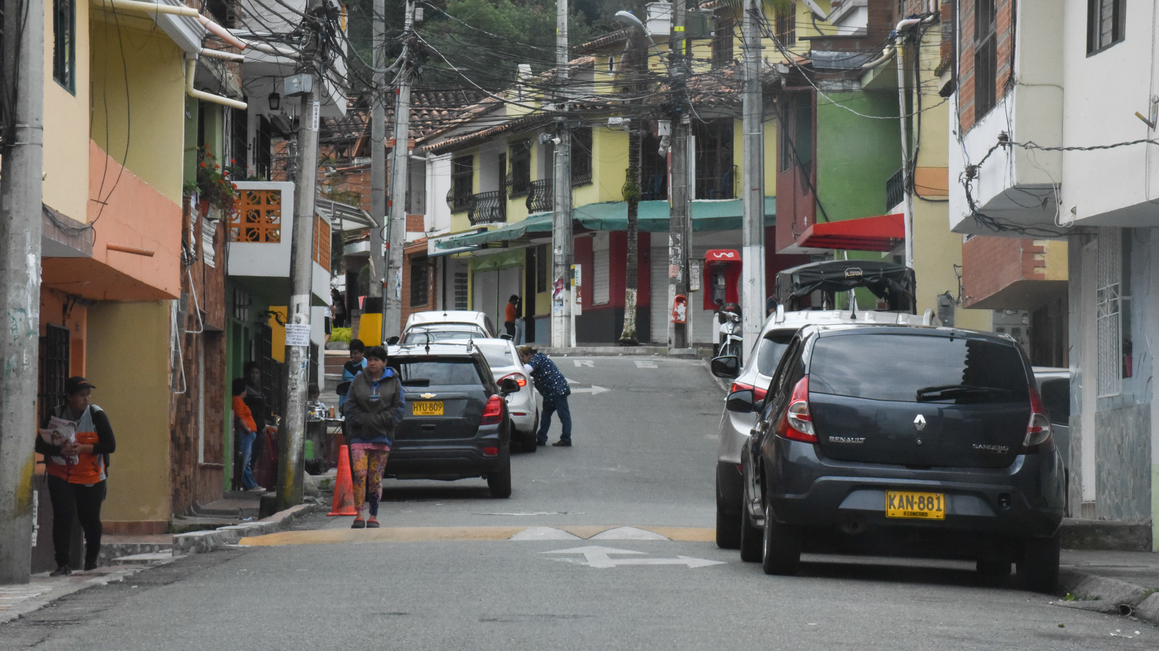
4. The Way Forward

Slide 27
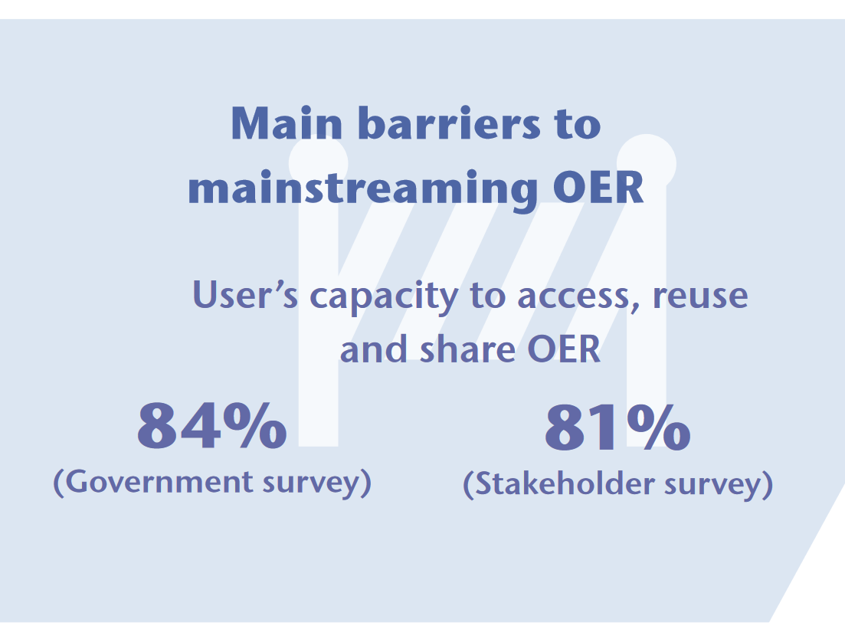
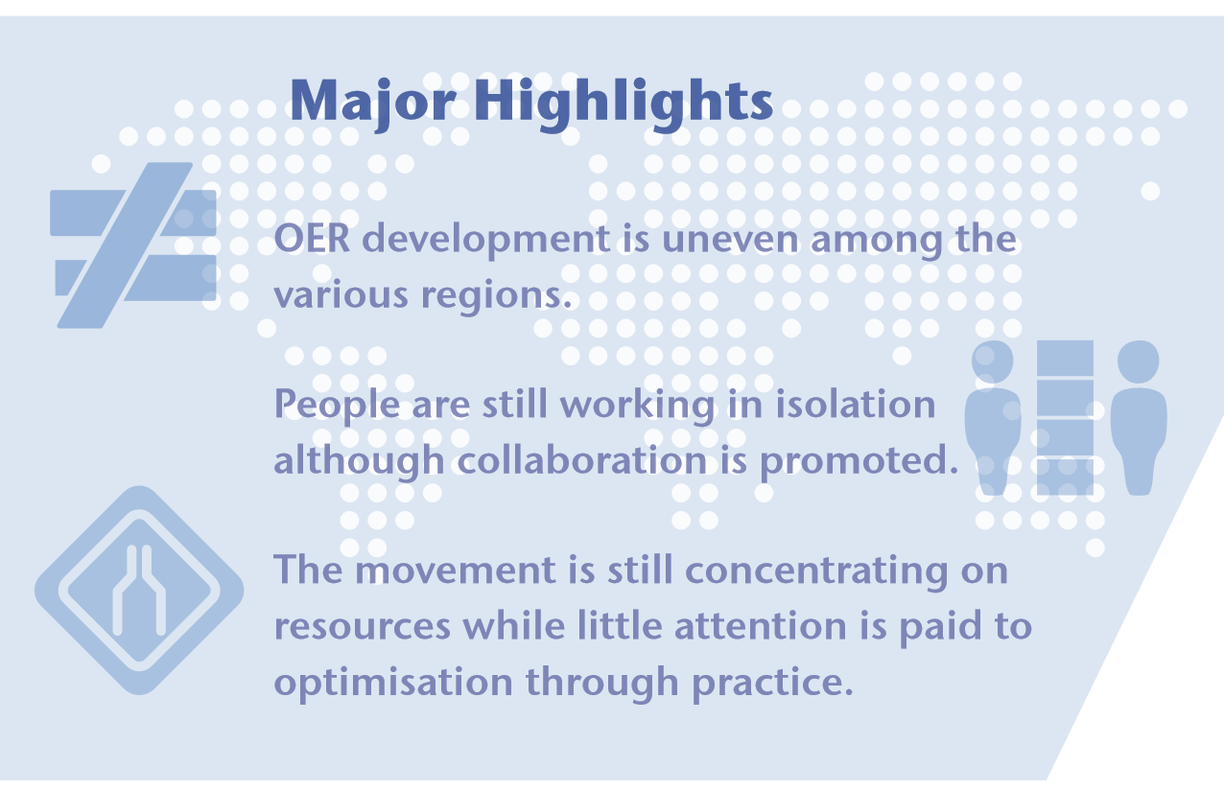
“Fewer than half (49%) of the respondents thought that relevant stakeholders have the necessary skills to access, use and share OER.” These skills are, first of all, skills in the use of information and communications technology, and secondly, skills in managing licenses and publication.
http://oasis.col.org/bitstream/handle/11599/2788/2017_COL_OER-Global-Report.pdf?sequence=1&isAllowed=y

Slide 28
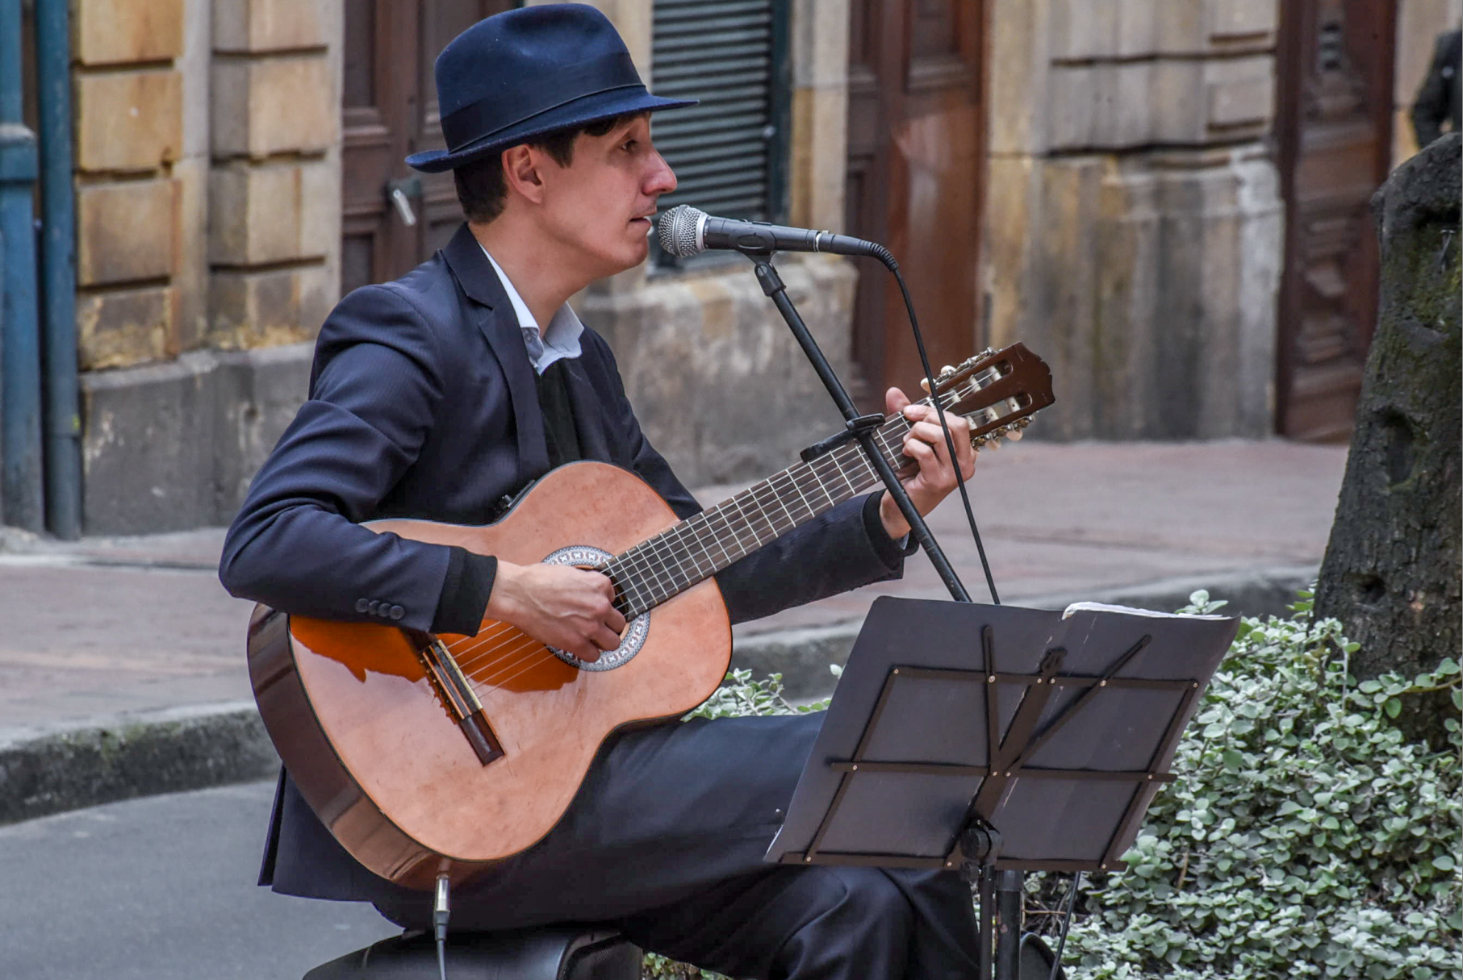
“Only 41% of the respondents felt that there are sufficient OER in the main language (or languages) of education in their country.” It has been argued that the development of open online resources creates an important cultural and political voice for a country. - Grainne Conole
https://www.tandfonline.com/doi/abs/10.1080/01587919.2012.700563?journalCode=cdie20

Slide 29
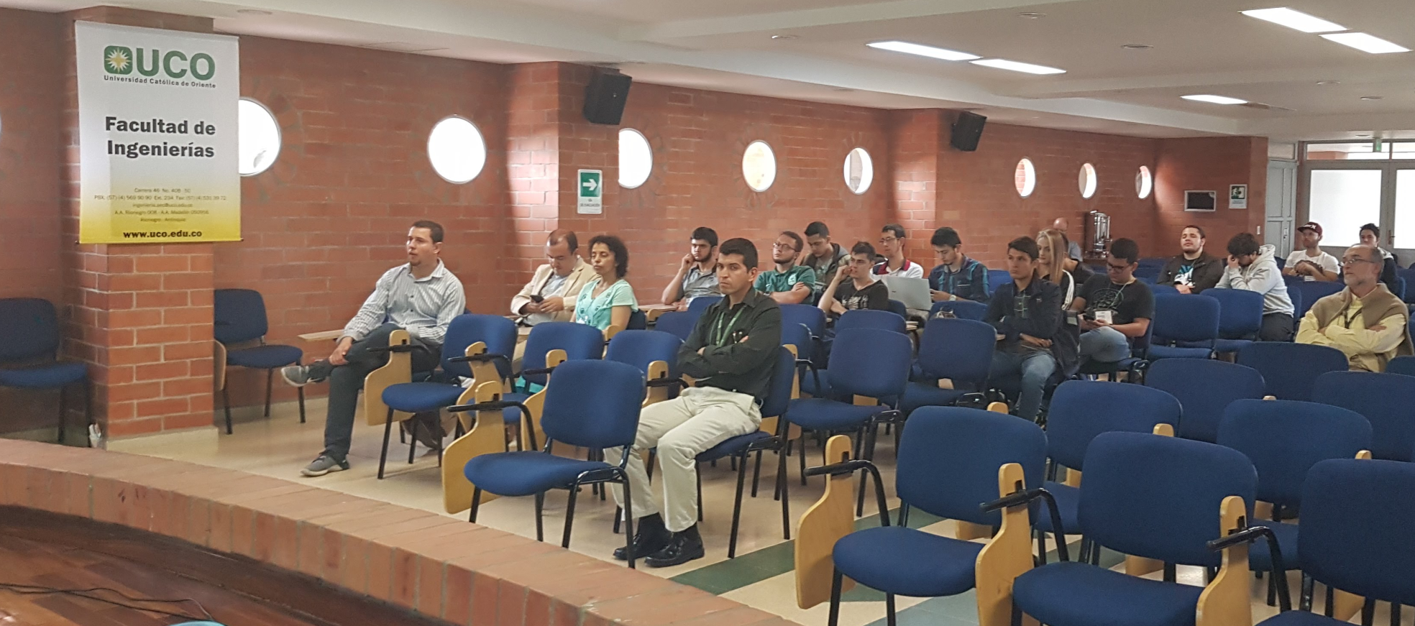
The creation of a mechanism for the production and sharing of OERs, with support from management, is also a mechanism for building a learning community of educators, and increasing instructional capacity generally.
http://www.oecd.org/education/school/44339174.pdf

Slide 30
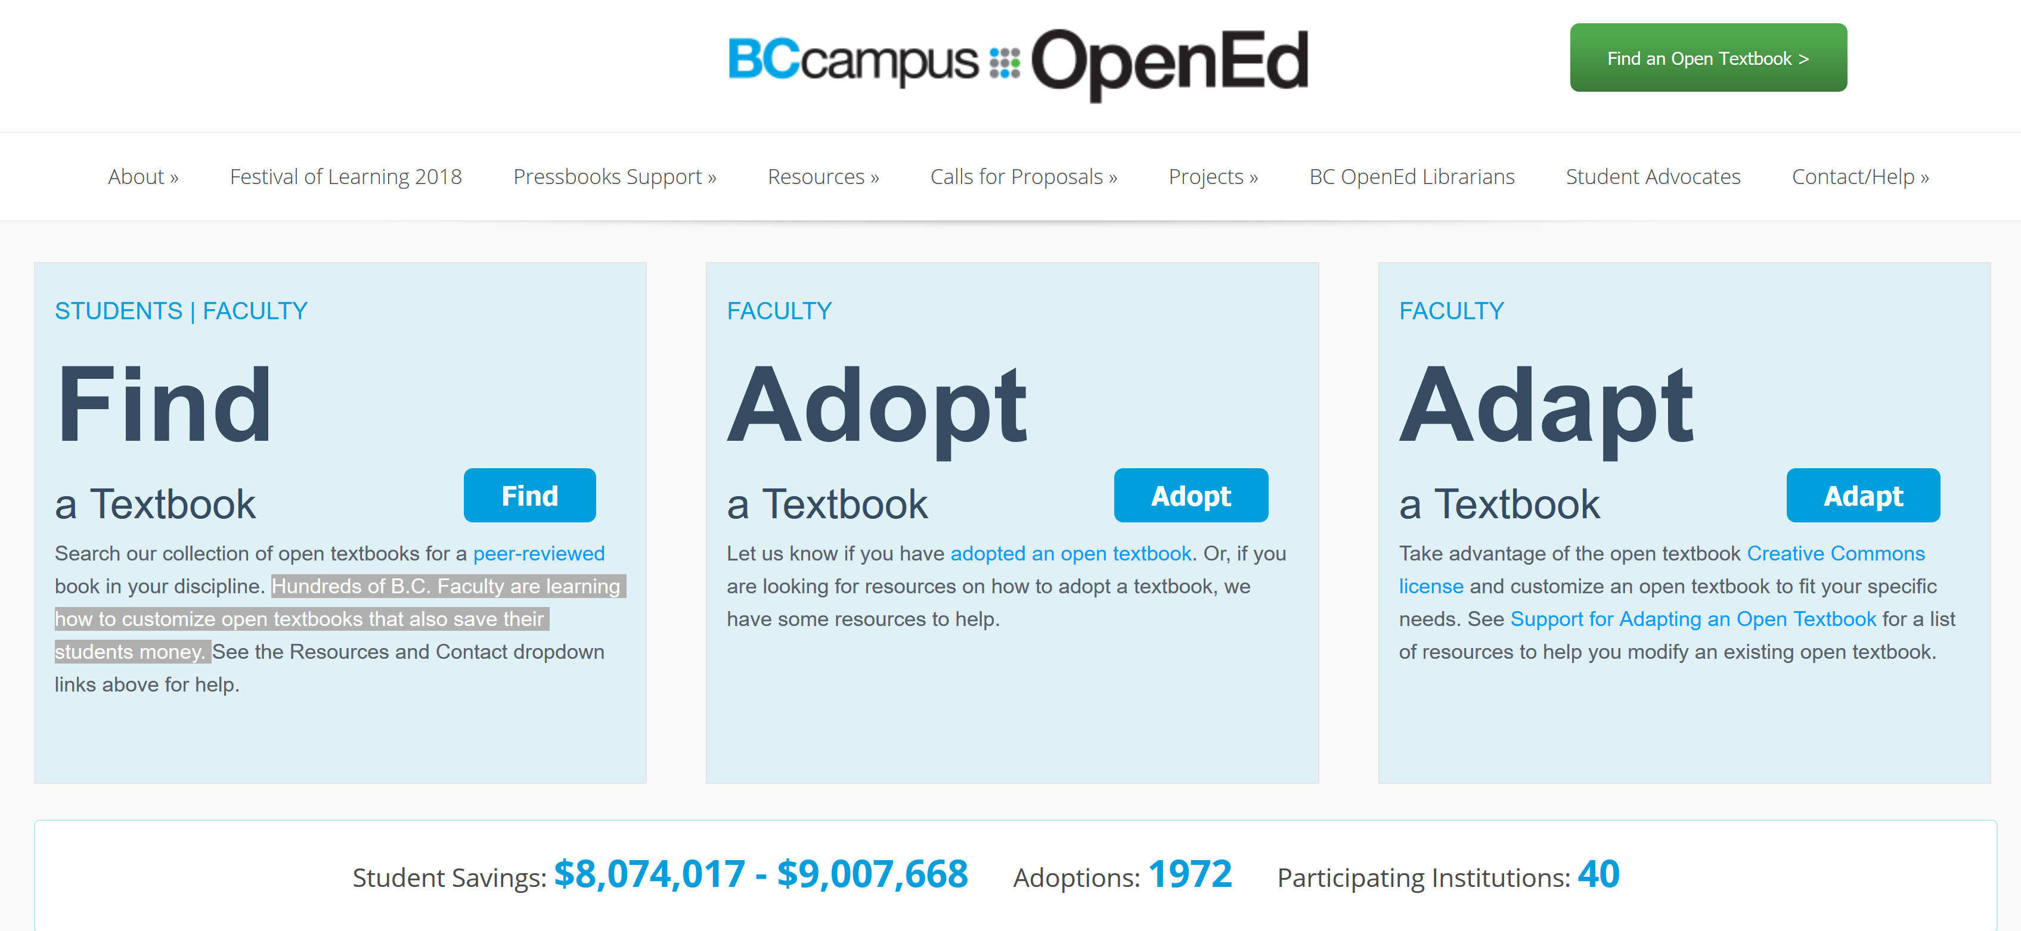
Support the community so the community can support itself. Eg. B.C. Campus: “Hundreds of B.C. Faculty are learning how to customize open textbooks that also save their students money.”
https://open.bccampus.ca/

Slide 31
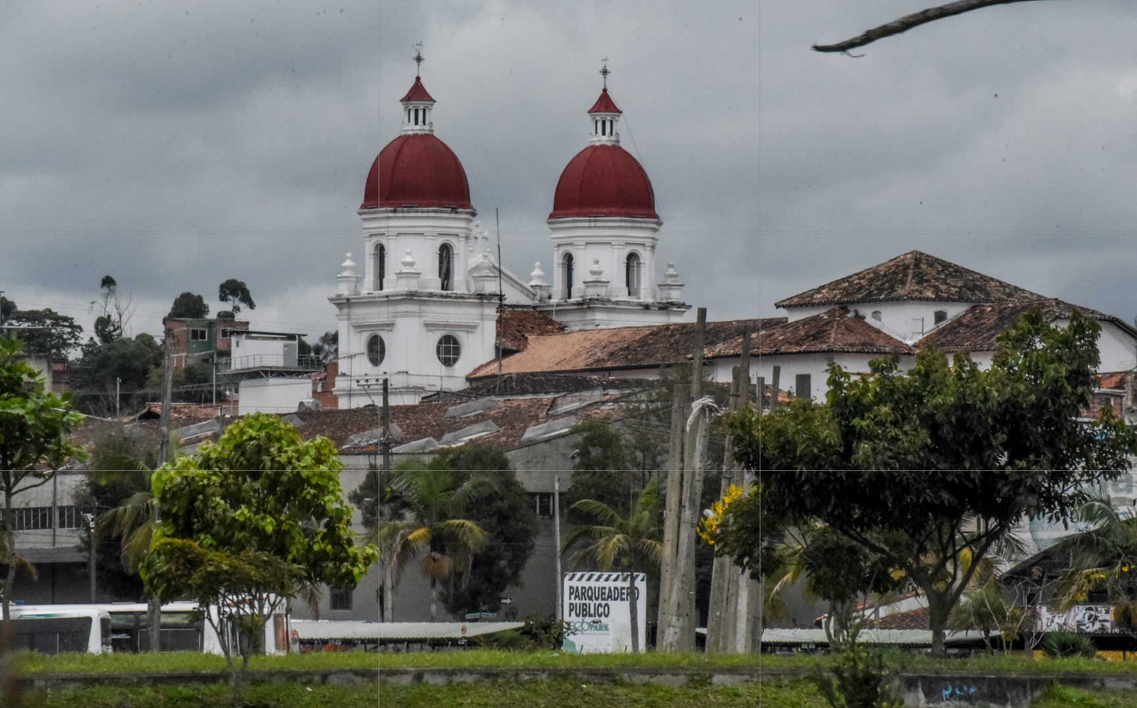
5. Four Steps to Peace - José Restrepo
http://www.bath.ac.uk/management/news_events/news/2017/23-10-jose-restrepo-explains-how-he-is-spreading-peace-in-colombia.html

Slide 32
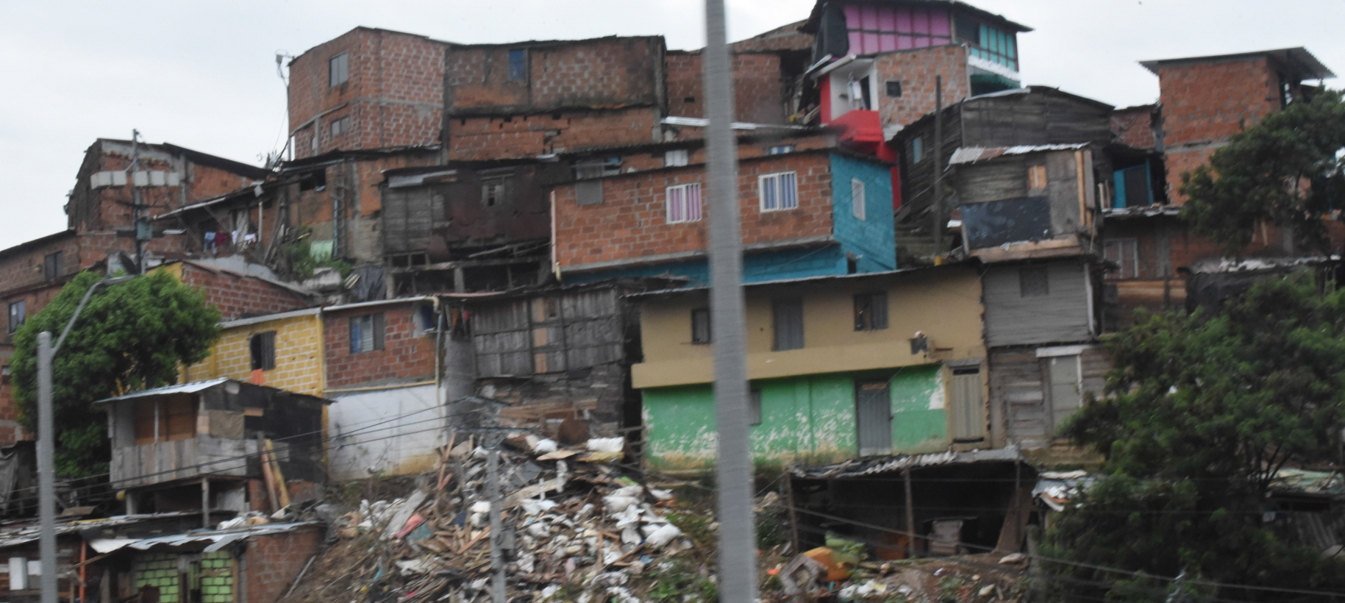
Redistribution - Scholarships for students from low income families and areas of conflict. Increase capacities in communications, information technologies, learning
http://aprende.colombiaaprende.edu.co/pilopaga

Slide 33
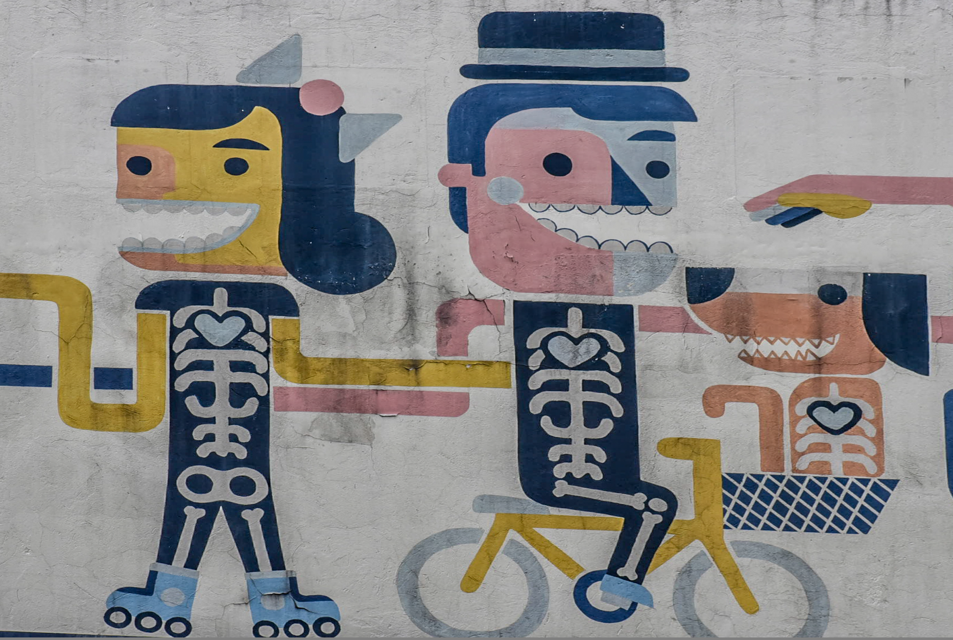
Recognition - gender equality and diversity while also promoting remembrance, truth and reconciliation. A focus on training of indigenous communities and ex-combatants.

Slide 34
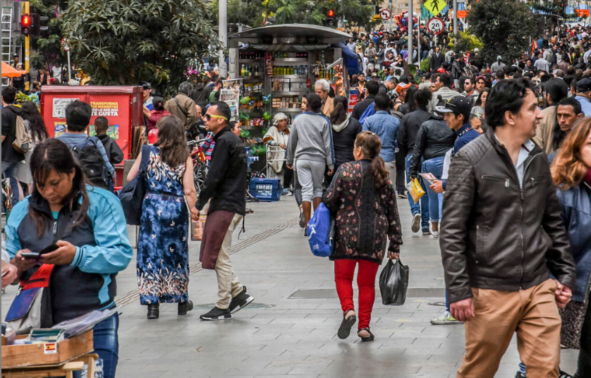
Representation - working together to promote interdisciplinary research to develop capacity to rebuild society, sharing curricula on human rights and writing textbooks to teach new generations.

Slide 35
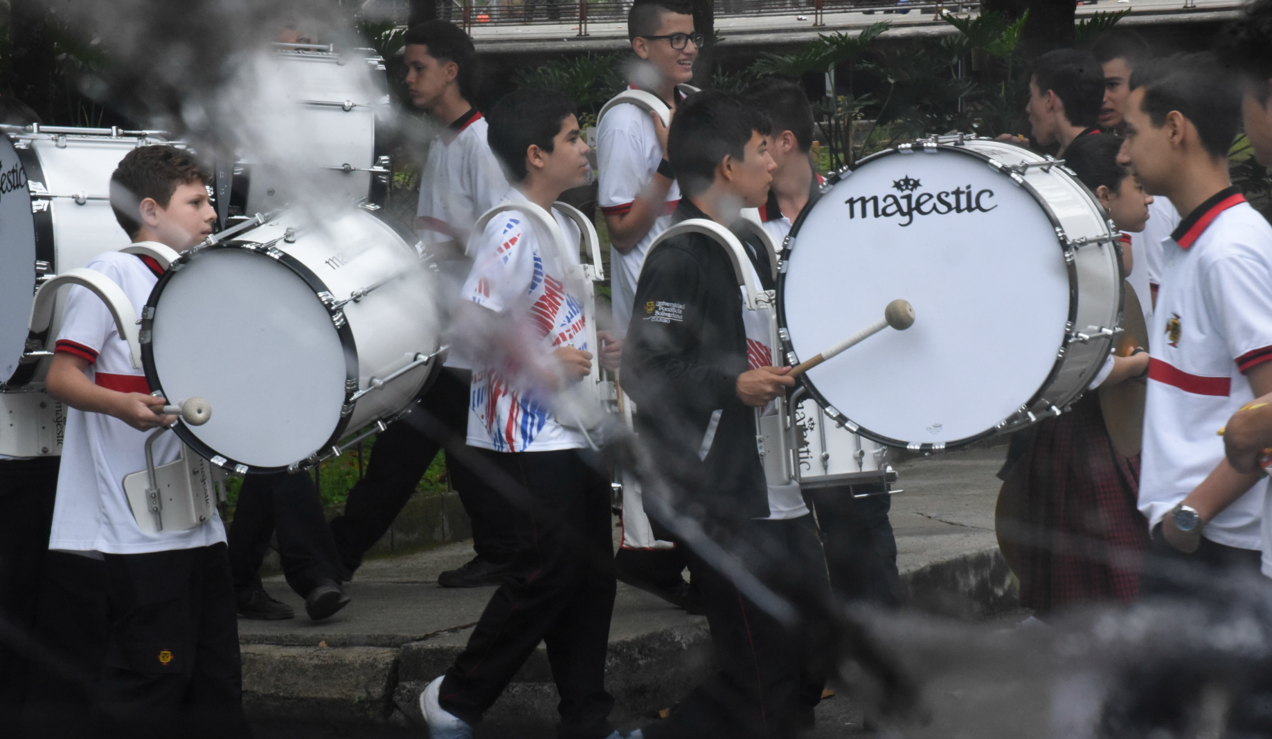
Reconciliation - promoting peaceful conflict resolution and offering alternative paths to success, self-expression, and community support

Slide 36
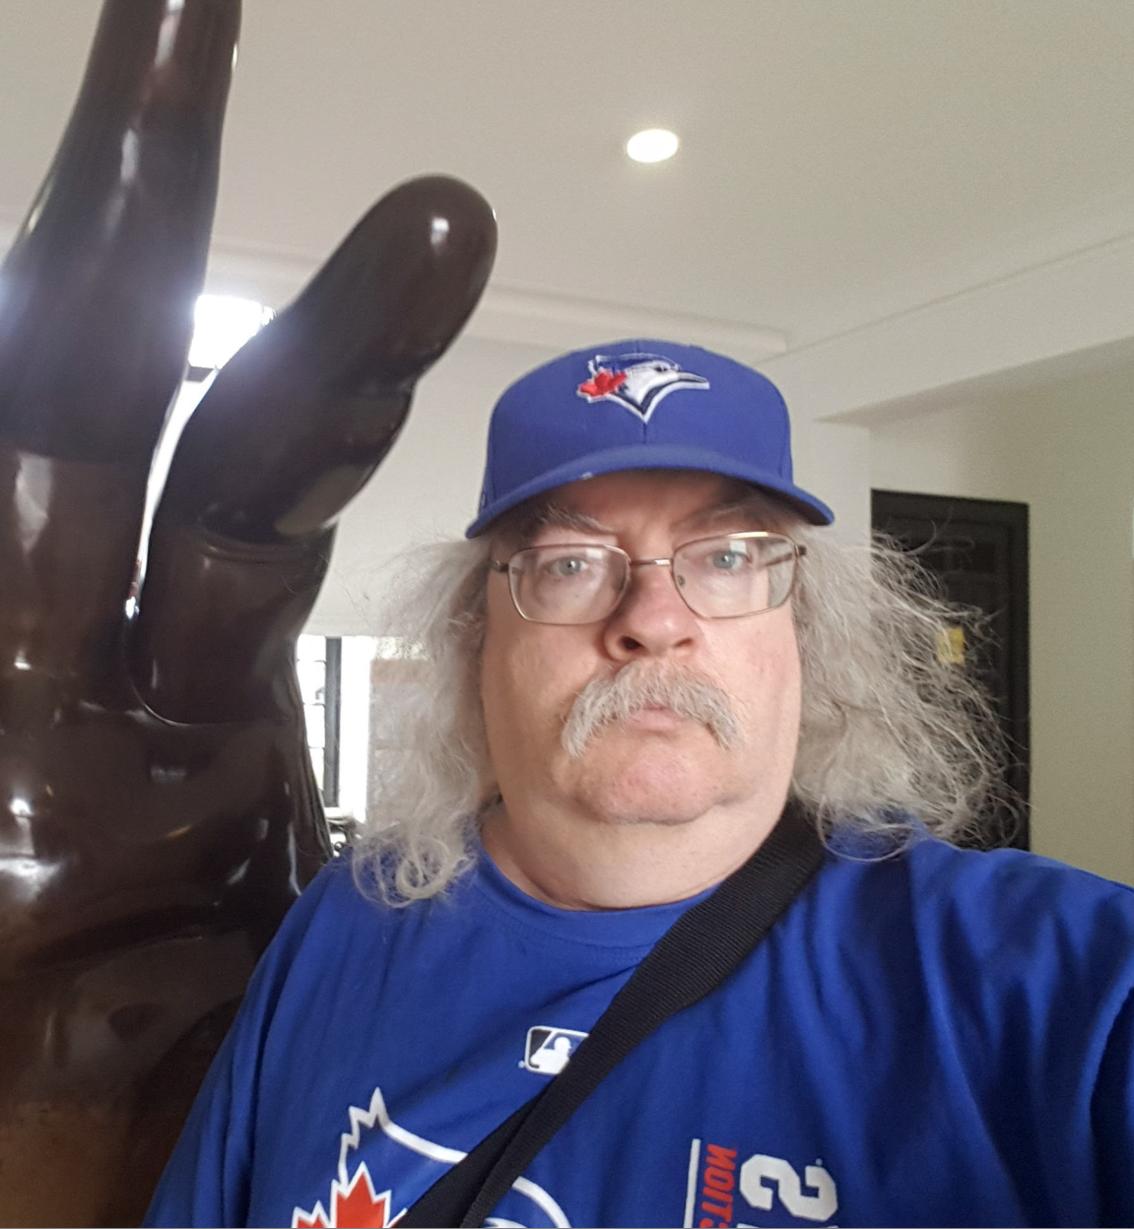
Stephen Downes
http://www.downes.ca

