Slide 1

Trends in the Future of Learning
Stephen Downes
College@ESDC, Gatineau, Quebec
December 14, 2017
http://www.downes.ca/presentation/484

Slide 2
A New Challenge
“With the automation of many of the functions employees currently perform, the emphasis will switch from answering simple queries to dealing with more complex problems that will require higher level of analysis, access to experts and greater autonomy.”

Slide 3
How can the College@ESDC equipped itself for what’s coming? What form(s) is learning, and especially operational training, likely to take in 10-15 years?

Slide 4

Part One. What Does Learning Become?
Relevant
Engaging
Personal

Slide 5
Relevant
Any time / Any place
Ubiquitous
Context-Aware
Problem-Focused

Slide 6

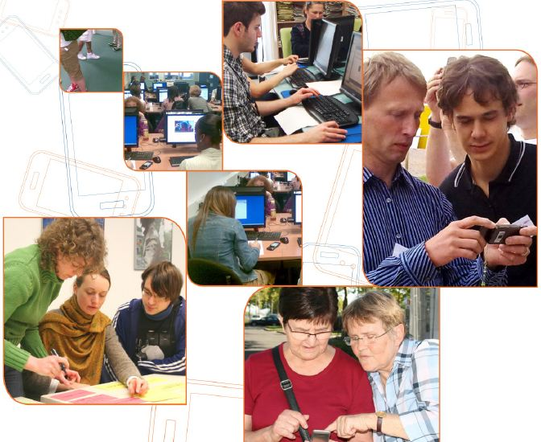
Case: Mobile Learning, Mobile Support
Access - learning as you go, with different devices
Device – smartphone only? Or tablets and laptops?
Location - learners can learn outside their office
Design - content specifically designed for mobile

Slide 7
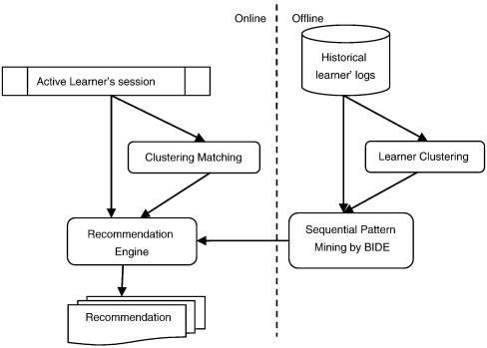
Case: Content Recommendations
Resource Recommendation
Collaborative filtering
Human cognitive modeling
Content analysis
Self-assessment
Sensor & data analysis
Salehi, 2013

Slide 8
Engaging
Engaging = Immersive + Wanted
We have to want to be there
And we have to believe that we’re there

Slide 9
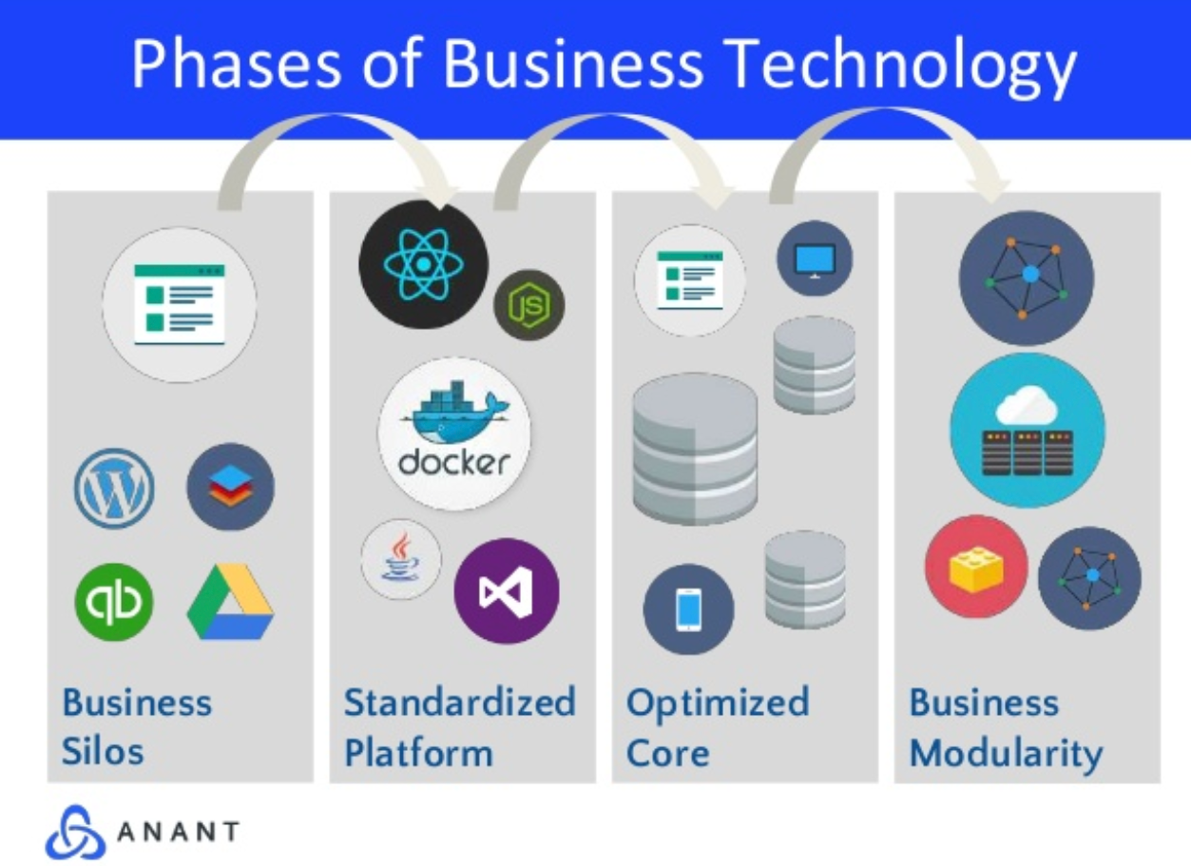
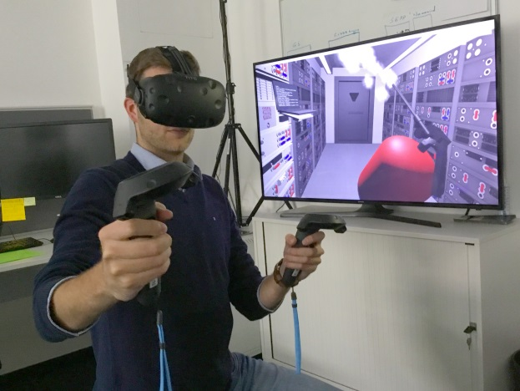
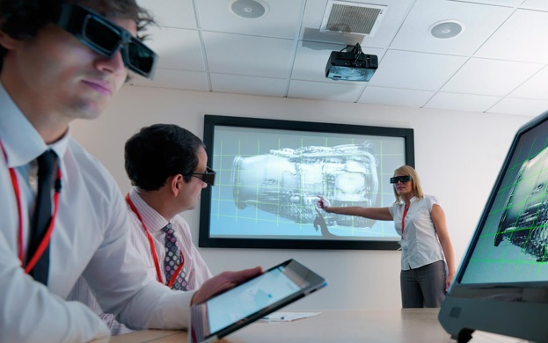
Immersive
Slack, Airtable, Trello: what makes them good? Presence
https://pt.slideshare.net/AnantCorp/team-collaboration-slack-airtable-trello-what-makes-them-good-76384318

Slide 10
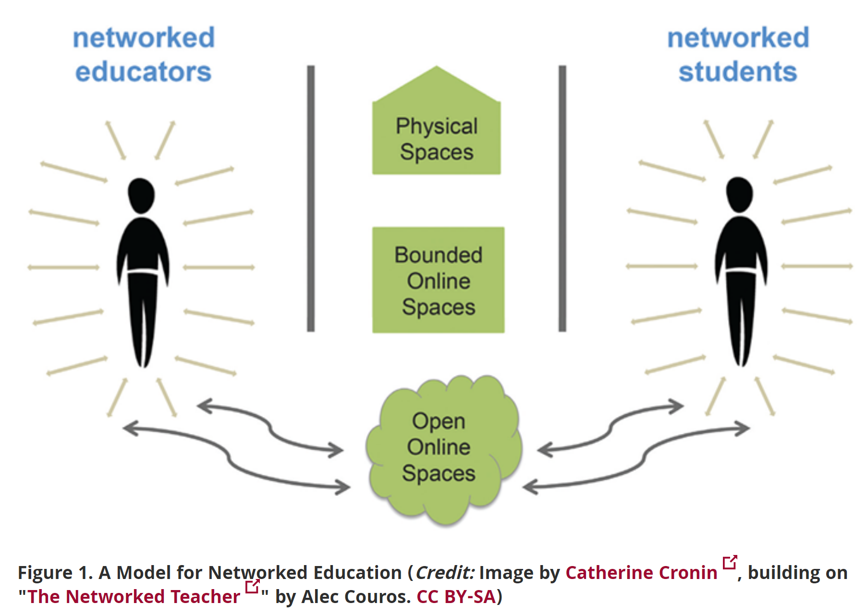
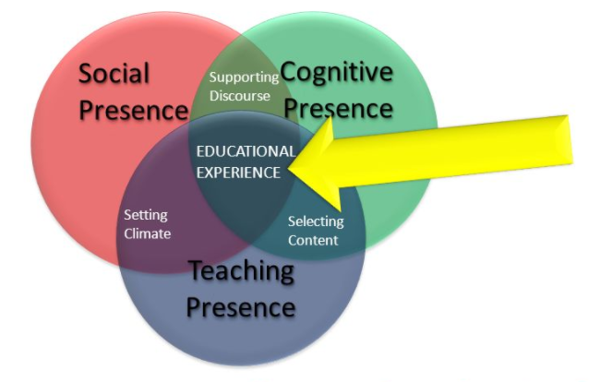
Presence
Presence is the idea that there is a person at the other end of the interaction… the presence of that person makes us believe

Slide 11
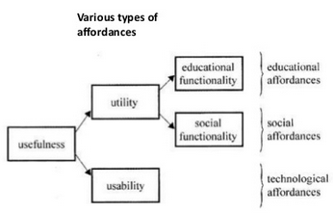
Affordances
What does wanted make you think of…?
personal, spontaneous, opportunistic
informal, pervasive, situated
private, context-aware
bite-sized, and portable
Jari Laru - https://www.slideshare.net/larux/affordances-short-introductionlarulet2011

Slide 12
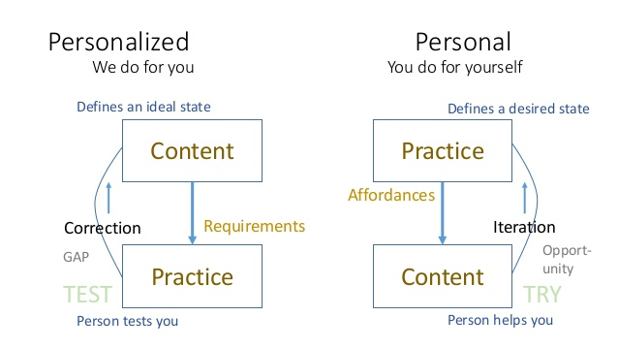
Personal

Slide 13
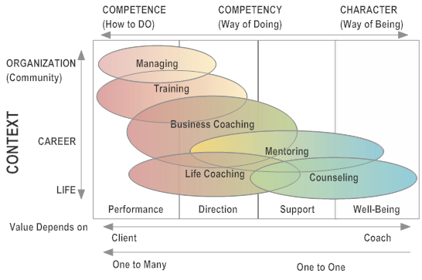
Competencies vs Support
http://leadershipadvantedge.com/

Slide 14
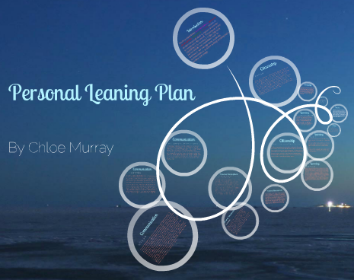
Case: Personal Learning Plan
Illuminate Education - data-based learning path
FilterED Global Filter - specializes in rapid personal path creation
MiCLUES - creates personal learning paths through museums and exhibits
ItsLearning - learning platform
Apereo OpenSSP - student success plan
Chloe Mnurray - https://prezi.com/9i69gkg75eqc/copy-of-chloe/

Slide 15
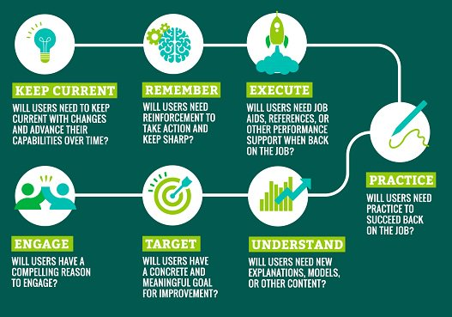
Practice vs Presentation
Don’t tell me, show me:
- “show me how to think strategically“
- “show me how to reframe an issue”
- “show me how to deal with the ambiguity of the world right now”
Steve Lowenthal - https://elearningindustry.com/bridging-the-learning-and-doing-gap-3-best-practices

Slide 16
Part Two. How Do We provide That?
Learning Resources
Environments
Assessment

Slide 17
Learning Resources
Open Educational Resources
Open Data and Data Books
Personalized Learning
Performance Support

Slide 18




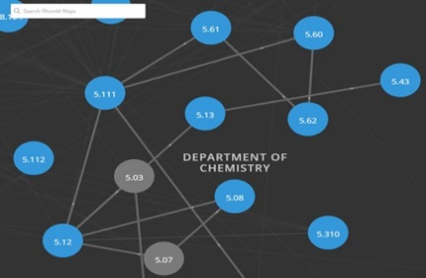


Open Educational Resources
https://www.oercommons.org/
https://openstax.org/
https://ocw.mit.edu/

Slide 19
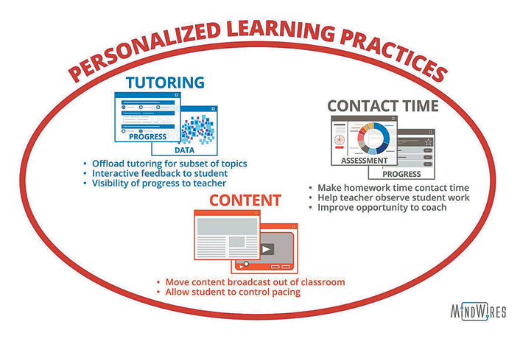
Personalized Learning
Practices:
Moving content broadcast out of the classroom
Turn class time into contact time
Providing tutoring
“…a delicate balance between student autonomy and instructor-led direction and scaffolding…”
Feldstein & Hill (2016)

Slide 20
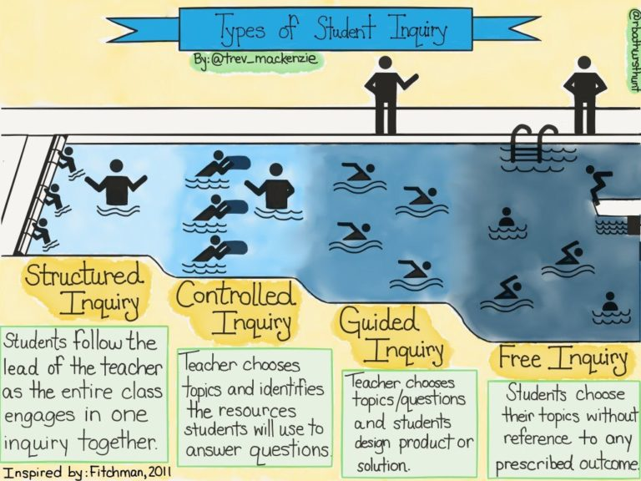
Case: Types of Student Inquiry
A range of approaches (after Dana Fichtman, Thomas & Boynton, 2011, Inquiry: a districtwide approach to staff and student learning) http://sk.sagepub.com/books/inquiry

Slide 21
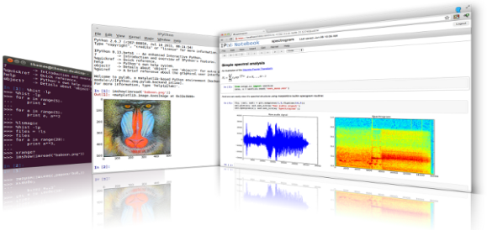

Open Data and Data Books
iPython is an interactive programming shell for the Python programming language https://ipython.org/
The Jupyter Notebook is an open-source web application that allows you to create and share documents that contain live code… http://jupyter.org/

Slide 22
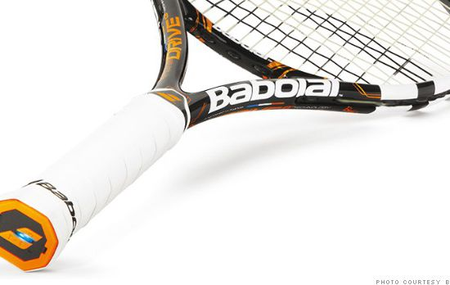
Performance Support
http://fortune.com/2014/05/27/a-tennis-racquet-that-isnt-just-strung-but-wired/

Slide 23
Environments
Learning platforms
Internet of Things
Social Learning
LTI, API and JSON
Cloud Apps and Storage

Slide 24
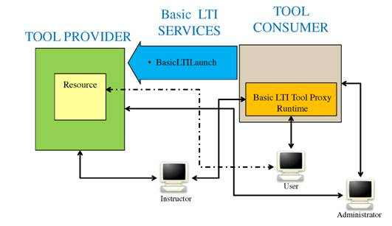
Learning Platforms
LTI Producer – provides features
LTI Consumer – connects to features
https://www.imsglobal.org/specs/ltiv1p0/implementation-guide

Slide 25
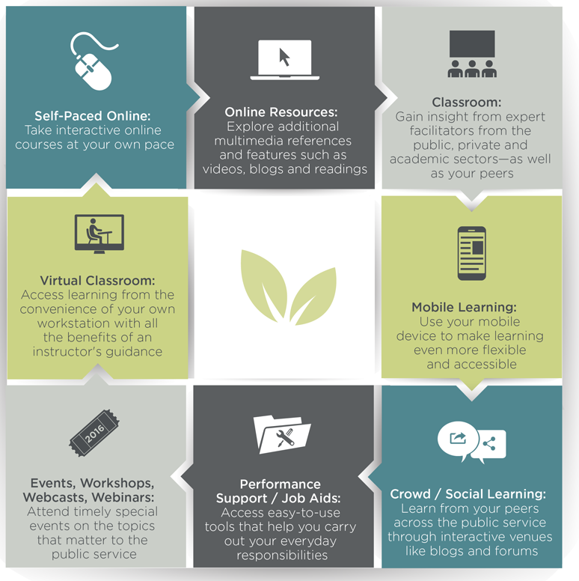
Case: CSPS GCCampus
Saba learning management system (LMS)
Drupal 7 content management system (CMS)
Moodle LMS
Kaltura OVP
CSPS service bus

Slide 26
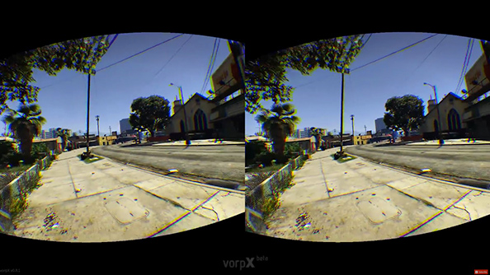
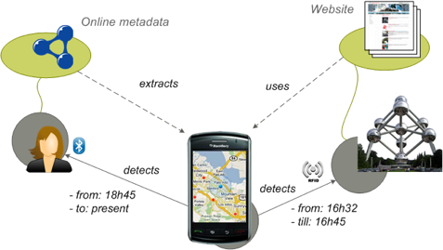
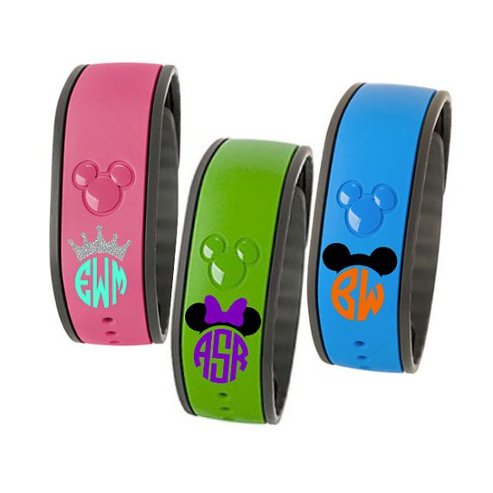
Internet of Things
https://www.pcgamesn.com/grand-theft-auto-v/the-best-grand-theft-auto-v-mods
WISE Research Group, 2012 - https://wise.vub.ac.be/project/context-aware-mobile-application-development
MagicBand. It’s a bracelet Disney hands out (story on Gizmodo)

Slide 27
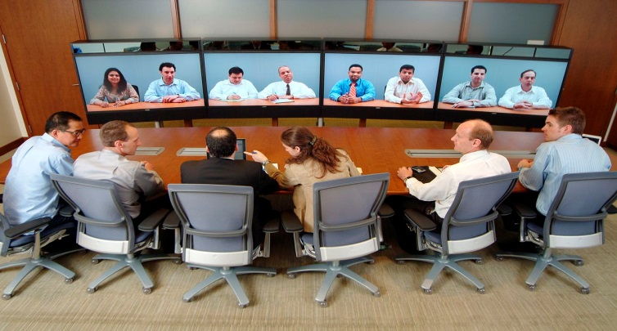
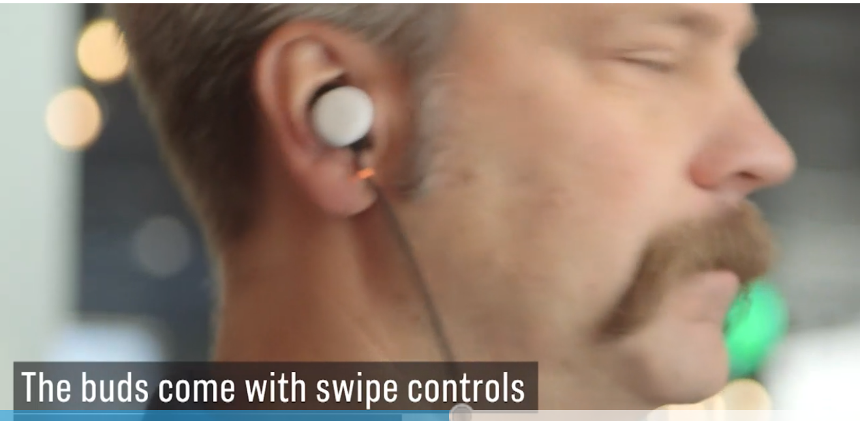
Social Learning
https://www.cnbc.com/2017/10/04/google-translation-earbuds-google-pixel-buds-launched.html

Slide 28
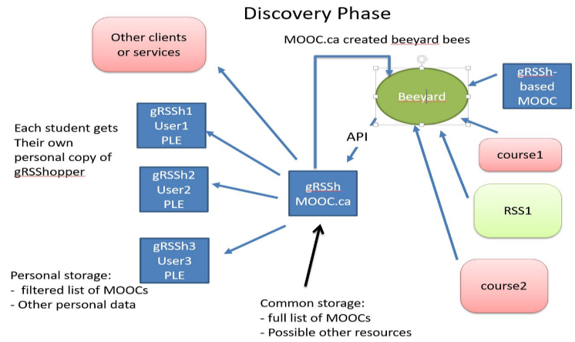
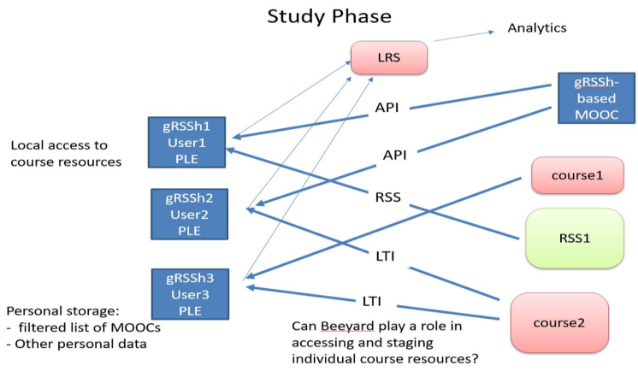
LTI / API / JSON

Slide 29
Case: Resource Integration
Linkage - each with a tab or an icon on the other system
Single signon - single unique identifier for all services
Common Services – Listed among other services
Extending the bus - user information and data exchanged
Learning Tools Interoperability - launched using SCORM or LTI
Full integration - Resources are available throughout GoC and vice versa

Slide 30
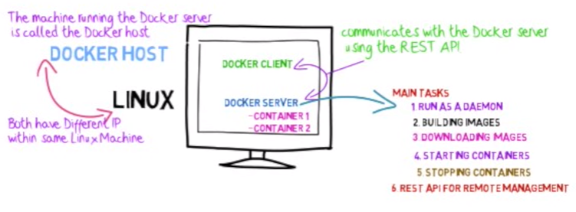
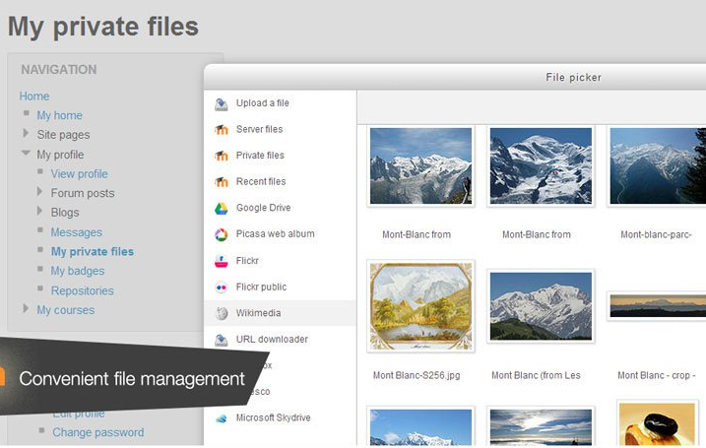
Cloud Apps & Storage
http://www.tomsitpro.com/articles/docker-enterprise-hub-orchestration,1-2375.html

Slide 31
Assessment
Competencies and Skills
Learning records
Quantified Self / Dashboards
Feed Forward

Slide 32
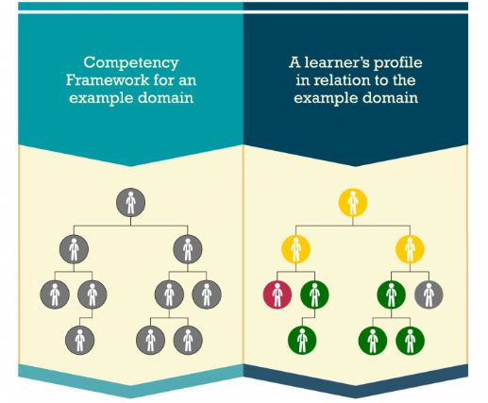

Competencies and Skills
Automated Assessment
Learning Plan
accurately and honestly measure a student’s achievement?
incentives for honest academic behaviour?
https://www.adlnet.gov/introducing-the-next-big-thing-cass/
http://pagecentertraining.psu.edu/public-relations-ethics/core-ethical-principles/lesson-2-sample-title/the-pillars-of-public-relations-ethics/

Slide 33
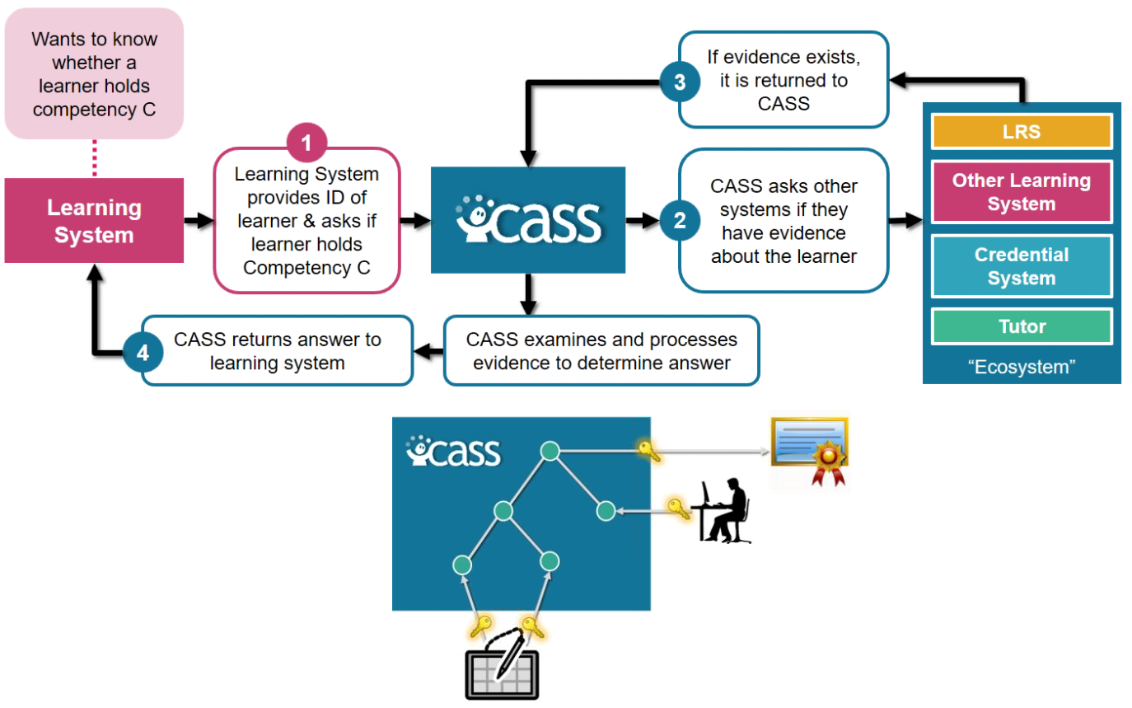
Case: Competencies and Skills Systems (CASS)
Workforce Planning
Recruiting and Onboarding
Performance and Goal Management
Learning Management
Career and Succession Planning
Compensation Management
ADL, 2016 - http://www.cassproject.org/

Slide 34
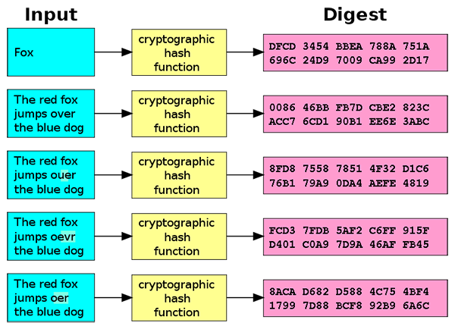
Learning Records
Doug Belshaw:
"If we used the blockchain for Open Badges," he writes, "then we could prove beyond reasonable doubt that the person receiving badge Y is the same person who created evidence X.
http://dmlcentral.net/blog/doug-belshaw/peering-deep-future-educational-credentialing
http://www.downes.ca/search/blockchain

Slide 35
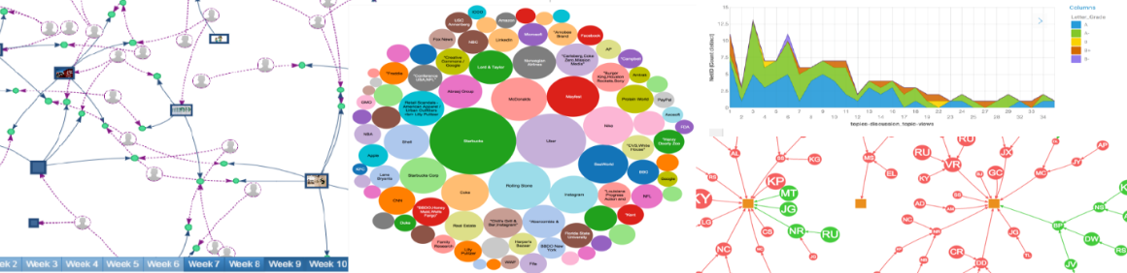
Quantified Self
Siemens and Long https://er.educause.edu/articles/2011/9/penetrating-the-fog-analytics-in-learning-and-education

Slide 36
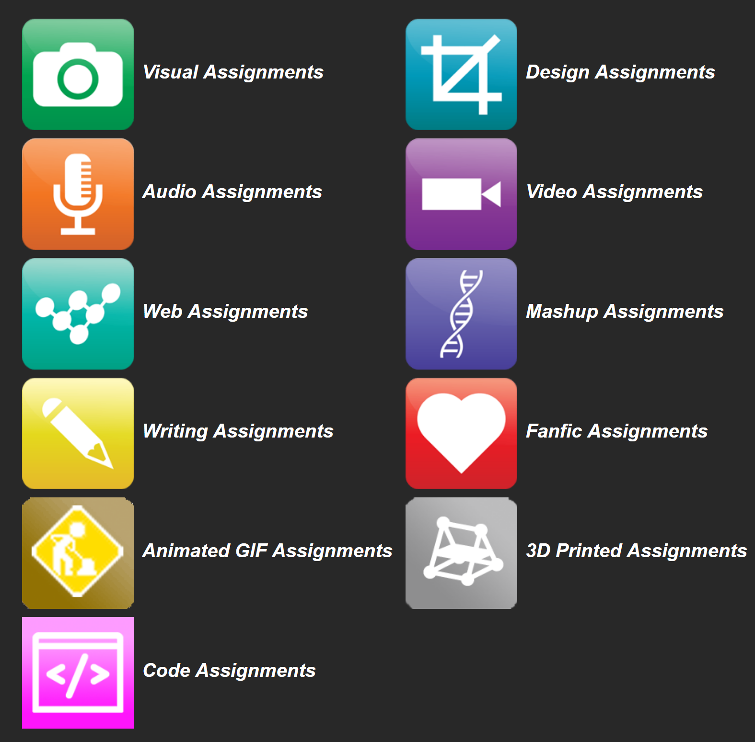
Feed Forward
OERs are now widely available through subject-specific libraries with provisions forauthoring as well
Course commentary
User-generated content
External content
Content curation
Collaborative learning
DS106 – assignment bank http://assignments.ds106.us/
Notes:
Can we trust the information being uploaded by people
Different mechanisms were suggested, from reviews to automated trust-evaluation algorithms.
Where the school is going with crowdsourcing.
Co-creation, collaboration - What's the project? What's the strategy?
There is a proliferation of platforms available, and hence a need to synch GCCampus with services like GCTools.
Course commentary - a person could write that they took a course and make a selfie video about the results.
User-generated content – gathering content from users to create courses or other learning resources.
External content – sourcing learning content from other departments
Content curation – get together and share (and rate) resources
Collaborative learning and social learning

Slide 37
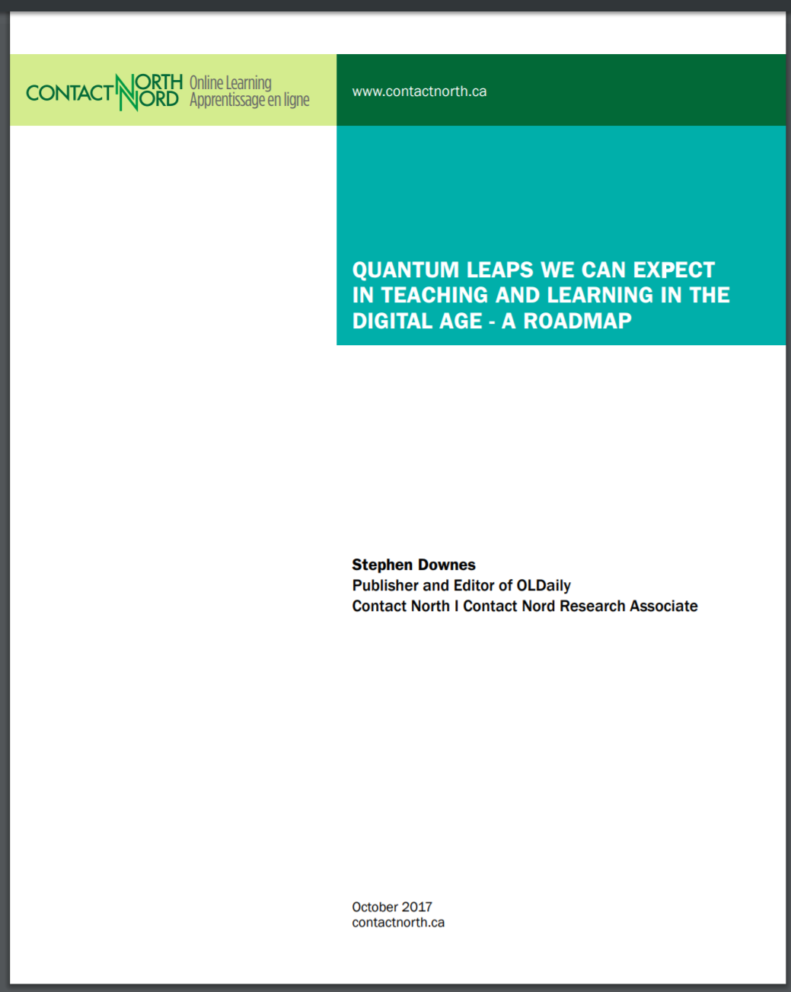
The Report…
You can download this report from: http://bit.ly/quantum-leaps
The report talks a lot about what will change (and some about what will not_ and also about how things change
Add your comments
http://bit.ly/quantum-edit

Slide 38
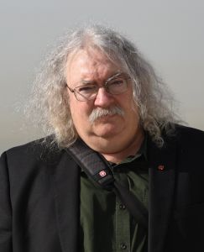
http://www.downes.ca

