Slide 1

gRSShopper in a Box
Setting Up And Using gRSShopper in a Box to Create MOOCs and Personal Learning Environments http://www.downes.ca/presentation/482
Stephen Downes
Online Educa Berlin
December 6, 2017

Slide 2
The Plan for Today
First Steps
Virtualization in Ed Tech
Break - 15:30 – 15:45
Exploring gRSShopper
gRSShopper as a Panel

Slide 3
First Steps
Creating your Virtualization Environment
Many choices, but here’s what we’re using for today:
  Virtual Box – https://www.virtualbox.org/wiki/Downloads
  Vagrant – https://www.vagrantup.com/downloads.html
  gRSShopper image – http://www.downes.ca/files/grsshopper-02.box
gRSShopper Source Code
  https://github.com/Downes/gRSShopper

Slide 4
Vagrantfile
# -*- mode: ruby -*-
# vi: set ft=ruby :
Vagrant.configure("2") do |config|
config.vm.box = "grsshopper-02"
config.vm.hostname = "grsshopper-02"
config.vm.network "forwarded_port", guest: 80, host: 8080
config.vm.network "private_network", ip: "192.192.192.192"
config.vm.synced_folder "./html", "/var/www/html", :mount_options => ["dmode=777", "fmode=666"]
# Optional NFS. Make sure to remove other synced_folder line too
#config.vm.synced_folder ".", "/var/www", :nfs => { :mount_options => ["dmode=777","fmode=666"] }
end

Slide 5
Local Directories
/gRSShopper02/
/html/
/public/
/files/
index.html
Vagrantfile
grsshopper-02.box

Slide 6
Installing gRSShopper as a Box
Open Command Prompt and Enter:
> cd c:\ … \gRSShopper02
> vagrant box add gRSShopper-02 gRSShopper-02.box
> vagrant up
Then open a web browser and enter:
http://192.192.192.192
- this will show C:\.. \gRSShopper02\html\public\index.html
Then open a web browser and enter:
http://192.192.192.192/cgi-bin/admin.cgi
- this will show the gRSShopper admin screen (or login, if you haven’t logged in)
- to log in: userid: admin password: admin

Slide 7
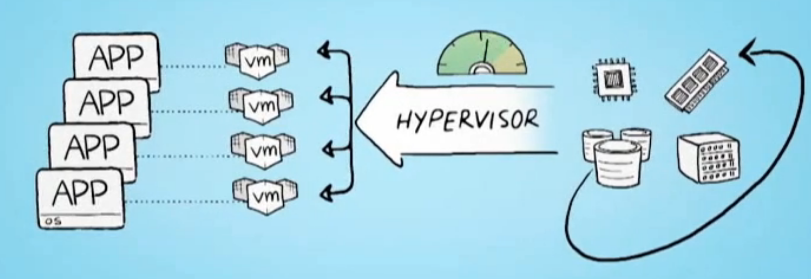
Virtualization in Ed Tech
Parallels - https://www.parallels.com/
VMWare - https://www.vmware.com/
XenServer - https://xenserver.org/
Virtual Box - https://www.virtualbox.org/
Hyper-V - https://docs.microsoft.com/en-us/virtualization/hyper-v-on-windows/quick-start/enable-hyper-v
Stephen Downes - Applications, Algorithms and Data - November 30, 2017

Slide 8
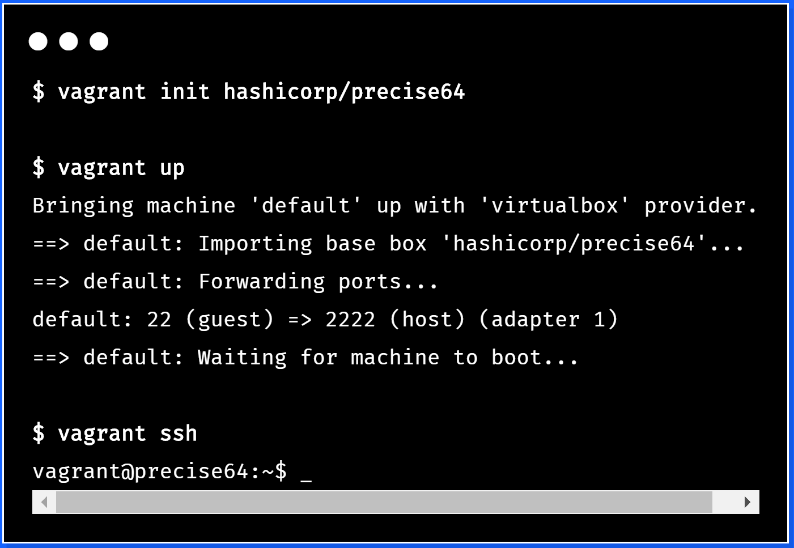

Virtualization Platforms - Vagrant
https://www.vagrantup.com/
Stephen Downes - Applications, Algorithms and Data - November 30, 2017

Slide 9
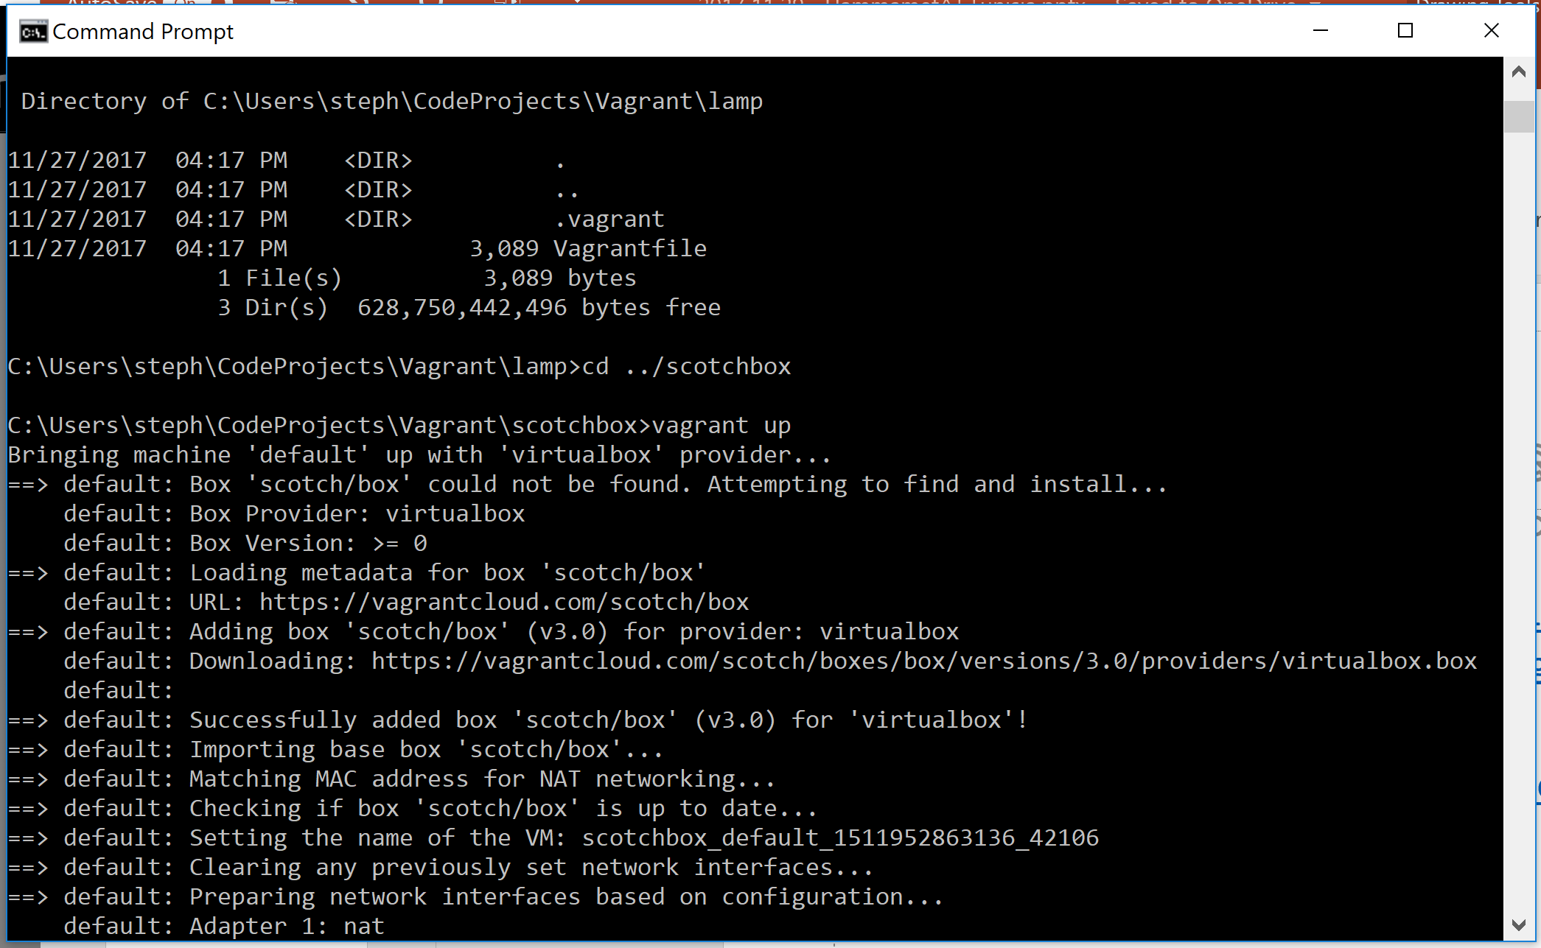
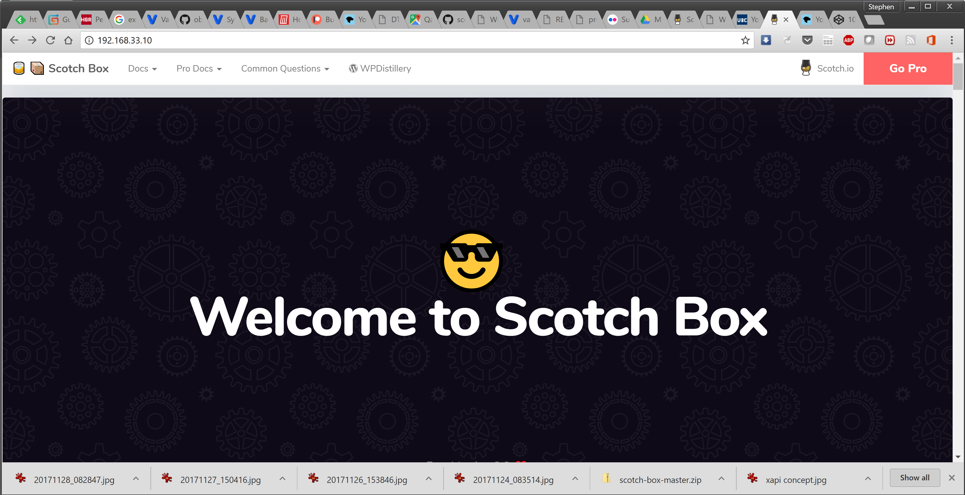
Loading and Running Vagrant
Scotch Box
  https://box.scotch.io/ -- http://192.168.33.10/
  WPDistillery - https://wpdistillery.org/ - for WordPress
Homestead
  Instructions - https://laravel.com/docs/5.5/homestead#first-steps
Stephen Downes - Applications, Algorithms and Data - November 30, 2017

Slide 10
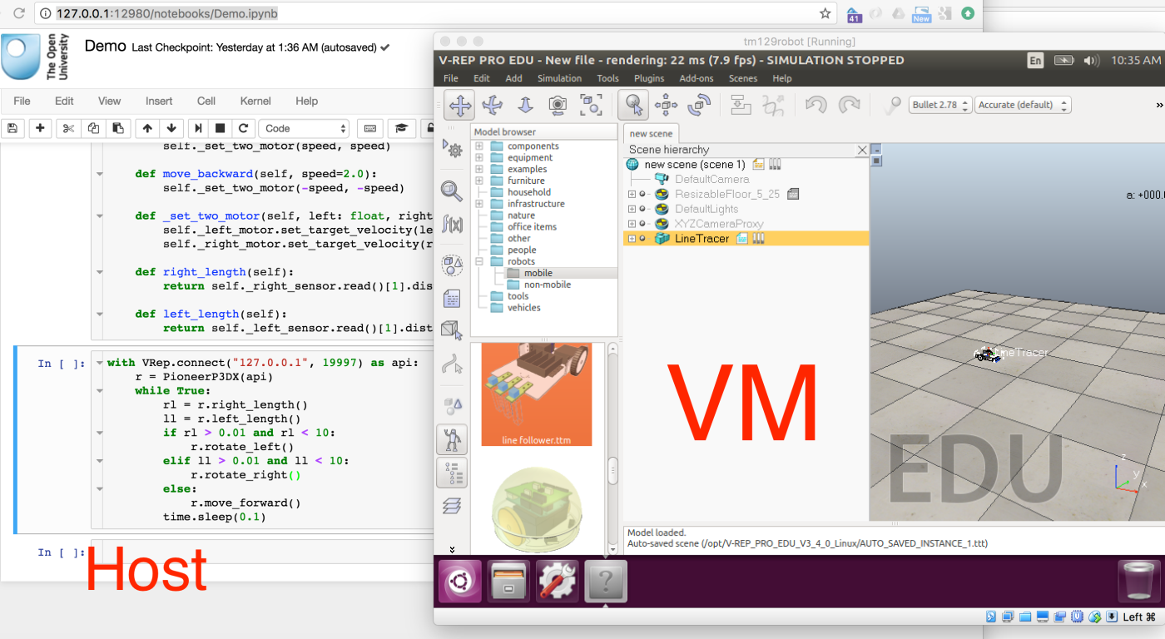
Vagrant as Learning Environment
Distributing Virtual Machines That Include a Virtual Desktop To Students – V-REP + Jupyter Notebooks – Tony Hirst https://blog.ouseful.info/2017/09/10/distributing-virtual-machines-that-include-a-virtual-desktop-to-students-v-rep-jupyter-notebooks/

Slide 11
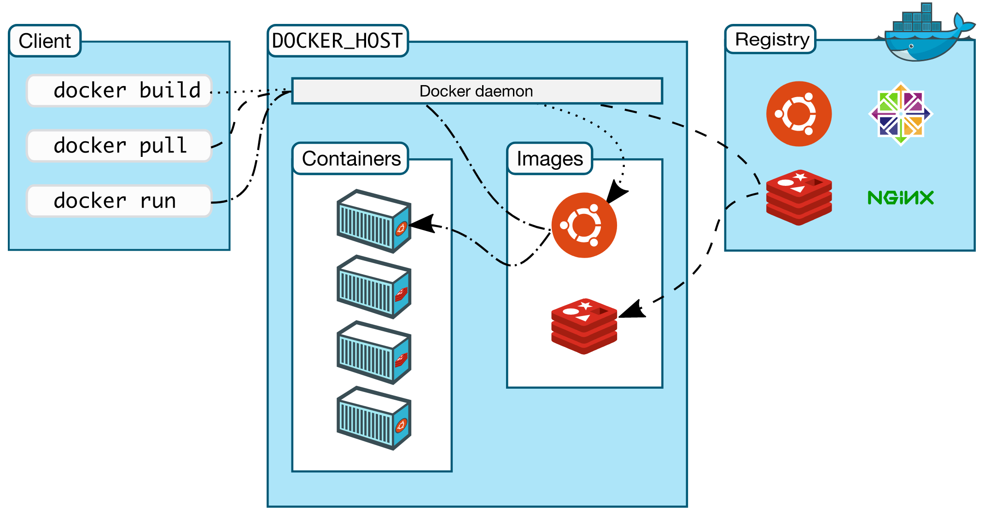
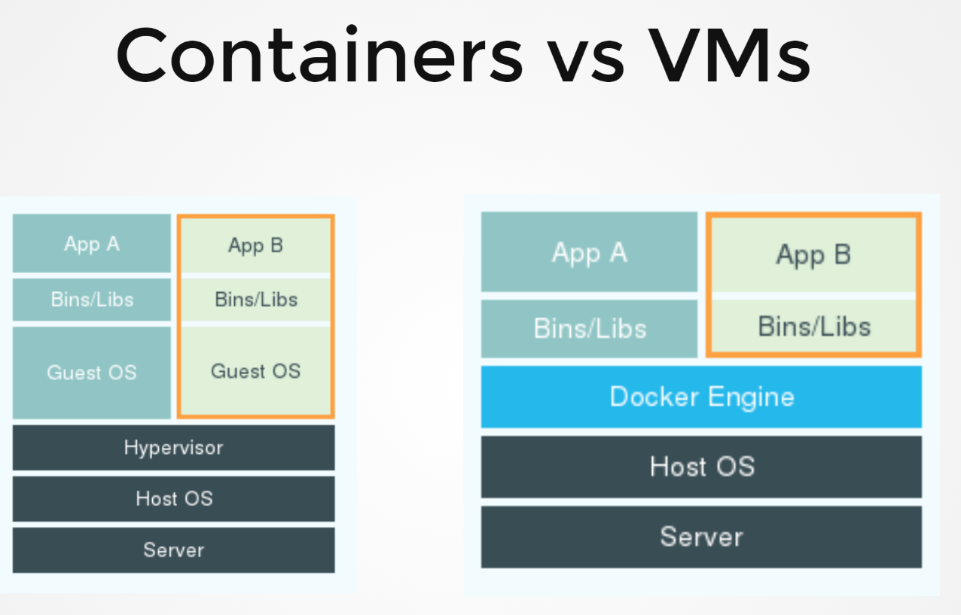
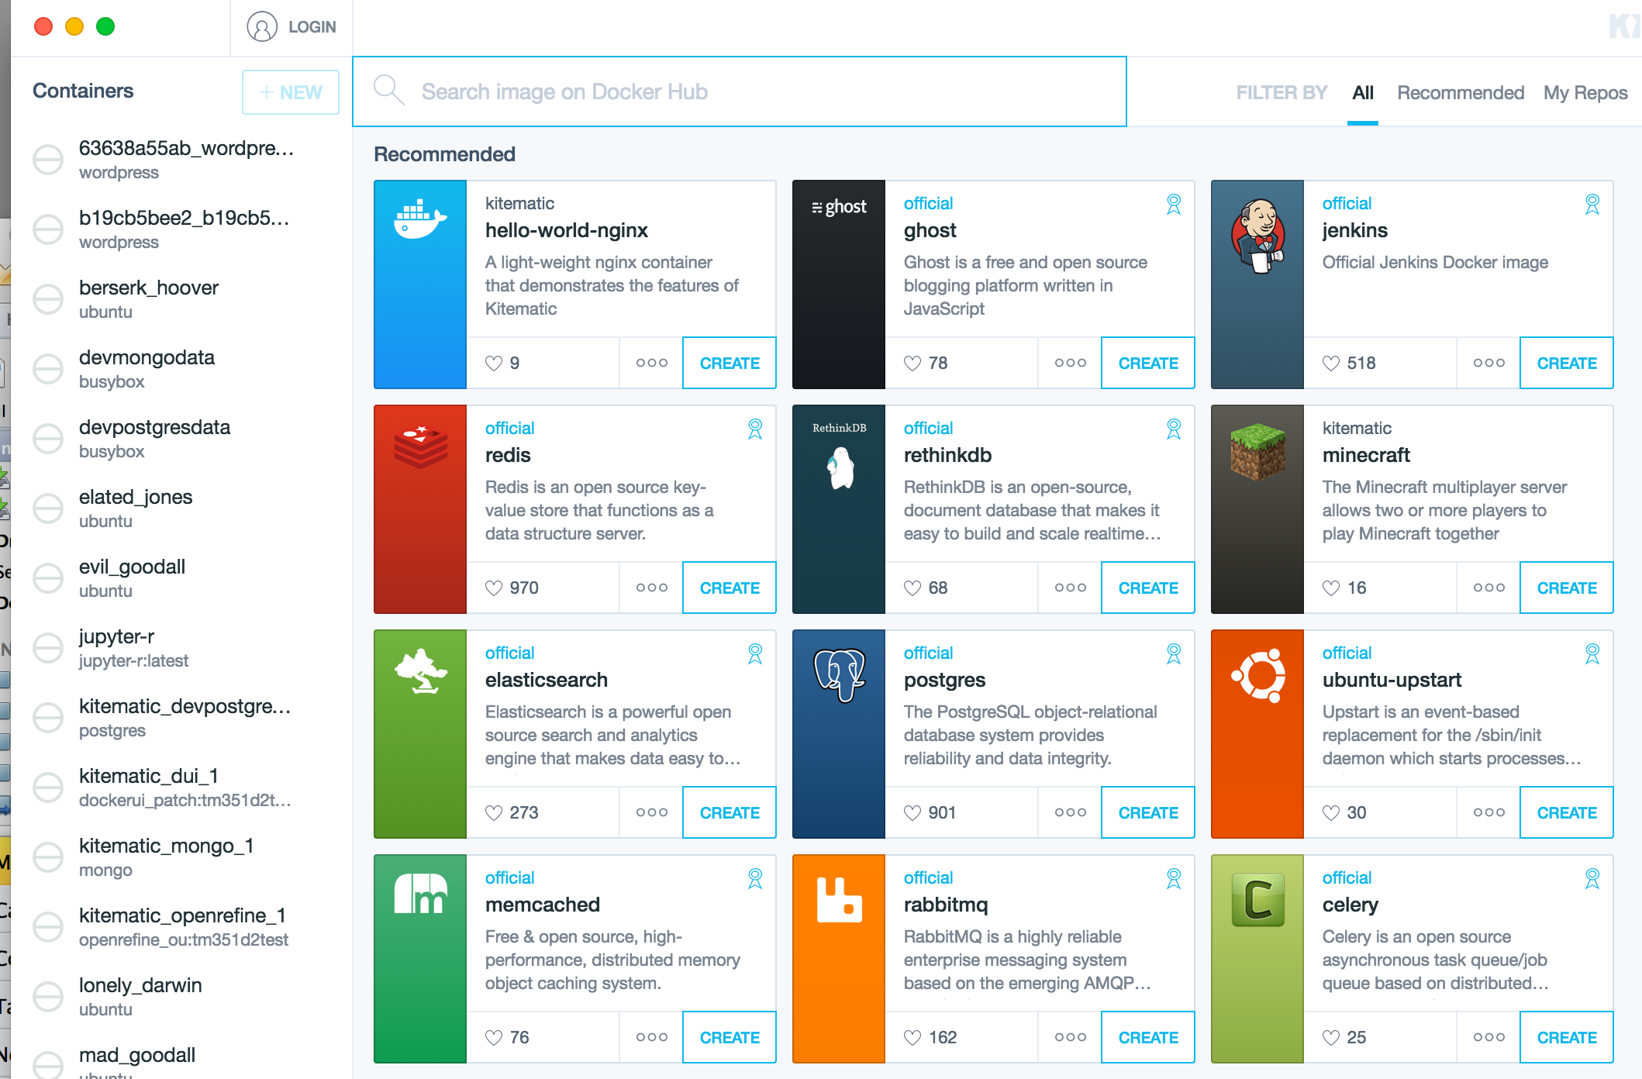
Docker
Stephen Downes - Applications, Algorithms and Data - November 30, 2017

Slide 12
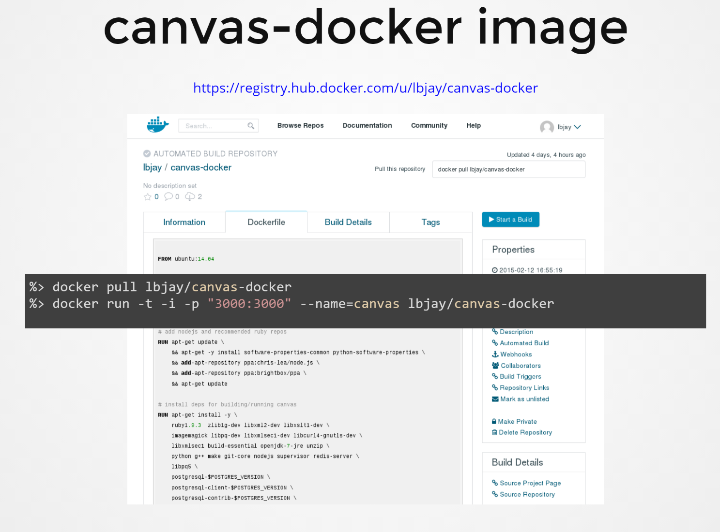
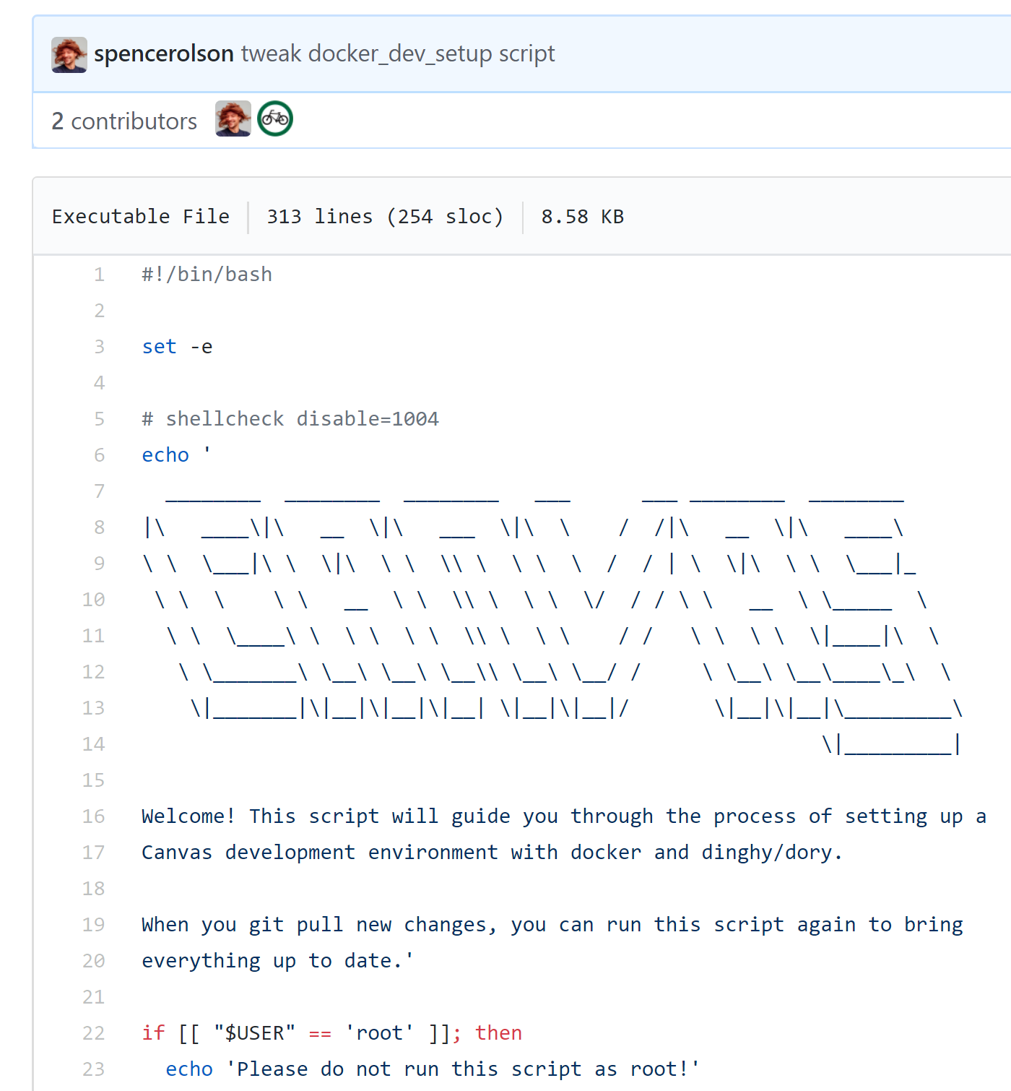
Canvas on Docker
https://github.com/instructure/canvas-lms/blob/master/script/docker_dev_setup.sh
http://slides.com/jamesluker/how-to-docker-2#/
Stephen Downes - Applications, Algorithms and Data - November 30, 2017

Slide 13
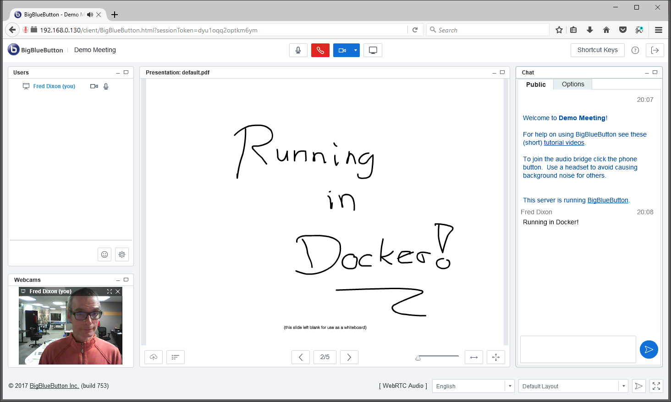
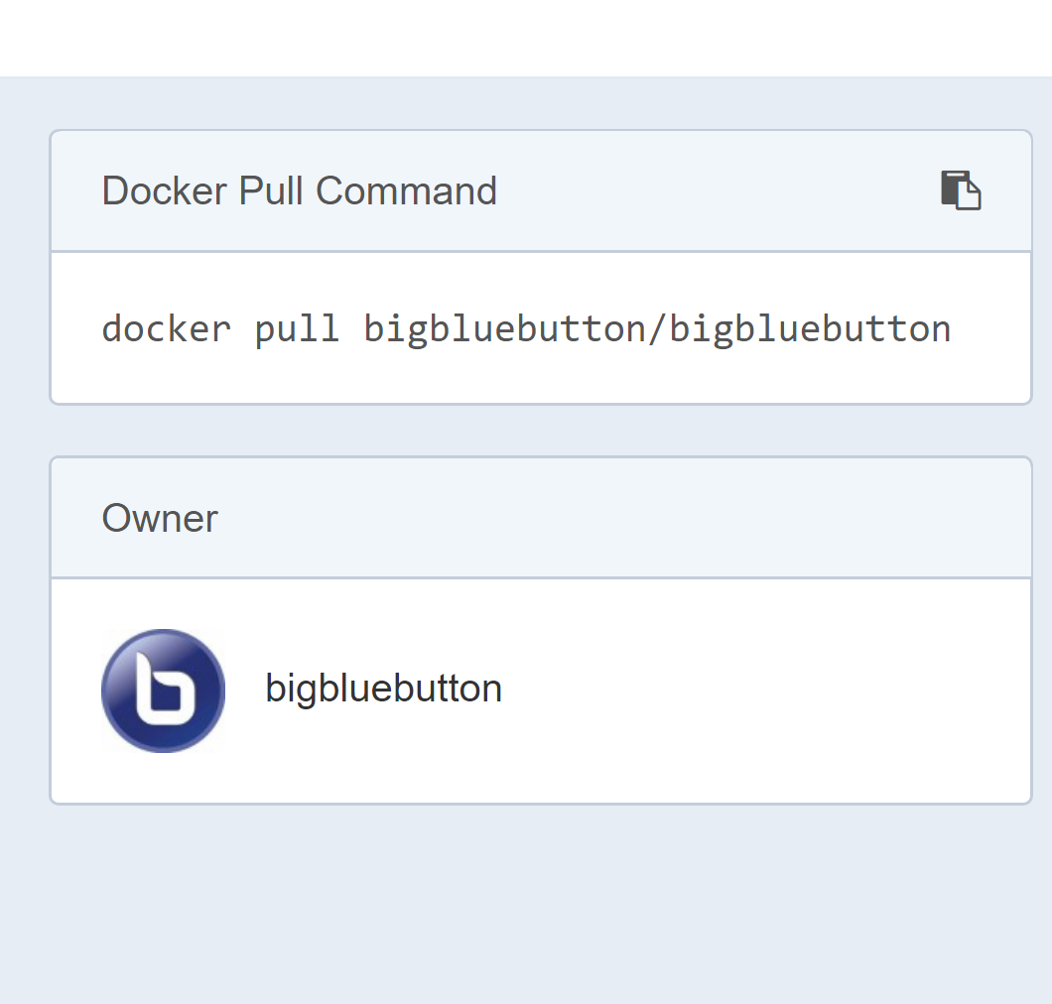
Big Blue Button in Docker
http://docs.bigbluebutton.org/labs/docker.html
https://hub.docker.com/r/bigbluebutton/bigbluebutton/
Stephen Downes - Applications, Algorithms and Data - November 30, 2017

Slide 14
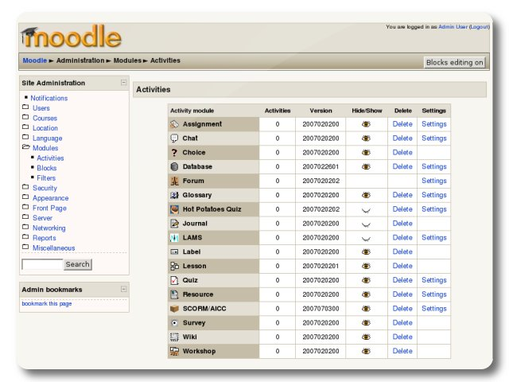
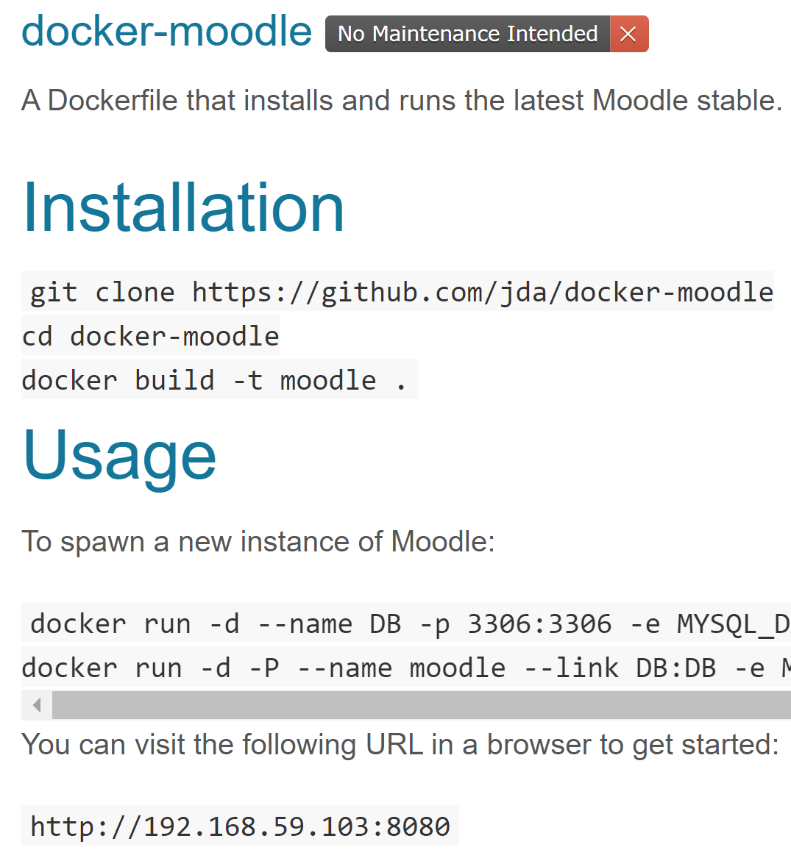
Moodle on Docker
https://hub.docker.com/r/jauer/moodle/
Stephen Downes - Applications, Algorithms and Data - November 30, 2017

Slide 15
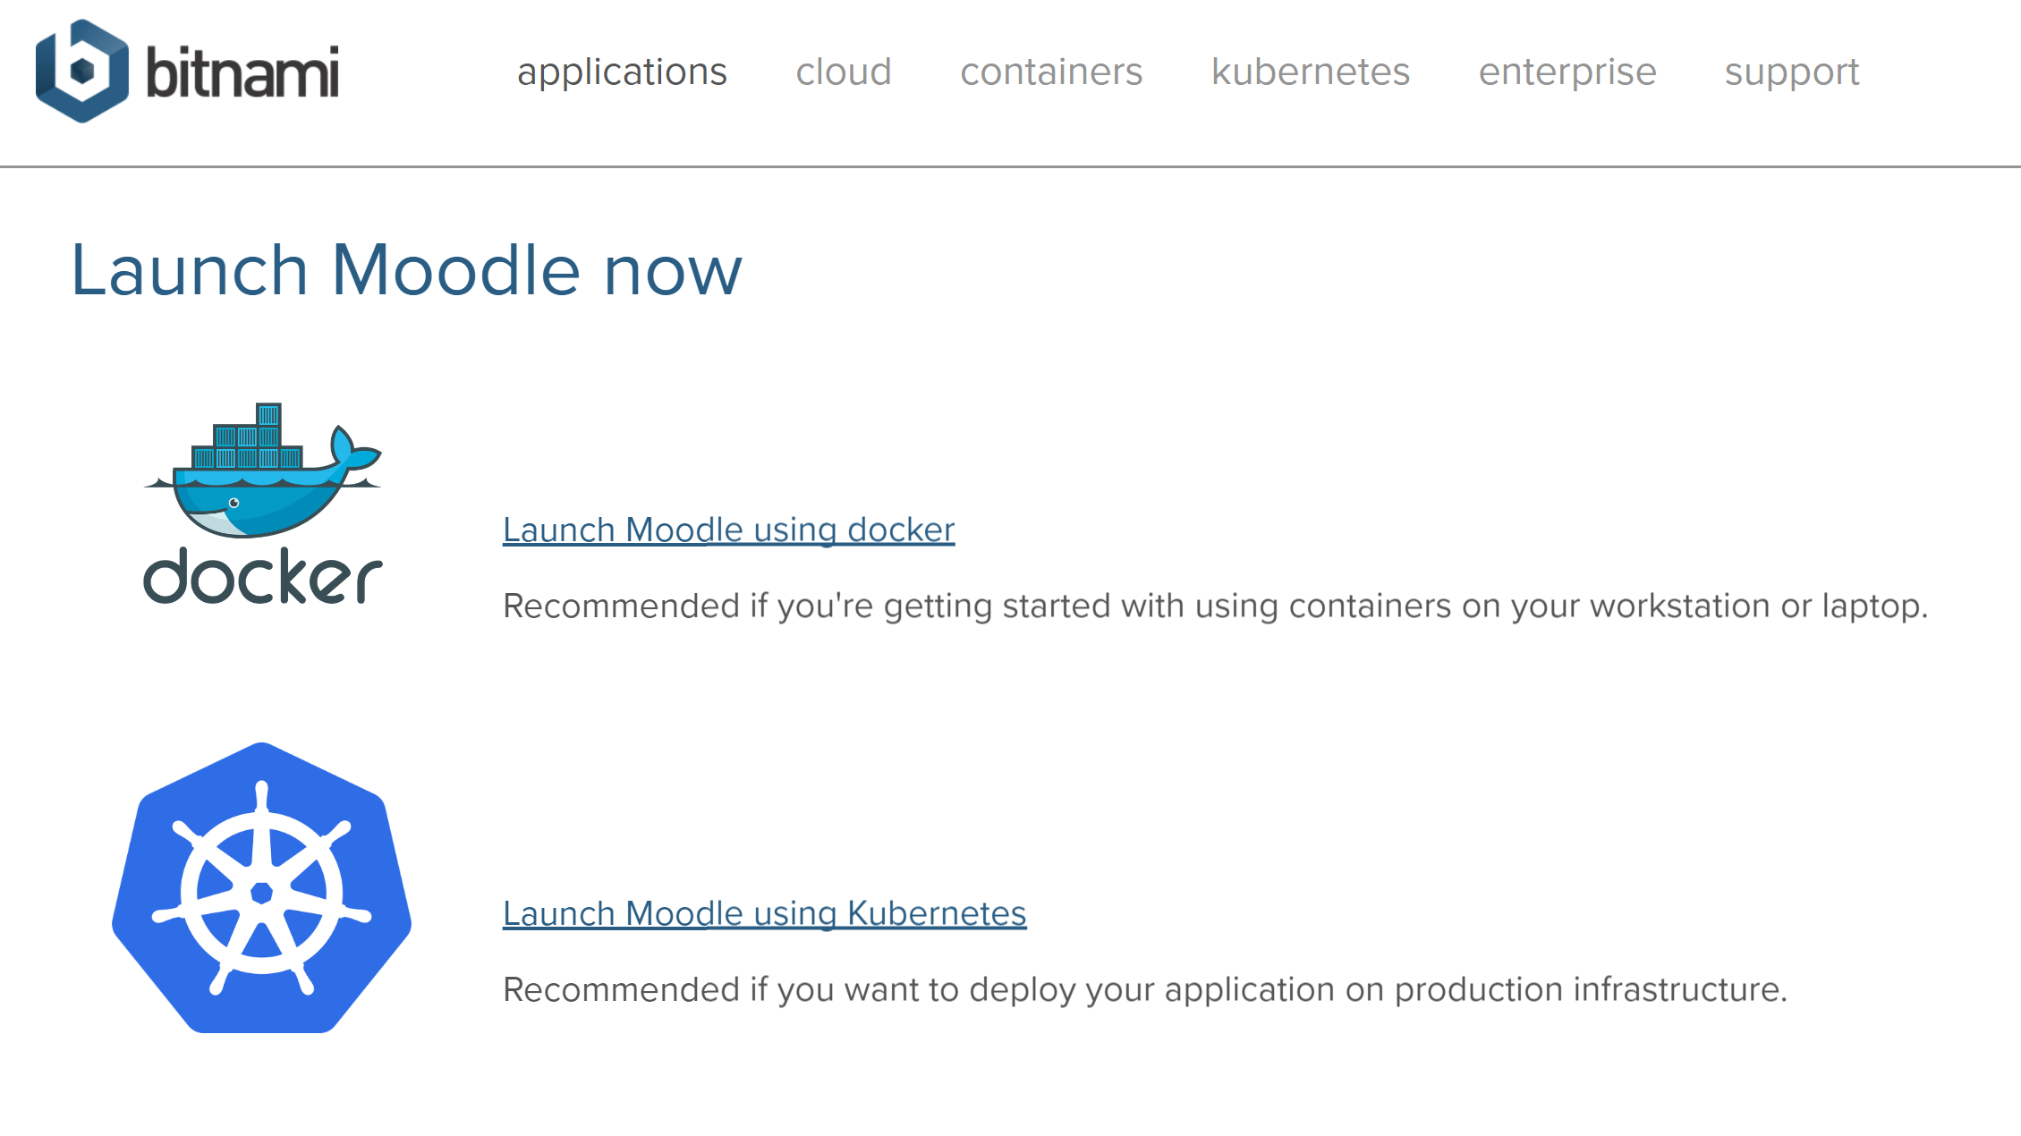
Options
https://bitnami.com/stack/moodle/containers
Stephen Downes - Applications, Algorithms and Data - November 30, 2017

Slide 16

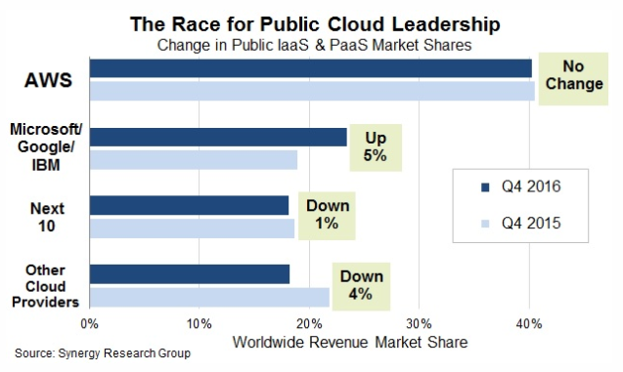




Cloud Infrastructure Providers
AWS – Amazon - https://aws.amazon.com/
Azure – Microsoft - https://azure.microsoft.com
Bluemix – IBM Cloud - https://www.ibm.com/cloud/
Google Cloud Platform - https://cloud.google.com/
Oracle Cloud - https://cloud.oracle.com/
https://www.srgresearch.com/articles/microsoft-google-and-ibm-charge-public-cloud-expense-smaller-providers
Stephen Downes - Applications, Algorithms and Data - November 30, 2017

Slide 17
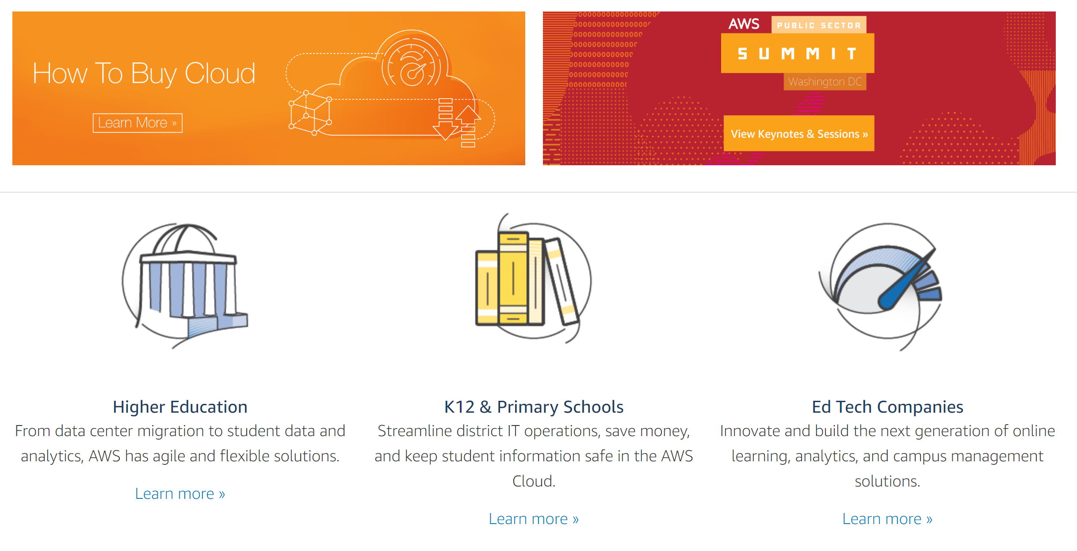

Cloud Computing for Education
Amazon Web Services - https://aws.amazon.com/education/
Stephen Downes - Applications, Algorithms and Data - November 30, 2017

Slide 18
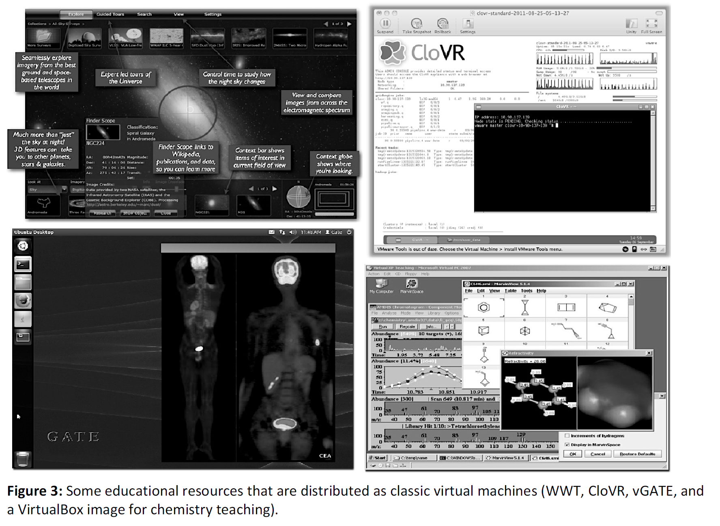
OER and Virtualization
Open Distribution of Virtual Containers as a Key Framework for Open Educational Resources and STEAM Subjects Alberto Corbi and Daniel Burgos
http://www.ejel.org/issue/download.html?idArticle=575
“Unikernels represent and deeper simplification of the virtual container approach, given that all necessary computing elements (operative system kernel, basic libraries, frameworks, drivers, scientific application, etc.)”
Stephen Downes - Applications, Algorithms and Data - November 30, 2017

Slide 19
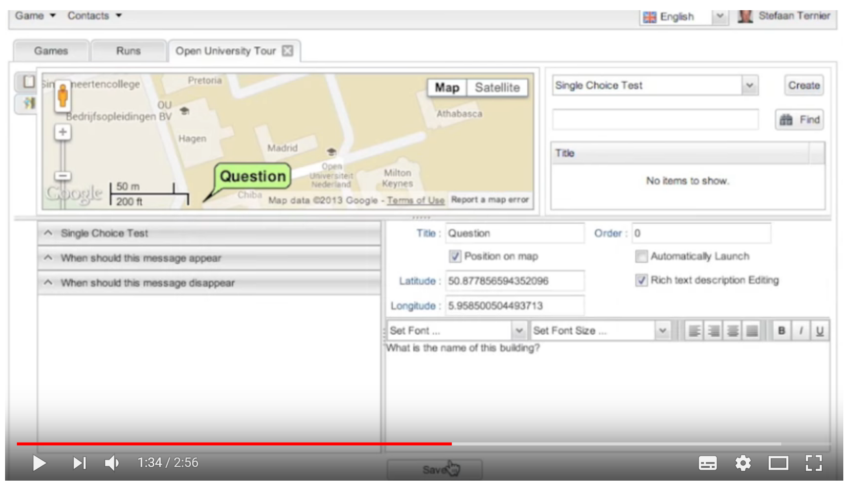
Mobile Authoring for ARLearn
“The Mobile Authoring Tool complements the ARLearn desktop-based environment. Hence, a mobile game author can wander around creating items and synchronizing real world artefacts with game content.”
ARLearn
ARLearn is a technical framework for creating mobile serious games
http://ar-learn.com/
https://dspace.ou.nl/bitstream/1820/5674/1/UAIS_Tabuenca_2014.pdf
Bernardo Tabuenca; Marco Kalz; Stefaan Ternier; Marcus Specht
https://www.youtube.com/watch?v=Lqk3yrcNjNI
Stephen Downes - Applications, Algorithms and Data - November 30, 2017

Slide 20
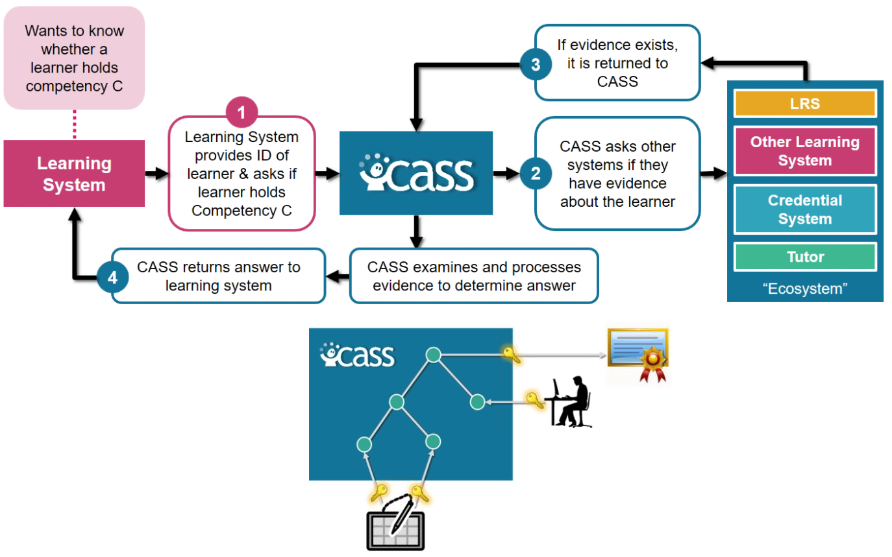
Interaction and Access Data
Unlocking Open Educational Resources (OERs) Interaction Data - David Massart, Elena Shulman
  http://www.dlib.org/dlib/may13/massart/05massart.html
Creativity in the Open Workshop
  http://blogs.ubc.ca/chendricks/
Advanced Distributed Learning (ADL):
Competencies and Skills Systems
Experience API (xAPI)
https://www.adlnet.gov/xapi/
Stephen Downes - Applications, Algorithms and Data - November 30, 2017

Slide 21
gRSShopper Functionality
Harvester
- atom, RSS, JSON
- blogs, discussions, pages
- Twitter, Facebook, etc
User management
- Login and authentication
- Newsletter subscription
- Social network information
Feed Manager
Distribution
- Email newsletter
- RSS / Atom / JSON feeds
- API to Twitter, Facebook, etc
Site Manager
- Course pages
- Events, etc.
- Newsletter pages

Slide 22
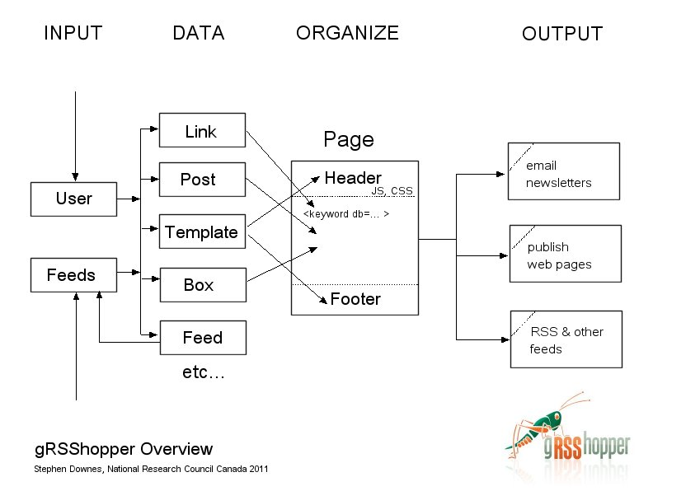
gRSShopper Flow
http://grsshopper.downes.ca

Slide 23
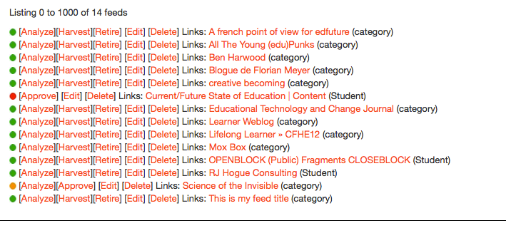
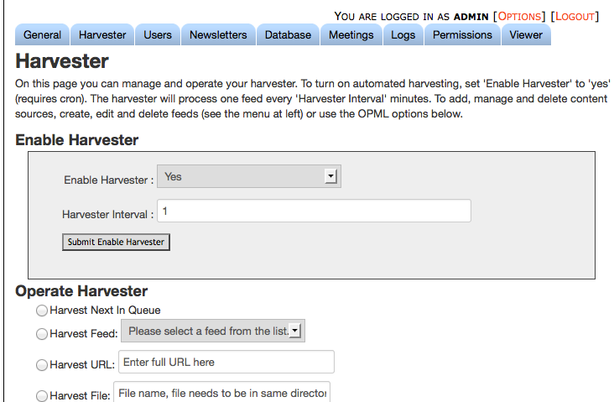
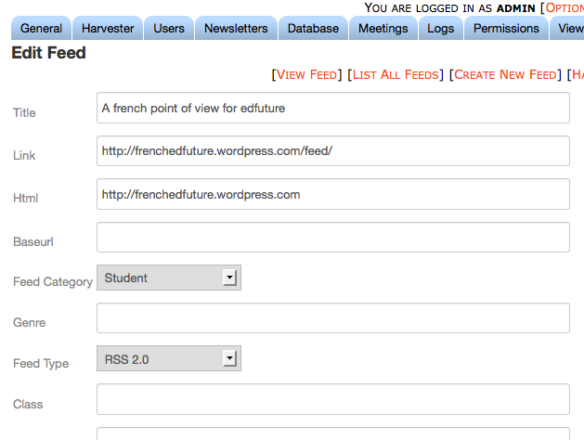
Feed Harvesting

Slide 24
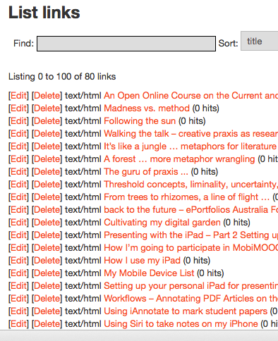
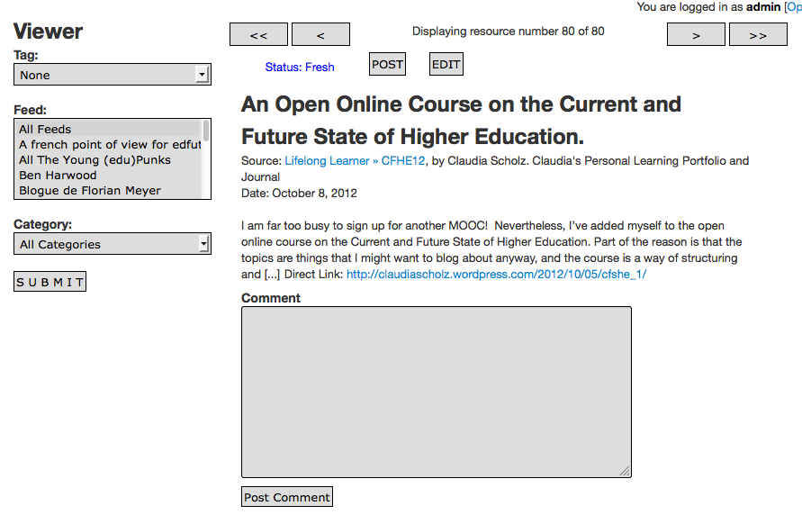
Viewing and Posting

Slide 25
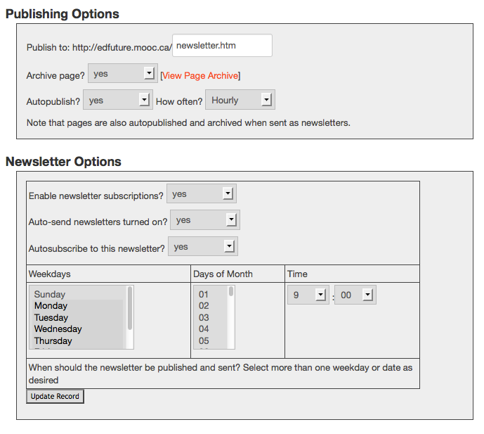
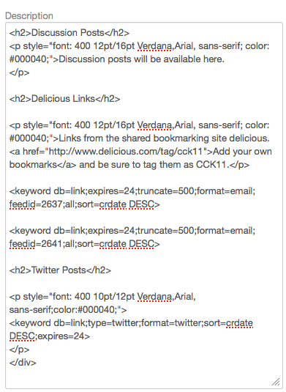
Mixing and Publishing

Slide 26
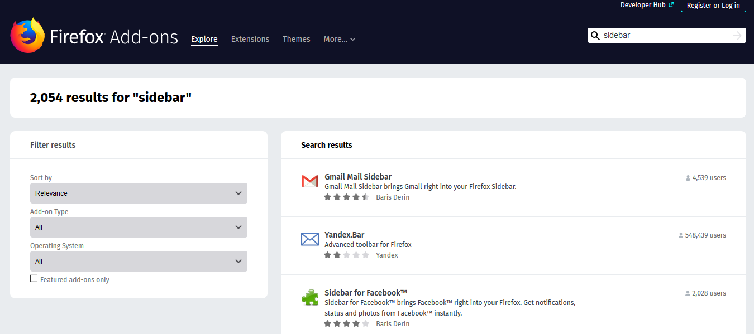
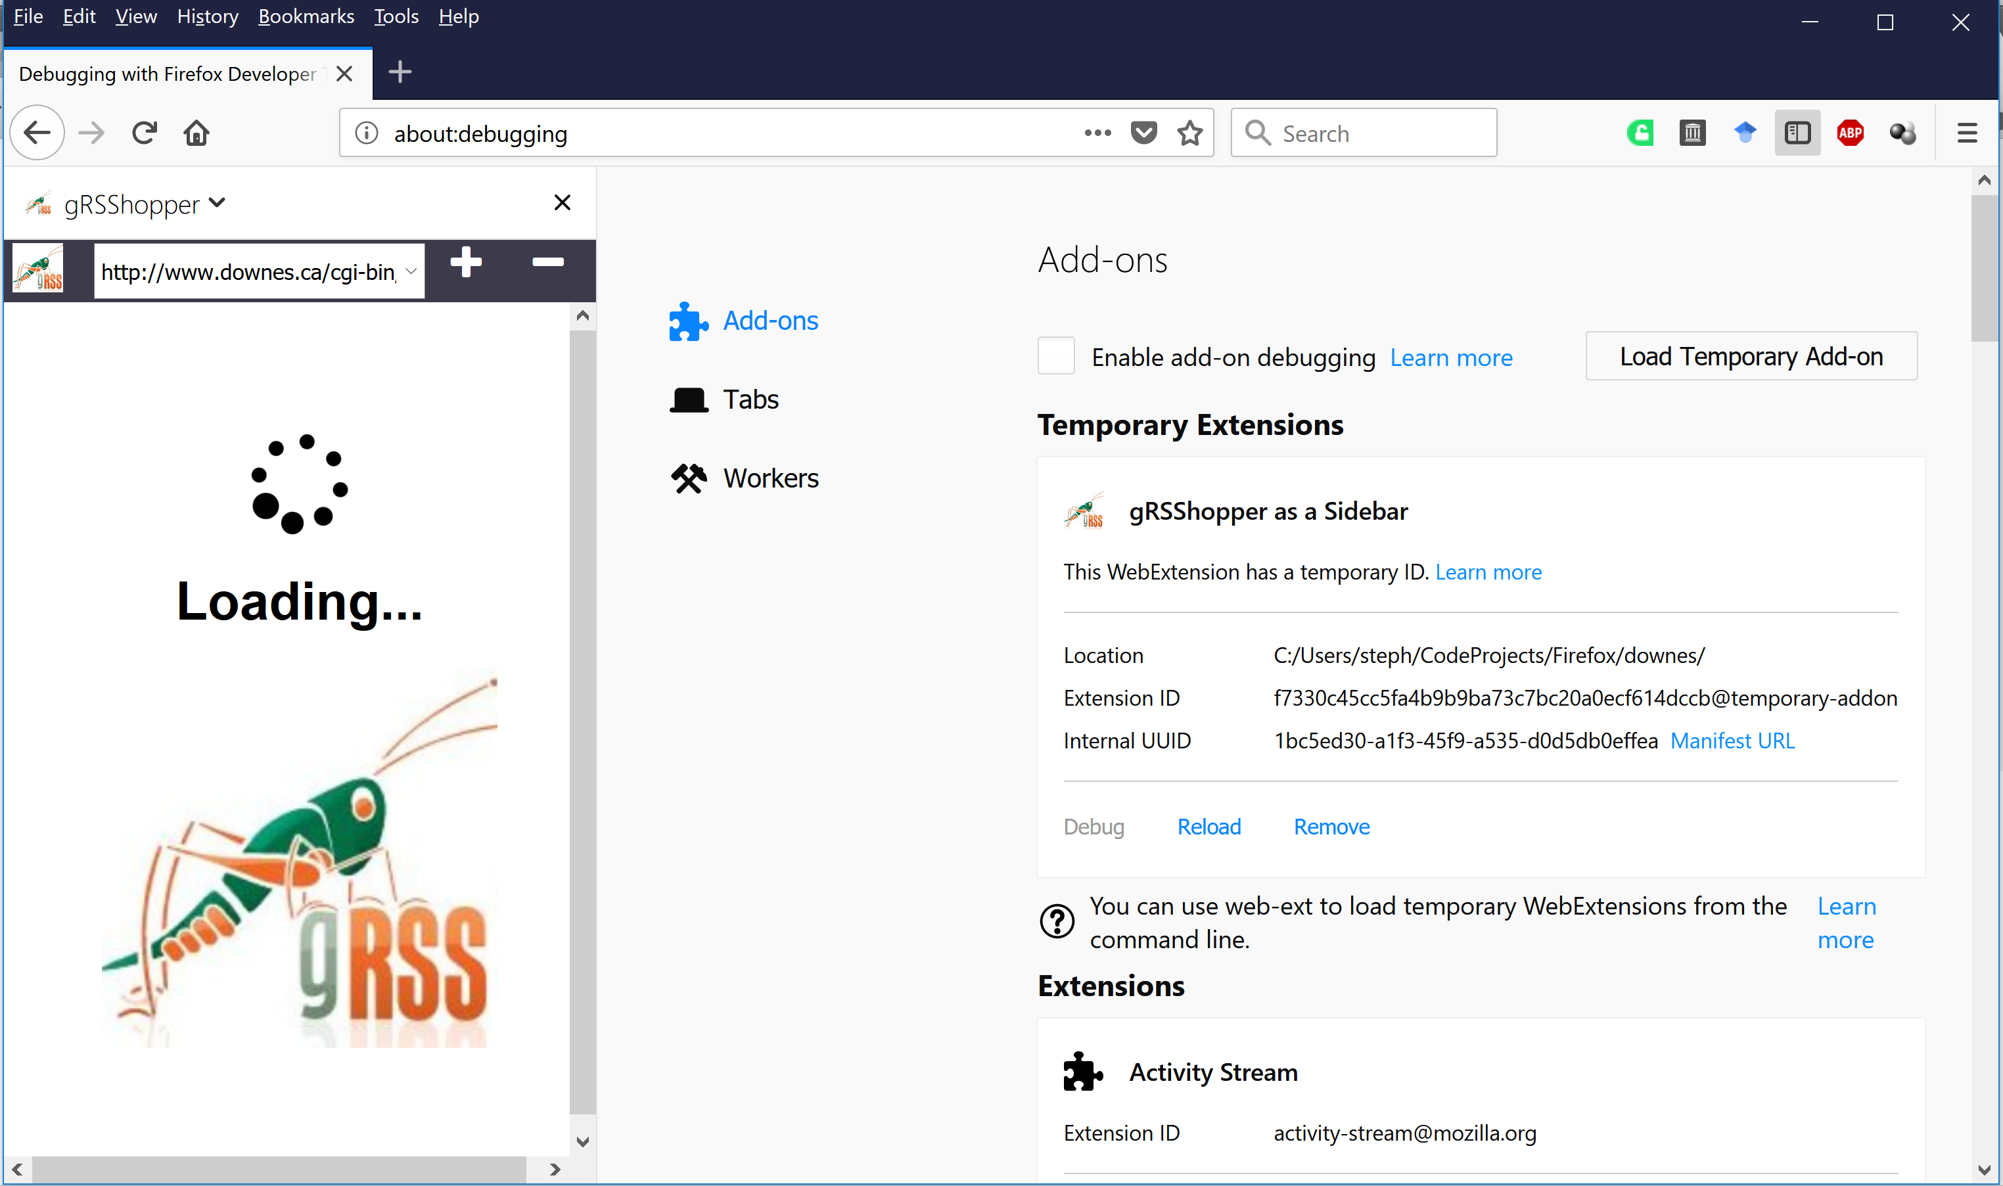
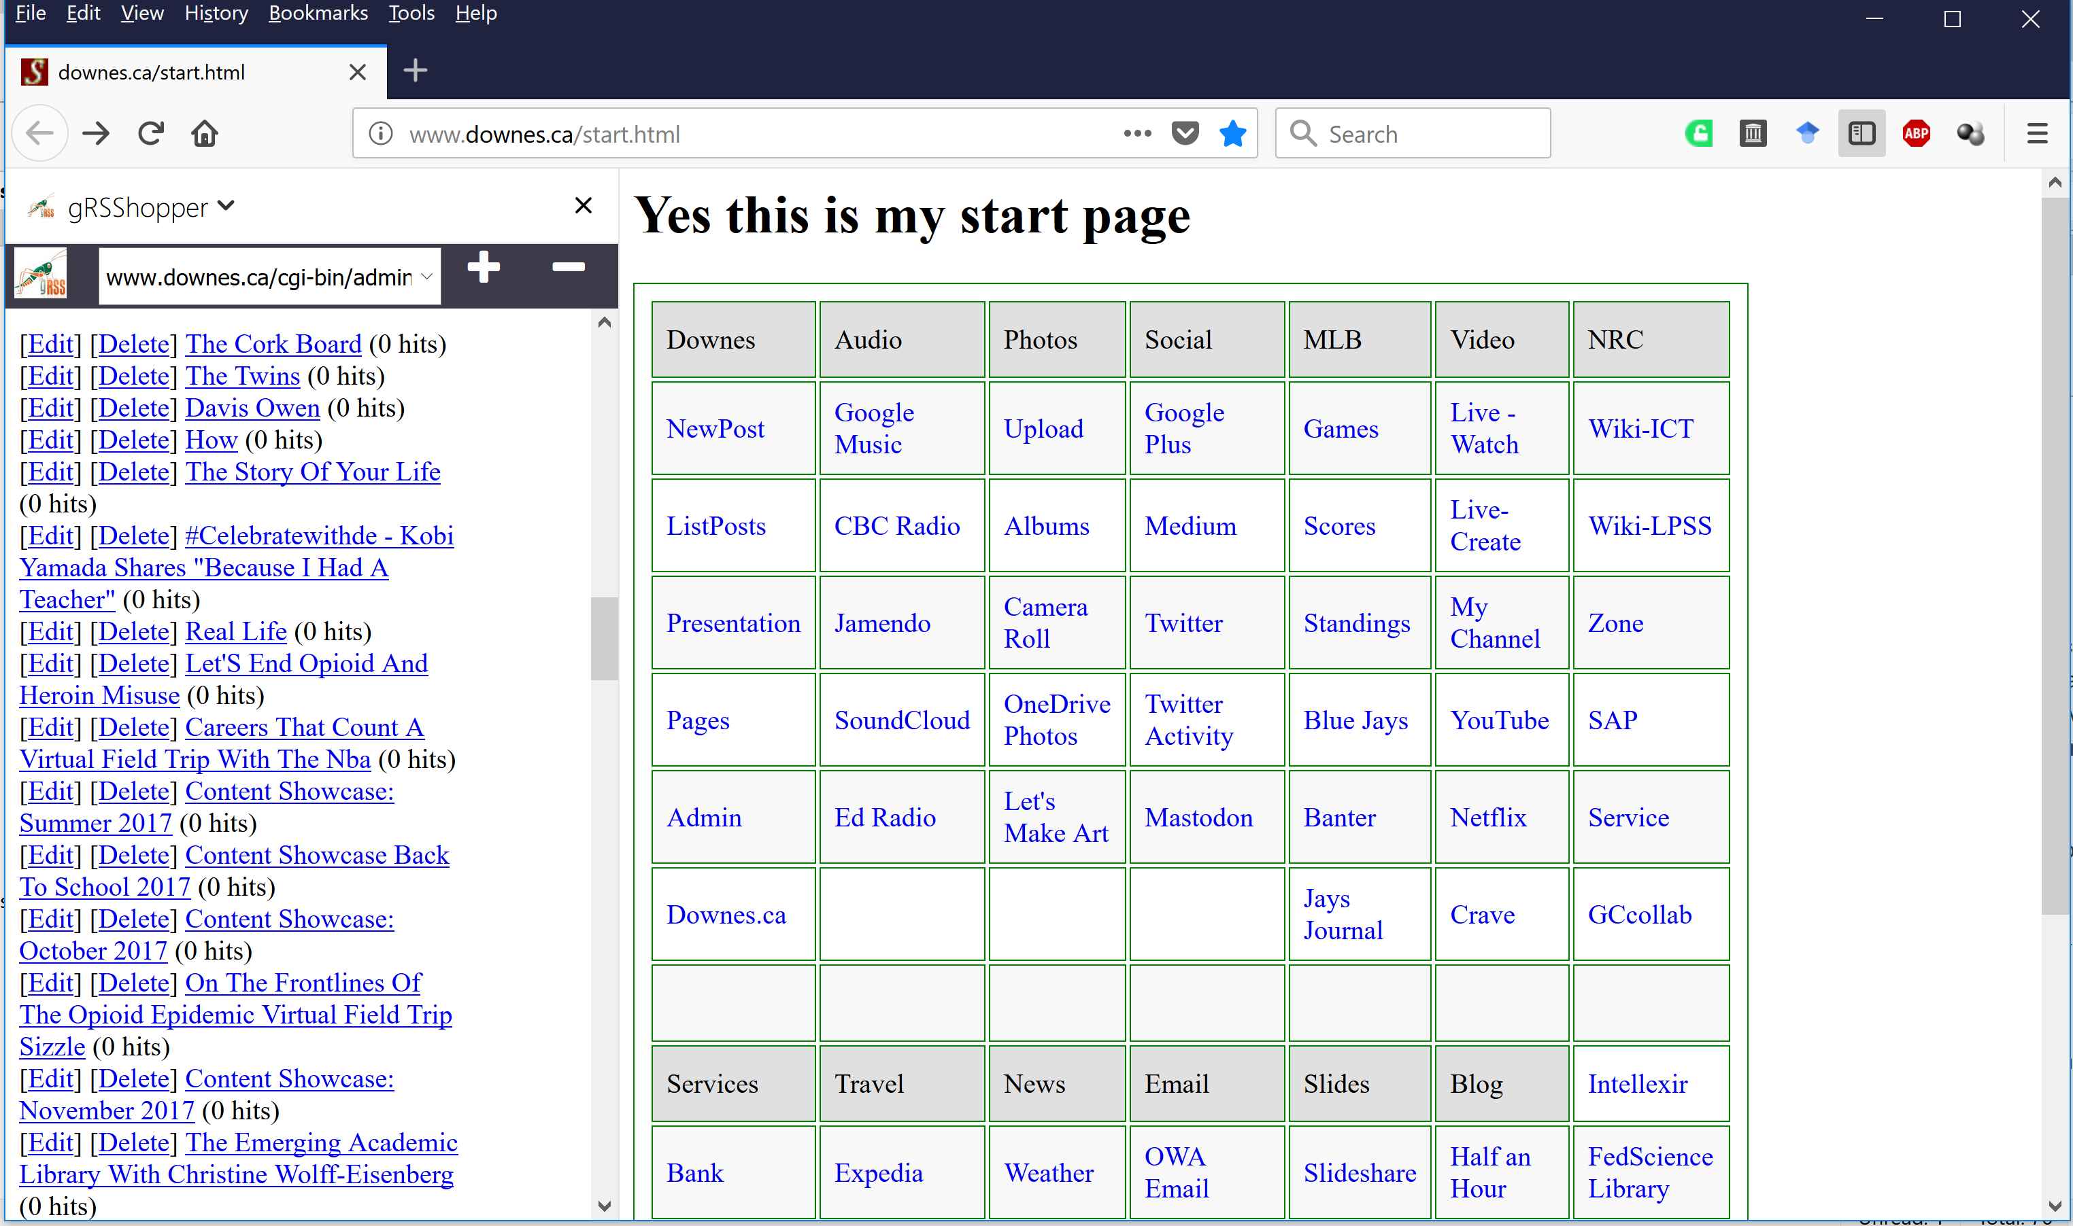
gRSShopper as a Panel
gRSShopper as a Firefox Sidebar
https://addons.mozilla.org/en-US/firefox/search/?q=sidebar&platform=WINNT&appver=58.0
Stephen Downes - Applications, Algorithms and Data - November 30, 2017

Slide 27
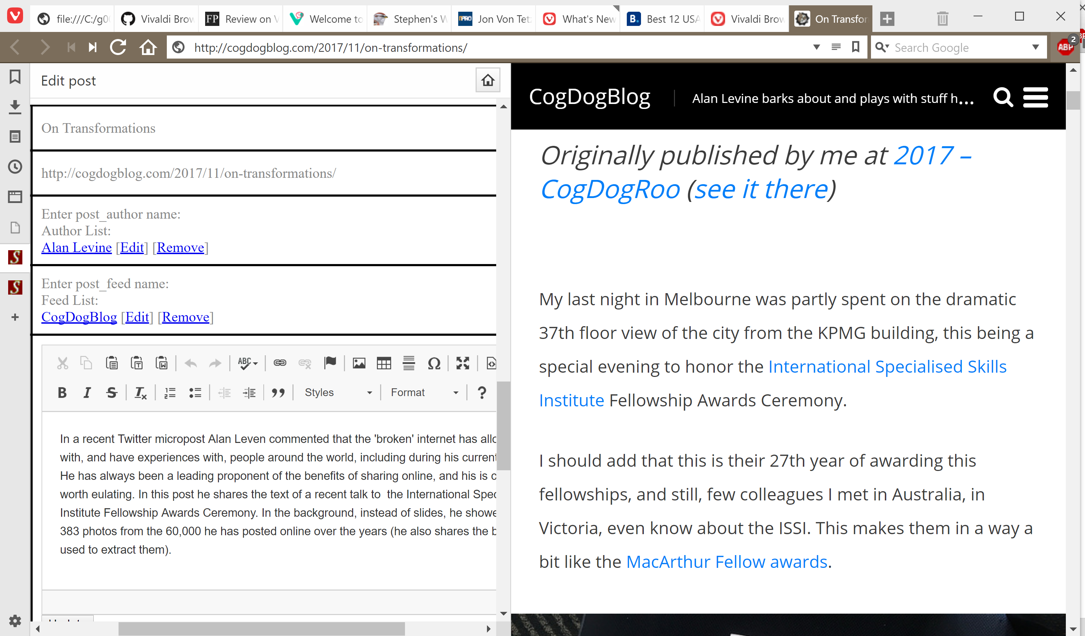
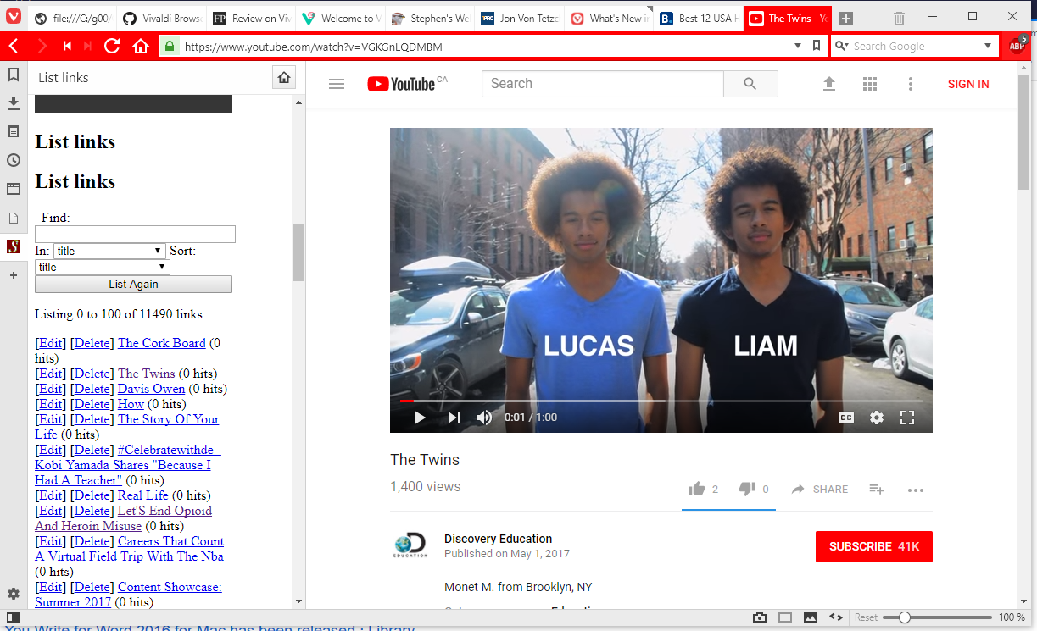
Applications in Other Applications
gRSShopper in Vivaldi
https://vivaldi.com/
Stephen Downes - Applications, Algorithms and Data - November 30, 2017

Slide 28
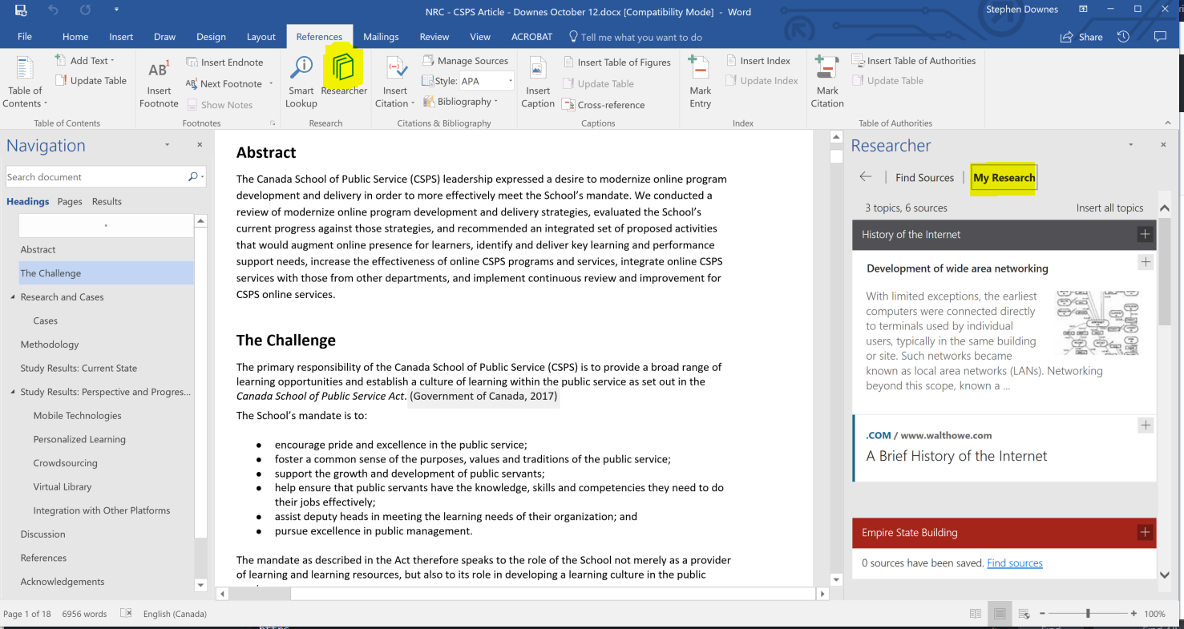

Applications in Other Applications
Research and References in an MS-Word Plugin
https://www.officetooltips.com/office_2013/tips/advanced_research_with_research_pane.html
Stephen Downes - Applications, Algorithms and Data - November 30, 2017

