Slide 1

Applications, Algorithms and Data: Open Educational Resources and the Next Generation of Virtual Learning
Stephen Downes
RELIF
Hammamet, Tunisia
November 30, 2017

Slide 2
Abstract: Open Educational Resources (OER) have traditionally been thought of as replacements for classroom materials such as textbooks, teaching aids, study guides, and background resources. In more recent years they have come to include multimedia resources such as animations, podcasts and videos, and they have led to the development of new educational modalities, such as massive open online courses (MOOCs). The next generation of OERs will take a step beyond traditional media and classroom support and begin to take advantage of the unique properties of virtual learning. Using examples such as virtual containers and actionable data books, education technology researcher Stephen Downes will sketch the future for the next generation of OERs as a distributed and interactive network of applications, algorithms and data.

Slide 3
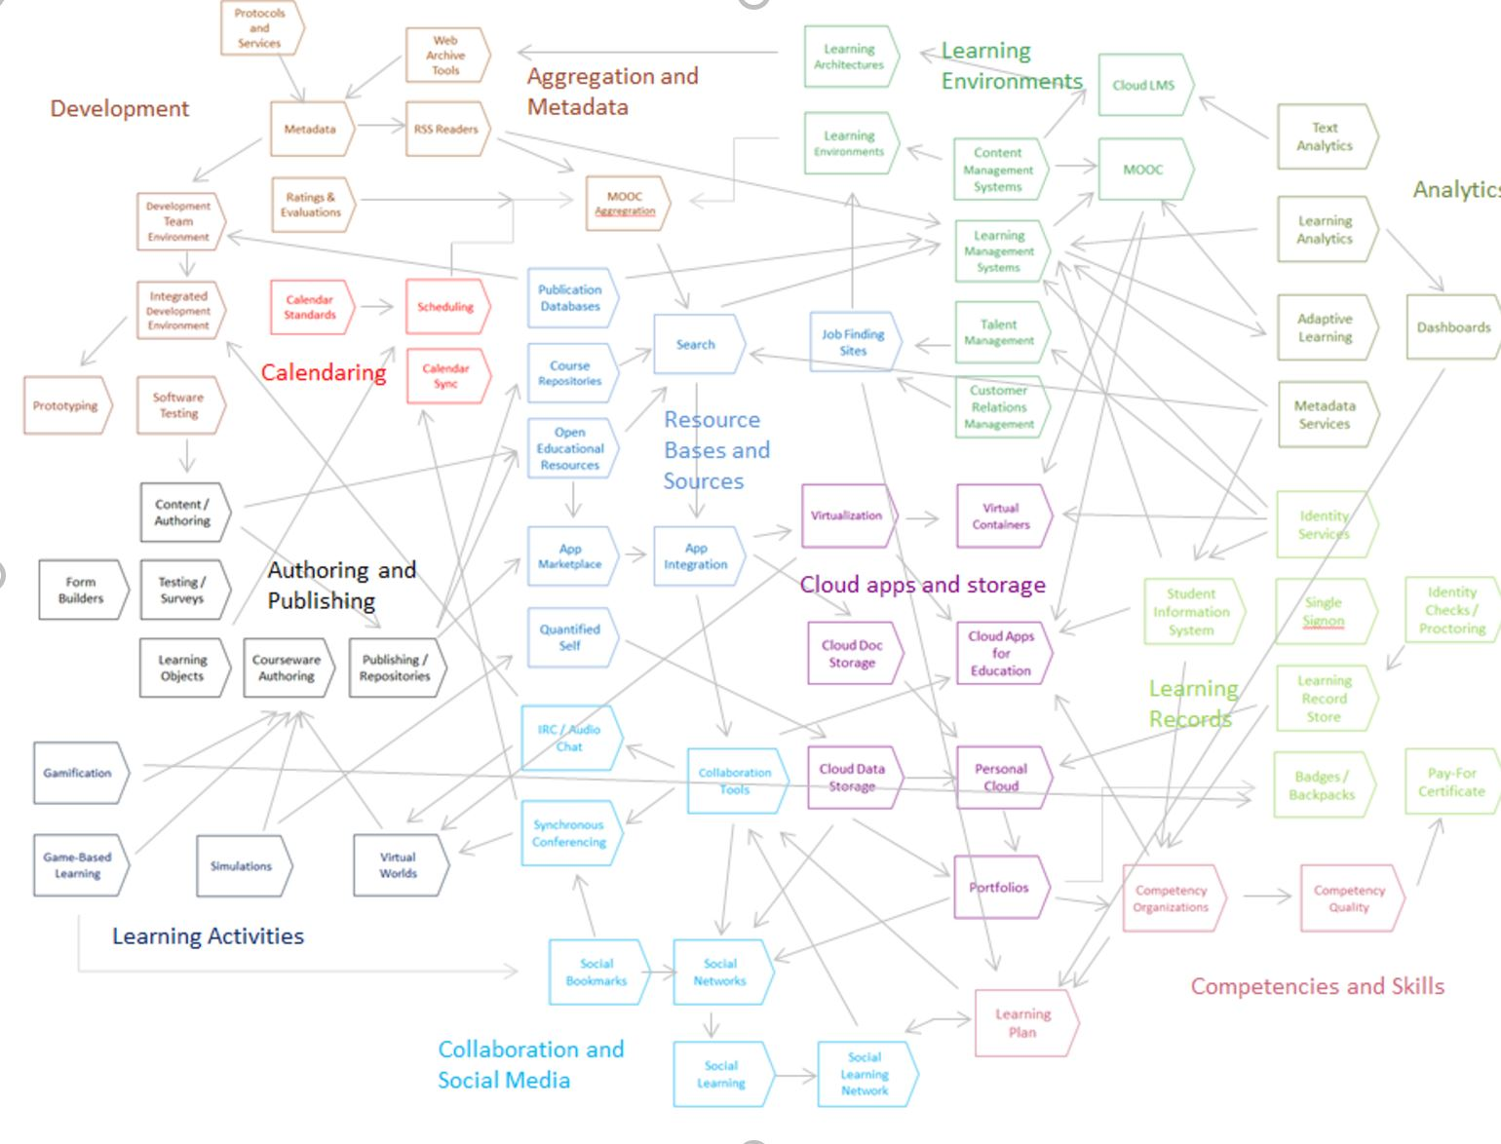
State of the Art

Slide 4



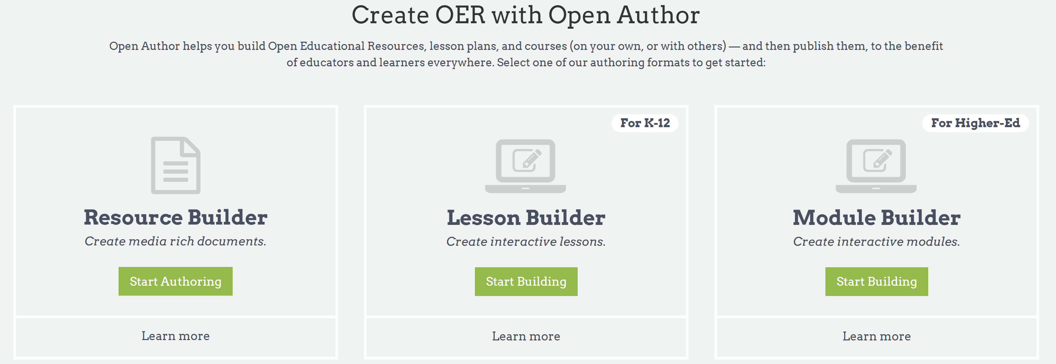
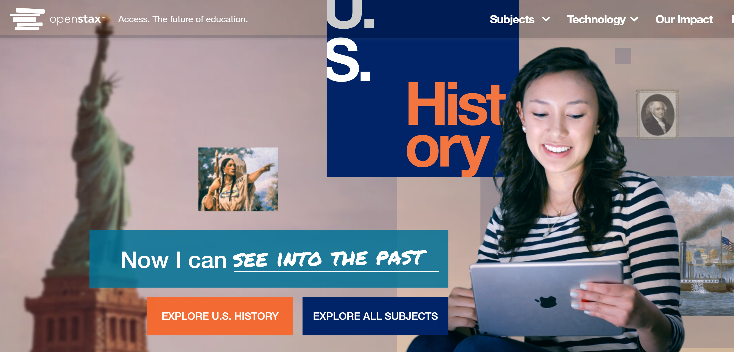
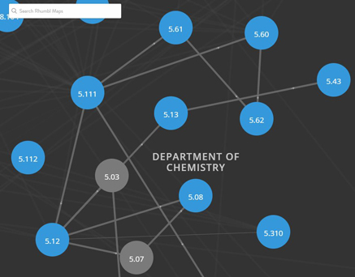
OER Repositories
https://www.oercommons.org/
https://openstax.org/
OERs are now widely available through subject-specific libraries with provisions for authoring as well
https://ocw.mit.edu/

Slide 5
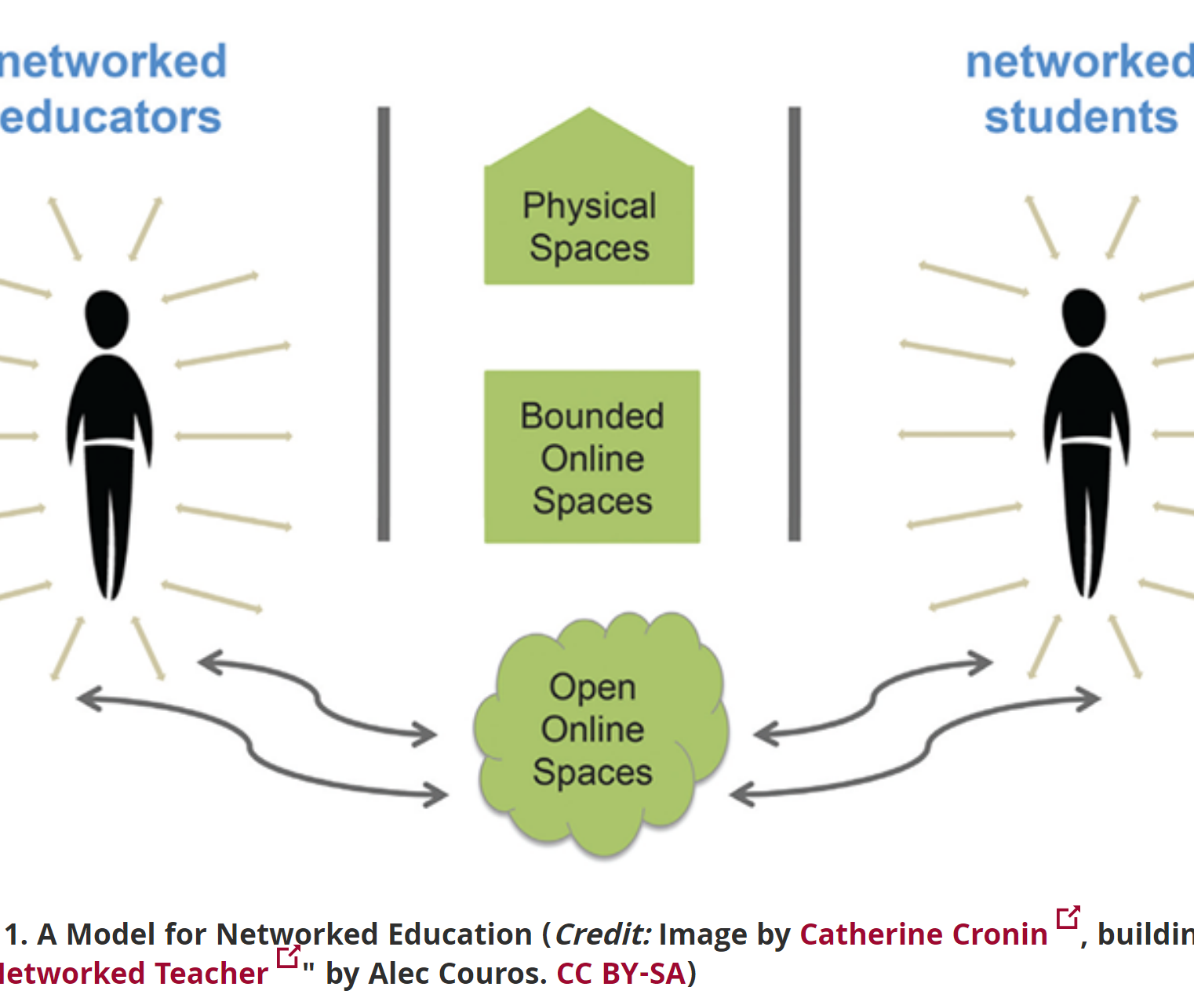
Open Resources, Open Teaching
Open Pedagogy – Using OER to Chane How We Teach – Heather Ross https://words.usask.ca/gmcte/2016/09/26/open-pedagogy-using-oer-to-change-how-we-teach/
Open Education, Open Questions – Catherine Cronin https://er.educause.edu/articles/2017/10/open-education-open-questions
  “The use of open practices by learners and educators is complex, personal, and contextual; it is also continually negotiated.”

Slide 6
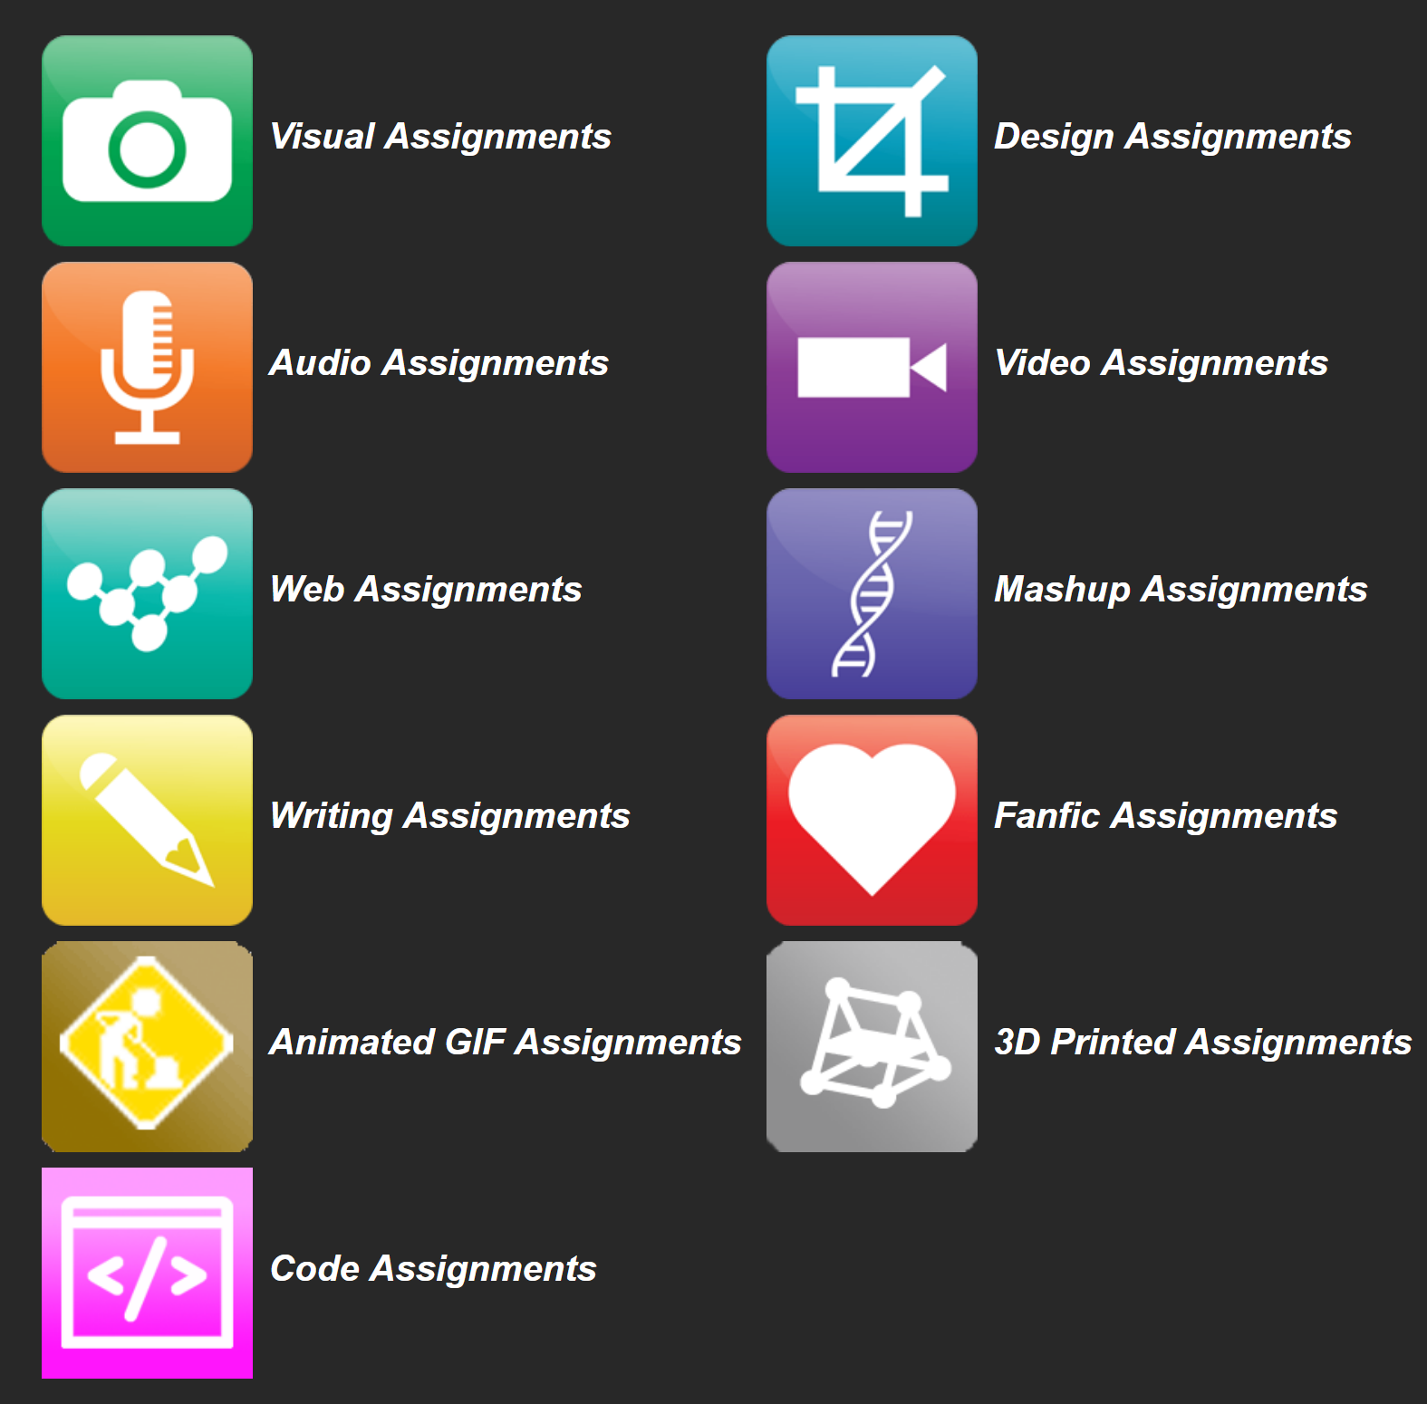
OERs as Student Production
DS106 – assignment bank http://assignments.ds106.us/
Domain of One’s Own - https://reclaimhosting.com/domain-of-ones-own/
Creation of OERs through ‘renewable assignments’ – Christina Hendricks http://flexible.learning.ubc.ca/news-events/renewable-assignments-student-work-adding-value-to-the-world/

Slide 7
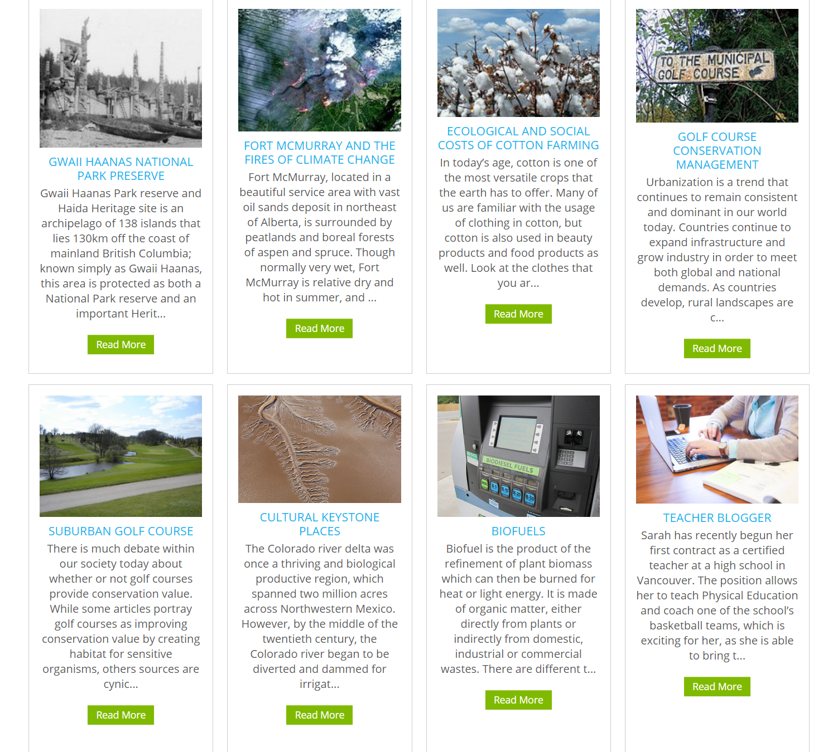
Open Case Studies
case studies that can be used by anyone, at UBC or elsewhere.
Many focus on topics in sustainability
cases on this site are open educational resources: they have an open license to allow for revision and reuse of the cases in other courses and contexts
Quoted from: http://cases.open.ubc.ca/

Slide 8
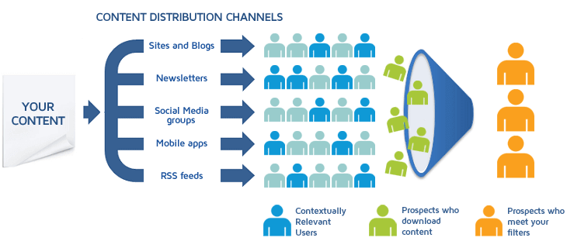
Content Syndication
Image: https://blog.izooto.com/best-content-syndication-tools/
Blog posts and comments were the core of CCK08
  gRSShopper – http://grsshopper.downes.ca
FeedPress - https://wordpress.org/plugins/feedpress/
FeedBurner - https://feedburner.google.com

Slide 9
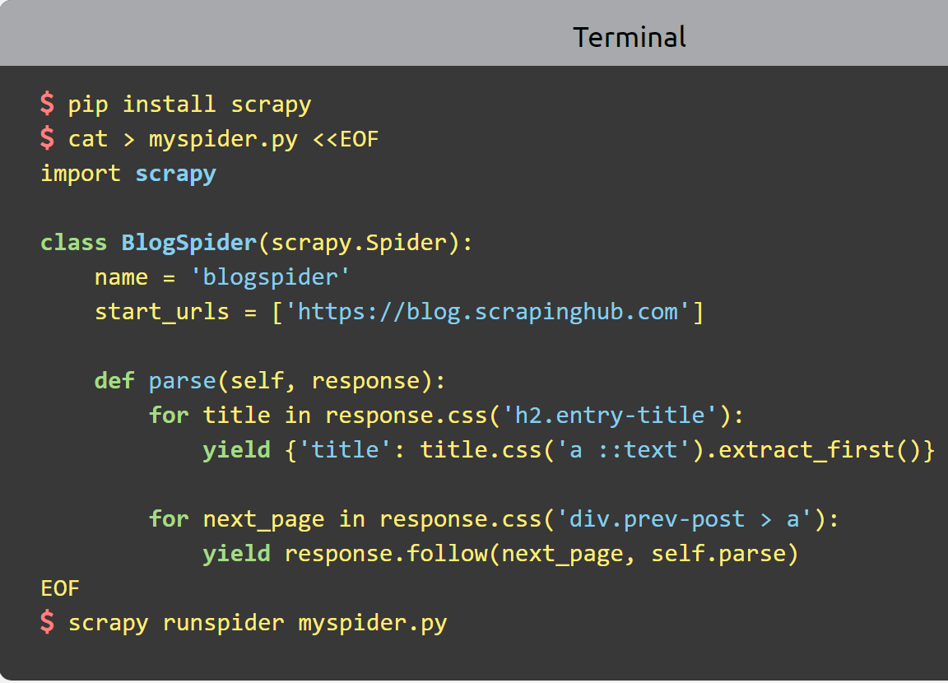
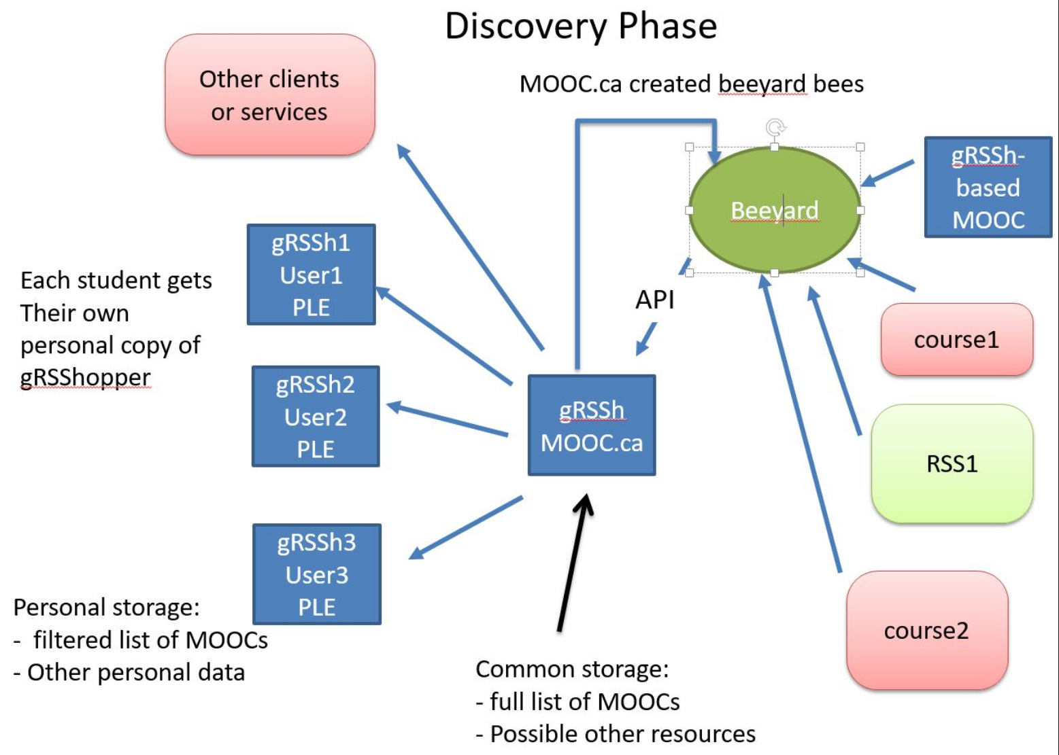
Scrapy
Python framework to aggregate and store content in RSS feeds and web sites
Forms the core of the NRC-developed ‘Beeyard’ application
https://scrapy.org/

Slide 10
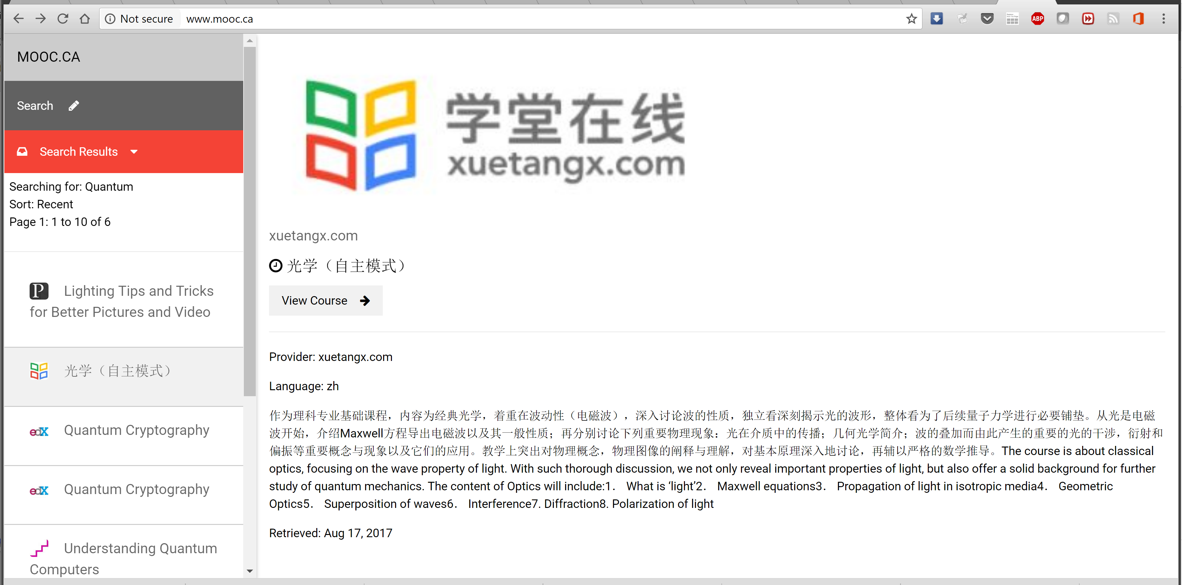

MOOC.ca and gRSShopper
http://grsshopper.downes.ca/
www.mooc.ca is an aggregator of MOOC course offerings (and is planned to aggregate OERs as well) using gRSShopper and Beeyard

Slide 11
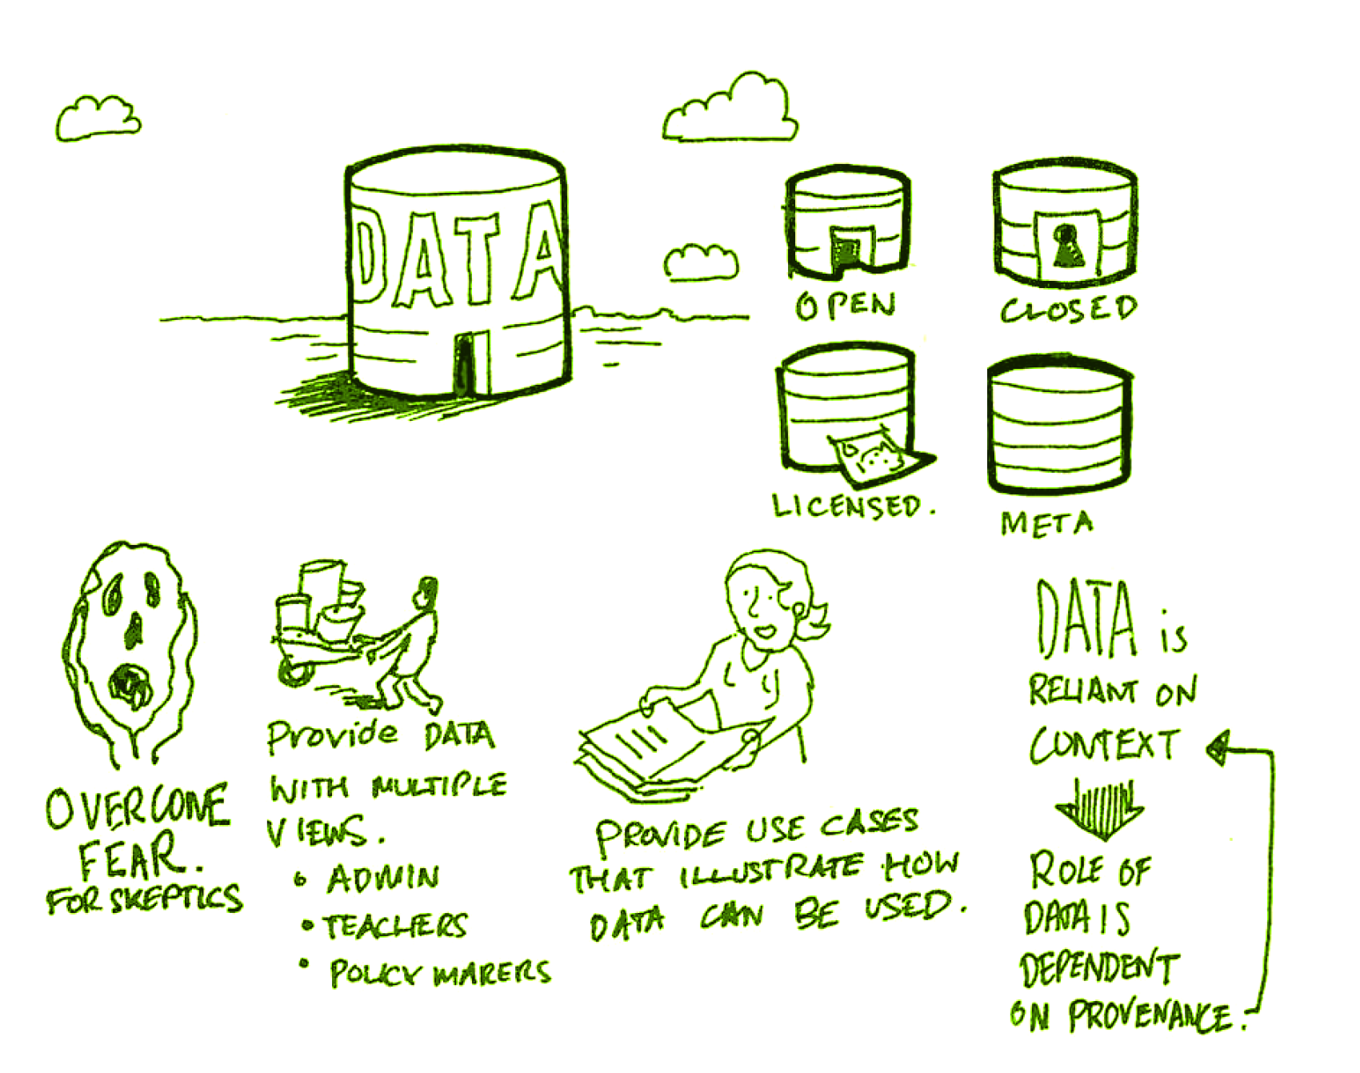
Open Data as OERs
Civic engagement in Italy
Into programming assignments
Article-level metrics
Geodata and Land Walks in Wales
Open data for sustainable development
Atenas, J., & Havemann, L. (Eds.). (2015). Open Data as Open Educational Resources: Case studies of emerging practice. London: Open Knowledge, Open Education Working Group. http://dx.doi.org/10.6084/m9.figshare.1590031
Also: Leo Havemann, slides http://eprints.bbk.ac.uk/14750/1/Leo_ODasOER_UCL_4March16.pdf

Slide 12
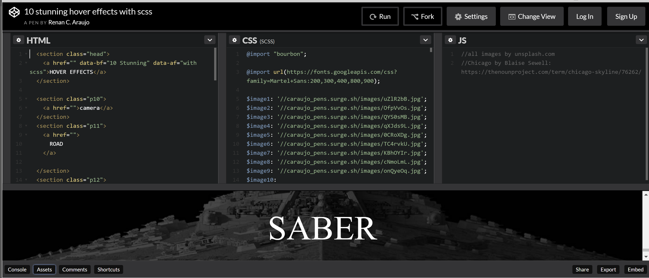
CodePen
https://codepen.io/caraujo/pen/LVPzxO

Slide 13
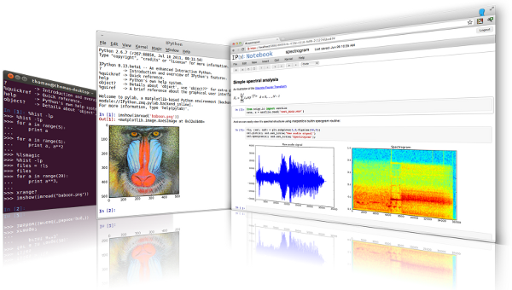

iPython and Jupyter
iPython is an interactive programming shell for the Python programming language https://ipython.org/
The Jupyter Notebook is an open-source web application that allows you to create and share documents that contain live code… http://jupyter.org/

Slide 14
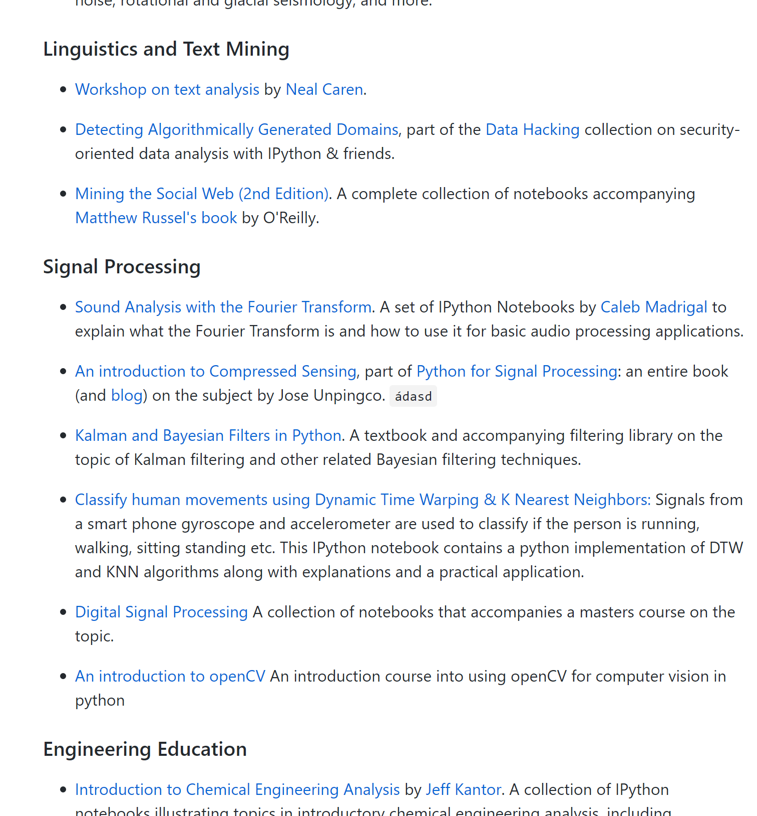
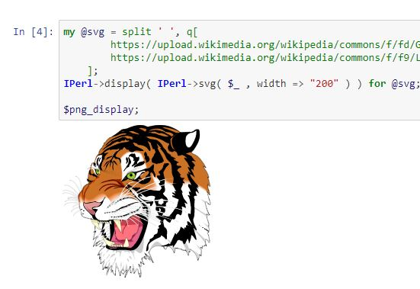
A gallery of interesting Jupyter Notebooks
https://github.com/jupyter/jupyter/wiki/A-gallery-of-interesting-Jupyter-Notebooks#machine-learning-statistics-and-probability

Slide 15

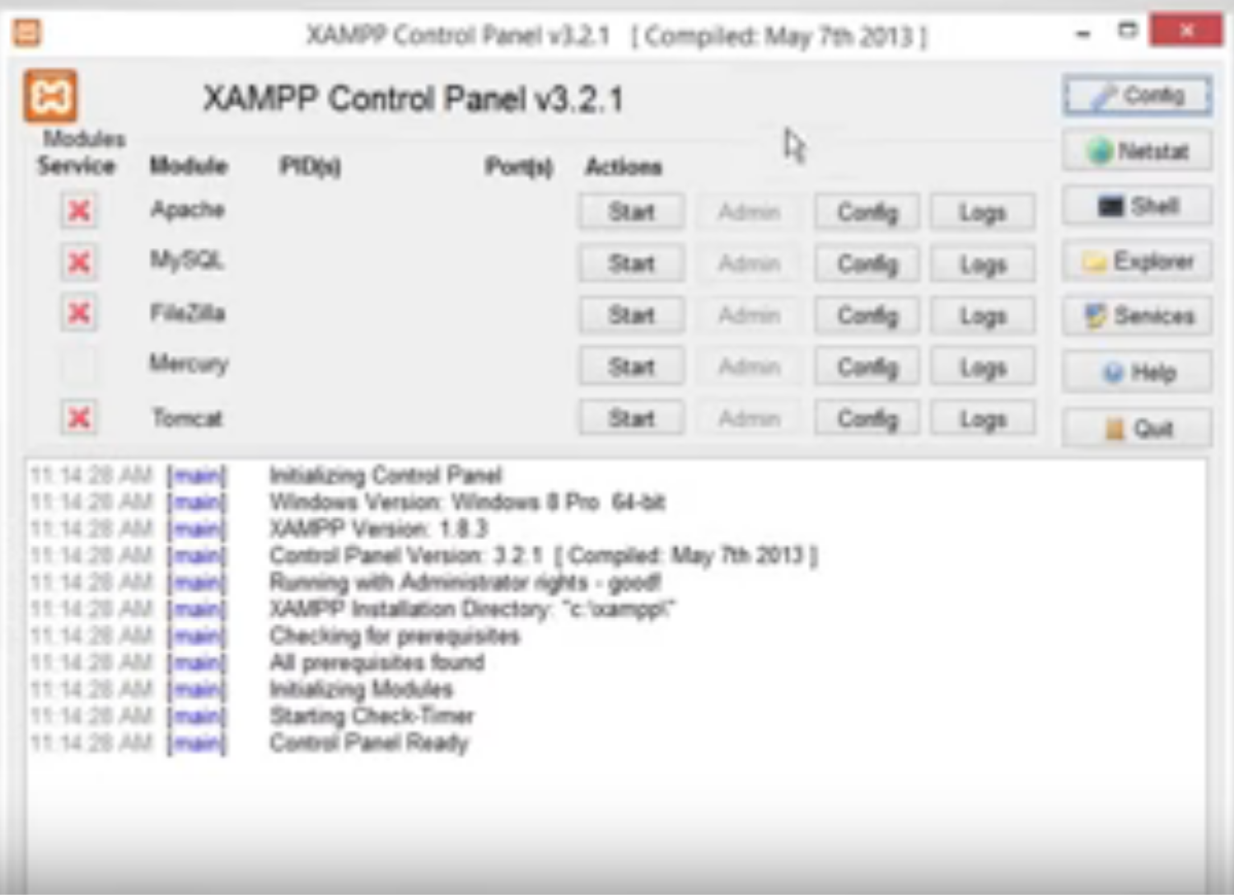
XAMPP
“XAMPP is a completely free, easy to install Apache distribution containing MariaDB, PHP, and Perl. The XAMPP open source package has been set up to be incredibly easy to install and to use.”
XAMPP on a USB Stick
https://portableapps.com/apps/development/xampp
https://willtan.com/installing-xampp-on-usb-flash-drive/
https://www.apachefriends.org/index.html

Slide 16
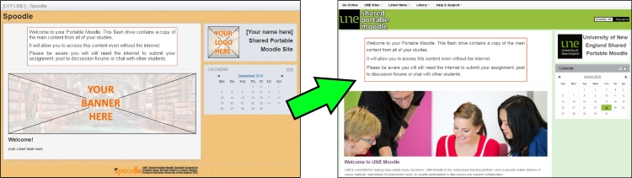
Moodle on a Stick
“Spoodle is an up to date portable moodle / ‘moodle on a stick’ solution for learners to access Moodle courses without requiring constant internet access.”
https://moodle.org/mod/forum/discuss.php?d=342367
https://www.youtube.com/watch?v=EsHEgSYKr4A

Slide 17
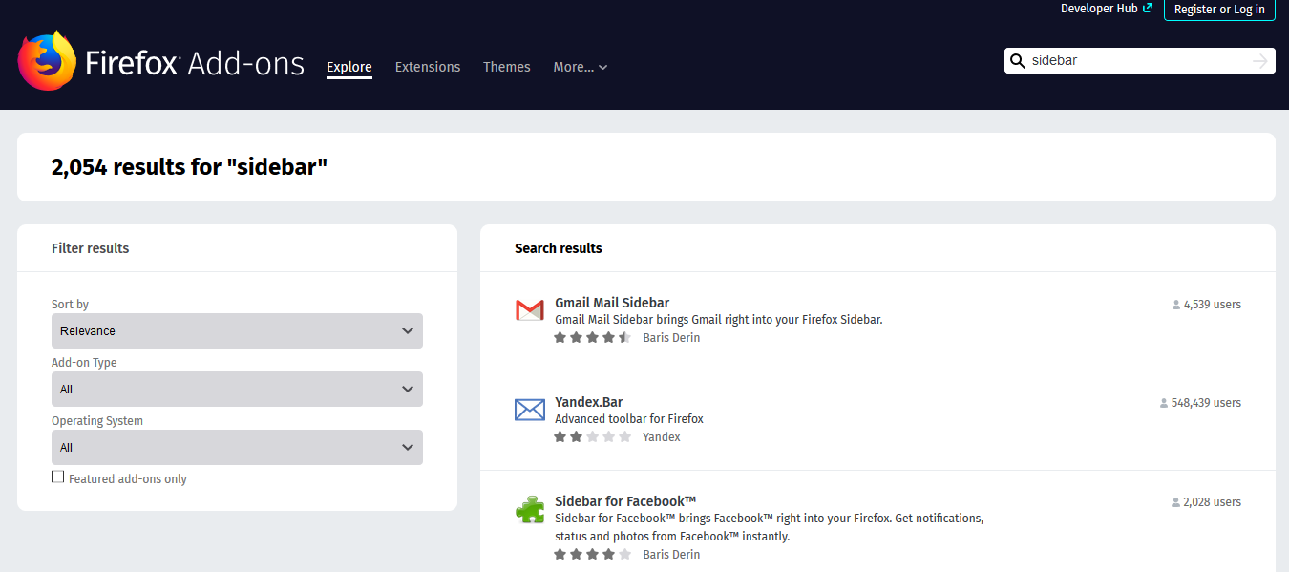
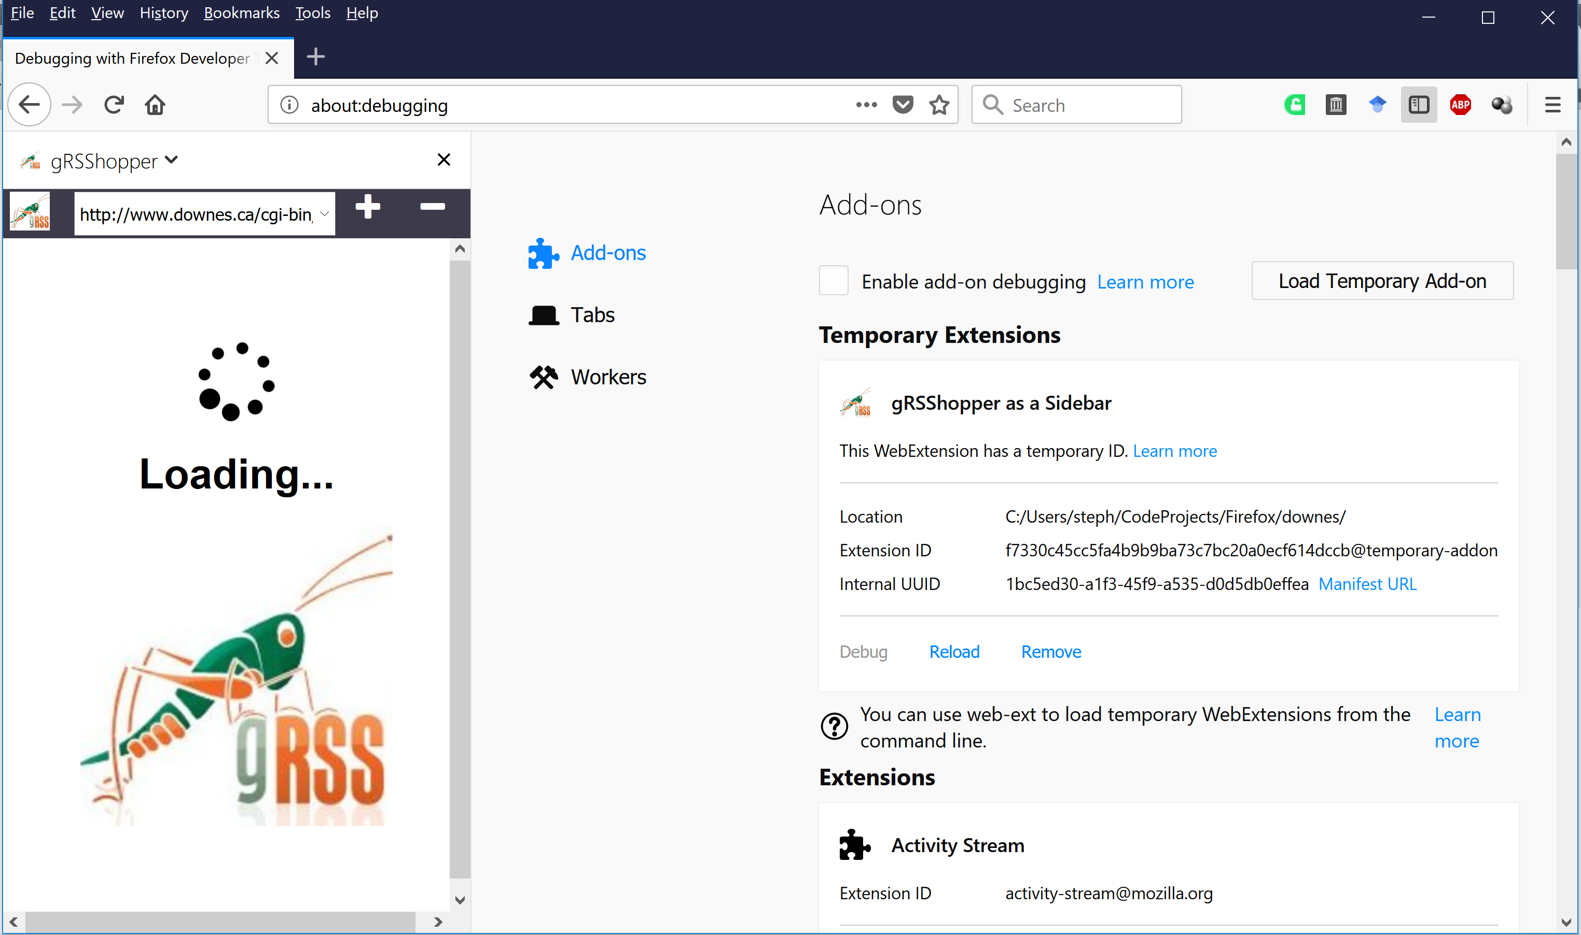
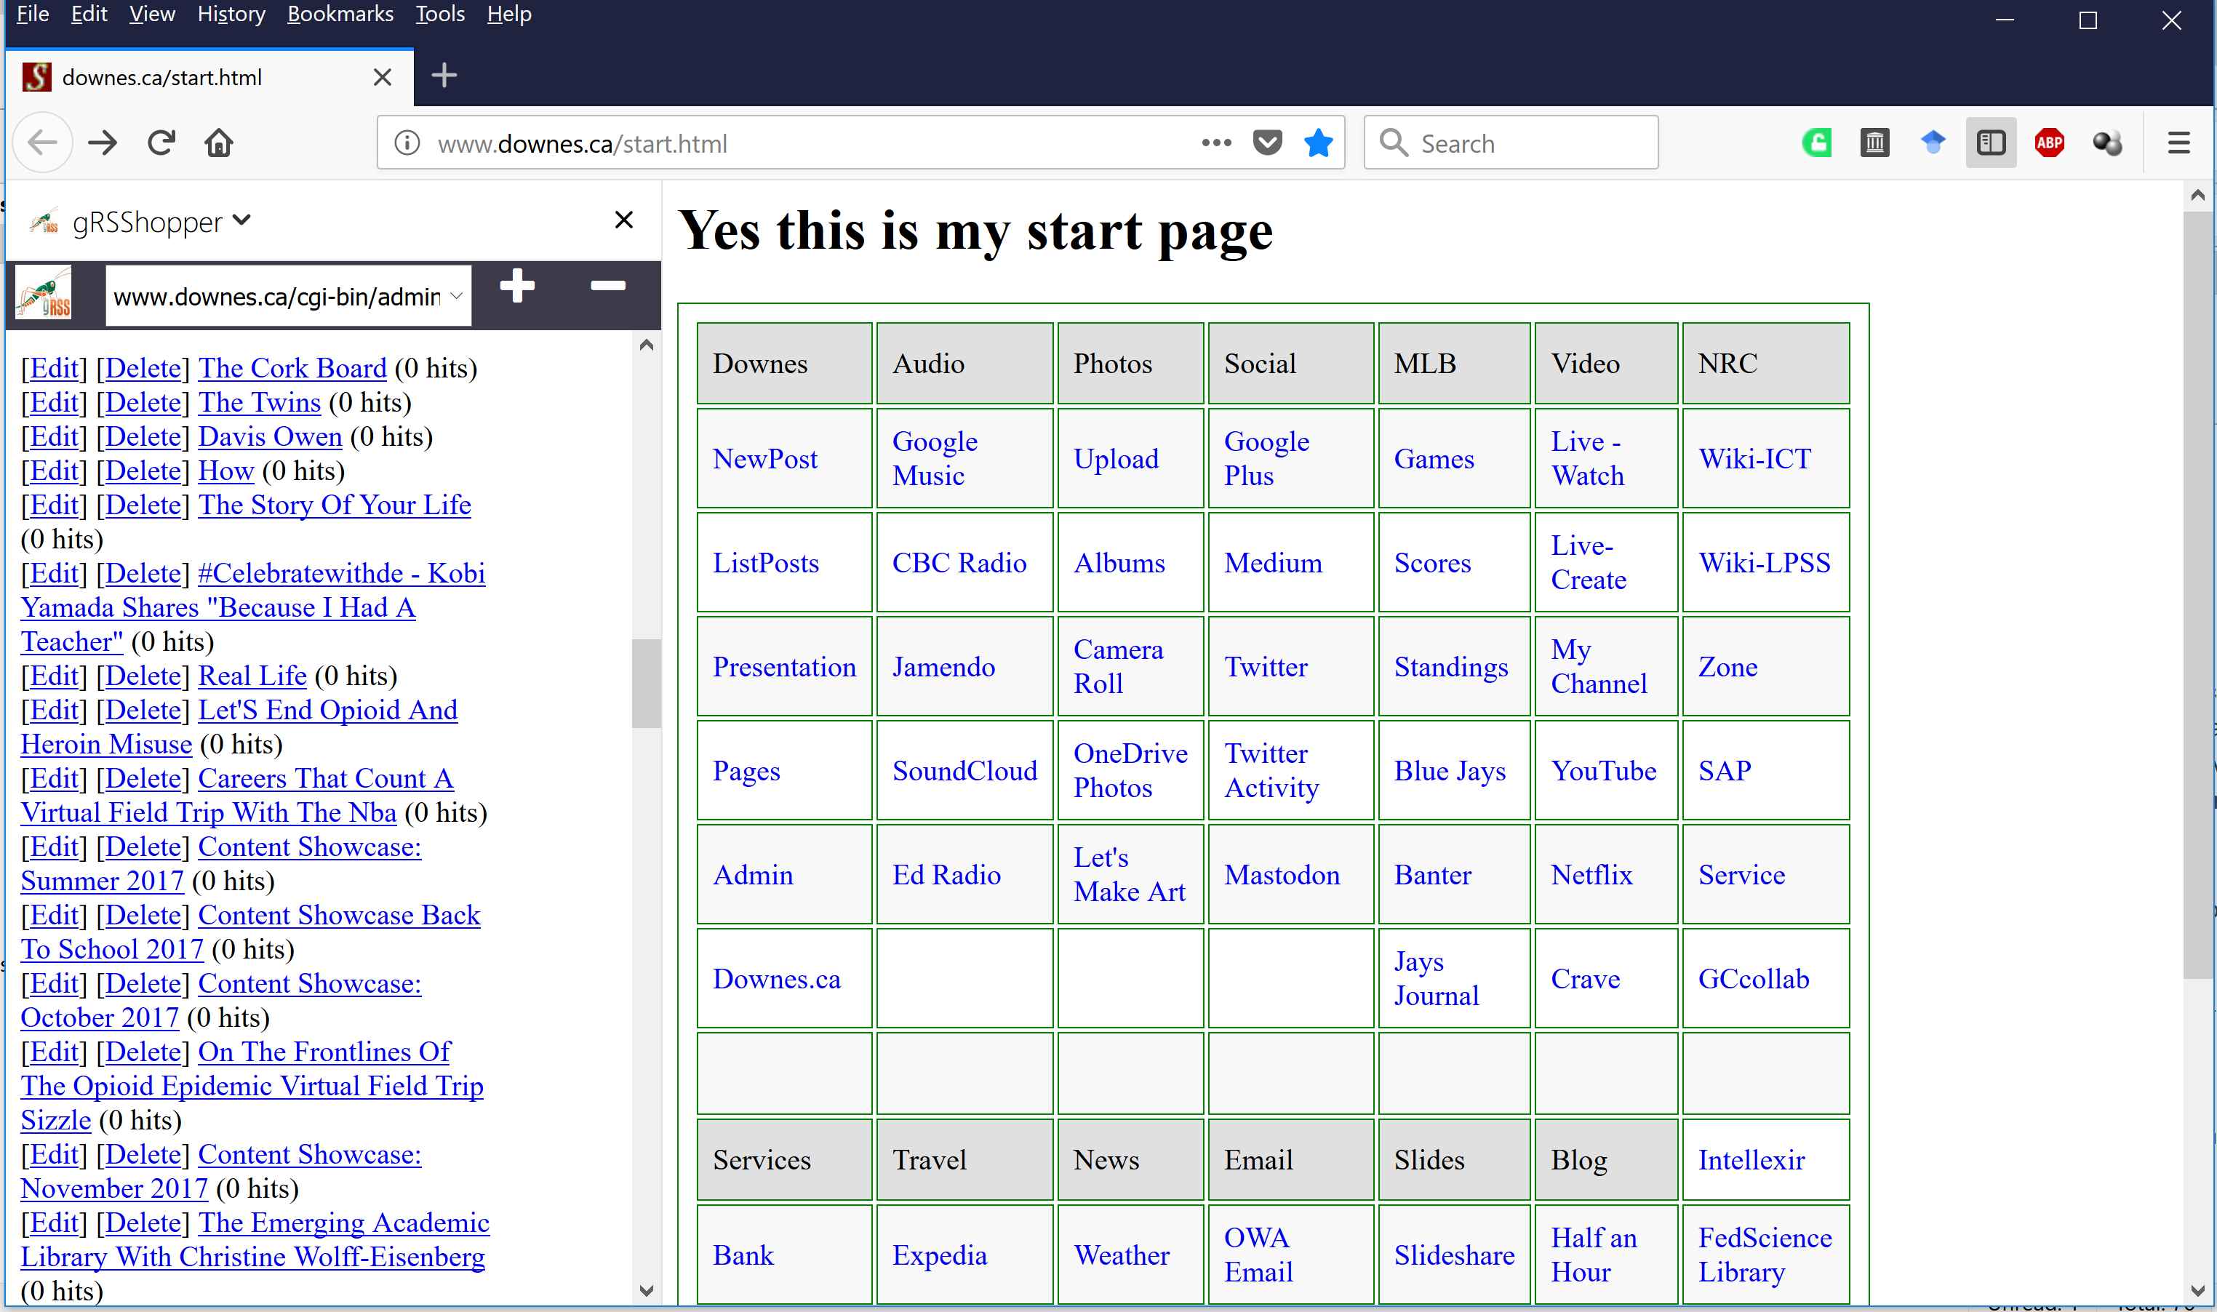
Embedding Applications in Other Applications
gRSShopper as a Firefox Sidebar
https://addons.mozilla.org/en-US/firefox/search/?q=sidebar&platform=WINNT&appver=58.0

Slide 18
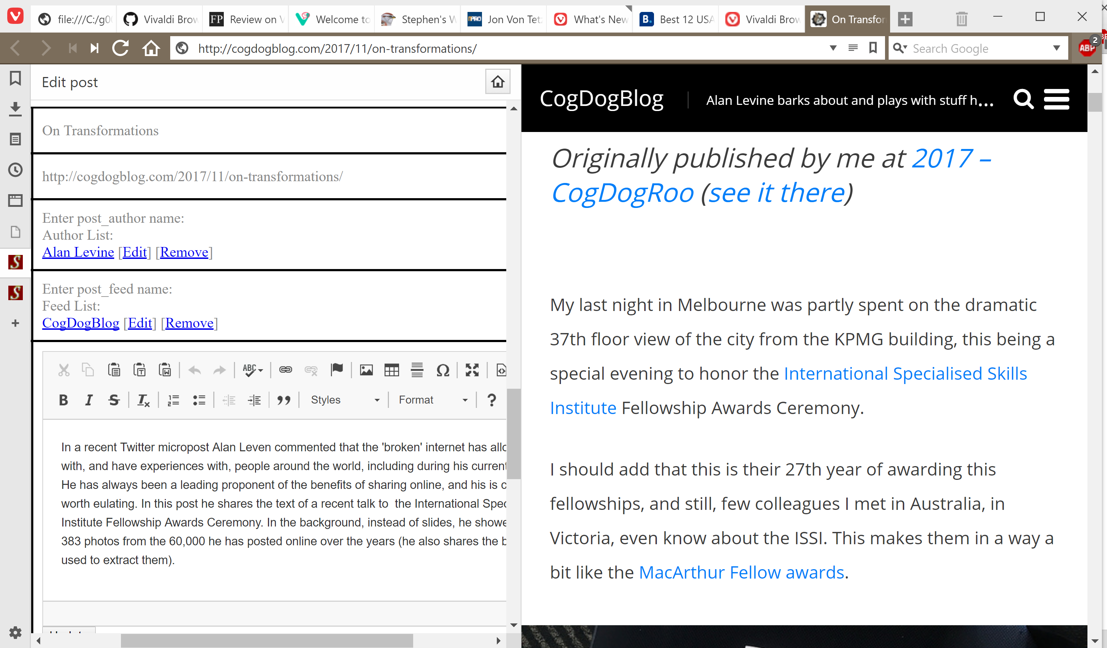
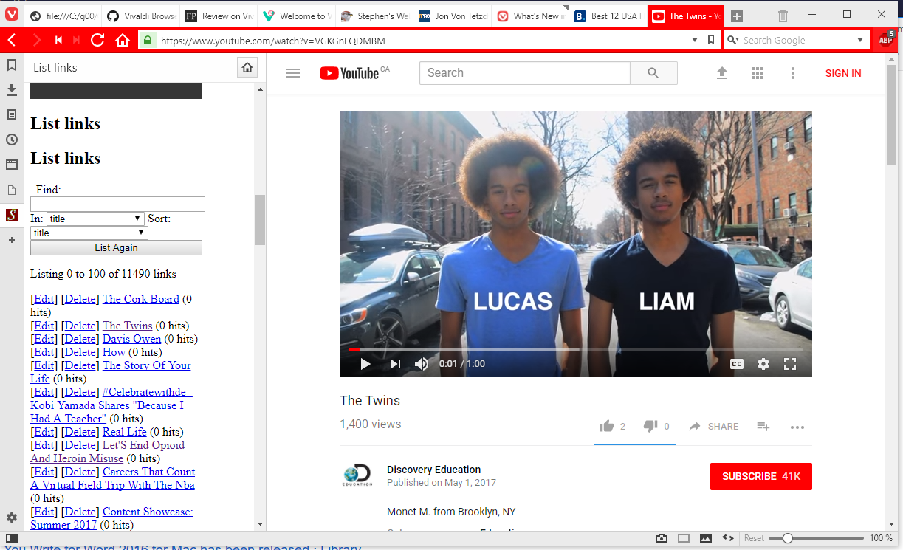
Embedding Applications in Other Applications
gRSShopper in Vivaldi
https://vivaldi.com/

Slide 19
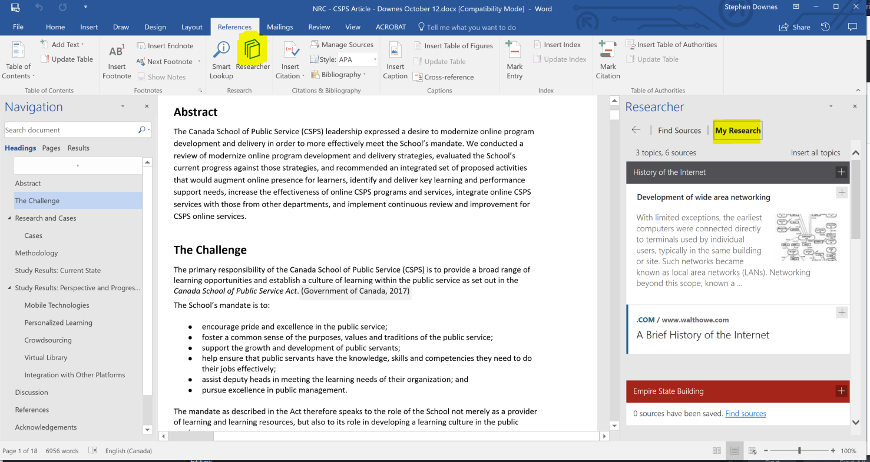

Embedding Applications in Other Applications
Research and References in an MS-Word Plugin
https://www.officetooltips.com/office_2013/tips/advanced_research_with_research_pane.html

Slide 20
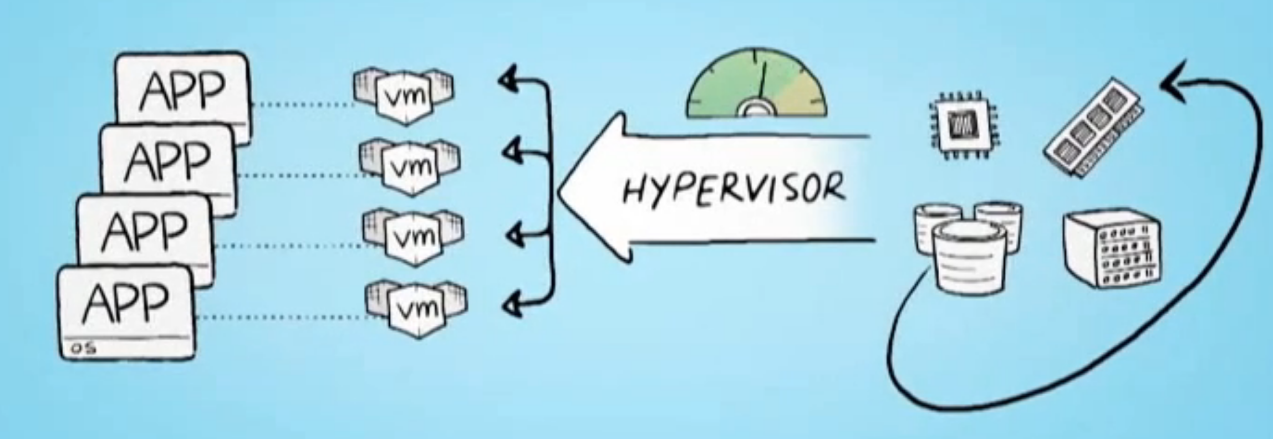
Server Virtualization
Parallels - https://www.parallels.com/
VMWare - https://www.vmware.com/
Virtual Box - https://www.virtualbox.org/
Hyper-V - https://docs.microsoft.com/en-us/virtualization/hyper-v-on-windows/quick-start/enable-hyper-v

Slide 21
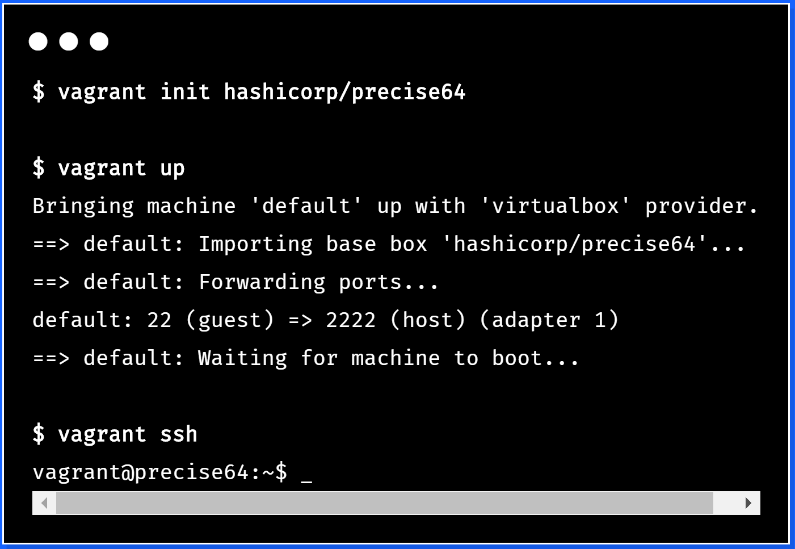
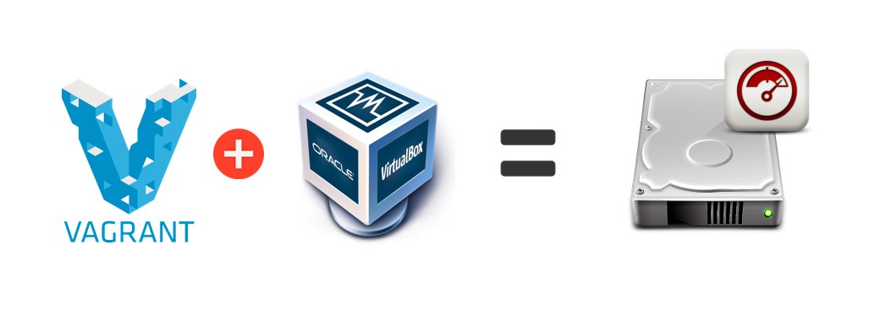
Virtualization Platforms - Vagrant
https://www.vagrantup.com/

Slide 22
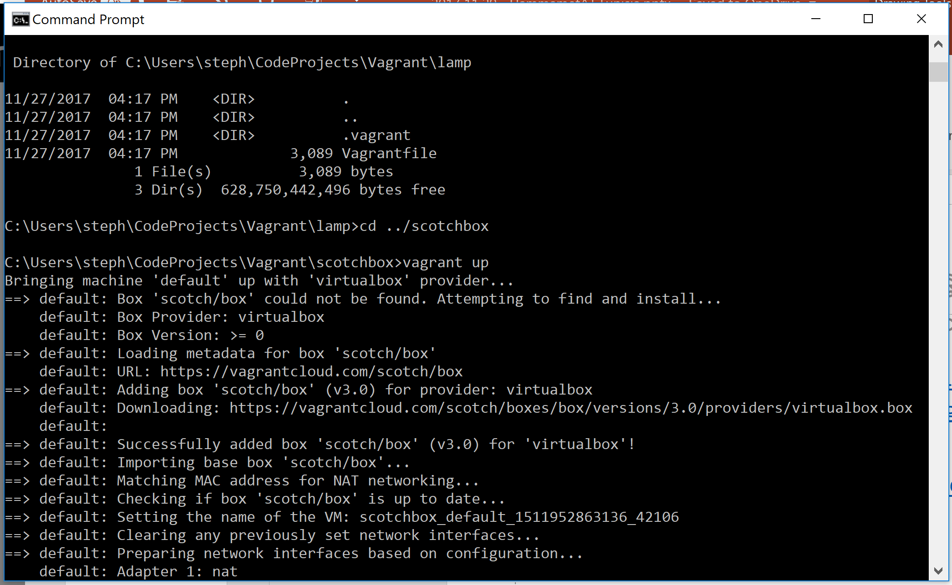
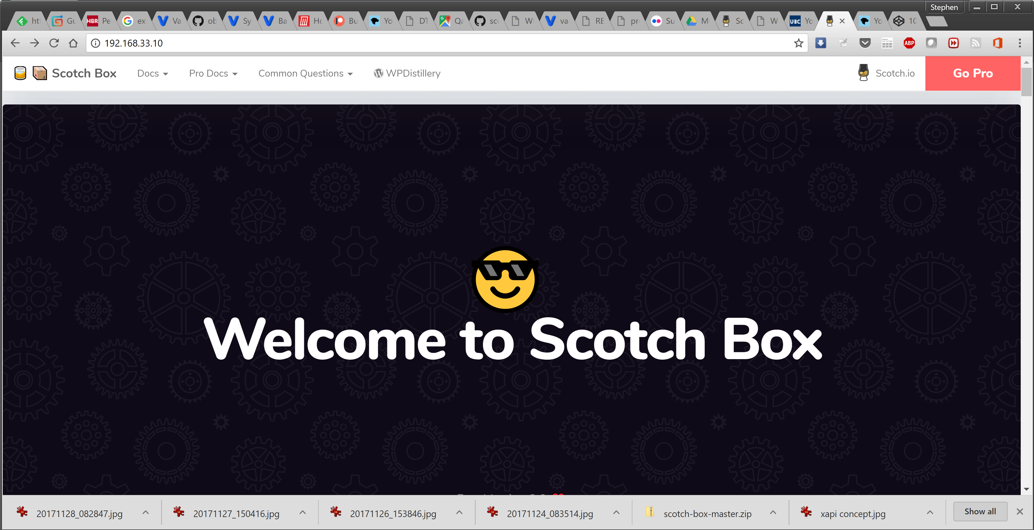
Loading and Running Vagrant Boxes
Scotch Box
  https://box.scotch.io/ -- http://192.168.33.10/
  WPDistillery - https://wpdistillery.org/ - for WordPress
Homestead
  Instructions - https://laravel.com/docs/5.5/homestead#first-steps

Slide 23
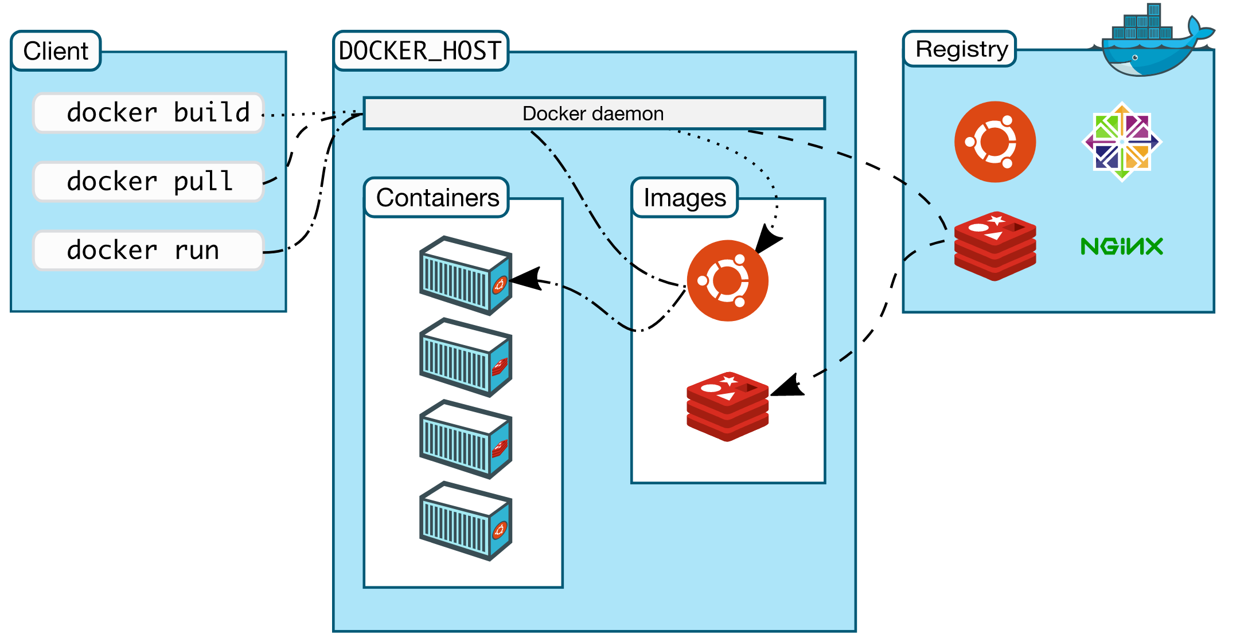
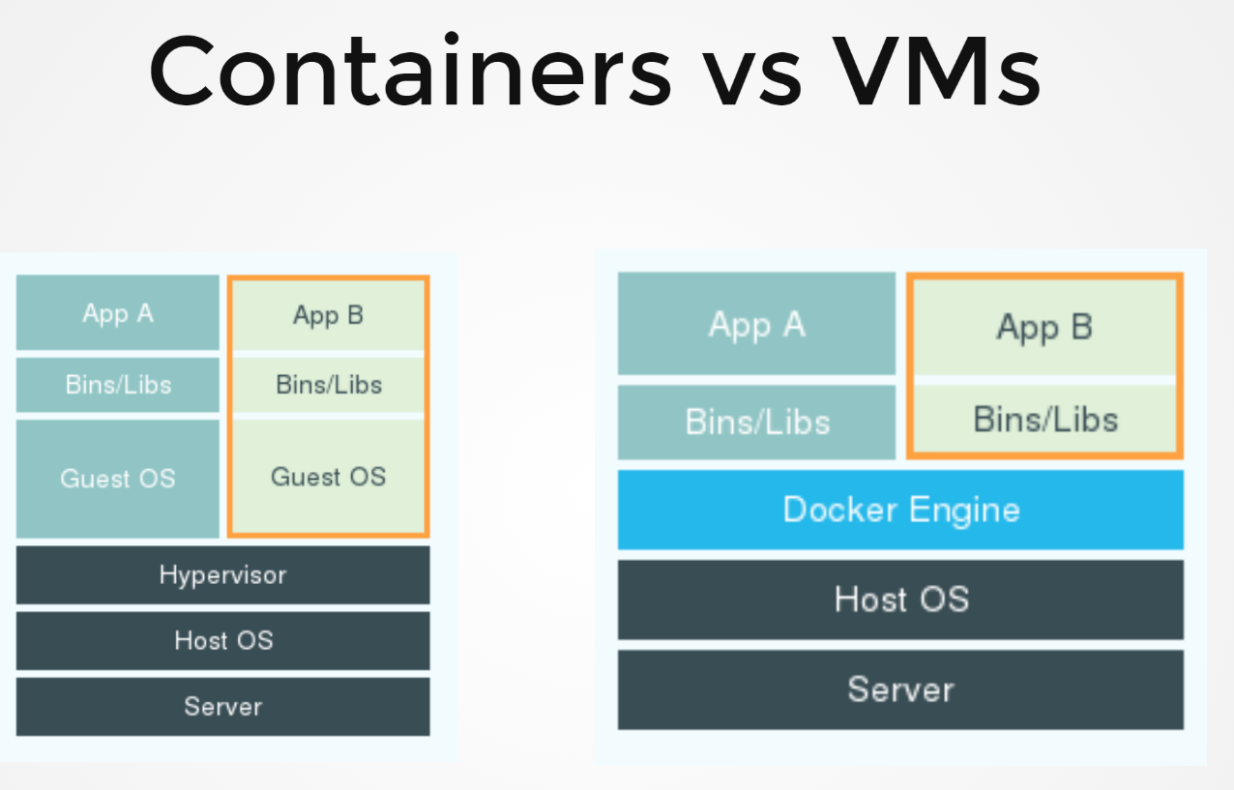
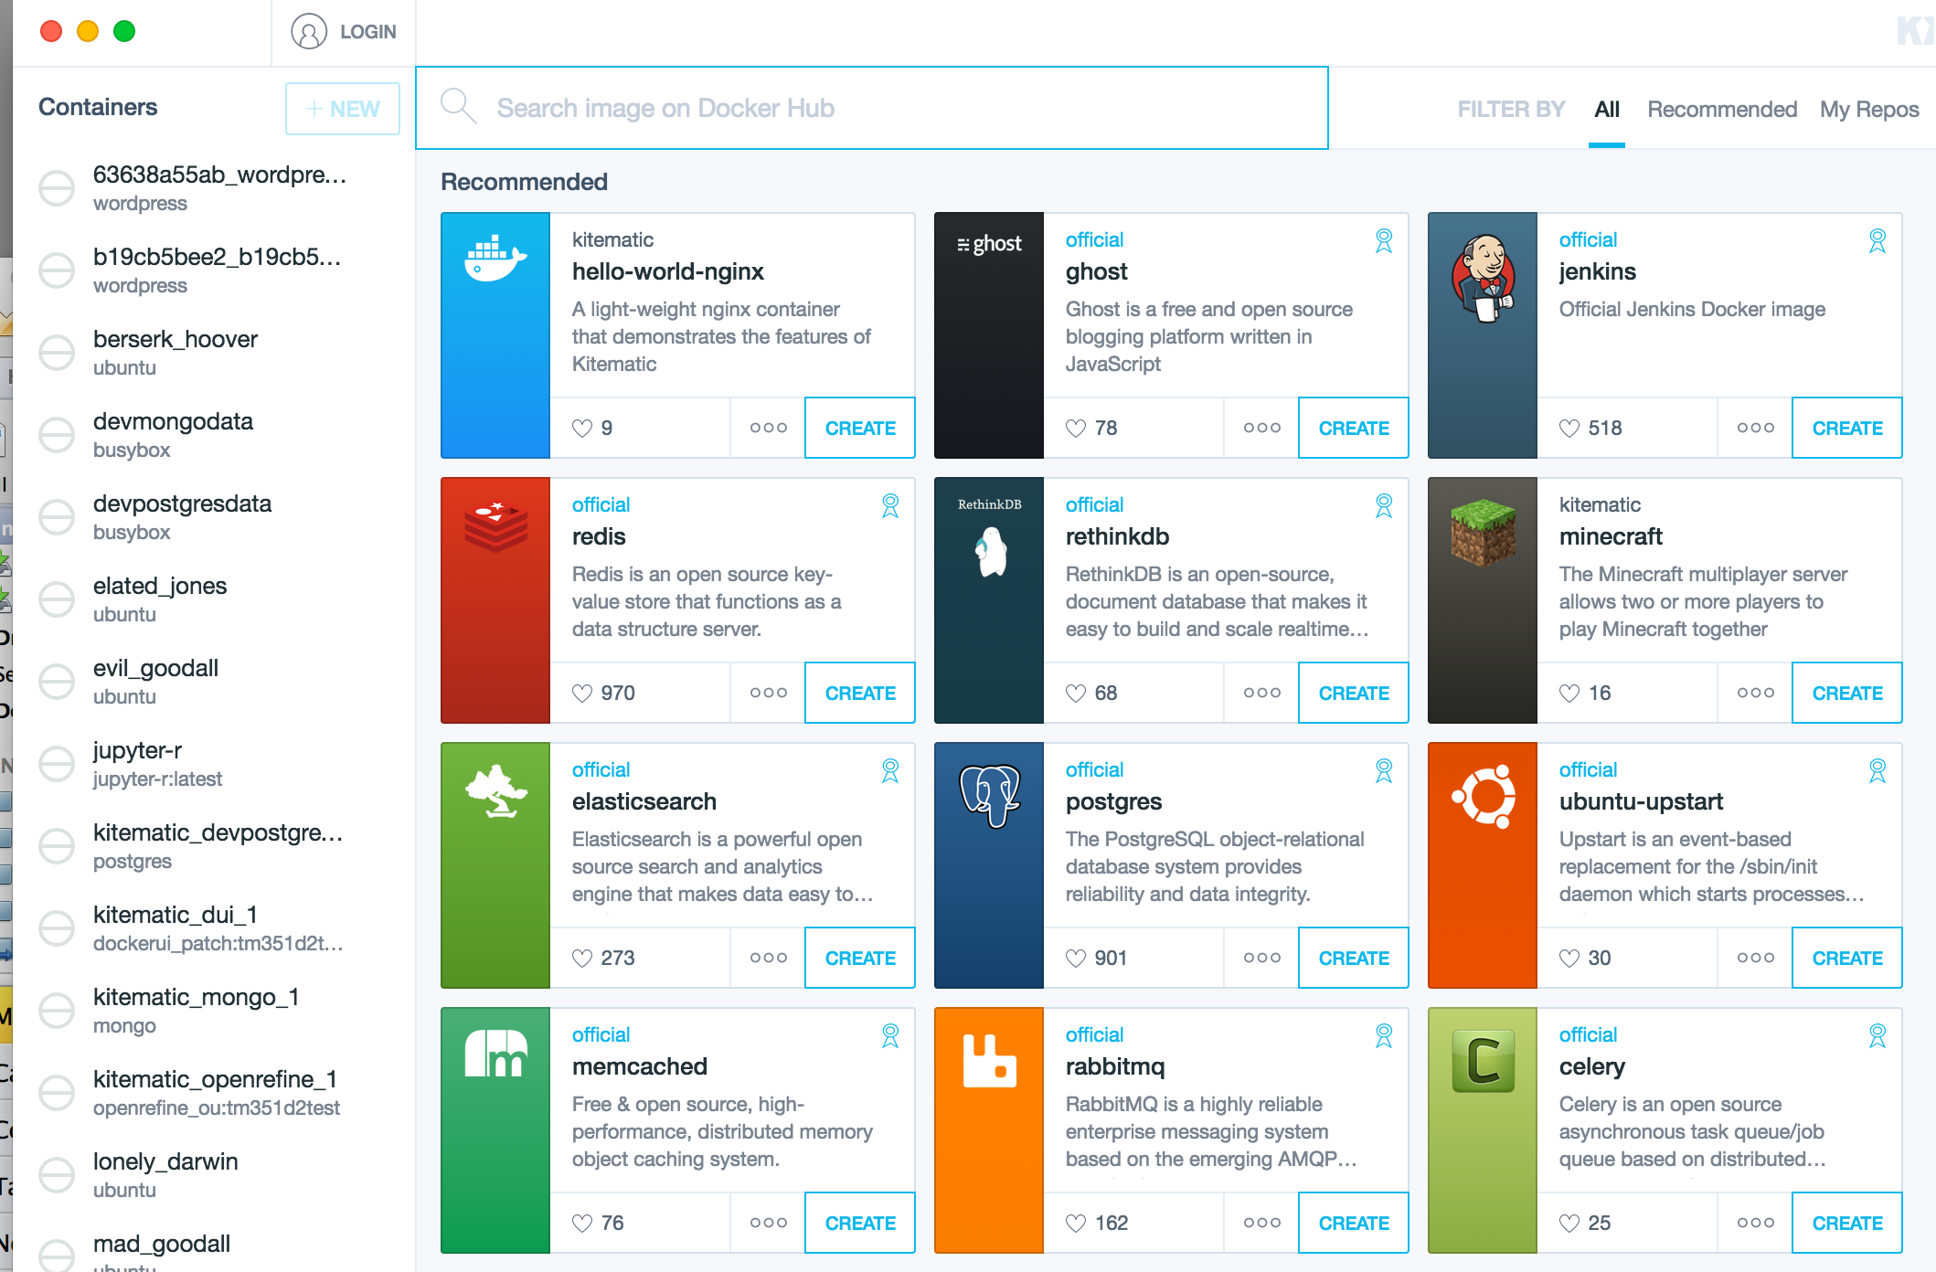
Docker

Slide 24
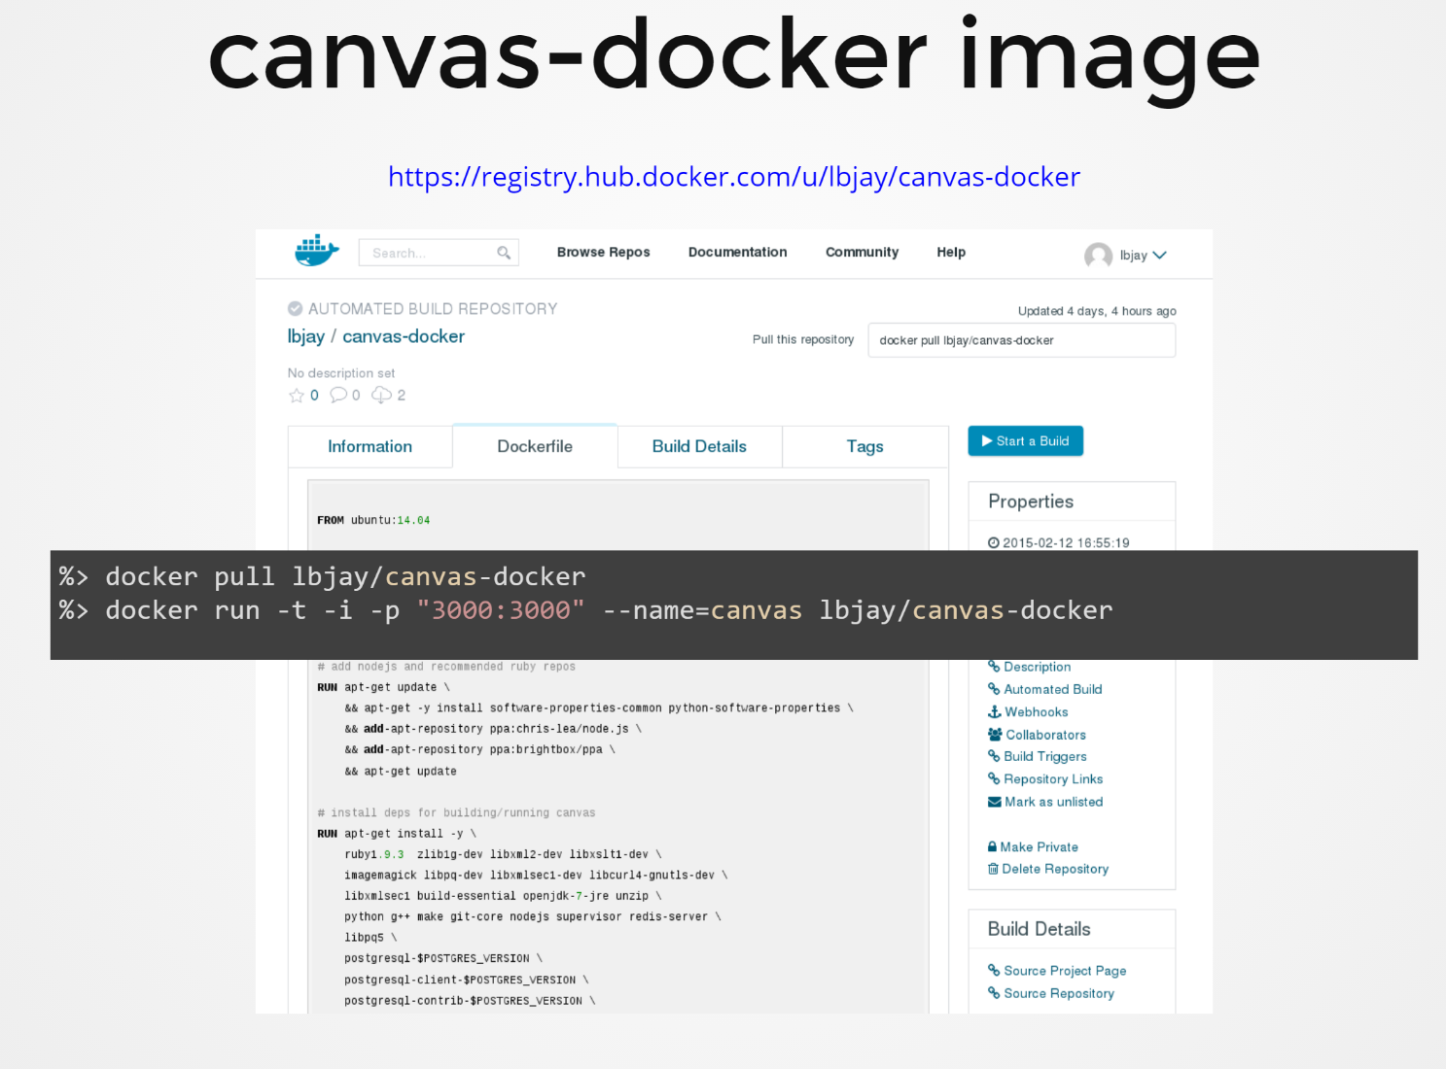
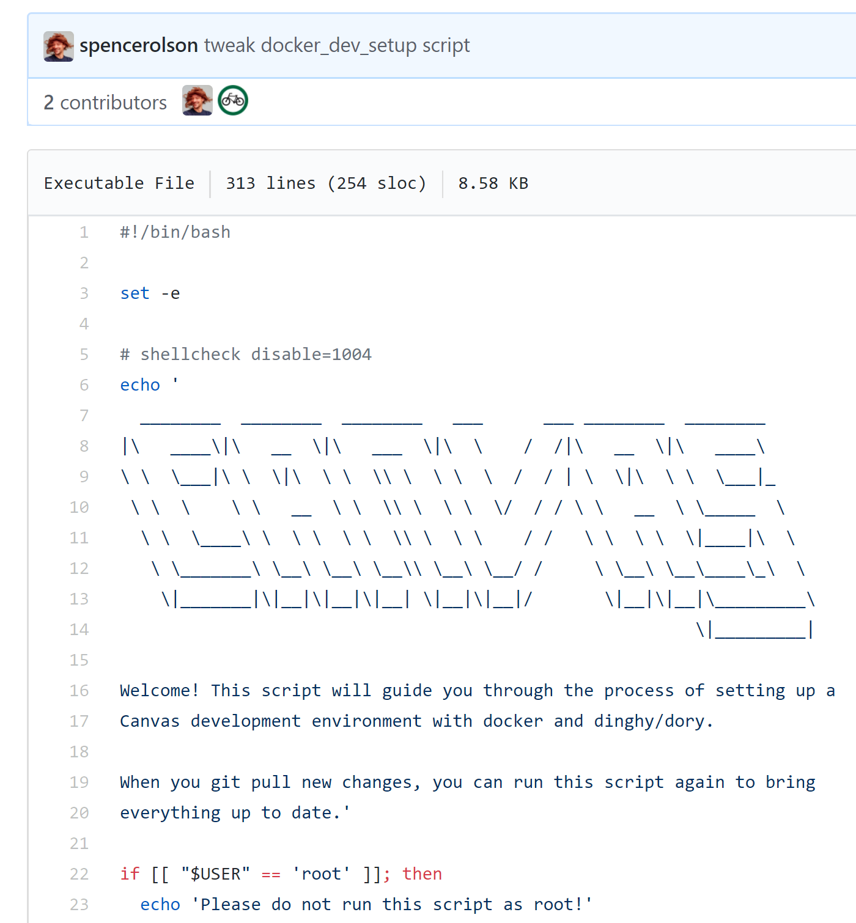
Canvas on Docker
https://github.com/instructure/canvas-lms/blob/master/script/docker_dev_setup.sh
http://slides.com/jamesluker/how-to-docker-2#/

Slide 25
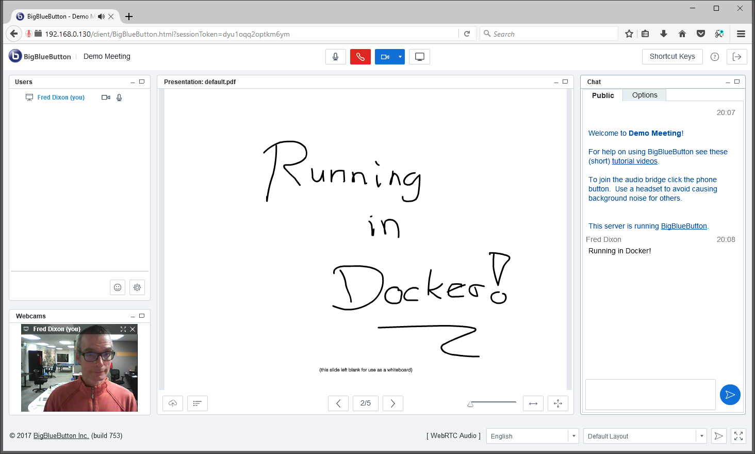
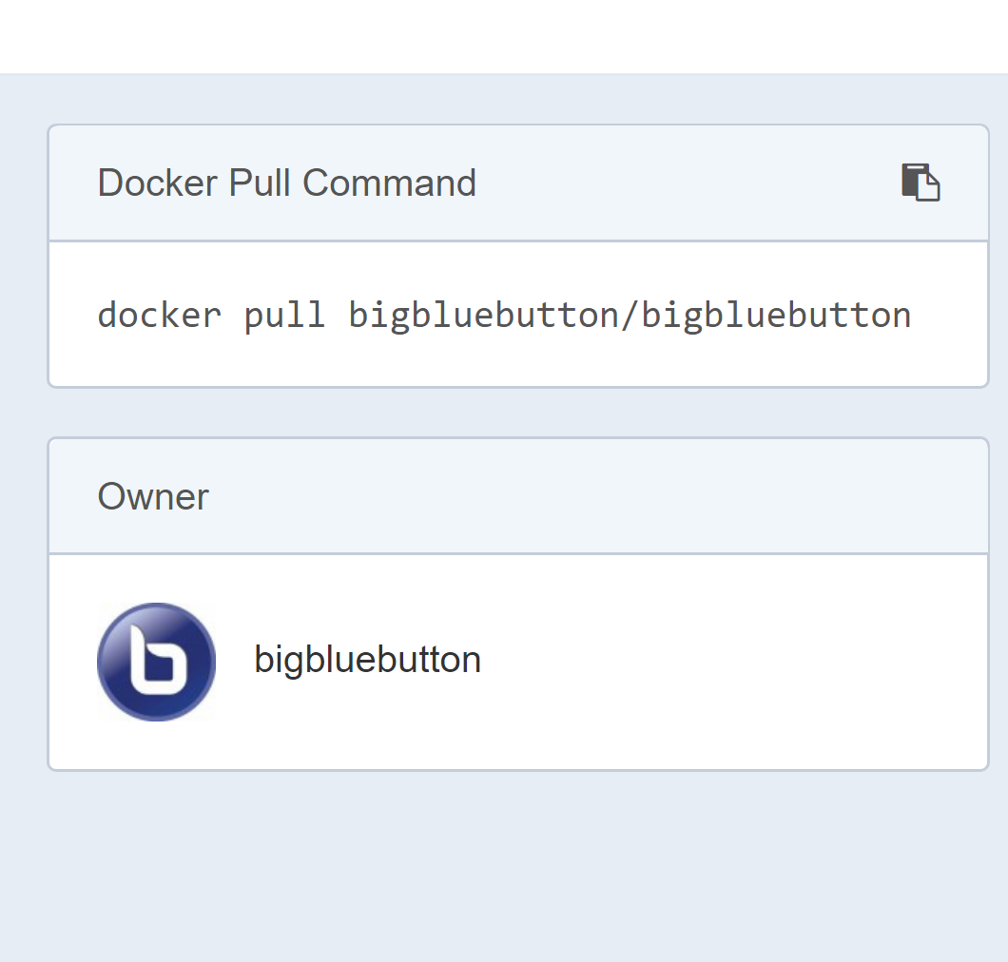
Big Blue Button in Docker
http://docs.bigbluebutton.org/labs/docker.html
https://hub.docker.com/r/bigbluebutton/bigbluebutton/

Slide 26
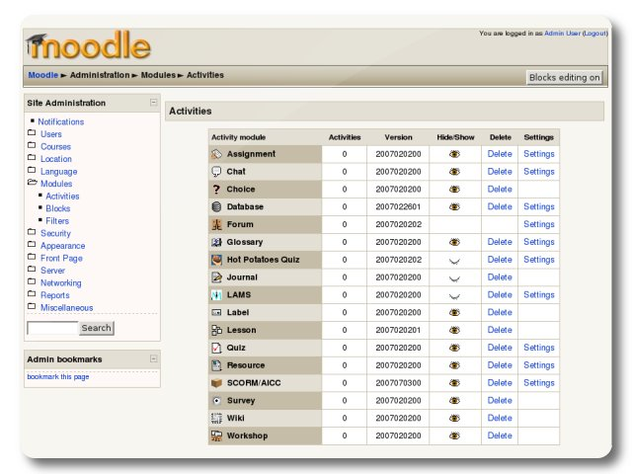
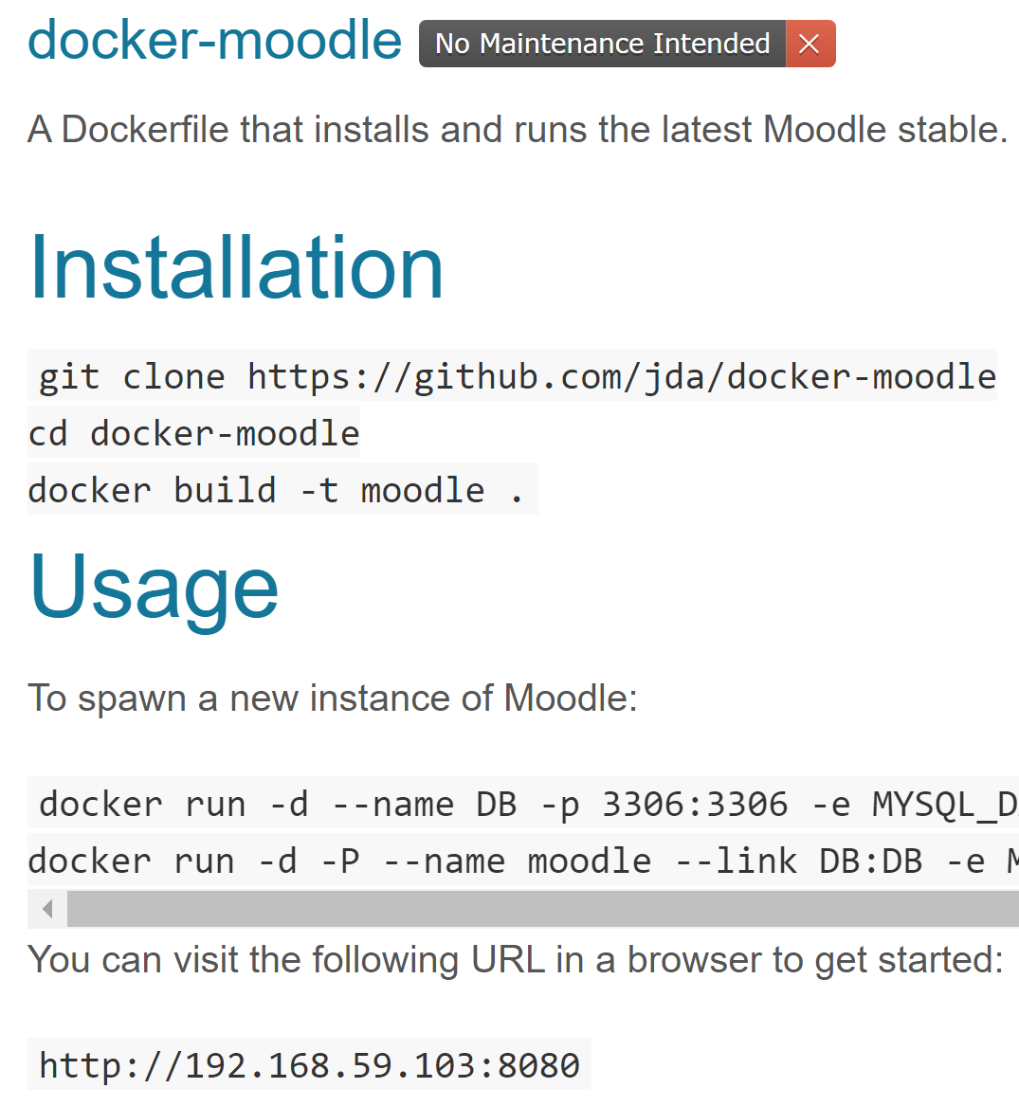
Moodle on Docker
https://hub.docker.com/r/jauer/moodle/

Slide 27
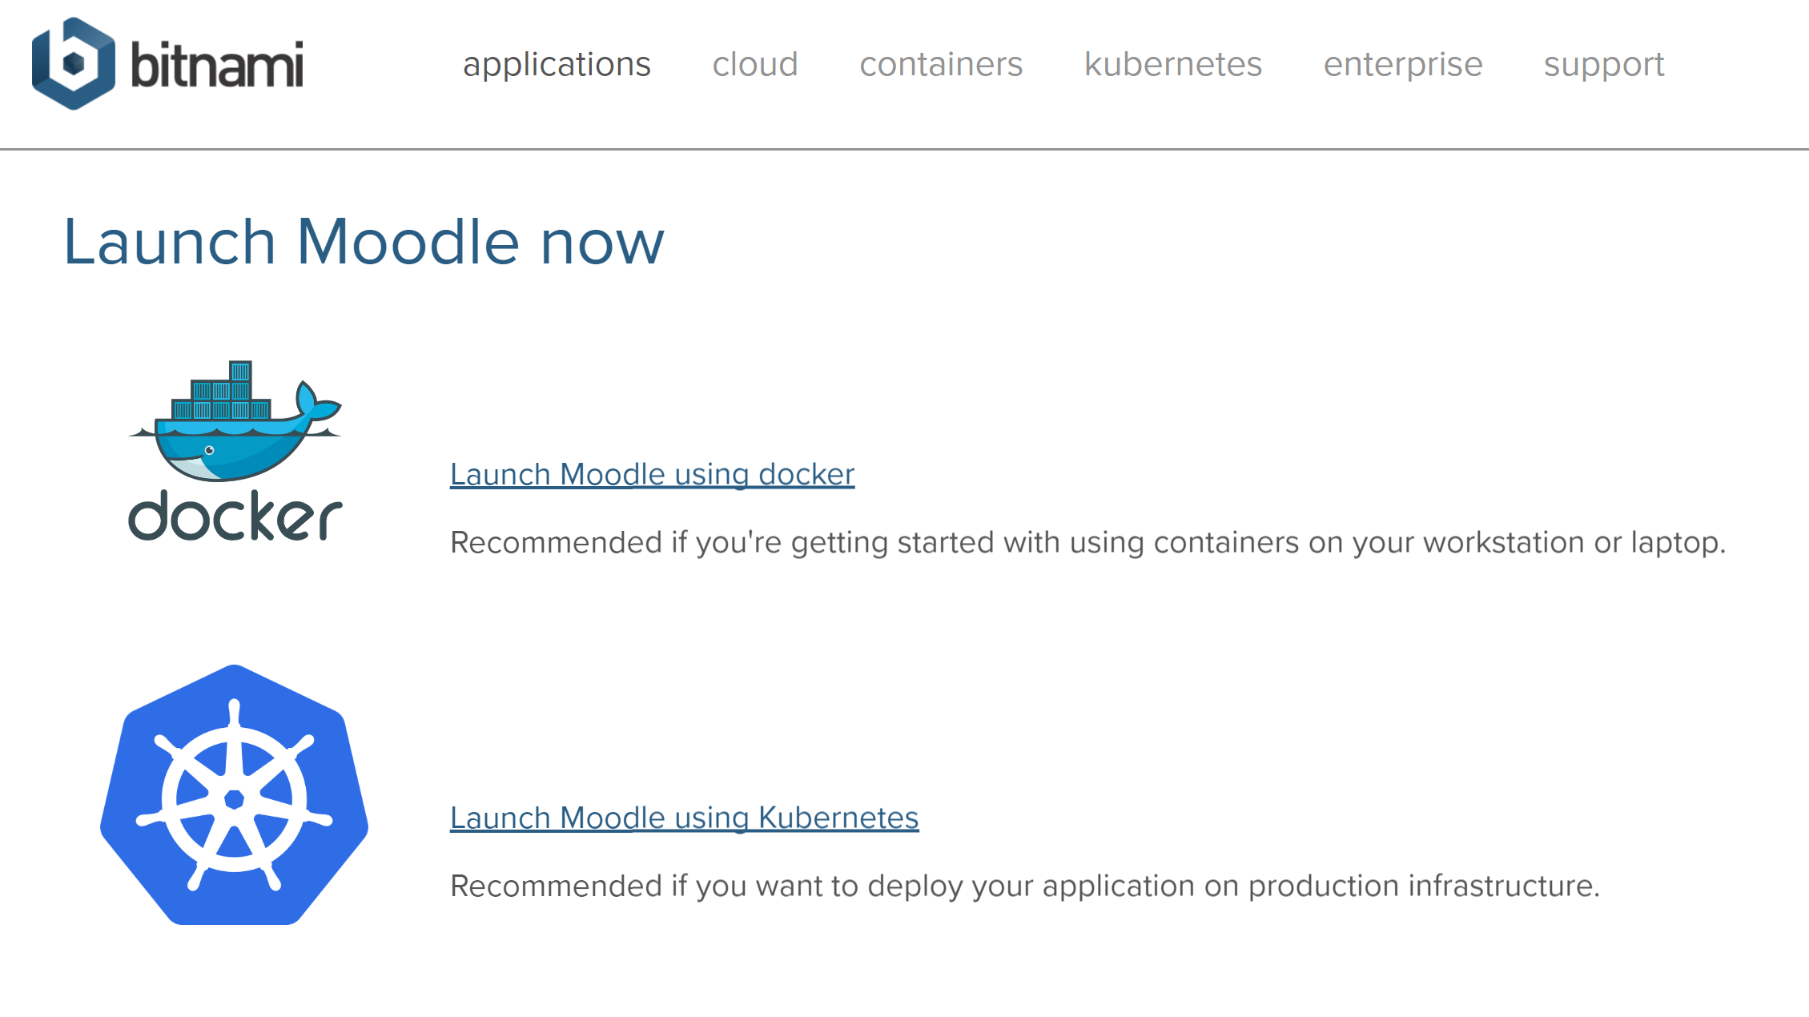
Options
https://bitnami.com/stack/moodle/containers

Slide 28

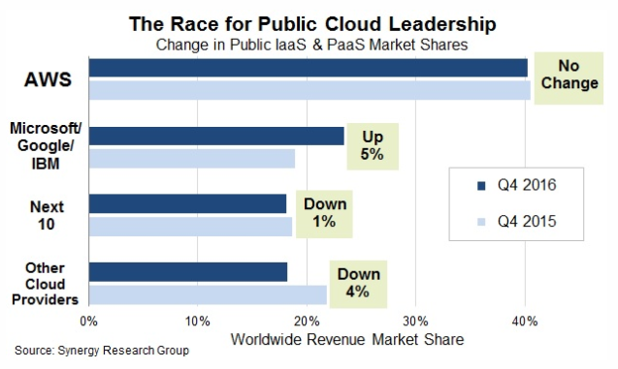




Cloud Infrastructure Providers
AWS – Amazon - https://aws.amazon.com/
Azure – Microsoft - https://azure.microsoft.com
Bluemix – IBM Cloud - https://www.ibm.com/cloud/
Google Cloud Platform - https://cloud.google.com/
Oracle Cloud - https://cloud.oracle.com/
https://www.srgresearch.com/articles/microsoft-google-and-ibm-charge-public-cloud-expense-smaller-providers

Slide 29
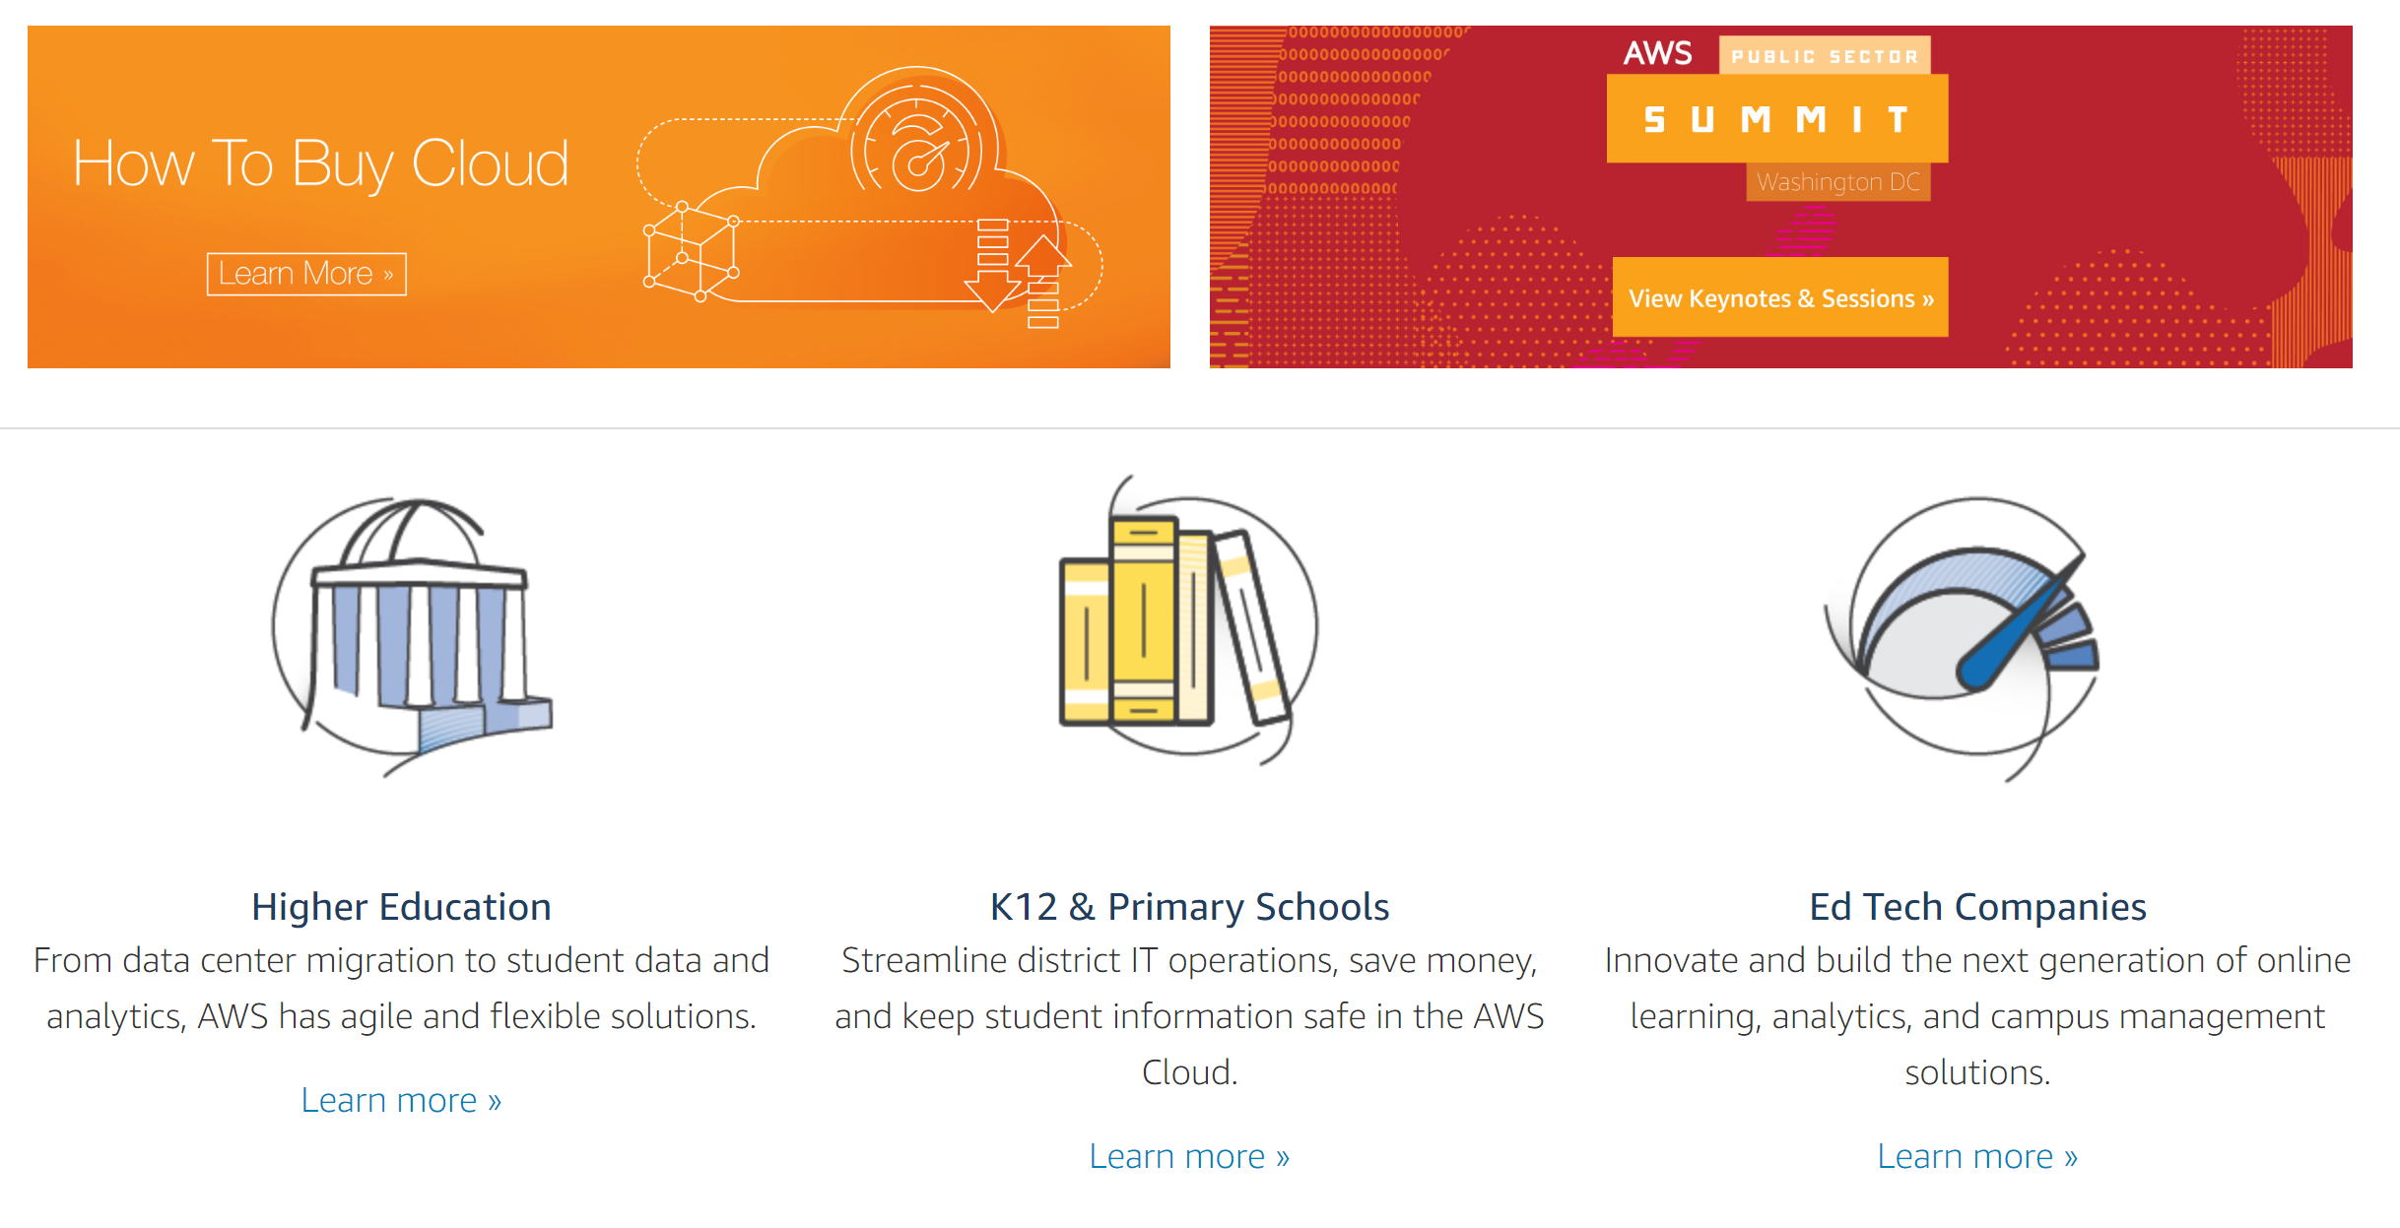
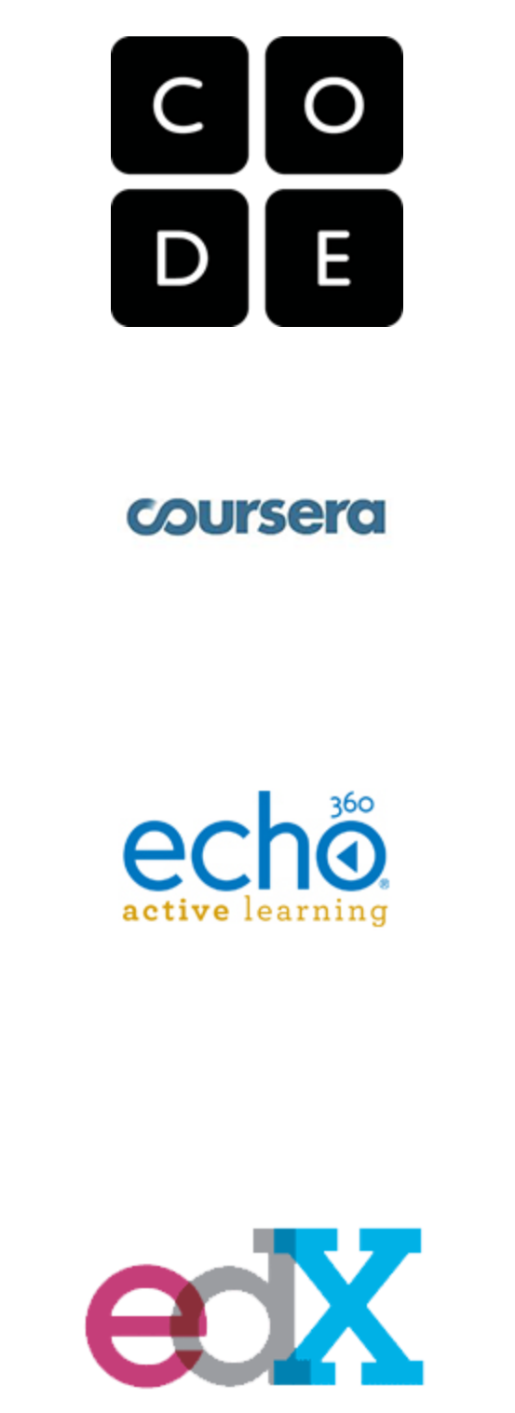
Cloud Computing for Education
Amazon Web Services - https://aws.amazon.com/education/

Slide 30
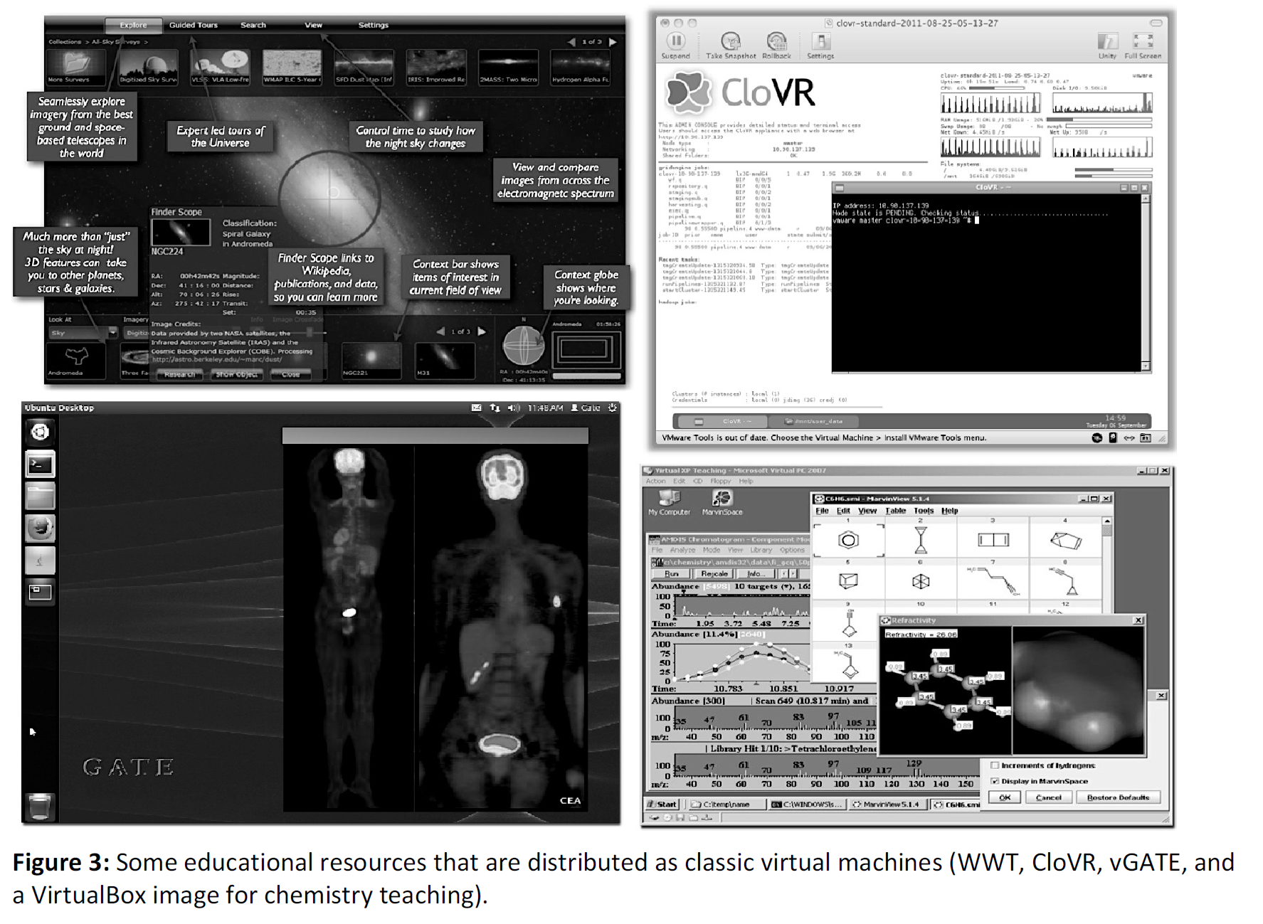
OER and Virtualization
Open Distribution of Virtual Containers as a Key Framework for Open Educational Resources and STEAM Subjects Alberto Corbi and Daniel Burgos
http://www.ejel.org/issue/download.html?idArticle=575
“Unikernels represent and deeper simplification of the virtual container approach, given that all necessary computing elements (operative system kernel, basic libraries, frameworks, drivers, scientific application, etc.)”

Slide 31
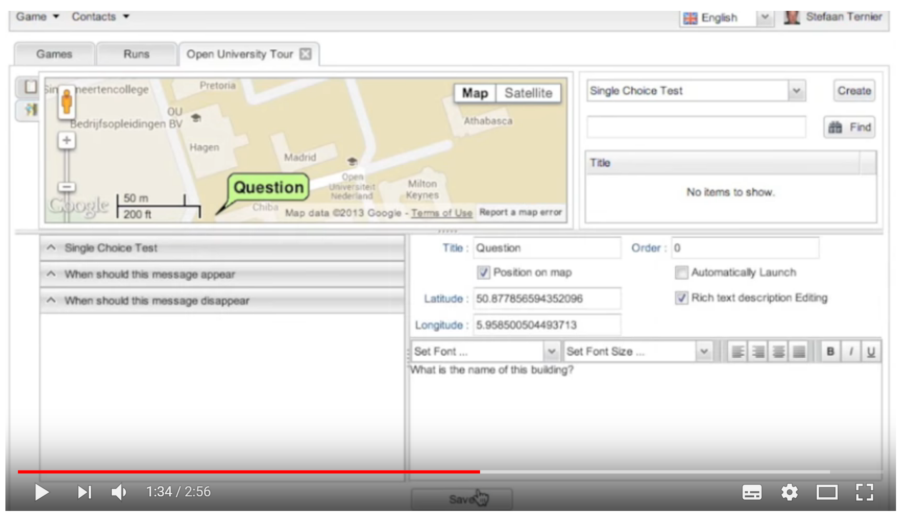
Mobile Authoring for ARLearn
“The Mobile Authoring Tool complements the ARLearn desktop-based environment. Hence, a mobile game author can wander around creating items and synchronizing real world artefacts with game content.”
ARLearn
ARLearn is a technical framework for creating mobile serious games
http://ar-learn.com/
https://dspace.ou.nl/bitstream/1820/5674/1/UAIS_Tabuenca_2014.pdf
Bernardo Tabuenca; Marco Kalz; Stefaan Ternier; Marcus Specht
https://www.youtube.com/watch?v=Lqk3yrcNjNI

Slide 32
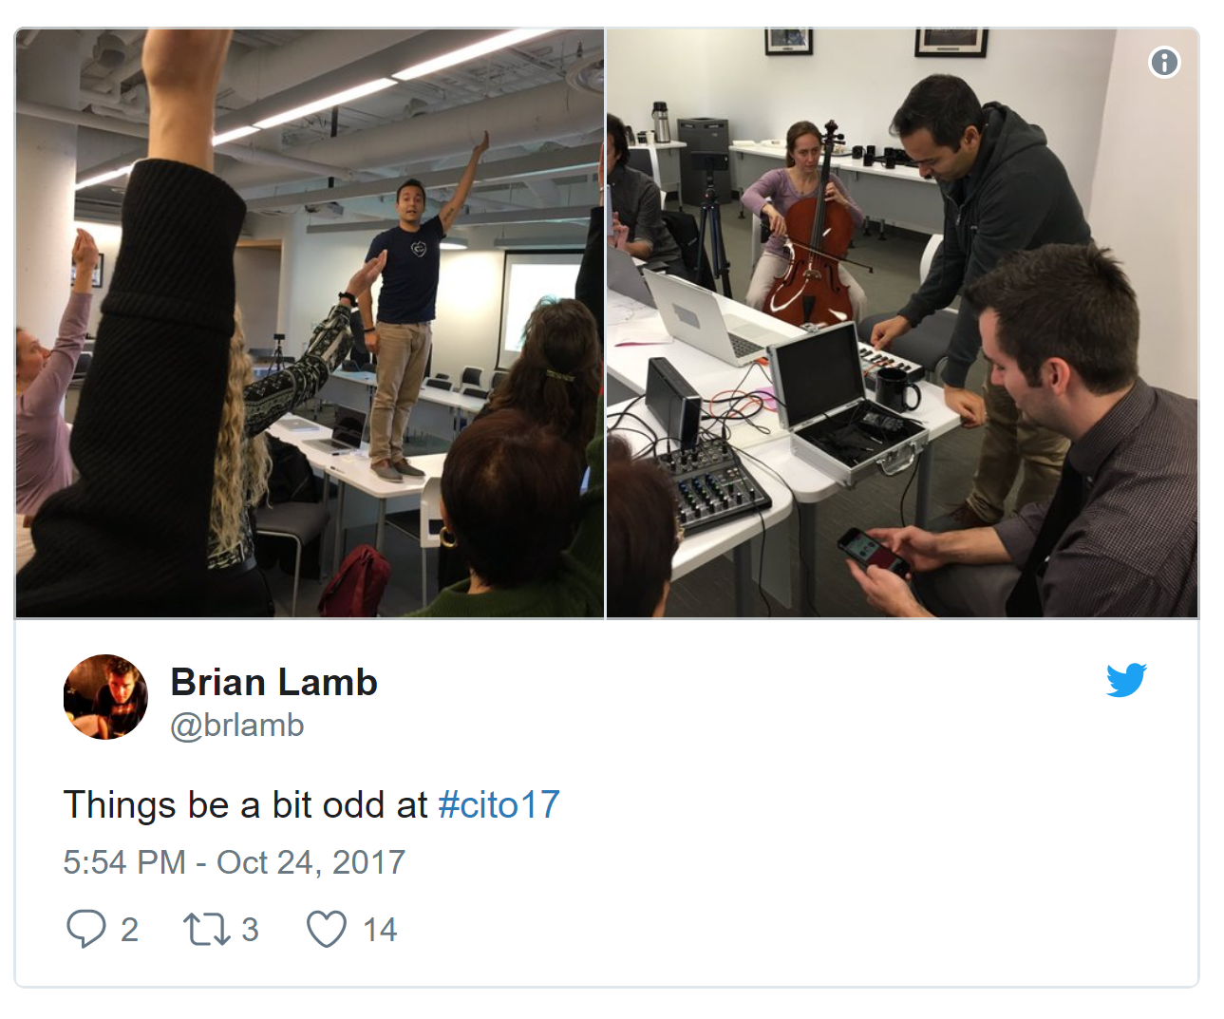
Happening Now…
Docker images to build OER
  https://gitlab.com/oer/docker
Creativity in the Open Workshop
  http://blogs.ubc.ca/chendricks/
Lti - xapi

