Slide 1

Applications, Algorithms and Data: Open Educational Resources and the Next Generation of Virtual Learning
Stephen Downes
RELIF
Hammamet, Tunisia
November 30, 2017

Slide 2
Abstract: Open Educational Resources (OER) have traditionally been thought of as replacements for classroom materials such as textbooks, teaching aids, study guides, and background resources. In more recent years they have come to include multimedia resources such as animations, podcasts and videos, and they have led to the development of new educational modalities, such as massive open online courses (MOOCs). The next generation of OERs will take a step beyond traditional media and classroom support and begin to take advantage of the unique properties of virtual learning. Using examples such as virtual containers and actionable data books, education technology researcher Stephen Downes will sketch the future for the next generation of OERs as a distributed and interactive network of applications, algorithms and data.

Slide 3
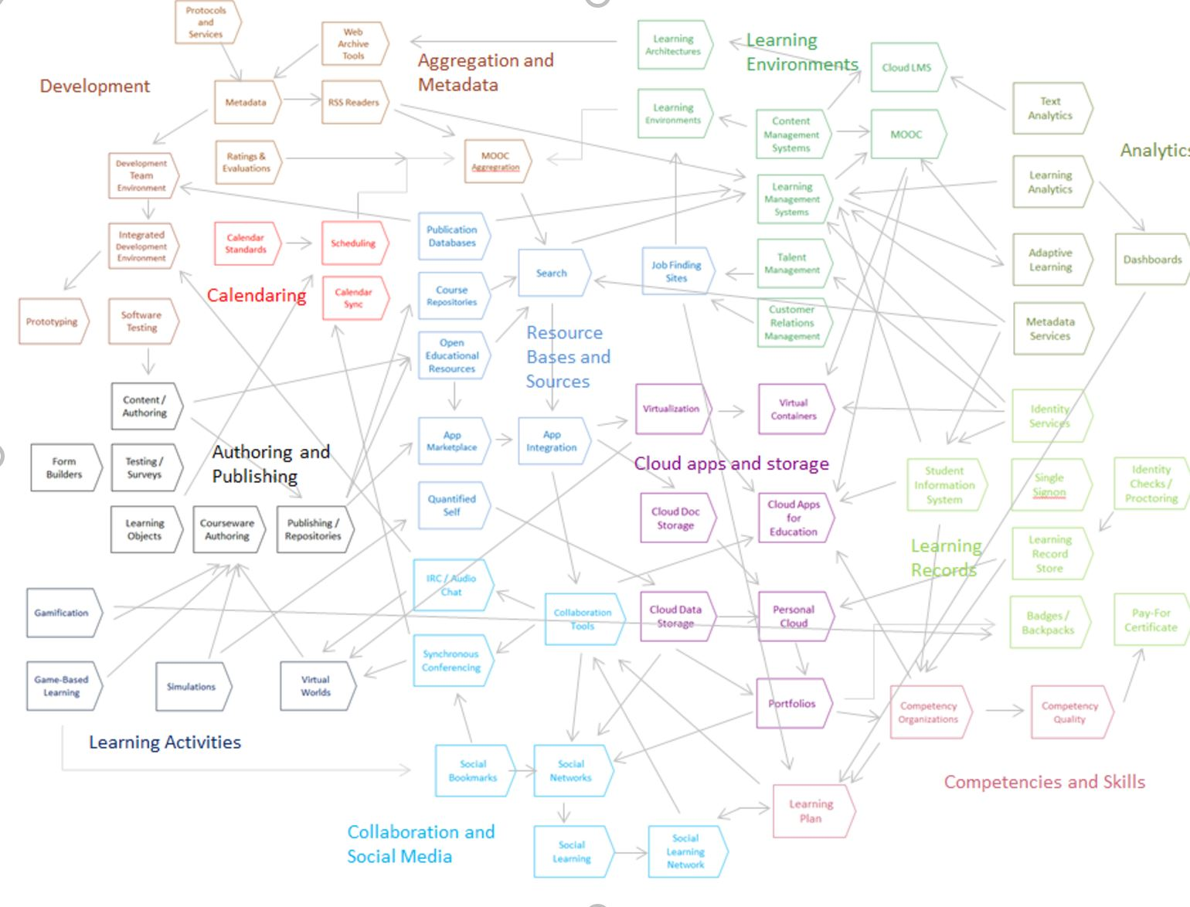
State of the Art

Slide 4
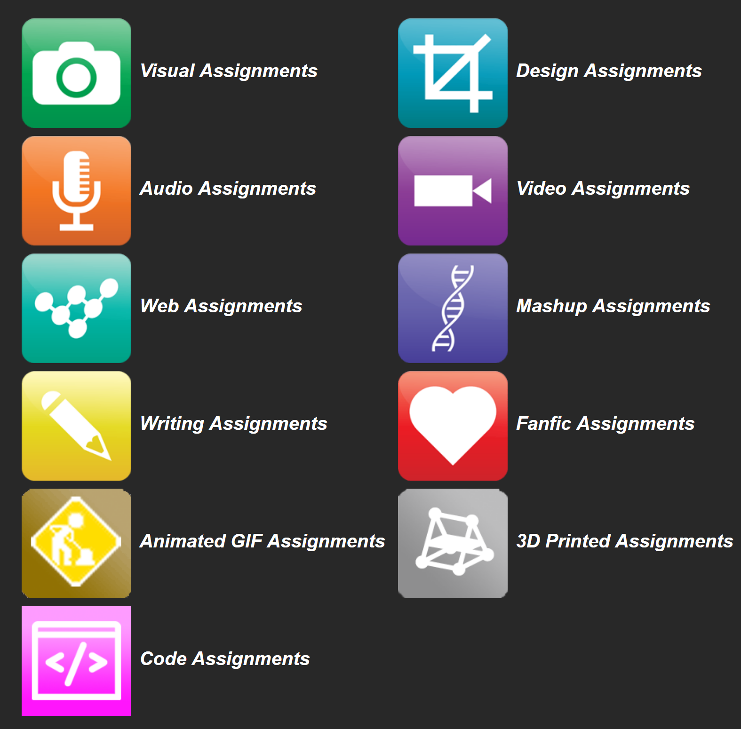
OERs as Student Production
DS106 – assignment bank http://assignments.ds106.us/
Domain of One’s Own - https://reclaimhosting.com/domain-of-ones-own/
Creation of OERs through ‘renewable assignments’ – Christina Hendricks http://flexible.learning.ubc.ca/news-events/renewable-assignments-student-work-adding-value-to-the-world/

Slide 5
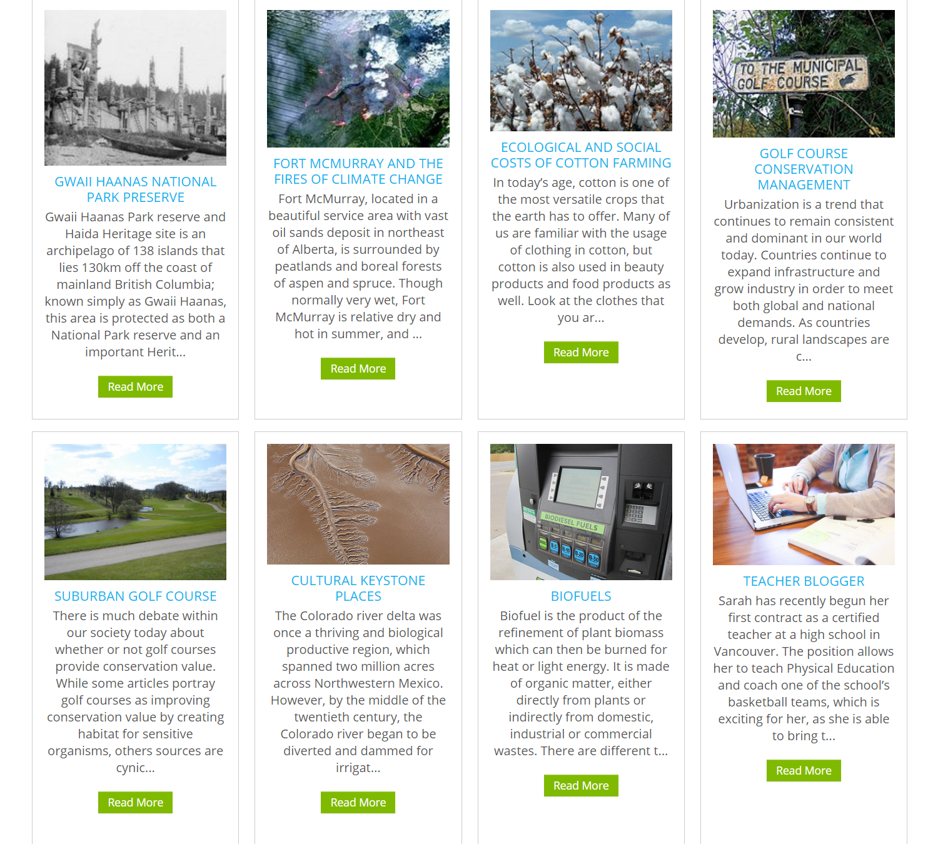
Open Case Studies
case studies that can be used by anyone, at UBC or elsewhere.
Many focus on topics in sustainability
cases on this site are open educational resources: they have an open license to allow for revision and reuse of the cases in other courses and contexts
Quoted from: http://cases.open.ubc.ca/

Slide 6
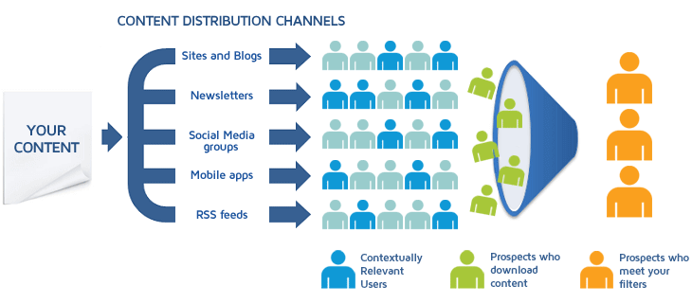
Content Syndication
Image: https://blog.izooto.com/best-content-syndication-tools/
Blog posts and comments were the core of CCK08
  gRSShopper – http://grsshopper.downes.ca
FeedPress - https://wordpress.org/plugins/feedpress/
FeedBurner - https://feedburner.google.com

Slide 7
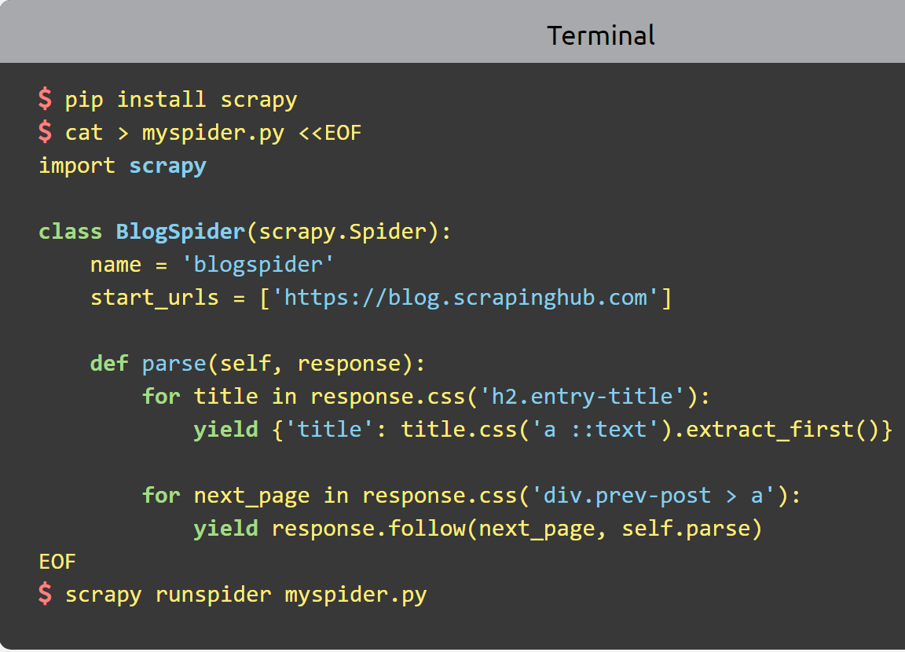
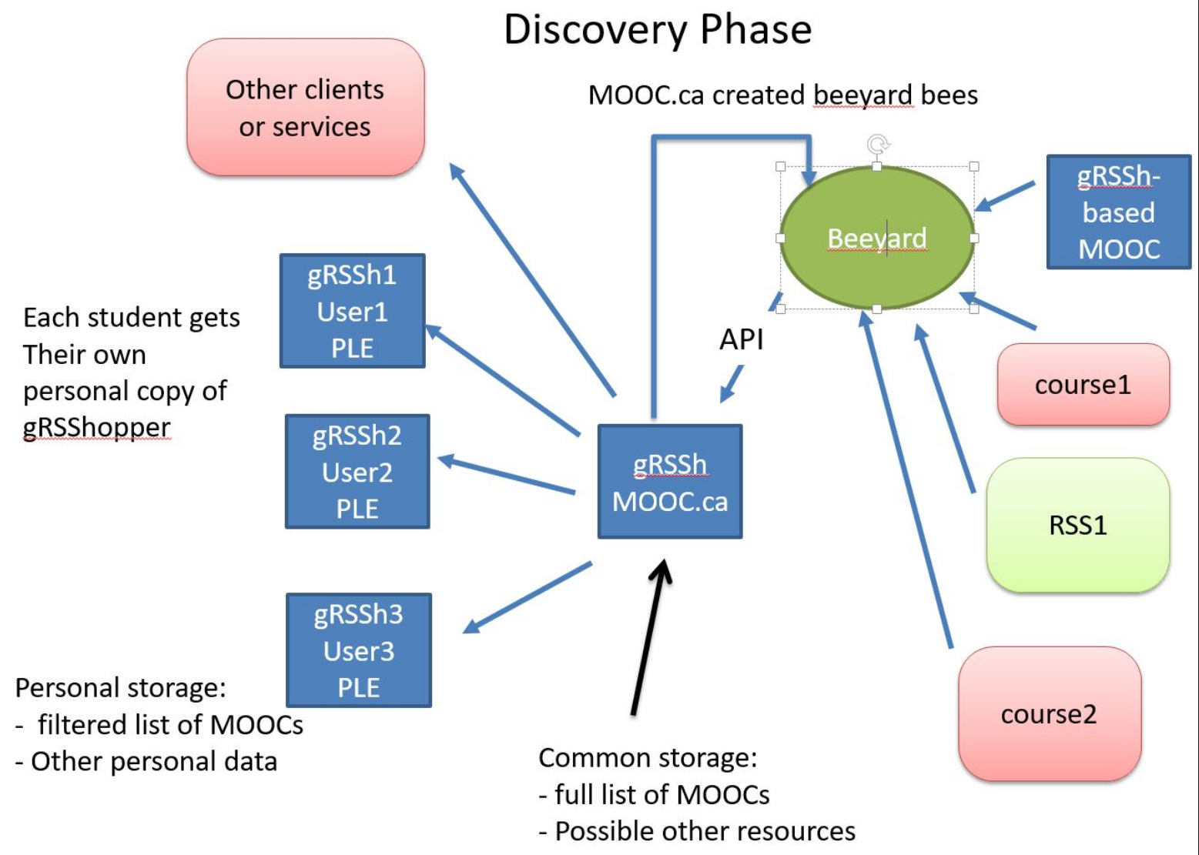
Scrapy
Python framework to aggregate and store content in RSS feeds and web sites
Forms the core of the NRC-developed ‘Beeyard’ application
https://scrapy.org/

Slide 8
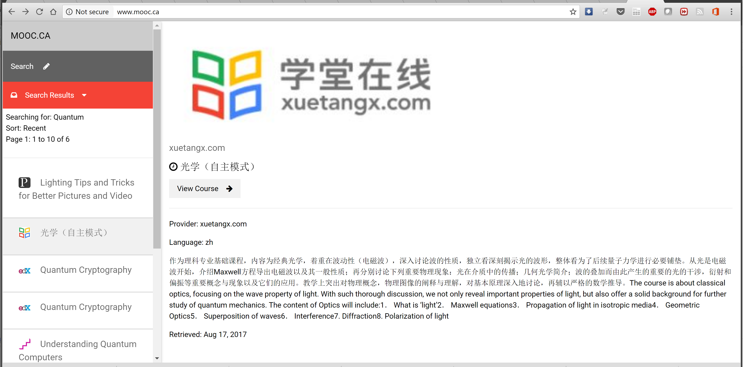

MOOC.ca and gRSShopper
http://grsshopper.downes.ca/
www.mooc.ca is an aggregator of MOOC course offerings (and is planned to aggregate OERs as well) using gRSShopper and Beeyard

Slide 9
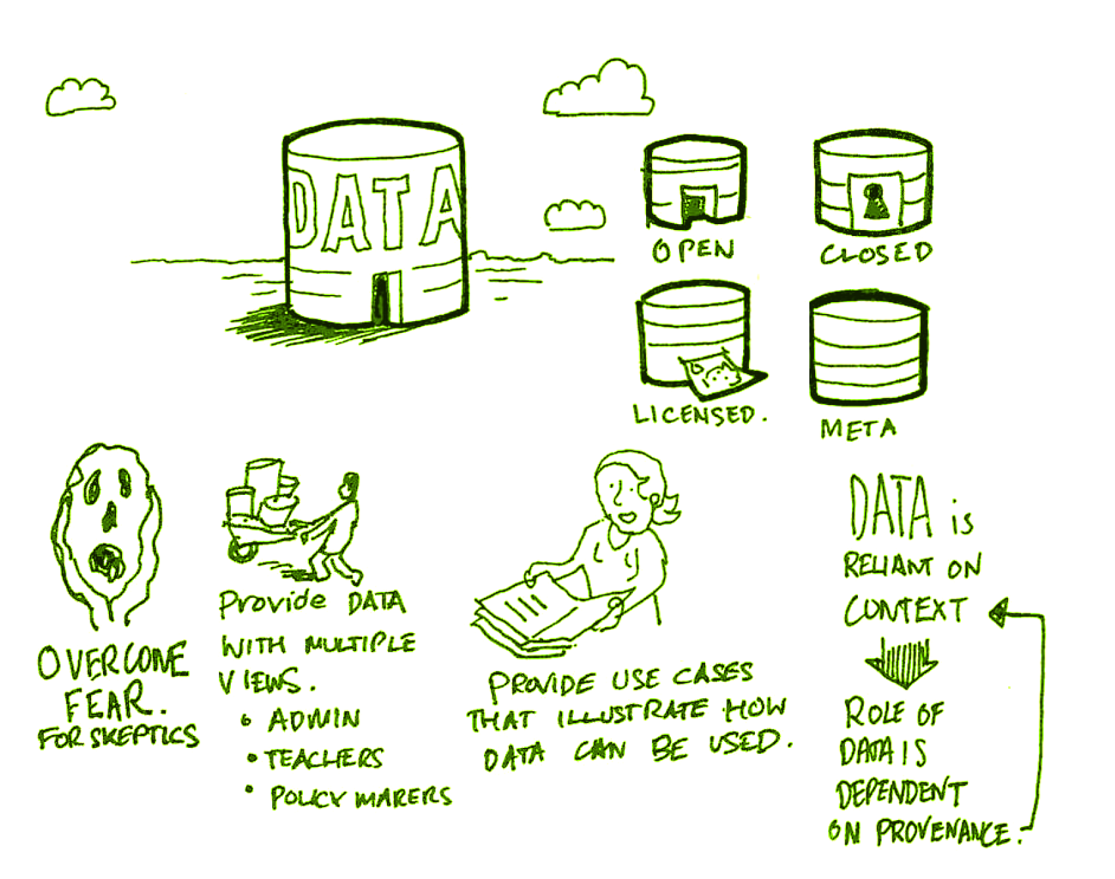
Open Data as OERs
Civic engagement in Italy
Into programming assignments
Article-level metrics
Geodata and Land Walks in Wales
Open data for sustainable development
Atenas, J., & Havemann, L. (Eds.). (2015). Open Data as Open Educational Resources: Case studies of emerging practice. London: Open Knowledge, Open Education Working Group. http://dx.doi.org/10.6084/m9.figshare.1590031
Also: Leo Havemann, slides http://eprints.bbk.ac.uk/14750/1/Leo_ODasOER_UCL_4March16.pdf

Slide 10
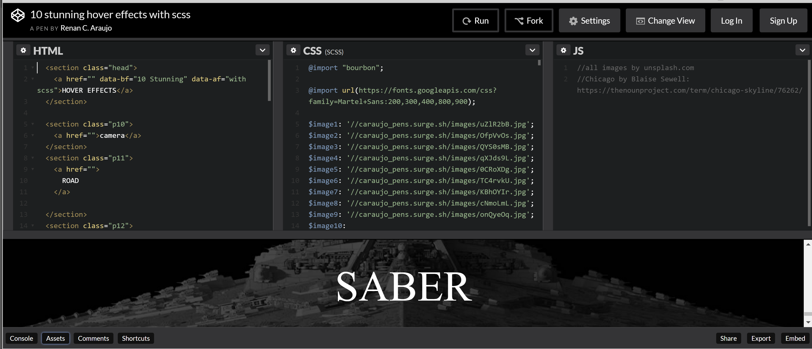
CodePen
https://codepen.io/caraujo/pen/LVPzxO

Slide 11
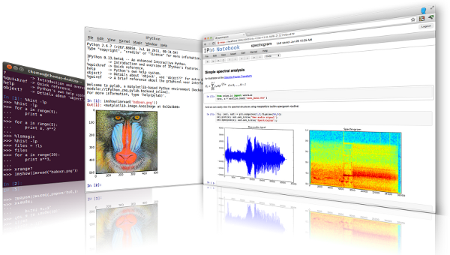

iPython and Jupyter
iPython is an interactive programming shell for the Python programming language https://ipython.org/
The Jupyter Notebook is an open-source web application that allows you to create and share documents that contain live code… http://jupyter.org/

Slide 12
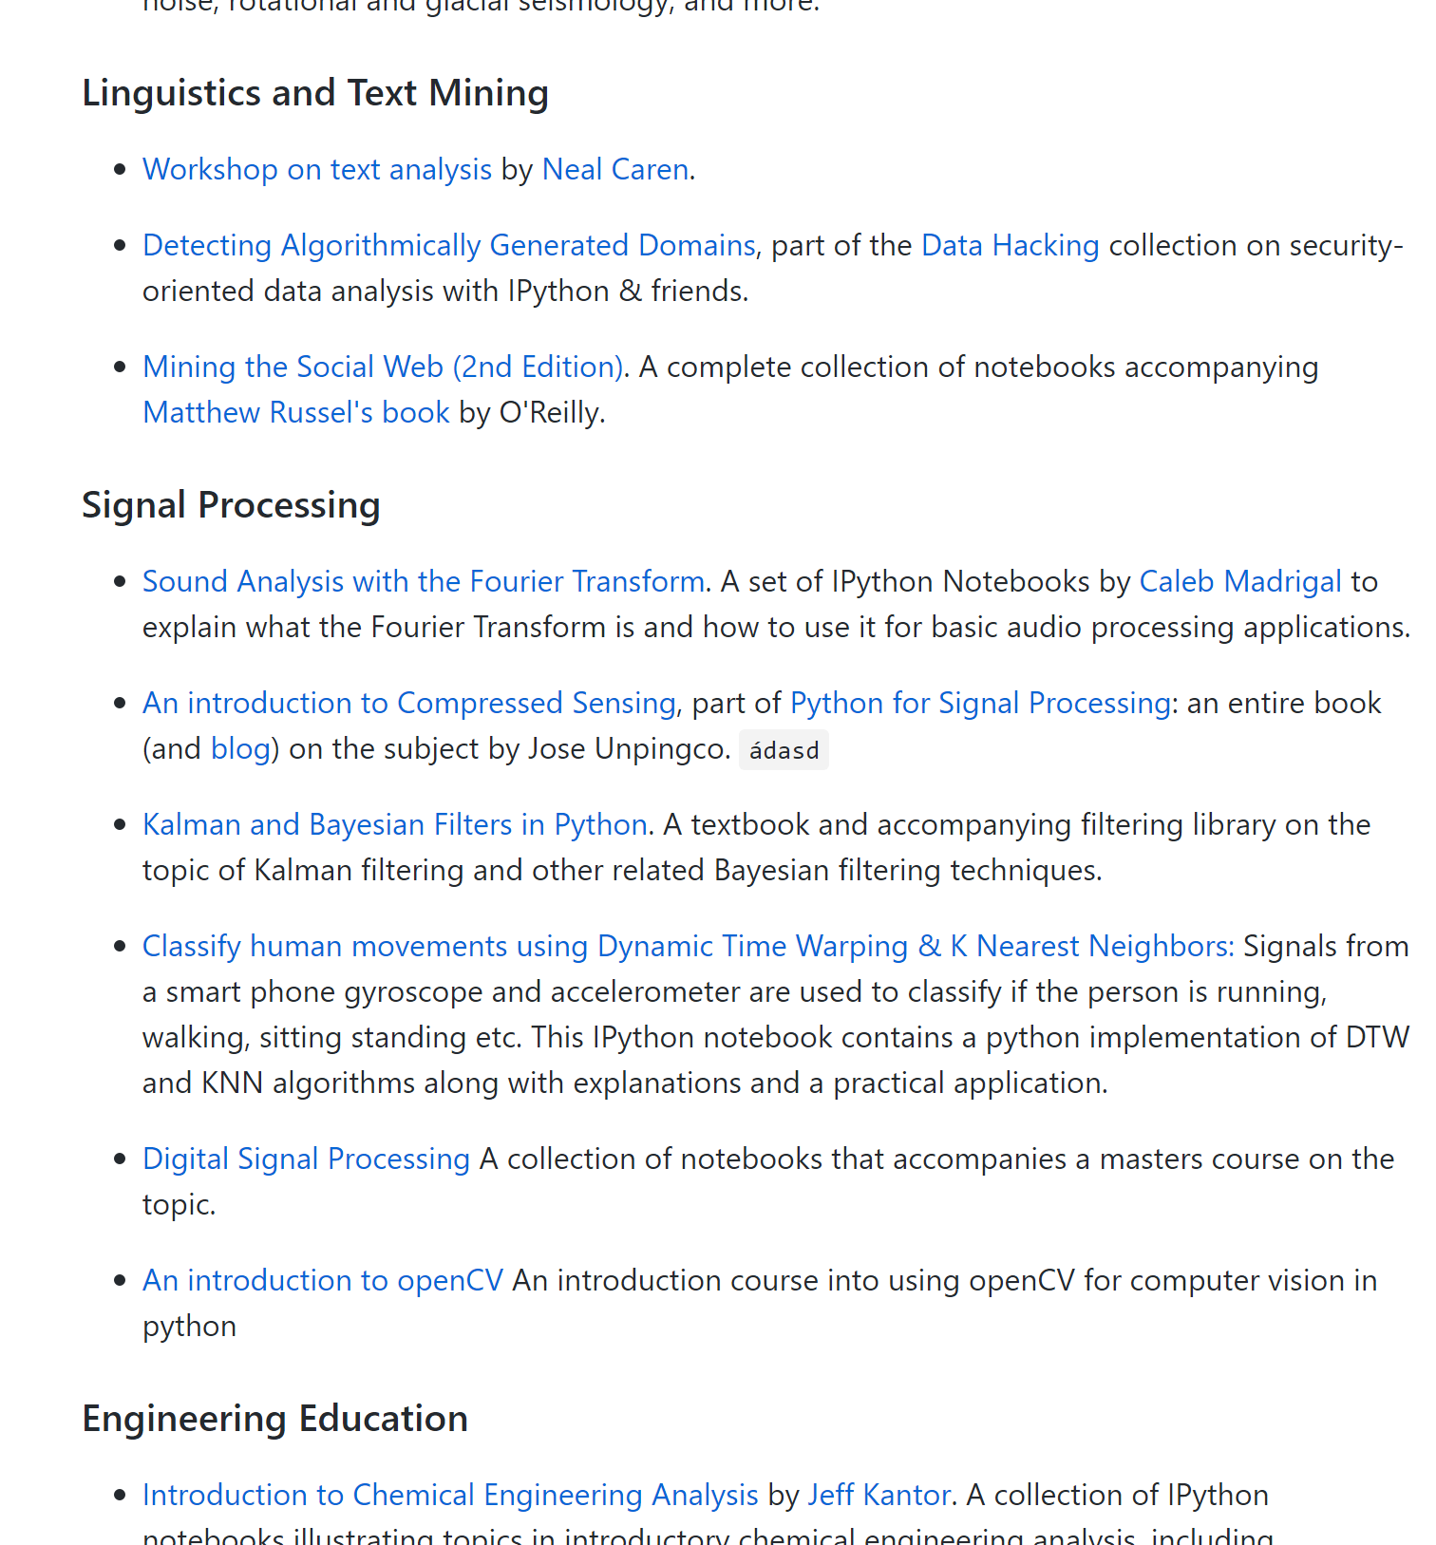
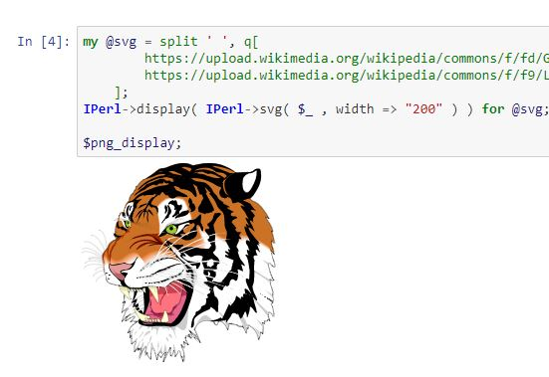
A gallery of interesting Jupyter Notebooks
https://github.com/jupyter/jupyter/wiki/A-gallery-of-interesting-Jupyter-Notebooks#machine-learning-statistics-and-probability

Slide 13

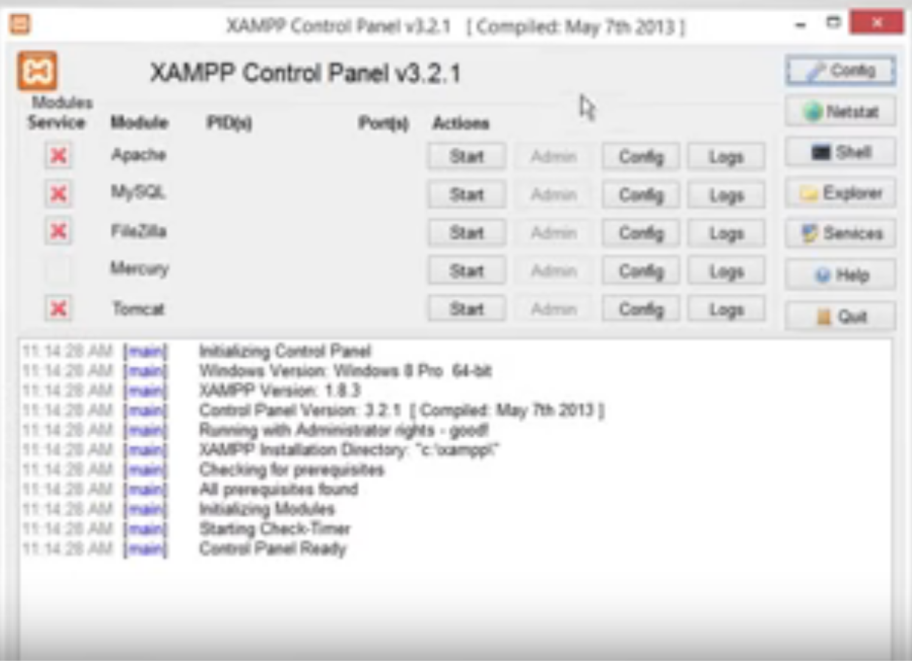
XAMPP
“XAMPP is a completely free, easy to install Apache distribution containing MariaDB, PHP, and Perl. The XAMPP open source package has been set up to be incredibly easy to install and to use.”
XAMPP on a USB Stick
https://portableapps.com/apps/development/xampp
https://willtan.com/installing-xampp-on-usb-flash-drive/
https://www.apachefriends.org/index.html

Slide 14
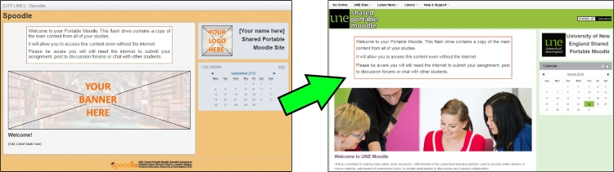
Moodle on a Stick
“Spoodle is an up to date portable moodle / ‘moodle on a stick’ solution for learners to access Moodle courses without requiring constant internet access.”
https://moodle.org/mod/forum/discuss.php?d=342367
https://www.youtube.com/watch?v=EsHEgSYKr4A

Slide 15
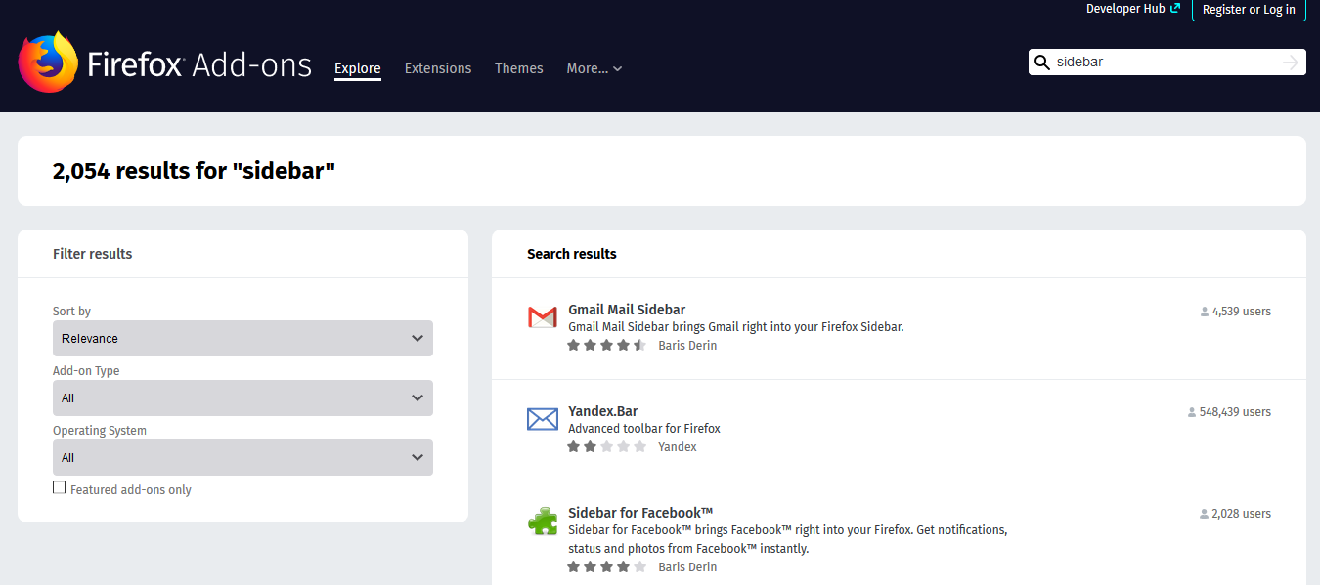
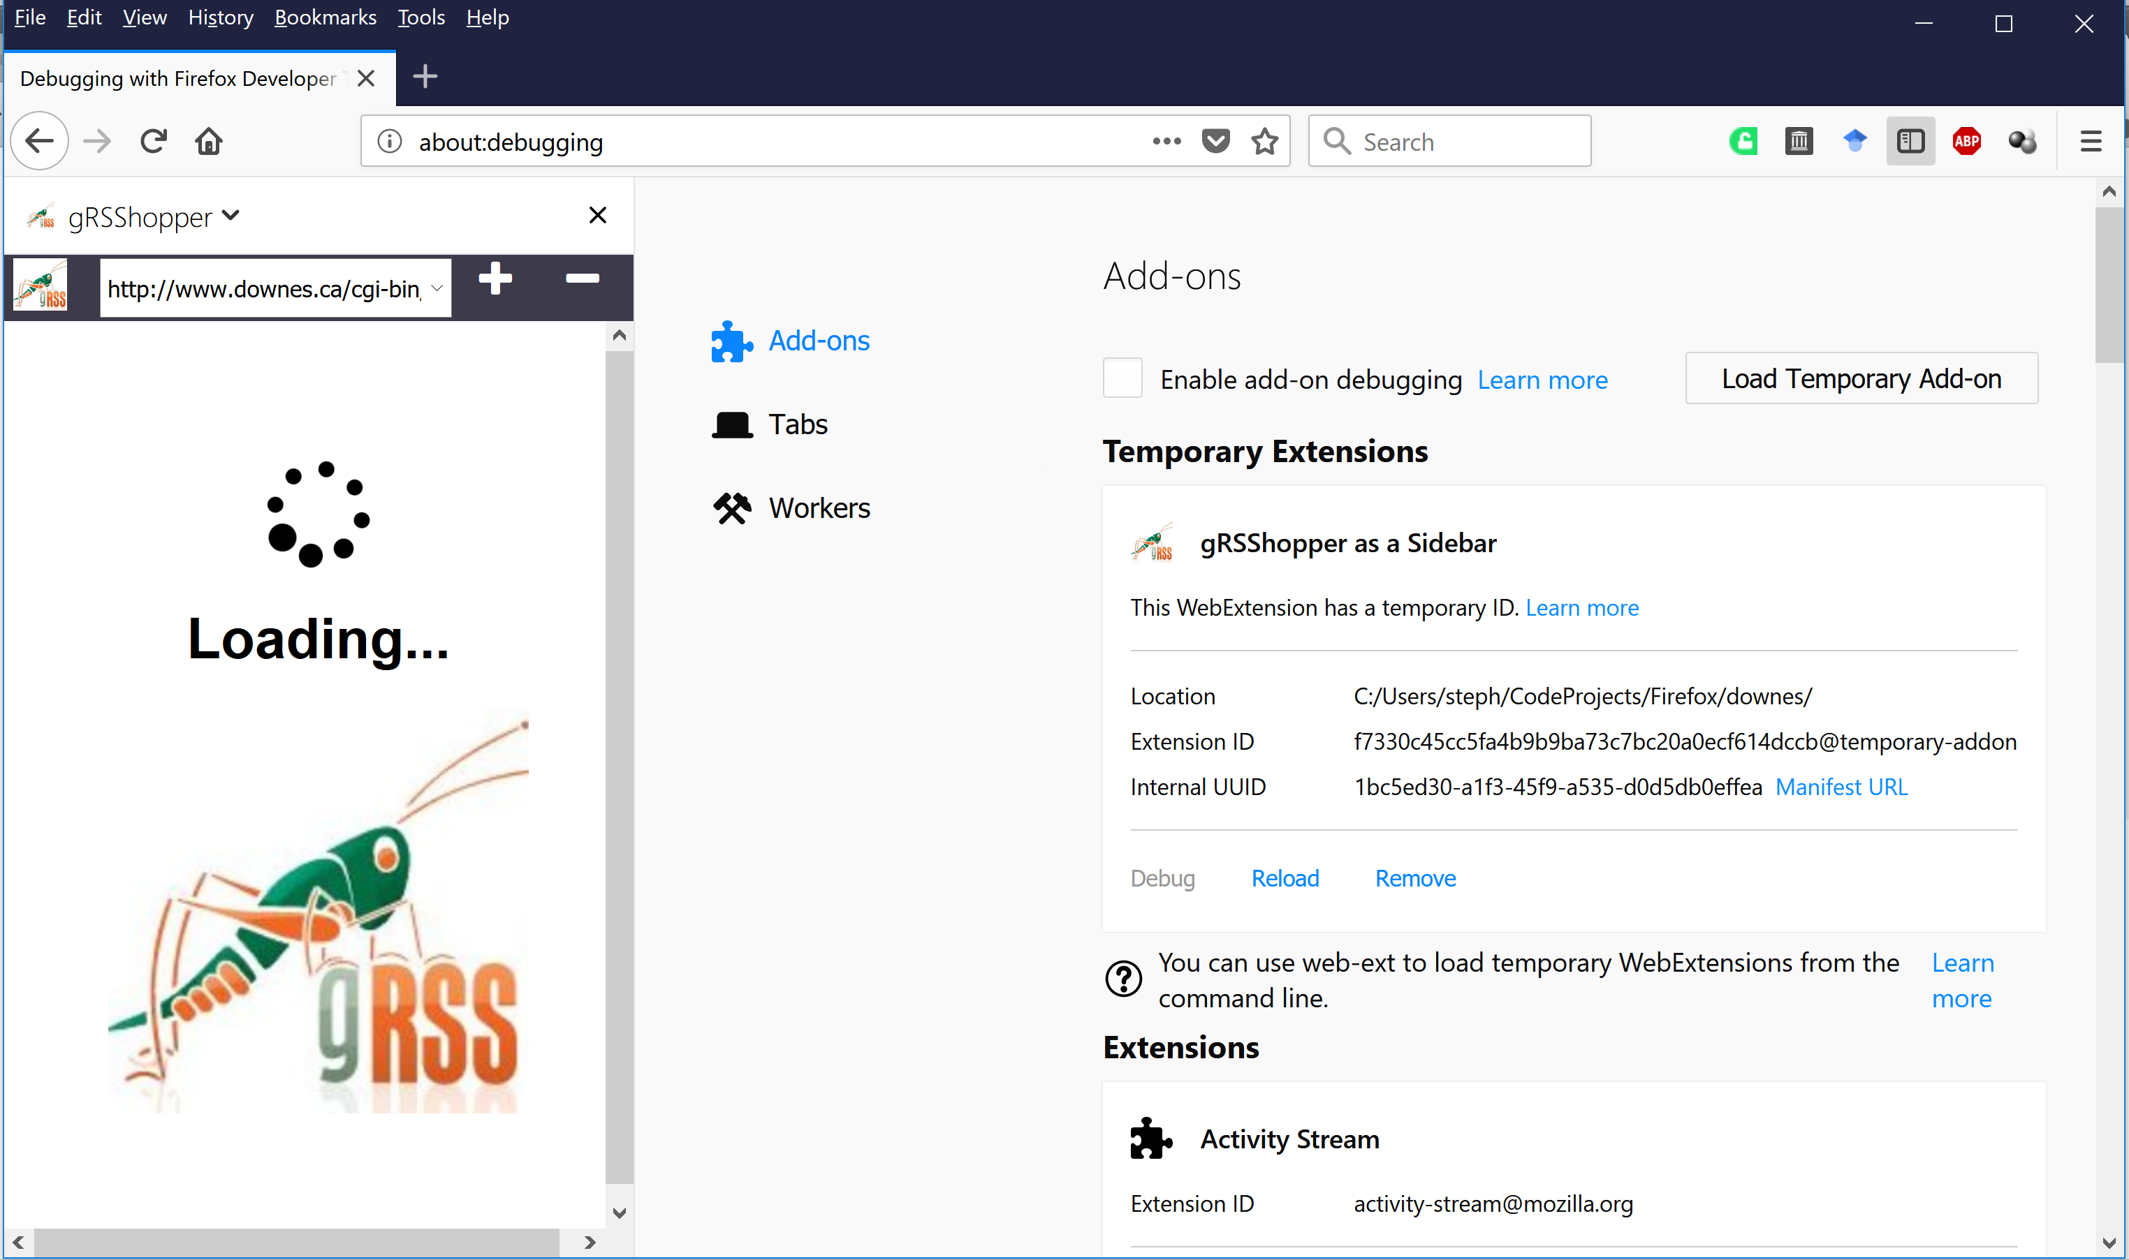
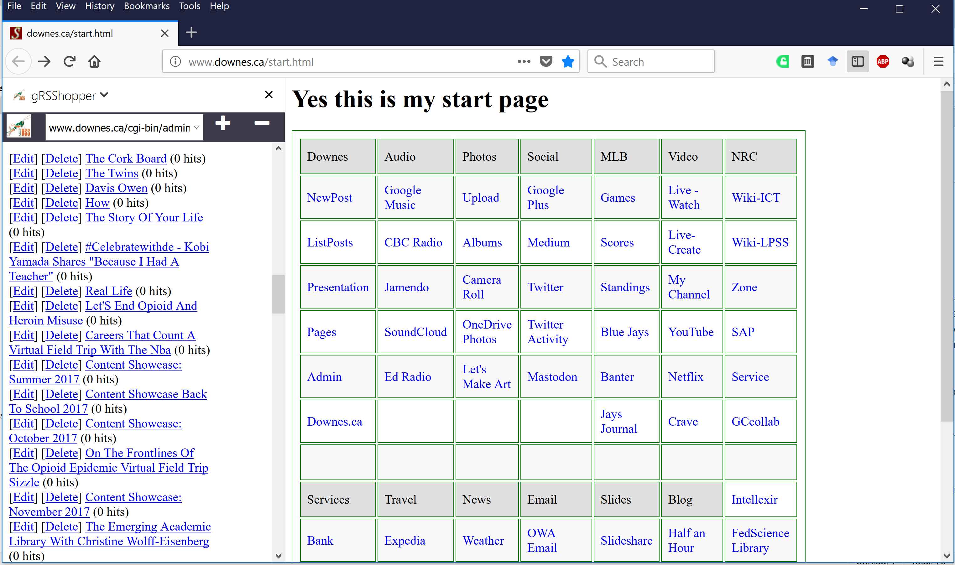
Embedding Applications in Other Applications
gRSShopper as a Firefox Sidebar
https://addons.mozilla.org/en-US/firefox/search/?q=sidebar&platform=WINNT&appver=58.0

Slide 16
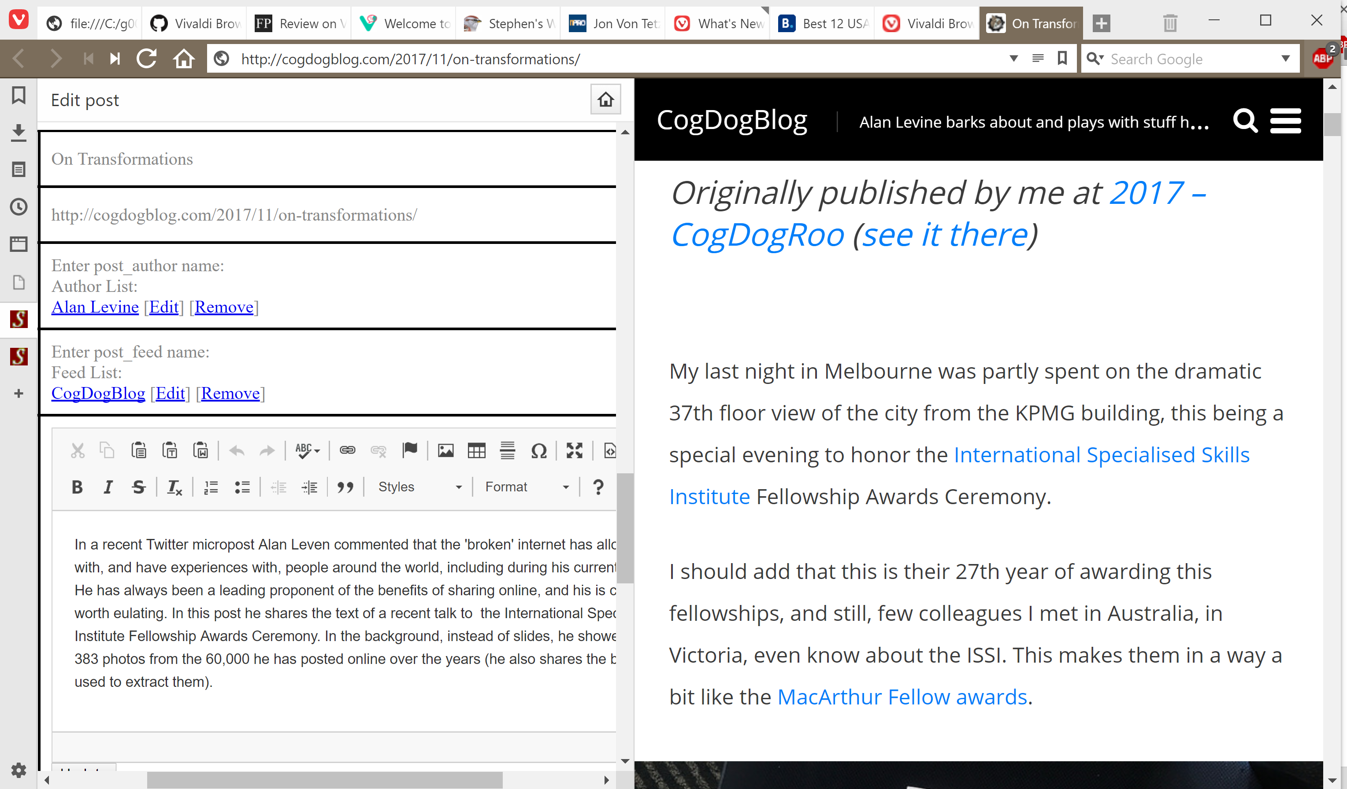
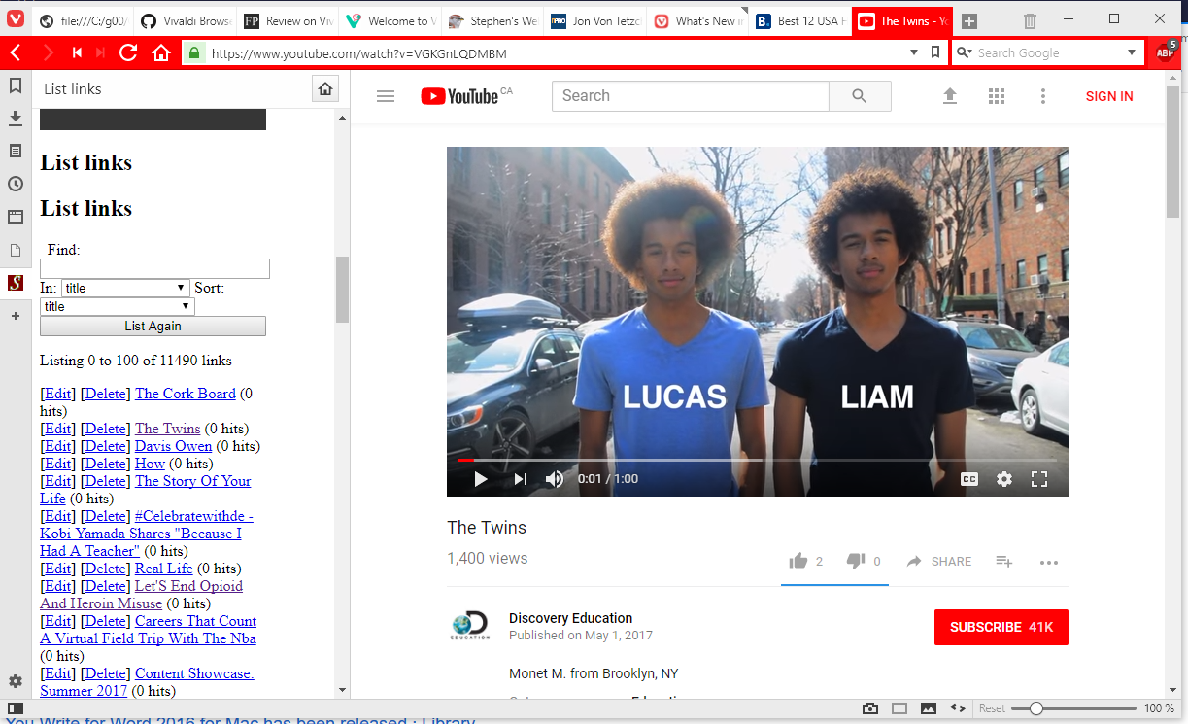
Embedding Applications in Other Applications
gRSShopper in Vivaldi
https://vivaldi.com/

Slide 17
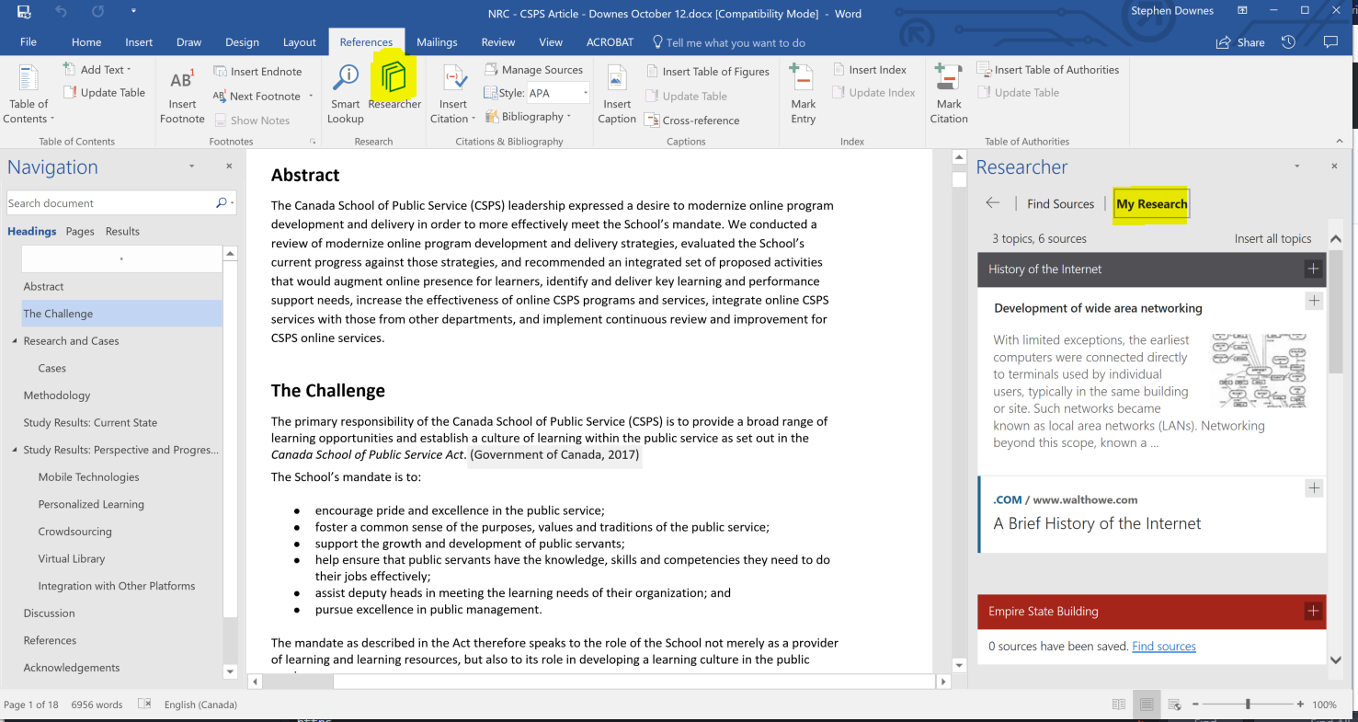

Embedding Applications in Other Applications
Research and References in an MS-Word Plugin
https://www.officetooltips.com/office_2013/tips/advanced_research_with_research_pane.html

Slide 18
Server Virtualization
Parallels
VMWare
Virtual Box
Hyper-V

Slide 19
Virtualization Platforms - Vagrant

Slide 20
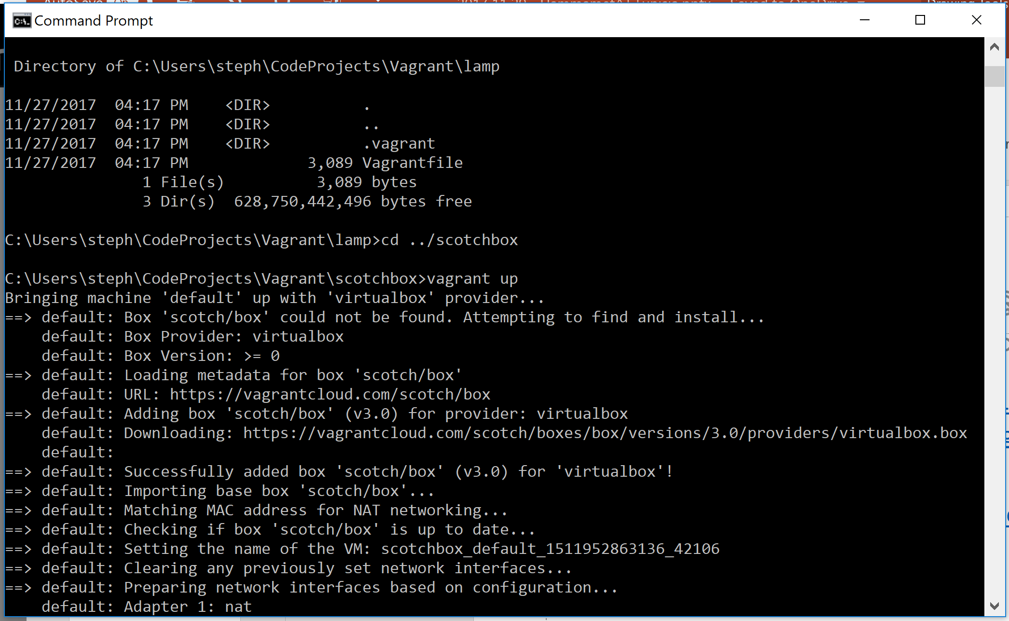
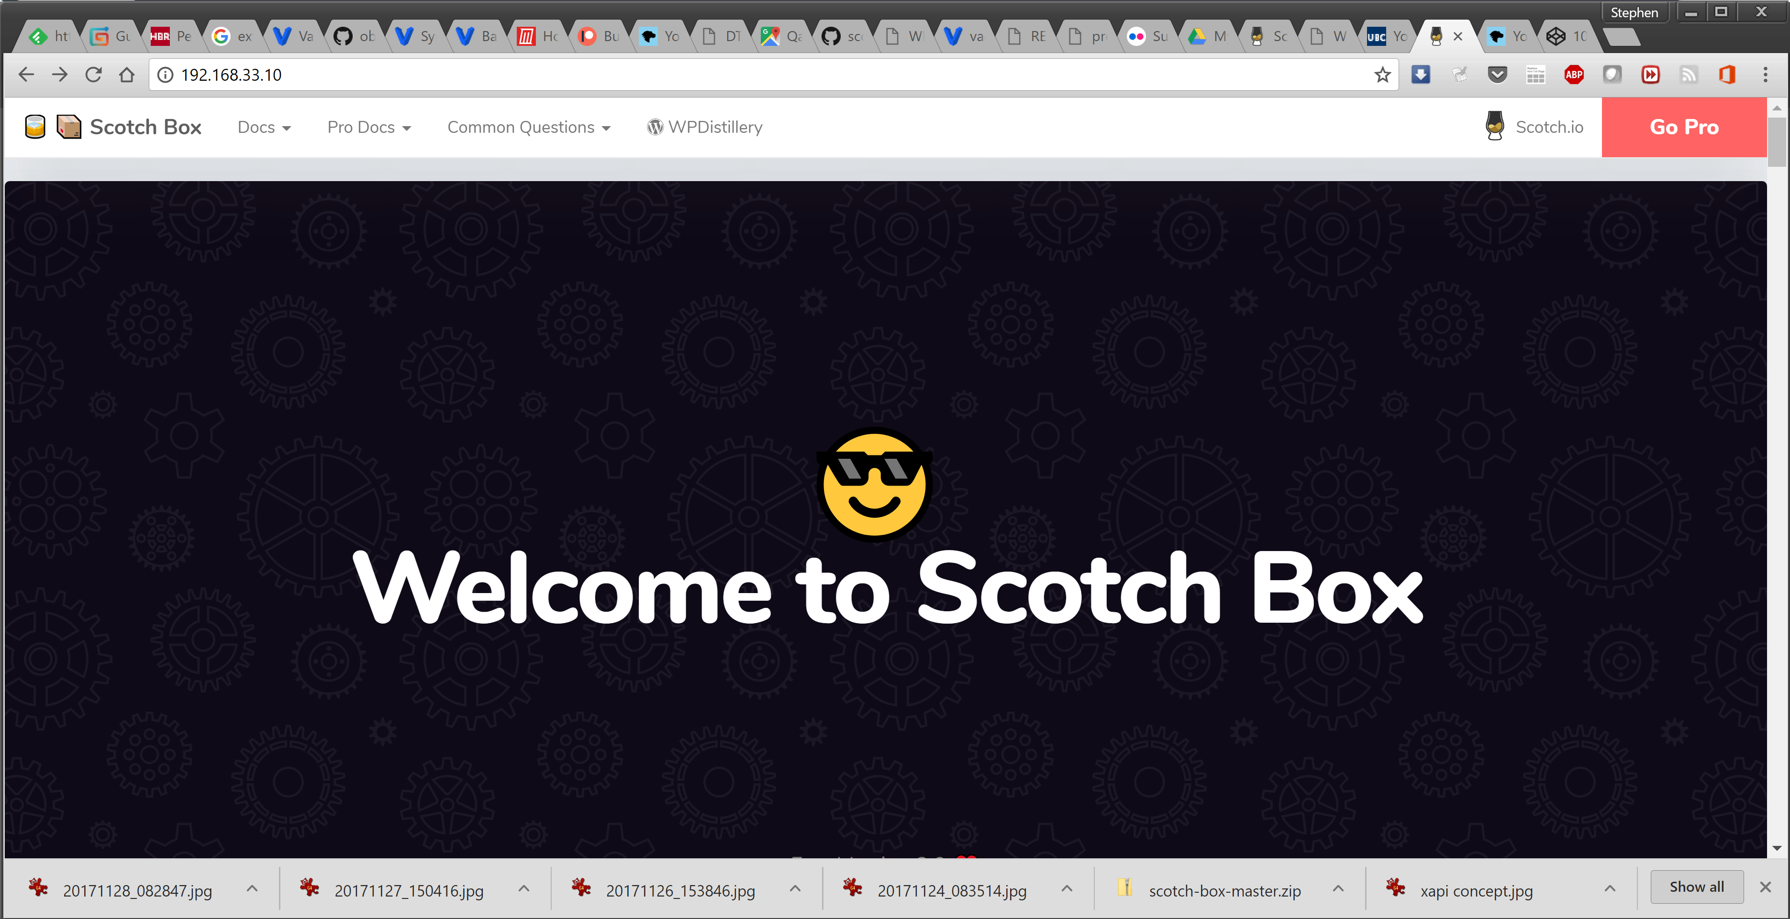
Loading and Running Vagrant Boxes
Scotch Box
  https://box.scotch.io/ -- http://192.168.33.10/
  WPDistillery - https://wpdistillery.org/ - for WordPress
Homestead
  Instructions - https://laravel.com/docs/5.5/homestead#first-steps

Slide 21
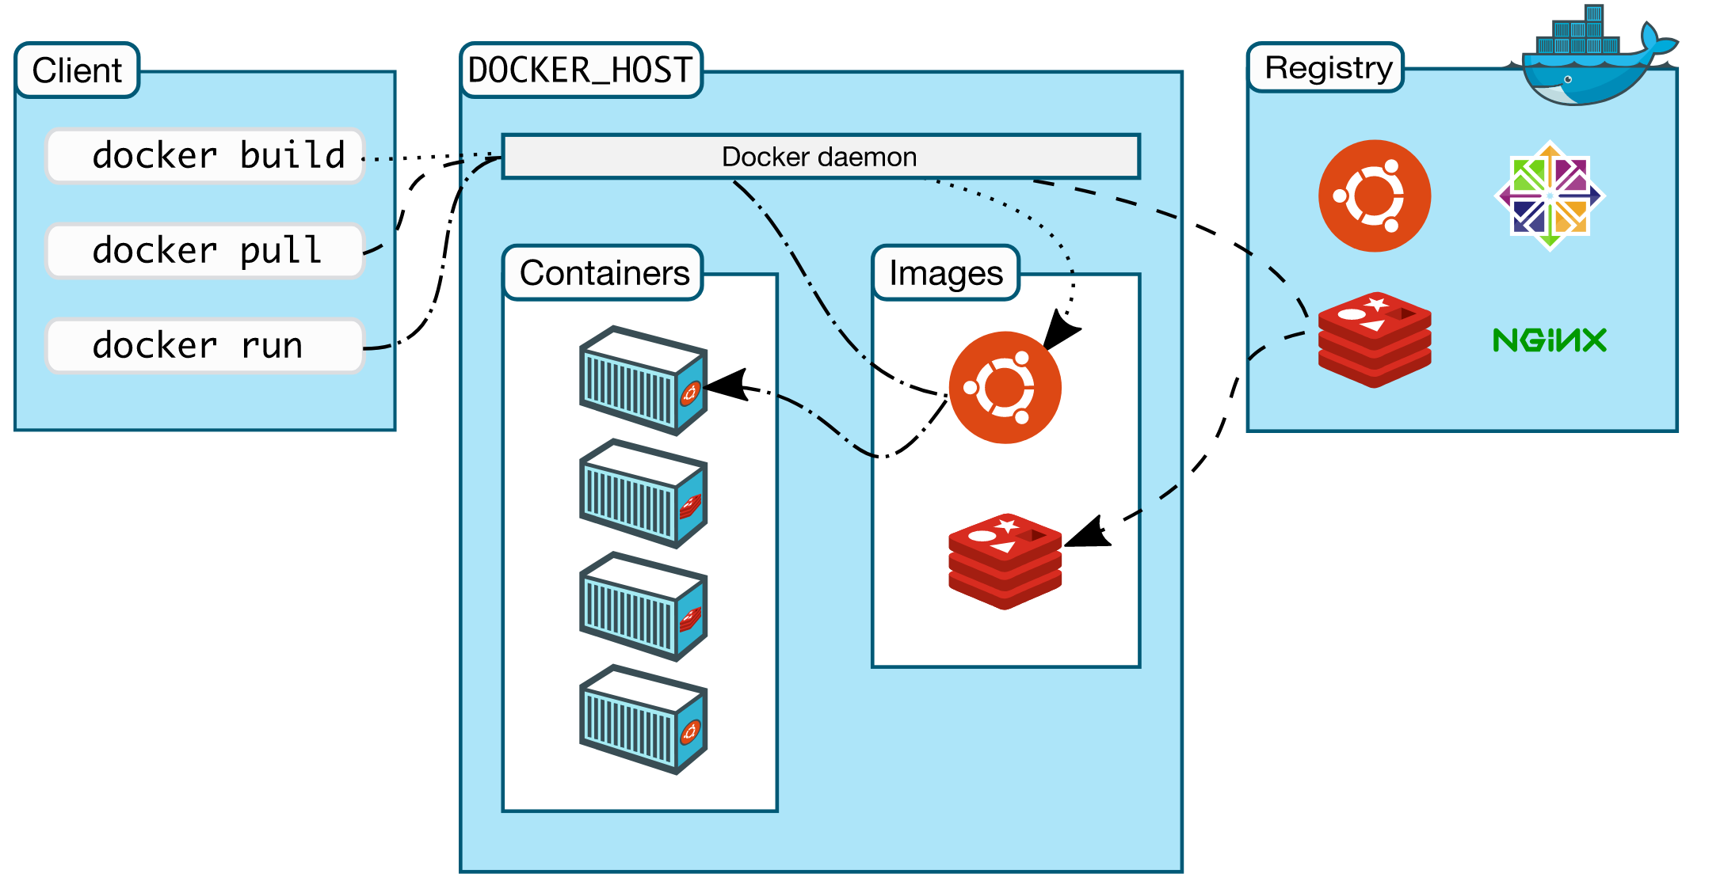
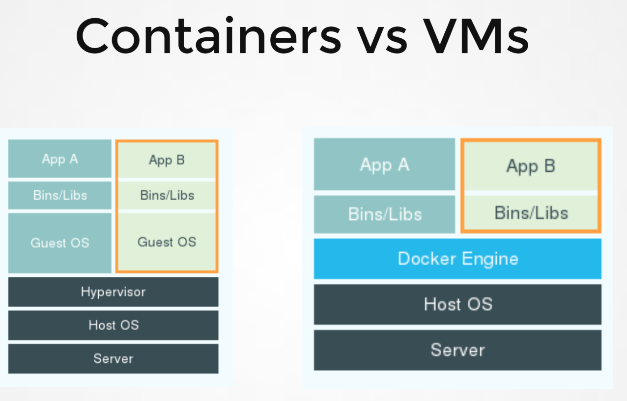
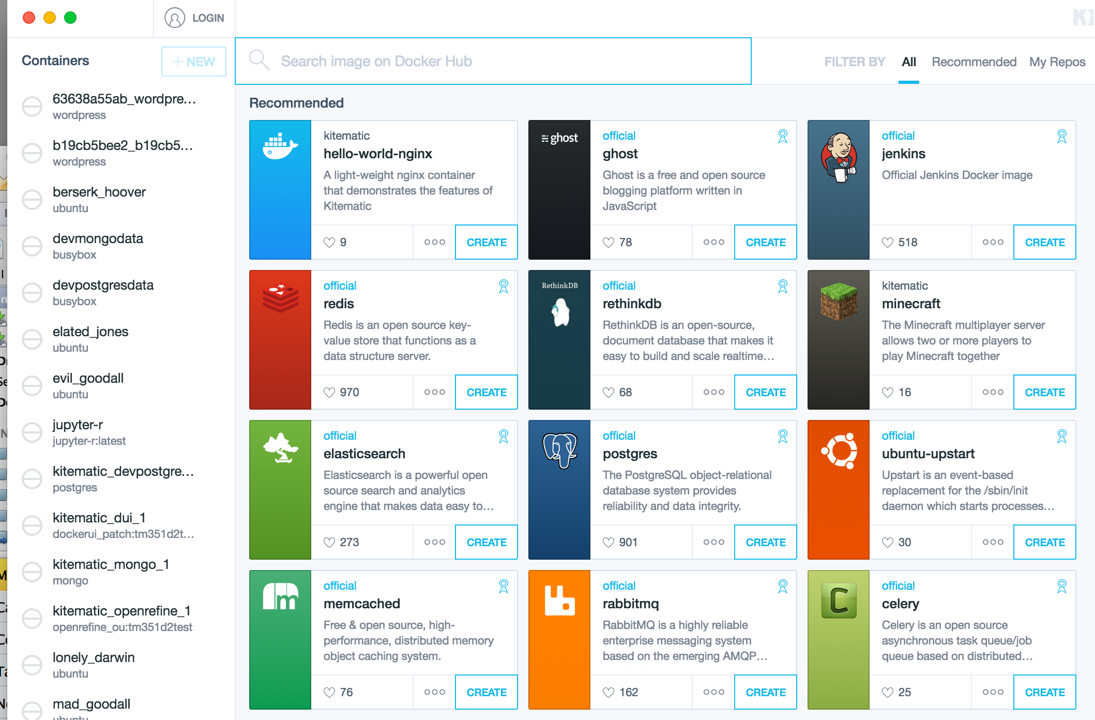
Docker

Slide 22
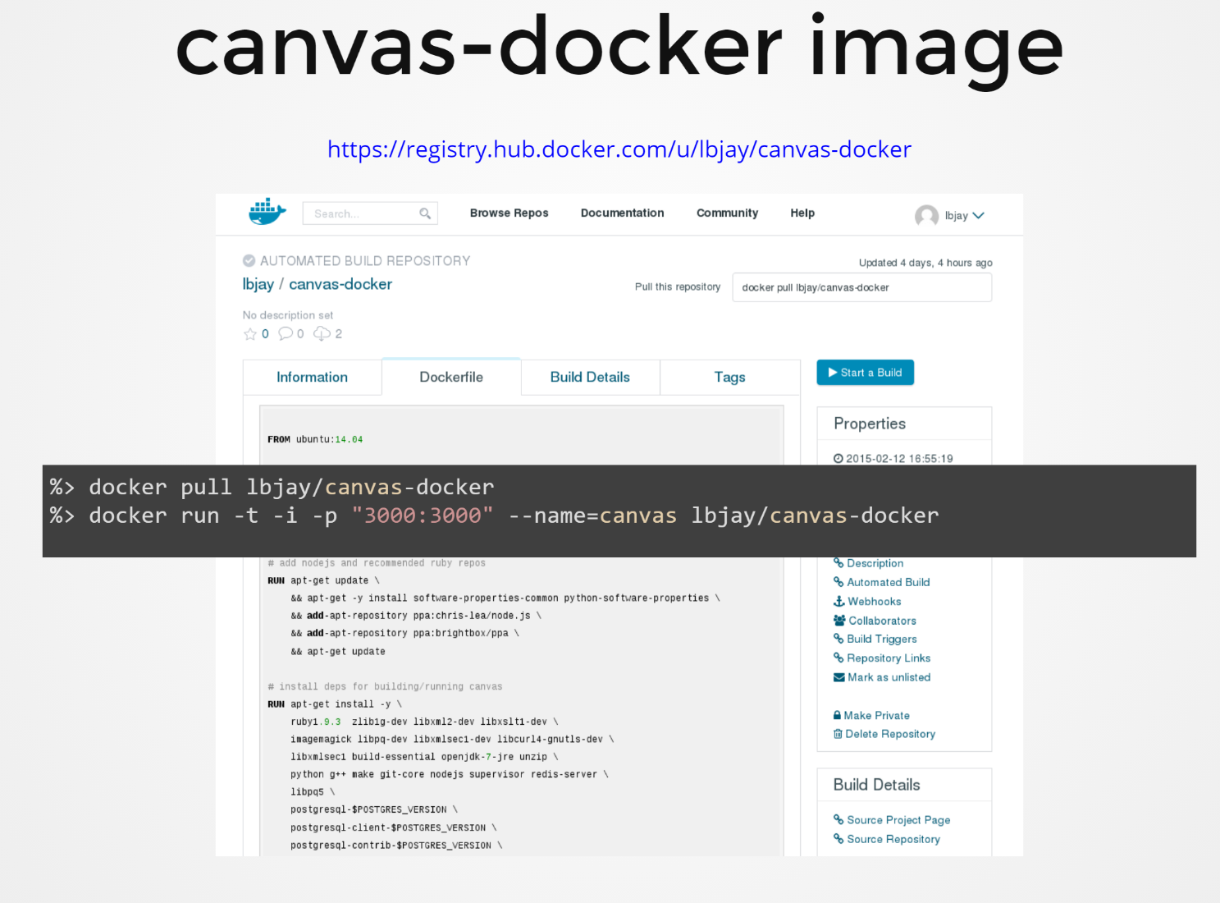
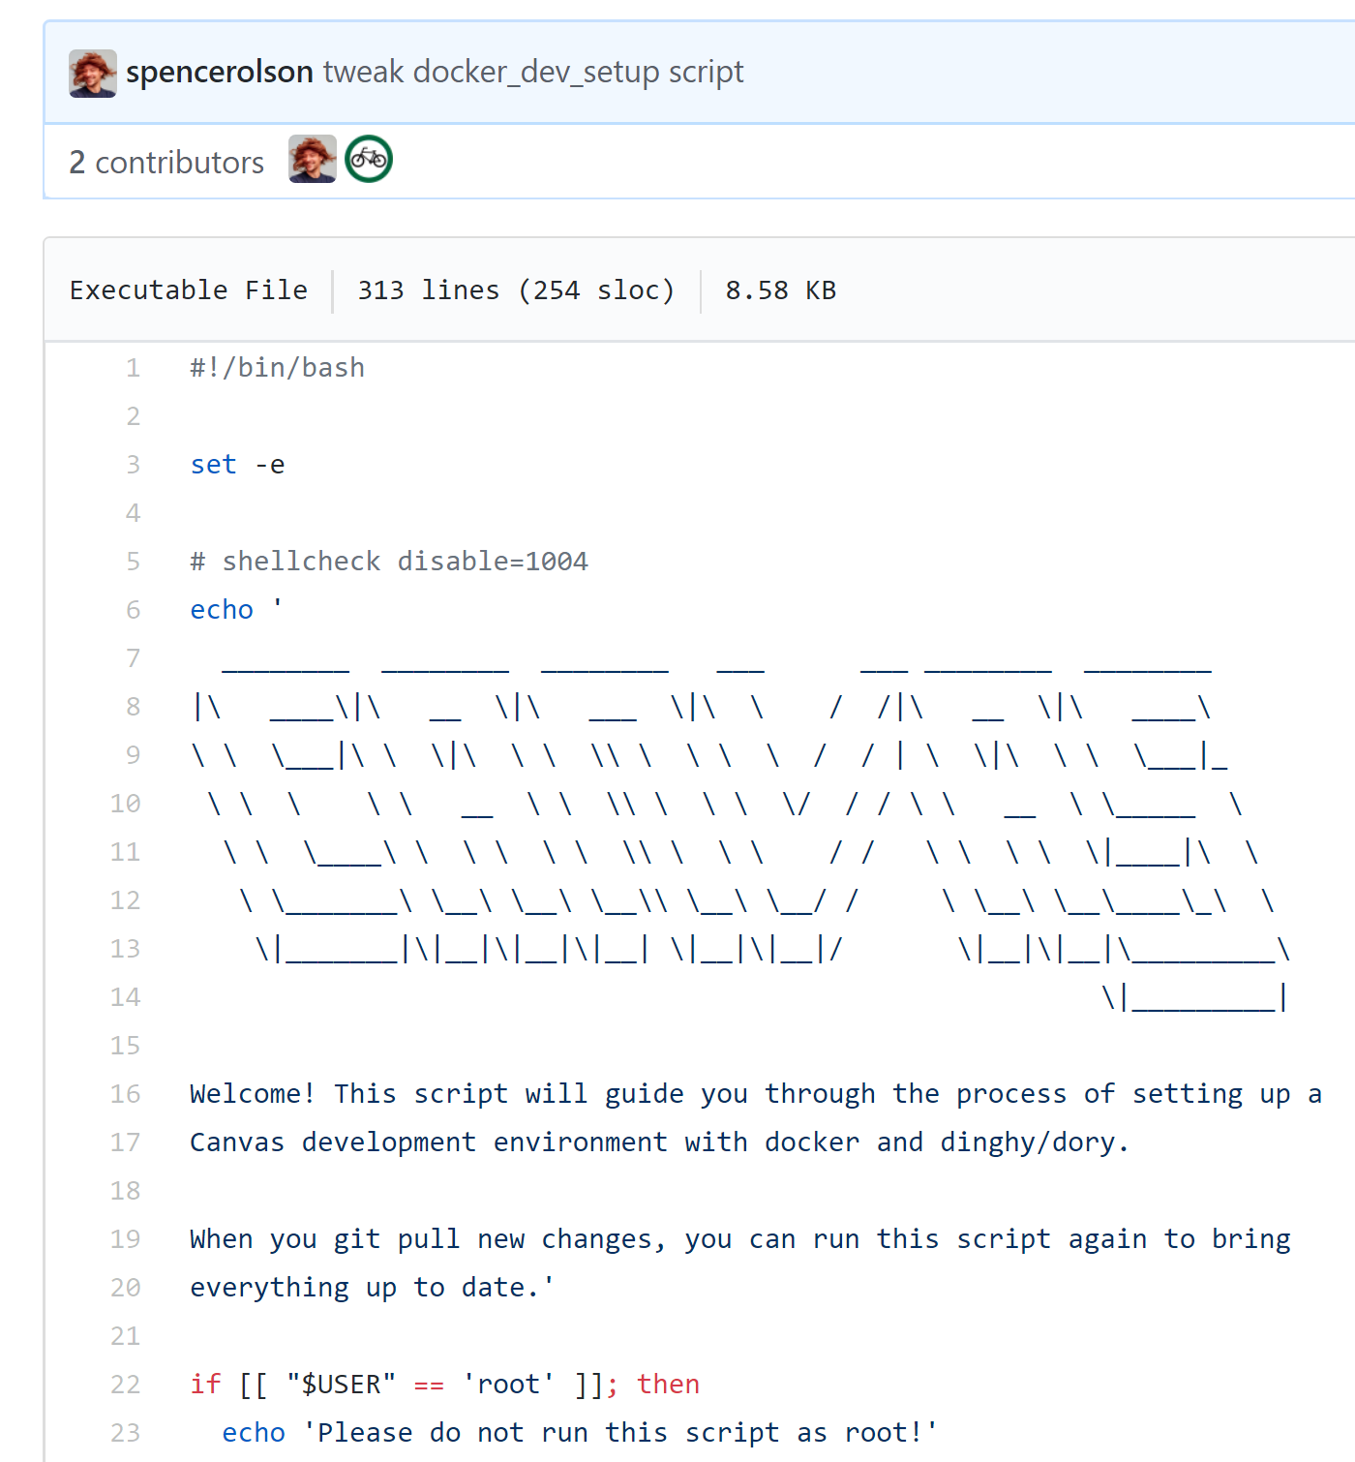
Canvas on Docker
https://github.com/instructure/canvas-lms/blob/master/script/docker_dev_setup.sh
http://slides.com/jamesluker/how-to-docker-2#/

Slide 23
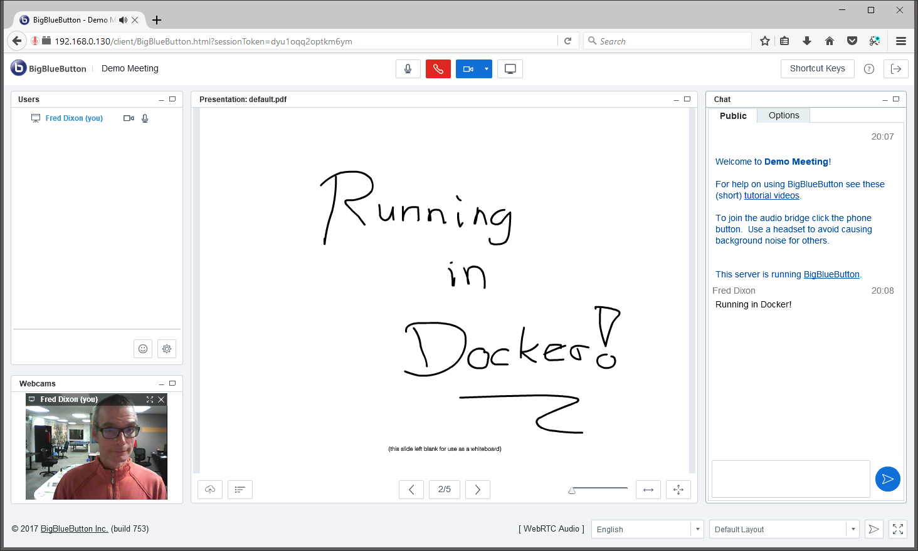
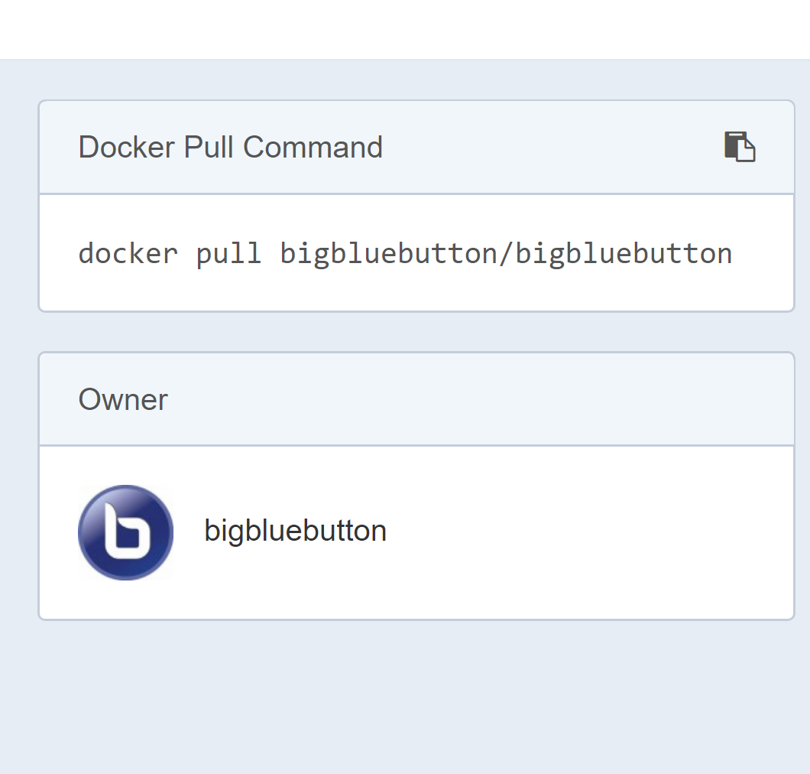
Big Blue Button in Docker
http://docs.bigbluebutton.org/labs/docker.html
https://hub.docker.com/r/bigbluebutton/bigbluebutton/

Slide 24
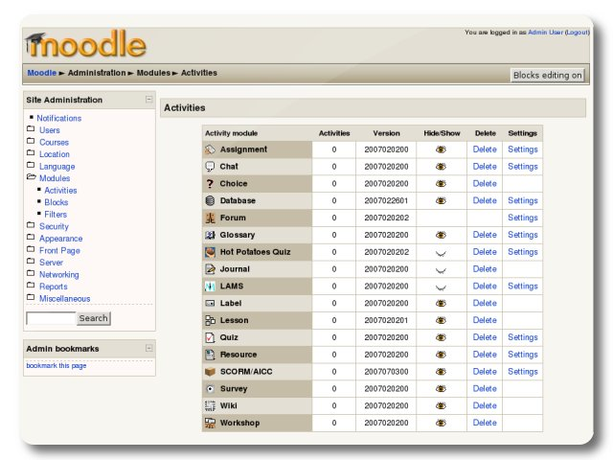
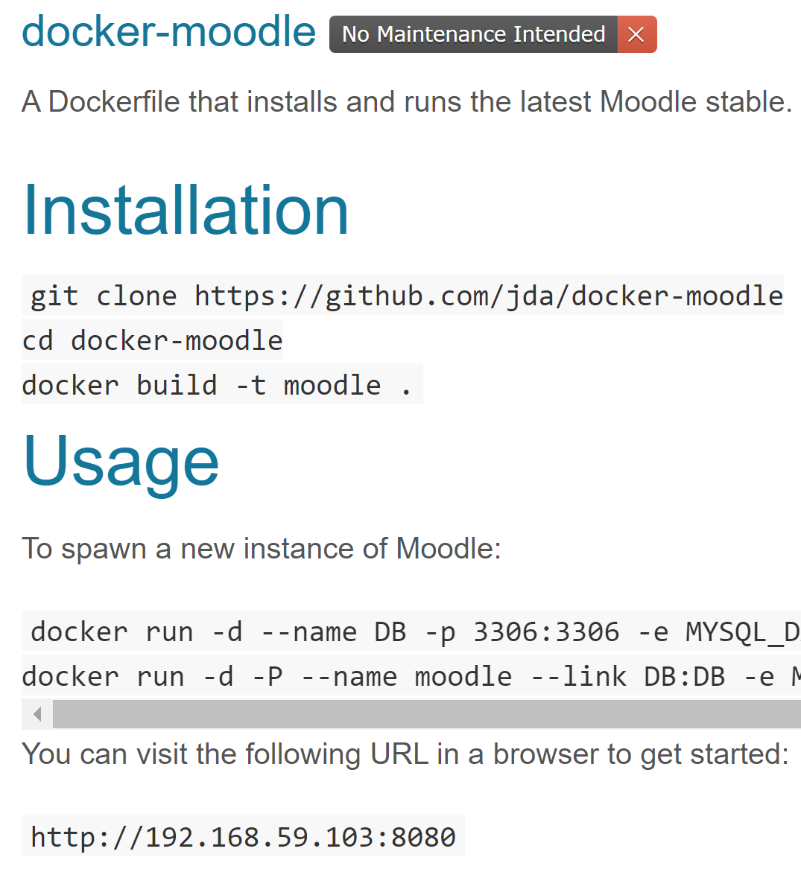
Moodle on Docker
https://hub.docker.com/r/jauer/moodle/

Slide 25
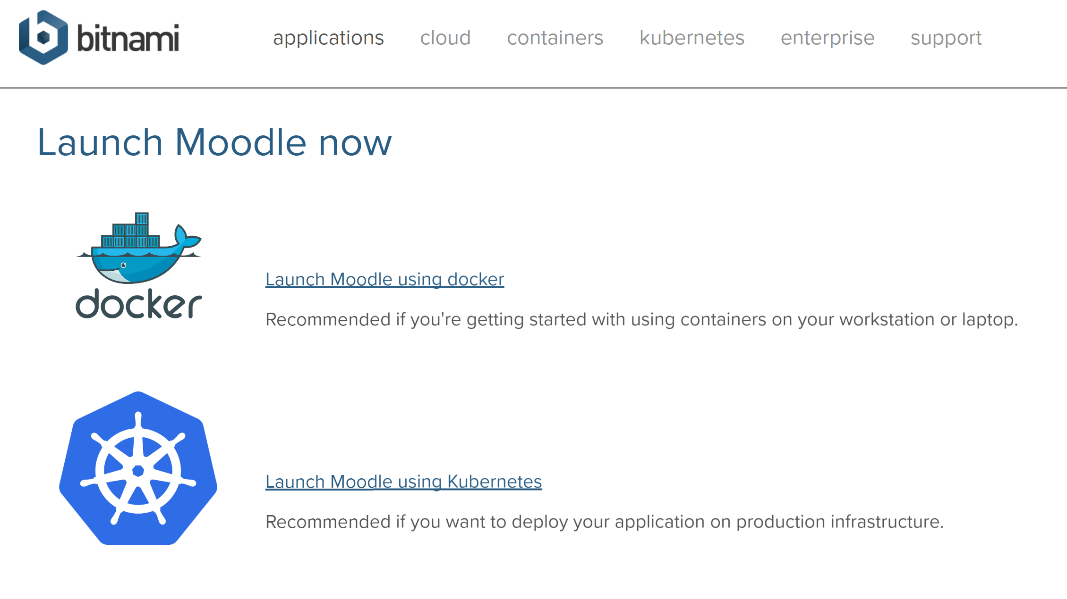
Options
https://bitnami.com/stack/moodle/containers

Slide 26
Cloud Infrastructure Providers
AWS
Azure
Bitnami

Slide 27
Happening Now…
Docker images to build OER
  https://gitlab.com/oer/docker

