Slide 1
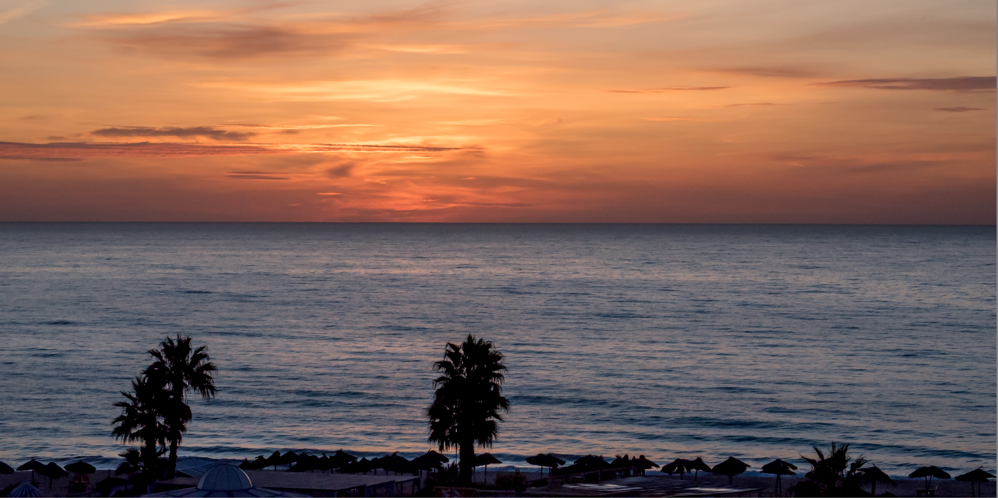
Applications, Algorithms and Data: Open Educational Resources and the Next Generation of Virtual Learning
Stephen Downes
RELIF
Hammamet, Tunisia
November 30, 2017
http://www.downes.ca/presentation/481

Slide 2
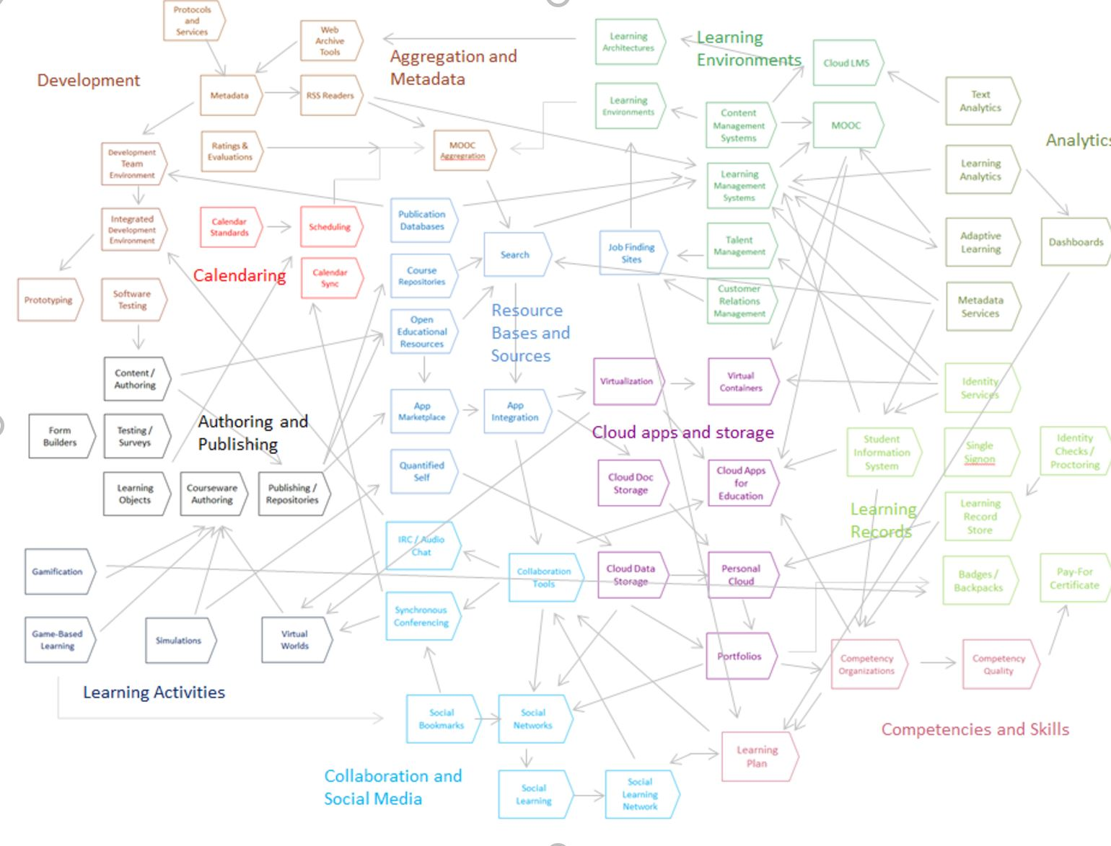
State of the Art
Stephen Downes - Applications, Algorithms and Data - November 30, 2017

Slide 3



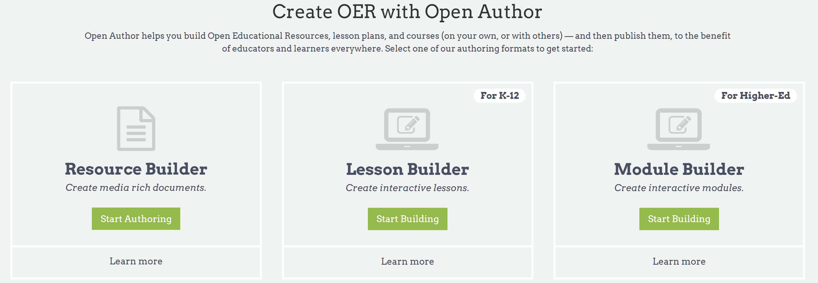
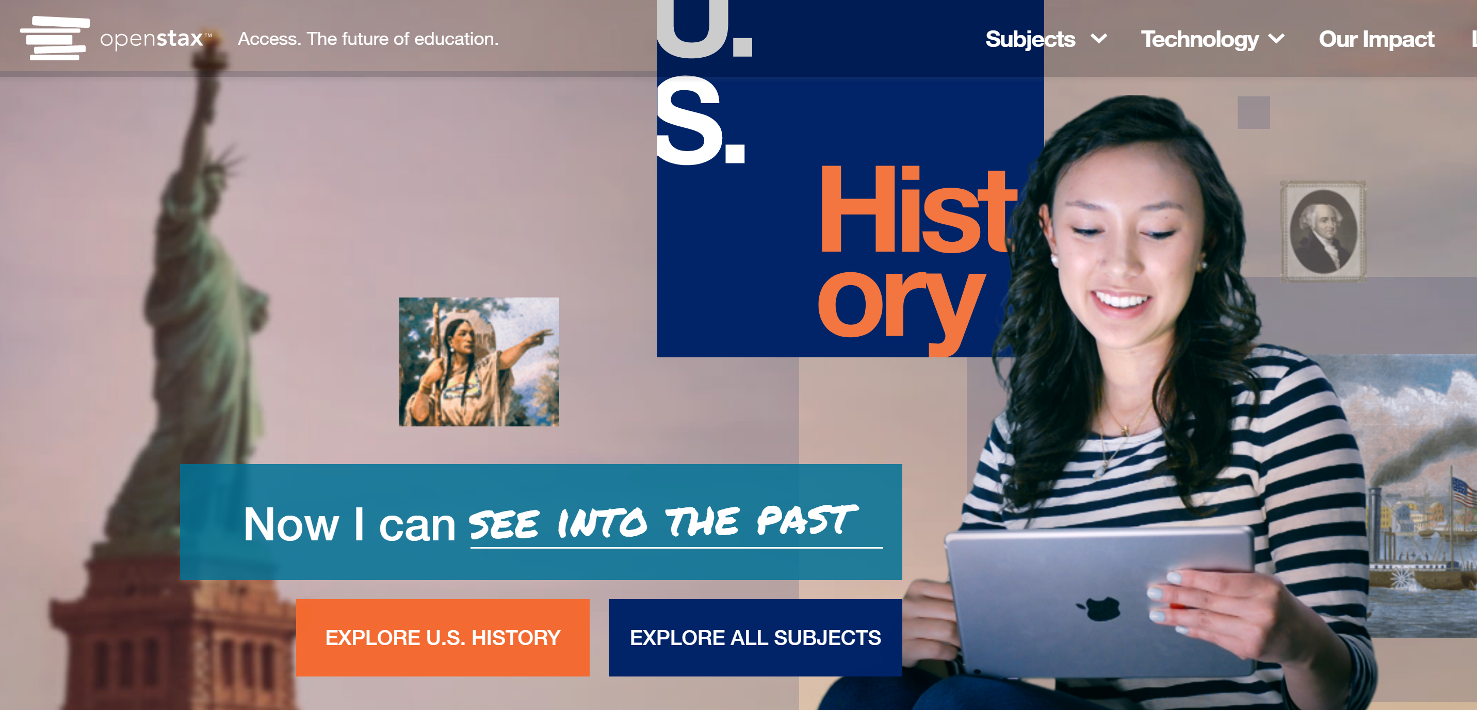
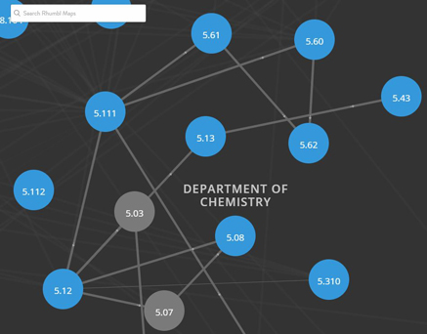
OER Repositories
https://www.oercommons.org/
https://openstax.org/
OERs are now widely available through subject-specific libraries with provisions for authoring as well
https://ocw.mit.edu/
http://irsc.libguides.com/openeducationalresources/oerrepositories
Stephen Downes - Applications, Algorithms and Data - November 30, 2017

Slide 4
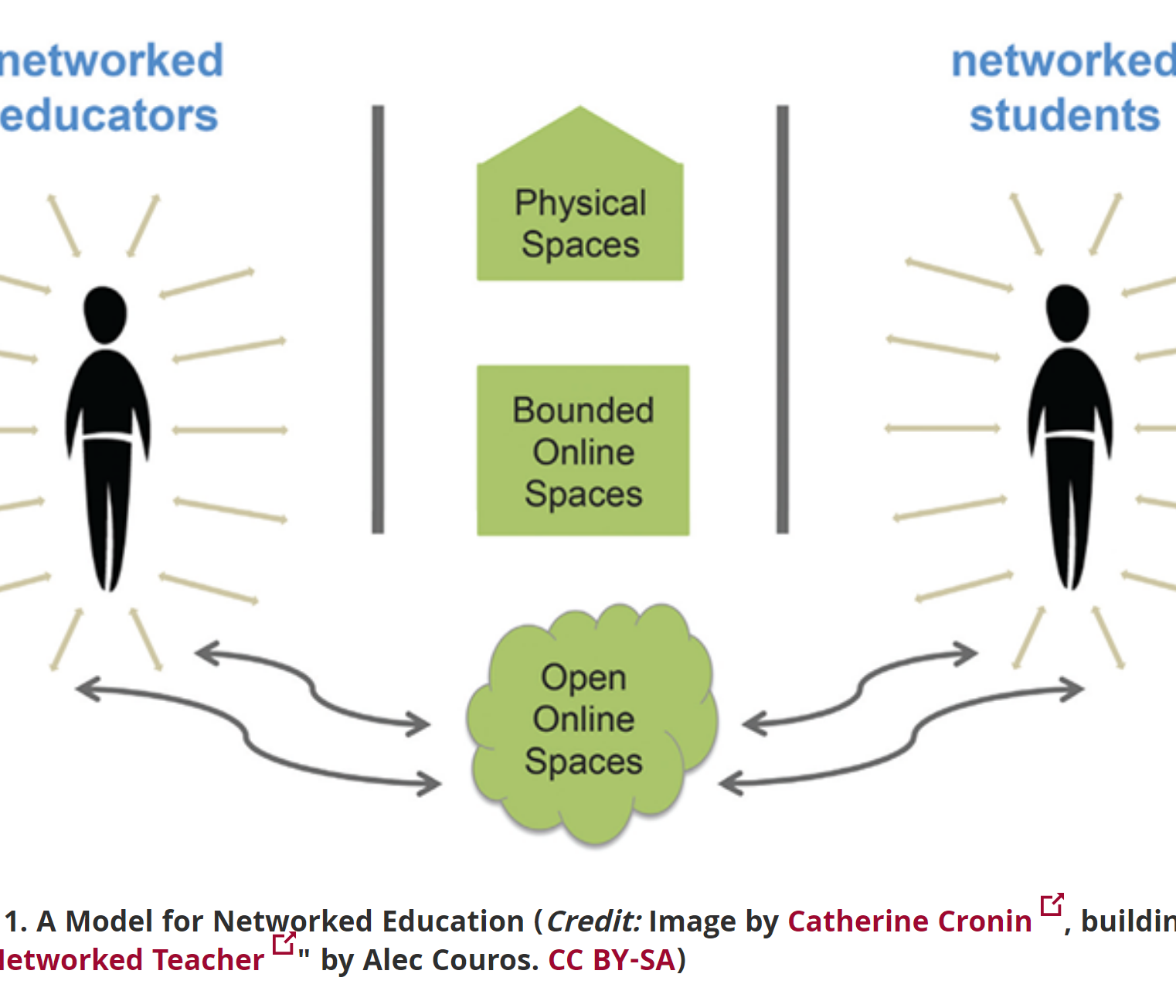
Open Resources, Open Teaching
Open Pedagogy – Using OER to Chane How We Teach – Heather Ross https://words.usask.ca/gmcte/2016/09/26/open-pedagogy-using-oer-to-change-how-we-teach/
Open Education, Open Questions – Catherine Cronin https://er.educause.edu/articles/2017/10/open-education-open-questions
  “The use of open practices by learners and educators is complex, personal, and contextual; it is also continually negotiated.”
Stephen Downes - Applications, Algorithms and Data - November 30, 2017

Slide 5
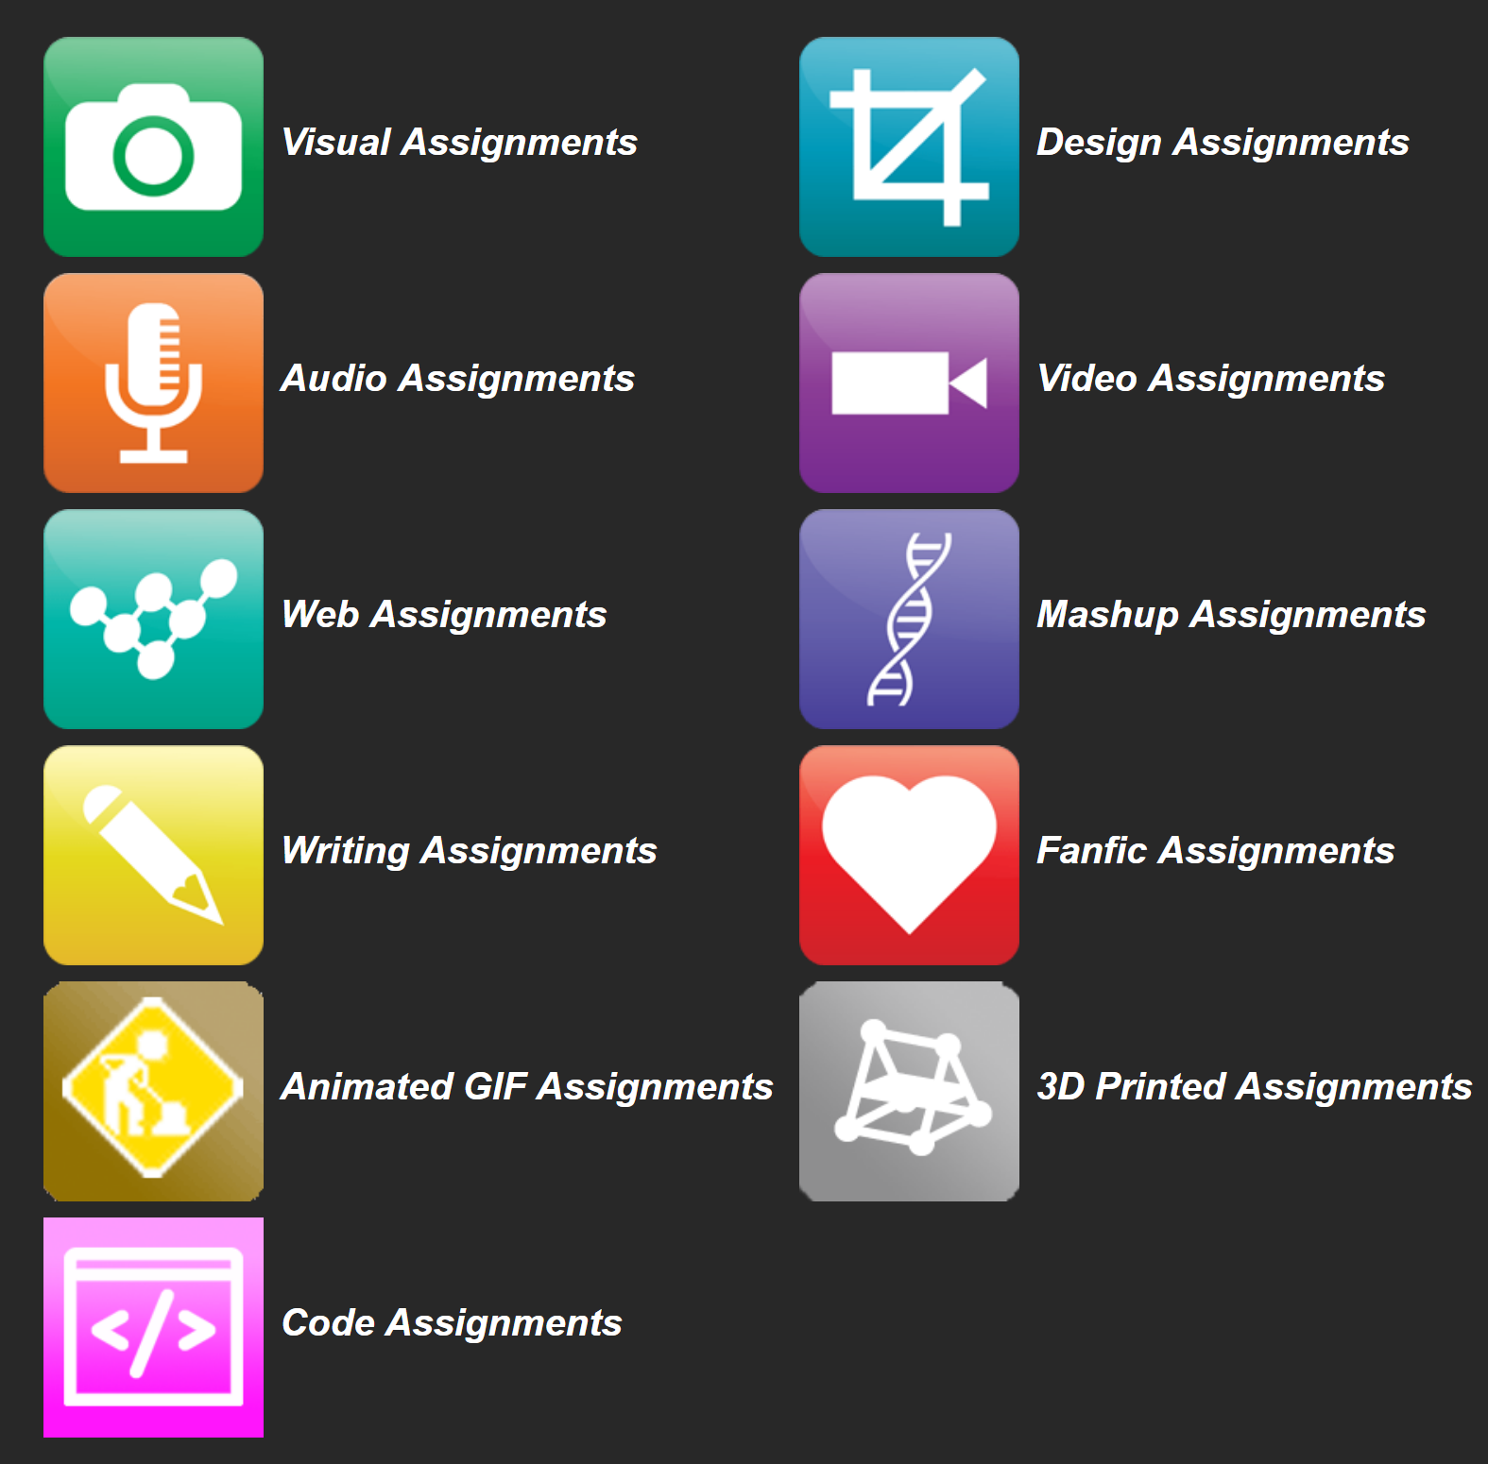
OERs as Student Production
DS106 – assignment bank http://assignments.ds106.us/
Domain of One’s Own - https://reclaimhosting.com/domain-of-ones-own/
Creation of OERs through ‘renewable assignments’ – Christina Hendricks http://flexible.learning.ubc.ca/news-events/renewable-assignments-student-work-adding-value-to-the-world/
Stephen Downes - Applications, Algorithms and Data - November 30, 2017

Slide 6
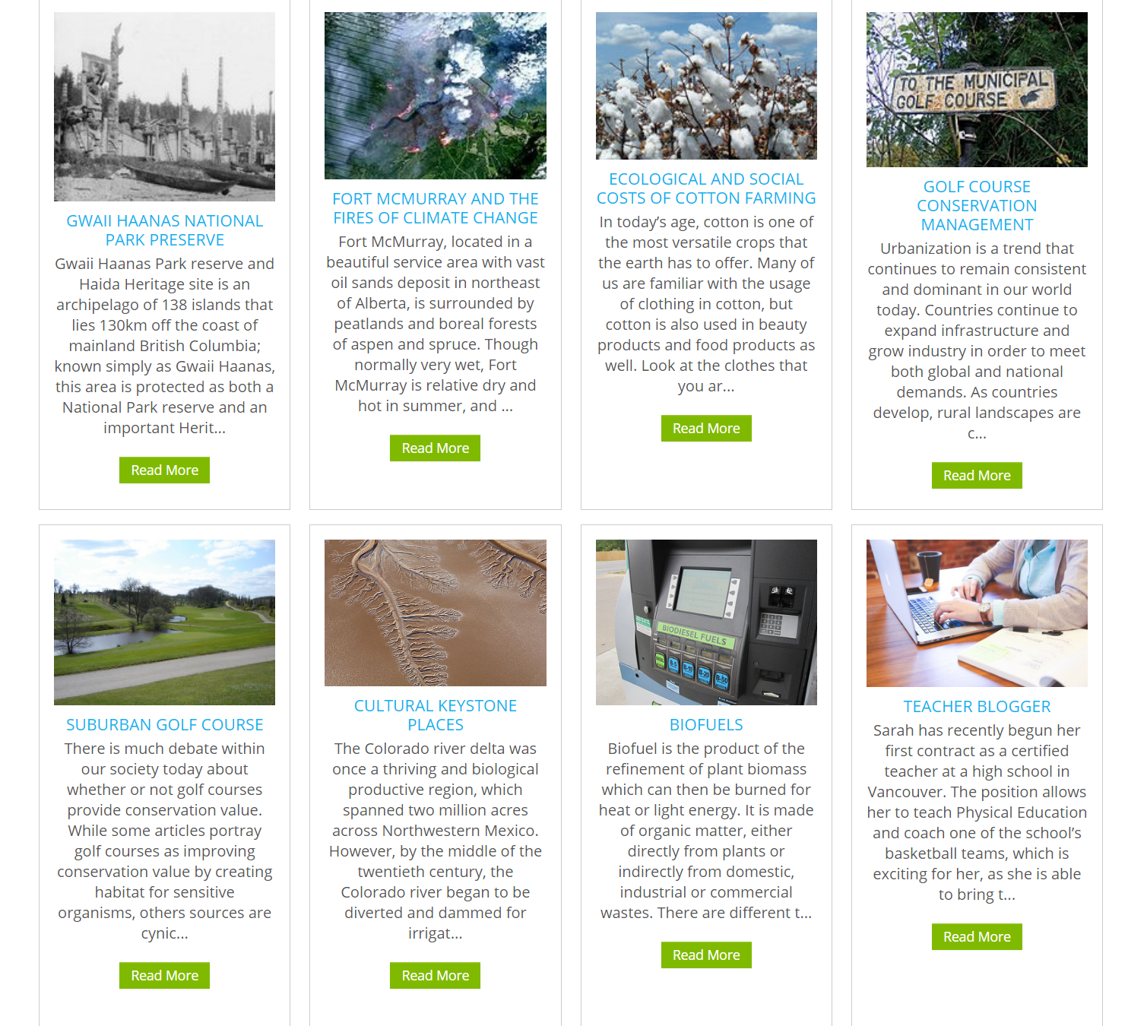
Open Case Studies
Case studies that can be used by anyone, at UBC or elsewhere.
Many focus on topics in sustainability
cases on this site are open educational resources: they have an open license to allow for revision and reuse of the cases in other courses and contexts
Quoted from: http://cases.open.ubc.ca/
Stephen Downes - Applications, Algorithms and Data - November 30, 2017

Slide 7
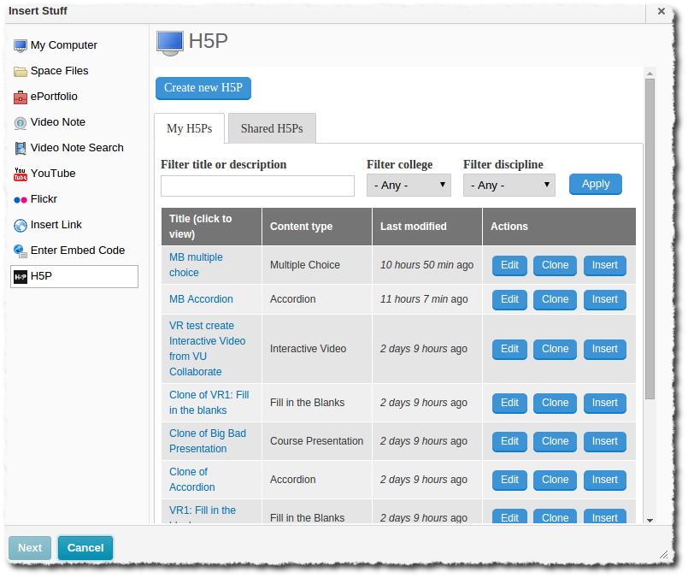
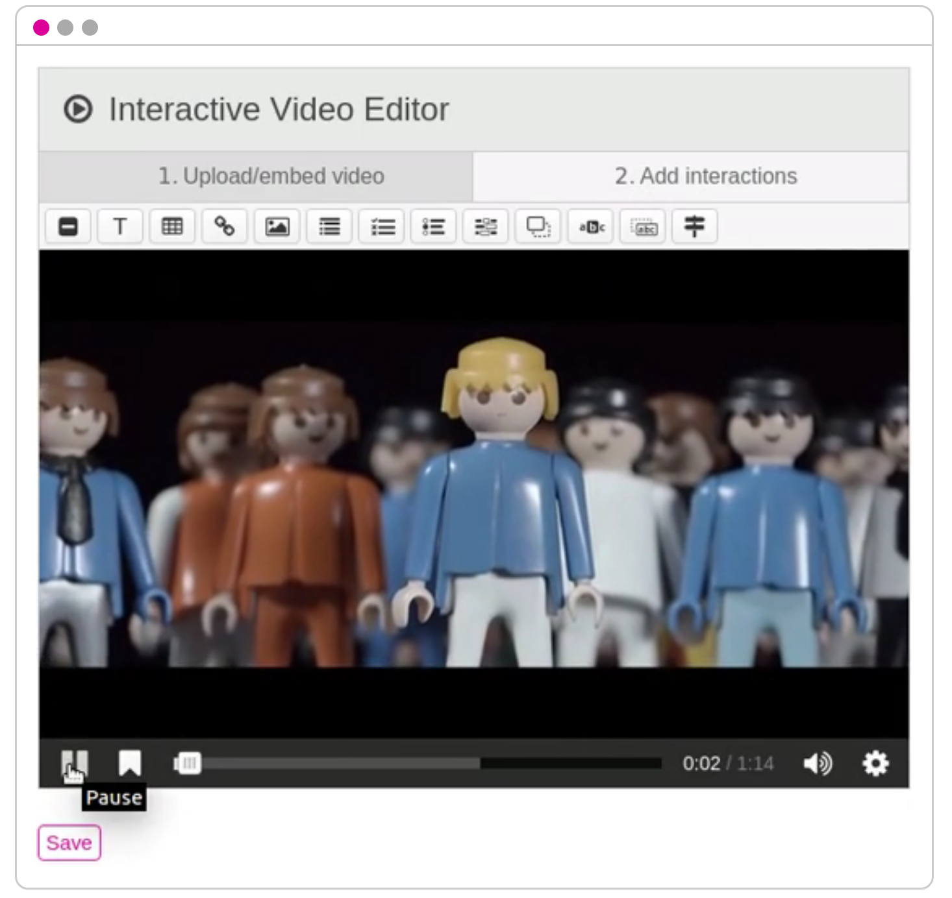
H5P
https://h5p.org/h5p-plus-brightspace-equals-smashing-interactive-learning
H5P is an abbreviation for HTML5 Package, and aims to make it easy for everyone to create, share and reuse interactive HTML5 content. – Wikipedia https://en.wikipedia.org/wiki/H5P
H5P is available as a Moodle plugin, a Drupal module and a WordPress plugin. https://h5p.org/

Slide 8
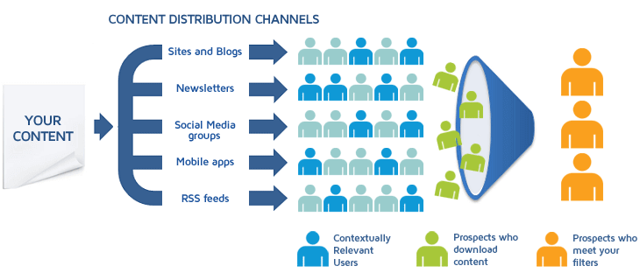
Content Syndication
Image: https://blog.izooto.com/best-content-syndication-tools/
Blog posts and comments were the core of CCK08
  gRSShopper – http://grsshopper.downes.ca
FeedPress - https://wordpress.org/plugins/feedpress/
FeedBurner - https://feedburner.google.com
Stephen Downes - Applications, Algorithms and Data - November 30, 2017

Slide 9
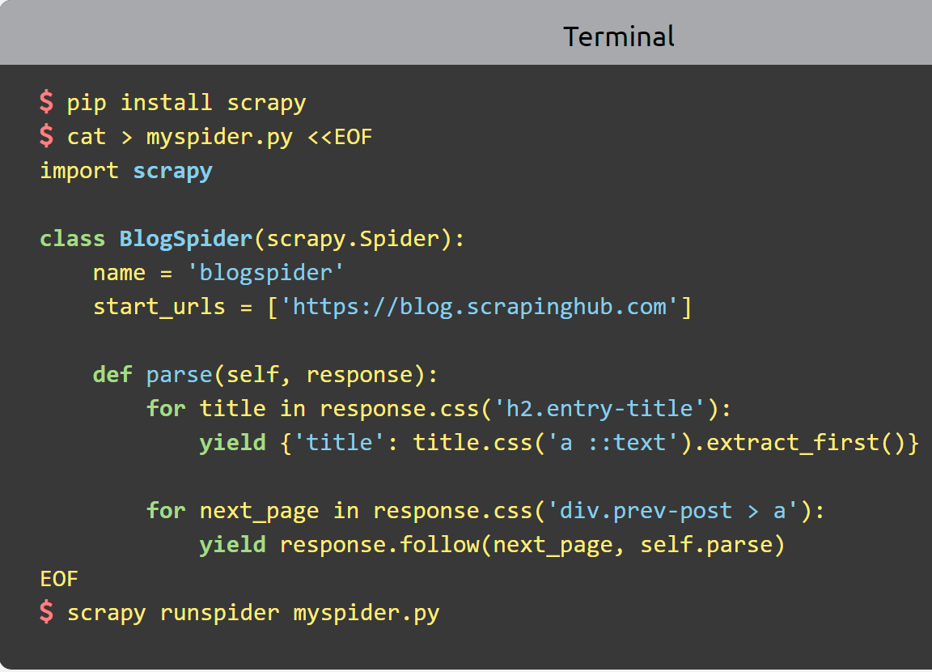
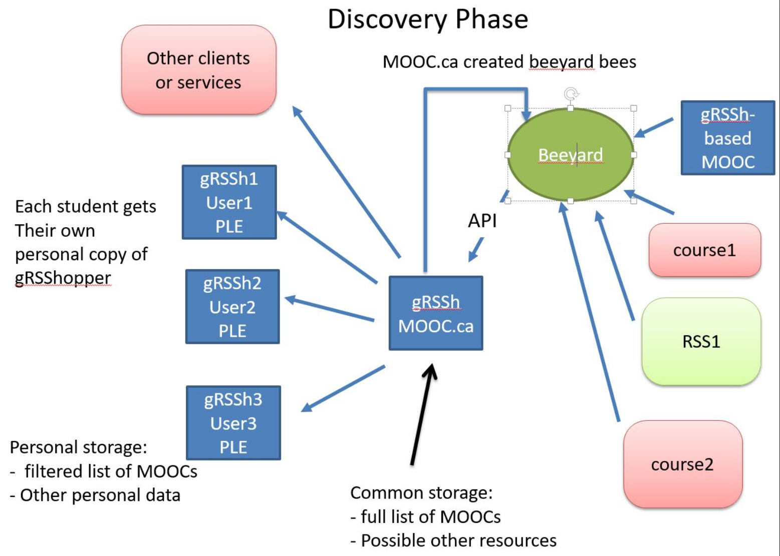
Scrapy
Python framework to aggregate and store content in RSS feeds and web sites
Forms the core of the NRC-developed ‘Beeyard’ application
https://scrapy.org/
Stephen Downes - Applications, Algorithms and Data - November 30, 2017

Slide 10
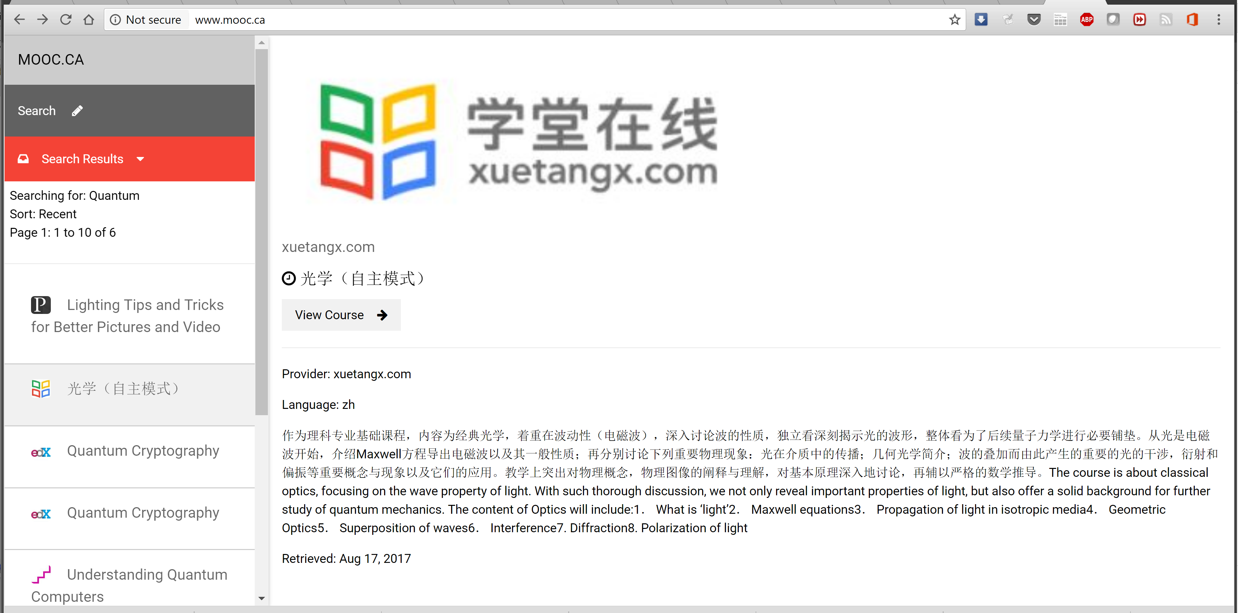

MOOC.ca and gRSShopper
http://grsshopper.downes.ca/
www.mooc.ca is an aggregator of MOOC course offerings (and is planned to aggregate OERs as well) using gRSShopper and Beeyard
Stephen Downes - Applications, Algorithms and Data - November 30, 2017

Slide 11
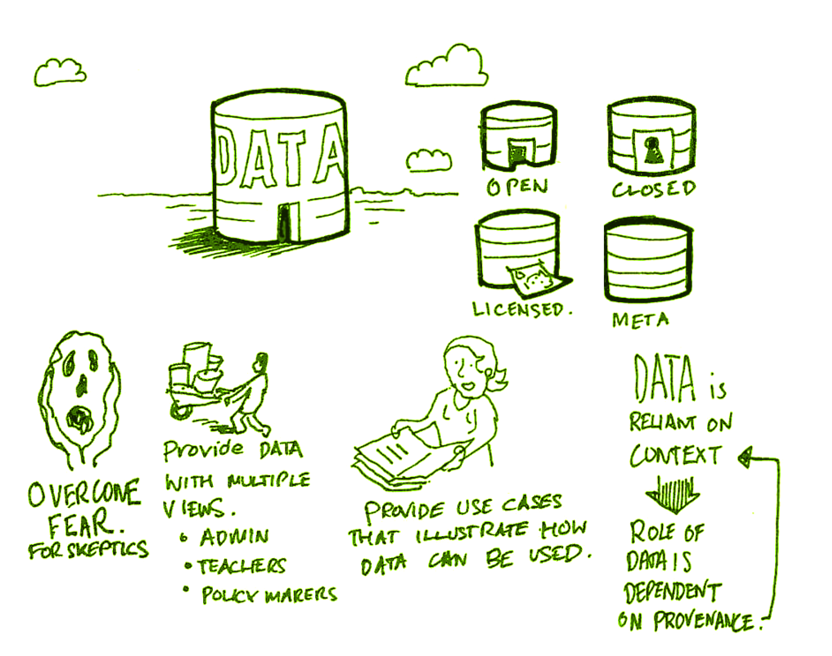
Open Data as OERs
Civic engagement in Italy
Into programming assignments
Article-level metrics
Geodata and Land Walks in Wales
Open data for sustainable development
Atenas, J., & Havemann, L. (Eds.). (2015). Open Data as Open Educational Resources: Case studies of emerging practice. London: Open Knowledge, Open Education Working Group. http://dx.doi.org/10.6084/m9.figshare.1590031
Also: Leo Havemann, slides http://eprints.bbk.ac.uk/14750/1/Leo_ODasOER_UCL_4March16.pdf
Stephen Downes - Applications, Algorithms and Data - November 30, 2017

Slide 12
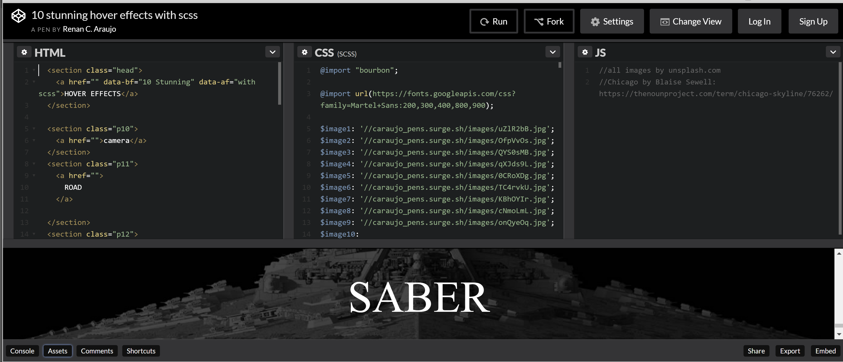
CodePen
https://codepen.io/caraujo/pen/LVPzxO
Stephen Downes - Applications, Algorithms and Data - November 30, 2017

Slide 13
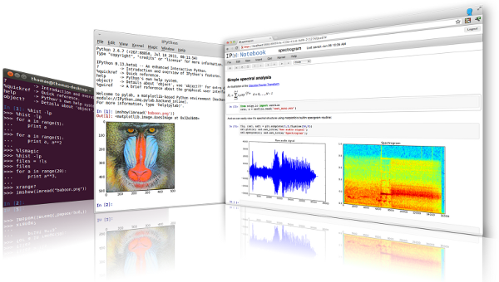

iPython and Jupyter
iPython is an interactive programming shell for the Python programming language https://ipython.org/
The Jupyter Notebook is an open-source web application that allows you to create and share documents that contain live code… http://jupyter.org/
Stephen Downes - Applications, Algorithms and Data - November 30, 2017

Slide 14
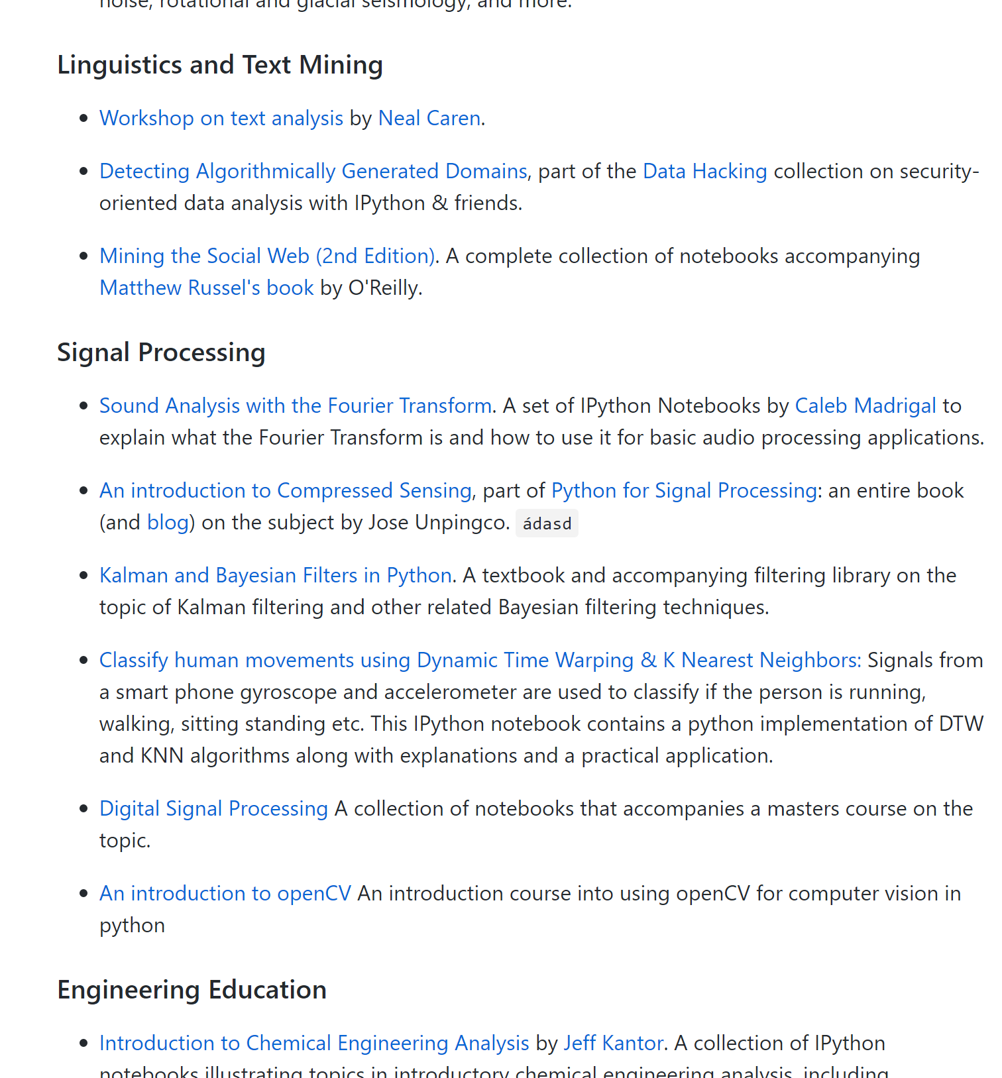
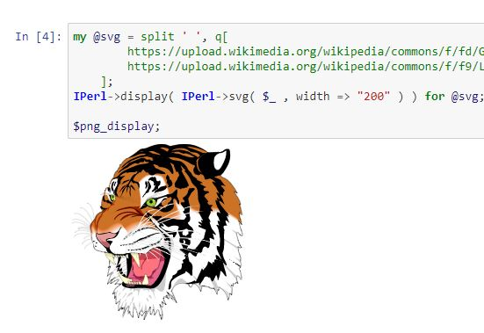
A gallery of Jupyter Notebooks
https://github.com/jupyter/jupyter/wiki/A-gallery-of-interesting-Jupyter-Notebooks#machine-learning-statistics-and-probability
Stephen Downes - Applications, Algorithms and Data - November 30, 2017

Slide 15
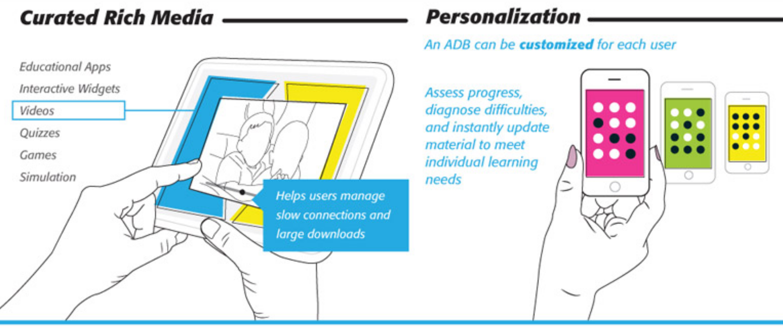
Actionable Data Book
“… mobile technology, experiential analytics, and rich media, delivered through interactive eBook technology.”
https://standards.ieee.org/develop/indconn/adb/index.html
The IEEE Actionable Data Book and EPUB 3
https://www.slideshare.net/JohnBCosta/adb-brief-for-edupub-2014

Slide 16

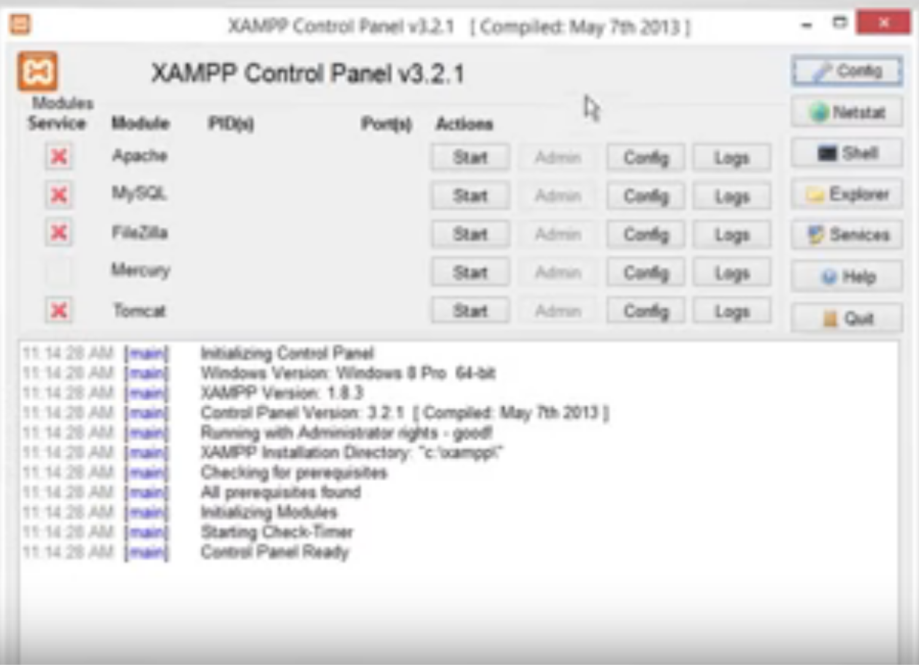
XAMPP
“XAMPP is a completely free, easy to install Apache distribution containing MariaDB, PHP, and Perl. The XAMPP open source package has been set up to be incredibly easy to install and to use.”
XAMPP on a USB Stick
https://portableapps.com/apps/development/xampp
https://willtan.com/installing-xampp-on-usb-flash-drive/
https://www.apachefriends.org/index.html
Stephen Downes - Applications, Algorithms and Data - November 30, 2017

Slide 17
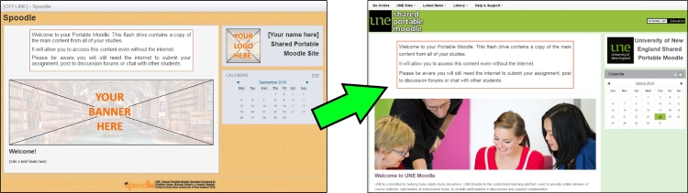
Spoodle
“Spoodle is an up to date portable moodle / ‘moodle on a stick’ solution for learners to access Moodle courses without requiring constant internet access.”
https://moodle.org/mod/forum/discuss.php?d=342367
https://www.youtube.com/watch?v=EsHEgSYKr4A
Stephen Downes - Applications, Algorithms and Data - November 30, 2017

Slide 18
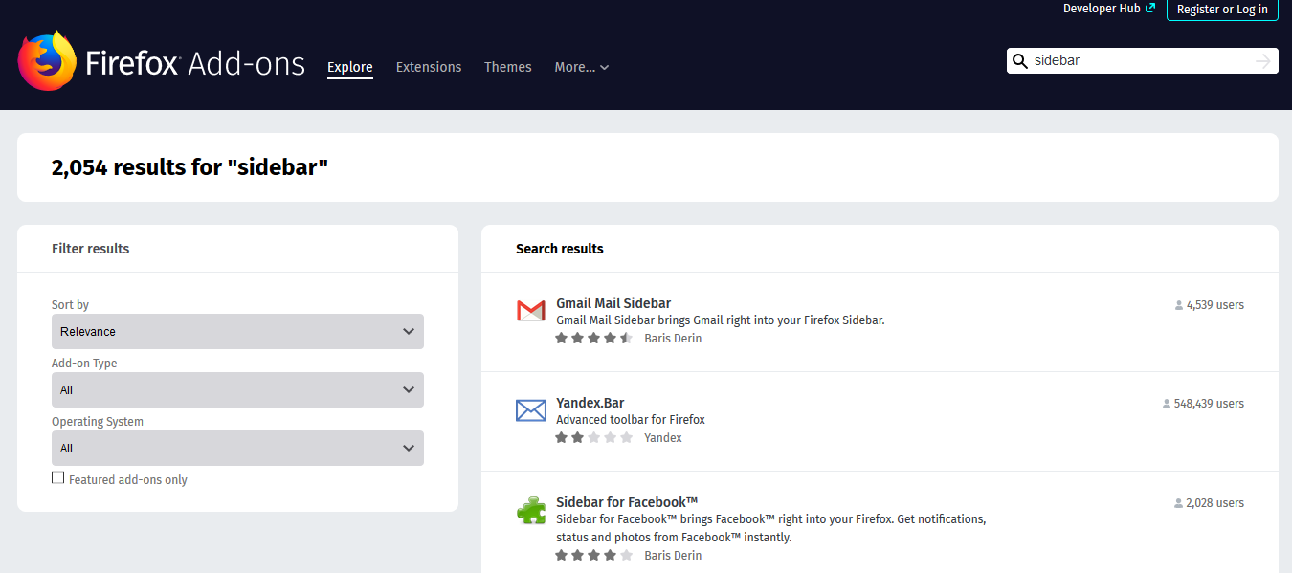
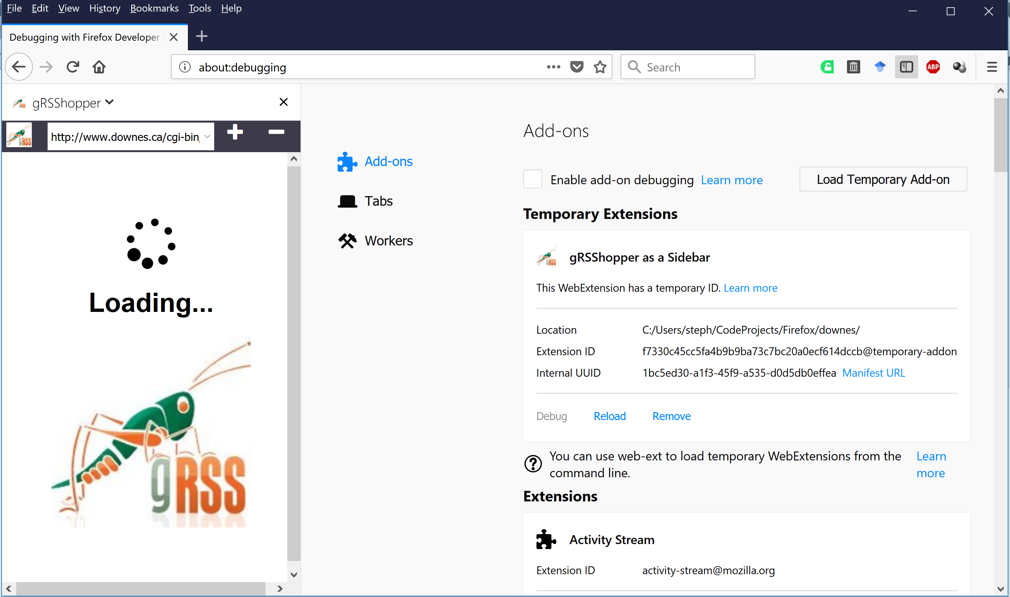
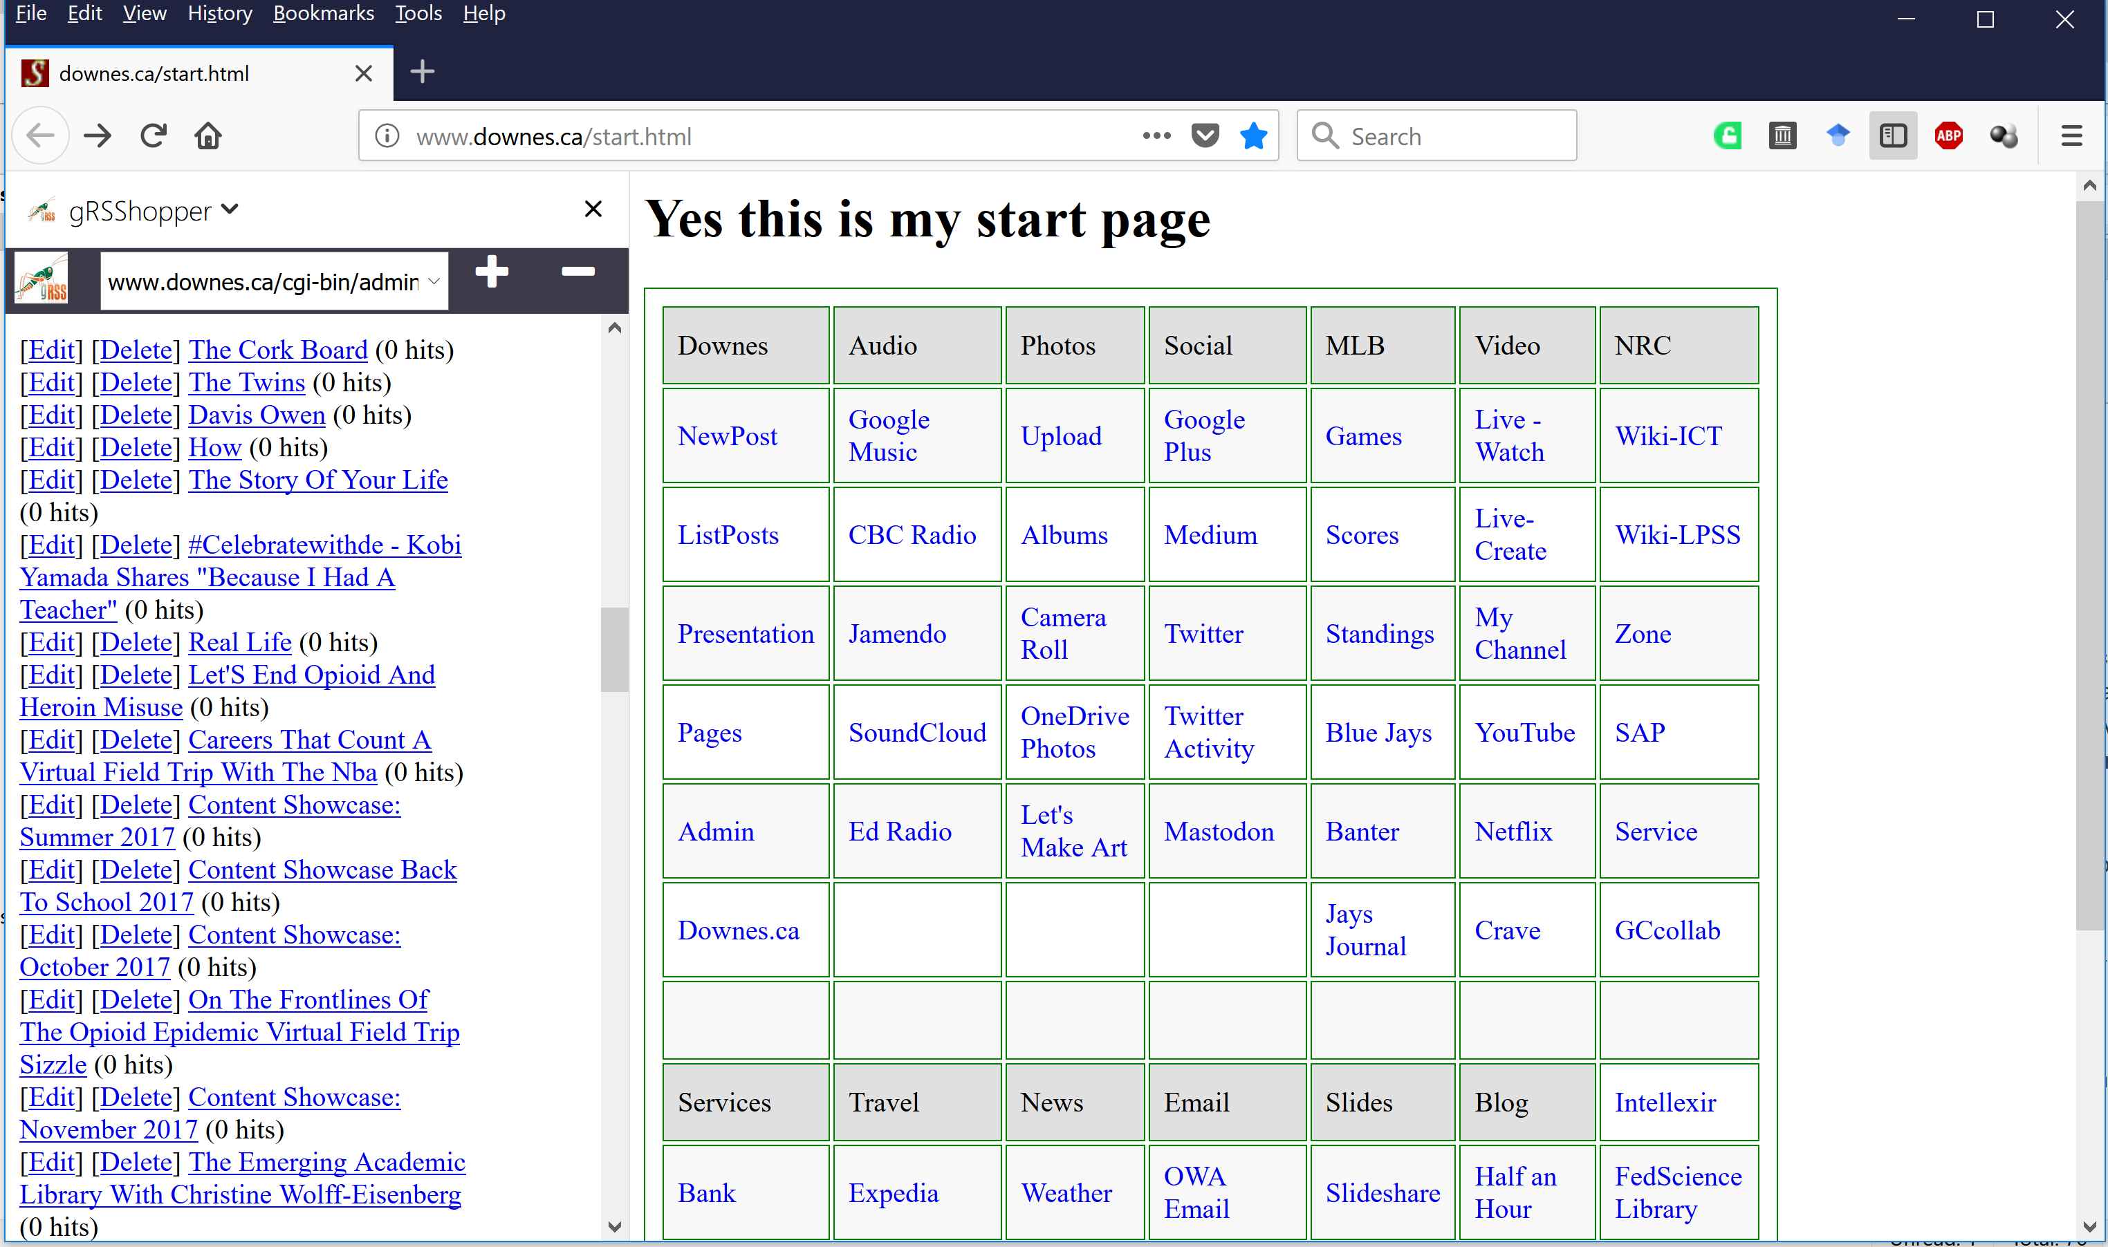
Applications in Other Applications
gRSShopper as a Firefox Sidebar
https://addons.mozilla.org/en-US/firefox/search/?q=sidebar&platform=WINNT&appver=58.0
Stephen Downes - Applications, Algorithms and Data - November 30, 2017

Slide 19
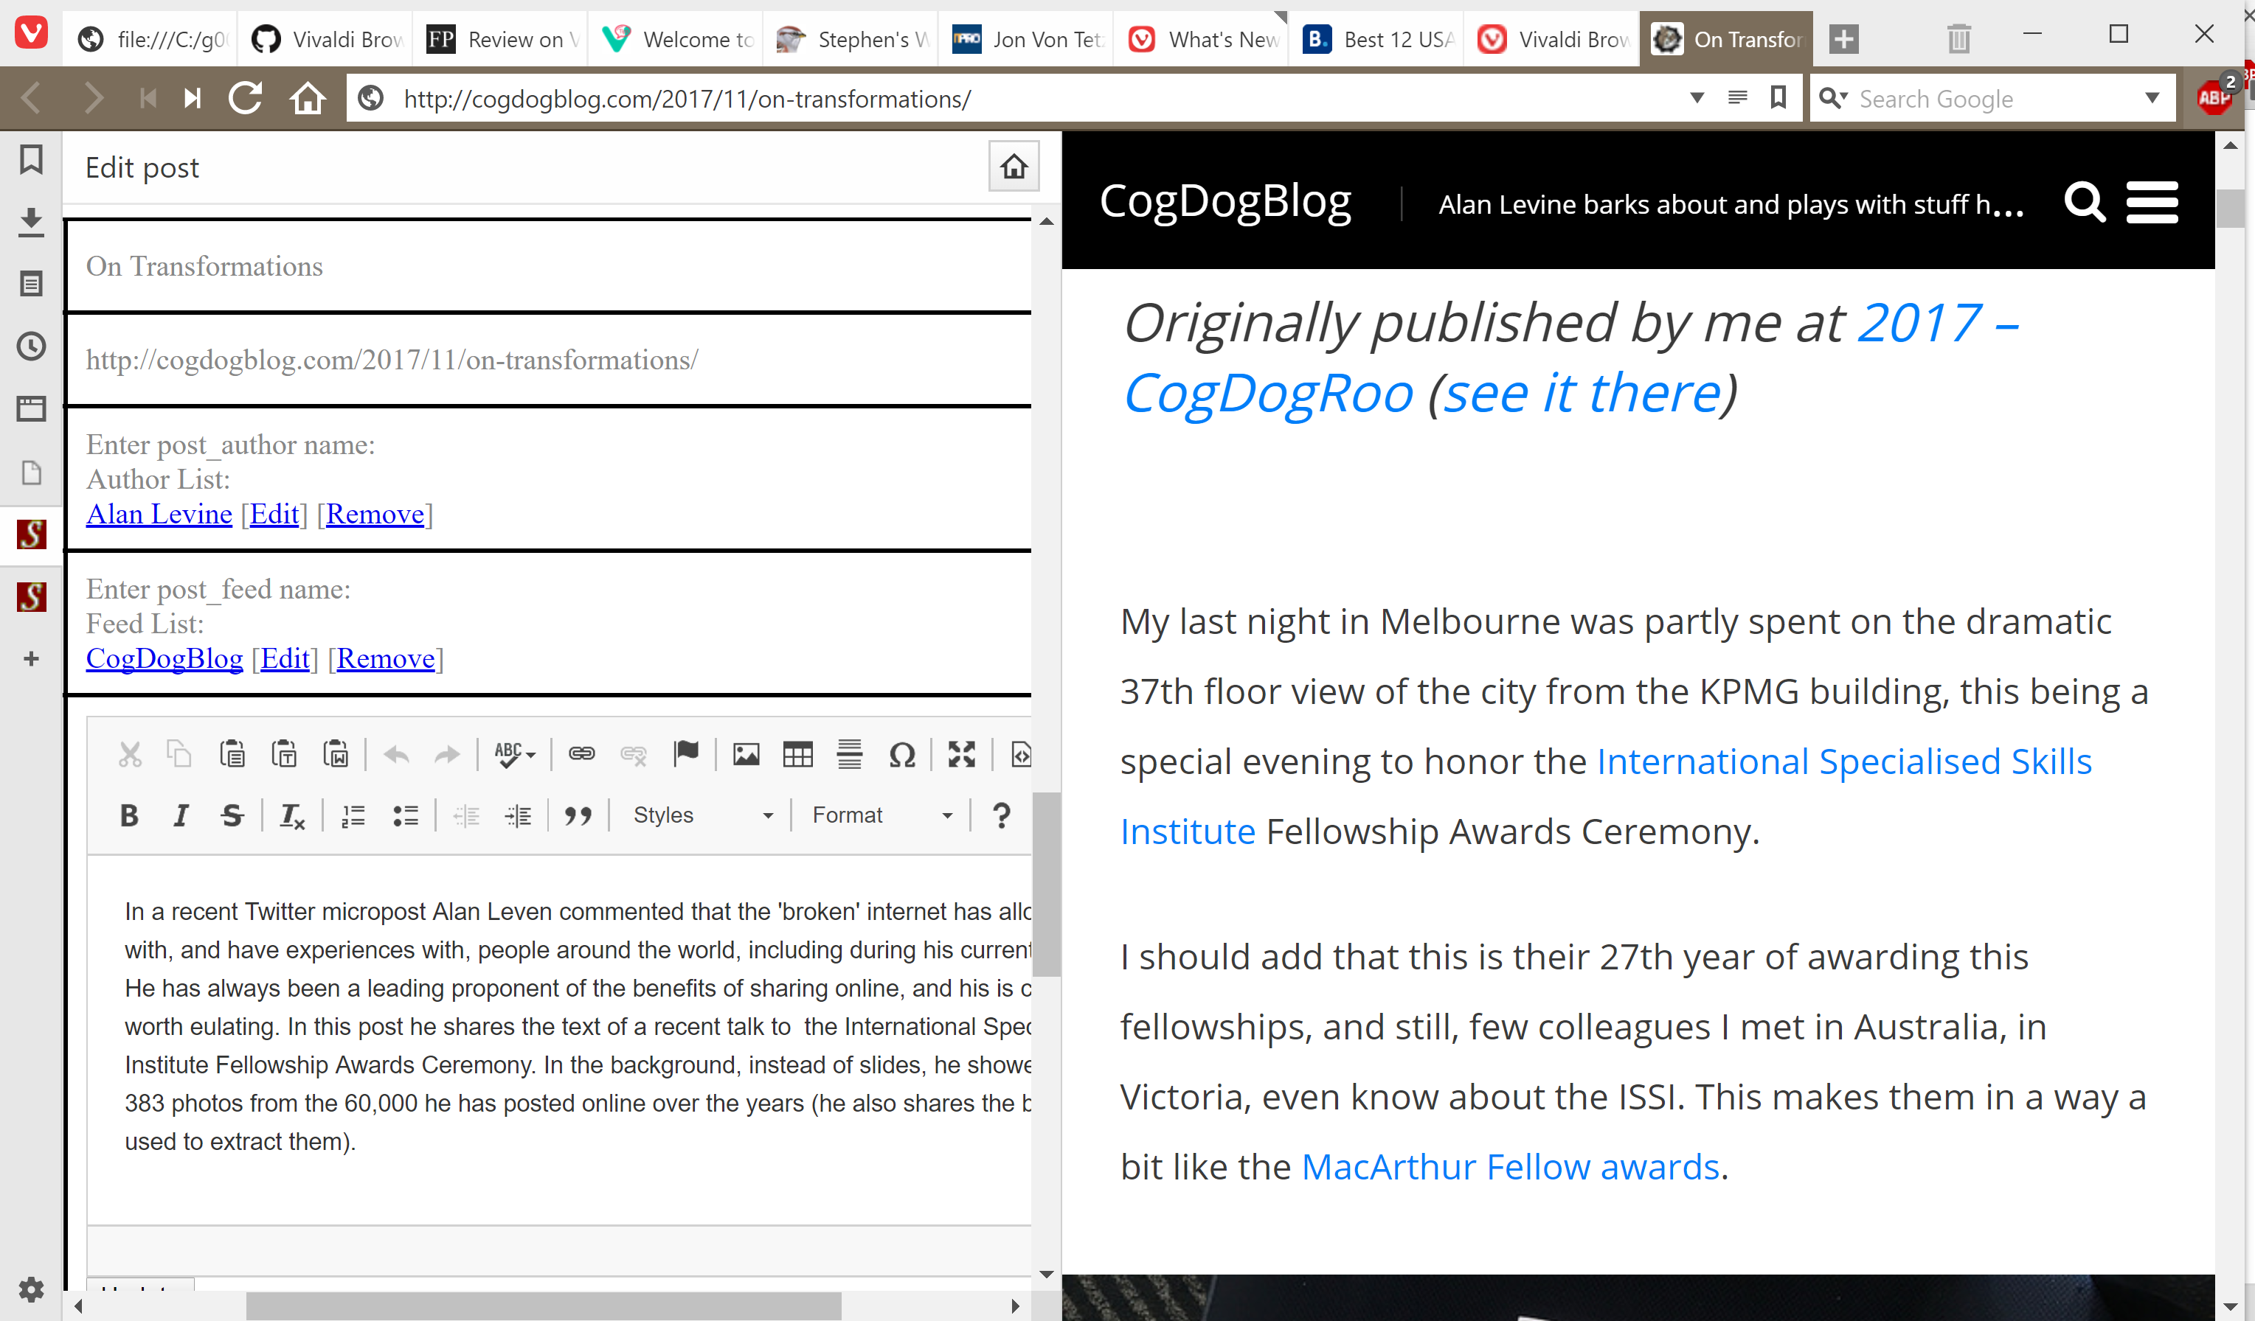
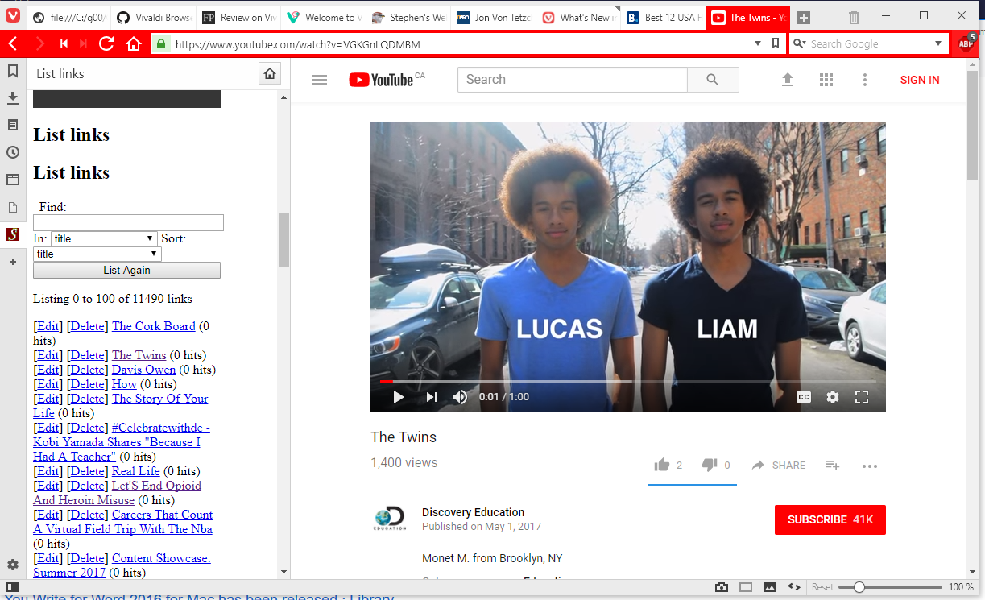
Applications in Other Applications
gRSShopper in Vivaldi
https://vivaldi.com/
Stephen Downes - Applications, Algorithms and Data - November 30, 2017

Slide 20
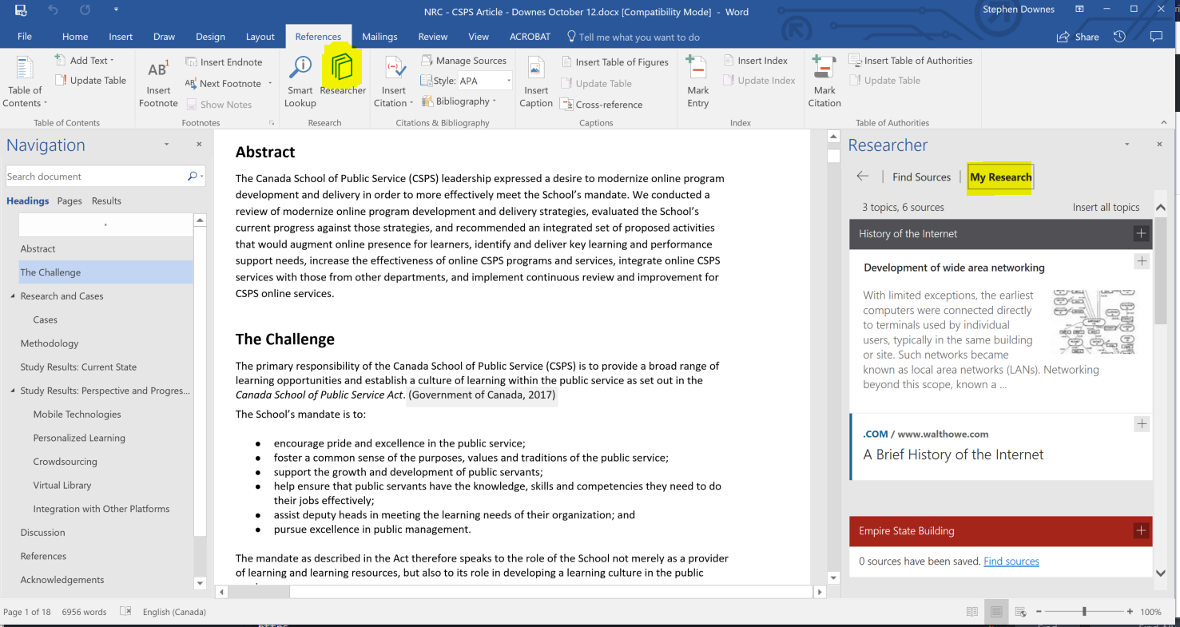

Applications in Other Applications
Research and References in an MS-Word Plugin
https://www.officetooltips.com/office_2013/tips/advanced_research_with_research_pane.html
Stephen Downes - Applications, Algorithms and Data - November 30, 2017

Slide 21
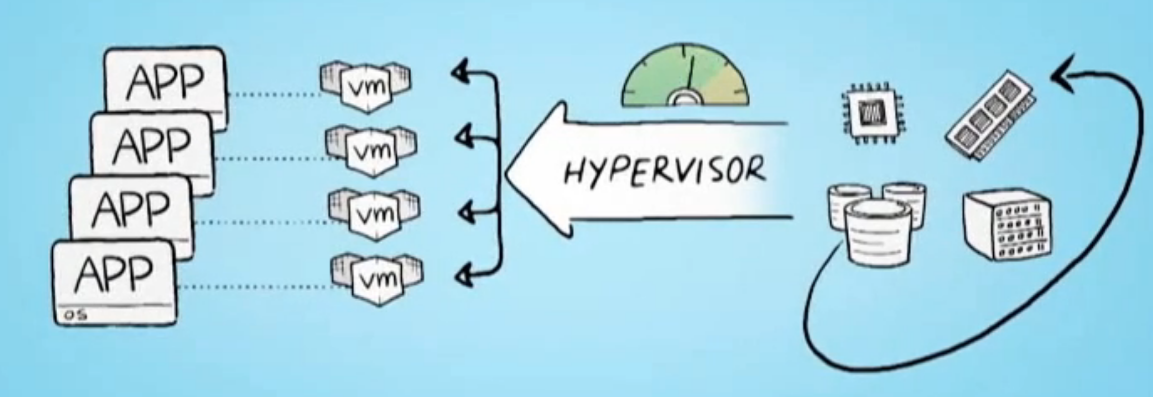
Server Virtualization
Parallels - https://www.parallels.com/
VMWare - https://www.vmware.com/
XenServer - https://xenserver.org/
Virtual Box - https://www.virtualbox.org/
Hyper-V - https://docs.microsoft.com/en-us/virtualization/hyper-v-on-windows/quick-start/enable-hyper-v
Stephen Downes - Applications, Algorithms and Data - November 30, 2017

Slide 22
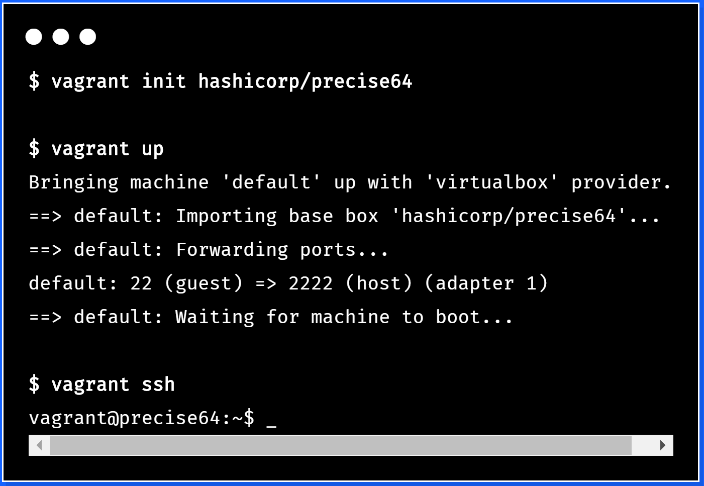

Virtualization Platforms - Vagrant
https://www.vagrantup.com/
Stephen Downes - Applications, Algorithms and Data - November 30, 2017

Slide 23
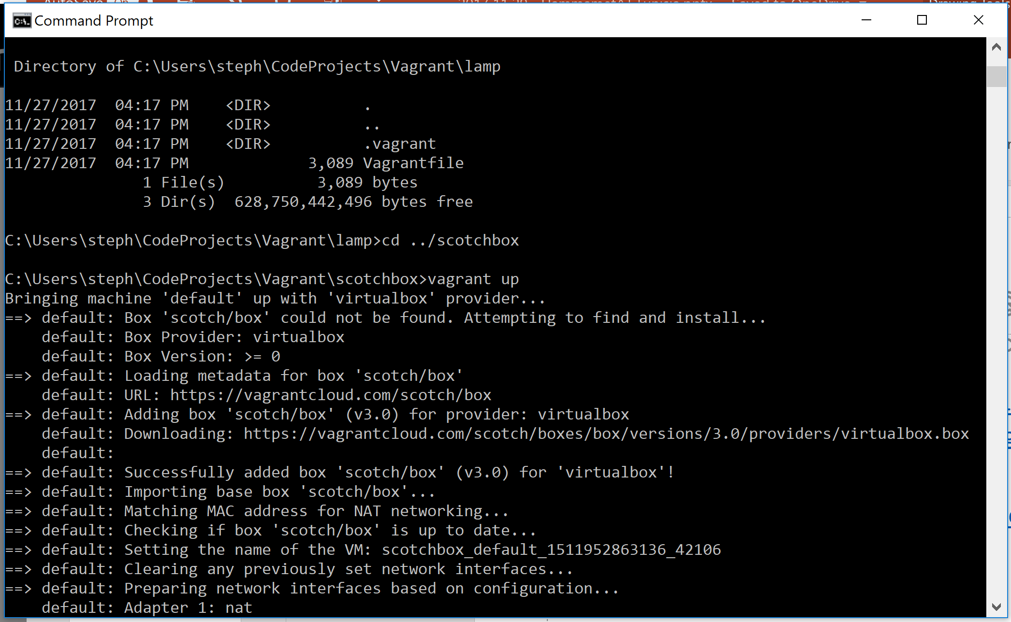
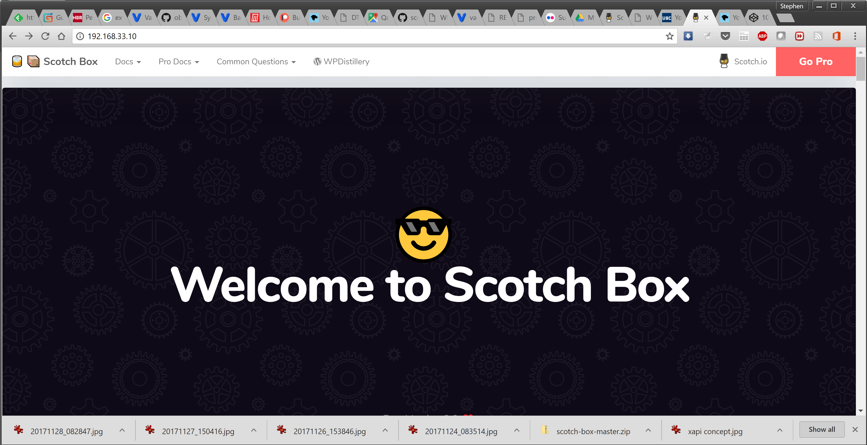
Loading and Running Vagrant
Scotch Box
  https://box.scotch.io/ -- http://192.168.33.10/
  WPDistillery - https://wpdistillery.org/ - for WordPress
Homestead
  Instructions - https://laravel.com/docs/5.5/homestead#first-steps
Stephen Downes - Applications, Algorithms and Data - November 30, 2017

Slide 24
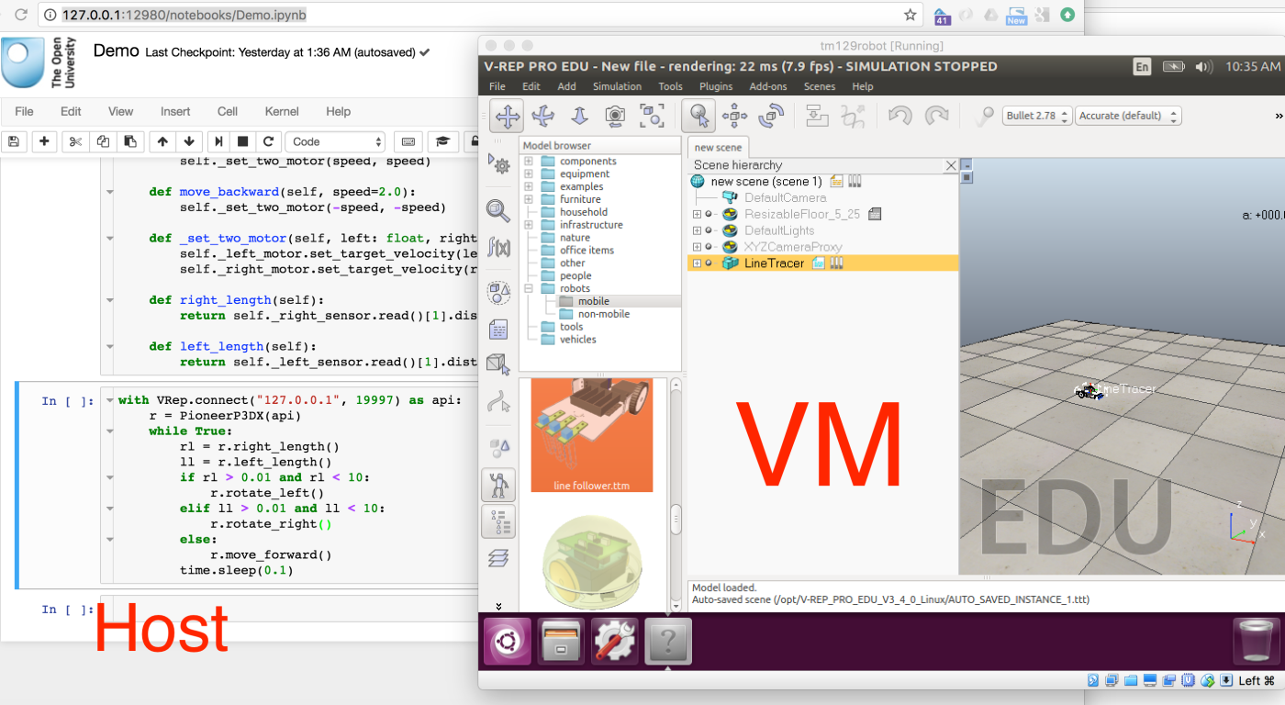
Vagrant as Learning Environment
Distributing Virtual Machines That Include a Virtual Desktop To Students – V-REP + Jupyter Notebooks – Tony Hirst https://blog.ouseful.info/2017/09/10/distributing-virtual-machines-that-include-a-virtual-desktop-to-students-v-rep-jupyter-notebooks/

Slide 25
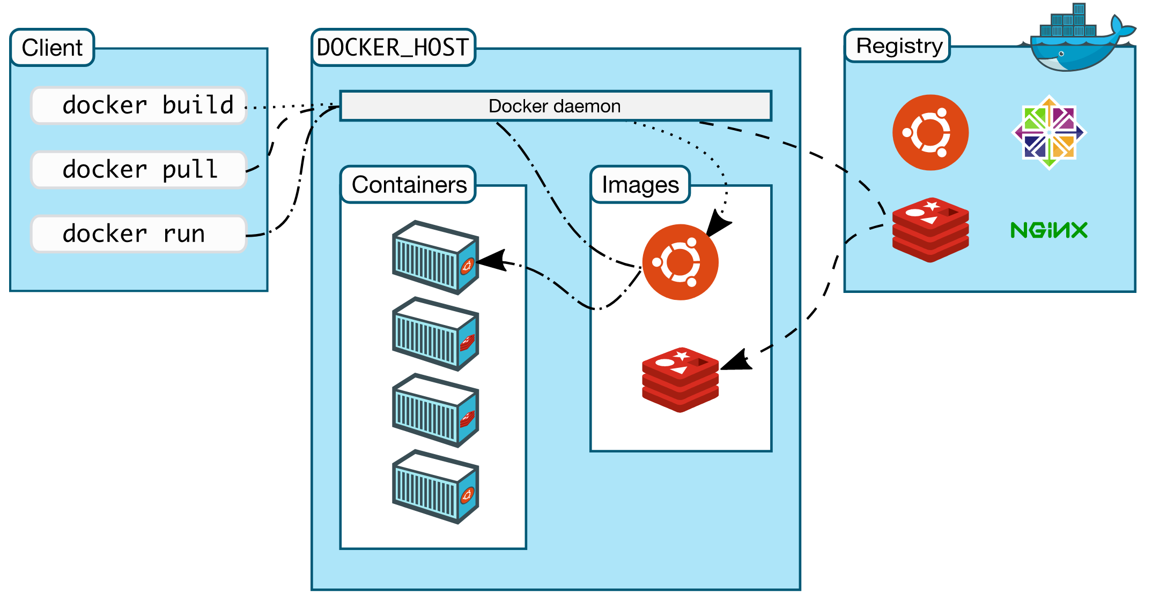
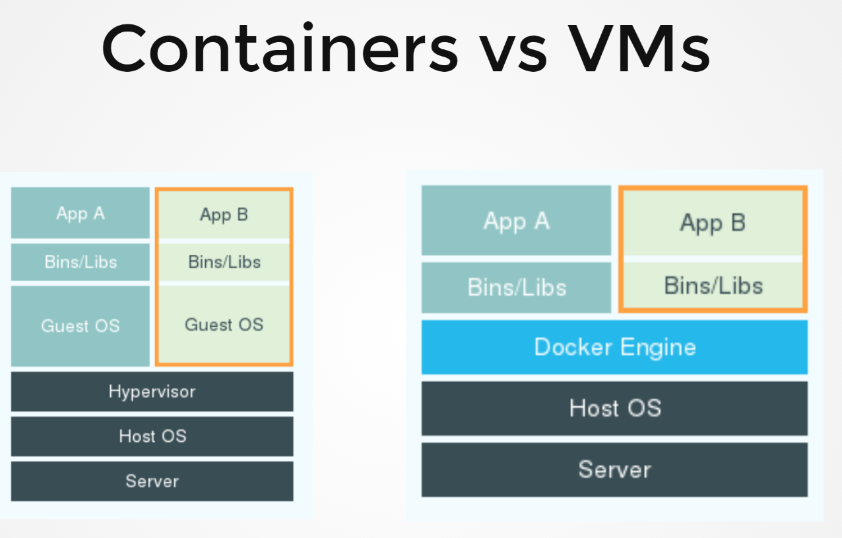
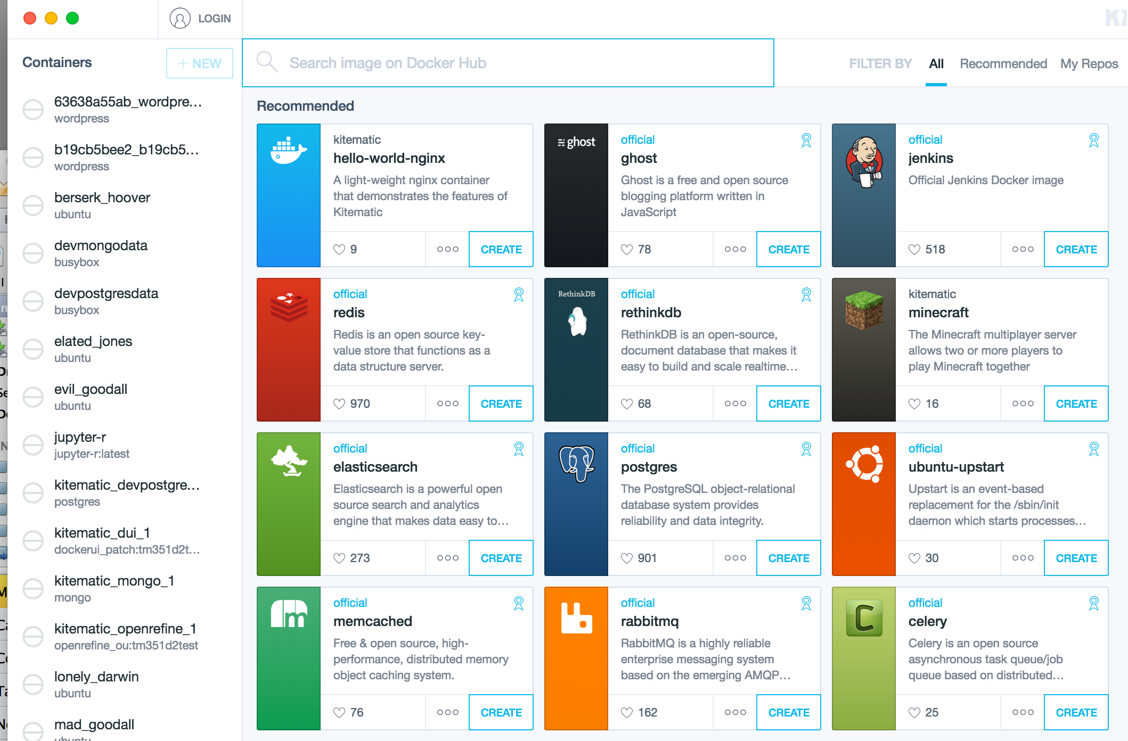
Docker
Stephen Downes - Applications, Algorithms and Data - November 30, 2017

Slide 26
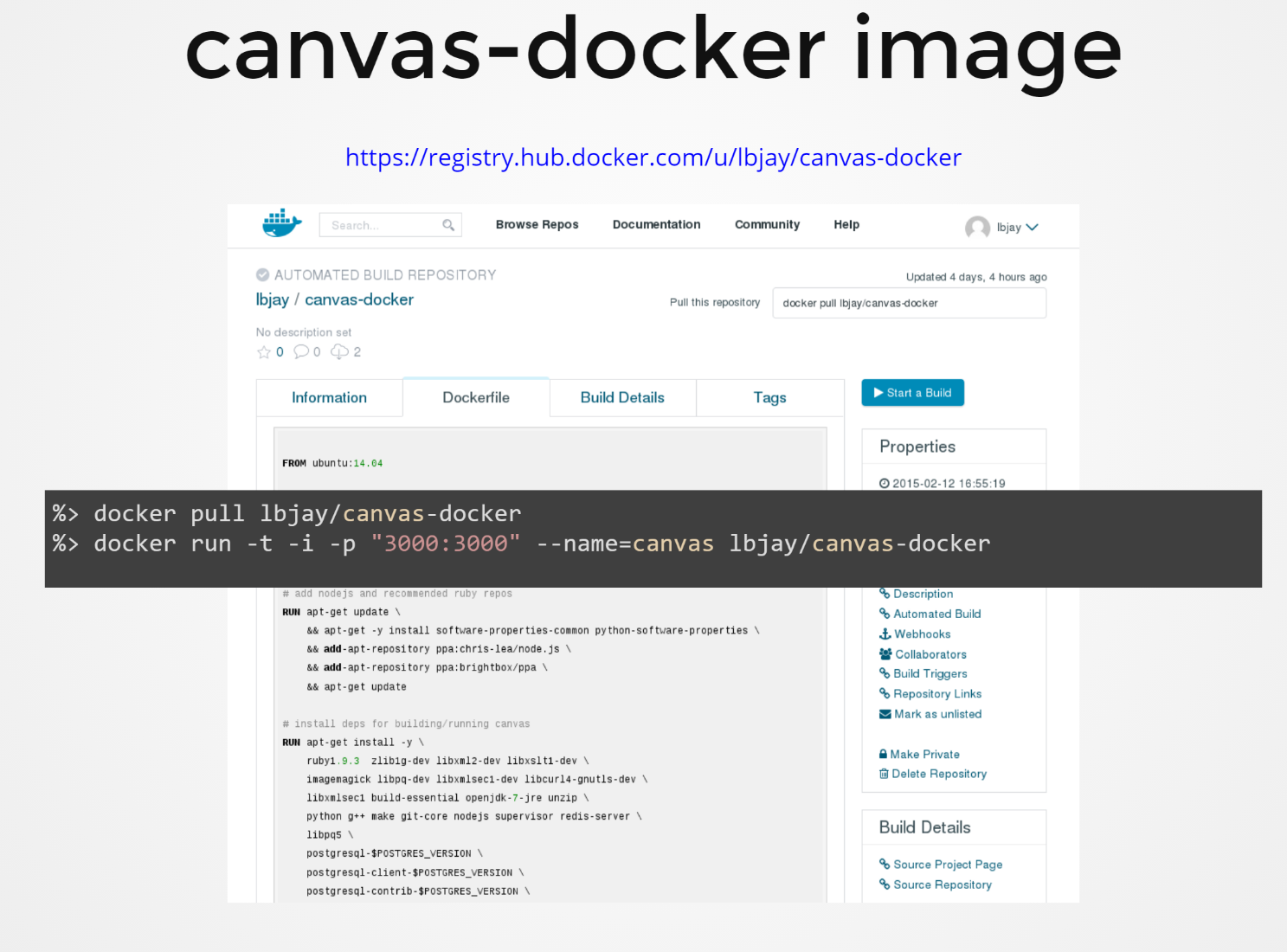
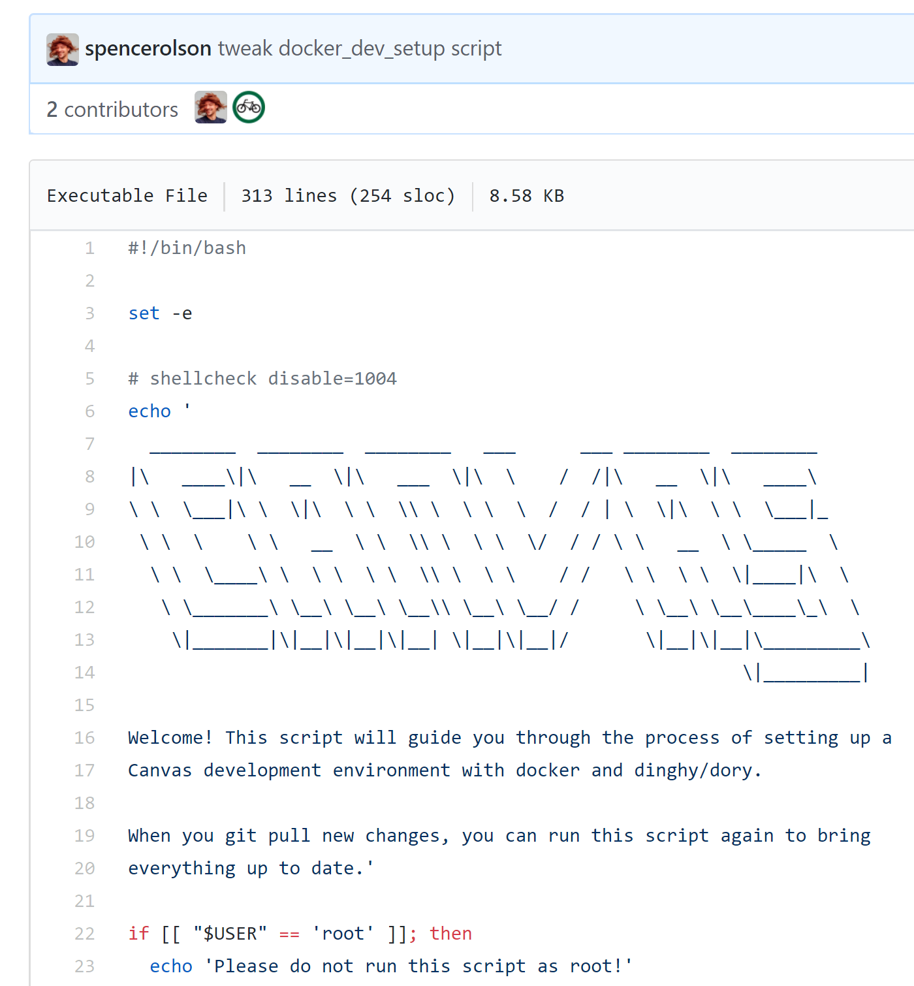
Canvas on Docker
https://github.com/instructure/canvas-lms/blob/master/script/docker_dev_setup.sh
http://slides.com/jamesluker/how-to-docker-2#/
Stephen Downes - Applications, Algorithms and Data - November 30, 2017

Slide 27
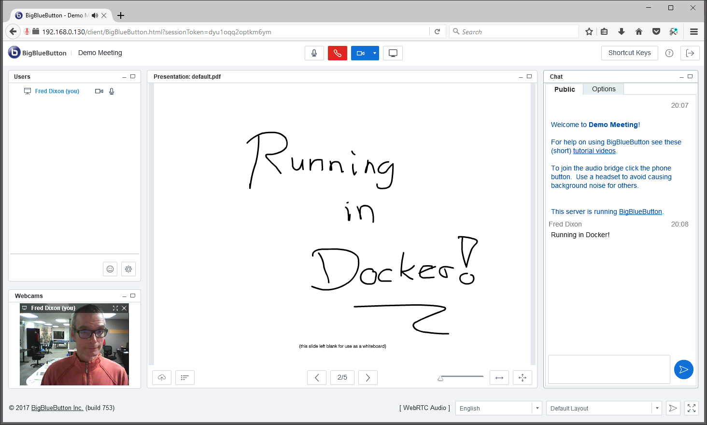
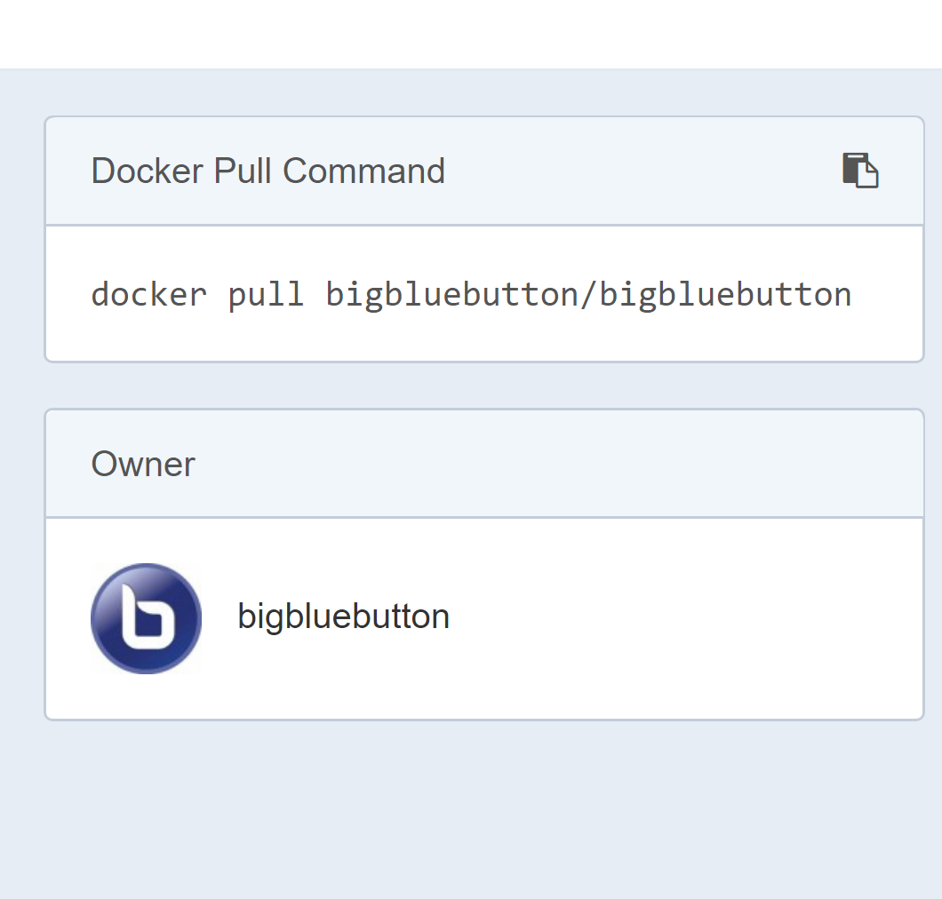
Big Blue Button in Docker
http://docs.bigbluebutton.org/labs/docker.html
https://hub.docker.com/r/bigbluebutton/bigbluebutton/
Stephen Downes - Applications, Algorithms and Data - November 30, 2017

Slide 28
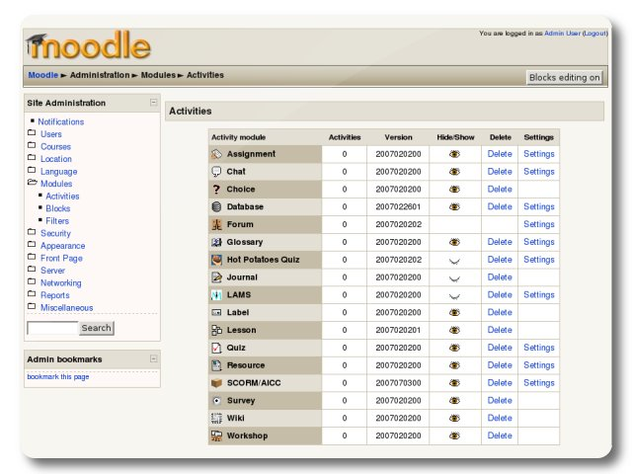
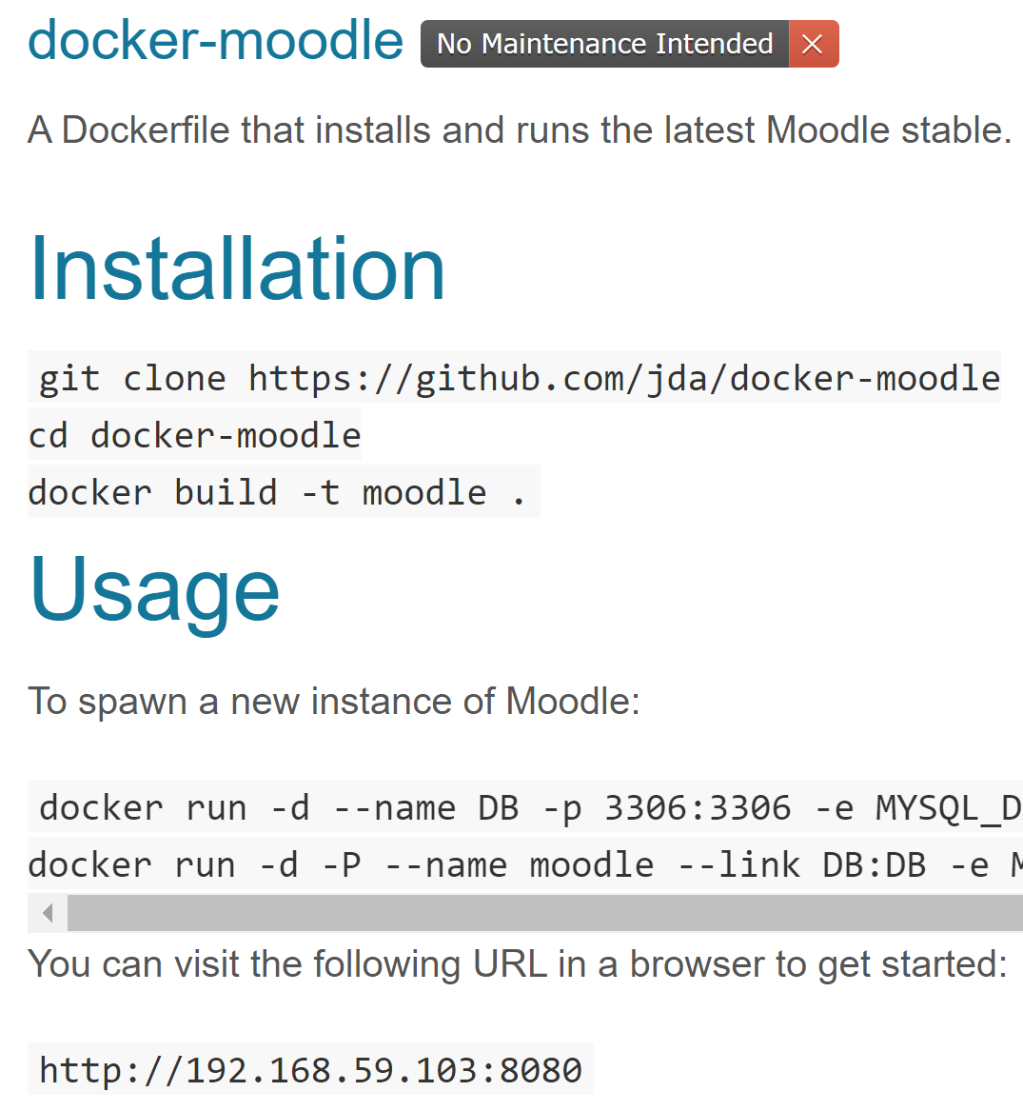
Moodle on Docker
https://hub.docker.com/r/jauer/moodle/
Stephen Downes - Applications, Algorithms and Data - November 30, 2017

Slide 29
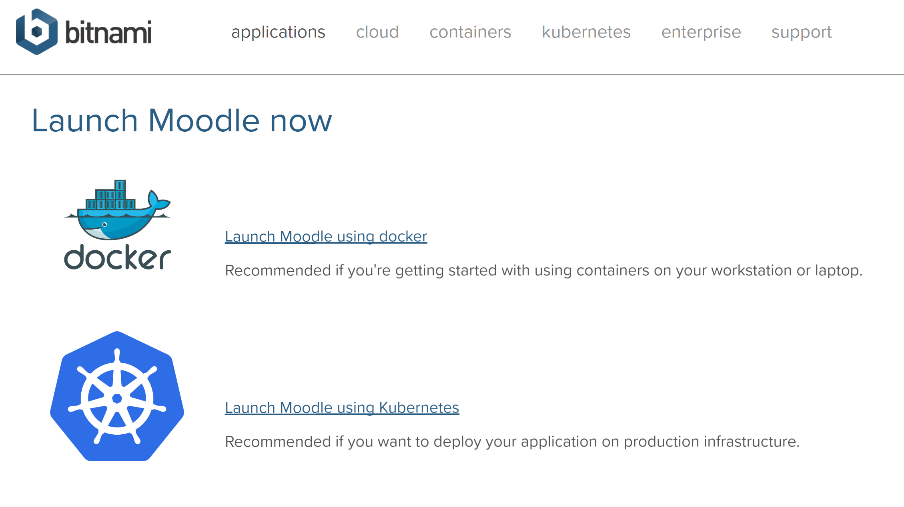
Options
https://bitnami.com/stack/moodle/containers
Stephen Downes - Applications, Algorithms and Data - November 30, 2017

Slide 30

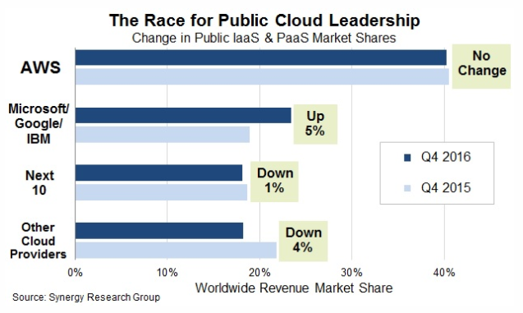




Cloud Infrastructure Providers
AWS – Amazon - https://aws.amazon.com/
Azure – Microsoft - https://azure.microsoft.com
Bluemix – IBM Cloud - https://www.ibm.com/cloud/
Google Cloud Platform - https://cloud.google.com/
Oracle Cloud - https://cloud.oracle.com/
https://www.srgresearch.com/articles/microsoft-google-and-ibm-charge-public-cloud-expense-smaller-providers
Stephen Downes - Applications, Algorithms and Data - November 30, 2017

Slide 31
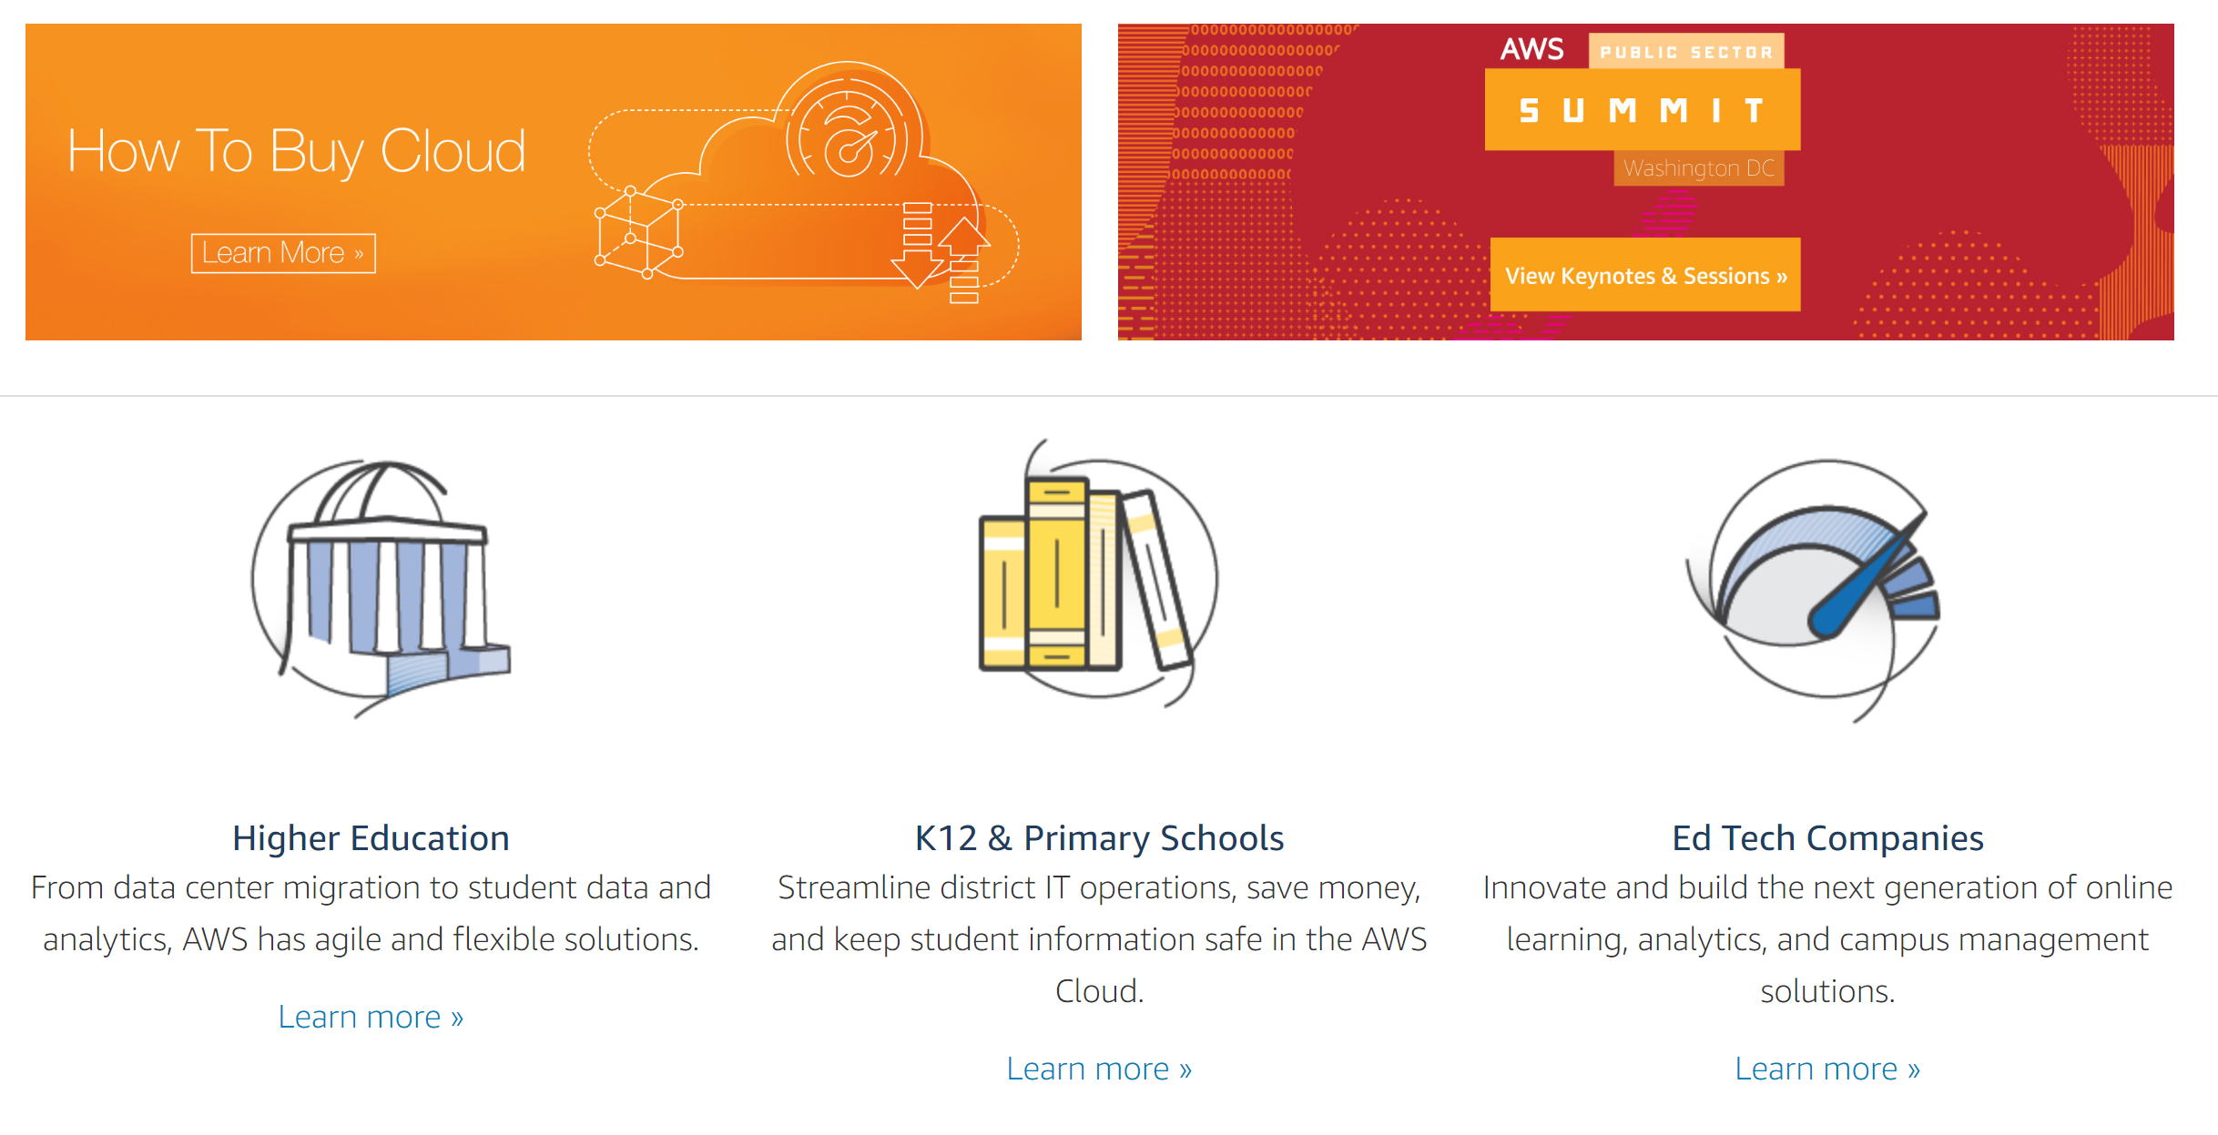

Cloud Computing for Education
Amazon Web Services - https://aws.amazon.com/education/
Stephen Downes - Applications, Algorithms and Data - November 30, 2017

Slide 32
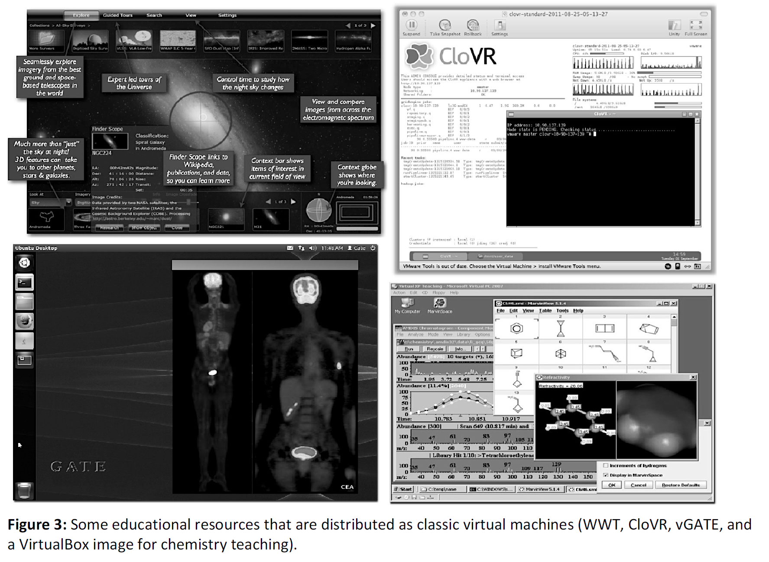
OER and Virtualization
Open Distribution of Virtual Containers as a Key Framework for Open Educational Resources and STEAM Subjects Alberto Corbi and Daniel Burgos
http://www.ejel.org/issue/download.html?idArticle=575
“Unikernels represent and deeper simplification of the virtual container approach, given that all necessary computing elements (operative system kernel, basic libraries, frameworks, drivers, scientific application, etc.)”
Stephen Downes - Applications, Algorithms and Data - November 30, 2017

Slide 33
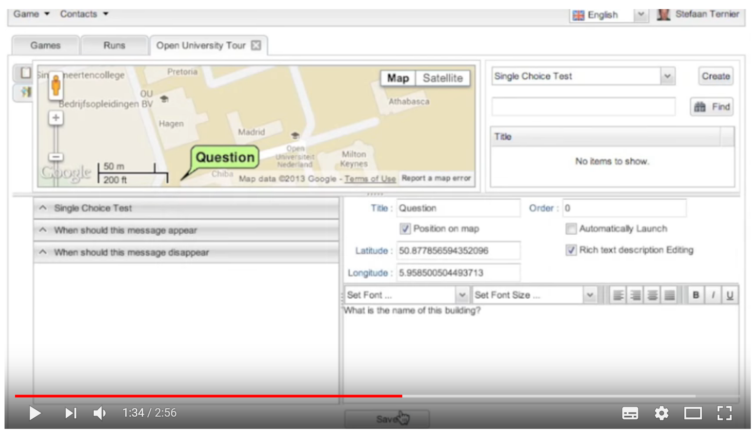
Mobile Authoring for ARLearn
“The Mobile Authoring Tool complements the ARLearn desktop-based environment. Hence, a mobile game author can wander around creating items and synchronizing real world artefacts with game content.”
ARLearn
ARLearn is a technical framework for creating mobile serious games
http://ar-learn.com/
https://dspace.ou.nl/bitstream/1820/5674/1/UAIS_Tabuenca_2014.pdf
Bernardo Tabuenca; Marco Kalz; Stefaan Ternier; Marcus Specht
https://www.youtube.com/watch?v=Lqk3yrcNjNI
Stephen Downes - Applications, Algorithms and Data - November 30, 2017

Slide 34
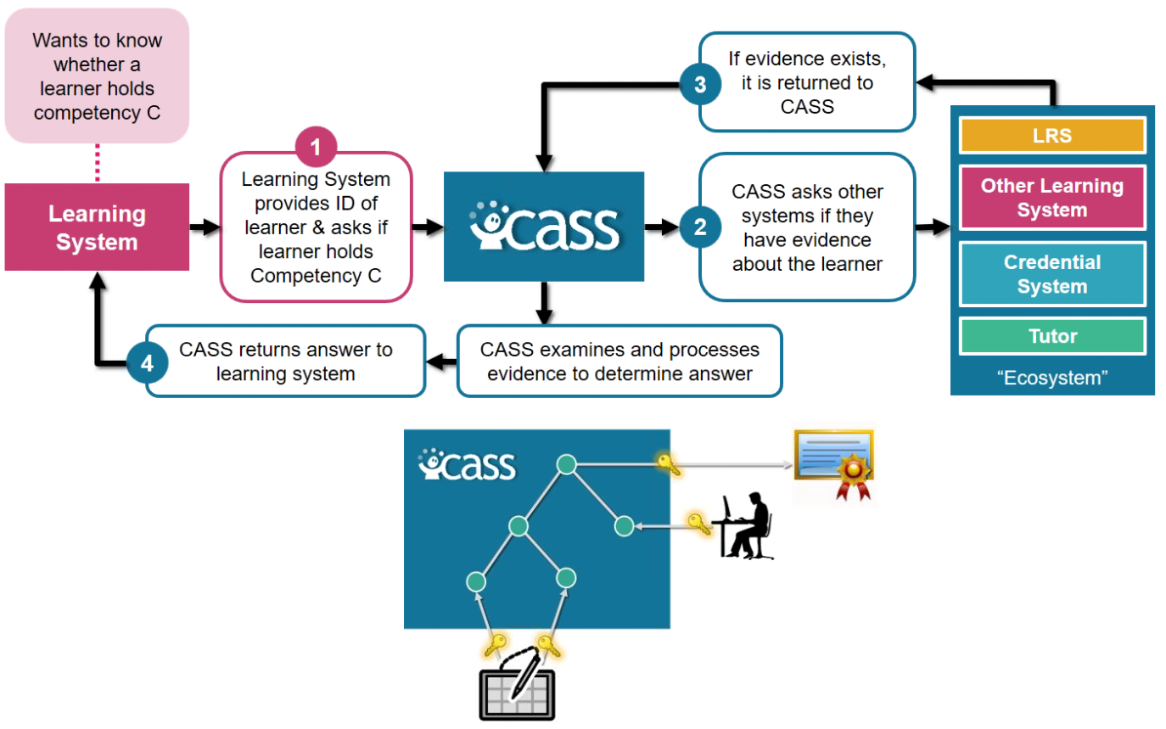
Interaction and Access Data
Unlocking Open Educational Resources (OERs) Interaction Data - David Massart, Elena Shulman
  http://www.dlib.org/dlib/may13/massart/05massart.html
Creativity in the Open Workshop
  http://blogs.ubc.ca/chendricks/
Advanced Distributed Learning (ADL):
Competencies and Skills Systems
Experience API (xAPI)
https://www.adlnet.gov/xapi/
Stephen Downes - Applications, Algorithms and Data - November 30, 2017

Slide 35
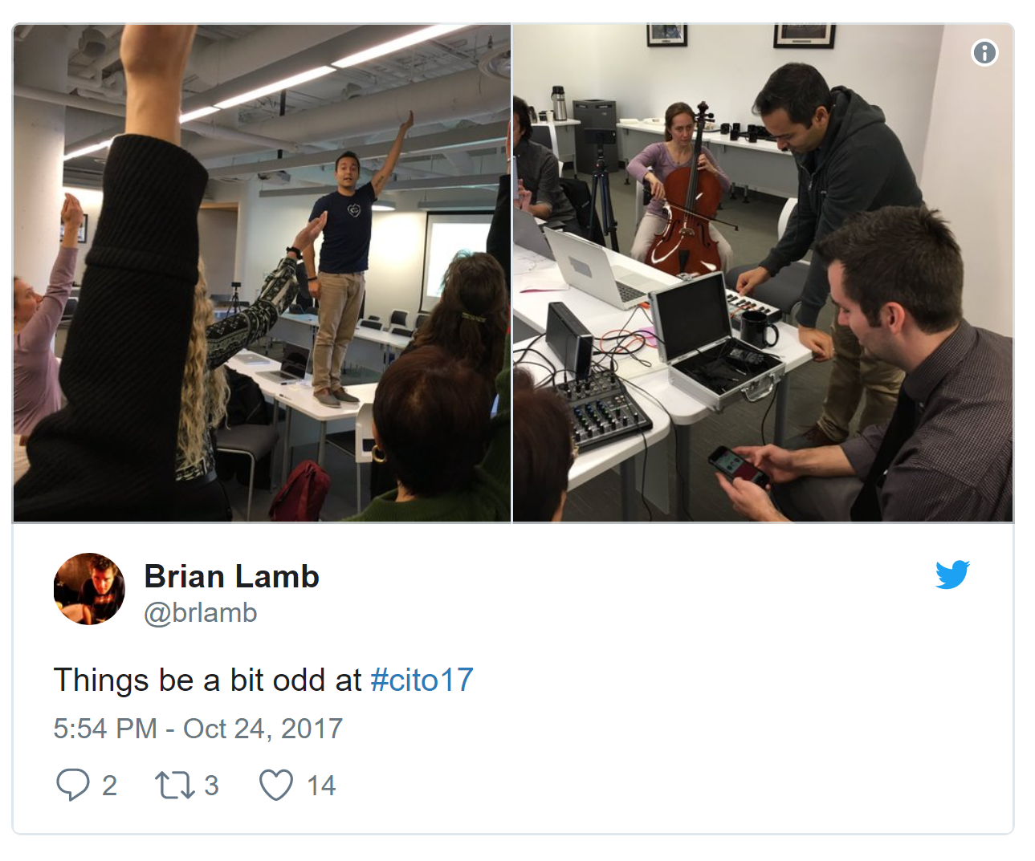
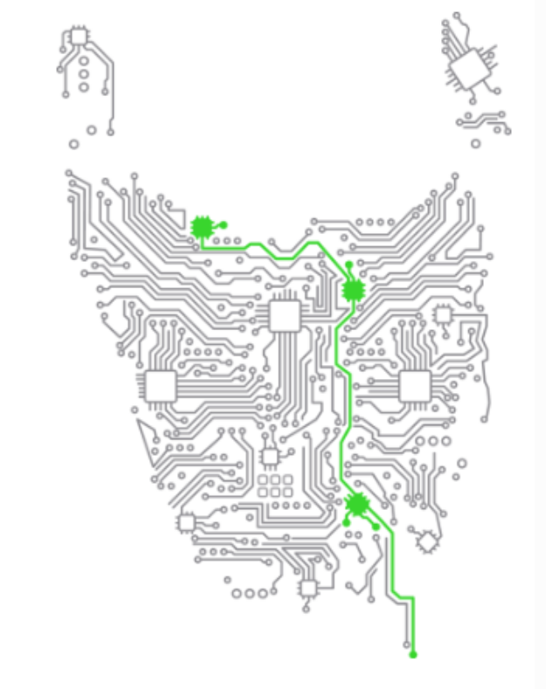
Happening Now…
Docker images to build OER
  https://gitlab.com/oer/docker
Creativity in the Open Workshop
  http://blogs.ubc.ca/chendricks/
Uhack Weekend (Tasmania)
  http://uhack-guide.readthedocs.io/en/latest/resources/project-hosting/
  https://uhack-tasmania-2017.devpost.com/
Stephen Downes - Applications, Algorithms and Data - November 30, 2017

Slide 36

Thank You
  http://www.downes.ca
Stephen Downes - Applications, Algorithms and Data - November 30, 2017

