Slide 1


Online Learning and MOOCs:
Visions and Pathways
Stephen Downes
China International Distance Education Conference 2017
Beijing, China

Slide 2
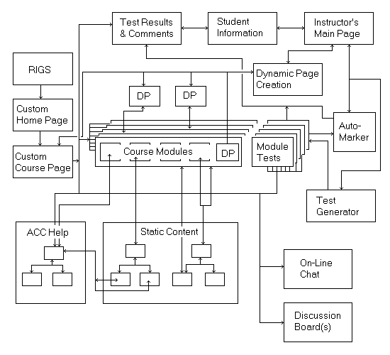
From LMS to MOOC
The dominant paradigm (that nobody uses) – learning objects
IEEE: "any entity, digital or non-digital, which can be used, re-used or referenced during technology supported learning.“
Wayne Hodgins – learning objects are like Legos, that can be put together in different ways; David Wiley – learning objects are like atoms

Slide 3
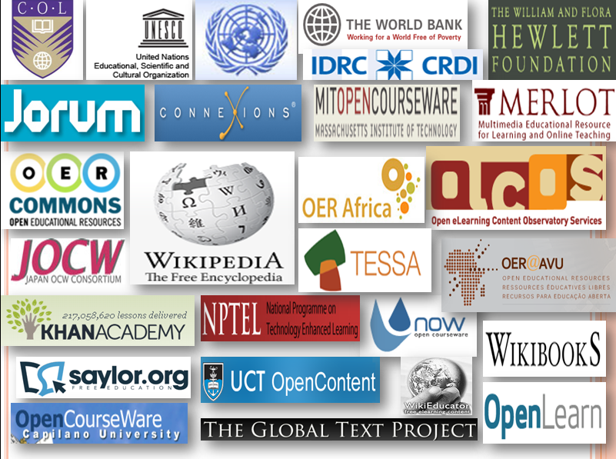
Content and Open educational Resources
People should stop thinking of learning objects as though they were classes or lessons or some such thing with built-in intent. It is preferable to think of them as a greatly enhanced vocabulary that can be used in a multidimensional (as opposed to merely linear) language

Slide 4
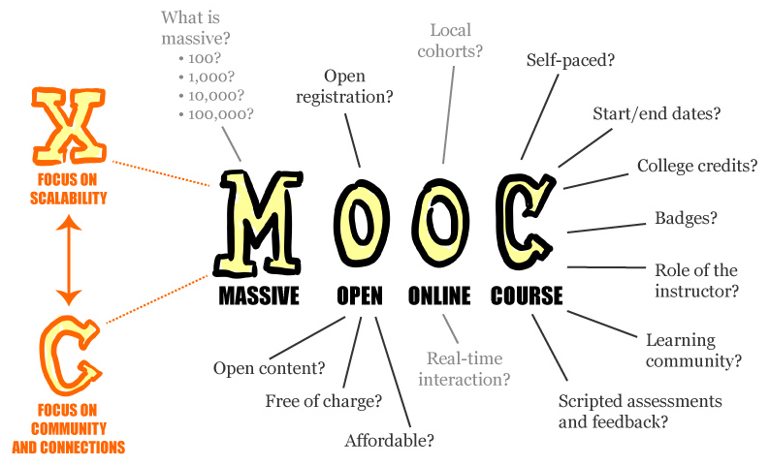
The MOOC
Massive Open Online Course (MOOC):
- ‘Massive’ by design - Network design avoids bottlenecks; scaling by mesh
- ‘Open’ as in door - Free as in ‘beer’ and ‘libre’, Open as in ‘content’ & in ‘door’
- ‘Online’ as in online - Local events encouraged, but the course isn’t offline
- ‘Course’ (as opposed to community) - In the sense of ‘a course of lectures’
Notes:
https://en.wikipedia.org/wiki/Massive_open_online_course

Slide 5
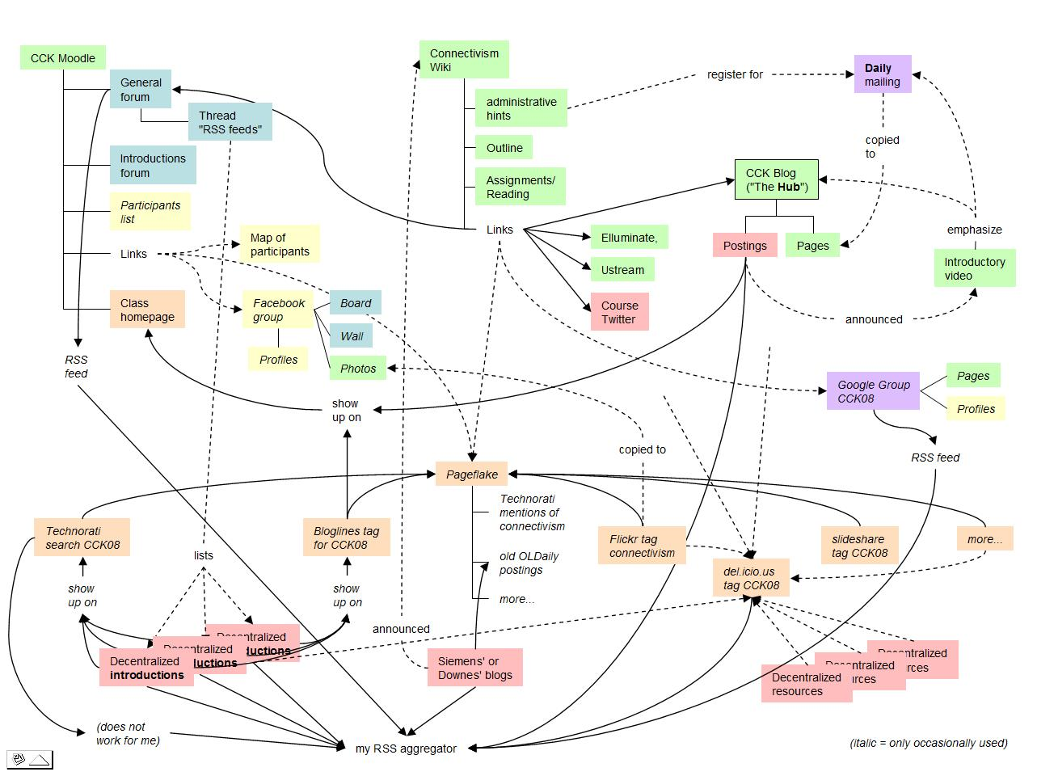
Origins of the MOOC
The idea was to recreate the concept of the 'course of lectures' from the traditional university. Students are responsible for their own education, often forming communities or societies to collaborate. Students would bring in additional resources, contribute to the discussions, and over time, develop their own thoughts and theses.

Slide 6
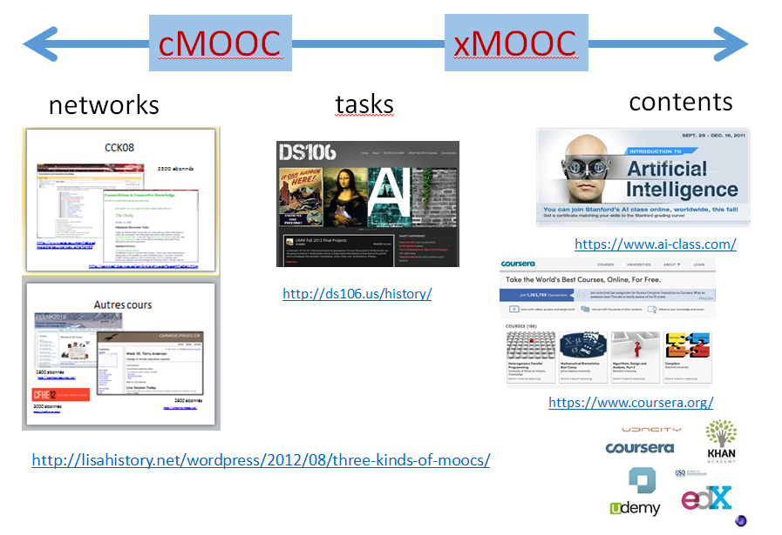
Adaptations: xMOOC and Beyond
The xMOOCs which followed (Stanford AI, EdX, etc
- they depended mostly on pre-recorded videos for content
- they dispensed pretty much entirely with the community
- the assignments were created centrally and became the means of assessment
- they commercialized and monetized the course (as opposed to the education)
Notes:
http://lisahistory.net/wordpress/2012/08/three-kinds-of-moocs/
http://ds106.us/history/
https://www.ai-class.com/
https://www.coursera.org/

Slide 7
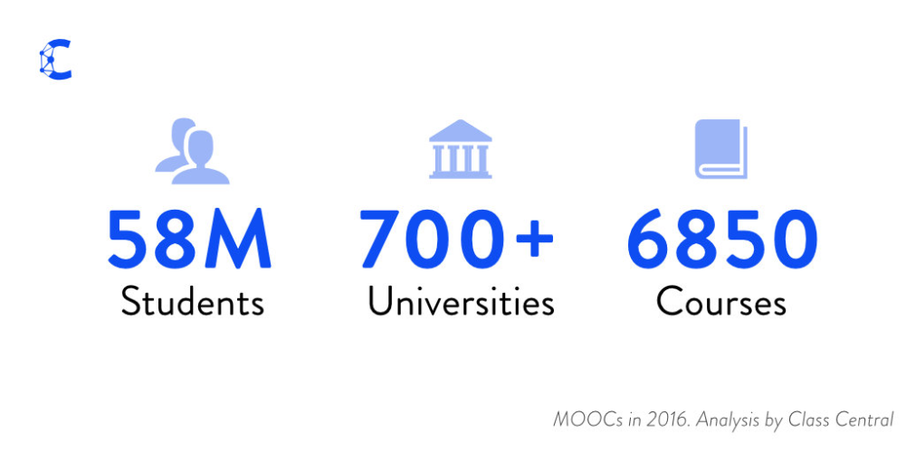
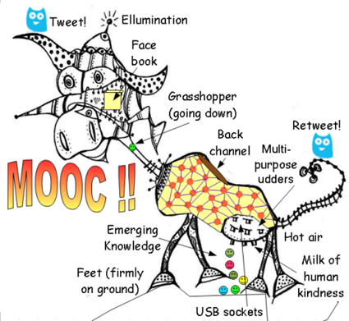
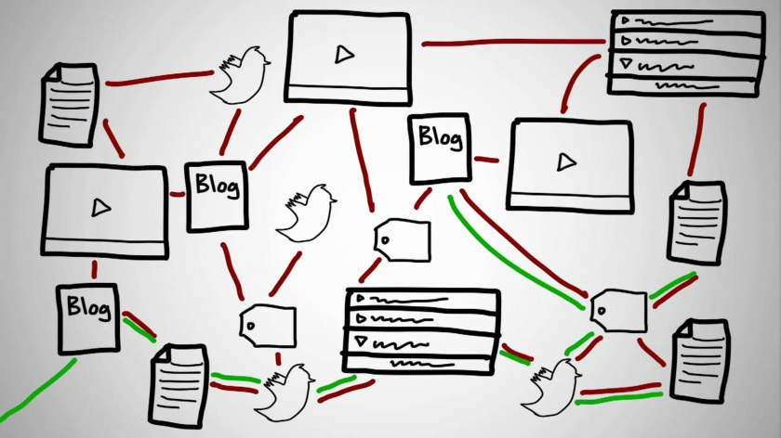
The MOOC Today
In 2016, “23 million people worldwide registered for a MOOC for the first time ever... This makes the total number of students who signed up for at least one MOOC estimated to be 58 million. 2,600+ new courses (vs. 1800 last year) were announced, taking the total number of courses to 6,850 from over 700 universities.” (Class Central)
Notes:
https://www.class-central.com/report/mooc-stats-2016/23 million people worldwide registered for a MOOC for the first time ever, according to data collected by Class Central. This makes the total number of students who signed up for at least one MOOC estimated to be 58 million.

Slide 8
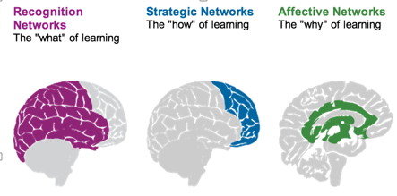
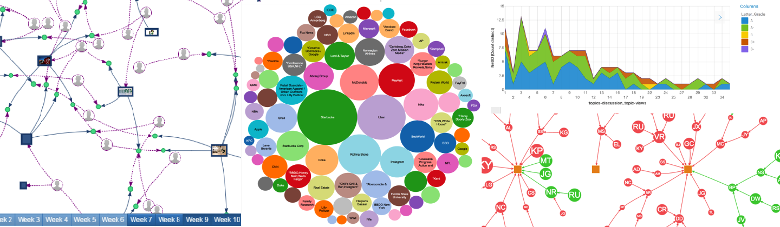
Learning Analytics
Siemens and Long
- Course-level: learning trails, social network analysis, discourse analysis
- Educational data-mining: predictive modeling, clustering, pattern mining
- Intelligent curriculum: semantically defined curricular resources
- Adaptive content: content sequence based on behavior, recommendation
- Adaptive learning: social interactions, learning activity, learner support
Notes:
https://er.educause.edu/articles/2011/9/penetrating-the-fog-analytics-in-learning-and-education
http://quantifiedself.com/
Predictive Analytics - eg. SmartKlass https://moodle.org/plugins/local_smart_klass
Recognition Tasks – eg. Learning Analytics enriched rubrics - https://docs.moodle.org/30/en/Learning_Analytics_Enriched_Rubrics
See also: http://www.vteducation.org/en/articles/learner-data/introduction-learning-analytics

Slide 9
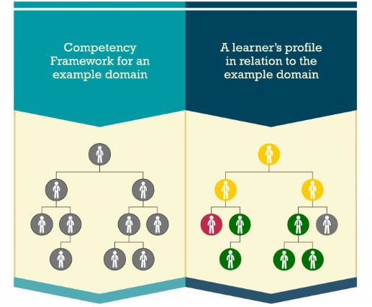
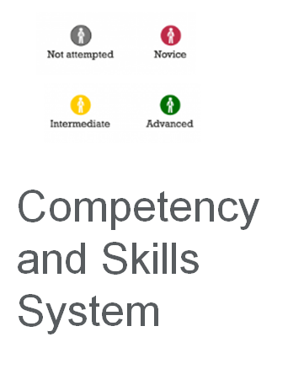
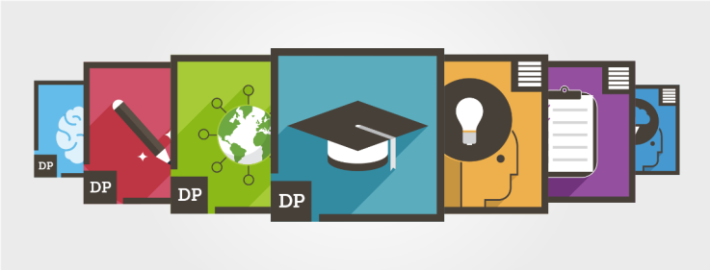
Competencies and Skills
Disaggregation of the traditional degree, breaking it into component parts (Horizon Report). “To be profitable privatisation depends on standardisation to scale.” (We The Educators). Credentials earn careers, but competencies earn gigs.

Slide 10
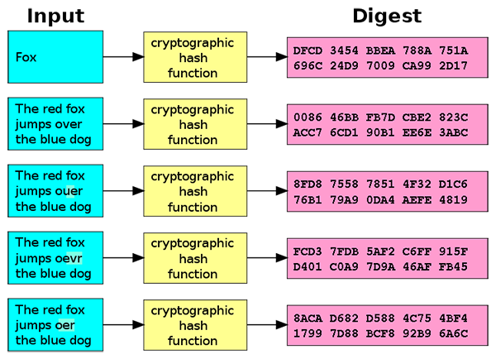
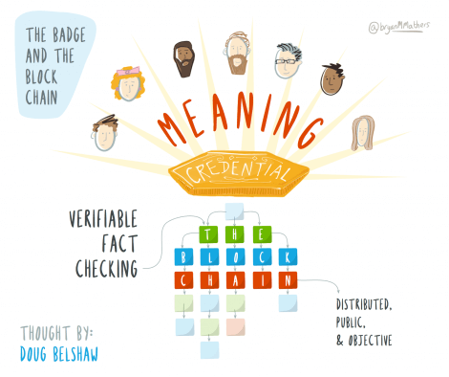
Badges and Blockchain
Doug Belshaw: "If we used the blockchain for Open Badges, then we could prove beyond reasonable doubt that the person receiving badge Y is the same person who created evidence X.” Sony plans to launch a testing platform powered by blockchain and that IBM plans to offer 'blockchain-as-a-service.'
Notes:
http://dmlcentral.net/blog/doug-belshaw/peering-deep-future-educational-credentialing
http://www.downes.ca/search/blockchain
https://bitcoinmagazine.com/articles/ibm-deploys-blockchain-as-a-service-announces-initiatives-to-make-the-blockchain-ready-for-business-1455726071/
https://techcrunch.com/2016/02/22/sony-is-building-an-education-and-testing-platform-powered-by-the-blockchain/
http://hackeducation.com/2016/02/25/blockchain-edu1

Slide 11
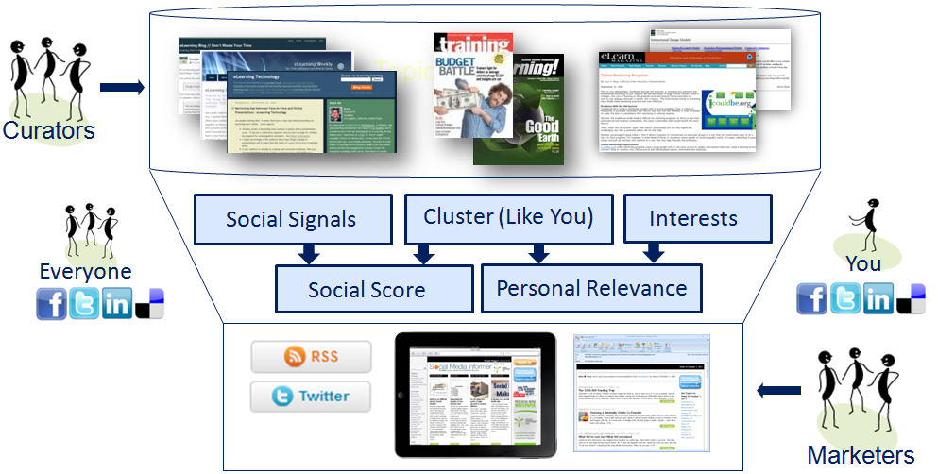
Future Directions: Personalization
“Personalized learning refers to instruction in which the pace of learning and the instructional approach are optimized for the needs of each learner. Learning objectives, instructional approaches, and instructional content (and its sequencing) may all vary based on learner needs… activities are meaningful and relevant to learners, driven by their interests, and often self-initiated.” (NEPC)
Notes:
Image: http://www.aggregage.com/personalization-explained
Reimagining the Role of Technology in Education: 2017 National Education Technology Plan Update https://tech.ed.gov/netp/

Slide 12
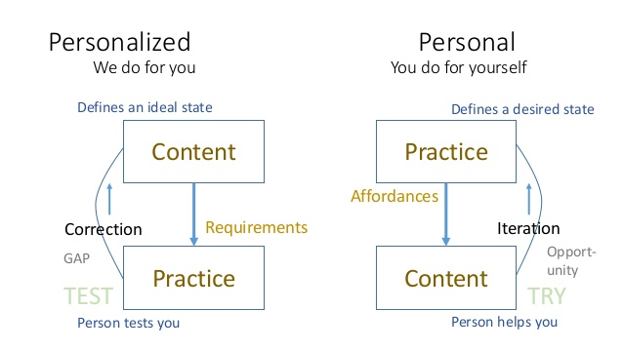
Personal Learning
The model I'm describing is based on the growth and development of the individual, rather than the idea of stuffing them full of facts. It is based on the idea that education is a cultural and social activity as well as a cognitive activity based on actual contributions to the community, rather than through testing or some other sort of game.

Slide 13
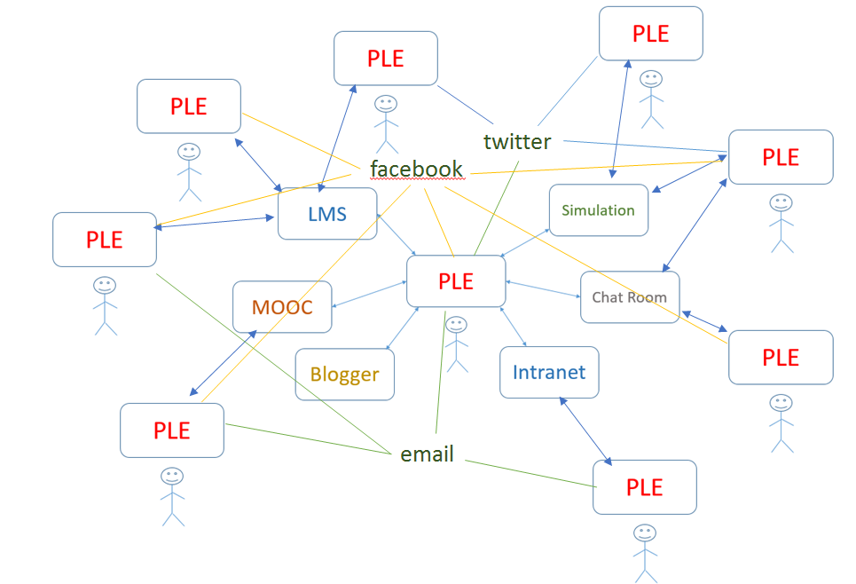
The Personal Learning Environment
It’s personal and you carry it with you
It’s a network – we don’t put everything in one package, but develop an infrastructure that links relevant resources
Different types of things, not just courses: access to learning resources, calling cards and communication tools, credentials, permits and licenses

Slide 14
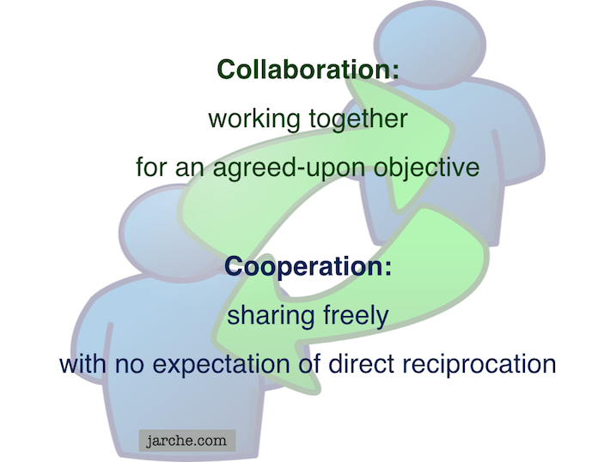
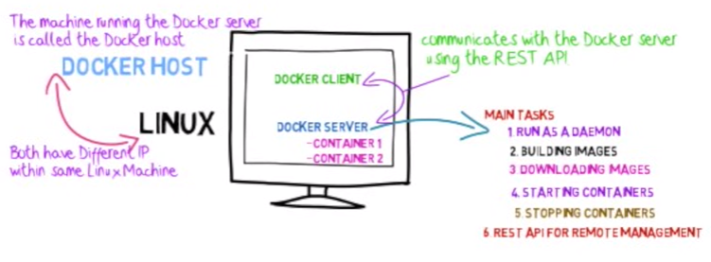
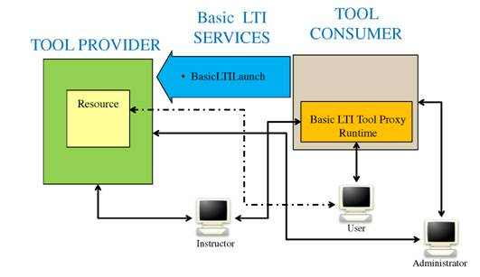
The Personal Cloud and services
The main enablers: microcomputing & cloud computing, wireless communication (and communication standards), sensors (and AI-augmented sensors), remote control / interfaces. LTI Producer – provides features; LTI Consumer – connects to features. Cloud services (such as Docker and AWS) provide remote storage and processing.
Notes:
Environments: VMWare Fusion, VirtualBox
Provisioners: Docker, Vagrant
Configuration: Chef, Puppet
Providers: AWS, MS Server
Services: MS Cognitive, Wolfram Alpha, Segment
Serverless CMS - http://www.downes.ca/post/66459
http://www.tomsitpro.com/articles/docker-enterprise-hub-orchestration,1-2375.html
https://cyber.law.harvard.edu/research/cooperation
Image: http://Jarche.com

Slide 15
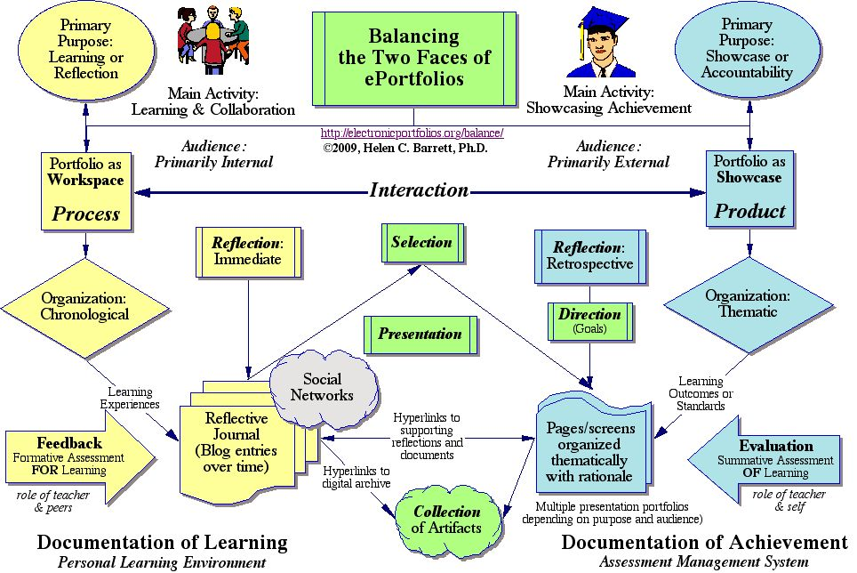
Personal learning record
How can an educational application support, integrate within, and measure the total state? How can the learner maintain his/her identity and integrity from environment to environment?
Notes:
https://sites.google.com/site/eportfolioapps/overview

Slide 16
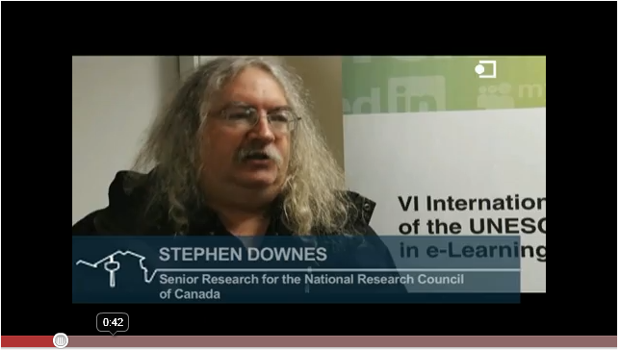

Stephen Downes
National Research Council Canada
http://www.downes.ca https://www.nrc-cnrc.gc.ca/

