Slide 1

gRSShopper in a Box
Objectives: to define, develop and test a distributed virtual learning technology
Presented by: Stephen Downes
Program: LPSS

Slide 2
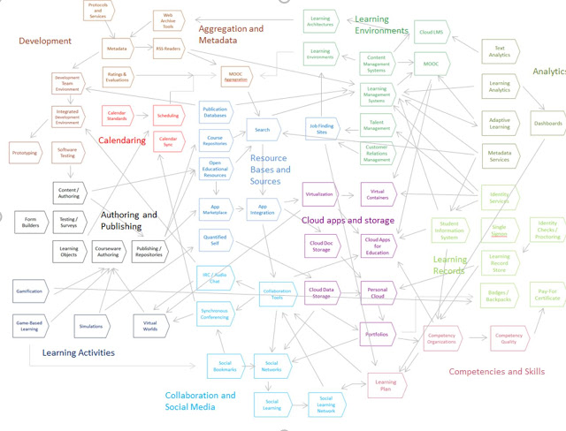
The learning technology landscape is a complex web of interlocking applications, stakeholders and data standards.
The key challenge is to work well with others within this environment.

Slide 3
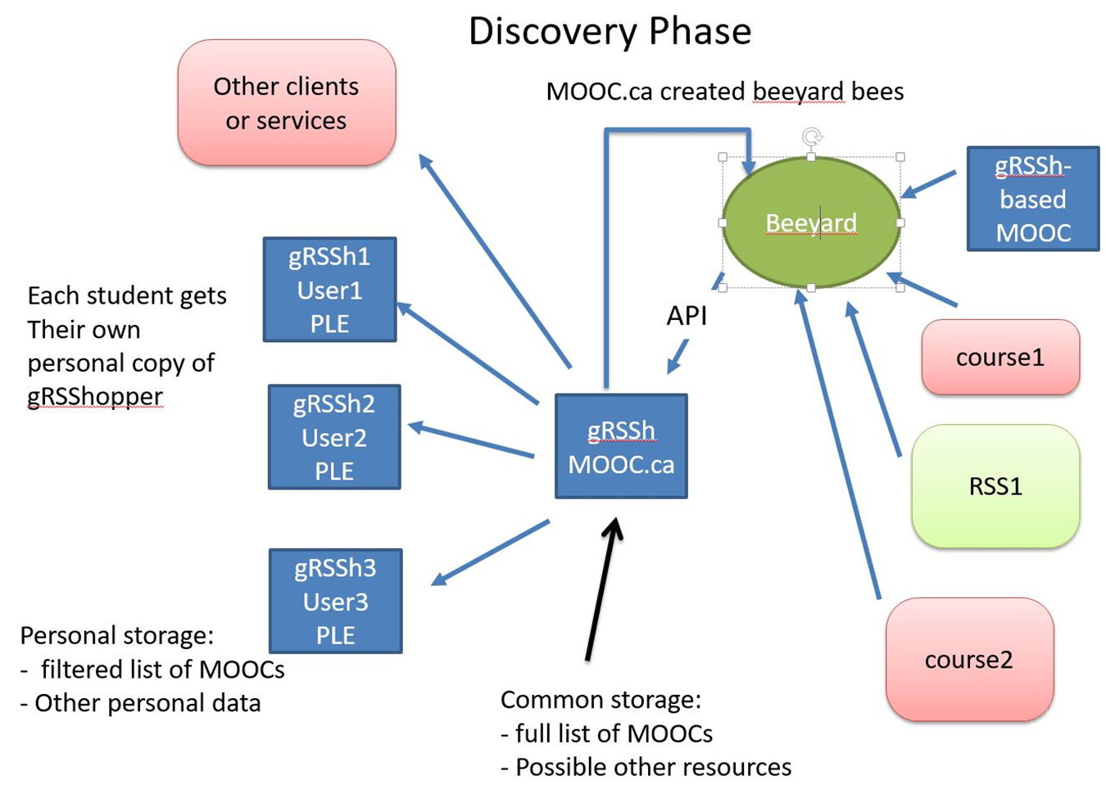
gRSShopper (blue boxes) was designed to discover and distribute learning environment resources to students.

Slide 4
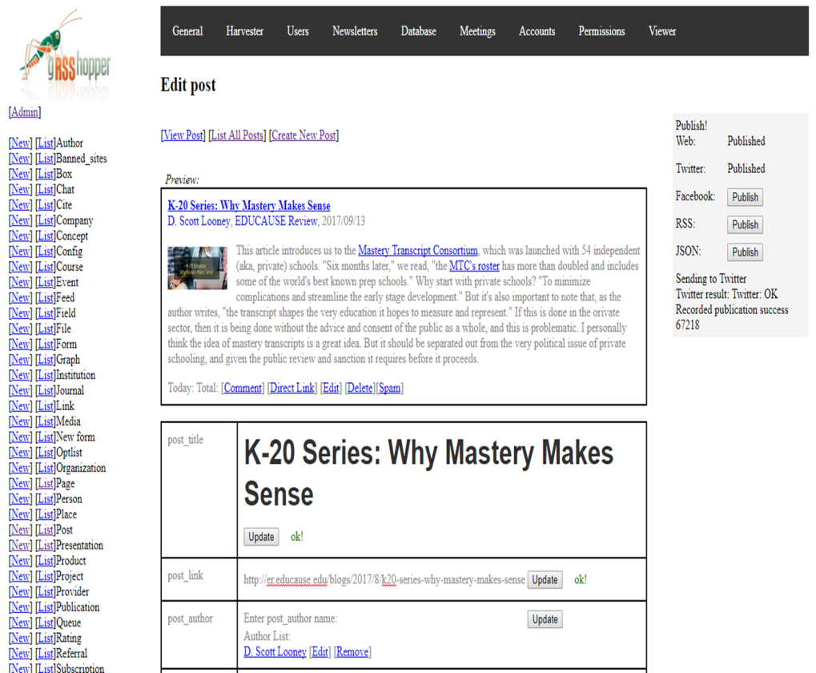
The software combines a resource harvester, content management system, and publishing platform.
It enables users to bring content together, remix it and repurpose it, and then feed it forward to other parts of the network.

Slide 5
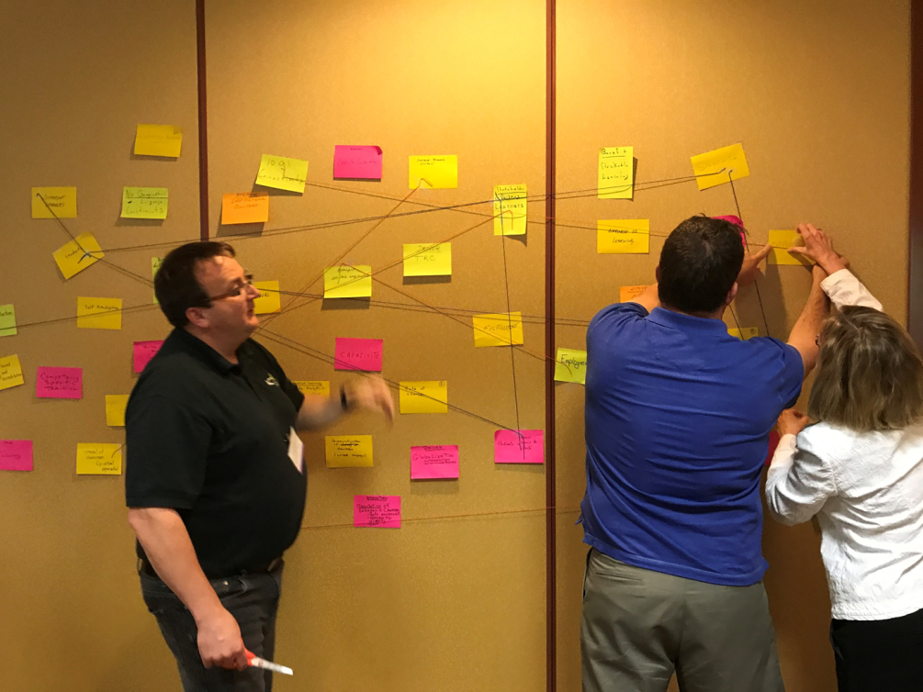
The concept and was created and validated through workshops conducted with stakeholder groups (including these college presidents) in Canada and around the world.
An early result was the development and delivery of of the world’s first Massive Open Online Course (MOOC).

Slide 6
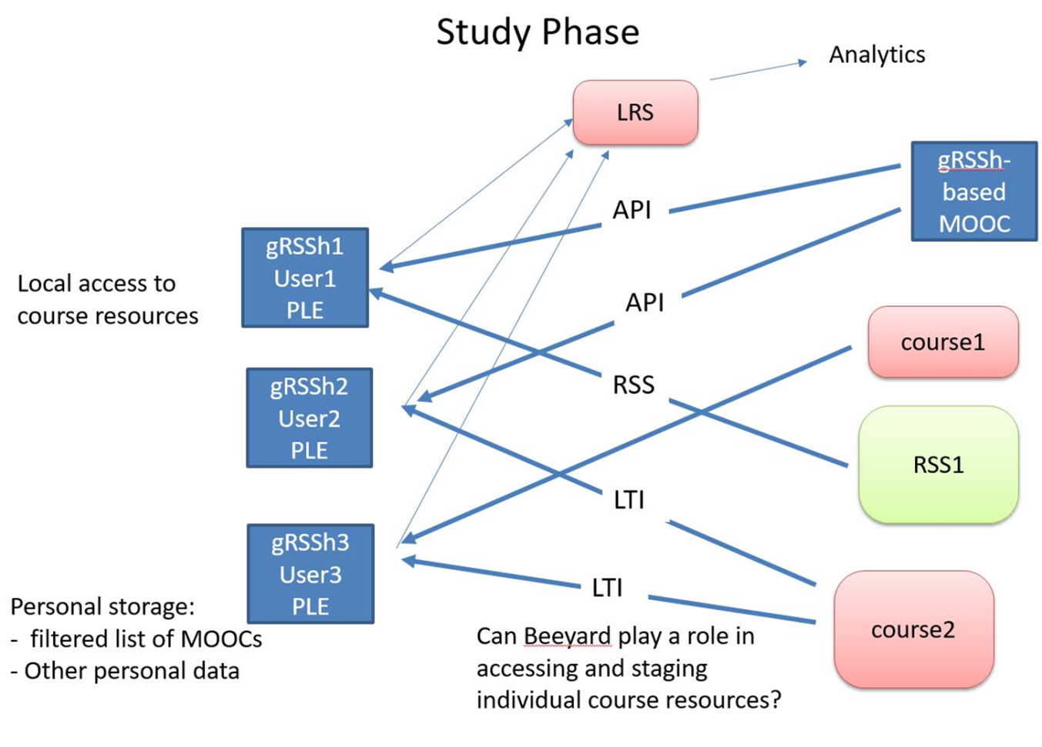
Now the challenge is to give each student their own gRSShopper instance, which requires virtual servers...

Slide 7
… in other words, to put gRSShopper in a box, so it can run anywhere: on a students computer, on a USB key, on a corporate intranet, in the cloud…
This work has produced a deep understanding of the internet ecosystem and has helped NRC work with a number of government and non-government partners.

