Slide 1

Becoming
Connected
Stephen Downes
Warsaw, Poland, August 25, 2017

Slide 2
Objective
To present the core ideas of connectivism in both a learning and scientific context, in a sense unifying the ideas of discovery, interaction and education.

Slide 3
Overview
What is Science?
How Do We Learn?
Implications for Practice
What is Connectivism?

Slide 4
Science
Proposal: the core idea of education (into a science, broadly conceived), in which to learn a discipline is to become like a practitioner of that discipline.

Slide 5
Connectivism
Proposal: the core idea of connectivism, in which knowledge is literally the set of connections between entities, and learning is the growth and development of those connections.

Slide 6
Learning
Proposal: the idea that we learn and grow by becoming connected
Distinguishing social knowledge and personal knowledge
This is an additional goal of both science and education

Slide 7
Practice
Proposal: the 'how' of learning; what we need to do in order to 'become connected’:
The ARRFF Process Model
Success Criteria: Autonomy, Openness…
Critical Literacies

Slide 8
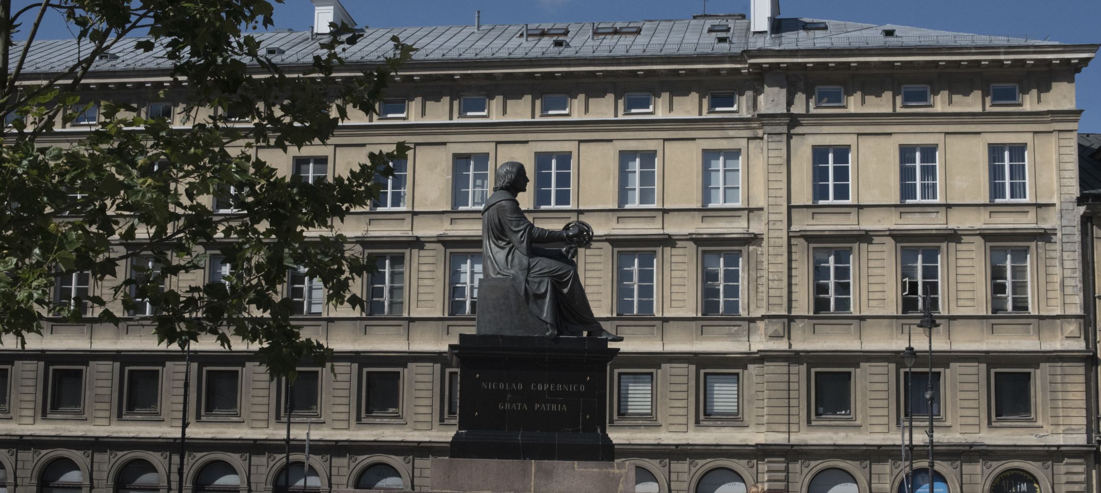
What Is
Science?

Slide 9
Domain
Science as a domain of discourse
The set of objects we talk about: a,b,c,…
The set of properties they share: P,Q,R,…

Slide 10
State Space
Rudolf Carnap: The Logical Foundations…
  Pa Qa Ra Sa …
  Pb Qb Rb Sb …
  Pb Qb Rb Sb …
  …

Slide 11
State Space
Rudolf Carnap: The Logical Foundations…
  Pa Qa Ra Sa …
  Pb Qb Rb Sb …
  Pc Qc Rc Sc …
  …
Detour:
Bayes Theorem
Data Analytics

Slide 12
Hypotheses
Hempel: The Deductive Nomological Model
  if Pa then Rb (Observed)
  (x,y) if Px then Ry (Hypothesis)
  Pc, thus Rd (Prediction)

Slide 13
Positivism
Science as the generation of general principles based on inference from observations
  Pa Qb Rb Sd (Observation Language)
  if p then q, p, thus q (Analytical)
  Pc causes Rd (General Principle)

Slide 14
Two Dogmas
The Failure of the Positivist Foundations…
Reductionism is False
No Analytic-Synthetic Distinction
(Quine, Two Dogmas of Empiricism)

Slide 15
Paradigms
Data, Instrument and Theory
Theory-Laden Data (Lauden)
Scientific Paradigms (Kuhn)
  Science as commonly accepted languages, practices, questions Way of Life

Slide 16
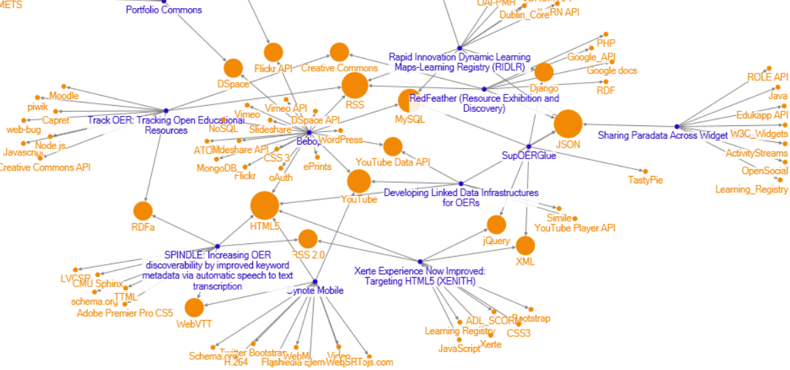
Community

Slide 17
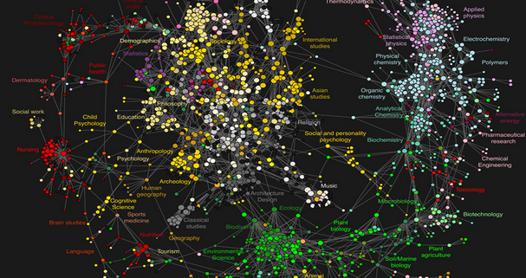
Sciences
Image: http://blog.physicsworld.com/2009/03/12/the-atlas-of-science/

Slide 18
Construction
Science as Construction
Constructive Empiricism (van Fraassen)
Constructing the World (Chalmers)
(But are we back to Carnap again?)
Chalmers review: http://ndpr.nd.edu/news/constructing-the-world/

Slide 19
Point of Decision
Foundation in language, representation, models
Something me make
as construction?
Science
as discovery?
Foundation in experience, immersion, practice
Something we become

Slide 20
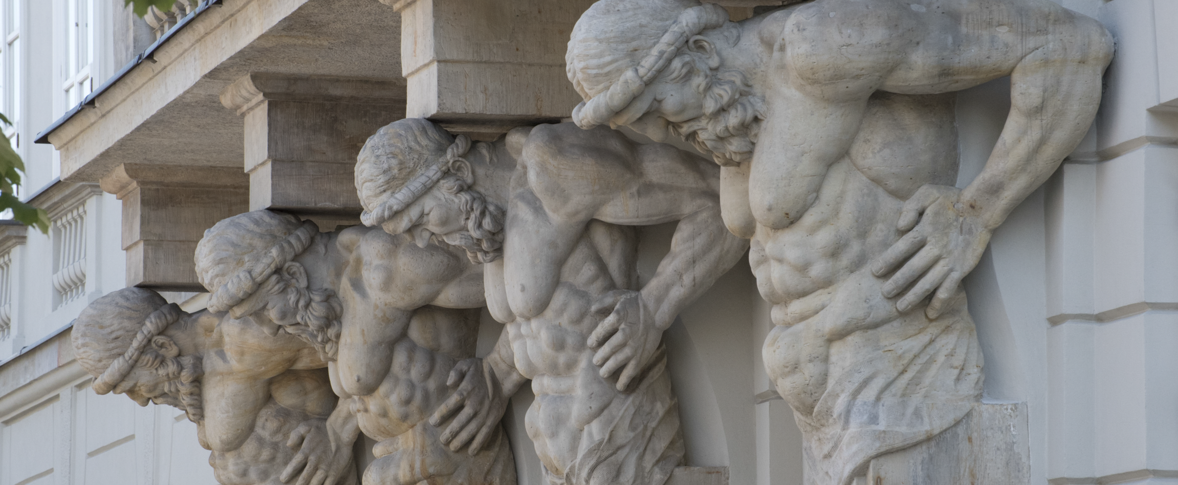
What Is
Connectivism?

Slide 21
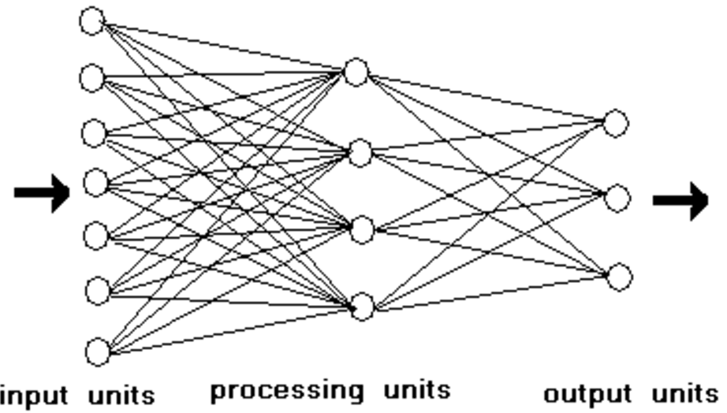
Connectionism
Network-based non-symbolic processing system

Slide 22
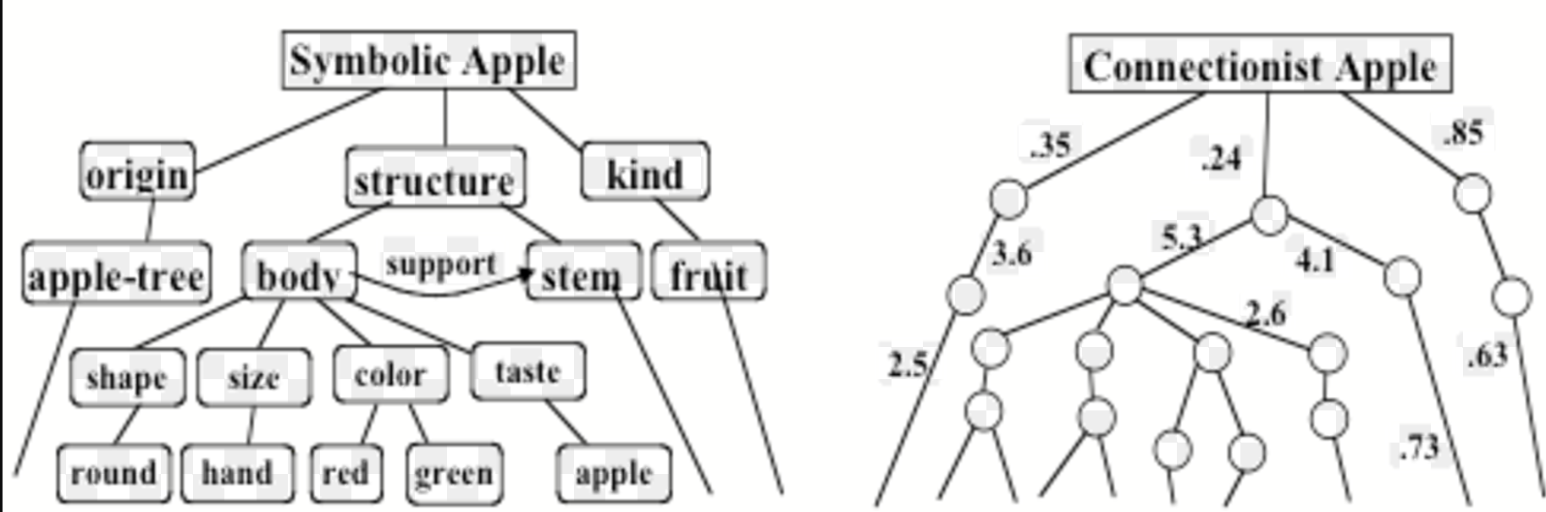
Representation
Symbols System – Model - Representation
Analogy – Image – Neural Network
https://web.media.mit.edu/~minsky/papers/SymbolicVs.Connectionist.html

Slide 23
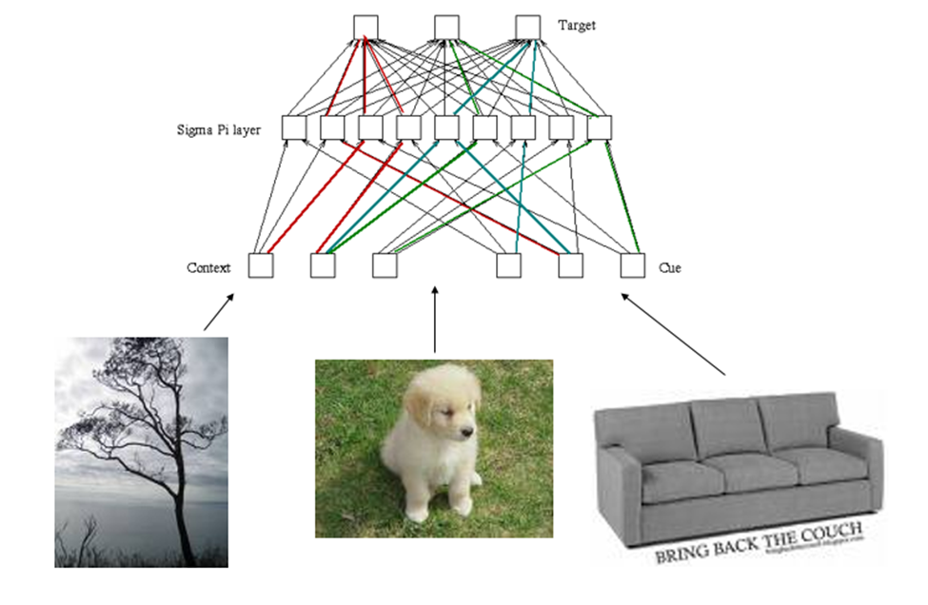
Distributed
A ‘concept’ is a pattern of connectivist in a network

Slide 24
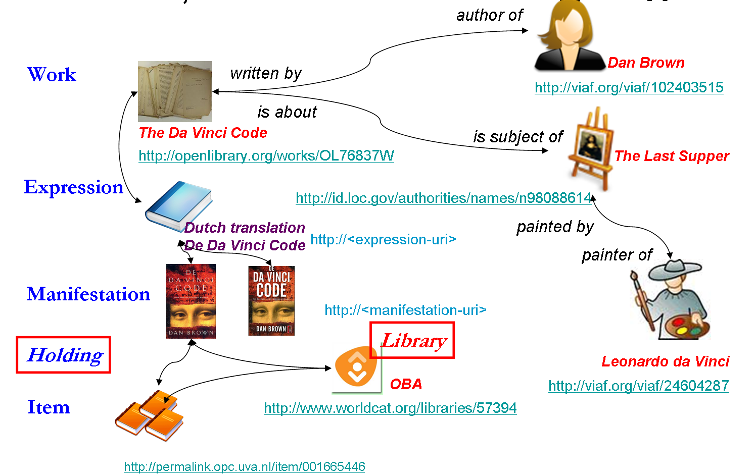
Linked Data
Though still employing symbols and language, steps away from inference and toward association

Slide 25
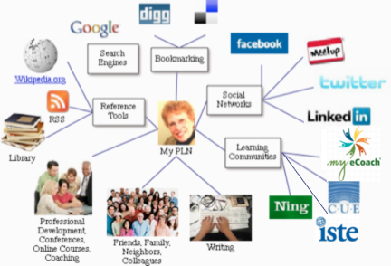
PLENK
Personal Learning Network & Environment
Your friends
Your concepts
Your learning

Slide 26
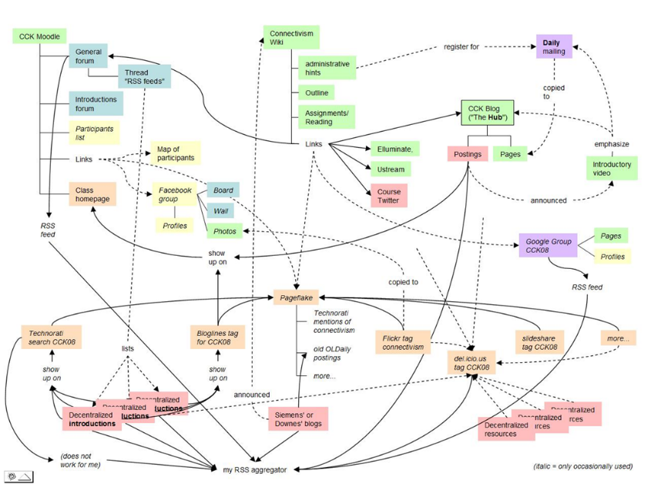
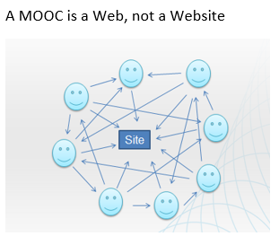
MOOC
https://sites.google.com/site/themoocguide/home

Slide 27
MOOC
Instead of seeing a course as a series of contents to be presented, envisions a course as a network of participants who find and exchange resources with each other (2008)

Slide 28
MOOC
An initial structure is developed and ‘seeded’ with custom-built or (preferably) existing OERs
Participants are encouraged to use their own sites to create or share resources
A mechanism (such as gRSShopper or BuddyPress) is employed to connect them

Slide 29
Community

Slide 30
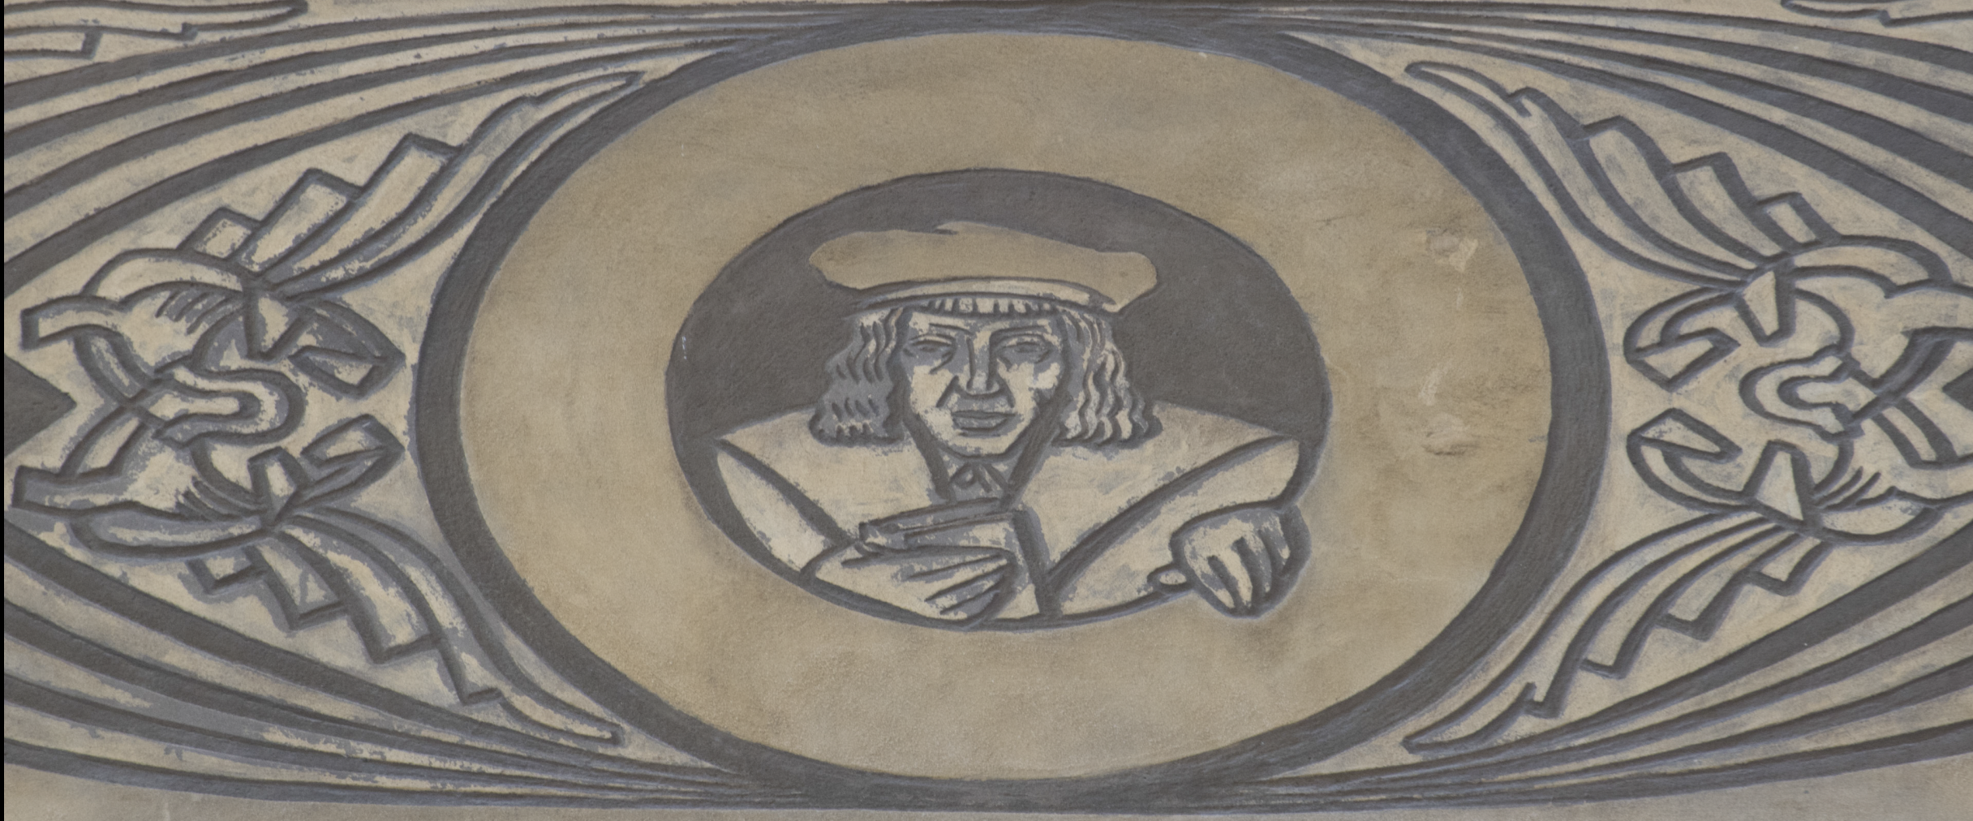
What Is
Learning?

Slide 31
Point of Decision
Foundation in language, representation, models
Something me make
as construction?
Learning
as discovery?
Foundation in experience, immersion, practice
Something we become

Slide 32
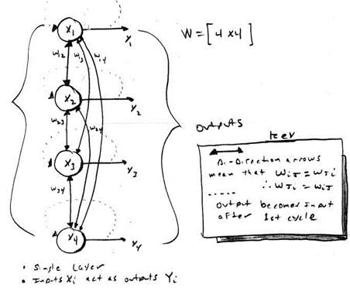
Network Learning
…is the creation and growing of connections
Hebbian associationism
Back propagation
Boltzmann ‘settling’, annealing

Slide 33
Network Learning
…is the development of these networks
A focus on both personal experience and social networks
Learning is a matter of practice and reflection
To know is to recognize

Slide 34
Parameters
Bandwidth (weight)
Signal / Noise
Current state
Activation function
Threshold value
Increments

Slide 35
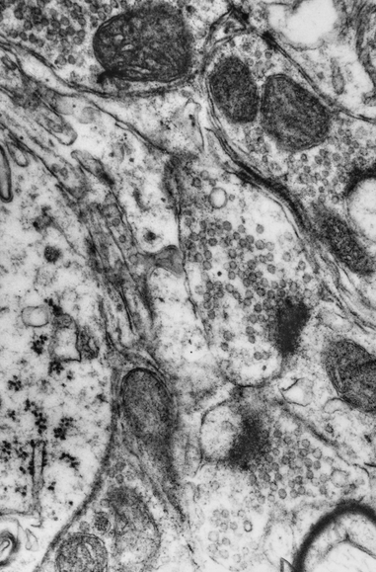
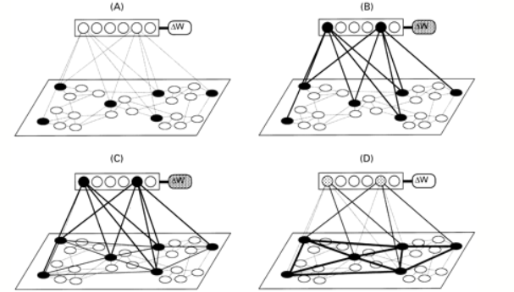
Synapses

Slide 36
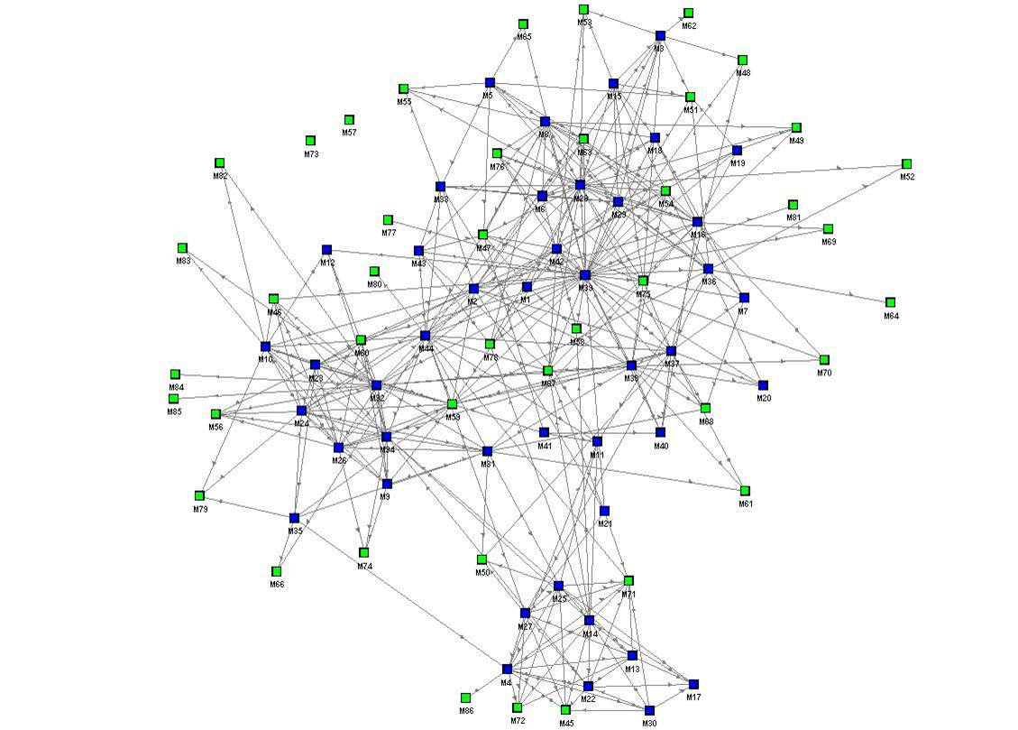
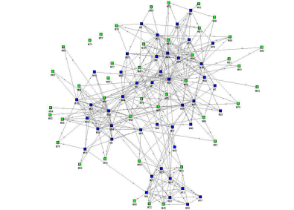
Core Concepts
Emergence Recognition

Slide 37
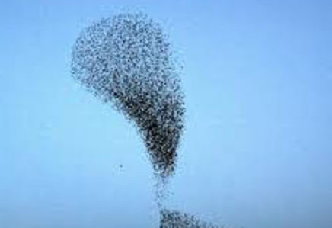

Emergence
The creation of apparent order out of patterns
Depends on perception, culture, way of seeing
Self-Organization

Slide 38
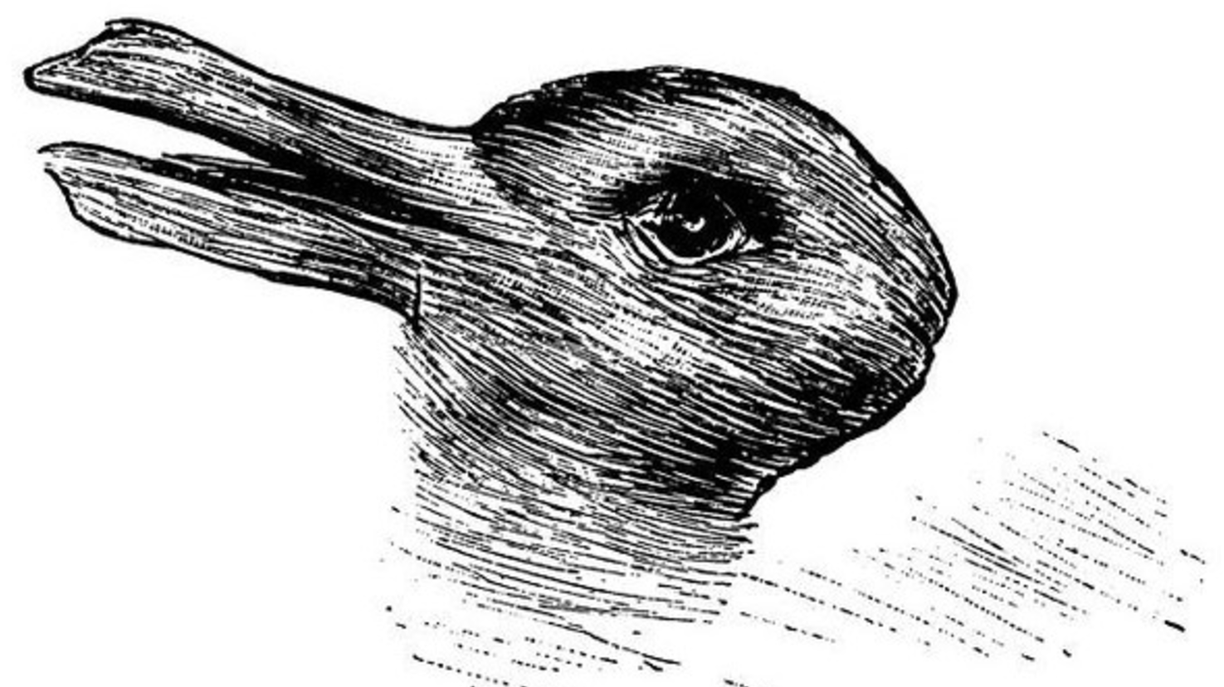
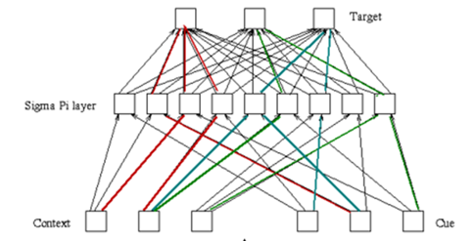
Recognition
Gestalt
Duck-Rabbit
Pattern Activation

Slide 39
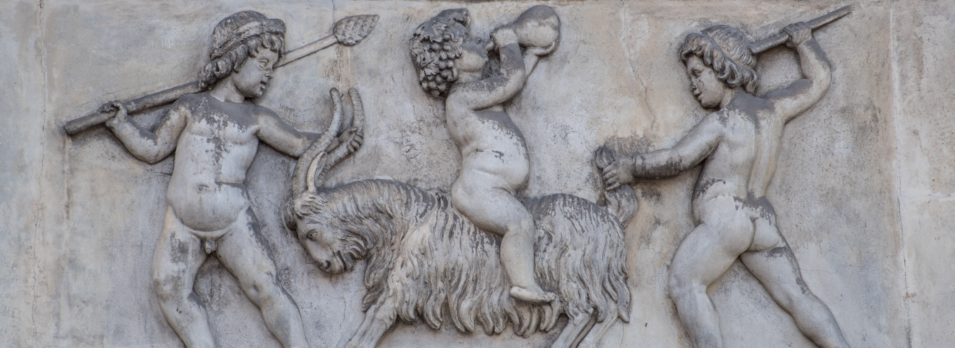
Implications for Practice

Slide 40
Objective
To present the core ideas of connectivism in both a learning and scientific context, in a sense unifying the ideas of discovery, interaction and education.

Slide 41
Method
Method as Discovery:
To discover something is to be immersed in it, to speak it and listen to people speaking in it
To immerse oneself in the world is to try listening and to try speaking

Slide 42
Principles
Autonomy – each entity has its own values and objectives and decides for itself
Diversity – each entity in a network is unique in role, function and perspective

Slide 43
Principles
Openness – membership in the network is fluid; content (signals, messages) enter and exit network
Interactivity – knowledge in the network is created by the interactive process (as opposed to the content of signals propagated through the network)

Slide 44
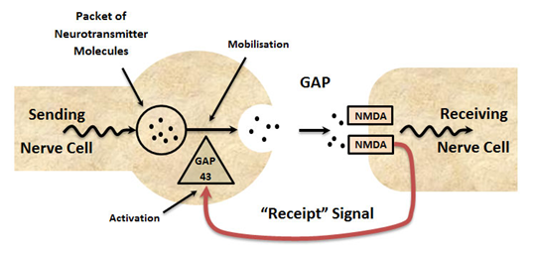
Process
Being a neuron in the network

Slide 45
Process
Aggregate – seek out connections and obtain resources through those connections
Remix – join the resources from multiple links together
Repurpose – adapt the remixed resources
Feed Forward – send the newly created resources on to the next nodes in the network

Slide 46
Model
70-20-10 Model of Learning & Development
Experience
Social
Classroom

Slide 47
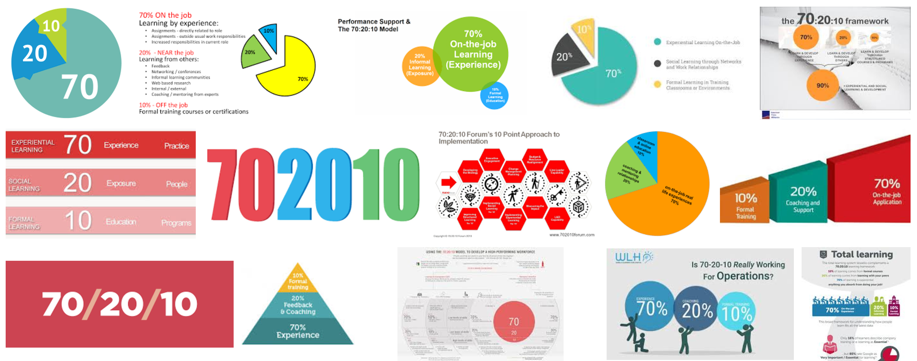
Method

Slide 48
Model
70-20-10 Model of Cognition
Recognition
Reasoning
Remembering

Slide 49
Model
70-20-10 Model of Cognition
Experience, practice, reflection, creation, sharing
Recognition
Reasoning
Remembering
Models, inference, representation, theorizing
Facts, data, names, content

Slide 50
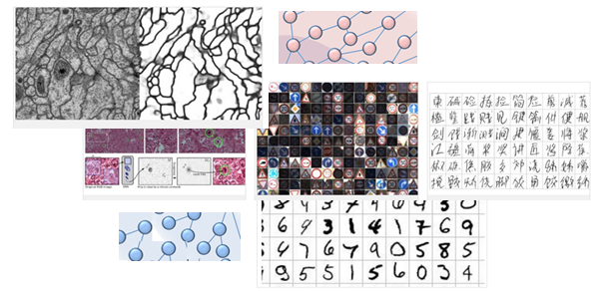
Reading the World
I don’t see the world as neat and ordered, like logic and mathematics – I see it as messy and complex

Slide 51
Reading the World
It’s not one language, but many languages; not one way of seeing, but many ways of seeing, not one way of being, but many ways

Slide 52
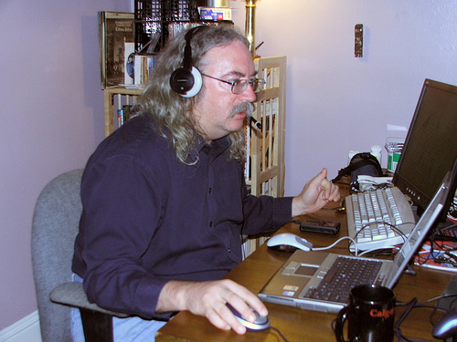
Thank You
Stephen Downes
http://www.downes.ca

