Slide 1
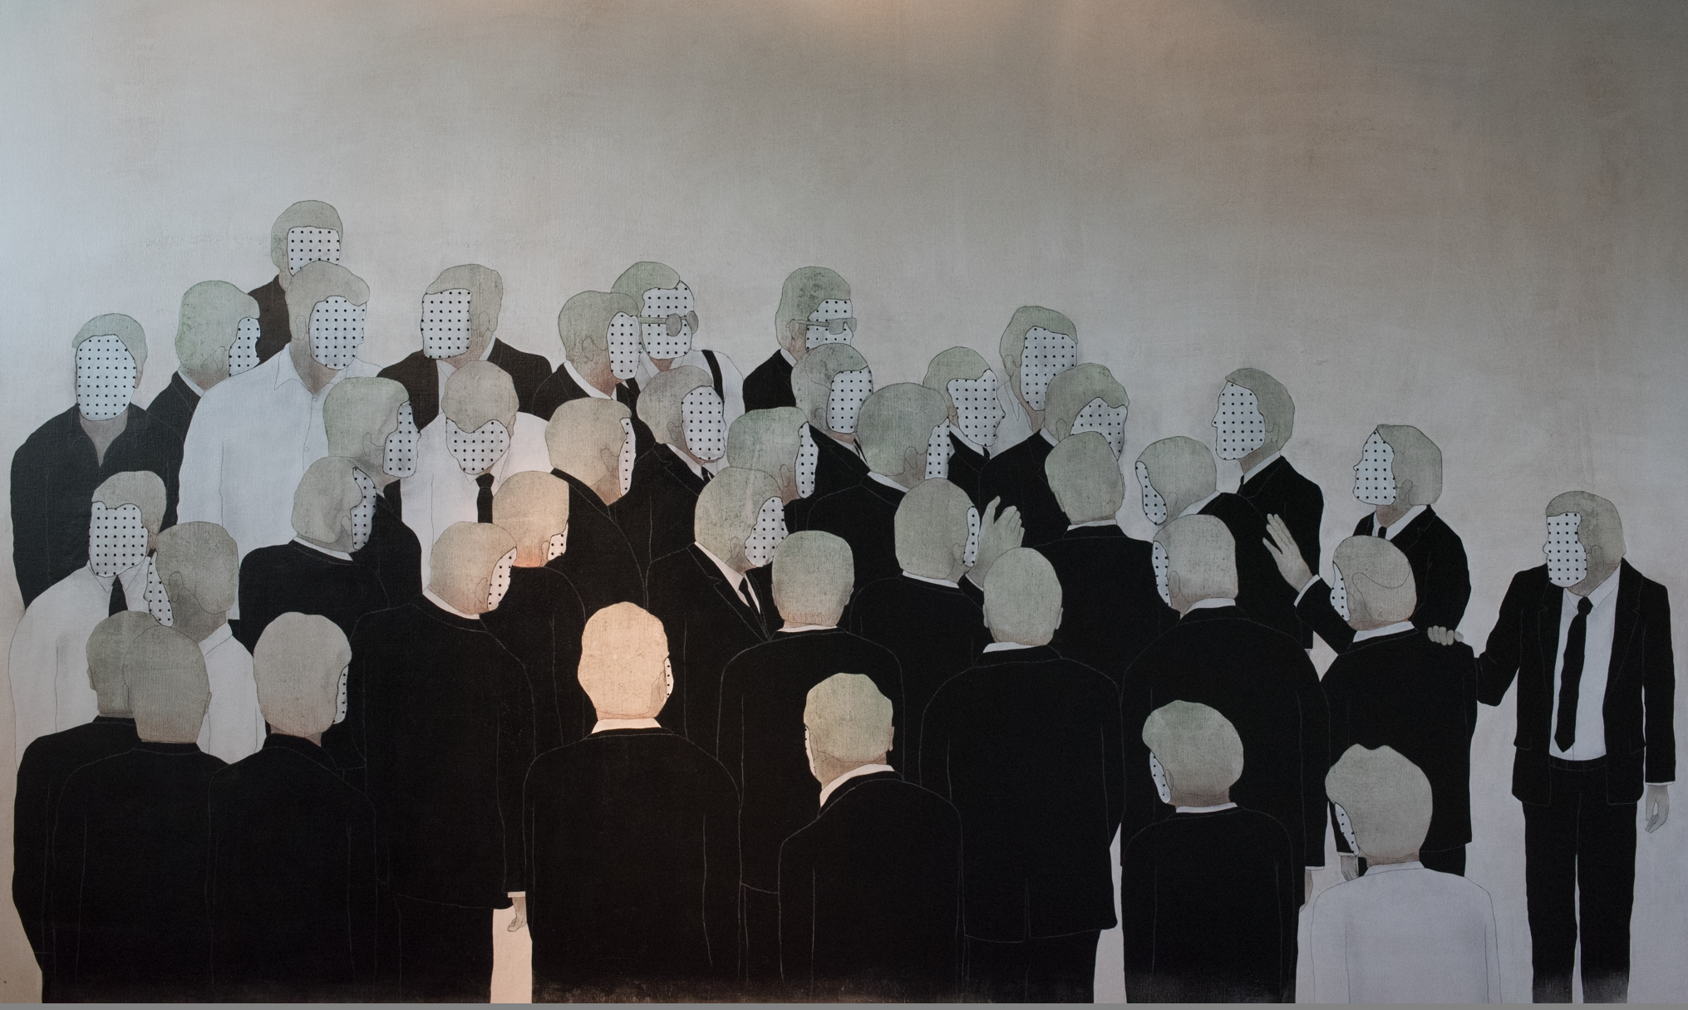
A Model of Personal Learning
Take Two
Stephen Downes
Ghent, June 20, 2017

Slide 2
Three Decades of Enquiry…
1986 – Models and Modality
1993 – The Network Phenomenon
1997 – Online Learning Environment (Ole)
1998 – The Future of Online Learning
1998 – Content Syndication and Online Learning
2000 – Learning Objects
2001 – Knowledge, Learning, Community
2001 – From Virtual to Reality
2002 – The Learning Marketplace
2003 – E-Learning 2.0
2004 – Horse and Palm Tree / Reading the Signs / “We are But Stewards”
2004 – Connectivism and Connective Knowledge
2006 – Models for Sustainable OER
2006 – Groups and Networks / The Semantic Condition
2007 – Personal Learning Environment
2007 – Personal Learning Environment
2008 – Massive Open Online Courses / Open Instructon
2009 – Speaking in LOLcats
2010 – Role(s) of the Educator
2010 – Critical Literacies
2011 – Knowledge as Recognition
2012 – Learning and Performance Support
2014 – Collaboration vs Cooperation
2014 – Personal Learning
2014 – The Personal Graph
2015 – Design vs Environment (Outcomes vs Affordances)
2016 – Change Drivers and Attractors / Transformation

Slide 3
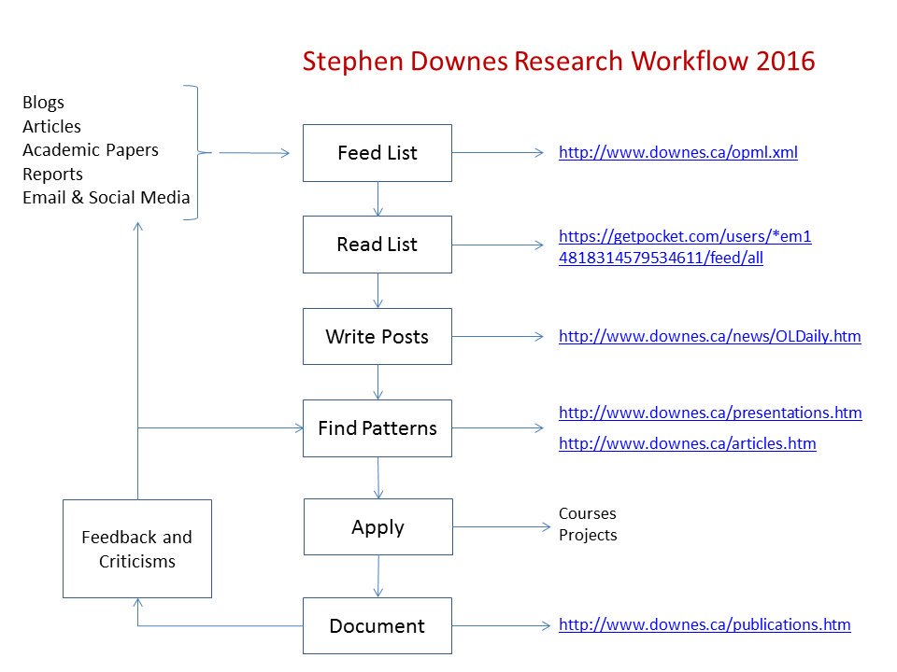
Aggregate
Remix
Repurpose
Feed Forward

Slide 4
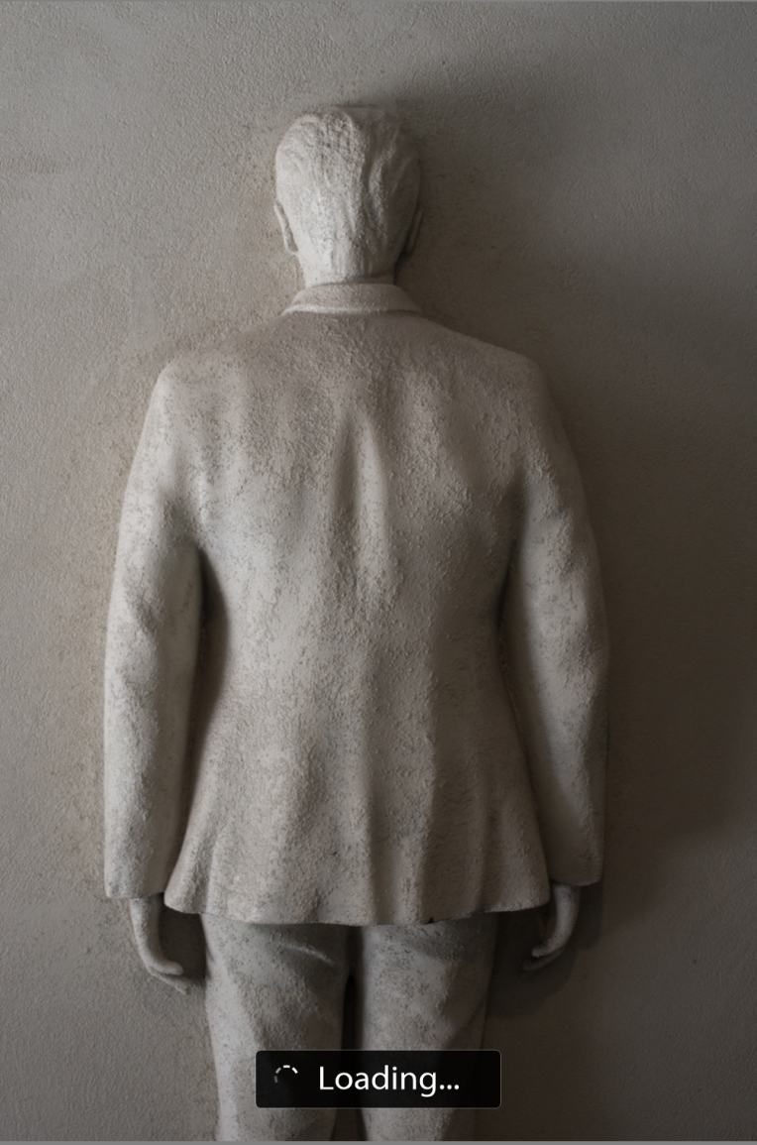
A Note About Models
With models, the answers are determined before the system or simulation is ever run…
Eg. “Carnegie Melon University received a two-year grant for research on and development of MOOCs platforms 'intelligent enough to mimic the traditional classroom experience'.”
http://unescochair.blogs.uoc.edu/blog/2014/06/25/a-goal-for-google-and-carnegie-mellons-mooc-research/

Slide 5

What’s missing in the standards-based models-based approach is what we used to think of as BAD
Bricolage – the doesn’t allow or cater for bricolage.
Affordances – leverage the technology to improve learning and teaching.
Distribution – implications for the institutional practice of e-learning."
http://davidtjones.wordpress.com/2014/03/31/bim-and-bad/
Notes:
BIM and BAD
David T. Jones, The Weblog of (a) David Jones, Apr 25, 2014
Commentary by Stephen Downes
I like this acronym - it's not complete, but it's a great start: "BAD is an acronym that captures what I think is missing from the institutional approach to university e-learning
Bricolage – the LMS as Enteprise Systems doesn’t allow or cater for bricolage.
Affordances – resulting in an inability to leverage the affordances of technology to improve learning and teaching.
Distribution – the idea that knowledge about how to improve L&T is distributed and the implications that has for the institutional practice of e-learning."
This wasn't what we were trying to develop when we developed MOOCs, but if this had been the description of what we were trying, it wouldn't have been far off.

Slide 6
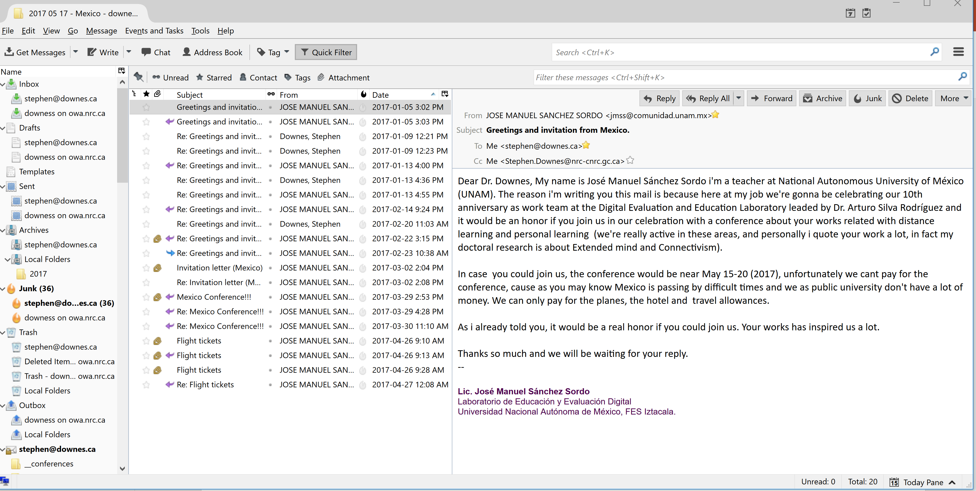
A Day in the Life?
https://roundcube.net/
https://www.google.com/gmail/

Slide 7
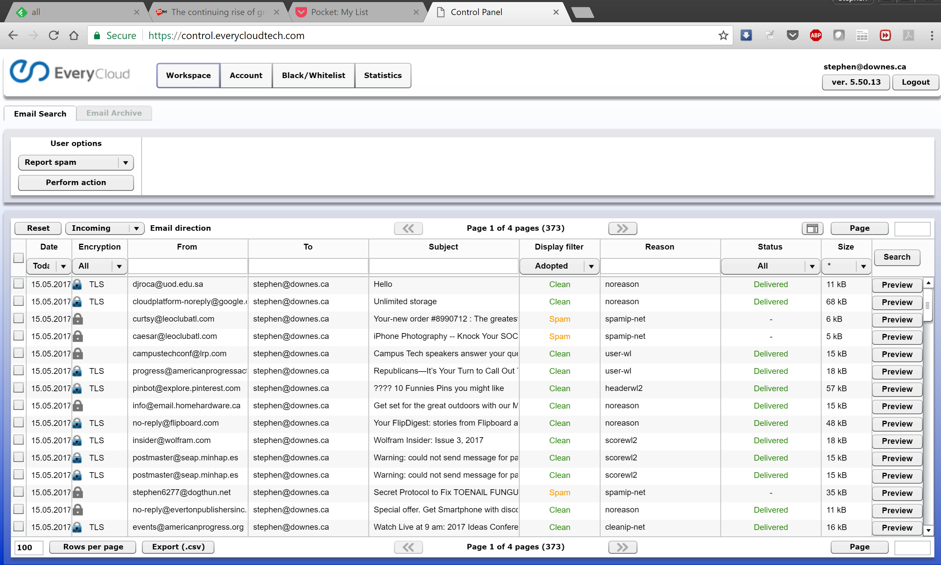
A Day in the Life?
http://postlayer.com/
https://www.everycloudtech.com/

Slide 8
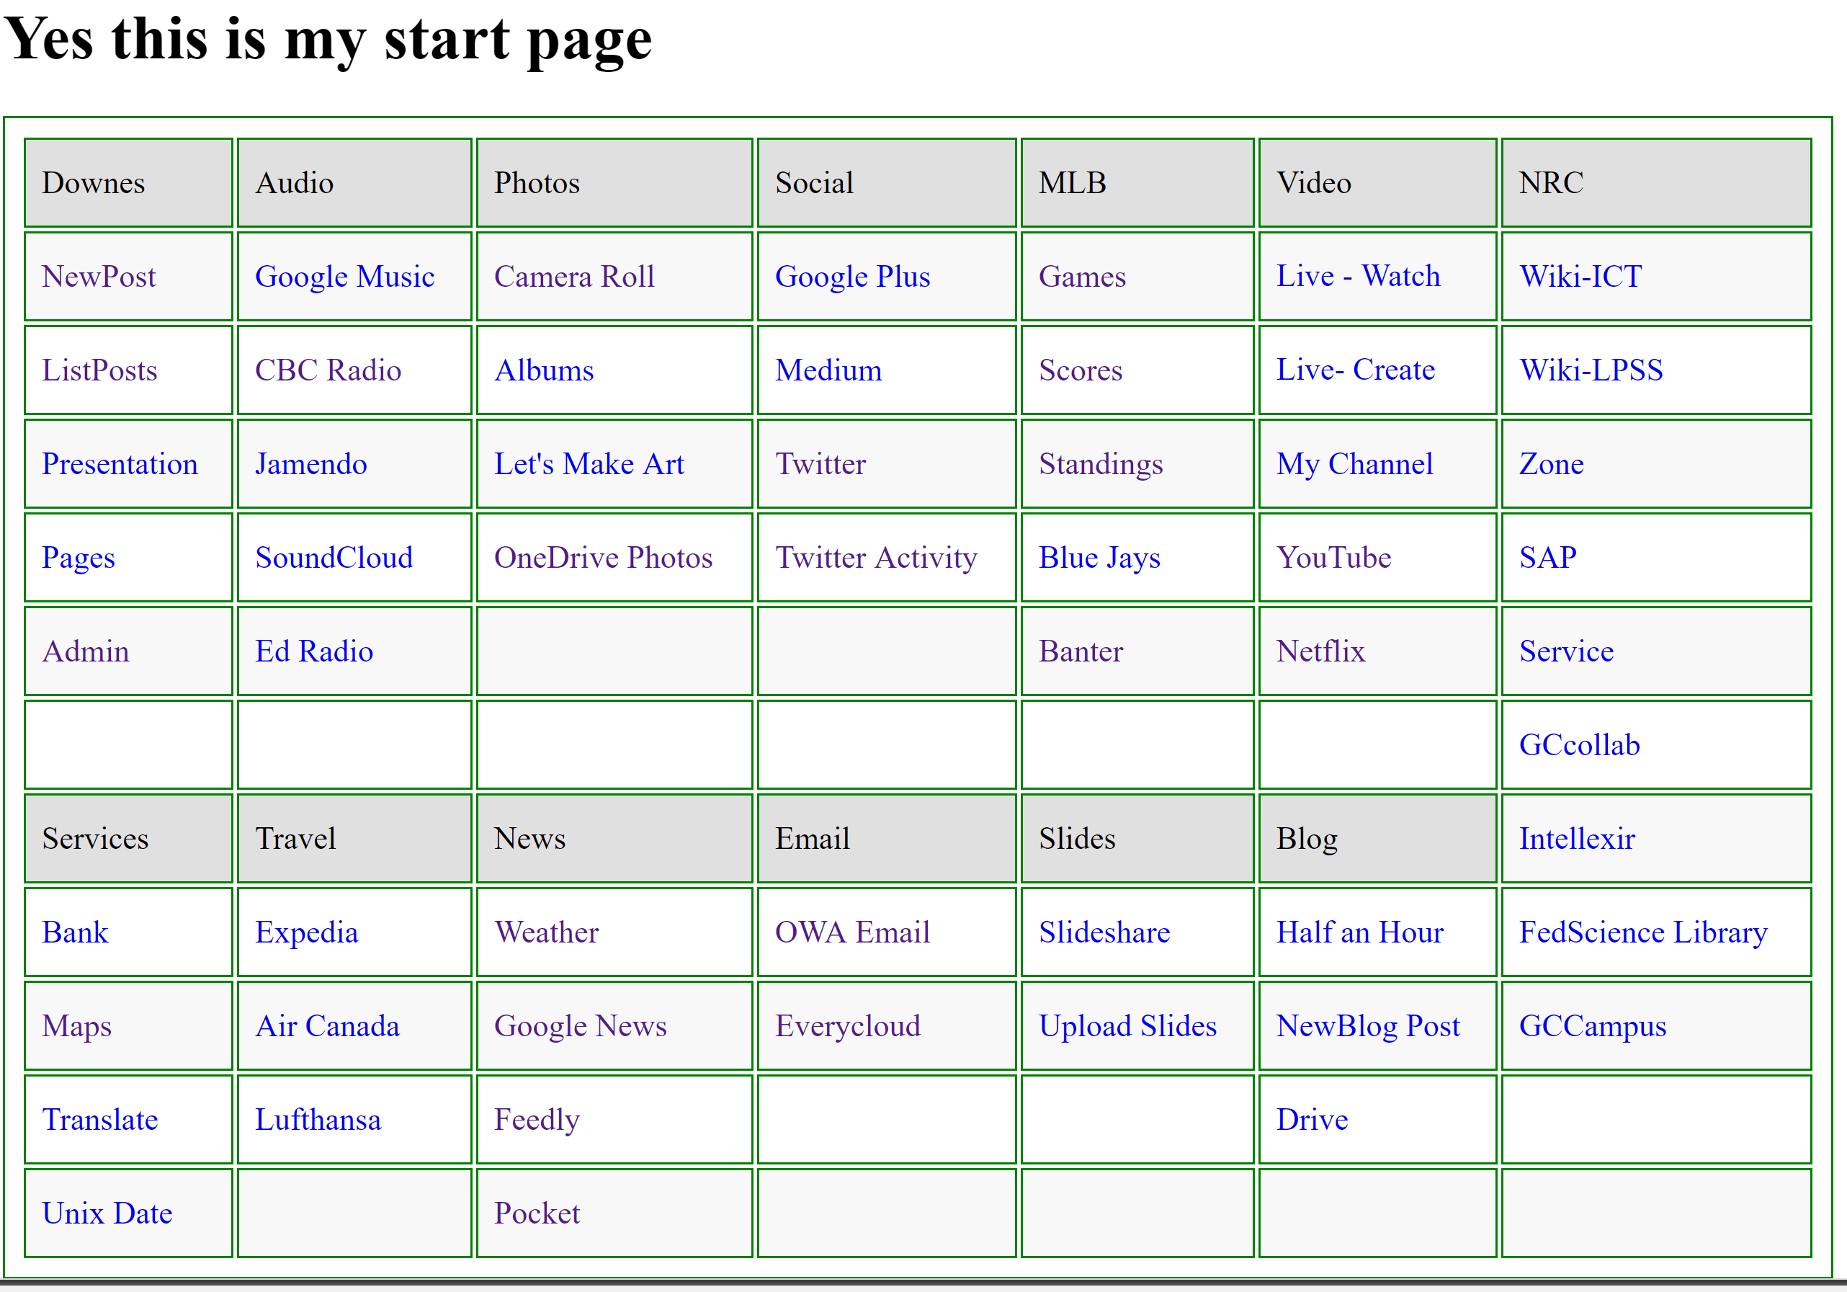
A Day in the Life?
http://www.downes.ca/start.html

Slide 9
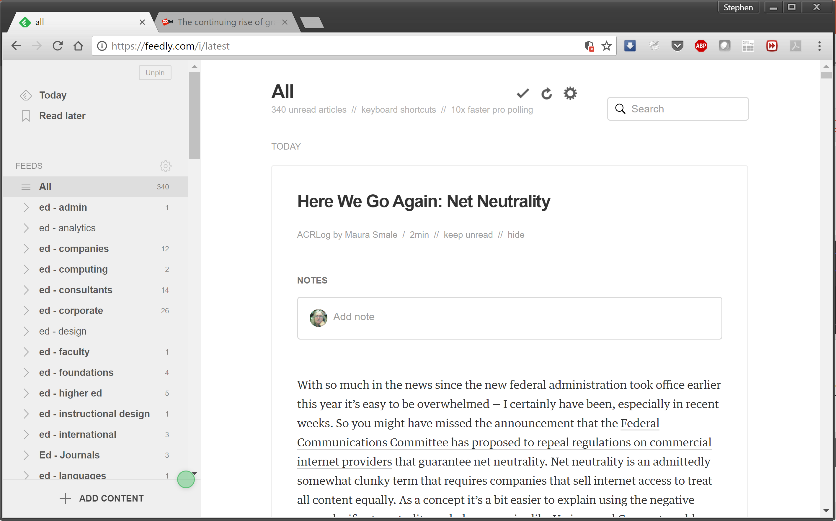
A Day in the Life?
https://feedly.com/i/latest
http://www.downes.ca/opml.xml

Slide 10
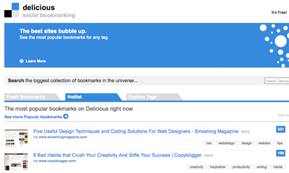
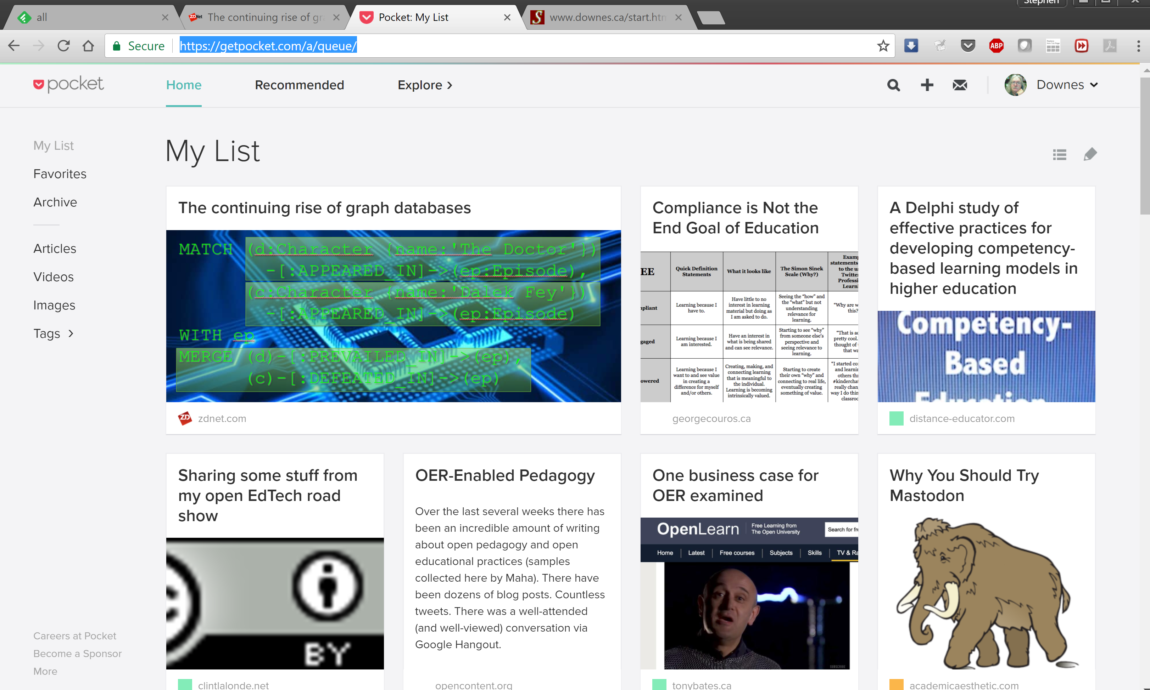
A Day in the Life?
https://getpocket.com

Slide 11
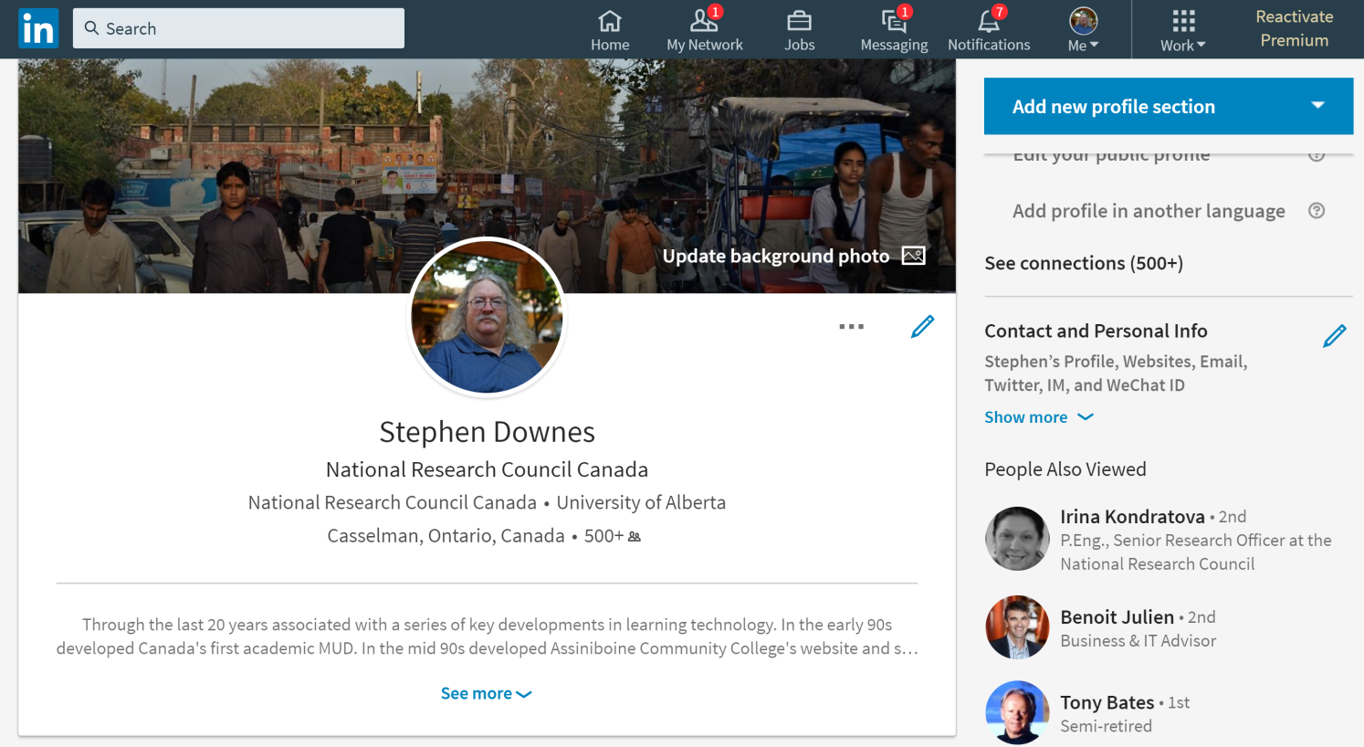
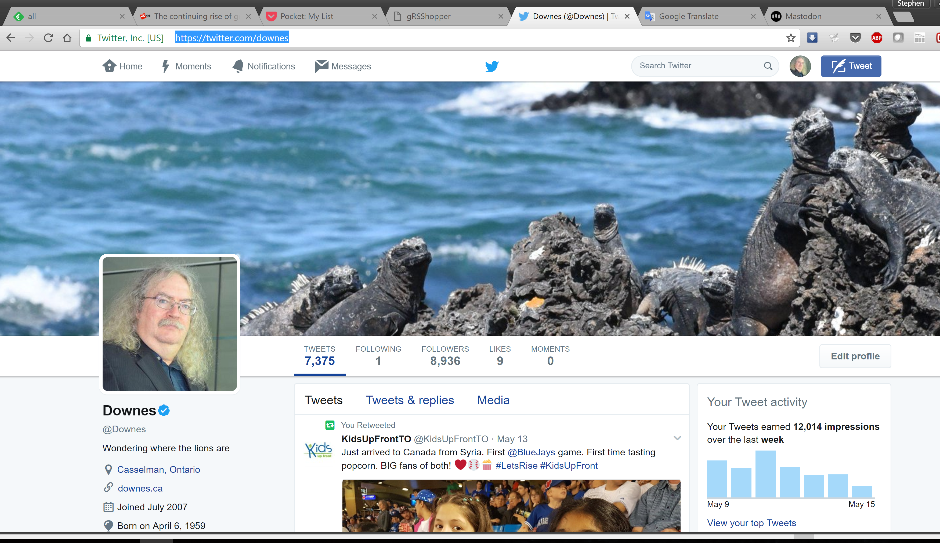
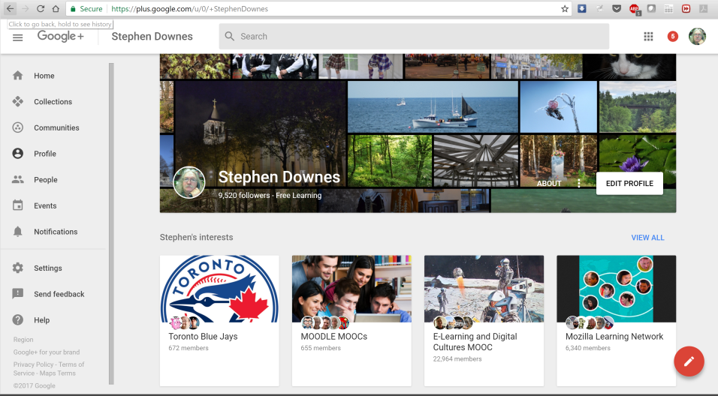
A Day in the Life?
https://www.linkedin.com/in/stdownes/
https://twitter.com/downes
https://plus.google.com/u/0/+StephenDownes

Slide 12

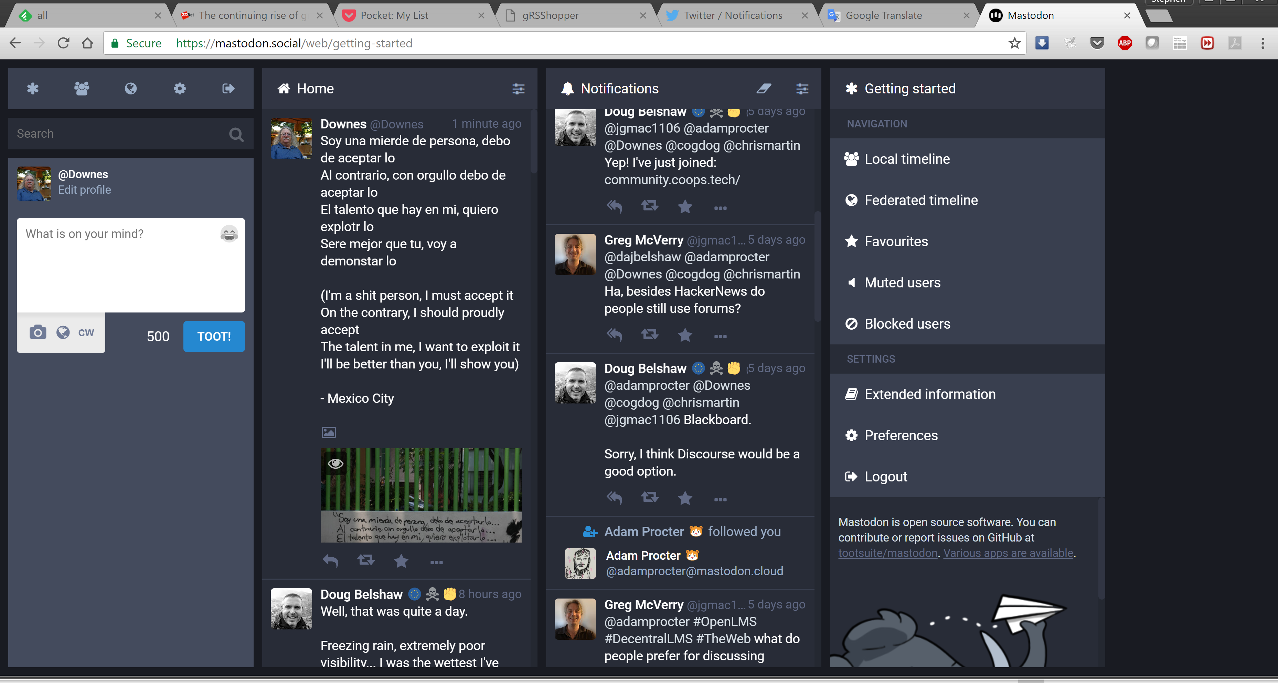

A Day in the Life?
https://www.joindiaspora.com/
https://mastodon.social/@Downes

Slide 13
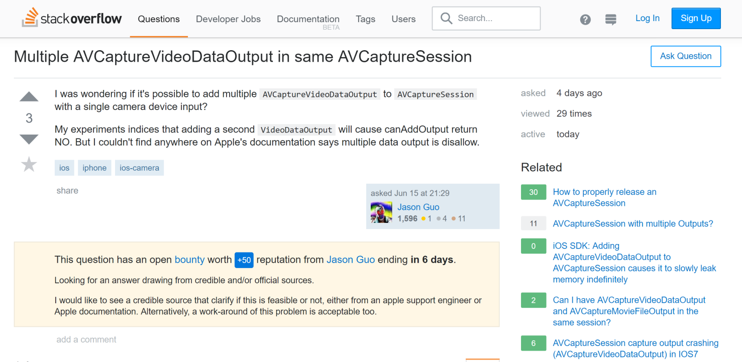
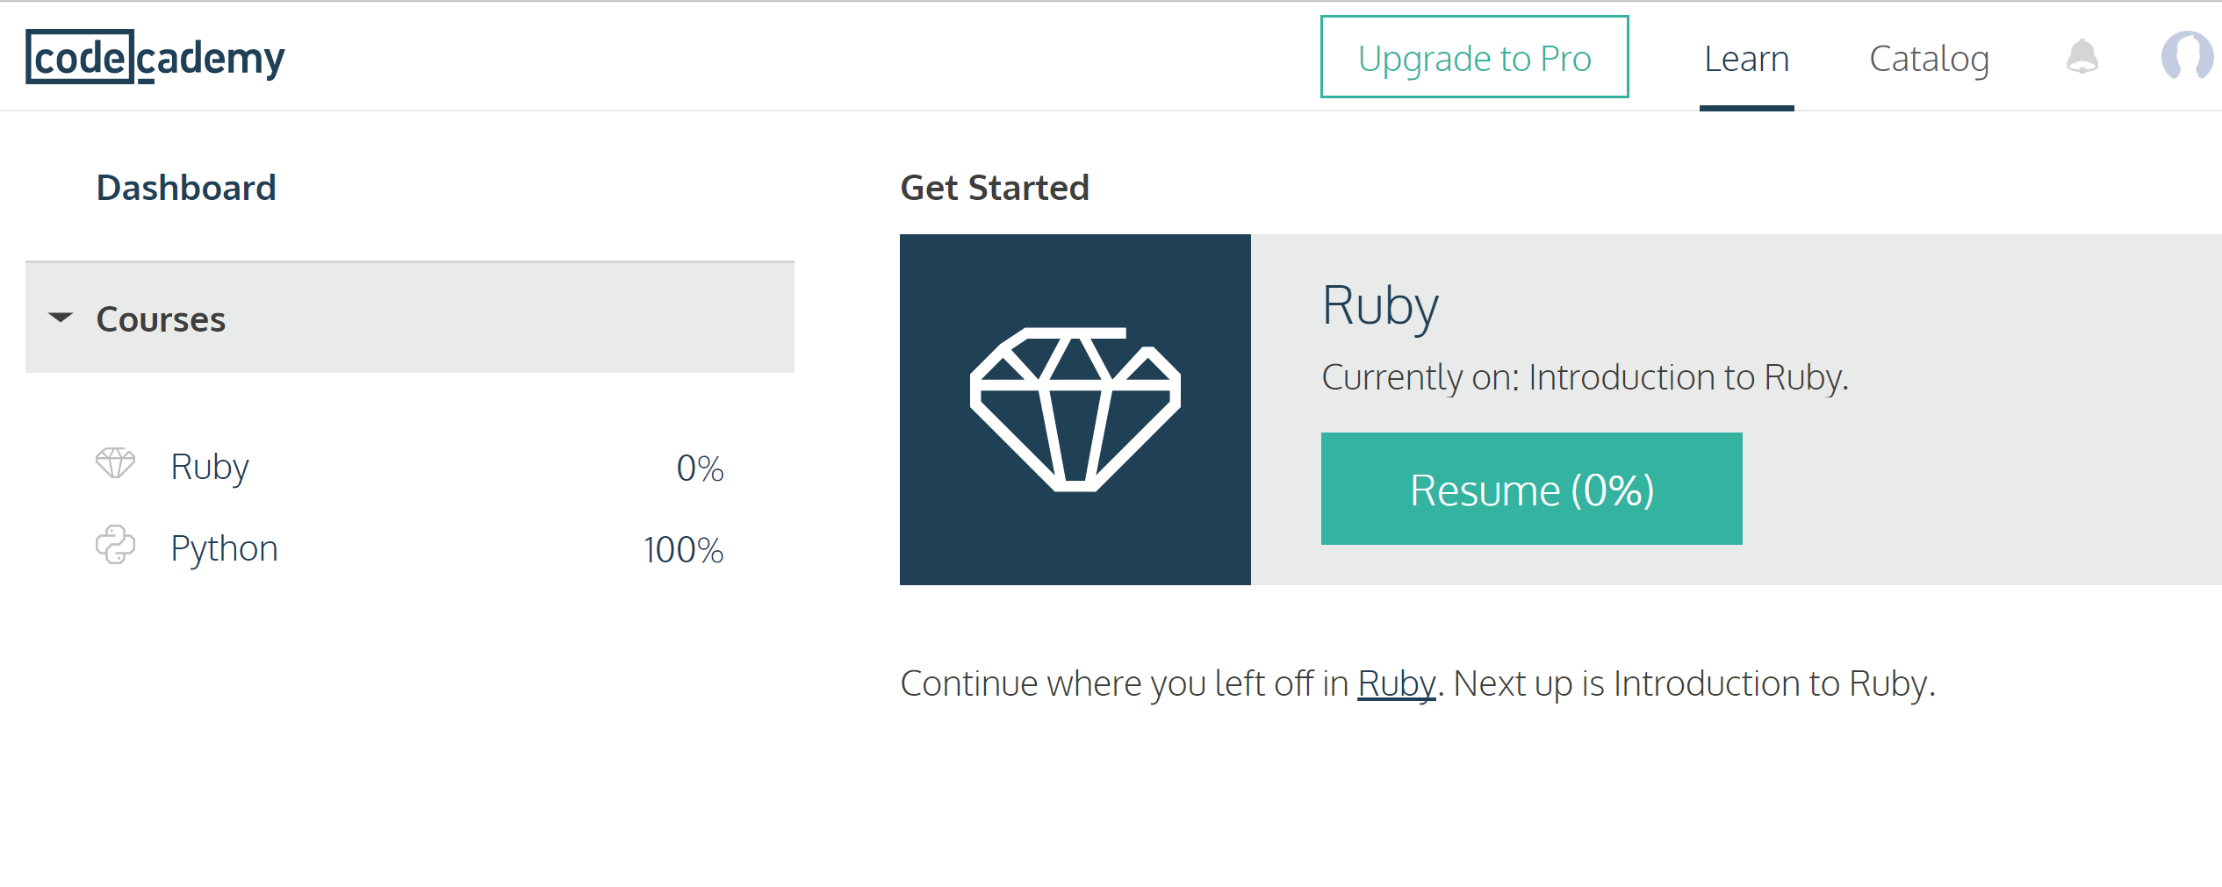
Learning
https://stackoverflow.com
https://www.codecademy.com/learn

Slide 14
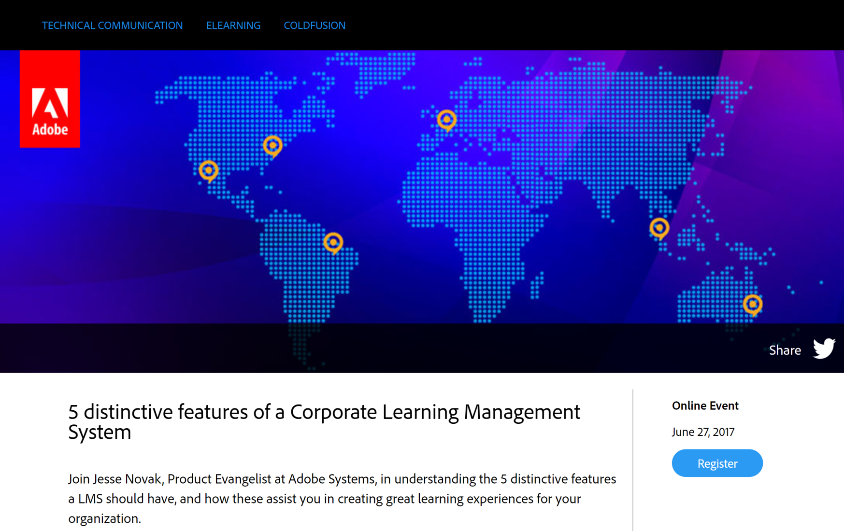
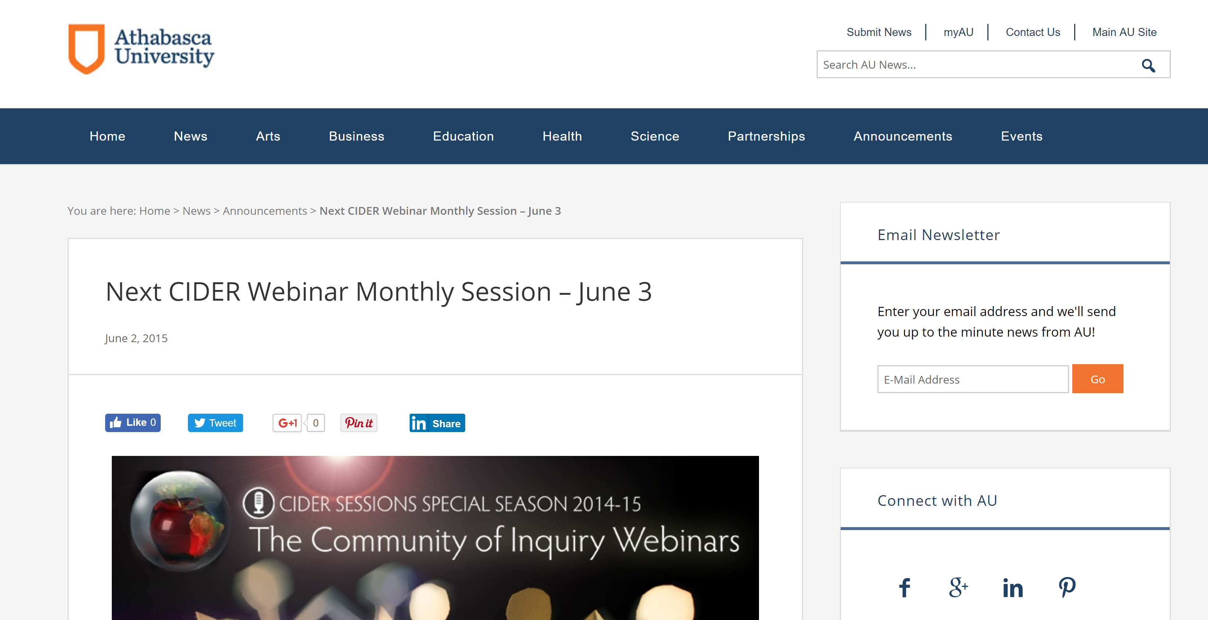
Learning
https://www.elearningguild.com/content.cfm?selection=doc.2973
http://news.athabascau.ca/news/next-cider-webinar-monthly-session-june-3/

Slide 15
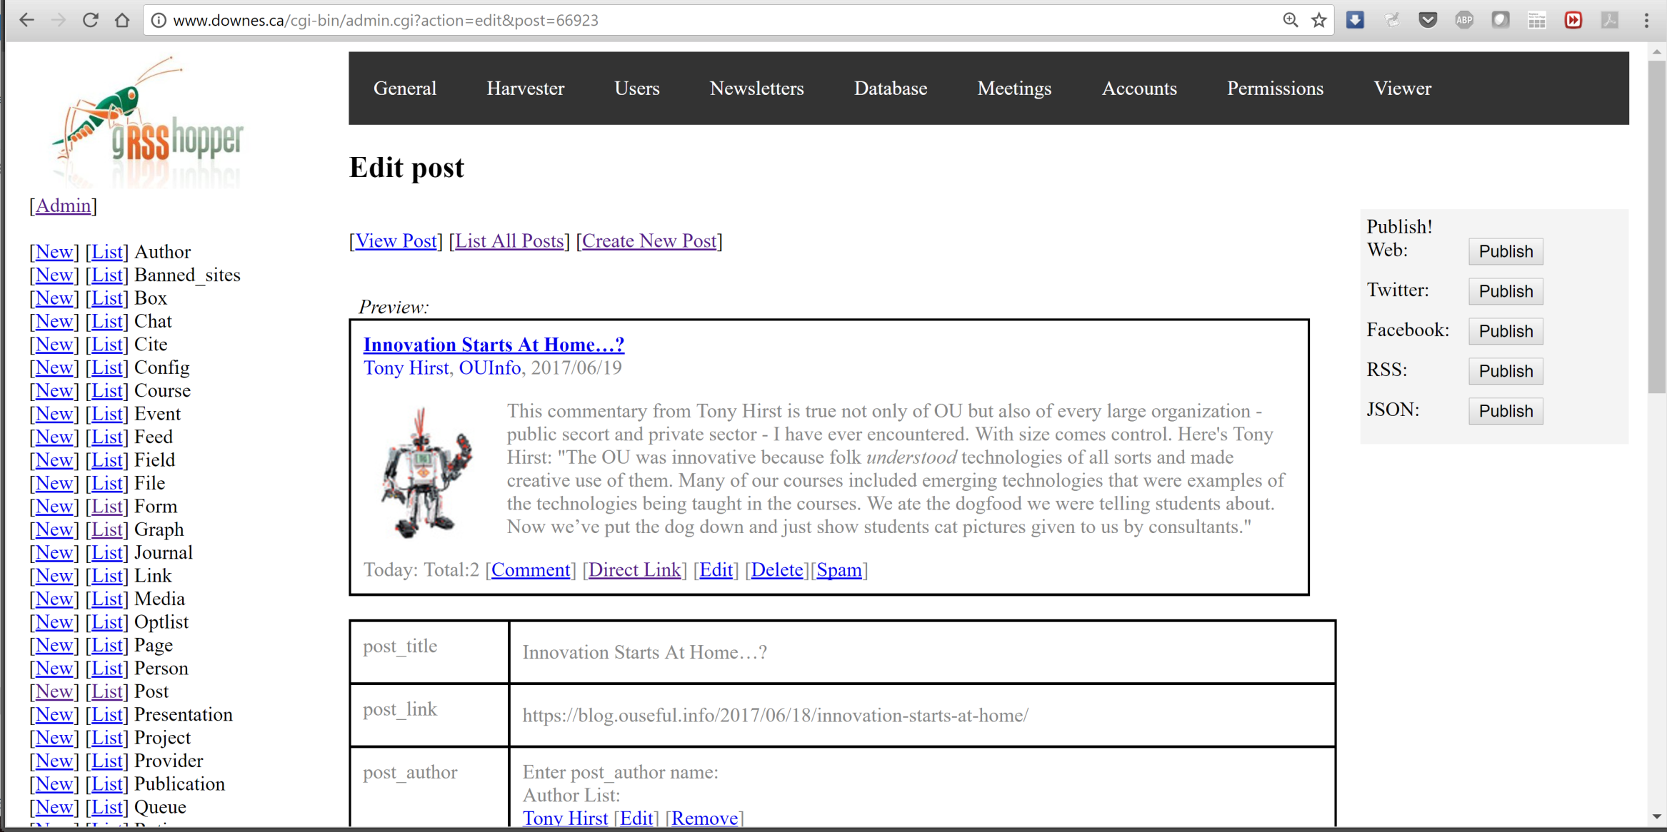
Saving
https://getpocket.com
http://grsshopper.downes.ca/

Slide 16
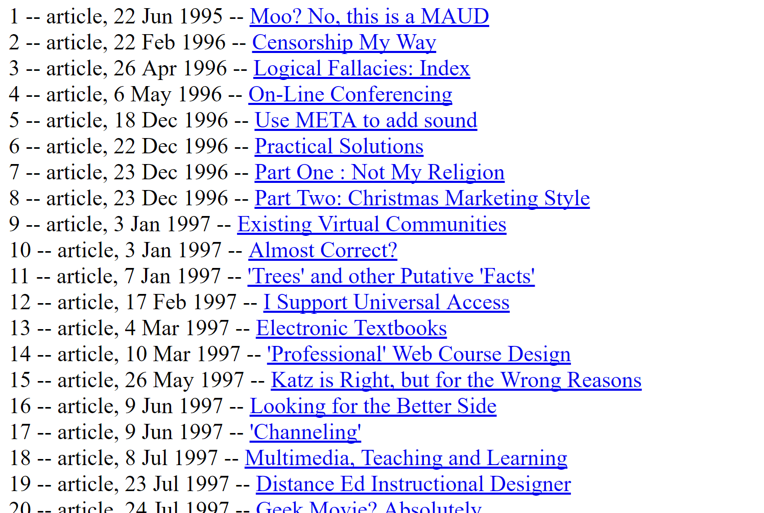
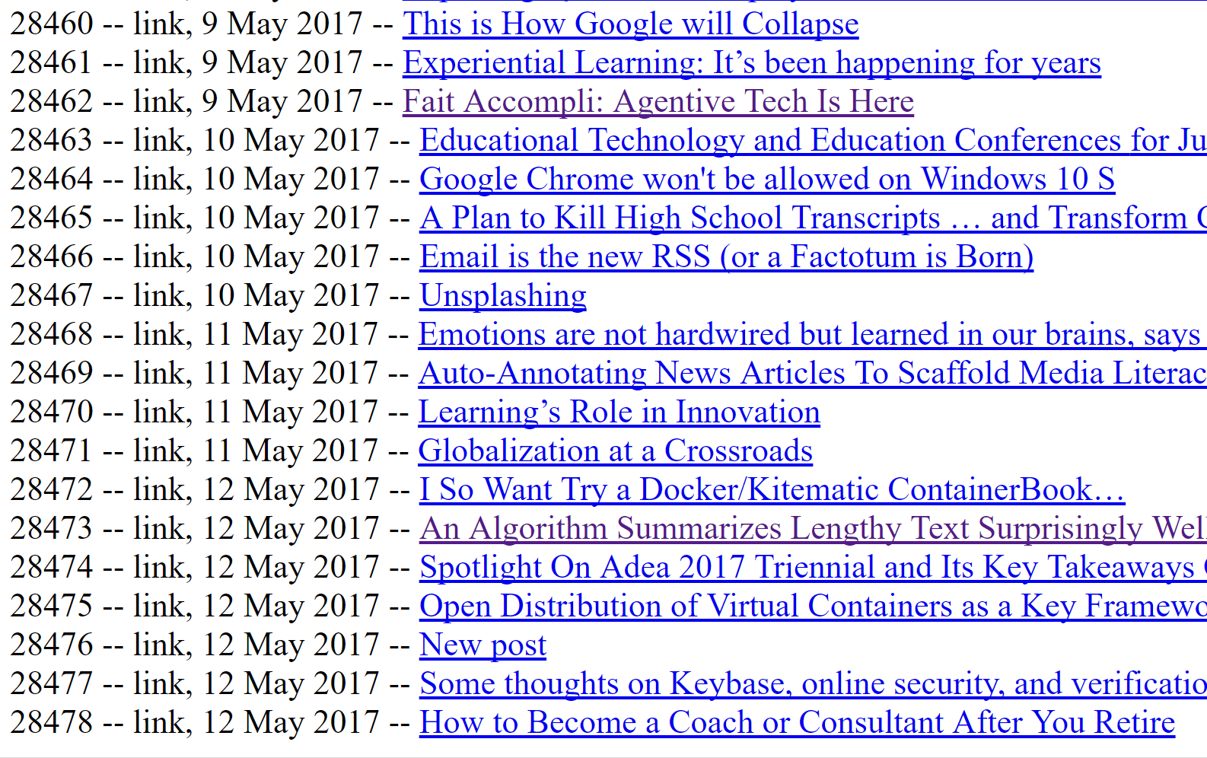
Post List
http://www.downes.ca/post_list.html

Slide 17
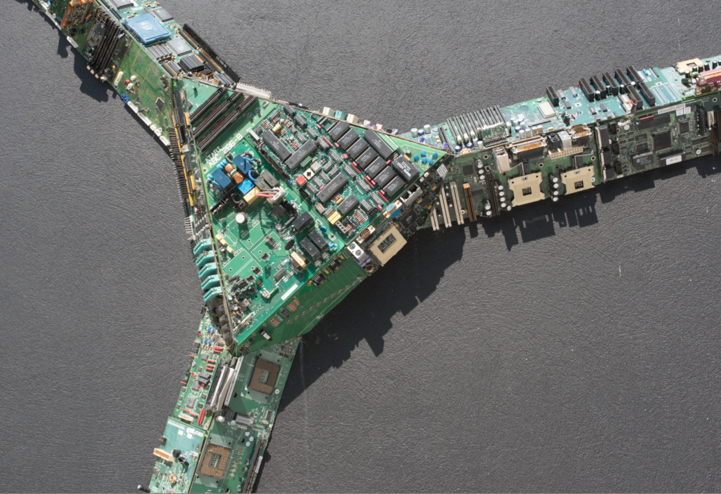
The Personal Learning Environment

Slide 18
Overview of the Concept of PLEs
LMS
Simulation
PLE
Chat Room
MOOC
Blogger
Intranet
Access to many services in one personal environment

Slide 19
Properties of the PLE…
What information should it record?
Who owns the data? How private is it?
What should it do?
What would a person do with it?
Where, exactly, is a PLE located?
PLE

Slide 20
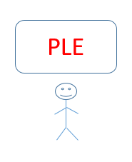
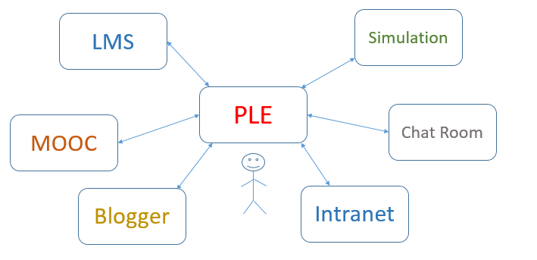
The Network of PLEs

Slide 21
The Social Network of PLEs
twitter
facebook
email

Slide 22
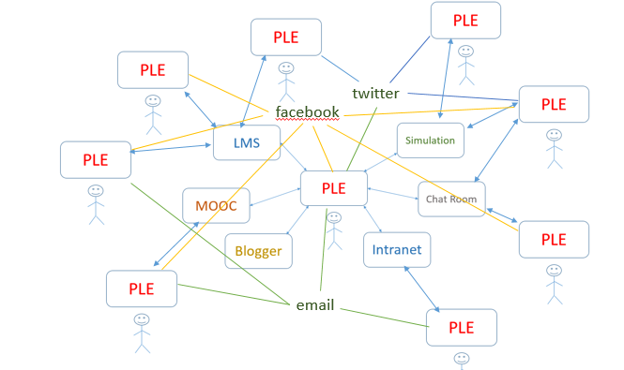
Properties of the Network…
How do people find each other? Services?
How do they communicate? What do they share?
How does a single PLE work with services?
Do we need centralized registries?

Slide 23

Why a personal learning environment?
10:30 – 11:30
What is the value proposition for a PLE?
  Note: value isn’t what you can do, it’s how you benefit
  This is usually stated in financial terms (earn more, cost less)
  Can also be stated in terms of quality: faster, bigger, better
  And can be non-financial goods: satisfaction, happiness, memories

Slide 24
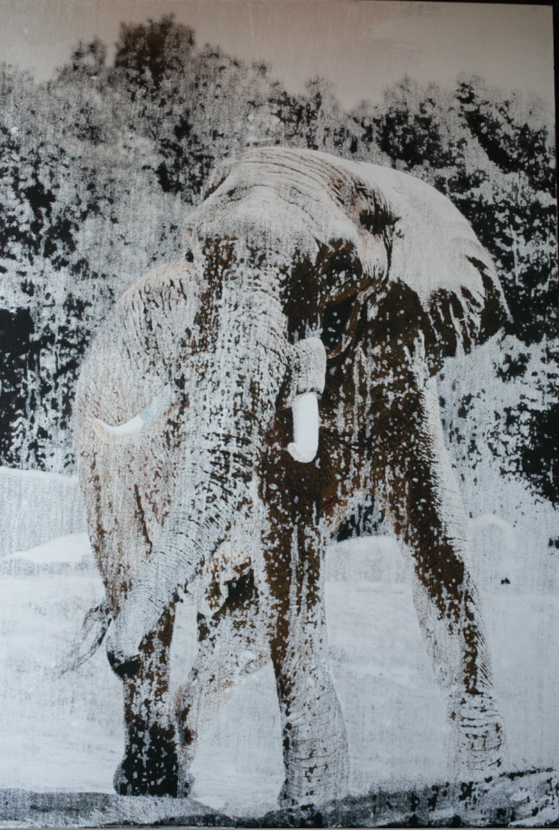
Education is not a search problem

Slide 25
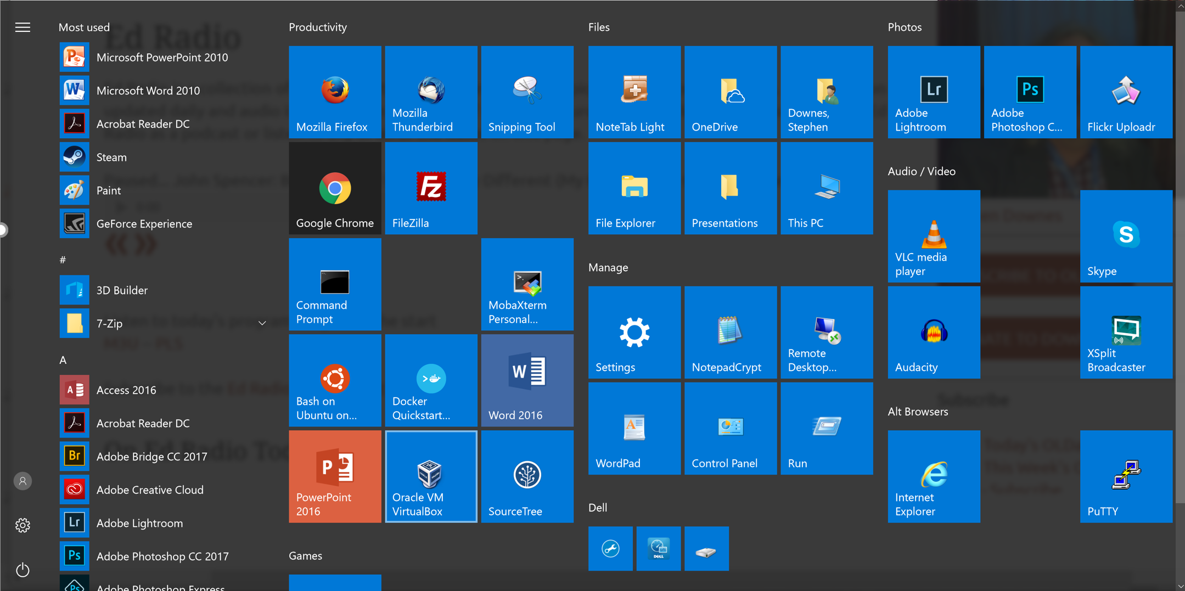
Making

Slide 26
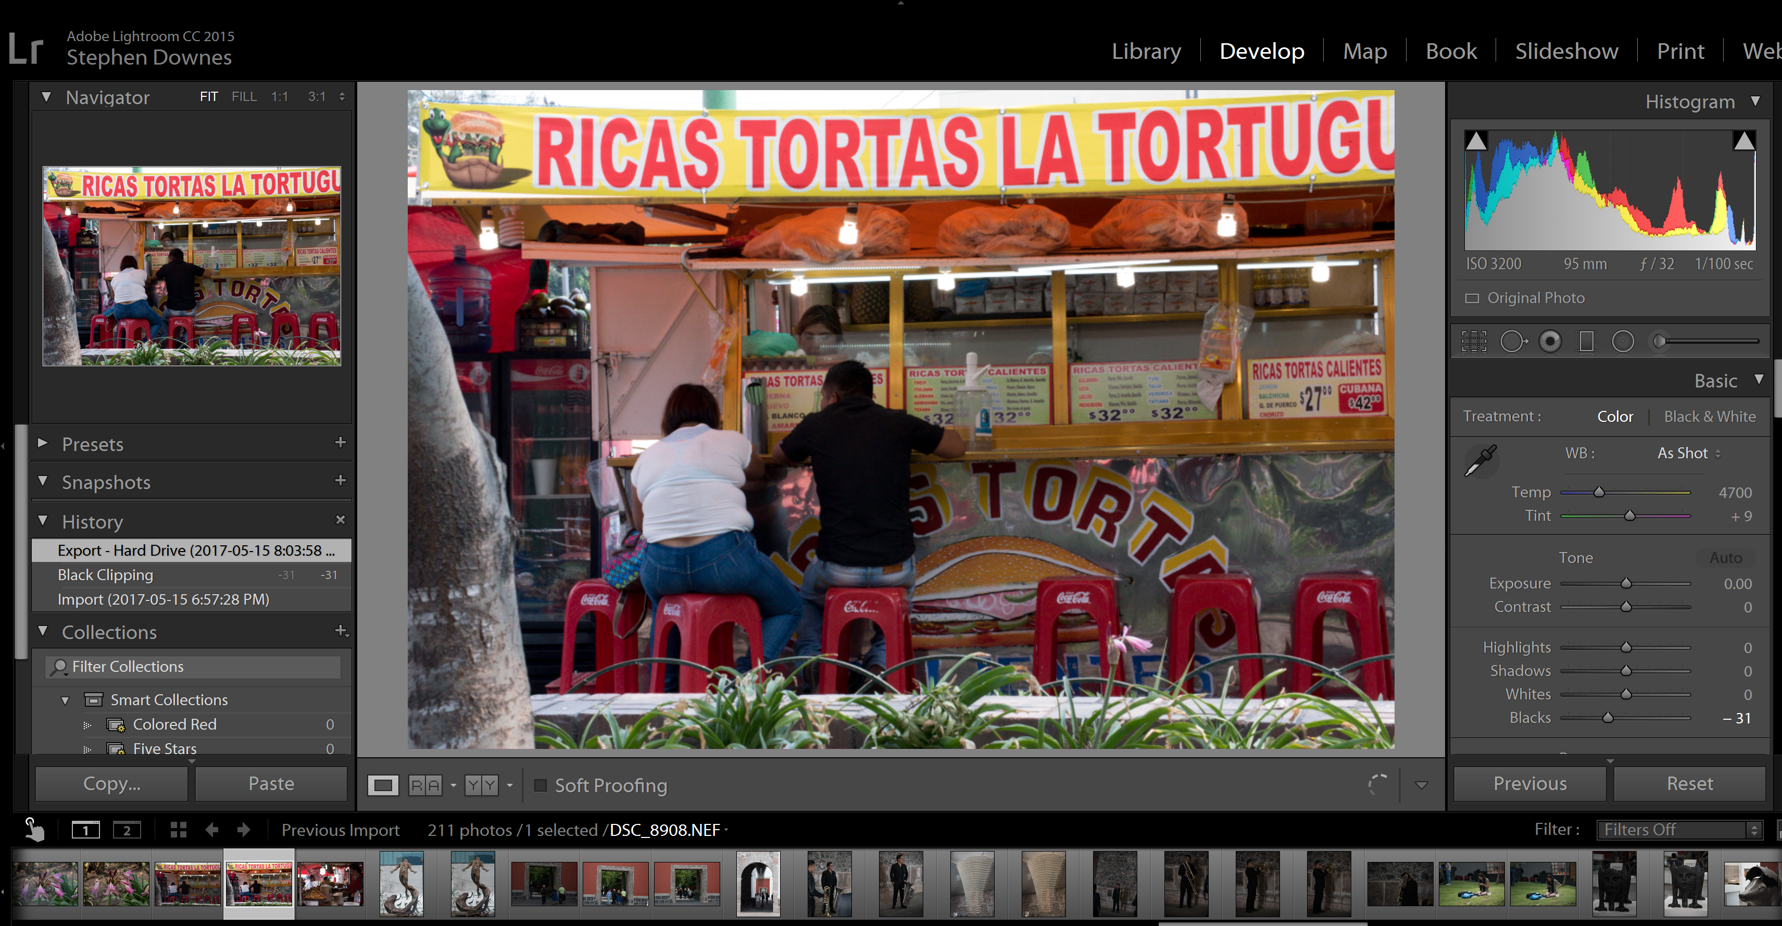
Making
https://lightroom.adobe.com/

Slide 27
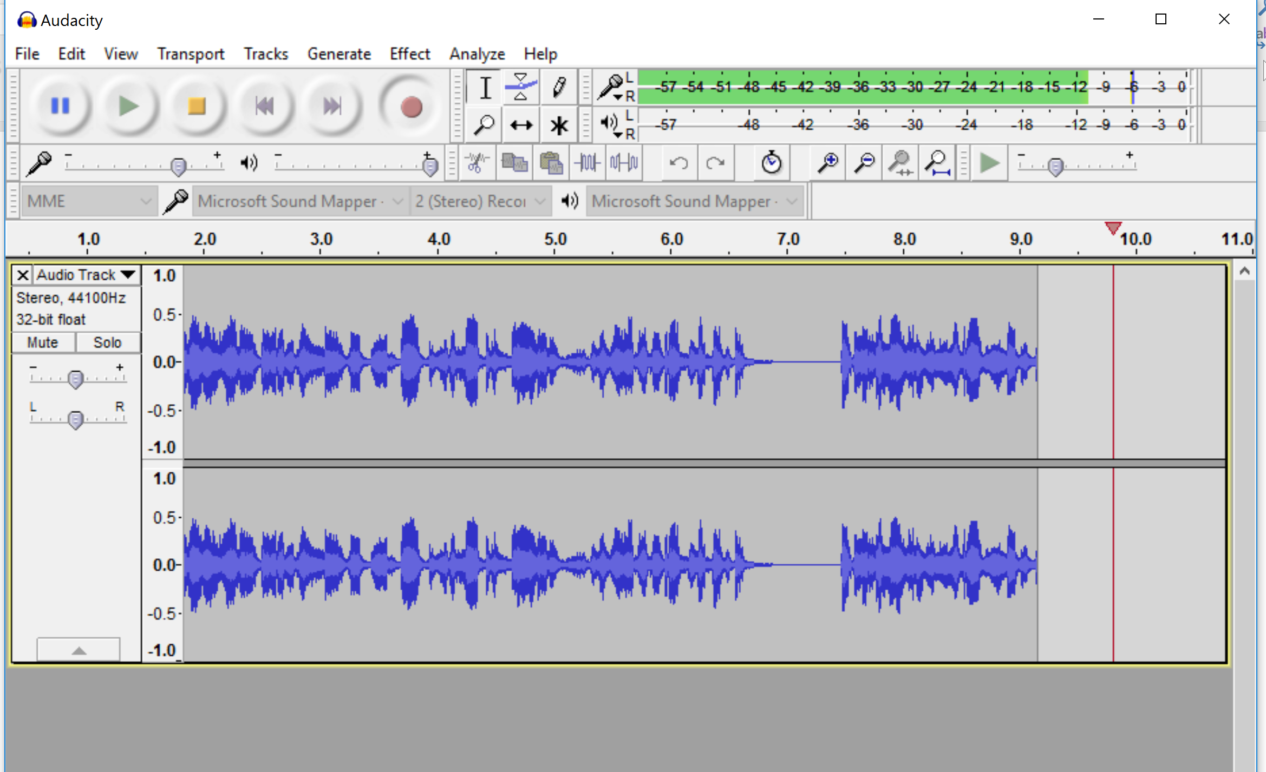
Making
http://www.audacityteam.org/download/

Slide 28
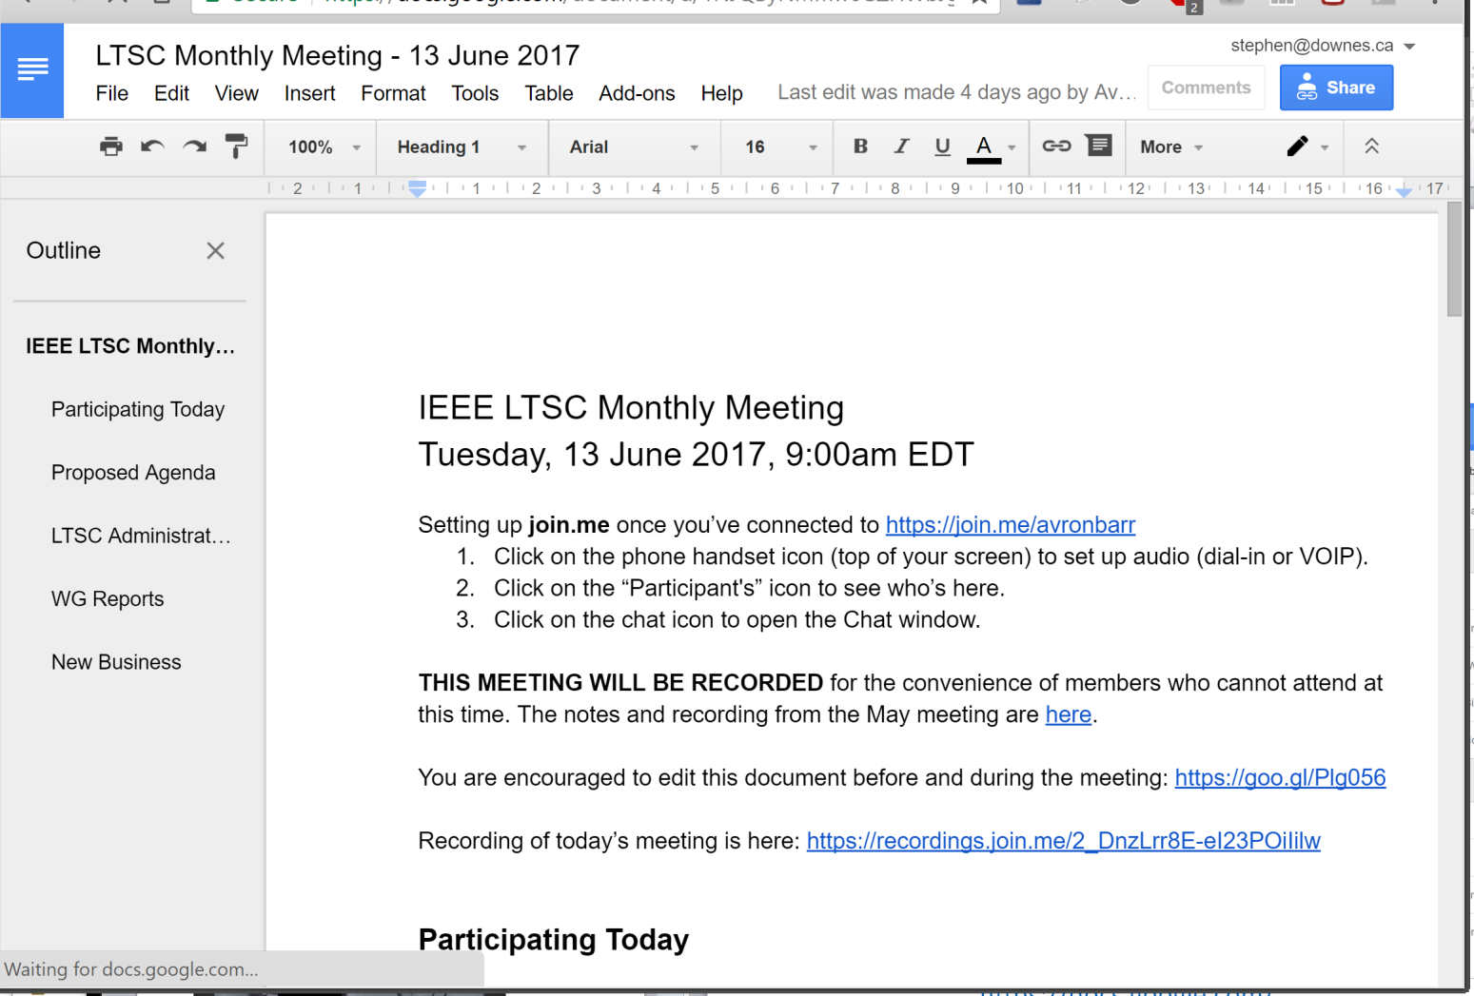
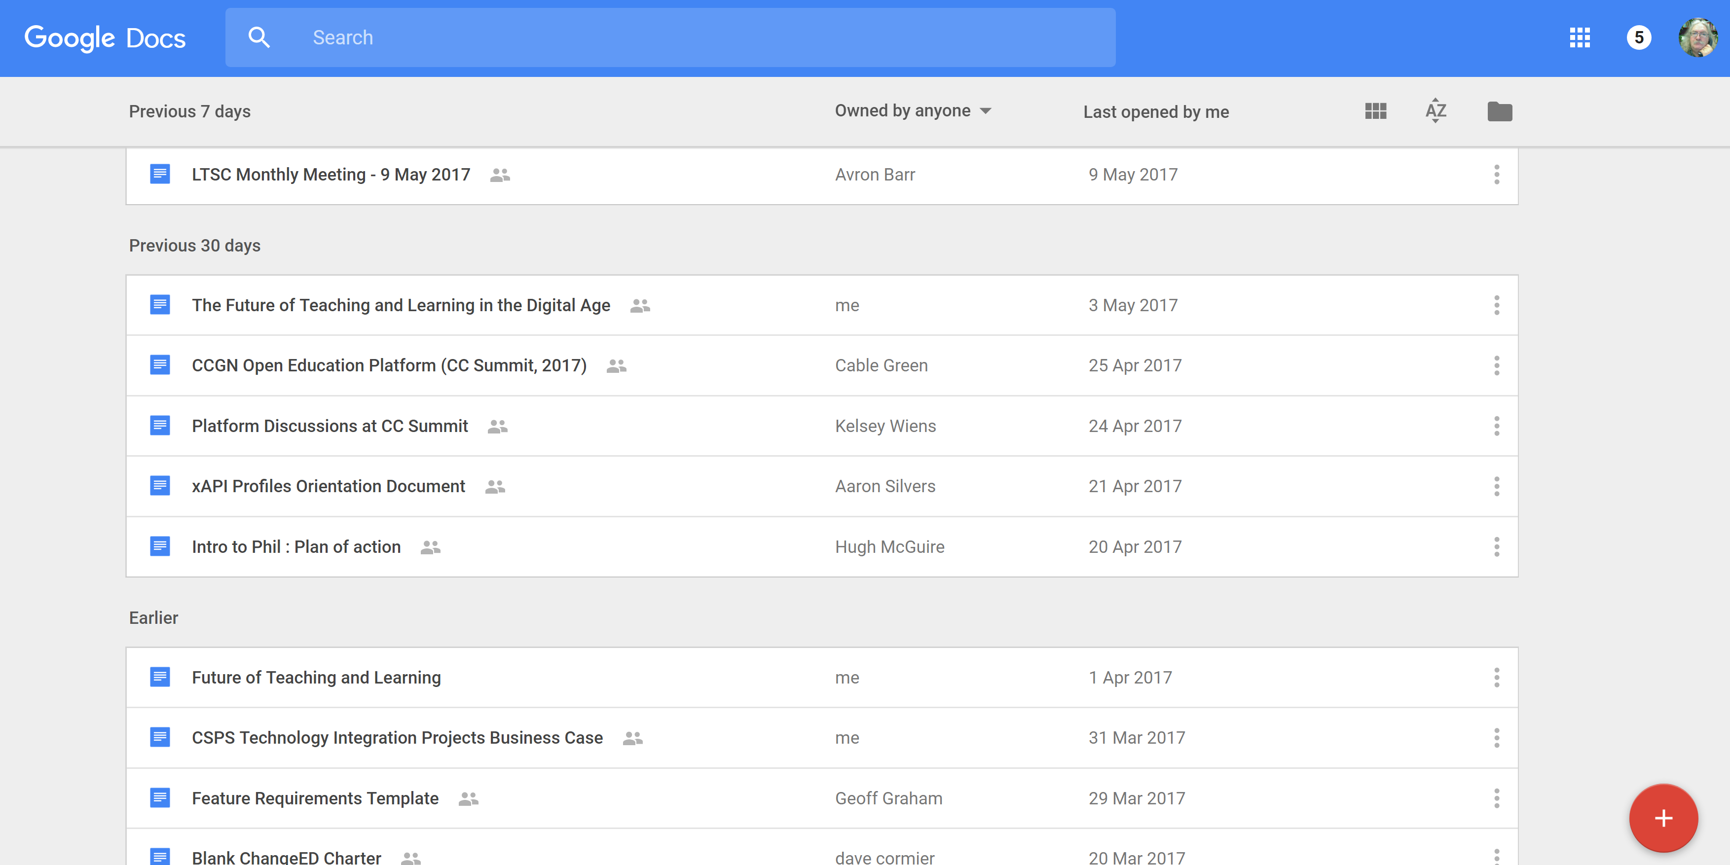
Making
https://docs.google.com/

Slide 29
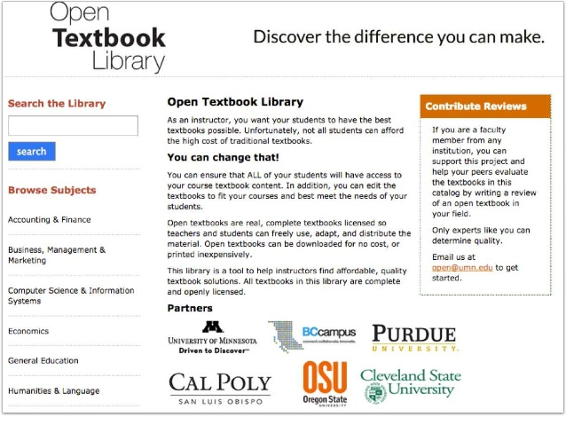
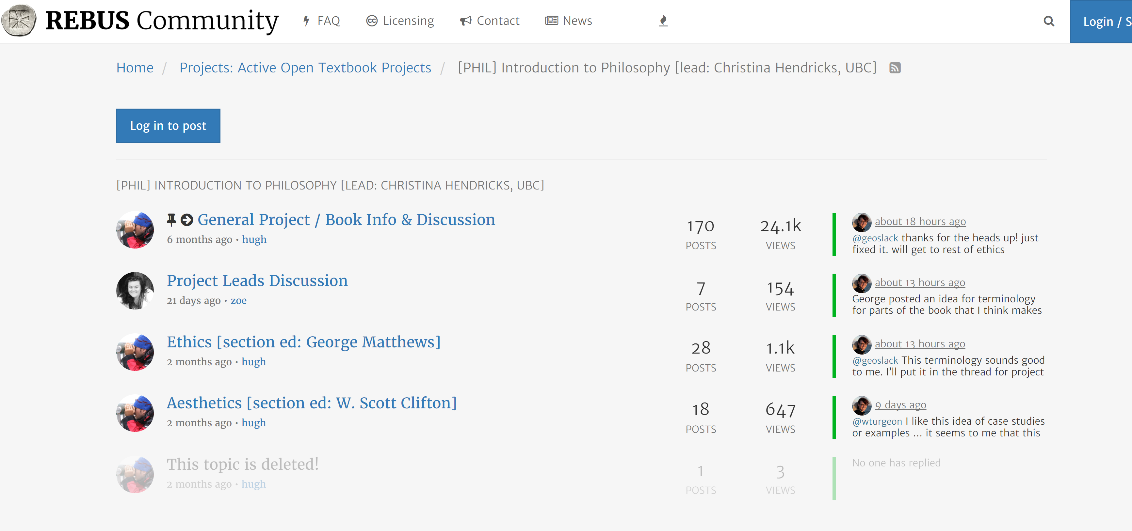
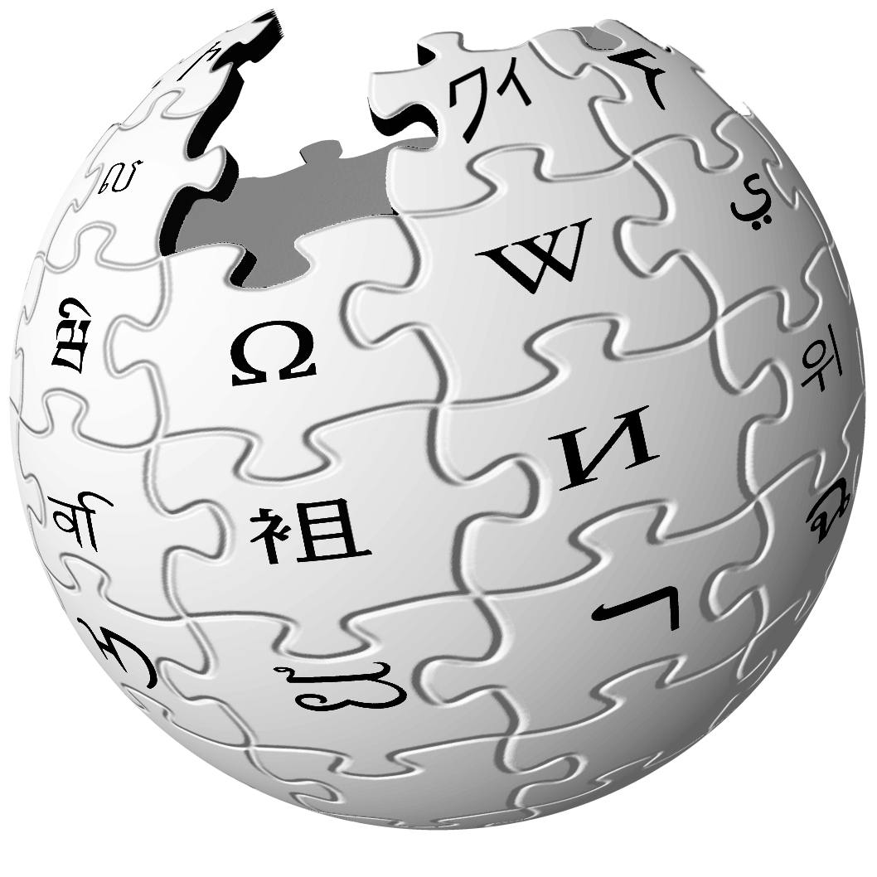
Making
https://forum.rebus.community/category/17/phil-introduction-to-philosophy-lead-christina-hendricks-ubc

Slide 30
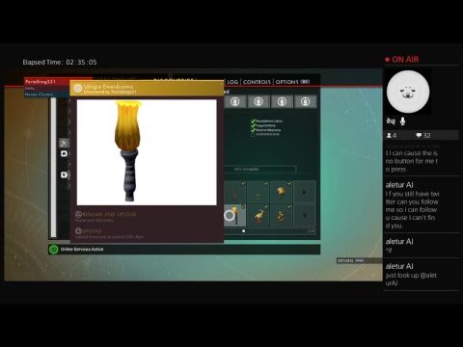
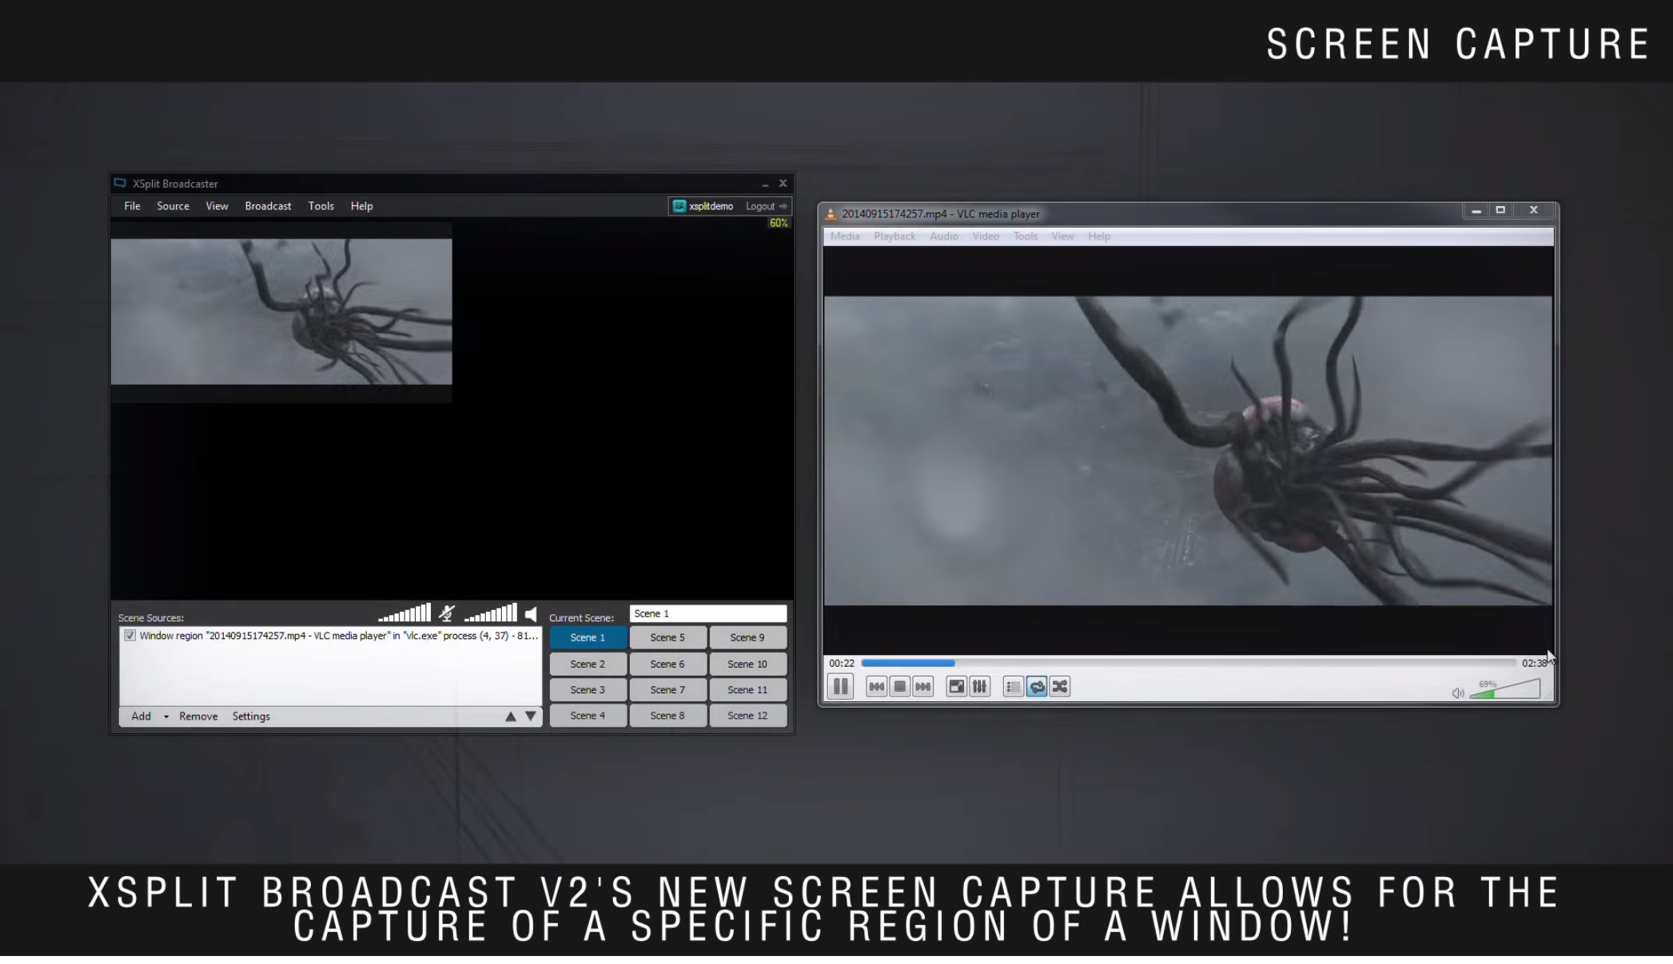
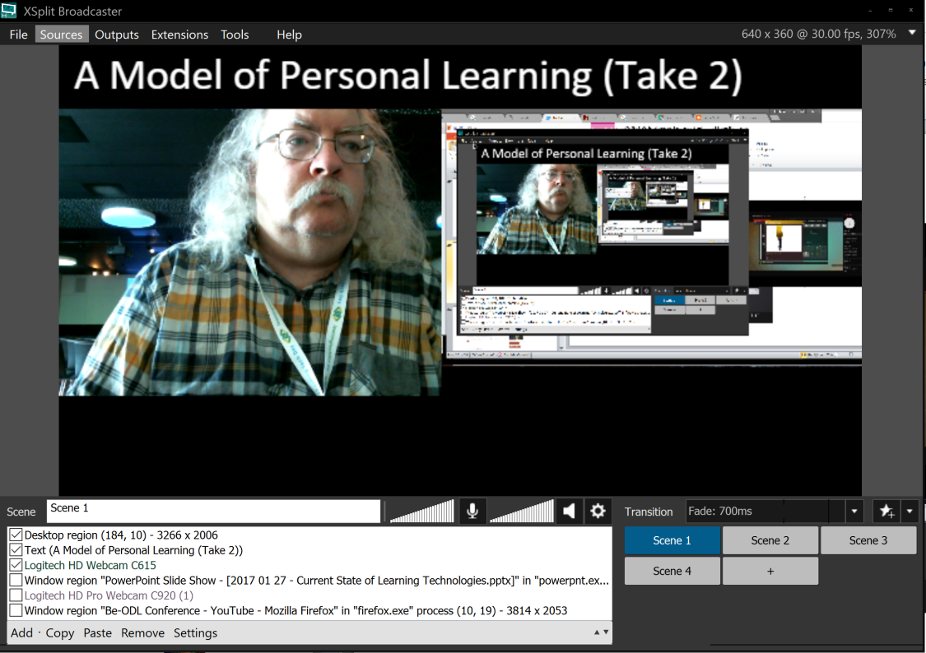
Making
https://www.xsplit.com/

Slide 31
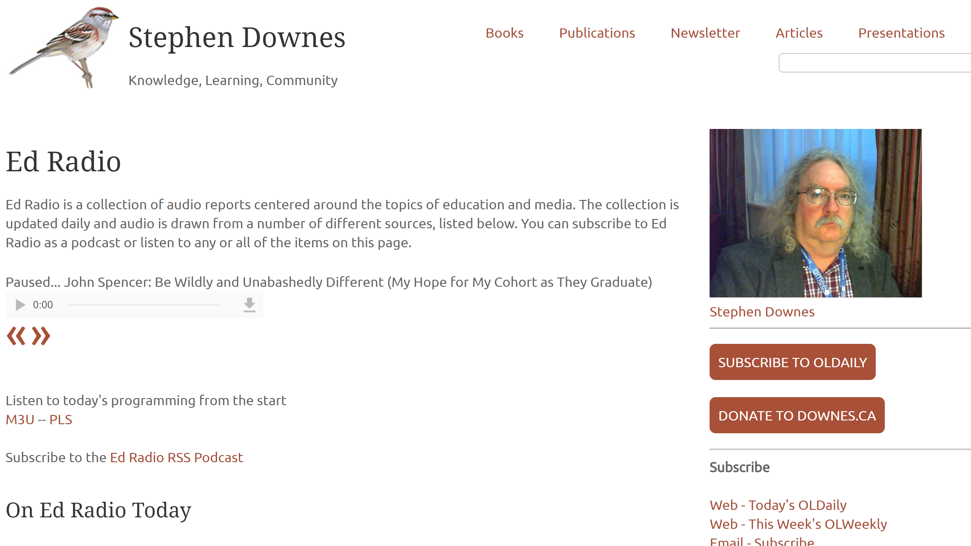

Sharing
http://www.downes.ca/edradio.htm

Slide 32
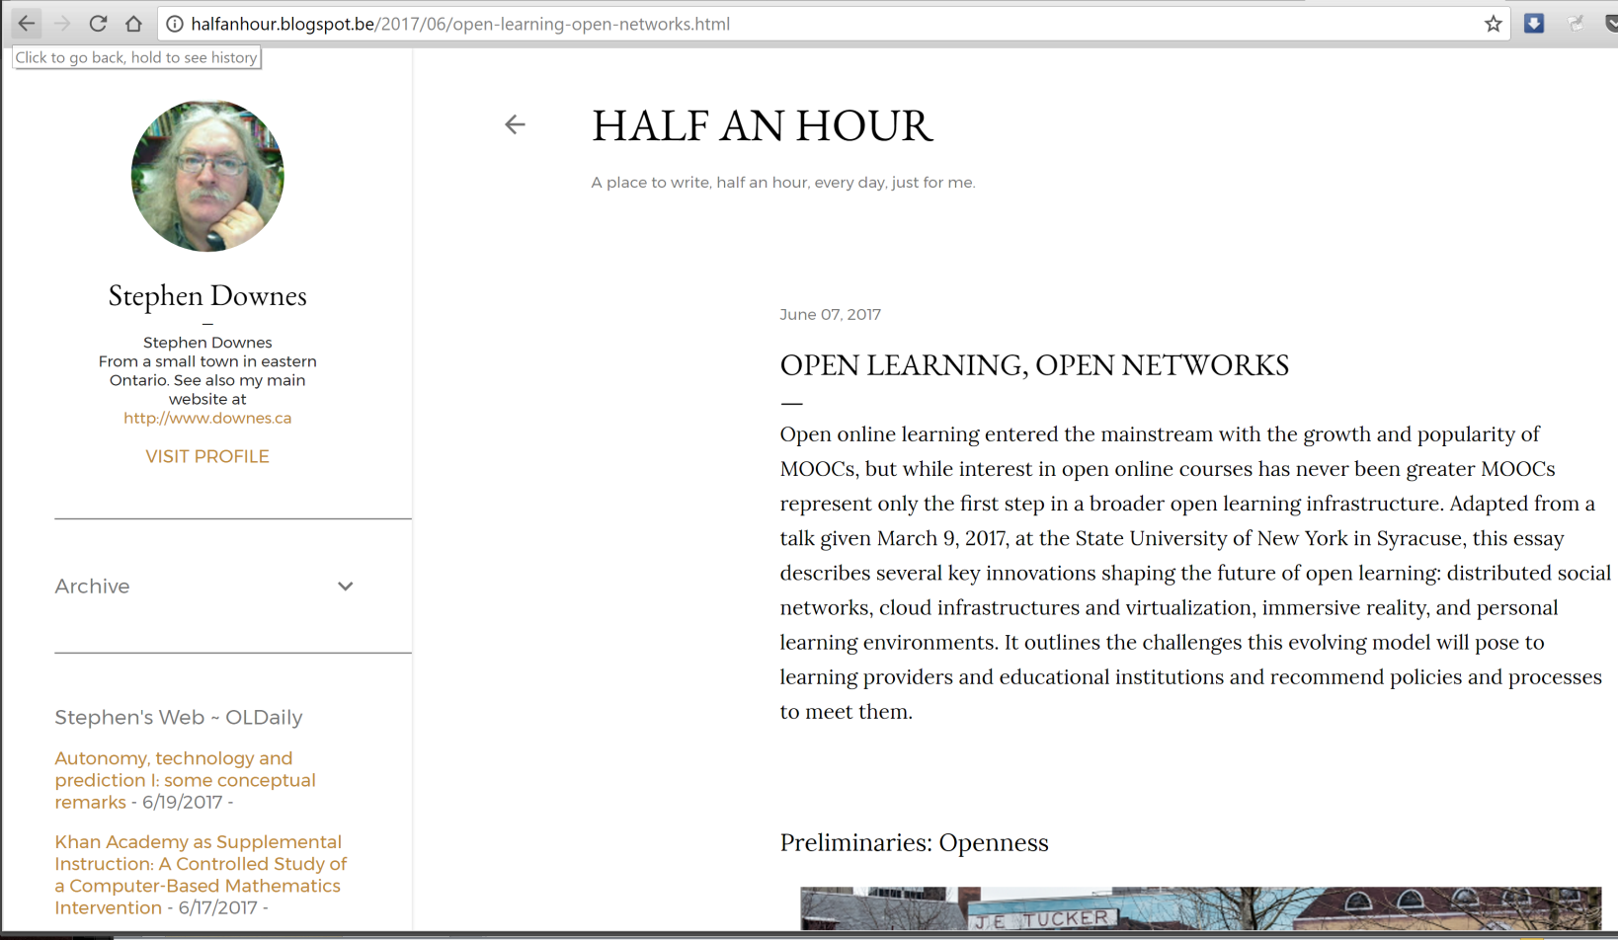
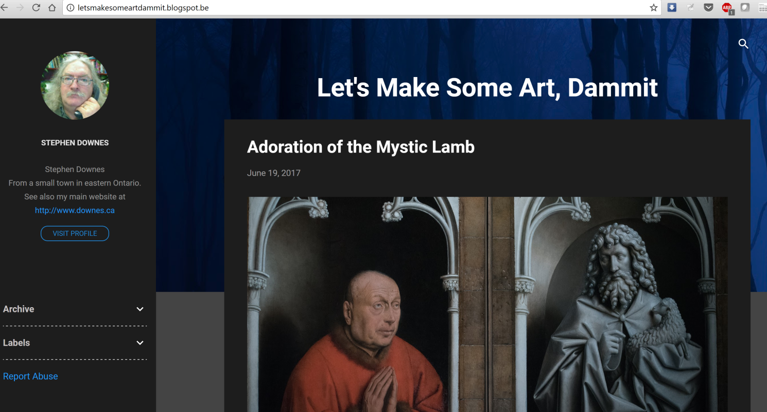
Sharing
http://letsmakesomeartdammit.blogspot.com
http://halfanhour.blogspot.com

Slide 33
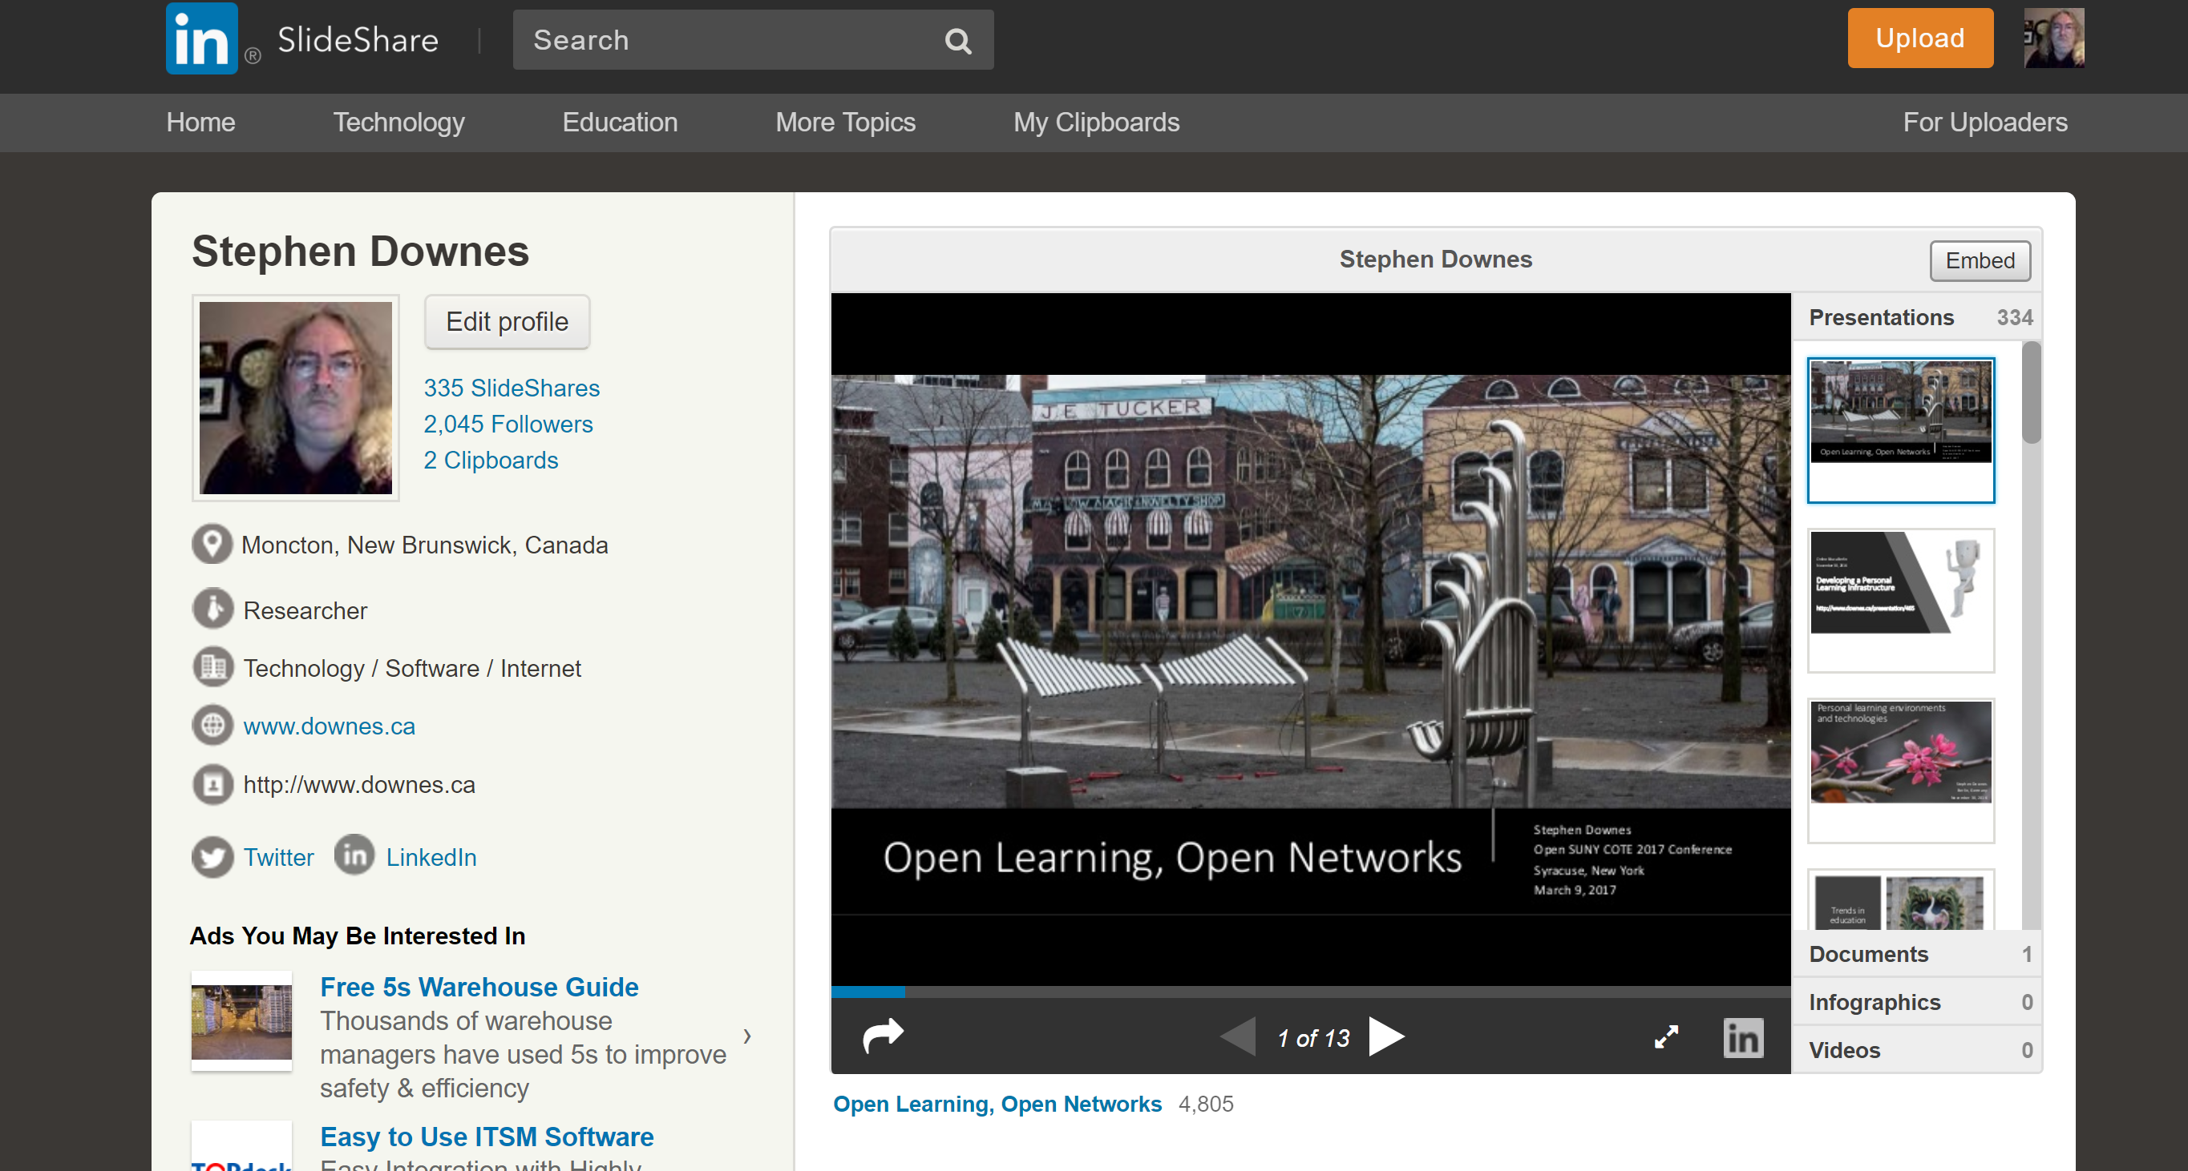
Sharing
https://www.slideshare.net/Downes

Slide 34
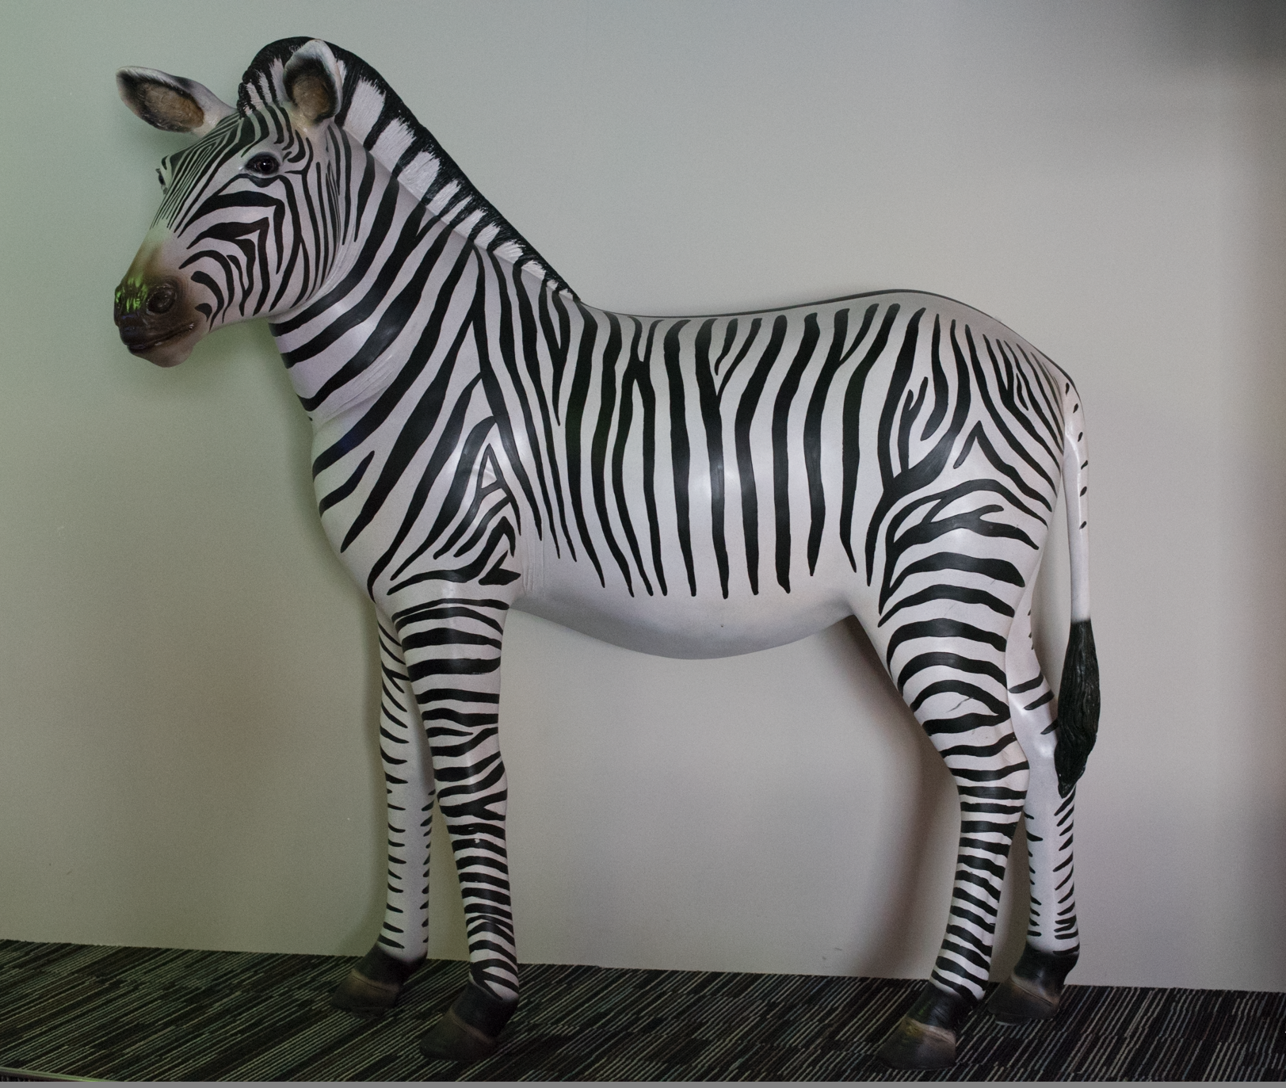
Toward Personal Learning

Slide 35
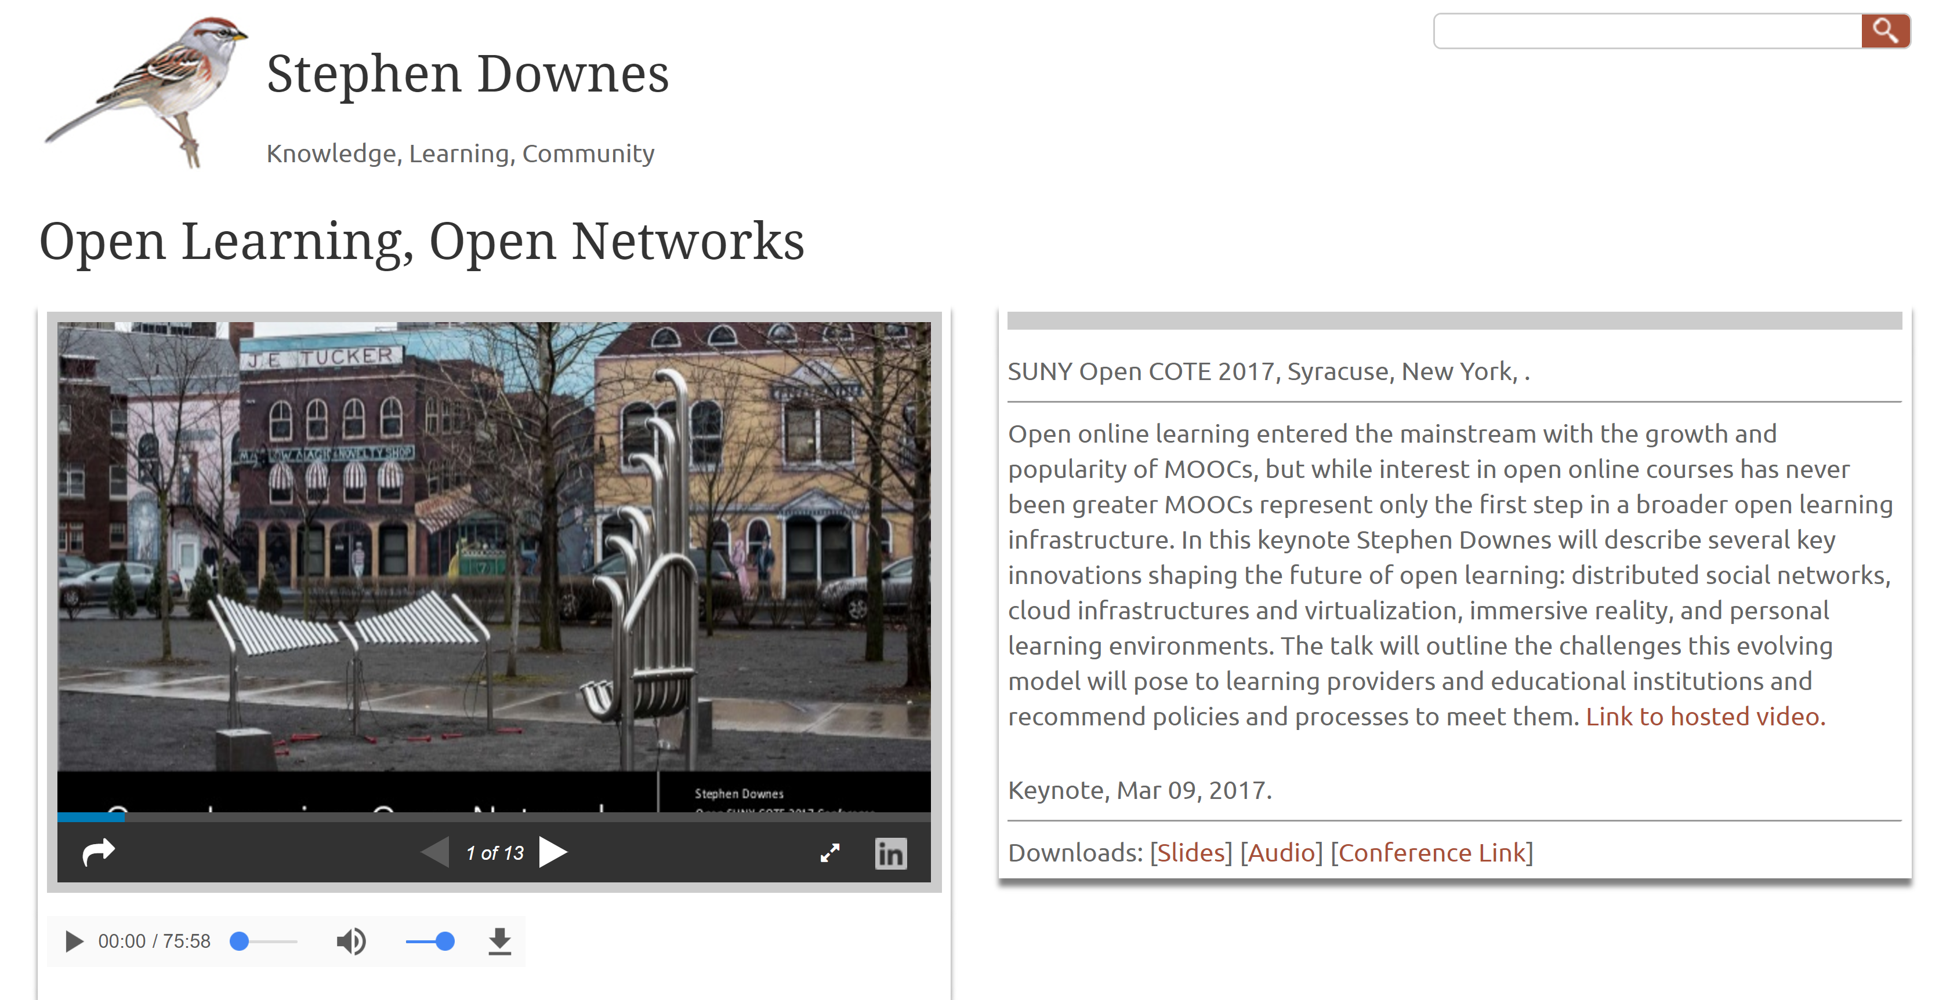
Sharing
http://www.downes.ca/presentation/468

Slide 36
New learning Paradigms
Path | Field
Course | Curriculum (as in ‘mapping’)
Sequence / Prequisite | Core / periphery / foundation
Movement / covered | Inquiry / Discovery / Gaps
Threshold / Levels | Coverage / Construction
Positioning – first / last | Grouping / Clustering
Objective / target | Serendipity / emergence
Leading / Led | Centred
Carrie Paechter, Metaphors of Space in Educational Theory and Practice http://www.tandfonline.com/doi/pdf/10.1080/14681360400200202

Slide 37
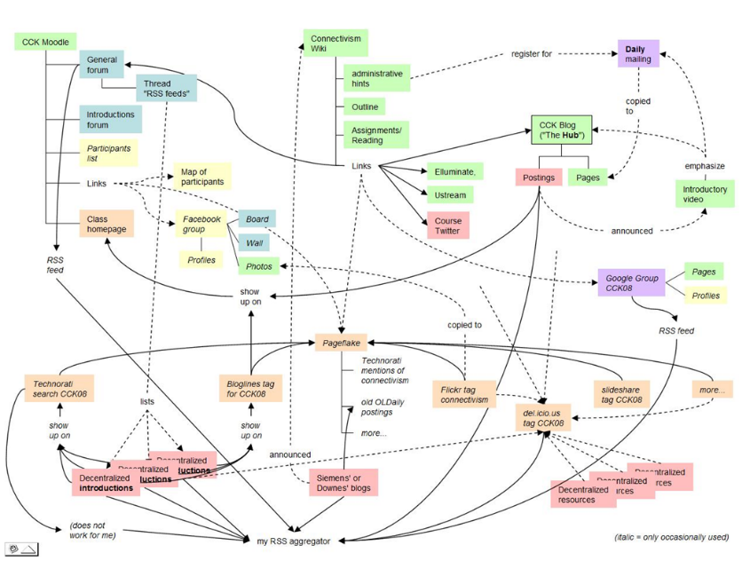
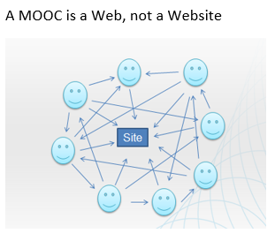
The Connectivist MOOC (cMOOC) Design
Instead of seeing a course as a series of contents to be presented, a course is a network of participants who find and exchange resources with each other
An initial structure is developed and ‘seeded’ with existing OERs
Participants encouraged to use their own sites to create or share resources
A mechanism (gRSShopper) is employed to connect them

Slide 38
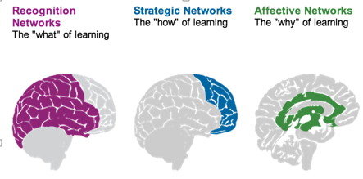
Personalization
What we learn
How we Learn
Why we learn
Rules-Based Events (like notifications)
User Models
Adaptive Learning

Slide 39
Two Approaches…
Content
Practice
Practice
Content

Slide 40
Two Approaches…
Defines an ideal state
Defines a desired state
Content
Practice
Practice
Content
TEST
TRY
Person tests you
Person helps you

Slide 41
Two Approaches…
Defines an ideal state
Defines a desired state
Content
Practice
Correction
Iteration
GAP
Practice
Content
Opport-unity
TEST
TRY
Person tests you
Person helps you

Slide 42
Library Environment
Defines an ideal state
Defines a desired state
Content
Practice
Affordances
Correction
Requirements
Iteration
GAP
Practice
Content
Opport-unity
TEST
TRY
Person tests you
Person helps you

Slide 43
Personalized Personal
We do for you You do for yourself
Defines an ideal state
Defines a desired state
Content
Practice
Affordances
Correction
Requirements
Iteration
GAP
Practice
Content
Opport-unity
TEST
TRY
Person tests you
Person helps you

Slide 44
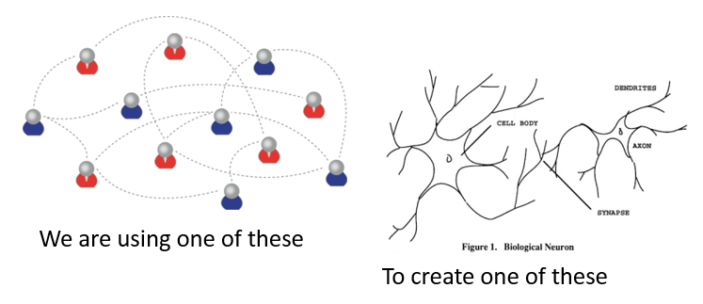
Learning Outcomes
Learning a discipline is a total state and not a collection of specific states
It is obtained through immersion in an environment rather than acquisition of particular entities
It is expressed functionally (can you perform ‘as a geographer’?) rather than cognitively (can you state ‘geography facts’ or do ‘geography tasks’?)

Slide 45
Extended Cognition
More than neural networks?
  Embodied learning, stigmergy, extended memory (Andy Clark)
Is my library a part of my cognition?
  Which books?
The problem of explanation

Slide 46
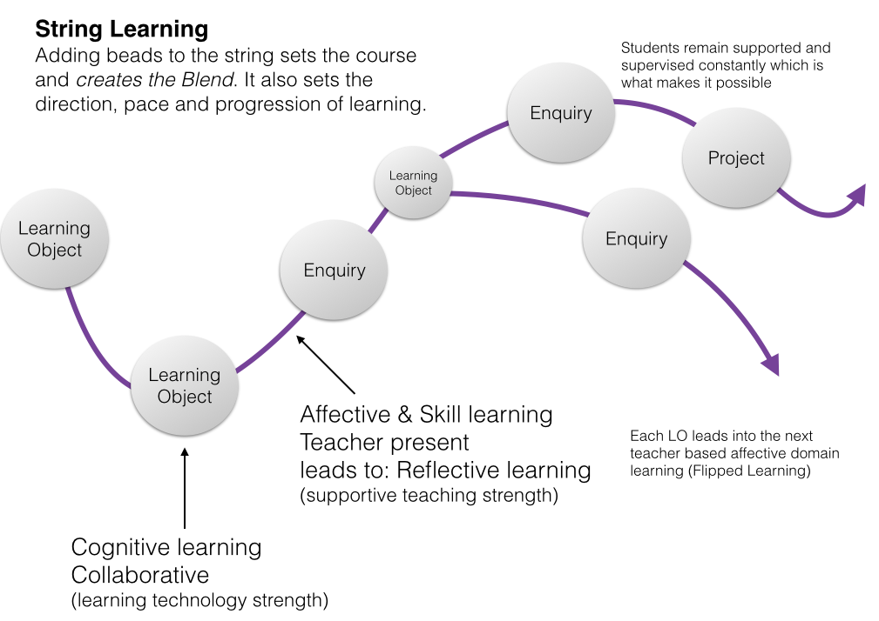
Cloud Environments
https://www.linkedin.com/pulse/string-learning-blend-objects-geoff-rebbeck?articleId=6932346018329088240

Slide 47
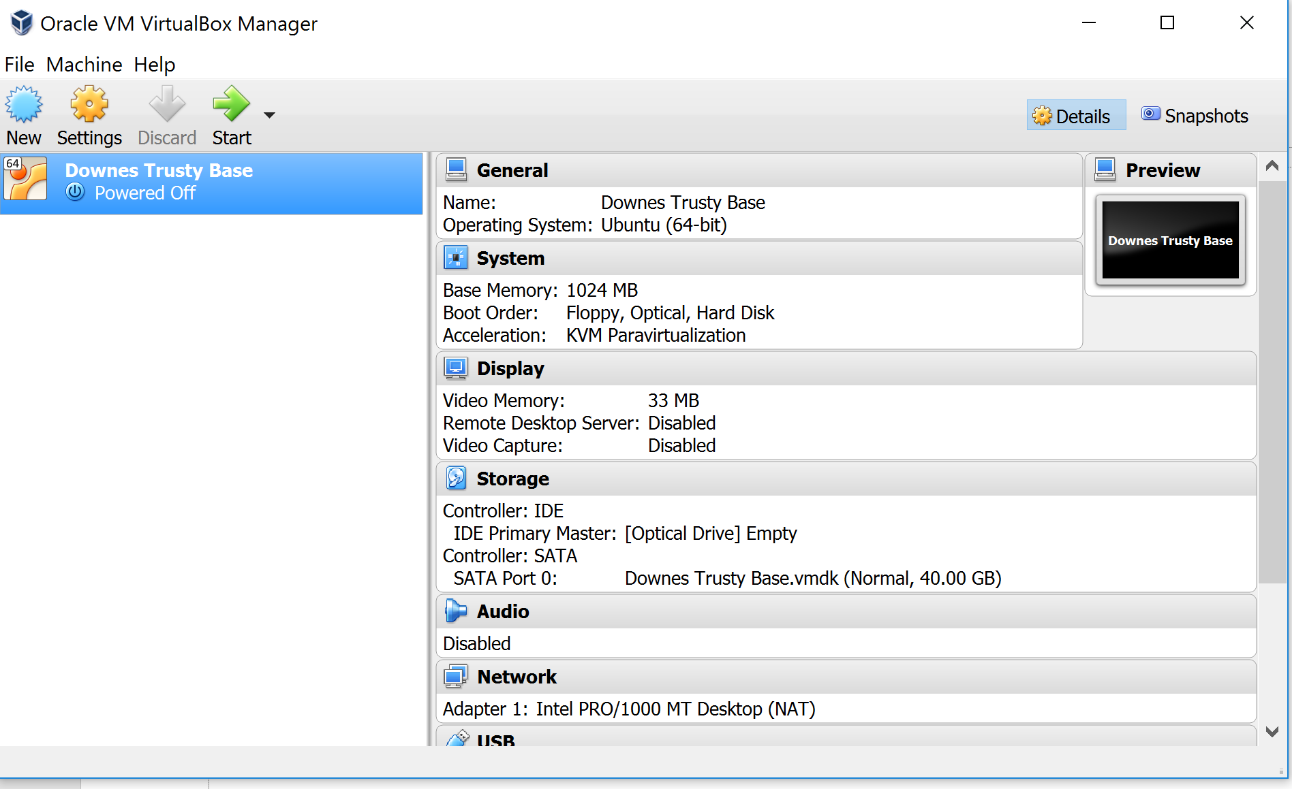
Making
https://www.virtualbox.org/

Slide 48
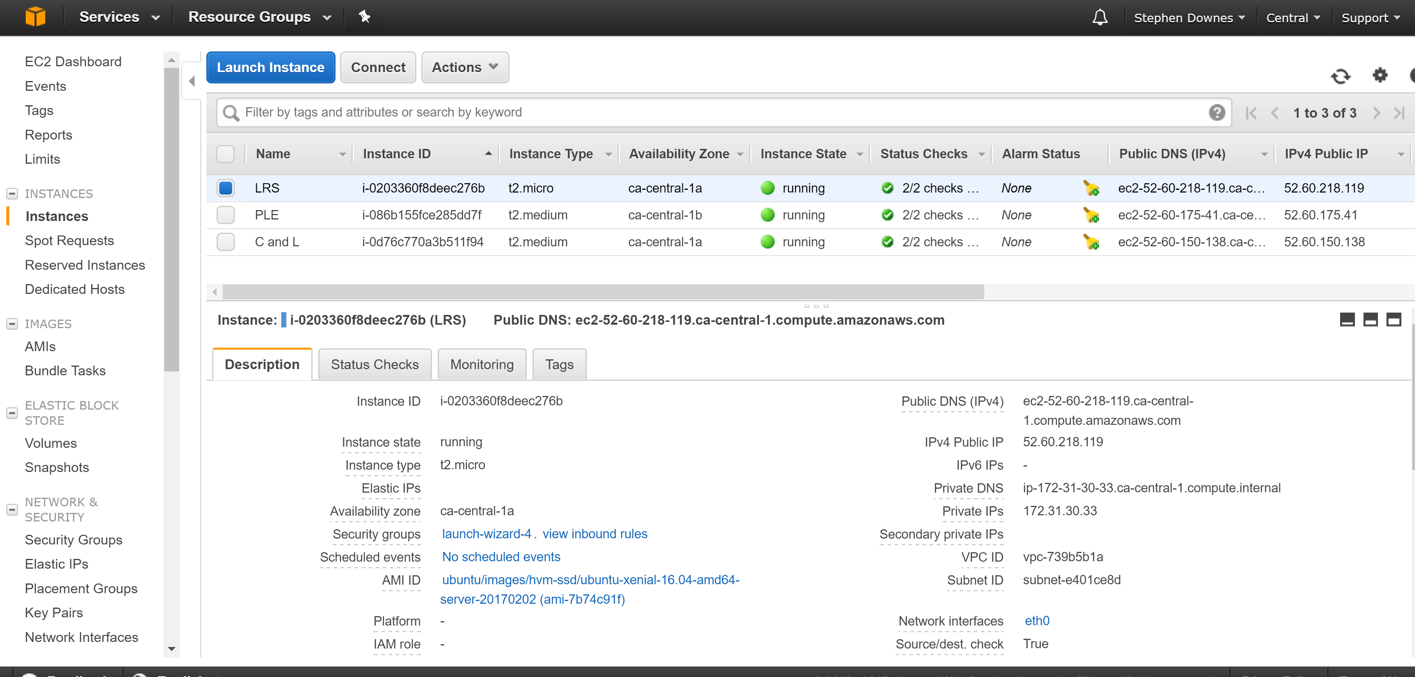
Cloud Environments
https://aws.amazon.com/console/

Slide 49
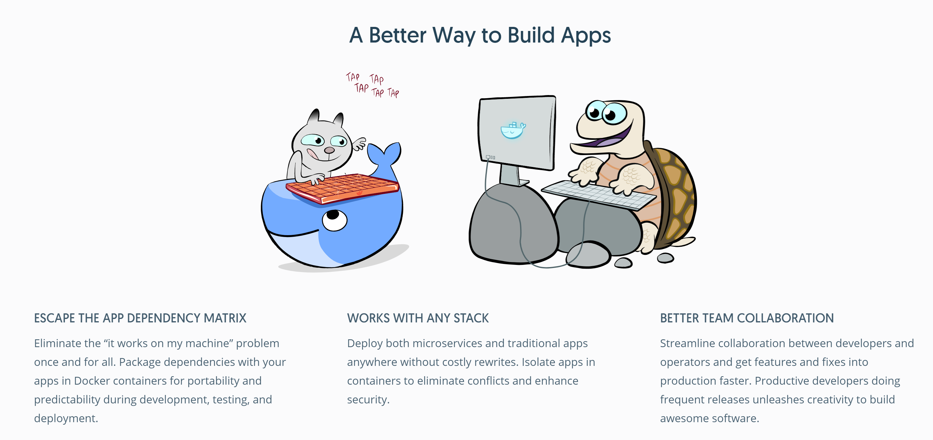
Cloud Environments
https://www.docker.com/

Slide 50

Learning Record Store
http://adlnet.github.io/xapi-statement-viewer/

Slide 51

Cloud Services
https://datarepository.wolframcloud.com/

Slide 52

Stephen Downes
http://www.downes.ca
Moncton, Canada, 2005
http://www.downes.ca/presentation/389

