Slide 1

A Model of Personal Learning
Stephen Downes
Mexico City
May 16, 2017

Slide 2
What does personal learning look like? Stephen Downes demonstrates the model he has developed over fifteen years of research on education technology and learning design. Based on gRSShopper – the software developed to run his newsletter and a series of Massive Open Online Courses (MOOCs) - Downes looks at the day-to-day routine of a personal learner with examples from his practice and a live demonstration of learning activities. Through the presentation Downes will explain the philosophy of Connectivism, a learning approach based on developing and growing personal learning networks, and will describe the ARRFF (Aggregate Remodel Repurpose Feed Forward) model of learning activities. Finally, he will offer insights regarding some key technologies on the horizon, such as server virtualization and augmented reality, and offer thoughts on the future of online learning.

Slide 3
A Note About Models
With models, the answers are determined before the system or simulation is ever run…
Eg. “Carnegie Melon University received a two-year grant for research on and development of MOOCs platforms 'intelligent enough to mimic the traditional classroom experience'.”
http://unescochair.blogs.uoc.edu/blog/2014/06/25/a-goal-for-google-and-carnegie-mellons-mooc-research/

Slide 4

What’s missing in the standard-based models-based approach is what we used to think of as BAD
Bricolage – the doesn’t allow or cater for bricolage.
Affordances – leverage the technology to improve learning and teaching.
Distribution – implications for the institutional practice of e-learning."
http://davidtjones.wordpress.com/2014/03/31/bim-and-bad/
Notes:
BIM and BAD
David T. Jones, The Weblog of (a) David Jones, Apr 25, 2014
Commentary by Stephen Downes
I like this acronym - it's not complete, but it's a great start: "BAD is an acronym that captures what I think is missing from the institutional approach to university e-learning
Bricolage – the LMS as Enteprise Systems doesn’t allow or cater for bricolage.
Affordances – resulting in an inability to leverage the affordances of technology to improve learning and teaching.
Distribution – the idea that knowledge about how to improve L&T is distributed and the implications that has for the institutional practice of e-learning."
This wasn't what we were trying to develop when we developed MOOCs, but if this had been the description of what we were trying, it wouldn't have been far off.

Slide 5
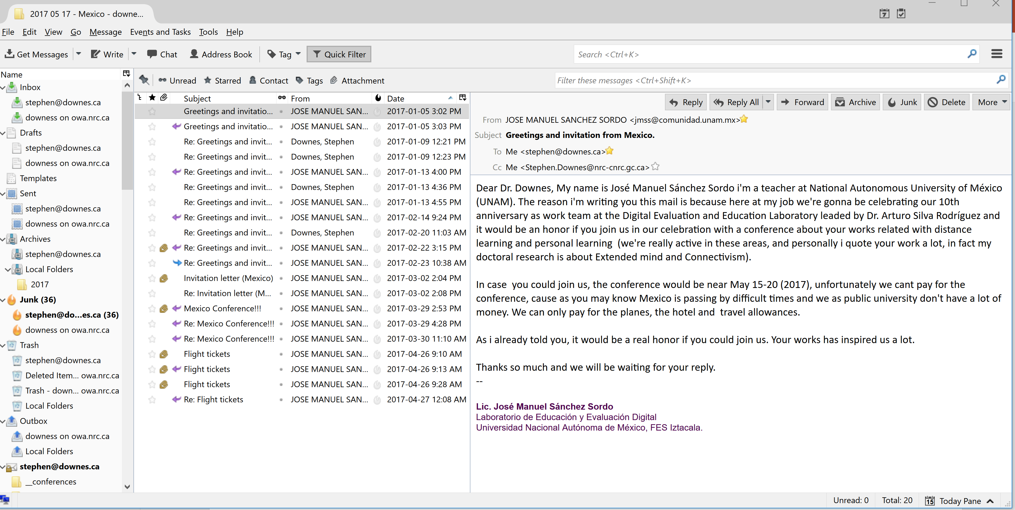
A Day in the Life?

Slide 6
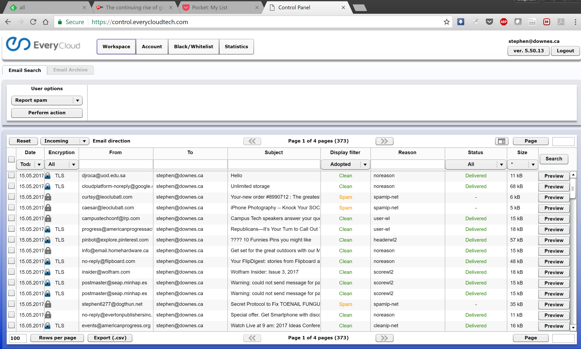
A Day in the Life?
https://www.everycloudtech.com/

Slide 7
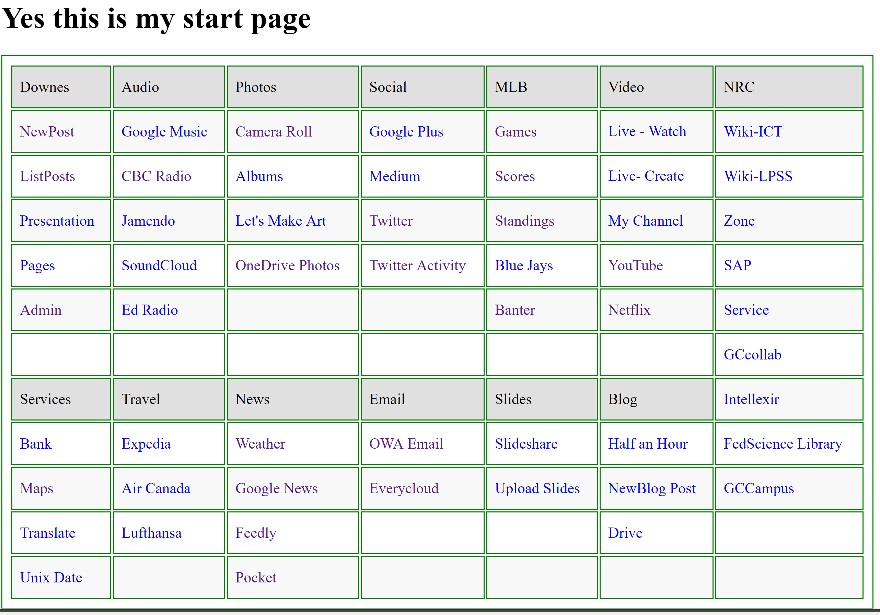
A Day in the Life?
http://www.downes.ca/start.html

Slide 8
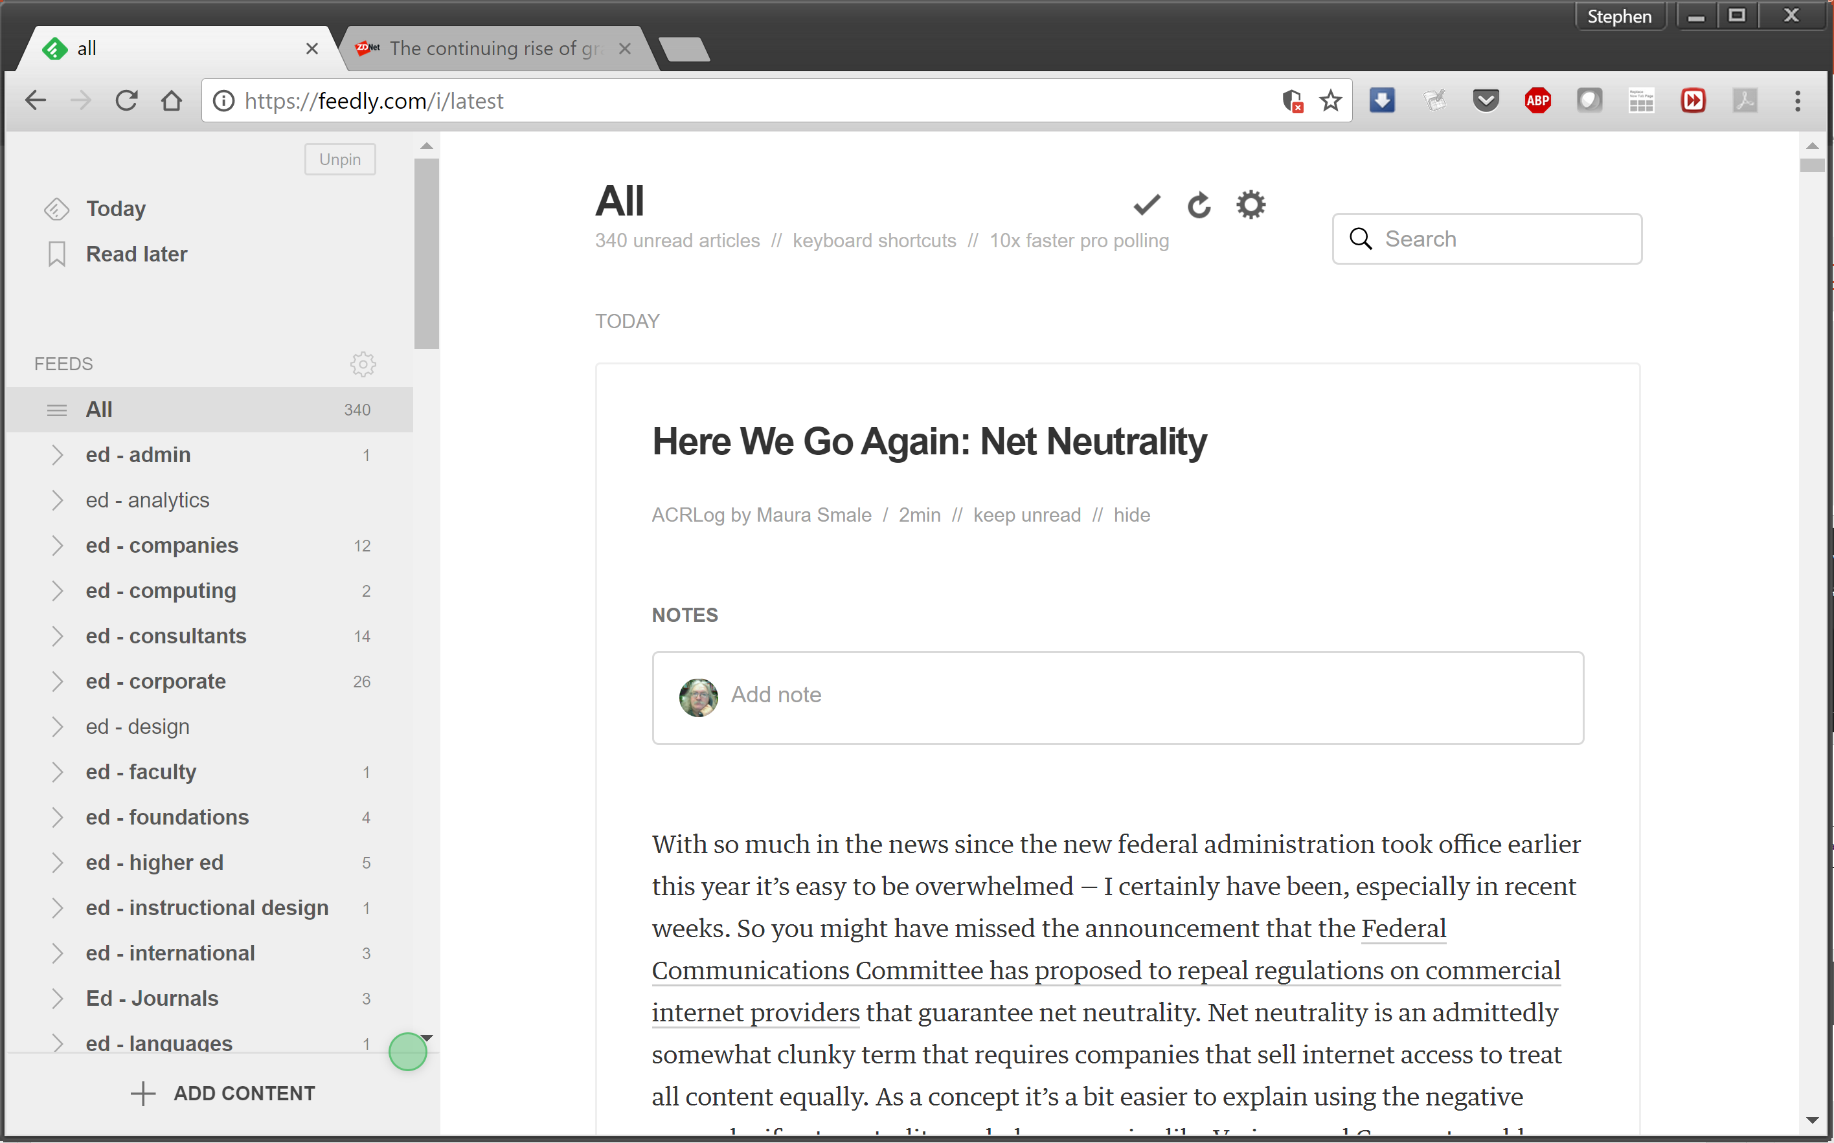
A Day in the Life?
https://feedly.com/i/latest
http://www.downes.ca/opml.xml

Slide 9
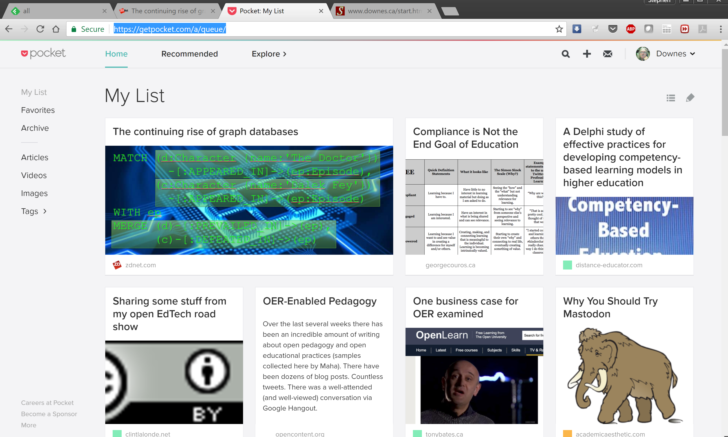
A Day in the Life?
https://getpocket.com

Slide 10
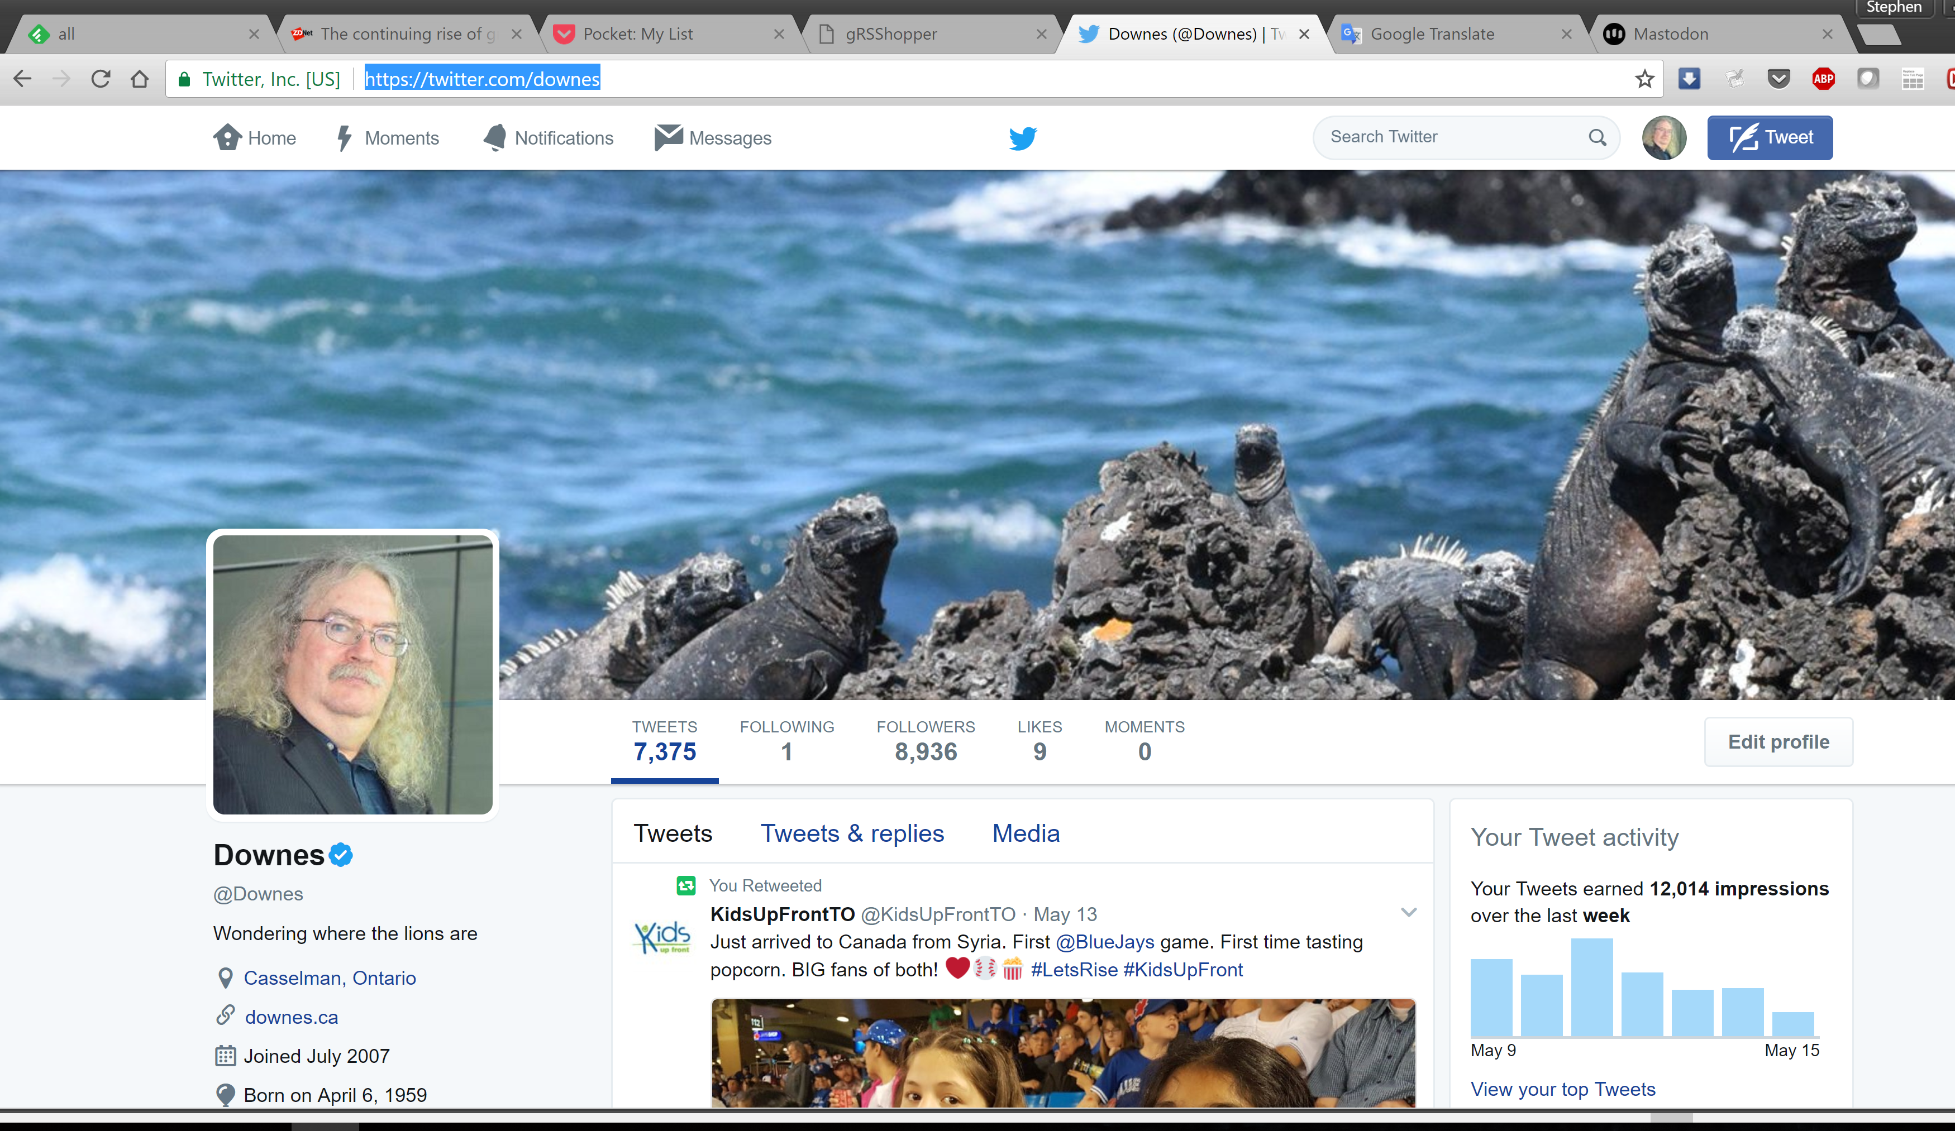
A Day in the Life?
https://twitter.com/downes

Slide 11
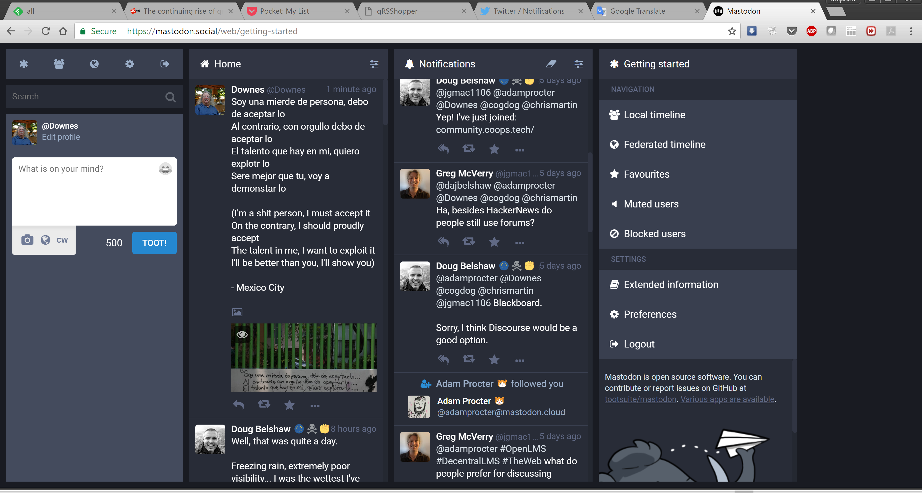
A Day in the Life?
https://mastodon.social/@Downes

Slide 12
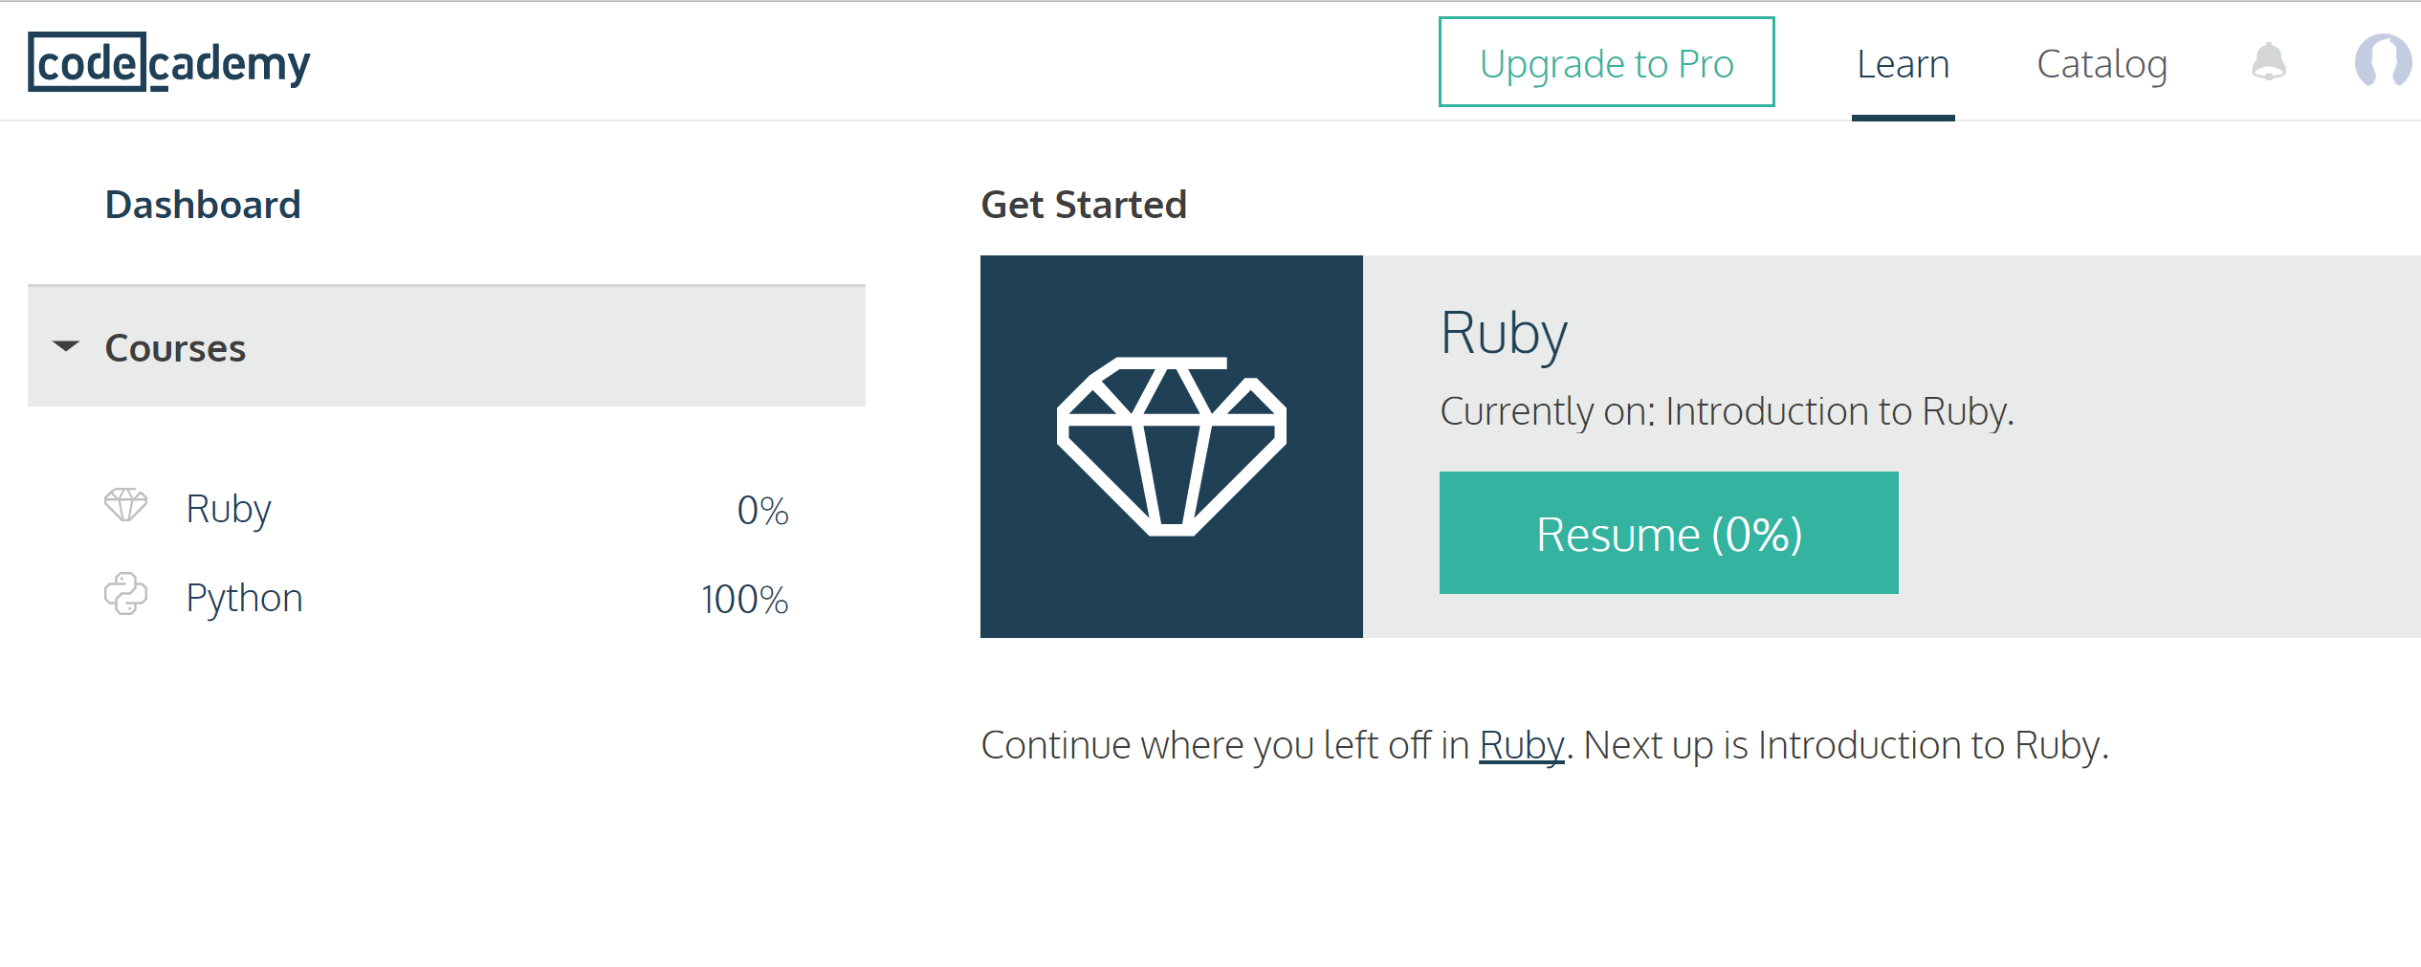
Learning
https://www.codecademy.com/learn

Slide 13
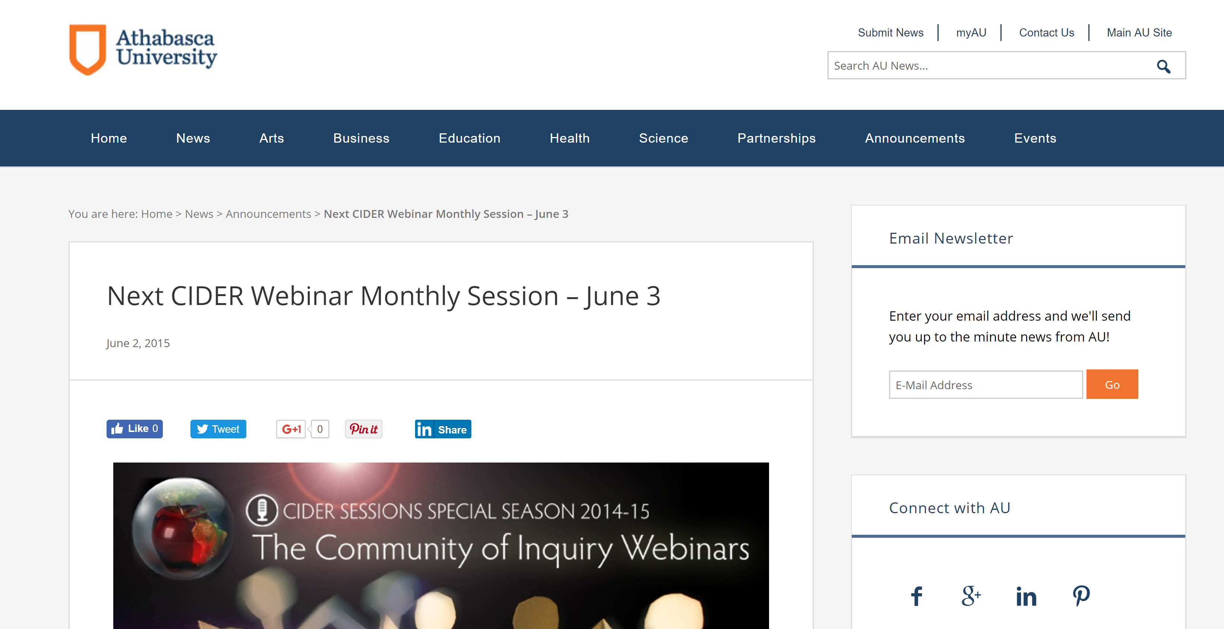
Learning
http://news.athabascau.ca/news/next-cider-webinar-monthly-session-june-3/

Slide 14
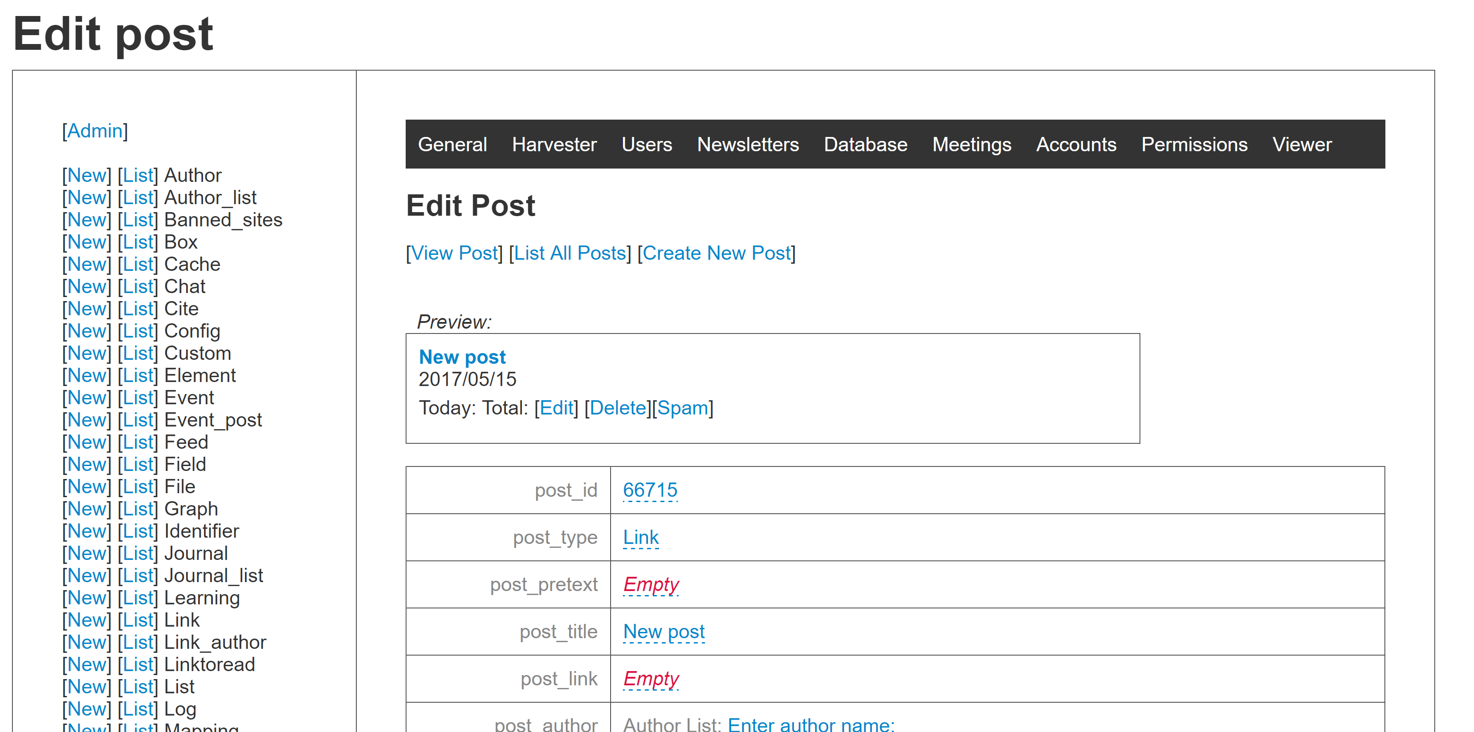
A Day in the Life?
https://getpocket.com
http://grsshopper.downes.ca/

Slide 15
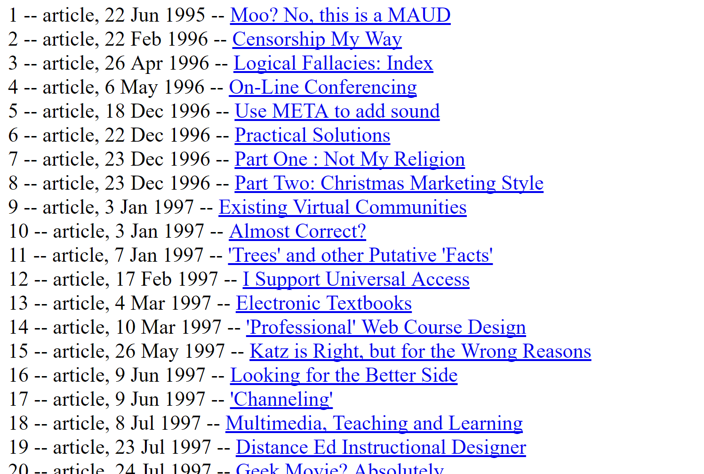
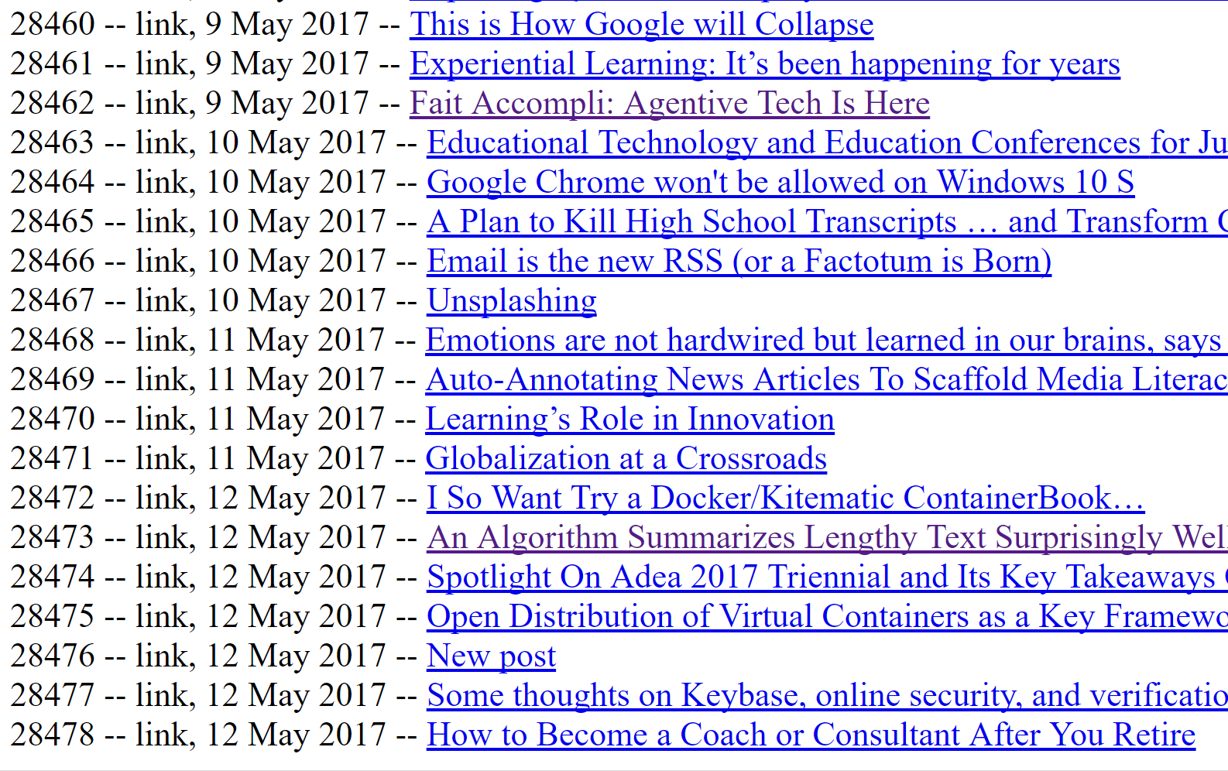
Post List
http://www.downes.ca/post_list.html

Slide 16
Overview of the Concept of PLEs
LMS
Simulation
PLE
Chat Room
MOOC
Blogger
Intranet
Access to many services in one personal environment

Slide 17
Properties of the PLE…
What information should it record?
Who owns the data? How private is it?
What should it do?
What would a person do with it?
Where, exactly, is a PLE located?
PLE

Slide 18
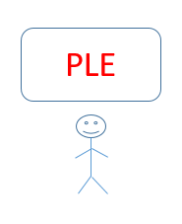
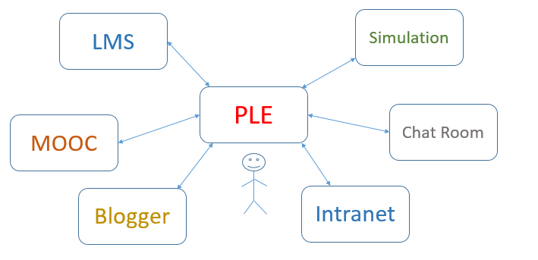
The Network of PLEs

Slide 19
The Social Network of PLEs
twitter
facebook
email

Slide 20
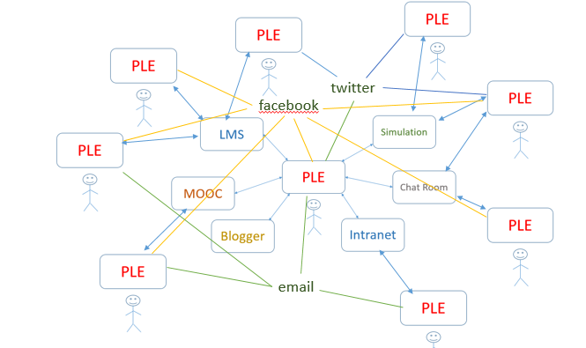
Properties of the Network…
How do people find each other? Services?
How do they communicate? What do they share?
How does a single PLE work with services?
Do we need centralized registries?

Slide 21
Why a personal learning environment?
10:30 – 11:30
What is the value proposition for a PLE?
  Note: value isn’t what you can do, it’s how you benefit
  This is usually stated in financial terms (earn more, cost less)
  Can also be stated in terms of quality: faster, bigger, better
  And can be non-financial goods: satisfaction, happiness, memories

Slide 23
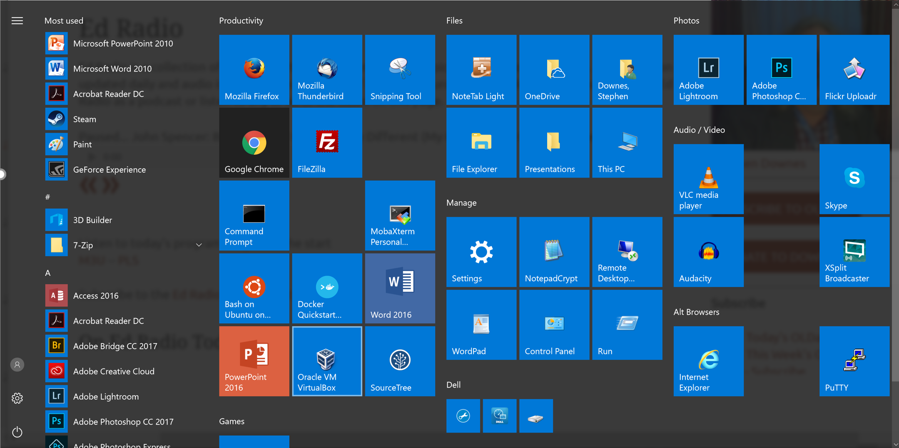
Making

Slide 24
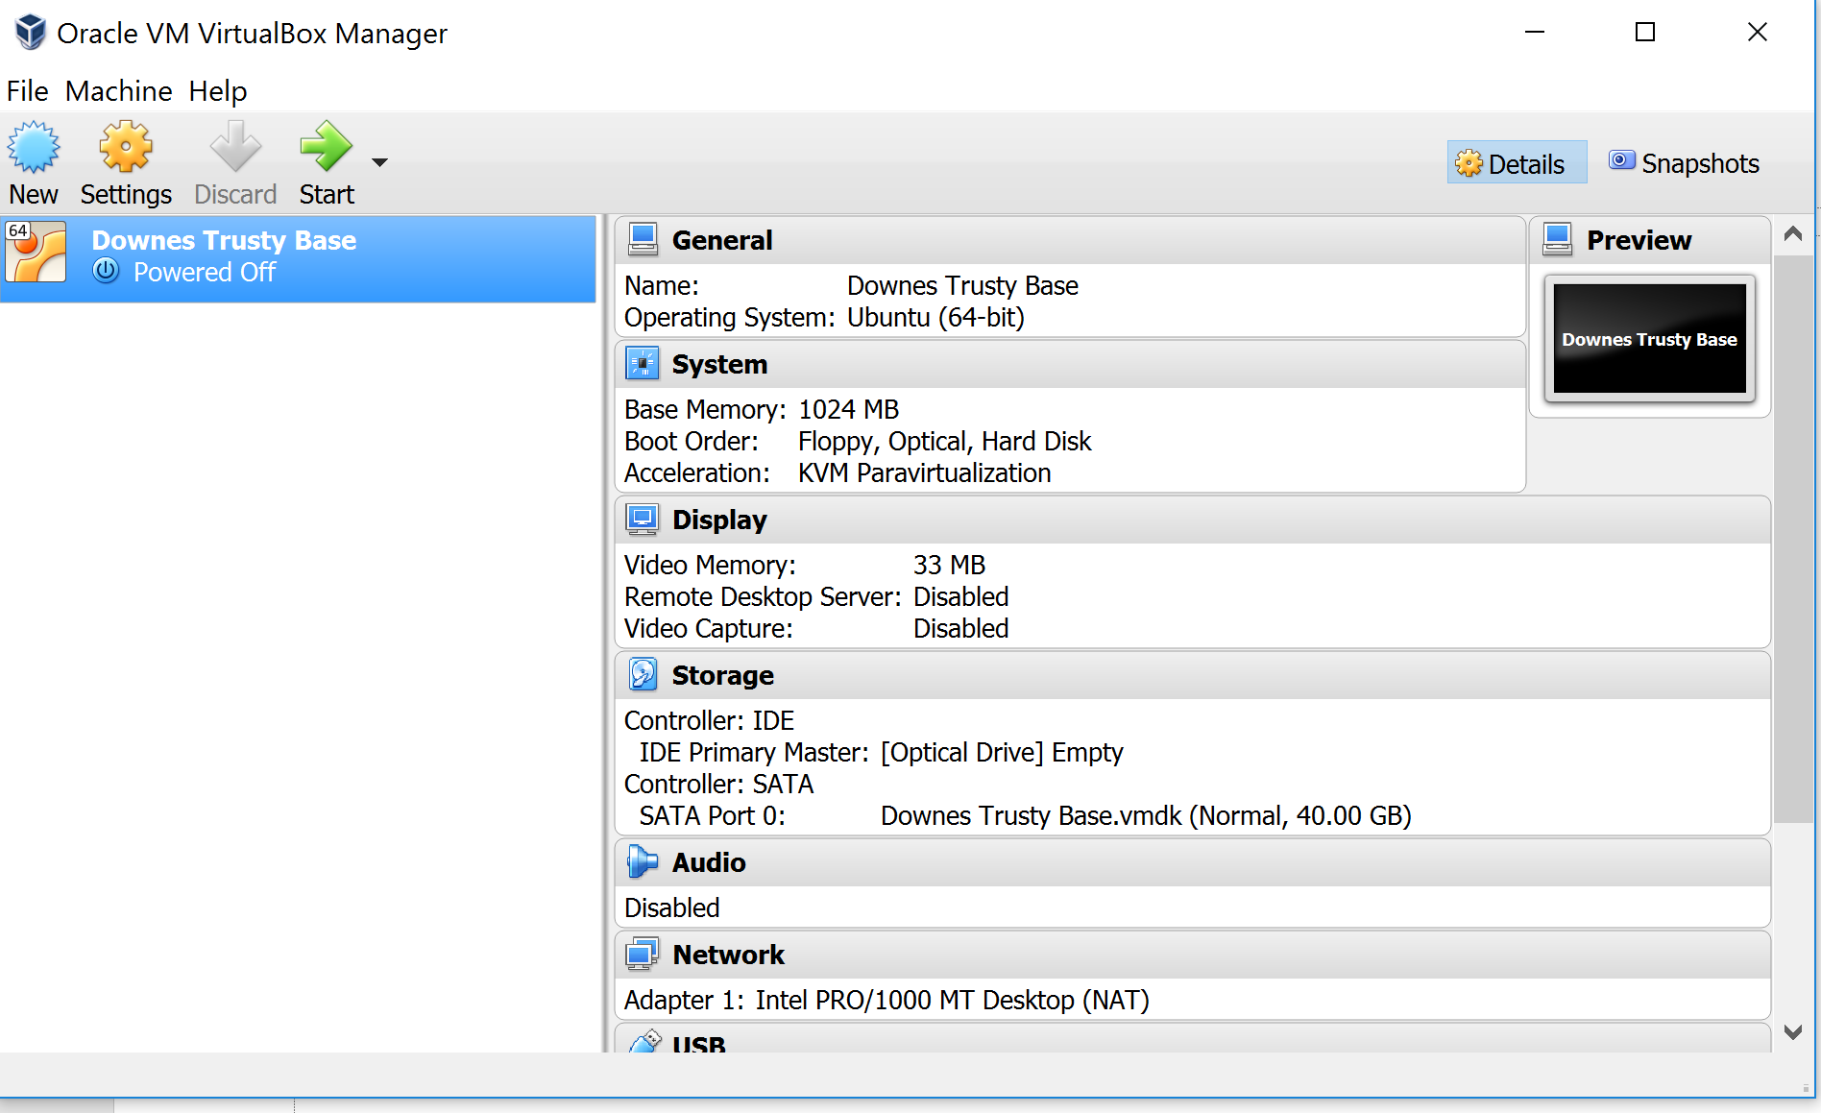
Making
https://www.virtualbox.org/

Slide 25
Making

Slide 26
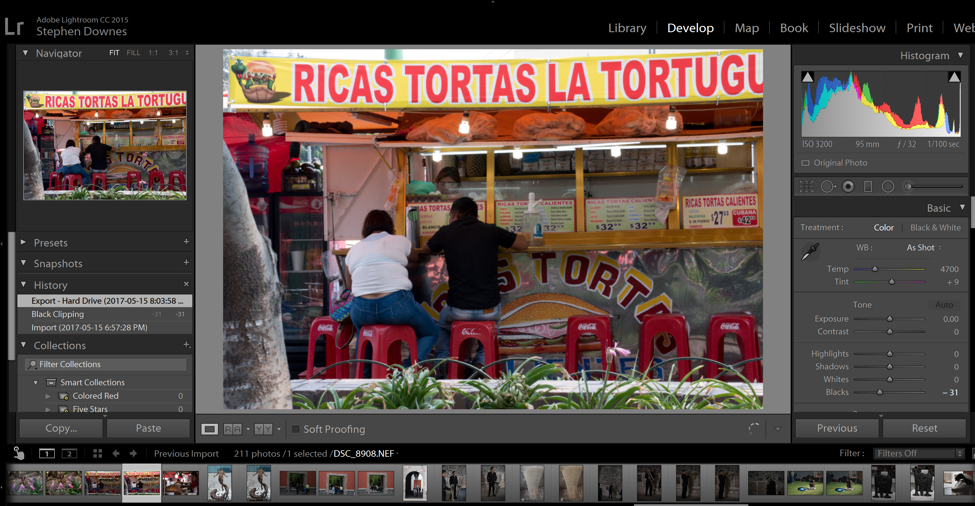
Making
https://lightroom.adobe.com/

Slide 27
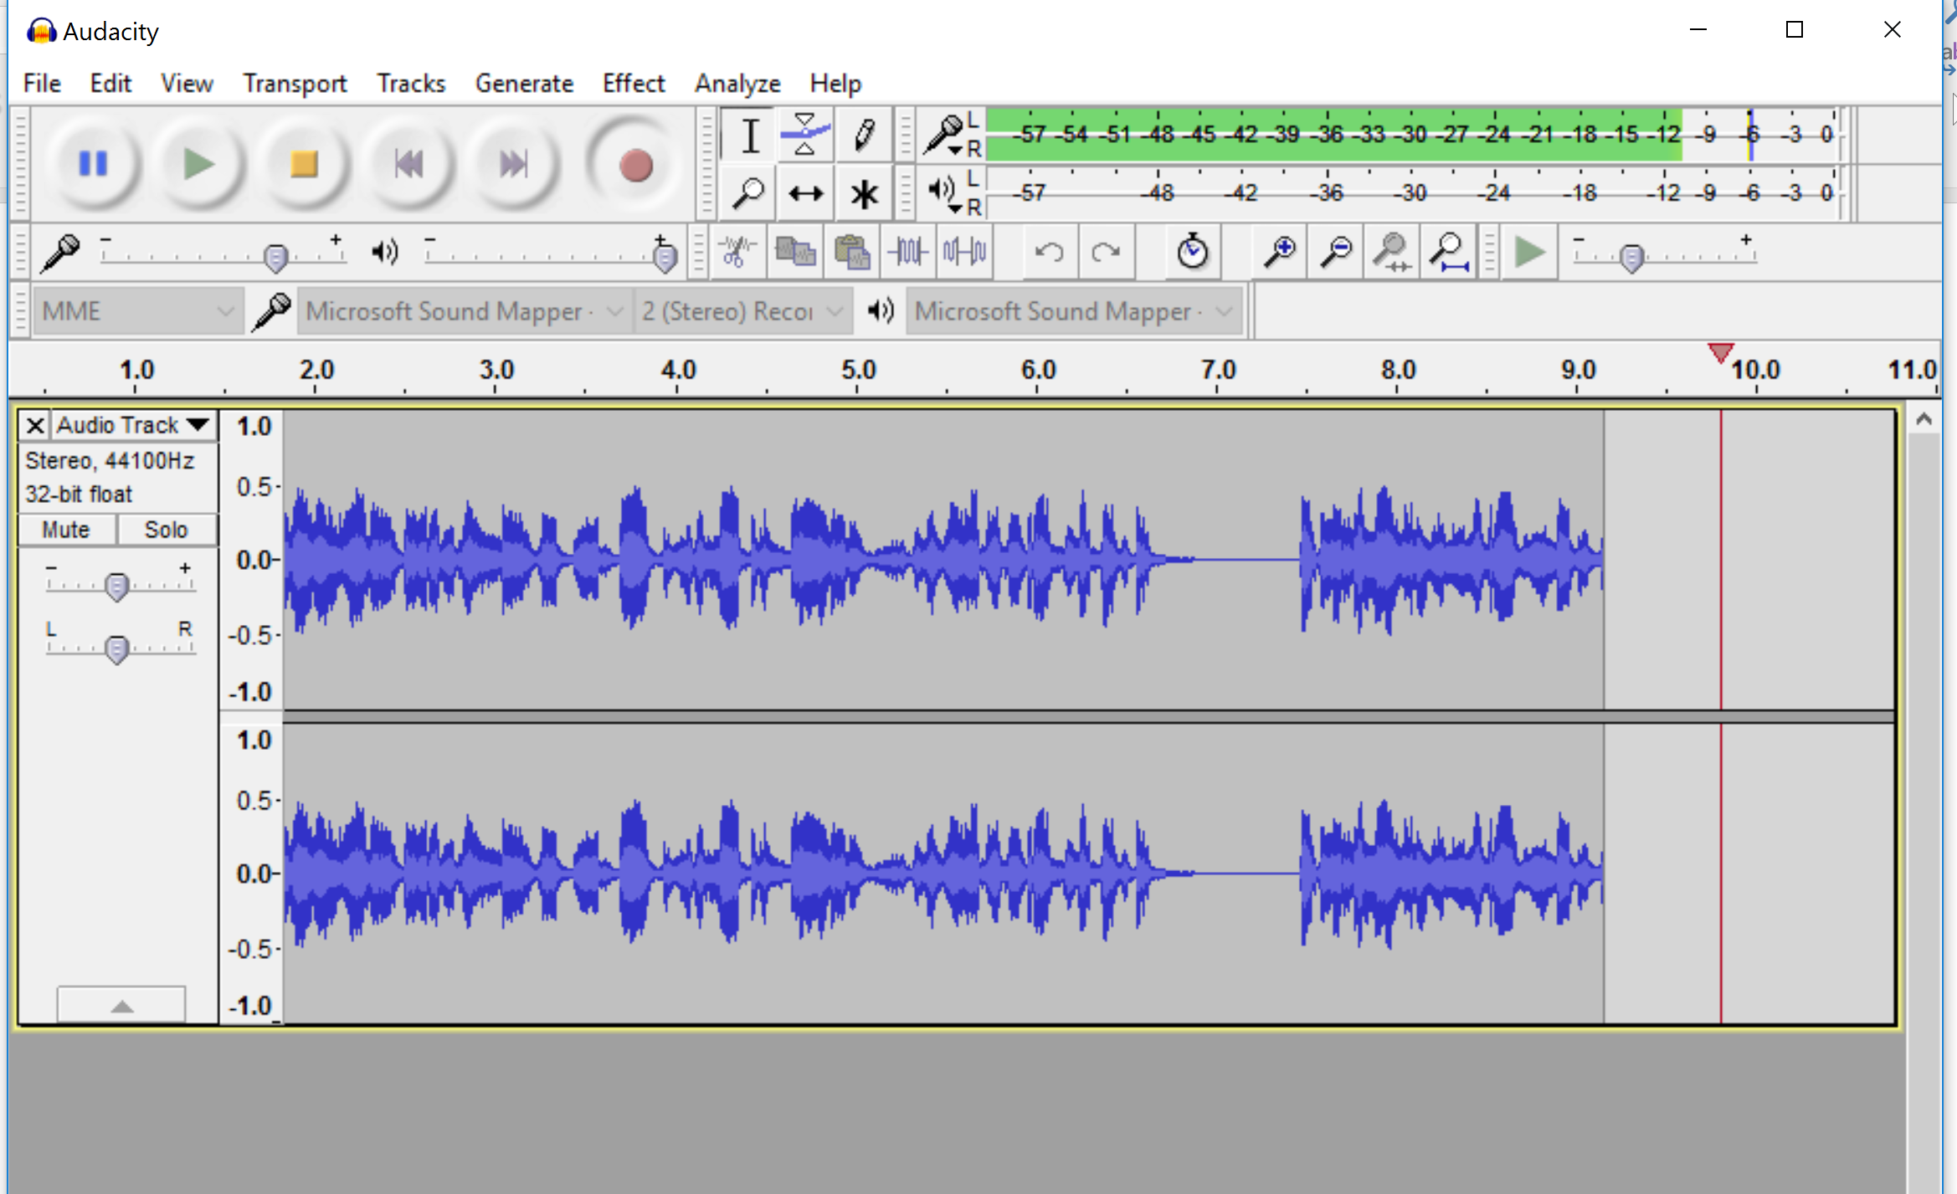
Making
http://www.audacityteam.org/download/

Slide 28
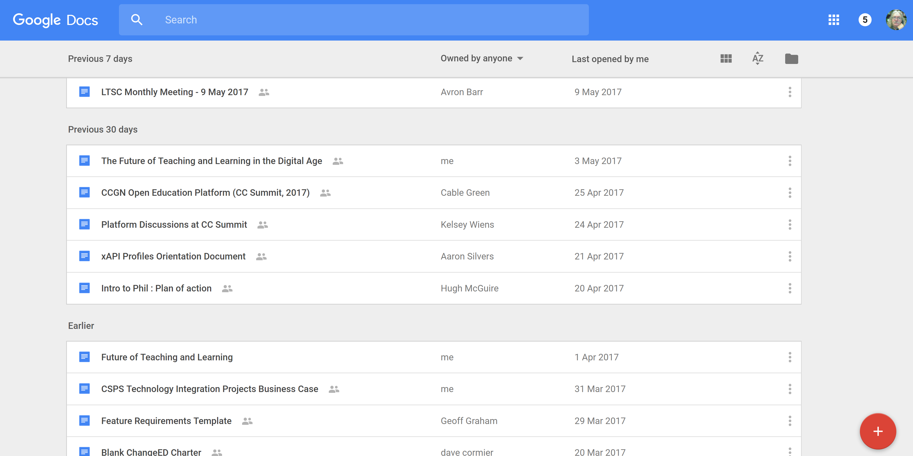
Making
https://docs.google.com/

Slide 29
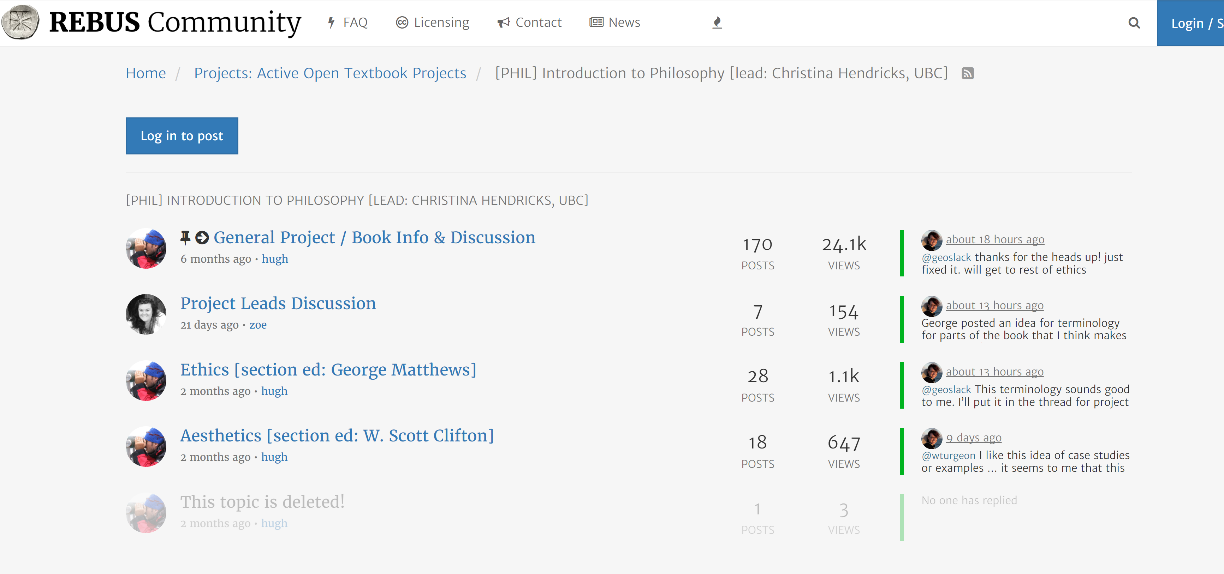
Making
https://forum.rebus.community/category/17/phil-introduction-to-philosophy-lead-christina-hendricks-ubc

Slide 30
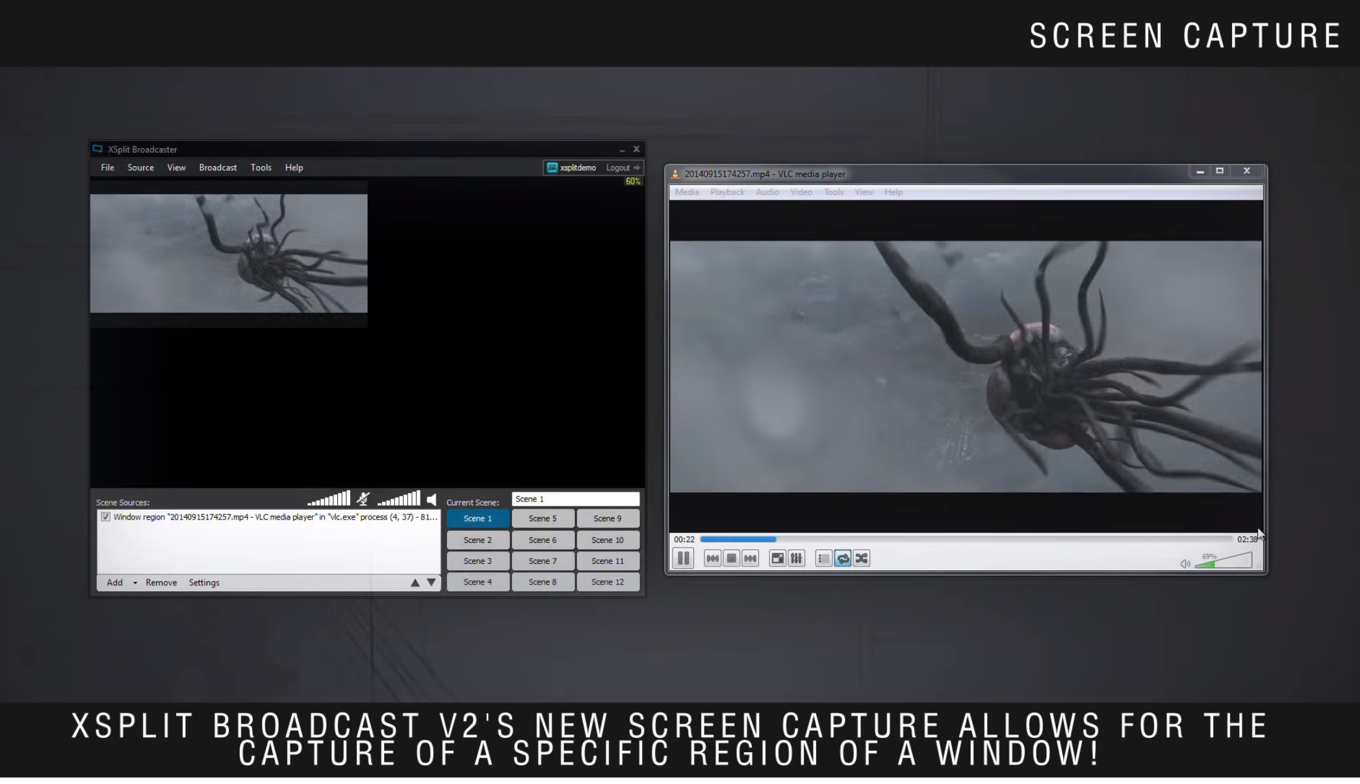
Making
https://www.xsplit.com/

Slide 31
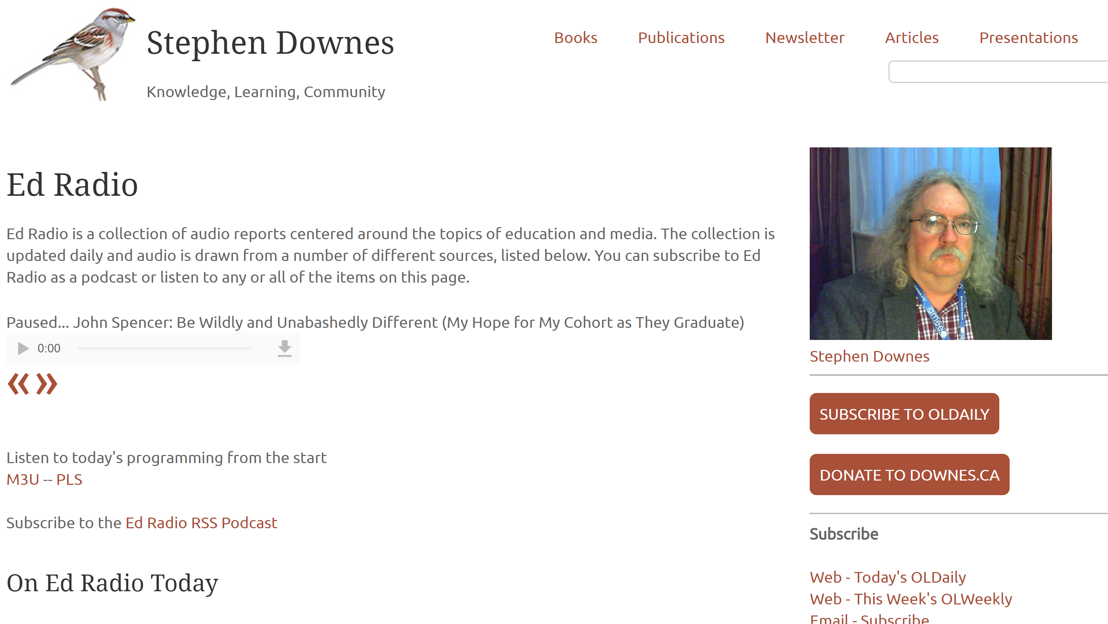
Sharing
http://www.downes.ca/edradio.htm

Slide 32
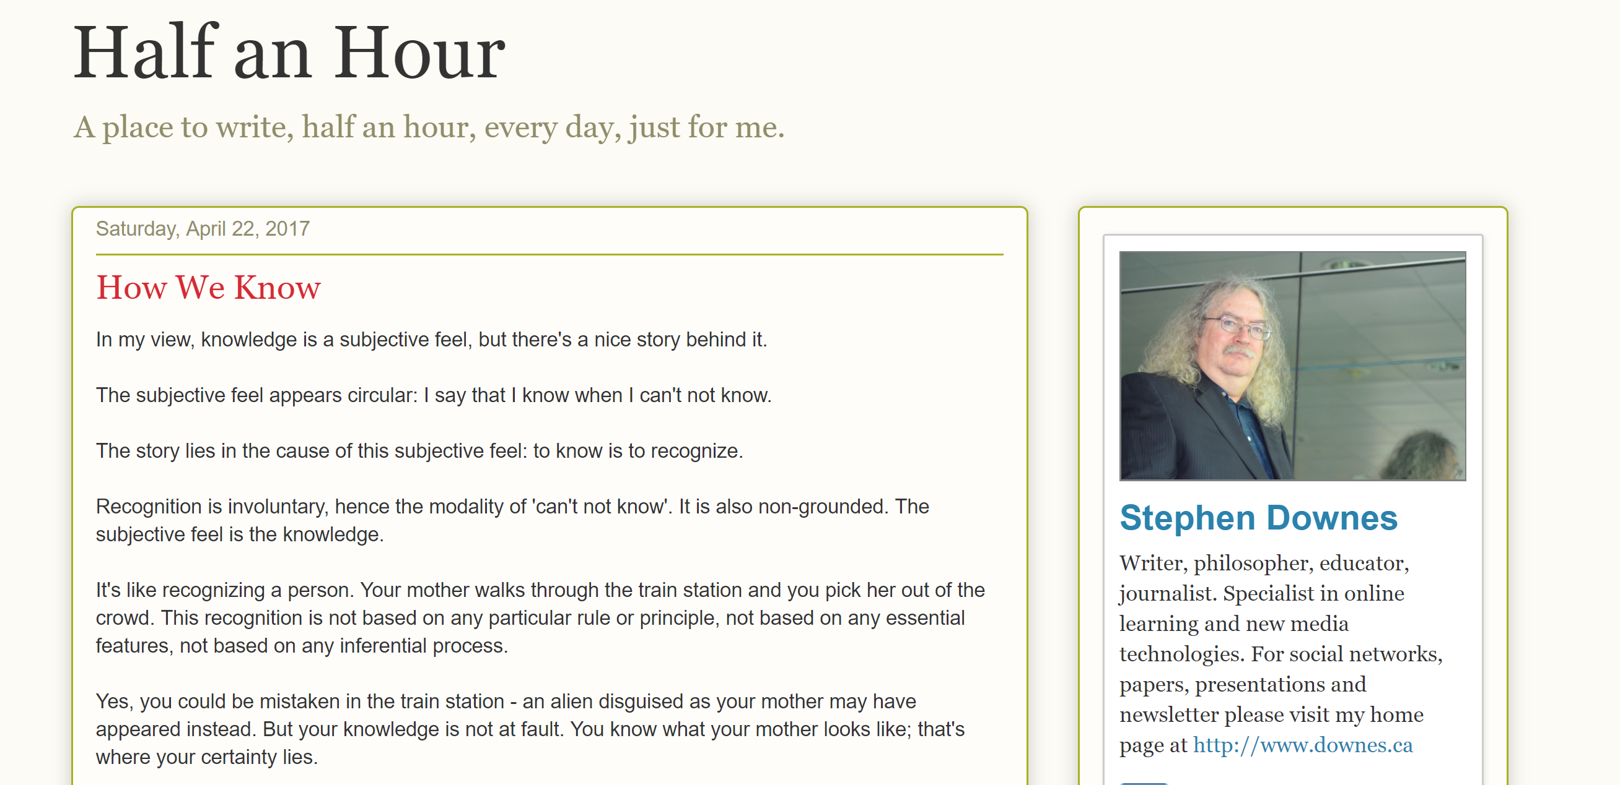
Sharing
http://halfanhour.blogspot.com

Slide 33
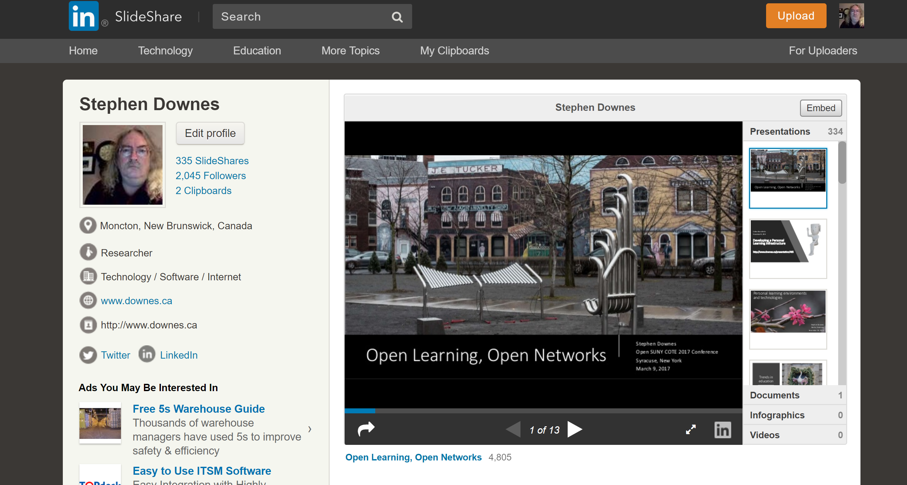
Sharing
https://www.slideshare.net/Downes

Slide 34
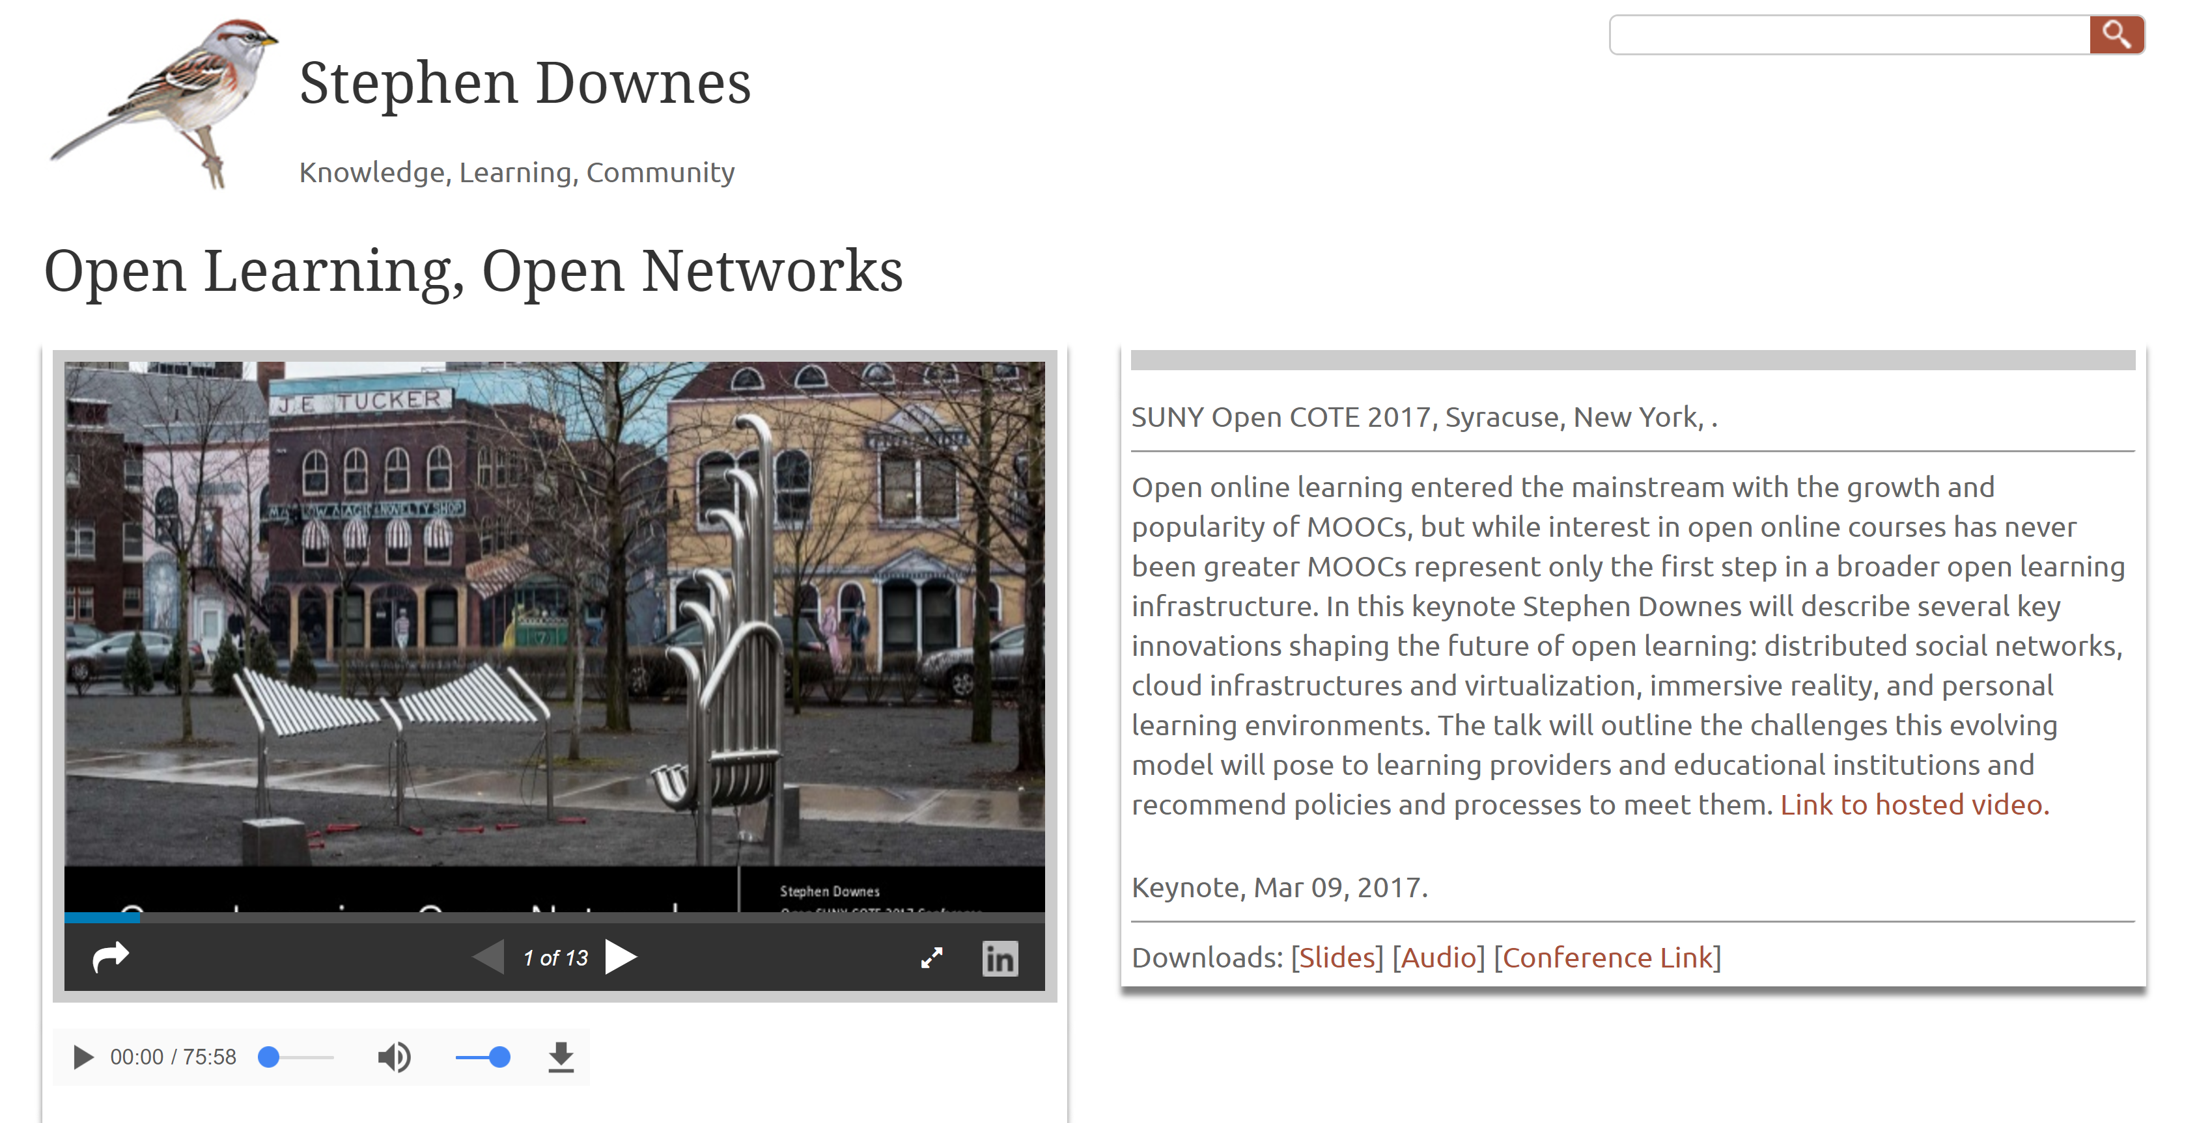
Sharing
http://www.downes.ca/presentation/468

Slide 35
New learning Paradigms
Path | Field
Course | Curriculum (as in ‘mapping’)
Sequence / Prequisite | Core / periphery / foundation
Movement / covered | Inquiry / Discovery / Gaps
Threshold / Levels | Coverage / Construction
Positioning – first / last | Grouping / Clustering
Objective / target | Serendipity / emergence
Leading / Led | Centred
Carrie Paechter, Metaphors of Space in Educational Theory and Practice http://www.tandfonline.com/doi/pdf/10.1080/14681360400200202

Slide 36
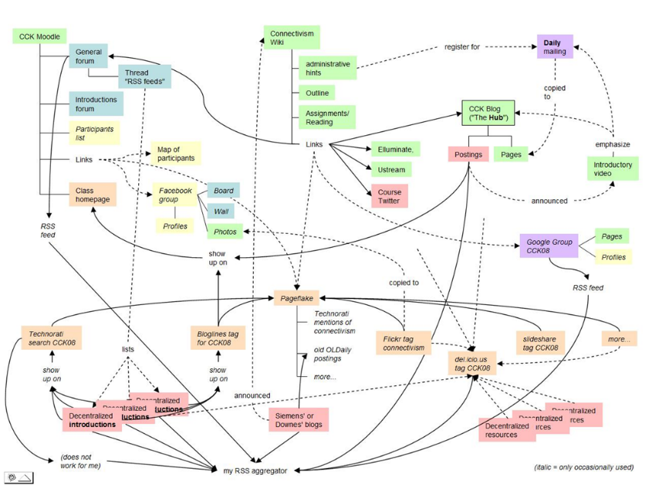
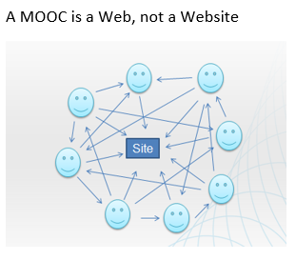
The Connectivist MOOC (cMOOC) Design
Instead of seeing a course as a series of contents to be presented, a course is a network of participants who find and exchange resources with each other
An initial structure is developed and ‘seeded’ with existing OERs
Participants encouraged to use their own sites to create or share resources
A mechanism (gRSShopper) is employed to connect them

Slide 37
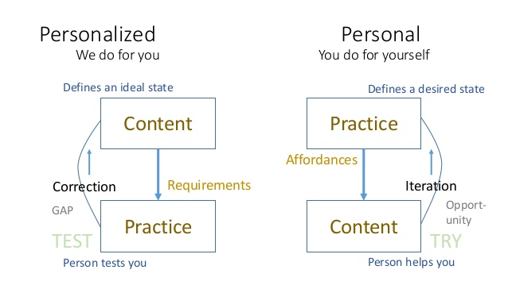
Learning is Personal

Slide 38
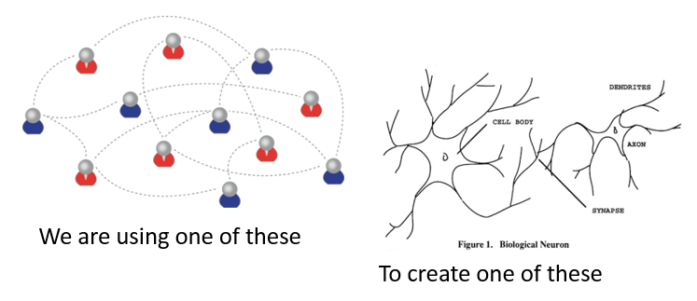
Learning Outcomes
Learning a discipline is a total state and not a collection of specific states
It is obtained through immersion in an environment rather than acquisition of particular entities
It is expressed functionally (can you perform ‘as a geographer’?) rather than cognitively (can you state ‘geography facts’ or do ‘geography tasks’?)

Slide 39
Extended Cognition
More than neural networks?
  Embodied learning, stigmergy, extended memory (Andy Clark)
Is my library a part of my cognition?
  Which books?
The problem of explanation

Slide 40
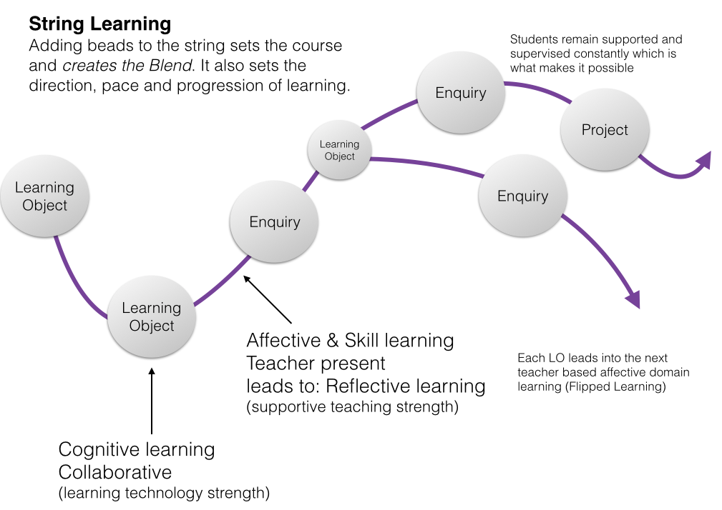
Cloud Environments
https://www.linkedin.com/pulse/string-learning-blend-objects-geoff-rebbeck?articleId=6932346018329088240

Slide 41
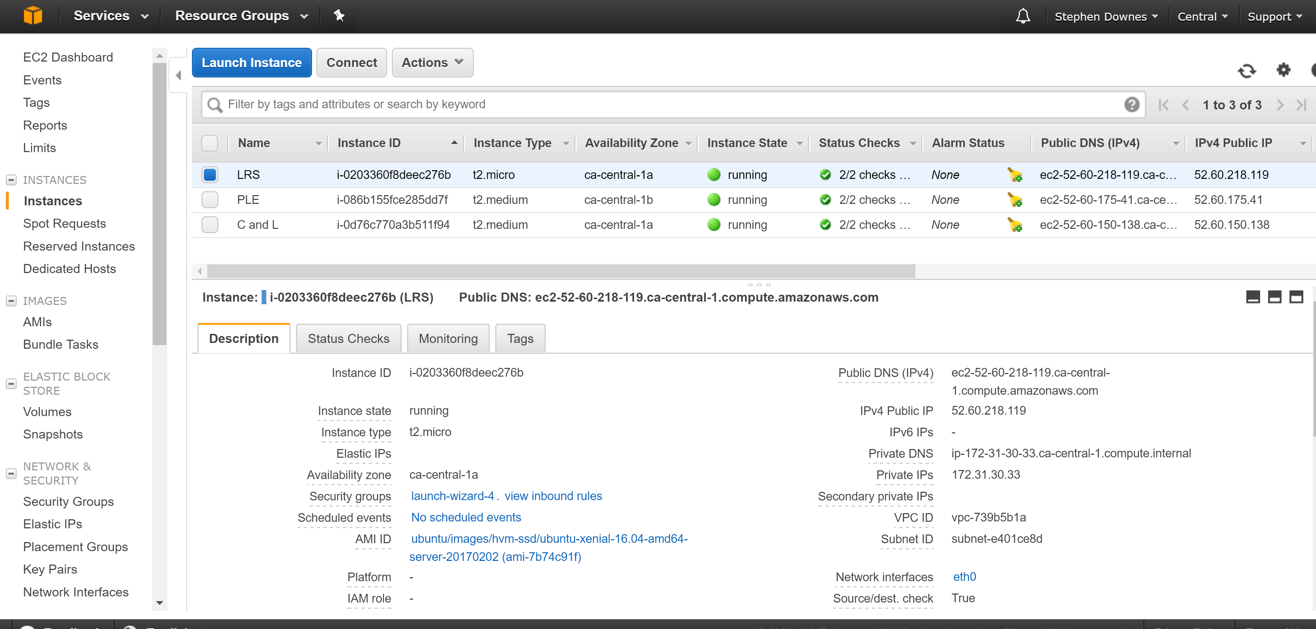
Cloud Environments
https://aws.amazon.com/console/

Slide 42
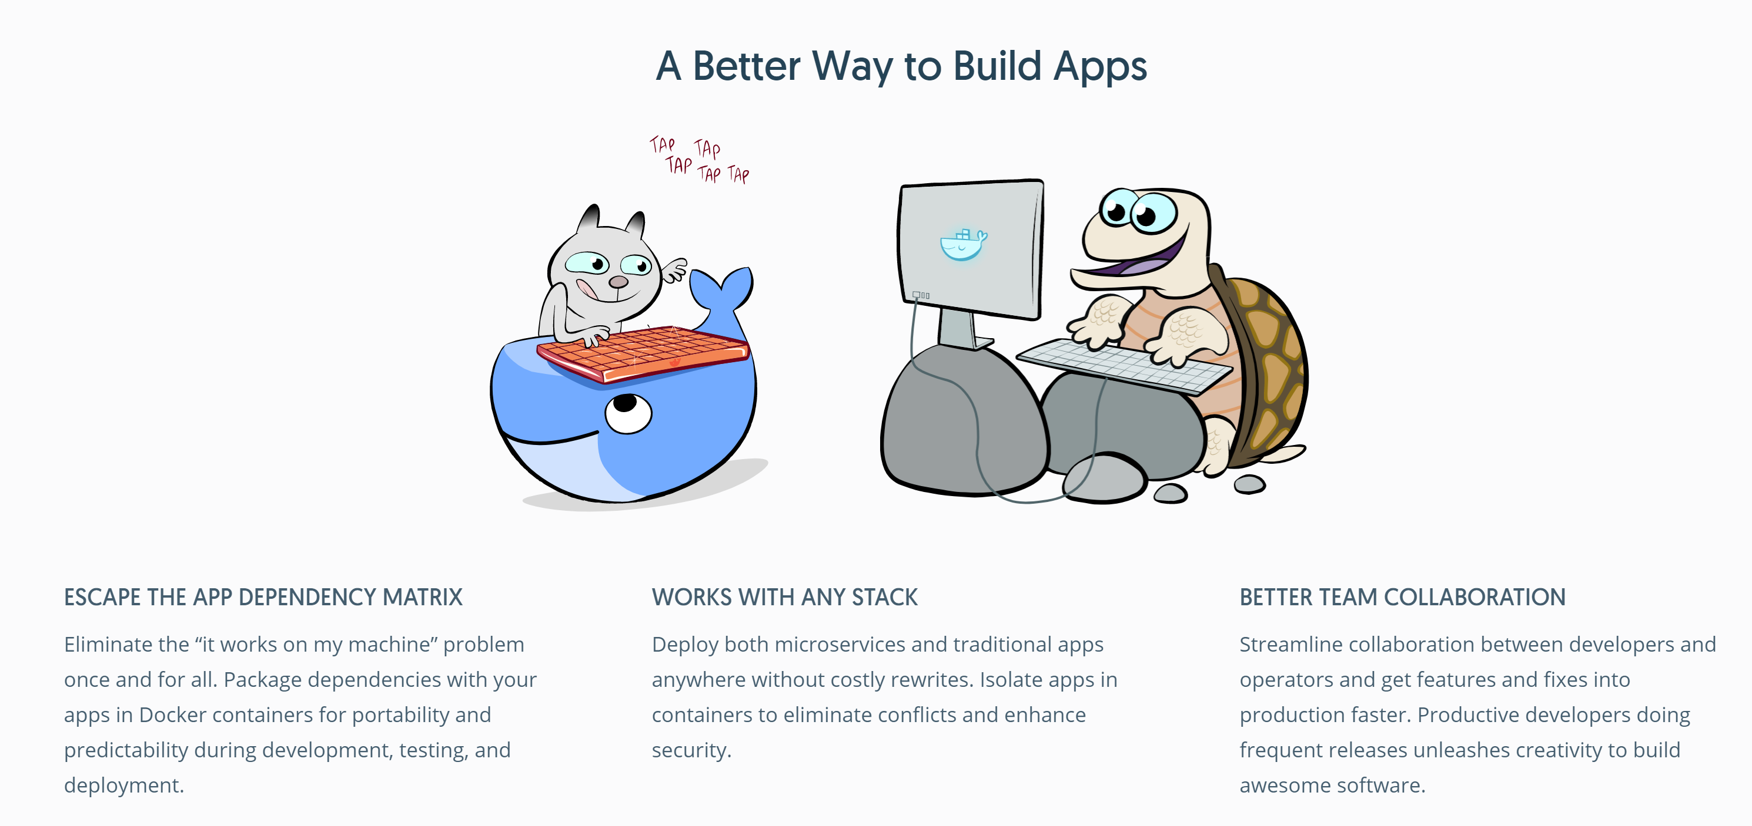
Cloud Environments
https://www.docker.com/

Slide 43
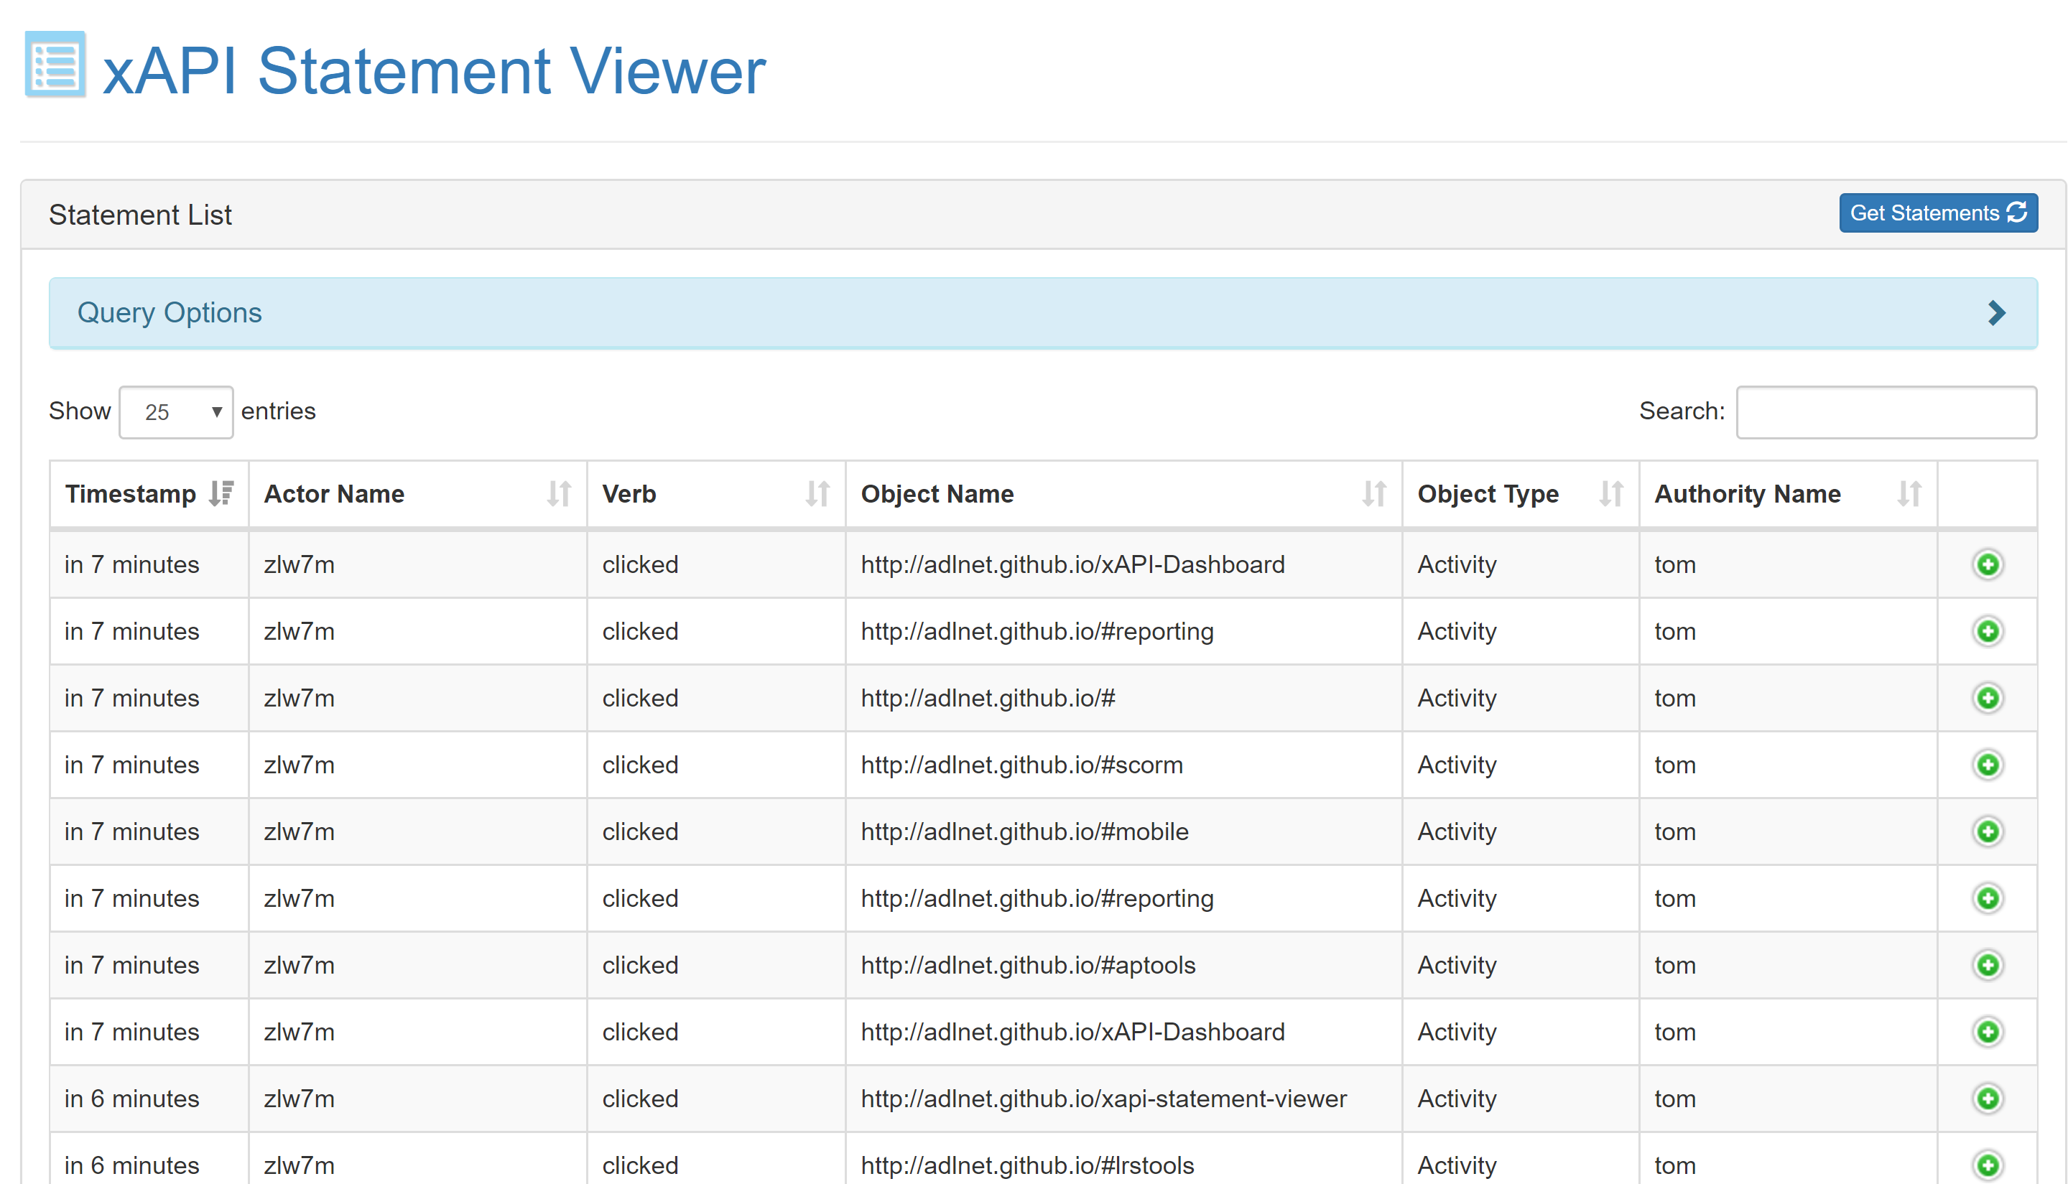
Learning Record Store
http://adlnet.github.io/xapi-statement-viewer/

Slide 44

Cloud Services
https://datarepository.wolframcloud.com/

Slide 45
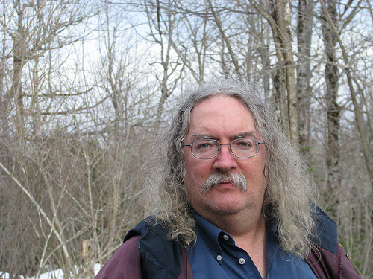
Stephen Downes
http://www.downes.ca
Moncton, Canada, 2005
http://www.downes.ca/presentation/389

