Slide 1
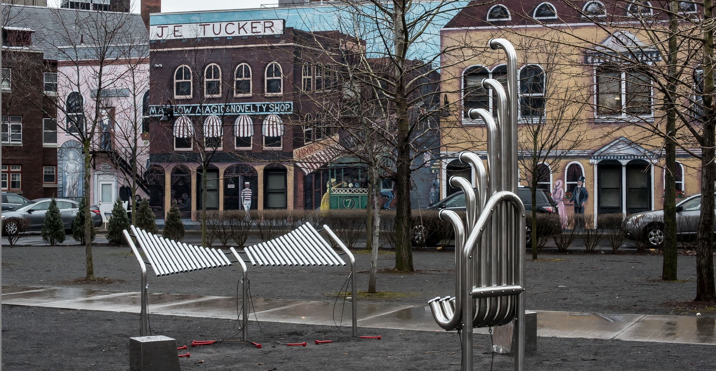
Open Learning, Open Networks
Stephen Downes
Open SUNY COTE 2017 Conference
Syracuse, New York
March 9, 2017

Slide 2
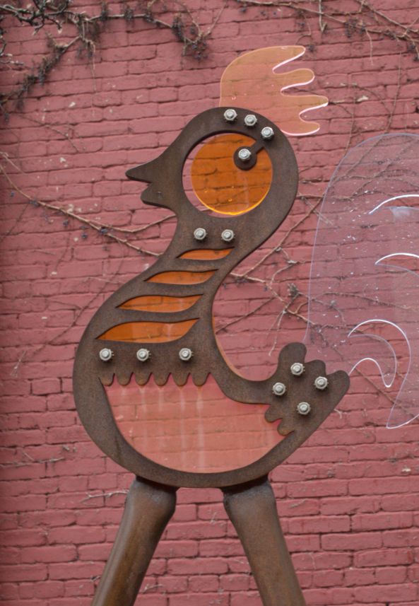
Share and Edit Links
http://bit.ly/2n3bPtm
Presentation Page
http://www.downes.ca/presentation/468
Join the Chat - #cotesummit
http://www.downes.ca/cgi-bin/cchat.cgi?chat_thread=753

Slide 3
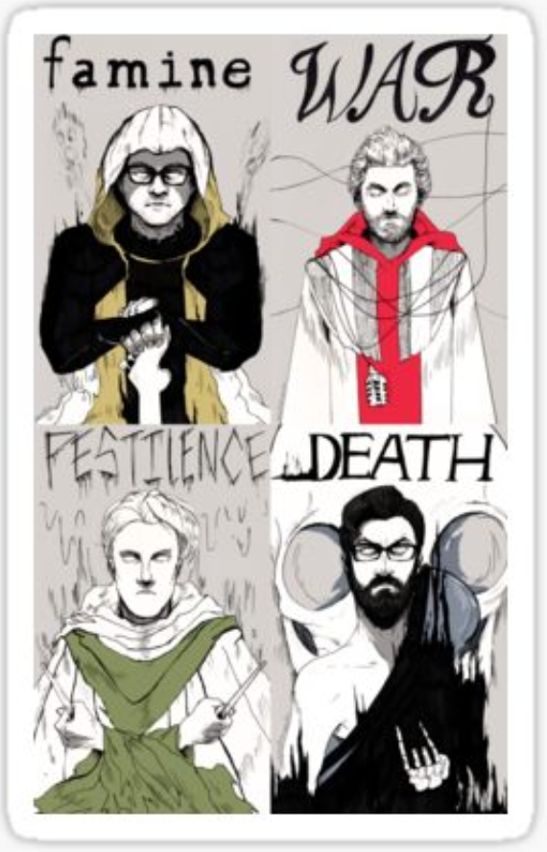
A Time of Challenges
The usual: famine, war, etc.
Plus:
  Climate Change https://climate.nasa.gov/
  Fake News https://shatteredmirror.ca/
  Poverty & Inequality http://www.oecd.org/social/inequality-and-poverty.htm
  Social Media http://www.npr.org/2016/11/08/500686320/did-social-media-ruin-election-2016
Redbubble - https://www.redbubble.com/shop/four+horsemen+stickers

Slide 4
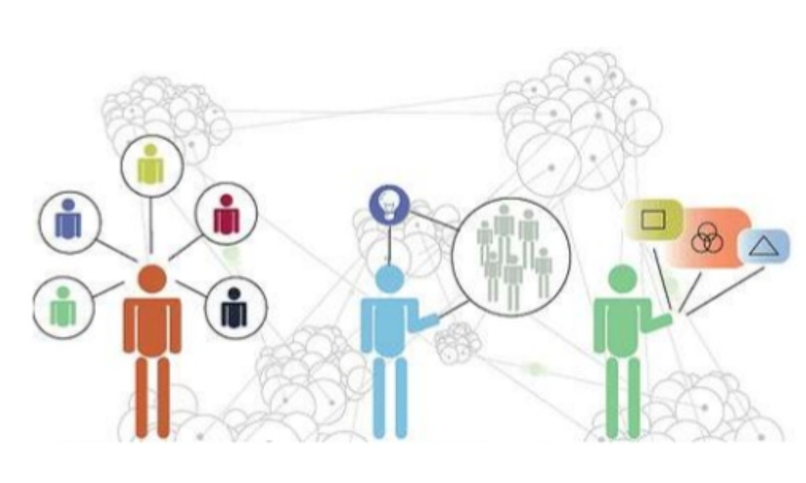
Current Work
Elearning Landscape – TBA
Future of eLearning – TBA
Canada School of Public Service - http://www.csps-efpc.gc.ca/index-eng.aspx
CASS - https://www.adlnet.gov/introducing-the-next-big-thing-cass/
MOOCs – yes, still – http://www.federica.eu/c/connectivism_and_learning http://candl.mooc.ca
MOOC Aggregation Engine – http://www.mooc.ca
Personal Learning Environments – gRSShopper in a Box – http://grasshopper.downes.ca
Connectivism - https://www.slideshare.net/CatherineFarrant/connectivist-learning-theory

Slide 5
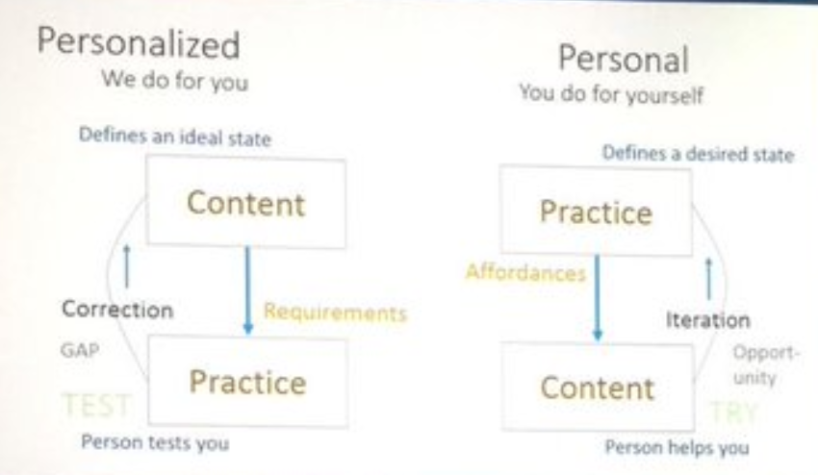
MOOCs
True History of the MOOC - https://sites.google.com/site/themoocguide/home
cMOOC and xMOOC - http://www.tonybates.ca/2014/10/13/comparing-xmoocs-and-cmoocs-philosophy-and-practice/
FutureLearn - https://www.futurelearn.com/
Personal Learning- http://www.downes.ca/presentation/380

Slide 6
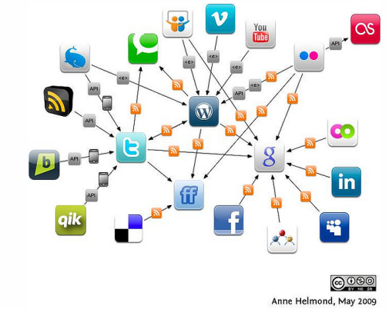
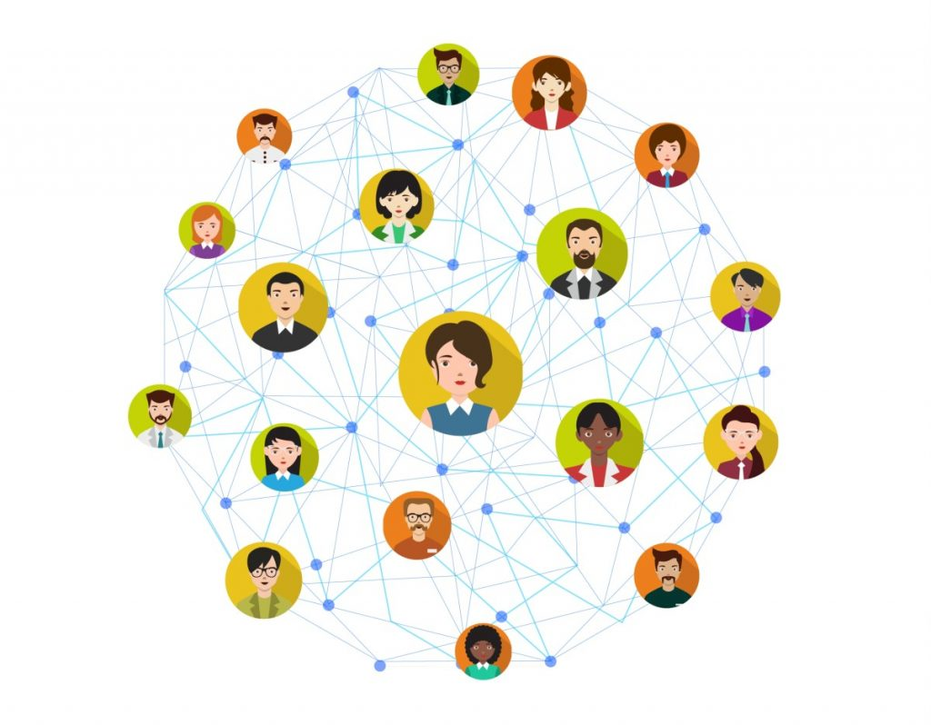
Distributed Social Networks
Opera Unite - http://mashable.com/2009/06/15/opera-unite/
Mozilla OS - https://www.npmjs.com/package/fxos-web-server
Diaspora - https://www.joindiaspora.com/
Solid - "social linked data“ - https://solid.mit.edu/
Keybase - https://keybase.io/
InterPlanetary File System (IPFS) - https://ipfs.io/

Slide 7
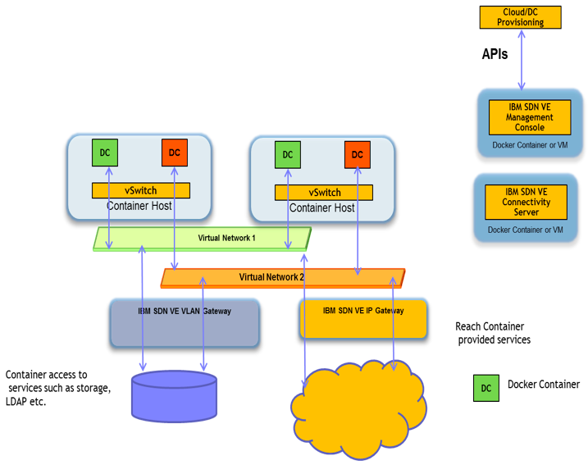
Cloud Infrastructures
Environments: VMWare Fusion, VirtualBox
Provisioners: Docker, Vagrant
Configuration: Chef, Puppet
Providers: AWS, MS Server
Services: MS Cognitive, Wolfram Alpha, Segment
Serverless CMS - http://www.downes.ca/post/66459

Slide 8
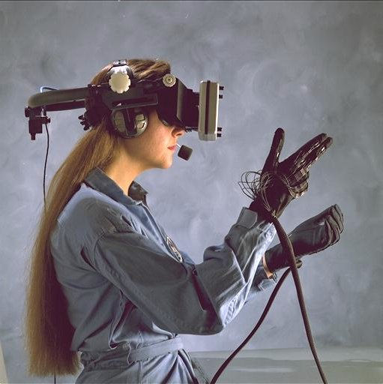
Immersive Reality
What is ‘Immersive’ – a VR helmet?
Key element of immersion: belief
  (authentic) applications that matter
  social presence (cognitive presence, teaching presence) - https://www.mnsu.edu/its/academic/isalt_social_presence_theory.pdf
  multi-modality – cognitive + kinesthetic, etc. - https://www.slideshare.net/jtholden/the-learning-styles-revelation-research-from-cognitive-science
Games and Gamification?

Slide 9
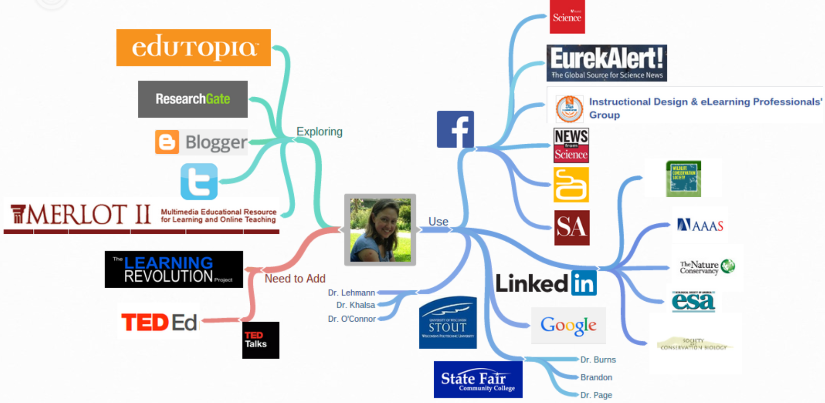
Personal Learning Environments
Resource Repository Network (Aggregation) - http://ec.europa.eu/ipg/standards/markup/web-content-syndication/index_en.htm
Personal Cloud – Dropbox, OwnCloud, etc. https://owncloud.org/
Personal Learning Record – Learning Record Store (xAPI) https://www.adlnet.gov/tla/
Personal Learning Assistant
  like Siri? Alexa?
Distributed Intelligence – MLaaS
https://www.slideshare.net/KarlSeiler/mlaas-machine-learning-as-a-service
Heather Taft http://taftportfolio.blogspot.com/p/personal-learning-environment-ple.html

Slide 10
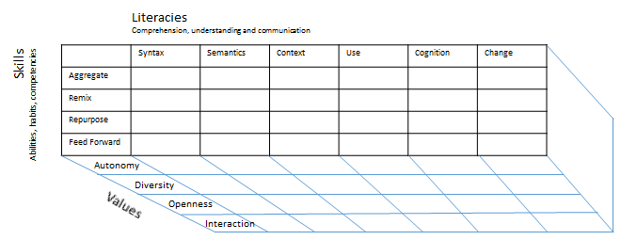
Challenges to Learning Providers
Content Knowledge Vs. Literacies
  Not just reading and writing…
  http://www.downes.ca/presentation/369
Employment skills Vs. Education
Courses Vs. Performance Support
Authority Vs. the Wisdom of Crowds
  Autonomy, Diversity, Openness, Interactivity
  Social Proof? https://en.wikipedia.org/wiki/Social_proof
Credentials Vs. Learning Vs. Connections - http://er.educause.edu/articles/2015/3/credentialing-in-higher-education-current-challenges-and-innovative-trends

Slide 11
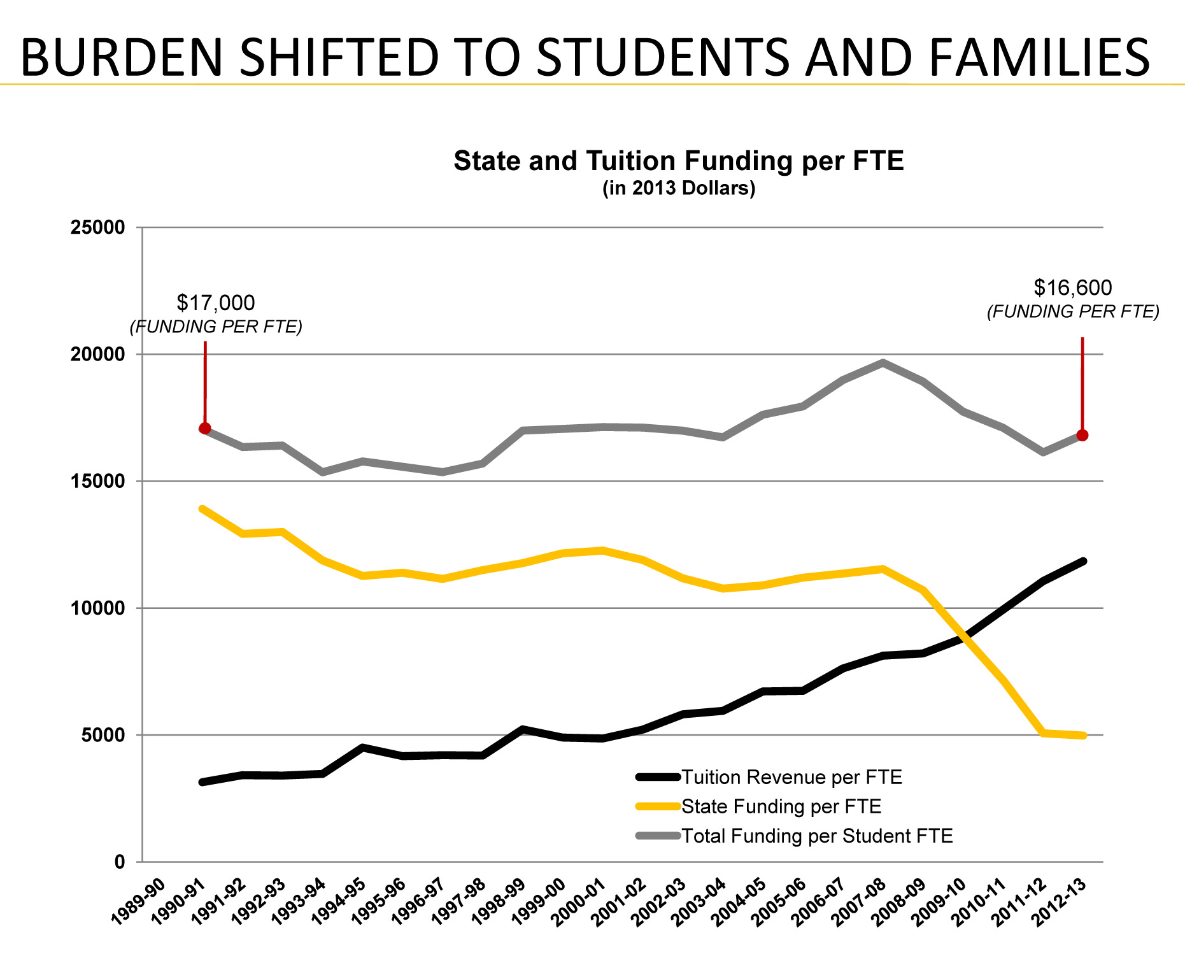
Challenges to Educational Institutions
Public Education Vs. Private Sector
Funding: Tuition, Grants, Reseach….?
Enterprise Vs. Distributed?
Federated Vs. Open? (Social signon Vs. Single Signon Vs. ??)
Transcripts Vs. Blockchain Vs. ?? http://blockgeeks.com/guides/what-is-blockchain-technology/
http://old.seattletimes.com/html/opinion/2018504888_guest25blakecole.html

Slide 12
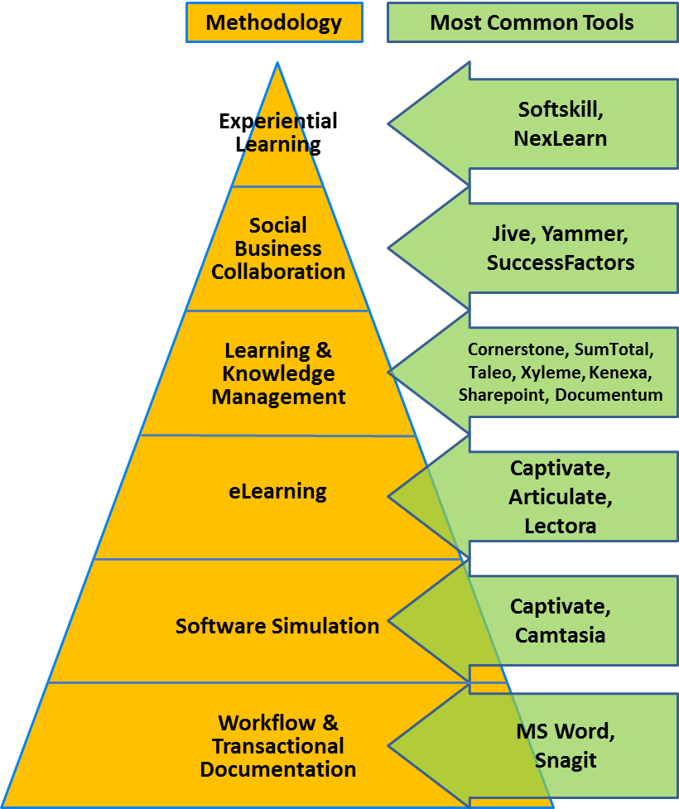
Moving Forward
Competencies? Vs. Capabilities http://www.downes.ca/post/64879
Badges? Vs. Evidence https://openbadges.org/
Classes Vs. Performance Support http://www.nrc-cnrc.gc.ca/eng/solutions/collaborative/lpss.html
Microlearning? Vs. Spaced Learning - https://www.td.org/Publications/Blogs/Science-of-Learning-Blog/2015/01/Spaced-Learning-an-Approach-to-Minimize-the-Forgetting-Curve
Course Libraries? Vs. Subscription-based Learning - http://www.downes.ca/news/OLDaily.htm
http://epiloguesystems.com/about/

Slide 13
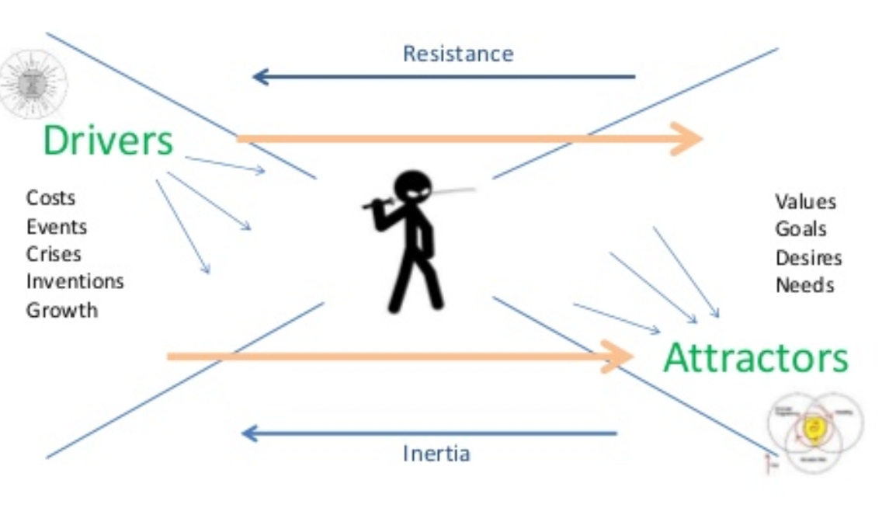
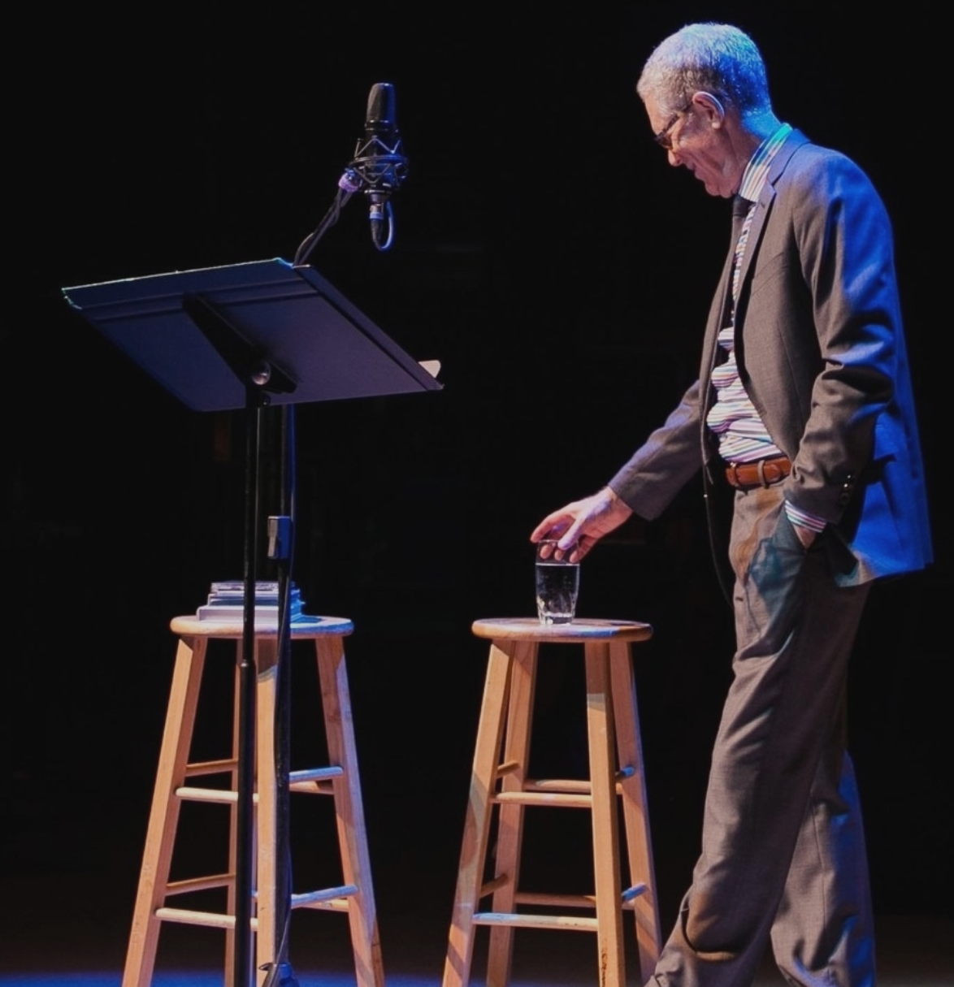
Doing the Right Thing
Who are your clients?
  The state? The governor?
  Technology companies?
  Your department? Your institution?
https://www.slideshare.net/Downes/disruptive-innovations-in-learning
What are you Building?
  Drivers Vs. Attractors
  Empowerment Vs. Dependence?
How does the story end?
https://www.vinylcafe.com/

