Slide 1


Learning Technology: Current State of the Canadian School of Public Service
Stephen Downes
February 24, 2017
National Research Council Canada
Conseil national
de recherches Canada

Slide 2

Background Information

Slide 3
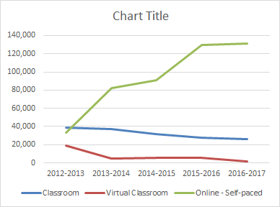
In-Class Learning
Traditional focus on in-class learning
  something the school understands and has developed expertise
Through online learning has increased dramatically, classroom-based learning has declined by only a bit more than 25 percent.

Slide 4
Business Model and Transformation
Learning is offered to departments as a centralized service.
This changes the way the school designs and offers courses.
Data collection and storage is necessary to track usage.

Slide 5
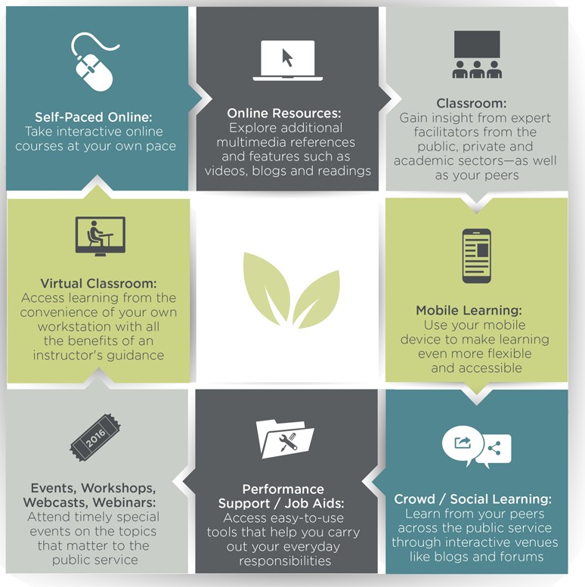
GC Campus Suite
Saba learning management system (LMS)
Drupal 7 content management system (CMS)
Moodle LMS
Kaltura OVP
CSPS service bus

Slide 6
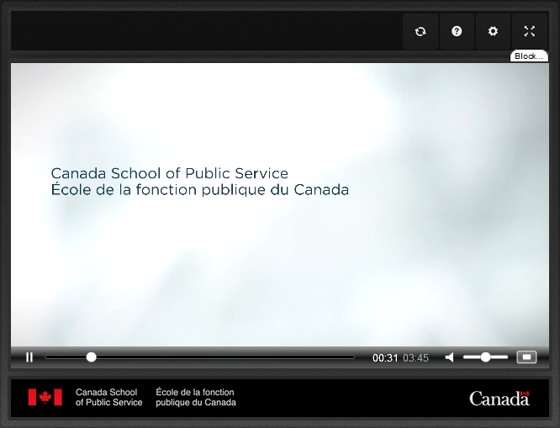
Events
Recently launched an events service using WebEx for online access and Moodle for asynchronous content
Video broadcast / player CanWebCast (now Collaborate.video)
Several people expressed enthusiastic support for the online events being broadcast on WebEx (and which also could be distributed as podcasts). A specific block of time is allocated for them, which makes scheduling much less ad hoc, and they address current and timely issues, and support immediate feedback.

Slide 7
Wider Environment
GC Tools, including including GCConnex, and
Human Resource (HR) and Treasury Board tools and applications, which include services such as MyGCHR
Neither replaces the LMS
Other tools event scheduling system, an email newsletter system, Survey Monkey and Cognos

Slide 8

Mobile Learning

Slide 9

Notes from the Workshop
Mobile learning is an emerging trend
Much more than simply playing existing courses on a mobile device
What is the business case for using mobile learning for the school?
What are the applications of mobile in large classrooms?
What do our CSPS learners need?

Slide 10
Defining Mobile Learning
Access - learning as you go, with different devices
Device – smartphone only? Or tablets and laptops?
Location - learners can learn outside their office
Design - content specifically designed for mobile
How does GCCampus currently support mobile?
  People can use GC Campus on mobile, versus
  GCCampus was not developed for mobile

Slide 11
Mobile device employment
Most everybody has a mobile device, including especially Androids or iPhones
Many department-issued Blackberries.
Not many people are using mobile devices to access content on GCCampus,
The market for mobile would be different than that for traditional learning content, and would not include all of GCCampus content.
People also mentioned the use of mobiles in classrooms

Slide 12
Mobile device employment
Figure 1.0 – Session by Device Category
Figure 3.0 – Session by Mobile Device
Mobile Device | # Session
(not set) | 168
Apple iPad | 70
Apple iPhone | 34
BlackBerry KBD | 19
BlackBerry Z10 | 3
Google Nexus 5 | 3
LG D852 G3 | 3
Samsung SGH | 3
Samsung SGH-I | 3
Samsung SM-G | 3
Figure 2.0 – Session by Browser
Browser Sessions | Number
Internet Explore | 15,716
Chrome | 1,534
Firefox | 591
Safari | 179
Edge | 26
BlackBerry | 24
Android Browse | 6
Opera | 4
UC Browser | 3
Iron | 1
Figure 4.0 – Session by Browser version

Slide 13
Mobile policy frameworks
Policy frameworks mentioned:
  Treasury Board Secretariat (TBS) guidelines:
    the Standard on Web Accessibility,
    the Standard on Web Usability and
    the Standard on Web Interoperability,
    The Web Experience Template (WET) kit
  The Government of Canada Policy on Acceptable Network and Device Use
  The World Wide Web Content Accessibility Guidelines (WCAG)
Need to incorporate background knowledge and best practices
  Eg. Jay Cross and Clark Quinn.
Policy matters: security requirements, device provision or device standards, equity of access, and the need for a smooth transition.

Slide 14
Mobile delivery standards
Participants weren’t aware of specific mobile delivery standards
Assumed delivery would be supported for both WiFi and telecom cellular phone standards.
CSPS is available outside the intranet
Universal Design for Learning (UDL) mentioned several times and currently used by CSPS.
Sharable Courseware Object Reference Model (SCORM) specifications and software as well as HTML and Javascript.

Slide 15
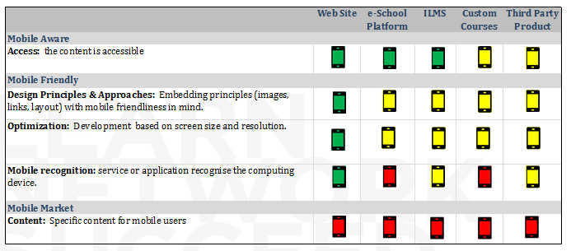
Mobile Delivery Standards (2)

Slide 16
Devices
Nobody suggested standardizing on Blackberry
Wide recognition that CSPS would need to be able to support a range of devices
Government is trending toward BYOD
Issues of support, security and service delivery
Impractical and too expensive to provide devices
Need to be as device-agnostic as possible; a preference for HTML5 rather than native applications

Slide 17
Pedagogical principles
The only formal principle mentioned as ADDIE
  Analyze, Design, Develop, Implement, and Evaluate
Need to standardize on a pedagogical model
Broad agreement what CSPS is doing is not sufficient to support mobile pedagogy
  The bias toward formal courses and the widespread employment of presentation mode were seen as an issues
  Other modalities such as performance support or knowledge management, would be difficult to deploy in the current environment
Suggestions for mobile included job aids, podcasting, spaced learning
Business needs should drive the mobile technology employed

Slide 18
Capacity and tools
Confidence in the team’s capacity in HTML5
Shortage of staffing resource
No capacity to venture into multiple directions.
Skills upgrading or time for learning needed. Possibly specialist staff would be needed
Larger-scale applications more challenging
Governance an issue - priorities shift frequently
Cultural shift among the largest challenges

Slide 19
Assessment and quality control standards
Course-completion surveys - Kirkpatrick Level 1
In-person scores slightly better than online
Unclear how much learning actually occurs
  UDL and WETkit themselves ensured quality, say some
  others argued that training is more than just transmitting information and more than just compliance
Quality control needs to focus more on business goals and learner needs
CPS needs to consider in its assessment process what feedback it actually needs

Slide 20
Adaptability to change
Recent transformation initiative – a lot of change has already taken place
  CSPS is adapting well to change
  a limit to how much change CSPS can handle.
Some the school isn’t adaptable to change
  the structure of the school hasn’t changed
  the major focus is still on classes and classroom delivery.
Some felt the school sometimes leapt into change without justification
  it was following “the next big thing”
  CSPS is very good at changing, but lacks the follow-though

Slide 21

Personalized Learning

Slide 22
Notes from the Workshop
A discussion of competencies
  CSPS works reasonably well with competencies
  the capture of learning activities is a difficult challenge.
A tension in different approaches
  GCConnex and GCCampus were developed using open source tools. But by contrast, the government employs large enterprise systems such as Saba and Skillsoft.
Transferability of learning
  Their records should follow them, perhaps tied to Prior Learning Assessment (PLA/PLR)
  some records might be private or proprietary.

Slide 23
Defining personalized learning
Content-awareness - the system knows who I am
Broker – the system brokers my access to resources
Adaptivity – the system adapts to my learning
Examples: Duolingo and Netflix
Mechanisms: metadata, recommendations, learning paths.
Issues related to personalization:
  the trap of always receiving the same kind of content
  balance individual preferences with corporate and business objectives.

Slide 24
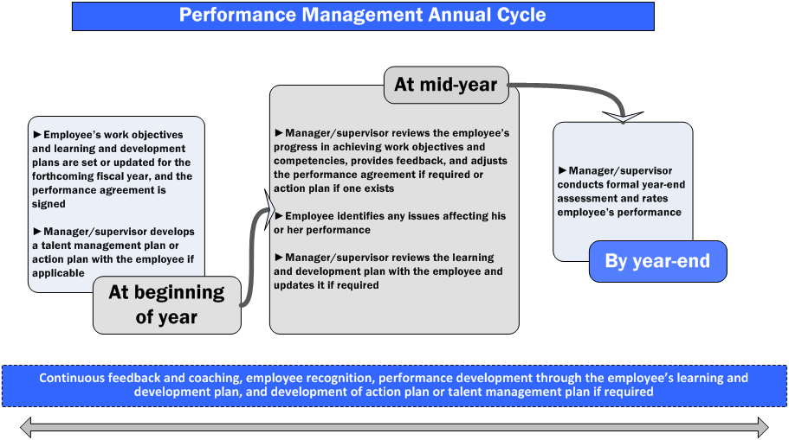
Existing tools for performance management
Learner’s pick topics of interest in GCCampus and MySchool News
No specific tools linked to performance management were identified.
Work under way to harmonize with the Office of the Chief Human Resources Officer at the Treasury Branch (OCHRO)
* Dichotomy between centralized and therefore fairly generalized job descriptions, and departmental and fairly specific job descriptions
* Dichotomy between desire and capacity when it comes to supporting performance management.
(Image: TBS)

Slide 25
Performance Support
Although it wasn’t explicitly addressed in the questions, a number of people raised the topic of performance support in this and other contexts.
One person reported having created a prototype in Moodle based on contextual and role-based navigation and focused on linking up workflow with processes and tasks.
  While completing tasks in a workplace environment a person could access tabs describing step-by-step instructions, details of steps, related resources, and contact information for help.
The existing system employed by CSPS was seen by several as offering poor performance support

Slide 26
Performance Support (2)
Personalized learning and performance support linked, suggesting the service should be more like Google than anything, where it knows what you need and will help get it for you.
At the executive level there have been many promotions in the system and the school hears a desperate need for "show me how":
- "show me how to think strategically"
- show me how to reframe an issue
- show me how to deal with the ambiguity of the world right now

Slide 27
Talent management framework
Treasury Board (and OCHRO specifically) employs PeopleSoft as the primary talent management system.
  issue of using PeopleSoft for talent management while using Saba for learning management
  There may be a change of approach when the existing Saba contract expires in 2018.
Individual departments also have their own learning management systems and their approach varies widely
In management training there is a more specific linkage between courses and competencies.
Contrast with talent management to design learning in the corporate sector

Slide 28
Competencies
More frequently mentioned were the Key Leadership Competencies (KLC) defined by the Treasury Branch.
Respondents also referred to the “16 core competencies” as well as competencies for functional communities. For example, the IS group (IS1-IS6) has 20 or 30 competencies which are increased as you go along (in a grid).
There has been a project underway to map competencies to courses.

Slide 29
Competencies (2)
Discussions about tagging learning materials directly
  significant undertaking, especially when consultations with the 16 functional communities is included
  what tags have business value, and what will be the outcome of this work?
  competencies can be subjective and subjectively evaluated
Prior learning assessment
  support for the idea but nothing currently in place
  Need a clear understanding of the concept.

Slide 30
Personal learning plans or learning paths
CSPS would like to support personalized learning paths, but that it’s not there yet.
Right now, people can create their own learning plans but there is no formal support
  CSPS was offering personalized learning plans for executives
  Also, people in regulatory functional communities have personalized learning paths
  But these were paper-based and not part of the online learning system
Saba supports learning paths, the features weren't turned on

Slide 31
Recommendation systems
A number of people mentioned resource recommendations
Aspects of content recommendation exist, such as the ‘MyPicks’ system in Drupal, but full-fledged collaborative filtering and push notifications are not implemented
A significant challenge is the low number of resources
  310 courses are listed, 33 job aids, about 100 videos, 2 case studies and a couple dozen blog posts
The underlying platforms have the capacity to support recommendations.
Recommendations would be more useful if they included external resources, but this raises a new set of issues

Slide 32
Informal learning
Acknowledgement that informal learning is permitted
Agreement that it is extremely important but unsupported
Several respondents suggested that the school should take a hands-off approach
We heard that there is a lack of buy-in in the sense of thinking informal learning is a key piece of a person's biography
The concern that informal learning would lead to abuse was mentioned several times
There were also concerns expressed about the creation of resources and artifacts for both performance support and informal learning

Slide 33
Personal learning records
Record in GCCampus does not extend to courses taken outside the school
There is a login to the school, and preferences in (for example) the Drupal system can be remembered
For executives, a stronger system exists, as it’s used to record prerequisites for promotion.
Some referred to a business intelligence (BI) project about 1.5 years into its mandate
Concerns about the resources needed to undertake such an effort, the focus of management on personal learning records, and the risks created by issues such as learner privacy and data security

Slide 34
Personal profiles or data archiving
Functionalities are extremely limited
A basic profile learners can complete (with an avatar and basic personal information)
Users can comment on posts and videos
Otherwise, there are no provisions for individuals to make their own resources available to others on GCCampus (even the blogs are open to instructors only)
Moreover, there was significant resistance to the idea of supporting that capacity and the view was expressed that GCConnex might be a better option (this will be explored more in the next section).

Slide 35
Automated mechanisms in place for profile creation
CSPS supports no mechanisms for automated profile creation or activity updates, and while this may be a useful activity, it seems to be beyond CSPS’s capacity at the moment.

Slide 36

Shared Learning & Crowd-Sourcing

Slide 37
Notes from the Workshop
Crowdsourcing ties in well with mobile learning, and as well supports the idea of social learning and collaborative learning.
Can we trust the information being uploaded by people
  Different mechanisms were suggested, from reviews to automated trust-evaluation algorithms.
Where the school is going with crowdsourcing.
  Co-creation, collaboration - What's the project? What's the strategy?
  There is a proliferation of platforms available, and hence a need to synch GCCampus with services like GCTools.
There’s a challenge to the idea of the school itself. The very act of bringing people to the school (CSPS) takes them away from their network.

Slide 38
Defining crowdsourcing
The messyspace - the deputy minister came up with idea of a 'messy space' for user-generated content.
Course commentary - a person could write that they took a course and make a selfie video about the results.
User-generated content – gathering content from users to create courses or other learning resources.
External content – sourcing learning content from other departments
Content curation – get together and share (and rate) resources
Collaborative learning and social learning

Slide 39
Defining (2)
A number of respondents also addressed the alternative pedagogies enabled through crowdsourcing methods
  flexible responses to emerging issues
  supports hands-on experience-based learning
  helps in the formation of personal networks and communities.
But is it useful? It depends on the learning objective, and it depends on the interests of the learners.
Crowdsourcing can be essential to producing meaningful and relevant content
  In many cases, content expires very quickly
  it may take 6 months to produce a nice video on a subject, however, by that time the ship has gone somewhere else.

Slide 40
Crowdsourcing and the School
Existing support is quite limited
Few examples were given, and only one course (the security course) was mentioned
The technology infrastructure for crowdsourcing does not exist in GCCampus or even in the CSPC technical environment generally
There is no standard understanding of crowdsourcing in the school
  Discussions forums are limited to management or above
  Only CSPS staff are able to blog in the GCCampus blogs
The voices in favour of crowdsourcing were very strongly in favour (and frustrated by the school’s resistance). The voices opposed were very opposed.

Slide 41
Crowdsourcing models
Respondents were not aware of specific models
Some of the different ways crowdsourcing could be approached:
  Massive Open Online Courses (MOOCs)
  Communities of practice
  Other models were new to most participants
Several people discussed Communities of Practice (CoP) specifically, but with the observations that they had been tried before without success
Other people couldn’t imagine the idea of people uploading their own content to GCCampus, particularly if that content were to be used for learning
  There are rules that govern such content, ranging from accessibility requirements to copyright clearance to bilingualism

Slide 42
Open, shared, social and crowd-sourced learning environments
Beyond discussion groups in Moodle and comments on other resources, there are no such environments supported by the school
  school is attempting to augment the role of informal learning through the addition of job aids and similar resources
  3rd party content on the site but not from departments or individuals
  the school adopted a wiki maybe 10 years ago and was working on Tomoye (a social network platform now owned by Sitrion)
  Contrast with the waterfall design process currently employed by the school.
Time and effort it would take to set up such a space
Creating courses informed by functional communities, departments such as Indigenous and Northern Affairs (INAC) and OHCRO

Slide 43
Automated social network formation and management
Collaborative filtering and and privacy preserving technologies exist to facilitate the automated creation of social networks and groups, and we asked whether any such technologies were employed at the school. They were not, with the exception of tools available in Moodle to create a cohort.

Slide 44
Applications of crowdsourcing
The most common response was the suggestion that participants could support the creation of a shared knowledge base
  collaborative development of resources
  development of tools
  facilitation of conversations and discussions around selected topics.
The current approach, we were told, is ad hoc
Broad agreement that the other suggestions in the list were good ideas, but there hadn’t been any thought or effort around this.
One person suggested using crowdsourcing to help CSPS set priorities, for example, about its future, its strategy, lines of business, needs analysis, and the like. “Let them vote up or vote down which things they want us to work on.”

Slide 45
Teaming environments and Messaging
Respondents were familiar with teaming software but nobody reported using it in a CSPS environment
No such services are officially supported at the school, though there may be ‘skunkworks’ applications.
Experience using such systems in other departments. These included Slack, JIRA, and Asana.
The LMS supports some messaging, and Cisco Spark had been supported in the past and may still be used by some
There was also an initiative to use Yammer in the past, but it did not gain momentum
Email, with text messaging also being infrequently used

Slide 46
Authorship, sharing, annotation and ratings
Support for such mechanisms at CSPS is limited
Some people mentioned the use of electronic surveys for Level 1 course evaluations
Others mentioned comments on resources.
There is no rating or annotation system used.
With respect to authorship, as noted previously, no such technologies are currently employed

Slide 47
Social presence
There was some awareness but not a deep awareness.
Research in this area and theory-based approaches were identified
The school does not have a theoretical approach to design or distance learning development; some people think about it, but not the school as a whole.
There is no real school philosophy, but it might be a good idea to have a concrete vision.
Others suggested that aspects of social presence are or would be valuable
  introducing marketing &communication to influence social presence
  mechanisms such as responding to comments
  suggested that social presence is seen as creating risk for the school.

Slide 48
Security and privacy constraints
We heard a wide range of responses
TBS has a variety of rules governing accessibility, bilingualism, common look and feel, information management, the protection of personal privacy, and more
Some said hese regulations make it effectively impossible for the school to manage or host third party or user materials.
Respondents also pointed to the responsibilities of the school with respect to personal learning information
In general, respondents agreed with the characterization that security and privacy issues create risk for the school.
There was disagreement on how risk should be managed.
The exact security risks are not known. No Privacy Impact Assessment (PIA) has been performed by the Privacy Commissioner

Slide 49
The New GCCollab
Some people thought there could be a role for GCCollab, while others disagreed, saying there’s no role at this time.
It was suggested that GCCollab could be used by the school to illustrate what it takes to perform various jobs in the public service. They also felt that there might be a marketing and communications role.
Others suggested giving access to colleges and universities to the school’s language products, so people who come in to the public service would have language skills.
They also saw opportunities where students could get involved in learning with policy developers, or to have real world case studies.

Slide 50
Resources & IT
We asked some respondents whether existing staff and financial resources would be sufficient to support a shared space or crowd-sourcing initiative.
More knowledge would be needed, we were told. An effort of perhaps 5 more people on IT, plus 3-4 people on GC Campus side, would be needed to support it.

Slide 51

Virtual Library

Slide 52
Notes from the Workshop
Original intent of plans to develop a virtual library was to offer online access to texts and resources employed in CSPS courses
Impact of government language policies on this initiative. The requirement is to be able to offer resources in multiple languages
Questions with respect to the corporate culture at CSPS. What are the top priorities for the school: a virtual library vs performance support?
Practical issues

Slide 53
Defining a virtual library
The school used to have a learning library and every department every department had libraries. So a virtual library was just a way to provide additional content support.
But we can imagine a wider possibility. With all the departmental libraries closing there is a greater opportunity to do something meaningful
In any case, there is conflict between the EBSCO user-pay model and the school’s everything-is-free model
Another interpretation of the meaning of ‘virtual library’ might be like GCCampus itself - a collection of courses, job aids, videos and other resources

Slide 54
Existing VLs in the GoC
Large number of virtual libraries in other government departments
Awareness of these libraries was limited, but there was awareness at a superficial level, especially with regard to the activities of Library and Archives Canada (LAC)
There was some support for working with or interoperating with other departments, question whether it is a core focus for the school.
Need for curation of materials that would be housed in a CSPS library?
Some people referenced possible interoperability via GCCampus.

Slide 55
Canada's Open Government initiative
We were not able to include questions about Canada’s Open Government initiative, and it was not raised by respondents.

Slide 56
Linkages to the wider library community
We were not able to include questions about linkages to the wider library community, and these were not raised by respondents.
We were told, however, that the school’s strategic directions branch is reaching out to possible development by universities, and the new executive development branch is looking at public-private sector development, for example, doing a 'teach plan' with Helios - where the school’s participants and their participants get together

Slide 57
Resource metadata standards
What we heard was that work on resource metadata standards has been an ongoing activity for the school for some time now
Staff were aware of initiatives such as Learning Object Metadata and Cancore.
However, GCCampus was conceived with the idea that metadata was not important, with the result that the system employed has very little metadata capability
Respondents also described initiatives to employ metadata for learning resources (MLR) and an effort to develop a taxonomy

Slide 58
Read and using metadata records
Work being done in this direction. Developers are working on a tool for 'learning product application' - an in-house tool built from scratch.
Efforts being made to make metadata creation more integrated with content creation tools
Respondents also described the role of the School Content Integration Committee (SCIC) with respect to metadata
The only use of metadata discoverable was the set of filtering options available in the Drupal search tool

Slide 59
Information management environment
Libraries typically employ content management systems in order to manage assets. We asked whether the school employs a CMS.
The school does not have a Learning Content Management System (LCMS). There is lightweight LCMS capability in the Saba LMS. It should be mentioned that Kaltura can function as a video asset CMS.

Slide 60
Open educational resources
There is no CSPS policy on open educational resources and no school-wide approach to them
There is some support for the concept but it is not universal
  there was a great deal of scepticism about the use of third party resources
A number of people expressed support for opening the school’s own resources
  and support from the Deputy Minister was cited with respect to some specific courses
  Frustration was expressed at the slow pace in distributing resources openly
  There is greater scrutiny of materials which may become public-facing.

Slide 61
Material assessment & quality control
There appeared to be no assessment function with respect to third party materials (to be fair, there was very little use of third party materials cited generally).
The major quality control initiative at the school is the School Content Integration Committee (SCIC)
  We heard that membership on this committee was unstable, and that it should be valued more than it is currently.
One respondent suggested that an electronic performance support system could employ a ratings system such that quality content would “float to the top”.
The school should look at what other institutions are doing, we were told. Other universities have published white papers on that and there is no need to reinvent the wheel.

Slide 62
Rights management and copy control
For CSPS materials, translations / copyright / accessibility requirements are validated by SCIC and are based on TBS standards.
Staff generally felt that the school was very compliant with these regulations , though because the standards are constantly changing it’s impossible to be 100% compliant
Concerns were expressed about the quality of translations

Slide 63

Integration with Other Platforms

Slide 64
Notes from the Workshop
The focus was almost entirely on integration with GCTools.
The possibility of integration with GCTools creates business challenges for CSPS
  exactly what would be connected?
  how deep would the integration go?
  who would be responsible for technology development?
  what would branding look like?
  how would user access be managed?

Slide 65
What does 'integration' mean?
Linkage - each with a tab or an icon on the other system
Single signon - single signon with GCCampus and GCTools.
Common Services - CSPS listed among the other services
Extending the bus - user information and data exchanged
Learning Tools Interoperability - launched using SCORM or LTI
Full integration - CSPS resources are available throughout GCTools and vice versa
Business value of integration
  universal support for a single signon mechanism
  integration as an excellent means to enable CSPS to deliver on its core mandate
  Several people mentioned the need for extended training and support to help learners use the new system.

Slide 66
Defining ‘other platforms'
CSPS plan envisioned integration with GCTools specifically
  Discussions are already underway with GCTools
  Concern that TBS is moving ahead too quickly
  GCConnex services are located behind the intranet
  Some others also raised doubts about the utility of GCConnex tools
  Majority indicated growing support for integration with GCConnex
The other major target - OCHRE
  Some felt CSPS is being pulled in two directions - are they more interested in tools, or performance management?
Some discussion about integration - or at least interoperability - with external tools such as Facebook and Twitter.
  On this, opinions were probably more divided than anywhere else, with some vehemently opposed to social networking services, and others pointing out that this is where most people work and communicate online already.

Slide 67
Knowledge of other platforms
We asked about participants’ knowledge of other platforms, primarily to evaluate what range of options was being considered.
All respondents were familiar with GCTools (though not necessarily every part of GCTools). Others mentioned services such as GEDS and the HRMS service that existed before Phoenix.
Several participants discussed the state of learning management systems within the Government of Canada generally

Slide 68
Employment and occupational platforms
We explored the question of integration between GCCampus and employment or occupational platforms
One thread of discussion considered the integration of GCCampus and performance management
  Maybe managers should be able to see learning records as part of performance review,
  Maybe there should be recognition of prior learning from work experience by the school.
The view was expressed that GCCampus could be linked with Government of Canada employment services, but not external services such as Monster or LinkedIn. “We should have a solid internal platform that's seamlessly integrated & not worry about what's outside.”

Slide 69
Identification and single sign-on
Everybody wants single signon, defined as “you sign on once to your government account, and then you have access to everything,” and
Multiple single signon projects exist in the Government of Canada.
  CSPS has its own Shibboleth-based system
  There is also the MyKey initiative.
  There is in addition the general desktop login people use in their own departments
  (note that we did not attempt a full survey of signon mechanisms).

Slide 70
Single Signon (2)
However, several issues were raised:
First, the level of security provided by (or required by) different signon systems varies
Second, there is not a clear definition of the need for, or business value, of signon requirements

Slide 71
Support for distributed environments
Different interpretations of ‘distributed’:
One respondent spoke of ‘distributing learning’ and made the point that 'build it and they will come' does not work
Support for subscription-based learning the school needs to remove the walls of learning from the containers they're in right now, said the respondent
Development of specific learning solutions for different departments. With the right application of metadata school staff should be able to approach a department and created a tailored program for them, we were told.
Geographical distribution. The government’s social presence in the regions is very important, maybe more important, we were told. In the long run, even Mirimichi (Phoenix) will work.

Slide 72
Expertise & Resources
Does CSPS have sufficient expertise and resources to implement the sort of integration programs being contemplated?
The most common response was that the resources do not exist
  Respondents said staff were capable of doing the work
  Gap between expectations and the resources needed to do the job
  The school could leverage work other people are already doing
  The school has fuelled the idea that specialists should perform certain tasks, while in fact people could do much more themselves, with the right amount of support
We also asked specifically about the stability and robustness of the existing platform, and especially the enterprise bus, which was created specifically for GC Campus

Slide 73

Strategic Directions

Slide 74
The New Business Model
As seen from the systems/solutions perspective:
  no service catalogue / pay once, you’re in
  looking to create ‘opt-in’ strategy for those outside core audience (eg. Canada Post)
  key challenge: knowing who CSPS clients are
They’re trying to do partnerships (3 pillar sourcing strategy)
  eg universities/3rd party vendors
  High interest in OGDs having place to publish content
Messy space /crowdsourcing
  DM wants to move forward with that
  But the department does not take risks (privacy, language, accessibility)
  Same sort of risks with ebooks/3rd party etc.

Slide 75
Drivers
Up to now, IT has been driving functionality, but we can't push it much further without content following
Great opportunity & the business value
  but the business requirements are not yet defined
  need the business cases & visions for the future
Need to change the delivery model
  can't imagine sitting in front of the screen for 4 hours
  want to be able to learn quickly
  or I want the traditional method
  it's not just the learning opportunity but also the networking opportunity

