Slide 1
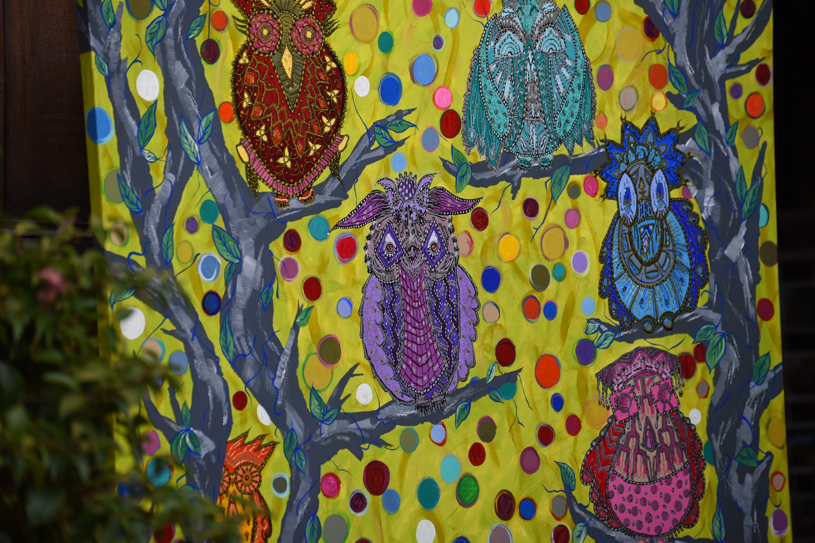
Stephen Downes
Beirut, Lebanon
November 7, 2016
Openness

Slide 2
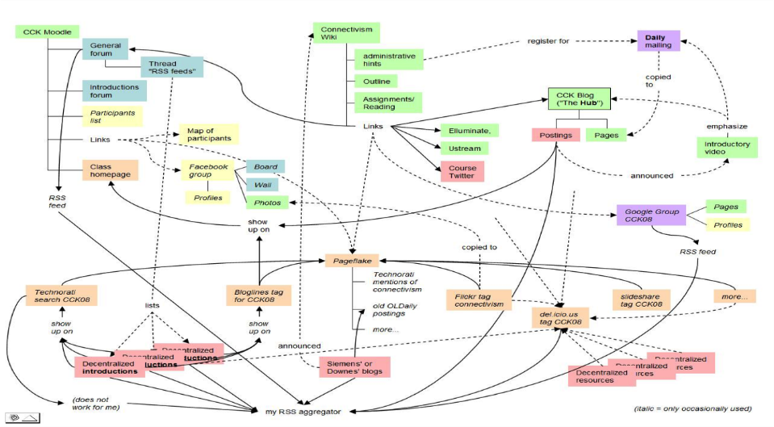
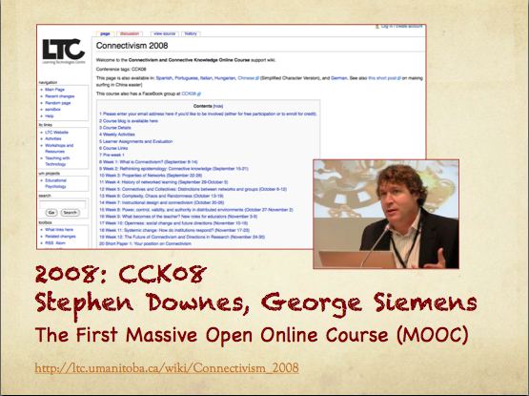
MOOC – CCK08
https://sites.google.com/site/themoocguide/3-cck08---the-distributed-course

Slide 3
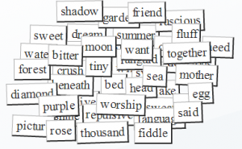
Think of OERs as words in a conversation

Slide 4
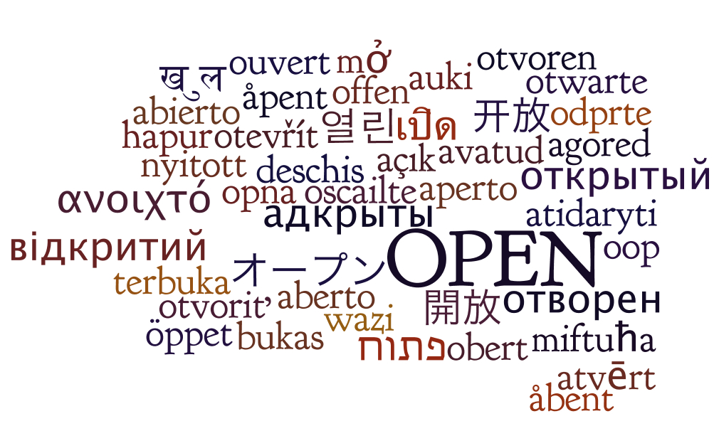
It forces us to think about how they can be used.
http://oerworkshop.pbworks.com/w/page/33932297/OER%20Workshop

Slide 5
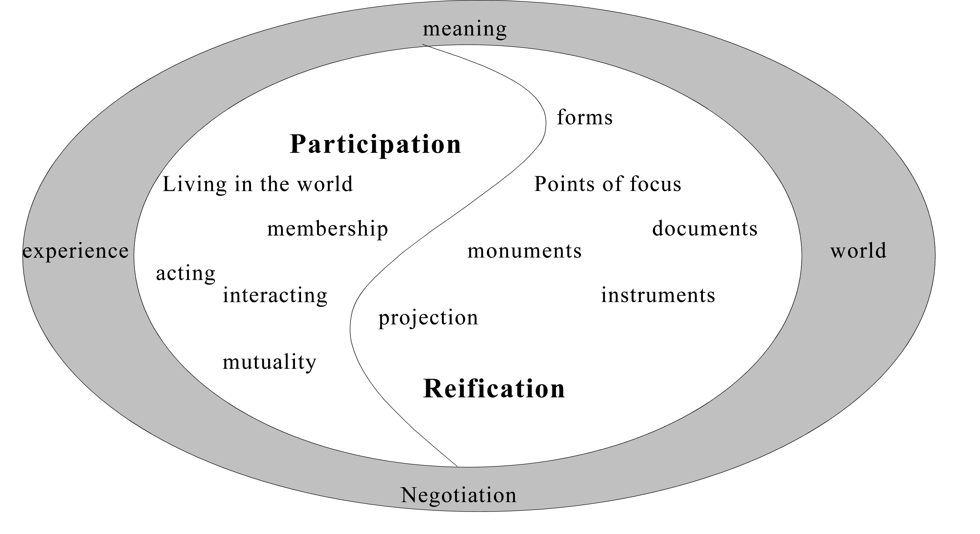
Knowledge is reified by, and is the product of, not only an individual, but of the wider community.
http://www.informationr.net/ir/8-1/paper142.html

Slide 6
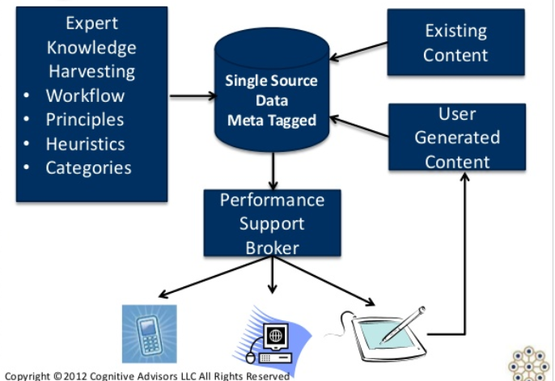
User-Generated OERs

Slide 7
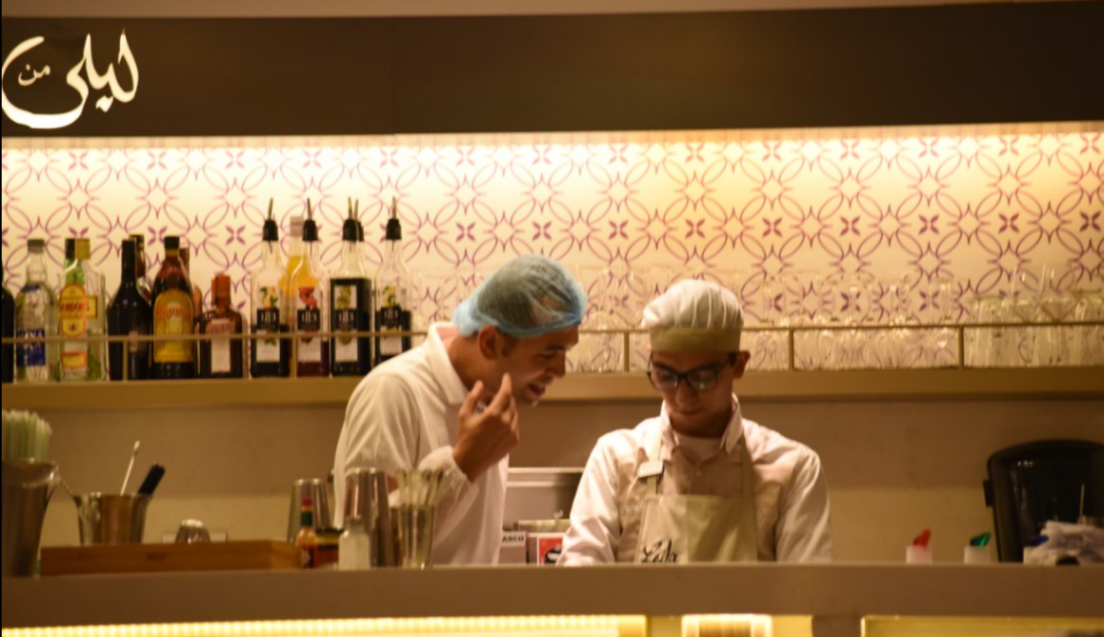
Working Out Loud
http://johnstepper.com/2014/01/04/the-5-elements-of-working-out-loud/

Slide 8
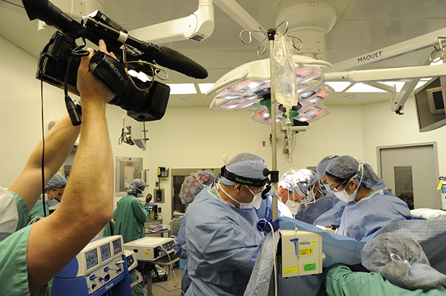
Creating Live OERs

Slide 9





Informal OER Ecosystem

