Slide 1

Theories of learning – epistemology of connectivism
Stephen Downes
Beirut, Lebanon
November 7, 2016

Slide 2
Ways of seeing the world
Experience | (Qualitative)
Reason | (Quantitative)

Slide 3
Basis of Knowledge
Experience | (Qualitative) | Perception
Reason | (Quantitative) | Cognition

Slide 4
A Third Way
Experience | (Qualitative) | Perception
Reason | (Quantitative) | Cognition
Interaction | (Connective) | Recognition

Slide 5
Pedagogical Divisions
Experience | Arts, drama, music, humanities, culinary, design, religion
Reason | Language, mathematics, logic, science, technology
Interaction | Practicum, internship, apprenticeship, fellowship

Slide 6
Literacies
Experience | Change | Progression, cycle, dialectic, growth
 | Semantics | Meaning, truth, value, purpose, classification, category
Reason | Syntax | Principles, rules, regularities, similarities, grammar, method
 | Cognition | Argument, explanation, definition, description
Interaction | Use | Practice, operation, interrogation, experimentation
 | Context | Space, environment, difference, background, culture

Slide 7
A Sense of Progression
Inexperienced |  | Experienced
Unknowing |  | Knowing
Unconnected |  | Connected

Slide 8
A Gap to Fill?
Inexperienced |  | Experienced
Unknowing | facts? | Knowing
Unconnected |  | Connected
Gap?

Slide 9
A Gap to Fill?
Inexperienced | writing, painting, drawing, acting, traveling, creating, tasting, discerning | Experienced
Unknowing | measuring, counting, calculating, inferring, demonstrating, explaining | Knowing
Unconnected | using, modeling, sharing, discussing, practicing, reflecting, connecting | Connected
Learning

Slide 10
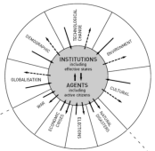

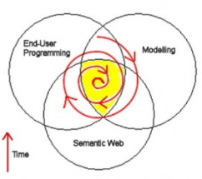
Causes of Change
Resistance
Drivers
‘Pedagogy’
Costs
Events
Crises
Inventions
Growth
Values
Goals
Desires
Needs
Attractors
‘Tech’
Inertia
Notes:
ACCA, 2012, Drivers of Change in the U.S. http://www.accaglobal.com/content/dam/acca/global/PDF-technical/futures/pol-af-docus.pdf
Simon L. Dolan, Salvador García, Samantha Diegoli, Alan Auerbach. 2000. Organisational Values as "Attractors of Chaos”: An Emerging Cultural Change to Manage Organisational Complexity. http://www.econ.upf.edu/docs/papers/downloads/485.pdf
Donald L. Gilstrap. 2005. Strange Attractors and Human Interaction: Leading Complex Organizations through the Use of Metaphors. https://ejournals.library.ualberta.ca/index.php/complicity/article/viewFile/8727/7047

Slide 11
Causes of Change in Education
Resistance
Drivers
‘Pedagogy’
Inexperience
Ignorance
Disconnection
Experience
Knowledge
Embodiment
Attractors
‘Tech’
Inertia
Notes:
ACCA, 2012, Drivers of Change in the U.S. http://www.accaglobal.com/content/dam/acca/global/PDF-technical/futures/pol-af-docus.pdf
Simon L. Dolan, Salvador García, Samantha Diegoli, Alan Auerbach. 2000. Organisational Values as "Attractors of Chaos”: An Emerging Cultural Change to Manage Organisational Complexity. http://www.econ.upf.edu/docs/papers/downloads/485.pdf
Donald L. Gilstrap. 2005. Strange Attractors and Human Interaction: Leading Complex Organizations through the Use of Metaphors. https://ejournals.library.ualberta.ca/index.php/complicity/article/viewFile/8727/7047

Slide 12
A Logic Model of Education
Input
Learning
Effect
Benefit

Slide 13
A Logic Model of Education
Inexperienced |  | Experienced
Unknowing |  | Knowing
Unconnected |  | Connected
Input
Learning
Effect
Benefit

Slide 14
Learning Theories
Behaviorism . (Instructivism) | transmission | Repetition
Cognitivism | construction | Representation
Connectivism | interaction | Connection
Input
Learning
Effect
Benefit

Slide 15
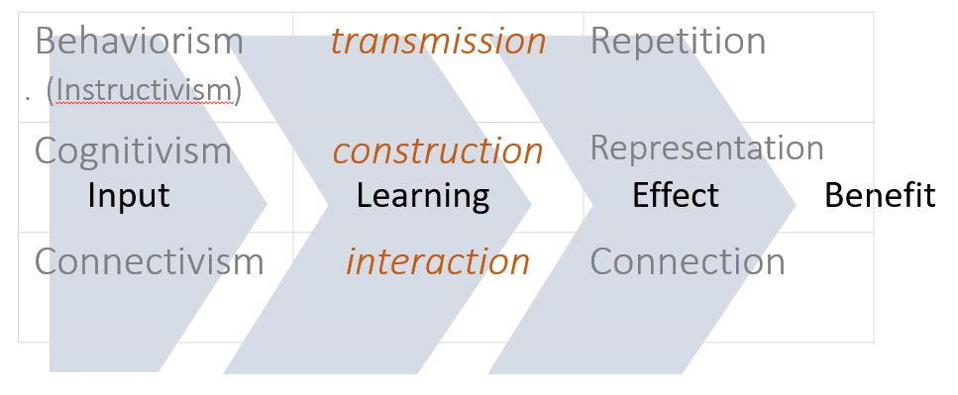
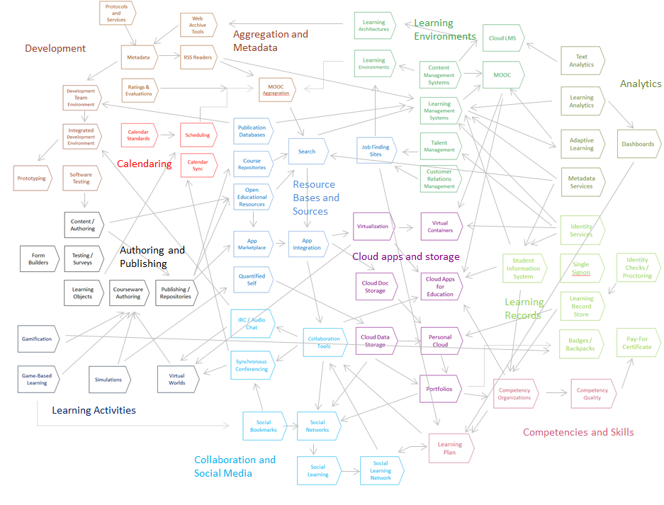
A Map of Learning Technology

Slide 16
A Map of Learning Technology

Slide 17
A Graph of Learning Technology

Slide 18
A Map of Learning Technology
Aggregation & Metadata
Software Development
Simulations & Virtual Reality
Learning Analytics
Learning Environments
Learning Content
Resource Repositories
Learning Records
Cloud Applications
Learning Activities
Communities & Social Media
Competencies & Skills

Slide 19
A Model of Learning Technology
Aggregation & Metadata
Software Development
Simulations & Virtual Reality
Learning Analytics
Learning Environments
Learning Content
Resource Repositories
Learning Records
Cloud Applications
Learning Activities
Communities & Social Media
Competencies & Skills

Slide 20
Learning Technology Value Chain
Aggregation & Metadata
Software Development
Simulations & Virtual Reality
Learning Analytics
Learning Environments
Learning Content
Resource Repositories
Learning Records
Cloud Applications
Learning Activities
Communities & Social Media
Competencies & Skills

Slide 21
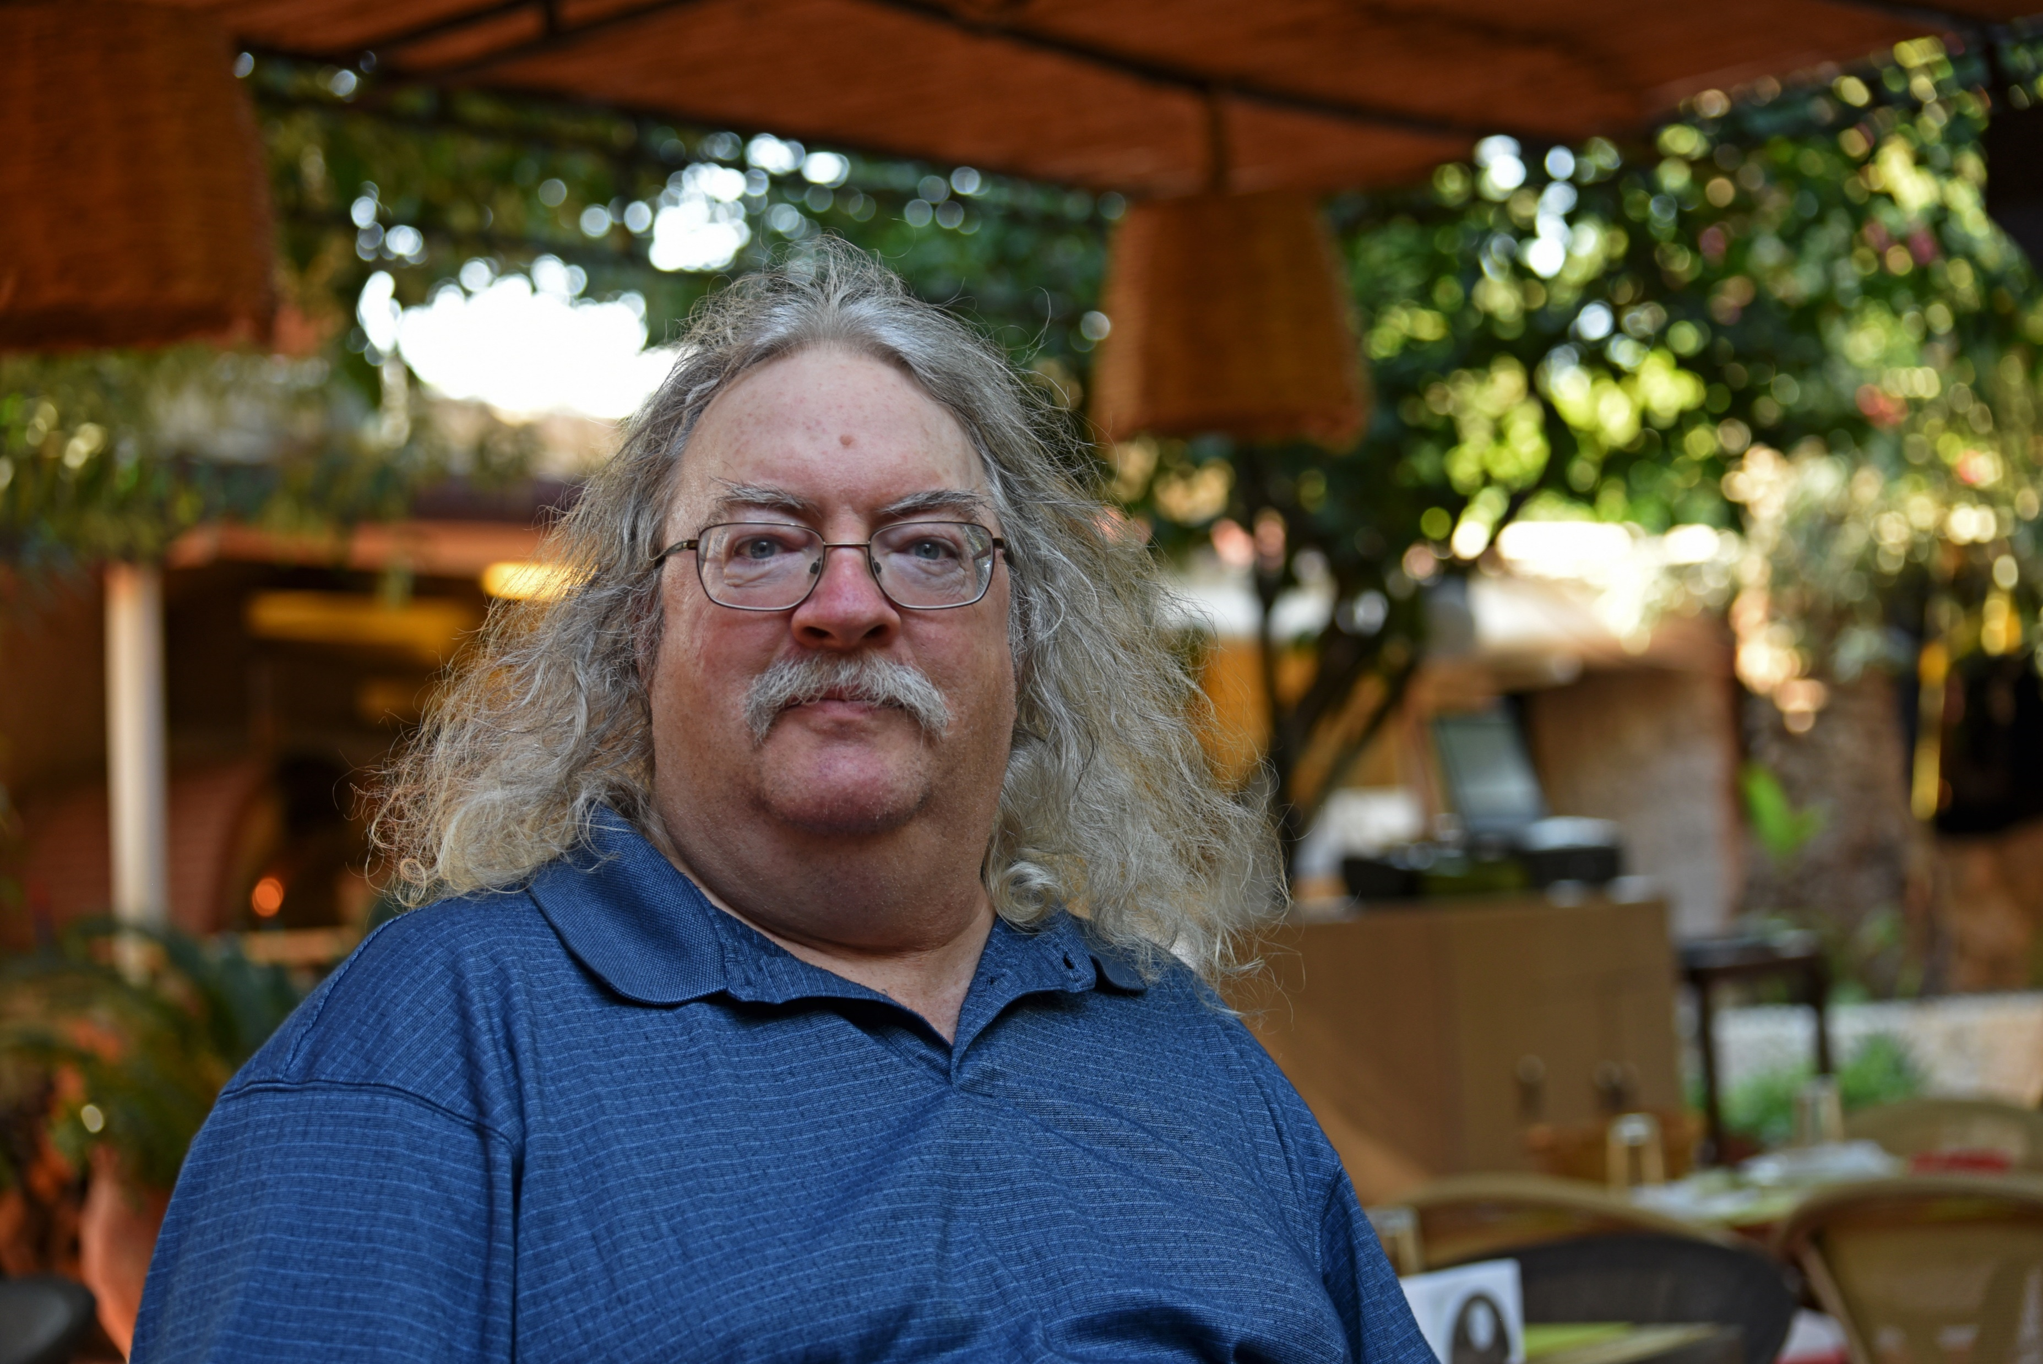
Stephen Downes
http://www.downes.ca

