Slide 1
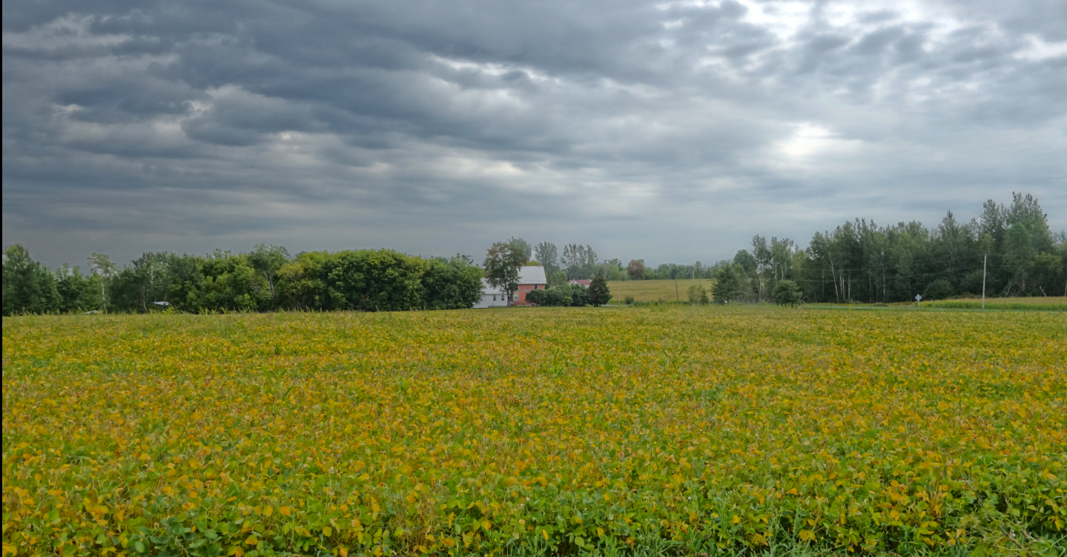
Learning Communities
Stephen Downes
October 13, 2016

Slide 2
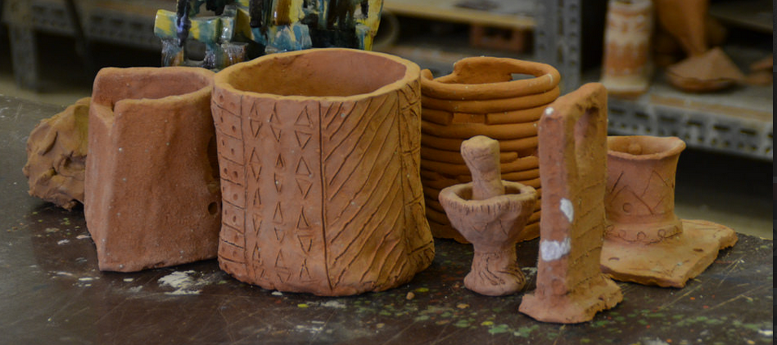
What is Education?
Riyadh, Saudi Arabia, 2015
Science as a "combination of evaluating evidence, coordinating evidence and models, and arriving at evidence-based judgments that are communicated through argumentation."
Ronald W. Rinehart, et.al. 2016. Critical Design Decisions for Successful Model-Based Inquiry in Science Classrooms. https://scholarworks.iu.edu/journals/index.php/ijdl/article/view/20137/28269

Slide 3
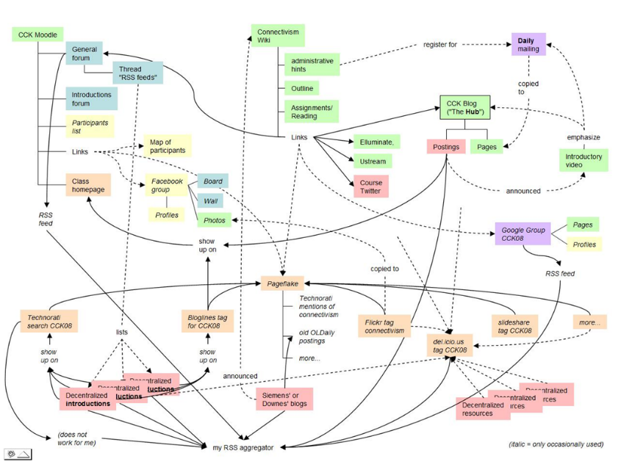
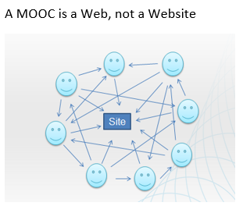
The Connectivist MOOC (cMOOC) Design
Instead of seeing a course as a series of contents to be presented, a course is a network of participants who find and exchange resources with each other
An initial structure is developed and ‘seeded’ with existing OERs
Participants encouraged to use their own sites to create or share resources
A mechanism (gRSShopper) is employed to connect them

Slide 4
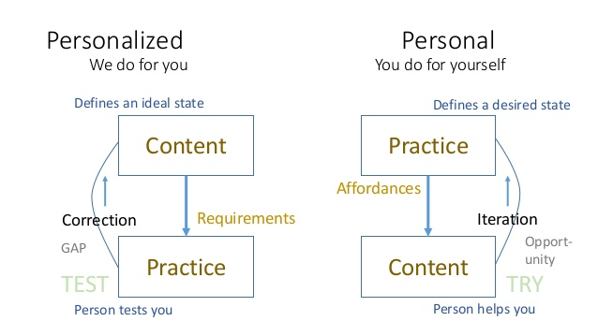
Learning is Personal

Slide 5
Design vs Environment
Path | Field
Course | Curriculum (as in ‘mapping’)
Sequence / Prequisite | Core / periphery / foundation
Movement / covered | Inquiry / Discovery / Gaps
Threshold / Levels | Coverage / Construction
Positioning – first / last | Grouping / Clustering
Objective / target | Serendipity / emergence
Leading / Led | Centred
Carrie Paechter, Metaphors of Space in Educational Theory and Practice http://www.tandfonline.com/doi/pdf/10.1080/14681360400200202

Slide 6
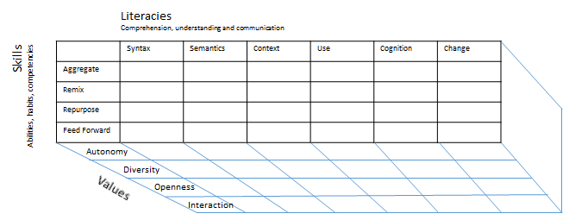
Method as Discovery:
You don’t learn a language, you discover it
To discover a language is to be immersed in it, to speak it and listen to people speaking in it
My scientific method (if it can be called that) is to go to the office each day and immerse myself in the world – to try listening, and to try speaking

Slide 7


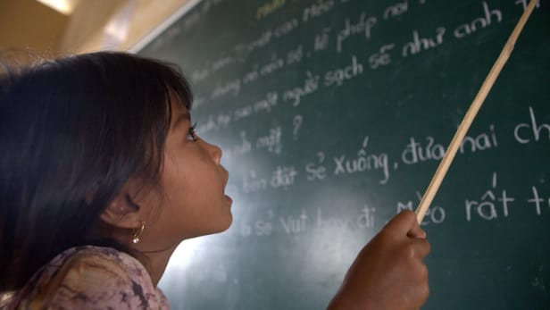
How do we know?

Slide 8

Success factors
What are the indicators of success for a learning community
  Retention (in some program)
  Lifespan of a learning community
    Eg. stages of a mailing list
  Engagement and interaction
    Number of participants
    Number of posts
    Shares or referrals

Slide 9
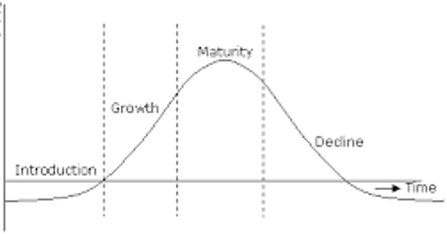
Lifecycle of a Mailing List
Mature discussions
Yes, you can announce your event
Informal rules
List advertised on other lists
Strict policies
Two people monopolize the list for their never-ending debate
Enthusiasts
No rules
Founding
No rules
List consists only of conference announcements and CFPs

Slide 10

Measuring CBE
There are four ways to measure competency-based results:
Project execution
Qualitative Data Sampling
Performance
Business Results
Diana Esparza 2016 HSR, Four Ways to Measure Competency Based Outcomes http://www.hrsg.ca/four-ways-to-measure-competency-based-outcomes/
http://www.pearsoned.com/education-blog/the-changing-role-of-faculty-from-traditional-ed-to-competency-based/

Slide 11
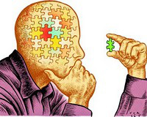
Why are we doing this?
To translate active learning into something that is meaningful and lasting, students need to learn . . . to reflect in action about the learning process itself.
    Smith, B. L., MacGregor, J., Matthews, R. S., & Gabelnick, F. (2004). Learning communities: Reforming undergraduate education. San Francisco, CA: Jossey‐Bass., p. 125

Slide 12
Effectiveness
When these learning communities are carefully planned and implemented, they can have a dramatic and positive effect on students. Unlike some educational trends that appear promising but lack resiliency, learning communities have proven to be effective across a variety of types of institutions and in a variety of different forms.
Journal of Student Success and Retention Vol. 2, No. 1, October 2015.
http://www.jossr.org/wp-content/uploads/2015/10/Learning-Communities-in-Higher-Education-JoSSR-submission-revised-10-26-2015.pdf

Slide 13
Scaling up learning communities
A paid coordinator and committed college leaders were essential to managing and scaling up learning communities.
As coordinators clarified expectations and offered support, faculty responded by changing their teaching practices.
Curricular integration remained difficult to implement widely and deeply.
Student cohorts led to strong relationships among students, creating both personal and academic support networks.
    Visher, M., Schneider, E., Wathington, H., & Collado, H. (2010). Scaling Up learning communities: The experience of six community colleges. New York, NY: MDRC. Retrieved from http://www.mdrc.org/sites/default/files/scaling_up_learning_communities_fr.pdf

Slide 14
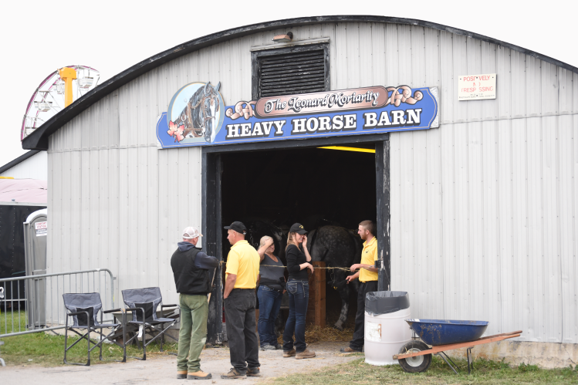
Best practices?
  PLCs work best …
  1. A culture that supports collaboration;
  2. The ability to take an objective/macro view of school efforts; and
  3. Shared beliefs
  and behaviors.
  http://www.dpi.state.nc.us/profdev/resources/proflearn/

Slide 15
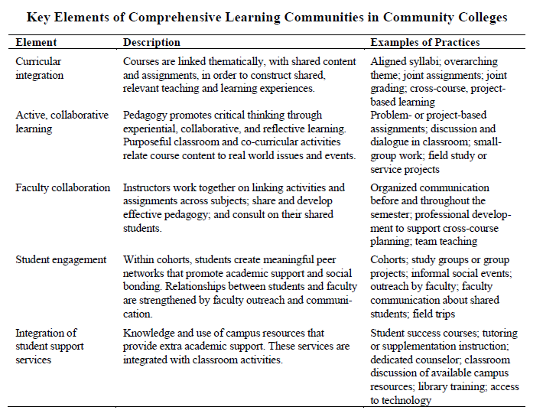
    Visher, M., Schneider, E., Wathington, H., & Collado, H. (2010). Scaling Up learning communities: The experience of six community colleges. New York, NY: MDRC. Retrieved from http://www.mdrc.org/sites/default/files/scaling_up_learning_communities_fr.pdf

Slide 16
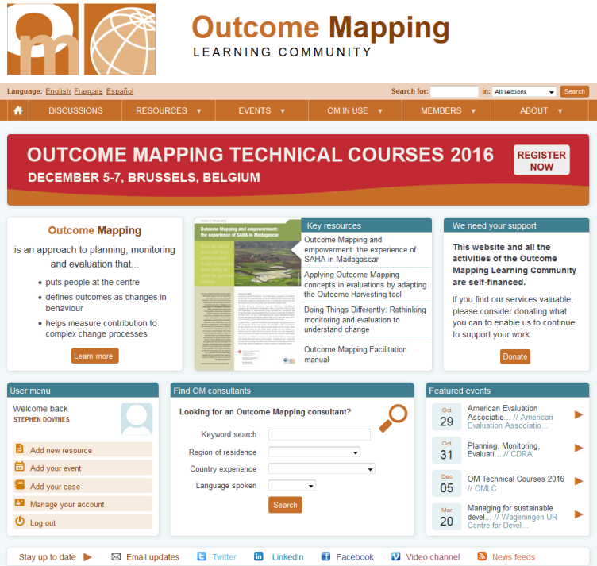
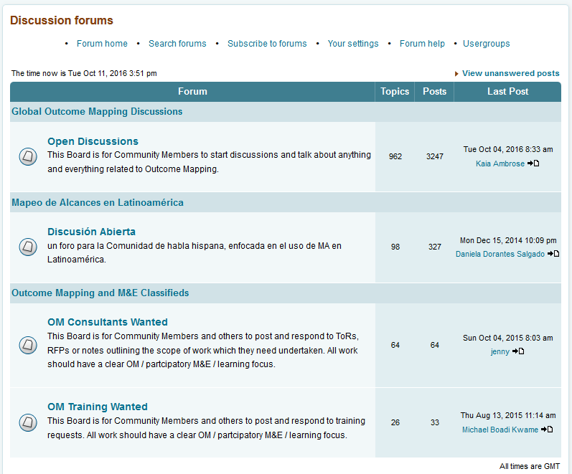
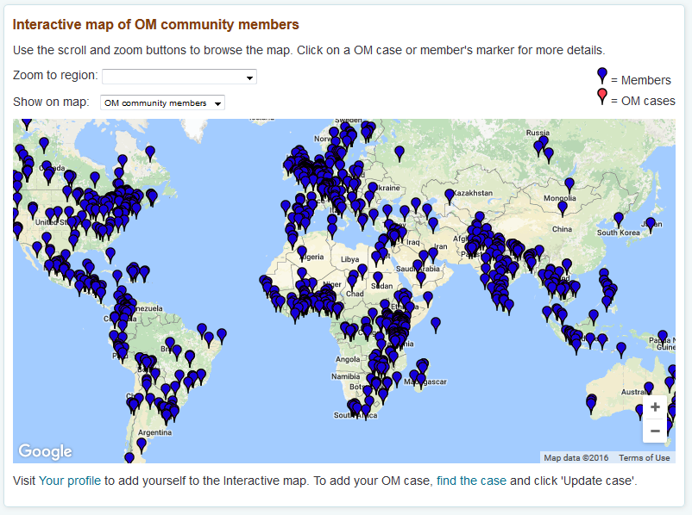
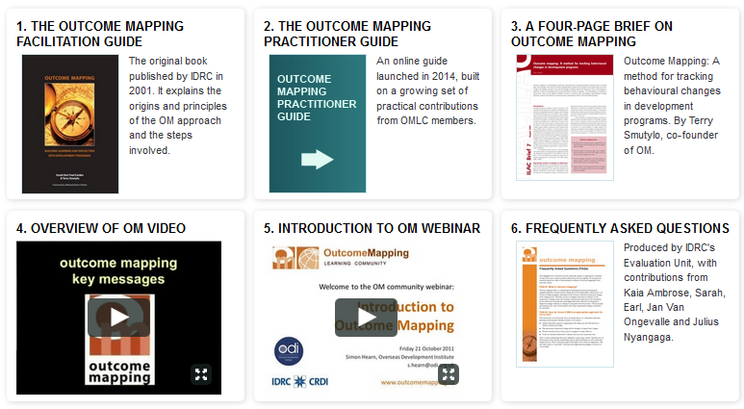
Outcome Mapping
http://www.outcomemapping.ca/

Slide 17


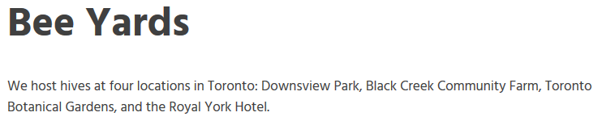
Toronto Beekeepers’ Collective
http://torontobeekeeping.ca/

Slide 18
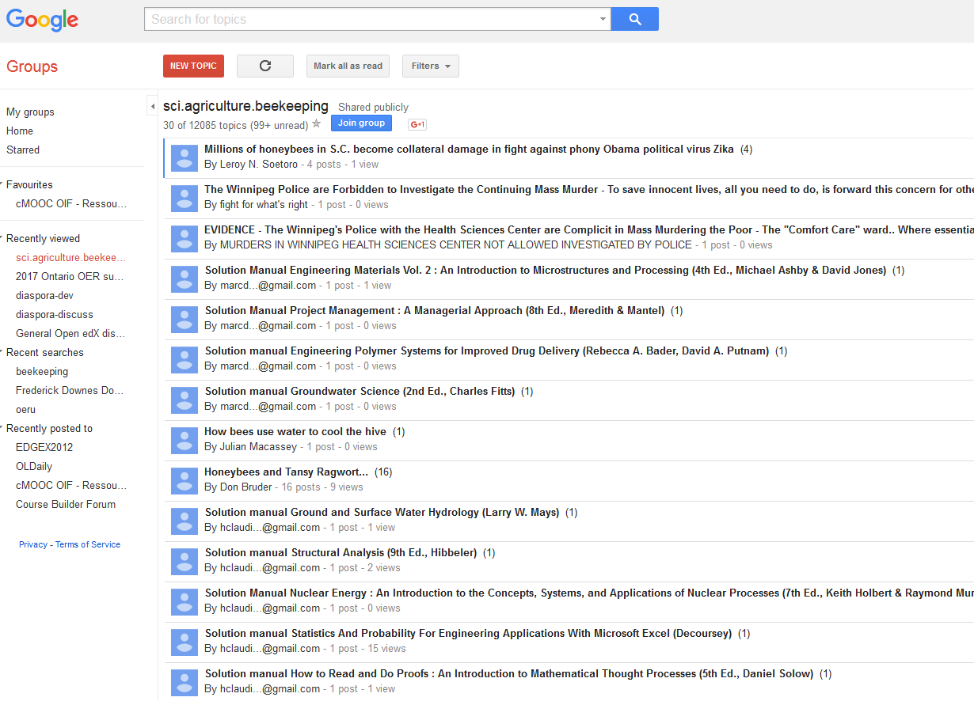
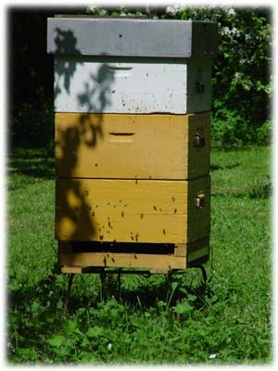
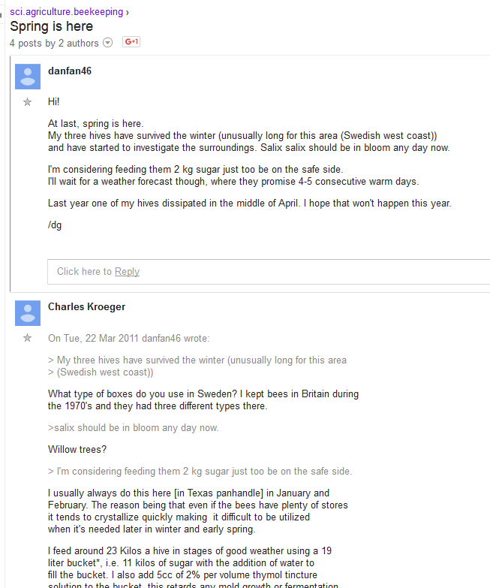
sci.agriculture.beekeeping
https://groups.google.com/forum/#!forum/sci.agriculture.beekeeping

Slide 19
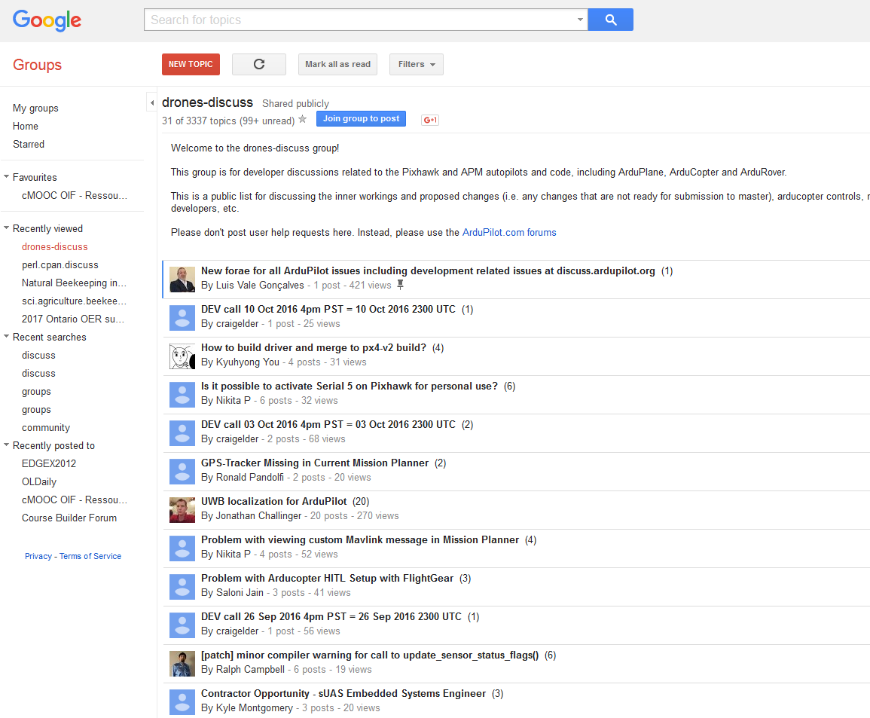
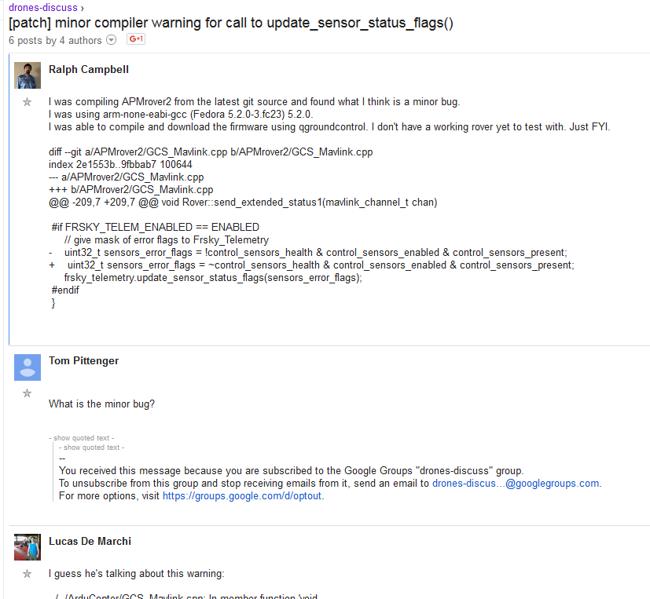
drones-discuss
https://groups.google.com/forum/#!forum/drones-discuss

Slide 20
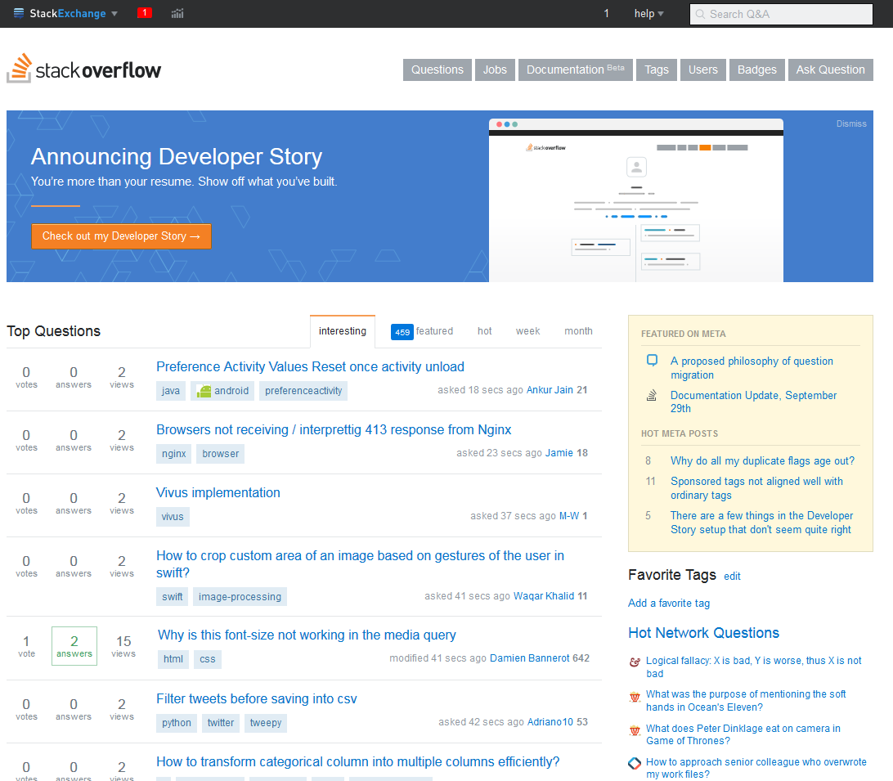
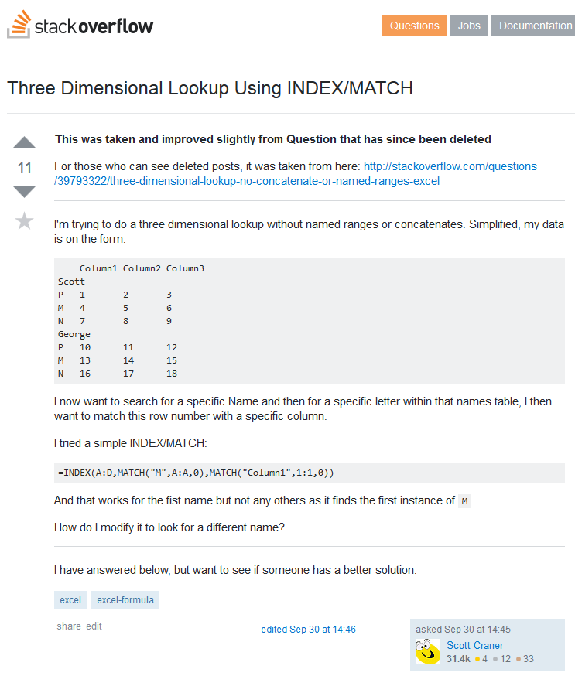
Stack Overflow
http://stackoverflow.com/

Slide 21

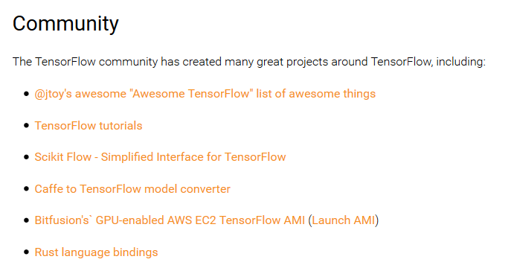
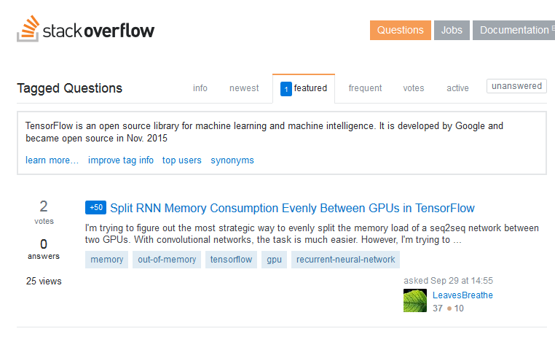
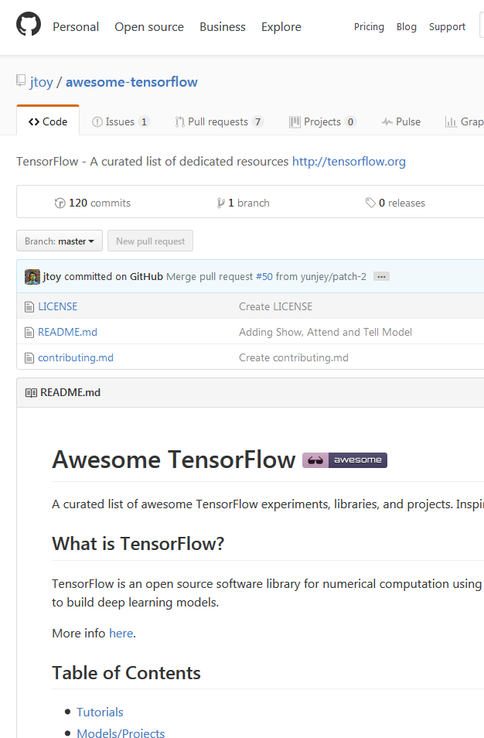
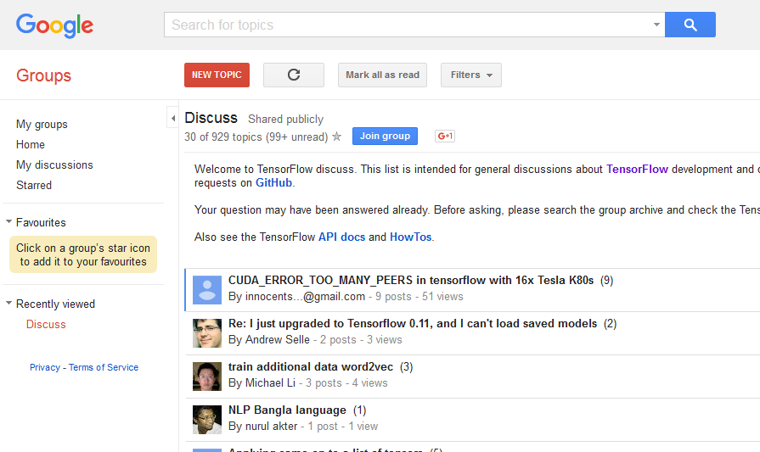
Tensor Flow
https://www.tensorflow.org/versions/r0.11/resources/index.html

Slide 22
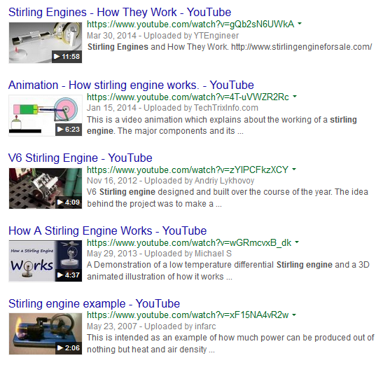
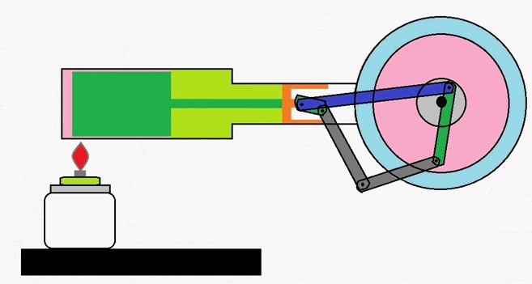
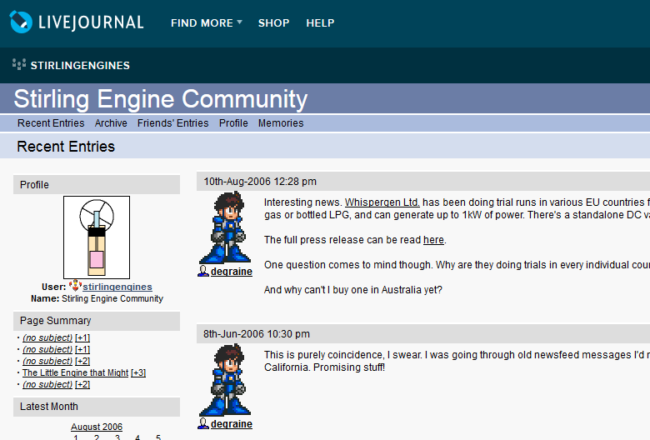
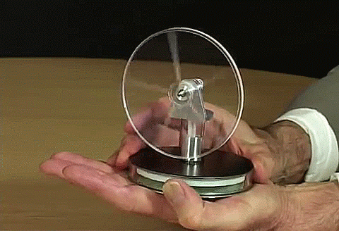
Stirling Engines
https://plus.google.com/+AndresMTrianon/posts/8uvXZGnPXLy
https://plus.google.com/communities/117518490246975838002

Slide 23
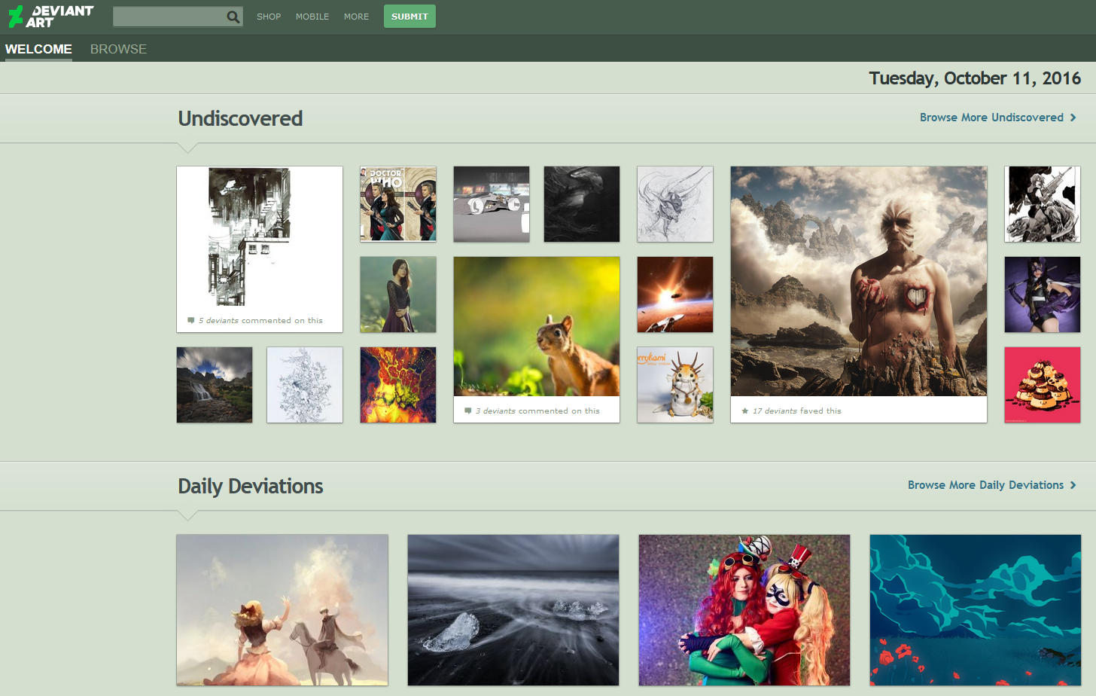

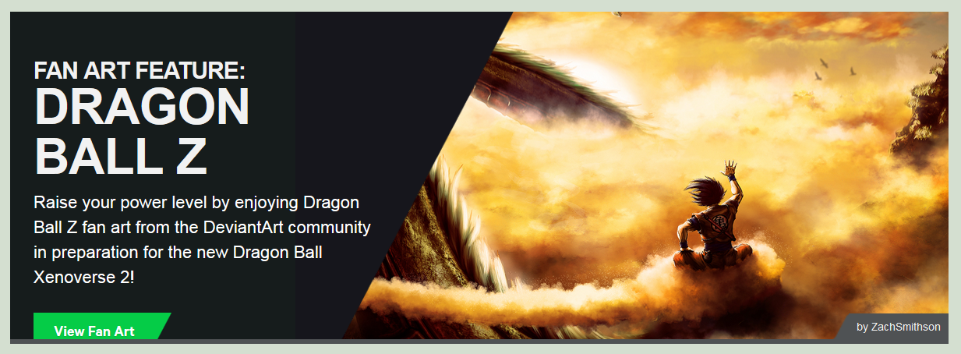
Deviant Art
http://www.deviantart.com/art/The-Future-639356834
337 million original works of art.
40 million members
https://www.deviantart.com/

Slide 24
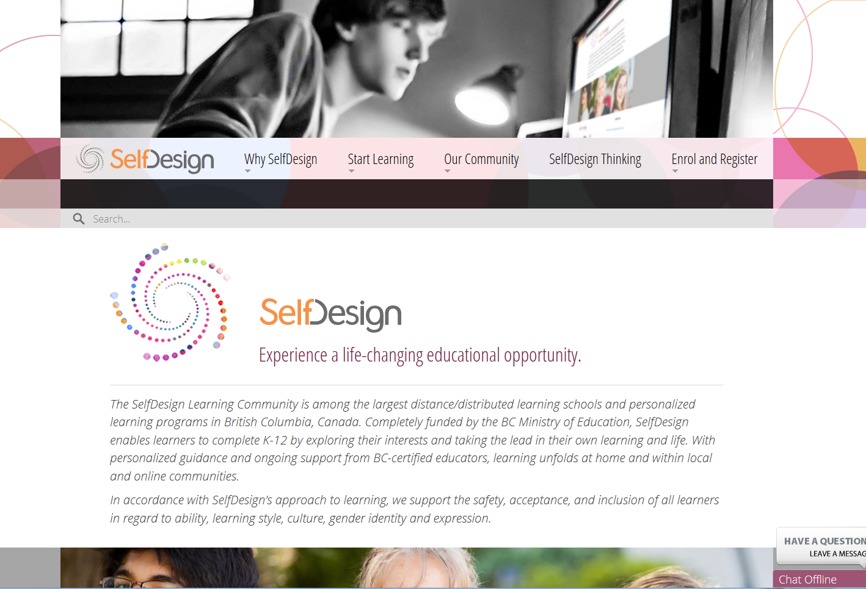
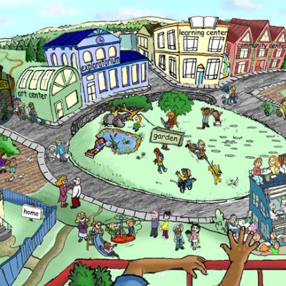

Self Design
Completely funded by the BC Ministry of Education, SelfDesign enables learners to complete K-12 by exploring their interests and taking the lead in their own learning and life. With personalized guidance and ongoing support from BC-certified educators, learning unfolds at home and within local and online communities.
http://selfdesign.org/
Notes:
A Certified Educational Alternative
Our K-12 program is a secular, “distributed learning” school certified and funded by the BC Ministry of Education. For SelfDesign, this means that instead of having a single bricks-and-mortar facility we use online communications and local learning opportunities to support learners and their families throughout British Columbia.
Tuition-Free Innovative Education
Our K-12 program is open to everyone in British Columbia and includes access to a range of learning resources and services. We believe that leading educational practices should be equally available to all.
Personalized for Each Learner
With SelfDesign, all learners join in designing their own learning plans, customizing how and what they will learn based on their own interests, curiosities, and learning goals.
Acknowledgement and Focus on Self-Awareness
One of the most important subjects of all is one’s self. The art and science of introspection is an underlying theme in our programming. As a result of this approach, our learners are known for their confidence, creativity, resourcefulness, and passion for life—all ingredients for happiness and success.
Support from a Certified Educator
All learners and their families are matched with a BC-certified educator who provides a range of support while validating learning for academic credit. In K-9, these educators are called learning consultants, and in 10-12 they are called guiding mentors. As reflected in these names, the educator’s role evolves as the learner grows older, from consulting and supporting parents to being an ally and guide for learners.
In 10-12, learners also have access to course mentors to provide subject expertise, as well as the option of working with an ESL trained mentor for learners whose first language is not English.
Self-Pacing
With SelfDesign, learners decide the pace of their own learning—accelerating or slowing down in particular areas as desired, often experiencing the equivalent of multiple grade levels at once. In this way, they gain more from each moment of learning by always working from a foundation of readiness and self-worth.
Flexible Learning Schedule
With SelfDesign, learning happens anytime—accommodating active families, traveling families, and learners with time-intensive commitments.
A Connection to Community
SelfDesign believes in creating opportunities to learn in community. We support families to connect with others online and in-person. Also, many learners connect to community through special learning opportunities & events, workshops, camps, volunteering, service learning, and more.

Slide 25

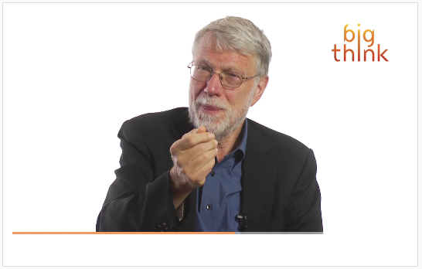
World of Warcraft
World of Warcraft as distributed, organic, highly adaptive learning community - great perspective from +john seely brown
Its players organize themselves into massive guilds, choose specialties according to their own interests, set their own goals and create “dashboards” – or tools to measure their own performance.
http://bigthink.com/think-tank/how-world-of-warcraft-could-save-your-business-and-the-economy
Notes:
10,000 new ideas a night

Slide 26
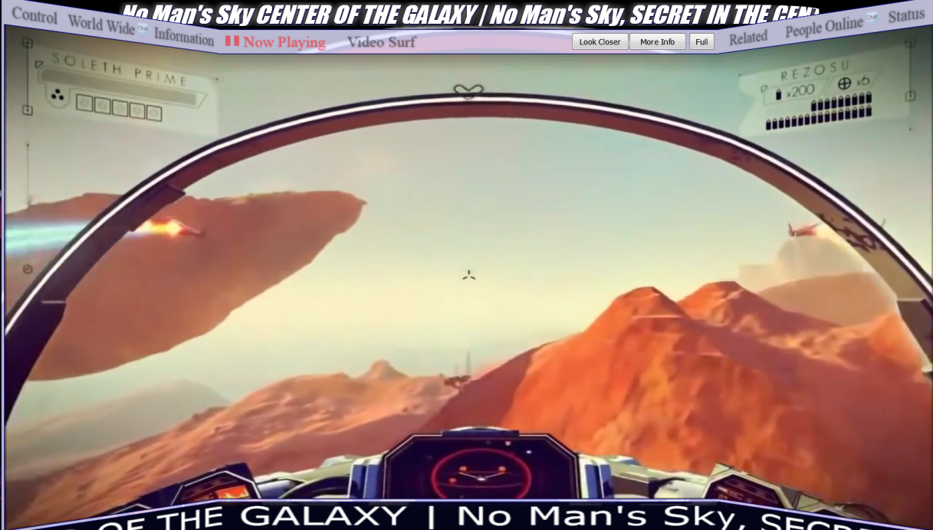
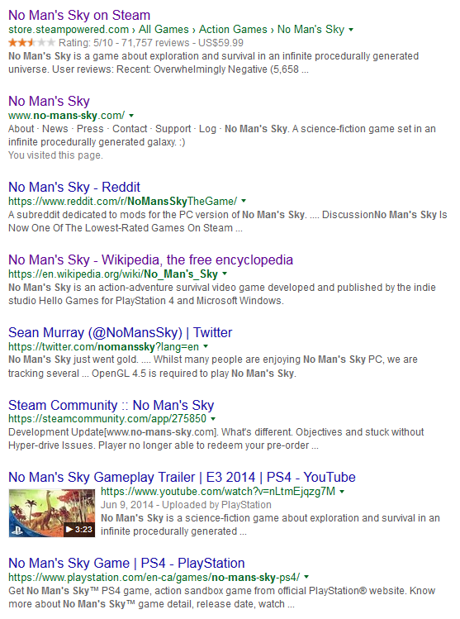

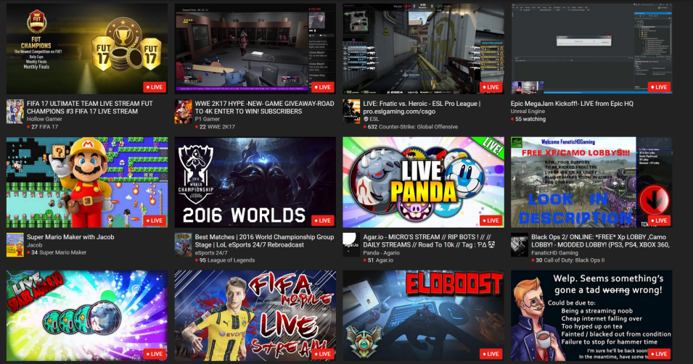
No Man’s Sky
https://gaming.youtube.com/

Slide 27
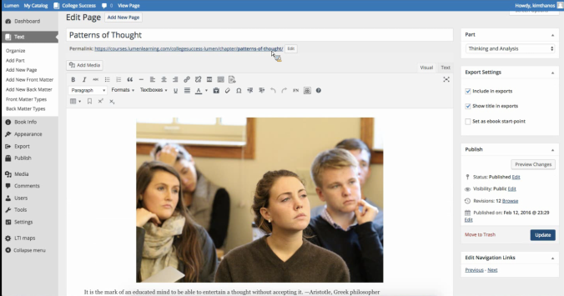
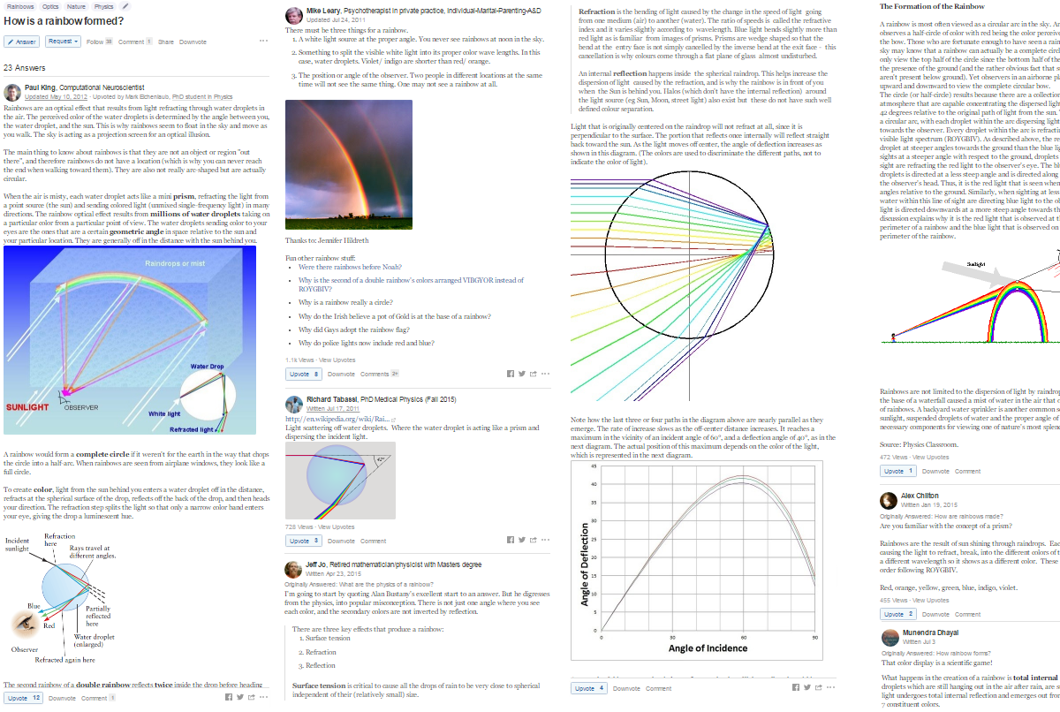
Why They Work
Caulfield – Choral explanations
“Everyone brings their own take, their own style, their own “me” to the project. And so the pattern is only a piece of the process, right?”
https://hapgood.us/2016/10/10/new-directions-in-open-education/

Slide 28
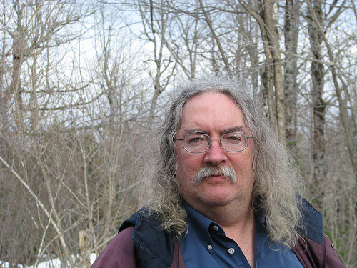
Stephen Downes
http://www.downes.ca
Moncton, Canada, 2005
http://www.downes.ca/presentation/389

