Slide 1

The MOOC Identity:
Designing Learning Environments
Stephen Downes
International MOOC Colloquium
U di Napoli Federico II
Anacapri, Italy
September 2, 2016

Slide 2

https://www.theguardian.com/uk-news/2016/jan/03/like-a-beautiful-painting-image-of-new-years-mayhem-in-manchester-goes-viral

Slide 3
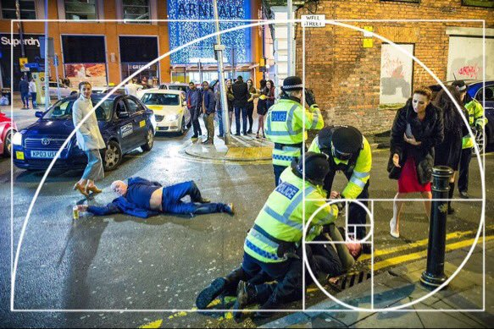
https://twitter.com/hughesroland/status/682921993331720196/photo/1?ref_src=twsrc%5Etfw

Slide 4
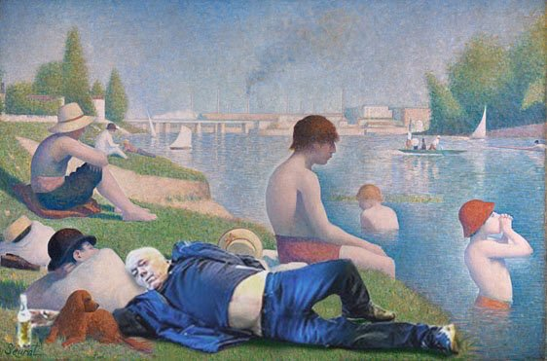

Slide 5
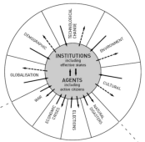

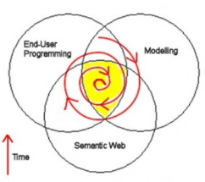
Causes of Change
Resistance
Drivers
‘Pedagogy’
Costs
Events
Crises
Inventions
Growth
Values
Goals
Desires
Needs
Attractors
‘Tech’
Inertia
Notes:
ACCA, 2012, Drivers of Change in the U.S. http://www.accaglobal.com/content/dam/acca/global/PDF-technical/futures/pol-af-docus.pdf
Simon L. Dolan, Salvador García, Samantha Diegoli, Alan Auerbach. 2000. Organisational Values as "Attractors of Chaos”: An Emerging Cultural Change to Manage Organisational Complexity. http://www.econ.upf.edu/docs/papers/downloads/485.pdf
Donald L. Gilstrap. 2005. Strange Attractors and Human Interaction: Leading Complex Organizations through the Use of Metaphors. https://ejournals.library.ualberta.ca/index.php/complicity/article/viewFile/8727/7047

Slide 6
What is Innovation?
Idea + Execution + Benefit
  innovation is defined “as change that creates a new dimension of performance” - Peter Drucker http://en.wikipedia.org/wiki/Innovation
  “Innovation is then simply new technology, i.e. the systematic application of (new) knowledge to (new) resources to produce (new) goods or (new) services” - Maciej Soltynski at Innovation.cc
https://www.ideatovalue.com/inno/nickskillicorn/2016/03/innovation-15-experts-share-innovation-definition/
http://www.freshconsulting.com/what-is-innovation/

Slide 7
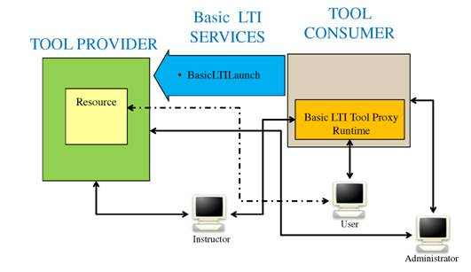
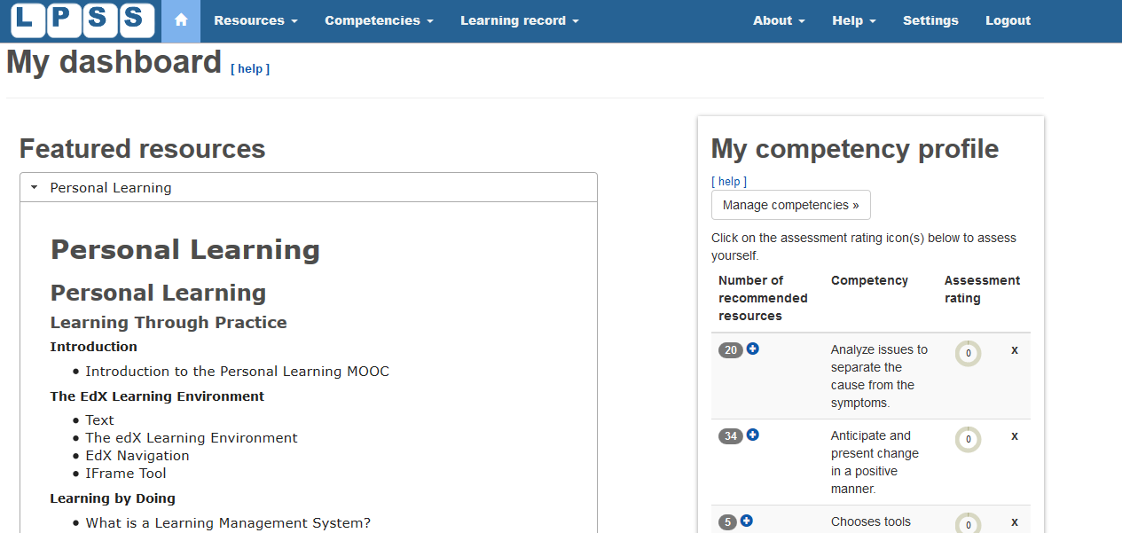
Learning Tools
LTI Producer – provides features
LTI Consumer – connects to features
https://www.imsglobal.org/specs/ltiv1p0/implementation-guide
Notes:
LTI Proivider plugin - https://moodle.org/plugins/local_ltiprovider
The LTI Provider is an application which provides features that other people want to and can connect to from their own LMS.
Provide access to full courses or single activities.
Single sign on
Change the navigation block of a course or activity for displaying information and links only regarding to your current course.
Send backs course or activity final grades to the LTI consumer tool
Modify the course or activity page for hiding the header, footer and left or right blocks
The LTI Consumer is an application which can connect to the 3rd party Provider system to avail of the features it has.
Eg. http://support.mediacore.com/customer/portal/articles/869178-configuring-a-lti-consumer

Slide 8
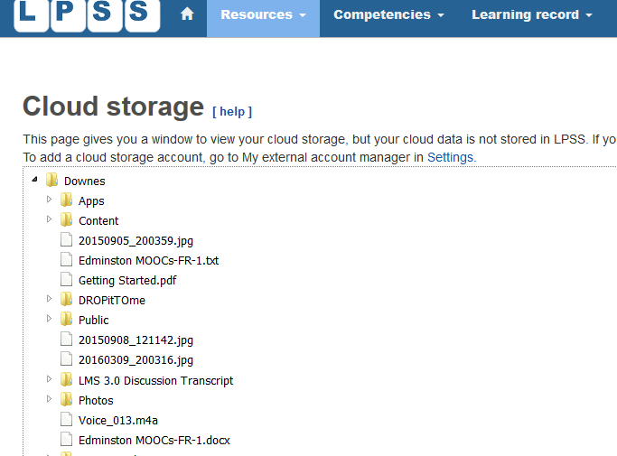
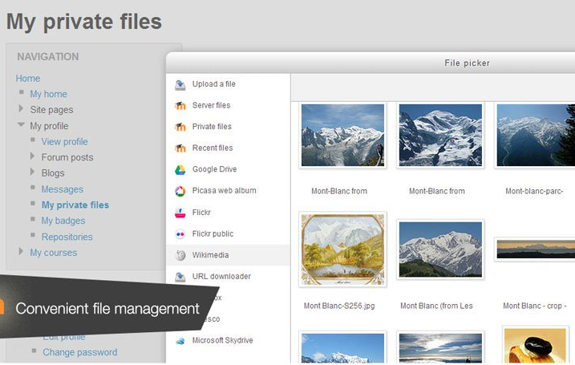
Cloud Storage
Cloud hosting of MOOC
File management
Notes:
MoodleCoud - https://moodle.com/cloud/
(includes BigBlueButton)
Cloud storage - https://docs.moodle.org/30/en/Working_with_files

Slide 9
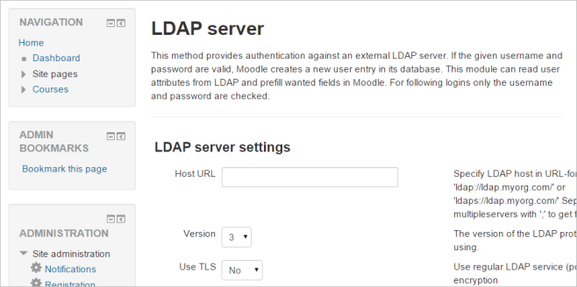

Authentication
Basic Moodle Authentication / Moodle Network
Authentication APIs / LDAP
Social Network Authentication
Notes:
Moodle Network - Moodle network feature allows a Moodle administrator to establish a link with another Moodle or a Mahara - https://docs.moodle.org/30/en/Mnet
LDAP - https://docs.moodle.org/30/en/LDAP_authentication
- Social net - Google / Facebook / Github / Linkedin / DropBox / Windows / VK / Battle.net authentication - https://moodle.org/plugins/browse.php?list=category&id=21 – even battle.net !

Slide 10
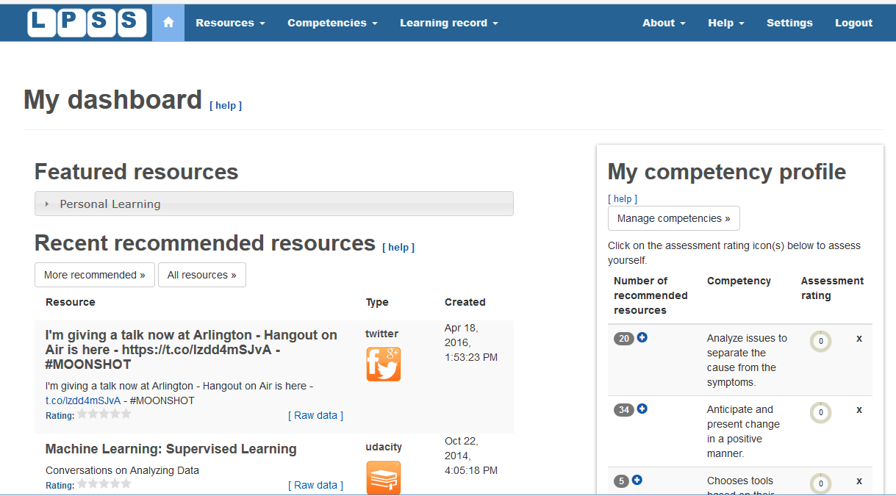
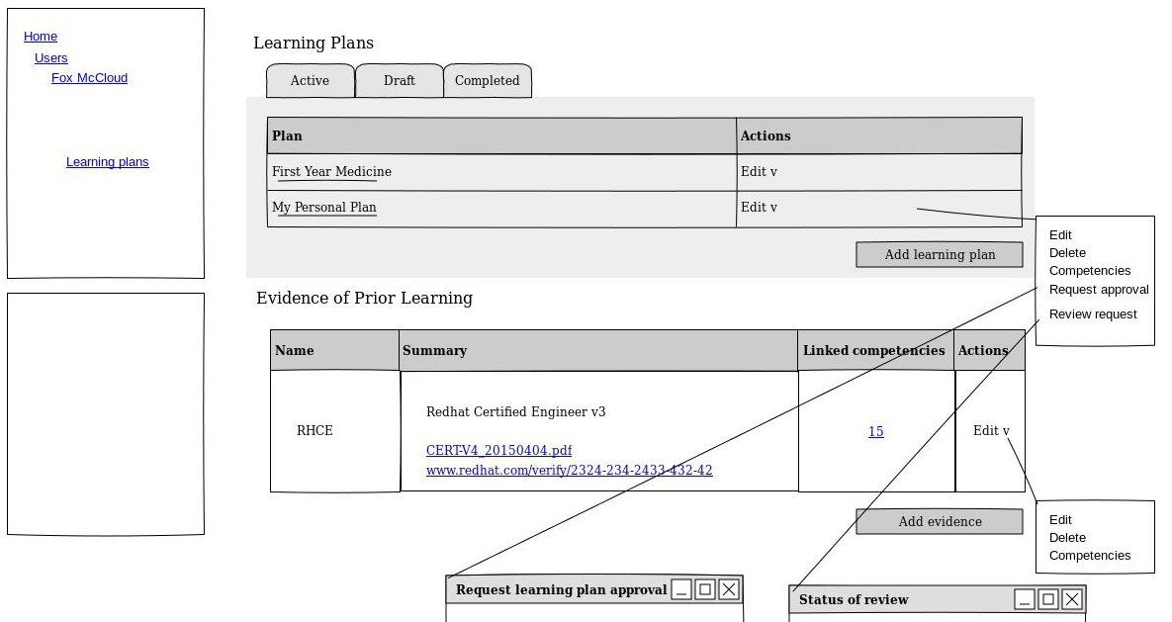
Outcomes and Competencies
Notes:
Competency Framework added in Moodle 3.1 - https://docs.moodle.org/dev/index.php?title=Competency_Based_Education
- Define competencies, learning plans, evidence of prior learning
Compentencies – eg. Compeencies Exabis - https://moodle.org/plugins/block_exacomp
The goal of this module is to bring competencies that have been provided (generate them at www.edustandards.org) into Moodle-courses. Competencies from a students' sight can be expressed as "I can”-statements (example: "I can use spreadsheet formulas to solve a mathematical problem”).

Slide 11
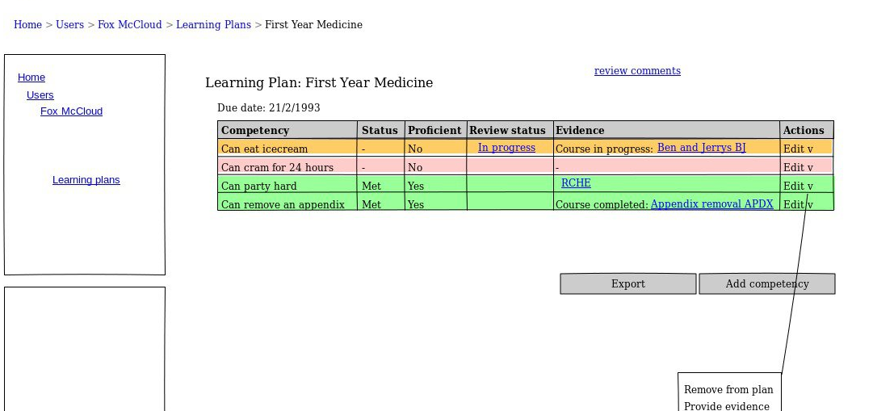
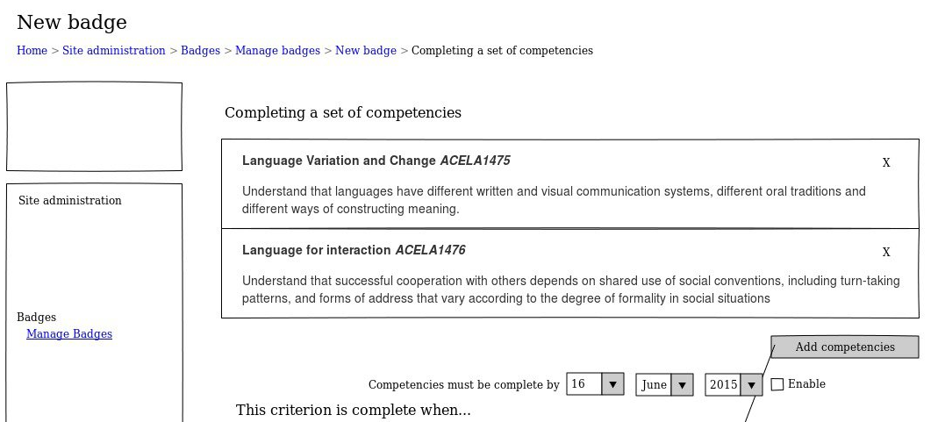
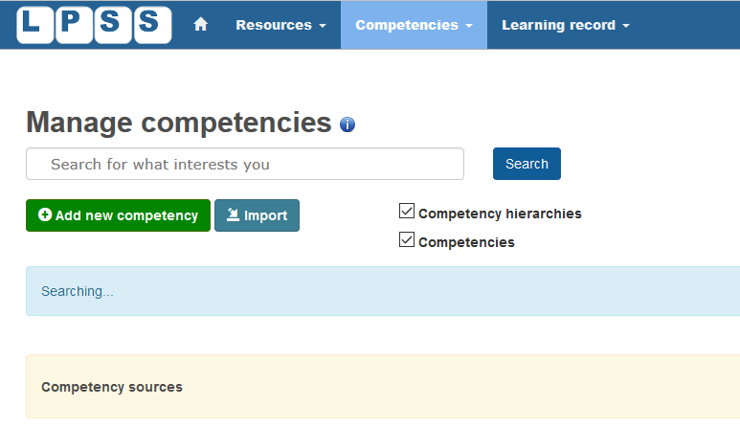
Learning Plans

Slide 12
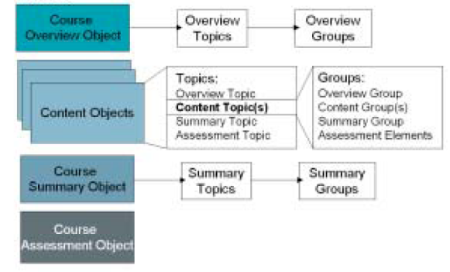
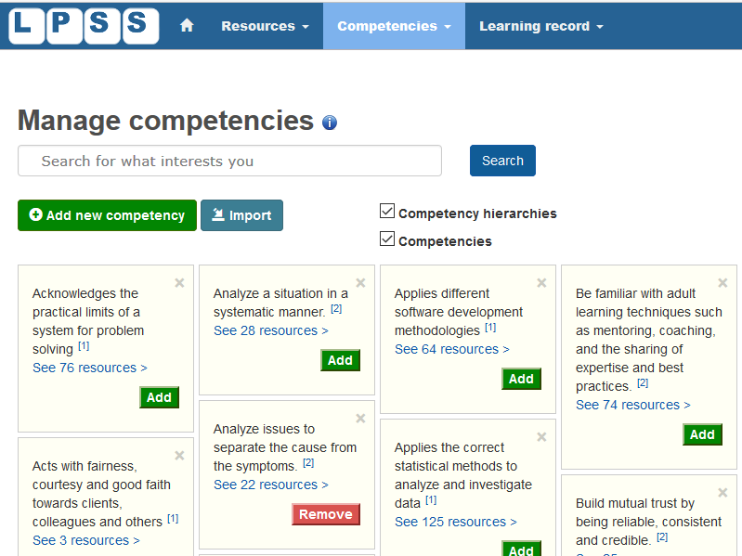
Learning Processes
Notes:
Image: http://www.learningsolutionsmag.com/articles/315/prudentials-lcms-implementation-learning-strategy-objects-and-the-design-process-part-1-of-2-parts/page2
Eg. Group Actuvities - https://teaching.unsw.edu.au/moodle-group-activity

Slide 13
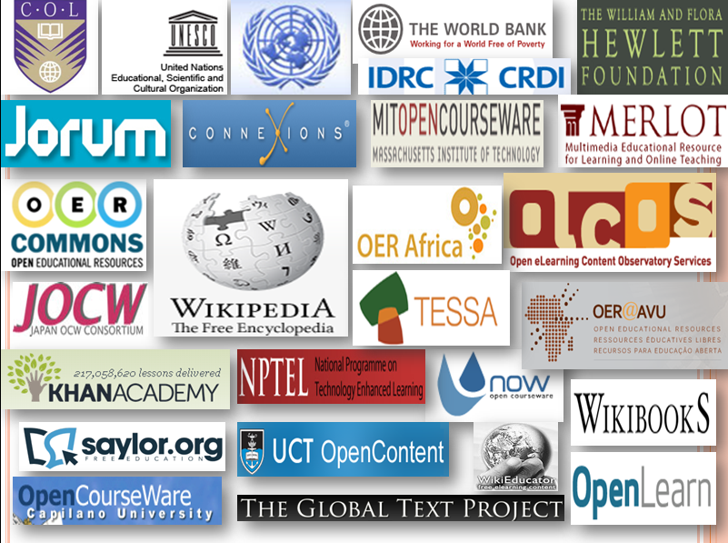
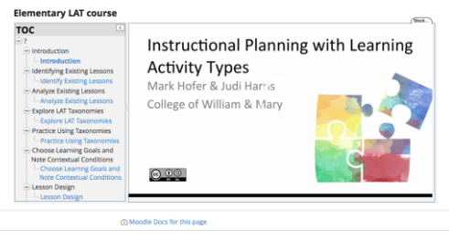
Content and OER
Notes:
Eg. Full downloadable courses in Moodle.net
Eg. Importing SCORM packages - http://www.jorum.ac.uk/support/guides/scorm-packages-in-jorum/
Eg. OpenEd Learning Library – integrates into Moodle – “OpenEd.com, the world’s largest archive of free K-12 educational material, recently announced that their library of over a million resources will now be integrated with select learning management systems, including Moodle LMS.”
http://blog.lambdasolutions.net/opened.coms-learning-library-now-integrates-with-moodle-learning-management-system
Eg. Importing Learning Actuvity Types (LATs) into Moodle OpenBook (ModuleO - https://davidtjones.wordpress.com/2016/04/02/first-steps-in-integrating-lats-oer-into-moodle-open-book/

Slide 14
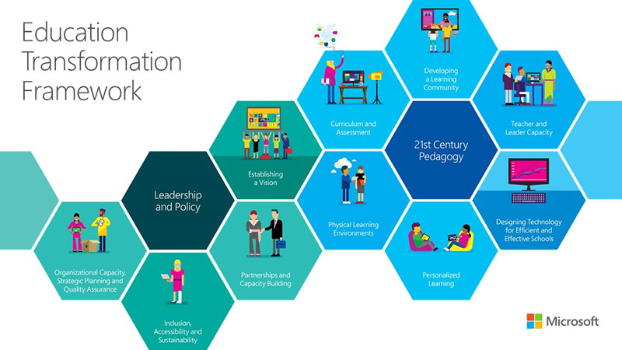
Microsoft’s Vision
Learning community
Teacher capacity
Efficient schools
Personalization
Physical learning environments
Curriculum & assessment
Is this really transformation?
Are these things we really want?
Microsoft, 2015. Education Transformation Toolkit. http://www.is-toolkit.com/education_transformation.html

Slide 15
Beyond Innovation
New
Idea + Execution + Benefit
Drivers
Attractors
=
Innovation
New
Benefit
Idea + Execution
=
Transformation

Slide 16
What is Transformation?
“In an organizational context, a process of profound and radical change that orients an organization in a new direction and takes it to an entirely different level of effectiveness.”
“Transformation implies a basic change of character and little or no resemblance with the past configuration or structure.”
Read more: http://www.businessdictionary.com/definition/transformation.html

Slide 17
Questions to Ask
What will new technology enable?
How will our wants and needs change?
Self-Actualization
Does Maslow speak for us?
Self-Esteem
Belonging
Safety and Security
WiFi
Physiological
Maslow, A. 1943. Hierarchy of Needs: A Theory of Human Motivation. http://psychclassics.yorku.ca/Maslow/motivation.htm

Slide 18
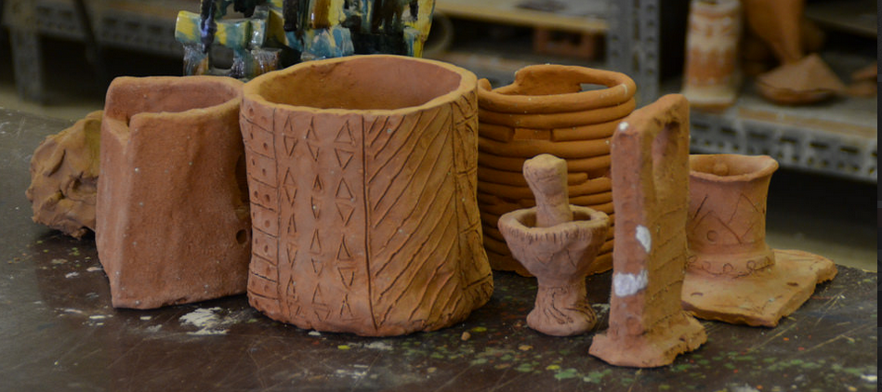
What is Education?
Riyadh, Saudi Arabia, 2015
Science as a "combination of evaluating evidence, coordinating evidence and models, and arriving at evidence-based judgments that are communicated through argumentation."
Ronald W. Rinehart, et.al. 2016. Critical Design Decisions for Successful Model-Based Inquiry in Science Classrooms. https://scholarworks.iu.edu/journals/index.php/ijdl/article/view/20137/28269

Slide 19
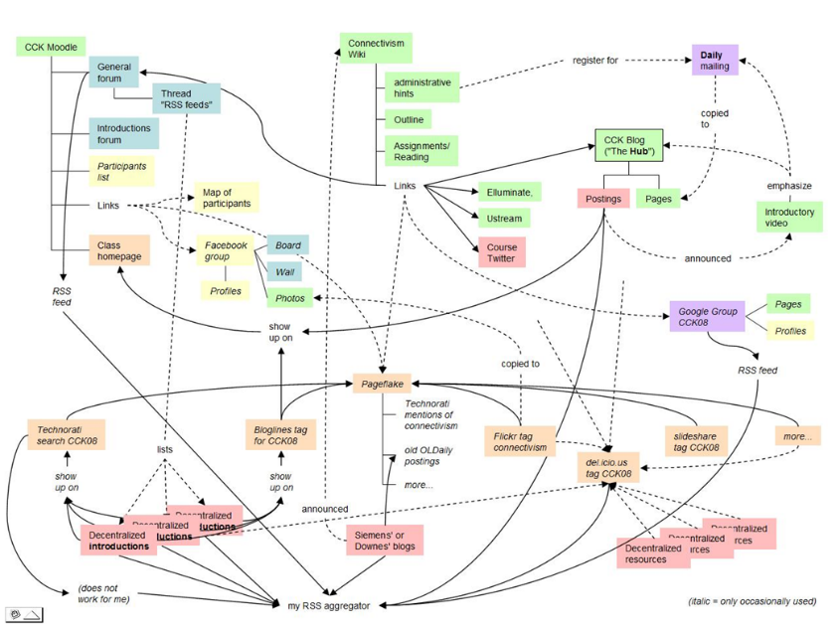
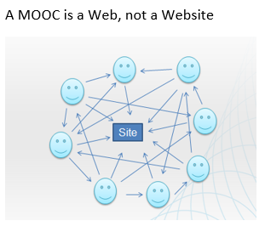
The Connectivist MOOC (cMOOC) Design
Instead of seeing a course as a series of contents to be presented, a course is a network of participants who find and exchange resources with each other
An initial structure is developed and ‘seeded’ with existing OERs
Participants encouraged to use their own sites to create or share resources
A mechanism (gRSShopper) is employed to connect them

Slide 20
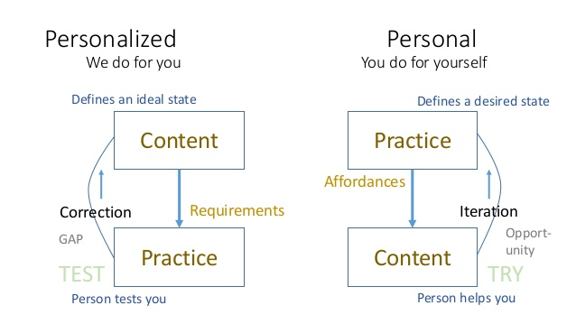
Learning is Personal

Slide 21
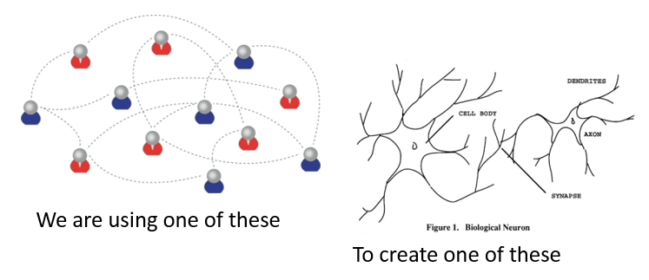
Learning Outcomes
Learning a discipline is a total state and not a collection of specific states
It is obtained through immersion in an environment rather than acquisition of particular entities
It is expressed functionally (can you perform ‘as a geographer’?) rather than cognitively (can you state ‘geography facts’ or do ‘geography tasks’?)

Slide 22
Design vs Environment
Path | Field
Course | Curriculum (as in ‘mapping’)
Sequence / Prequisite | Core / periphery / foundation
Movement / covered | Inquiry / Discovery / Gaps
Threshold / Levels | Coverage / Construction
Positioning – first / last | Grouping / Clustering
Objective / target | Serendipity / emergence
Leading / Led | Centred
Carrie Paechter, Metaphors of Space in Educational Theory and Practice http://www.tandfonline.com/doi/pdf/10.1080/14681360400200202

Slide 23
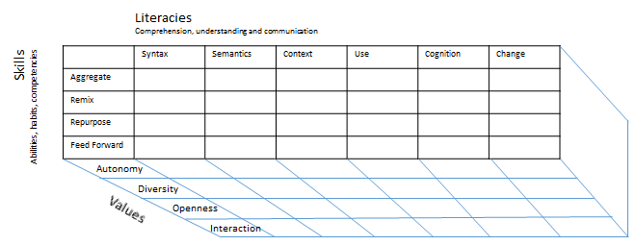
Method as Discovery:
You don’t learn a language, you discover it
To discover a language is to be immersed in it, to speak it and listen to people speaking in it
My scientific method (if it can be called that) is to go to the office each day and immerse myself in the world – to try listening, and to try speaking

Slide 24
The Network in the LMS
Browser
Moodle
Robot Car
D2L

Slide 25
The Network in the LMS
Browser
Moodle
D2L
Data
Data
Identity
Services
Identity
Services
SIS/MIS Banner
Content and Services

Slide 26
The PLE in the Network
PLE
Moodle
SIS/MIS/Banner
Content & Services
D2L
Robot car
Data
Identity
Posts
Papers
Photos
Name / ID
Credentials
Social Network
Friends
Groups

Slide 27
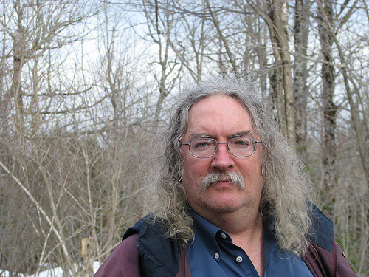
Stephen Downes
http://www.downes.ca
Moncton, Canada, 2005
http://www.downes.ca/presentation/389

