Slide 1

Developing a Personal Learning Infrastructure
TCU International e-Learning Conference 2016, Bangkok, Thailand
Stephen Downes, August 1, 2016

Slide 2
This workshop will map the technological infrastructure for a personal learning network. It will describe the major protocols supporting personal learning and describe how third party applications (such as simulation engines or learning management systems) interact with personal learning environments. It will draw on the technology developed by the National Research Council’s ‘Learning and Performance Support Systems’ to create a testbed technology environment.

Slide 3
Agenda
13:30 – 13:45 Introductions and Aliases
13:45 – 14:00 What is a PLE?
14:00 – 14:15 Value Proposition Workshop
14:15 – 14:30 Elements of the PLE
14:30 – 14:45 Roles and Tasks Workshop
14:45 – 15:00 Break
15:00 – 15:30 Underlying Technologies
15:30 – 16:00 Task Priorization Exercise
16:00 – 16:30 Building the PLE environment
            with knowledge of e-learning interoperability technologies, we will ‘moot’ a PLE infrastructure

Slide 4
Introductions and Aliases

Slide 5

Introductions and Aliases
10:00 – 10:30
Split into five groups as assigned:
  Users (slightly larger group)
  Sponsors (who will pay to have it built)
  Developers (who will actually build it)
  Marketing (who will sell it)
  Operations (who will keep it running)

Slide 6
Users
Choose a person - yourself, your child, a person you know
  it needs to be a specific person with a name, age, place of residence, educational background.
Chose a context or environment - do you work at a law office? A grocery store? Are they a teacher? Are they a farmer in the field?

Slide 7
Sponsors
Choose a person who would pay for the system
  What problem are they trying to solve?
  Why would they be willing to pay?
Examples:
  Company investing in training systems
  College or university administrators
  Government employment support official

Slide 8
Developers
Choose a specialization (don’t worry if you aren’t really a developer)
For example:
  Database engineer
  User interface designer
  Platform services
Ask yourself:
  What information do I need to be able to do the job?
  How does this look like products that already exist?

Slide 9
Marketing
Some roles and questions:
  Business development
  Copy writer
  Purchaser / distributor
Some marketing questions to ask:
  What’s the best business model?
  How can it address client needs?
  Where are the best channels to market it?

Slide 10
Operations and Maintenance
How do we keep the product running?
How do we keep maintenance sustainable?
What roles need to be filled to manage these?

Slide 11
What is a PLE?

Slide 12
Overview of the Concept of PLEs
LMS
Simulation
PLE
Chat Room
MOOC
Blogger
Intranet
Access to many services in one personal environment

Slide 13
Properties of the PLE…
What information should it record?
Who owns the data? How private is it?
What should it do?
What would a person do with it?
Where, exactly, is a PLE located?
PLE

Slide 14
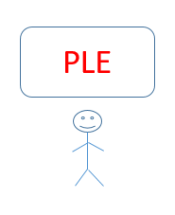
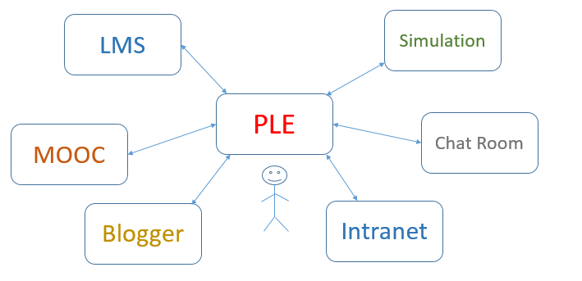
The Network of PLEs

Slide 15
The Social Network of PLEs
twitter
facebook
email

Slide 16
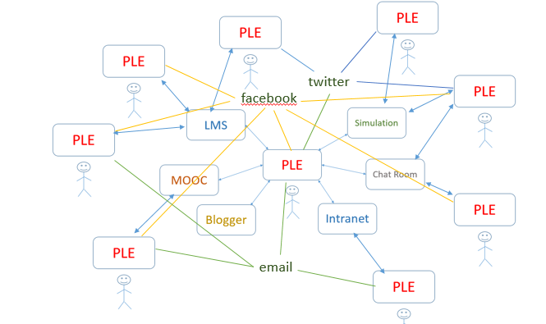
Properties of the Network…
How do people find each other? Services?
How do they communicate? What do they share?
How does a single PLE work with services?
Do we need centralized registries?

Slide 17

Why a personal learning environment?
10:30 – 11:30
What is the value proposition for a PLE?
  Note: value isn’t what you can do, it’s how you benefit
  This is usually stated in financial terms (earn more, cost less)
  Can also be stated in terms of quality: faster, bigger, better
  And can be non-financial goods: satisfaction, happiness, memories
Many elements of the interactive exercises were drawn from Alain Désilets,
Envisioning the Right Thing How to facilitate a collaborative project visioning workshop

Slide 18
Value Proposition Workshop

Slide 19
What is a PLE?
12:00 – 13:30
Elements of a personal learning environment (interactive exercise to define major elements, e.g. resource network, personal learning record, learning assistant, analytics)
What we want to do here is to ask ourselves what a PLE will do
This involves asking why we want a PLE to begin with
So, back in your original groups, consider the following….

Slide 20
The Value Proposition…
For: | Target user
Who: | Pressing need
The PLE is: | Name and type of product
That: | ‘Killer Feature’…. Reason to buy (or to pay for)
Contrarily to: | Main alternative
It allows them to: | Distinguishing feature

Slide 21
Value Proposition Workshop
Five new groups, each with a:
  User
  Sponsor
  Developer
  Marketer
  Operator
Draft value propositions and record them

Slide 22
Elements of the PLE

Slide 23

















Course Provider Perspective
Subscribed
students
Student
content
Site
Course
content
Live online events
Event recordings

Slide 24
The Student’s Perspective
Site
A range of different resources and services

Slide 25
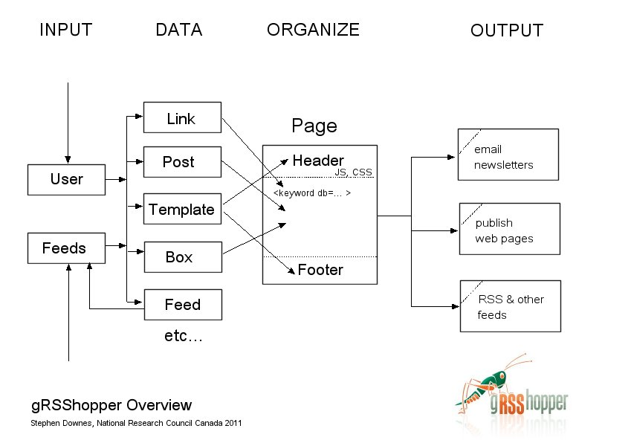
gRSShopper
http://grsshopper.downes.ca

Slide 26
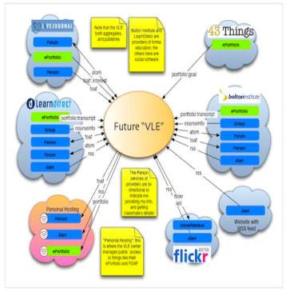
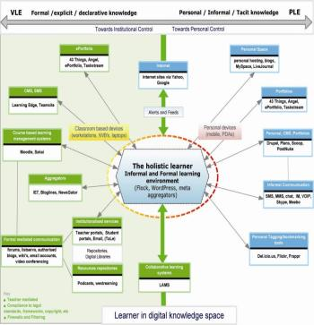
The design is based on putting the learner at the centre
Scott Wilson (left), Tim Hand (right)
https://www.google.com/search?q=ple+diagrams
http://www.edtechpost.ca/ple_diagrams/index.php/mind-map-3

Slide 27
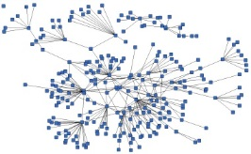
Built Around the Personal Learning Record
Stuff Goes Out
Stuff Comes In
Learning Activities
I read and watch stuff
I play with toys
I make stuff
Things, Properties, Relations
Things I did
Stuff I make
Big stuff goes here
Me
Questions
Personal Library
Pictures
Books
Movies
Answers
Learning Analytics Services

Slide 28
Roles and Tasks Workshop

Slide 29
What Tasks Will Users Perform?
Roles… what role or function will the PLE serve?
  What are the metrics that will measure this role
One you have found measurable roles, list them
Then ask: what tasks must the PLE perform to fulfill this role

Slide 30
What Role Does a PLE Fulfil?
As many roles as you want
Role(s) | Metric #1 | Metric #2 | Metric #3

Slide 31
What Tasks Will Users Perform?
Role(s) | Task #1 | Task #2 | Task #3
Don’t Feel limited by only three tasks… make as many as you want
Put each task on its on PostIt note

Slide 32
Underlying Technologies

Slide 33
Personal Learning Record
OERs
Portfolio, artifacts and evidence
Badges, certificates, credentials, competencies
Activity Record - LRS
PLR

Slide 34
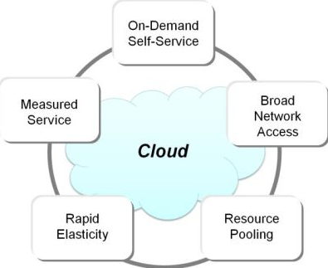
Core interaction elements in cloud technologies
14:30 – 15:00
Core interaction elements in cloud technologies (APIs, REST.JSON, OAuth, and related core technologies)

Slide 35
RRN Aggregation and Storage
Personal
Context
Article
Photograph
Video
Person
Author
Publisher
Organization
Job Opportunity
Competency
Cetrificate
Event
Location / Place
Time / Date
Email
RSS
OAI
Sharepoint
Facebook
Twitter
Monster
Government
Repositories
Desire2Learn
Coursera
EdX
etc
Parsing
Scraping
Analytics
etc
Storage
RELATIONS

Slide 36
Core interaction elements in cloud technologies
14:30 – 15:00
Core interaction elements in cloud technologies (APIs, REST.JSON, OAuth, and related core technologies)

Slide 37
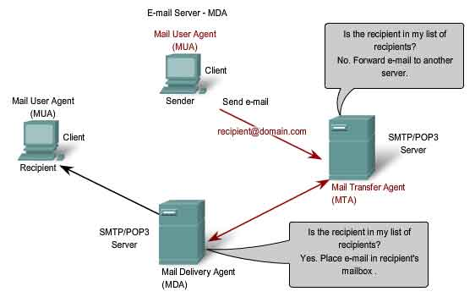
Email – POP, IMAP, SMTP

Slide 38
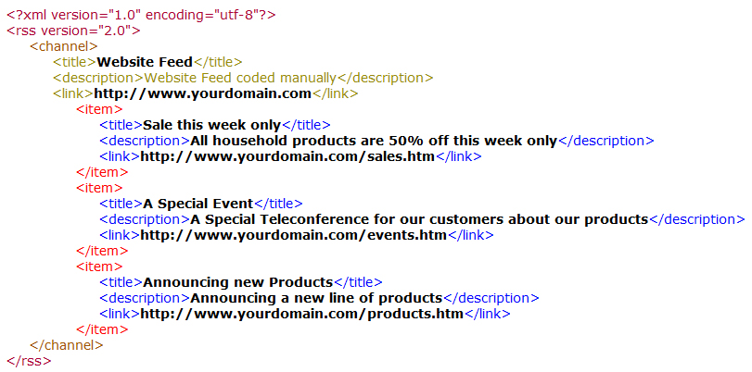
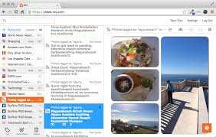
RSS
http://uk.queryclick.com/seo-news/how-rss-feeds-will-change-your-life/

Slide 39
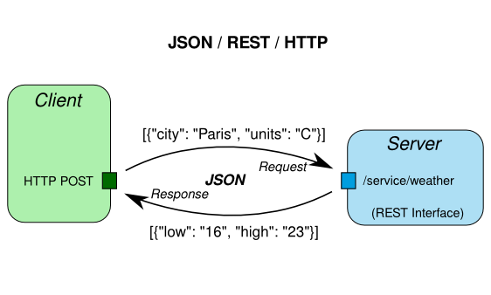
API / REST / JSON
http://linkeddataorchestration.com/2014/01/28/data-modeling-for-apis-part-2-rest-and-json/

Slide 40
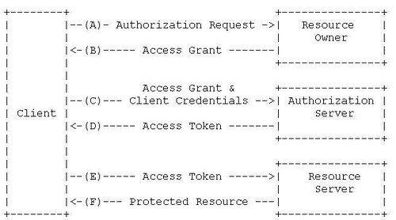
OAuth
http://loicginoux.github.io/blog/2014/03/20/introduction-to-oauth2-dot-0-protocol/

Slide 41
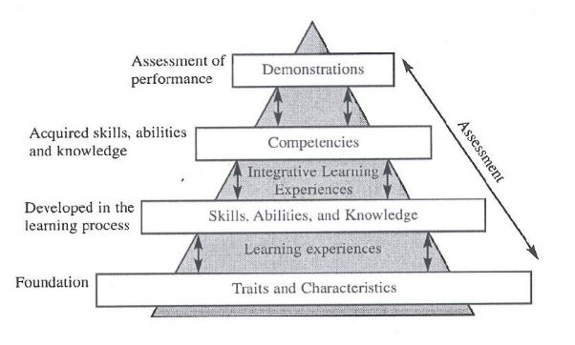
Underlying common e-learning technologies
15:00 – 15:30
Overview of xAPI, LTI and other e-learning tools interoperability
http://halfanhour.blogspot.de/2014/09/beyond-assessment-recognizing.html

Slide 42
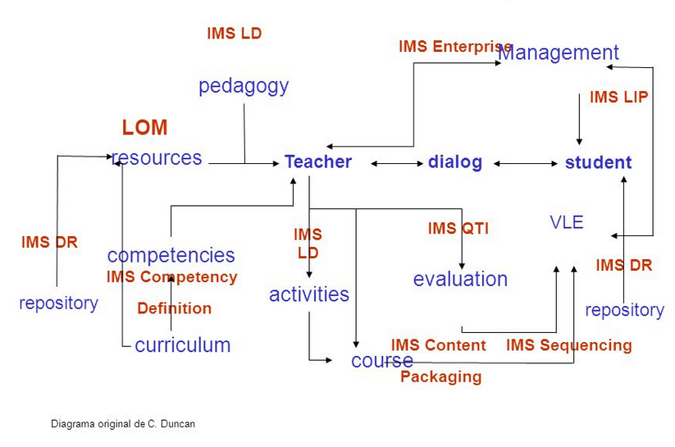
Learning Resources – LOM, Packaging
http://slideplayer.com/slide/5725018/

Slide 43
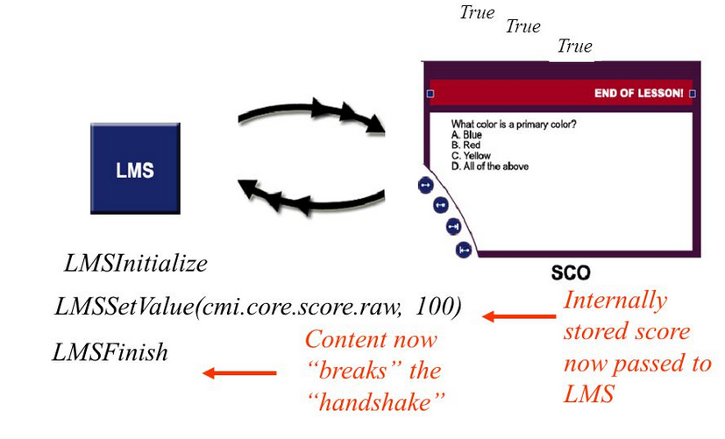
Resources – SCORM Run Time Envrionment
http://images.slideplayer.com/19/5777721/slides/slide_65.jpg

Slide 44
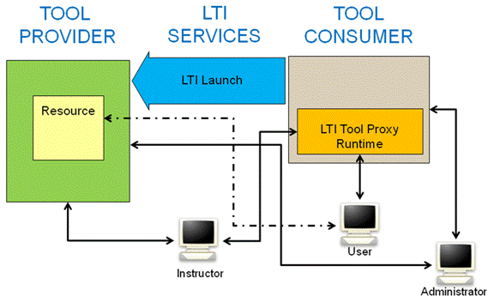
IMS Learning Tools Interoperability (LTI)
https://www.imsglobal.org/specs/ltiv1p1/implementation-guide

Slide 45
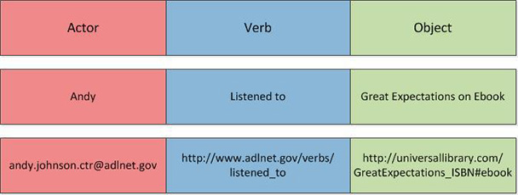
The eXperience API
http://www.learningsolutionsmag.com/articles/1526/five-things-a-web-developer-needs-to-know-about-the-xapi

Slide 46
Task Priorization Exercise

Slide 47
What Tasks Will Users Perform?
Task priorization process…..
  Vote for the tasks you thing are most important
  Yes, you may vote more than once
  We will select the top dozen or so tasks

Slide 48
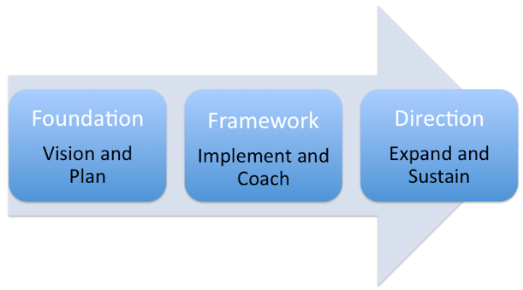
Building the PLE environment
16:00 – 17:00
With knowledge of e-learning interoperability technologies, we will ‘moot’ a PLE infrastructure

Slide 49
Building the PLE environment

Slide 50
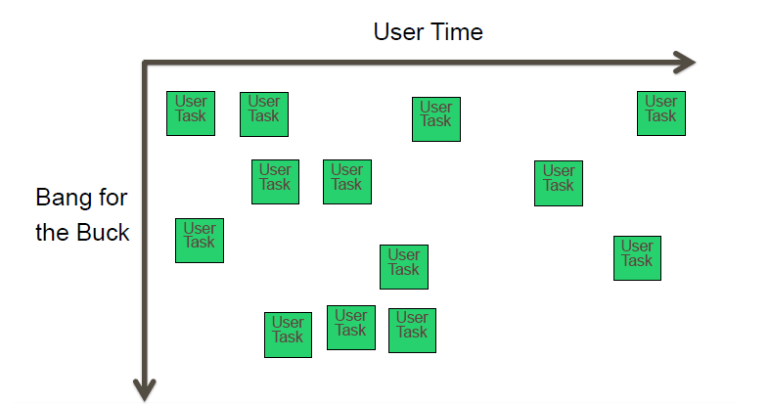
Exercise: Plot Tasks

Slide 51
Exercise: Plot Tasks
Users tend to do the tasks on the left before the tasks on the right
Tasks at the top are easy to implement, and produce high value to the user

Slide 52
Results

Slide 53
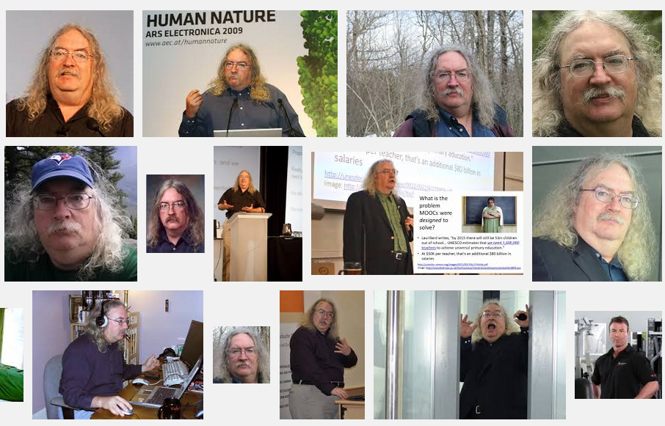
Stephen Downes
http://www.downes.ca

