Slide 1
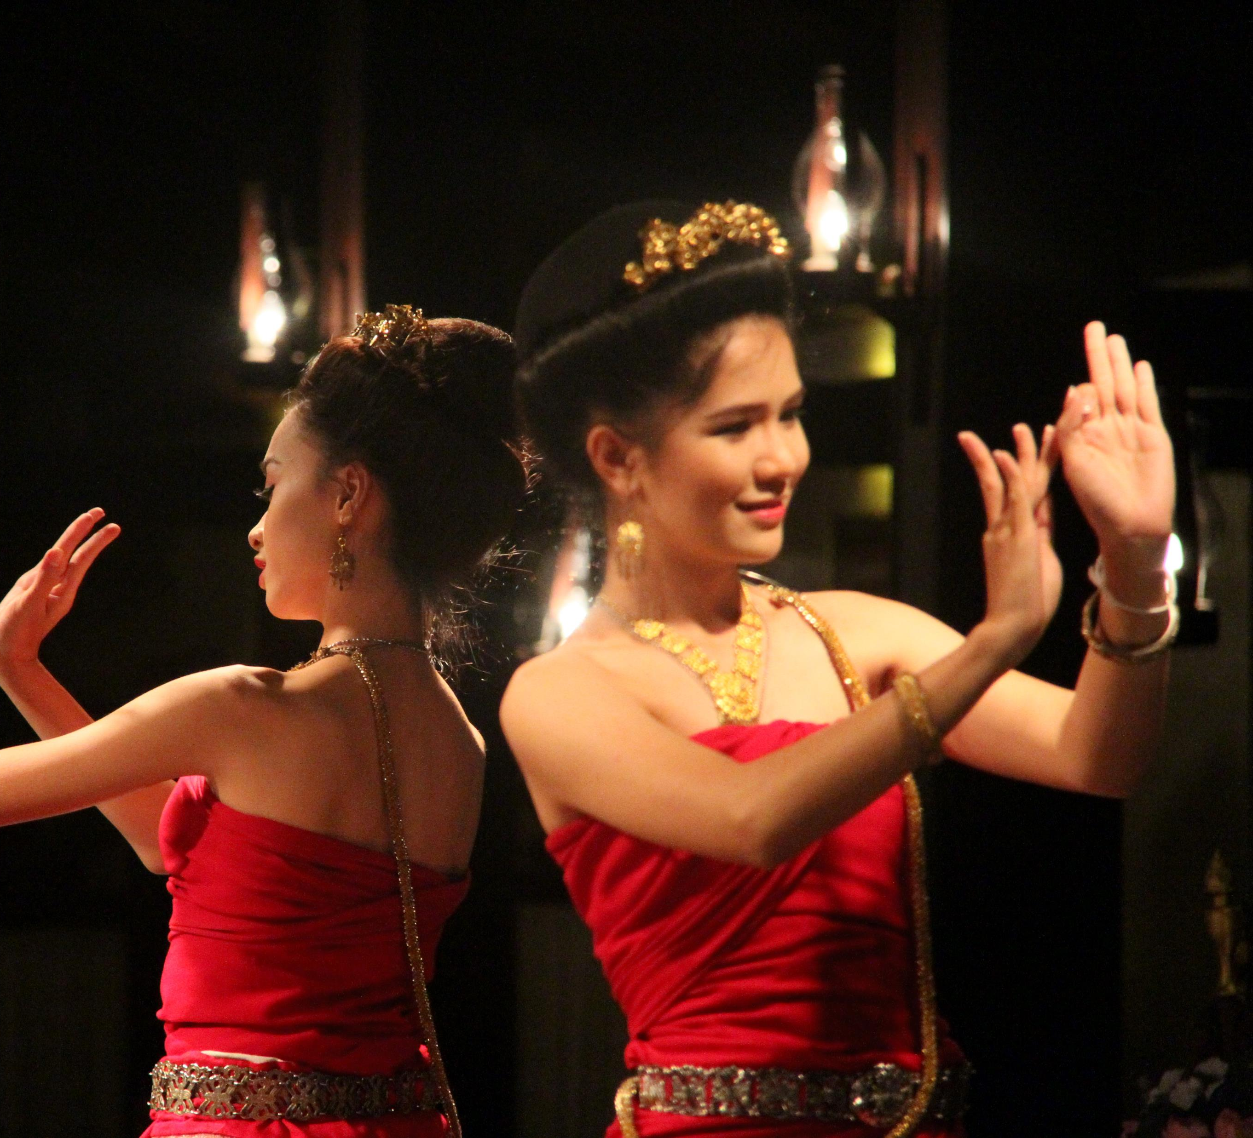
Disruptive Innovations in Learning
Stephen Downes
Bangkok, Thailand
July 27, 2016
http://www.downes.ca/presentation/389

Slide 2
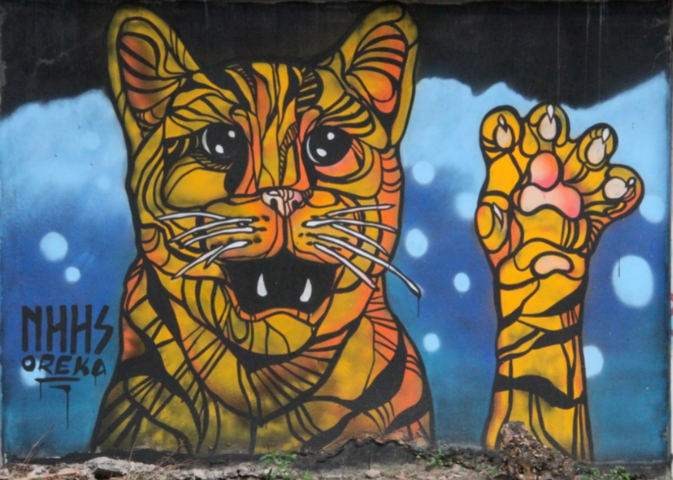
1. Innovation
1. Innovation
Chiang Mai, Thailand, 2016

Slide 3
What is Innovation?
Idea + Execution + Benefit
  Change that creates a new dimension of performance - Peter Drucker http://en.wikipedia.org/wiki/Innovation
  “the systematic application of (new) knowledge to (new) resources to produce (new) goods or (new) services” - Maciej Soltynski Innovation.cc
https://www.ideatovalue.com/inno/nickskillicorn/2016/03/innovation-15-experts-share-innovation-definition/
http://www.freshconsulting.com/what-is-innovation/

Slide 4
The Idea
Product innovation – a new type of product of service
Process innovation – change in the production function, eg. change in input mix
Organizational innovation – change in managerial procedures
Market innovation – eg. developing a new market for an existing product
Input innovation – new raw material, new energy source, etc
Jati Sengupta, 2014, Theory of Innovation: A New Paradigm of Growth, p. 4 (Schumpeterian model) http://www.springer.com/us/book/9783319021829

Slide 5
The Benefit (Sustaining)
Different ways of talking about direction
  Better quality of experience
    - eg. 4K – bigger pictures
    ‘student success’
  Lower cost
  Increased efficiency and productivity
    Typically, ‘standards’
  Solutions to problems
    Access, engagement, completion

Slide 6

The Benefit (Disruptive)
Incumbents target high end customers
Disruptors target with product & price advantage:
  low-end footholds
  new market footholds
Not just product innovations;
Can be business model, etc.
Tbilisi, Georgia, 2014
Clayton M. Christensen, Michael E. Raynor, Rory McDonald, 2015. What is Disriptive Innovation? https://hbr.org/2015/12/what-is-disruptive-innovation

Slide 7
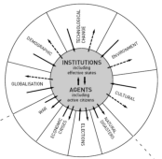

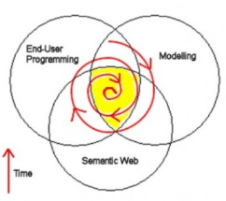
Causes of Change
Resistance
Drivers
Costs
Events
Crises
Inventions
Growth
Values
Goals
Desires
Needs
Attractors
Inertia
Notes:
ACCA, 2012, Drivers of Change in the U.S. http://www.accaglobal.com/content/dam/acca/global/PDF-technical/futures/pol-af-docus.pdf
Simon L. Dolan, Salvador García, Samantha Diegoli, Alan Auerbach. 2000. Organisational Values as "Attractors of Chaos”: An Emerging Cultural Change to Manage Organisational Complexity. http://www.econ.upf.edu/docs/papers/downloads/485.pdf
Donald L. Gilstrap. 2005. Strange Attractors and Human Interaction: Leading Complex Organizations through the Use of Metaphors. https://ejournals.library.ualberta.ca/index.php/complicity/article/viewFile/8727/7047

Slide 8
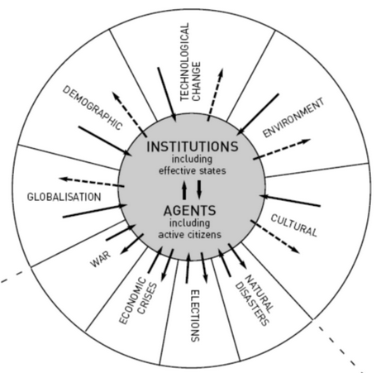
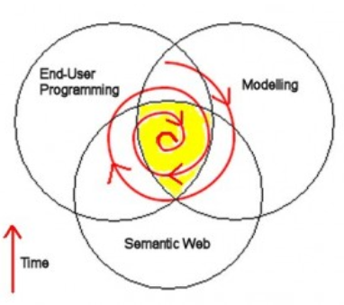
Innovation as an Attractor
We think of change an innovation as working in the same direction, but typically they are working in opposite directions:
Drivers: out from the centre, toward uncertainty and chaos
Attractors: toward the centre, toward order
  And especially preserving what was
  Sometimes: adaptation to change
Notes:
Images: driver: Duncan Green, 2016. https://oxfamblogs.org/fp2p/egypt-what-are-the-drivers-of-change/ attractor: Peter Hale (no longer extant)

Slide 9
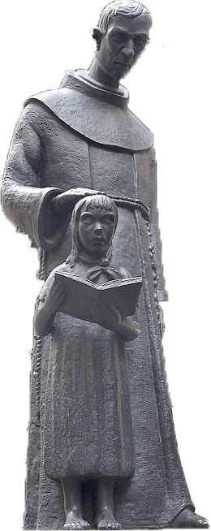
Innovation in Education
Is education “ripe for disruption”?
Changes in tech that didn’t change learning
  TV, Video, overhead projectors
  Portable classrooms
  Learning management system
  Clickers?
  Second Life
Innovations but not disruptions
Mexico City, Mexico, 2016
Tony Bates. 2014. A Short History of Educational Technology. http://www.tonybates.ca/2014/12/10/a-short-history-of-educational-technology/

Slide 10
A Candidate for Disruption?
Online Learning (1995f) & The MOOC (2008f)
  “Stalled efforts to push MOOCs through the institutional membrane that surrounds higher-education credentialing have cast doubt on whether large-scale free courses will end up disrupting anything.” Steve Kolowich
  “The reality of online learning… a substantial increase even in years of financial pressures on enrollments.”
Jim Farmer, 2013, MOOCs: A Disruptive Innovation or Not? http://mfeldstein.com/moocs-a-disruptive-innovation-or-not/

Slide 11
What Counts as Innovation?
It depends on how the world sees you
  Is there ‘demand’ for the new thing (eg., a market, buyers, users)
  Is there a ‘business case’ for it? (Cost/value model)
  Is there a ‘benefit’ for the customer (greater income, lower cost, amusement)?
What happens when these change?

Slide 12

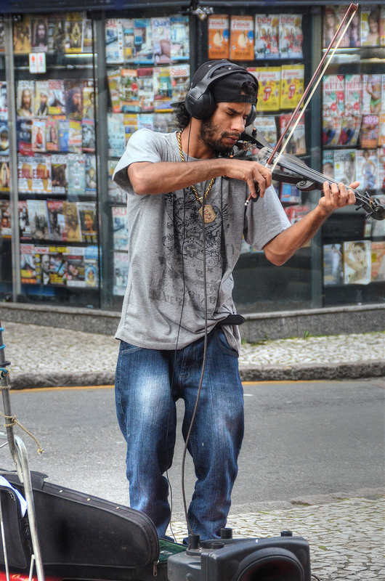
Who Speaks for Us?
Who defines innovation?
Who defines student success?
George Couros. 2016. Who is Defining Student Success? http://connectedprincipals.com/archives/12581
Curitiba, Brazil, 2015

Slide 13
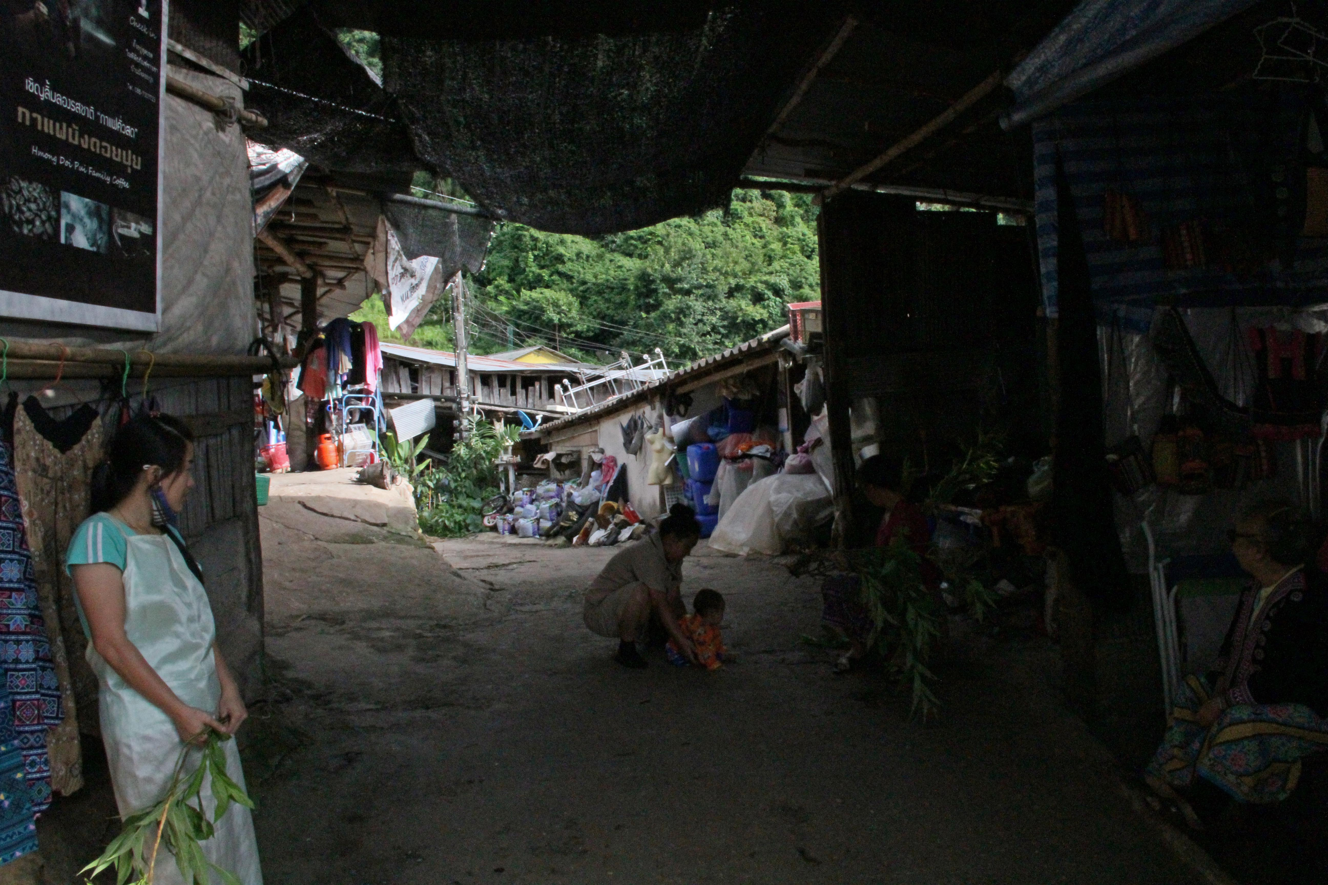
2. Innovations

Slide 14
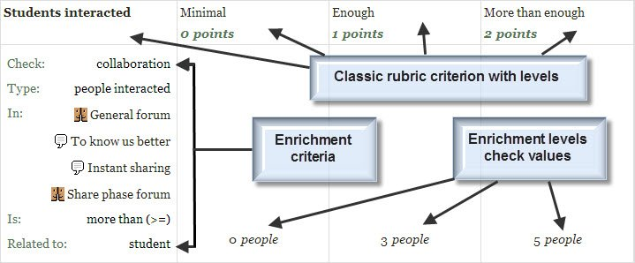
Machine learning and AI?
decision engines - these are expert systems that are based on rule-driven strategies
pattern recognition - perceptual systems that identify patterns from partial or disorganized data
cluster detection - detecting nearest neighbours and categories of things

Slide 15
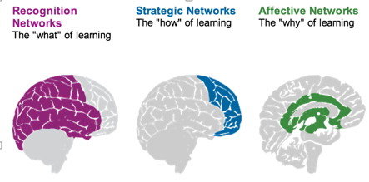
Personalization
Rules-Based Events (like notifications)
User Models
Adaptive Learning

Slide 16

Handheld Learning
Performance Support
  The future of learning isn’t the mobile phone
  It’s in the integrated performance support system

Slide 17
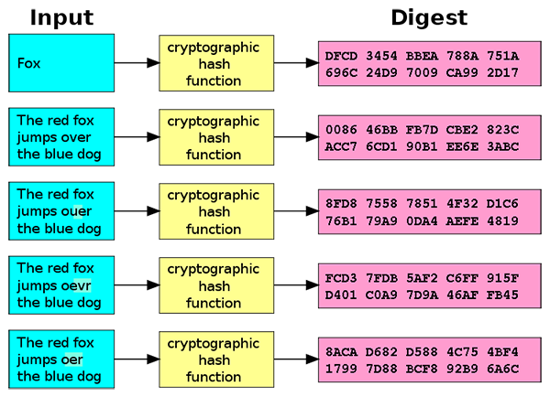
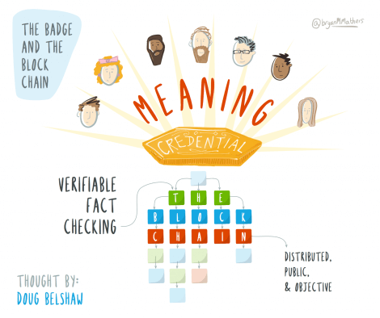
Badges and Blockchain
Belshaw: we could prove beyond reasonable doubt that the person receiving badge Y is the same person who created evidence X.
Sony plans to launch a testing platform powered by blockchain and that IBM plans to offer 'blockchain-as-a-service,'"

Slide 18
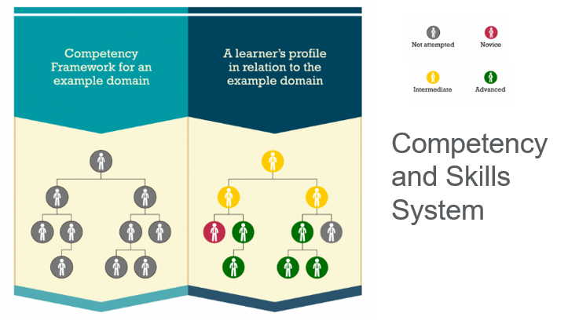
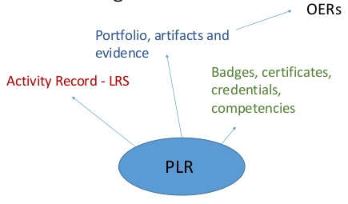
Competency and Skills System (CASS)

Slide 19
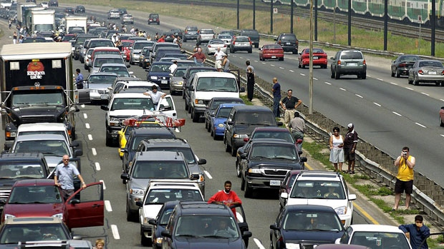
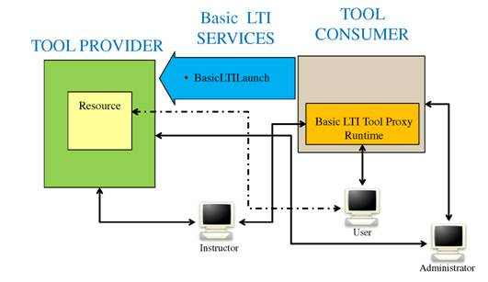
Games, Sims and Virtual Reality
‘Gamification’ – adds game elements to learning
‘Serious Games’ – employs a game to facilitate learning
    What happens when companies know the state of all your devices?
Learning Tools
  LTI Producer – provides features
  LTI Consumer – connects to features

Slide 20
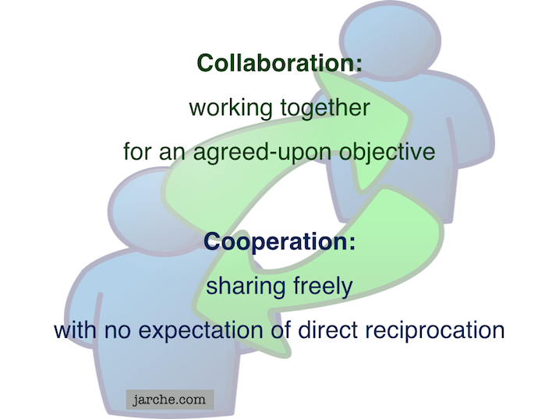
Translation and Collaborative Technology
Communication is and will be everywhere
But the future lies in cooperation, not collaboration
What happens when companies know the state of all your devices?

Slide 21
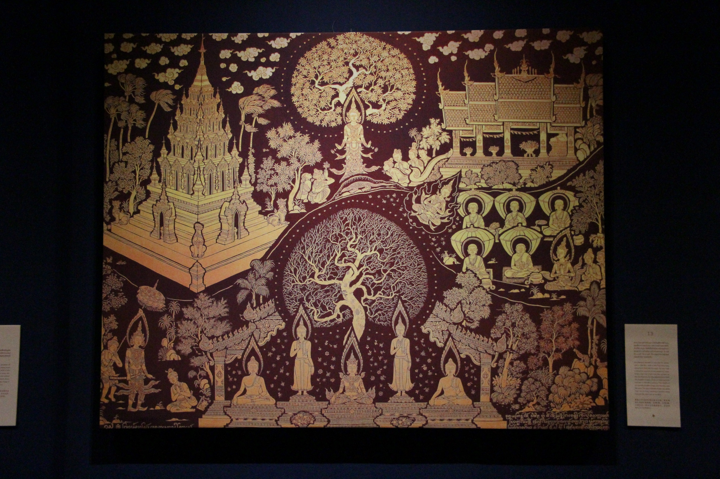
3. Transformation

Slide 22
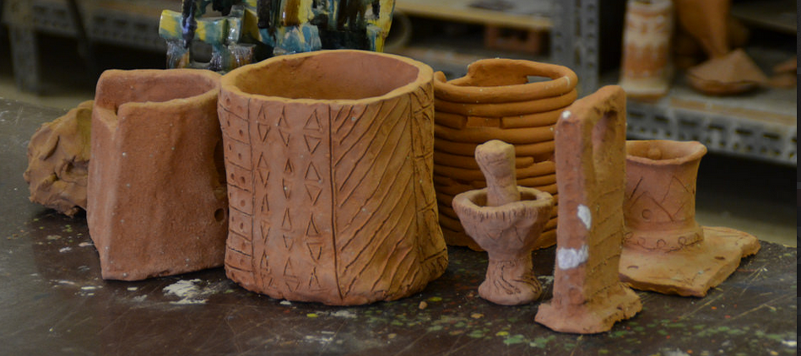
What are Research & Development?
Riyadh, Saudi Arabia, 2015
Science as a "combination of evaluating evidence, coordinating evidence and models, and arriving at evidence-based judgments that are communicated through argumentation."
Ronald W. Rinehart, et.al. 2016. Critical Design Decisions for Successful Model-Based Inquiry in Science Classrooms. https://scholarworks.iu.edu/journals/index.php/ijdl/article/view/20137/28269

Slide 23
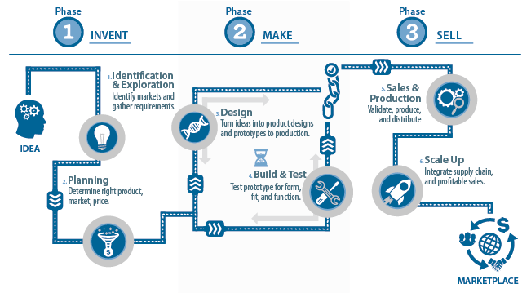
Stages of Innovation
Does selling really come after making?
Image: SD Manufacturing, http://www.sdmanufacturing.com/services/innovation/

Slide 24
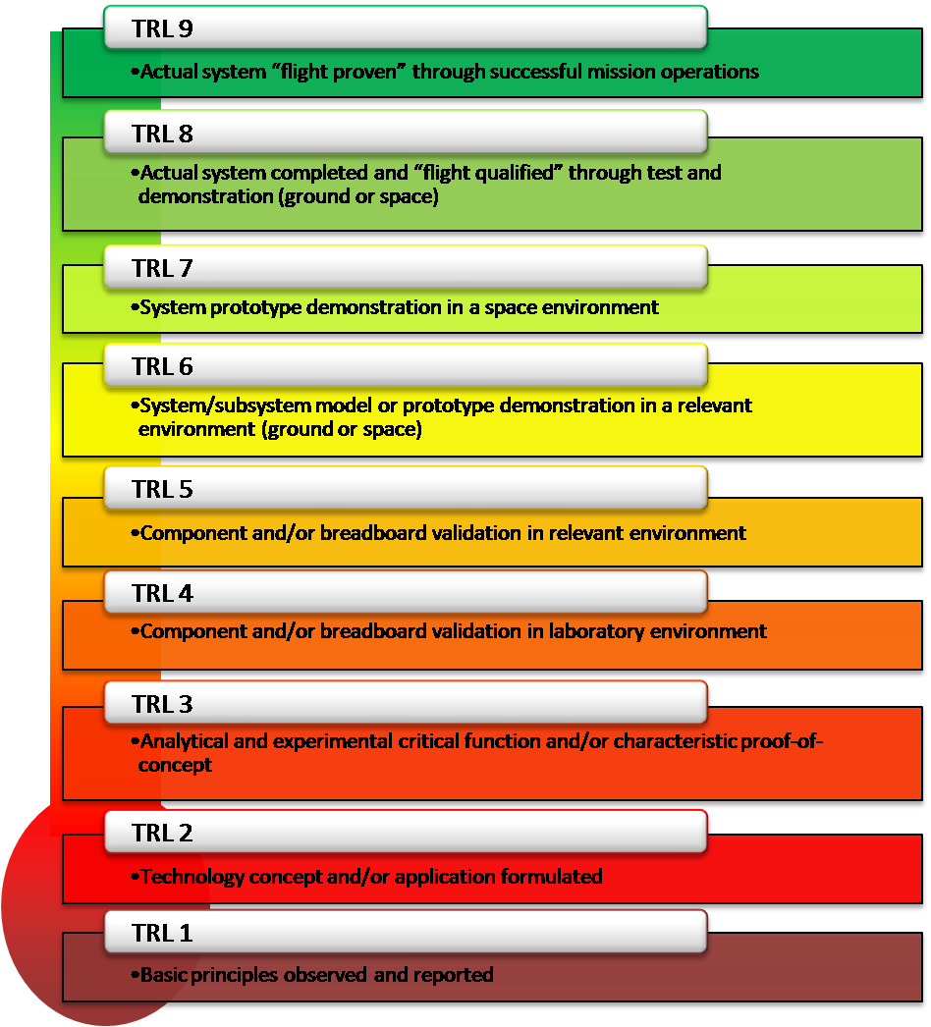
Technology Readiness Levels
From concept to prototype to qualification to proof…
Image: NASA https://www.nasa.gov/directorates/heo/scan/engineering/technology/txt_accordion1.html

Slide 25
Beyond Innovation
New
Idea + Execution + Benefit
Drivers
Attractors
=
Innovation
New
Benefit
Idea + Execution
=
Transformation

Slide 26
What is Transformation?
“In an organizational context, a process of profound and radical change that orients an organization in a new direction and takes it to an entirely different level of effectiveness.”
“Transformation implies a basic change of character and little or no resemblance with the past configuration or structure.”
Read more: http://www.businessdictionary.com/definition/transformation.html

Slide 27
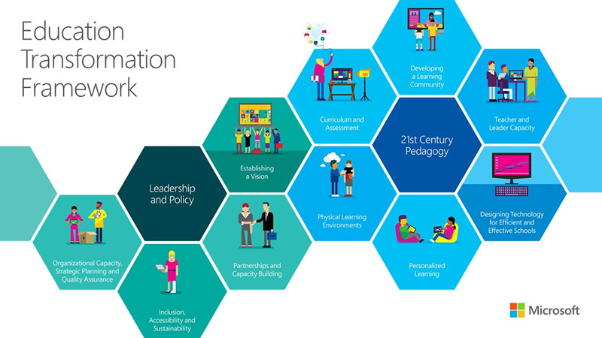
Microsoft’s Vision
Learning community
Teacher capacity
Efficient schools
Personalization
Physical learning environments
Curriculum & assessment
Is this really transformation?
Are these things we really want?
Microsoft, 2015. Education Transformation Toolkit. http://www.is-toolkit.com/education_transformation.html

Slide 28
Questions to Ask
What will new technology enable?
How will our wants and needs change?
Self-Actualization
Does Maslow speak for us?
Self-Esteem
Belonging
Safety and Security
WiFi
Physiological
Maslow, A. 1943. Hierarchy of Needs: A Theory of Human Motivation. http://psychclassics.yorku.ca/Maslow/motivation.htm

Slide 29
Transformation of Education
Now we’re asking the right kind of question
Look at how education has been transformed through the years based on changing definitions of need:
  past needs: storytelling
  present needs: ‘apprenticeship’ (aka child labour)
  future needs: preparing for the factory
  potential needs: the route to academia

Slide 30
What Next?
What is the right kind of question?
How will education be transformed into the future based on changing definitions of need:
  my needs: how can I become a knowing person?
  our needs: how can we create new knowledge together?

Slide 31
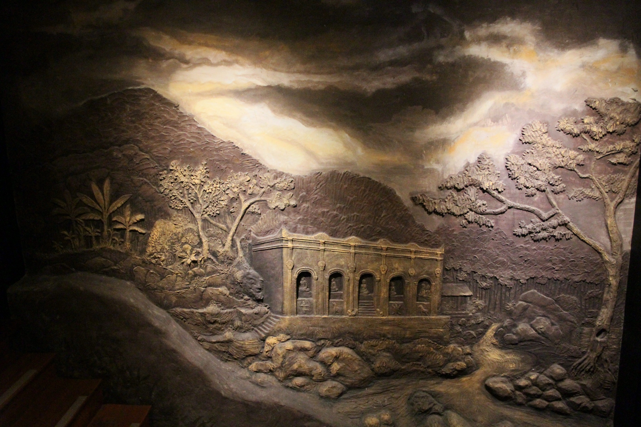
4. Transformations

Slide 32
Reframing the Issues in Education
Students must pay too much to study and learn
Assessment is unreliable and (often) unfair
Texts and resources are locked behind paywalls
Content is poorly communicated
Life as a student is incredibly stressful
Research studies are poorly designed.
Education science rarely replicates
http://www.vox.com/2016/7/14/12016710/science-challeges-research-funding-peer-review-process

Slide 33
New Models of Deployment
Conventional Wisdom |  | Big Bang Wisdom
Focus on one innovation (low cost, product, customer) | Strategic Discipline | Focus on all three at once
Target small group first, then mainstream | New-Product Marketing | Market to all at once, scale swiftly
Low cost feature-poor technologies | Innovation Method | Experimentation on popular platforms
Adapted from Larry Downes and Paul F. Nunes. 2013. Dig Bang Disruption. Harvard Business Review. c/o Accenture. https://www.accenture.com/t20150521T020819__w__/us-en/_acnmedia/Accenture/Conversion-Assets/Blogs/Documents/1/Accenture-Big-Bang-Disruption.pdf

Slide 34
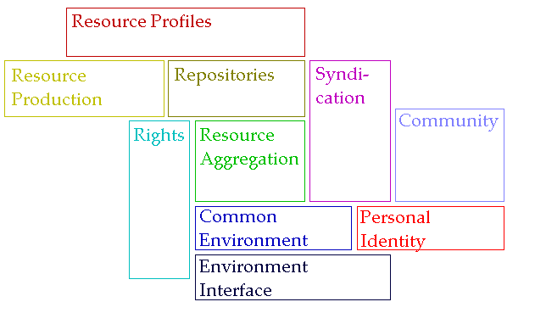
The New Institutional Perspective
Don’t do things to people, do things with people, help people do things
If we have to ask “how do we motivate people” then we’re taking the wrong approach – Kohn; “Knowledge sharing is your job” – Buckman; Provide opportunities for autonomy, mastery, purpose – Pink

Slide 35
New learning Paradigms
Path | Field
Course | Curriculum (as in ‘mapping’)
Sequence / Prequisite | Core / periphery / foundation
Movement / covered | Inquiry / Discovery / Gaps
Threshold / Levels | Coverage / Construction
Positioning – first / last | Grouping / Clustering
Objective / target | Serendipity / emergence
Leading / Led | Centred
Carrie Paechter, Metaphors of Space in Educational Theory and Practice http://www.tandfonline.com/doi/pdf/10.1080/14681360400200202

Slide 36
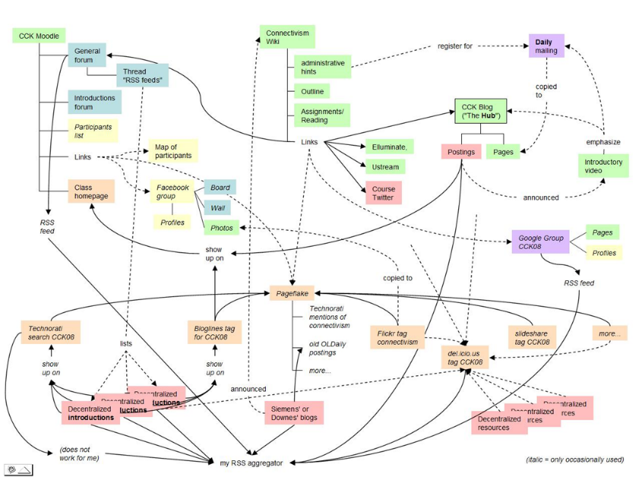
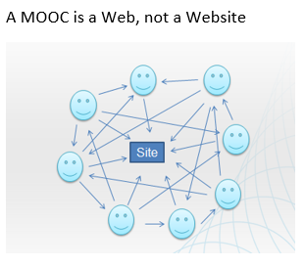
The Connectivist MOOC (cMOOC) Design
Instead of seeing a course as a series of contents to be presented, a course is a network of participants who find and exchange resources with each other
An initial structure is developed and ‘seeded’ with existing OERs
Participants encouraged to use their own sites to create or share resources
A mechanism (gRSShopper) is employed to connect them

Slide 37
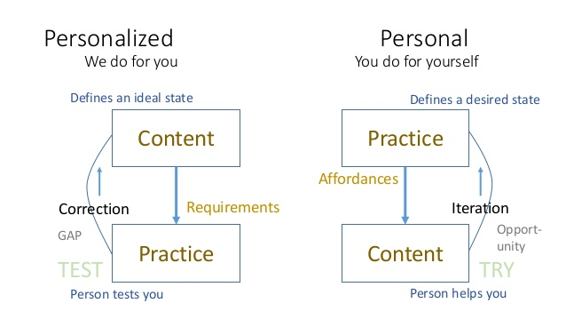
Learning is Personal

Slide 38
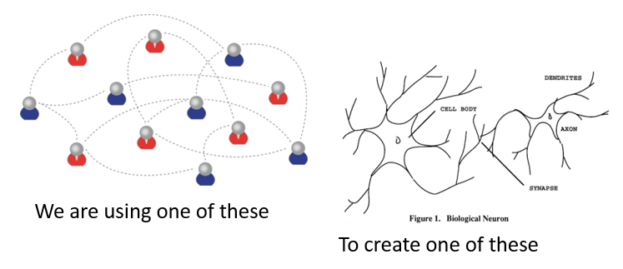
Learning Outcomes
Learning a discipline is a total state and not a collection of specific states
It is obtained through immersion in an environment rather than acquisition of particular entities
It is expressed functionally (can you perform ‘as a geographer’?) rather than cognitively (can you state ‘geography facts’ or do ‘geography tasks’?)

Slide 39

The New Model of Work and Learning
Sharing - create linked documents, data, and objects in a distributed network
Contributing - employ social networking applications of the Web to facilitate group communication
Co-creating - work through networks that facilitate cooperative group work toward common goals

Slide 40
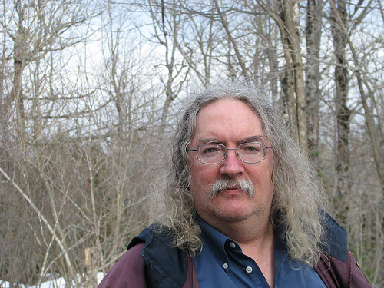
Stephen Downes
http://www.downes.ca
Moncton, Canada, 2005
http://www.downes.ca/presentation/389

