Slide 1
The importance of faculty in the higher education experience
Stephen Downes
for Instituto Tecnológico y de Estudios Superiores de Monterrey
National Faculty Meeting, Mexico City, July 4, 2016
http://www.downes.ca/presentation/387

Slide 2
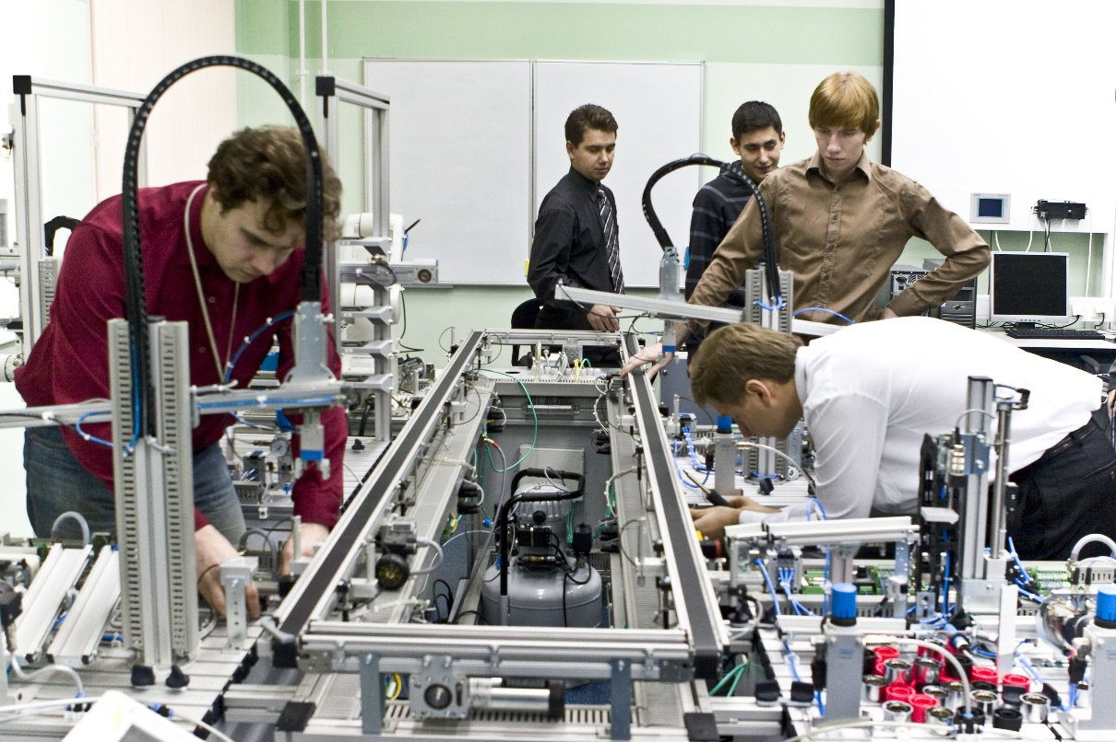
1. New Forms of Learning
Image: https://en.wikipedia.org/wiki/Education

Slide 3
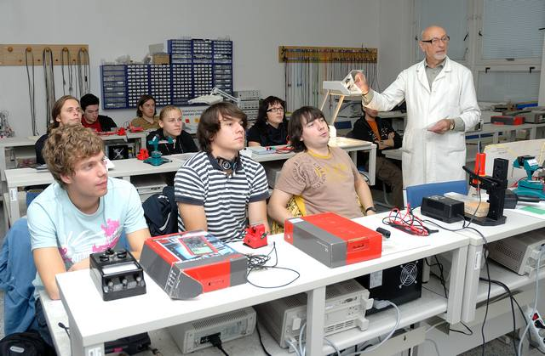
We have entered the technological era
Tools include learning management systems
Digital learning resources and eBooks
Online discussions, conferencing, collaborative authoring
Image: https://en.wikipedia.org/wiki/Education

Slide 4
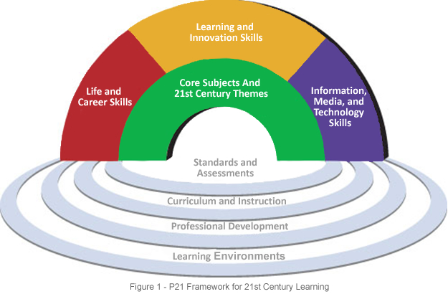
We have embraced 21st Century pedagogy
It’s not just about transmitting content
We employ active learning methodologies
Project and problem-based learning
We create challenges & learners take control,
eg. service learning, entrepreneurship, etc
https://en.wikipedia.org/wiki/21st_century_skills
http://www.p21.org/our-work/p21-framework
http://www.crlt.umich.edu/tstrategies/tsal

Slide 5
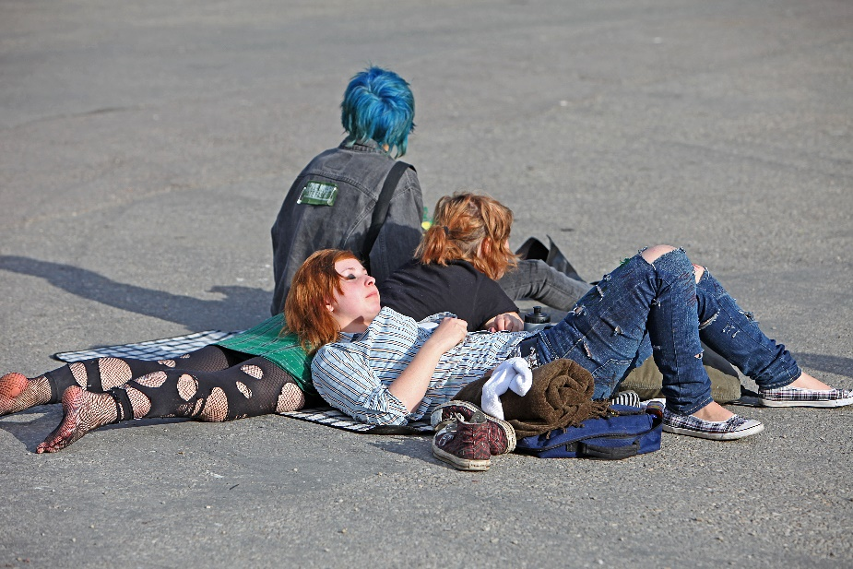
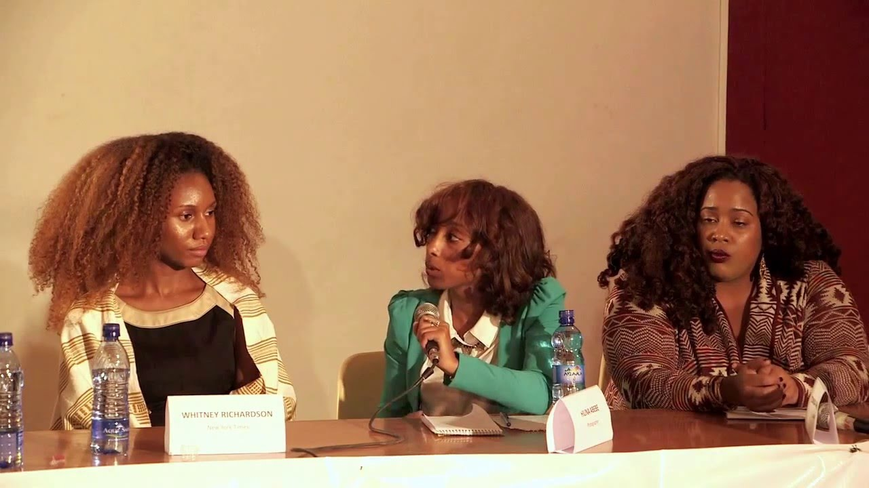
2. The Changing Shape of Learning
Our education system still resembles the traditional model, but this is now changing
Images: https://www.youtube.com/watch?v=3Oqsly9o35M ; https://en.wikipedia.org/wiki/Cultural_identity

Slide 6
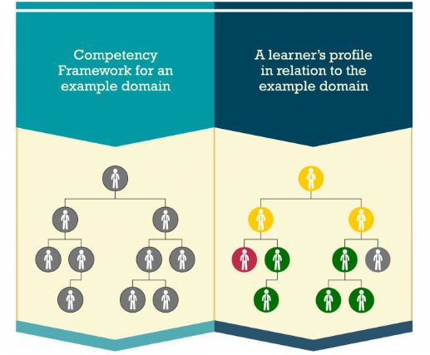


We were focused on courses, programs, disciplines, but now
On the one hand, looking at microcredentials
On the other hand, looking at overarching competencies like digital literacies
Competency and Skills System
https://www.adlnet.gov/introducing-the-next-big-thing-cass/

Slide 7
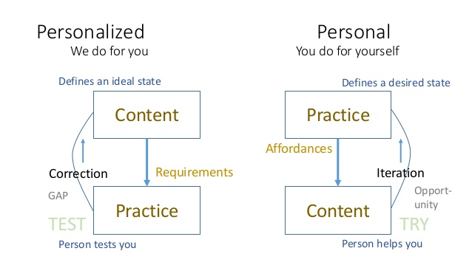
We were looking at same standardized package for every student, now
Want to adapt learning to each individual need
http://www.downes.ca/post/65065
http://teachweb2.blogspot.com/2010/08/personal-vs-personalized-learning.html

Slide 8
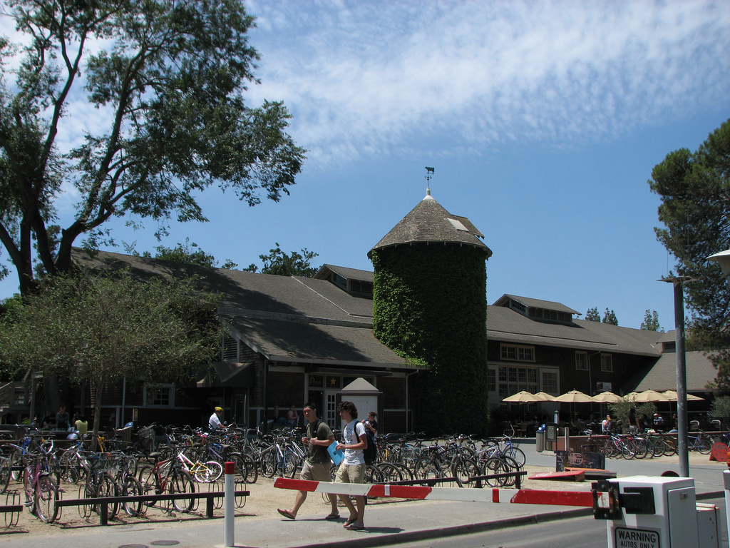
The old institutional silos still remain
In Canada, for example, the process of ‘articulation’ remains a challenge
Credentials created in one country are not accepted in another country
Multinational initiatives like the Bologna process are complex and difficult
http://ec.europa.eu/education/policy/higher-education/bologna-process_en.htm
https://www.linkedin.com/pulse/classic-example-how-difficult-fight-silo-mentality-become-don-capener
http://opencontent.org/blog/archives/3393

Slide 9
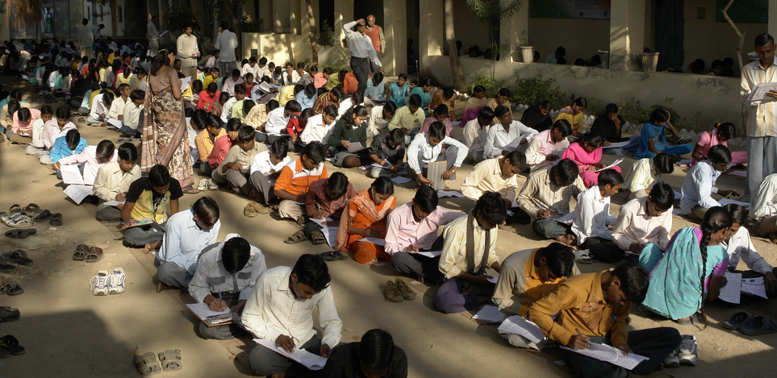
We have not advanced significantly in assessment
Tests and essays are not adequate, looking for genuine learning
Issues around recognition of learning
http://www.centerforpubliceducation.org/Main-Menu/Instruction/High-stakes-testing-and-effects-on-instruction-At-a-glance/High-stakes-testing-and-effects-on-instruction-Research-review.html
http://capla.ca/what-is-rpl/
Image: https://en.wikipedia.org/wiki/Test_(assessment)

Slide 10
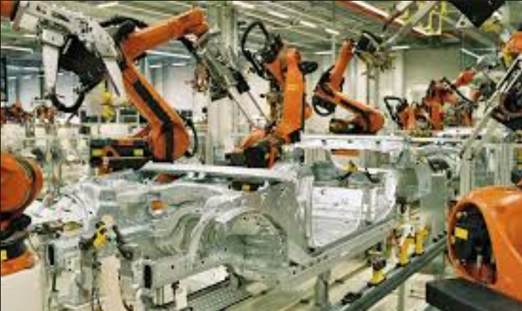
3. New Technologies Changing the Landscape
http://teachonline.ca/tools-trends/exploring-future-education/2016-look-future-online-learning-part-1
http://halfanhour.blogspot.com.tr/2016/03/the-2016-look-at-future-of-online.html
Image: https://en.wikipedia.org/wiki/High_tech

Slide 11
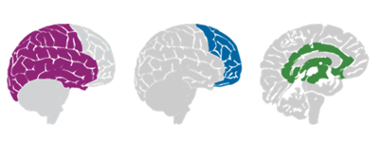
Machine learning and artificial intelligence
Not simply for adaptive learning
The idea is to create an environment
We talk about predictive analytics as though finishing a course is the problem
The real future is in the quantified self
http://quantifiedself.com/
http://www.wtec.org/loyola/kb/c1_s1.htm
http://research.microsoft.com/en-us/um/people/cmbishop/prml/

Slide 12
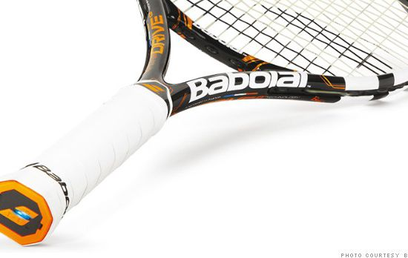
Handheld and Mobile Computing
The future of learning isn’t the mobile phone
It’s in the integrated performance support system
Mary Meeker http://www.slideshare.net/kleinerperkins/2016-internet-trends-report?ref=http://www.kpcb.com/internet-trends
http://fortune.com/2014/05/27/a-tennis-racquet-that-isnt-just-strung-but-wired/

Slide 13
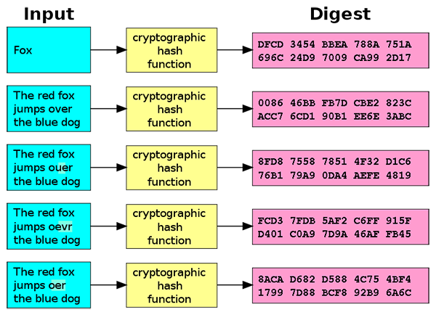
Badges and Blockchain
Open Badges initiative and microcredentials
Proposals to use the blockchain to record credentials
http://dmlcentral.net/blog/doug-belshaw/peering-deep-future-educational-credentialing
http://www.downes.ca/search/blockchain
Audrey Watters: http://hackeducation.com/2016/02/25/blockchain-edu1
https://magazine.backfeed.cc/dao-alive-now-let-evolution-begin/

Slide 14
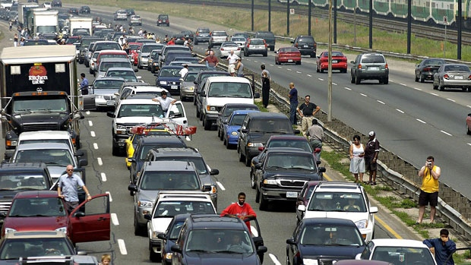
Internet of Things
What happens when companies know the state of all your devices?
http://www.cbc.ca/news/canada/car-tracking-devices-spark-privacy-concerns-1.1366687

Slide 15
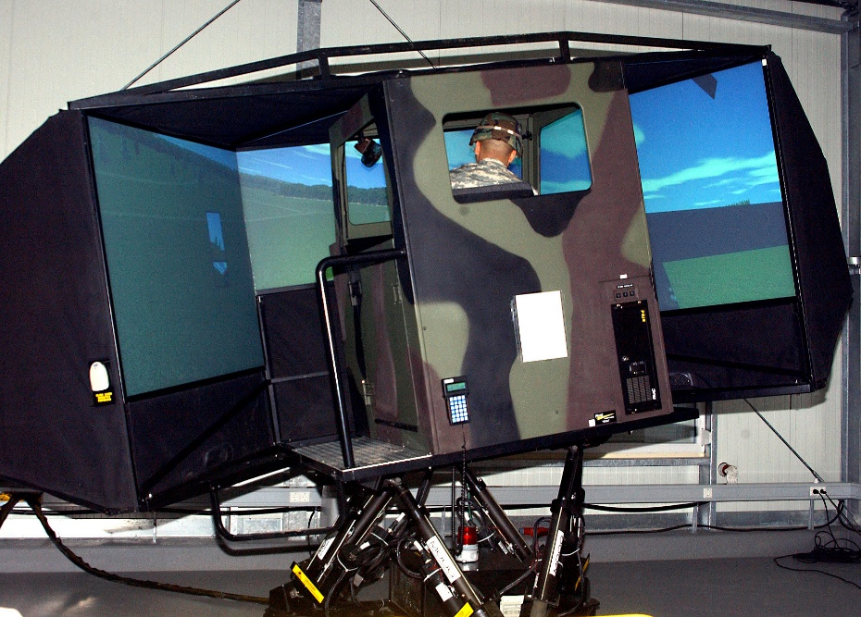
Games, Sims and Virtual Reality
‘Gamification’ – adds game elements to learning
‘Serious Games’ – employs a game to facilitate learning
https://badgeville.com/wiki/Gamification
http://donaldclarkplanb.blogspot.ca/2014/11/oculus-rift-freezers-smilers-grippers.html
http://www.downes.ca/search/oculus
https://blog.teachlr.com/surviving-gamification/

Slide 16
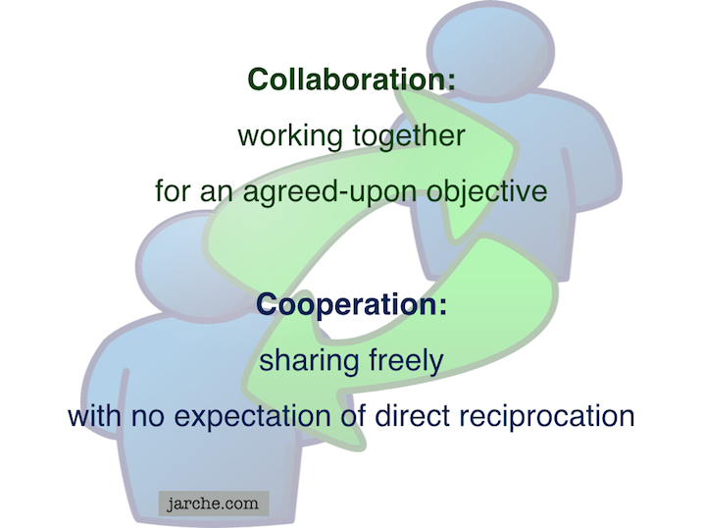
Translation and Cooperative Technology
Communication is and will be everywhere
The future lies in cooperation, not collaboration
Cooperation includes machines – think distributed applications
https://cyber.law.harvard.edu/research/cooperation
Image: http://Jarche.com
https://www.imsglobal.org/specs/ltiv1p0/implementation-guide
http://www.tomsitpro.com/articles/docker-enterprise-hub-orchestration,1-2375.html

Slide 17
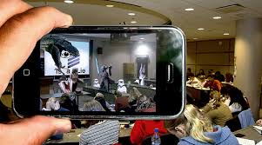
4. Learning in the Future
Image: http://evertonpom.blogspot.com/2013/10/the-future-of-technology-in-education.html

Slide 18
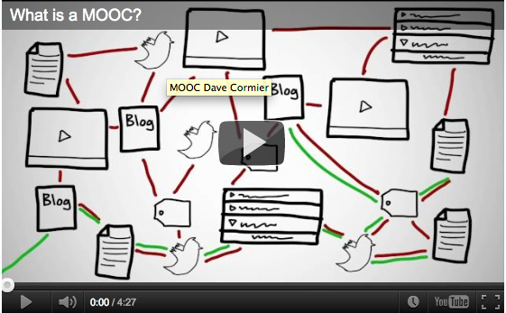
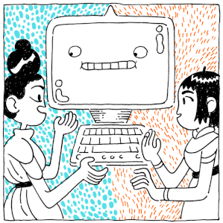
Learning contents
Automatically produced, free, open and digital
Addressed to specific needs or competences
Image: https://www.flickr.com/photos/opensourceway/6554315179

Slide 19
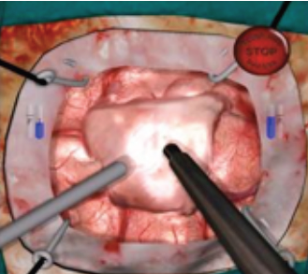
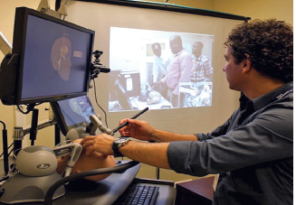
Learning Environments
Not just MOOCs; Complex, linked to tools, distributed
Based on 21st century learning and scientific methodologies
http://www.tonybates.ca/2012/03/03/more-reflections-on-moocs-and-mitx/
https://scholarworks.iu.edu/journals/index.php/ijdl/article/view/20137/28269

Slide 20
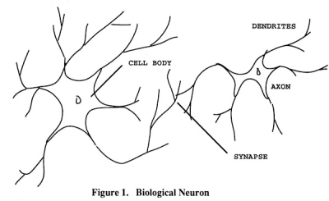
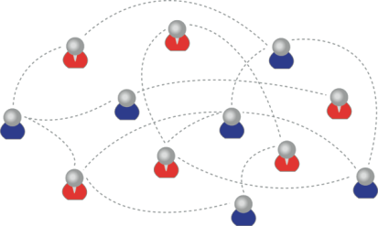
Assessment and recognition
May involve microcredentials, variety of recognition
Based on actual evidence
Feed directly into employment or project support tools
We recognize this
By performance in this

Slide 21

5. The New Role for Faculty

Slide 22
The challenges
Students don’t need contents any more
Students don’t need experts any more
We want them to figure things out, translate, try activities, work with others
Engaging = Immersive + Wanted
We have to want to be there
And we have to believe that we’re there
http://www.sciencedirect.com/science/article/pii/S1319157813000372
http://www4.ncsu.edu/unity/lockers/users/f/felder/public/Columns/Active.pdf
http://www.poynter.org/2016/the-associated-press-will-use-automated-writing-to-cover-the-minor-leagues/419489/

Slide 23
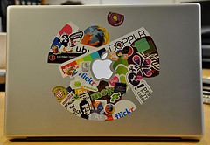
Think about your own learning…
You need input that is relevant, usable and interactive
It’s all about context
The airplane cockpit is no place for a two week course
Learning will be like water or electricity – or text
http://campustechnology.com/articles/2014/06/09/report-students-expect-future-universities-to-be-flexible-accessible-career-oriented.aspx

Slide 24
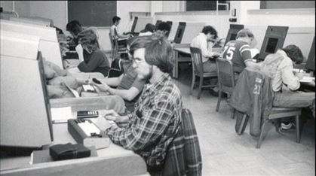
Think about your own learning…
To learn is to practise and reflect
You need support, sometimes, but mostly you need examples and models
http://hackeducation.com/2014/06/18/unfathomable-cetis2014/

Slide 25
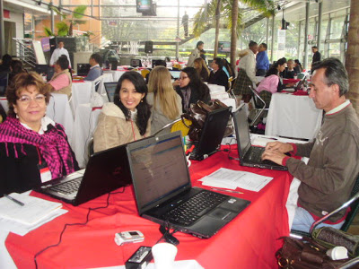
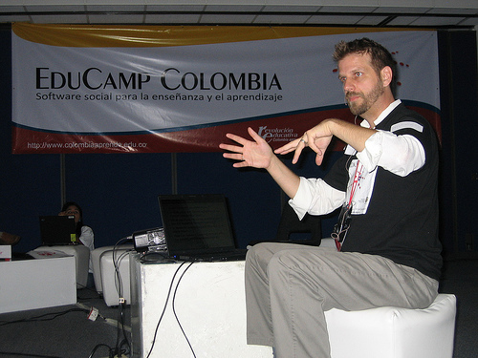
Think about your own learning…
To teach is to model and demonstrate
Showing how to be a practitioner in the field – be a carpenter, a physicist, etc…
Show how you try, fail, learn, etc
http://www.flickriver.com/photos/qadmon/3106848811/
http://pertinenciaeducativa09.blogspot.ca/2009/10/educamp-colombia-aprendizaje-en-un.html
http://www.irrodl.org/index.php/irrodl/article/view/884/1677

Slide 26
The New Institutional Perspective
From Management to Meaning
Don’t do things to people, do things with people, help people do things
If we have to ask “how do we motivate people” then we’re taking the wrong approach – Kohn
“Knowledge sharing is your job” – Buckman
Provide opportunities for autonomy, mastery, purpose – Pink
http://www.downes.ca/presentation/98

Slide 27
The New Model of Work and Learning
Sharing - create linked documents, data, and objects within a distributed network
Contributing - employ social networking applications of the Web to facilitate group communication
Co-creating - work through networks that facilitate cooperative group work toward common goals

Slide 28
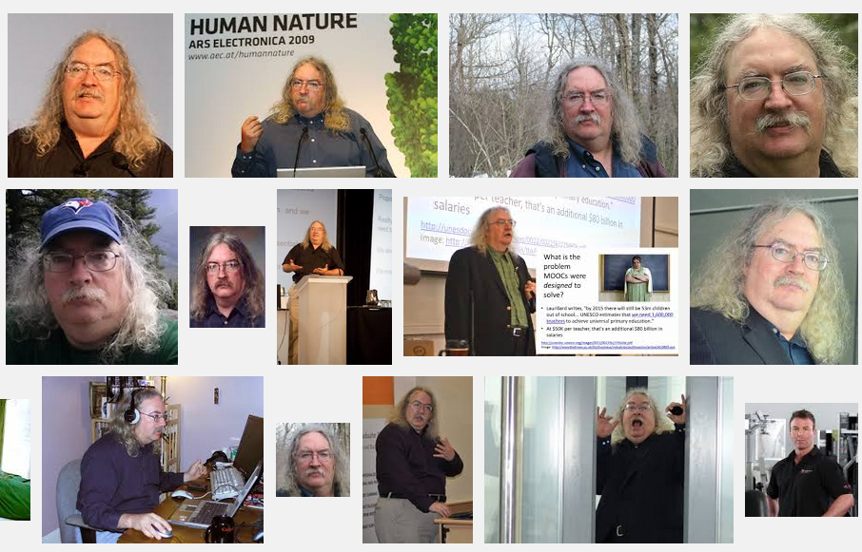
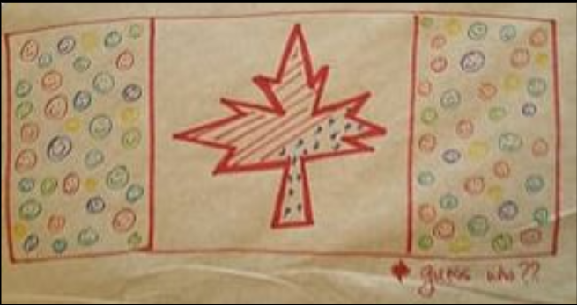
Stephen Downes
http://www.downes.ca

