Slide 1

Learning,
Doing, and the
Golden Ratio
Stephen Downes
June 9, 2016
Kapuskasing, Ontario

Slide 2
Our objective for today
We will create a 6-sentence essay on the future of learning

Slide 3

https://www.theguardian.com/uk-news/2016/jan/03/like-a-beautiful-painting-image-of-new-years-mayhem-in-manchester-goes-viral

Slide 4
Questions and Topics
The new roles of professor…
learning is doing…
personalized vs personal learning…
evaluation in the new era…
the main challenges in education in the 21st century…

Slide 5
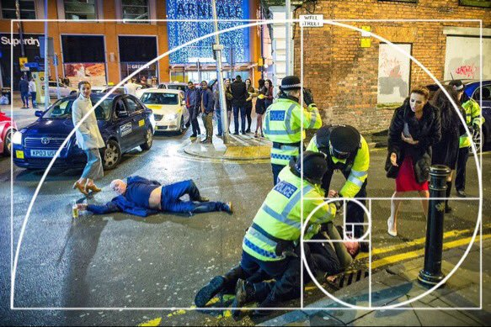
https://twitter.com/hughesroland/status/682921993331720196/photo/1?ref_src=twsrc%5Etfw

Slide 6
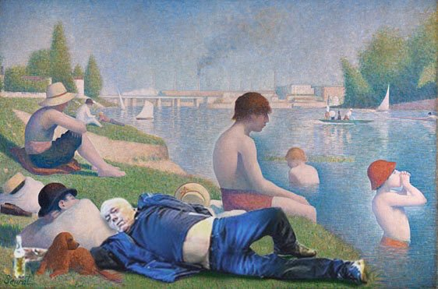

Slide 7
Today’s Imperatives
critical thinking
innovation & creativity
learning to learn
collaboration
communication
global citizenship
From this morning’s presentation

Slide 8
Design vs Environment
Path | Field
Course | Curriculum (as in ‘mapping’)
Sequence / Prequisite | Core / periphery / foundation
Movement / covered | Inquiry / Discovery / Gaps
Threshold / Levels | Coverage / Construction
Positioning – first / last | Grouping / Clustering
Objective / target | Serendipity / emergence
Leading / Led | Centred
Carrie Paechter, Metaphors of Space in Educational Theory and Practice http://www.tandfonline.com/doi/pdf/10.1080/14681360400200202

Slide 9
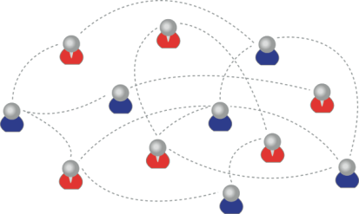
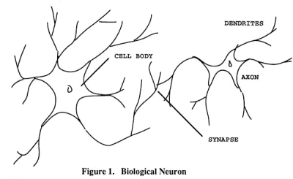
Learning Outcomes
We are using one of these
To create one of these
Personal knowledge consists of neural connections, not facts and data

Slide 10
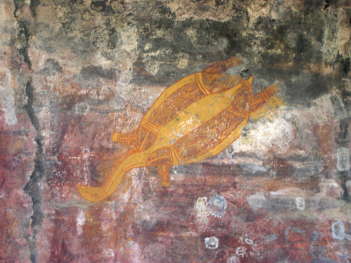
Inference and belief
We understand the future in the same way we understand the past, by studying the signs - S. Downes
http://www.downes.ca/post/20

Slide 11
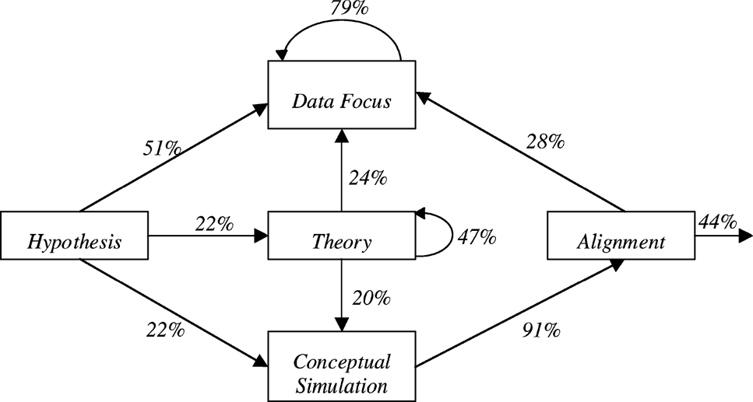
Science as language, learning as conversation, knowledge as inference
“What if…”: The Use of Conceptual Simulations in Scientific Reasoning
http://www.informaworld.com/smpp/1925728116-26233474/ftinterface~db=all~content=a788101161~fulltext=713240928

Slide 12
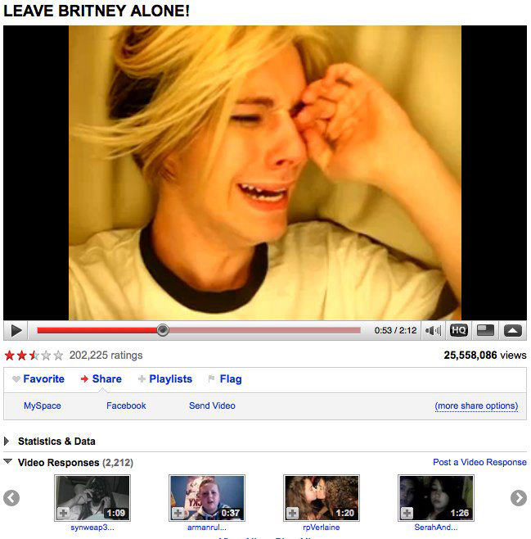
The Second Thesis, Part B
This means getting beyond narrow text-based conceptions we have of media

Slide 13
Conceptions Like:
messages have a sender and a receiver
words get meaning from what they represent
truth is based on the real world
events have a cause, and causes can be known
science is based on forming and testing hypotheses
These, taken together, constitute, a static, linear, coherent picture of the world
The world, as though it were a book, or a library
Not everyone sees it that way

Slide 14
A frame for understanding new media
Morris, Derrida and a little Lao Tzu
Syntax | Cognition
Semantics | Context
Pragmatics | Change
We need this frame because (as Jukes said) if we aren’t looking for these things, we just won’t see them.

Slide 15
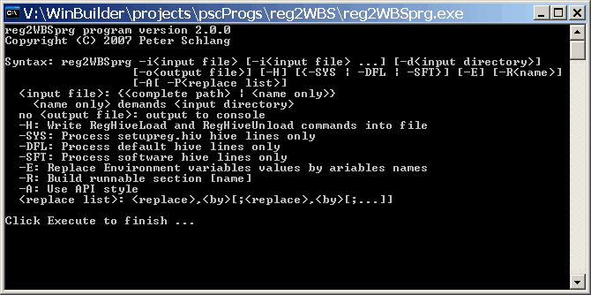
Syntax
Not just rules and grammar
Forms: archetypes? Platonic ideals?
Rules: grammar = logical syntax
Operations: procedures, motor skills
Patterns: regularities, substitutivity (eggcorns, tropes)
Similarities: Tversky - properties, etc

Slide 16
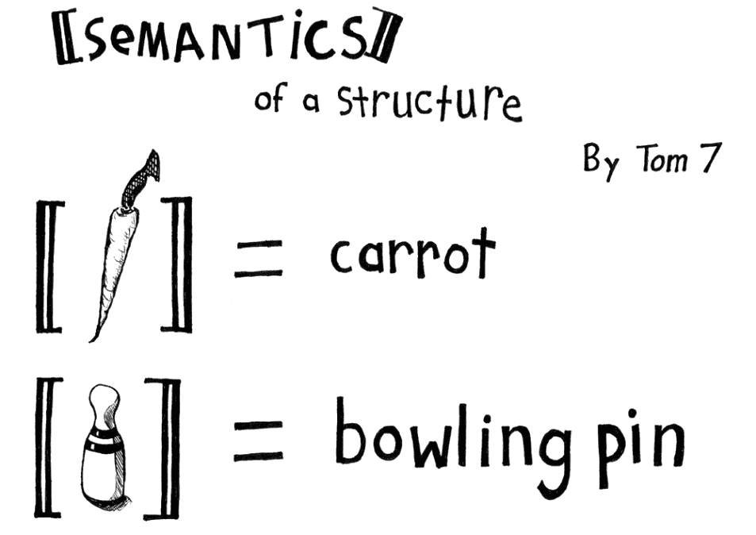
Semantics
theories of truth / meaning / purpose / goal
http://www.cs.cmu.edu/~tom7/csnotes/fall02/semantics.gif
- Sense and reference (connotation and denotation)
- Interpretation (Eg. In probability, Carnap - logical space; Reichenbach - frequency; Ramsey - wagering / strength of belief)
- Forms of association: Hebbian, contiguity, back-prop, Boltzmann
- Decisions and decision theory: voting / consensus / emergence

Slide 17
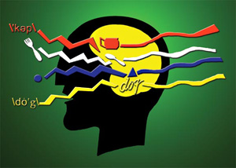
Pragmatics
use, actions, impact
Speech acts (J.L. Austin, Searle) assertives, directives, commissives, expressives, declarations (but also - harmful acts, harassment, etc)
Interrogation (Heidegger) and presupposition
Meaning (Wittgenstein - meaning is use)

Slide 18
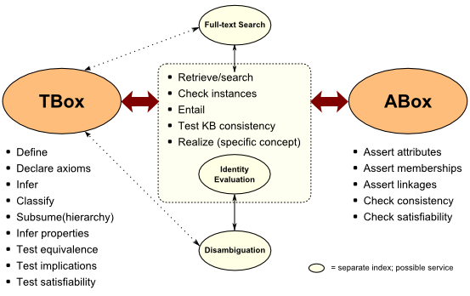
Cognition
reasoning, inference and explanation
http://www.mkbergman.com/category/description-logics/
  description - X (definite description, allegory, metaphor)
  definition - X is Y (ostensive, lexical, logical (necess. & suff conds), family resemblance - but also, identity, personal identity, etc
  argument - X therefore Y - inductive, deductive, abductive (but also: modal, probability (Bayesian), deontic (obligations), doxastic (belief), etc.)
  explanation - X because of Y (causal, statistical, chaotic/emergent)

Slide 19
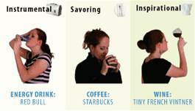
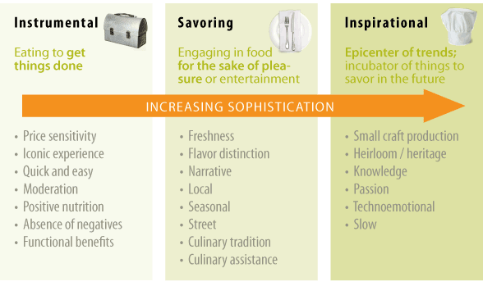
Context
placement, environment
http://www.occasionbasedmarketing.com/what-it-is
- explanation (Hanson, van Fraassen, Heidegger)
- meaning (Quine); tense - range of possibilities
- vocabulary (Derrida); ontologies, logical space
Frames (Lakoff) and worldviews

Slide 20
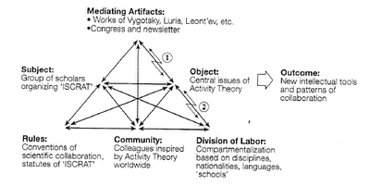
Change
relation and connection: I Ching, logical relation
flow: Hegel - historicity, directionality; McLuhan - 4 things
- progression / logic -- games, for example: quiz&points, branch-and-tree, database
- scheduling - timetabling - events; activity theory / LaaN

Slide 21
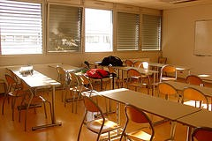
21st Century Skills Languages
http://spotlight.macfound.org/btr/entry/new_media_literacies/
The ‘skills’ described by Jenkins – performance, simulation, appropriation, etc - are actually languages and should be understood in terms of these six dimensions

Slide 22
21st Century Languages
Languages Elements | Performance | Simulation | Appropriation
Syntax
Semantics
Pragmatics
Cognition
Context
Change

Slide 23
Example: Performance - Syntax
Languages Elements | Performance (the ability to adopt alternative identities for the purpose of improvisation and discovery)(subcategories?)
Syntax: - Forms - Rules - Operations - Patterns - Similarities | - Presentation acting, method acting - “Know your lines” etc http://filmtvcareers.about.com/od/gettingthejob/a/GJ_Actor_Tips.htm - Stanislavski’s system (etc…) http://en.wikipedia.org/wiki/Stanislavski%27s_system - Ritual Performance (etc.) http://www.let.rug.nl/koster/papers/JHP.Koster2.Edit.pdf - Comparing Tales (etc.) http://artsedge.kennedy-center.org/content/2343/

Slide 24

The Inflexible Law of Learning
It's when we do stuff that we learn, not when stuff does something for us.

Slide 25
6 groups
One for each critical literacy

Slide 26
The Future in 2016
Machine learning and artificial intelligence
Handheld and Mobile Computing
Outcomes and Competencies
Internet of Things
Games, Sims and Virtual Reality
Translation and Collaborative Technology
http://teachonline.ca/tools-trends/exploring-future-education/2016-look-future-online-learning-part-1
http://halfanhour.blogspot.com.tr/2016/03/the-2016-look-at-future-of-online.html

Slide 27
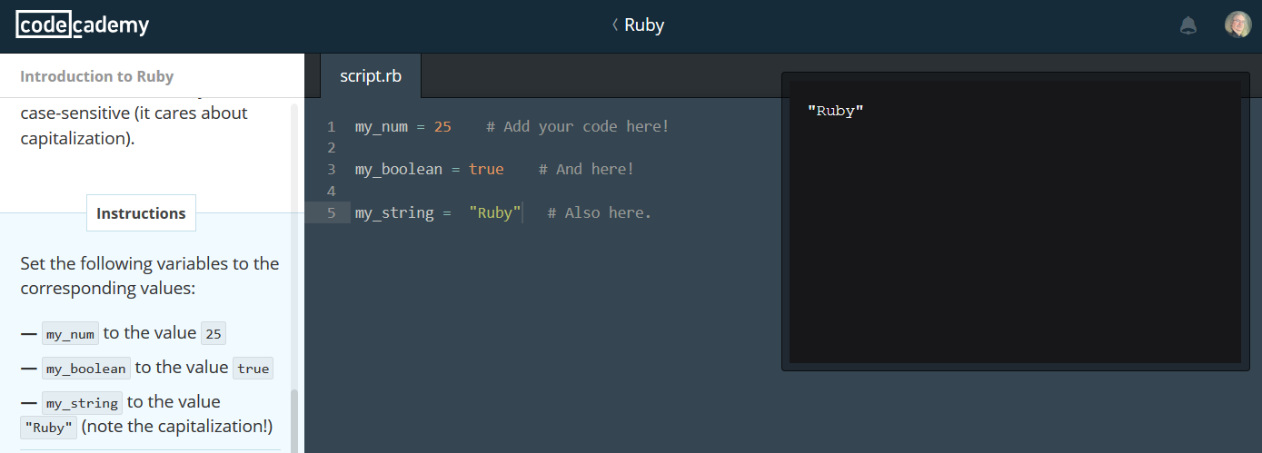
1. Machine learning and AI
Not simply for adaptive learning
The idea is to create an environment
https://www.codecademy.com/

Slide 28
Three Types of AI
decision engines - these are expert systems that are based on rule-driven strategies
pattern recognition - perceptual systems that identify patterns from partial or disorganized data
cluster detection - detecting nearest neighbours and categories of things
http://www.wtec.org/loyola/kb/c1_s1.htm
http://research.microsoft.com/en-us/um/people/cmbishop/prml/

Slide 29
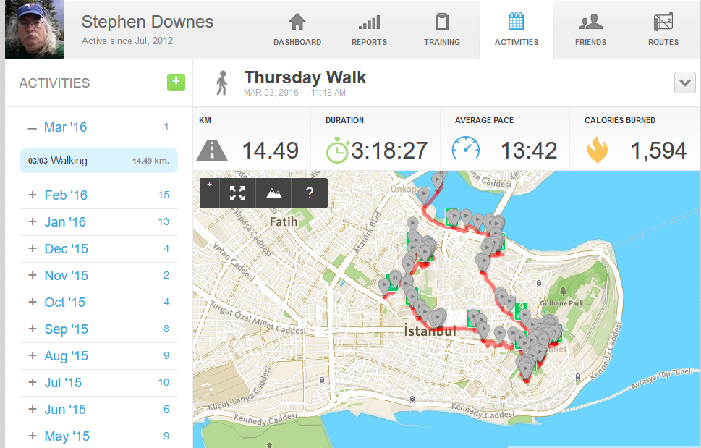
Learning Analytics
We talk about predictive analytics as though finishing a course is the problem
The real future is in the quantified self
http://quantifiedself.com/

Slide 30
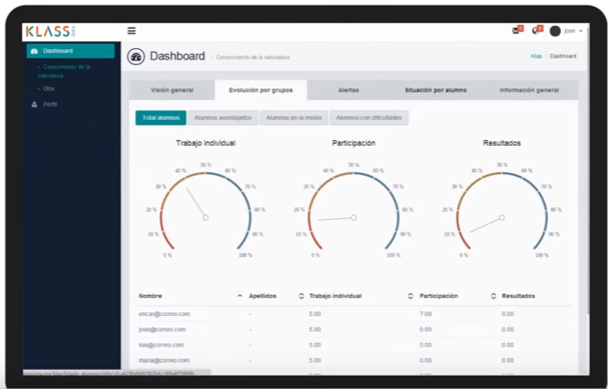
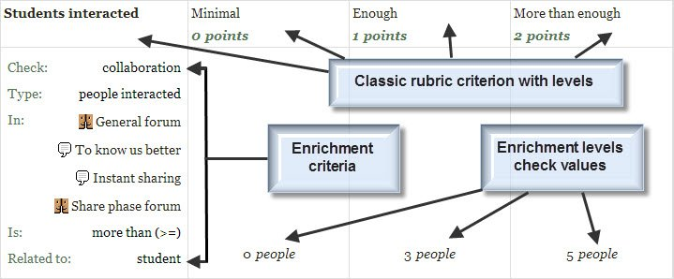
Predictive Analytics
Recognition Tasks
Notes:
Predictive Analytics - eg. SmartKlass https://moodle.org/plugins/local_smart_klass
Recognition Tasks – eg. Learning Analytics enriched rubrics - https://docs.moodle.org/30/en/Learning_Analytics_Enriched_Rubrics
See also: http://www.vteducation.org/en/articles/learner-data/introduction-learning-analytics

Slide 31
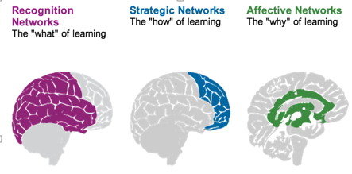
Personalized Learning
Rules-Based Events (like notifications)
User Models
Adaptive Learning
Notes:
- rules-based interactions – eg. Personalized Learning Designer (Blackboard / Moodlerooms) http://www.moodlerooms.com/3-rules-you-cant-live-without-the-personalized-learning-designer/

Slide 32
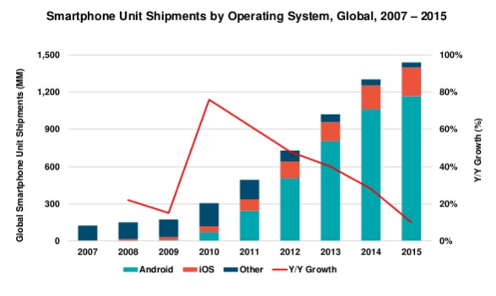
2. Handheld and Mobile Computing
Mary Meeker http://www.slideshare.net/kleinerperkins/2016-internet-trends-report?ref=http://www.kpcb.com/internet-trends

Slide 33
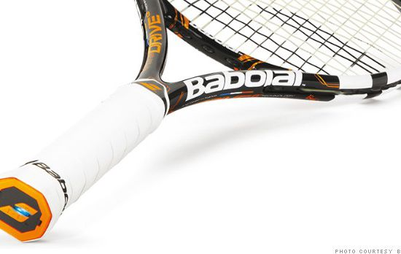
Performance Support
The future of learning isn’t the mobile phone
It’s in the integrated performance support system
http://fortune.com/2014/05/27/a-tennis-racquet-that-isnt-just-strung-but-wired/

Slide 34
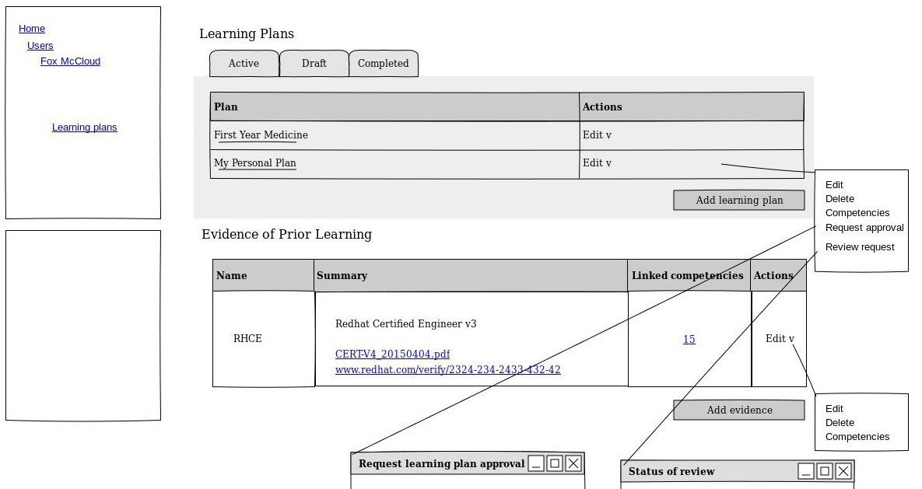
3. Outcomes and Competencies
Notes:
Competency Framework added in Moodle 3.1 - https://docs.moodle.org/dev/index.php?title=Competency_Based_Education
- Define competencies, learning plans, evidence of prior learning
Compentencies – eg. Compeencies Exabis - https://moodle.org/plugins/block_exacomp
The goal of this module is to bring competencies that have been provided (generate them at www.edustandards.org) into Moodle-courses. Competencies from a students' sight can be expressed as "I can”-statements (example: "I can use spreadsheet formulas to solve a mathematical problem”).

Slide 35
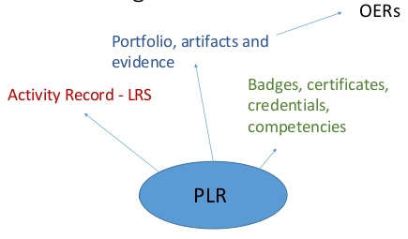
Personal Learning Records

Slide 36
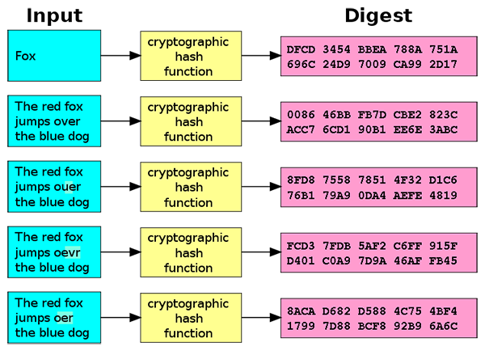
Badges and Blockchain
Doug Belshaw:
"If we used the blockchain for Open Badges," he writes, "then we could prove beyond reasonable doubt that the person receiving badge Y is the same person who created evidence X.
http://dmlcentral.net/blog/doug-belshaw/peering-deep-future-educational-credentialing
http://www.downes.ca/search/blockchain

Slide 37
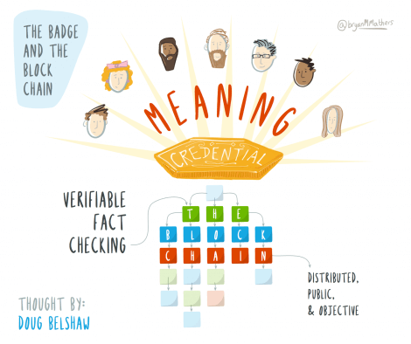
Credentials
Sony plans to launch a testing platform powered by blockchain and that IBM plans to offer 'blockchain-as-a-service,'"
Audrey Watters
http://hackeducation.com/2016/02/25/blockchain-edu1

Slide 38
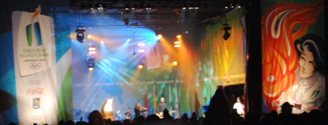
The Dao
Ethereum is a decentralized platform that runs smart contracts https://www.ethereum.org/
The Dao is a 'distributed corporation' that receives investments, chooses projects, and pays for their development; some of these projects return revenue to Dao and others don't. https://magazine.backfeed.cc/dao-alive-now-let-evolution-begin/

Slide 39
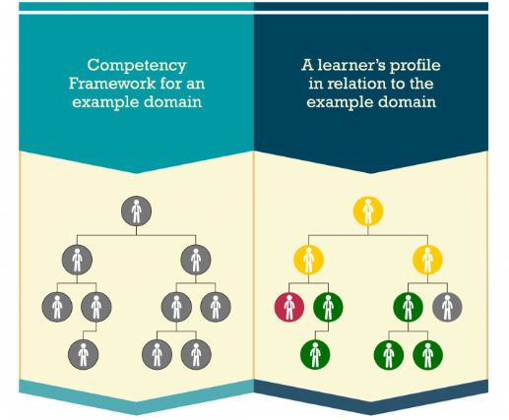


CASS
Competency and Skills System
https://www.adlnet.gov/introducing-the-next-big-thing-cass/

Slide 40
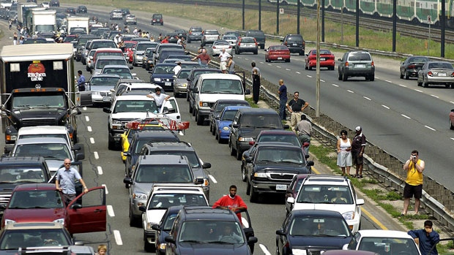
4. Internet of Things
What happens when companies know the state of all your devices?
http://www.cbc.ca/news/canada/car-tracking-devices-spark-privacy-concerns-1.1366687

Slide 41

5. Games, Sims and Virtual Reality
‘Gamification’ – adds game elements to learning
‘Serious Games’ – employs a game to facilitate learning
https://badgeville.com/wiki/Gamification

Slide 42
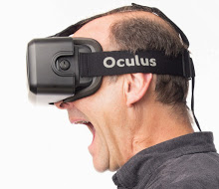
Oculus Rift
1. Freezers
2. Smilers
3. Grippers
4. Swayers
5. Screamers
6. Freak-outs
http://donaldclarkplanb.blogspot.ca/2014/11/oculus-rift-freezers-smilers-grippers.html
http://www.downes.ca/search/oculus

Slide 43
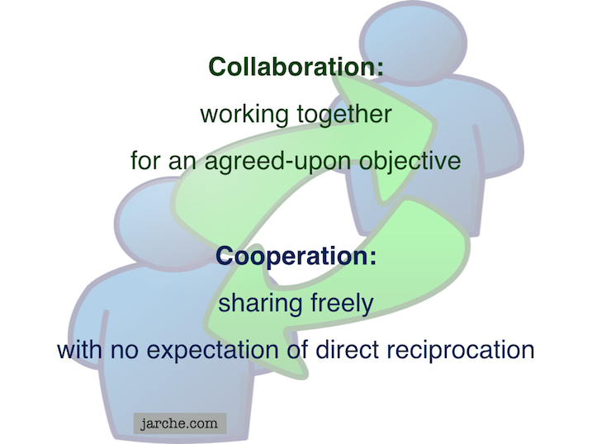
6. Translation and Collaborative Technology
Communication is and will be everywhere
But the future lies in cooperation, not collaboration
https://cyber.law.harvard.edu/research/cooperation
Image: http://Jarche.com

Slide 44
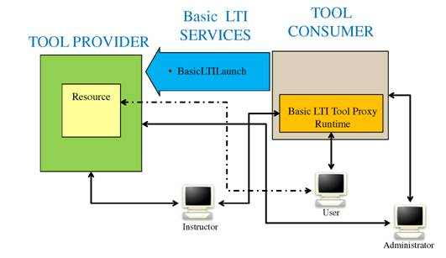
Learning Tools
LTI Producer – provides features
LTI Consumer – connects to features
https://www.imsglobal.org/specs/ltiv1p0/implementation-guide
Notes:
LTI Proivider plugin - https://moodle.org/plugins/local_ltiprovider
The LTI Provider is an application which provides features that other people want to and can connect to from their own LMS.
Provide access to full courses or single activities.
Single sign on
Change the navigation block of a course or activity for displaying information and links only regarding to your current course.
Send backs course or activity final grades to the LTI consumer tool
Modify the course or activity page for hiding the header, footer and left or right blocks
The LTI Consumer is an application which can connect to the 3rd party Provider system to avail of the features it has.
Eg. http://support.mediacore.com/customer/portal/articles/869178-configuring-a-lti-consumer

Slide 45
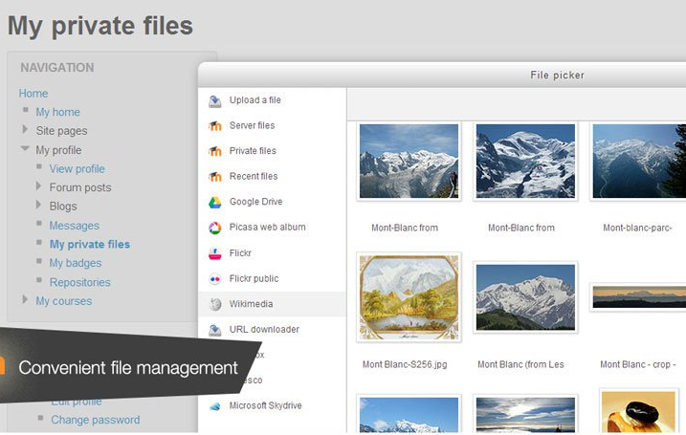
Cloud Storage
Cloud hosting of Moodle
File management
Notes:
MoodleCoud - https://moodle.com/cloud/
(includes BigBlueButton)
Cloud storage - https://docs.moodle.org/30/en/Working_with_files

Slide 46
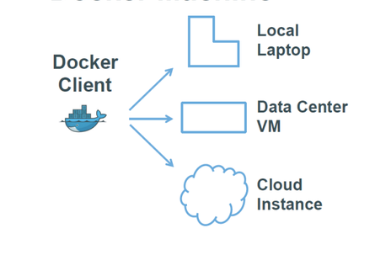
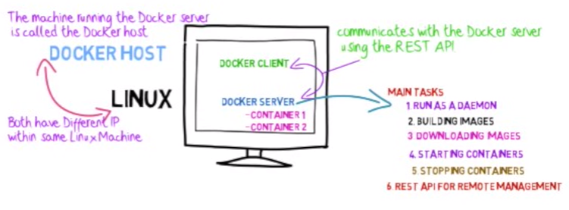
Docker
http://www.tomsitpro.com/articles/docker-enterprise-hub-orchestration,1-2375.html
Notes:
Image: http://www.tomsitpro.com/articles/docker-enterprise-hub-orchestration,1-2375.html
https://www.youtube.com/watch?v=pgiFwriExYg

Slide 47
6 groups
One for each emerging technology

Slide 48
Each person
Create your sentence:
  From the perspective of your critical literacy
  About the emerging technology

Slide 49
6 groups
Randomized
Using whatever method you deem appropriate, select one of the members’ sentences

Slide 50
Results
Artificial intelligence will challenge our perspective of change in society.
Handheld and mobile computing are tools that will become assistants of life.
Blockchains make human beings measurable but don’t take into account the subjects’ dreams, fears, desires, ie, their actual humanity.
Cognition is left to machines so the only cognitive effort left to mankind is to remember where our iPhones are.
Games, sims and virtual reality: we could see it coming. Change was coming and it came. And we don’t know where it will go from here.
Collaborative technologies increase the number of interactions but diminish their quality.

Slide 51
Reflections….
Autonomy
Diversity
Openness
Interactivity

Slide 52
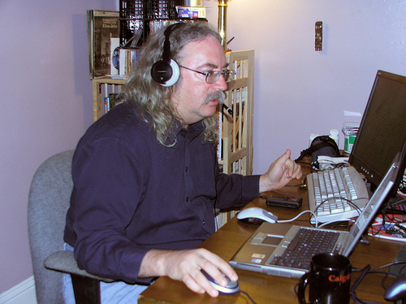
http://www.downes.ca

