Slide 1
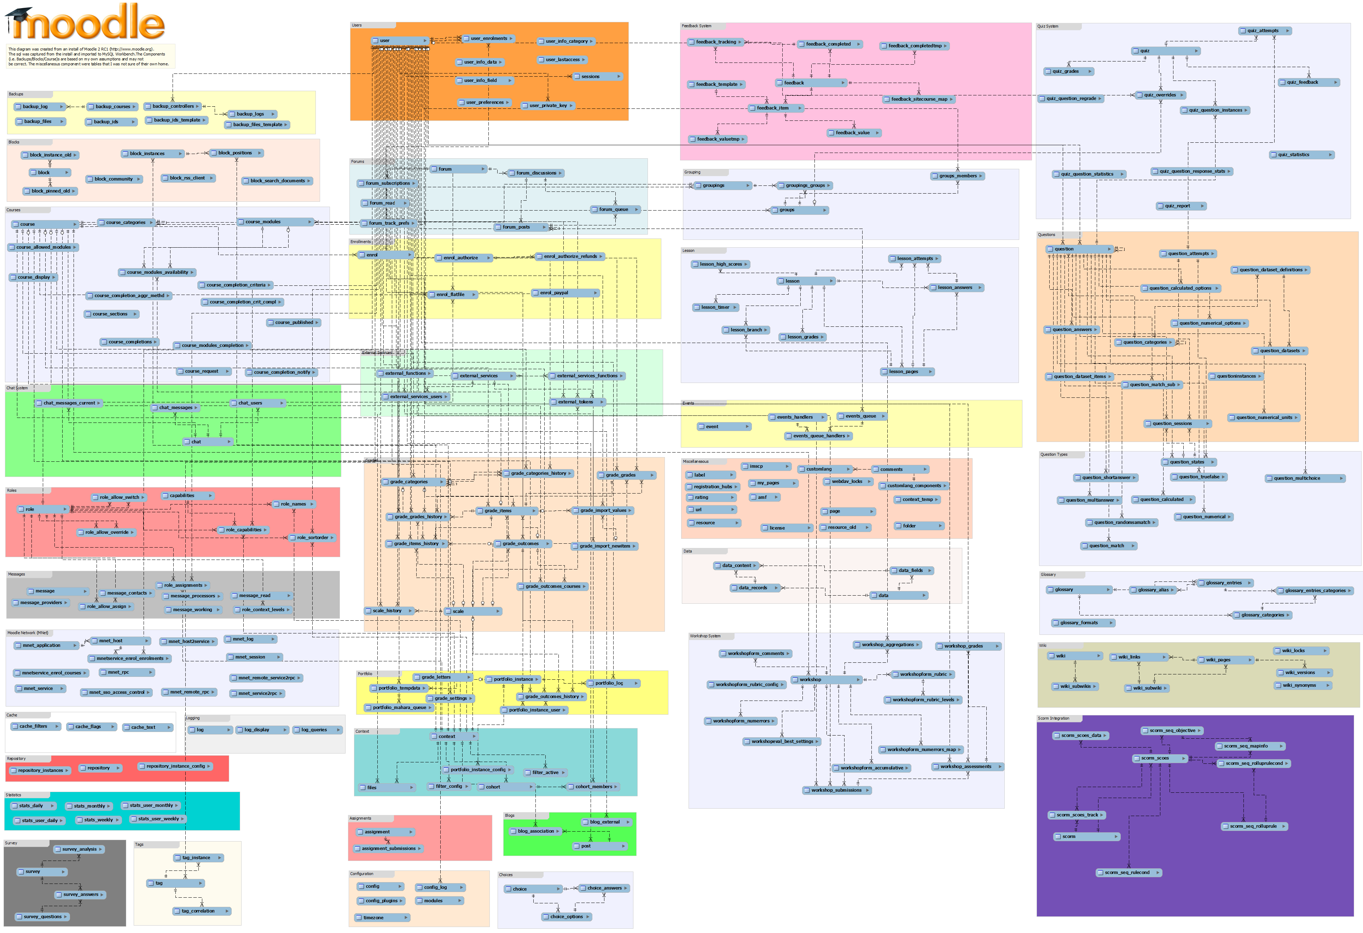
Extending
Moodle
Stephen Downes
Asticou Centre
Gatineau, Quebec
May 18, 2016

Slide 2
The Challenge
How can an educational application support, integrate within, and measure the total state?
How can the learner maintain his/her identity and integrity from environment to environment?

Slide 3
Three Trends
Interoperability
Moodle Roadmap
Modern Learning
Extending Moodle

Slide 4
Three Trends
MOOCs
Learning Analytics
Personalized Learning

Slide 5
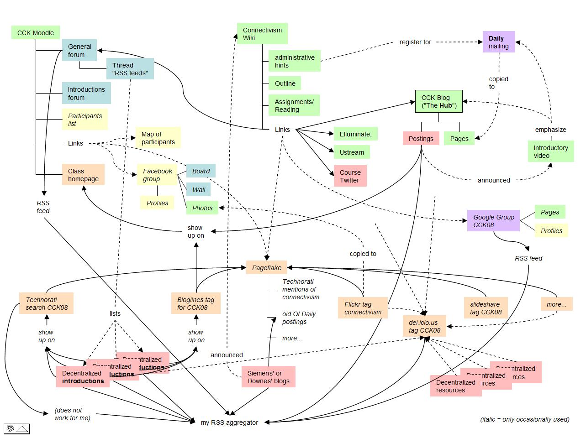
MOOCs
Massive
Open
Online
Course
Notes:
Massive
Open
Online
Course

Slide 6
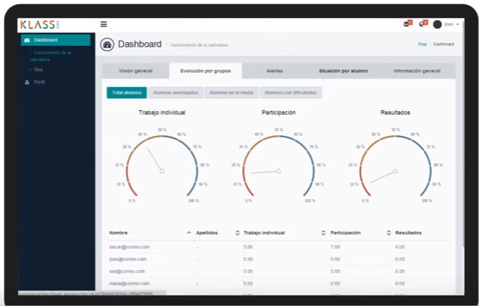
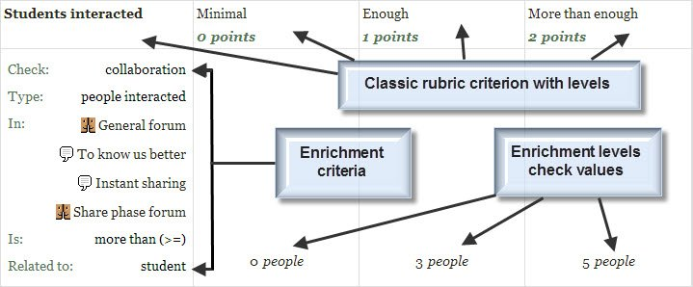
Learning Analytics
Predictive Analytics
Recognition Tasks
Notes:
Predictive Analytics - eg. SmartKlass https://moodle.org/plugins/local_smart_klass
Recognition Tasks – eg. Learning Analytics enriched rubrics - https://docs.moodle.org/30/en/Learning_Analytics_Enriched_Rubrics
See also: http://www.vteducation.org/en/articles/learner-data/introduction-learning-analytics

Slide 7
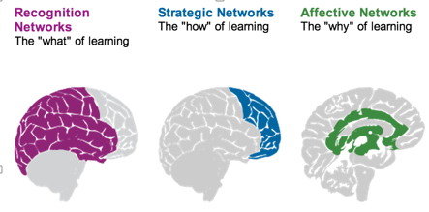
Personalized Learning
Rules-Based Events (like notifications)
User Models
Adaptive Learning
Notes:
- rules-based interactions – eg. Personalized Learning Designer (Blackboard / Moodlerooms) http://www.moodlerooms.com/3-rules-you-cant-live-without-the-personalized-learning-designer/

Slide 8
Interoperability
Learning Tools
Cloud Storage
Authentication

Slide 9
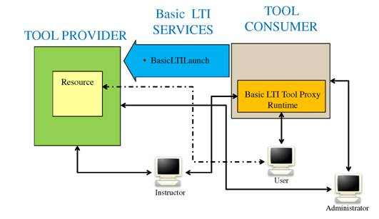
Learning Tools
LTI Producer – provides features
LTI Consumer – connects to features
https://www.imsglobal.org/specs/ltiv1p0/implementation-guide
Notes:
LTI Proivider plugin - https://moodle.org/plugins/local_ltiprovider
The LTI Provider is an application which provides features that other people want to and can connect to from their own LMS.
Provide access to full courses or single activities.
Single sign on
Change the navigation block of a course or activity for displaying information and links only regarding to your current course.
Send backs course or activity final grades to the LTI consumer tool
Modify the course or activity page for hiding the header, footer and left or right blocks
The LTI Consumer is an application which can connect to the 3rd party Provider system to avail of the features it has.
Eg. http://support.mediacore.com/customer/portal/articles/869178-configuring-a-lti-consumer

Slide 10
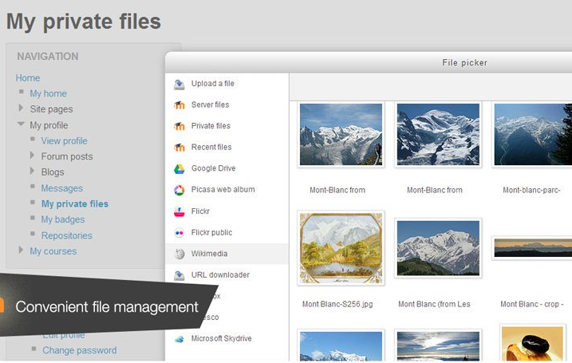
Cloud Storage
Cloud hosting of Moodle
File management
Notes:
MoodleCoud - https://moodle.com/cloud/
(includes BigBlueButton)
Cloud storage - https://docs.moodle.org/30/en/Working_with_files

Slide 11
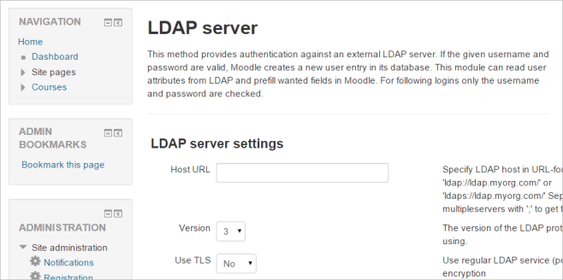

Authentication
Basic Moodle Authentication / Moodle Network
Authentication APIs / LDAP
Social Network Authentication
Notes:
Moodle Network - Moodle network feature allows a Moodle administrator to establish a link with another Moodle or a Mahara - https://docs.moodle.org/30/en/Mnet
LDAP - https://docs.moodle.org/30/en/LDAP_authentication
- Social net - Google / Facebook / Github / Linkedin / DropBox / Windows / VK / Battle.net authentication - https://moodle.org/plugins/browse.php?list=category&id=21 – even battle.net !

Slide 12
Moodle Roadmap
Outcomes and competencies
Learning plans
Learning processes
Content and OER
https://docs.moodle.org/dev/Roadmap#Management

Slide 13
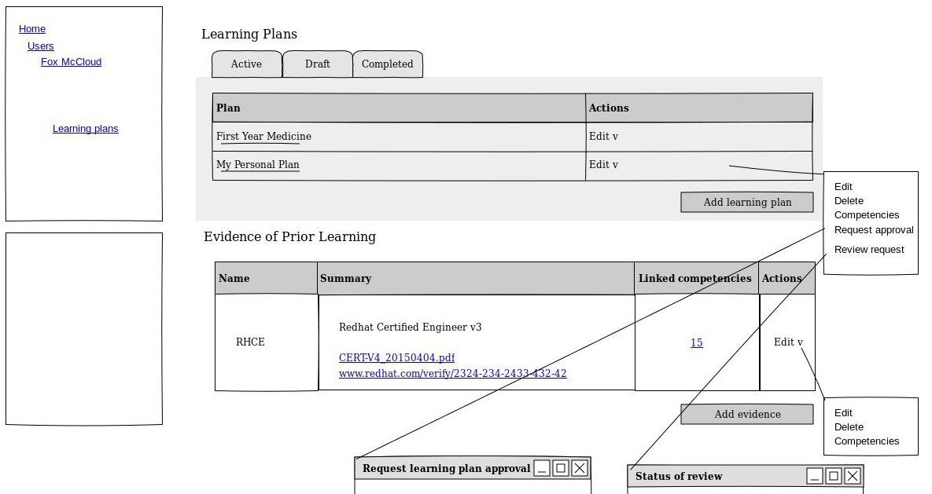
Outcomes and Competencies
Notes:
Competency Framework added in Moodle 3.1 - https://docs.moodle.org/dev/index.php?title=Competency_Based_Education
- Define competencies, learning plans, evidence of prior learning
Compentencies – eg. Compeencies Exabis - https://moodle.org/plugins/block_exacomp
The goal of this module is to bring competencies that have been provided (generate them at www.edustandards.org) into Moodle-courses. Competencies from a students' sight can be expressed as "I can”-statements (example: "I can use spreadsheet formulas to solve a mathematical problem”).

Slide 14
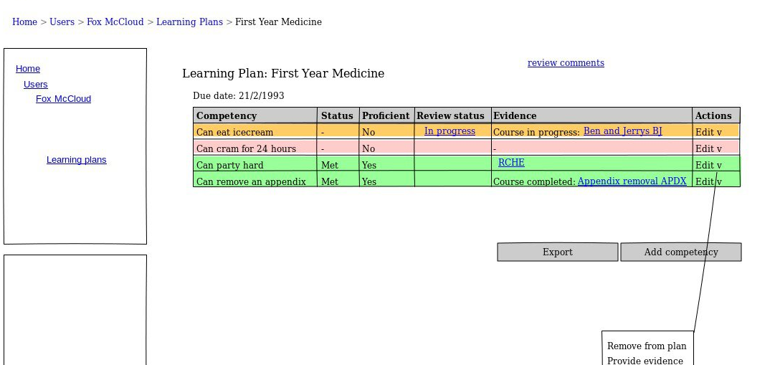
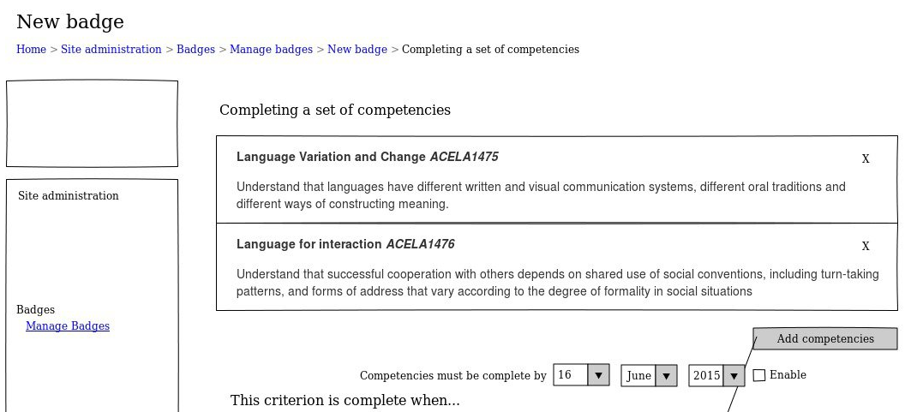
Learning Plans

Slide 15
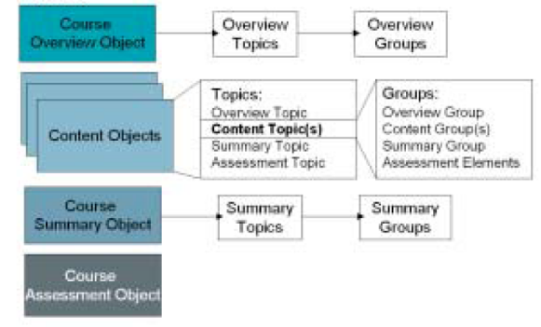
Learning Processes
Notes:
Image: http://www.learningsolutionsmag.com/articles/315/prudentials-lcms-implementation-learning-strategy-objects-and-the-design-process-part-1-of-2-parts/page2
Eg. Group Actuvities - https://teaching.unsw.edu.au/moodle-group-activity

Slide 16

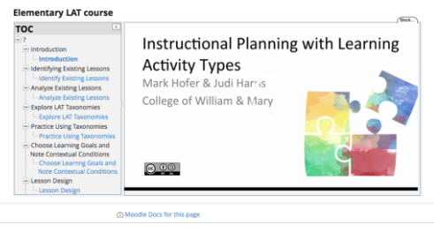
Content and OER
Notes:
Eg. Full downloadable courses in Moodle.net
Eg. Importing SCORM packages - http://www.jorum.ac.uk/support/guides/scorm-packages-in-jorum/
Eg. OpenEd Learning Library – integrates into Moodle – “OpenEd.com, the world’s largest archive of free K-12 educational material, recently announced that their library of over a million resources will now be integrated with select learning management systems, including Moodle LMS.”
http://blog.lambdasolutions.net/opened.coms-learning-library-now-integrates-with-moodle-learning-management-system
Eg. Importing Learning Actuvity Types (LATs) into Moodle OpenBook (ModuleO - https://davidtjones.wordpress.com/2016/04/02/first-steps-in-integrating-lats-oer-into-moodle-open-book/

Slide 17
Modern Learning
Personal Learning Records
CASS
Docker

Slide 18
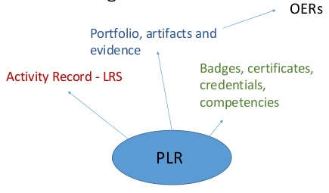
Personal Learning Records

Slide 19
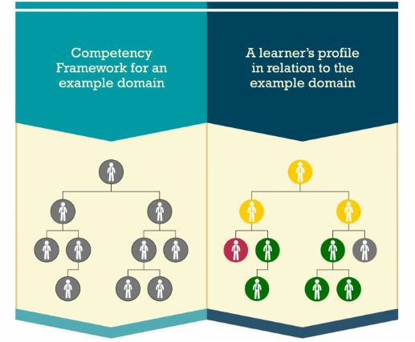


CASS
Competency and Skills System
https://www.adlnet.gov/introducing-the-next-big-thing-cass/

Slide 20
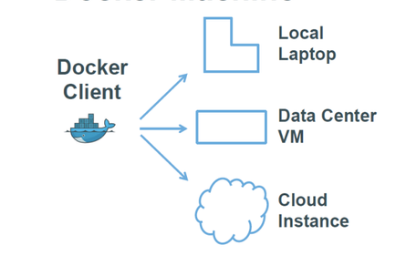
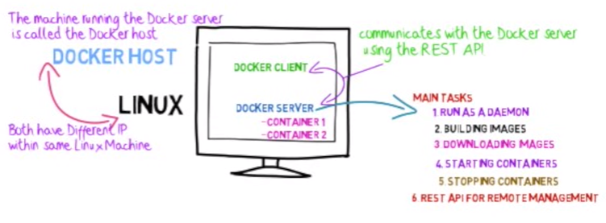
Docker
http://www.tomsitpro.com/articles/docker-enterprise-hub-orchestration,1-2375.html
Notes:
Image: http://www.tomsitpro.com/articles/docker-enterprise-hub-orchestration,1-2375.html
https://www.youtube.com/watch?v=pgiFwriExYg

Slide 21
Extending Moodle
Simulations and Work Environments
Employment and Work Opportunities
Personal Learning Environment (PLE)

Slide 22
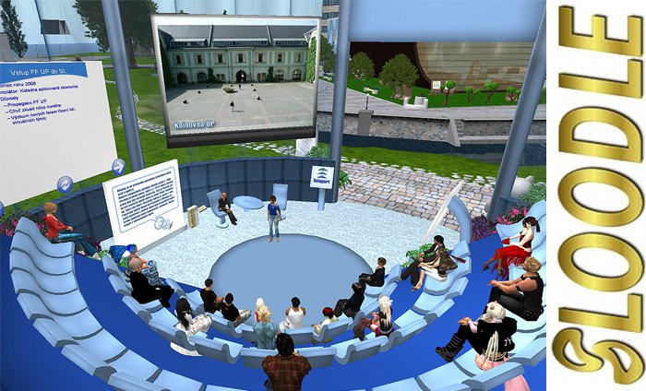
Sims and Work Environments
Notes:
Eg. Easy Java Sims - http://www.um.es/fem/EjsWiki/Main/WhatIsEJS
SLOODLE - https://www.sloodle.org/ - Simulation-Linked Object-Oriented Dynamic Learning ...
SLOODLE is a free and open source project which integrates the multi-user virtual environments of Second Life® and/or OpenSim with the Moodle™ learning management system.

Slide 23

Employment and Opportunities

Slide 24
The Network in the LMS
Browser
Moodle
Robot Car
D2L

Slide 25
The Network in the LMS
Browser
Moodle
D2L
Data
Data
Identity
Services
Identity
Services
SIS/MIS Banner
Content and Services

Slide 26
The PLE in the Network
PLE
Moodle
SIS/MIS/Banner
Content & Services
D2L
Robot car
Data
Identity
Posts
Papers
Photos
Name / ID
Credentials
Social Network
Friends
Groups

Slide 27
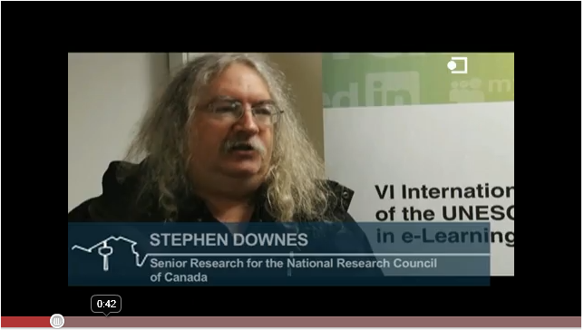
http://www.youtube.com/watch?v=X0iI0pgTUx0
http://www.downes.ca
Stephen Downes

